Slide 1
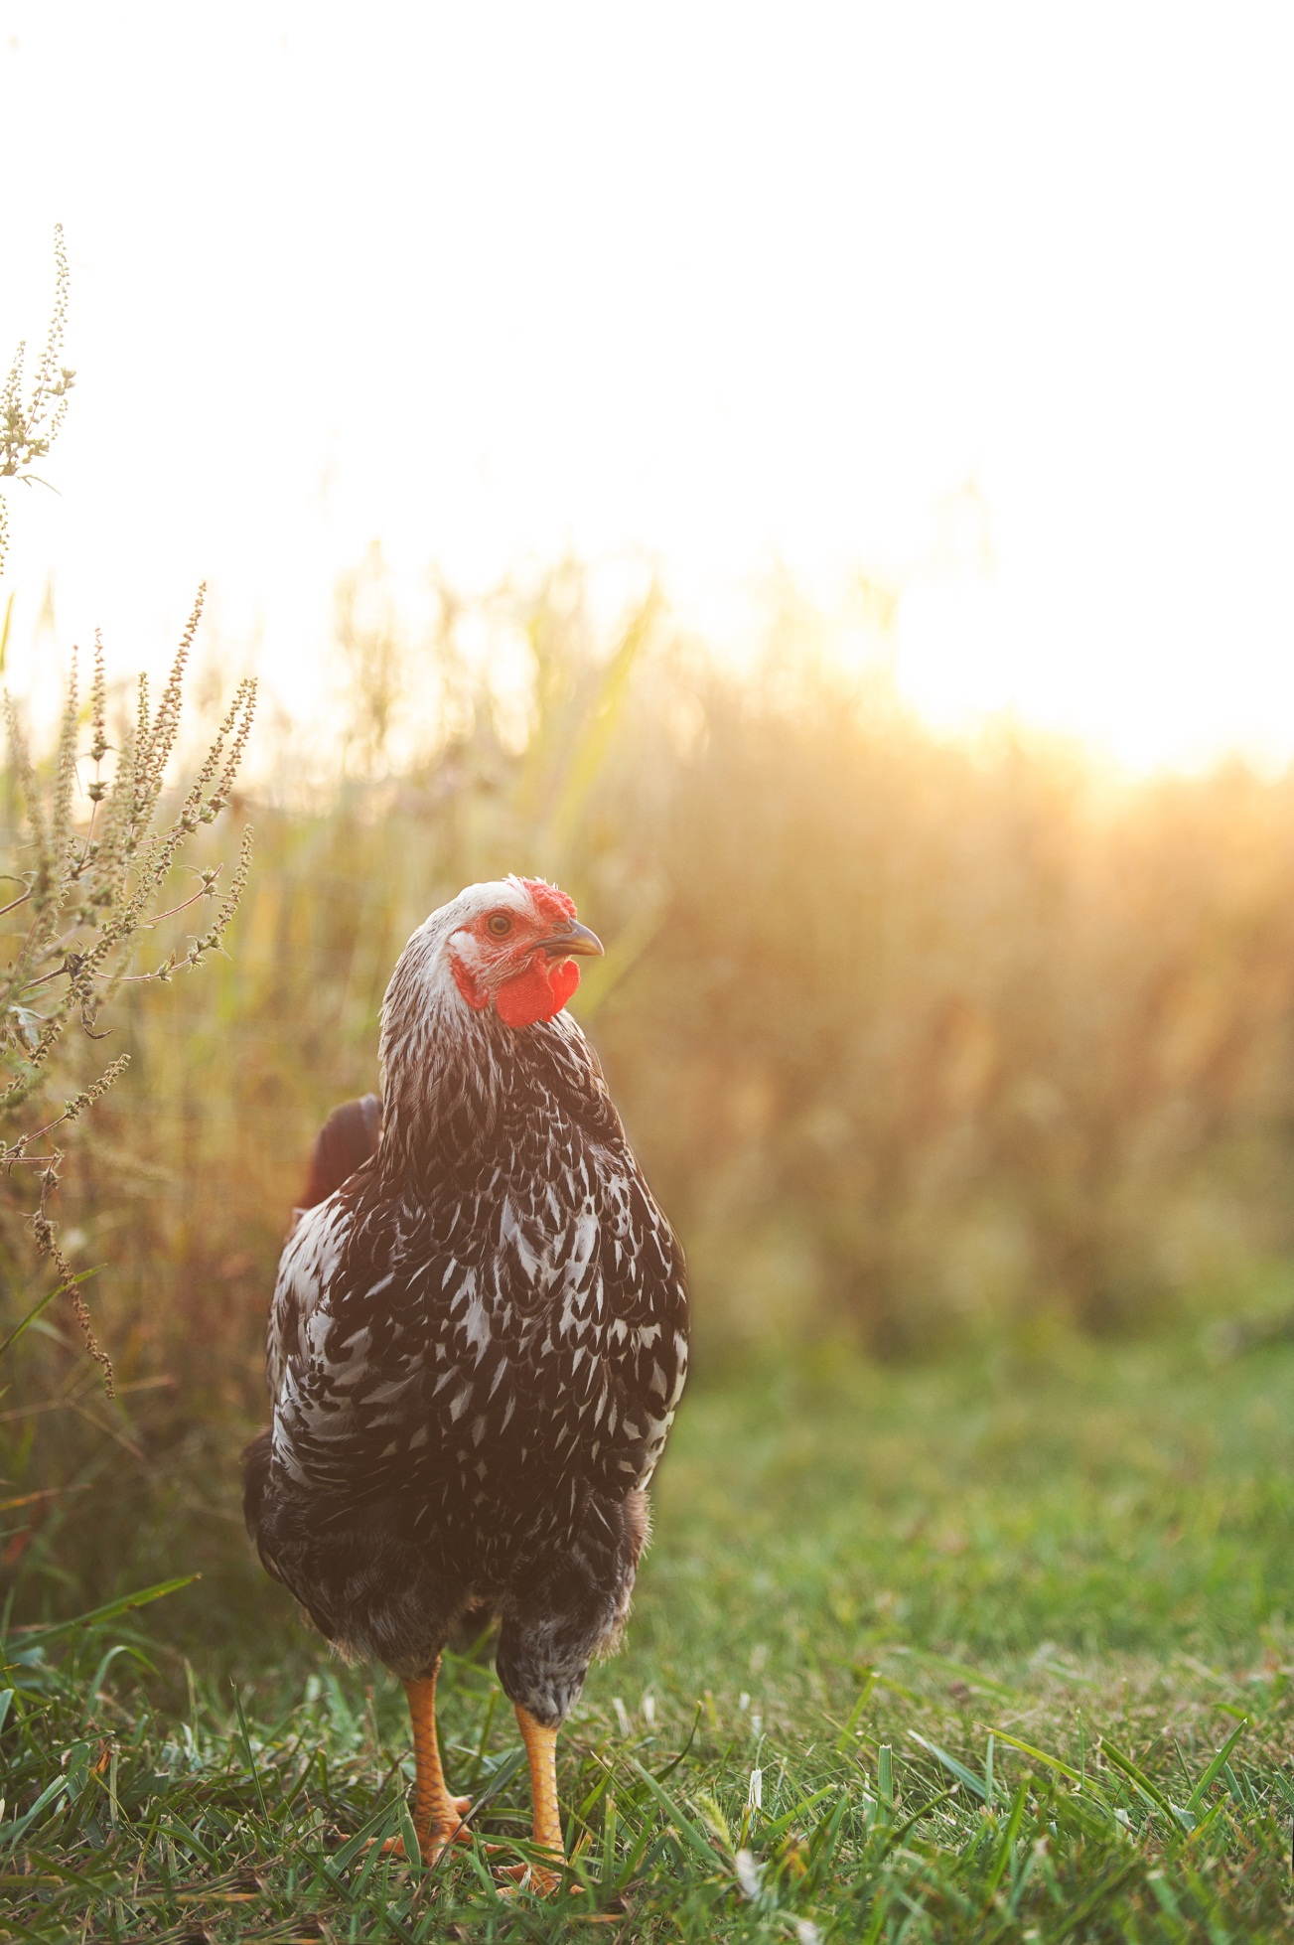
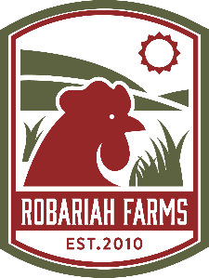
Local Kosher Pasture-Raised
Bringing local back to kosher.
Deerfield, MA
Notes:
How many of you eat meat?
How many of you have been a vegetarian?
How many of you who eat meat are choosy about the meat you eat?
How many of you keep kosher?

Slide 2
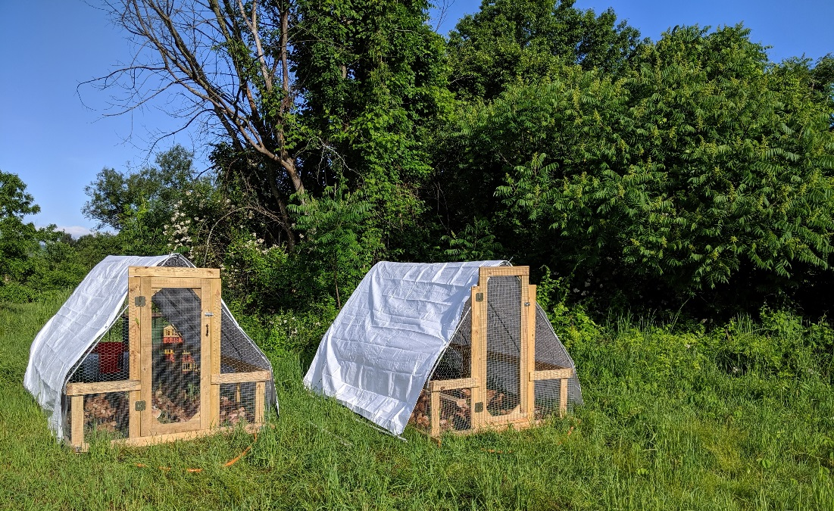
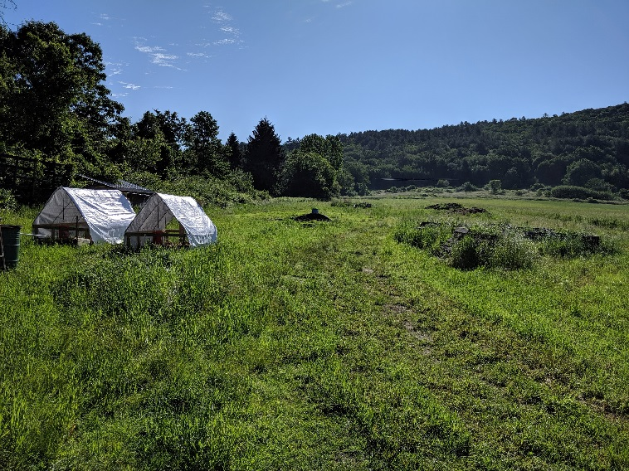
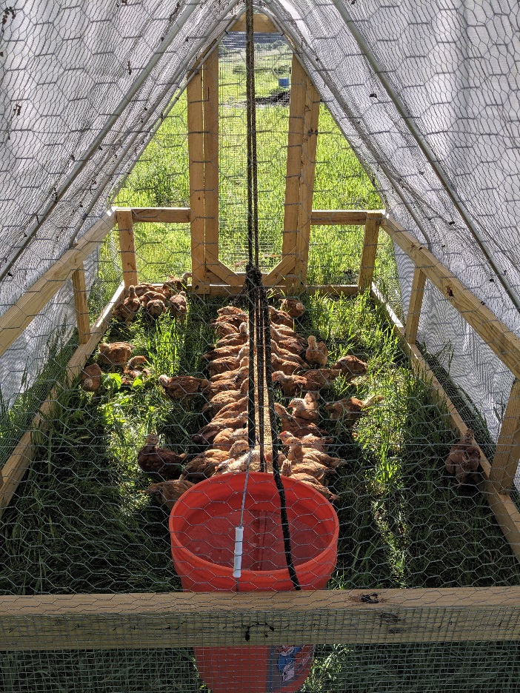
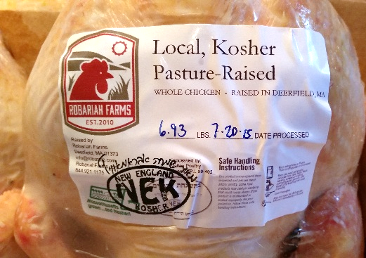
Who We Are
Notes:
My name is Robert Friedman
Along with my wife, Shemariah, owner of Robariah Farms
We specialize in LOCAL, PASTURE-RAISED, KOSHER meat.
Adamah in 2004, met Shemariah and Jacob Fine.
First direct intersection with Judaism and agriculture.
Board of Jewish Farm School from until last year.
Kibbutz in Israel.
Shema has masters in Regional Planning.
I am part-time MBA student at Isenberg.

Slide 3
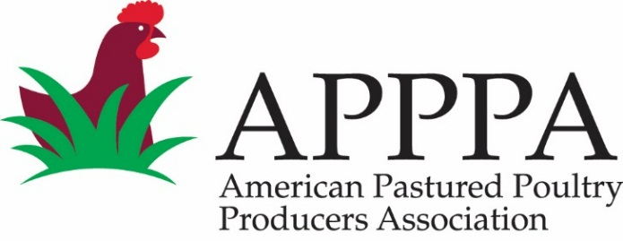
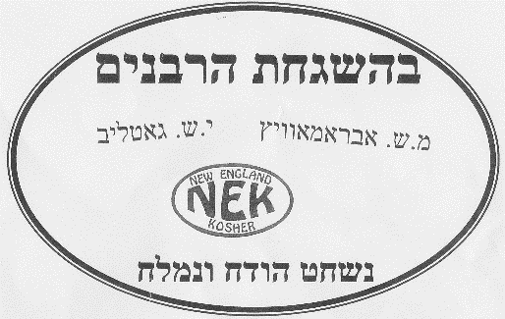
What We Do
Local
Pasture-Raised
Kosher
Notes:
1. LOCAL We are located in Deerfield, MA.
In the last 4 years, we have raised more than 3,000 chickens, turkeys, and ducks.
We sell retail and wholesale
to groceries, restaurants, and institutions in the Pioneer Valley and Boston areas, such as River Valley Market, Green Fields Market, and Atlas Farm Store.
Our customers individuals and entities who are willing to use their purchasing power
To buy meat from animals that were raised in healthy conditions and processed in human conditions.
This includes kosher customers seeking a local product and
Non-kosher customers concerned with animal welfare and sustainability.
2. PASTURE-RAISED Our flocks are raised 100% on PASTURE 24/7.
We provide CONSTANT access to fresh green pasture, sunlight, and ventilation.
3. KOSHER We process our birds KOSHER, to certify that EACH PRODUCT we PRODUCE and SELL is processed by HIGHLY trained personnel using an established ETHICAL framework.

Slide 4
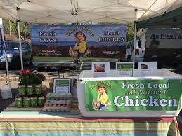
What is kosher?
Literally means “clean” or “pure”
Refers to food that has been ritually prepared or blessed
Originated out of Old Testament
Land animals that "chews the cud" and has a completely split hoof is ritually clean (e.g., cows, sheep, goat)
Water animals with fins and scales
Birds with a crop, an extra finger, a gizzard that can be peeled, and is not be a bird of prey
Oral law codified it
Notes:
Shehiyah (שהייה; delay or pausing) - A pause or hesitation during the incision of even a moment makes the animal's flesh unkosher. The knife must move in an uninterrupted sweep. Shehiyah occurs if the shochet accidentally stops the slaughtering process after either the trachea or esophagus has been cut, but before they have been cut the majority of the way through. Pausing can happen accidentally if muscle contractions in the animal's neck pull one of these organs out of contact with the blade. The latter case is especially common in turkeys.
Derasah (דרסה; pressing/chopping) - The knife must be drawn across the throat by forward/backward movements, not by hacking or pressing. Any undue pressure renders the animal unkosher. Derasah is the forbidden action that occurs when the shochet pushes the knife into the animal's throat without moving it back and forth, chops rather than slices, or positions the animal improperly so that either its head presses down on the blade as it expires or the shochet must push the knife into the throat against the force of gravity. There are those^{[6]} who opine that it is forbidden to have the animal in an upright position during shechita due to the prohibition of derasah (pressing). They maintain that the animal must be on its back, lying on its side, suspended upside down by a rope or chain, or placed in a barrel-like pen that turns the animal on its back for slaughter. However the Orthodox Union accepts upright slaughter as long as the head is properly supported and today all cattle processing facilities in the U.S., except for theAgriprocessors plant in Iowa, use upright slaughter pens. South American kosher abattoirs primarily use the rotating pen, shackle and hoist as well as shackle and drag methods of slaughter.^{[7]}
Haladah (חלדה; digging or burying) - The knife must be drawn over the throat so that it is visible while shechita is being performed. It must not be stabbed into the neck or buried by fur, hide, or feathers in the case of a bird. Haladah occurs if the shochet either accidentally cuts into the animal's throat so deeply that the entire width of the knife disappears in the wound, uses a knife that is too short so that the end disappears in the wound, or if a foreign object falls over the knife so the shochet loses sight of the incision.
Hagramah (הגרמה; cutting in the wrong location) - The limits within which the knife may be applied are from the large ring in the windpipe to the top of the upper lobe of the lung when it is inflated, and corresponding to the length of the pharynx. Slaughtering above or below these limits renders the meat unkosher.
Iqqur (עיקור; tearing) - If either the esophagus or the trachea is torn during the shechita incision the carcass is rendered unkosher and cannot be eaten by Jews. Iqqur occurs if the shochet accidentally uses a chalaf with an imperfection on the blade, such as a scratch or nick, that causes a section of blade to be lower than the surface of the blade.^{[8][9][10]}
Breaching any of these five rules renders the animal nevelah; the animal is regarded in Jewish law as if it were carrion.
Temple Grandin has stated that she has "observed that if the rules (of the five forbidden techniques) are disobeyed the animal will struggle. If these rules are obeyed the animal has little reaction."^{[11]}

Slide 5
What is forbidden in kosher?
Five rules of the cut
Shehiyah (שהייה; delay or pausing)
Derasah (דרסה; pressing/chopping)
Haladah (חלדה; digging or burying)
Hagramah (הגרמה; cutting in the wrong location)
Iqqur (עיקור; tearing)
Prohibition against consuming blood
Soak and salt
Notes:
Shehiyah (שהייה; delay or pausing) - A pause or hesitation during the incision of even a moment makes the animal's flesh unkosher. The knife must move in an uninterrupted sweep. Shehiyah occurs if the shochet accidentally stops the slaughtering process after either the trachea or esophagus has been cut, but before they have been cut the majority of the way through. Pausing can happen accidentally if muscle contractions in the animal's neck pull one of these organs out of contact with the blade. The latter case is especially common in turkeys.
Derasah (דרסה; pressing/chopping) - The knife must be drawn across the throat by forward/backward movements, not by hacking or pressing. Any undue pressure renders the animal unkosher. Derasah is the forbidden action that occurs when the shochet pushes the knife into the animal's throat without moving it back and forth, chops rather than slices, or positions the animal improperly so that either its head presses down on the blade as it expires or the shochet must push the knife into the throat against the force of gravity. There are those^{[6]} who opine that it is forbidden to have the animal in an upright position during shechita due to the prohibition of derasah (pressing). They maintain that the animal must be on its back, lying on its side, suspended upside down by a rope or chain, or placed in a barrel-like pen that turns the animal on its back for slaughter. However the Orthodox Union accepts upright slaughter as long as the head is properly supported and today all cattle processing facilities in the U.S., except for theAgriprocessors plant in Iowa, use upright slaughter pens. South American kosher abattoirs primarily use the rotating pen, shackle and hoist as well as shackle and drag methods of slaughter.^{[7]}
Haladah (חלדה; digging or burying) - The knife must be drawn over the throat so that it is visible while shechita is being performed. It must not be stabbed into the neck or buried by fur, hide, or feathers in the case of a bird. Haladah occurs if the shochet either accidentally cuts into the animal's throat so deeply that the entire width of the knife disappears in the wound, uses a knife that is too short so that the end disappears in the wound, or if a foreign object falls over the knife so the shochet loses sight of the incision.
Hagramah (הגרמה; cutting in the wrong location) - The limits within which the knife may be applied are from the large ring in the windpipe to the top of the upper lobe of the lung when it is inflated, and corresponding to the length of the pharynx. Slaughtering above or below these limits renders the meat unkosher.
Iqqur (עיקור; tearing) - If either the esophagus or the trachea is torn during the shechita incision the carcass is rendered unkosher and cannot be eaten by Jews. Iqqur occurs if the shochet accidentally uses a chalaf with an imperfection on the blade, such as a scratch or nick, that causes a section of blade to be lower than the surface of the blade.^{[8][9][10]}
Breaching any of these five rules renders the animal nevelah; the animal is regarded in Jewish law as if it were carrion.
Temple Grandin has stated that she has "observed that if the rules (of the five forbidden techniques) are disobeyed the animal will struggle. If these rules are obeyed the animal has little reaction."^{[11]}

Slide 6
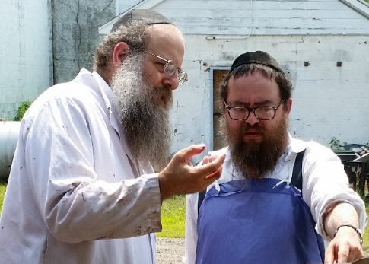
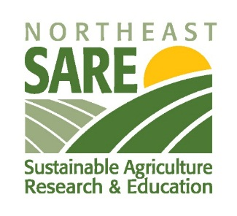
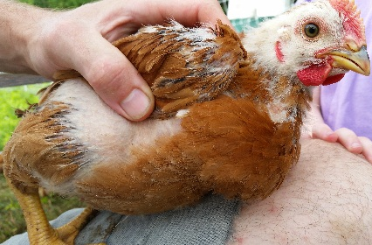
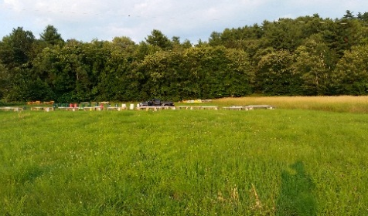
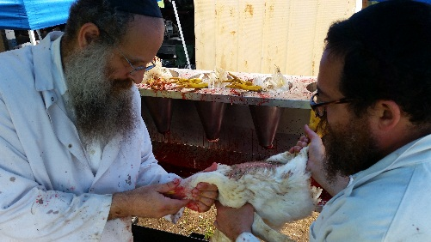
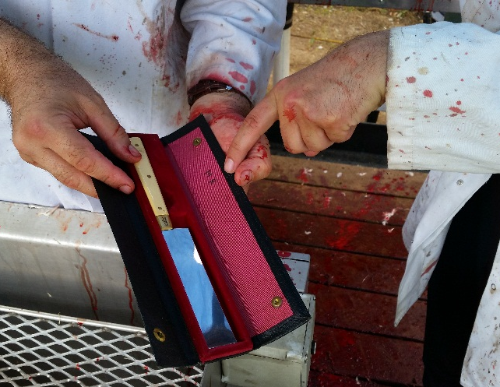
What it all means
Notes:
In 2015 we received a sizable grant from SUSTAINABLE AGRICULTURE RESEARCH and EDUCATION (SARE) organization
To pilot LOCAL KOSHER processing using state-certified facilities.
We are comparing the economic viability of local kosher processing to larger-scale kosher processors in the region.
We are stuck between local and big processors.
Why research kosher? According to a 2009 Mintel market research report, 44% of the kosher market is Jewish consumers. In Massachusetts and New England, 4-5% of the population is Jewish—almost double the national percentage. While 15% of those who purchase kosher products do so for religious reasons, most who seek out kosher products buy the items for food quality (62%), healthfulness (51%), and food safety (34%). 19% of the kosher market is Muslim who consume food certified as Halal.
6 steps to kosher processing:
Kill
Pluck
Eviscerate
Soak
Salt
rinse

Slide 7
What it all means

Slide 8
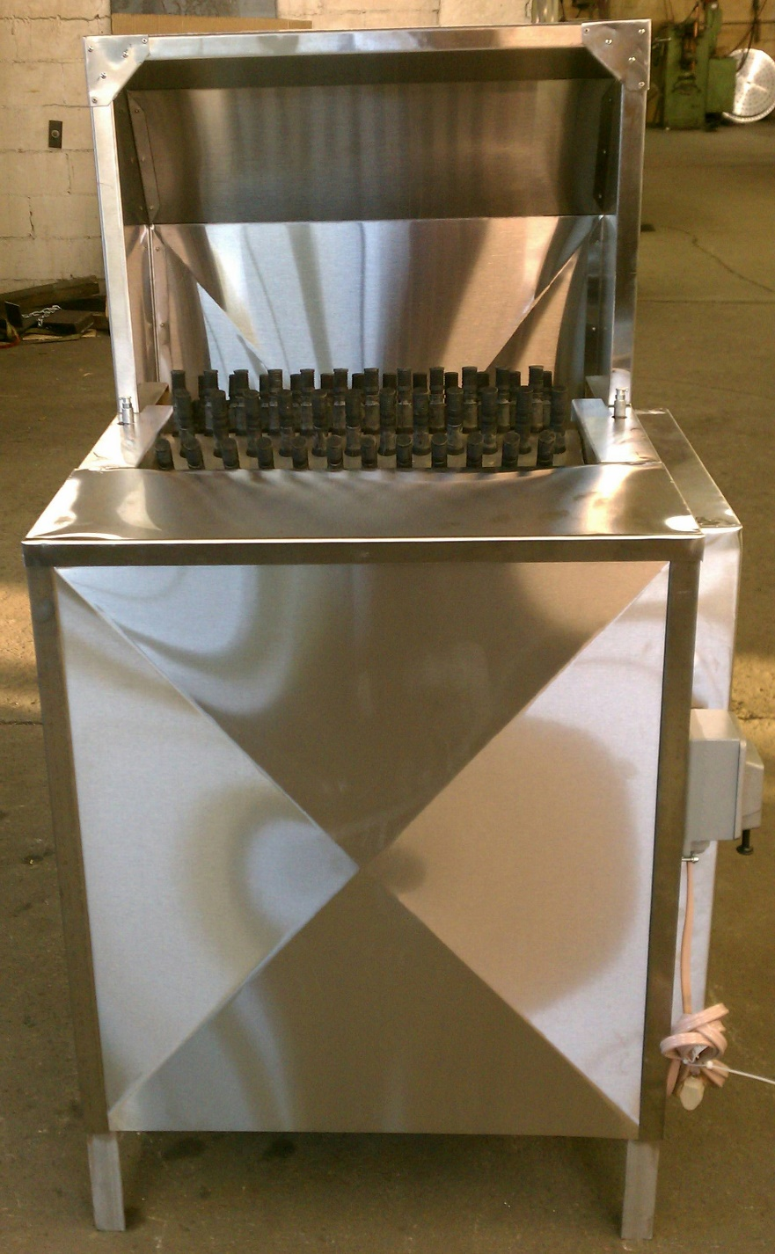
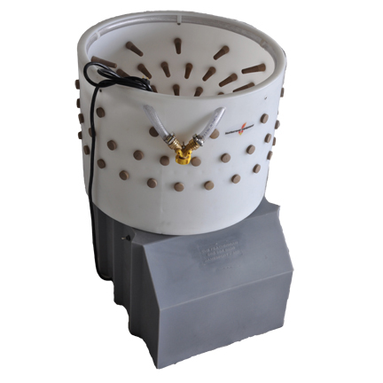
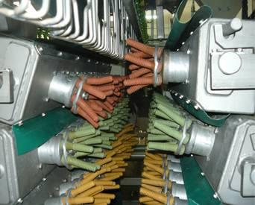
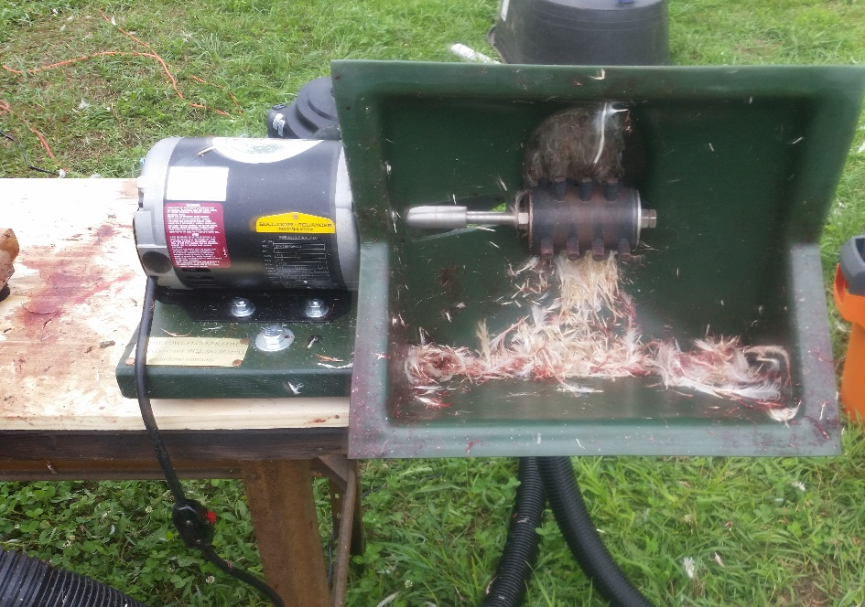
What it all means

Slide 9
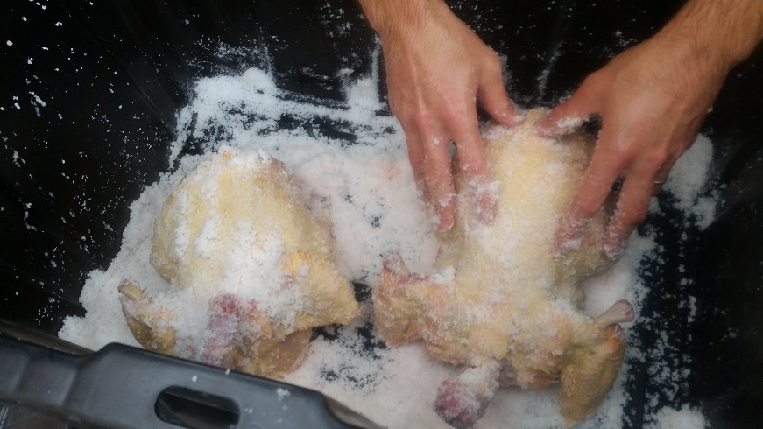
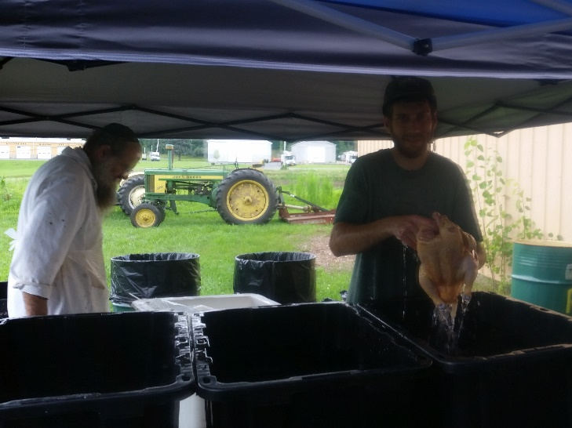
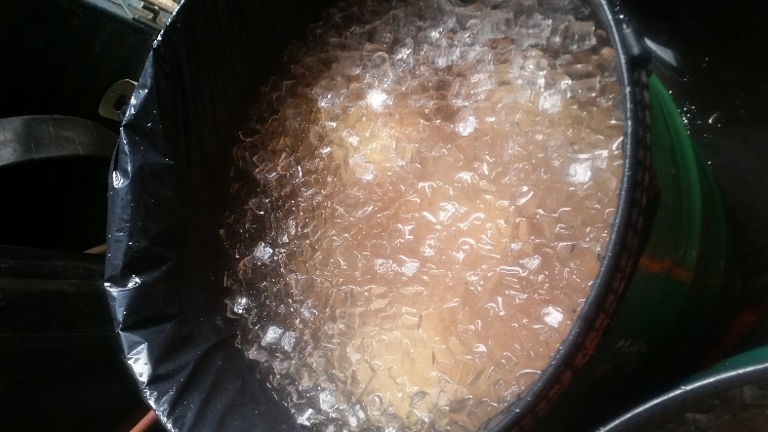
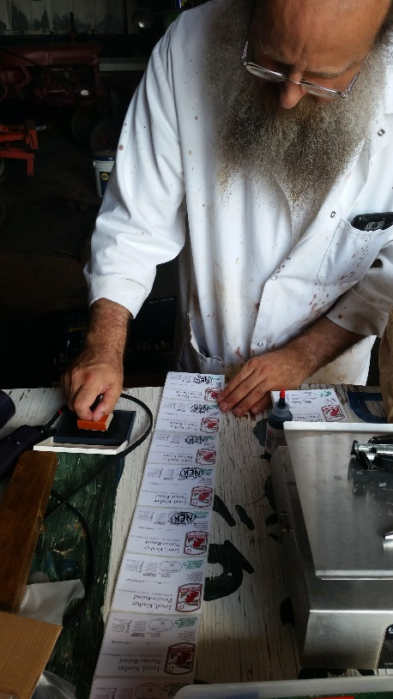
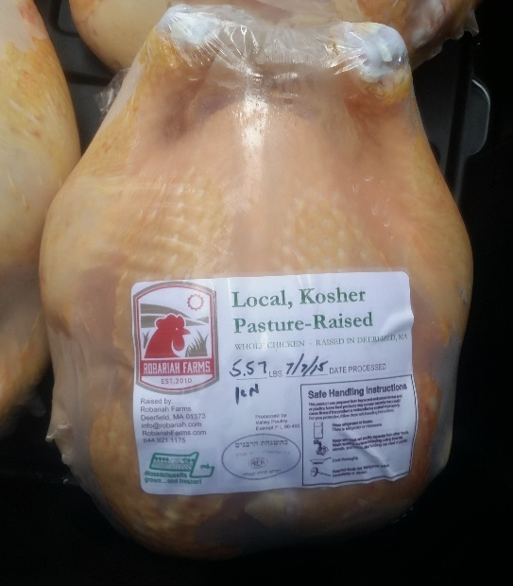
What it all means

Slide 10
Contact
Web - RobariahFarms.com
Email - info@robariah.com
Twitter - @RobariahFarms
Facebook – RobariahFarms

