Slide 1
Non-traditional farm transition planning and value transfer via mentoring and creative lease agreements
Our project team:
Cindy Hale and Jeff Hall Sue and Amy Roper Susanne Hinrichs, Extension educator, Agricultural Business Management Team
Rachel Armstrong, CEO and Attorney Julie Allen, program coordinator
This material is based upon work that is supported by the National Institute of Food and Agriculture, U.S. Department of Agriculture, under agreement number
2023-38640-39573 through the North Central Region SARE program under project number FNC24-1417. USDA is an equal opportunity employer and service provider. Any opinions, findings, conclusions, or recommendations expressed in this publication are those of the author(s) and do not necessarily reflect the view of the U.S. Department of Agriculture.

Slide 2
Non-traditional farm transition planning and value transfer via mentoring and creative lease agreements
Housekeeping:
We will be recording this and making it available after the field day
please keep your microphones muted unless you are talking.
Please keep your camera on if you can, seeing each other makes conversations better
add your name, location, status (retiring farmer, aspiring farmer) to the chat
Service providers in the farm transition space, please add your name, organization and contact information in the chat, so folks can follow-up up with you.
We want the conversations today to be led by the farmers ☺
Questions? Put them in the chat

Slide 3
Non-traditional farm transition planning and value transfer via mentoring and creative lease agreements
What to expect today…
Overview of our project, from each of our project partners
Break out groups to discuss some key topics from our surveys & experience
Reconciling different values, perspectives & expectations of farmers
Legal tool: what might they be and preparing to use them
Equity: realities of addressing disenfranchisement and power disparities
Considerations before starting

Slide 4
Non-traditional farm transition planning and value transfer via mentoring and creative lease agreements
Aging farmers want to retire, but not sell their land
Young/aspiring farmers need access to land
Young farmers could have access not just to land, but advanced production capacity, infrastructure and mentorship
Retiring farmers don’t want to see their farms degrade
How to find each other?
How to make these relationships work?
How to make the economics work?

Slide 5
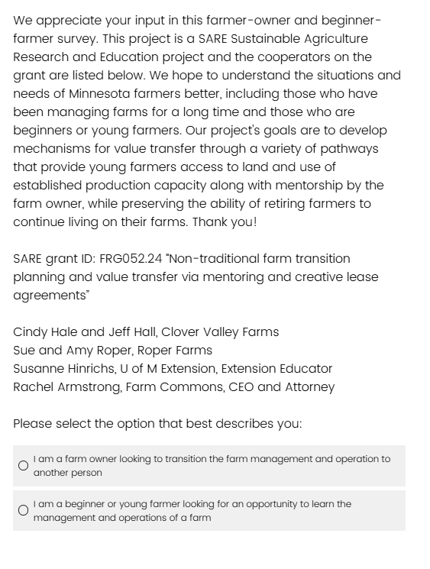
Non-traditional farm transition planning and value transfer via mentoring and creative lease agreements
What we have done -Year 1
Learning about other’s journeys: Survey of retiring and aspiring farmers
1st year of mentorship and value transfer experiment completed
Next Steps - Year 2
Reflection, what have we learned, how have our perspectives changed?
Planning for year 2, including developing a formal lease agreement
Sharing our results, tools, what worked and what didn’t

Slide 6
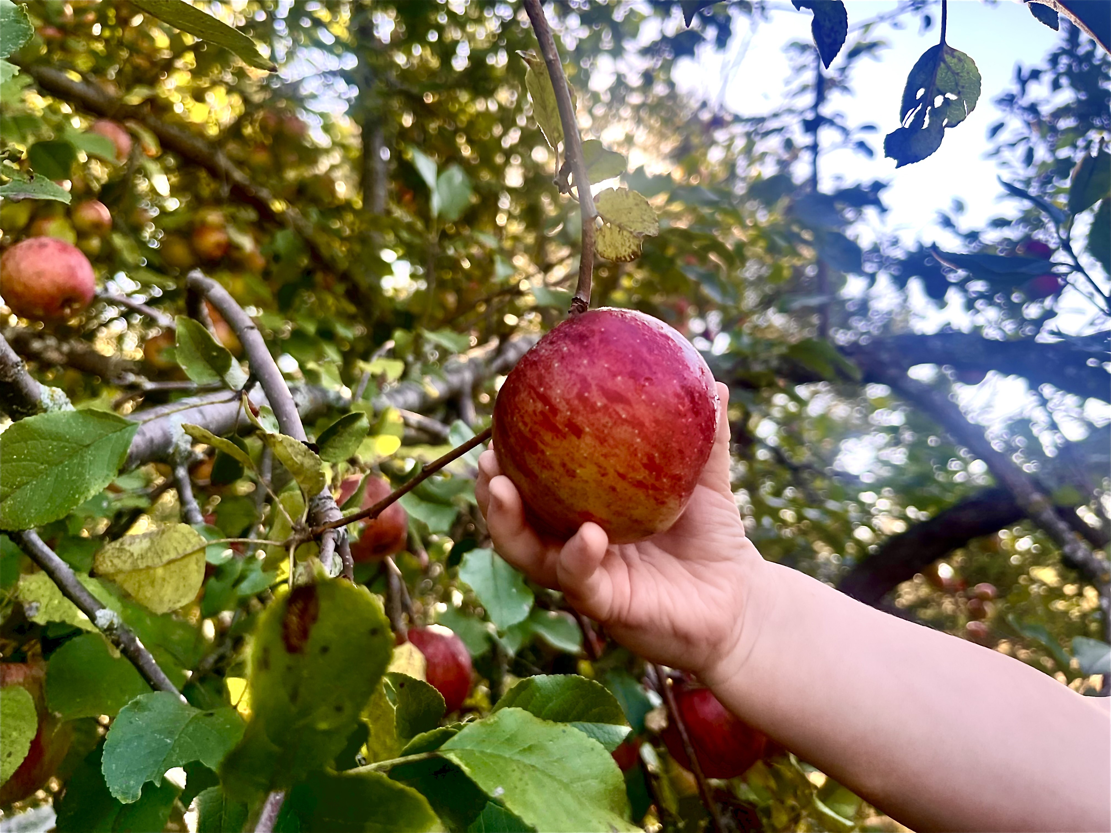
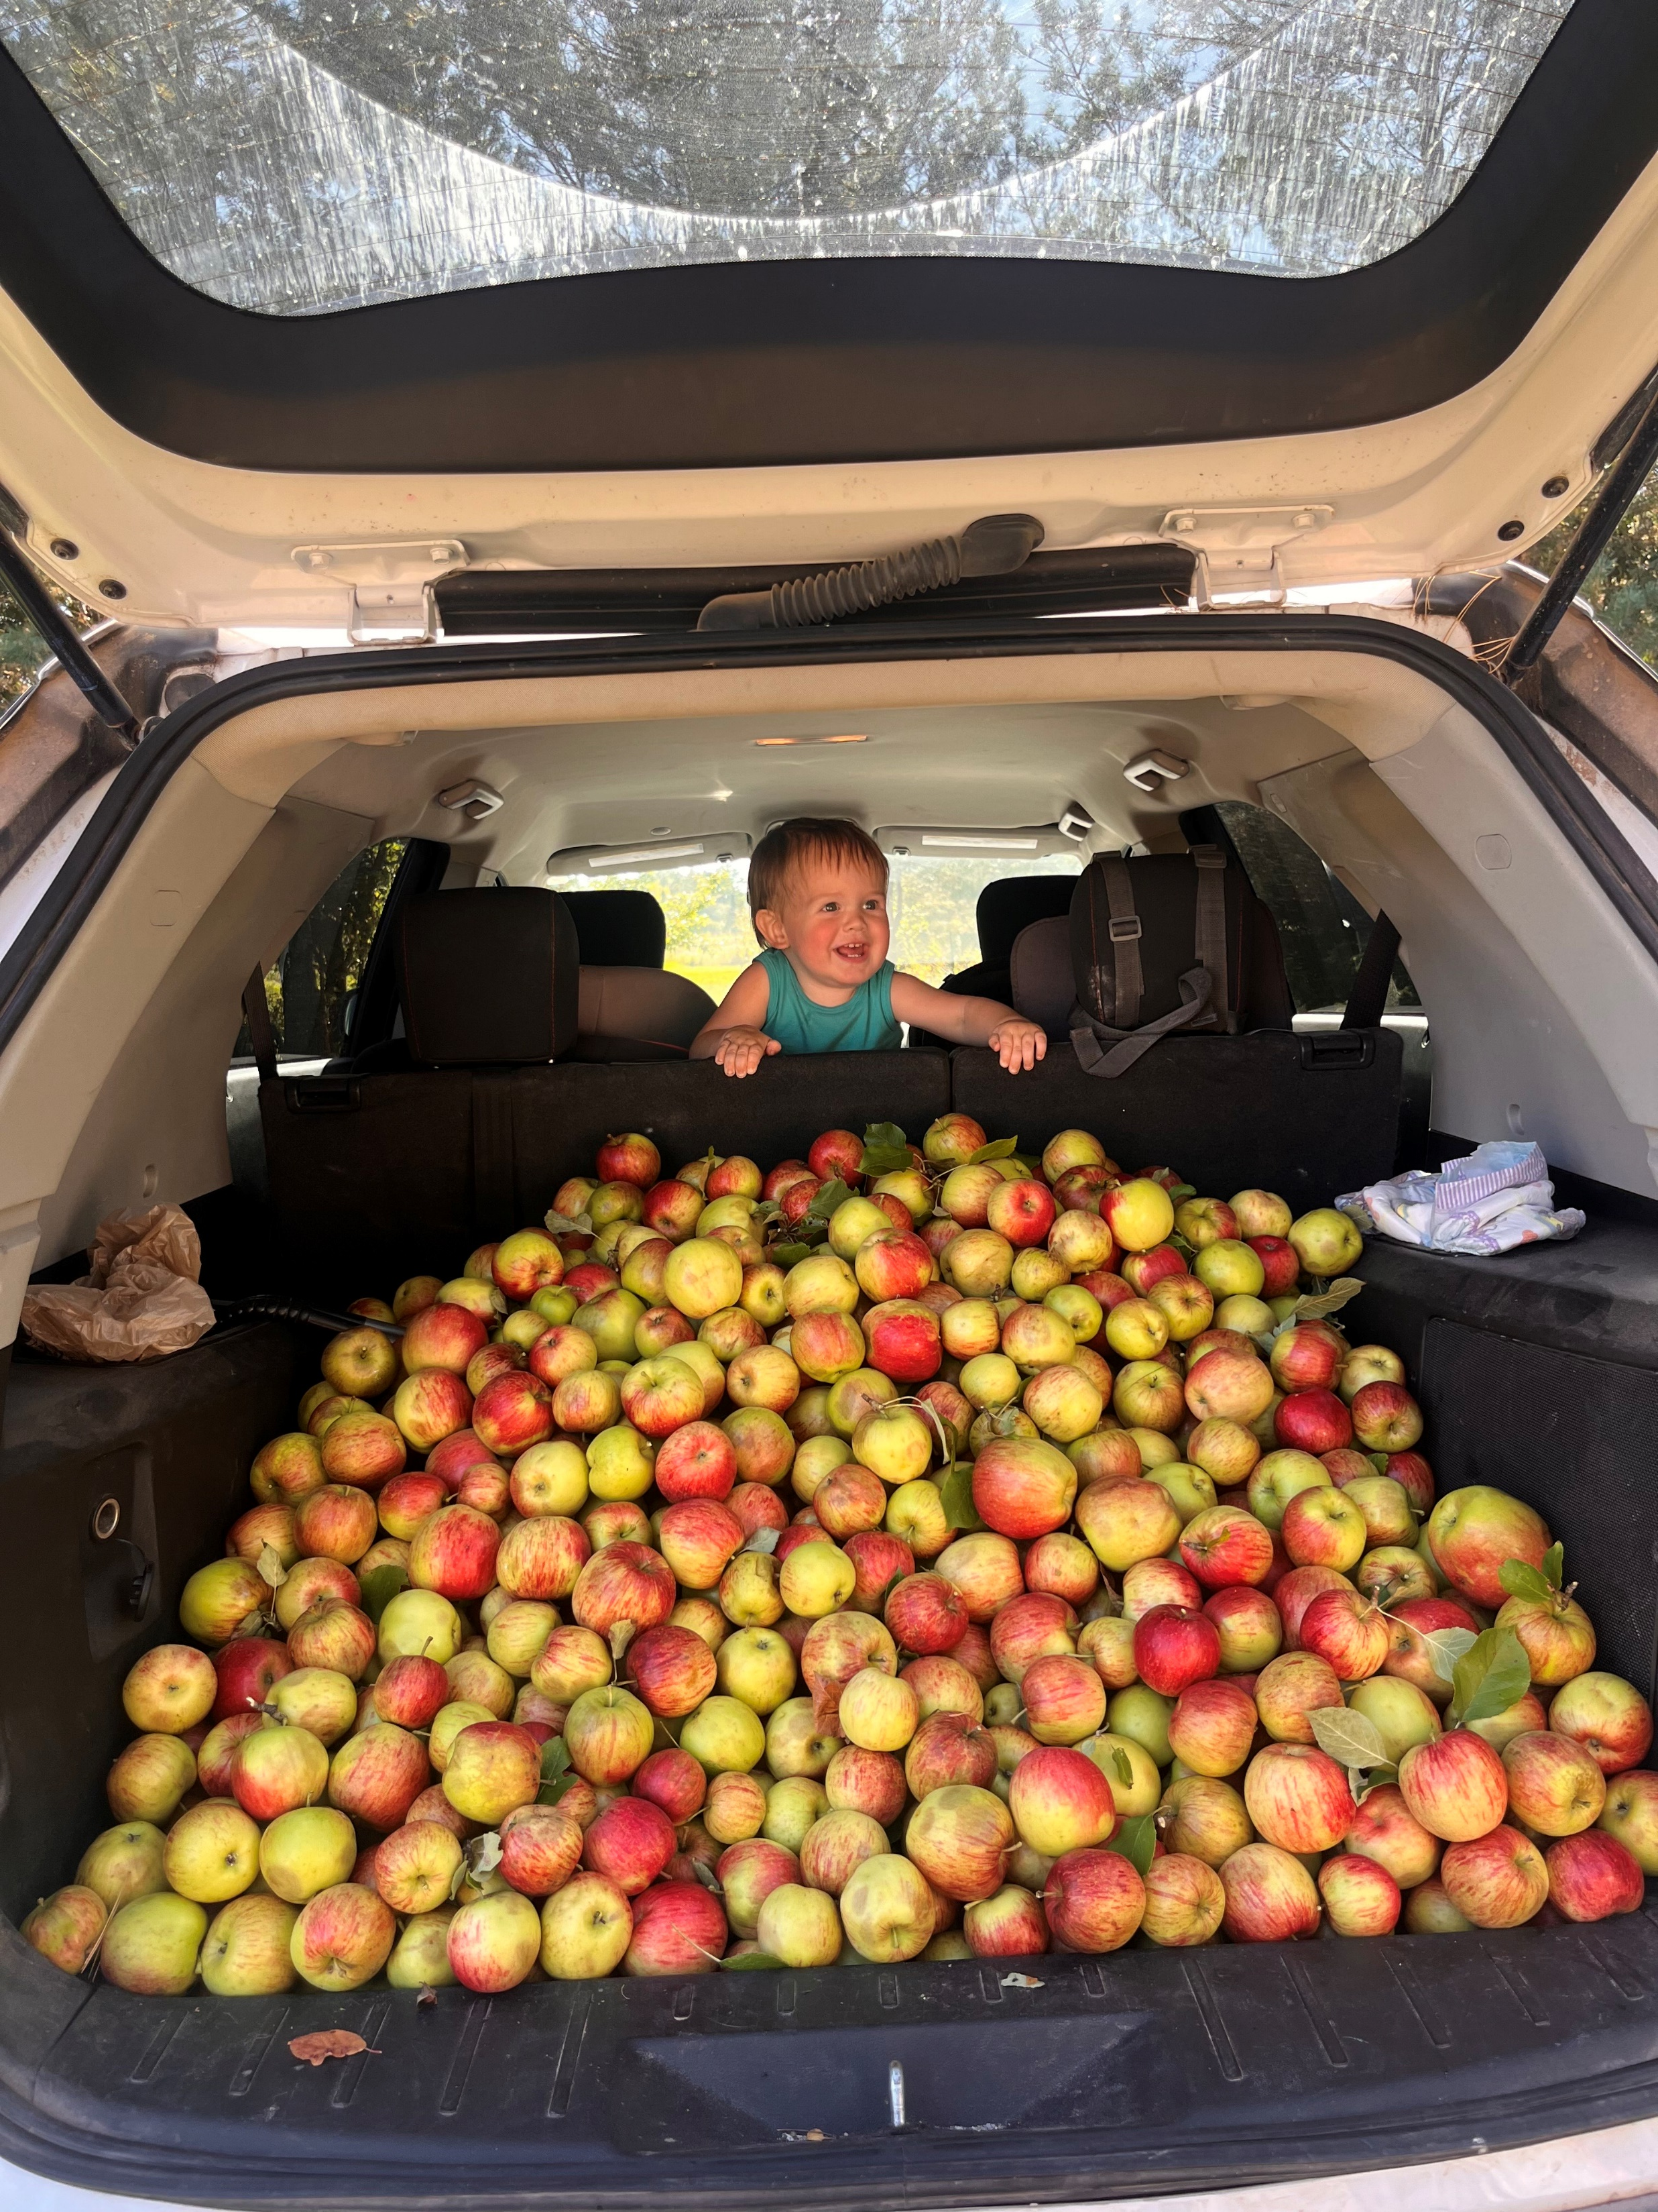
Value transfer & mentoring – year 1
Cindy Hale and Jeff Hall
Mentoring:
Every Monday 10am-2pm, May – October
Side by side introductions to fruit types & varieties, management practices, IPM, harvesting expectations, sale options, pricing and value-added products.
Value Transfer:
Cuttings & nursery stock (Elderberry, Juneberry, Currants) = $318
Rhubarb, Honeyberry, Red & Black Currants, Apples - 16 varieties, Plums & Pears = $6,495
Direct sales = $938
Value-Added Sales = $1,567

Slide 7
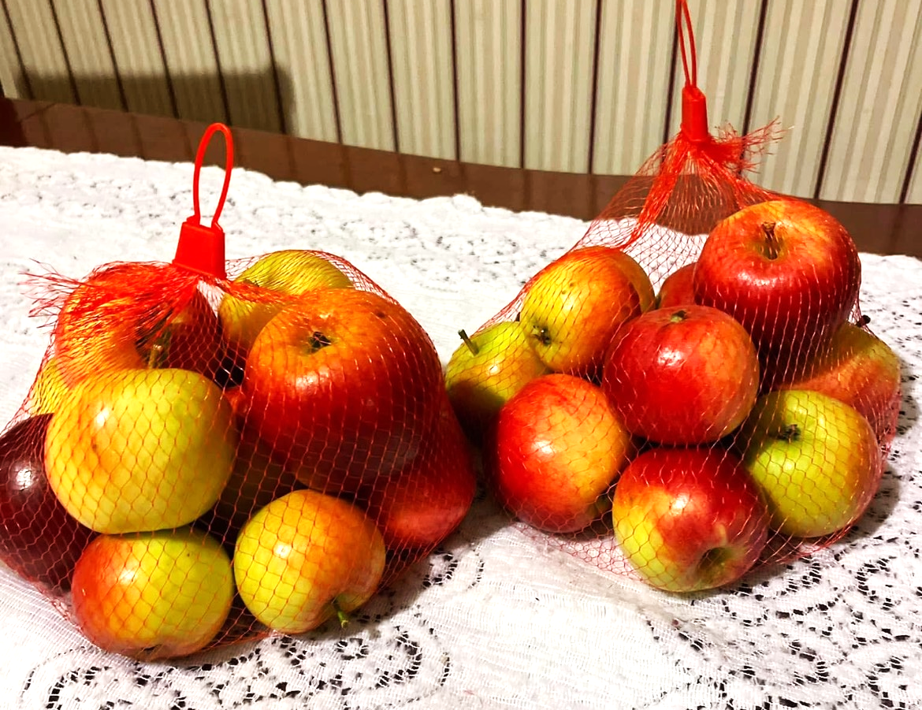
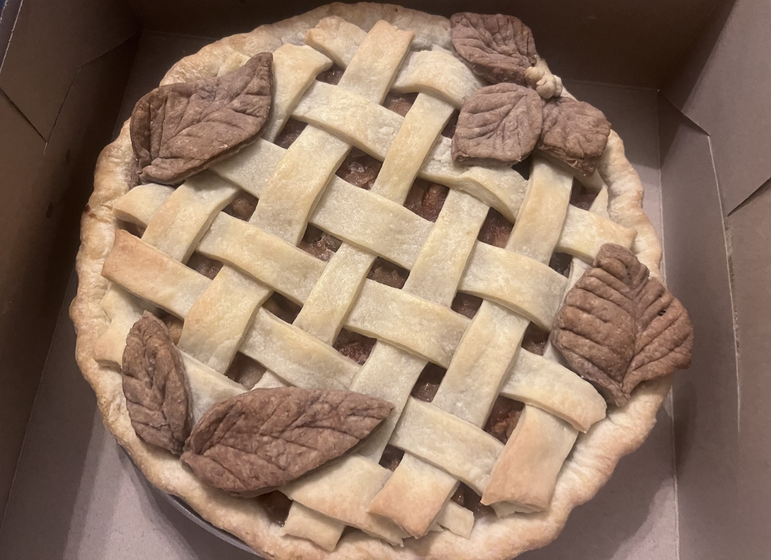
Value transfer & mentoring – year 1
Cindy Hale and Jeff Hall
Mentoring Challenges:
Not enough time on farm
Steep learning curve
Identifying the right person for different tasks
Value Transfer Challenges:
Inability to harvest when fruit was ready
Crop failures (Juneberry, Elderberry)
Understanding and planning for production timing and volumes
Value-Added Sales: products, pricing, non-perishable vs. perishable (waste)
Record keeping

Slide 8
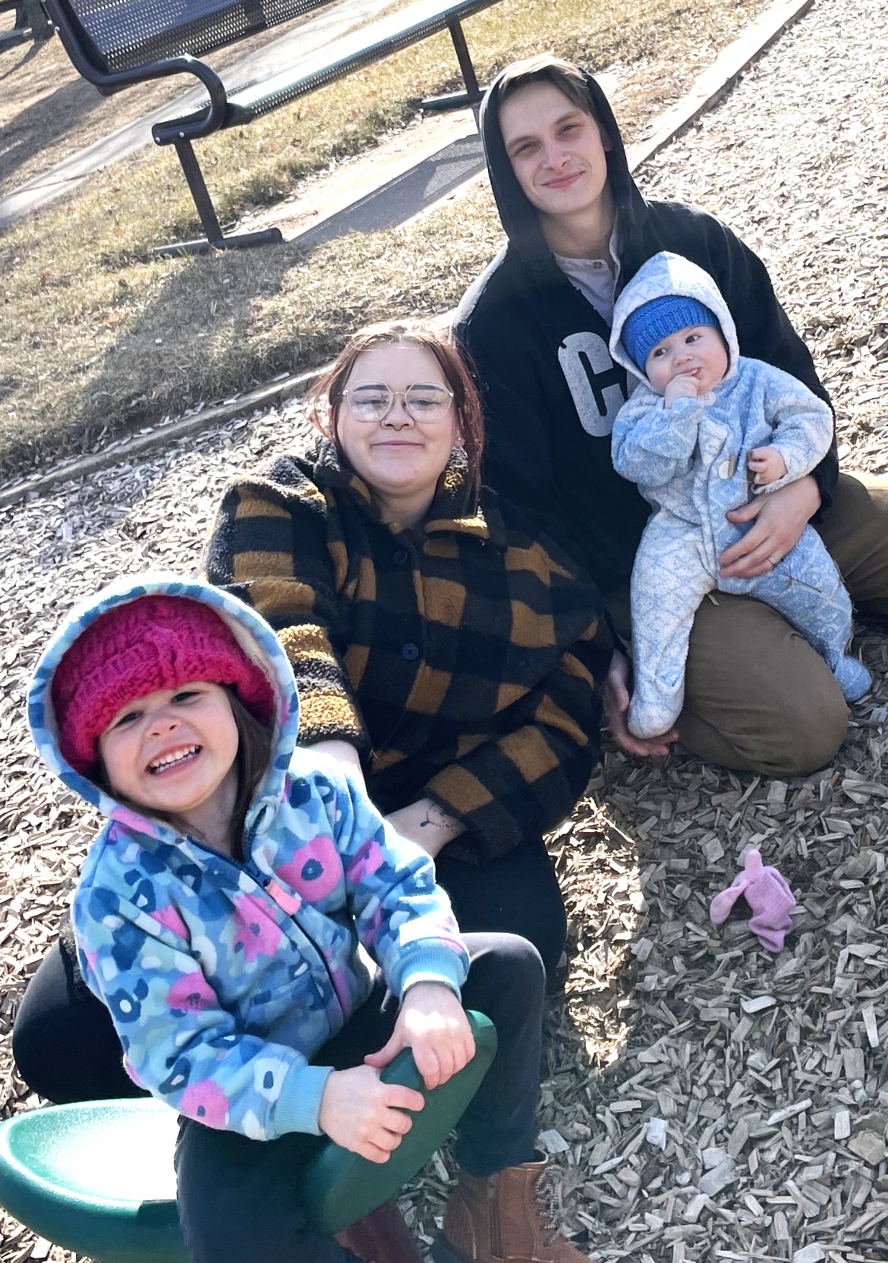
Mentoring & Value transfer – year 1
Sue and Amy Roper
Mentoring:
Generations 1, 2, 3 & 4
Creating new enterprises for Roper Farms
Value Transfer:
Cuttings & nursery stock, the future
Access to mature production capacity
Direct sales
Value-Added Sales

Slide 9
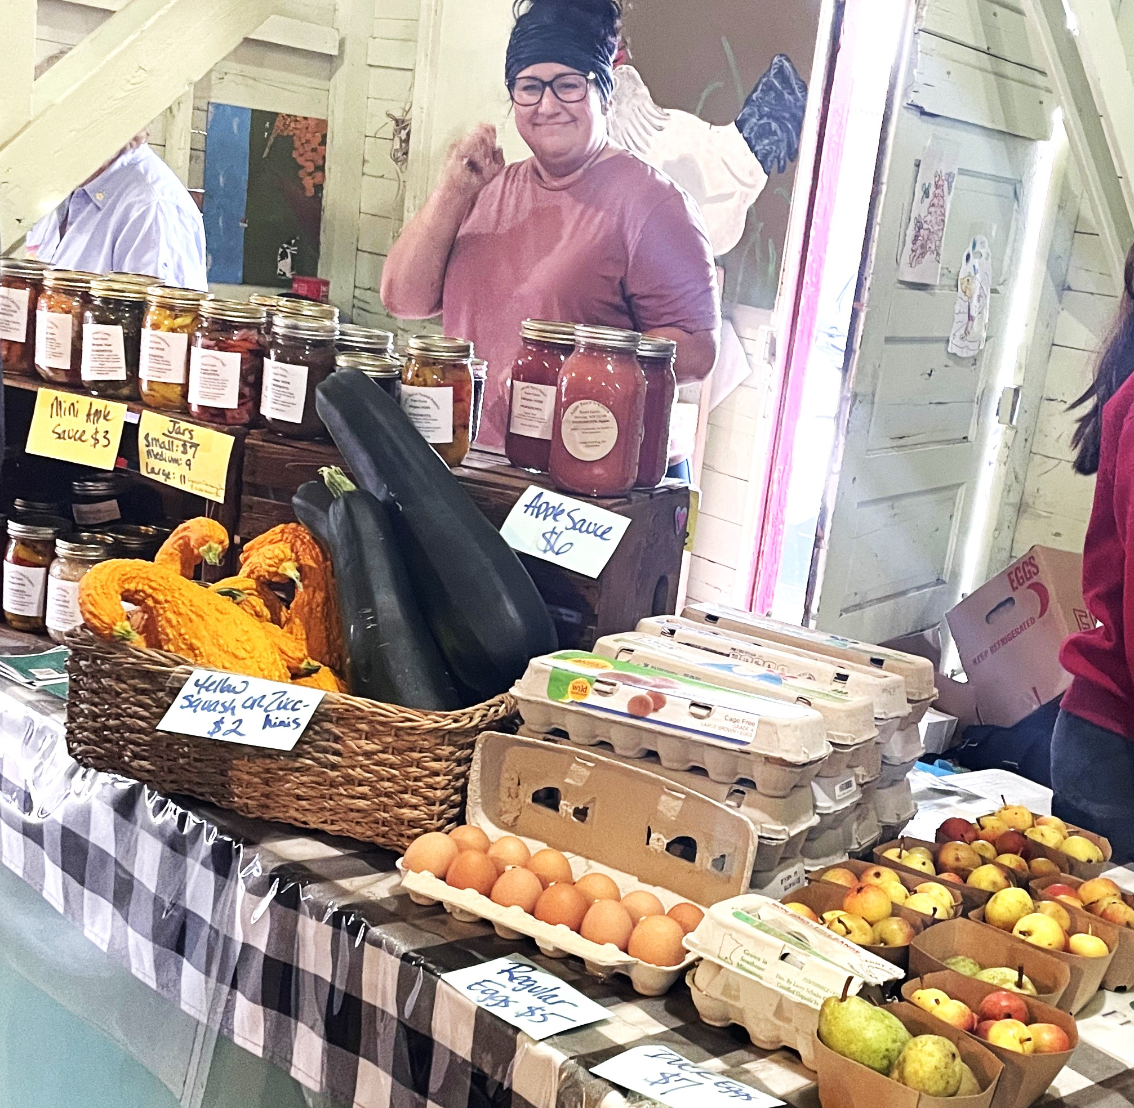
Mentoring & Value transfer – year 1
Sue and Amy Roper
Mentee Challenges:
Learning new rhythms of seasons and responsibilities
Steep learning curve
Identifying the right person for different tasks
Value Transfer Challenges:
Availability to harvest in spur of the moments as needed.
How to best use the raw agricultural product
Understanding and planning for production timing and volumes
Understanding what feels like work completion for the mentors.
Record keeping in a system that works for everyone

Slide 10
Rachel Armstrong, ED and Attorney
We empower agricultural communities to resolve their own legal vulnerabilities, within an ecosystem of support
https://farmcommons.org/

Slide 11
Rachel Armstrong, ED and Attorney
Legally speaking…
All kinds of creative arrangements are possible!
The central challenge: figuring out what you want together.
Sales agreements
Lease agreements

Slide 12
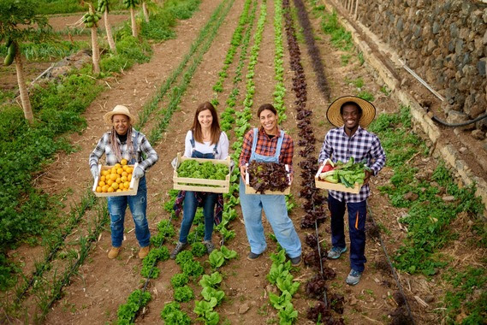
Susanne Hinrichs, Extension educator Agricultural Business Management Team
Farm owner & Beginner farmer Survey Results

Slide 13
Farm Owner Respondent Demographics
Age:
10% younger than 50 years.
19% between 50-60 years old
24% between 61-65 years old
29% between 66-70 years old
19% 71 years or older
Farmers looking for a management transition Survey 12/2024
SARE Grant: Farm Management Transition Survey: Farm Owner Section

Slide 14
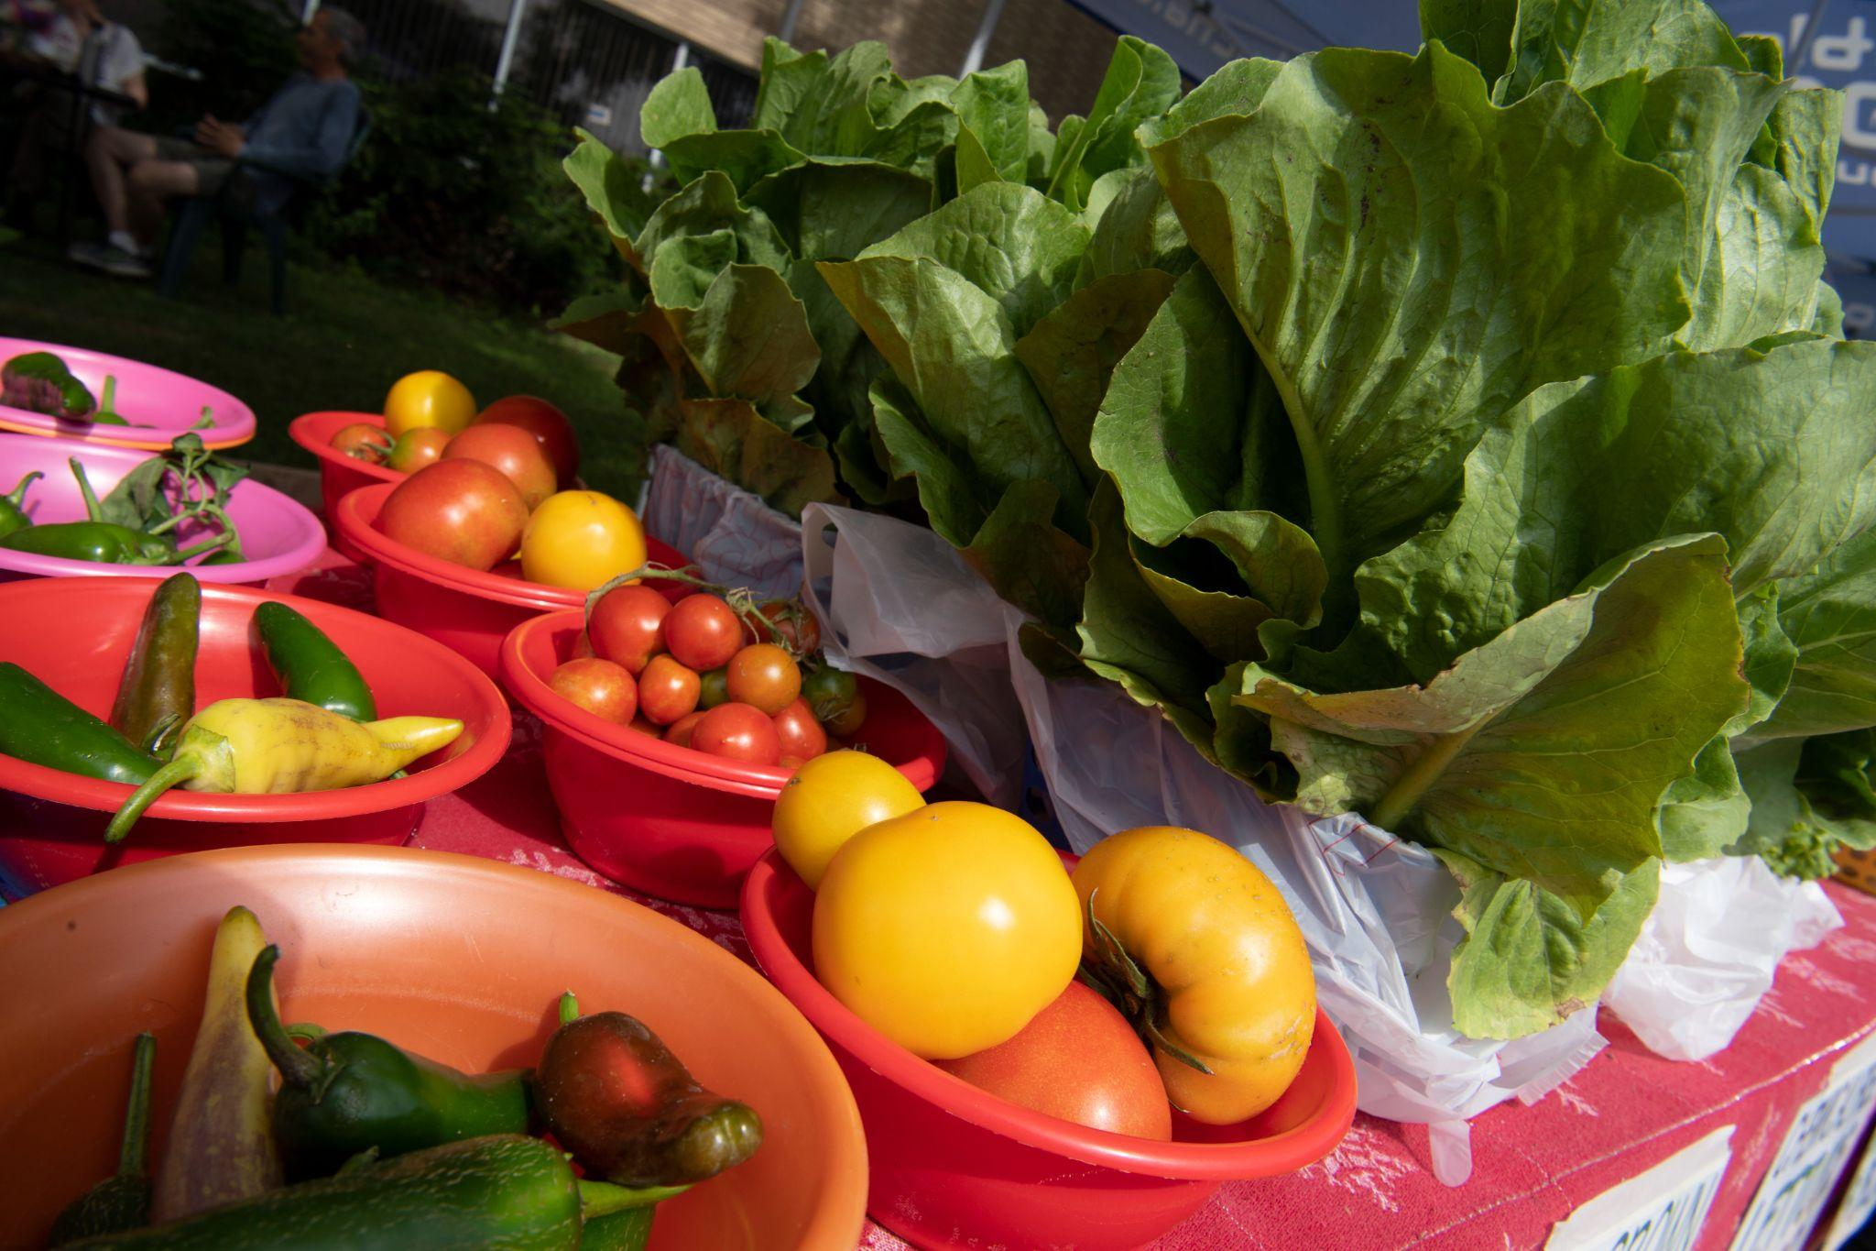
Types of Agricultural Products produced by respondents
Most common products:
Vegetables (13%),
Fruits (19%),
Herbs (11%),
Fresh or frozen meat products (10%).
Other notable products: Grains, agritourism, livestock, hay, eggs, and value-added products.
SARE Grant: Farm Management Transition Survey: Farm Owner Section

Slide 15
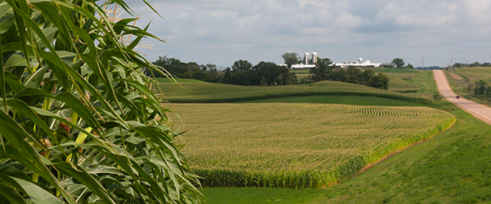
Ways respondents market their farm products
Direct to consumer (24%)
Farmers markets (19%)
Wholesale (19%)
On-farm stands (19%)
Other methods: Livestock auction, online platforms, food hubs, and off-farm retail stores.
SARE Grant: Farm Management Transition Survey: Farm Owner Section

Slide 16
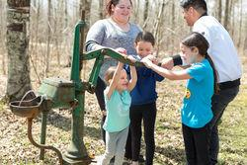
Survey respondents size of farm
Majority of respondents said their farm is small to medium in acreage:
29% farm 1-10 acres.
19% farm 11-20 acres.
14% farm 21-50 acres.
SARE Grant: Farm Management Transition Survey: Farm Owner Section

Slide 17
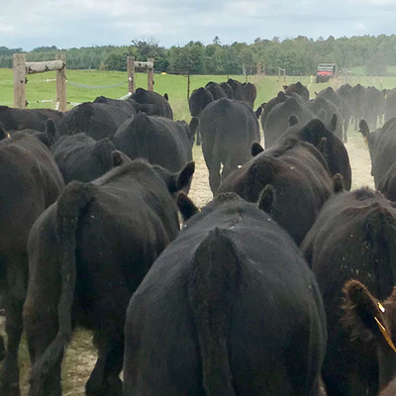
Approaches tried for mentorship & succession
Paid employees, interns, or beginner farmers (13%).
Land leasing (18%).
WWOOFing or volunteer programs (13%).
Common challenges:
Prospective farmers not staying,
differing goals,
lack of resources.
SARE Grant: Farm Management Transition Survey: Farm Owner Section

Slide 18
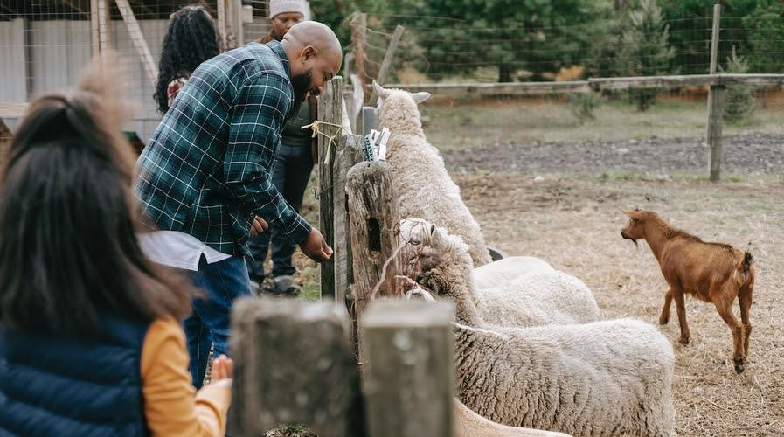
Beginner Farmers looking for a farm opportunity Survey 12/2024
SARE Grant: Farm Management Transition Survey: Beginner Farmer Section

Slide 19
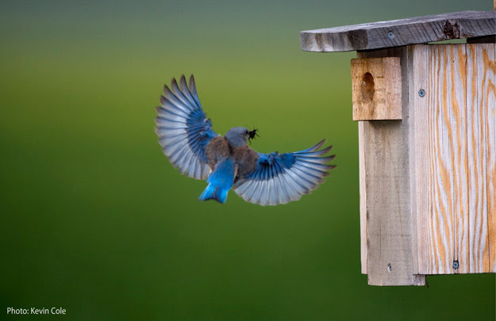
Beginner Farmers looking for a farm opportunity Survey 12/2024
Age range:
The majority respondents between 26-40 years (71% combined).
A notable percentage (10%) are over 50 years old.
Family:
27% are in a committed relationship with a co-farmer.
24% have children under 18.
SARE Grant: Farm Management Transition Survey: Beginner Farmer Section

Slide 20
Beginner Farmers current location vs desired farming location
71% of respondents are not currently living where they ultimately want to farm.
Most prefer to farm in Minnesota (57%) or Wisconsin (14%), with others open to the Midwest or specific states like Illinois and Michigan.
SARE Grant: Farm Management Transition Survey: Beginner Farmer Section

Slide 21
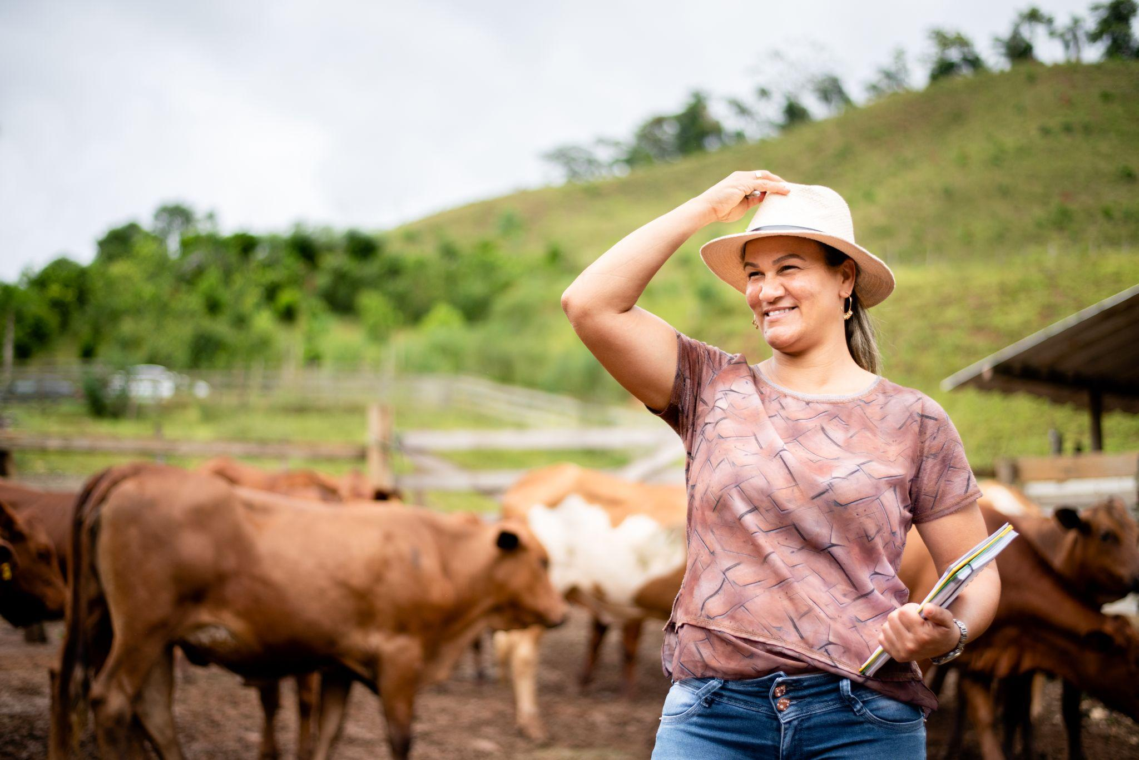
Considerations for beginner farmers on farm location
Proximity to family (24%) and soil type (16%) are key factors influencing location decisions.
Existing infrastructure and housing availability are also significant considerations.
SARE Grant: Farm Management Transition Survey: Beginner Farmer Section

Slide 22
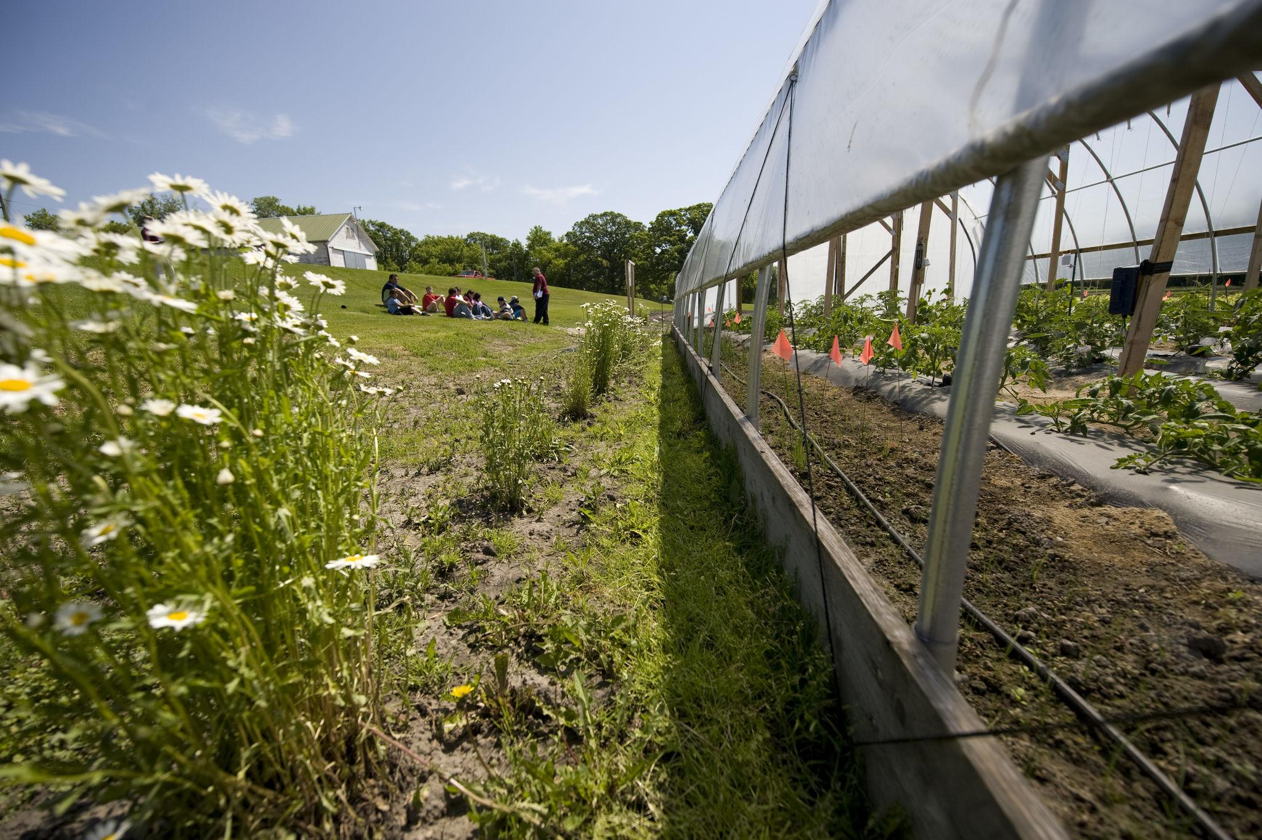
Types of products beginner farmers are interested in producing
The most often mentioned products are vegetables (20%), fruits (17%), and herbs (17%).
A significant number are also interested in value-added products (14%) like jams, honey, or ready-to-eat foods.
SARE Grant: Farm Management Transition Survey: Beginner Farmer Section

Slide 23
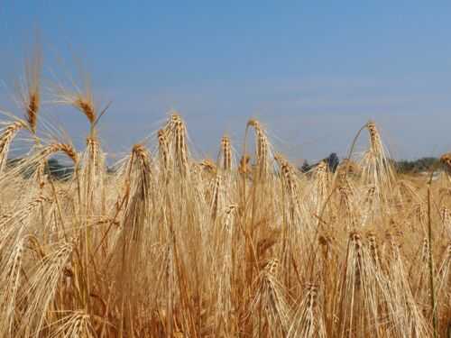
Challenges for beginner farmers in accessing land and mentorship
Key obstacles include financial constraints (17%) and finding farmers who can accommodate their needs (14%).
Other barriers to land access involve land cost and lack of infrastructure (12% and 7%).
SARE Grant: Farm Management Transition Survey: Beginner Farmer Section

Slide 24
Types of mentorship and training beginner for which farmers are looking
Many have tried mentorship through paid or unpaid internships (25% and 14%, respectively), though challenges include differing goals and financial conflicts (19% and 17%).
Farm management courses and farmer training programs are often mentioned as helpful.
SARE Grant: Farm Management Transition Survey: Beginner Farmer Section

Slide 25
Income needs of farmer owners and beginner farmers during a transition
Farmer Owners
29% need to generate income to cover overhead costs.
24% want to generate income from the farm's sale down the road.
Beginner Farmers
Primary income from farming is needed by 19% of respondents, while 42% are looking for farming to provide supplementary income.
SARE Grant: Farm Management Transition Survey: Beginner Farmer Section

Slide 26
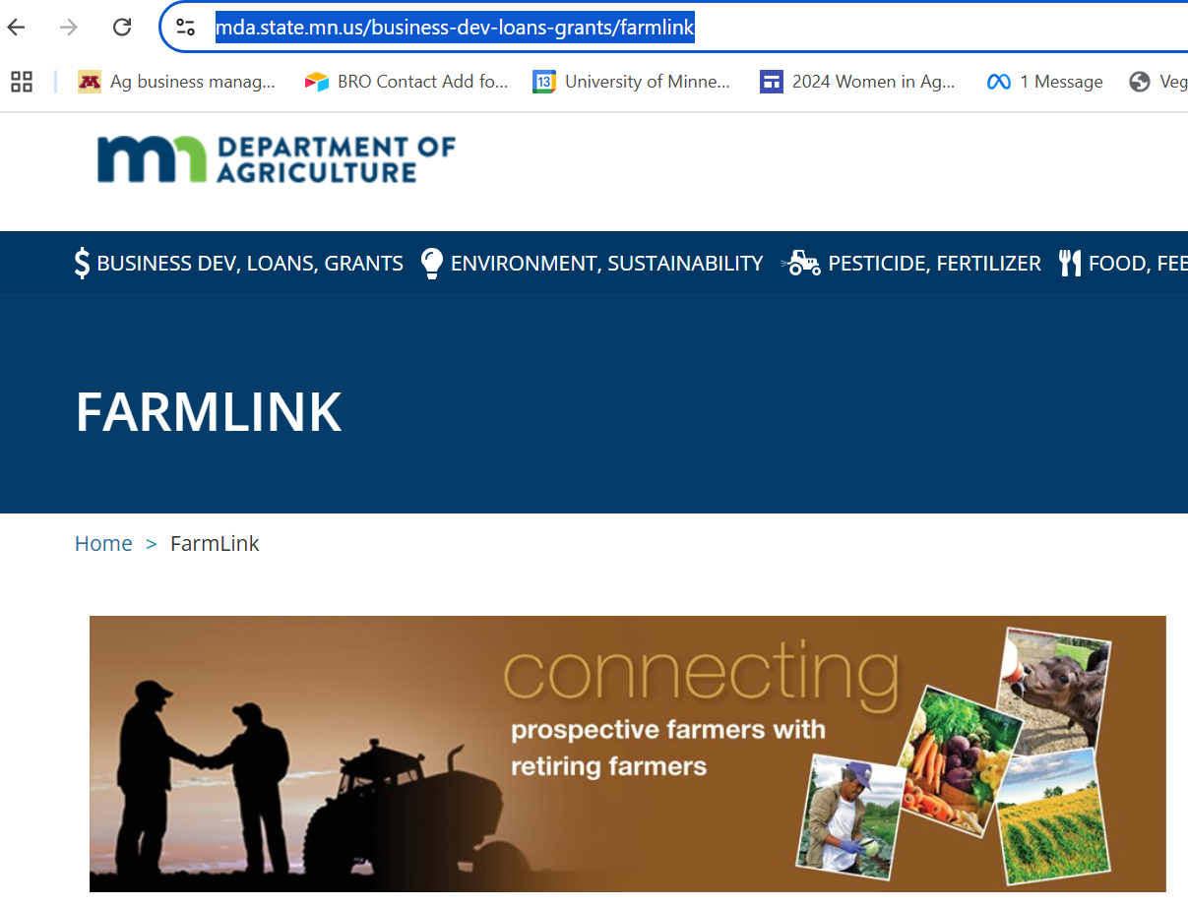
Ways in Minnesota for farm owners and beginner farmers to meet
MN Dept of Ag Farmlink
UMN Extension workshops & retreats
Email list & matchmaking of Farmland Access Hub at Renewing the Countryside nonprofit

Slide 27
Susanne Hinrichs, Extension educator Agricultural Business Management Team
Educational topics farm owners say they want
Education Topics of Interest
Farm transition, business succession, and estate planning (40%).
Production topics (20%).
Value-added products and direct marketing (6%).

Slide 28
-Lake Superior Chapter- Sustainable Farming Association
The LSSFA is a coalition of producers and consumers moving farm practices and food systems into a sustainable future.
We encompass NE Minnesota and NW Wisconsin.
We’re a chapter of the SFA of MN, whose mission is to transform agriculture, one farm at a time.
www.sfa-mn.org

Slide 29
-Lake Superior Chapter- Sustainable Farming Association
WHAT WE DO:
Lake Superior Harvest Festival
Farmer-to-Farmer Field Days
Social / Networking Events
www.RootsandRecipes.org

Slide 30
Non-traditional farm transition planning and value transfer via mentoring and creative lease agreements
Questions?
Break out Groups…how they will work
Reconciling different values, perspectives & expectations of farmers
Legal tool: what might they be and preparing to use them
Equity: realities of addressing disenfranchisement and power disparities
Considerations before starting

Slide 31
Non-traditional farm transition planning and value transfer via mentoring and creative lease agreements
Break out Groups…reporting back to the whole group
Reconciling different values, perspectives & expectations of farmers
Legal tool: what might they be and preparing to use them
Equity: realities of addressing disenfranchisement and power disparities
Considerations before starting

Slide 32
Non-traditional farm transition planning and value transfer via mentoring and creative lease agreements
THANK YOU!
Cindy Hale and Jeff Hall Sue and Amy Roper Susanne Hinrichs, Extension educator, Agricultural Business Management Team
Rachel Armstrong, CEO and Attorney Julie Allen, program coordinator
This material is based upon work that is supported by the National Institute of Food and Agriculture, U.S. Department of Agriculture, under agreement number
2023-38640-39573 through the North Central Region SARE program under project number FNC24-1417. USDA is an equal opportunity employer and service provider. Any opinions, findings, conclusions, or recommendations expressed in this publication are those of the author(s) and do not necessarily reflect the view of the U.S. Department of Agriculture.

