Slide 1
Johnson-su bioreactor and compost extract seed treatment
MN wheat Research and Promotion Council – On-farm research Network
UMN Crookston

Slide 2
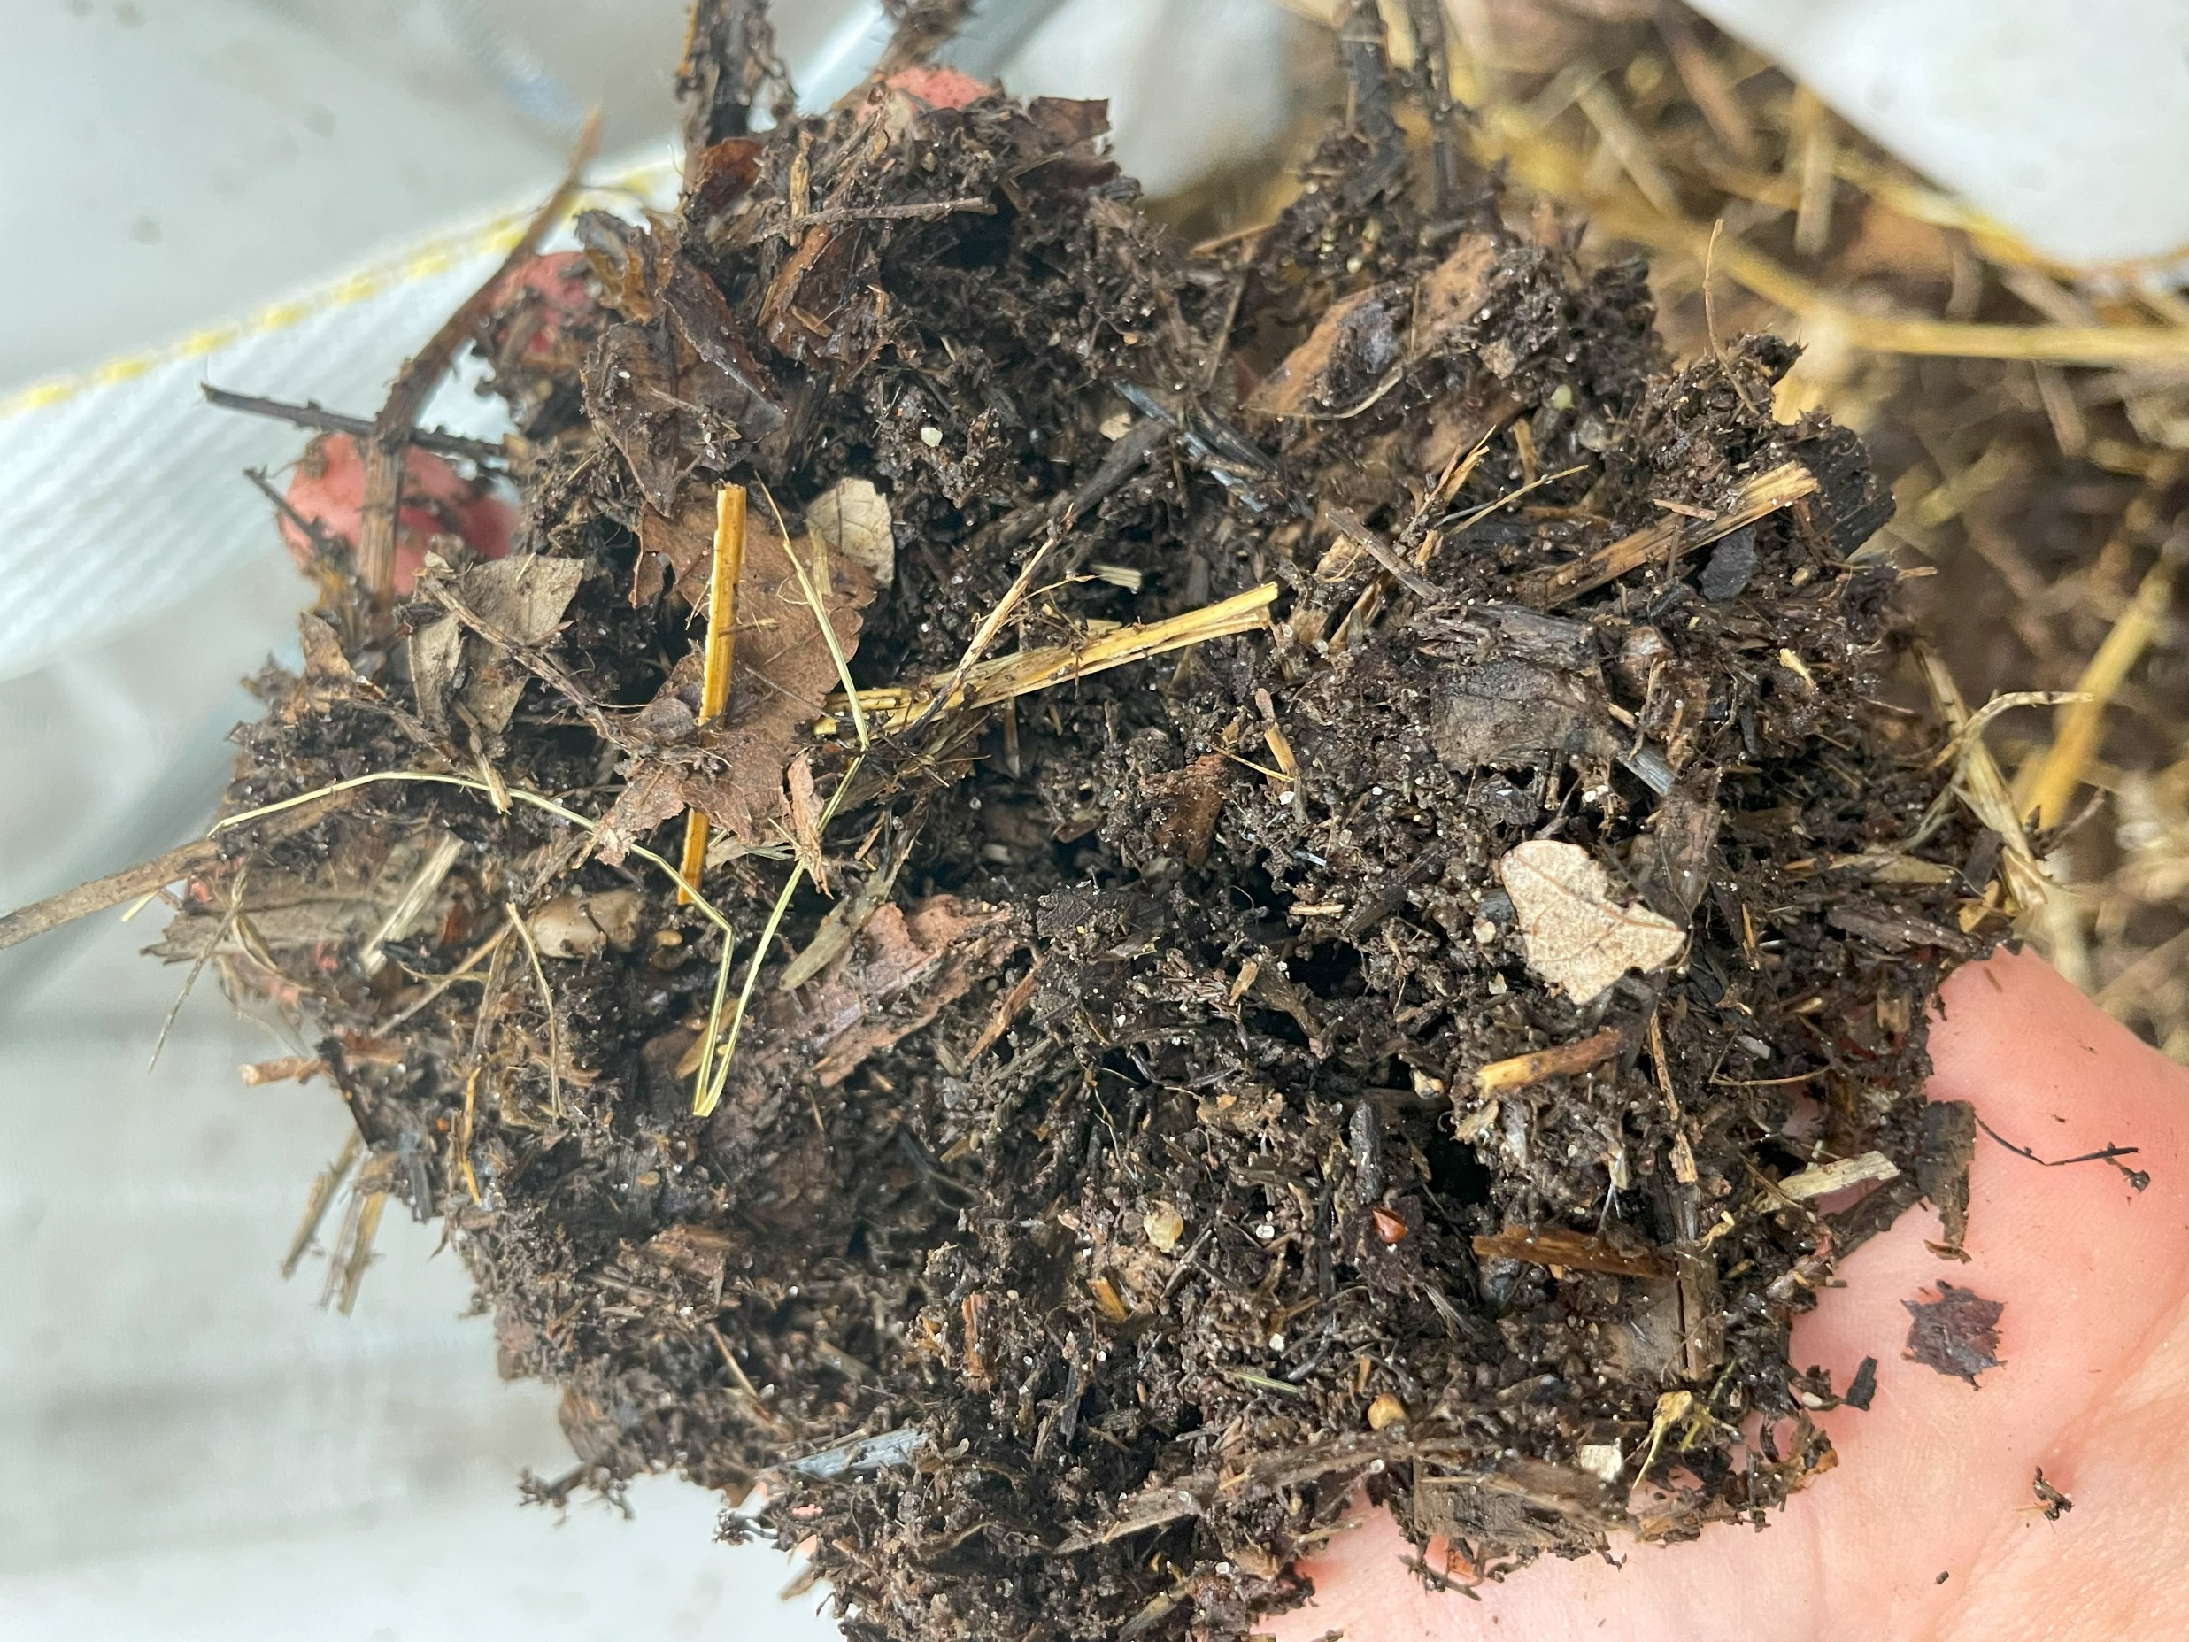
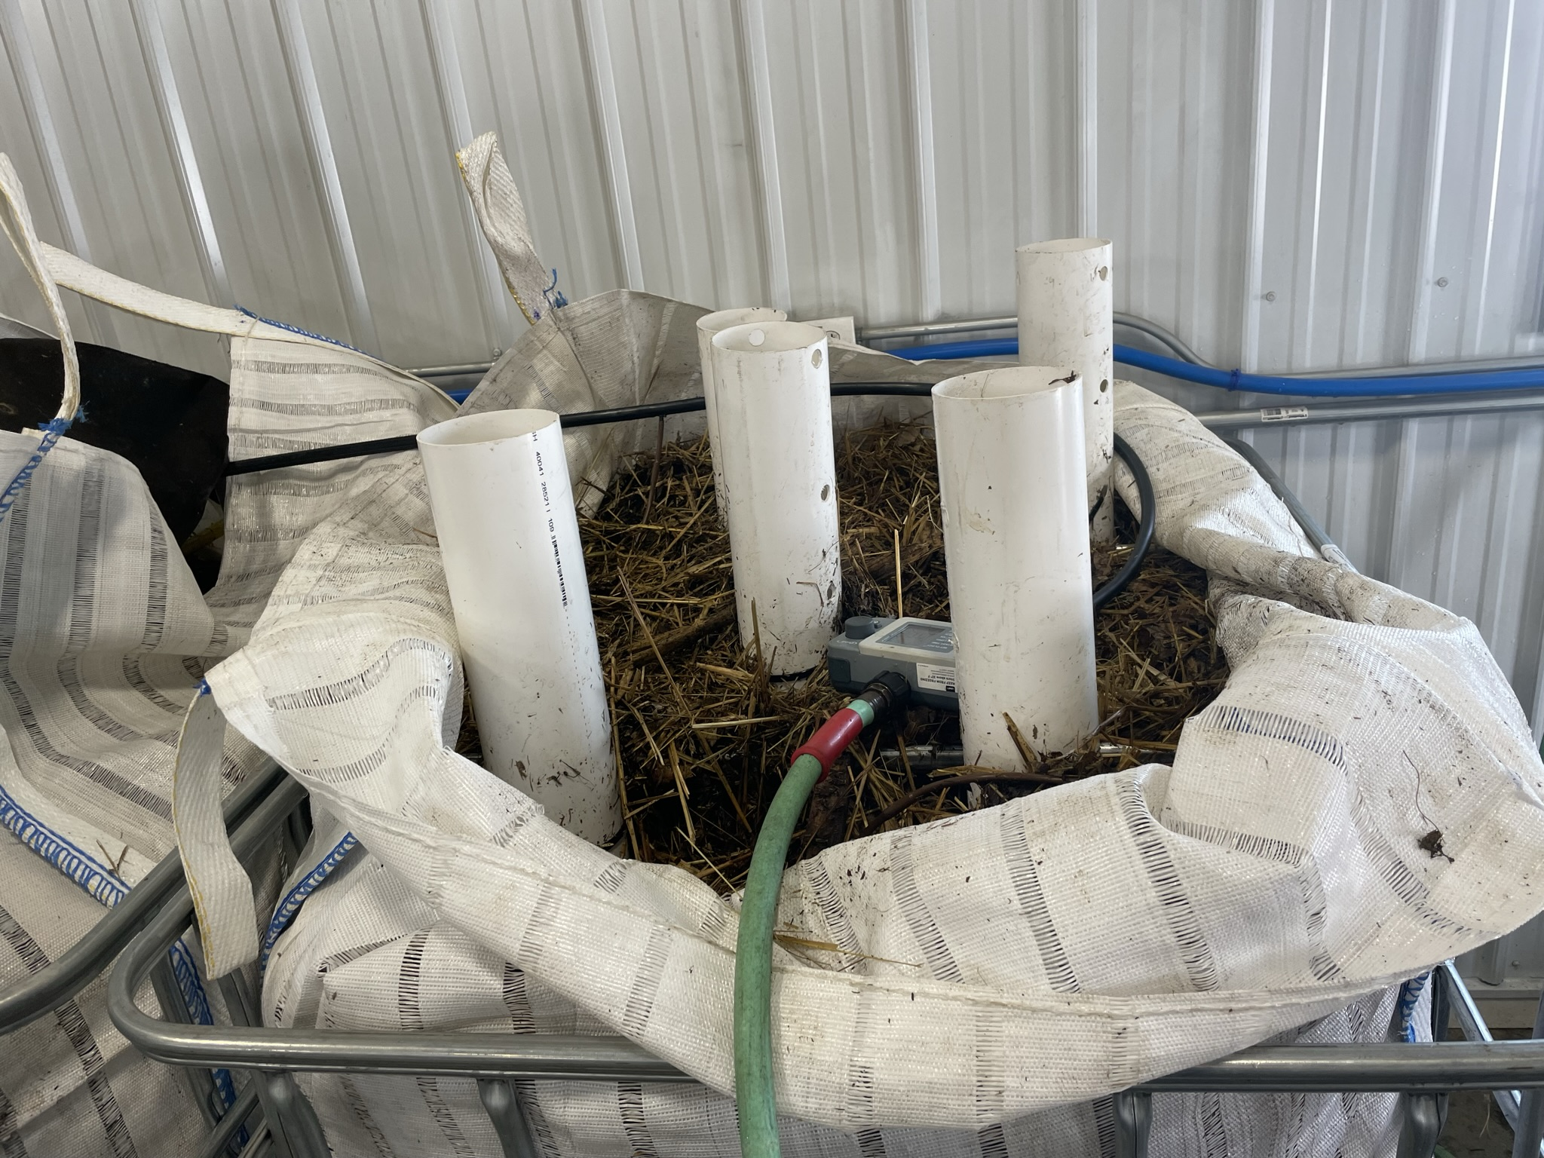
Johnson-su bioreactor
Areated composting method that doesn’t require turning
Treat seed with whole community of living microorganisms

Slide 3
Johnson-su bioreactor
Objectives
Demonstrate methods to economically create and use a Johnson-Su Bioreactor on a commercial crop farm
Determine if N and P fertilizer can be reduced by using compost extract
Evaluate fungal and bacterial species diversity and quantity in compost extract
Educate regenerative and conventional farmers about the principles and methods behind the compost extract application to wheat and soybean and how to replicate the process on their own farm

Slide 4
Large Plot Treatments
Crookston
0 N, 50% N, and 100% N, with compost extract
Red Lake Falls - Wheat
Control – Farmer fertilizer rate, no extract
Compost extract + 50% N + 0 P
Compost extract + 0N + 0P
Red Lake Falls – Sunflower
Control – No extract
Treatment – In-furrow liquid compost extract at 6 gal/acre
BiomeMakers Microbiome Analysis of Vermicast
137 species fungi
848 species bacteria
985 microbial species total
Page 13

Slide 5
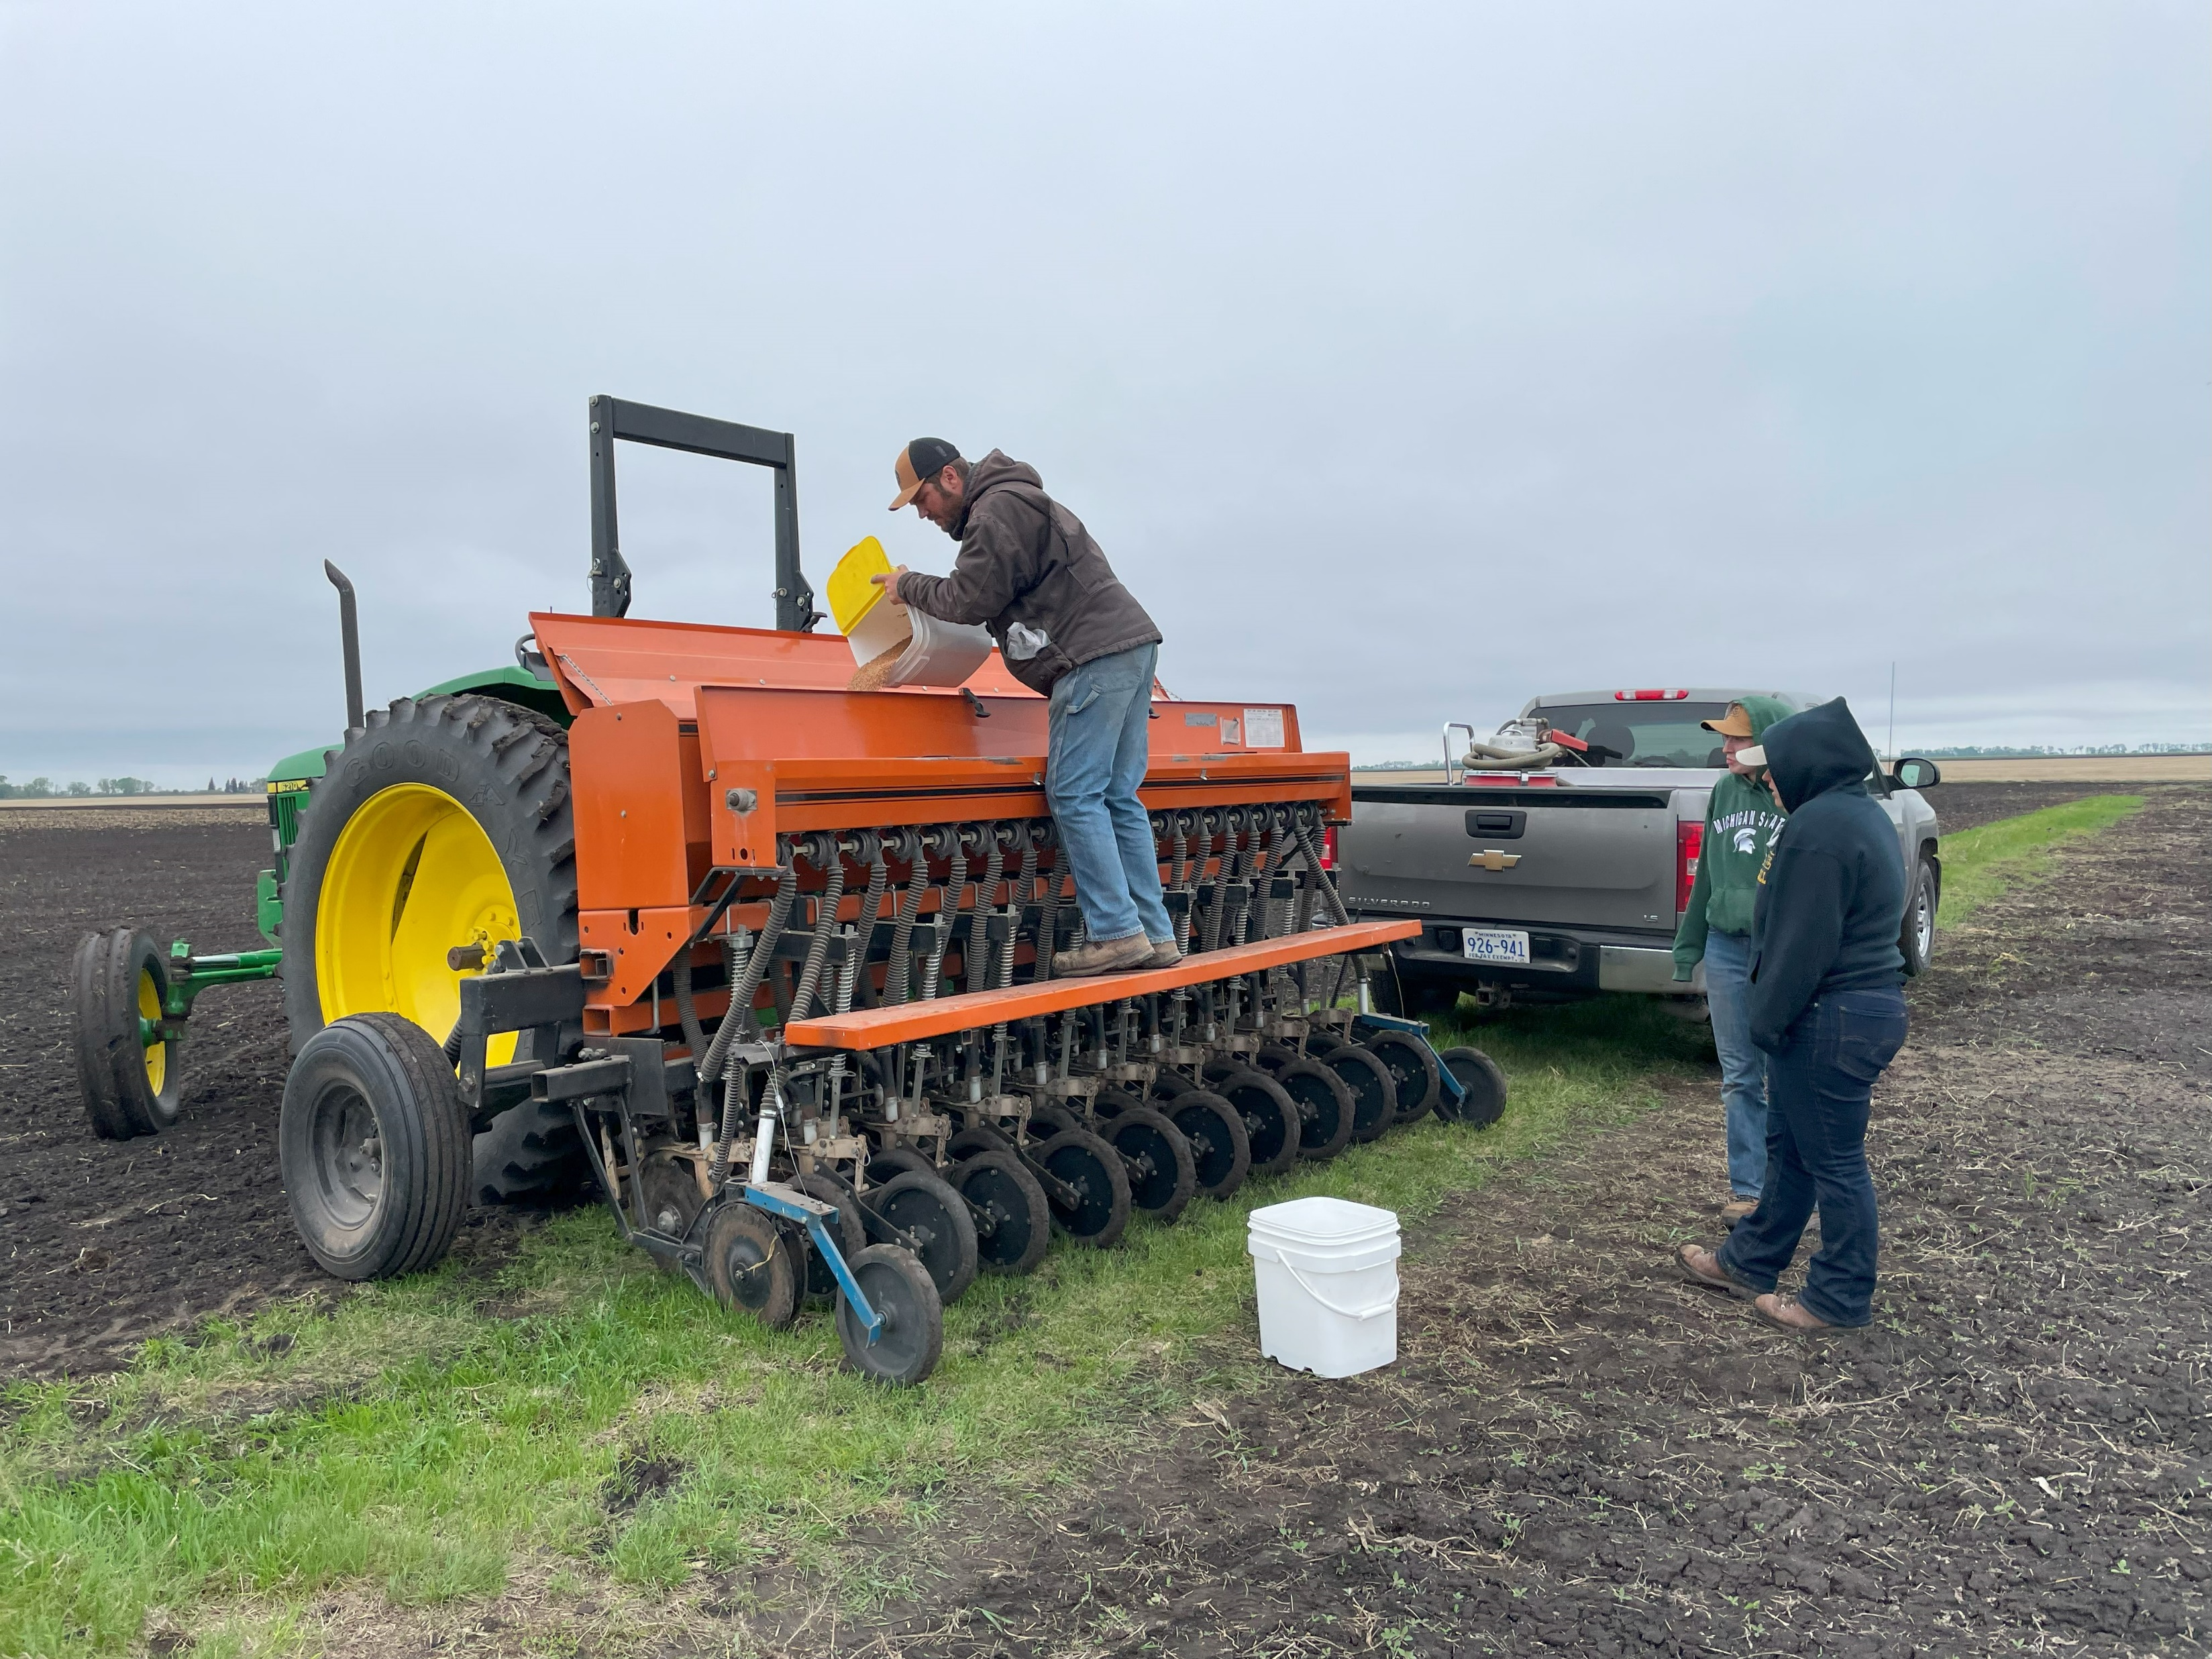
small Plot Treatments
0, 60, 120, 180 lbs N; with compost extract (wheat only)
0, 120, 180 lbs N; no compost extract (wheat only)
0, 20, 40, 60 lbs P2O5; with compost extract (wheat and soybeans)
0, 40, 60 lbs P2O5; no compost extract (wheat and soybeans)
Page 13

Slide 6
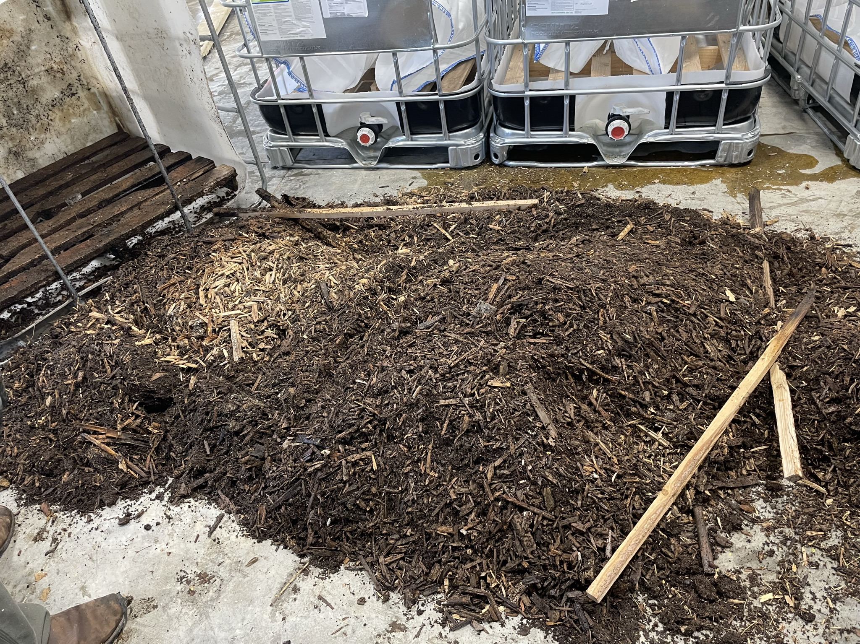
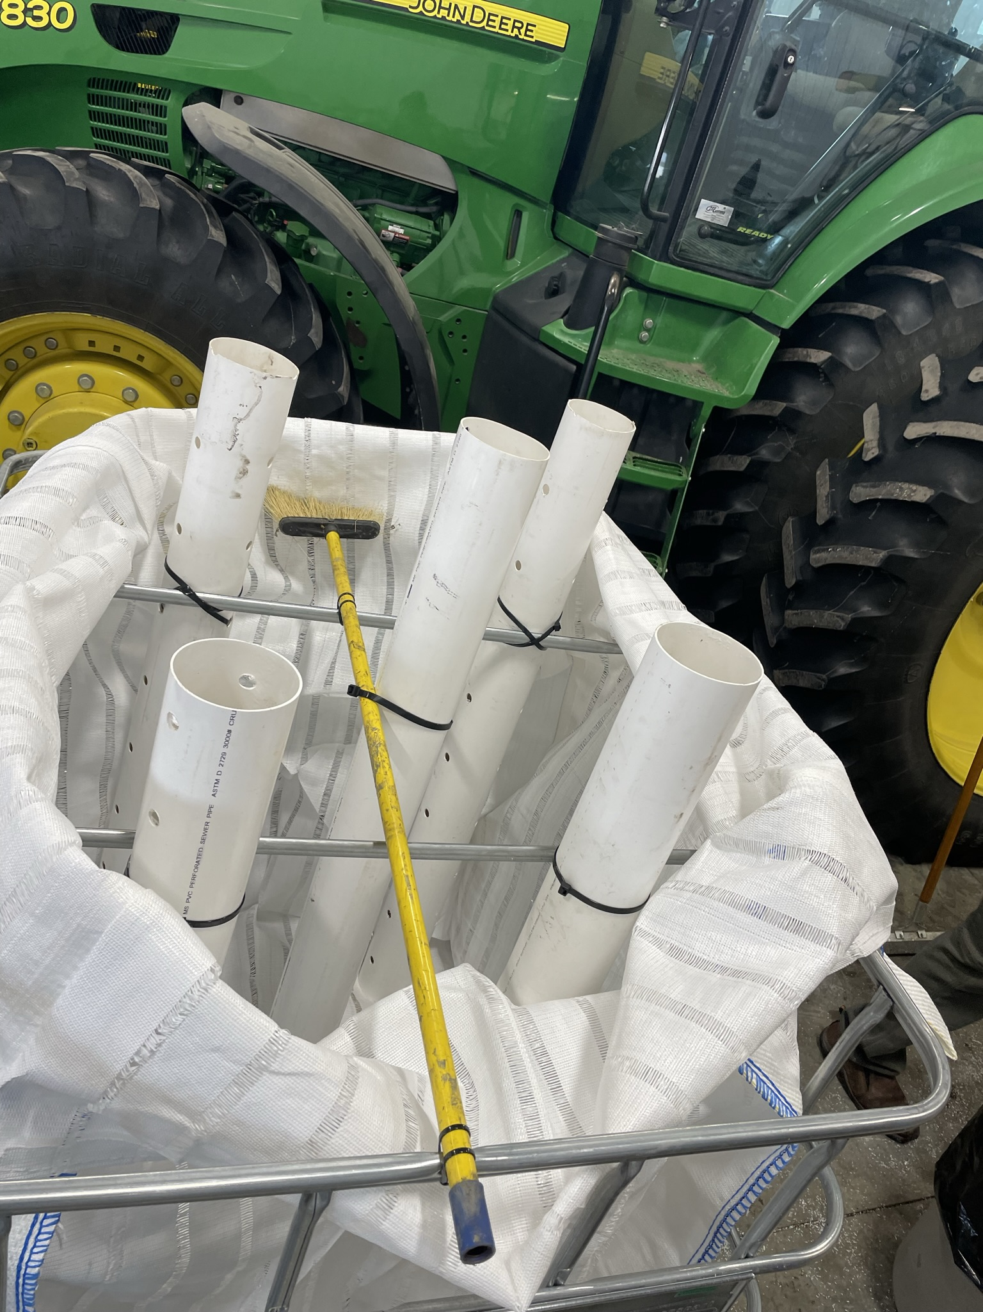
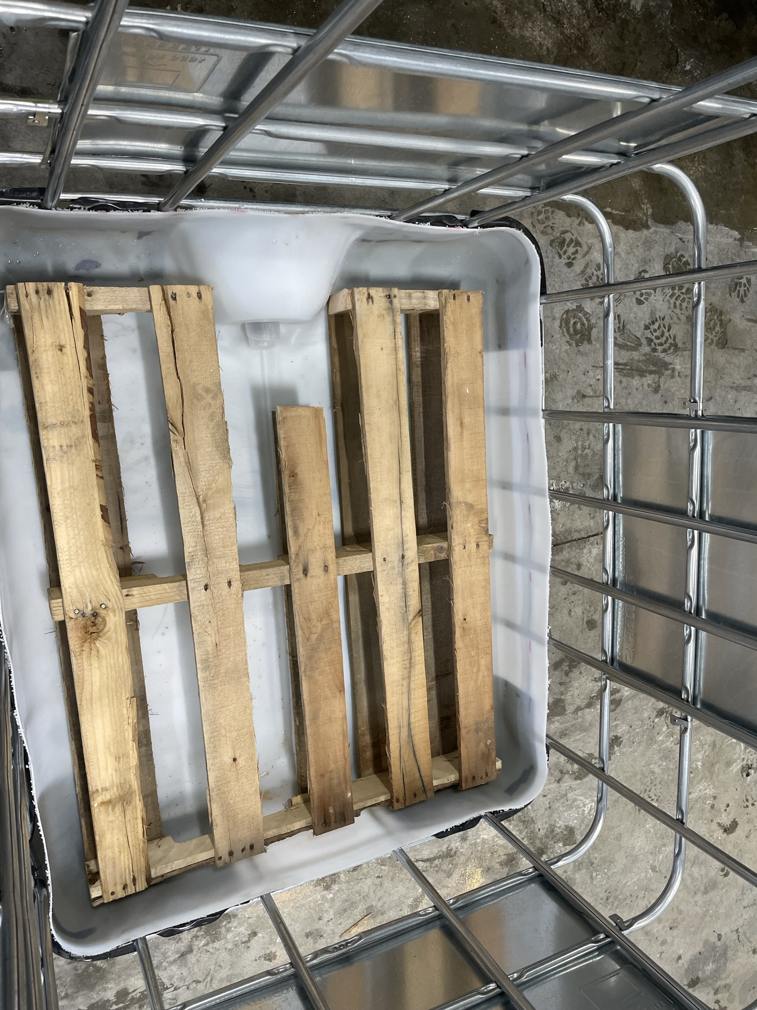
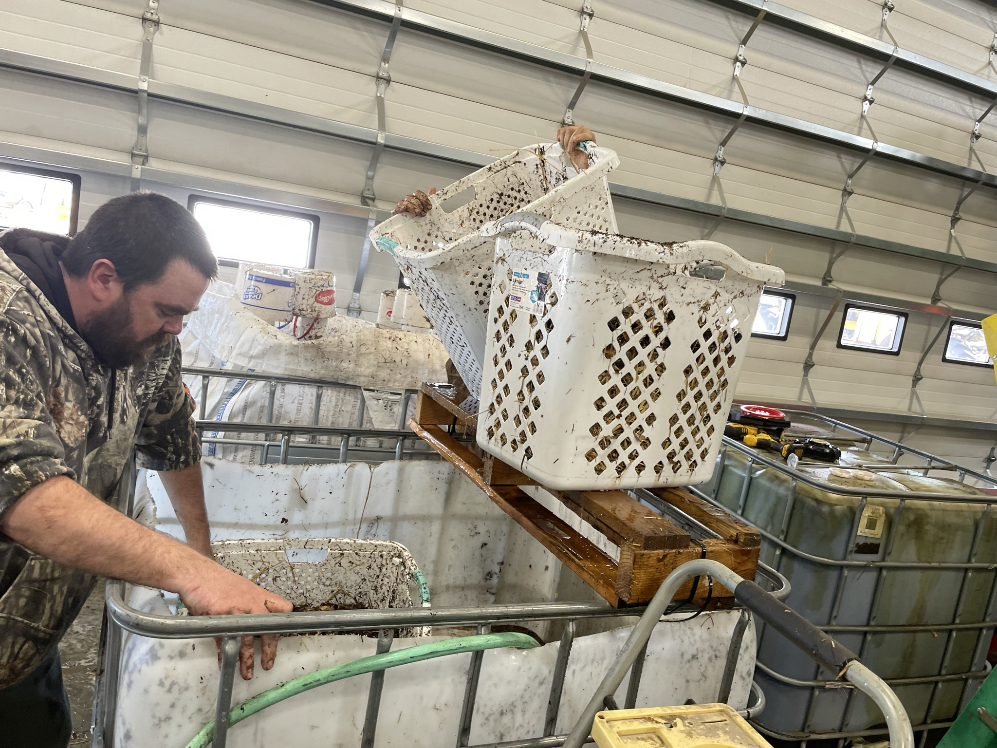
Johnson-su bioreactor

Slide 7
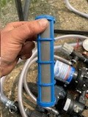
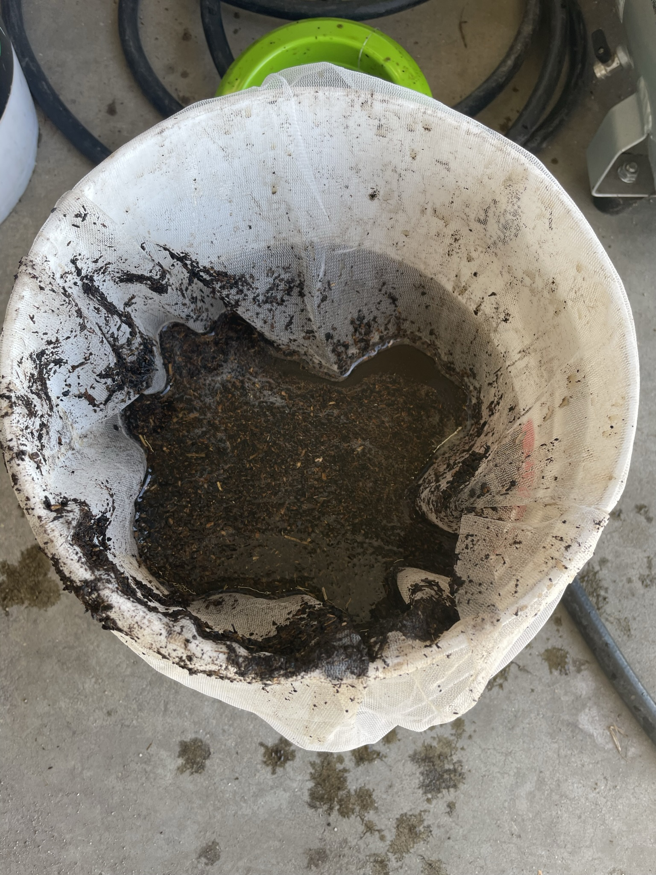
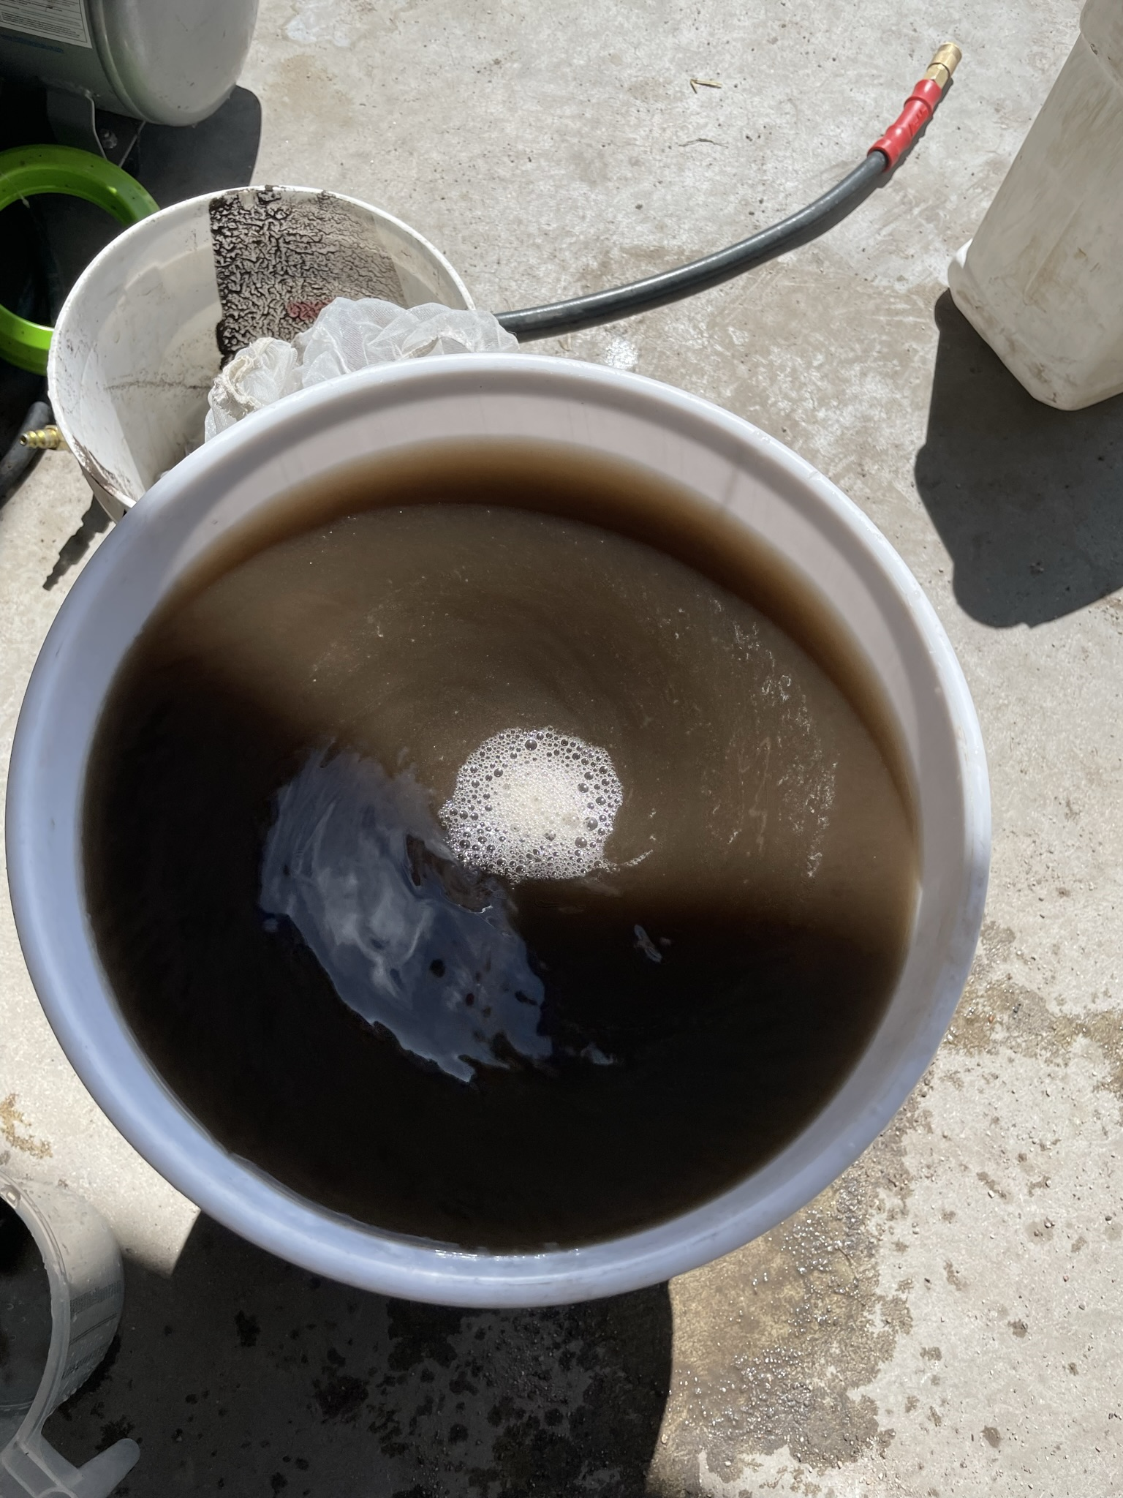
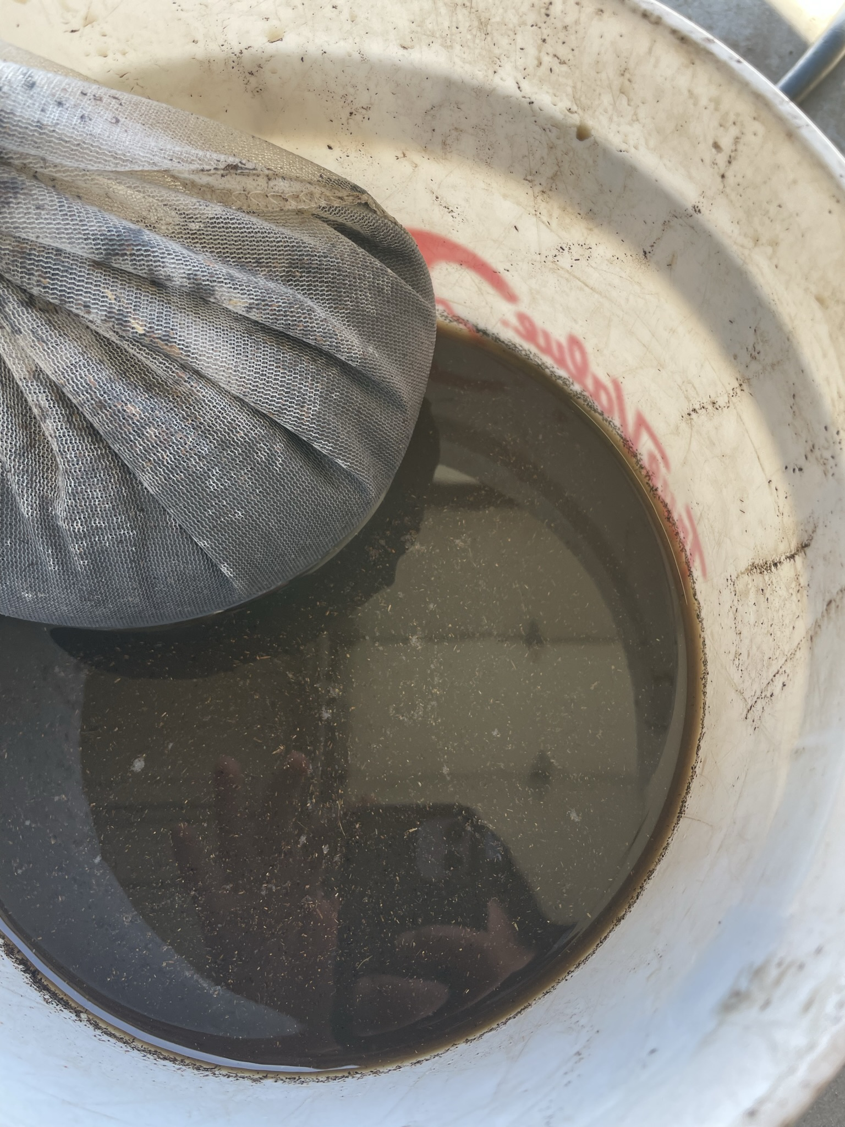
Johnson-su bioreactor - Extraction

Slide 8
Johnson-su bioreactor
Table 12. Agronomic information for the 2023 locations at Crookston and Red Lake Falls, MN.
Location | Crookston | RLF - Wheat | RLF - Sunflower
Variety | AP Murdock | Shelly | P64ME01
Planting Date | 5/22/2023 | 5/16/2023 | 23-May
Harvest Date | 30-Aug | 31-Aug | 17-Nov
Previous Crop | Soybean | Soybean | Soybean
Field Rate Fertilizer | 120 lbs Urea | 50 lbs Map | 9-12 gal UAN at side-dress
 | 0 lbs P | 55lbs ESN | 0 lbs P
 | 0 lbs K | 66 lbs Urea | 0 lbs K
Page 14

Slide 9
Johnson-su bioreactor - Crookston
Table 13. Yield, protein, moisture, and test weight from individual locations in 2023.
Crookston | Treatment | Yield (bu/ac) | Protein (%) | Moisture (%) | TW (lbs/bu)
Wheat | 100% N + Extract | 30.1 | 15.4 | 15.0 | 60.4
AP Murdock | 50% N + Extract | 30.1 | 15.2 | 15.3 | 60.6
 | 0 N + Extract | 30.8 | 14.7 | 15.0 | 60.3
 | LSD 90% CL | NS | 0.3 | NS | NS
 | CV (%) | 4.9% | 2.9% | 2.6% | 0.6%
Page 15

Slide 10
Johnson-su bioreactor - crookston
Table 13. Yield, protein, moisture, and test weight from individual locations in 2023.
Crookston | Treatment | Yield (bu/ac) | Protein (%) | Moisture (%) | TW (lbs/bu)
Wheat | 100% N + Extract | 30.1 | 15.4 | 15.0 | 60.4
AP Murdock | 50% N + Extract | 30.1 | 15.2 | 15.3 | 60.6
 | 0 N + Extract | 30.8 | 14.7 | 15.0 | 60.3
 | LSD 90% CL | NS | 0.3 | NS | NS
 | CV (%) | 4.9% | 2.9% | 2.6% | 0.6%
Page 15

Slide 11
Johnson-su bioreactor – red lake falls wheat
Table 13. Yield, protein, moisture, and test weight from individual locations in 2023.
Red Lake Falls | Treatment | Yield (bu/ac) | Protein (%) | Moisture (%) | TW (lbs/bu)
Wheat | 100% NP | 72.7 | 10.8 | 15.6 | 59.3
MN-Rothsay | 50% N + Extract | 63.9 | 10.4 | 15.7 | 59.5
 | 0 N + Extract | 50.4 | 10.1 | 15.7 | 59.4
 | LSD 90% CL | 3.4 | 0.3 | NS | NS
 | CV (%) | 15.8% | 3.6% | 2.5% | 0.6%
Page 15

Slide 12
Johnson-su bioreactor – red lake falls wheat
Table 13. Yield, protein, moisture, and test weight from individual locations in 2023.
Red Lake Falls | Treatment | Yield (bu/ac) | Protein (%) | Moisture (%) | TW (lbs/bu)
Wheat | 100% NP | 72.7 | 10.8 | 15.6 | 59.3
MN-Rothsay | 50% N + Extract | 63.9 | 10.4 | 15.7 | 59.5
 | 0 N + Extract | 50.4 | 10.1 | 15.7 | 59.4
 | LSD 90% CL | 3.4 | 0.3 | NS | NS
 | CV (%) | 15.8% | 3.6% | 2.5% | 0.6%
Page 15

Slide 13
Johnson-su bioreactor – red lake falls sunflower
Table 13. Yield, protein, moisture, and test weight from individual locations in 2023.
Red Lake Falls | Treatment | Yield (bu/ac) | Protein (%) | Moisture (%) | TW (lbs/bu)
Sunflower | Control | 2728 | -- | 9.9 | 29.4
P64ME01 | In-furrow Extract | 2806 | -- | 9.9 | 29.3
 | LSD 90% CL | 64 | -- | NS | NS
 | CV (%) | 2.1% | -- | 1.8% | 1.7%
Page 15

Slide 14
Johnson-su bioreactor – Tissue test and PLFA
Table 14. Selected means of flag leaf tissue analysis and PLFA soil test.
Location | Treatment | Tissue N (%) | Tissue P (%) | Tissue K (%) | Tissue S (%) | Bacteria (%) | Total Fungi (%) | %AMF¹ Total Fungi | Fungi: Bacteria²
Crookston | 0 N | 5.3 | 0.27 | 1.70 | 0.39 | 39.77 | 1.62 | 0.82 | 0.04
 | 100% N | 5.2 | 0.28 | 1.85 | 0.43 | 37.16 | 5.50 | 2.99 | 0.15
 | 50% N | 5.4 | 0.28 | 1.73 | 0.42 | 39.31 | 2.80 | 1.53 | 0.06
Red Lake Falls | 100% NP | 4.7 | 0.41 | 1.60 | 0.36 | 28.44 | 5.86 | 3.21 | 0.22
Wheat | CE+0 N | 4.2 | 0.39 | 1.58 | 0.29 | 29.67 | 5.55 | 3.22 | 0.19
 | CE+50% N | 4.4 | 0.40 | 1.68 | 0.31 | 26.97 | 4.24 | 2.80 | 0.16
1 – Percent of total fungal mass present that is made of Arbuscular Mycorrhizal Fungi (AMF)
2 – Target Fungi:Bacteria ratio is closer to 1:1
Page 15

Slide 15
Johnson-su bioreactor – Year 1 summary
N rate treatments were too great to measure any potential biological response
A better choice of treatments would have been similar to the treatments used in the Pivot Bio.
There was a small but significant yield increase with the in-furrow application in sunflowers, which aligns with
Anecdotal evidence extract efficacy foliar application < seed treatment < in-furrow application.
There was a small but significant yield increase with the in-furrow application in sunflowers, which aligns with
Next season will test and use compost extract made this spring 2023
Page 15

