Slide 1
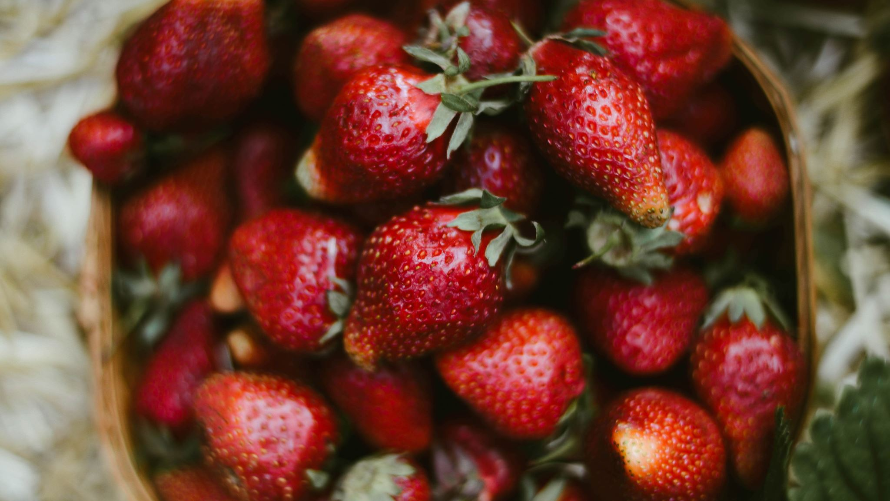
Strawberry SARE Grant
Grow Strawberries Organically
Maria Velikonja
CEO, Carniola Farms, Parsonsburg MD
November 5, 2022

Slide 2
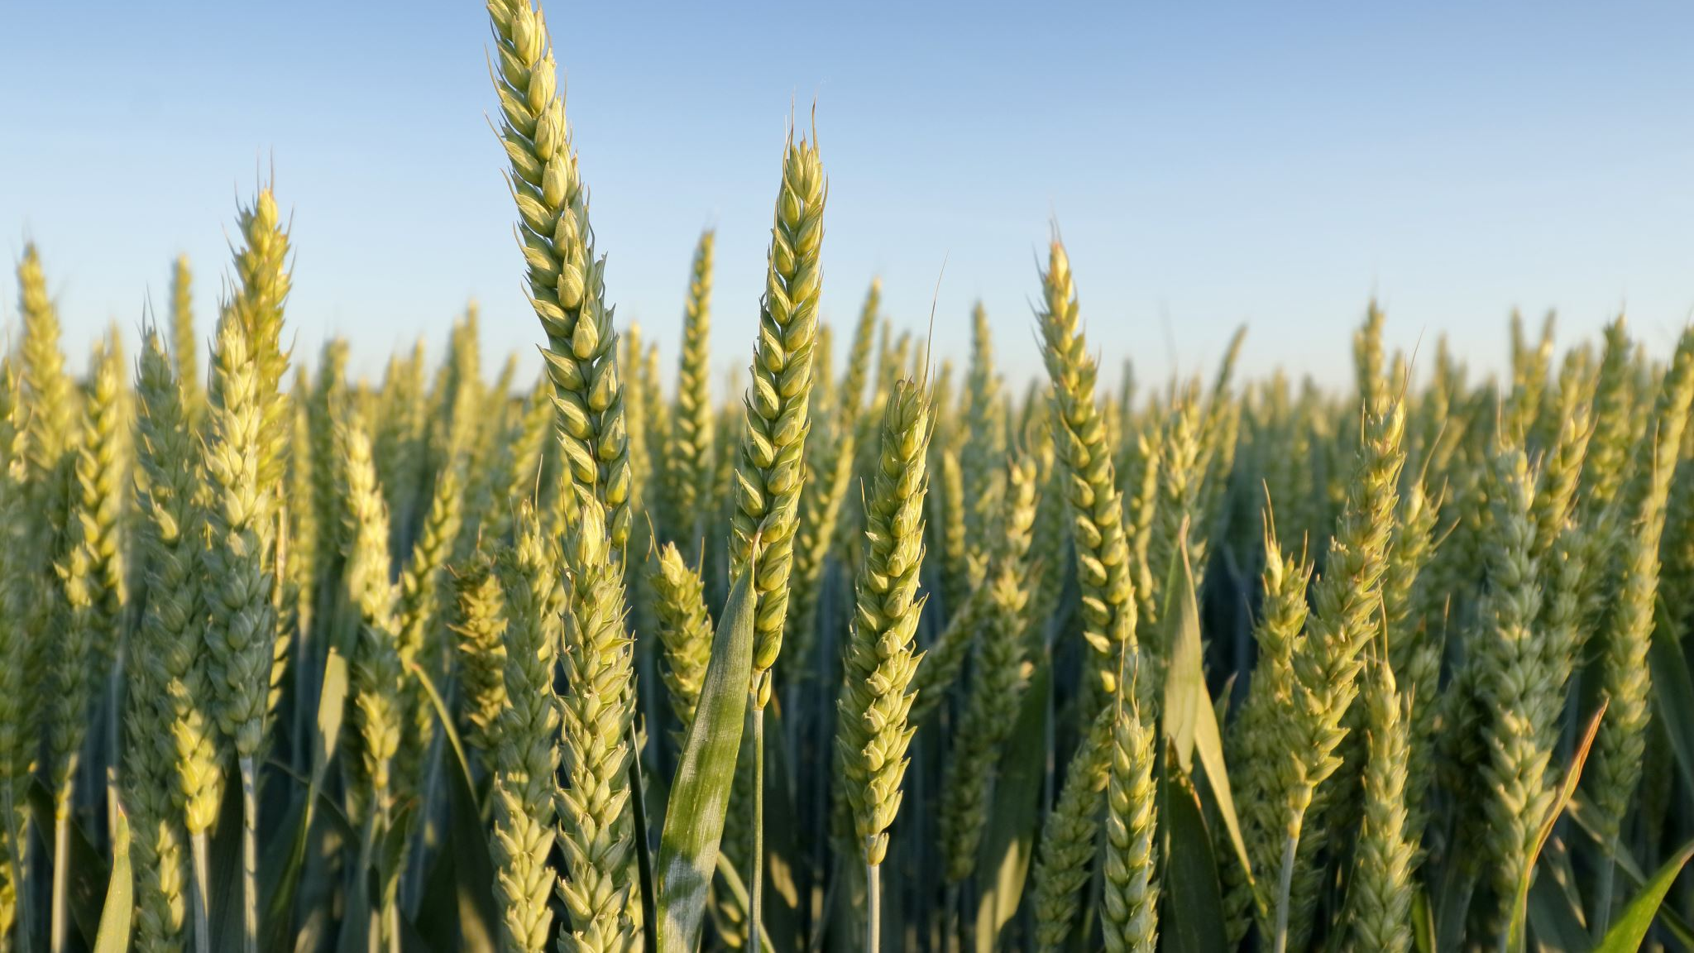
SARE Grant
The Sustainable Agriculture Research and Education (SARE) program is a decentralized and competitive grants program operating in every state.
SARE is divided into four different regions that operate are separate entities and run grant programs for their states.
Carniola Farms received a two-year grant to study the foliar application of kaolin clay to manage pest and diseases in day neutral strawberries.
Carniola Farms uses only organic methods on the farm.

Slide 3
Project Description and Summary
To demonstrate that kaolin clay spray can be applied to strawberries to prevent disease and control pests, in lieu of toxic synthetic chemicals.
Problem: Strawberries in mid-Atlantic dominated by June bearers/short day cultivars
Pest and disease pressure on eastern shore are high due to high temps/humidity
This has prevented farmers from growing strawberries without the use of toxic inorganic pesticides
This study examines the benefits of spraying Kaolin clay on two varieties of day neutral strawberries, to reduce diseases and thwart pests. This sustainable approach promotes organic cultivation of strawberries in our area.

Slide 4
Objectives
Evaluate effectiveness of Kaolin clay spray on different day neutral strawberries in controlling common fungal strawberry diseases (leaf scorch, gray mold, strawberry leaf spot)
Evaluate effectiveness of Kaolin clay spray on different day neutral strawberries in thwarting common pests (Japanese beetle, crickets, leaf hoppers).

Slide 5
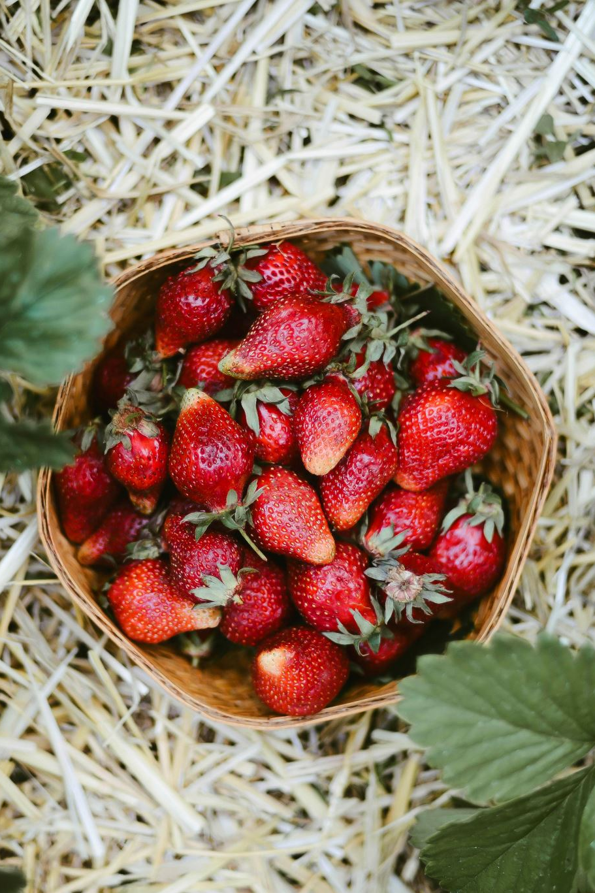
Materials and Methods
Strawberries planted in beds using wood chips as mulch.
Drip irrigation used
100 plants each San Andreas and Seascape
50% of plants used as control and untreated, creating four sections
Kaolin spray applied every 7-10 days
All strawberry plants received organic fertilizer treatments (primarily comfrey tea)
Plants were examined weekly for pests and diseases and given severity ratings between 1 to 5 for a) gray mold; b) leaf scorch/leaf spot; and c)insect damage

Slide 6
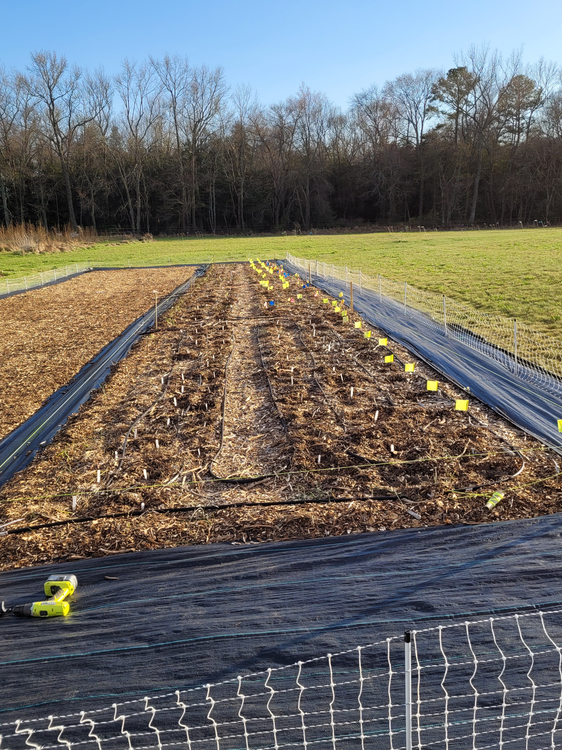
Planting strawberries in March

Slide 7
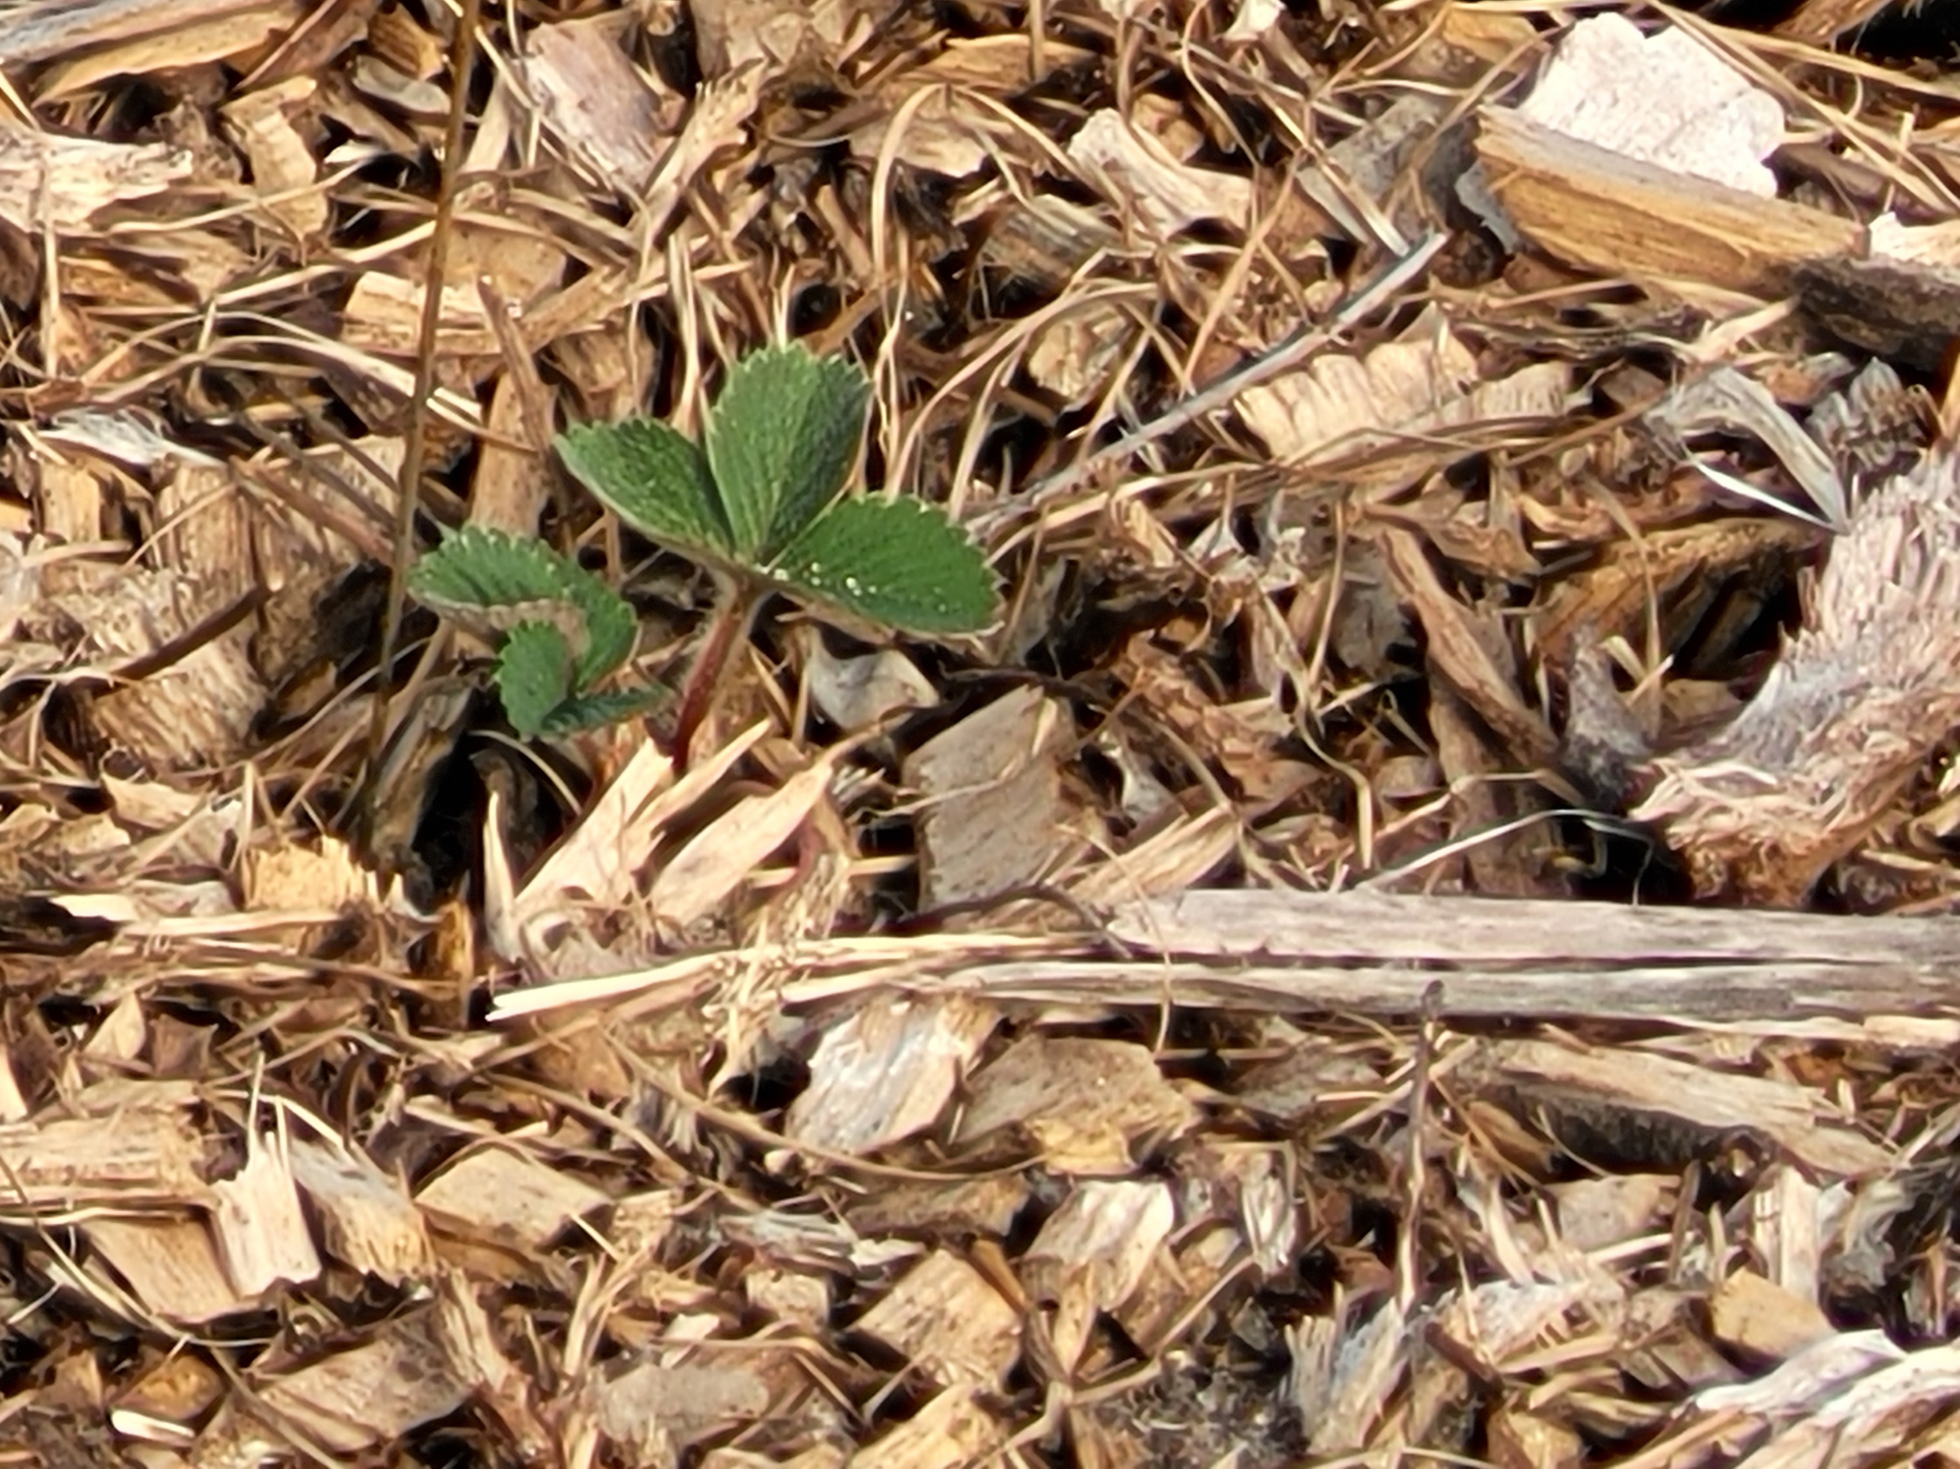
April

Slide 8
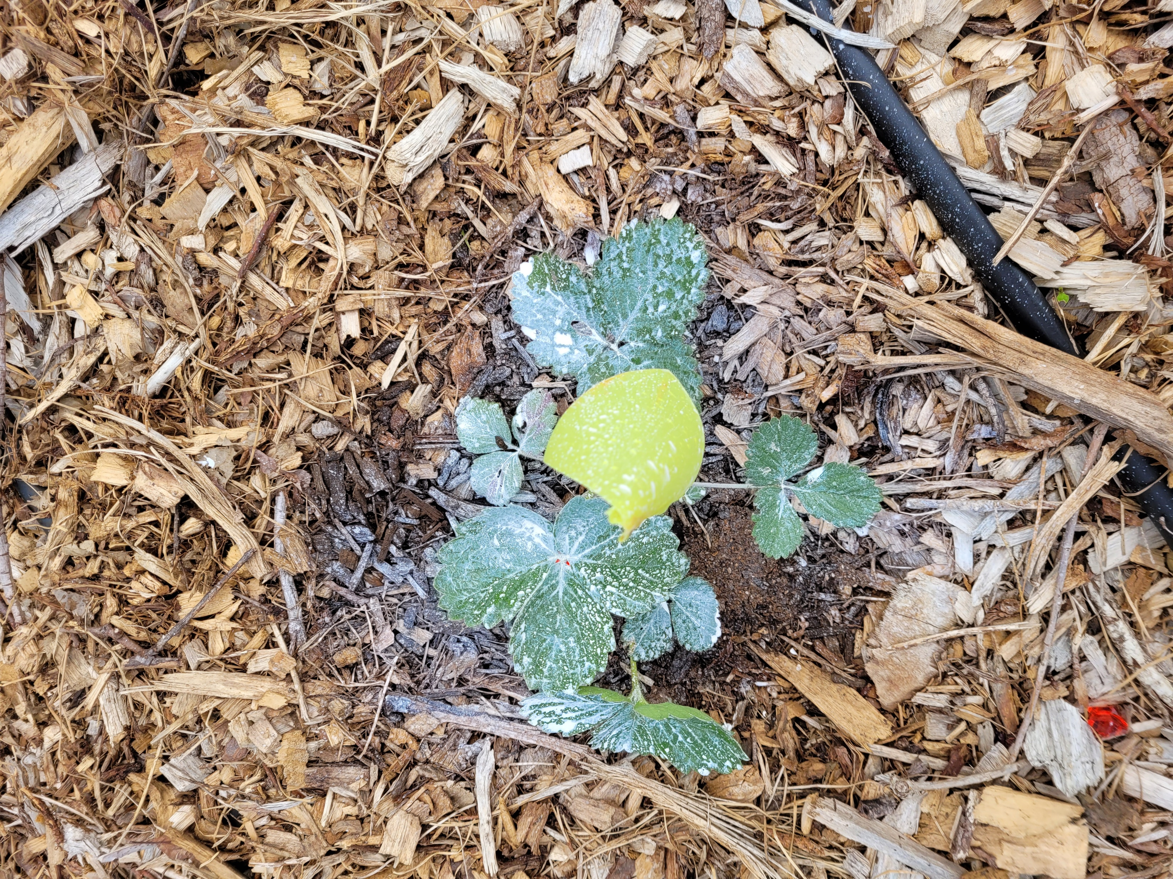
May

Slide 9
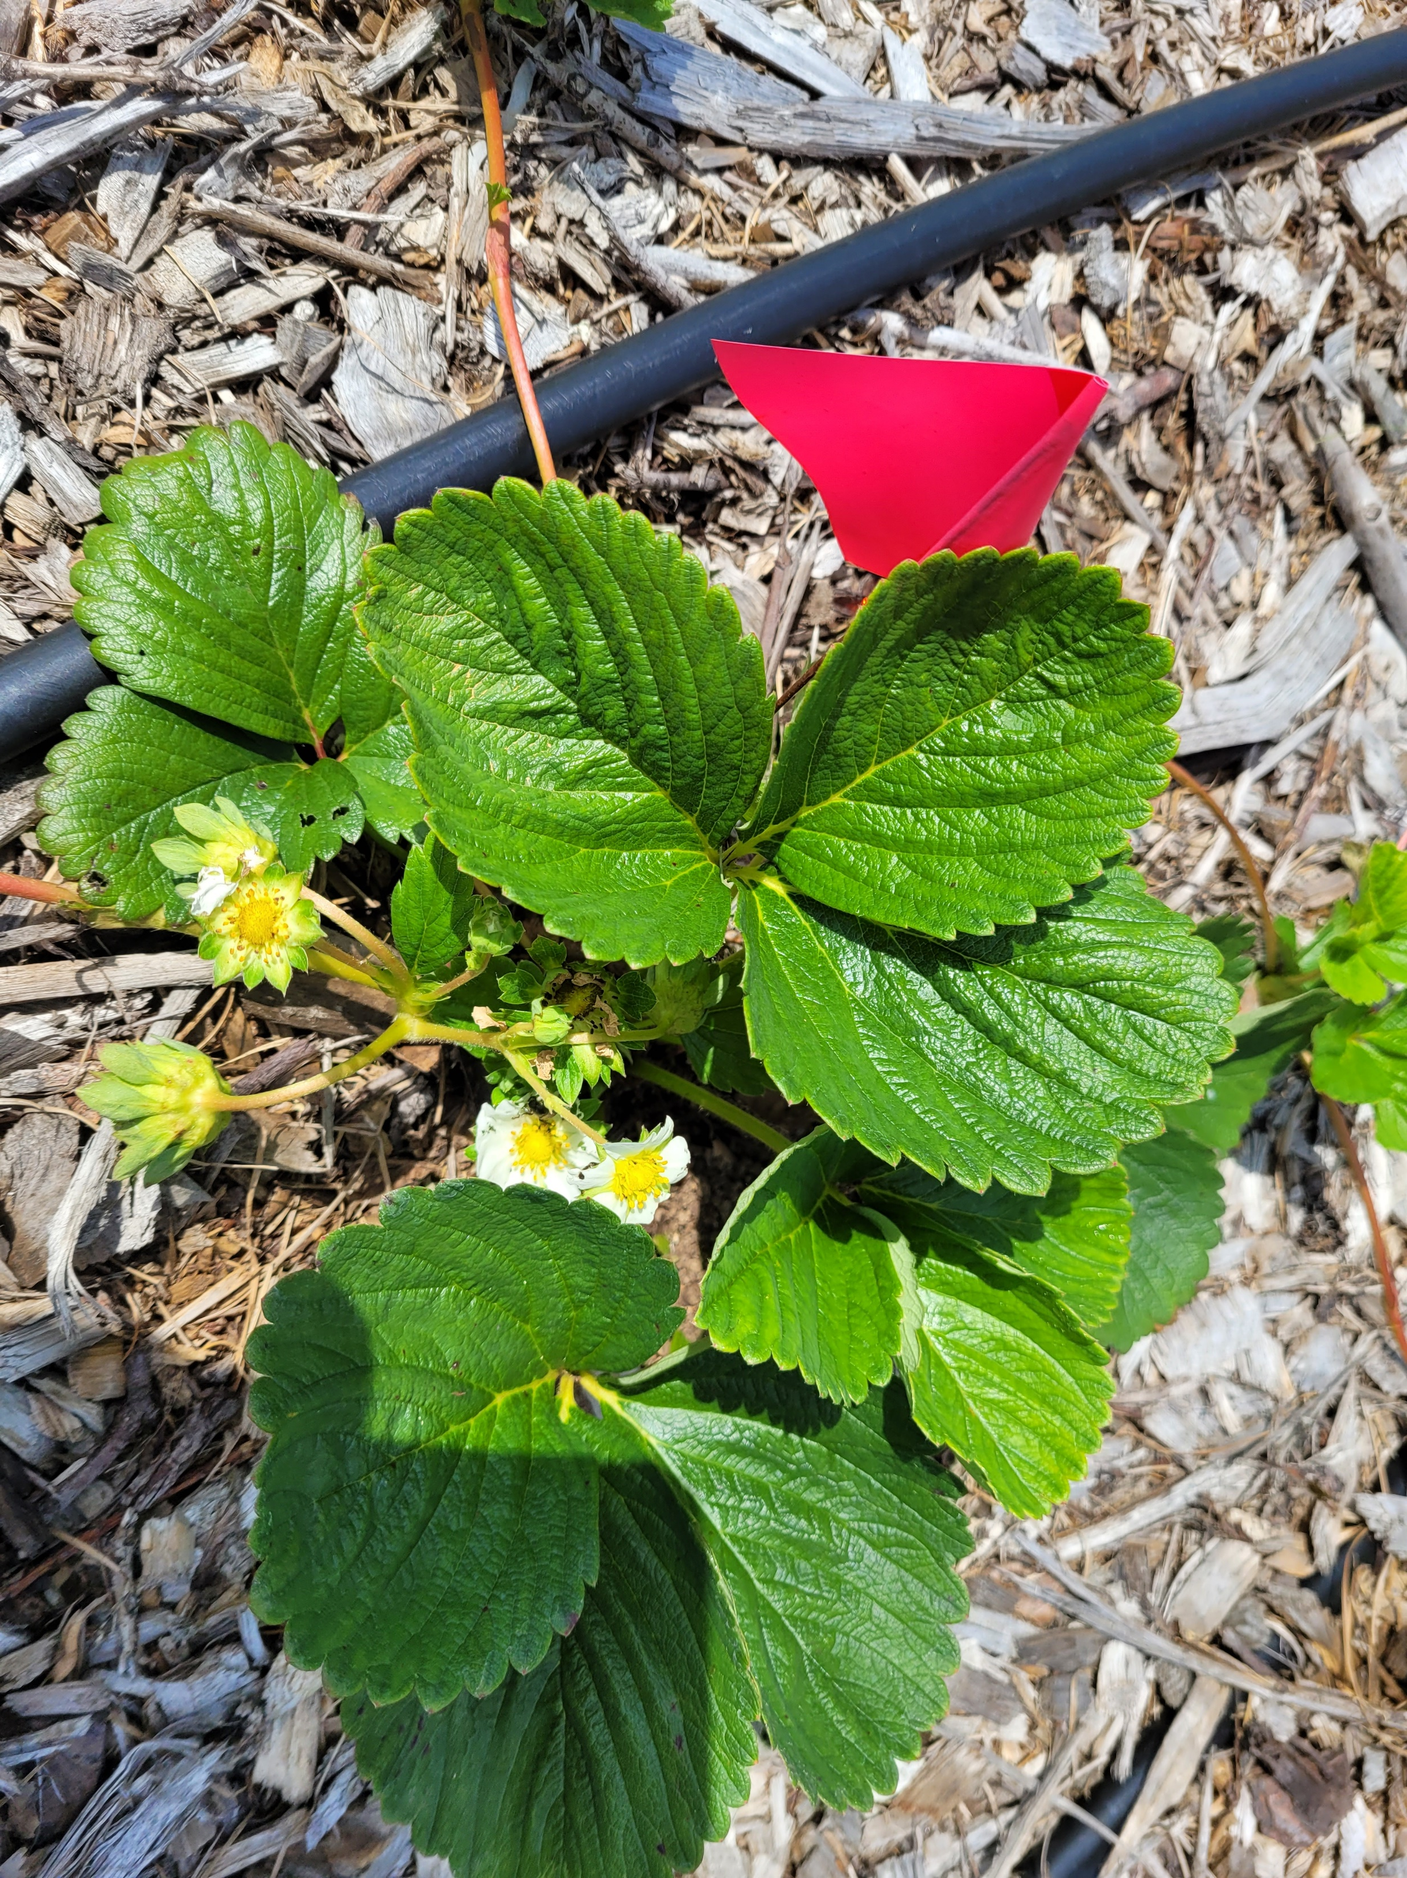
June

Slide 10
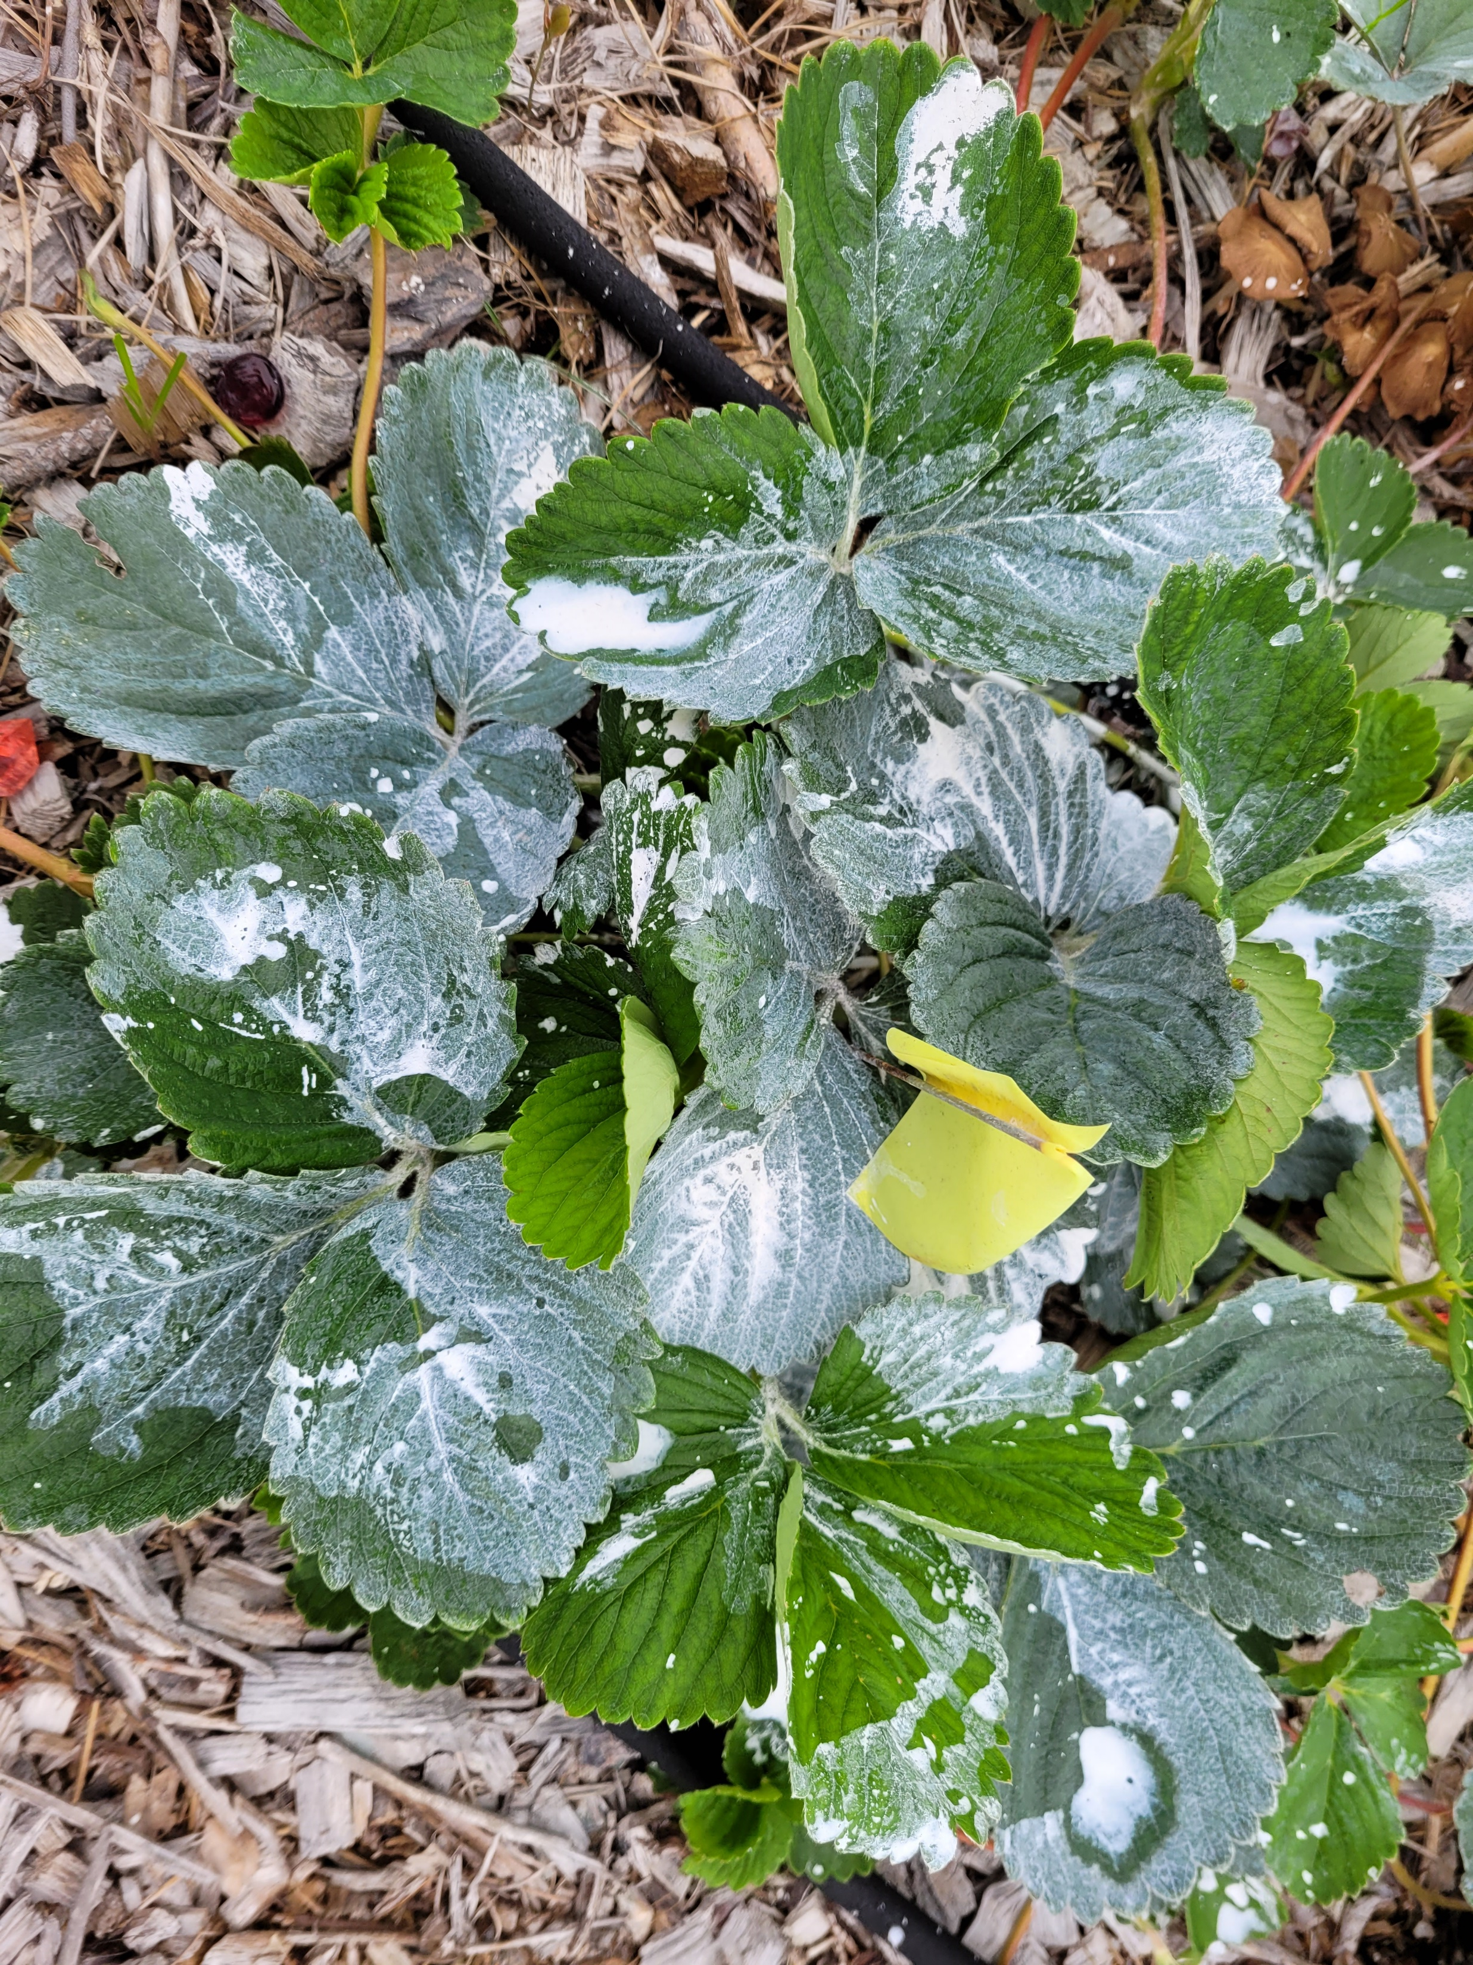
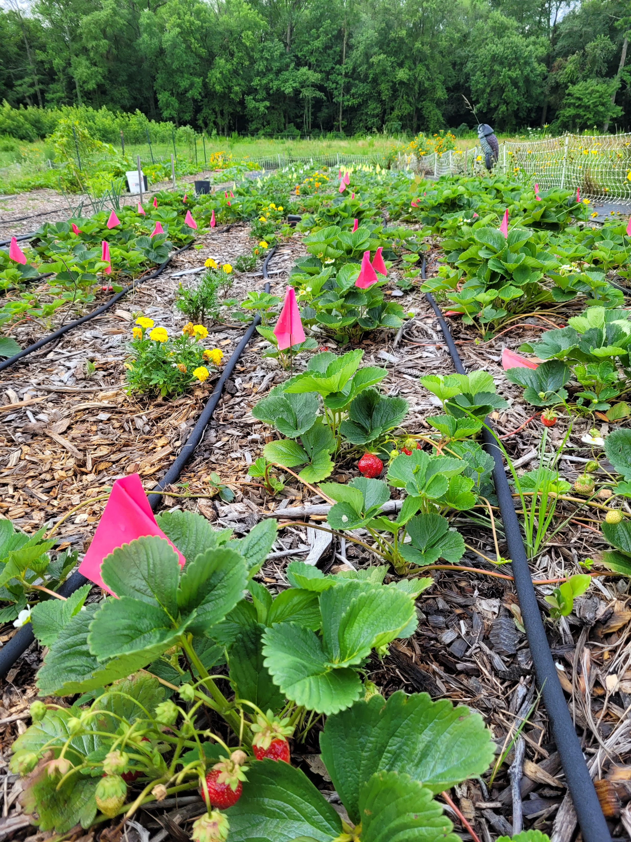
July

Slide 11
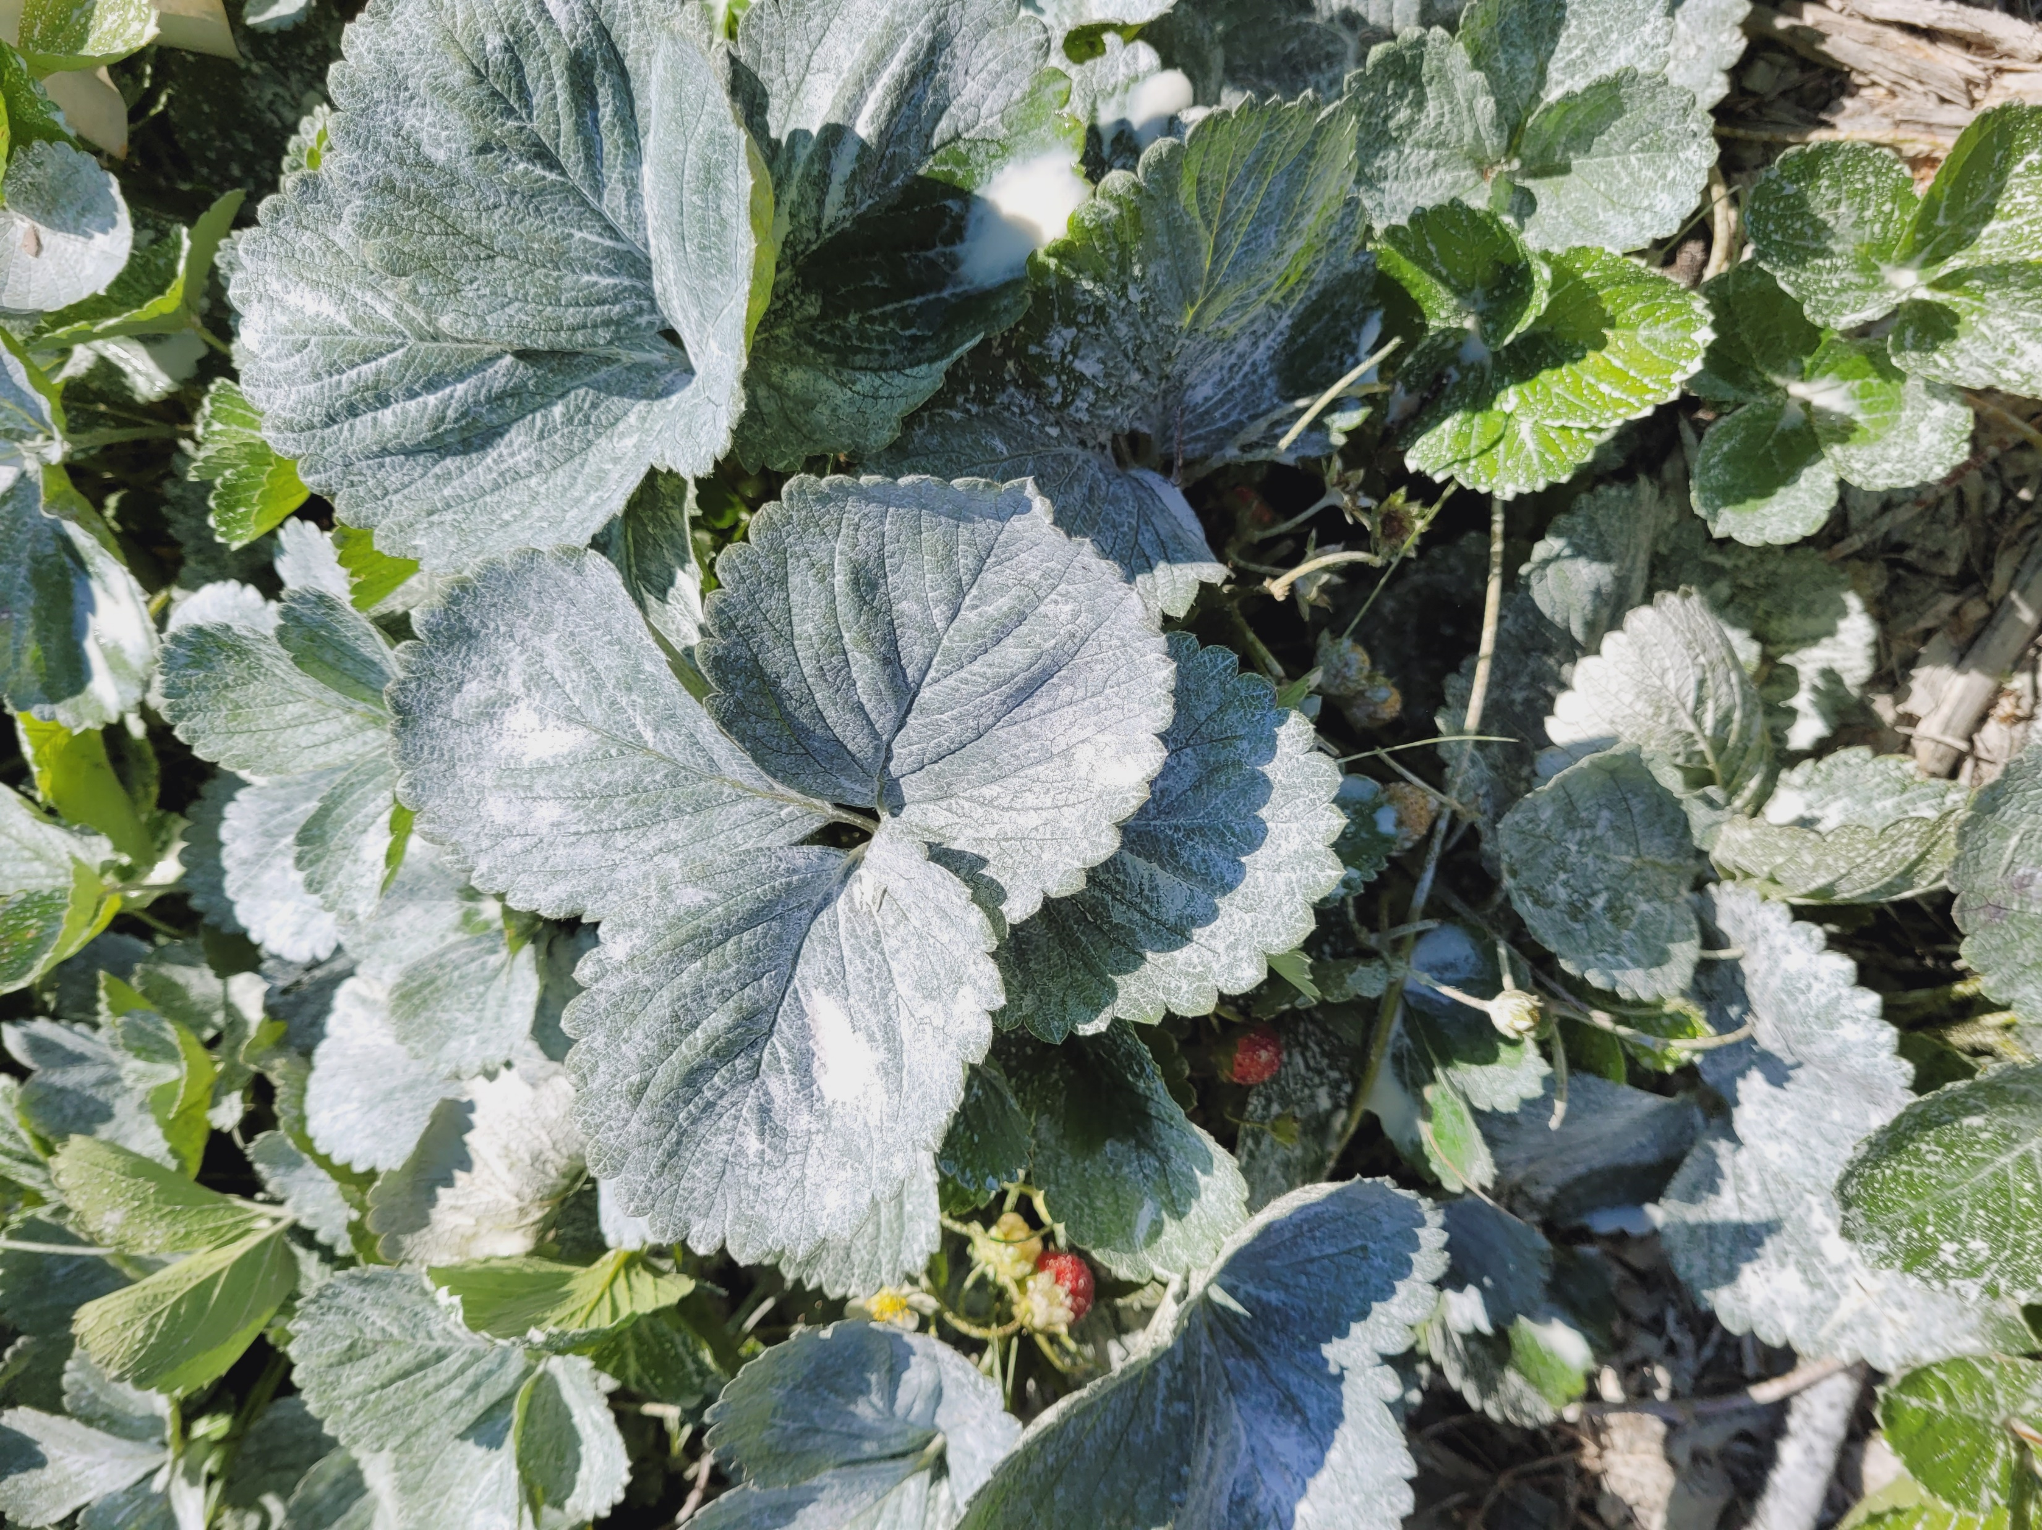
August

Slide 12
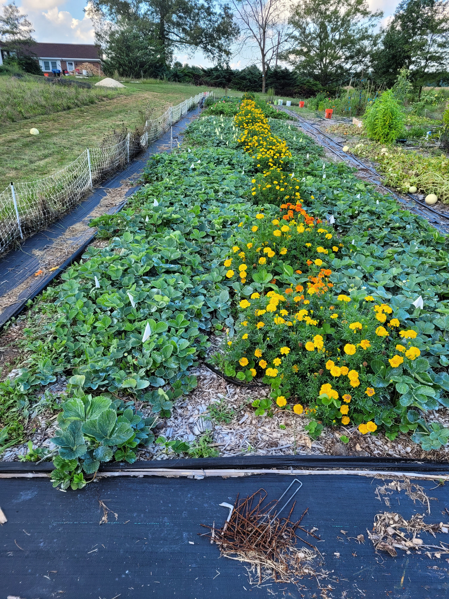
September: Strawberries in all four sections multiplied. The two sections sprayed with kaolin clay had visibly larger plants, and more plants.

Slide 13
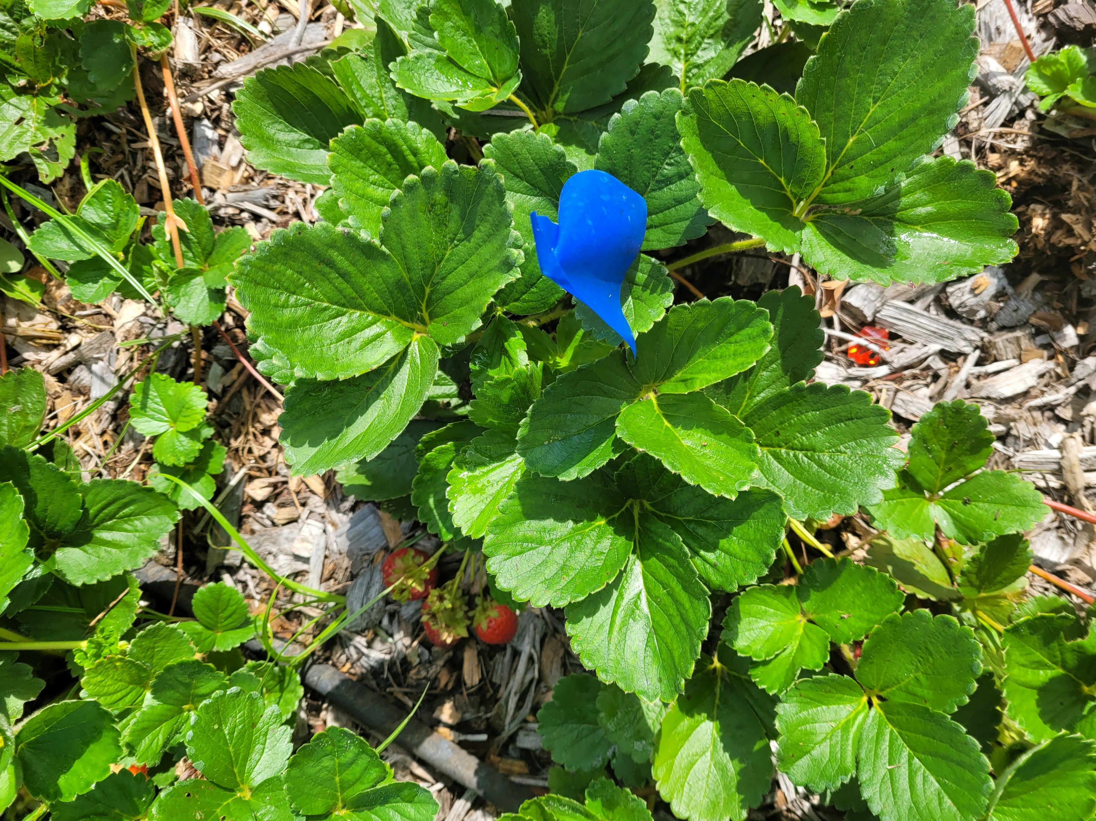

Slide 14
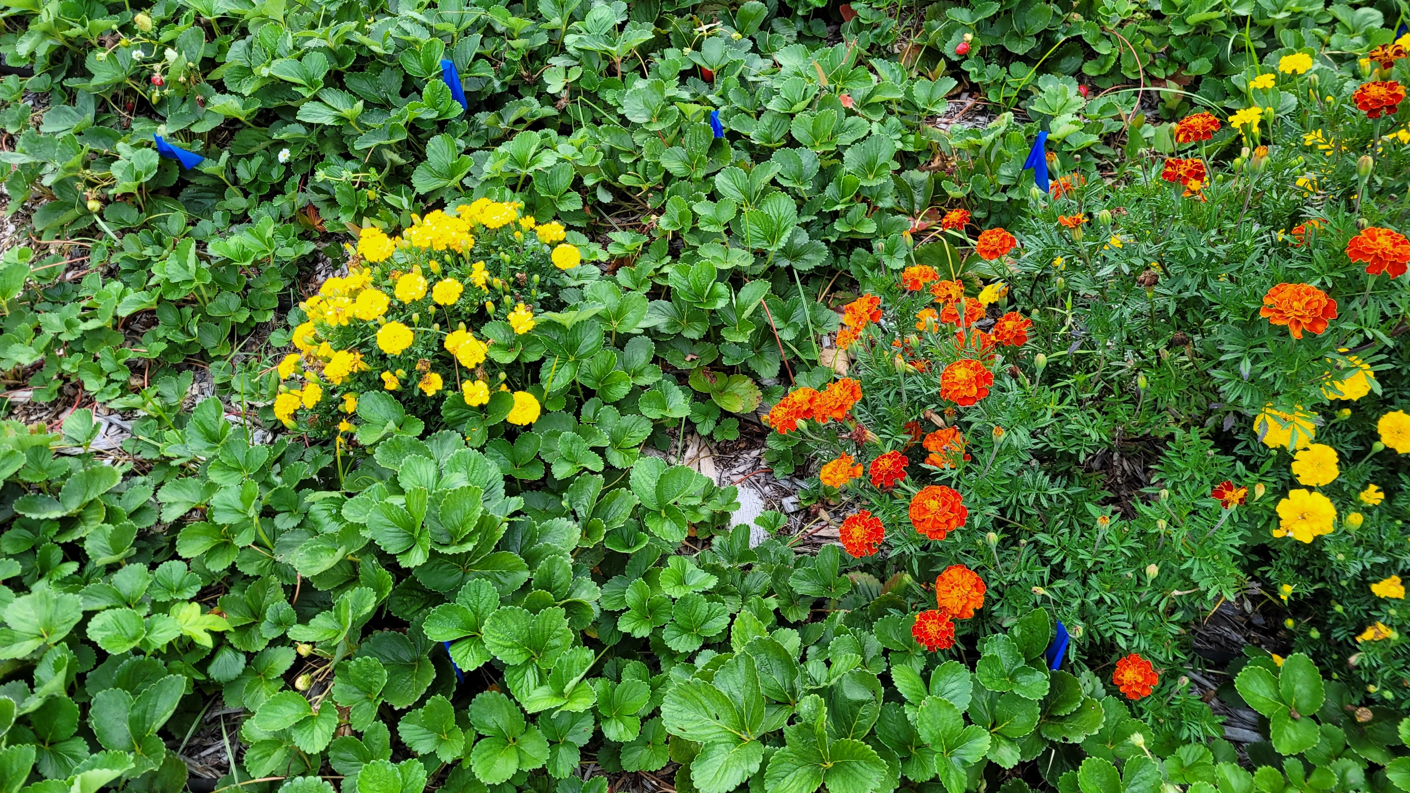

Slide 15
Results for 2022
Mold was not present on any plants (0)
Leaf scorch and leaf spot were minimally present or not present (1)
Insect damage was minimally present, with slightly more insect nibbling on leaves on untreated plants. (1)
Plants grew quickly in all sections. Treated sections had slightly more growth.

Slide 16
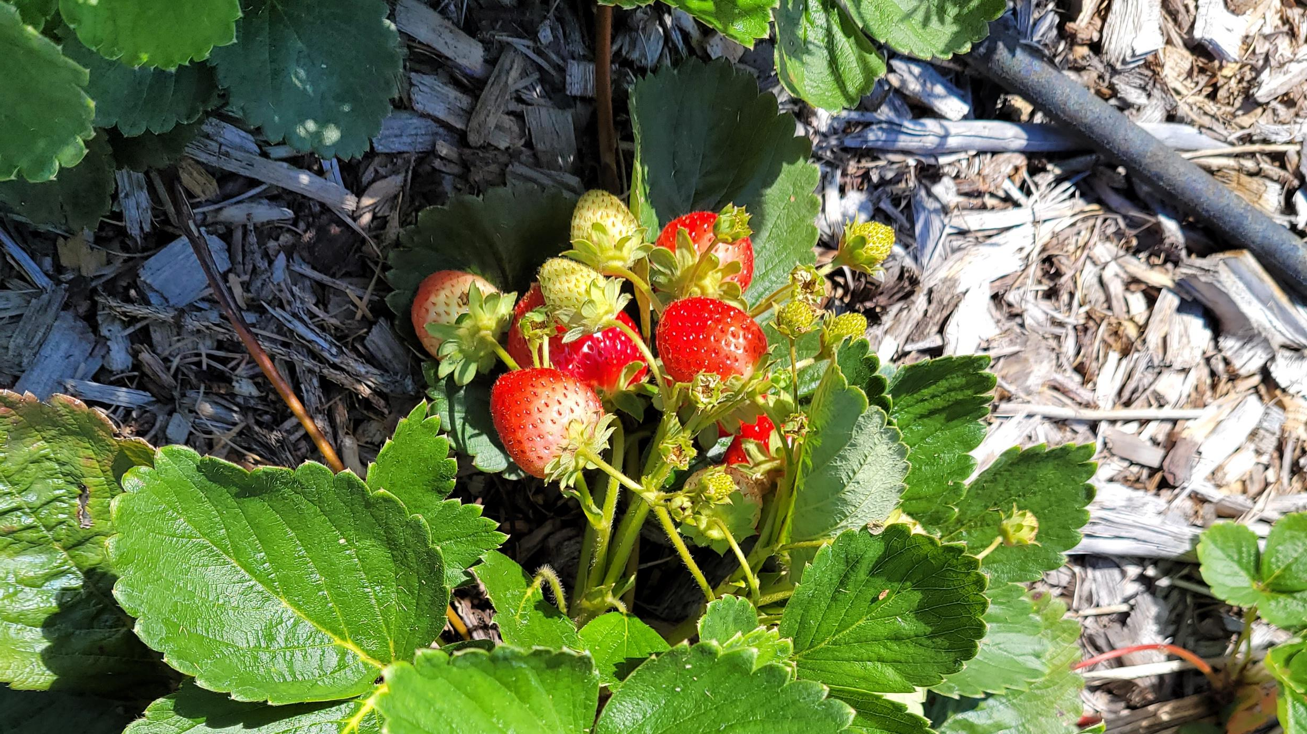
Questions?
Maria Velikonja
carniolafarms@gmail.com
Carniola Farms
Parsonsburg MD

