Slide 1
Grant and Professional Development Opportunities
A First Look

Slide 2
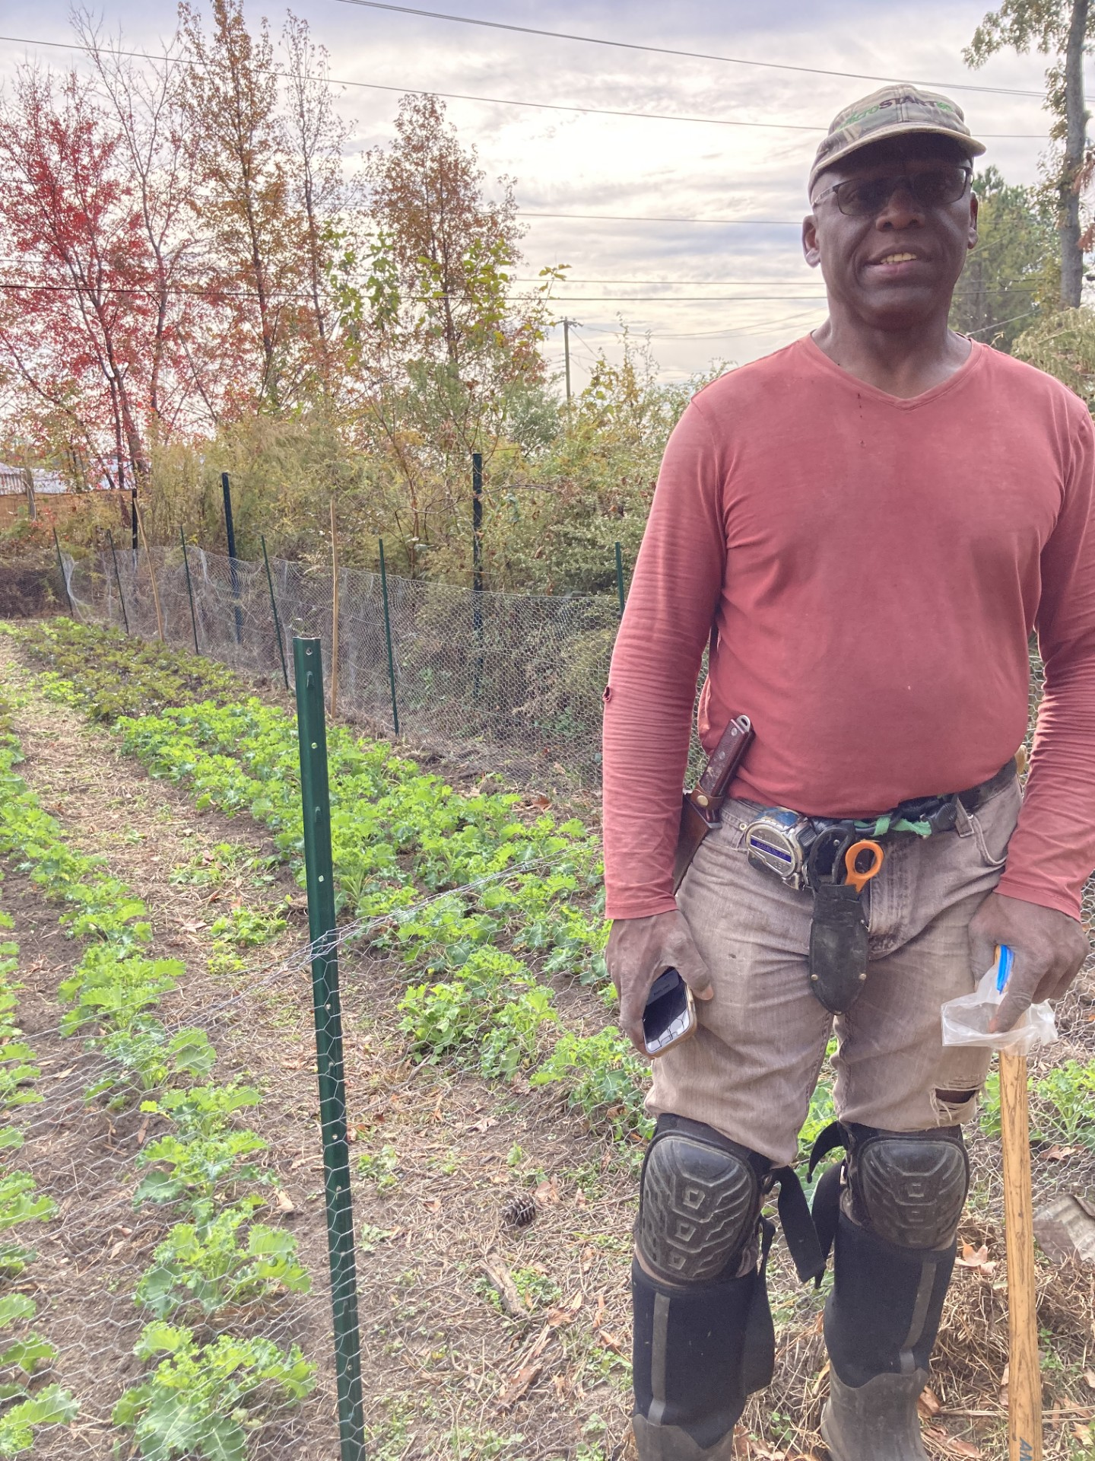
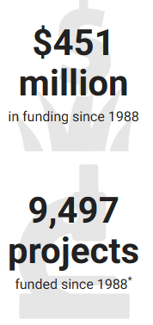
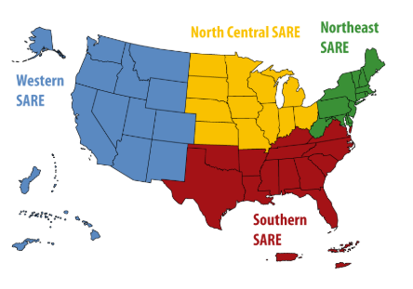
What is SARE?
Sustainable Agriculture Research & Education Program
USDA, founded by Farm Bill 1988
3 pillars: Profit, Place & People
Profitability
Environmental stewardship
Community quality of life
Grants, Professional Development, & Education/Outreach
for farmers, researchers, students and agriculture professionals
4 regions: North Central, Northeast, Southern, Western
Notes:
Patrick Johnson – VA woodchips for weed control, native legume as cover crop

Slide 3
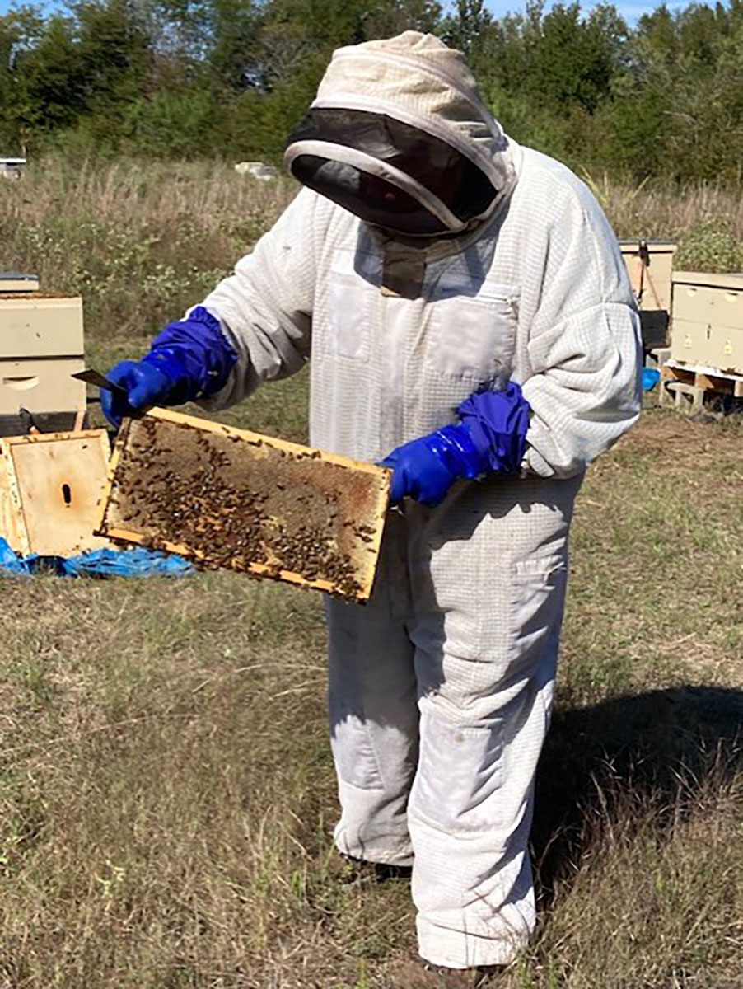
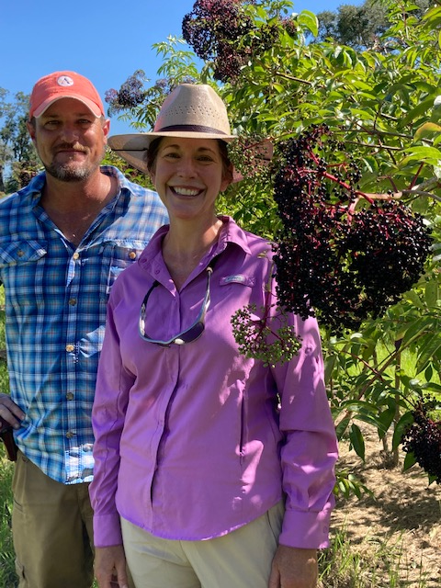
Grant opportunities
https://southern.sare.org/grants/
Graduate Student Grant
Open February / Due May / Awarded August
Amount $22,000 for 2 years
For graduate students.
Education Grant
Open May / Due August / Awarded February
Amount: $50,000 for 2 years
For academic institutions and organizations, such as non-profits and non-governmental organizations.
Research and Education Grant
Open March / Due June / Awarded February
Amount $400,000 for 3 years
For teams of interdisciplinary researchers that encourage a systems approach in sustainable agriculture.
Notes:
Heather Martin & David Jarnagin, Dan Brantner

Slide 4
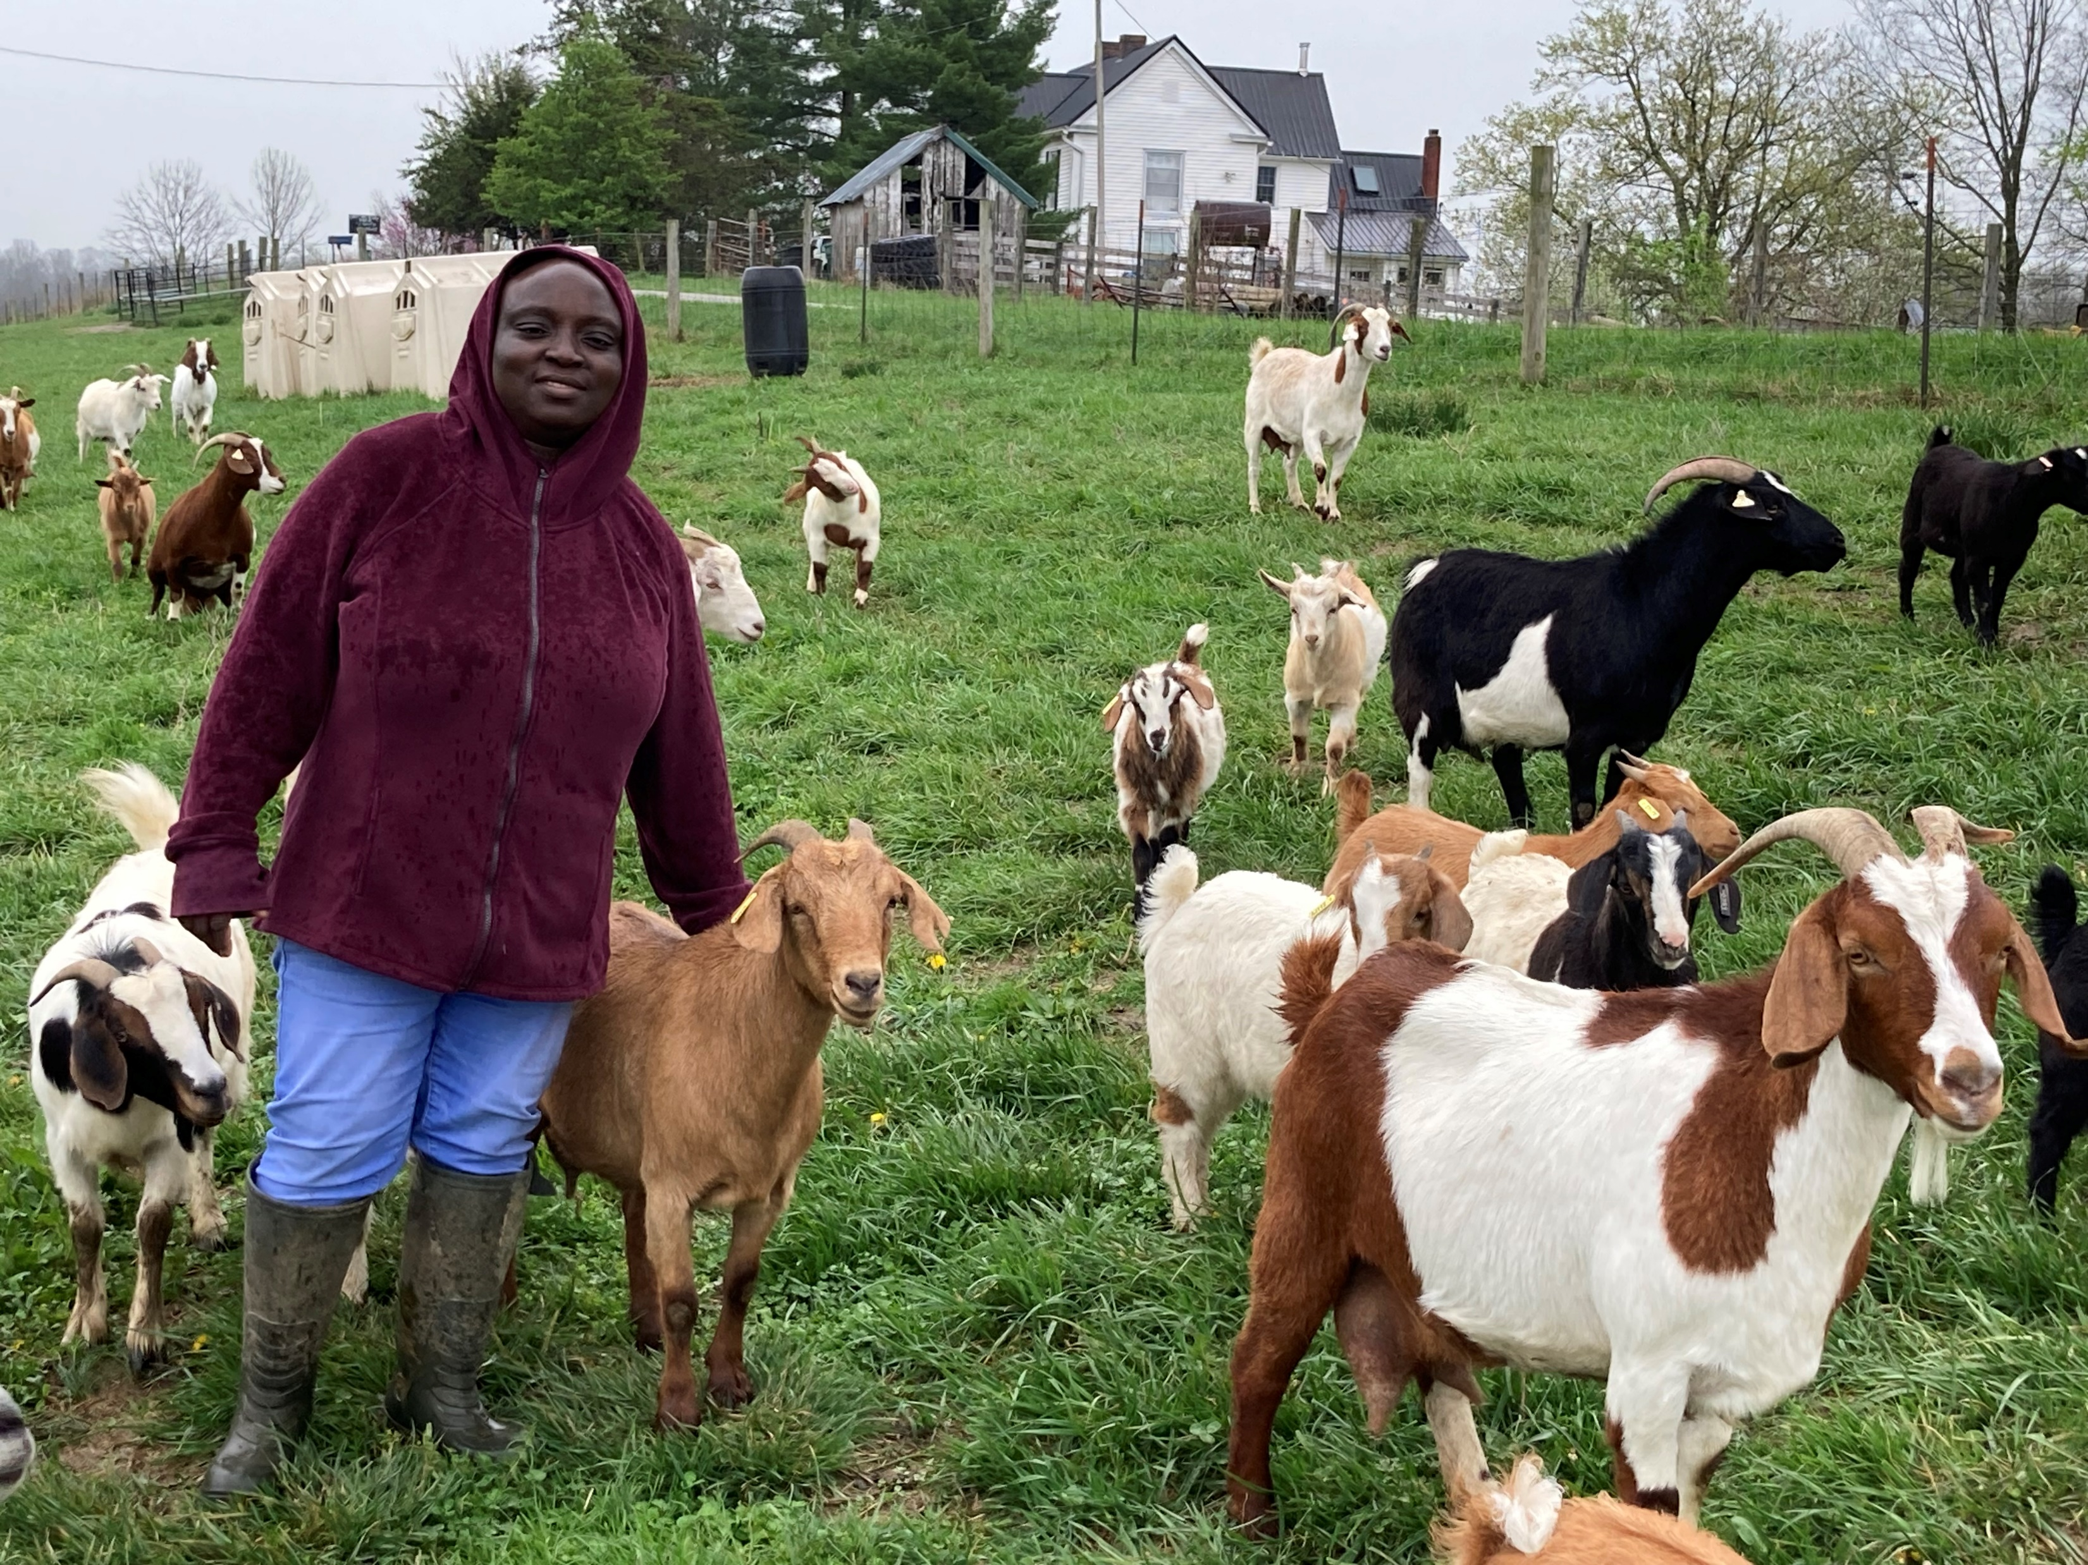
Grant opportunities cont'd
https://southern.sare.org/grants/
Professional Development Grant
Open July / Due August / Awarded February
Amount There is no funding cap for projects. Priority is given to those less than $80,000 for 1 or 2 years.
For ag professionals and ag educators who work directly with farmers and ranchers.
Producer Grant
Open September / Due December / Awarded March
Amount $20,000 (individual)-$25,000 (farmer organization) for 2 years
For farmers and ranchers or farmer organizations.
On-Farm Research Grant
Open September / Due November / Awarded March
Amount $30,000 for 2 years
Agricultural professionals who currently and regularly work with farmers and ranchers.
Notes:
Fatima Johnson

Slide 5
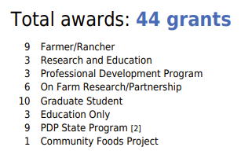
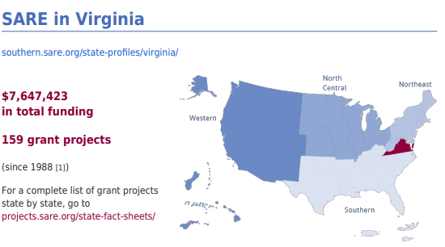
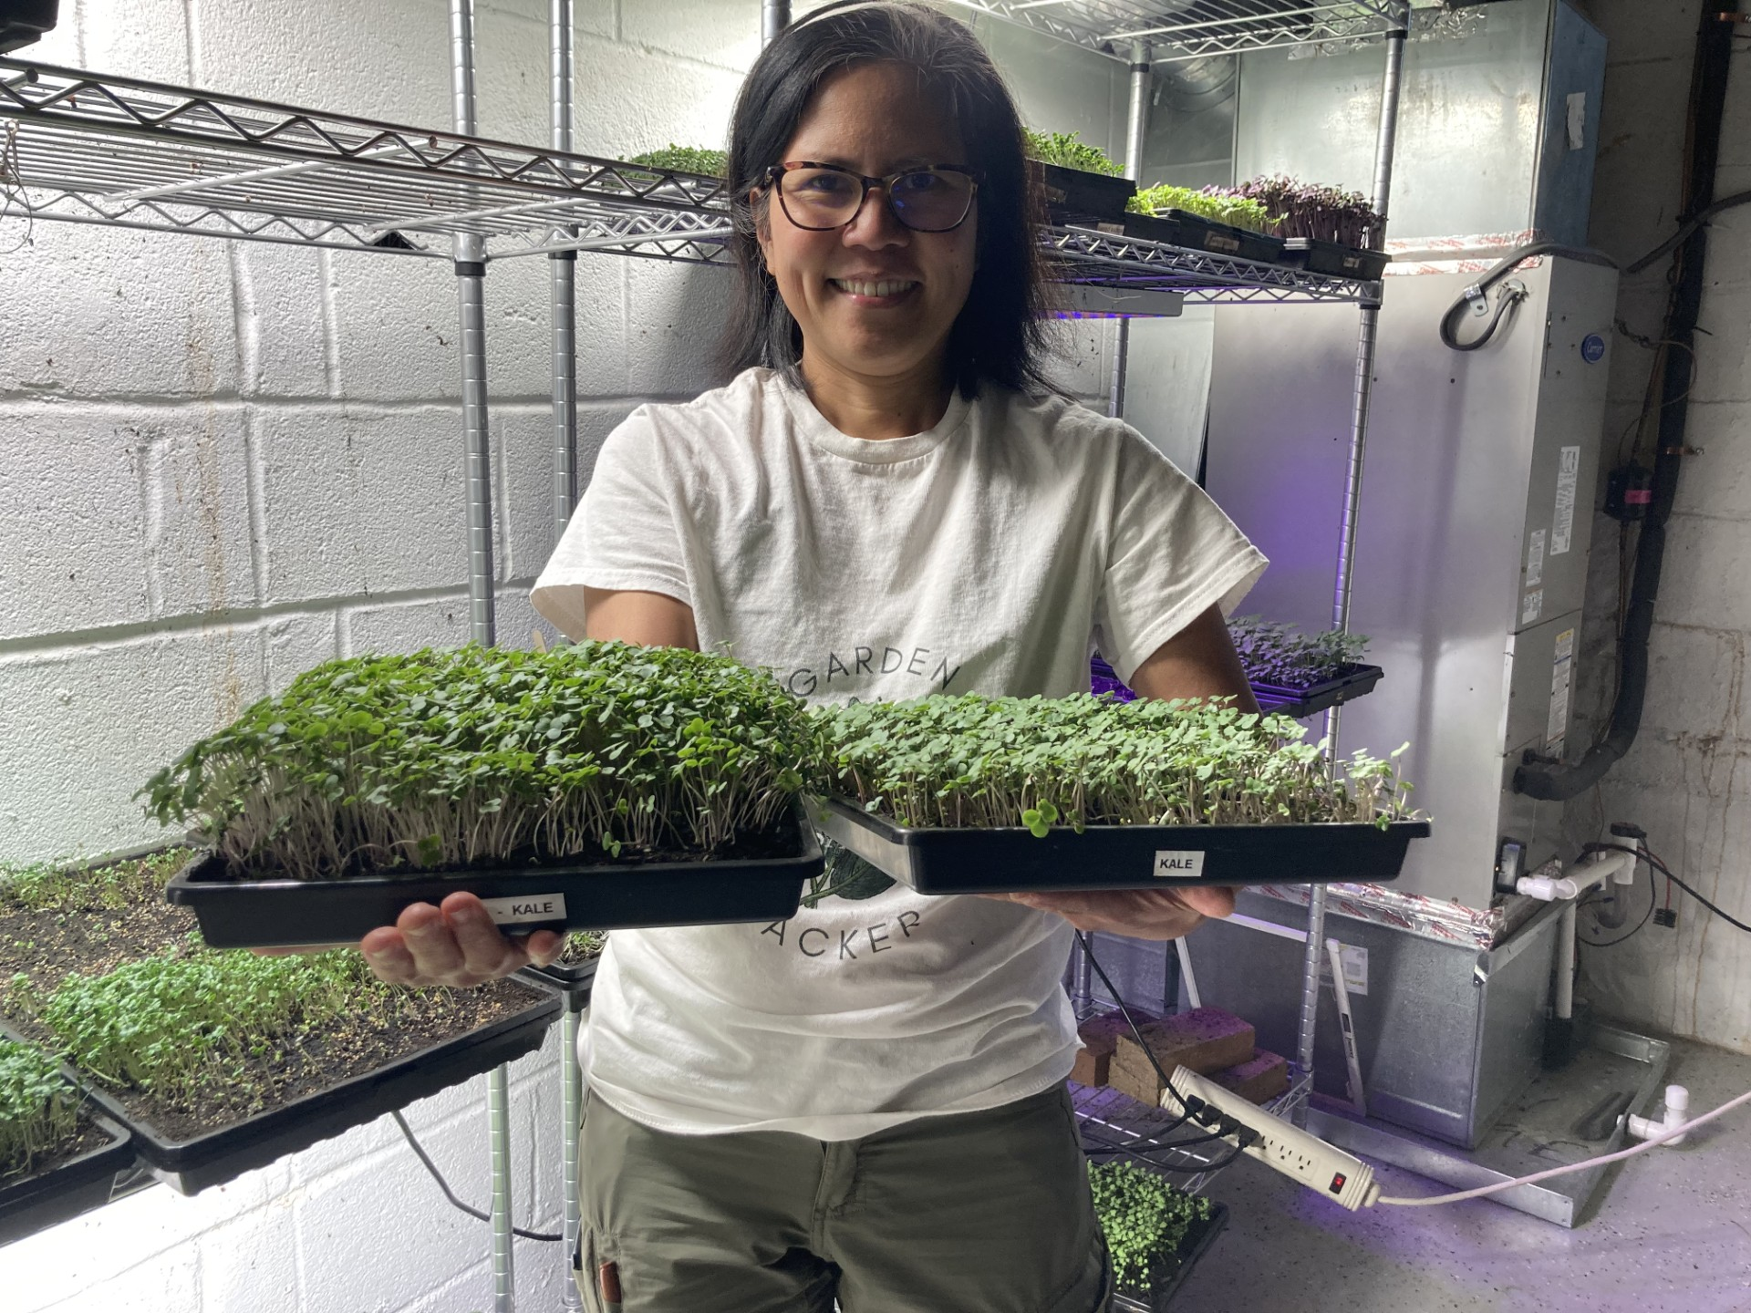
From 2019-2024
Notes:
Nicky Schauder, Permaculture Gardens - Leesburg, vermicompost tea

Slide 6
Prior & current SARE Producer Grants in Virginia
What Projects Are Eligible?
Livestock
Enhanced genetic selection of dairy sheep for the Southern US, Marcia McDuffie
Plant Breeding
Summer and Winter Squash Research and Breeding for the Southeast, Edmund Frost
Soil health
Effects of Aerated Compost Tea on Swiss Chard, Kale & Lettuce Production in Virginia, Nicky Schauder
On-farm renewable energy
Pest and weed management
Pastured livestock and rotational grazing
No-till and conservation tillage
Cover crops
High tunnels and season extension
Crop rotations
Marketing
Sustainable communities
Integrated systems
Pollinators
Local and regional food systems
Small ruminants
and more!
Image from https://www.permaculturegardens.org/compost-tea-research
Notes:
Powdery mildew cucerbits; The image is a DNA sample of the types of bacteria in vermicompost, study of its microbiology and how it changes when made into compost tea

Slide 7
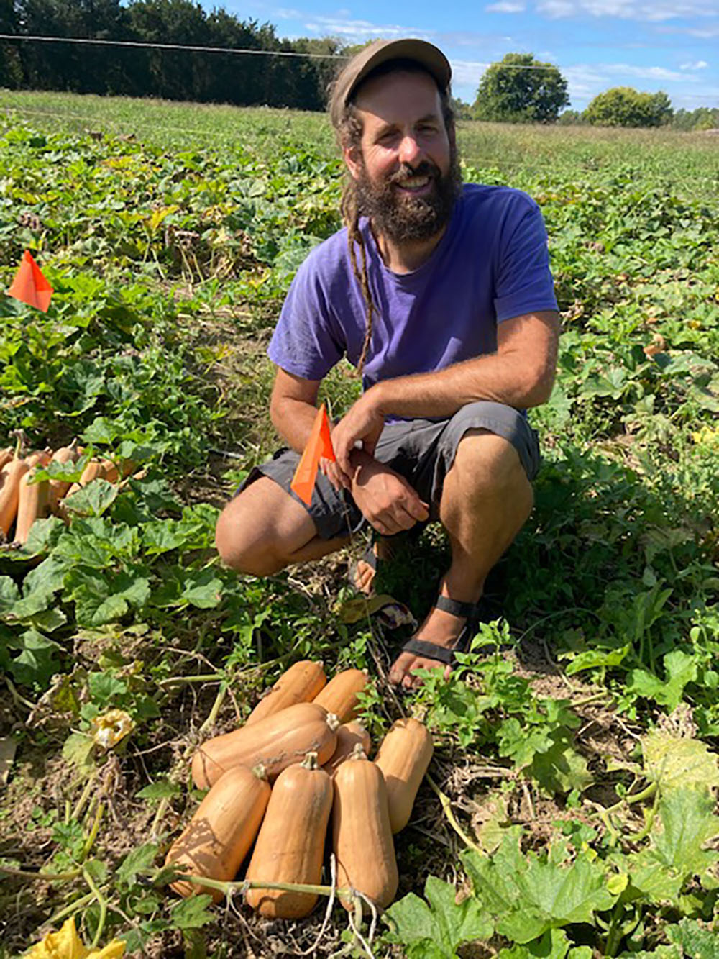
Producer Grant Eligibility
Farmer must have $1,000 in documented income from farm to qualify for the grant.
SARE will fund any size farm and a farmer with any length of time farming.
SARE Grants cannot be used to start a farm. SARE grants are intended for projects involving research and education only, not to defray the costs associated with starting a farm.
Watch: SSARE Producer Grant – Writing a Grant Proposal
https://youtu.be/mW_6vbFUvfo
Notes:
Edmund Frost, Louisa, Sweet Anna butternut squash

Slide 8
Producer Grant Expenses
This is a reimbursement grant.
Farmers must pay for materials up front and will be paid back as they submit invoices.
Allowable expenses: SARE will fund labor, materials, travel, outreach, refreshments, & miscellaneous items.
Non-allowable expenses: SARE will not “pay a farmer to farm.” SARE funding cannot be used to make large purchases for land, equipment or capital investment) or for full meals.
Tip: Make sure the budget reflects the size of the project
(not too much of any amount, i.e., do not order more seed than the size of the test area).

Slide 9
Other considerations
Look Back
Build your project on other SARE grants. Use the online database to see what else has been tried for this topic.
How will your research benefit other farmers?
Collaborate
SARE values collaborative research.
Involve a Researcher, Ag professional (Project Assistant, Extension Agent), other farmer, or NGO to assist with and provide guidance.
Share out
Sharing out what you learn from the research is an important part of SARE.
Make a plan to host field days, present at conferences online via YouTube videos, podcasts or webinars.

Slide 10
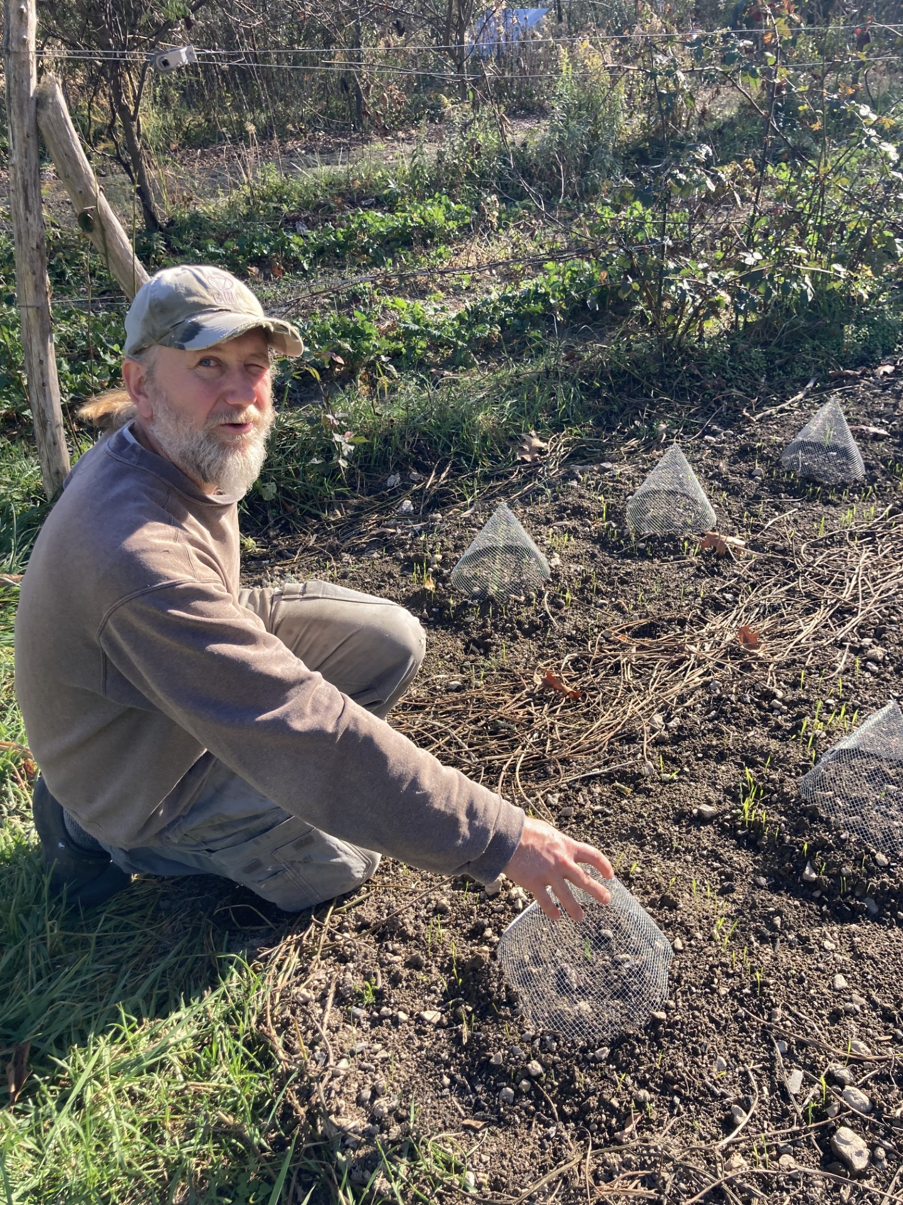
Resources
SARE Staff:
State Coordinators & Program Assistants
1
Website: Research what is available and what else has been done
2
Bulletin:
How to conduct research on your farm
3
Books & Publications:
Building Better Soils
Managing Cover Crops Profitably
And more!
4
Zip drives:
With a lot of great resources and articles in sustainable agriculture
5
Professional Development Opportunities
6
Travel Scholarships & Conference Sponsorships
7
Fellows Program:
2 year program for Ag Professionals
8
Sustainable Ag Leadership Program
Apply by: 1/10/25
9
Notes:
Jason Meyers Benner, Keezletown peas

Slide 11
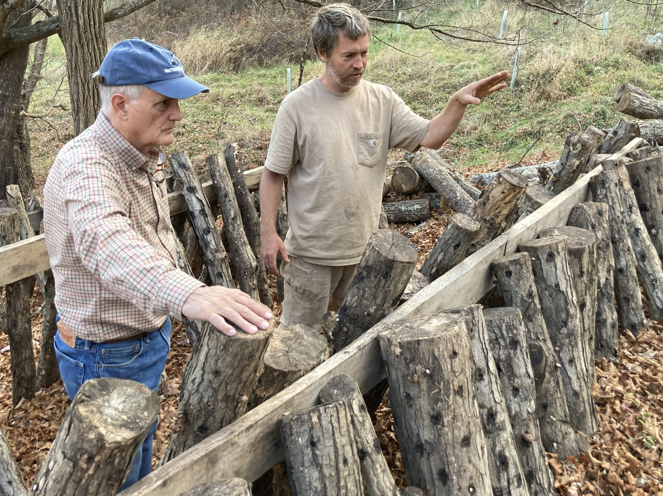
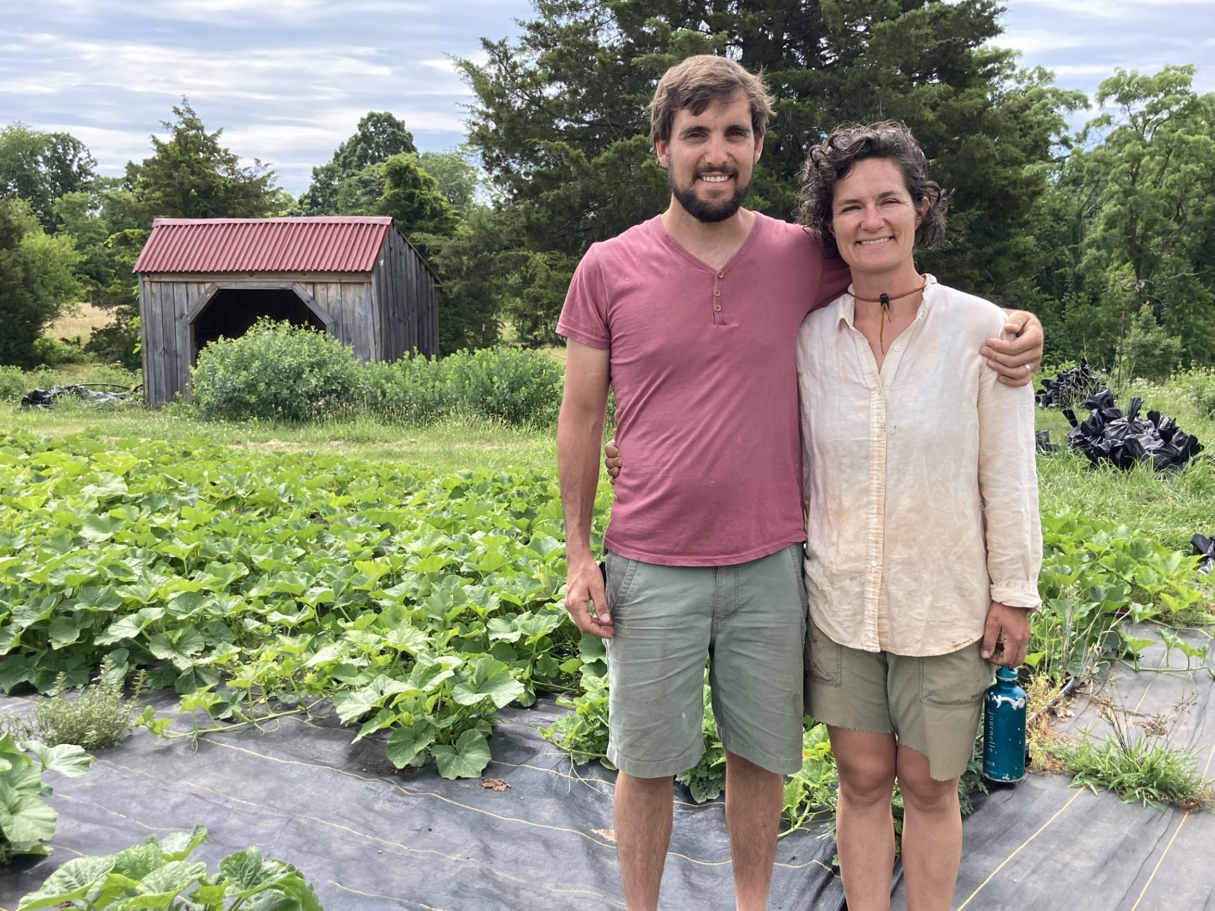
Websites
https://SARE.org
https://southern.sare.org/
Notes:
Will Sheperd & Tomm Hammett VT (logs), Michael Grantz & Arden Jones VA (small grains)

Slide 12
Contacts
Virginia State University
Sanjun Gu – State Coordinator
sgu@vsu.edu
Peter Coffey - Program Assistant
plcoffey@vsu.edu
804-894-4214
Virginia Tech
Eric Bendfeldt – Coordinator
ebendfel@vt.edu
Marian Dalke – Program Assistant
mdalke@vt.edu
540-232-6010
Please reach out!

Slide 13
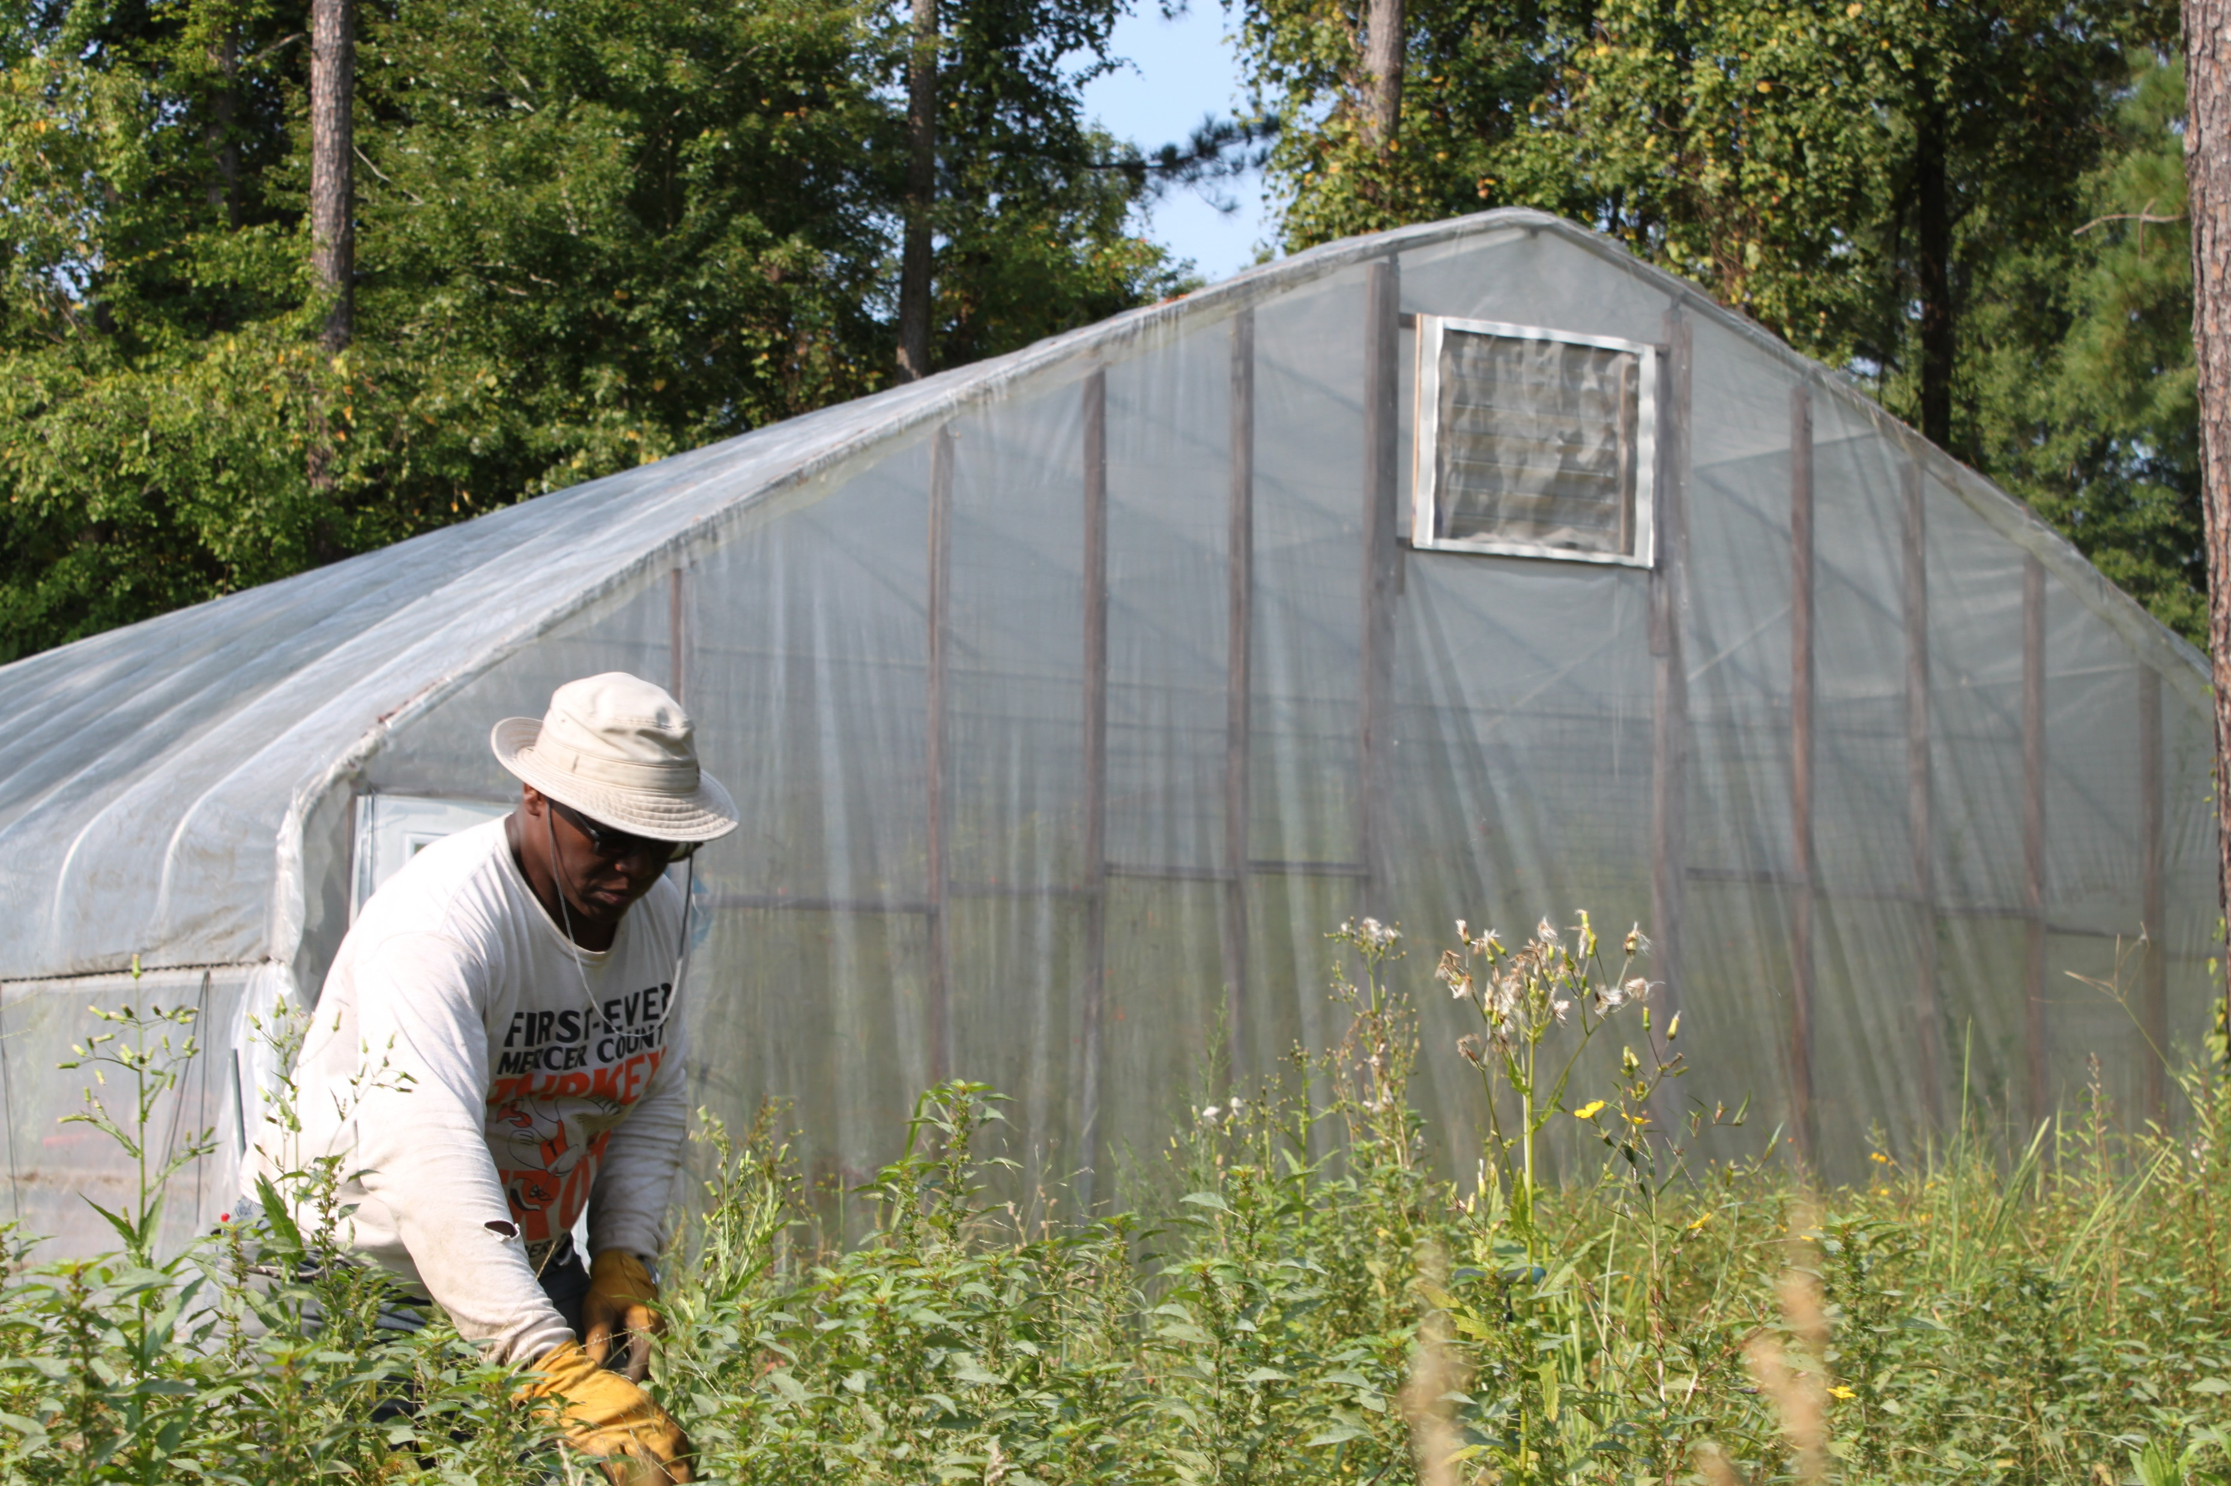
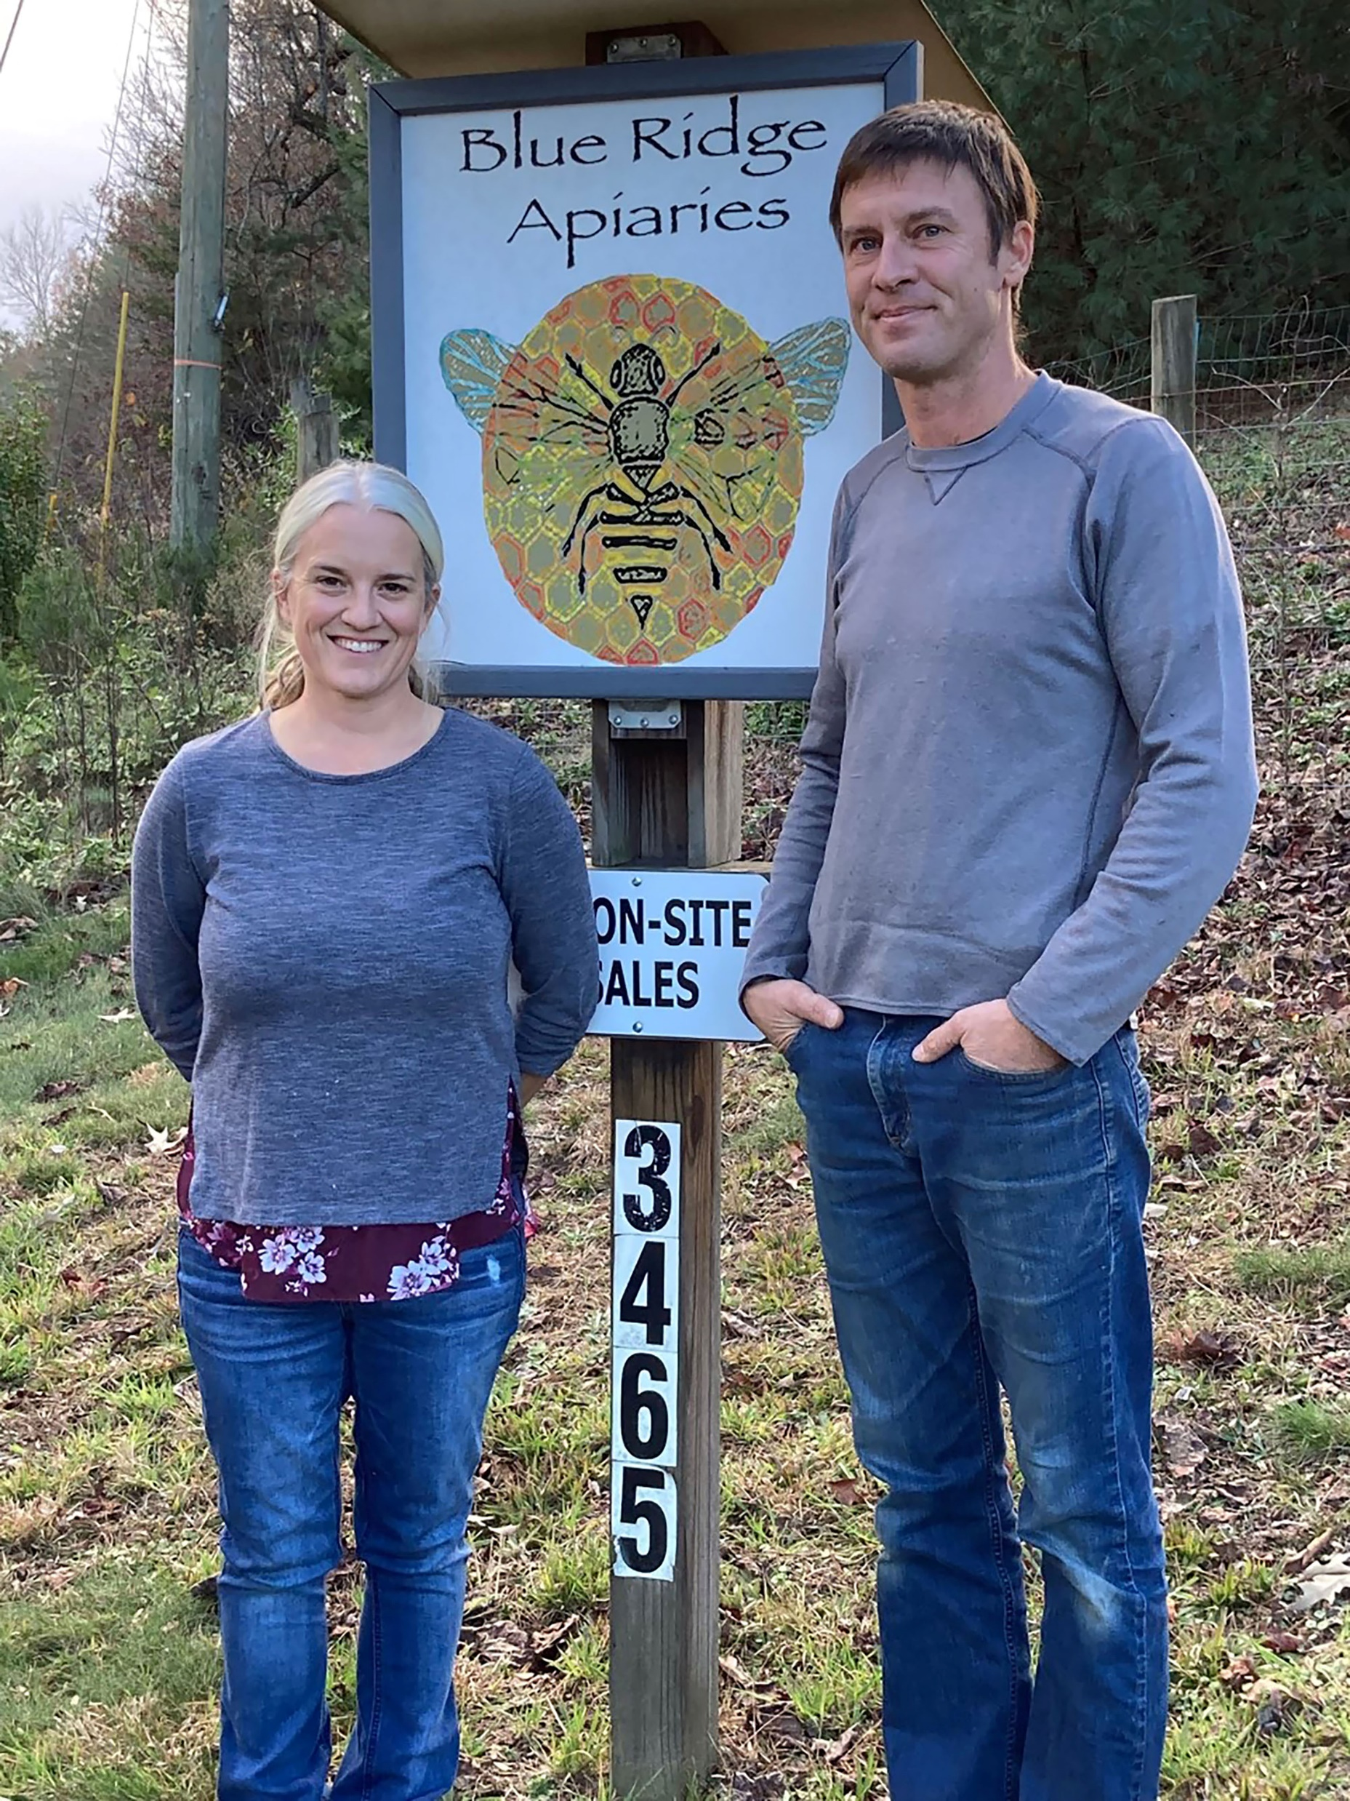
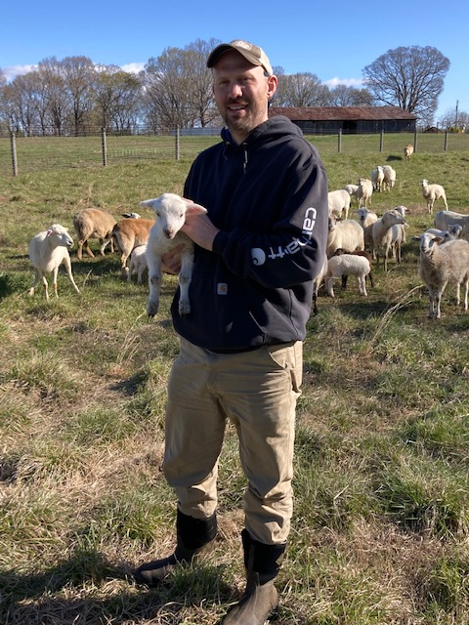
Questions
Notes:
Patrick Johnson (hoop house VA), Lee Holcolm (sheep), Ryan & Launi Higgs (bees)

