Slide 1
Alternative Weed Control Strategies in Sorghum with Companion Crops
A Partnership grant with north central region of
Sustainable agriculture research and education

Slide 2
Project objectives
Demonstrate appropriate companion crops can be viable alternatives to crop protection products
Demonstrate which families of companion crops can benefit sorghum production
Provide demonstration plots available for others to observe as well as host field day
Document results of yield variance and economic differences between companion plots and non-companion fields along with soil health benefits ie: total carbon, infiltration, bulk density, penetration resistance, soil respiration and macro-invertebrate population counts

Slide 3
What Actually Happened
15 acres of sorghum with a companion cover crop mix as a demonstration/education plot. The companion crop mix was designed to provide available soil nutrients in symbiosis with the sorghum, and provide weed suppression. No-till on the Plains worked with four participating producers and a cover crop seed provider to determine the best species to meet the needs of the project objectives. the companion species/mixes were consistent at all of the sites. Two sites used moisture probes to measure water availability inside and outside the plot.

Slide 4
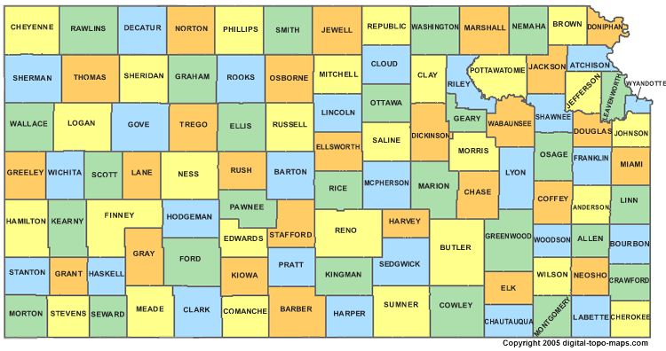

Slide 5
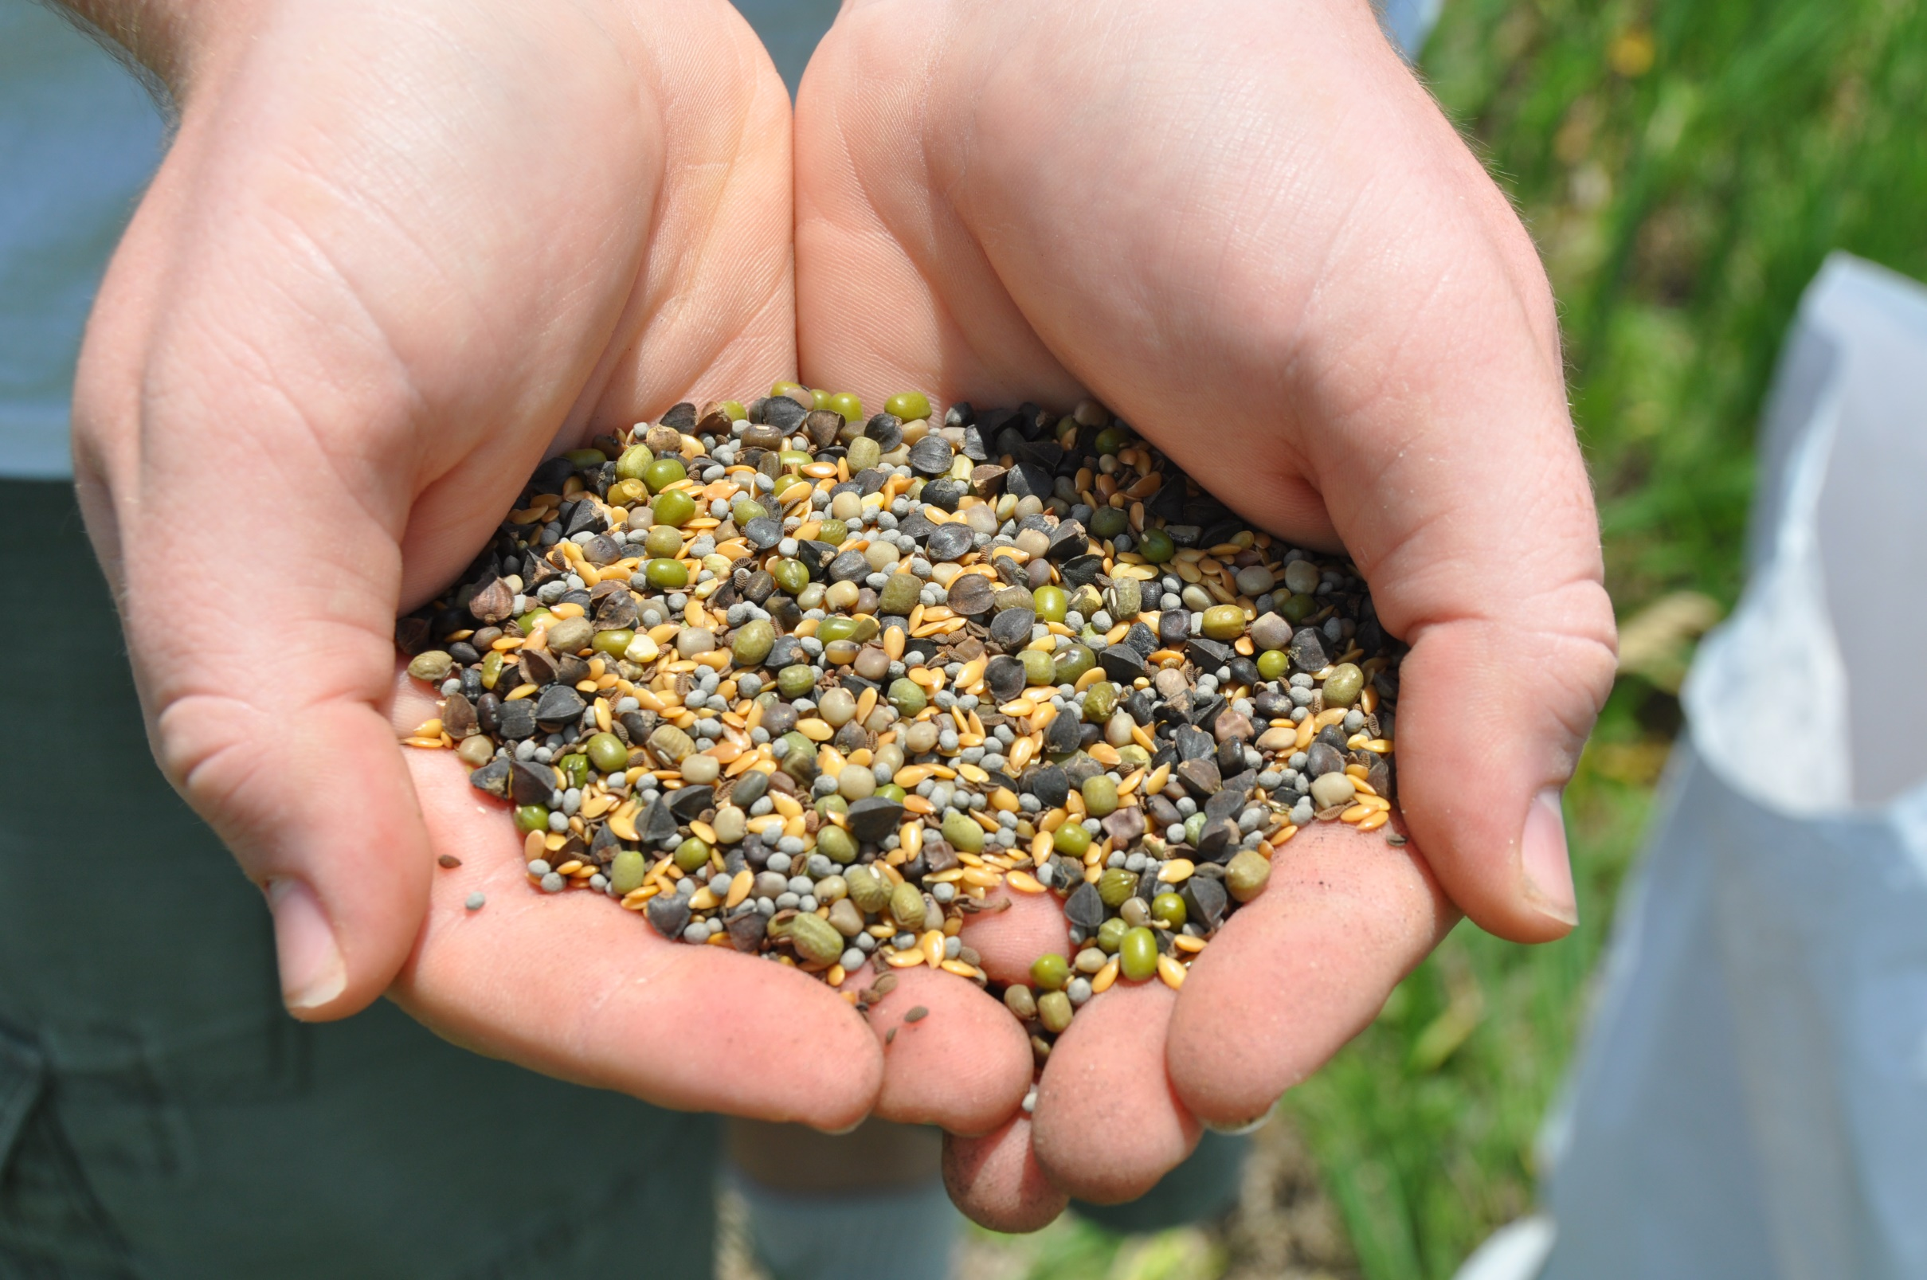
Companion species
Buckwheat 4.5 lb
Mung bean 4.0 lb
Flax 3.88 lb
Brown Mustard 0.17 lb
Yellow Mustard 0.17 lb
Guar 3.88 lb
Planted 15-16 lbs per acre
Cost $21.90/acre

Slide 6
Other Information
Sorghum planted at 45,000-60,000 seeds per acre
Some of the Plots had Pre-residual herbicides prior to planting but nothing after planting on plots
All But one of the plots had a cover crop planted ahead of the sorghum
3 of the 4 plots had companions planted In the same furrow as the sorghum, one had them between the rows
All but 1 of the plots had Nitrogen applied before planting starter fertilizer applied with the sorghum, no post fertilizer was applied
No additional herbicides or insecticides were applied to the plots
Due to wet Spring and Early Summer, all of the plantings were delayed (plant dates were June 7, 18, 29 and July 2, 2019, 15-30 Days later than “normal”)

Slide 7
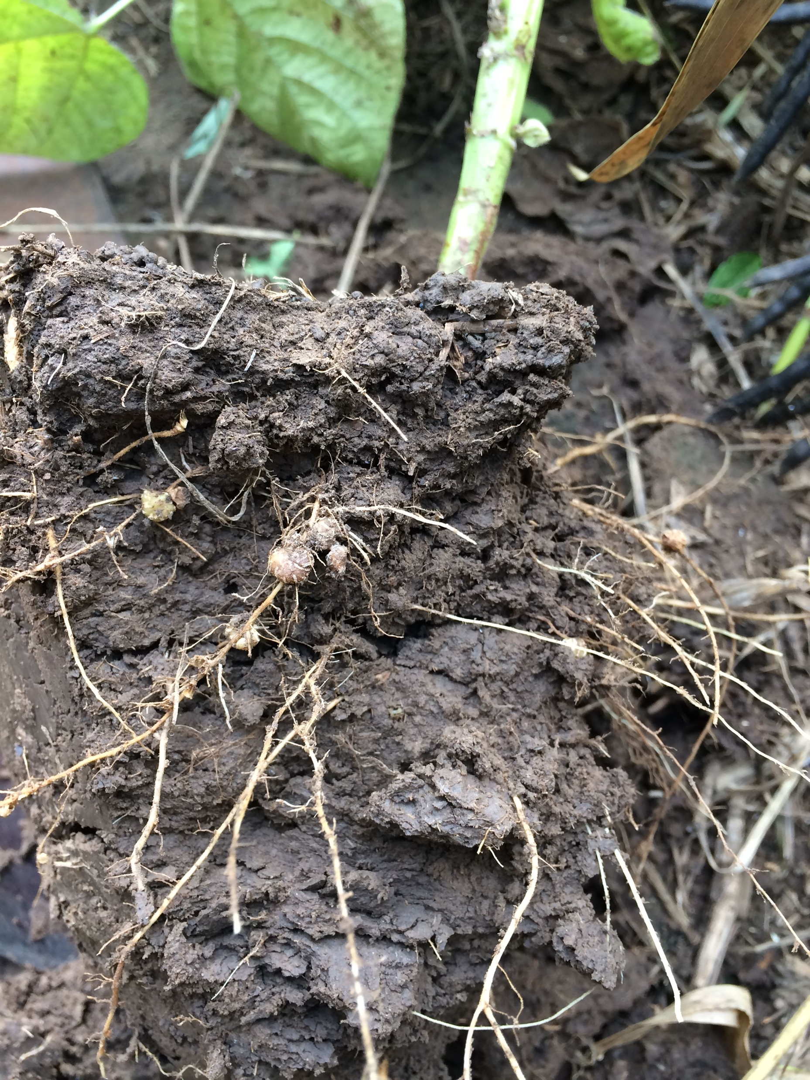
Saline County

Slide 8
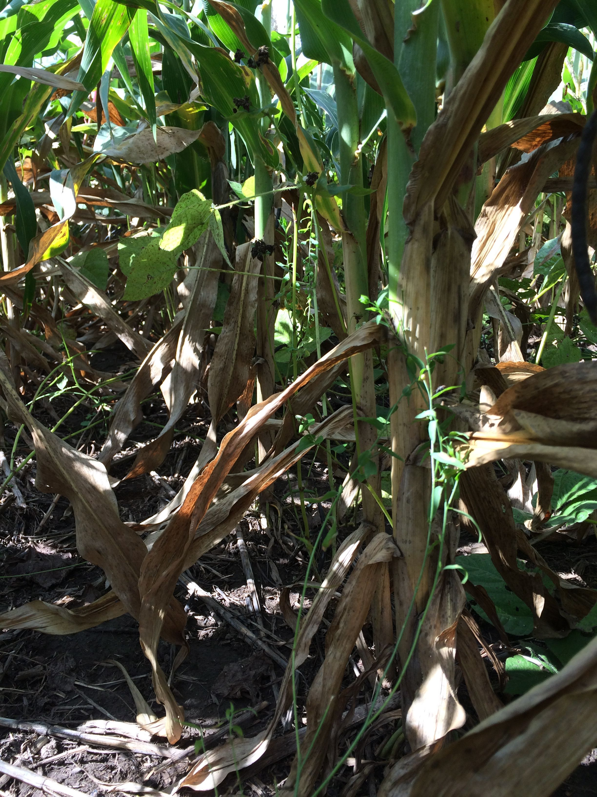

Slide 9
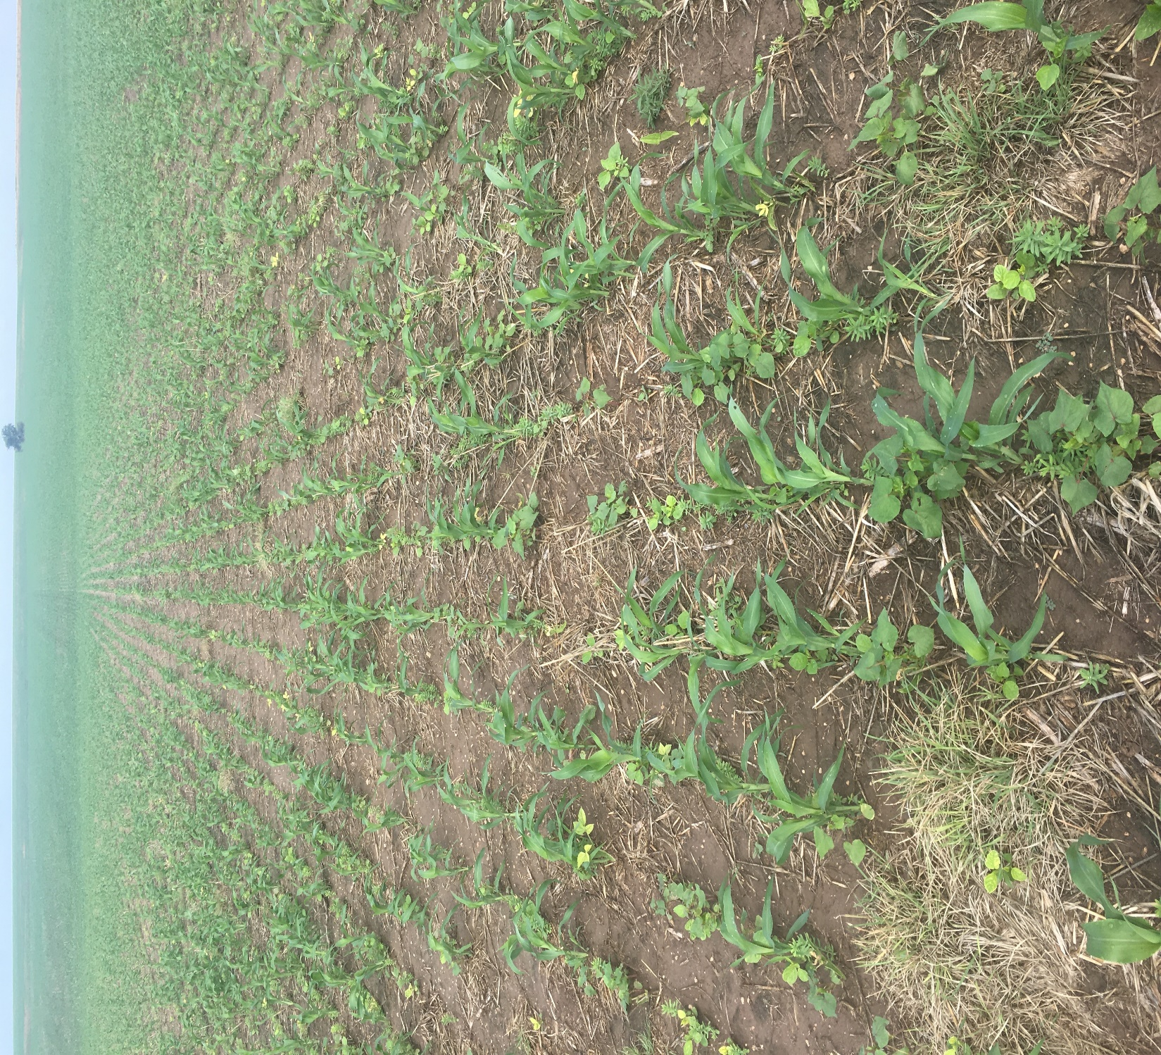
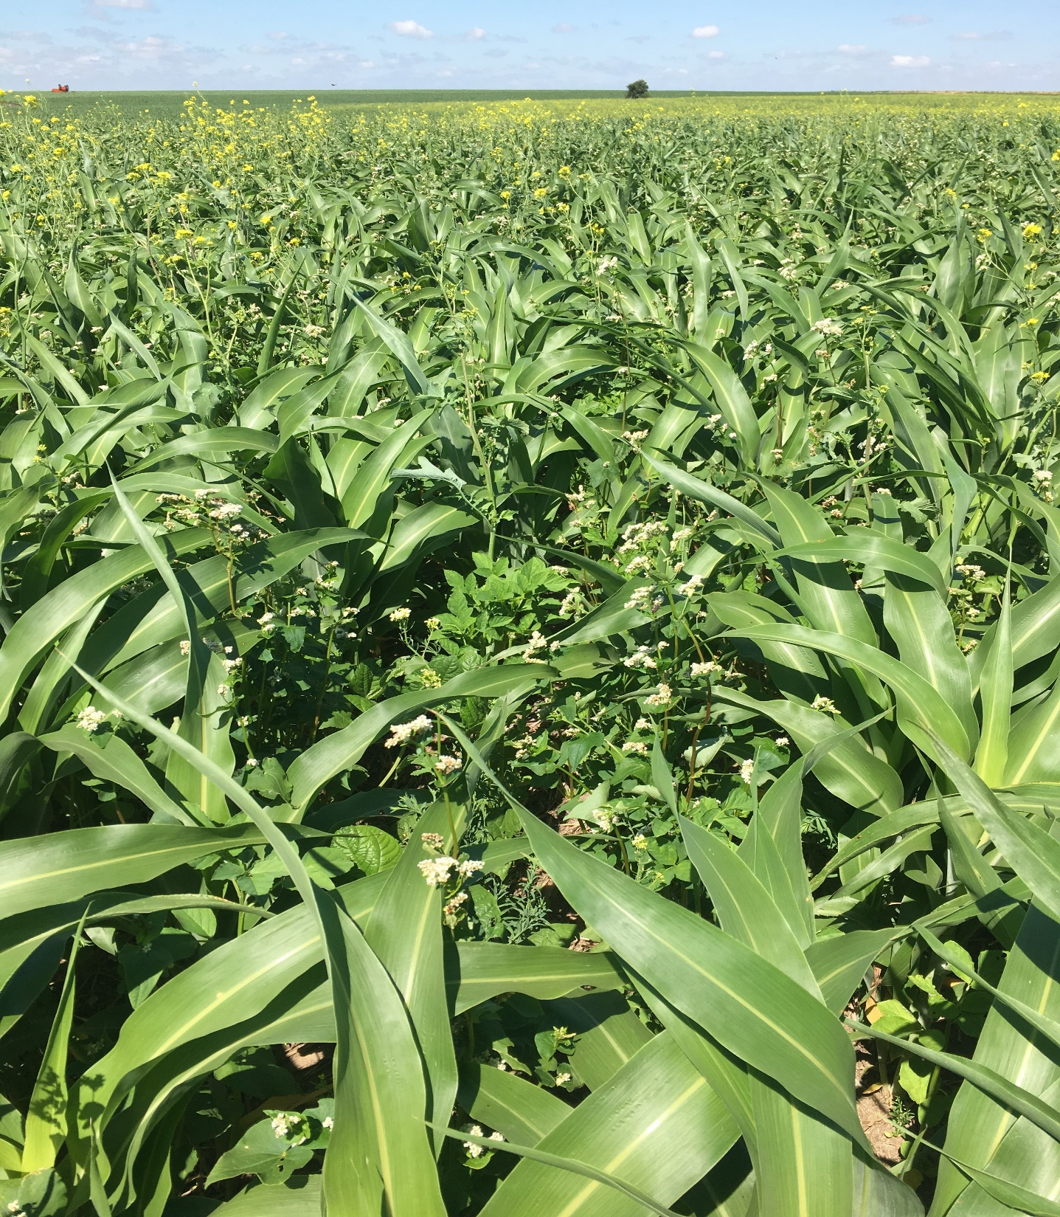
Ford County

Slide 10
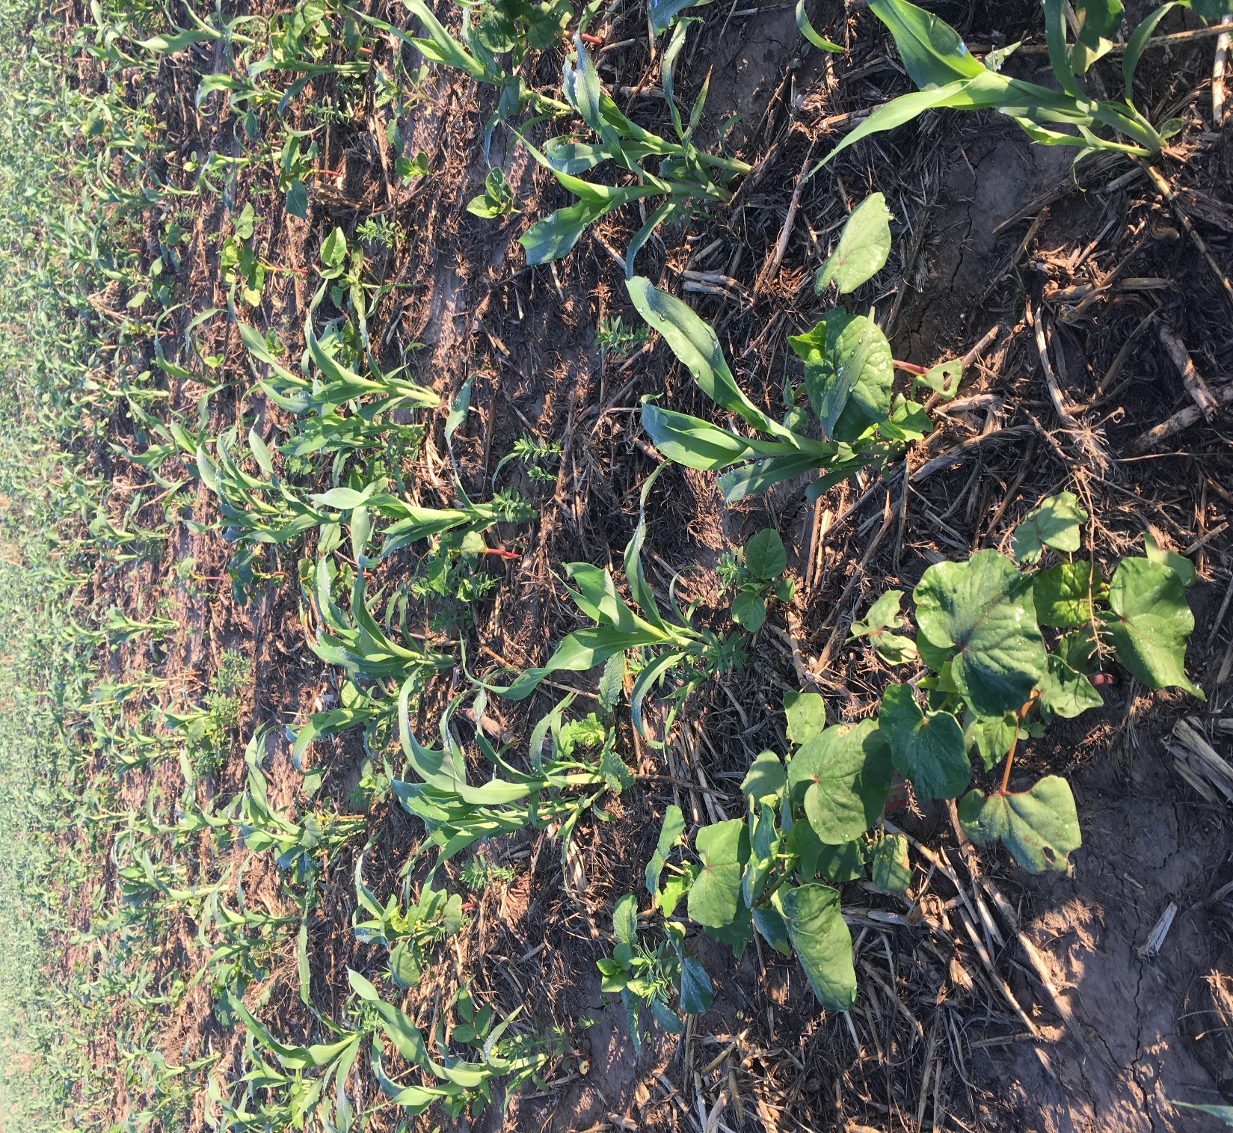
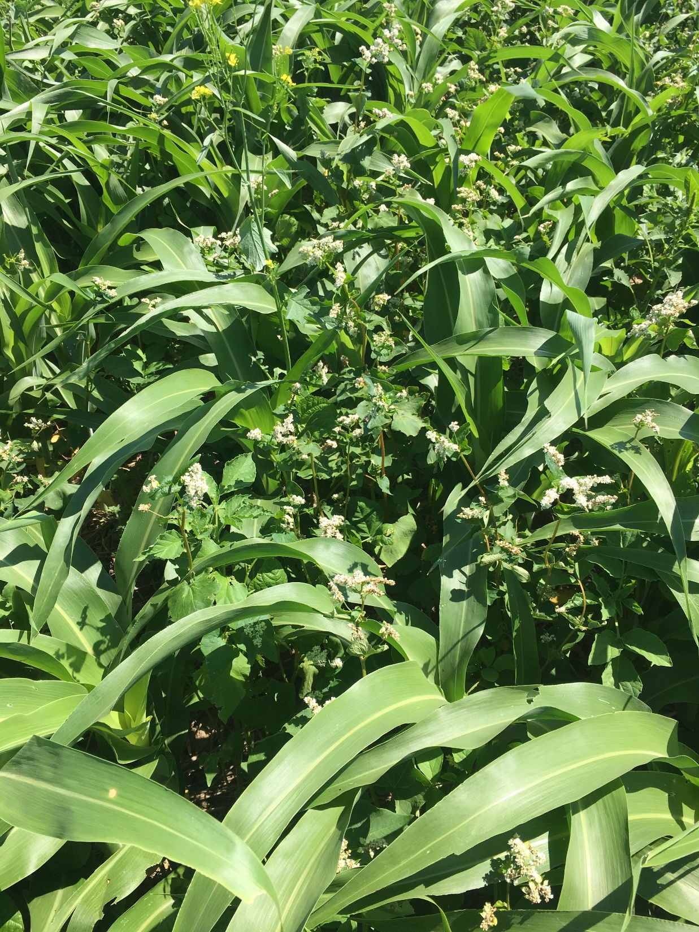

Slide 11
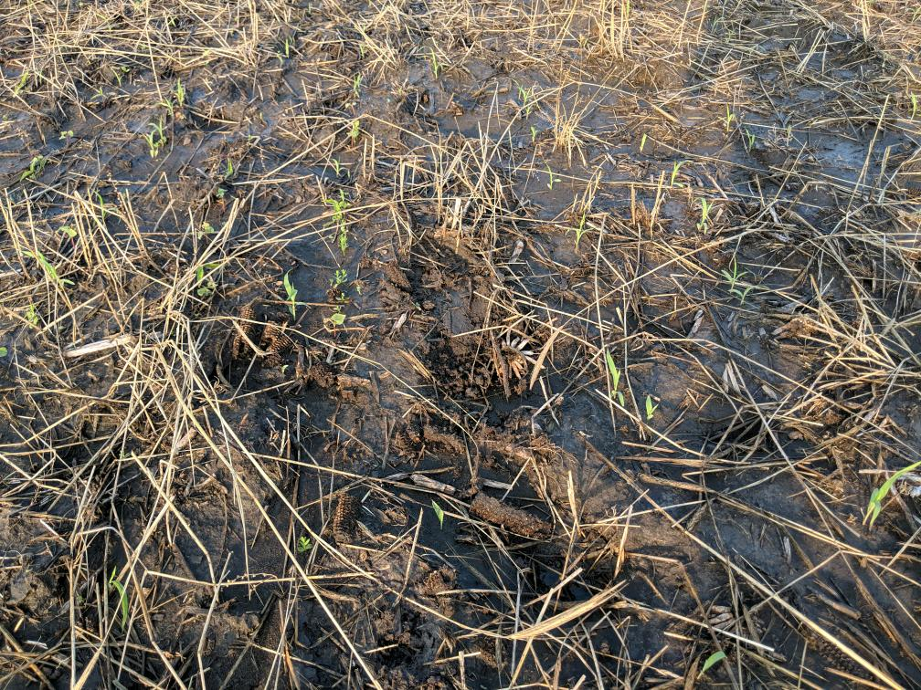
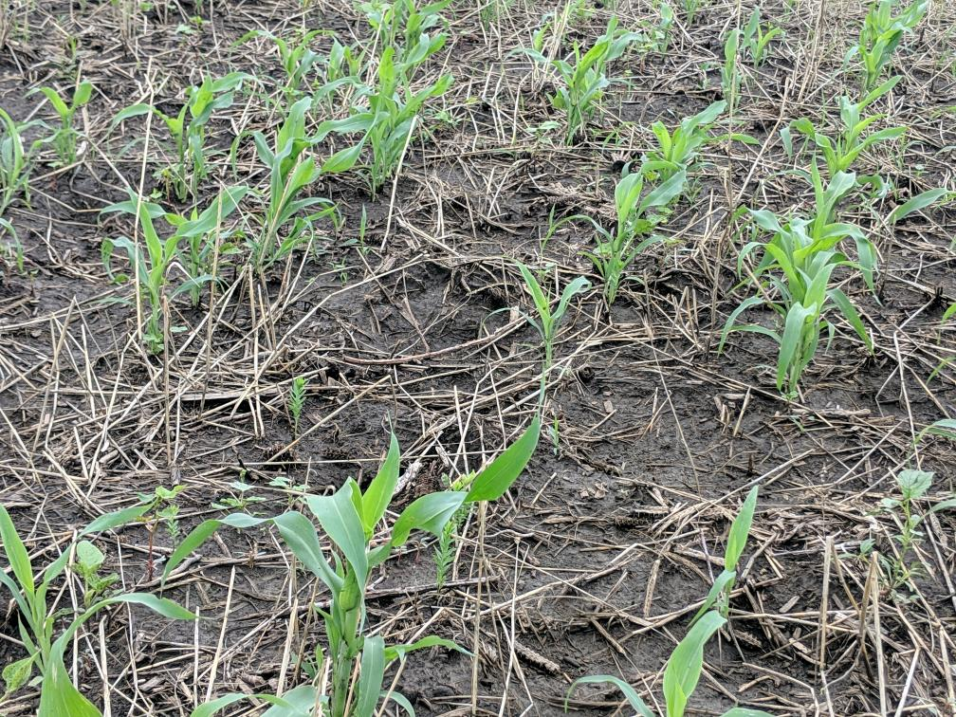
July
Osage County

Slide 12
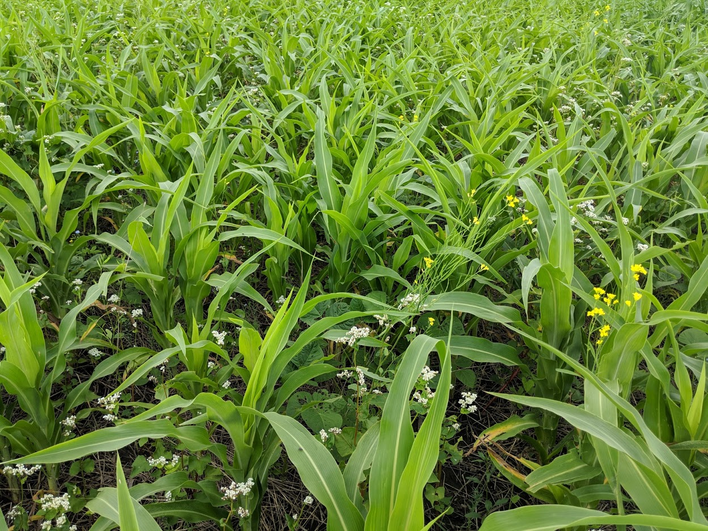
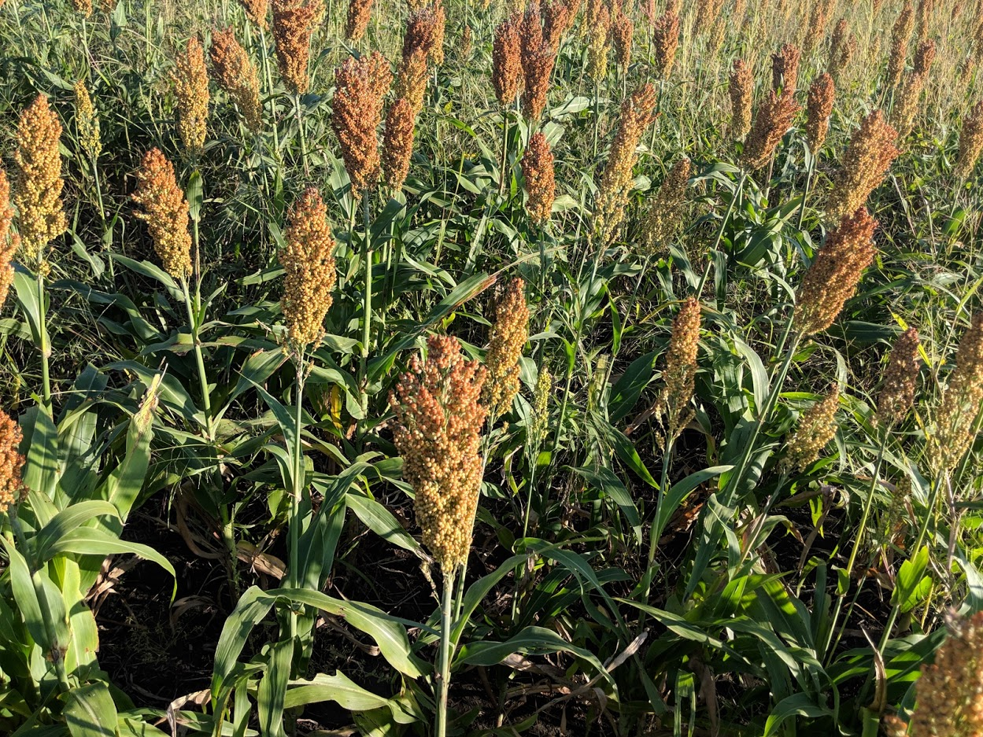

Slide 13
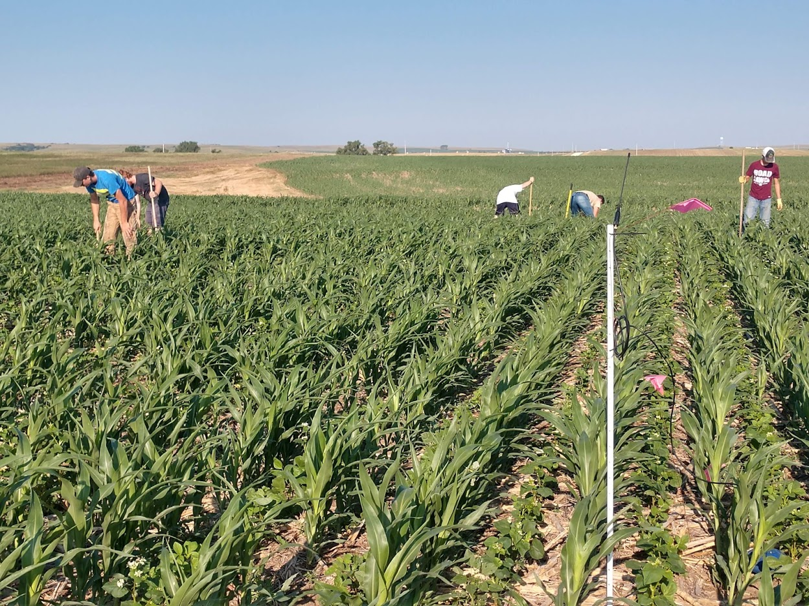
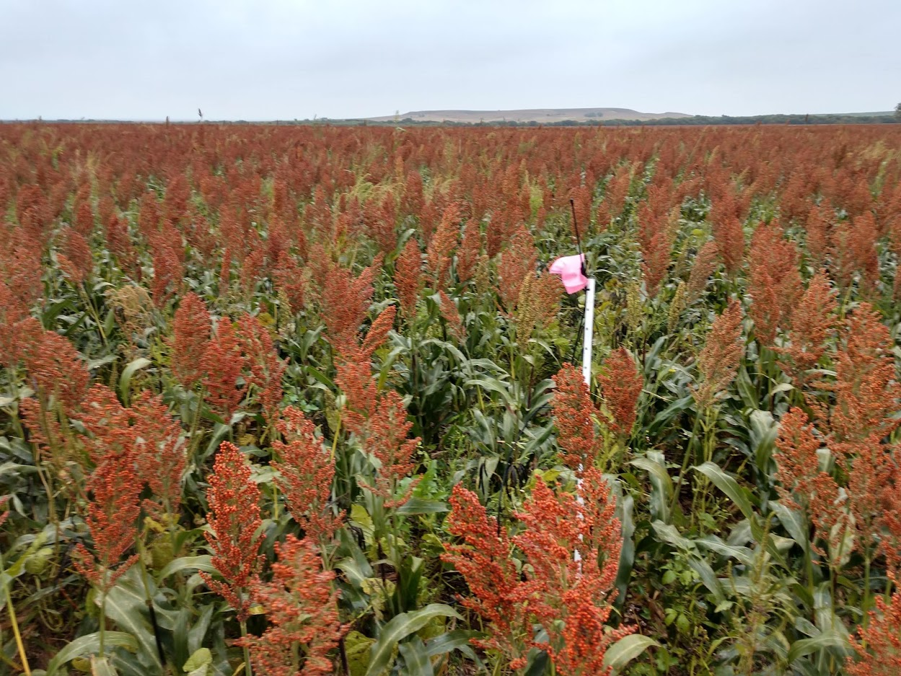
Mitchell county
July

Slide 14
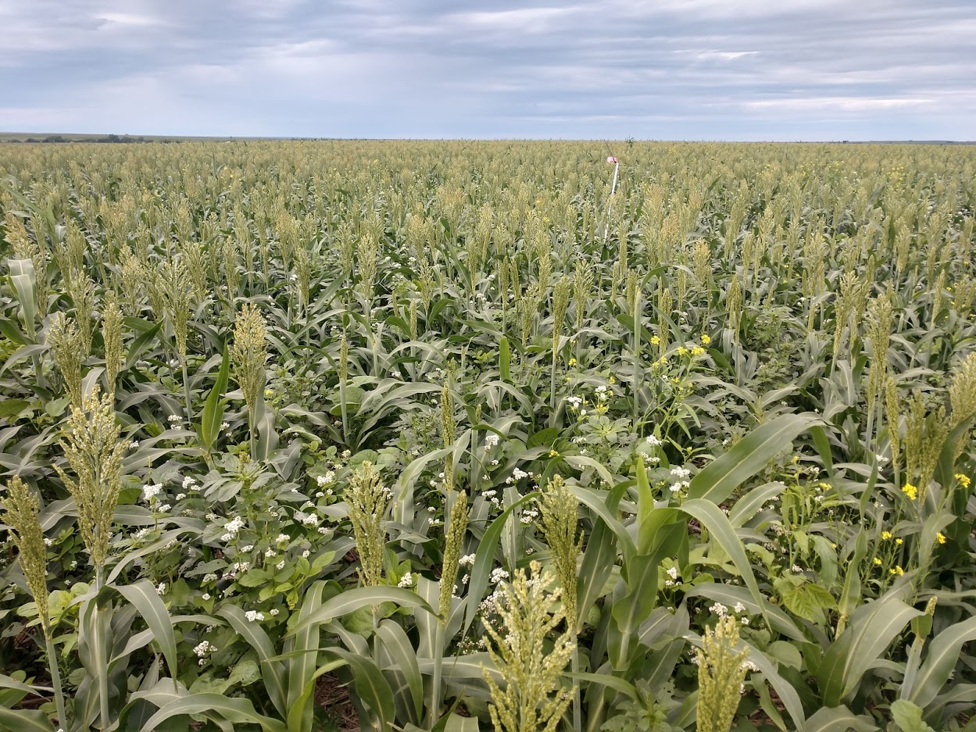
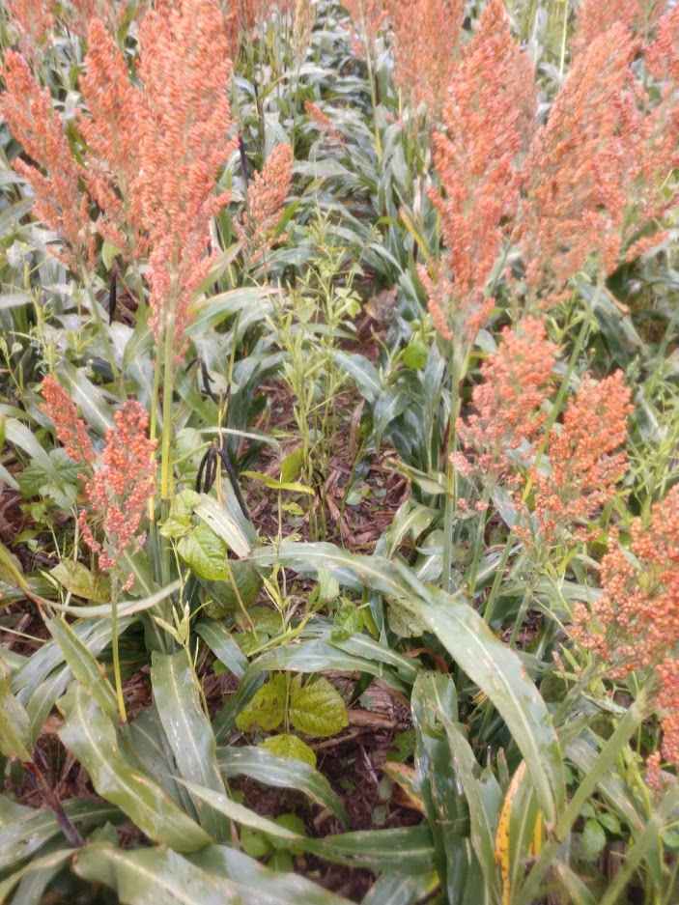
July

Slide 15
2019 Yield results
Site | Yield Inside Plot, bu/acre | Yield Outside Plot, bu/acre
Ford County | 70 | 78
Mitchell County | 71.7 | 77.2
Osage County | 24.84 | 35.29
Saline County | 103 | 121
*

Slide 16
2018 Yield results
Site | Yield Inside Plot, bu/acre | Yield Outside Plot, bu/acre
Ford County * | 76 | 82
Mitchell County | 121.9 | 121.2
Osage County ** | 23.4 | 24.3
Saline County | 107 | 109
* Field and plot had hail damage on July 29, sorghum without hail damage yielded 110 bu/acre
** No moisture from plant date, June 1, until August 20

Slide 17
Post Herbicide applications outside Plot area
Ford-None
Mitchell- NONE
Osage- $40/acre
Saline- none

Slide 18
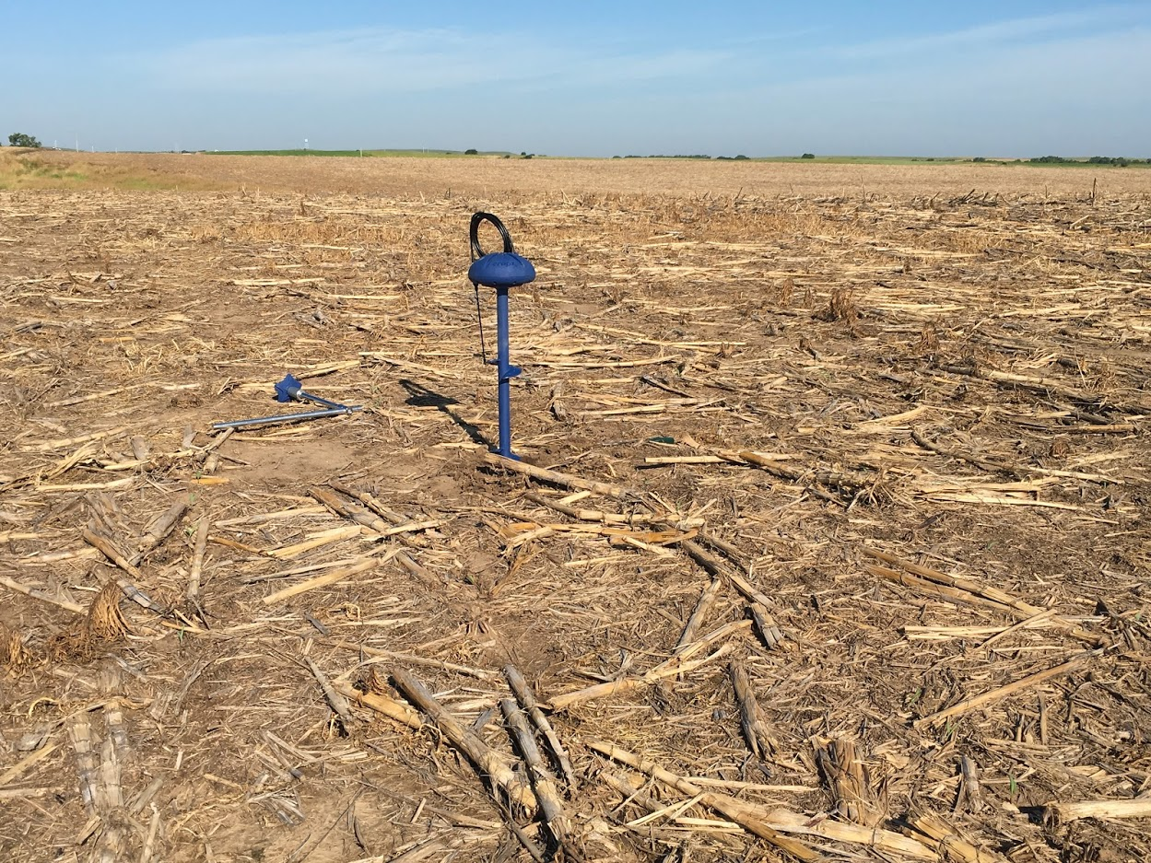
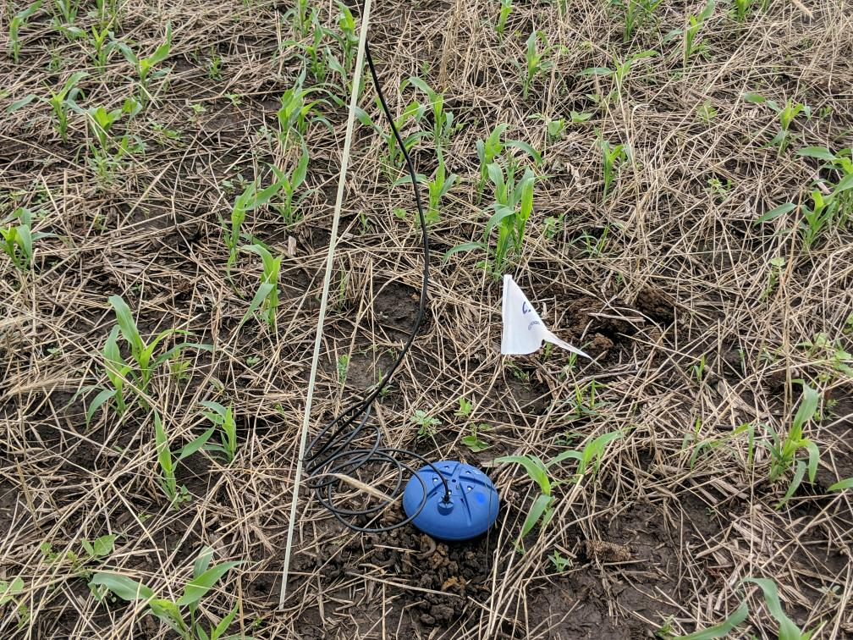
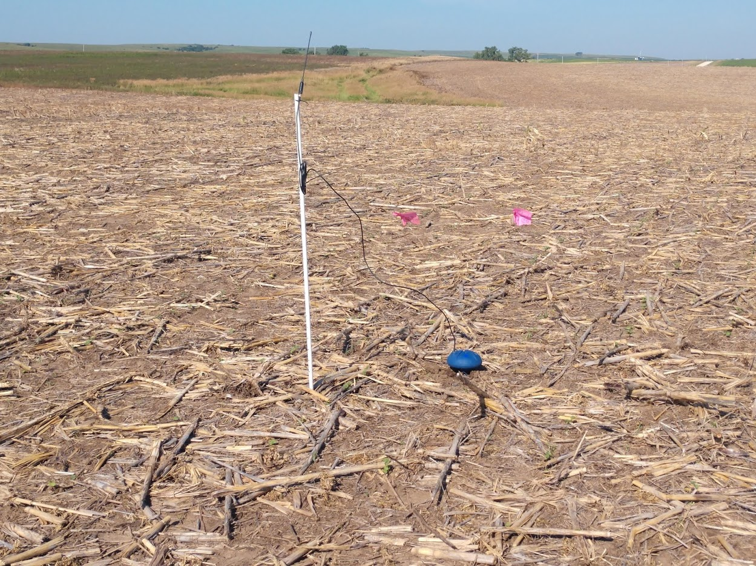
Crop X Moisture Probes

Slide 19
Moisture results Osage Co

Slide 20
Moisture Results Mitchell Co

Slide 21
Soil sampling – Aggregate Stability
 | July-19 |  | November-19
Sample | Management | %Aggregates | Management | % Aggregates
Mitchell Co. (DP) | No Cover Crops | 58.84 | No Cover Crops | 36.66
 | Cover Crops | 53.47 | Cover Crops | 22.63
Ford County (LF) | No Cover Crops | 69.42 | No Cover Crops | 64.03
 | Cover Crops | 25.13 | Cover Crops | 18.29
Osage County (KT | No Cover Crops Fertilizer | 61.91 | No cover Crops Fertilizer | 45.42
 | Cover Crops Fertilizer | 54.96 | Cover Crops Fertilizer | 39.03
 | No CC No Fertilizer | 64.05 | No CC No Fertilizer | 54.99
 | Covers No fertilizer | 57.22 | Covers No Fertilizer | 58.65
Saline Co. (JK) | No Cover Crops | 26.75 | No Cover Crops | 28.03
 | Cover Crops | 26.33 | Cover Crops | 16.79
Data Provided by SSRA 5 Joe Anderson, TL and Brian Nester, SS
Notes:
This is the total percentage out of 100 from a sample of soil that was dried sieved to 8mm and then run through the dipping method and the percentage is what is left on the sieve.
The purpose of the aggregate analysis is to determine the size distribution of the water-stable aggregates and the amount of aggregation. A soil sample is placed on a nest of screens under water. The screens are moved up and down for a specified amount of time. The mass of the soil remaining on the individual screens is determined, corrected for sand/gravel and the percent macro and microaggregate stability is calculated.
Values are low in the Dec. 18 dates due to the extremely high rainfall in the fall. Weak aggregates that were just built can collapse under water pressure.

Slide 22
Soil sampling results – Total Carbon
 | Jul-19 |  | Nov-19
Sample | Management | Total Carbon | Management | Total Carbon
Mitchell Co. (DP) | No Covers | 2.5 | No Covers | 2.0
 | Cover Crops | 2.2 | Cover Crops | 2.1
Ford Co. (LF) | No Covers | 2.9 | No Covers | 2.7
 | Cover Crops | 1.2 | Cover Crops | 1.4
Osage Count (KT) | No Covers Fert. | 2.7 | No Covers Fert. | 2.1
 | Cover Crops Fert | 3.3 | Cover Crops Fert | 3.0
 | No CC No Fert | 3.0 | No CC No Fert | 2.0
 | CC No Fert | 2.8 | CC No Fert | 1.4
Saline Co. (JK) | No Cover Crops | 2.5 | No Cover Crops | 2.0
 | Cover Crops | 2.6 | Cover Crops | 1.8
Data Provided by SSRA 5 Joe Anderson, TL and Brian Nester, SS
Notes:
Soil organic carbon is a measurable component of soil organic matter. Organic matter makes up just 2–10% of most soil's mass and has an important role in the physical, chemical and biological function of agricultural soils.
Organic matter contributes to nutrient retention and turnover, soil structure, moisture retention and availability, degradation of pollutants, carbon sequestration and soil resilience.
You can get SOM from TOC by multiplying the value by 1.74 or 2.

Slide 23
Soil sampling results - Active Carbon
 | Jul-19 |  | Nov-19
Sample | Management | Active Carbon | Management | Active Carbon
Mitchell Co. (DP) | No Covers | 493 | No Covers | 415
 | Cover Crops | 477 | Cover Crops | 440
Ford Co. (LF) | No Covers | 479 | No Covers | 406
 | Cover Crops | 344 | Cover Crops | 369
Osage Count (KT) | No Covers Fert. | 557 | No Covers Fert. | 640
 | Cover Crops Fert | 645 | Cover Crops Fert | 719
 | No CC No Fert | 678 | No CC No Fert | 676
 | CC No Fert | 687 | CC No Fert | 703
Saline Co. (JK) | No Cover Crops | 556 | No Cover Crops | 528
 | Cover Crops | 530 | Cover Crops | 432
Data Provided by SSRA 5 Joe Anderson, TL and Brian Nester, SS
Notes:
Active C (also known as permanganate-oxidizable C or POXC) measures the portion of soil organic matter that can serve as a readily available food and energy source for the soil microbial community, thus helping to maintain a healthy soil food web. To measure active C, soil is reacted with a potassium permanganate solution, which has a deep purple color. As the solution oxidizes, it loses some of its color. This loss of color upon reaction is directly proportional to the amount of active C in the soil sample, which is determined by using a spectrophotometer and calibrated against standards of known concentration. Duplicate soil samples are air dried to constant weight, shaken with 0.02 KMnO4 solution, allowed to settle, diluted and absorbance measured at 550 nm. The SOP is from Schindelbeck (2016) and is based on the method of Weil et al. (2003).
Increasing POXC reflects practices that promote SOM accumulation and it is considered a useful indicator of long-term soil C sequestration (Hurisso et al. 2016).

Slide 24
General Observations from Demonstration plots
Planting date makes big impact on the success of this combination
Pre-Plant soil cover maybe the most important factor for early weed control without a quick germinating companion species
Plot with Cover crops did show greater moisture use even with early saturated soil conditions
The mix did have positive benefits on weed populations in some of the demonstration plots, but not in every case
Companion mix did have benefit to soils

