Slide 1
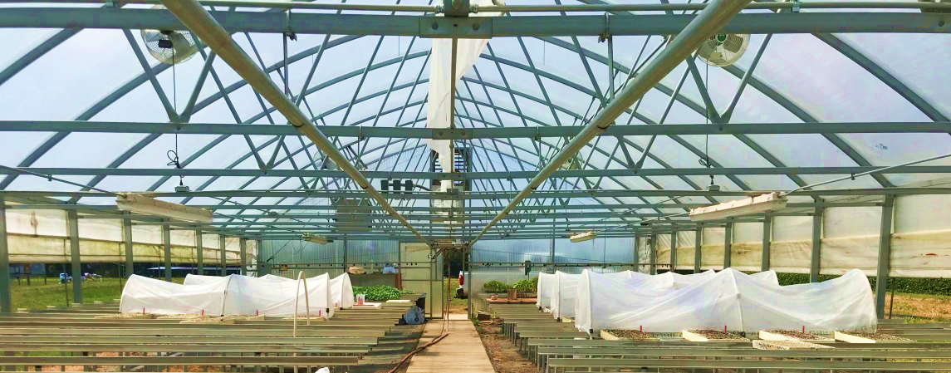
Greenhouse protection
Seedlings Protected in an insect cage
Seedlings Not-Protected
Treatment 1: Verimark (13.5 fl oz/A)
Treatment 2: Requeim (2 qt/A)
Treatment 3: Actigard (0.25 fl oz/A)
Treatment 4: Non-treated check
Treatment 1: Verimark (13.5 fl oz/A)
Treatment 2: Requeim (2 qt/A)
Treatment 3: Actigard (0.25 fl oz/A)
Treatment 4: Non-treated check
Treatments were drenched at the base of the seedlings at planting.
Four replications per treatment.

Slide 2
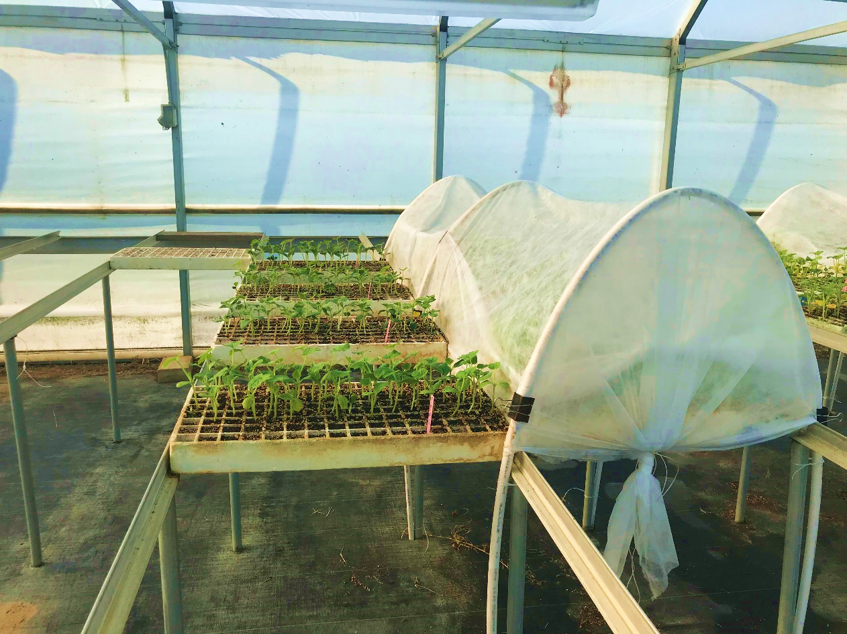
Greenhouse protection

Slide 3
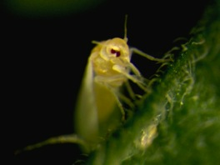
Greenhouse protection
Not-protected
Protected
Treatments | Mean whitefly counts
Verimark (13.5 fl oz/A) | 0.9 bc
Requeim (2 qt/A) | 0.2 c
Actigard (0.25 fl oz/A) | 1.2 b
Non-treated check | 2.2 a
Treatments | Mean whitefly counts
Verimark (13.5 fl oz/A) | 0.0
Requeim (2 qt/A) | 0.0
Actigard (0.25 fl oz/A) | 0.0
Non-treated check | 0.0

Slide 4
Whitefly immatures
Not-protected
Protected
Treatments | Mean eggs and nymphs count
Verimark (13.5 fl oz/A) | 20.8 a
Requeim (2 qt/A) | 19.2 a
Actigard (0.25 fl oz/A) | 15.6 a
Non-treated check | 23.7 a
Treatments | Mean eggs and nymphs count
Verimark (13.5 fl oz/A) | 0.50 b
Requeim (2 qt/A) | 0.40 b
Actigard (0.25 fl oz/A) | 0.55 b
Non-treated check | 2.0 a

Slide 5
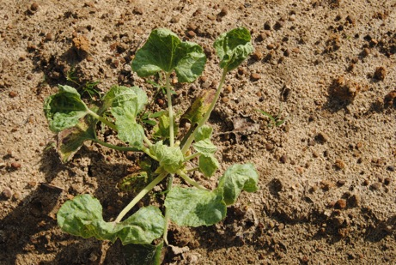
Virus incidence
Not-protected
Protected
Treatments | Mean CuLCrV incidence (%)
Verimark (13.5 fl oz/A) | 1.2 a
Requeim (2 qt/A) | 2.4 a
Actigard (0.25 fl oz/A) | 2.6 a
Non-treated check | 1.2 a
Treatments | Mean CuLCrV incidence (%)
Verimark (13.5 fl oz/A) | 0.25 b
Requeim (2 qt/A) | 0.29 b
Actigard (0.25 fl oz/A) | 0.65 a
Non-treated check | 0.24 b

Slide 6
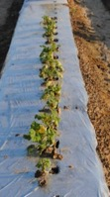
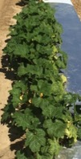
Squash resistance
Tifton preliminary fall trial
Commercial yellow and zucchini squash evaluation (20 vars.)
Yellow oval – yellow squash; green oval- zucchini squash
A
B

Slide 7
Squash resistance: Virus severity and plant vigor
Yellow oval – yellow squash; green oval- zucchini squash

Slide 8
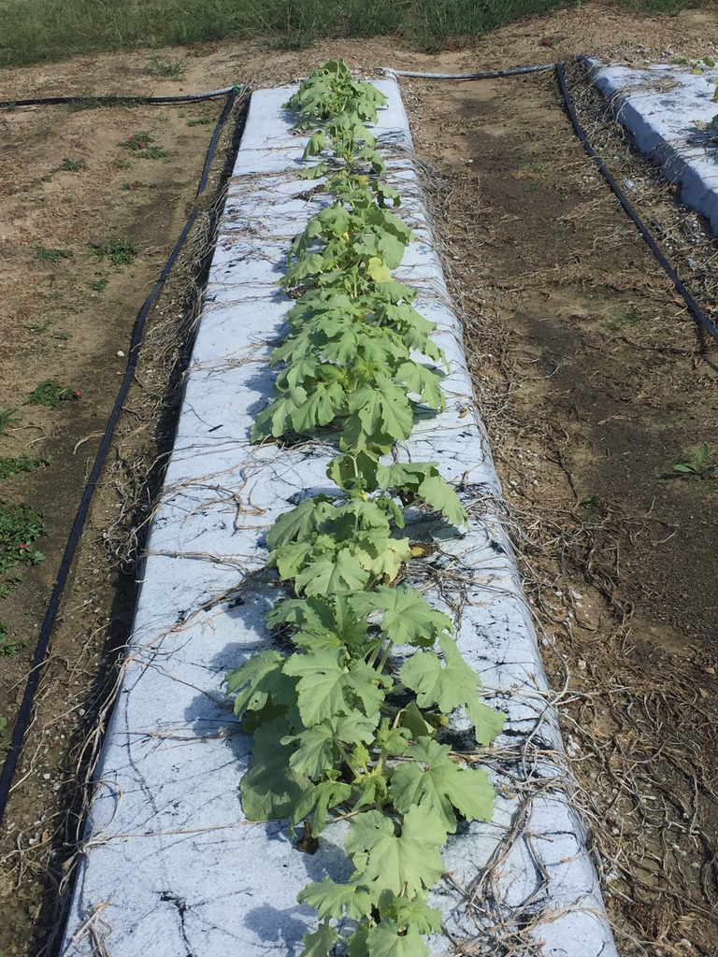
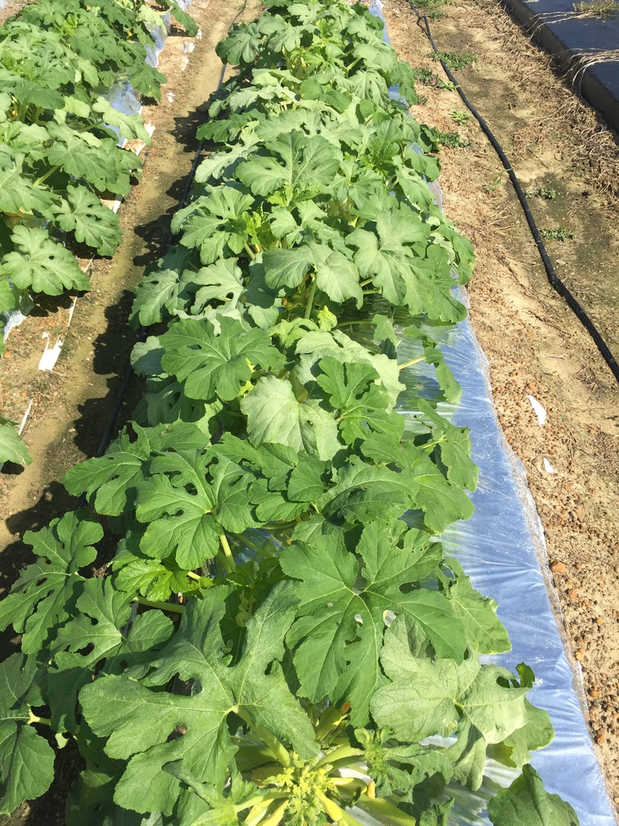
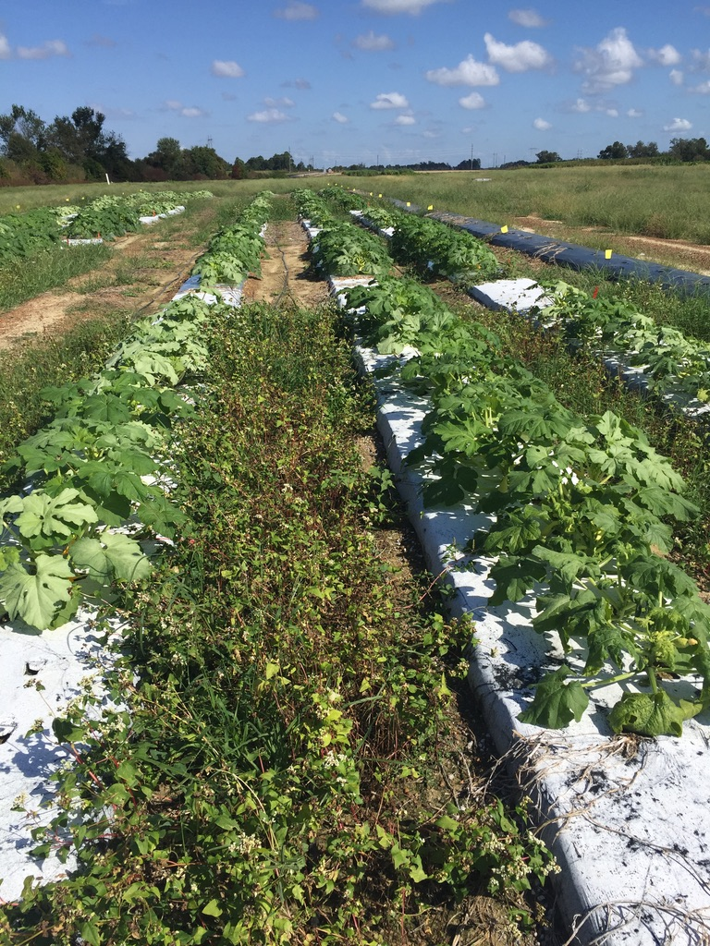
Cultural tactics: mulch
21-Sep
d
03-Oct
28-Sep

Slide 9
Cultural tactics: mulch
d
Severity
Silvering
Vigor

Slide 10
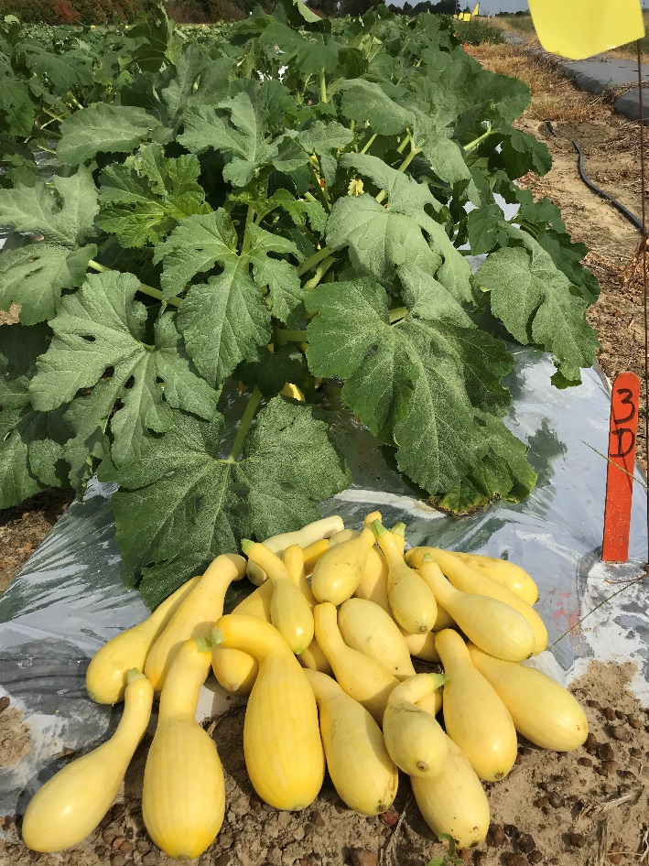
Cultural tactics: mulch
Fancy
d
Medium
Cull

Slide 11
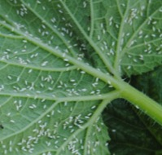
Insecticides at planting
21-Sep
28-Sep
03-Oct
d

Slide 12
Insecticides at planting
Severity
Silvering
Vigor

Slide 13
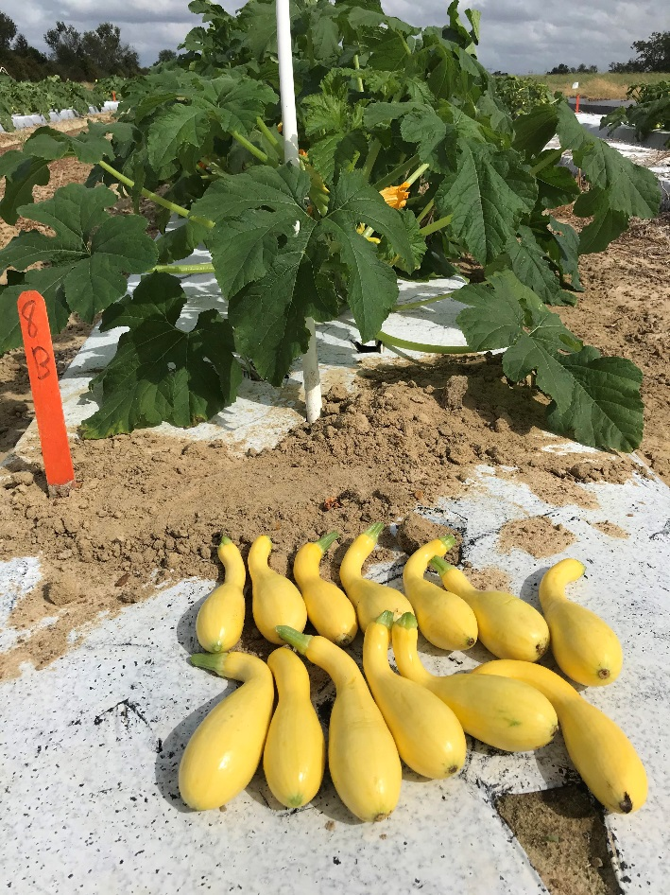
Insecticides at planting
Fancy
Medium
Cull

Slide 14
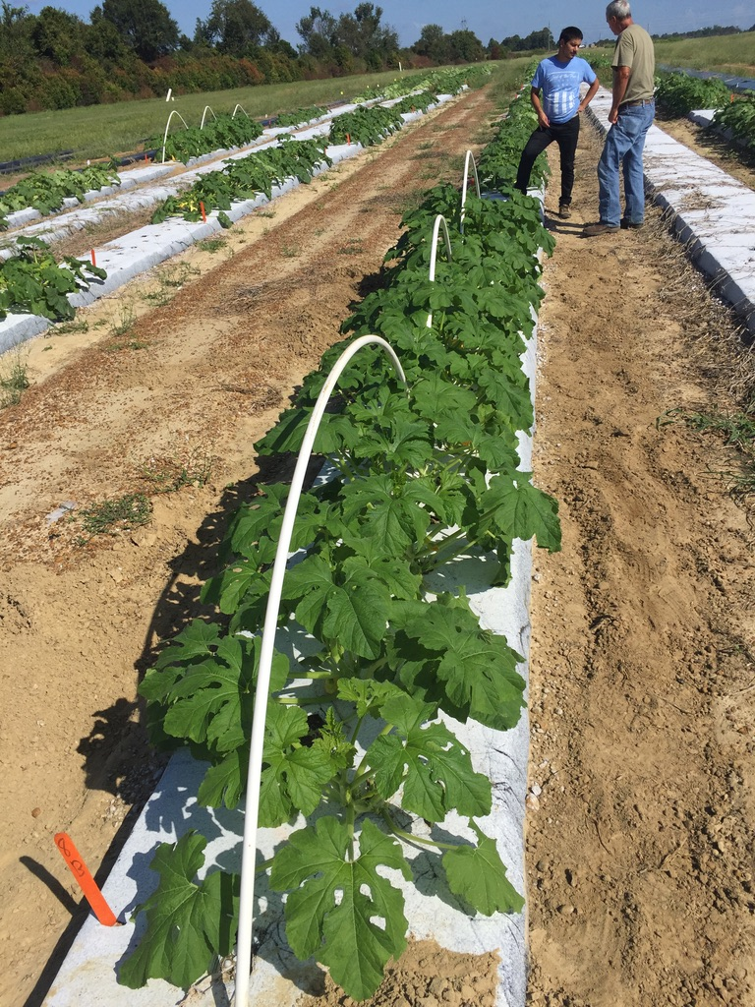
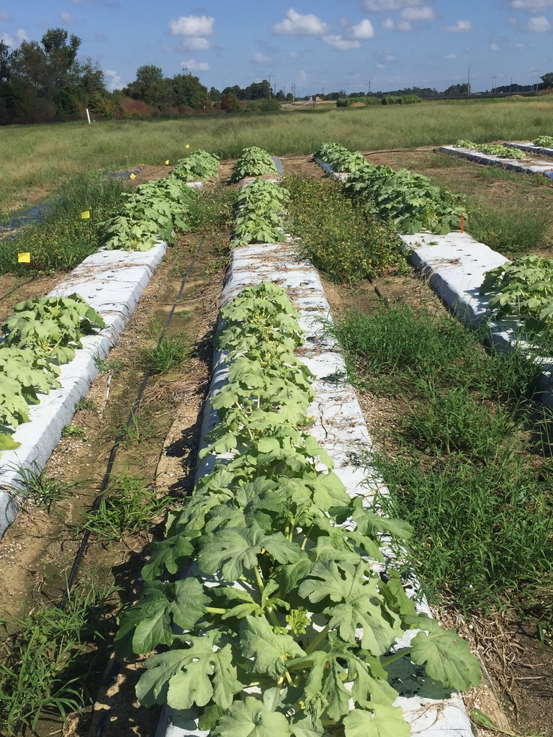
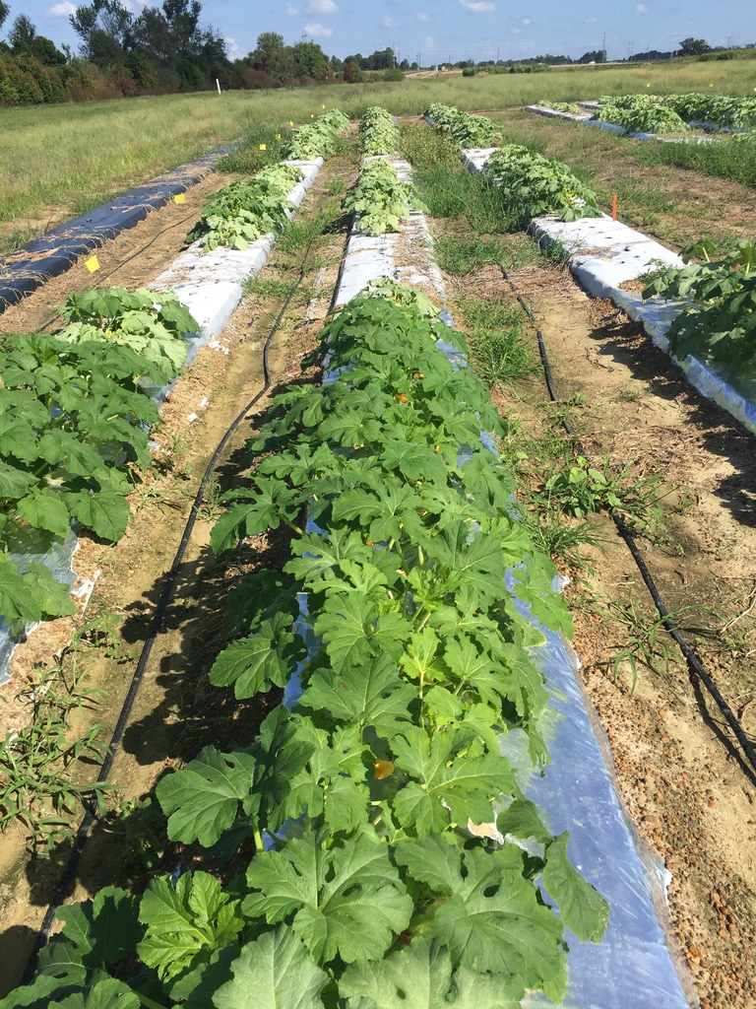
Integrating management options
Host resistance + Cultural tactics + chemical tactics

