Slide 1
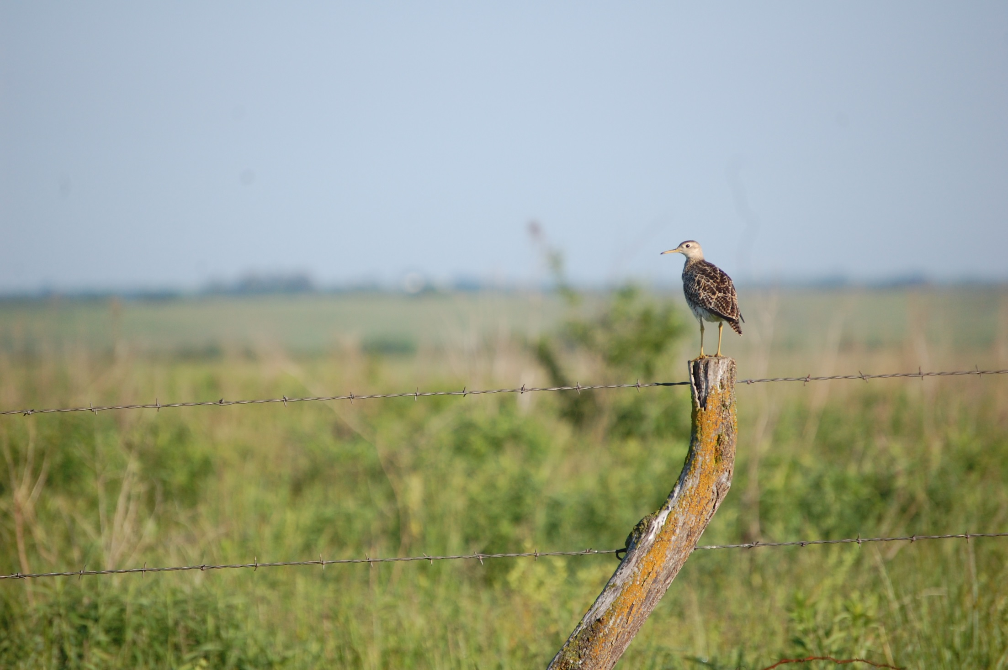
Agricultural, ecological, and social responses to an invasive grass and its removal in working Midwestern grasslands
Jaime Coon, Scott Nelson, and James Miller
NCR-SARE Update
23 Aug. 2016

Slide 2
Tall fescue (Schedonorus phoenix)
Notes:
-Cool-season grass that grows in a thick, dense mat
-Highly drought tolerant and high productivity
-But could tall fescue still function as a grassland?

Slide 3
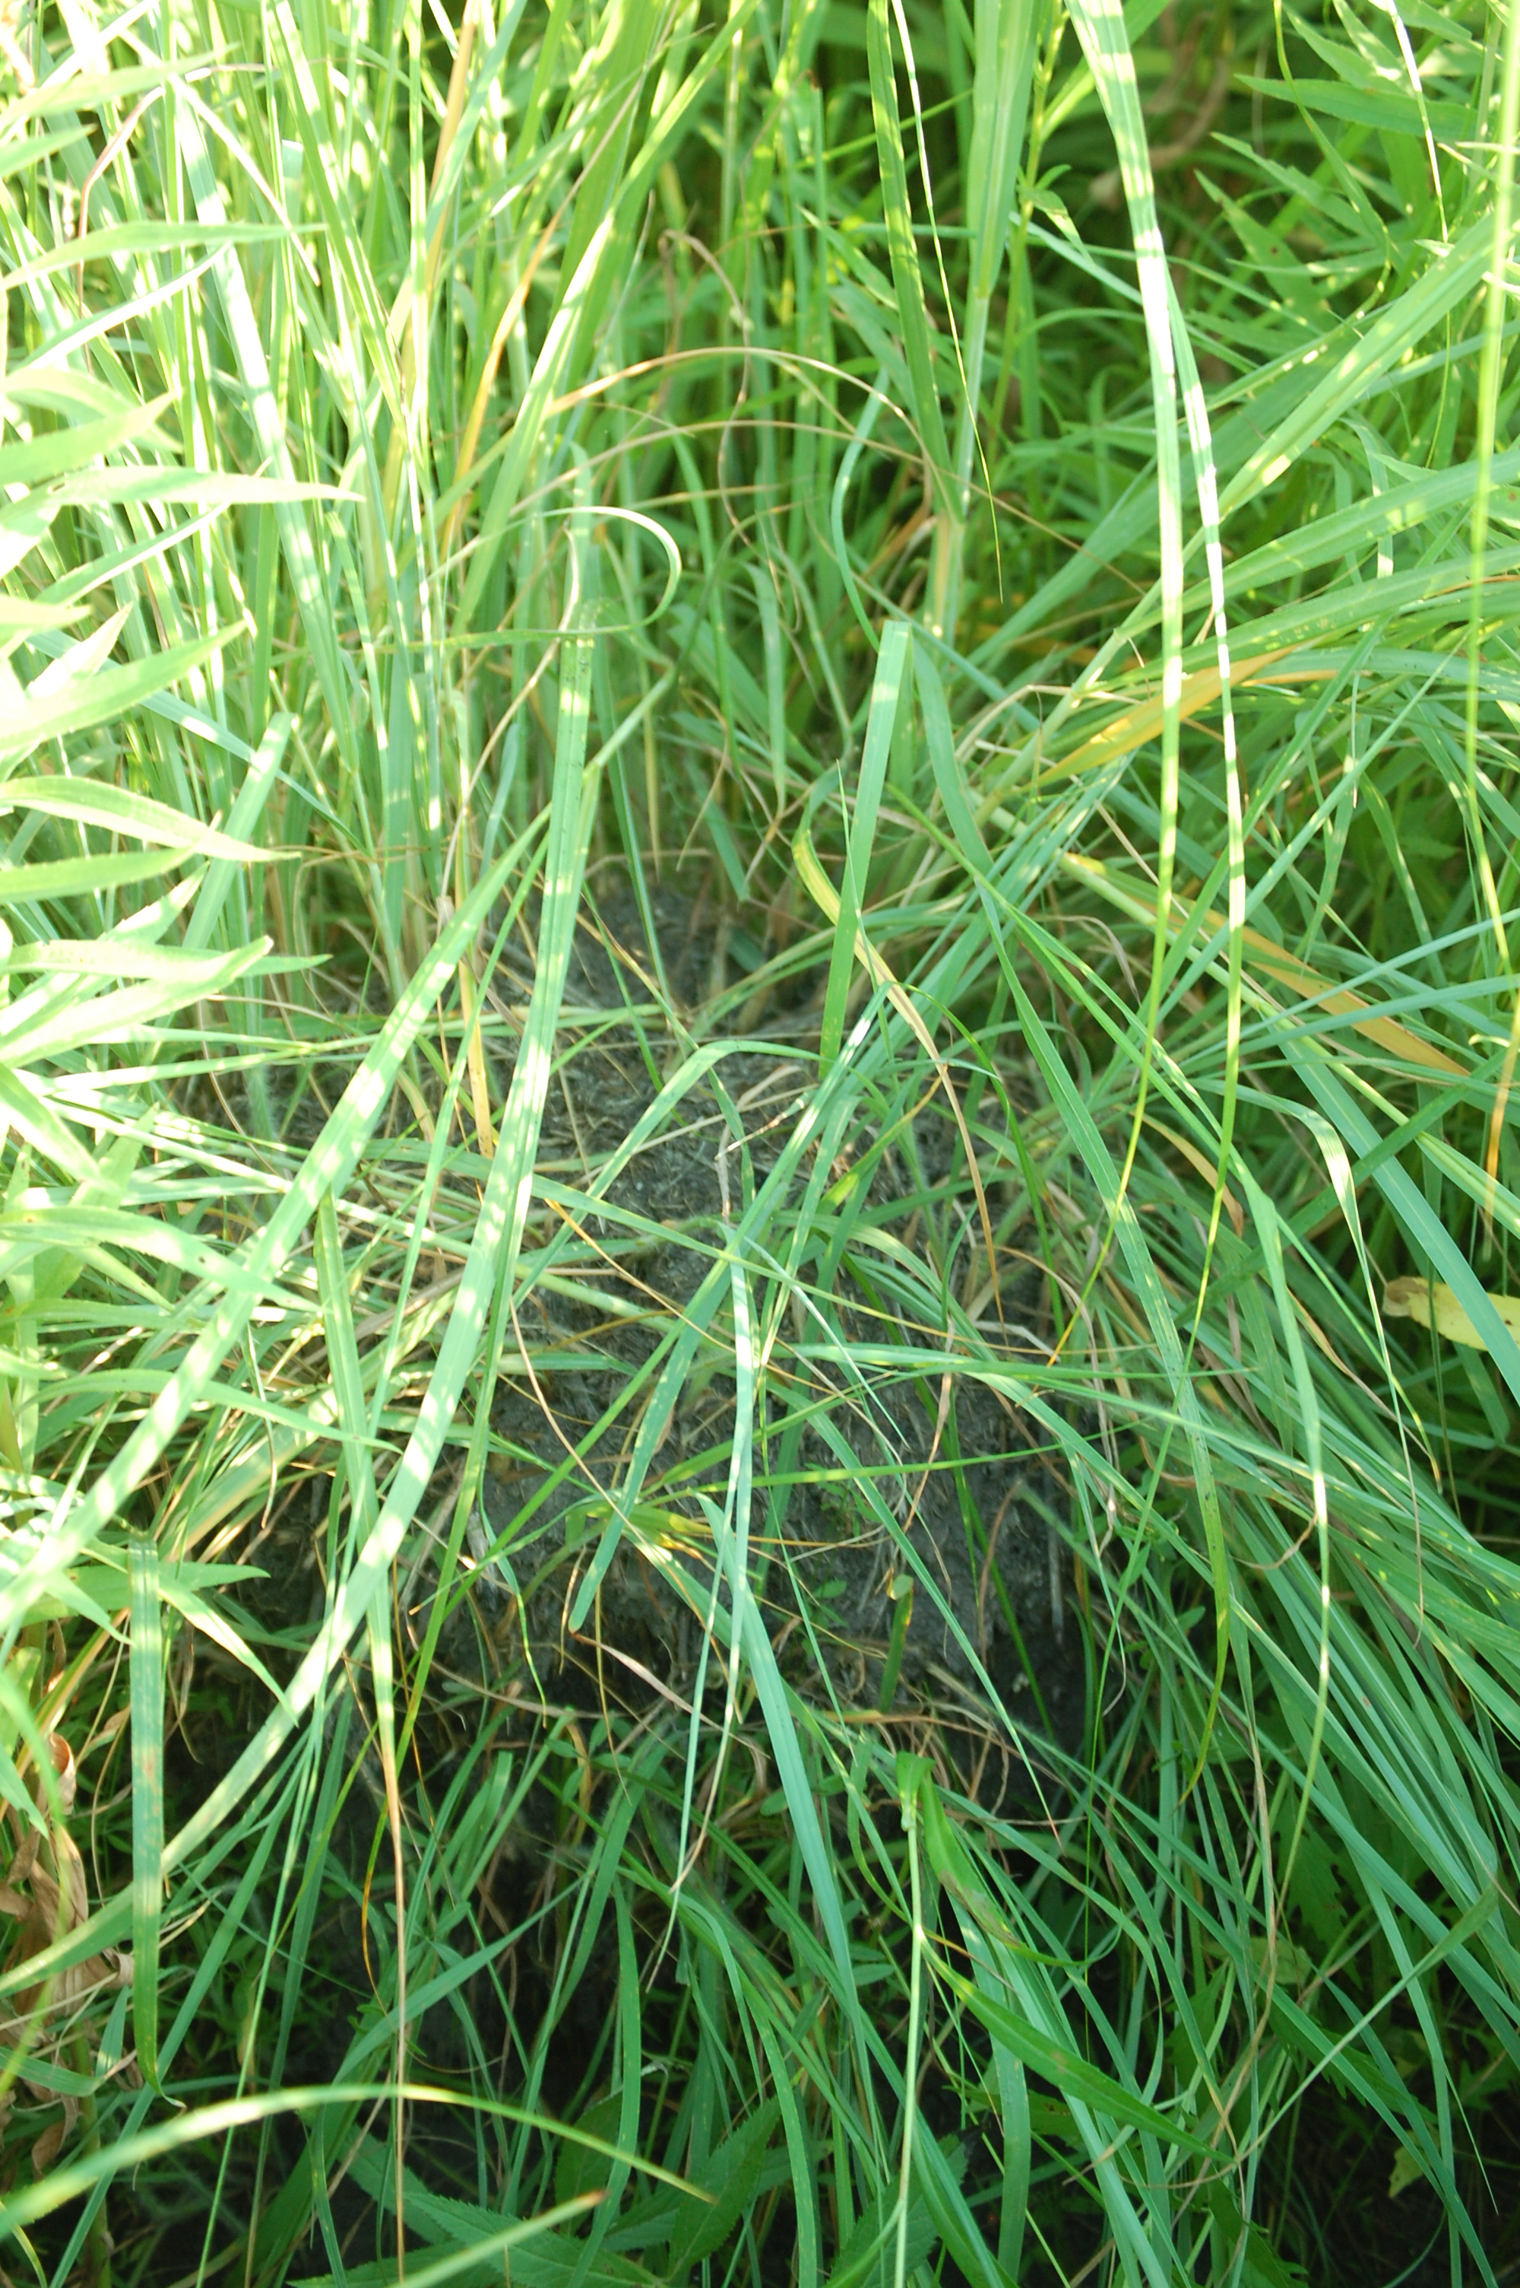
Tall Fescue in the US
In 1940s, farmers began planting Kentucky-31, a new drought-resistant and hardy tall fescue cultivar
About 14 million ha of tall fescue planted in US as of 1970s
Most infected with endophytic fungus
Endophyte discovered in 1973 in Georgia
Advantages Herbage growth 50% greater in endophyte infected fescue
Under stress, 75% of endophyte-free fescue died, 100% of endophyte-infected fescue survived

Slide 4
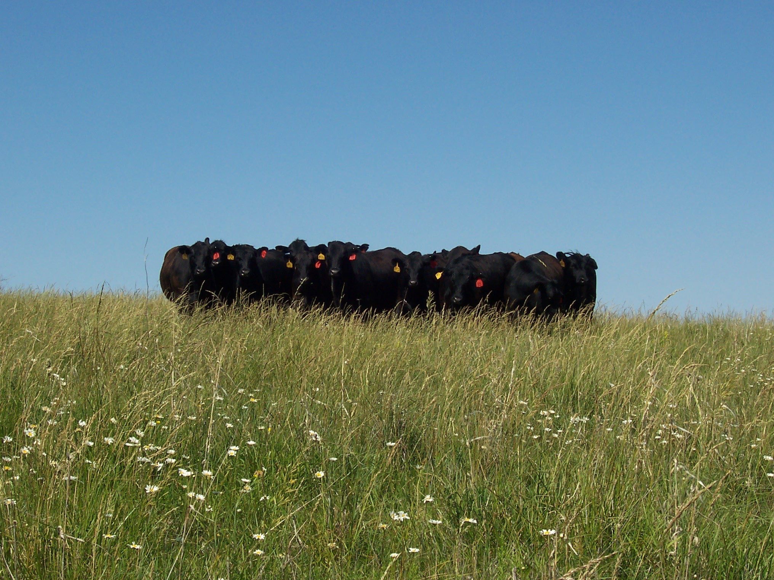
Fescue toxicosis
Fescue foot
Agalactia
Lowered reproduction
Fat necrosis

Slide 5
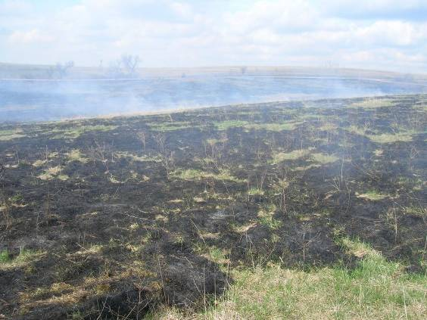
Incomplete and patchy burns

Slide 6
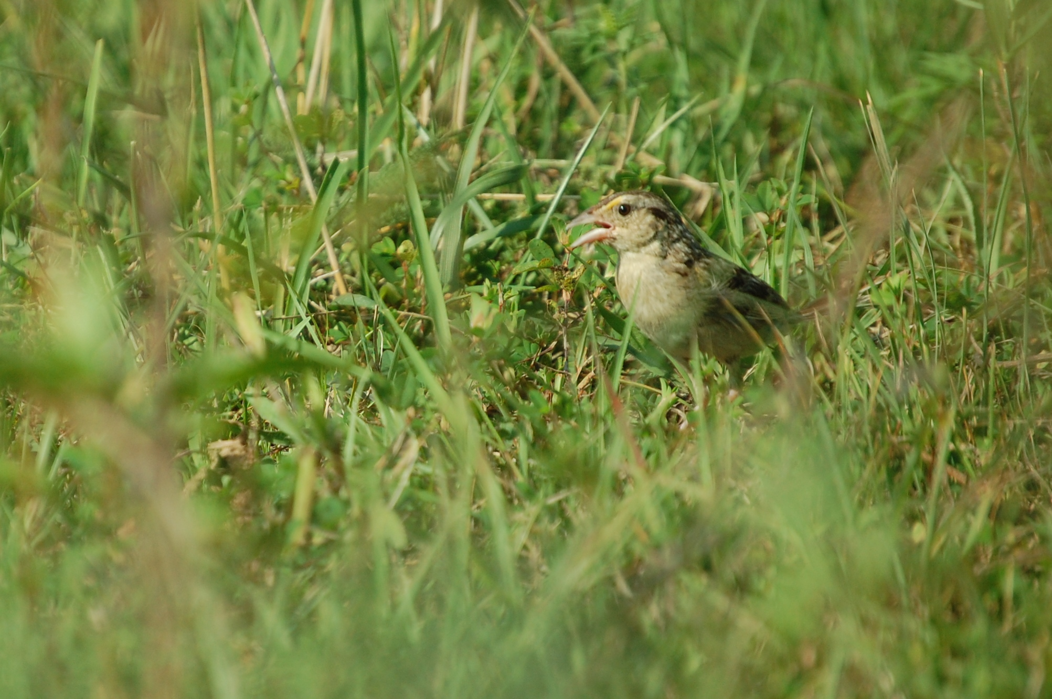
Poor bird habitat?

Slide 7
Invasive grasses exist in a social-ecological system
Social
Ecological
Cattle producers
Invertebrates
Recreationists
Tall fescue
Prairie plants
Researchers
Wildlife
Managers
Soil
Notes:
-30% of Midwestern grassland has been lost in the last decade
-Even some common species are declining, some by 50% recently
-Habitat quality of remaining grasslands mayb e degraded by invasive exotic grasses
-There is some emerging thought that fescue should not be planted for cattle either, although there is some resistance

Slide 8
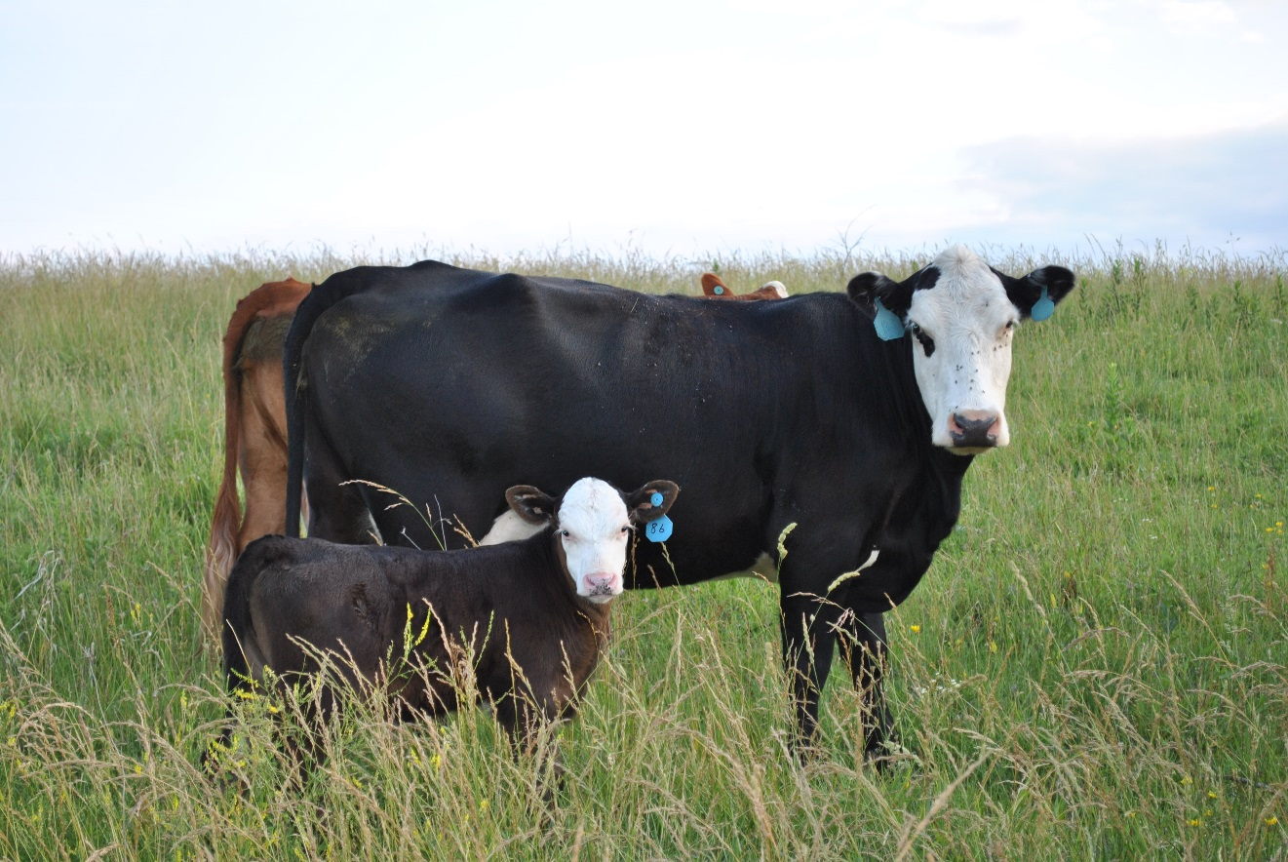
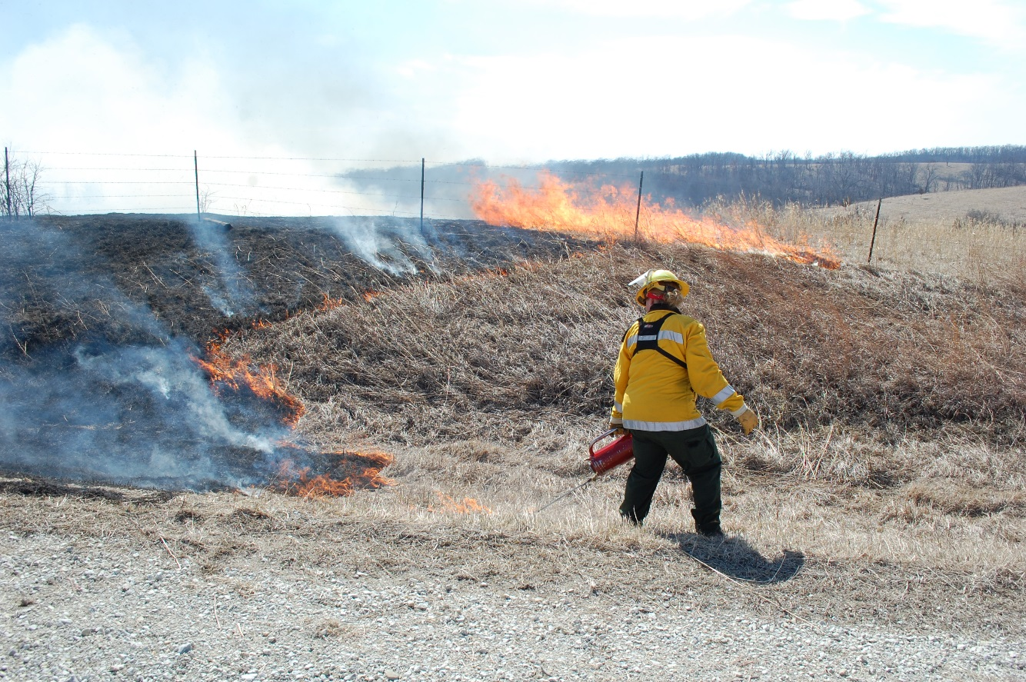
Study Region: Grand River Grasslands
Encompasses 5,000 ha on Iowa-Missouri border
58% of the area is composed of grasslands
Identified by The Nature Conservancy as the best known prospect for restoring a functional tallgrass prairie in the Midwest
The area has been a target of ecological and social research since 2006
Most remaining grasslands in the region exist on private lands

Slide 9
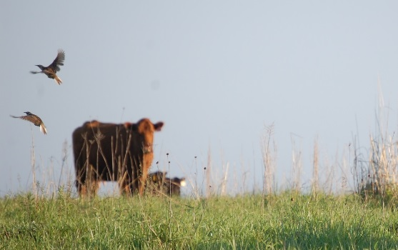
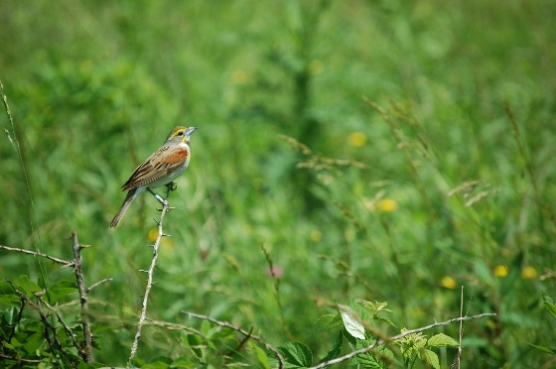
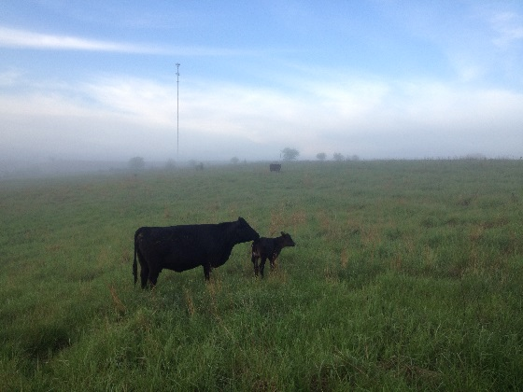
Project Goals
AGRICULTURAL: Determine if cattle avoid foraging in tall fescue patches
ECOLOGICAL: Evaluate the impact of tall fescue on arthropod and bird assemblages
SOCIOLOGICAL: Elucidate barriers to tall fescue removal on private lands

Slide 10
AGRICULTURAL

Slide 11
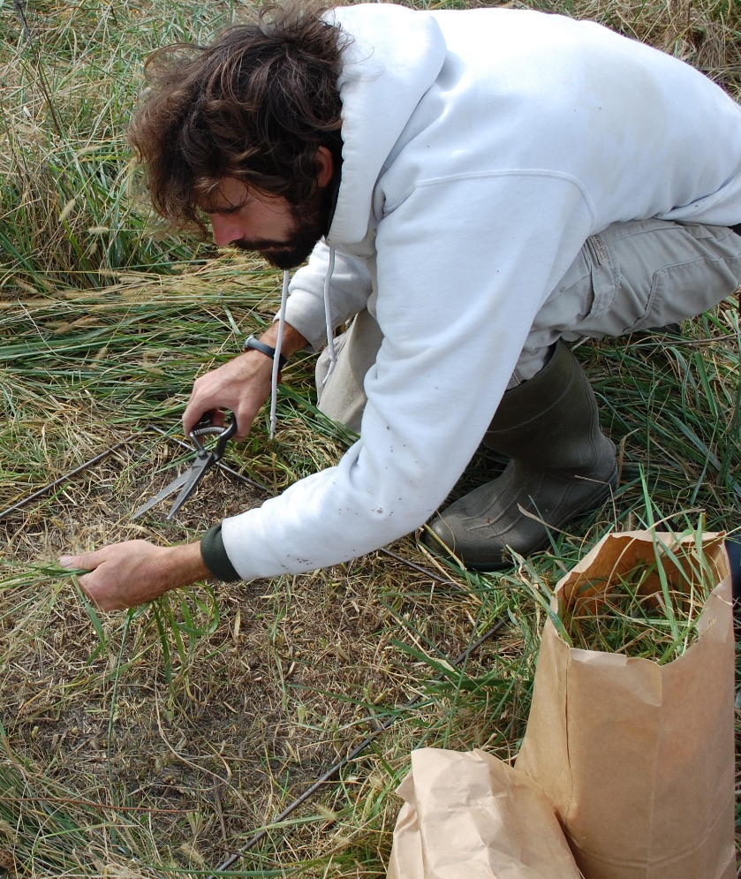
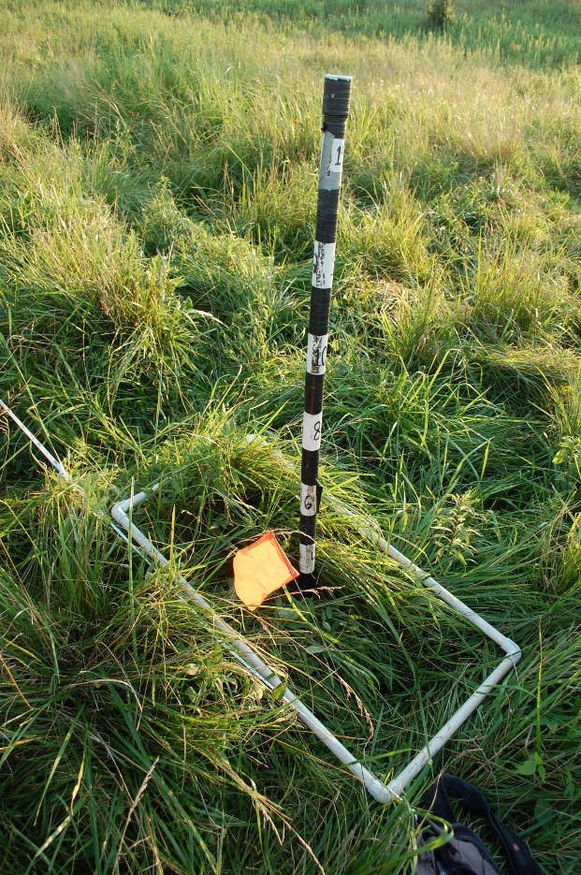
AGRICULTURAL
Improved understanding of relationships between tall fescue and cattle foraging
Fieldwork completed during Summer 2016 as planned
Four pastures sampled
Collected intensive grazing preference data at 45 quadrats in June and 30 quadrats in July/August

Slide 12
2. ECOLOGICAL

Slide 13
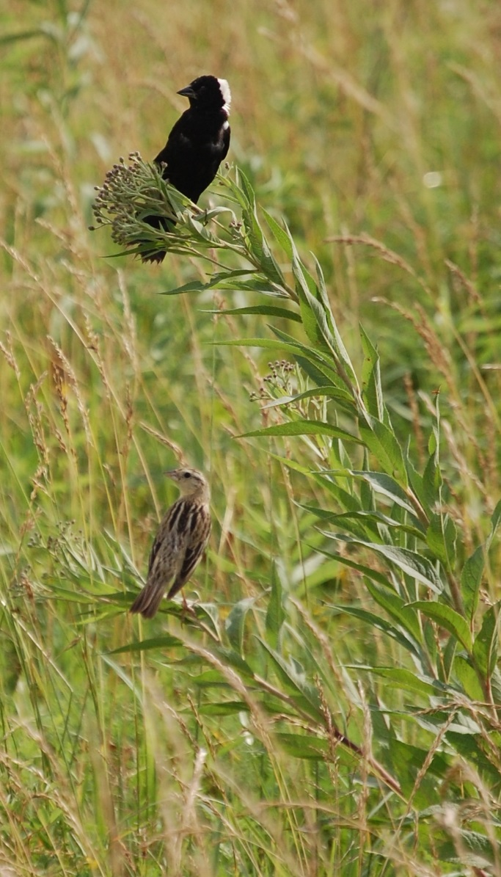
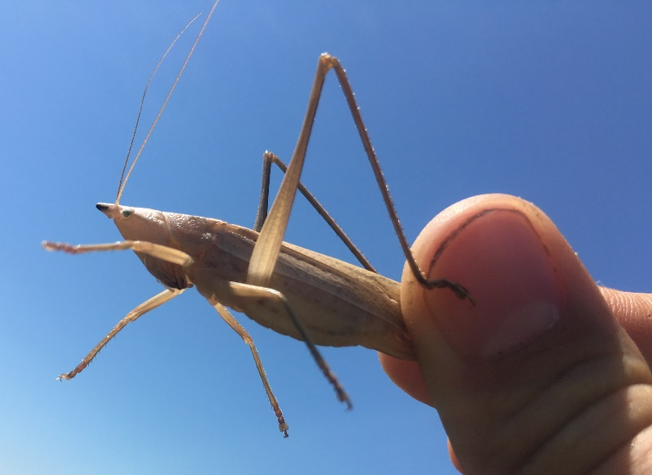
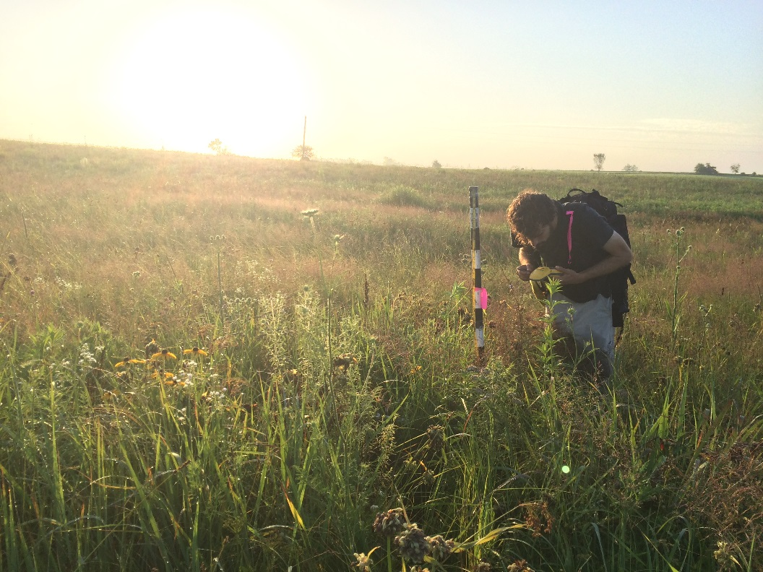
ECOLOGICAL
Improved understanding of the impact of tall fescue abundance on birds and arthropods
Fieldwork completed during Summer 2016 as planned, will continue in Summer 2017
19 pastures were sampled
Birds (5x)
Arthropods (2x)
Vegetation (1x)

Slide 14
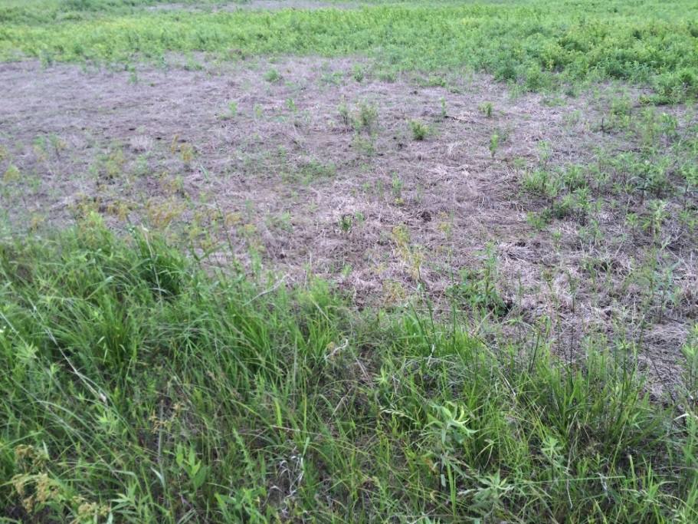
ECOLOGICAL
Spray + Seed
Control
Spray Only
Improved understanding of the impact of tall fescue removal on birds and arthropods
Fieldwork completed during Summer 2016 as planned, will continue in Summer 2017
10 pastures were sampled (birds, vegetation, and arthropods):
Six experimental pastures
Four adaptive-management pastures
Spray Only
Control
Notes:
BSH, LTR, GIL, STE, RC2, PYW, RCH, 235, FRS, FRN

Slide 15
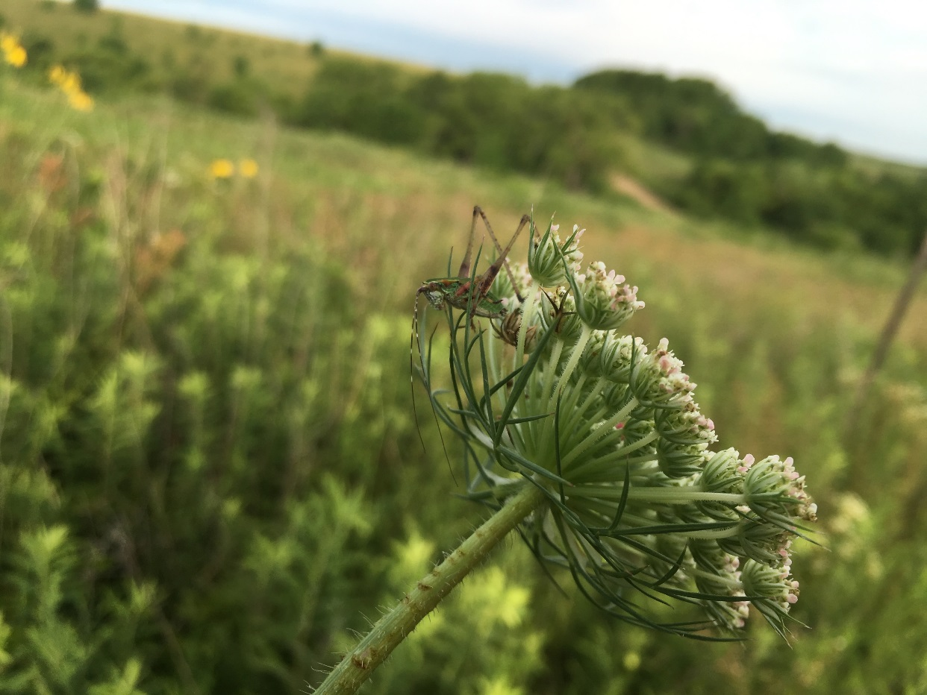
ECOLOGICAL
Next steps
Sort and identify arthropods
Relate avian and vegetation data to arthropod data
Obtain another year of data (Summer 2017)
Notes:
BSH, LTR, GIL, STE, RC2, PYW, RCH, 235, FRS, FRN

Slide 16
Preliminary Results (2015) —Effects of herbicide?
*
*
* α=0.1

Slide 17
3. SOCIOLOGICAL

Slide 18
Invasive grasses exist in a social-ecological system
External factors
Race, gender, class
Institutions
Physical contexts
Community involvement is a predictor of success for invasive management
However, invasive management is often divisive
This is because predicting human behavior is complicated
Intrinsic processes
External factors
Internal processes
Values
Beliefs
Personal norms

Slide 19
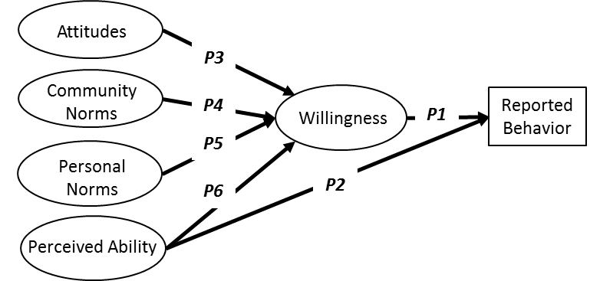
Study Design
Using Theory of Planned Behavior to explore invasive management decision-making
Very little research exists on rural landowner perceptions of invasive management

Slide 20
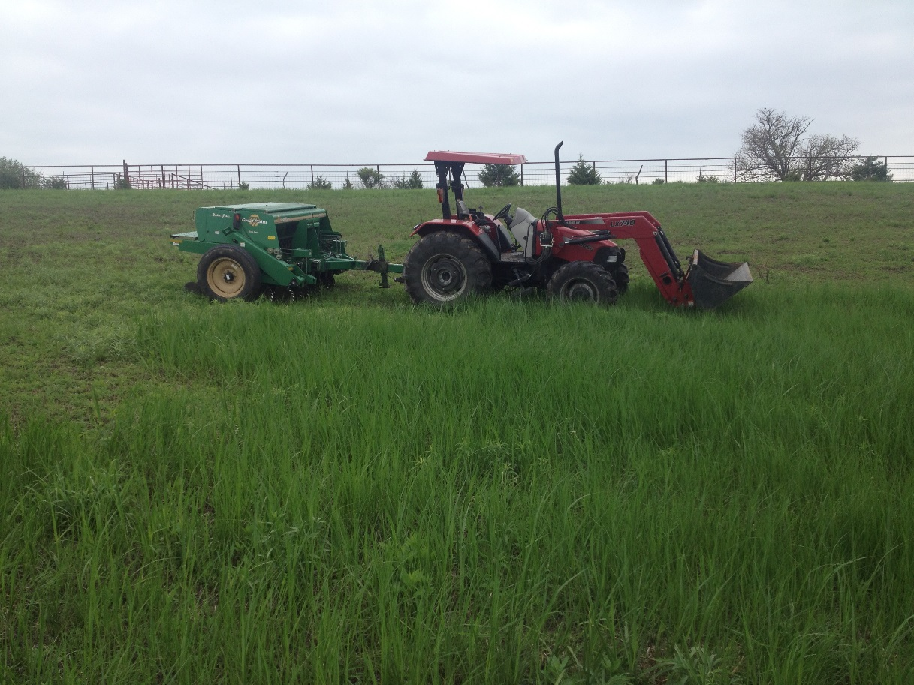
SOCIOLOGICAL
Understanding of potential barriers to invasive species removal
May 2016 survey writing work session with collaborators
Survey is fully drafted
IRB approval complete
Next steps
Pilot testing (late September)
Final IRB-approval (mid-November)
Surveys sent out (February 2017)

Slide 21
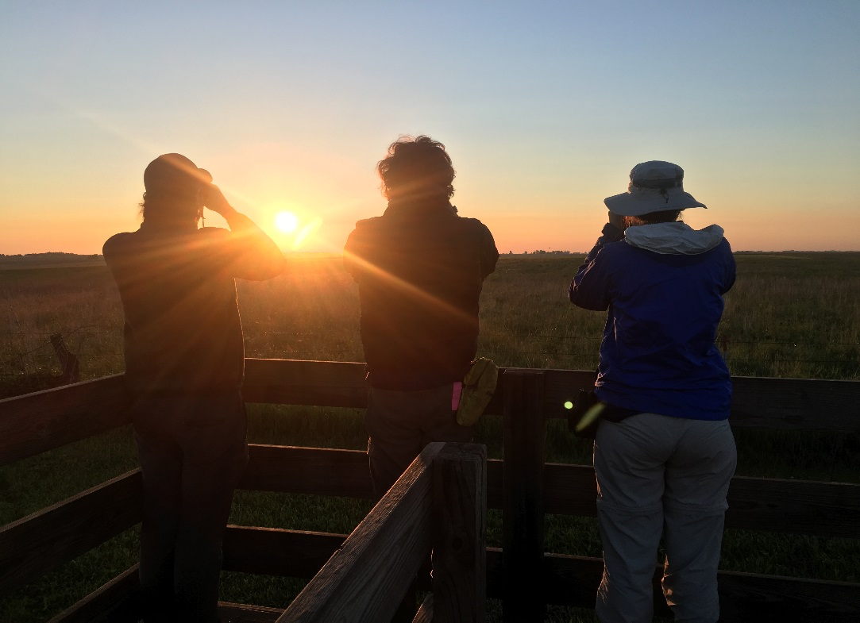
OUTREACH
Established a credit-based internship program
Recruited at internship fair at Graceland University
Two local interns worked 10+ hrs/wk
Established an “internship for a day” program
Targets high school students
One local student “worked” three days with us in Summer 2016

Slide 22
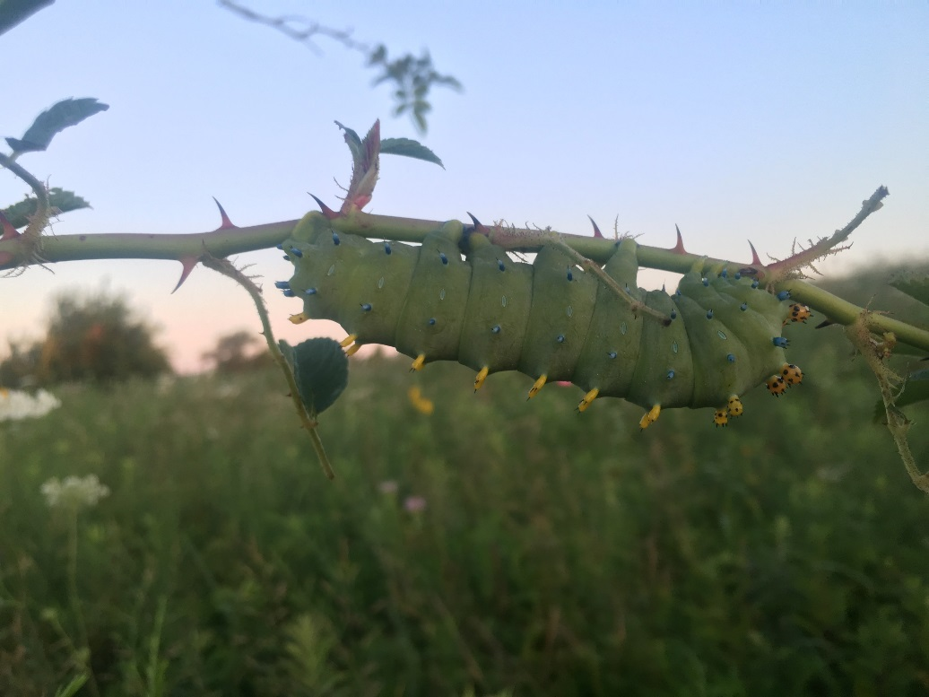
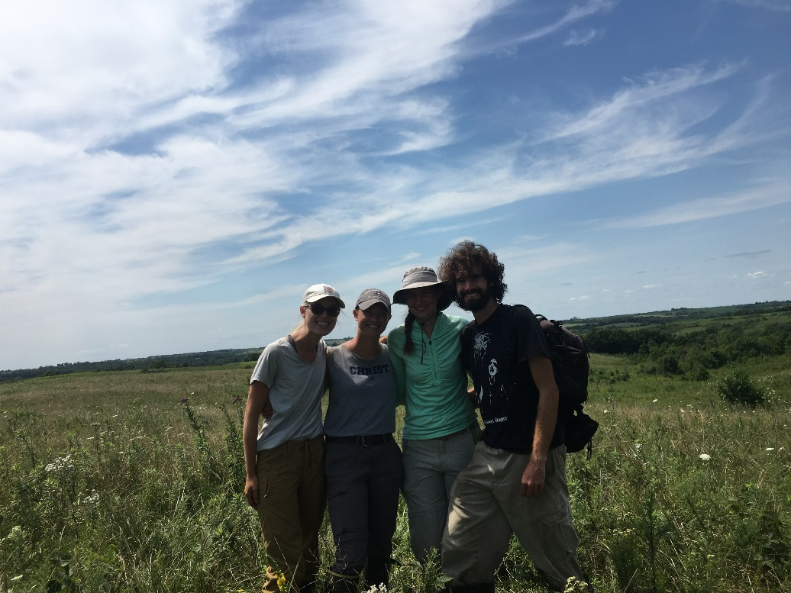
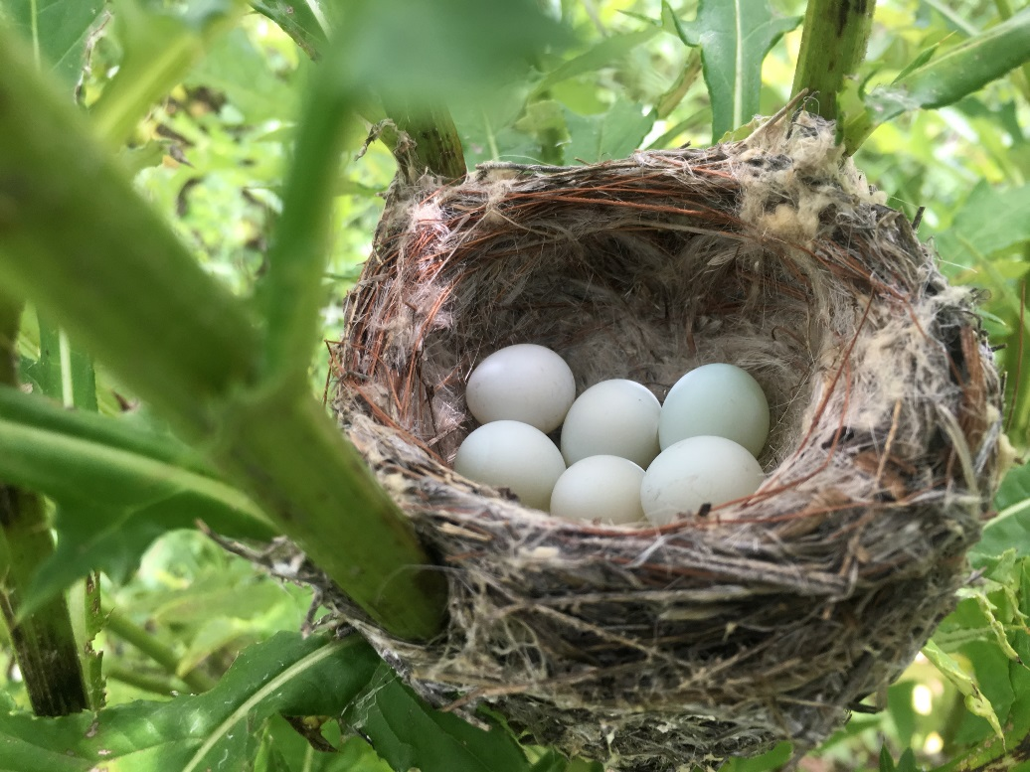
Any questions?

