Slide 1
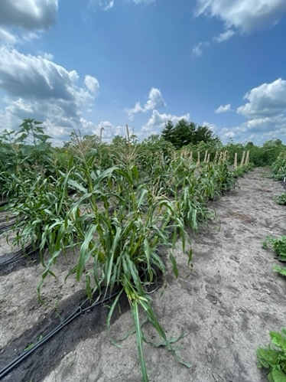
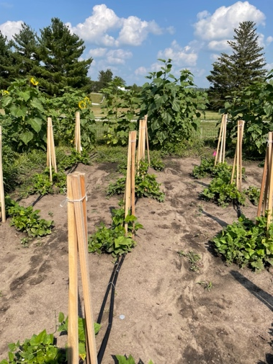
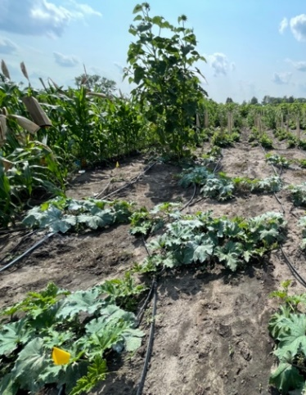
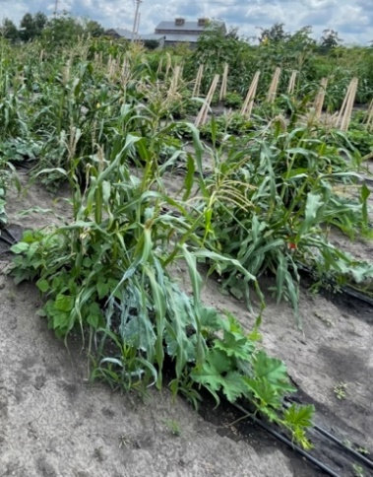
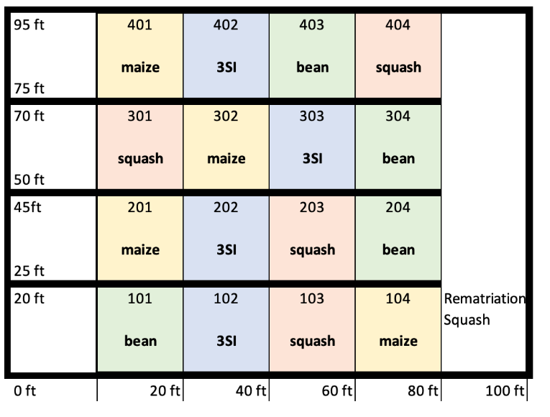
Extension and Outreach
Reuniting the Three Sister Native American Intercropping and Soil Health
The purpose of this project is to create a common, unifying experiment, replicated at multiple Midwestern U.S. locations, testing the effects of planting the Three Sisters (maize, beans and squash) together versus individually on soil and plant health. This project engages Native citizen scientists and bring communities together in a network of experiments for a greater understanding of how the Three Sisters affects soil and plant health. The Three Sister Project at ISU has two components, working with Native gardeners to grow Three or Four Sisters plots in their own communities and growing a plot at ISU. Our plot contains Four Sisters, corn, beans, squash, and sunflowers. We worked with our advisory board to determine what the plots would look like, how the sisters would be cared for, and where the seeds would come from. As a group, we selected seeds from the USDA and Seed Savers Exchange that needed to be rematriated and donate the seeds produced back to Native communities that could welcome them home. We also donate our produce to our collaborators and people in local communities.
Collaborators and Advisory Board
Nebraska Indian Community College (Omaha, Santee Sioux, Sioux City urban communities), Dream of Wild Health (Minneapolis/St. Paul Native communities, Natives people throughout Minnesota), Oneida nation of Wisconsin and the Menominee nation of Wisconsin.
Department Name
A)
B)
C)
D)
Acknowledgements
E)
Each plot is comprised of 16 mounds of the determined treatment.
A) A maize monocrop plot. B) A bean monocrop plot. C) A squash monocrop plot. D) Three Sisters plot. E) 2022 randomized replicated blocked experiment layout.
Data Collected: yield, soil temperature and moisture, SPAD, flowering dates, smut biomass, soil microbial biomass carbon and nitrogen, and soil available nutrients.
Acknowledgements: We wish to acknowledge our presence as a guest on Indigenous land. For generations, Ioway, Meskwaki, Sauk, Dakota, and Oto peoples, among others, have stewarded the lands where our project lives. Thank you to our funding sources, SARE and NIFA.

Slide 2
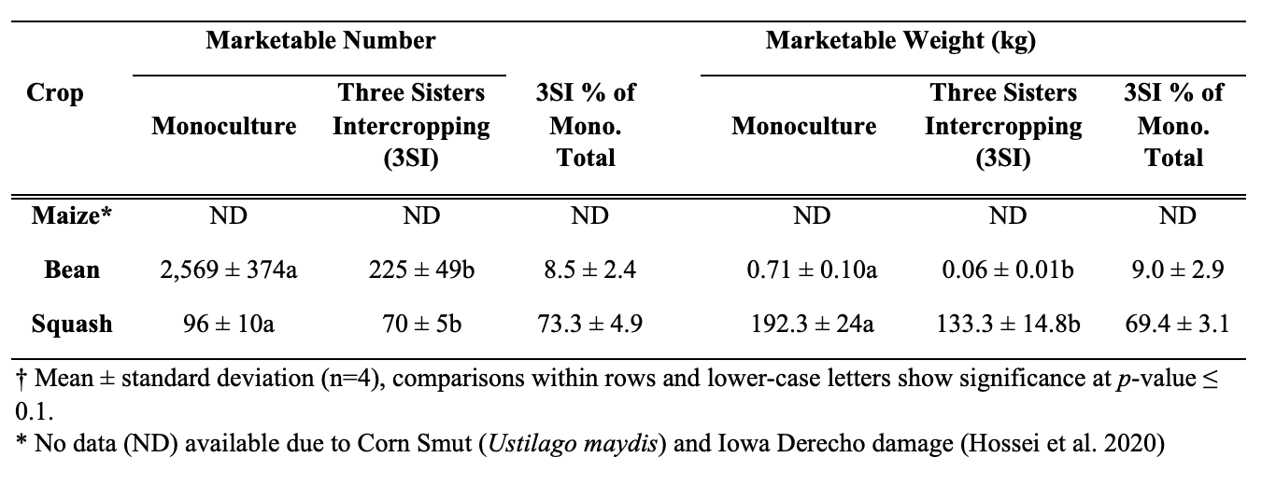
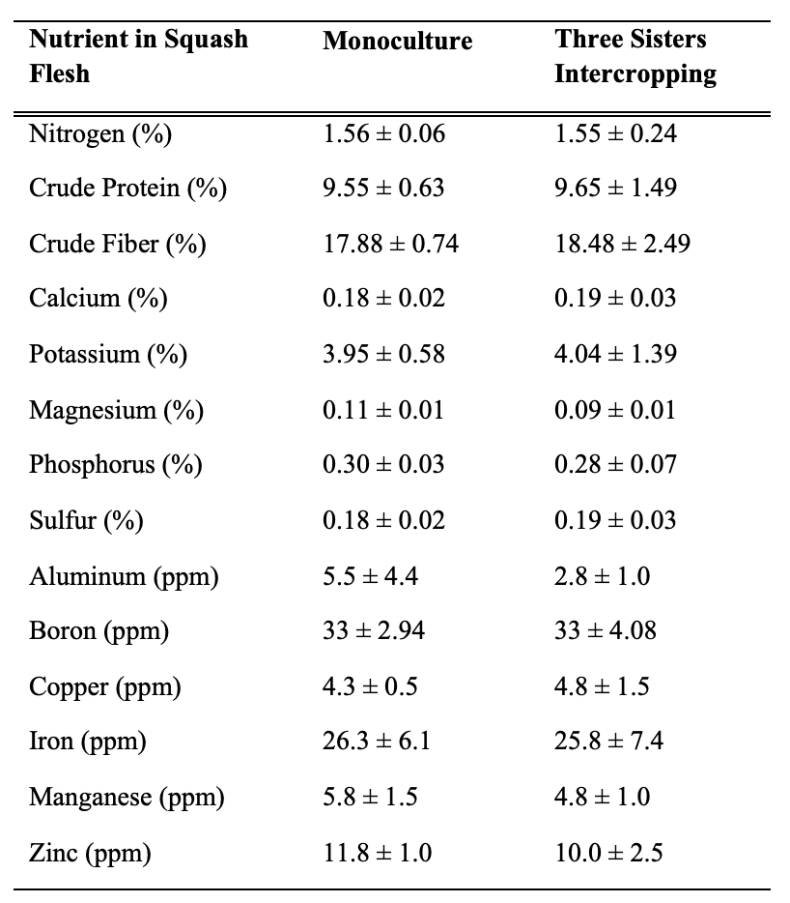
Extension and Outreach
Data & Results
Table 1. Crop yield as marketable number and weights†.
Table 2. Mean ± standard deviation of nutrient concentrations in flesh of pumpkin squash (Algonquin Long Pie Pumpkin)
Figure 1. Soil properties measured on 15 August 2020 at the Iowa State University Three Sisters intercropping Research Experiment (ISU-3SI). a) Soil extractable nitrate, e) 24 h soil respiration with air-dried, rewet soils, i) microbial biomass C-to-N ratio, Replicates for each treatment shown with open circles (n=4), and significant differences between Monoculture vs. Three Sisters intercropping (M+B+S) indicated by asterisks (* < 0.1, ** <0.01, *** <0.001). These figures were taken from (Kapayou & Herrighty et al., Np)
D.G. Kapayou†, E.M. Herrighty† , C. Gish Hill, V. Cano Camacho, A. Nair, D.M. Winham, M.D. McDaniel. Forthcoming. “Reuniting the Three Sisters: Collaborative science with Native growers to improve soil and community health.” Agriculture and Human Values.

Slide 3
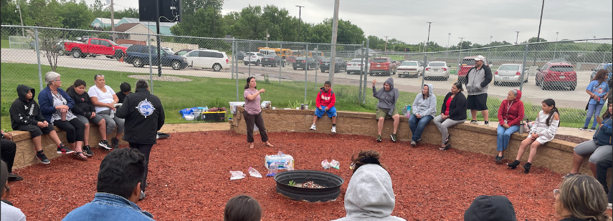
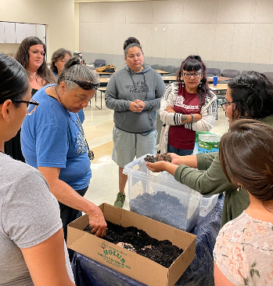
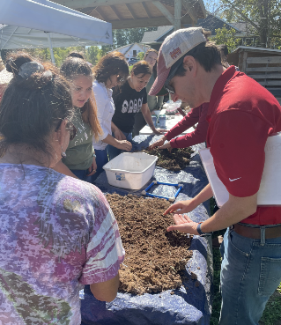
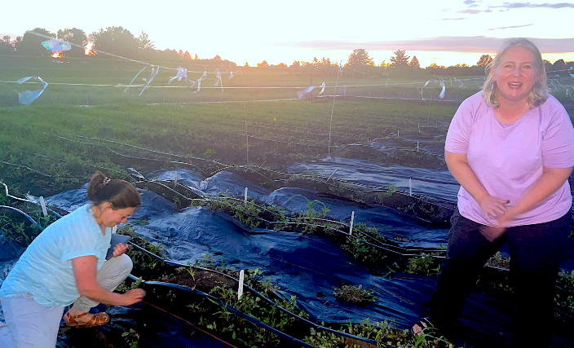
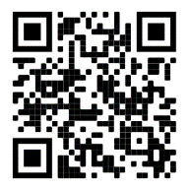
Extension and Outreach
Project at a Glance
Total Number of Workshop........................ 10
Pre-K-12 Workshops………………………3
Average attendees per workshop…….……25
Cooking demonstrations……………….…10
Ethnographic interviews………………......29
Number of collaborative grower………….7
Master Thesis & Publications……...……...5
Workshop Topics Covered
Soil fertility and health in home gardens
How to set up drip irrigation
Seed saving for home gardeners
DIY soil health test
Key insect pests of squash, beans, and corn
Composting basics & troubleshooting
Foods & culture (by Arly, Anthony & LaVonne)
Drone basics (by Steve Webster)
Field Day at Horticulture Research Station
Soils basics and home gardening
Introduction to permaculture*
Orchard care and start Up*
*upcoming in 2022
Scan for more information on our website!
Contact: Dr. Christina Gish Hill
Phone: 515-294-0101
Email: cghill@iastate.edu
Research Team: Dr. Christina Gish Hill, Dr. Ajay Nair, Dr. Marshall McDaniel, and Dr. Donna Winham Graduate Students and Staff: Susana Cabrera Mariz, Kristine Micheletti, and Valeria Cano Camacho Graduated 2022: Emma Herrighty and Derrick Kapayou

