Slide 1
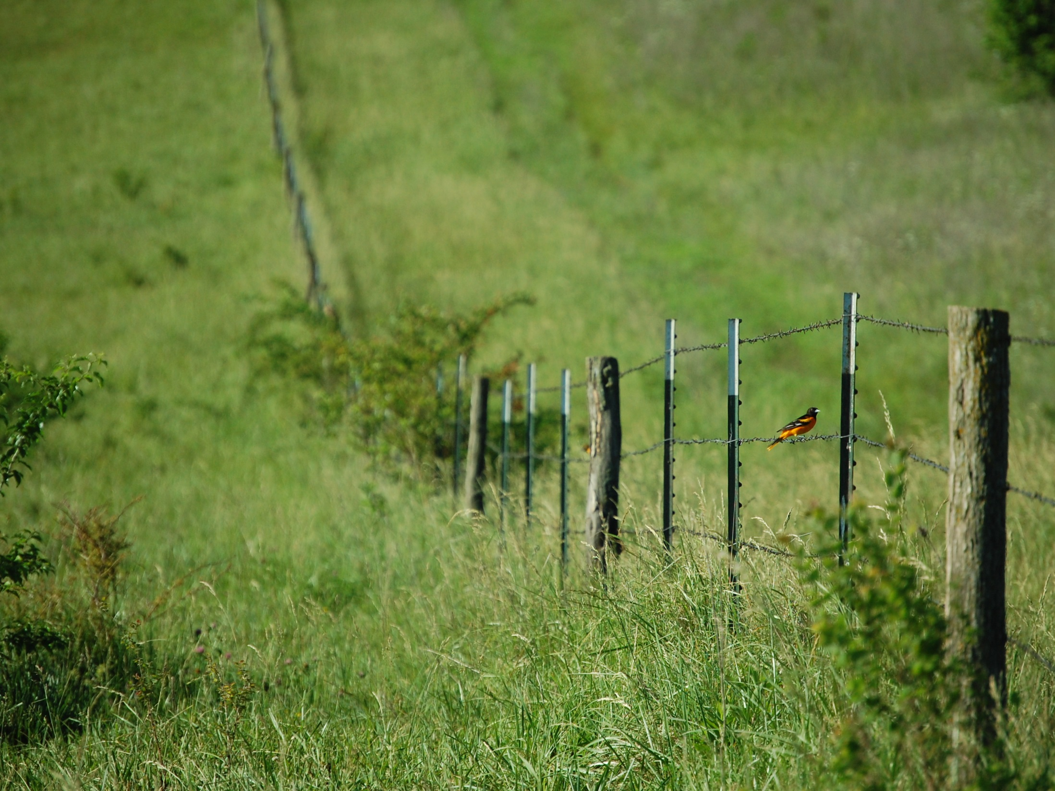
Tall Fescue:
An Invasive Grass Impacts Songbirds and Cattle in a Working Landscape
Scott B. Maresh Nelson, Jaime J. Coon, Courtney J. Duchardt,
James R. Miller, Walter H. Schacht, and Diane M. Debinski

Slide 2
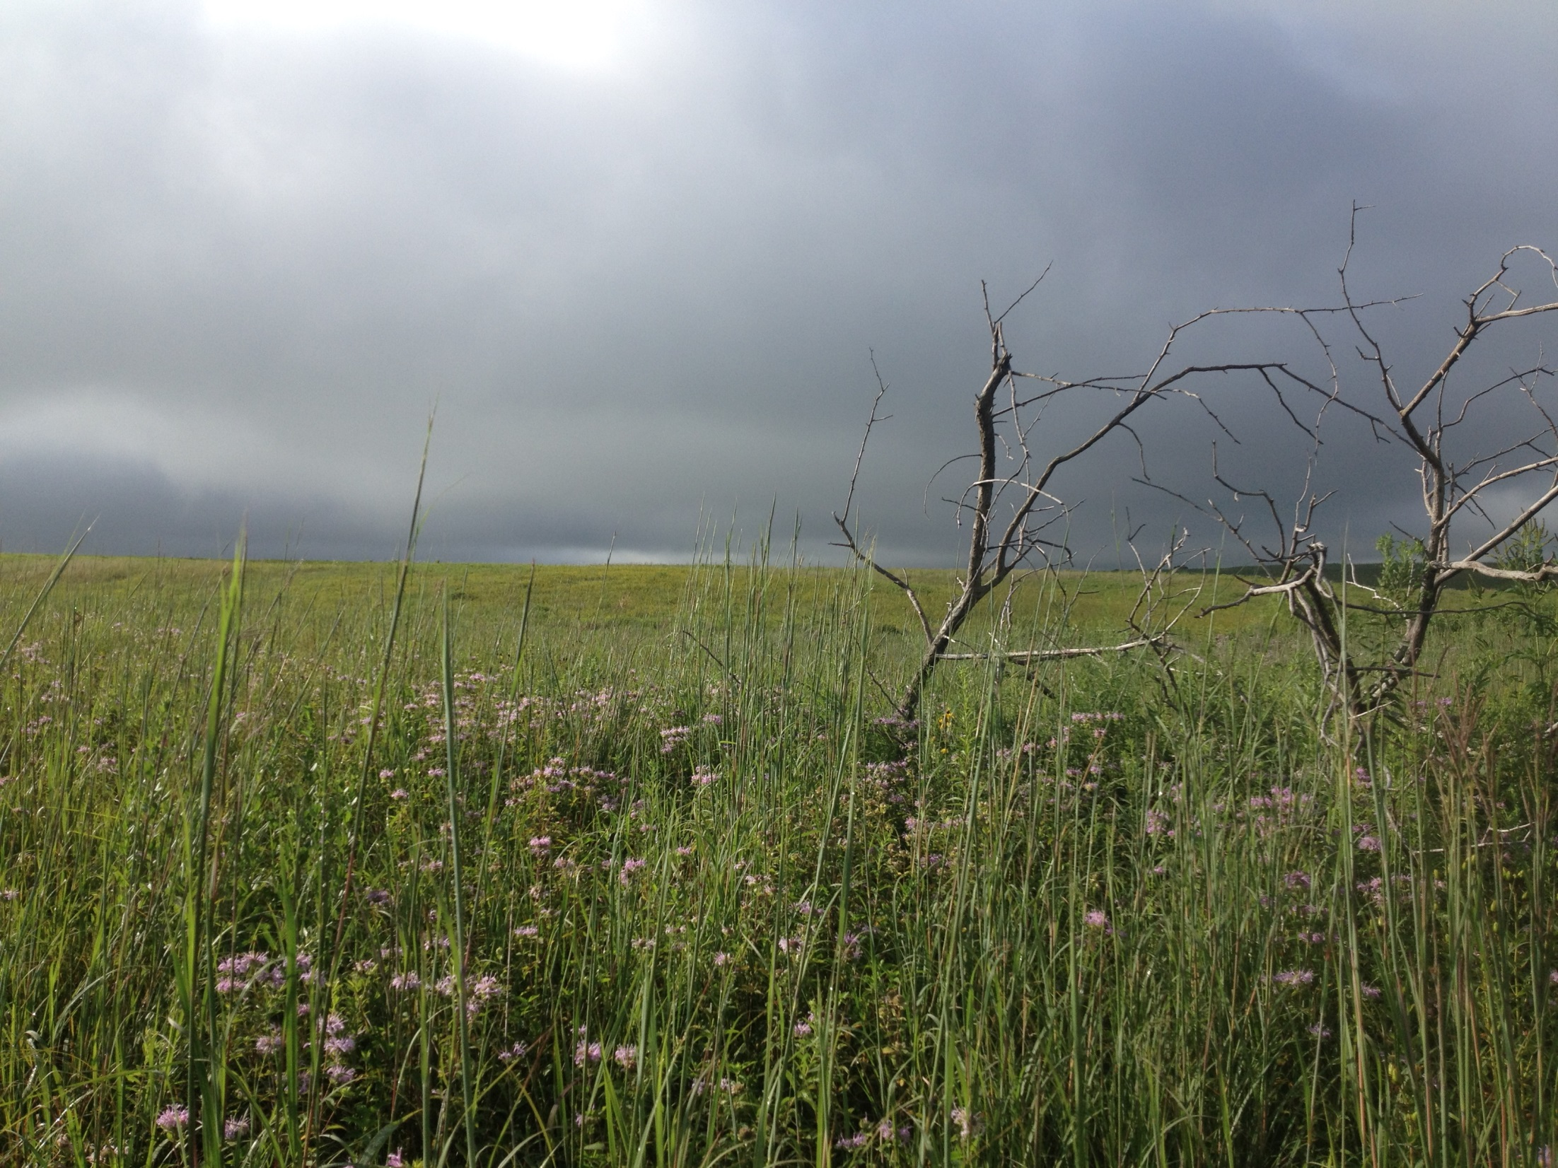
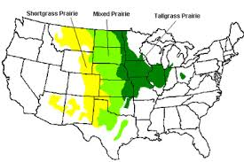
Tallgrass prairies are one of the most endangered ecosystems in the world
<0.1% Remain Unplowed
CHALLENGES
Crop conversion
Loss of historic disturbance patterns
Invasive species

Slide 3
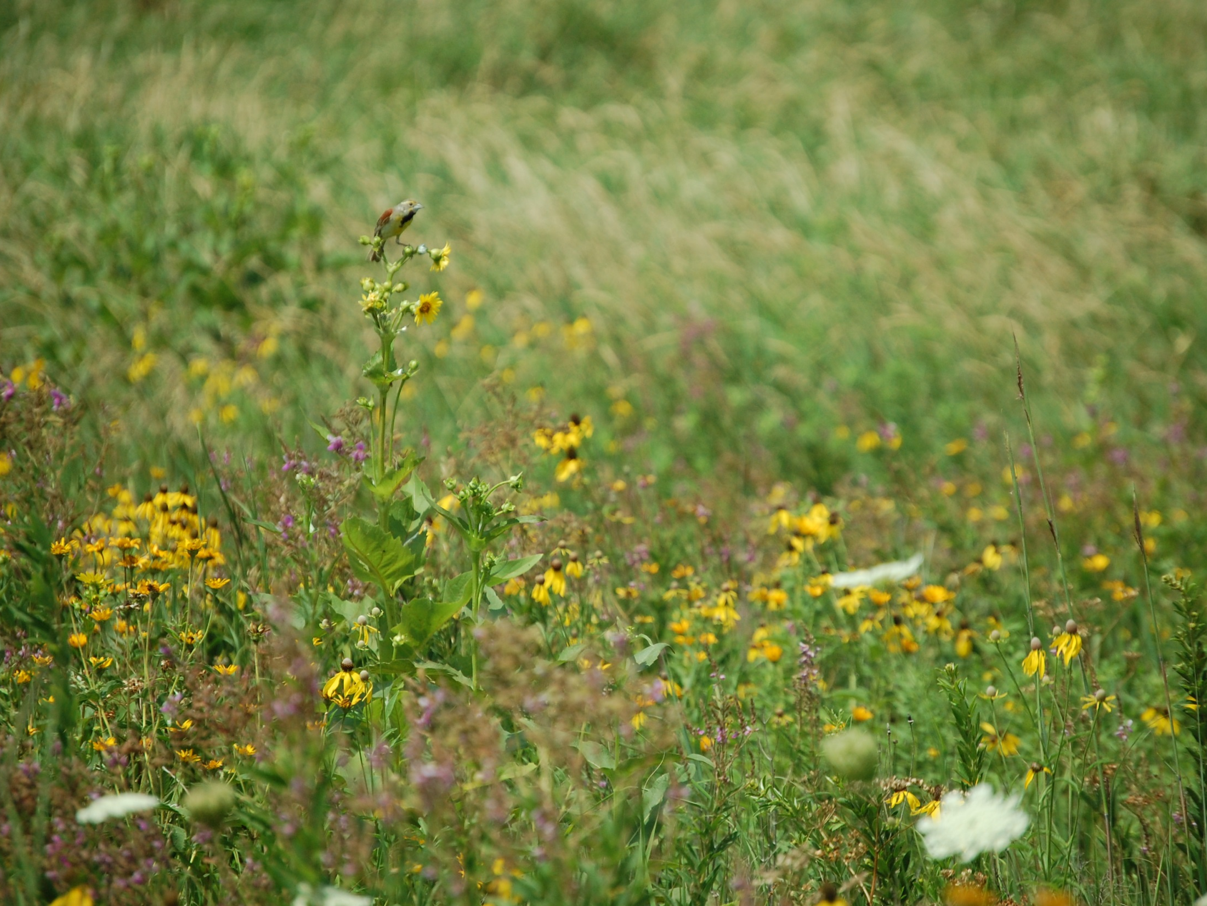
  Prairies historically resembled this…

Slide 4
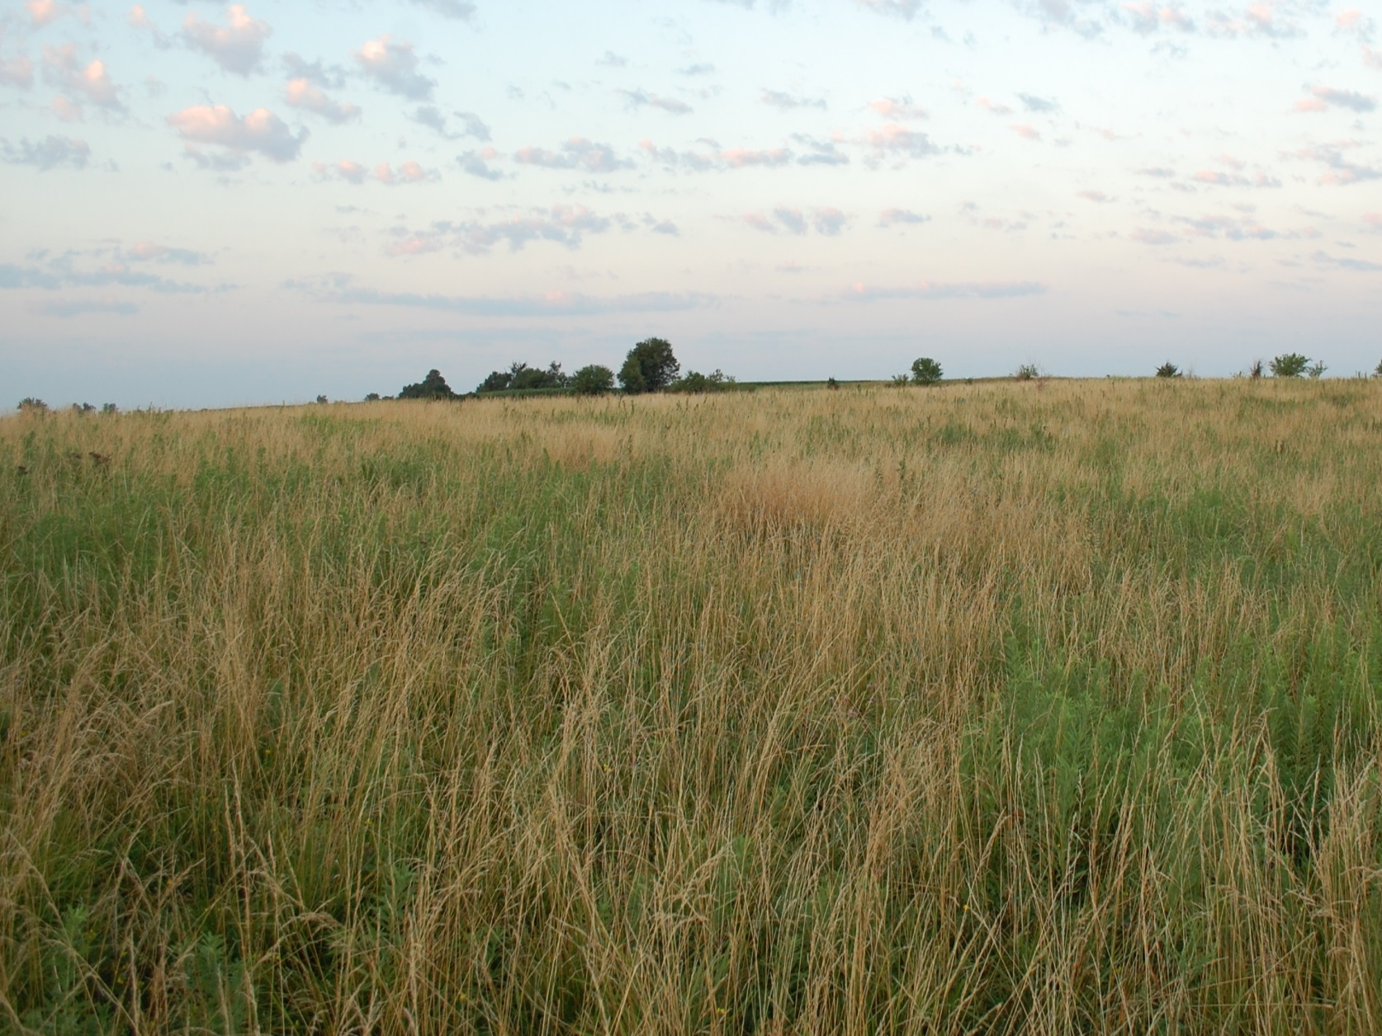
But now many look like this.

Slide 5
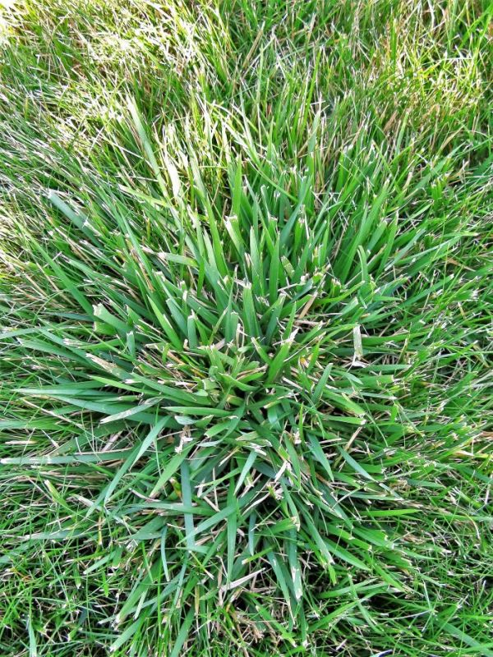
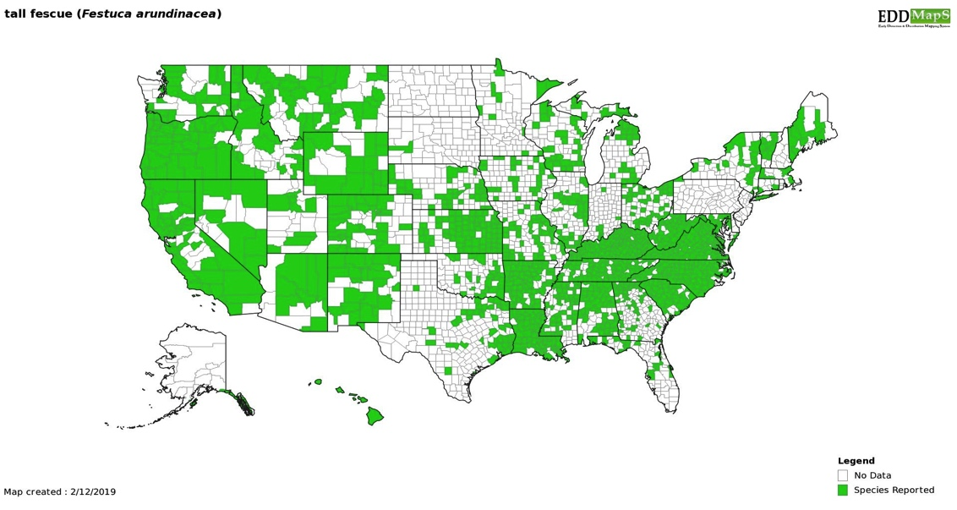
Tall Fescue
(Festuca arundinacea; syn. Schedonorus arundinaceus; syn. Schedonorus phoenix; syn. Lolium arundinaceum)
C3 (cool-season) grass from Eurasia
Popularized as cattle forage in 1940s
Now one of the most widespread grasses in the U.S.
Intentionally planted
Livestock forage
Erosion control
CRP (1990s)
Turfgrass
(invasiveplantatlas.org)

Slide 6
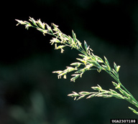
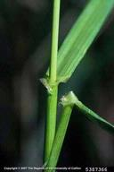
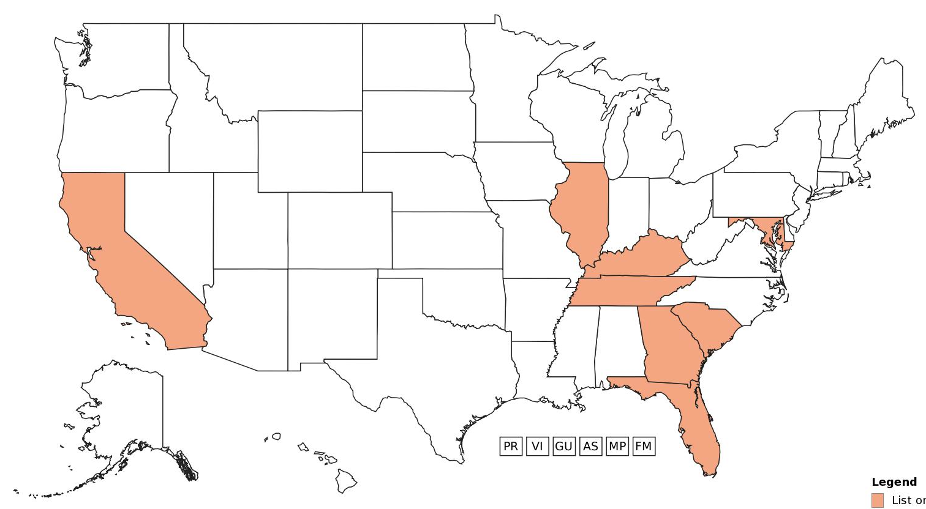
Listed as invasive in eight states
Rhizomatous spread
Invasion mechanisms unclear
Why is tall fescue a problem?
(invasiveplantatlas.org)

Slide 7
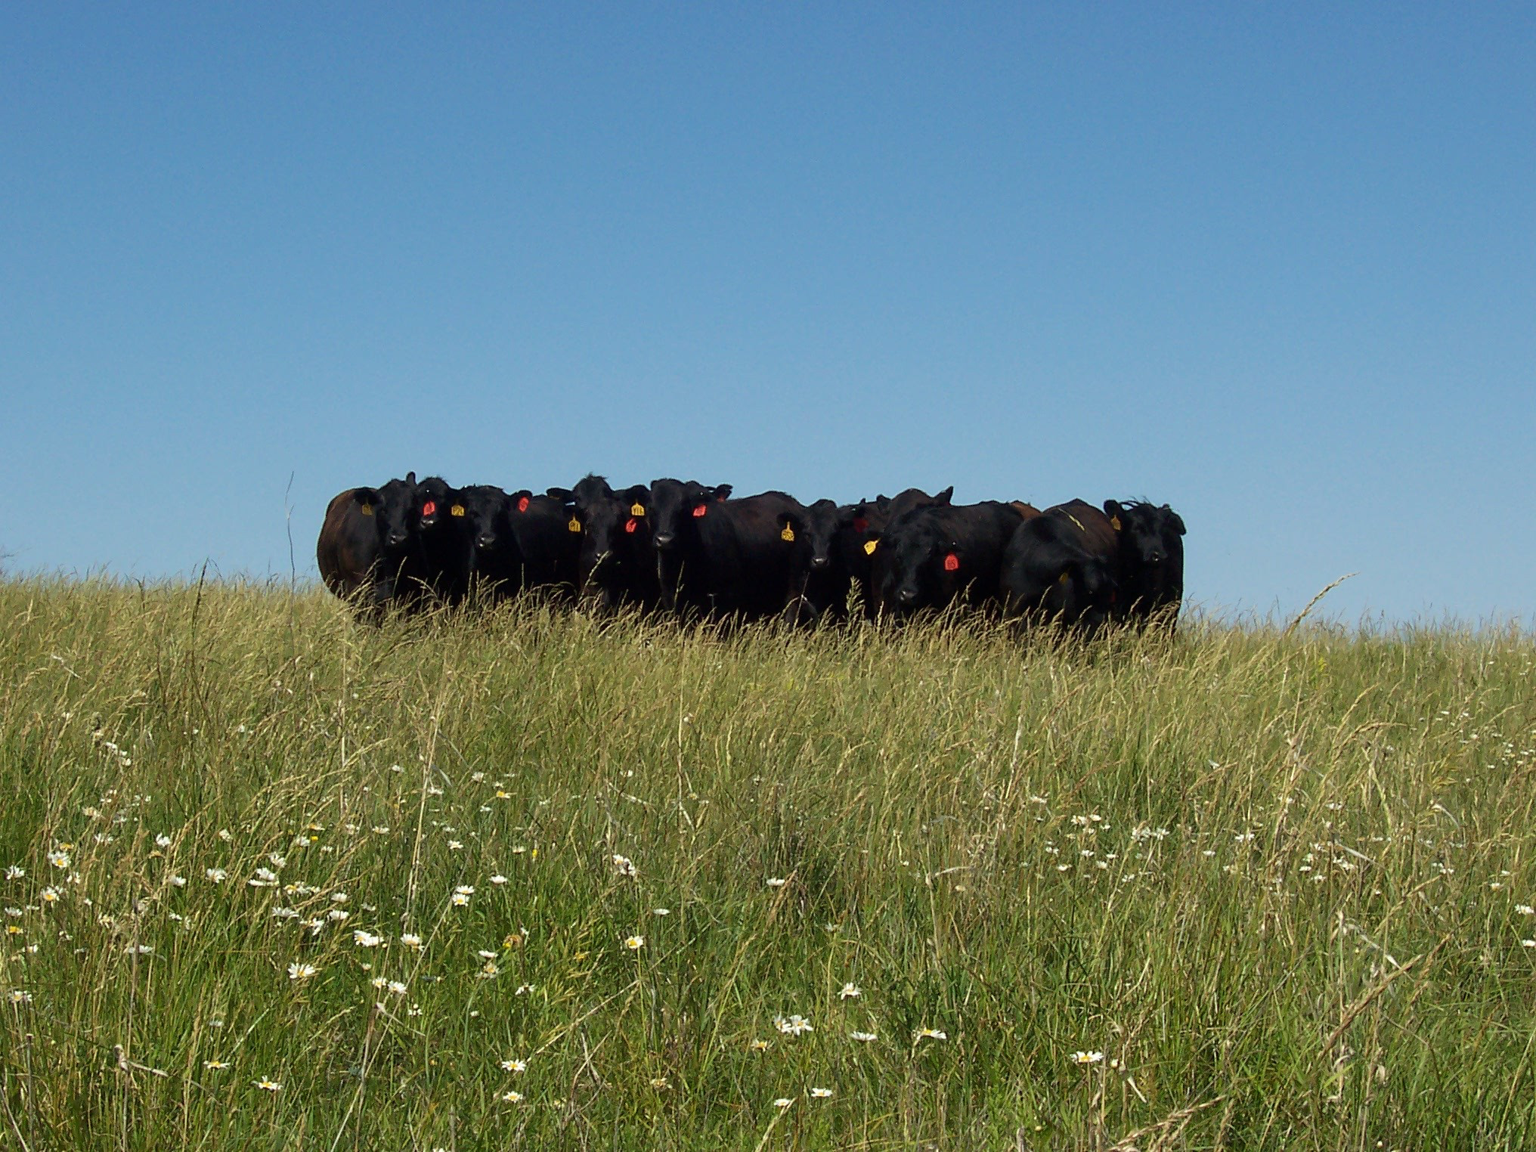
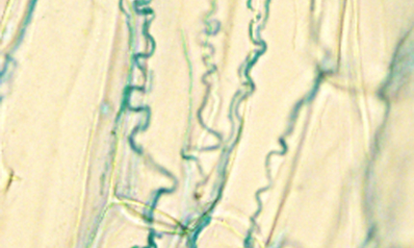
Fungal endophyte: Epichloe coenophiala
Drought-hardy forage, but…
Carolyn Young
Fescue toxicosis
Fescue foot
Agalactia
Lowered reproduction
Fat necrosis

Slide 8
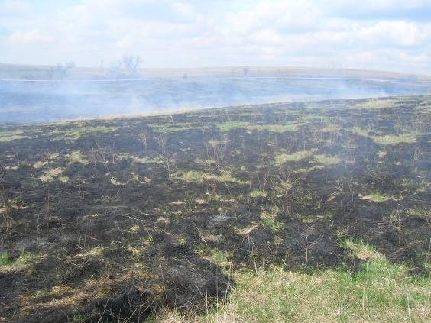
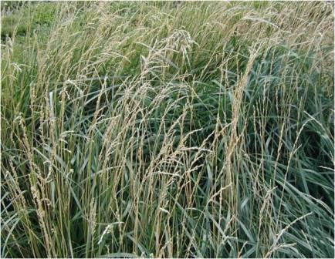
  Incomplete and patchy burns (McGranahan et al. 2012a)
  Reduced plant diversity
  (McGranahan et al. 2012b)

Slide 9
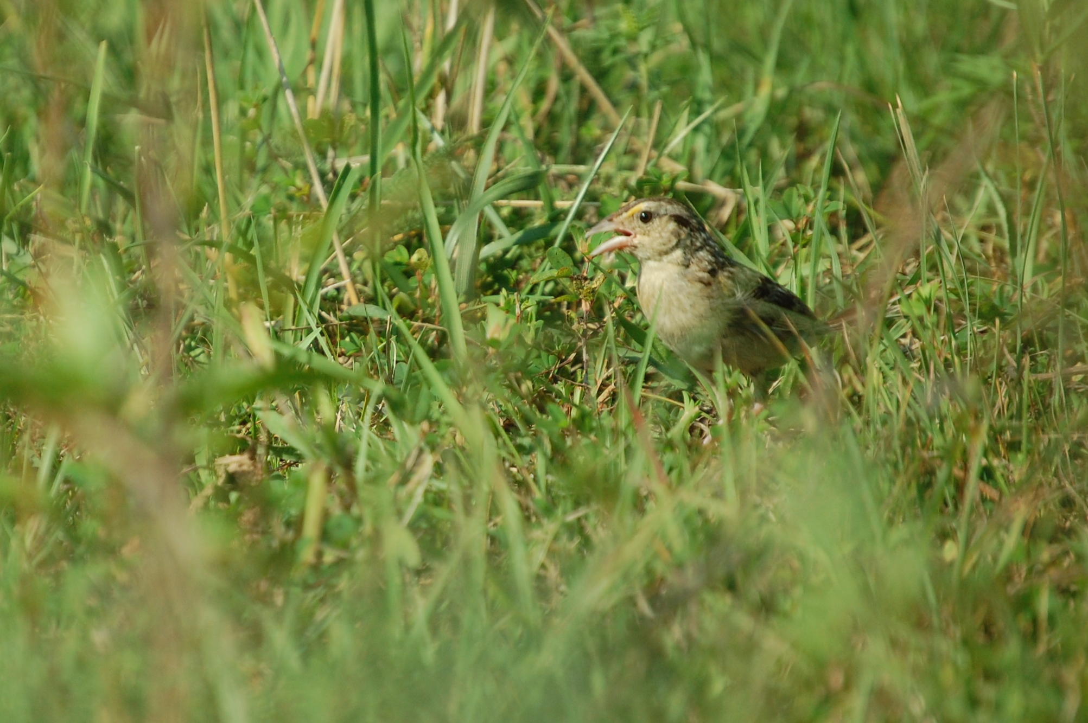
  What are the impacts on wildlife?
Grasshopper Sparrow in tall fescue

Slide 10
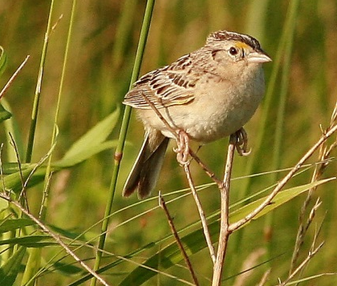
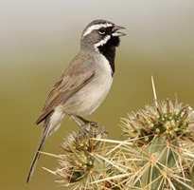
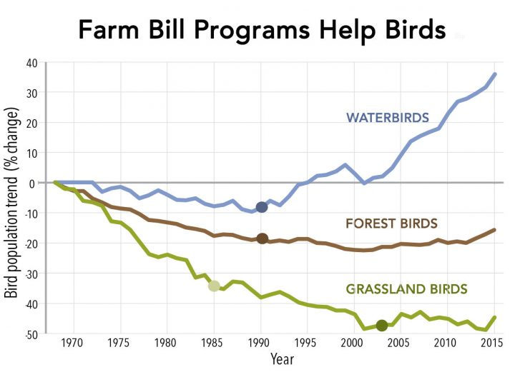
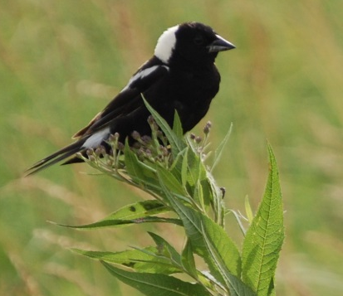
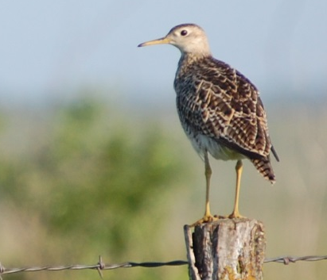
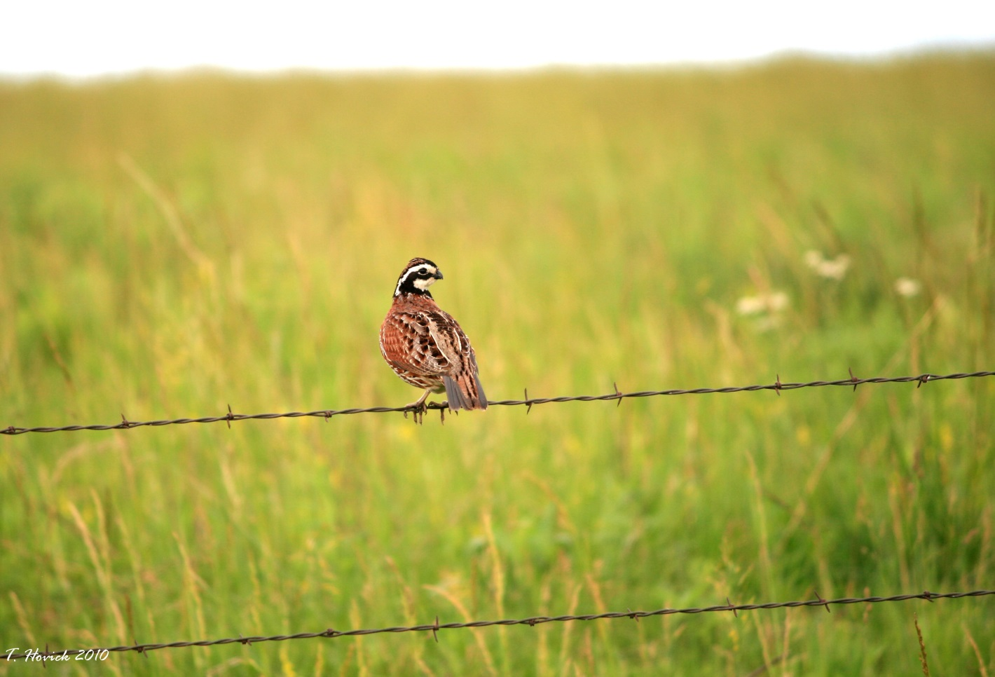
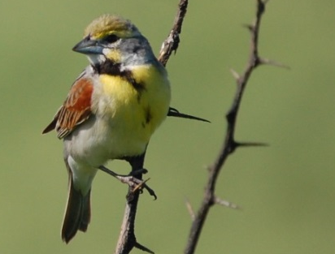
Grassland bird populations have declined
Grasshopper Sparrow
Black-Throated Sparrow
T. Hovick
L. Seitz
Bobolink
Upland Sandpiper
S. Nelson
S. Nelson
Northern Bobwhite
Dickcissel
Partners in Flight
T. Hovick
S. Nelson

Slide 11
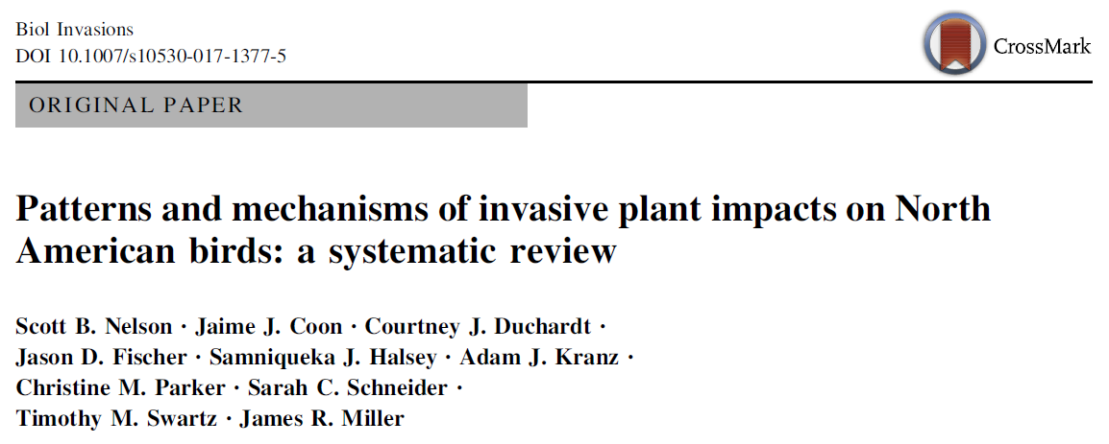
Impacts of invasive plants on birds are Extensively studied
Reviewed 124 articles published from 1980-2014
41 U.S. states, 3 Mexican states, & 8 Canadian provinces
72 invasive plant species & 219 bird species
Noted whether impacts were Negative, Neutral, or Positive

Slide 12
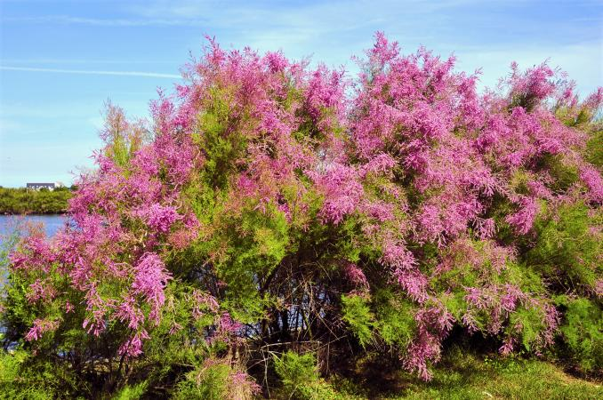
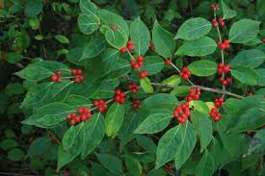
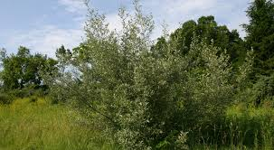
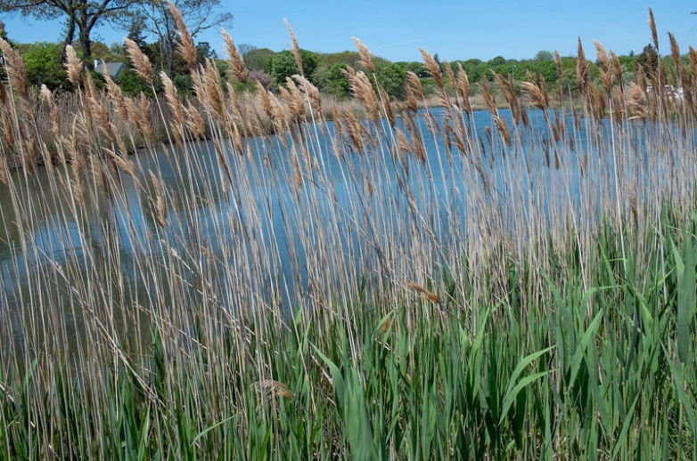
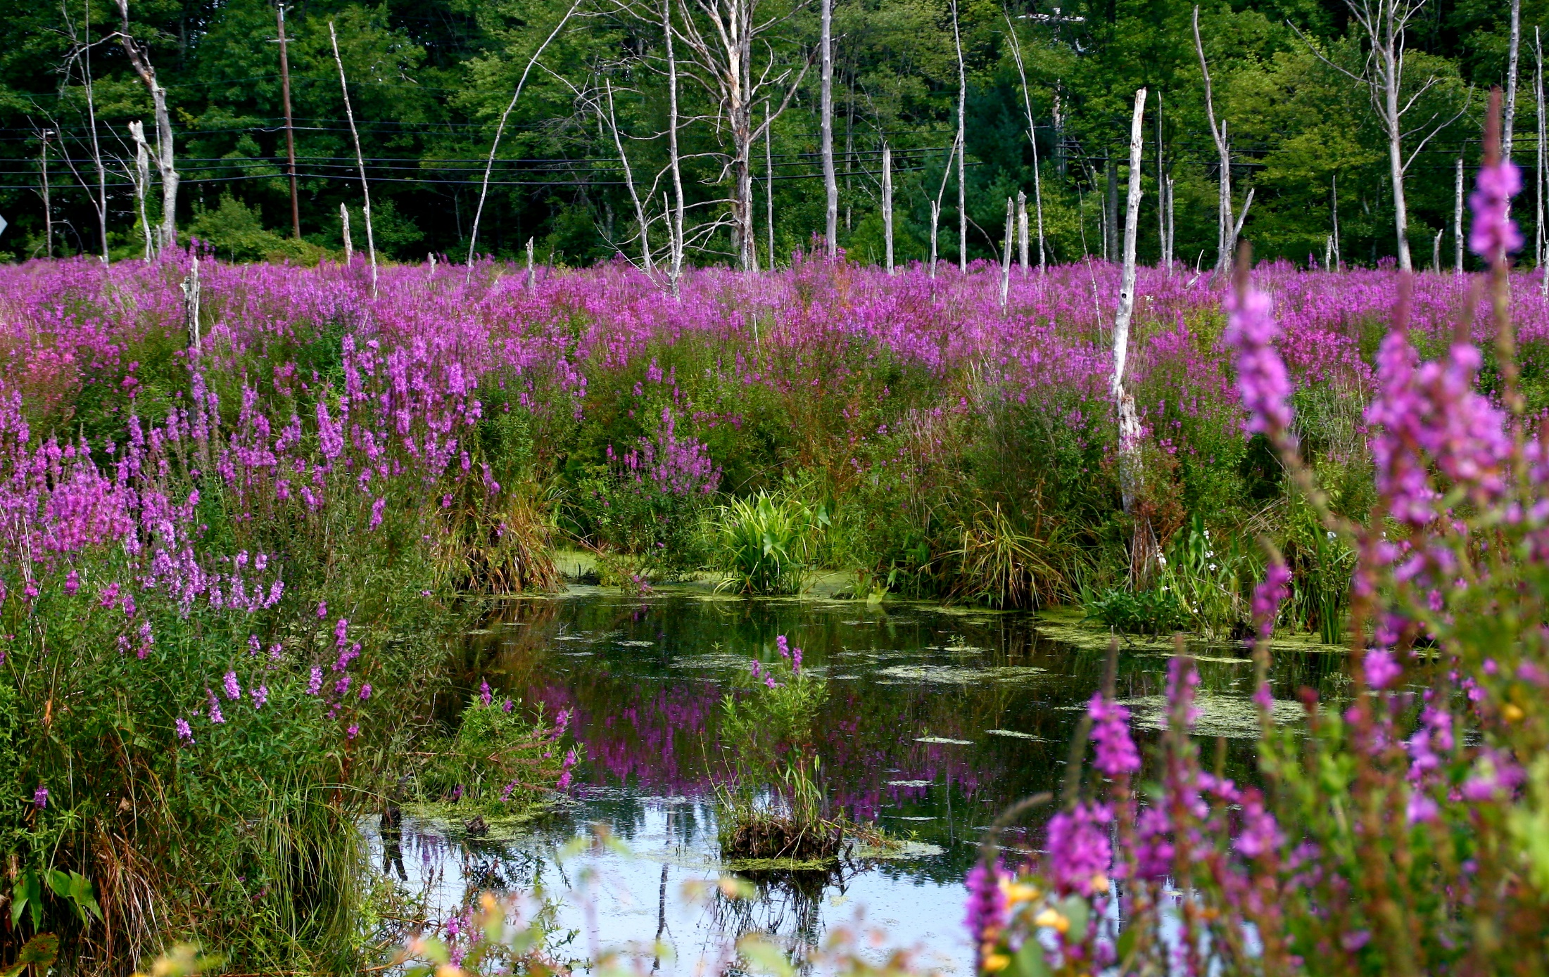
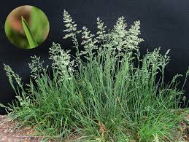
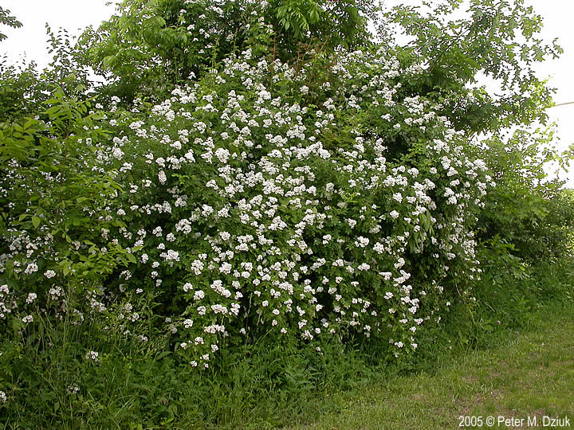
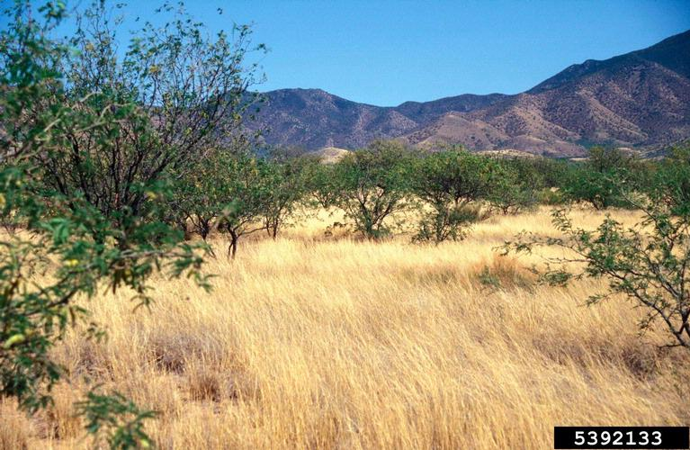
Saltcedar spp.
Honeysuckle spp.
Autumn olive
Phragmites
Purple loosestrife
Kentucky bluegrass
Multiflora rose
And many, many more…
Lehman lovegrass

Slide 13
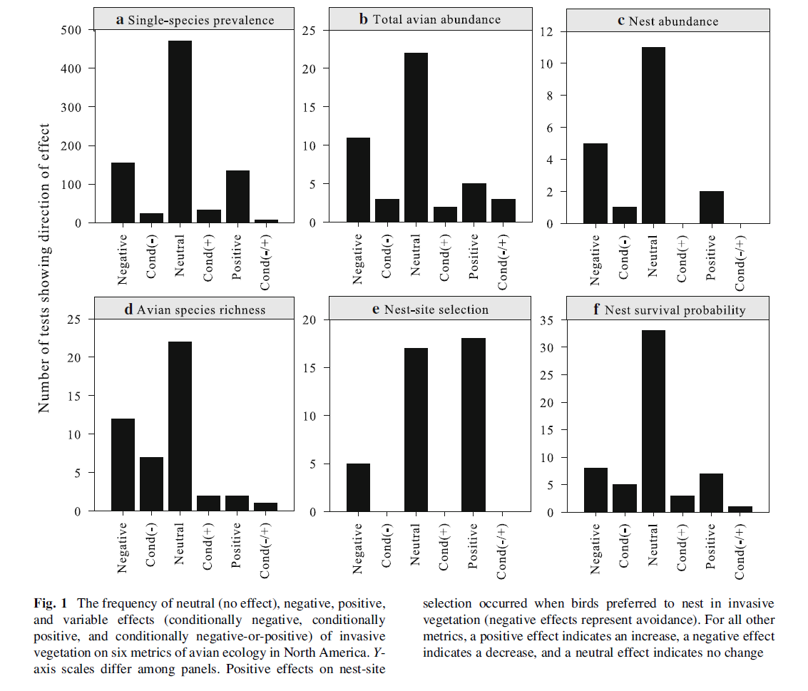
Invasive plants usually do not impact avian abundance
Number of tests reporting each effect direction

Slide 14
Invasions often reduce avian Richness, often not Nest Survival
Number of tests reporting each effect direction

Slide 15
  So why tall fescue?
Potential Mechanisms
Unsuitable vegetation structure?
  Too short?
  Too dense?
  Too homogeneous?
Low arthropod abundance?
Low use by northern bobwhites (Osborne et al. 2012)
High predation on grasshopper sparrow nests (Lyons et al. 2015)
No effect on grassland bird predation rates (Galligan et al. 2006)

Slide 16
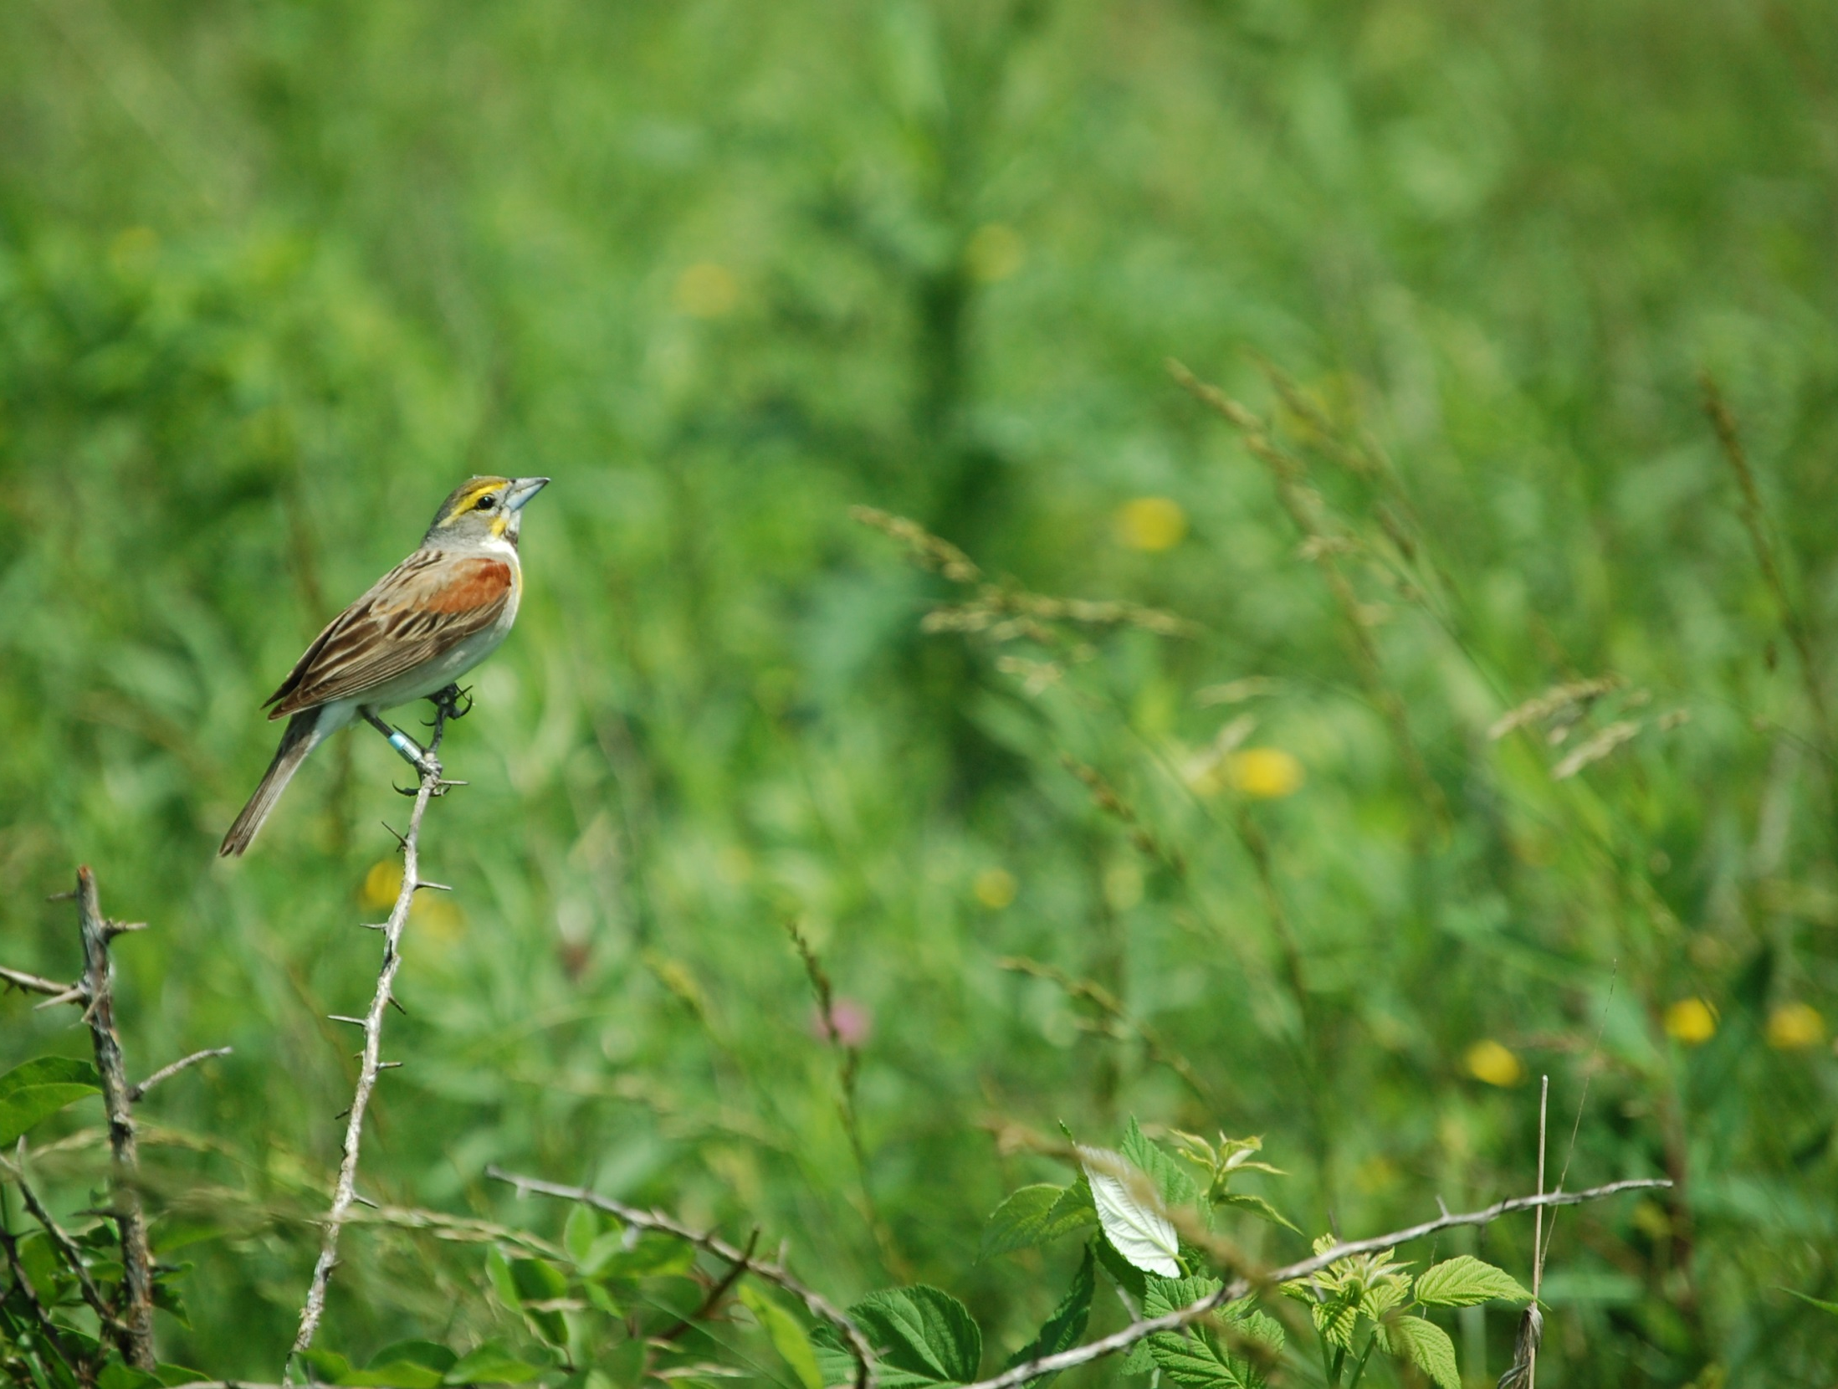
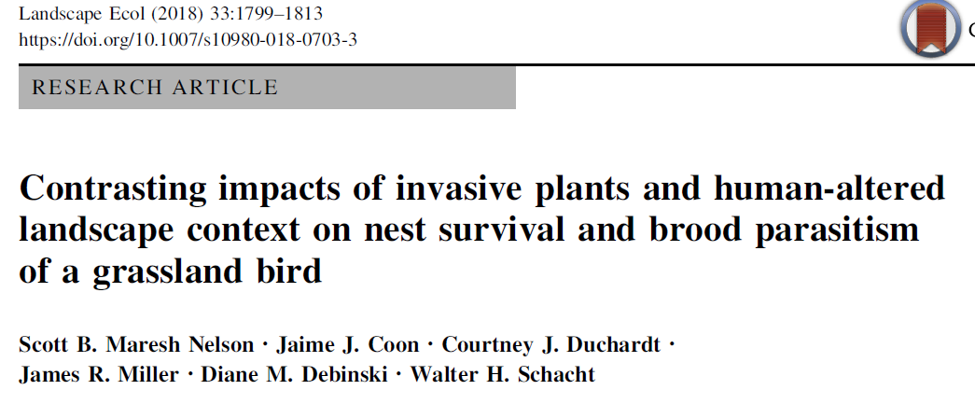
We examined Effects of
Tall Fescue on Dickcissels

Slide 17
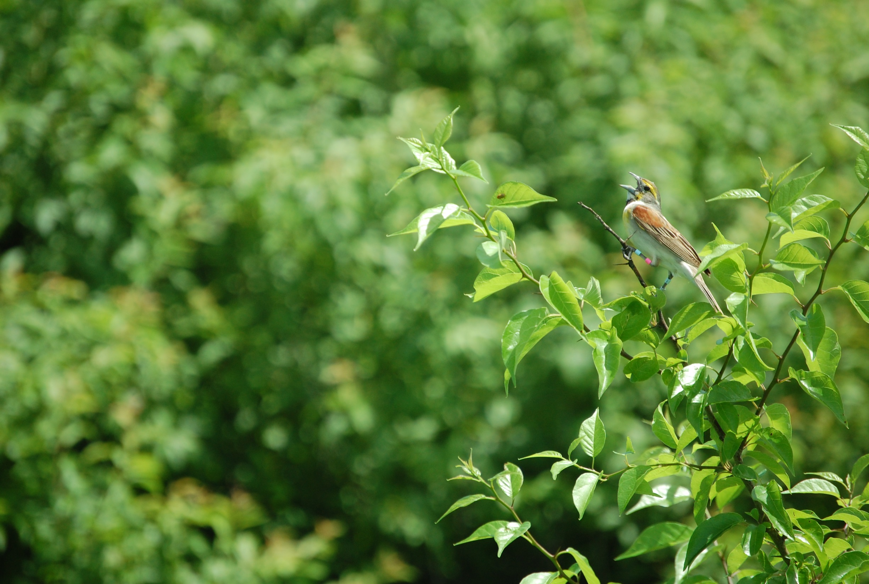
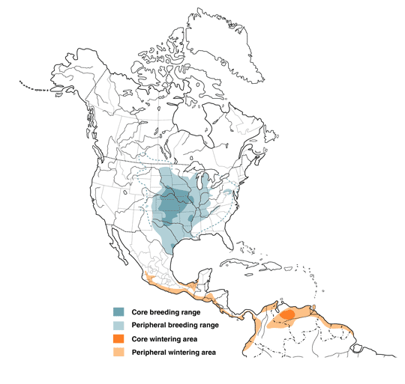
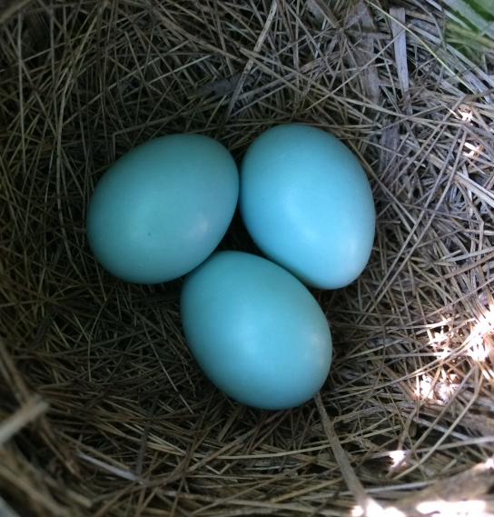
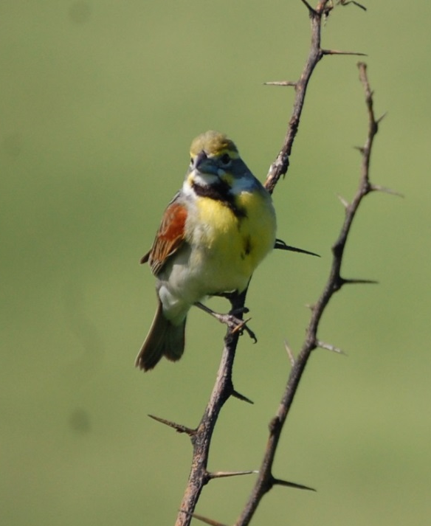
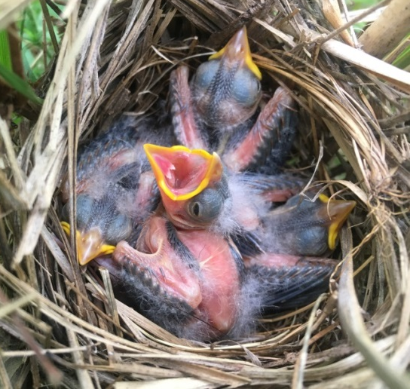
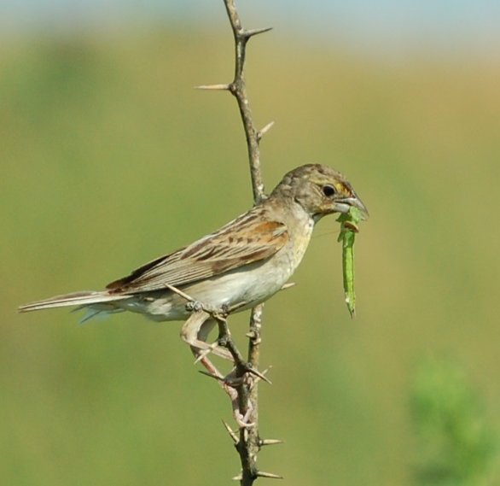
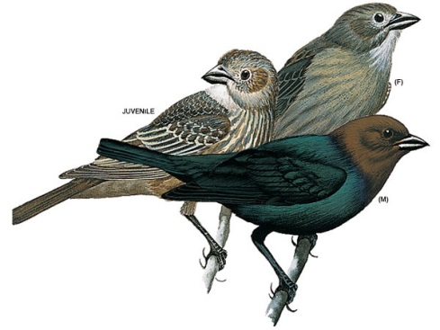
The Dickcissel
Spiza americana
Eggs
Male
Nestlings
Parasitized by
Brown-headed Cowbirds
Female
Jaime Coon
Birds of North America
Online
National Geographic

Slide 18
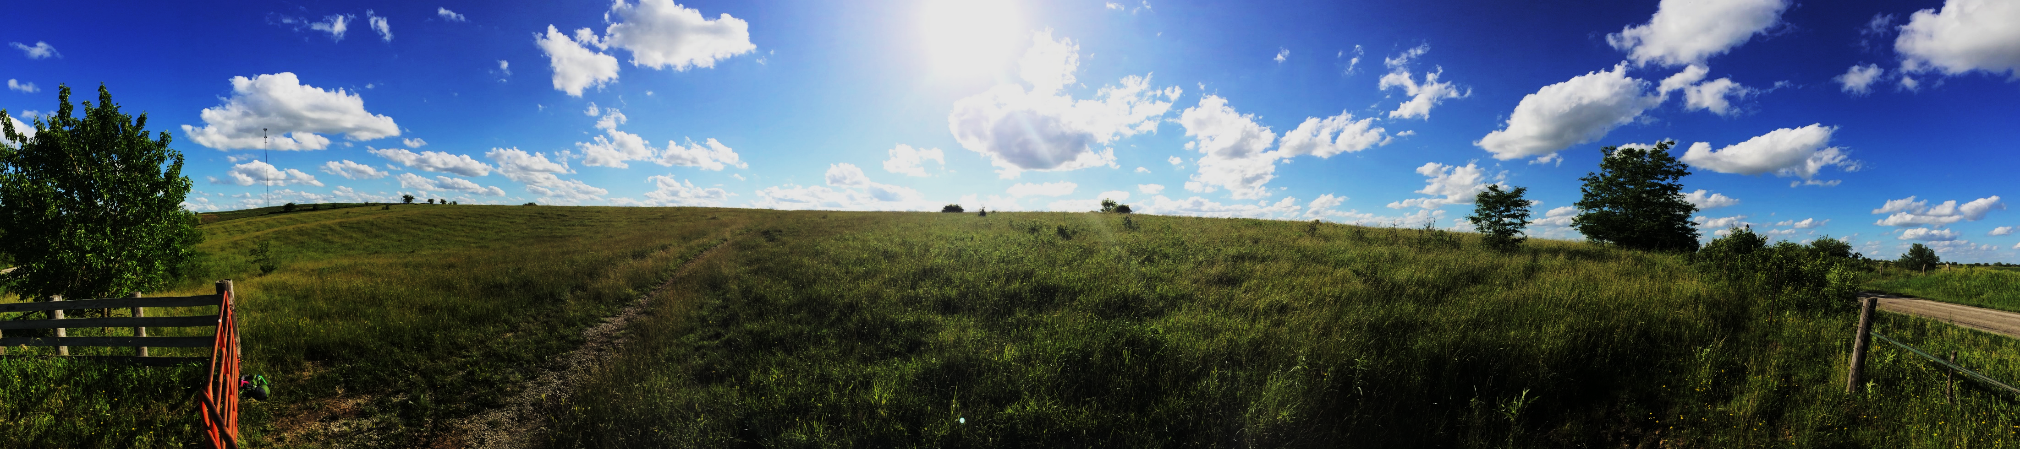
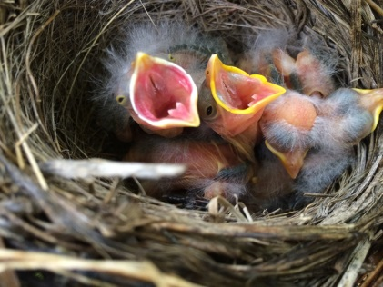
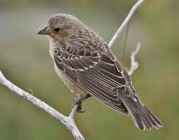
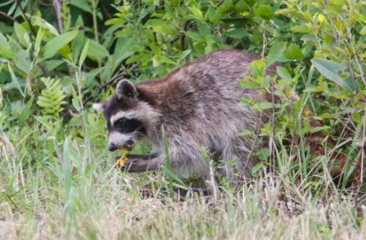
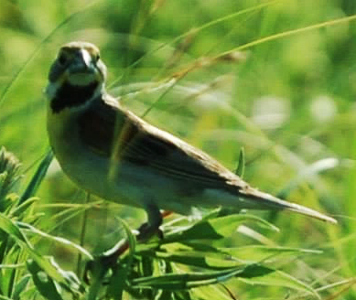
Research questions:
How does tall fescue impact…
  Parasitism by brown-headed cowbirds?
  Risk of nest predation?
  Fledgling production?
  Dickcissel densities and habitat preferences?
J. Coon
C. Talcroft
Road’s End Naturalist

Slide 19
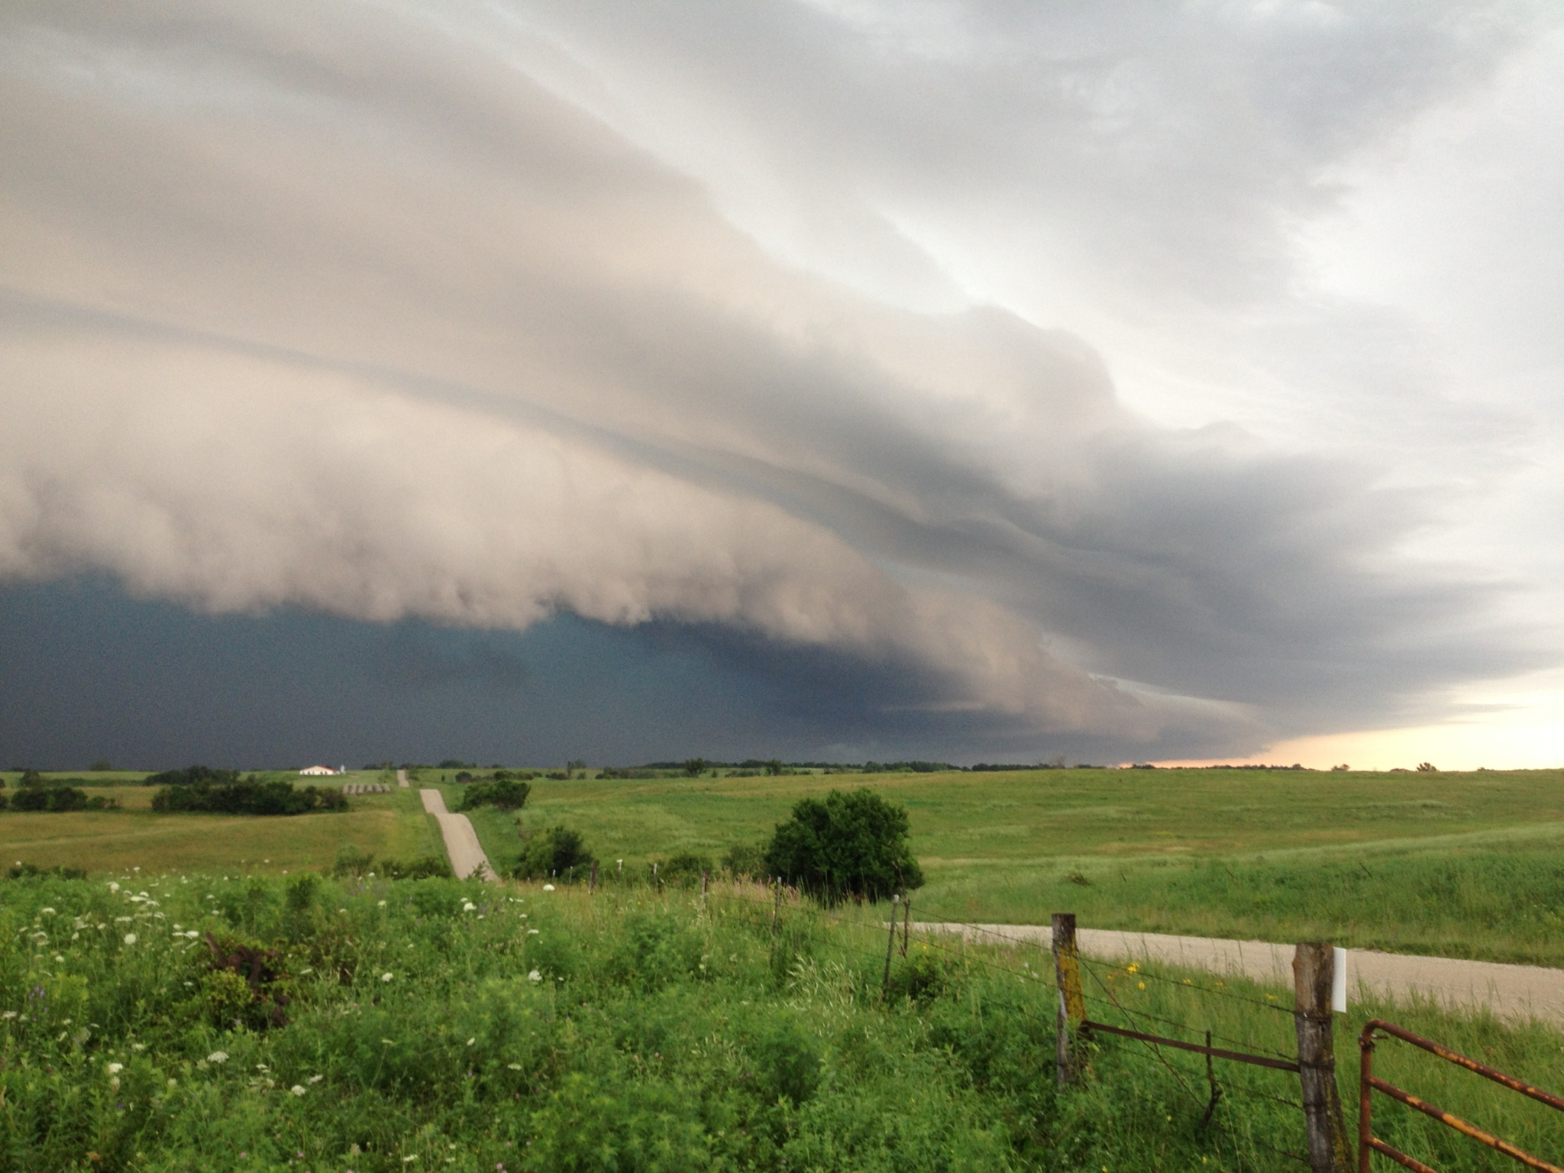
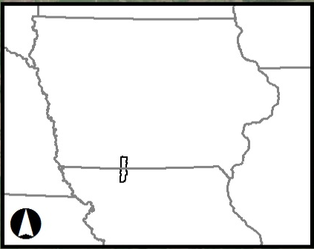
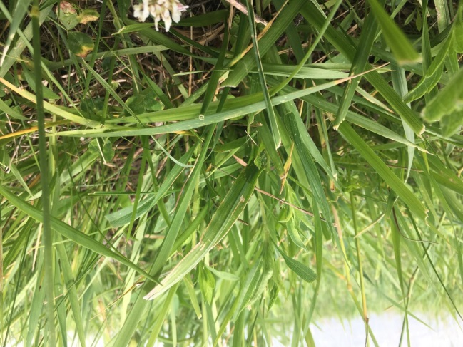
The Grand River Grasslands
80,000 acres in Southern Iowa and Northern Missouri
Nest Ecology:
2013-2016
Habitat Use:
2014-2015
Jaime Coon

Slide 20
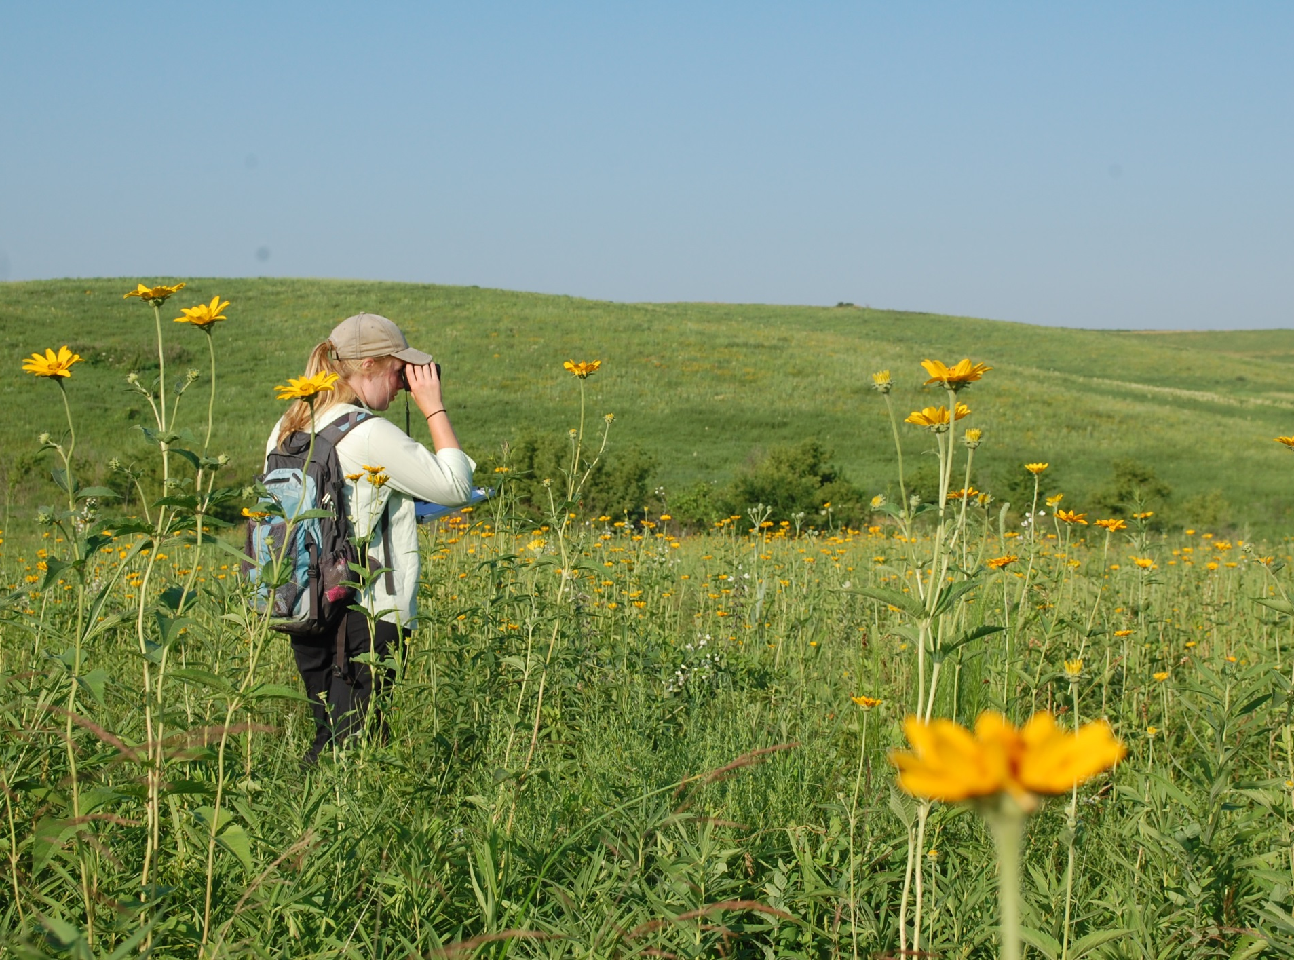


Mapped Dickcissel Territories on 7 Pastures
Every 3-8 days (May-August)

Slide 21






Nest Monitoring

Slide 22



Measured vegetation around nests
Measured vegetation within 5 m of nests
Also measured in Territories & Patches
  Tall fescue
  Other exotic grasses
  Woody cover
  Plant biomass (Robel)

Slide 23

RESULTS
Probability that a Nest will be Parasitized increases with nearby tall fescue cover
448 nests

Slide 24

Probability that a Nest will be Survive decreases with nearby tall fescue cover
A drop from 20% to 3% probability of fledging!
465 nests

Slide 25
Similarly,
fledgling production per territory decreases as tall fescue increases within patches

Slide 26

Tall fescue did not influence dickcissel habitat selection
No effect on…
  Territory density
  Nest density
  Territory settlement
  Polygyny levels

Slide 27


Key takeaways
Strong effect of TALL FESCUE on fitness
But why?
Nest concealment?

Slide 28
Key takeaways
Strong effect of TALL FESCUE on fitness
But why?
Nest concealment?
Altered arthropod community alters provisioning?
Dickcissel habitat selection was unaffected by invasive plants –
A mild ecological trap?

Slide 29

Evidence is mounting that tall fescue is a problem for wildlife.
But what about for cattle?
Endophyte protects against drought, but produces toxins.
Maresh Nelson SB, Coon JJ, Schacht WS, Miller JR. 2019. Cattle select against the invasive grass tall fescue in heterogeneous pastures managed with prescribed fire. In press, Grass and Forage Science.

Slide 30

Do cattle prefer to eat tall fescue or alternative forages?
Research shows cattle prefer legumes over tall fescue
Few data on other forages or in heterogeneous pastures
Sampled four Pastures:
Availability of Five Forages
Cattle Use of Each Forage

Slide 31
Pasture-scale:
Cattle restrict use of tall fescue

Slide 32

Quadrat-scale:
Cattle graze less in areas with more tall fescue

Slide 33

Key Takeaways
Tall fescue extremely abundant
Cattle eat it, but prefer other forages
Could reduce fescue without losing forage quality

Slide 34
Multiple lines of evidence for negative impacts of tall fescue
• Negative health effects on cattle
• Competition with native plants
• Poor burn coverage
• REDUCED WILDLIFE FITNESS
• LIMITED USE BY CATTLE
  It is time to advocate controlling and replacing tall fescue

Slide 35


Acknowledgements
Co-authors
Jaime Coon, Courtney Duchardt, Jim Miller, Walter Schacht, Diane Debinski
Lab Mates
Jane Capozzelli, Timothy Swartz, Christine Parker, Jason Fischer, Sam Halsey, Adam Kranz, Tim Lyons, Sarah Schneider
Field & Lab Assistance:
Shannon Rusk, Josh Rusk, Devin Jen, Iris Bradley, Annie Meyer, Matt Kneitel, Omar Garza, Kristin Malone, Ben Vizzachero, Tracy Park, Amy West, Yanzhu Chen, Roshan Kumar, Magda Gustyn, April Wendling, Jenna Johnson, Ryan Harr
Funding:
USFWS & State Wildlife Grants Program; USDA NIFA & SARE, Frances Peacock Award, Garden Club of America, Wilson Ornithological Society

Slide 36

Questions?

Slide 37




Landowner Survey
(Jaime Coon)
Most people believe that native grasses are better for cattle and wildlife vs. tall fescue
>40% are very willing to remove fescue using herbicide
…and 36% removed non-native grasses using herbicide in the last 10 years
T. Swartz

