Slide 1
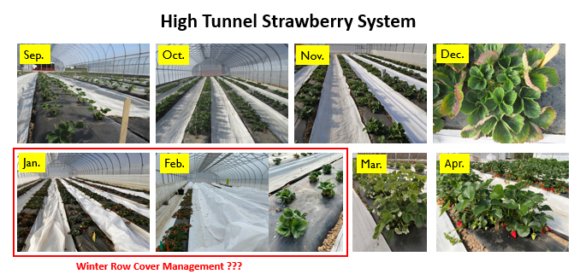
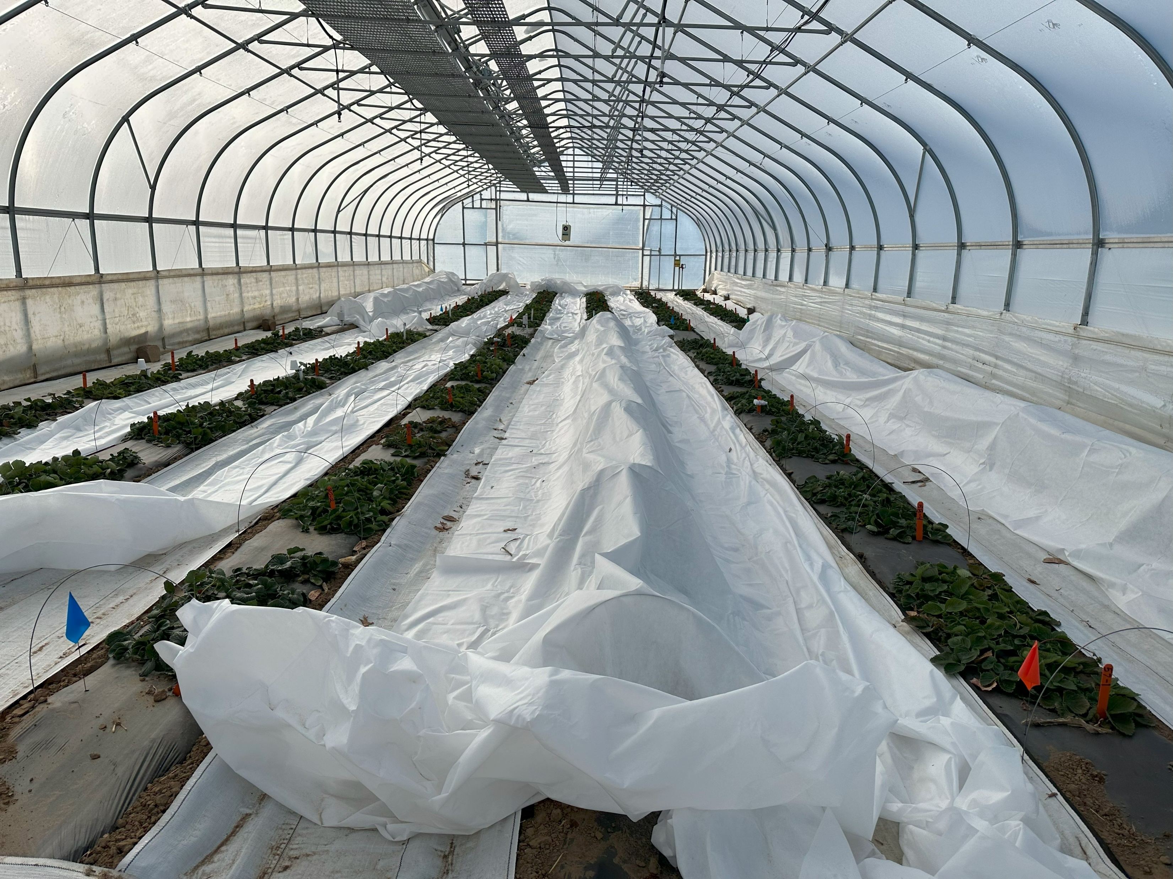
Active vs. Passive Row Cover Management: Impacts on Abiotic Growing Conditions, Yield, and Pests on Overwintering Strawberry
Samantha Anne Willden², Wenjing Guan¹, Laura Ingwell², Dean Haseman¹
^{1.} Department of Horticulture and Landscape Architecture. Purdue University, 4369 North Purdue Rd, Vincennes, IN 47591.
^{2.} Department of Entomology, Purdue University, 901 W State Street, West Lafayette, IN 47907
Introduction
Results
Locally produced strawberries have outstanding market potential. However, strawberry production has been decreasing in the north-central US, partly due to high production risks associated with the traditional matted-row system. The plasticulture system has drawn attention due to its potential benefits, but it faces challenges with plug plant availability in late summer. Farmers may choose to use bare-root plants and plant in the summer. However, the high labor demand for planting bare-root plants on plastic and the intensive plant care in the summer have limited the use of plasticulture systems to small-scale operations.
High tunnels are widely adapted for strawberry production worldwide. In China, around 90% of strawberry acreage is in protected cultures, including greenhouses, high tunnels, and low tunnels. This structure protects plants from strong winds and rainfall, providing additional heat units and moderate frost protection.
The high tunnel production system has been proven successful in Indiana. The fall-planted strawberries may be harvested for up to eight weeks after planting and yield more than 2 lbs/plant on plasticulture inside a high tunnel in southern Indiana. Initial studies found that cultivars with a low chilling requirement, such as Radiance, tend to have the highest yield in the system.
Row Cover Management Impacts on Strawberry Yield
Temperature
No cover resulted in lower minimum temperatures compared to the cover treatments.
The maximum temperatures were similar among treatments.
Temperatures were similar between Passive hoops and Passive no hoops.
Relative humidity
The highest relative humidity was observed for the active management treatment compared to the lowest that was observed for the passive treatment without hoops.
Light
The average daily PAR was highest for the no cover treatment compared the lowest PAR that was recorded for the passive row cover management treatment with hoops and without hoops
Differences among the treatments were most apparent when the outside photoperiod was highest during the season.
Depending on the day, PAR reduction could be more than 50% under row covers.
In our initial exploration of using this system, we applied an active row cover management approach in the winter, i.e., covering and uncovering the plants frequently in the winter months according to temperatures. Although the management approach optimized the winter environment for plant growth, it added labor in crop management, and it may not be feasible for farmers who are not on-site during winter months. We initiated the current study to understand the effect of row cover management in the winter on strawberry yield and pest dynamics to optimize the system.
Row Cover Management Impacts on Strawberry Yield
Marketable strawberry yields were similar among the covering treatments in both seasons.
Row Cover Management Impacts on Pest Presence
Materials and Methods
- The study was conducted in two seasons. 2021-2022 and 2022-2023.
- Strawberry plus were planted on Sep. 7 2021 and Sep. 8 2022 on plastic covered bed inside high tunnels at the Southwest Purdue Ag Center in Vincennes, IN.
- In 2021-2022, cultivar Chandler and Sensation were evaluated. In 2022-2023, seven cultivars were evaluated: Chandler, Sweet Charlie, Merced, Sensation, Ruby June, San Andreas and Monterey.
- During winter months, three cover management approaches were evaluated in the first season: No cover, Active (hoops), and Passive (hoops). In the second season, in addition to the above three treatments, an additional management approach, Passive (without hoops), was added.
- One layer of Agribon AG-50 row cover (1.5 oz./sq.yd), 50% light transmission was used in the study.
Spider Mites
- Fewest spider mites were observed during mid-November until mid-January.
- A single release of the predatory mite Neoseiulus fallacis was made into the high tunnel on Nov 4 2022. Predatory mites were recovered at low densities during the season, and did not vary significantly among covering treatments
Aphids
- Few aphids were observed on plants from October to December 2022. But populations slowly increased until reaching peak density in February 2023 before row covers were removed.
- Following row cover removal, aphid density declined for all treatments. Covering treatment did not have a significant impact on aphid density overall, but aphid density was markedly higher under all row covers compared to the no-cover treatment
No cover: Did not use row covers in the entire winter
Active (hoops): Row covers were actively managed. The beds were covered when the forecasted outside temperature was below 35 °F. Uncovered when the high tunnel inside temp raised above 50 °F.
Passive (hoops): Row covers were passively managed. The beds were covered when the forecasted outside temps were constantly lower than 20 °F. Row covers were placed on hoops. Row covers were removed after the below-20 °F days were passed.
Passive (without hoops): The management was the same as in the above treatment. But row covers were placed directly on top of the plants.
Discussion and Conclusion
- Although row covers maintained warmer temperatures and reduced light intensity, marketable strawberry yield did not vary among the covering treatments.
- Warmer temperature under the row covers increased aphid population. TSSM appeared well managed by predatory mites, but additional releases may be necessary in the early spring.
Acknowledgment: this material is based upon work supported by Specialty Crop Research Initiative (SCRI) [grant no. 2021-51181-35858/project accession no. 1027430] from the USDA National Institute of Food and Agriculture. This work is also supported by the USDA National Institute of Food and Agriculture under award number 2021-38640-34714 through the North Central Region SARE program under project number LNC21-454.
Results of the study indicated that using active row cover management in the production system in winter may be optional. Without using row covers, strawberry yields were similar to those using row covers, suggesting row covers may not be required in the winter in most years in the region.

