Slide 1
Integrated Rotation Systems for Soilborne Disease, Weed and Fertility Management in Strawberry/Vegetable Production
M. Zavatta¹, C. Shennan¹, J. Muramoto¹, G. Baird¹, S.T. Koike², M.P. Bolda², and K. Klonsky³
¹ Department of Environmental Studies, University of California, Santa Cruz ² University of California, Cooperative Extension
³ Department of Agricultural and Resource Economics, University of California, Davis

Slide 2
Background
Vegetable and strawberry production in CA: $9 billion in 2011.
Problems
Approach
Conventional production:
Fumigant dependant systems
Alternative to fumigant?
Organic production:
Verticillium wilt in strawberries regardless of crop rotation in diversified farms
High cost of weed management
Broccoli rotation (Bro)
for Verticillium wilt control
Mustard seed cake (MC) for weed suppression
Anaerobic soil disinfestation (ASD)
for Verticillium wilt control
Integrated approaches?

Slide 3
Goal
To evaluate effect of broccoli rotation, mustard seed cake (MC) and anaerobic soil disinfestation (ASD), alone or in combination, on controlling Verticillium wilt, weed suppression, N dynamics and crop yield in both conventional and organic systems

Slide 4
Experimental Design
  Randomized block split plot designed field trials with 4 replicates at 2 sites (organic and conventional)
  Main plot: crop rotation
    broccoli-strawberry-winter cover crop*-lettuce*
    cauliflower-strawberry-winter cover crop*-lettuce*
    fallow-strawberry-winter cover crop*-lettuce*
  Split plot: soil treatment for strawberries
    MC (B. juncea : S. alba = 1:1 weight) 3.4 t/ha
    ASD w/ rice bran 20 t/ha
    MC 3.4t/ha + ASD w/ rice bran16.6t/ha
    untreated check (UTC)
    fumigation w/ Pic-clor60**
* Organic only
** Conventional only

Slide 5
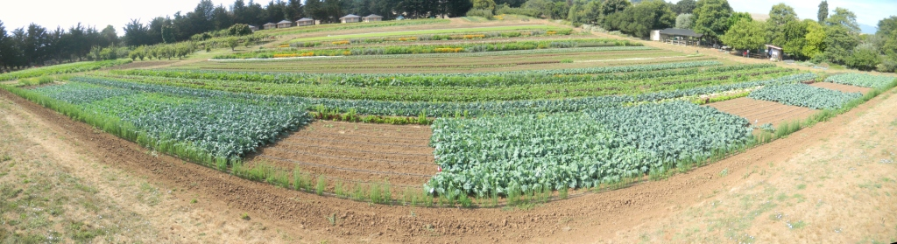
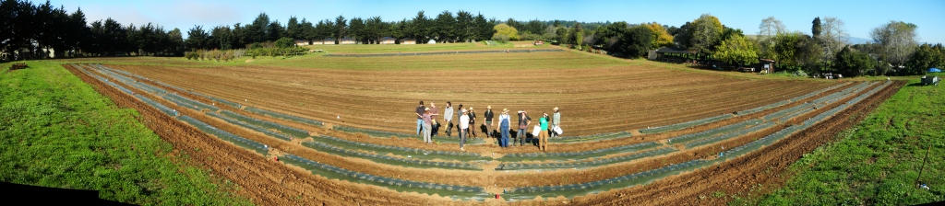
Organic site, UCSC Organic farm, Santa Cruz, CA. 5 ms/g soil
Block 1
Block 4
Block 2
Block 3
Cauliflower
Fallow
Broccoli
Broccoli
Fallow
Cauliflower
August 2011
Block 1
Block 4
Block 2
Block 3
MC
ASD+MC
UTC
UTC
ASD
ASD+MC
ASD
MC
November 2011

Slide 6
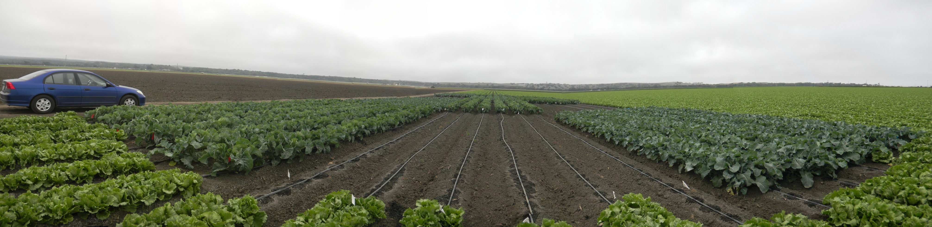
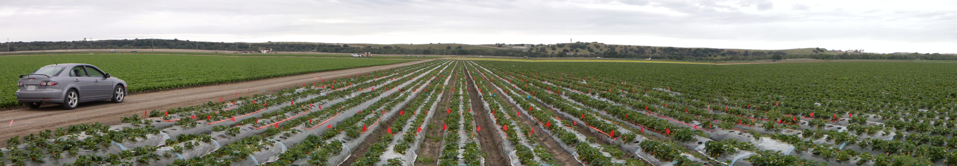
Conventional site, Salinas, CA. 12 ms/g soil
Block 3
Block 1
Block 2
Block 4
Cauliflower
Broccoli
Fallow
August 2011
Block 1
Block 2
Block 3
Block 4
Pic-Clor
ASD+MC
ASD
UTC
MC
May 2012

Slide 7
Variables Monitored
  N dynamics
    Soil nitrate (0-15 cm depth)
Weeds
  Weed density under clear plastic “window” (strawberries only)
Verticillium dahliae
  Viable microsclerotia in soil (ms/g soil)
  Wilt score: 1 (healthy) – 8 (dead)
  Infection rate of strawberry plant (%)
  Crop yield and biomass

Slide 8
Soil Nitrate Dynamics (Org. 0-15cm)
~6 months

Slide 9
Soil Nitrate Dynamics (Conv. 0-15cm)
a
a
a
ab
ab
ab
bc
a
b
c
ab
b
ab
ab
b

Slide 10
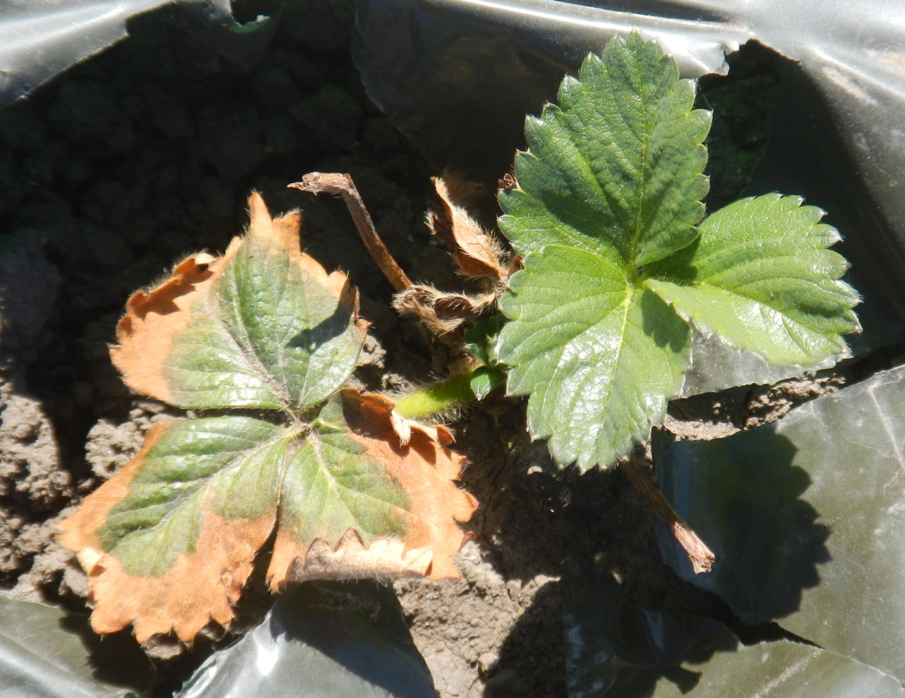
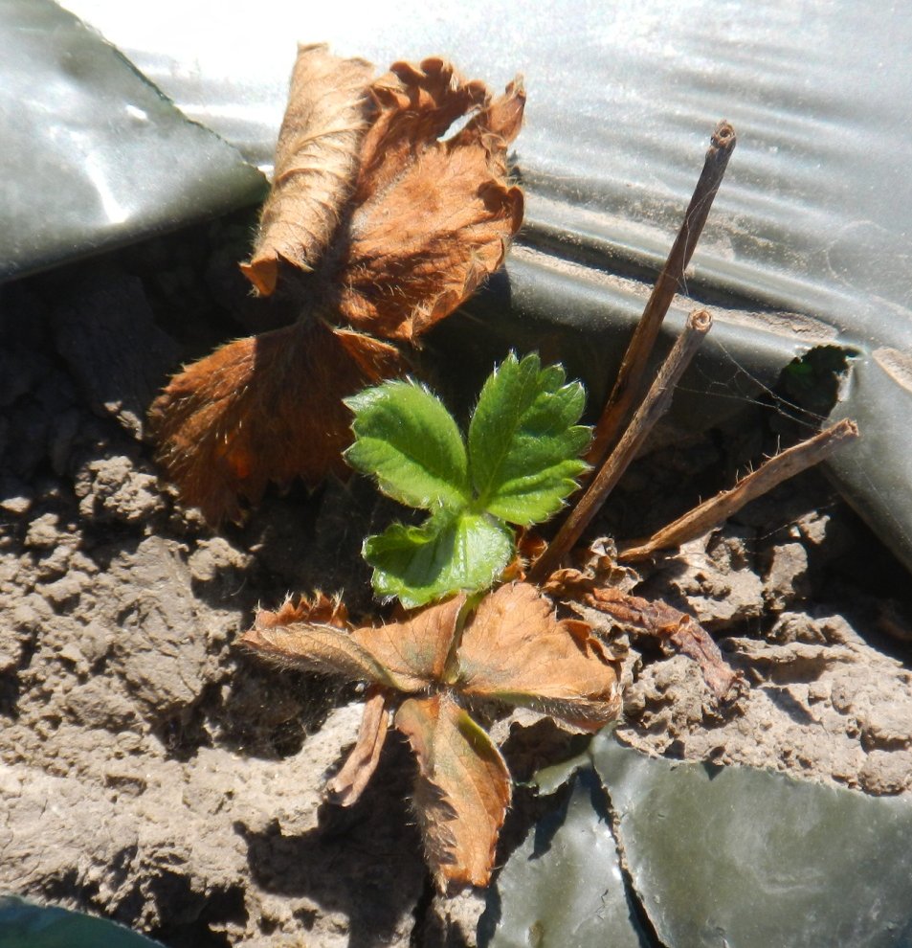
Salt Burn Damage at ASD plots (Conv. Jan. 2012)
ASD w/ 20t/ha rice bran (N 2%) -> 400 kg-N/ha
MC 3.4t/ha (N 6%) -> 200 kg-N/ha
ASD w/ 16.6t/ha rice bran + MC 3.4t/ha -> 530 kg-N/ha
c.f. N uptake by CA strawberry: 200-250 kg-N/ha/season
Notes:
Leaf photo’s leaf damage level is +, right side is ++

Slide 11
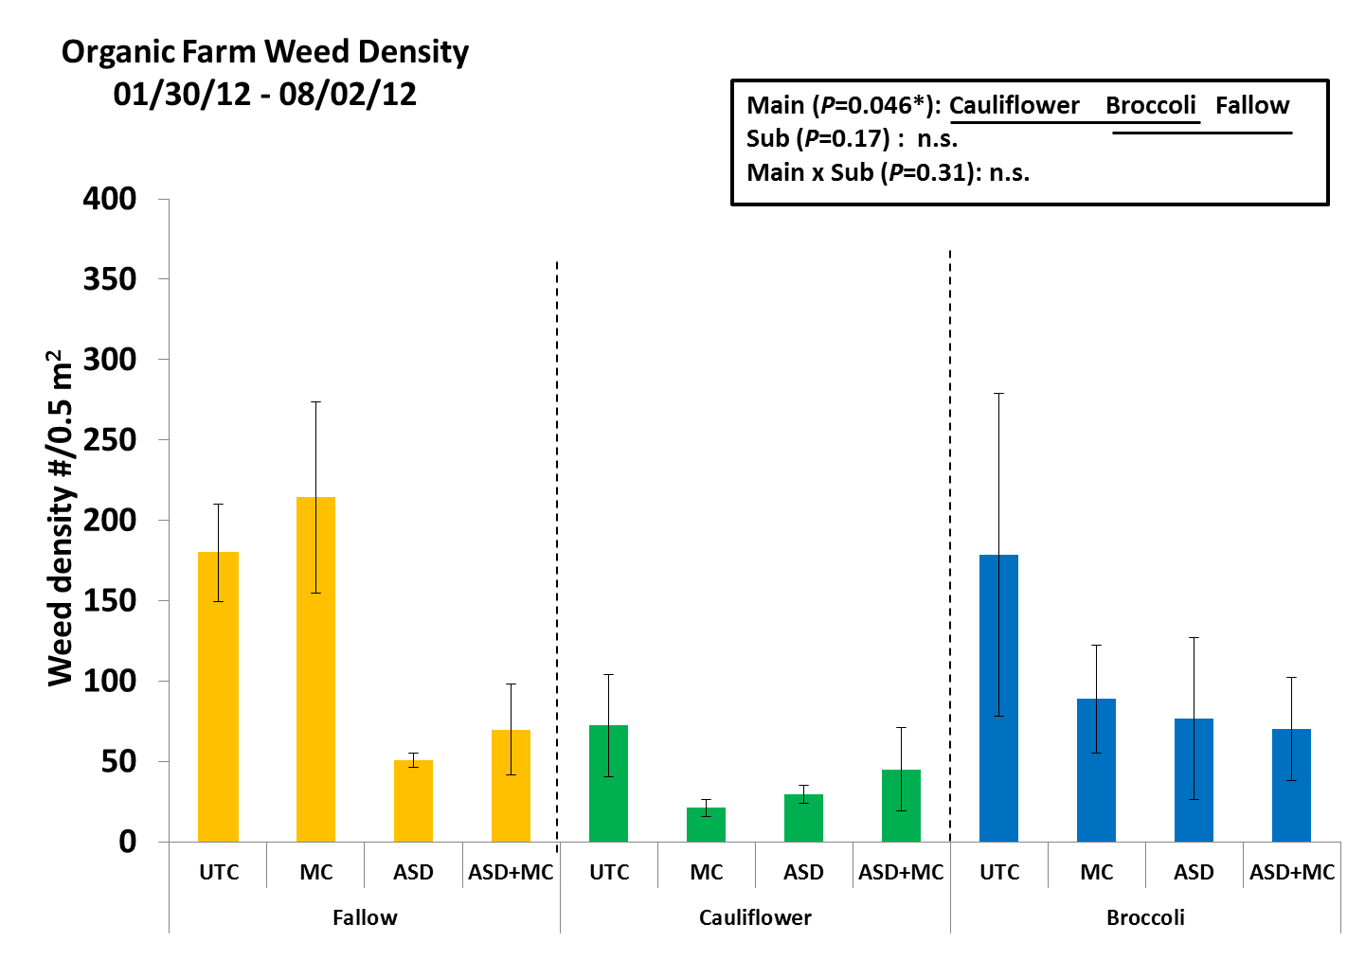
Weed Density
Org. Jan. 12 – Aug. 12

Slide 12
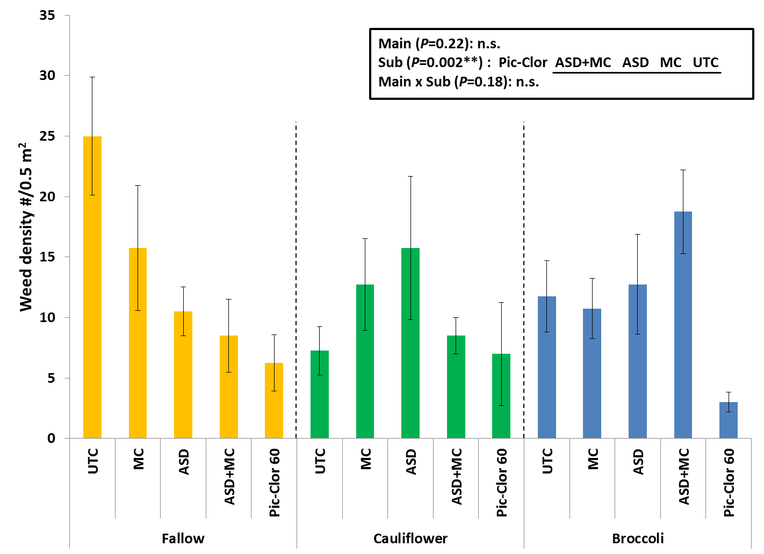
Weed Density
Conv. March 12 – July 12

Slide 13
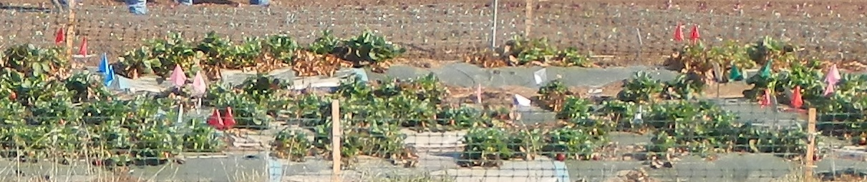
Wilt Score of Strawberry Plants (Org. )
a
ab
ab
b

Slide 14
Organic Strawberry
V. dahliae Infection Rate %

Slide 15
Changes in Verticillium dahliae Microsclerotia Number in Topsoil of Organic site.
Statistical analysis was performed for log-transformed data. Numbers in the table show the back-transformed populations of viable V. dahliae microsclerotia/gram soil.

Slide 16
Org. Strawberry
Marketable Fruit Yield

Slide 17
Org. Strawberry
Marketable Fruit Yield
N fertility effect
V. wilt suppression effect

Slide 18
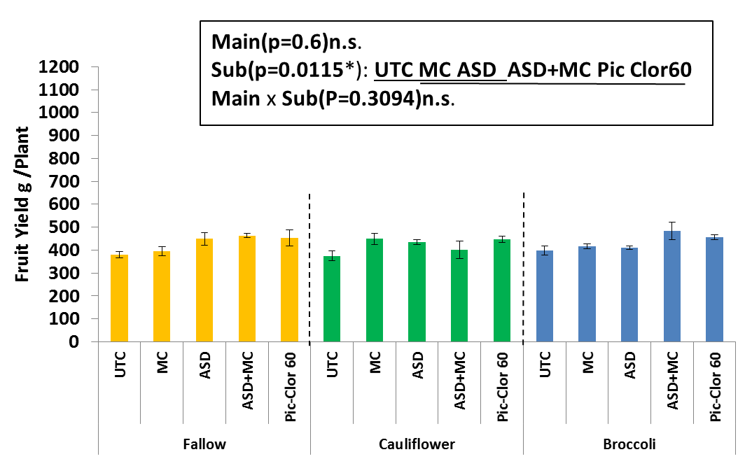
Conv.
Strawberry
Marketable Fruit Yield
(early to mid season yield)
Main (P=0.6): n.s.
Sub (P=0.01*): UTC MC ASD ASD+MC Pic-Clor
Main x Sub (P=0.31): n.s.

Slide 19
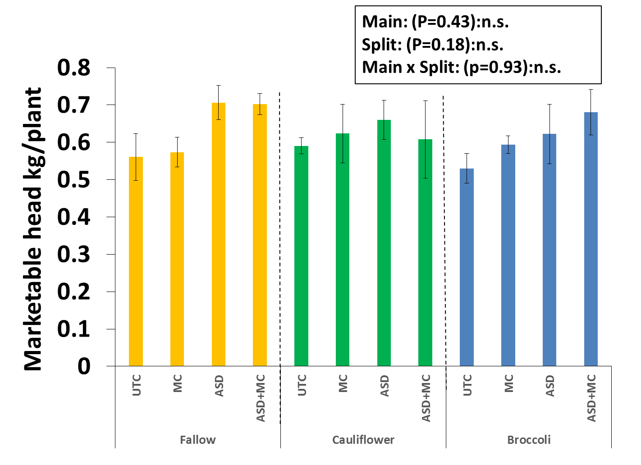
Org. Lettuce
Marketable Yield

Slide 21
Conclusions
N dynamics:
  Rice bran released significant amount of nitrate for ~6 months from ASD application
  Benefitted early growth and yield
  Excess N caused salt damage to strawberry plants (esp. Conv. site) & NO₃ leaching to the environment
  Need to reduce N inputs in ASD by using lower-N carbon source or lowering rate of rice bran
    e.g. molasses, cover crop + lower rate of rice bran

Slide 22
Conclusions (Cont.)
Weed suppression:
  ASD, MC had limited capacity
V. dahliae suppression:
  ASD+MC and ASD showed reduction of
  V. dahliae infection in strawberry plant (Org. site)
  V. dahliae microsclerotia number in soil was lower at ASD and ASD+MC even after 2 years from treatment
  Broccoli did not show any effect

Slide 23
Conclusions (Cont.)
Crop yield:
  Strawberry’s marketable fruit yield at ASD and ASD+MC was highest in Org. and ASD+MC was comparable to fumigation in Conv. (early-mid season yield)
Overall:
  ASD worked well in V. wilt suppression and yield increase but no additive or synergistic effect of MC and/or broccoli rotation was observed
  Yield increase in ASD appears to be caused by a combination of N provision (early season) and disease suppression (late season)

Slide 24
Acknowledgements
Gary Tanimura and Glenn Noma of Tanimura and Antle Fresh Foods Inc
Elizabeth Milazzo, Darryl Wong, Andrew Webster, and Damian Parr of CASFS, UCSC
James Leap of USDA-ARS
Thomas Flewell of Dole Fresh Foods, Inc.
Staff, students and volunteers of the Shennan lab
This project was partially funded by the USDA Western Sustainable Agriculture Research and Education Program SW11-116 and Organic Farming Research Foundation

Slide 25
Questions?
Joji Muramoto joji@ucsc.edu

