Slide 1
Minnesota Soil Health Coalition
Partnering for our resources
Notes:
introductions

Slide 2
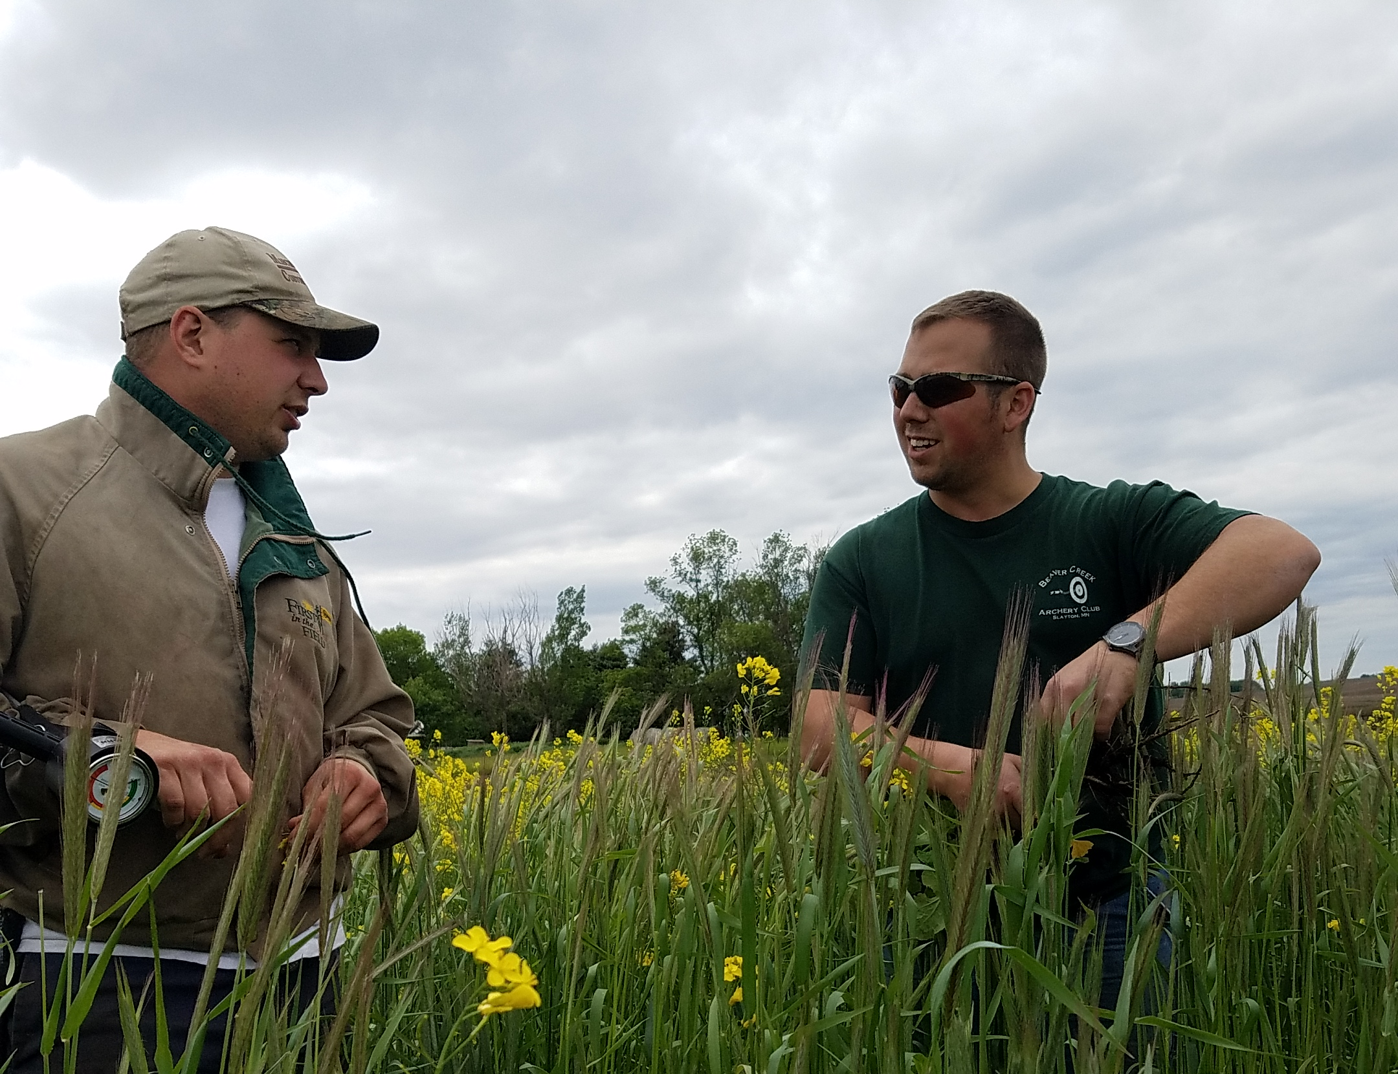
Mission
Producer driven education, outreach, and adoption utilizing information exchange to promote the principles of Soil Health practices
Notes:
Jennifer

Slide 3
Goals of the Coalition
Provide education, training, and logistical information to farmers, agency staff, and the general public
Unite conservation agencies, farmers, and industry to advocate for large scale adoption of soil health principals
Develop and maintain the farmer to farmer mentor program
Create and maintain a statewide soil health forum
Organize and collaborate on events, trainings, field days, and meetings with producers and other entities
Establish research base-Ag Center at MN College for a minimum of 5 year agreement for testing, data, and information exchange of soil health practice implementation in Minnesota
Develop agreements with MN farmers and monitor management, soil health, and economics
Develop and maintain a website with information about the organization, relevant technical information, links to information, calendar of events, and contacts for the organization
Leadership development, education, and training opportunities
Promote large scale adoption of soil health practices, making a measurable positive impact on soil erosion, surface water quality, and soil infiltration for Minnesota

Slide 4
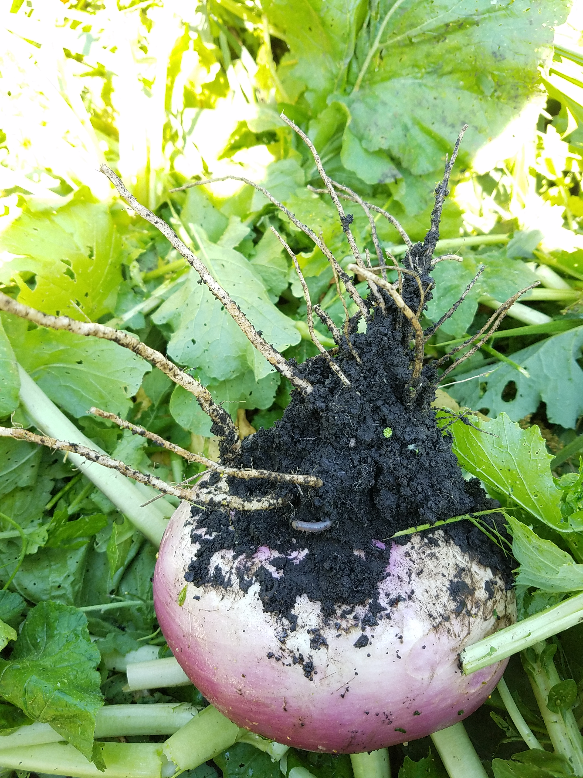
What Makes Us Unique
Farmer motivated Soil Health education
Farmer to Farmer mentorship network
Statewide Soil Health forum
Unite conservation agencies, farmers, and industry
Practical field scale Soil Health research
Education and training opportunities
Customer driven conservation
A ready group of experienced farmers to provide agencies, other producers, and organizations with technical information
Education, trouble-shooting, and logistics provided by farmers
Notes:
Holly
Additional benefits:
· Promote large scale adoption of Soil Health practices
· Leadership development opportunities
· Promotion of Best Management Practices on working lands
Customer driven conservation- the coalition will set goals and priorities based on real farmers and current customers needs and wants

Slide 5
Education & Outreach
Children’s Water Festival 2019
Water Storage Forum Soil Health & Water Storage
MOSH Stakeholder Meeting
5th Grade Field Day at Gilfillan
Women Caring for the Land – New Ulm
TUNE Camp Soil Health Youth Event
Prevent Plant Meeting – Sleepy Eye
Prevent Plant Meeting-Wabasso
Cover Crop “How To”
Family Night at the Farm
4R Technology Review Field Day
Farm Fest Cover Crop Plots
Kickoff Event
Cover Crop Logistics - teaching staff
Cover Crops for Soil Health, Forage, & the Bottom Line
LINC Education
Life in the Pits
Women Conserving the Land
Soil Health & Cover Crop Field Day
3rd Annual Liepold Farms Field Day
Soil Geomorphology and Management - youth
Annual Environmental Fair – Lake Shetek
Le Sueur River Watershed Meeting
McKnight Success Stories
Minnesota State Technical Committee Meeting
SFA Conservation Highlights
Radio spots
November 2019 Successful Farming
Soil health research with the University of MN
Board member and mentor on KEYC
Women in Ag KNUJ radio program
Website with technical information, mentor network, events, and news www.mnsoilhealth.org

