Slide 1
Economics of Seed Production: Enterprise Budgets
Notes:
Kitt with OSA
A bit about OSA
Zoom out a bit, take us into the bigger picture of why small regional seed companies, seed savers, and decentralized seed systems are important

Slide 2
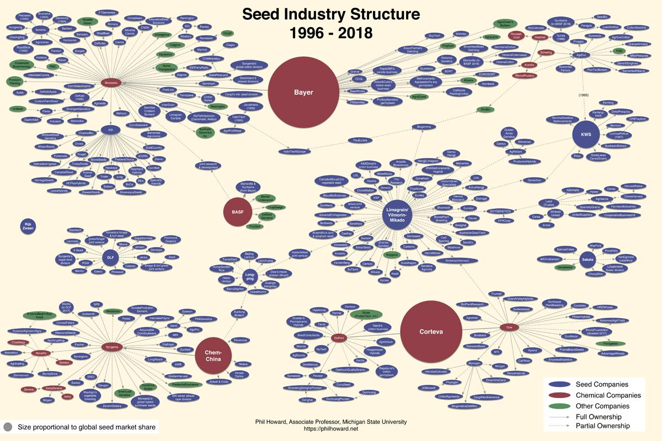
Notes:
Big 4, Bayer, Corteva, Chem China and BSF, control over 60% of global proprietary seed sales.
In the US an industry is no longer competitive when four or fewer entities control 40% or higher. The seed industry continues to exceed this benchmark not only across the entire global supply, but across crop types as well. For example, even before the Big 4 merged, three firms (Monsanto, Syngenta, and Vilmorin) controlled 60 percent of the global vegetable seed market.
This as implications for crop biodiversity, farmers’ ability to adapt to changing climates and markets, human nutrition (mass marketing food system), and farmers’ bottom lines (able to save seed or buy affordable seed).
Threats to:
Biodiversity (material is not available for breeding/ adaptation)
Farmer’s income (not a competitive market, high rates, no ability to save and replant seed, no ability to improve seed for better performance).
Loss of cultural continuity, all over the world, farmers’ varieties are being lost because of market pressure to conform.

Slide 3
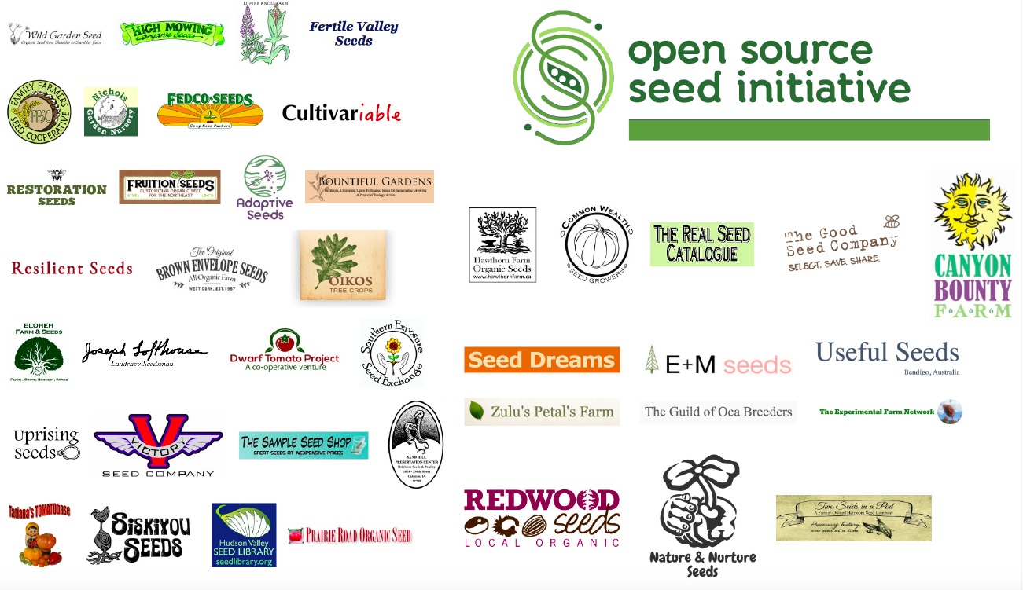
Slide: Julie Dawson

Slide 4
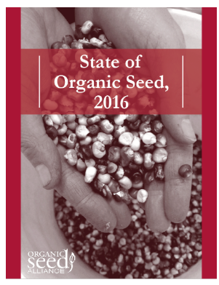
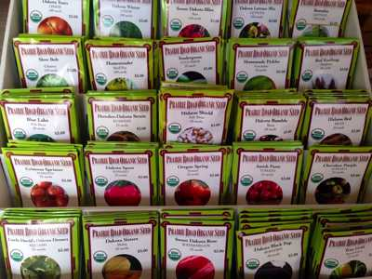
Demand for organic seed continues to grow
Notes:
SOS 2016 Stats:
NOP seed rule enforcement: requiring more steps for farmers to demonstrate looking for organic equivalent.
Biggest challenge to purchasing organic seed: specific varieties are not available in organic form, or insufficient quantities (also, desirable traits not present and higher price).
Organic seed supply is not keeping up with growth in demand for organic products.
27% of organic growers (across crop types) use all organic seed. Only 18% of vegetable growers
Organic seed is generally between 0-40% higher in price than conventional. (average is 65%, but that’s because of some extreme outliers, where organic seed is 300% more expensive).
Lack of experienced reliable seed growers is a major growth barrier for organic seed companies. So a crop failure from one farm means a total crop failure.
Need for mentoring, which OSA is trying to provide, but regional seed networks can also facilitate.
Survey of 10% of organic farmers nationally, 63% already produce organic seed for on-farm use or commercial contracts.
There was a 69% increase in total organic crop production in the United States between 2008 and 2014. Between 2015 and 2016, the number of certified organic farms in the US increased by 11%; certified acreage increased 15%; and there was a sales increase of 27% (Ag. Marketing Resource Center, 2017). Conventional grain corn sales only grew by 7% in this timeframe (U.S. Department of Agriculture, 2017).
Consumers prefer organically produced food primarily because of concerns regarding personal health, the environment and animal welfare, and are willing to pay the price premiums at the retail level (Greene et al., 2016).

Slide 5
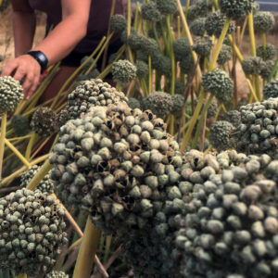
Demand for organic varieties continues to grow (NOP rule enforcement)
Organic seed companies need high quality seed producers
Notes:
SOS 2016 Stats:
NOP seed rule enforcement: requiring more steps for farmers to demonstrate looking for organic equivalent.
Organic seed supply is not keeping up with growth in demand for organic products.
27% of organic growers (across crop types) use all organic seed. Only 18% of vegetable growers
Biggest challenge to purchasing organic seed: specific varieties are not available in organic form, or insufficient quantities (also, desirable traits not present and higher price).
Organic seed is generally between 0-40% higher in price than conventional. (average is 65%, but that’s because of some extreme outliers, where organic seed is 300% more expensive).
Lack of experienced reliable seed growers is a major growth barrier for organic seed companies. So a crop failure from one farm means a total crop failure.
Need for mentoring, which OSA is trying to provide, but regional seed networks can also facilitate.
Survey of 10% of organic farmers nationally, 63% already produce organic seed for on-farm use or commercial contracts.

Slide 6
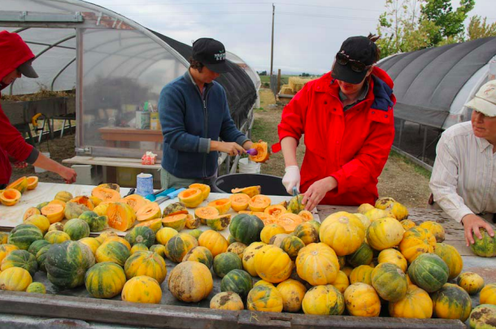
Demand for organic varieties continues to grow (NOP rule enforcement)
Organic seed companies need high quality seed producers
Well-chosen seed crops can add income to the farm enterprise
Notes:
SOS 2016 Stats:
NOP seed rule enforcement: requiring more steps for farmers to demonstrate looking for organic equivalent.
Organic seed supply is not keeping up with growth in demand for organic products.
27% of organic growers (across crop types) use all organic seed. Only 18% of vegetable growers
Biggest challenge to purchasing organic seed: specific varieties are not available in organic form, or insufficient quantities (also, desirable traits not present and higher price).
Organic seed is generally between 0-40% higher in price than conventional. (average is 65%, but that’s because of some extreme outliers, where organic seed is 300% more expensive).
Lack of experienced reliable seed growers is a major growth barrier for organic seed companies. So a crop failure from one farm means a total crop failure.
Need for mentoring, which OSA is trying to provide, but regional seed networks can also facilitate.
Survey of 10% of organic farmers nationally, 63% already produce organic seed for on-farm use or commercial contracts.

Slide 7
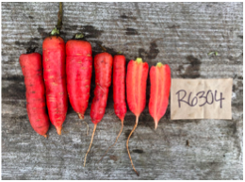
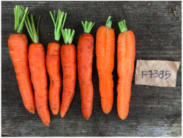
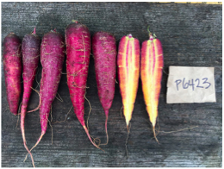
Demand for organic varieties continues to grow (NOP rule enforcement)
Organic seed companies need high quality seed producers
Well-chosen seed crops can add income to the farm enterprise
Producing or purchasing seed bred for organic systems supports the organic variety pipeline
Notes:
There is a need for research/ trial and error on organic seed production traits and methods- OSA is putting in a grant for this.
There is a need for organic certifier education regarding seed production
SOS 2016 Stats:
NOP seed rule enforcement: requiring more steps for farmers to demonstrate looking for organic equivalent.
Organic seed supply is not keeping up with growth in demand for organic products.
27% of organic growers (across crop types) use all organic seed. Only 18% of vegetable growers
Biggest challenge to purchasing organic seed: specific varieties are not available in organic form, or insufficient quantities (also, desirable traits not present and higher price).
Organic seed is generally between 0-40% higher in price than conventional. (average is 65%, but that’s because of some extreme outliers, where organic seed is 300% more expensive).
Lack of experienced reliable seed growers is a major growth barrier for organic seed companies. So a crop failure from one farm means a total crop failure.
Need for mentoring, which OSA is trying to provide, but regional seed networks can also facilitate.
Survey of 10% of organic farmers nationally, 63% already produce organic seed for on-farm use or commercial contracts.

Slide 8
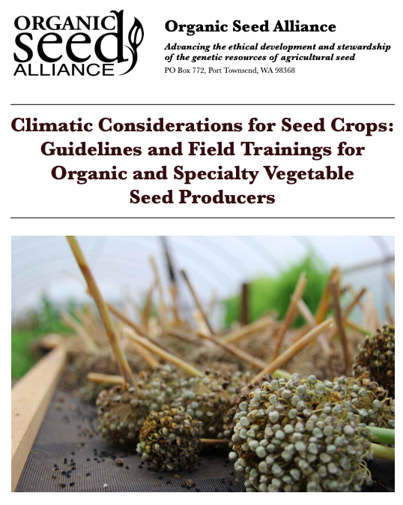
Could seed production work for my farm?
Climatic considerations
Temperature
Day length
Frost free days
Precipitation
Wind
Insect activity
Notes:
SEED PRODUCTION FOR PERSONAL OR COMMERCIAL USE
Do you have the environmental conditions for pollination and fertilization of the species you are producing?
Temp: too much heat or cold- pollen viability or damage to apical growing points. Biennials: minimum temperature for vernalization. Broccoli and radish can be vernalized in 1 season. Diurnal temperature fluctuation
Day length: influences flower initiation in many crops (photoperiodism). Cabbage, carrot, onion, spinach (requires 14 hour days to initiate flowering)
Frost free days: Seed crops often require a longer growing season. Lettuce, more than twice as long for seed.
Precipitation: plant health, pollinator activity, seed dry-down/ disease potential, early germination,
Wind: pollination, dry-down, lodging
Land in general and space for proper isolation
• Yield and economic data by crop and region
• Resources on production practices (weed, disease,
and pest management)
• Support to troubleshoot production challenges (access
to experts)
• Testing equipment and facilities (germination and
GMO contamination)
• Scale-appropriate and affordable equipment
• Handling and storage facilities
• Marketing assistance

Slide 9
Could seed production work for my farm?
Economic considerations
Markets
Land requirements
Isolation distances
Operating costs
Stock seed through storage
Equipment and machinery
Scale appropriate
Testing
Germination, seedborne diseases, GMO contamination
Labor
Existing knowledge/ access to resources
Notes:
Markets: (which crops, how much and when?)
Land requirements: (lease or ownership) keep isolation distances in mind
Operating costs: access to quality stock seed (was an issue in SOS, stock seed may need to be “cleaned up.”
land prep all the way through post harvest, seed cleaning and storage.
Planting, harvesting, seed extraction, cleaning, drying, storage equipment,
Can I borrow or use something I already have? Divide costs among crops equipment is used for. Unless a piece of equipment is crop specific.
Transaction cost: also refers to time taken to build marketing relationships. Knowledge about how to navigate commercial constracts, which OSA is part of a project to offer education around.

Slide 10
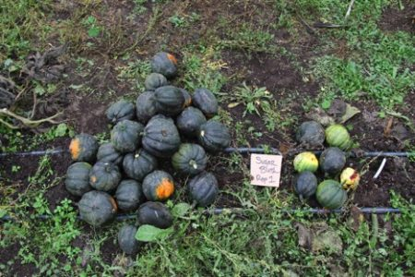
Enterprise budget analysis
Slide courtesy of Ryan Pesch
5 producers involved in seed enterprise project
4 crops produced
Small spaces:
Tomato seed production: 1,000-2,000 SF
Potato production: 300-600 SF
Carrots: 100 SF
Selection of harvest for seed only a portion of crop, 10-25%

Slide 11
A Tale of Labor: Direct Costs Minimal
Slide courtesy of Ryan Pesch
Field production time = greenhouse work, tillage/bed prep, planting, mulching, fertilizing
Seed production time = harvest, extraction, drying, winnowing, germination tests
Range of inputs/return per crop (one farm example):
 | Carrots | Tomatoes | Potatoes | Squash
Yield (lbs) | 0.5 | 0.25 | 300 | 2
Input costs | $ 63 | $ 40 | $ 178 | $ 5
Field production time (hours) | 13 | 13.5 | 33 | 3.7
Seed production time (hour) | 16 | 12 | 20 | 10
Labor @ $15/hr. | $ 435 | $ 383 | $ 795 | $ 206

Slide 12
Profitability tied to Production Efficiency
Tomatoes | Farm A | Farm B
Space (SF) | 780 | 1,000
Yield (lbs) | 0.25 | 0.248
Input costs
soil mix | $ 20 | $ 4
fertilizer | $ 20 | $ -
Subtotal | $ 40 | $ 4
Field production time
Seeding/greenhouse work | 5.5 | 3.3
Planting | 4 | 0.2
Weeding/cultivating/hoeing | 3 | 0.1
Fertilizing | 1
Mulching |  | 1.6
Seed production time
Harvesting | 4 | 0.75
Bucketing/cleaning | 2 | 3
Drying | 1 | 0.5
Screening/winnowing | 2 | 2
Storing/organizing | 1 | 1
Germ testing | 2 | 2
Subtotal | 25.5 | 11.45
Total with labor @ $15/hr | $ 423 | $ 175
Wide variation between growers in labor inputs
Relates to production system (all hand, mechanized, semi-mechanized)
Comparison between two operations:
Slide courtesy of Ryan Pesch

Slide 13
Thank you!
kitt@seedalliance.org
Notes:
Find preferred method to communicate with growers to gather unified data
Have organizational, educational support and resources for growers and managers (OSA, UMN extension (enterprise analysis), SFA of MN, etc).
Business support (SBDC, Universities)
Clean, process, dry, seed in one location and celebrate successes (Annual Gathering and Feast!)
Grow same seed varieties at multiple sites, and grow extra seed- mitigate risk
Save seed from best plants – and from multiple plants (preserve genetics)
Start small – a handful of varieties, a handful of experienced reliable growers
Sell seed that experienced growers have already been saving for years. Regionally adapted, have story and growing recommendations.
Other considerations?

