Slide 1
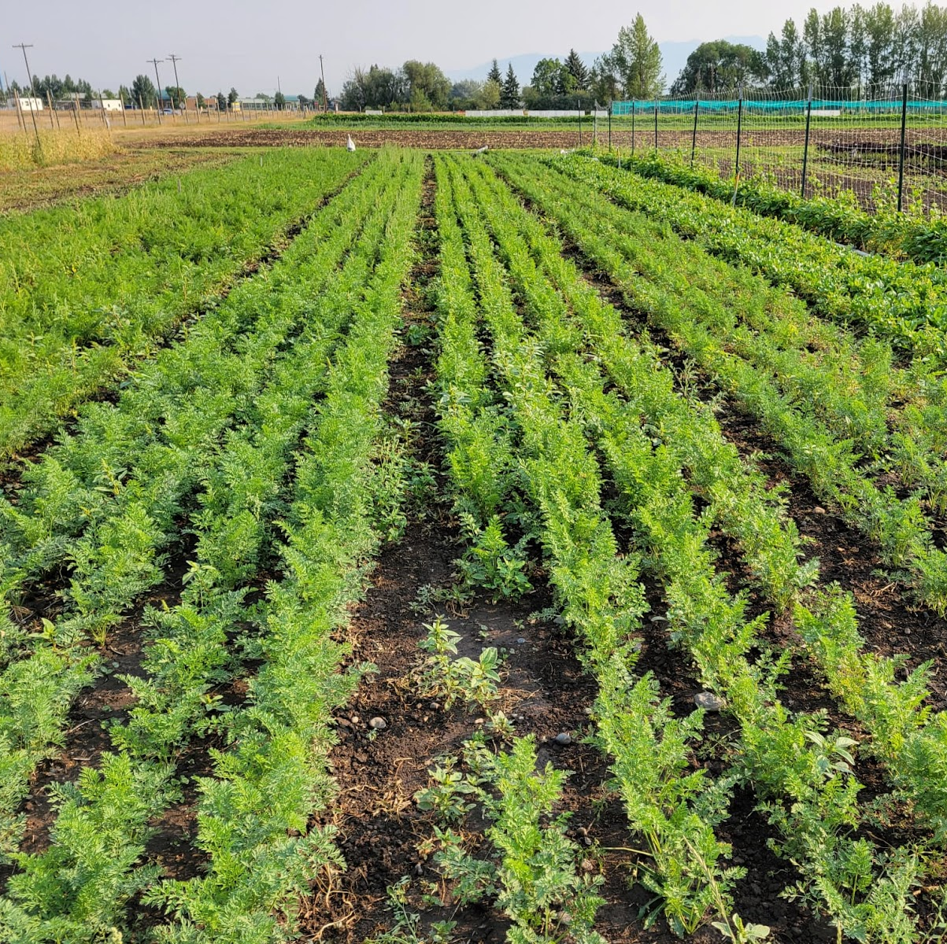

System Thinking in my Research:
Carrots as a Model for Increasing the Sustainability of Vegetable Farms in Montana
Notes:
Don’t need to re-introcue or title

Slide 2
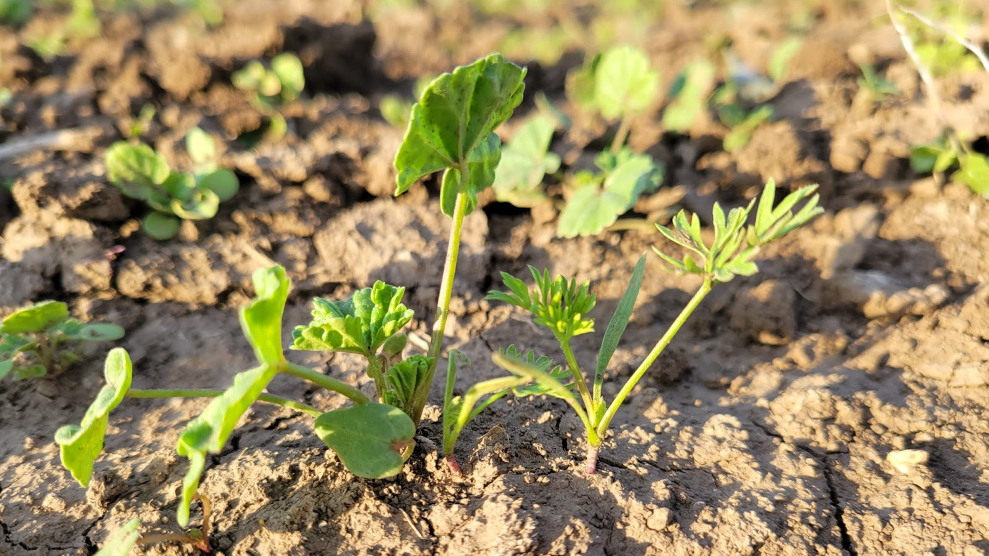

Slide 3
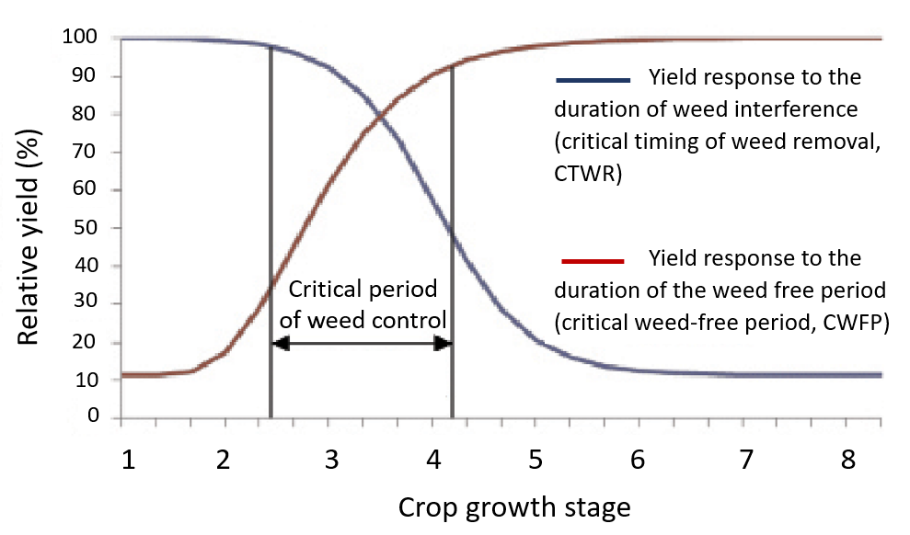
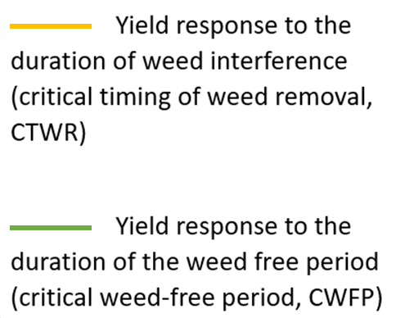
Defining the critical period of weed control
Critical period of weed control
The period in which weed removal is necessary to avoid yield and economic loss
Notes:
Blue- how long crop can coexist yield reduction
Red- how long crops must remain weed free to maintain high yields

Slide 4
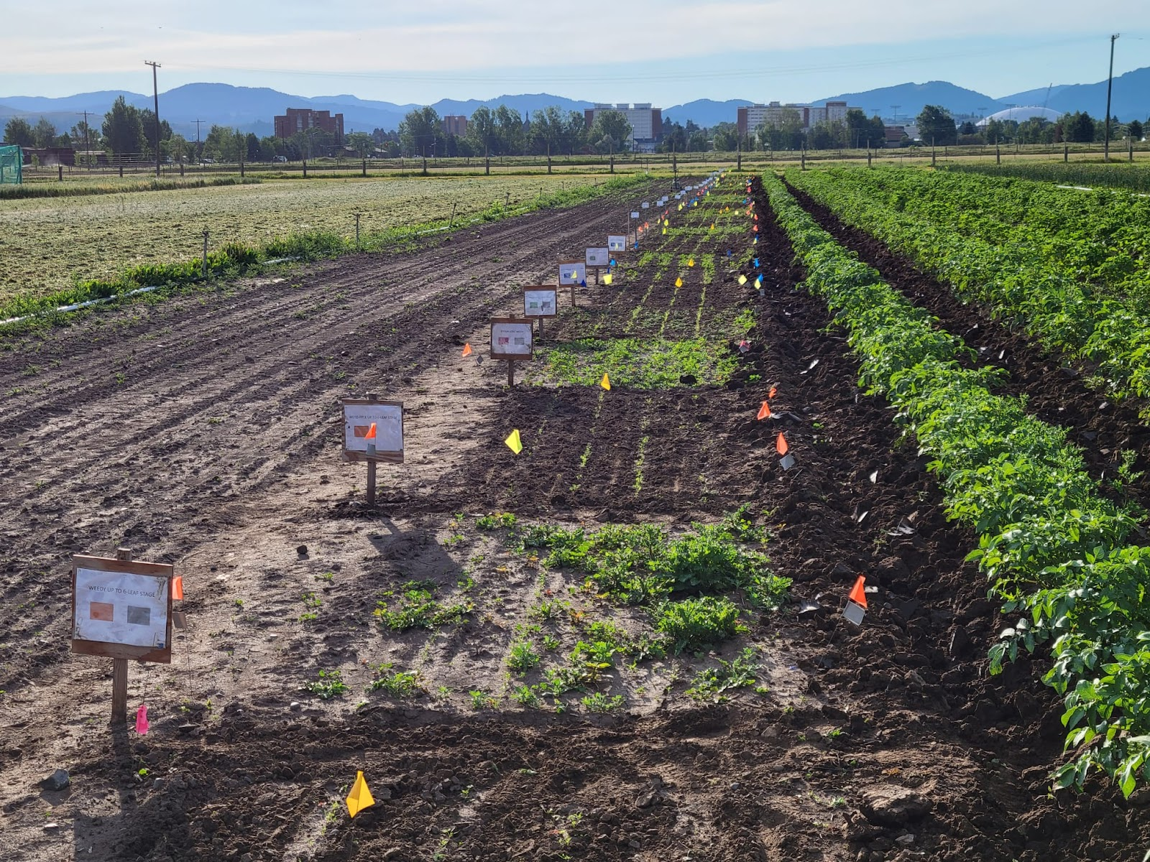
Experimental Design
Townes Harvest Garden, MSU
9 treatments:
  Weedy up to the 2, 4 ,10 leaf stage
  Weed free up to the 2, 4, 10 leaf stage
  Weedy season long
  Weed free season long
Notes:
Explain where/what Towne Harvest is

Slide 5
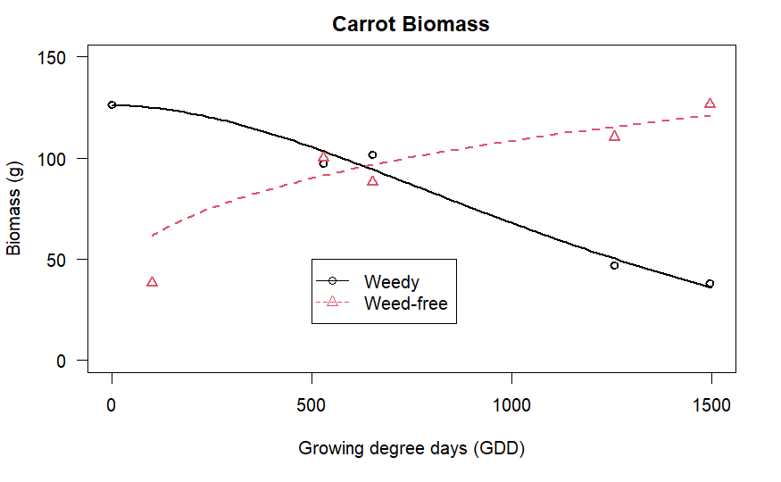

Slide 6
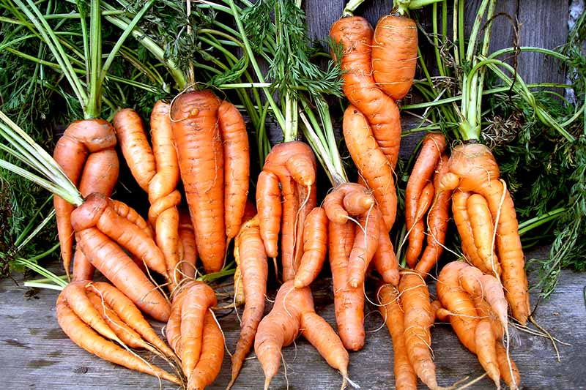
Gardener’s Path

Slide 7
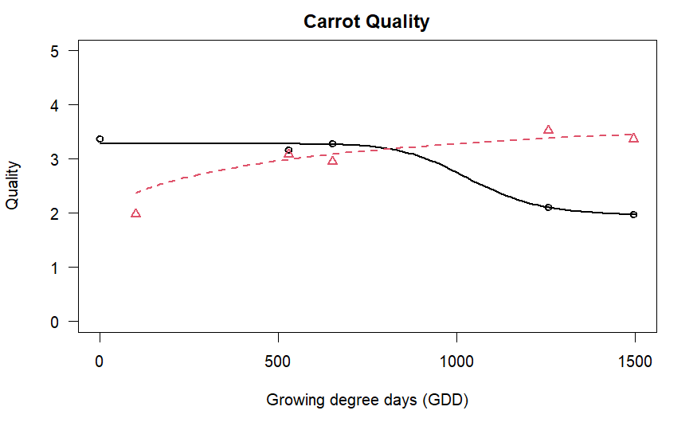

Slide 8
Is this increasing resiliency from a systems perspective???
We can think bigger!!!

Slide 9
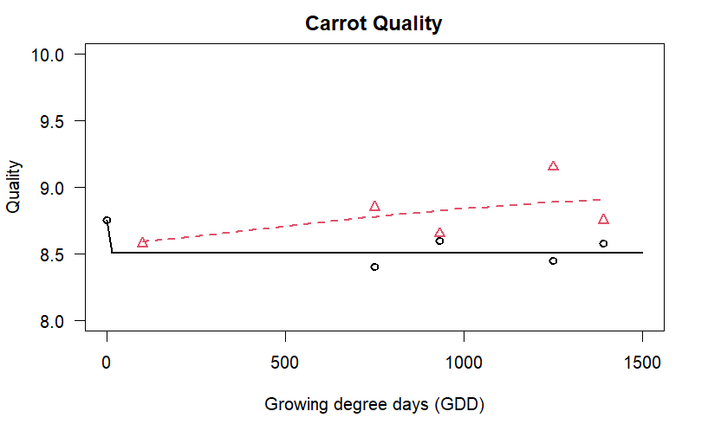
Carrot Sugar Content

Slide 10
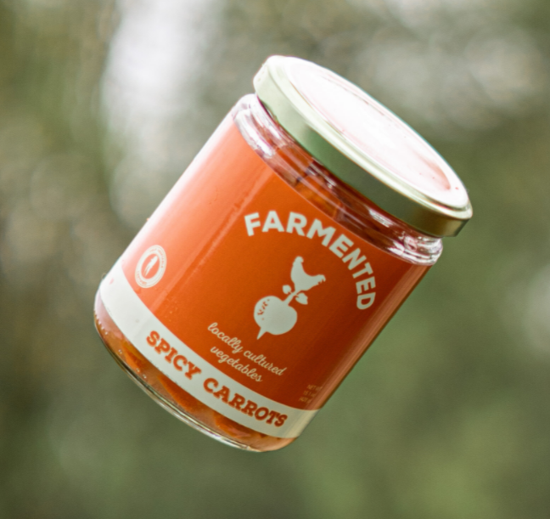

Value added products: raw products that are enhanced to increase their market value
Local companies will provide information on
  Potential value-added products for carrots
  Estimation of labor costs
  Price “ugly” produce

Slide 11
Step further… thinking more of resiliency in the long term

Slide 12
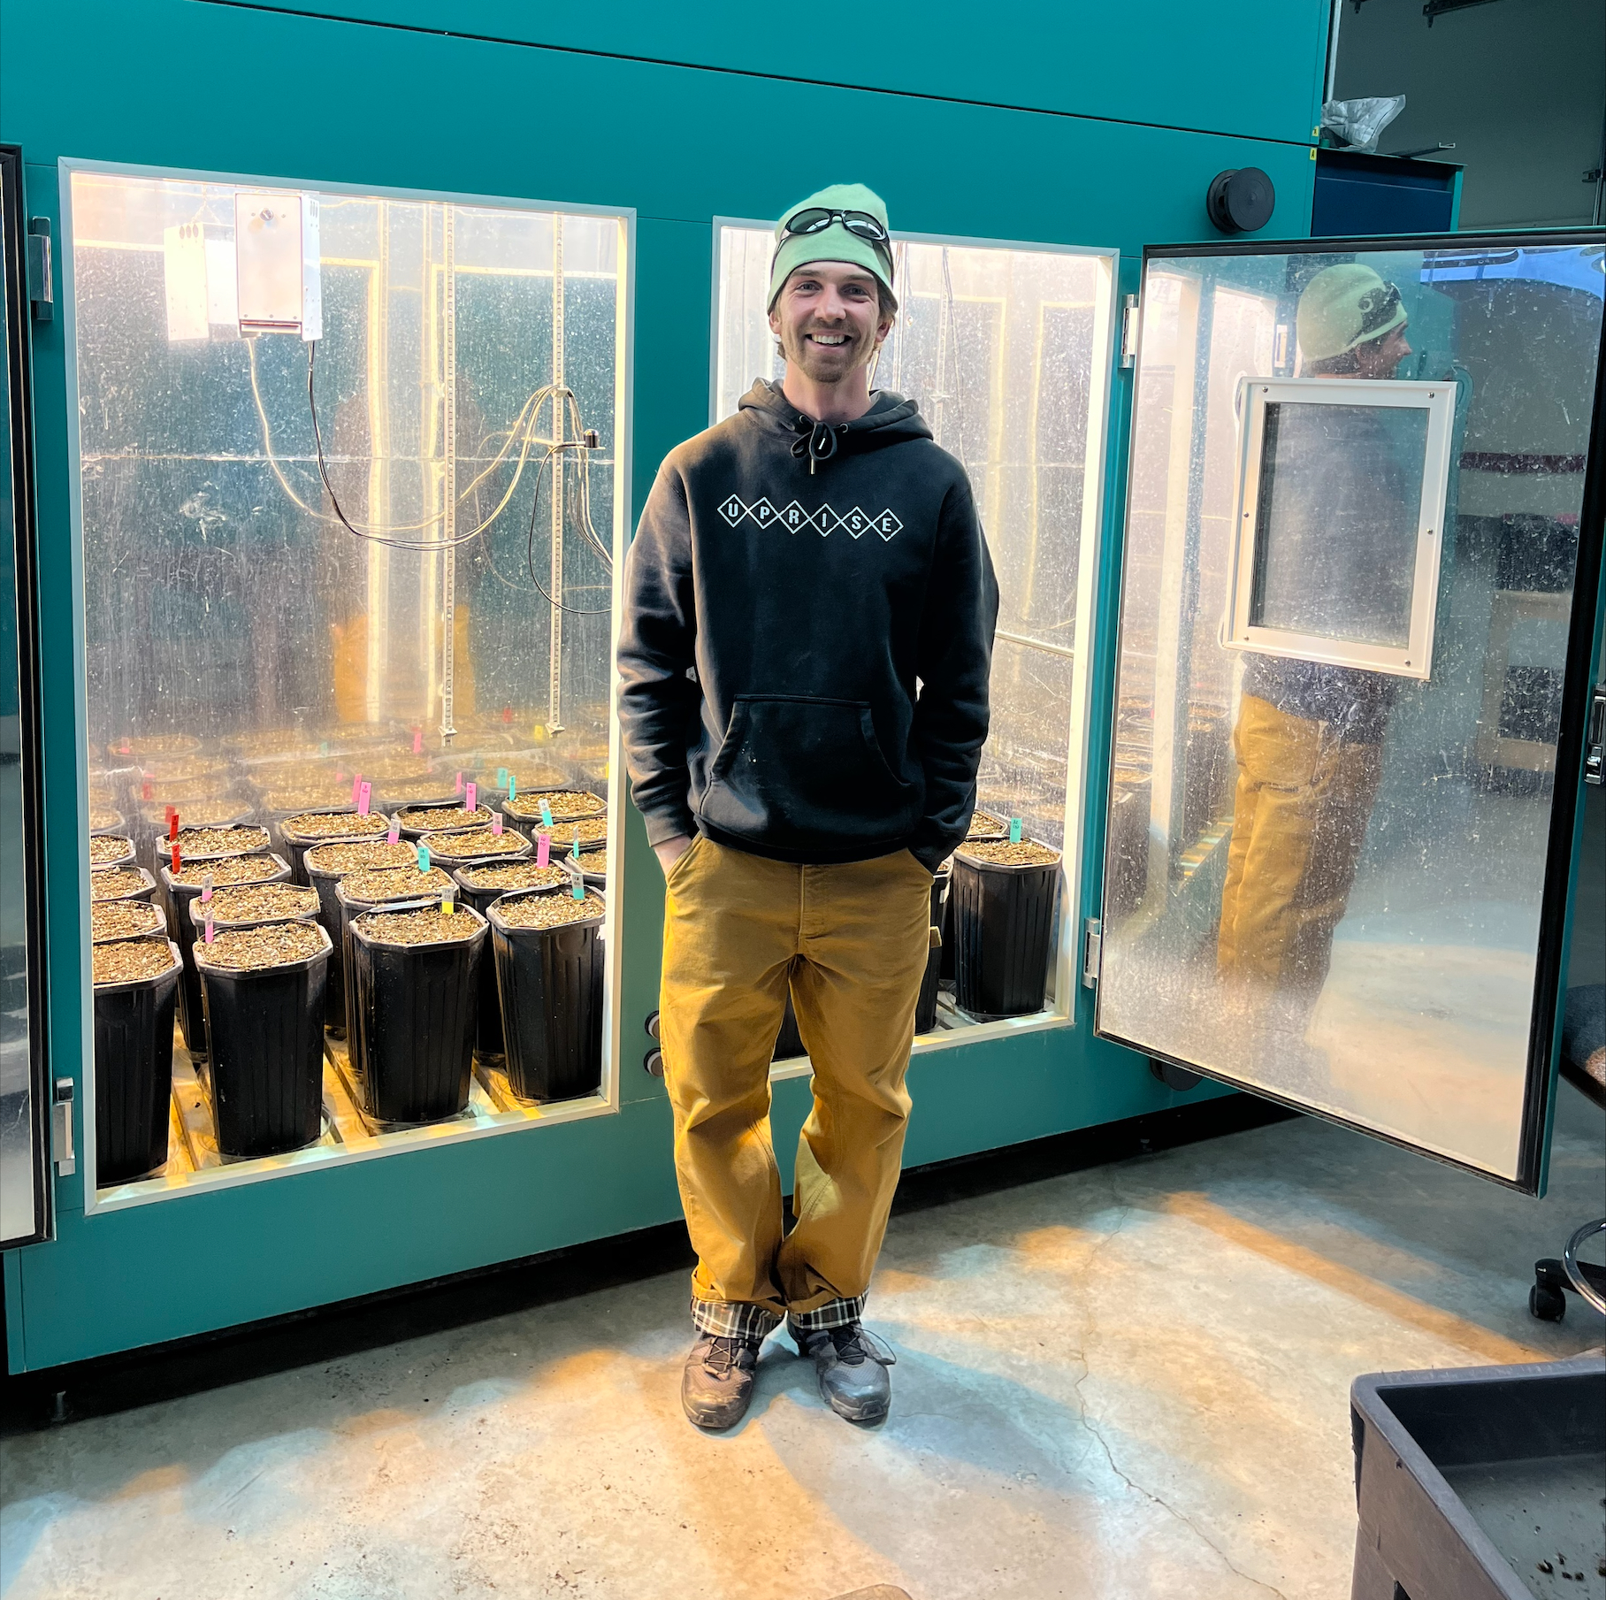
How will the Critical Period of Weed Control change with climate change?
Greenhouse experiment in elevated and ambient CO₂
Kevin Sheridan

Slide 13
What other things can you think of that could be incorporated into this system?
What other nodes could we connect?

