Slide 1
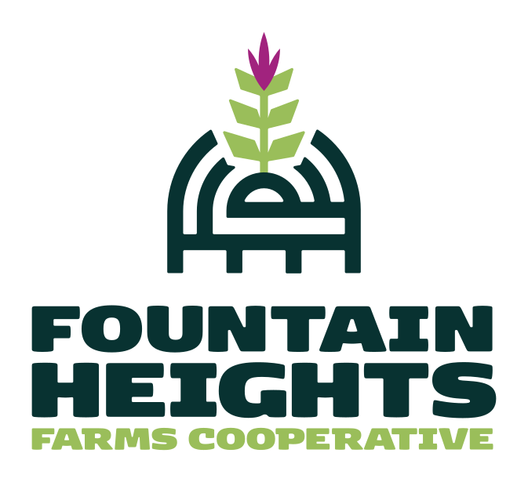
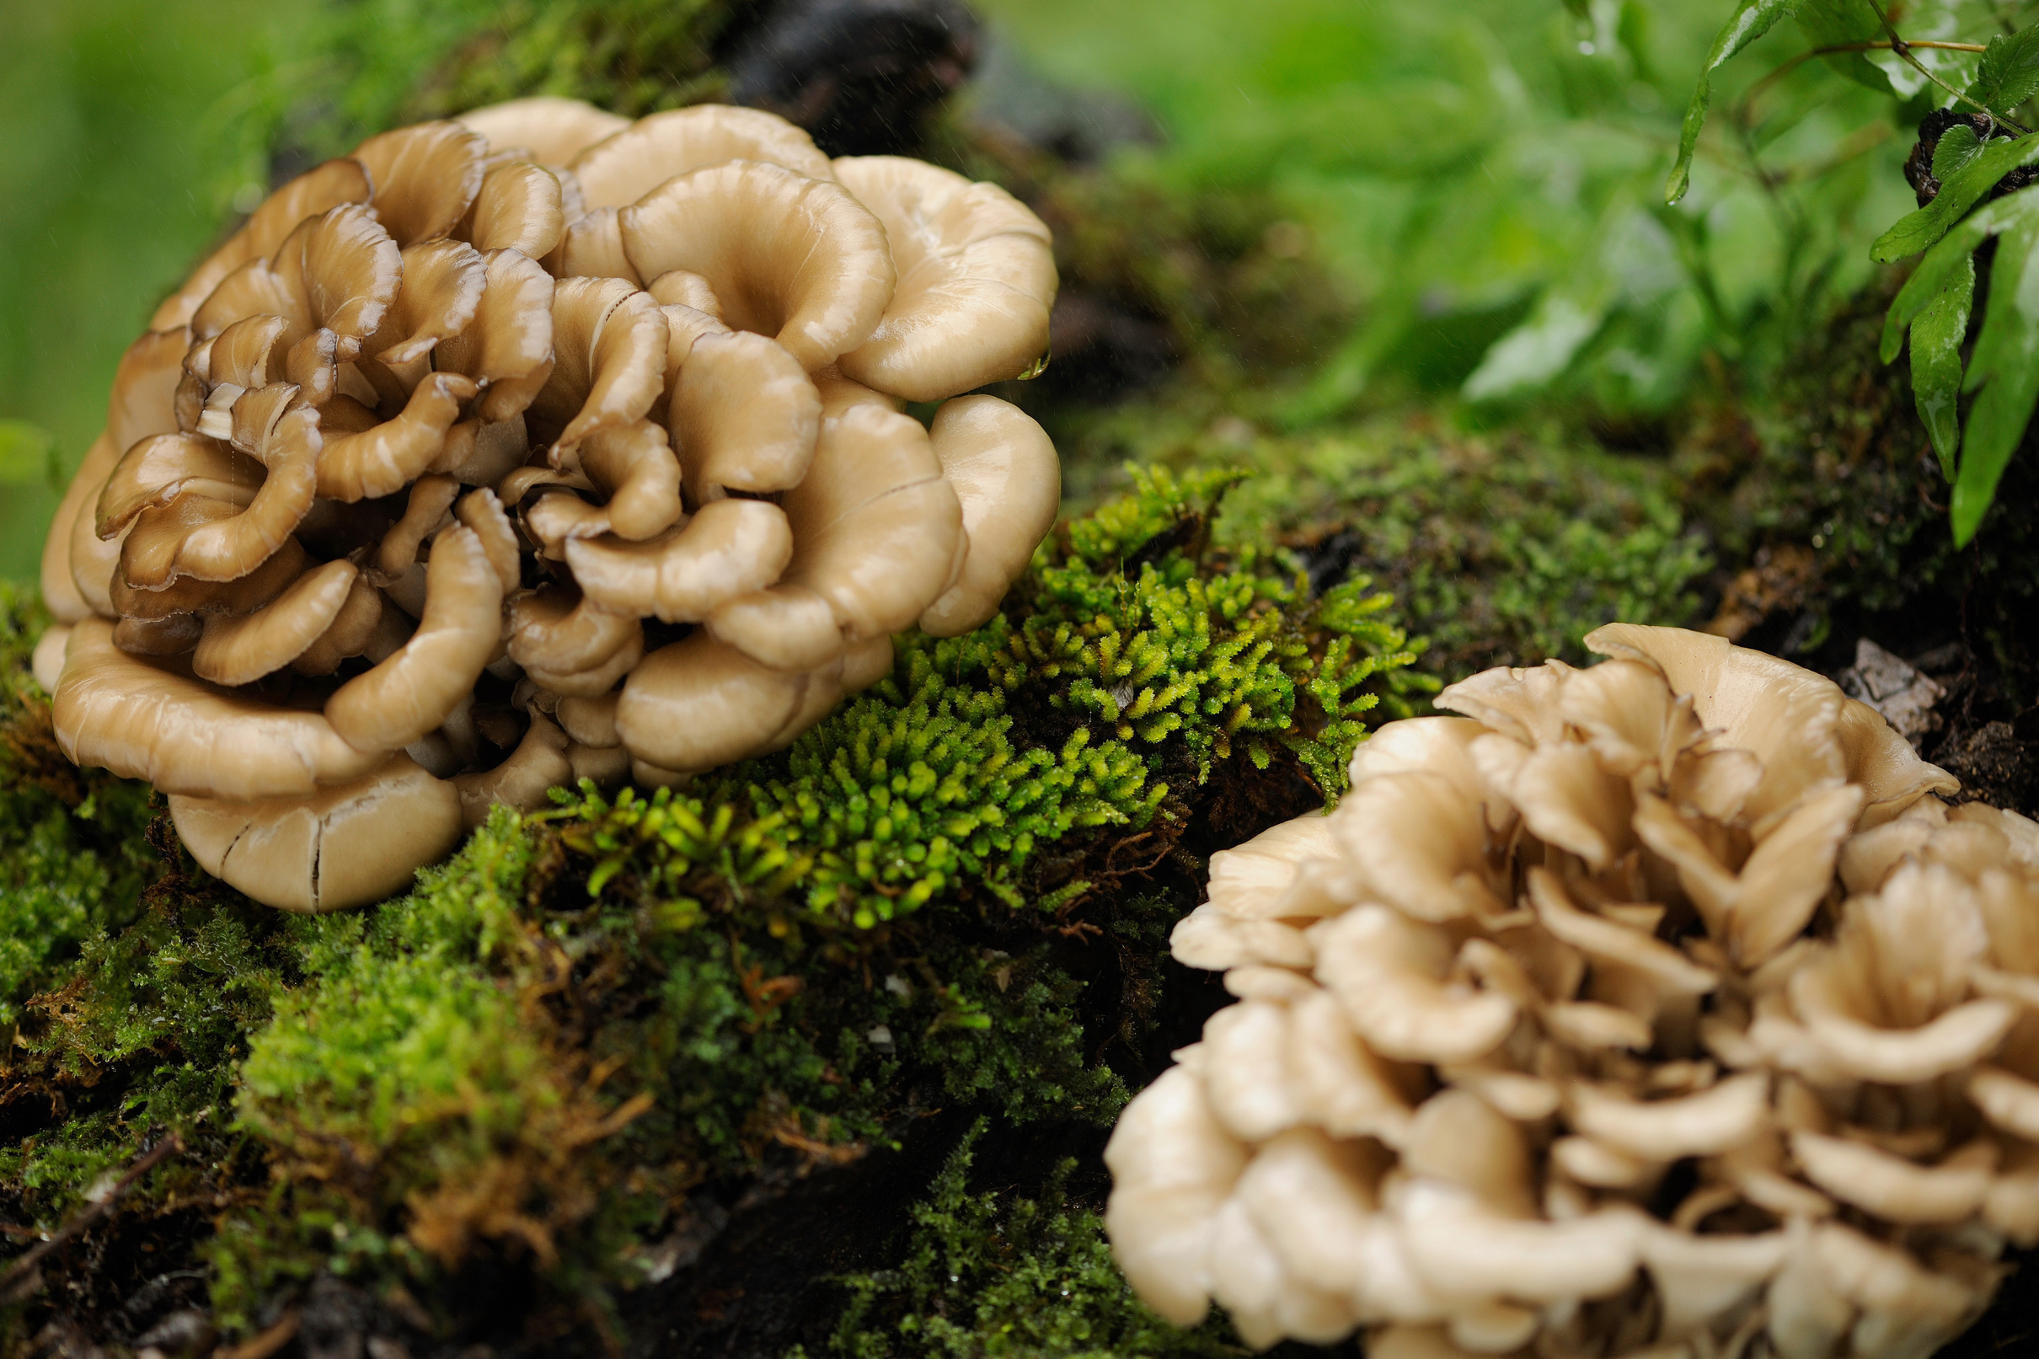

Urban Mushrooms
Fountain Heights Farms
On Mimosa Wood

Slide 2
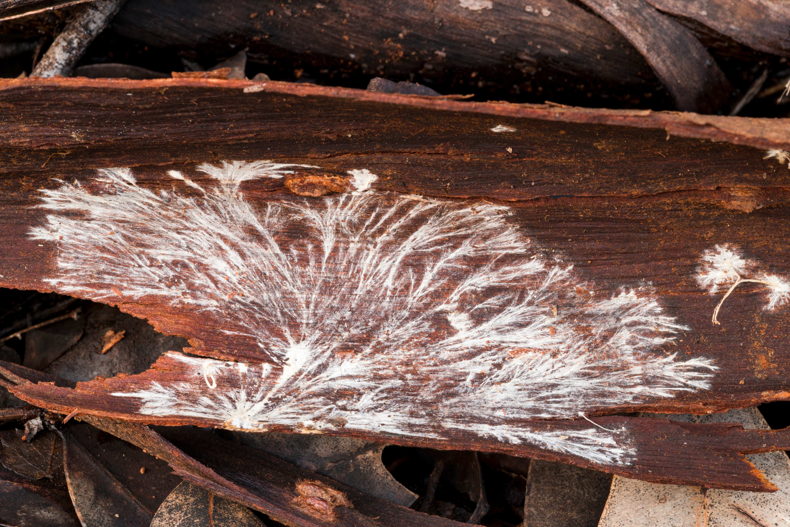
Fountain Heights Farms
Many thanks to our creator, the earth that sustains us, and our ancestors and brethren who have cared for our earth for milenia. We are grateful and responsible...

Slide 3
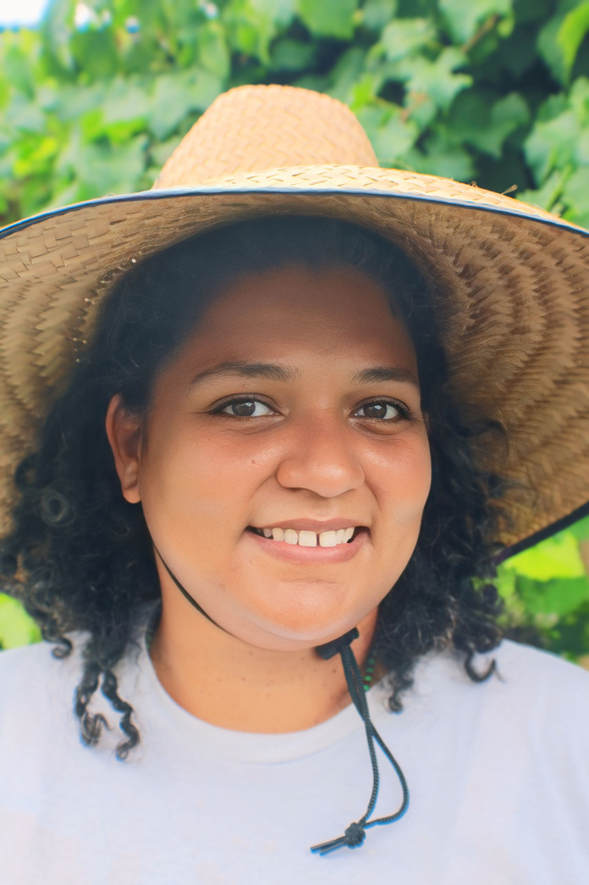

About Us
Fountain Heights Farms enriches the historic Fountain Heights community through urban farming, championing Black, Indigenous, and POC land ownership, and delivering culturally inclusive education.
We prioritize access to fresh, culturally relevant foods, support land justice, foster flexible food system employment, and empower our community through reflective, responsive education.
M. Dominique Villanueva (she/her)
Farmer, CoFounder, and Executive of Vision & Strategy for Fountain Heights Farms, an 11-site urban farm system in Birmingham, AL
This project FS22-343
was funded by the Southern Sustainable Agriculture Research & Education (SSARE) program.

Slide 4
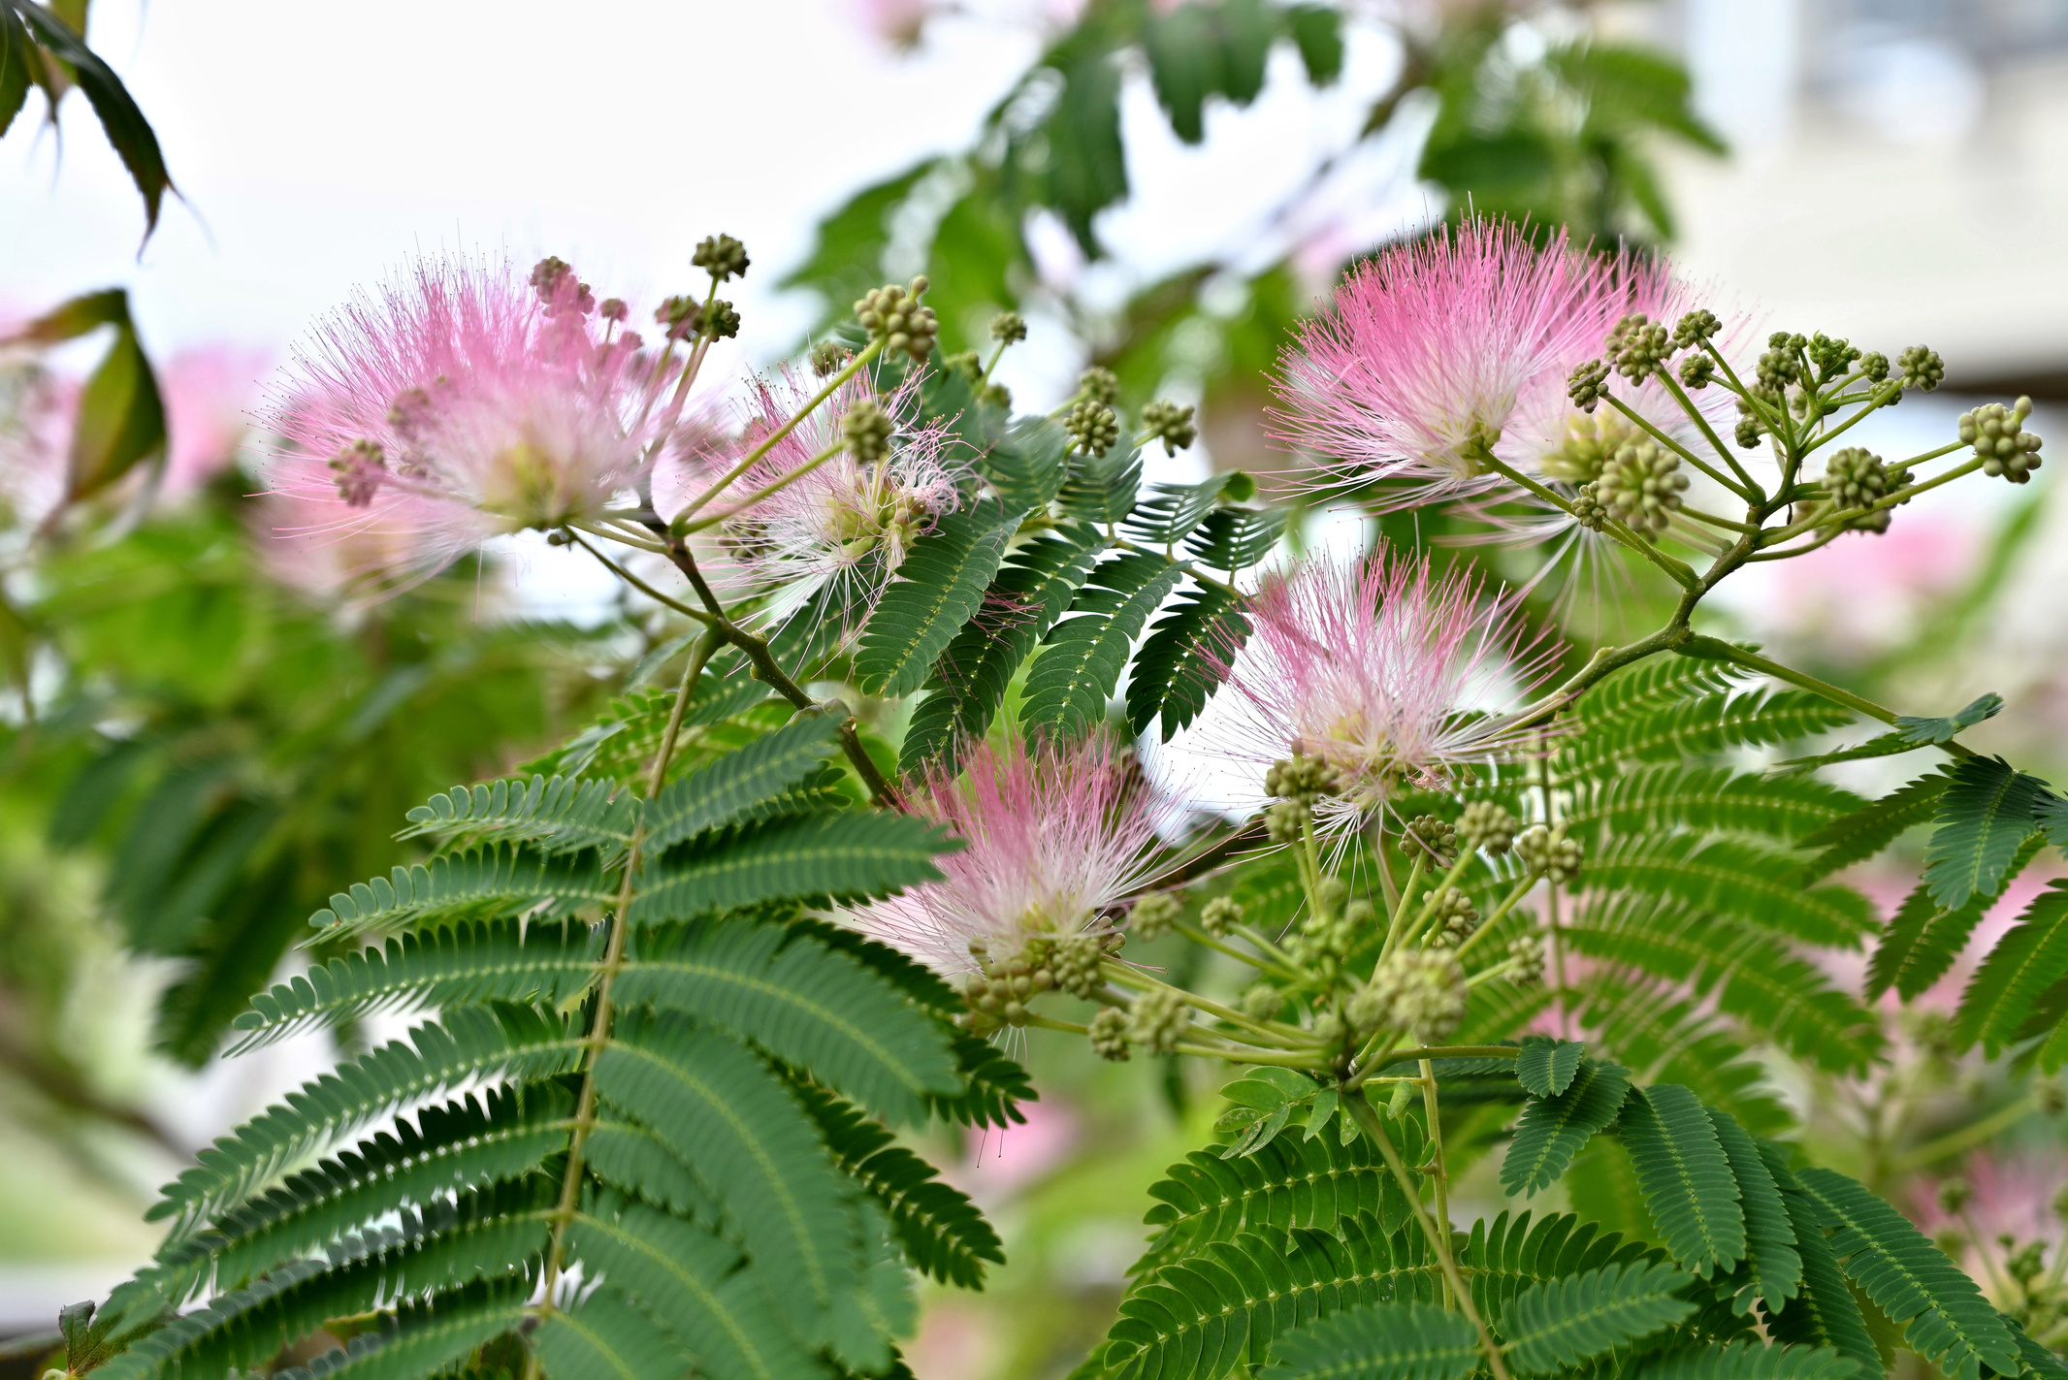
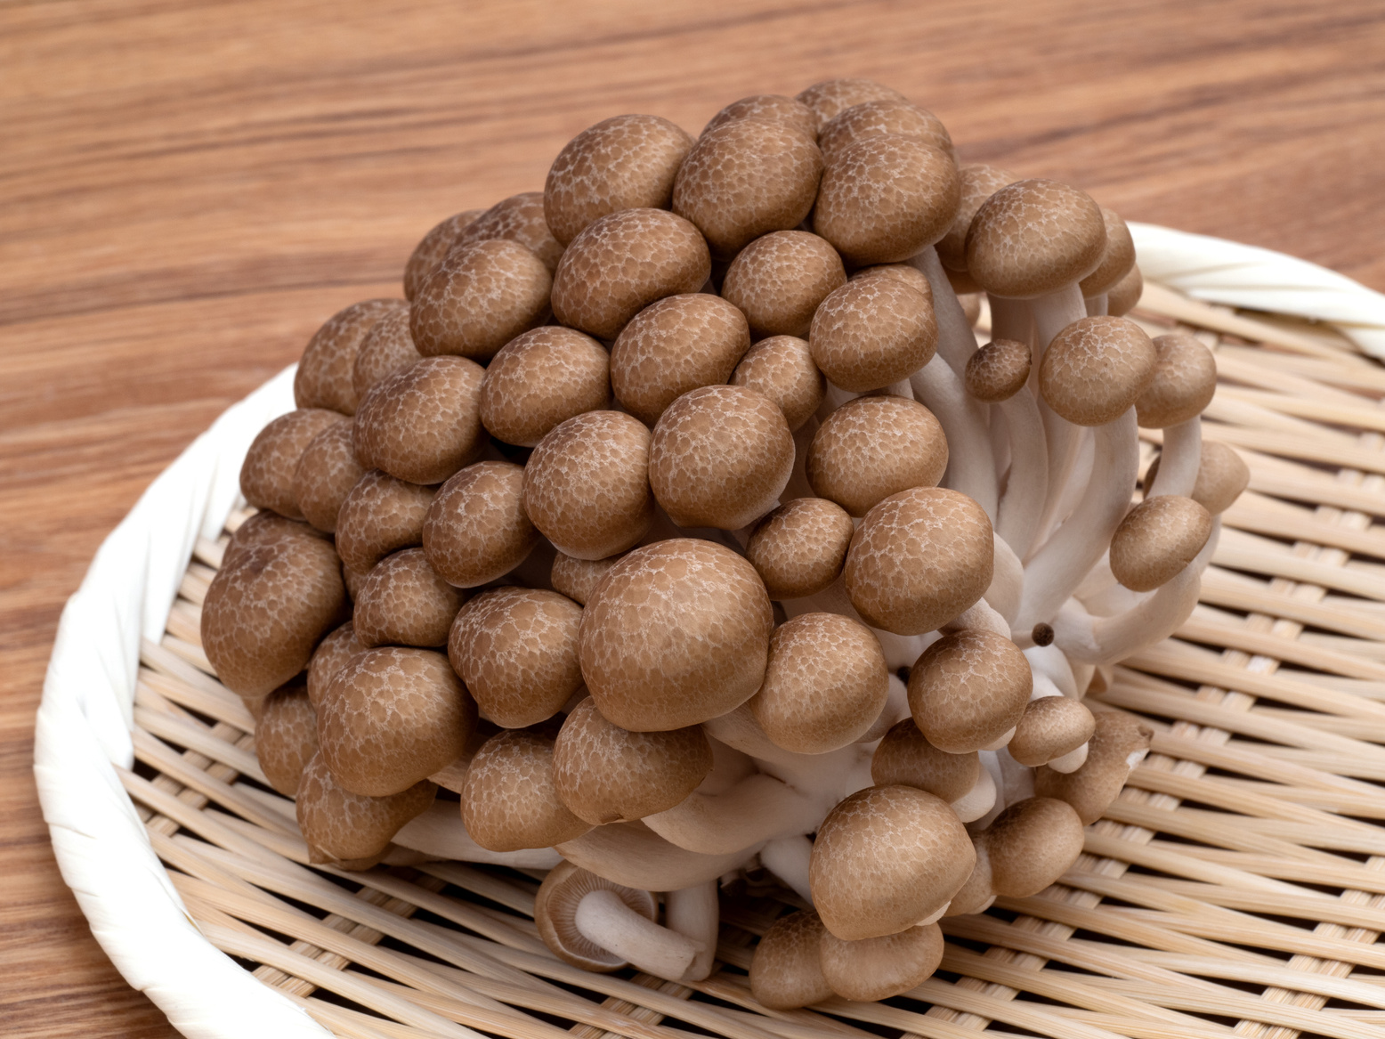
About the project
The purpose of the Urban Mushrooms on Mimosa Wood Project is to test the viability, yield, and length of the production of growing mushrooms outdoors using Mimosa logs while considering some of the community improvements that may come for the project.
How can we increase income for our neighbors in a way that takes into account their specific needs and abilities?
This project FS22-343
was funded by the Southern Sustainable Agriculture Research & Education (SSARE) program.
Notes:
Primary Goals:
Can mushrooms successfully grow on Mimosa logs?
How do Mimosa log yields compare to Paper Mulberry logs?
How long will Mimosa logs continue to produce mushrooms?
Secondary Goals:
Does mushroom farming on invasive logs improve urban farm efficiency?
Can it create a replicable, low-cost model for other farmers?
Will clearing blighted lots for mushroom cultivation enhance community well-being?

Slide 5
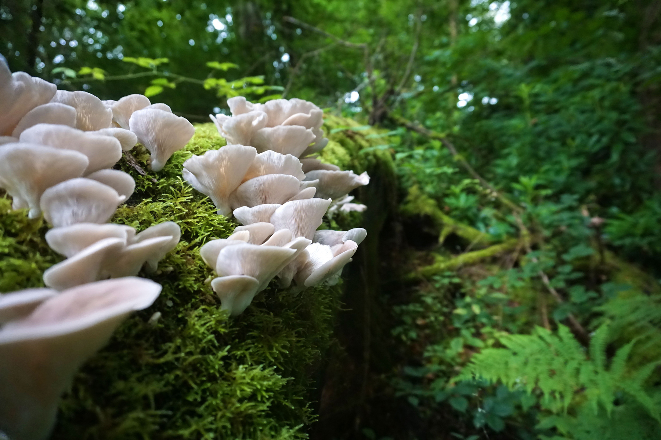
Primary Goals:
    Can mushrooms successfully grow on Mimosa logs?
    How do Mimosa log yields compare to Paper Mulberry logs?
Secondary Goals:
    Does mushroom farming on invasive logs improve urban farm income?
    Can it create a replicable, low-cost model for other farmers, neighbors, and communities?
    Will clearing blighted lots for mushroom cultivation enhance community well-being?
This project FS22-343
was funded by the Southern Sustainable Agriculture Research & Education (SSARE) program.

Slide 6
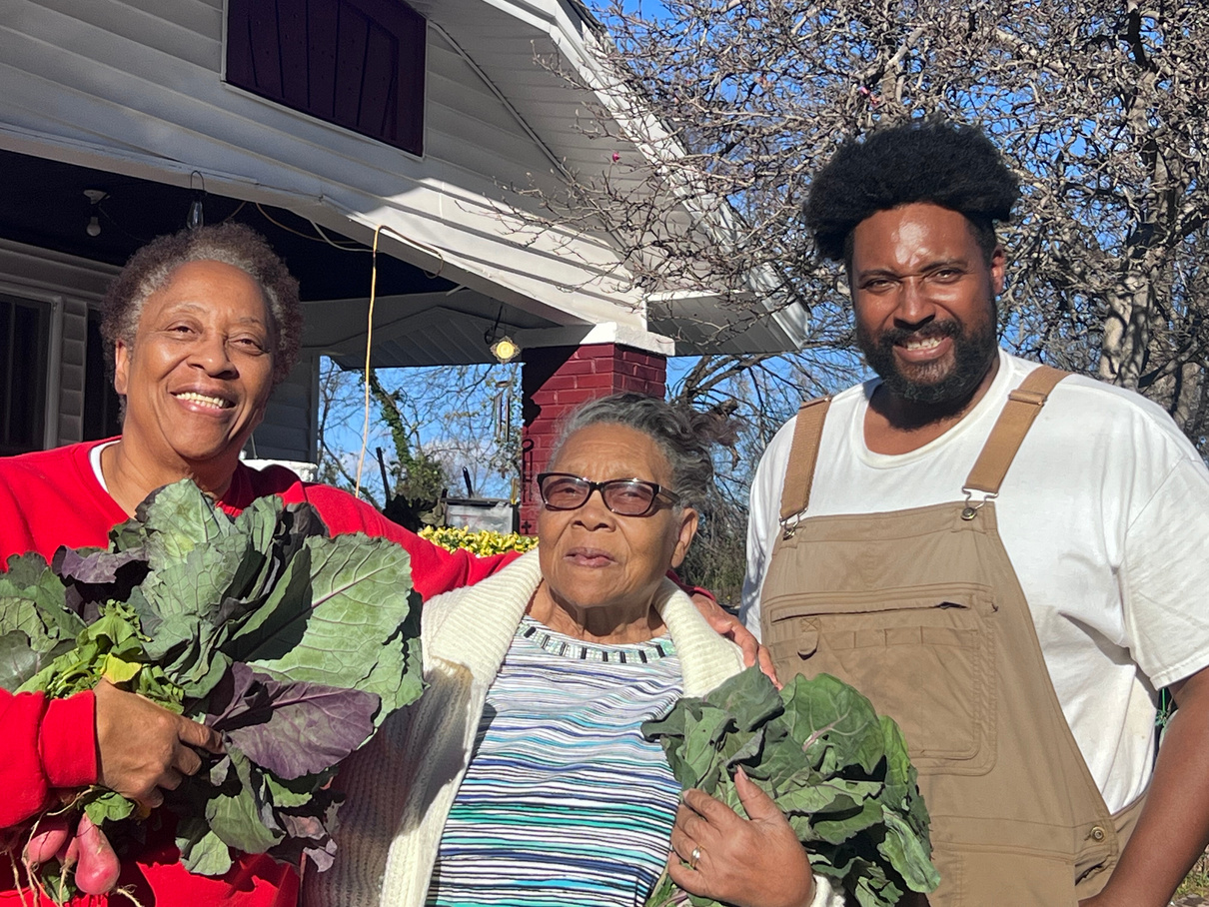
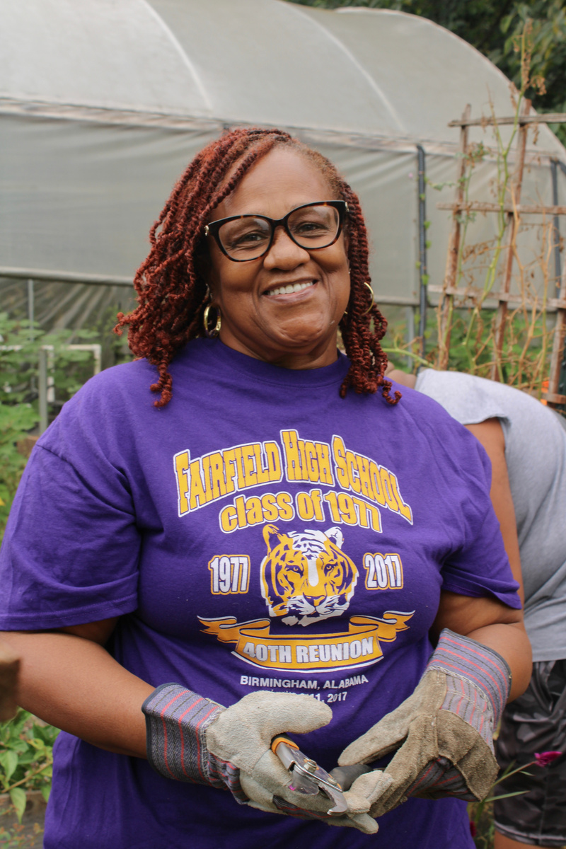

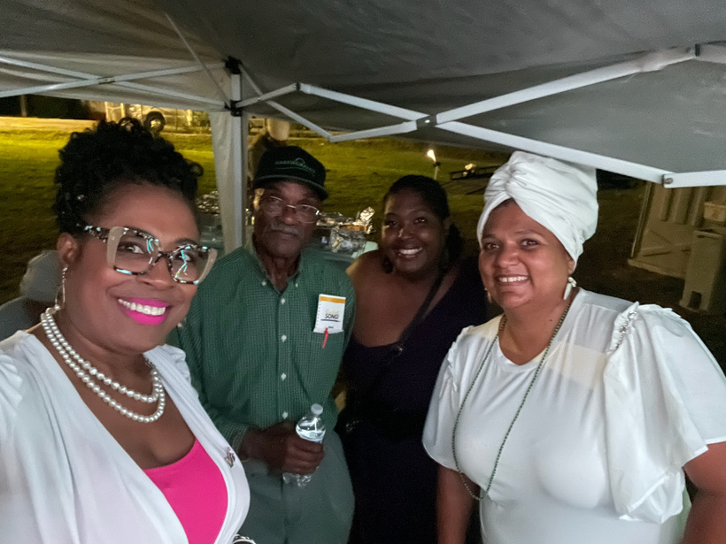

Our Cooperators
Community Care Means Everybody Eats
Ms. Senata & Aunt T
Ms. Bouie
Christopher Gooden
Ms. Battle, Mr. Whatley, Ms. Lyons, and Me
Mushroom farmers, neighbors, and longtime residents of Fountain Heights
Mushroom farmer, neighbor, and longtime resident of Fountain Heights
Herbalist, Farmer, and CoFounder for Fountain Heights Farms, an 11-site urban farm system in Birmingham, AL
Neighborhood Association Vice President, Secretary, and President, all residents of Fountain Heights for over 50 years.

Slide 7
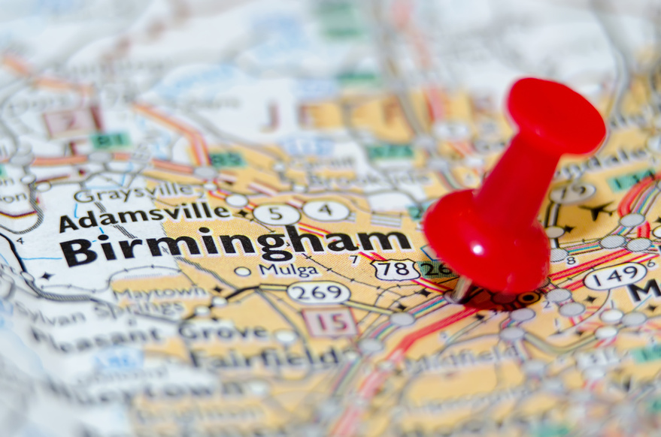
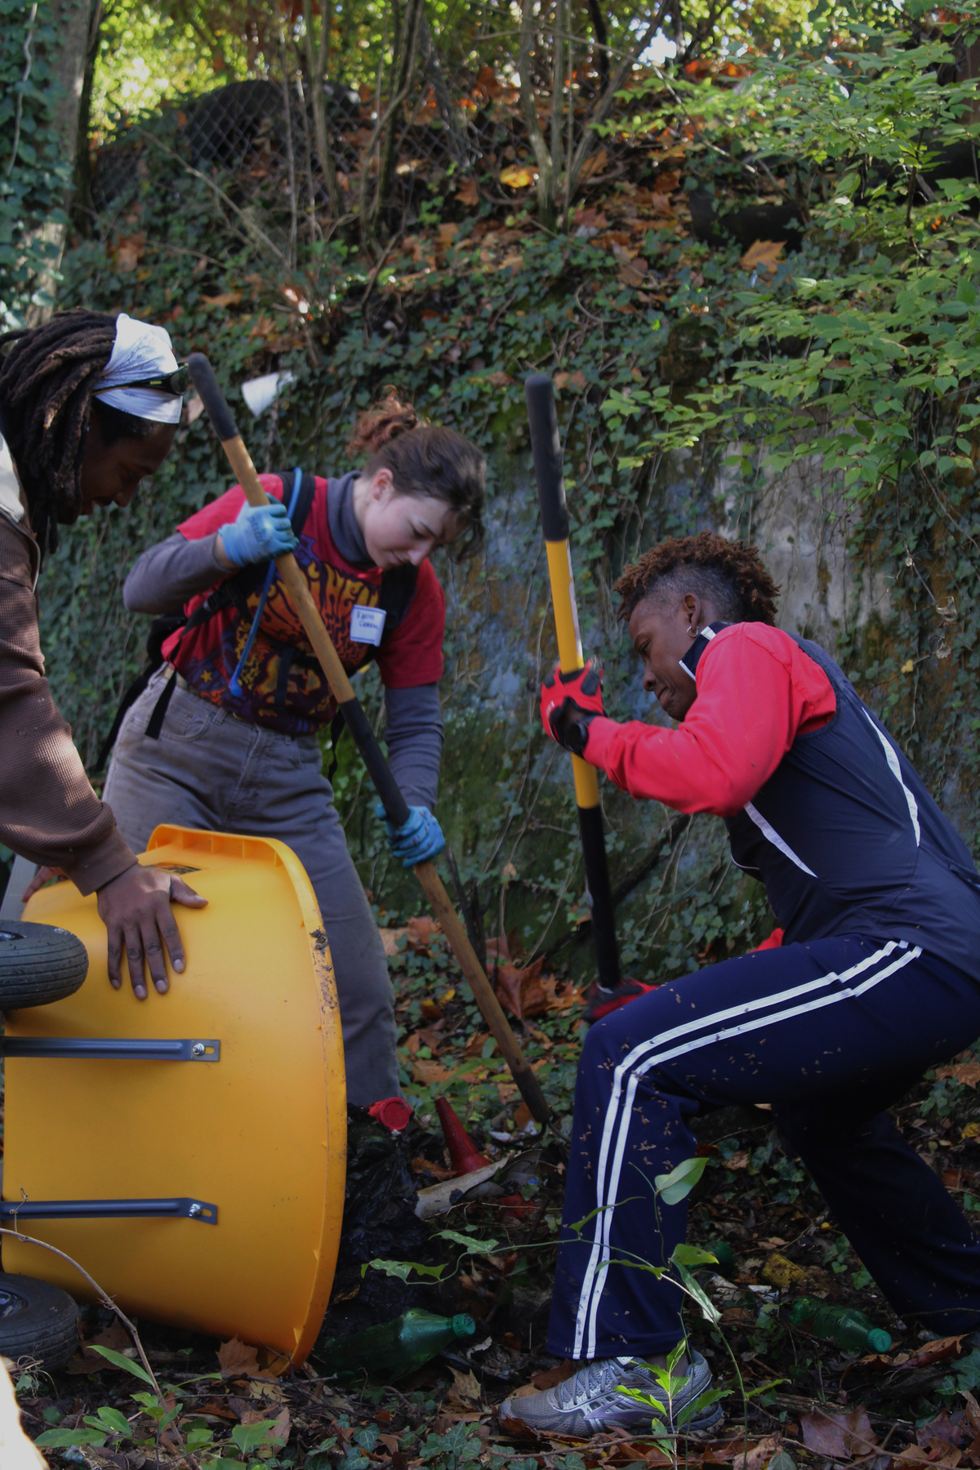
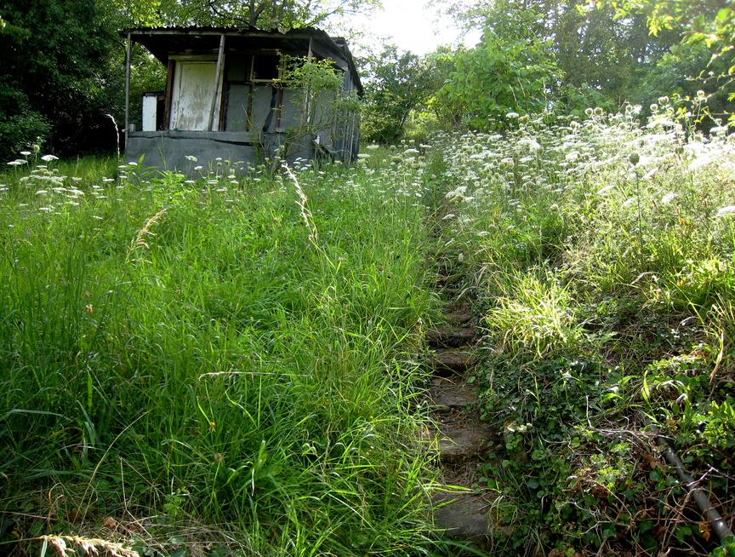

Community Survey
  On a scale of 1-5, how satisfied are you with the overall appearance of the urban mushroom farm space in your community?
  Have you noticed any changes in the appearance of the neighborhood since the inception of the urban mushroom farm space?
  How do you feel about the level of community involvement and engagement related to the urban mushroom farm space?
  Has the urban mushroom farm space increased or decreased your sense of community in the area?
  Has the urban mushroom farm space had any impact on your mental and emotional well-being?
  Have you purchased or consumed any products from the urban mushroom farm space?
  Would you like to see more urban mushroom farm spaces or similar initiatives in your community?

Slide 8

Pre-project Results
 | 1 Very Unsatisfied | 2 Unsatisfied | 3 Neutral | 4 Satisfied | 5 Very Satisfied
Satisfaction with appearance (1-5) | 44 | 56 | 0 | 0 | 0
Community involvement rating (1-5) | 48 | 52 | 0 | 0 | 0
 | Yes | No
Noticed neighborhood changes? | 9 | 91
Purchased/consumed products? | 12 | 88
Want more urban mushroom farms? | 73 | 27
 | Negative | No Change | Positive
Sense of community impact | 12 | 78 | 10
Impact on mental/emotional well-being | 14 | 76 | 9

Slide 9
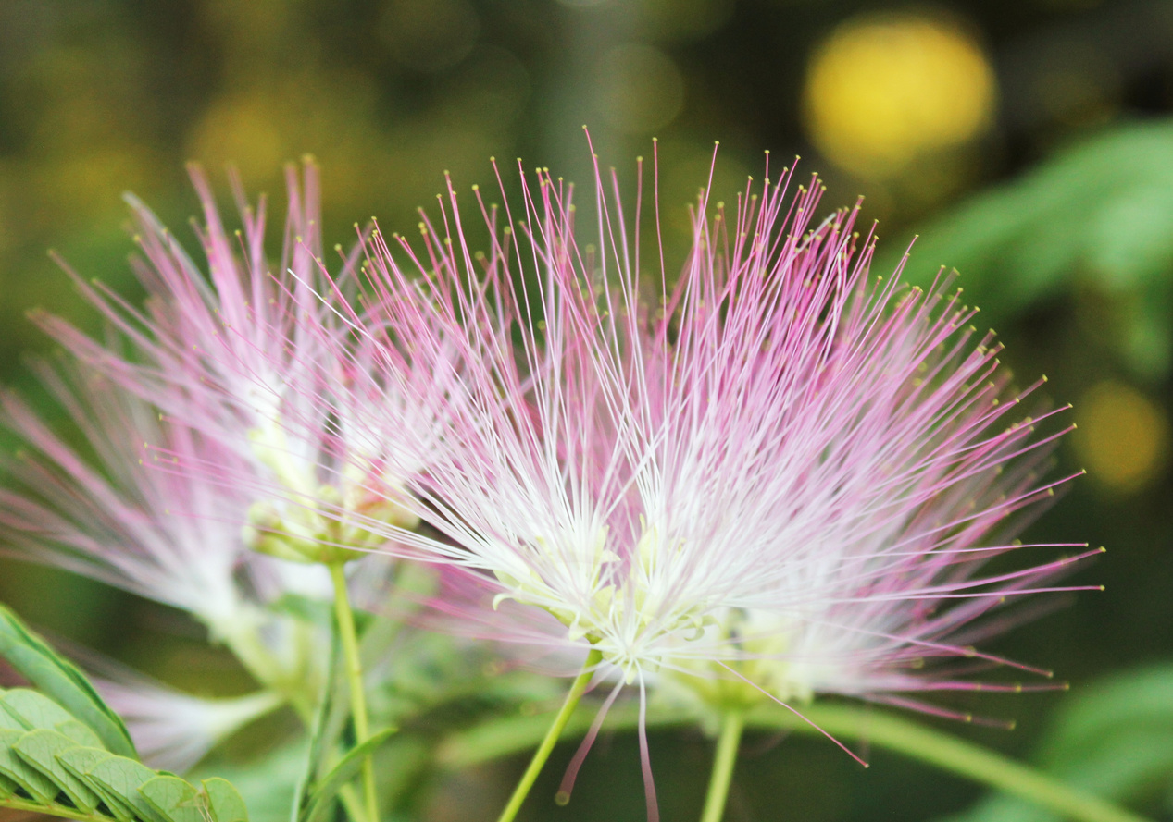
How to Identify a Mimosa Tree
  Look for the tree's distinctive compound leaves, which are fern-like in appearance and composed of numerous small leaflets. Each leaflet is typically between 1-2 inches long and oblong in shape.
  Check for the tree's fluffy, pinkish-purple flowers, which bloom in early summer and have a sweet, delicate fragrance. The flowers are typically 1-2 inches in diameter and resemble pom-poms.
This project FS22-343
was funded by the Southern Sustainable Agriculture Research & Education (SSARE) program.

Slide 10
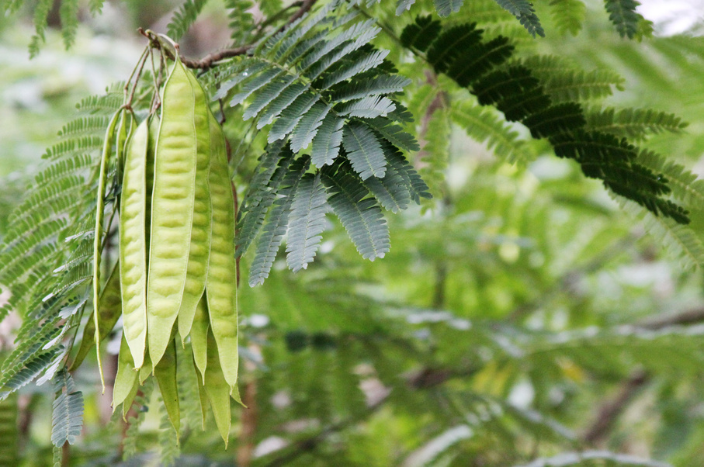
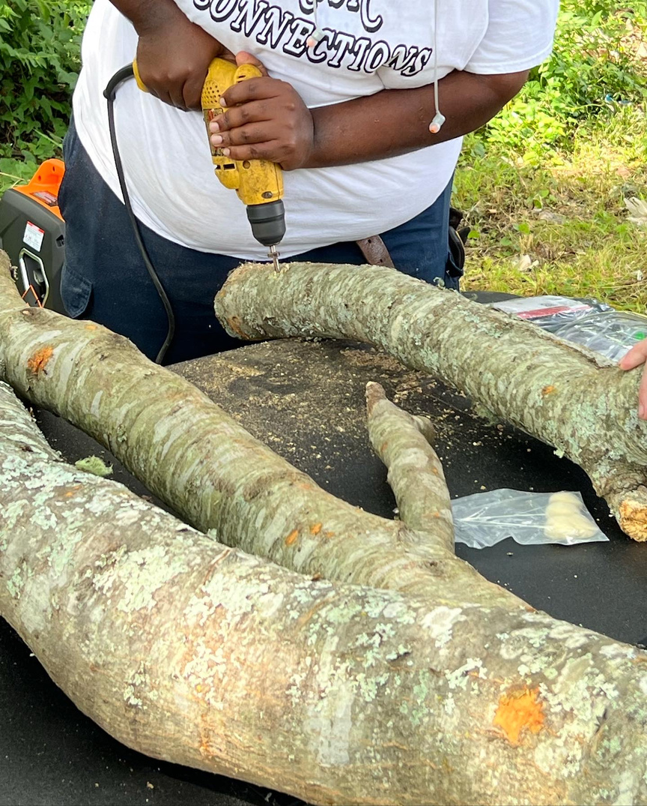
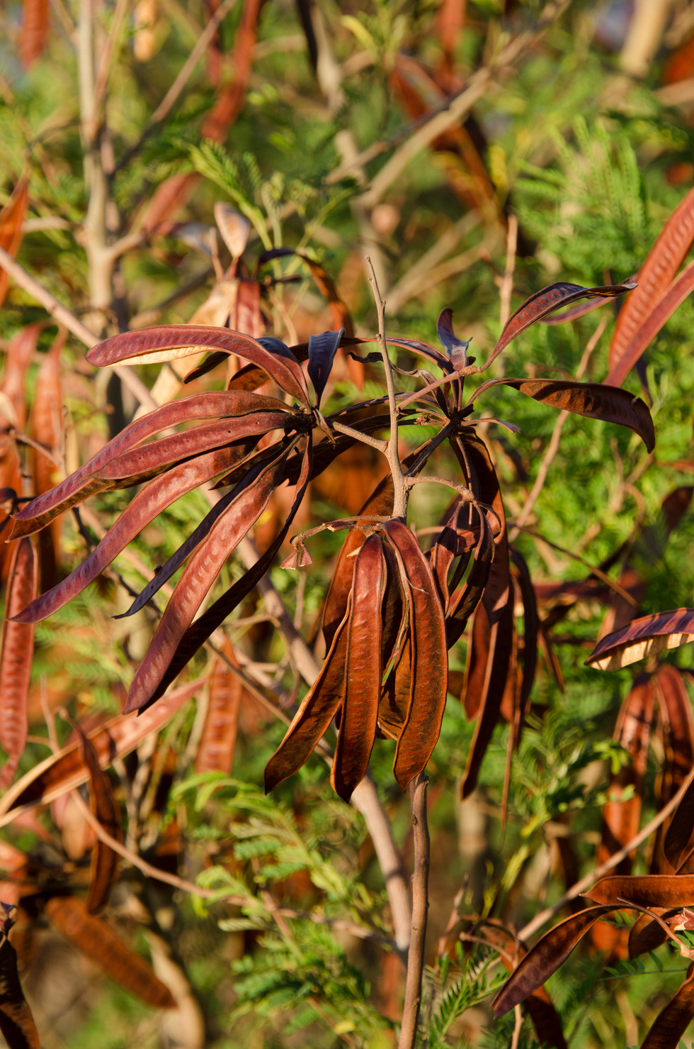
How to Identify a Mimosa Tree
3. Look for the tree's seed pods, which are flat, brown, and up to 8 inches long. The pods are typically found hanging in clusters from the branches of the tree.
4. Check the tree's bark, which is generally gray or brown and rough to the touch, with very few deep ridges and furrows.
This project FS22-343
was funded by the Southern Sustainable Agriculture Research & Education (SSARE) program.

Slide 11
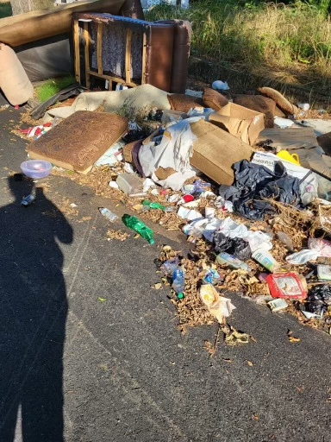
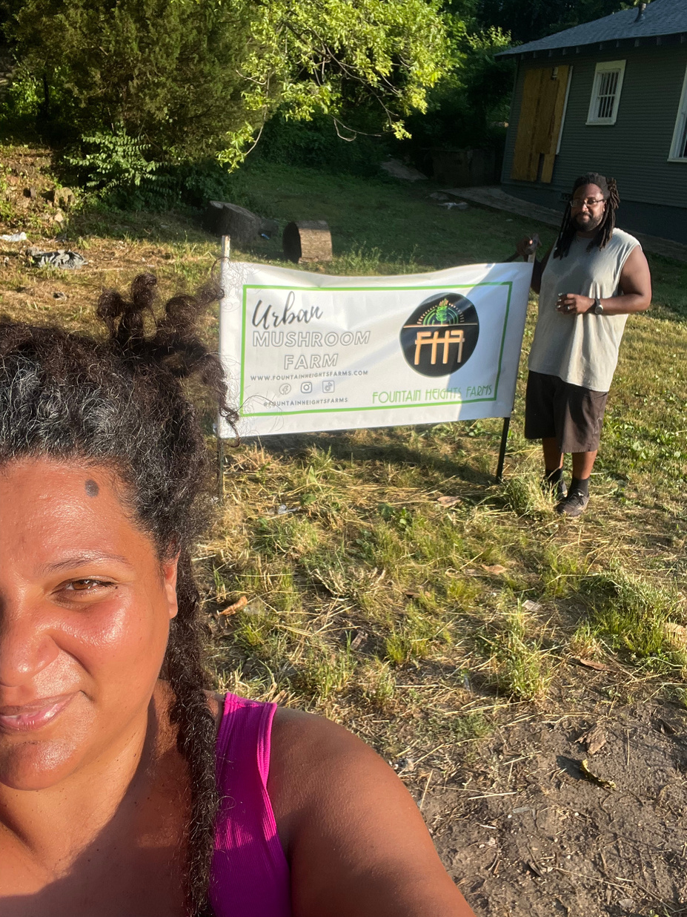

From lot clean up to mushroom farm space!
Log Preparation & Inoculation
Step 1: Clear a vacant lot in Fountain Heights with community volunteers.
Step 2: Harvest and cut 40 logs from Mimosa and Paper Mulberry trees found on the lot or from a nearby location.
This project FS22-343
was funded by the Southern Sustainable Agriculture Research & Education (SSARE) program.

Slide 12
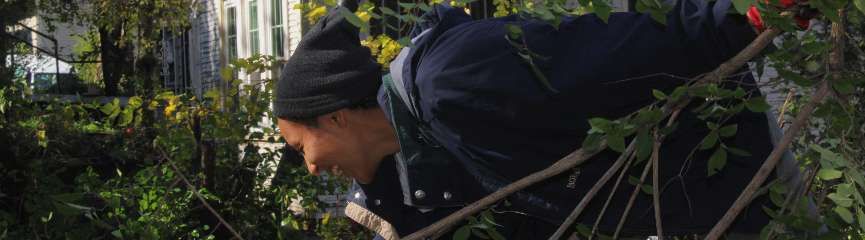

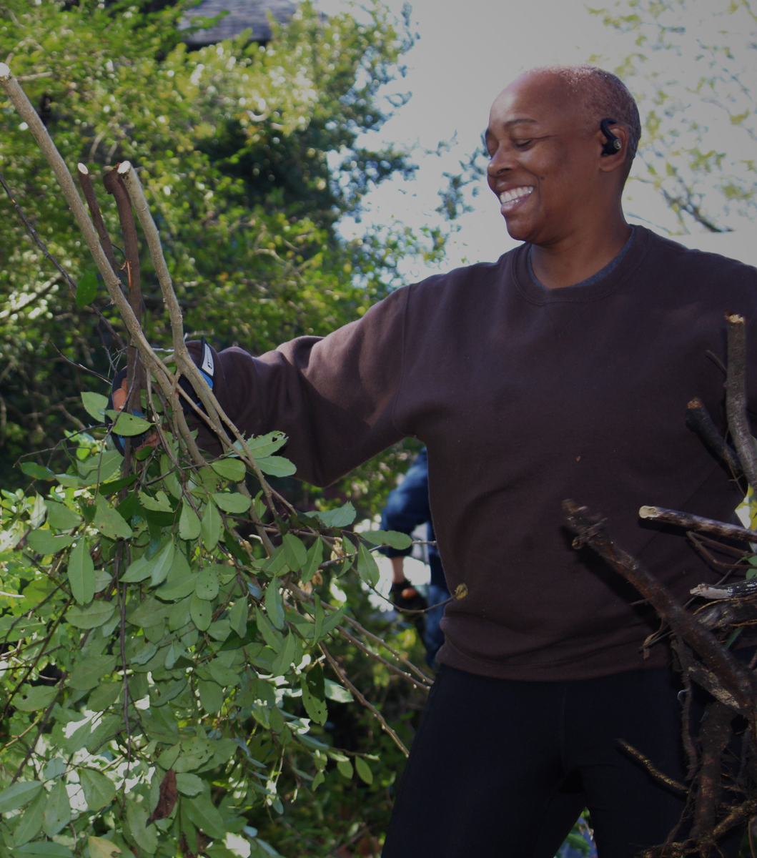
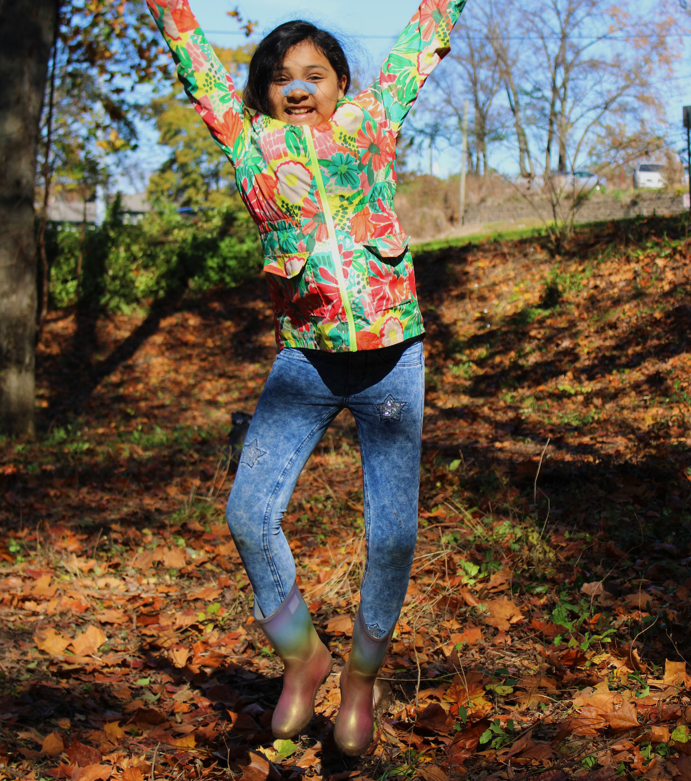
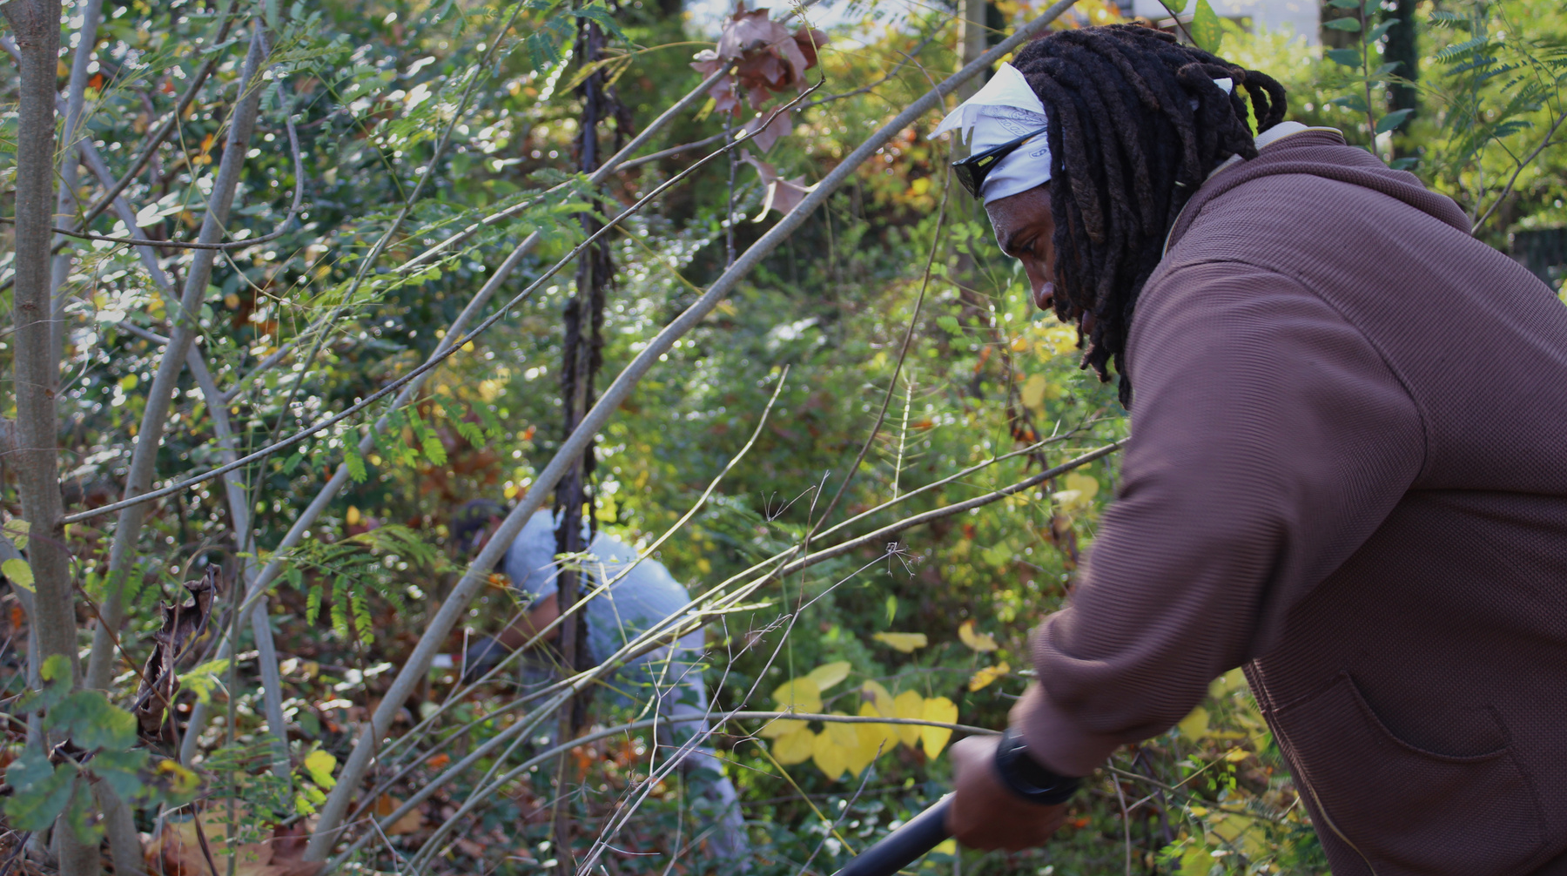

Slide 13
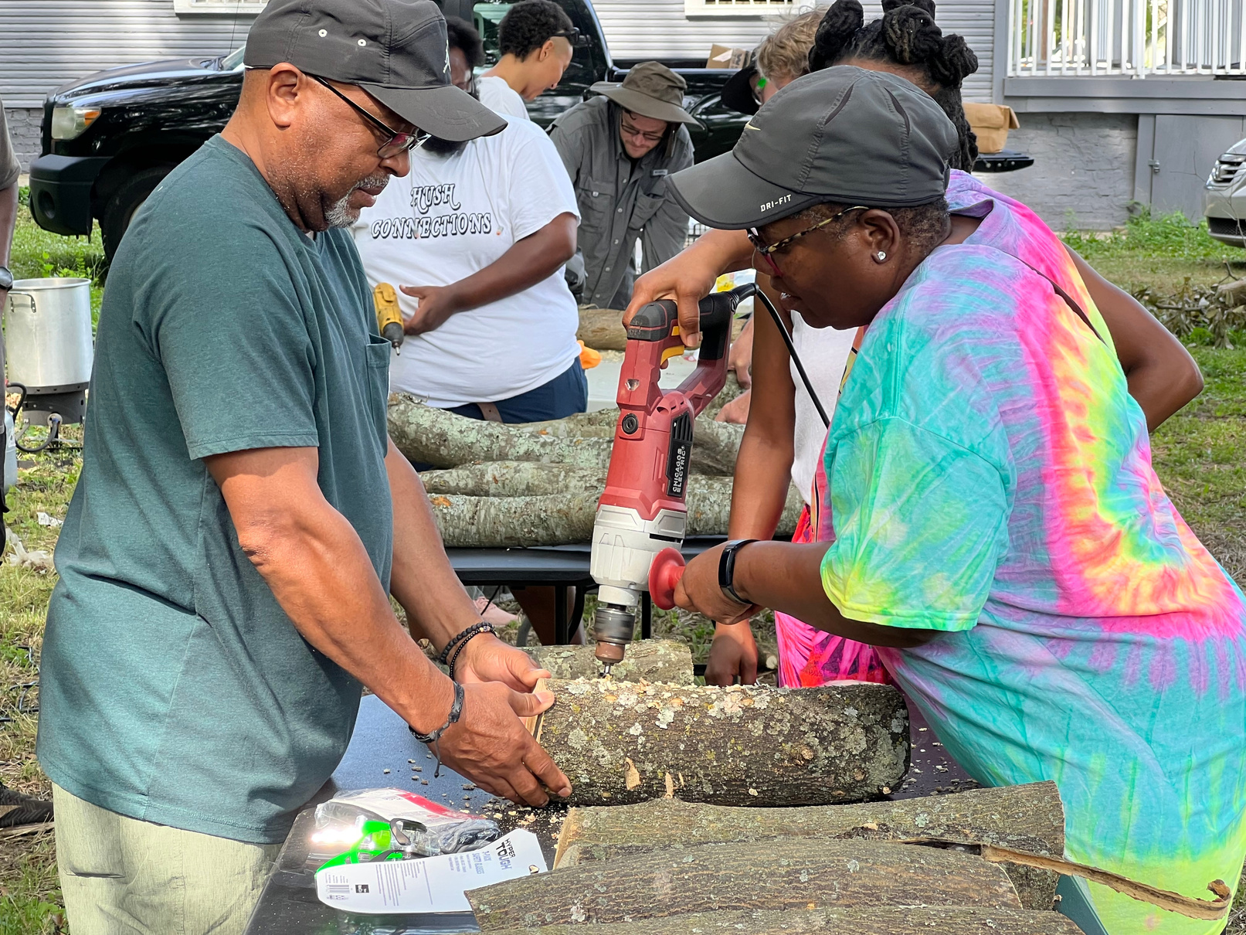
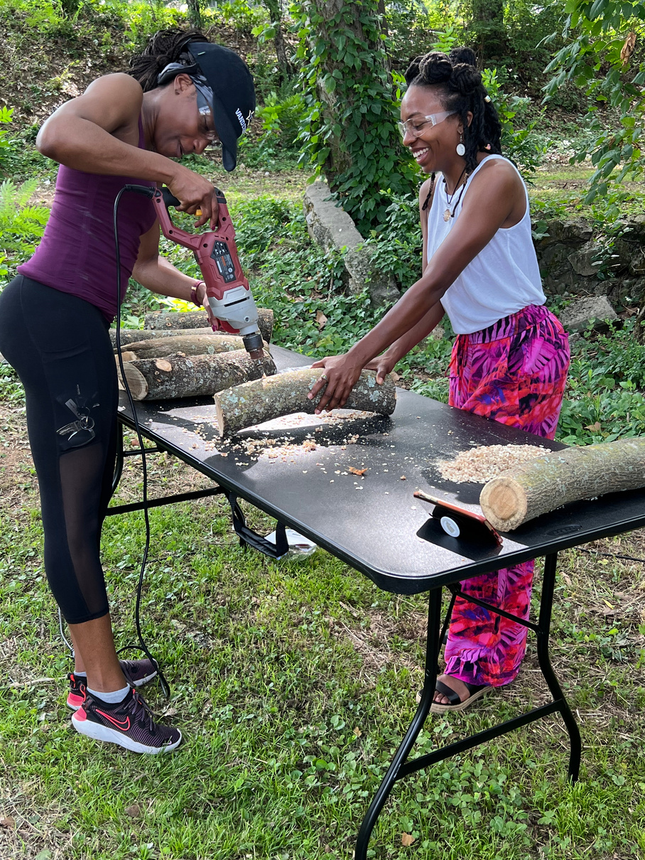
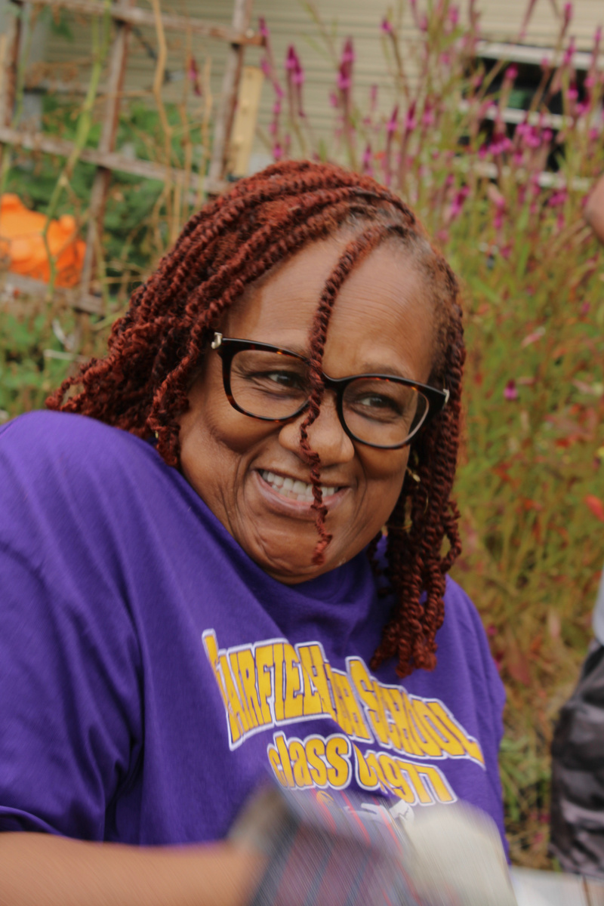
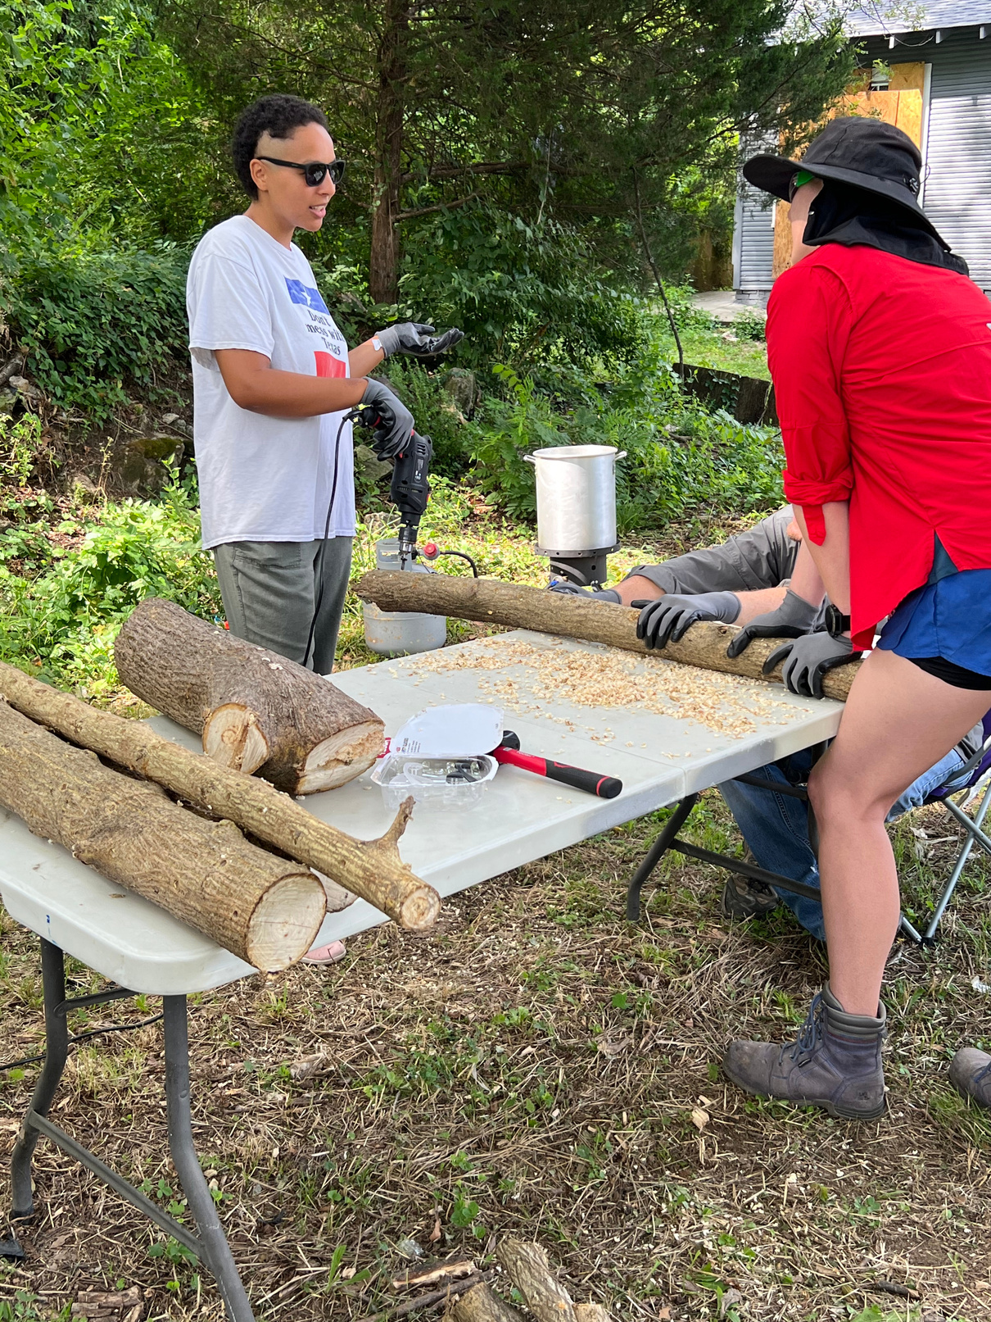
Moving closer to mushrooms
Log Preparation & Inoculation
Step 3: Host four mushroom inoculation workshops for urban farmers and community members.
Step 4: Place logs in an urban micro-farm setting for natural fruiting.
This project FS22-343
was funded by the Southern Sustainable Agriculture Research & Education (SSARE) program.

Slide 14
How to Innoculate logs
  Choose your mushroom species: Select the type of mushroom you want to grow and purchase inoculated sawdust or grain spawn from a reputable supplier.
  Obtain suitable logs: Cut freshly cut logs from deciduous trees such as oak, maple, or beech. Logs should be between 3 and 8 inches in diameter and 3 to 4 feet long. Make sure the bark is intact and free of damage or disease.
  Drill holes in the logs: Using a drill bit, drill holes into the logs about 1-2 inches deep and spaced about 4 to 6 inches apart in rows. The spacing of holes depends on the size of the log.
This project FS22-343
was funded by the Southern Sustainable Agriculture Research & Education (SSARE) program.

Slide 15
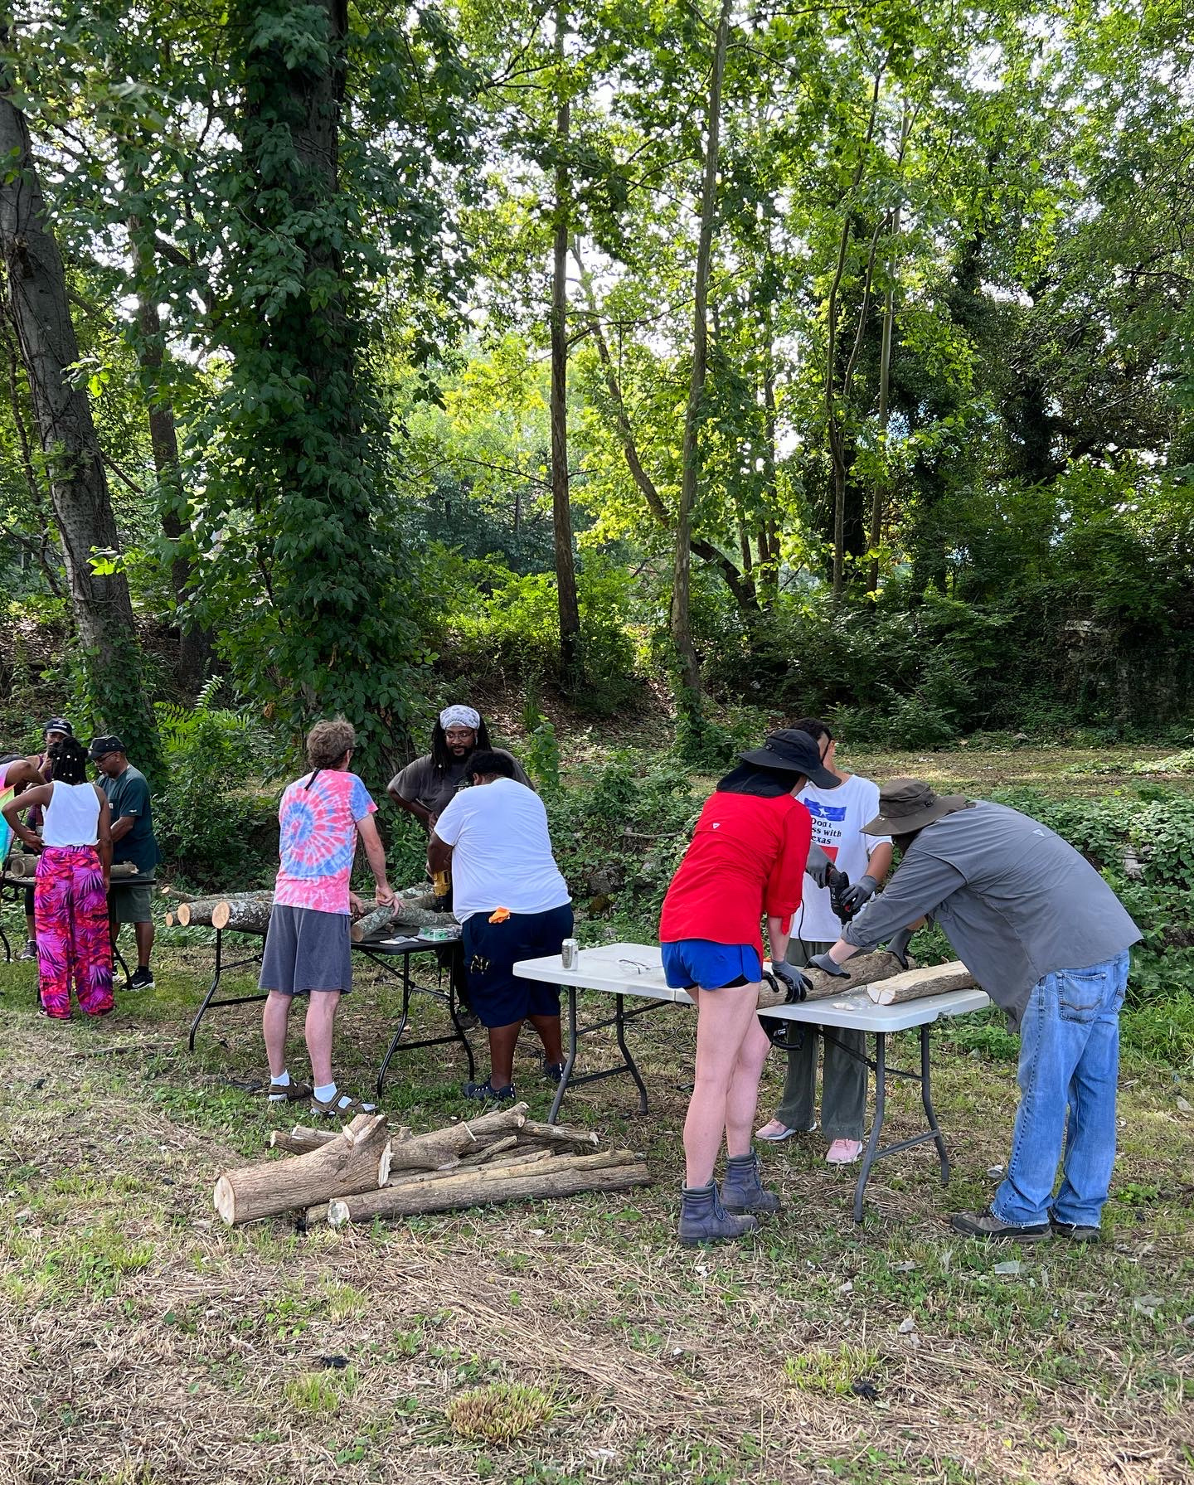
How to Innoculate Logs
4. Insert mushroom spawn: Take the mushroom spawn, which is typically in pellet form, and place it into the holes you drilled. Cover the holes with wax to prevent contamination.
5. Incubate logs: After inserting the spawn, stack the logs in a shady location, and keep them moist for about six to twelve months. The ideal temperature range is between 60 and 80 degrees Fahrenheit.
6. Harvest mushrooms: Once the mycelium has colonized the log, small mushroom pins will start to form. Keep the logs moist and harvest the mushrooms as they grow. The first fruiting may occur within 6 to 18 months after inoculation, depending on the species and environmental conditions.
7. Continue harvesting mushrooms for several years.
This project FS22-343
was funded by the Southern Sustainable Agriculture Research & Education (SSARE) program.

Slide 16
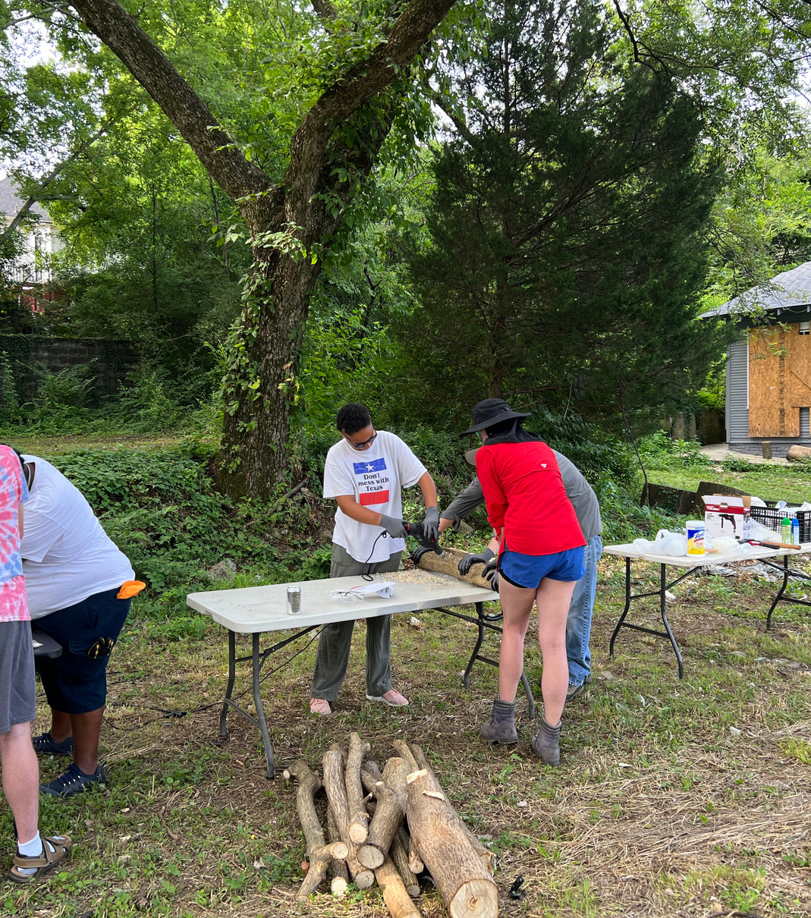
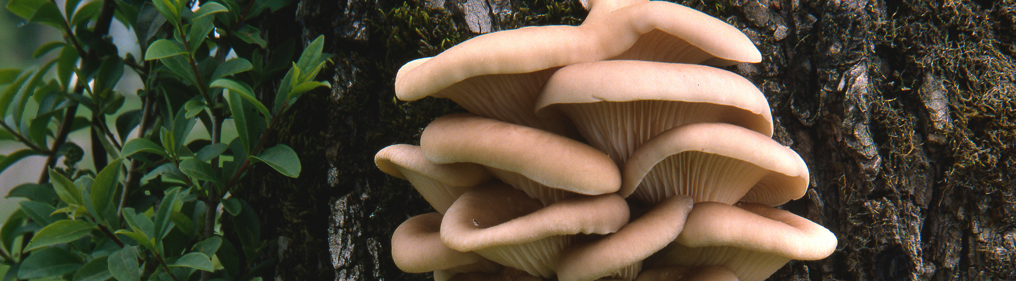
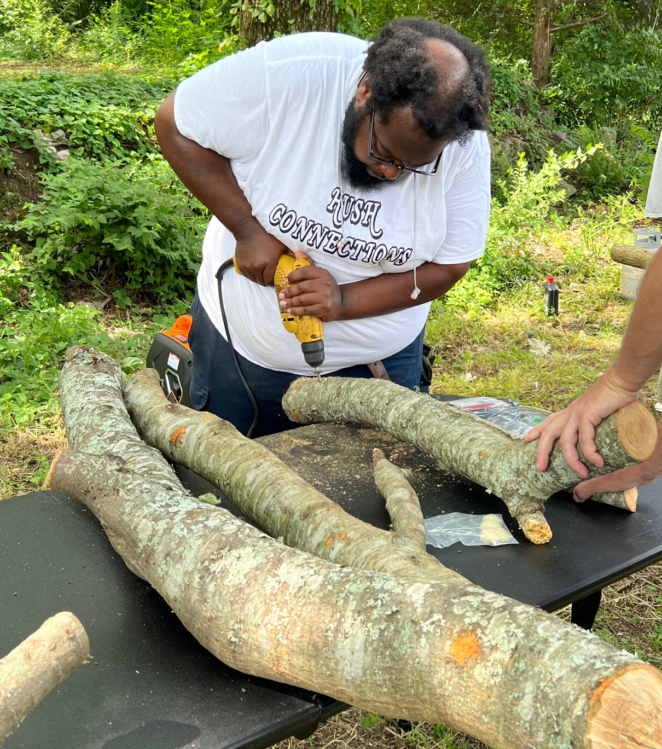
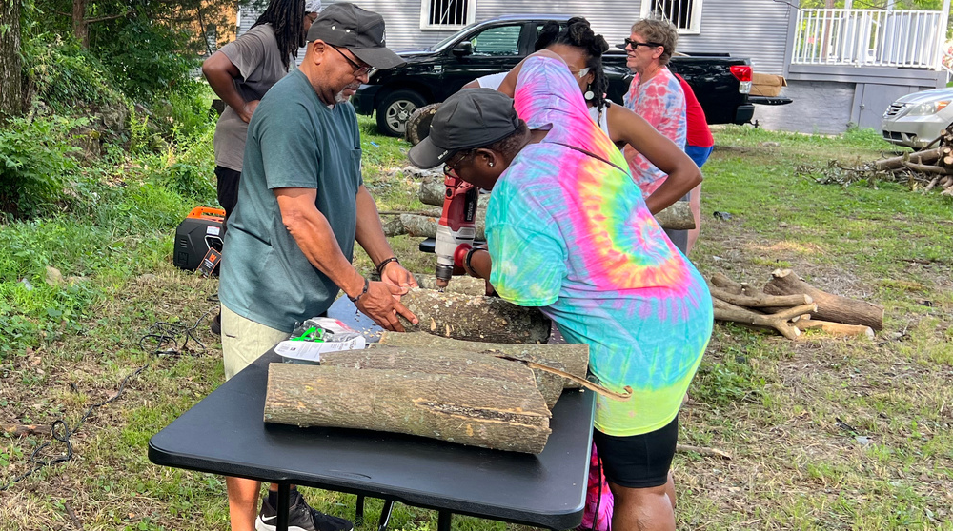

Slide 17

 | 1 Very Unsatisfied | 2 Unsatisfied | 3 Neutral | 4 Satisfied | 5 Very Satisfied
Satisfaction with appearance (1-5) | 0 | 0 | 30 | 34 | 36
Community involvement rating (1-5) | 0 | 0 | 36 | 38 | 26
 | Yes | No
Noticed neighborhood changes? | 83 | 17
Purchased/consumed products? | 61 | 39
Want more urban mushroom farms? | 86 | 14
 | Negative | No Change | Positive
Sense of community impact | 5 | 27 | 68
Impact on mental/emotional well-being | 6 | 16 | 77
This project FS22-343
was funded by the Southern Sustainable Agriculture Research & Education (SSARE) program.

Slide 18
What about the farmers?
Challenges for Urban Farmers:
  Small urban farms often operate with limited space and labor.
  High labor crops require time-strapped farmers to make trade-offs between profit and workload.
Why Mushrooms Are Ideal:
  Minimal daily maintenance (logs inoculated once and require occasional soaking).
  Periodic harvesting, not constant attention.
  High-value specialty crop with strong market demand.
  Little soil space needed—grown directly on invasive tree logs.
This project FS22-343
was funded by the Southern Sustainable Agriculture Research & Education (SSARE) program.

Slide 19
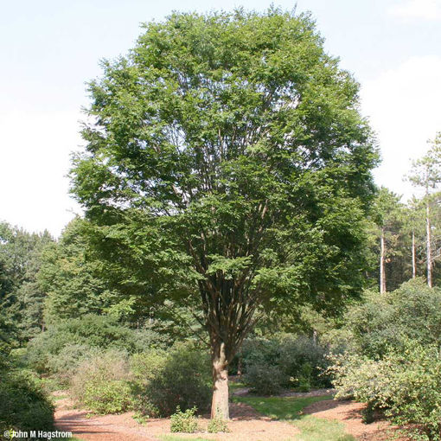
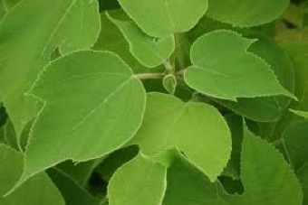
Leveraging “Urban” Tree Species
The Problems:
  Ways to increase revenue
  Mimosa (Albizia julibrissin) is a fast-growing, invasive species that dominates blighted lots in urban Birmingham.
The Solution: Productive Use of Invasive Logs
  Logs are readily available, low or no-cost, and renewable for mushroom production.
  Turns out Mimosa isn’t great for growing mushrooms, but there are so many other urban trees that are like Japanese Zelkova, Paper Mulberry, Bradford Pear, Tree of Heaven and others.
Japanese Zelkova
Paper Mulberry

Slide 20
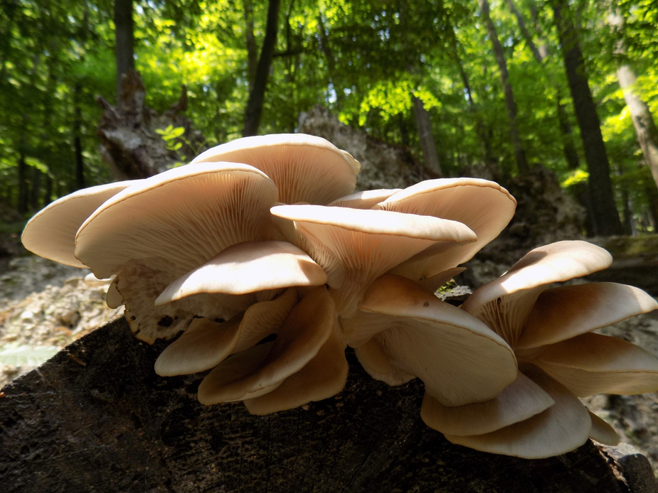
How much did we make?
Total Y1 Yield (All Logs)
Log Type | Median yield per Log (lbs) | Total Yield LBS (40 logs) | $12 Average Price / LB
Paper Mulberry | 6.5 | 78 | $ 936.00
Mimosa | 0 | 0 | $ -
Total | 6.5 | 78 | $ 936.00
Total Y2 Yield (All Logs)
Log Type | Median yield per Log (lbs) | Total Yield LBS (40 logs) | $12 Average Price / LB
Paper Mulberry | 7.25 | 87 | $ 1,044.00
Mimosa | 0 | 0 | $ -
Total | 7.25 | 87 | $ 1,044.00

Slide 21
Key Take Aways
The Urban Mushrooms on Mimosa Wood Project has contributed to agricultural sustainability by demonstrating the need to use invasive species for productive use while responsibly managing their growth.
✅ Paper Mulberry logs are the more reliable option, yielding 78-87 lbs.
✅ Mimosa logs yield nothing, but it is worth testing other types of non-native trees.
✅ Total harvest: 167 lbs of mushrooms over 1-2 years.
✅ Scaling up: Because of the small space requirements, urban farmers can inoculate successions of logs creating outdoor urban mushroom farms throughout a neighborhood.
We have to be creative in the ways we care for ourselves and our neighbors. Working through a true community participatory research project brought our neighborhood closer together, gave elders a new sense of purpose, put a little money in everyone’s pocket, and made our neighborhood more beautiful.
This project FS22-343
was funded by the Southern Sustainable Agriculture Research & Education (SSARE) program.

Slide 22
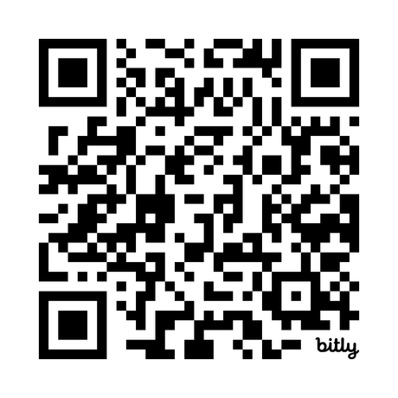
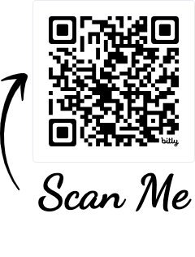
www.fountainheightsfarms.com
Social Media:
@FountainHeightsFarms
info@fountainheightsfarms.com
www.WeAllEatCSA.com
Social Media:
@WeAllEatCSA
Tori@WeAllEatCSA.com

