Slide 1
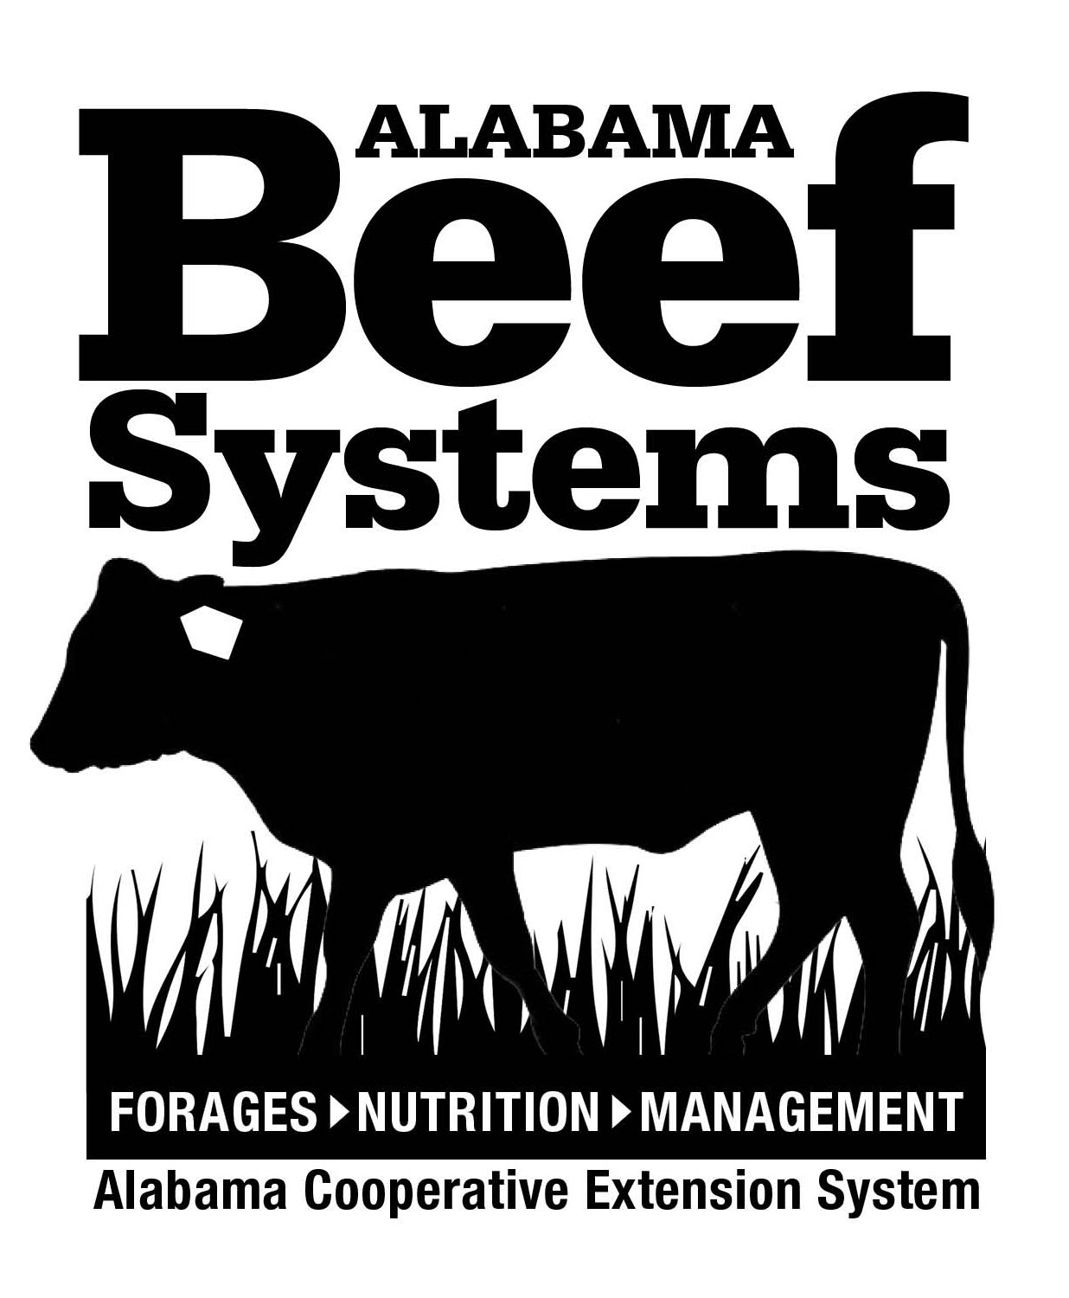
Development of a Farmer-Based Working Group Program for
Beef-Forage Systems Management in Alabama
Mullenix, M.K. and G.L. Thompson*¹
¹Auburn University/Alabama Cooperative Extension System, Auburn, AL
Introduction
In 2016, the Alabama Cooperative Extension System Animal Science and Forage Team facilitated the development of a farmer-based working group for beef producers in North Alabama. A working group is defined as a farmer-to-farmer network focused on a common theme or series of topics of interest. This program was developed in response to the need for more advanced educational programming at the beef-forage interface for program participants who have completed other Extension flagship programs such as the Master Cattle Producers, Master Cattlemen 101 Program, and Practical Ranch Management Workshop series. The intended audience were beef farmers with more than 10 years of experience in the industry.
Table 1. Evaluation and preference of educational delivery methods used in the working group.
On-Farm Practices Adopted from Working Group Discussions
Working towards more than 300 days of grazing per year
Precision soil sampling
Rotational stocking and bale grazing
Improved calf marketing
Participants reported an average economic impact of $2,500 per operation from this program.
Producer Testimonial:
One participant indicated that he saved more than $3,500 this year in fertilizer from the adoption of precision soil sampling in pastures and hayfields.
Educational Delivery Methods
A series of five meetings were organized to highlight technologies and strategies for agronomic, animal, and economic best practices in beef cattle operations.
Farmer meetings were located on-farm or at Auburn University affiliated research stations and demonstration sites and offered from August 2016 through April 2017.
Topics included: value-added calf marketing, bull selection/genetics, precision soil sampling, dealing with tall fescue toxicosis, rotational grazing, bale grazing, and water quantity/quality dynamics in grazed ecosystems.
Hands-On Demonstrations
On-Farm Tours of Management Practices
Discussion Leaders and Speakers on Various Management Topics
Conclusions
Following the completion of the program in April, participants indicated that they were highly satisfied with the delivery method and practices shared during the discussion sessions. 62% of the participants reported that they learned the most from holding discussion groups on a given topic at on-farm locations. Results of this program indicate that a farmer-focused discussion group is an effective method for improving the understanding of beef production systems and may enhance on-farm adoption of forage management practices. This program model also effectively uses local Extension and on-farm resources for educational delivery.
Acknowledgments: This work was funded by a USDA Southern SARE Professional Development Grant (ES16-129).

