Slide 1
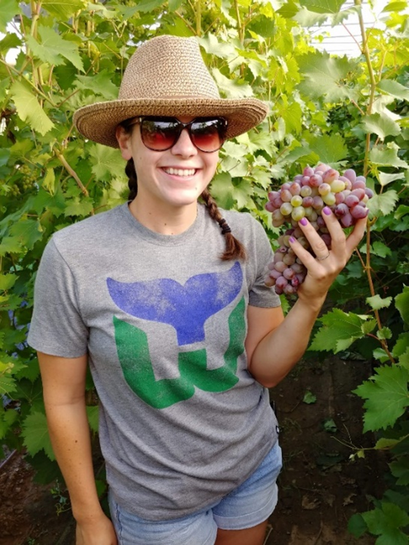
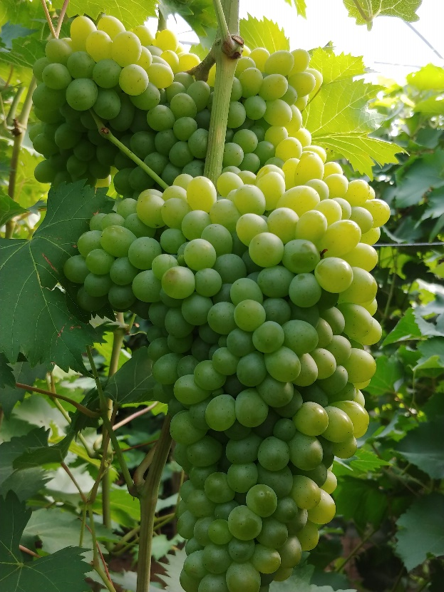
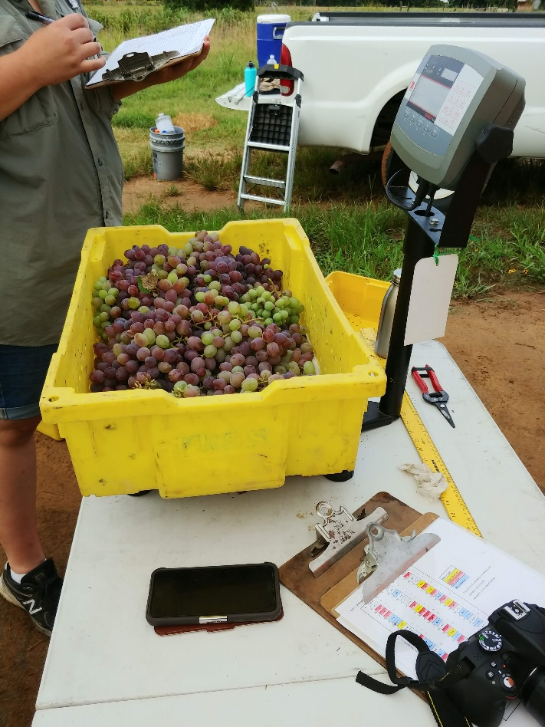
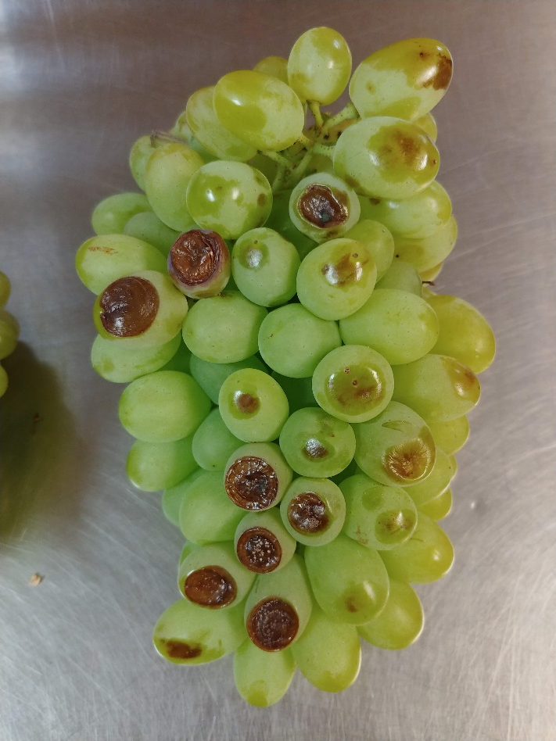
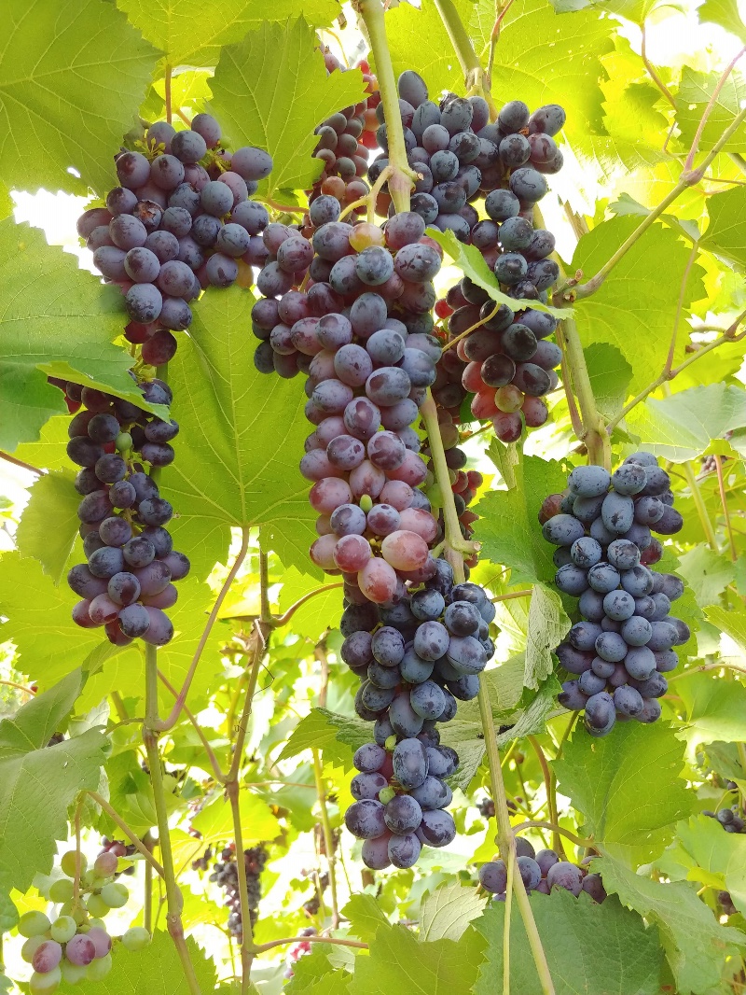
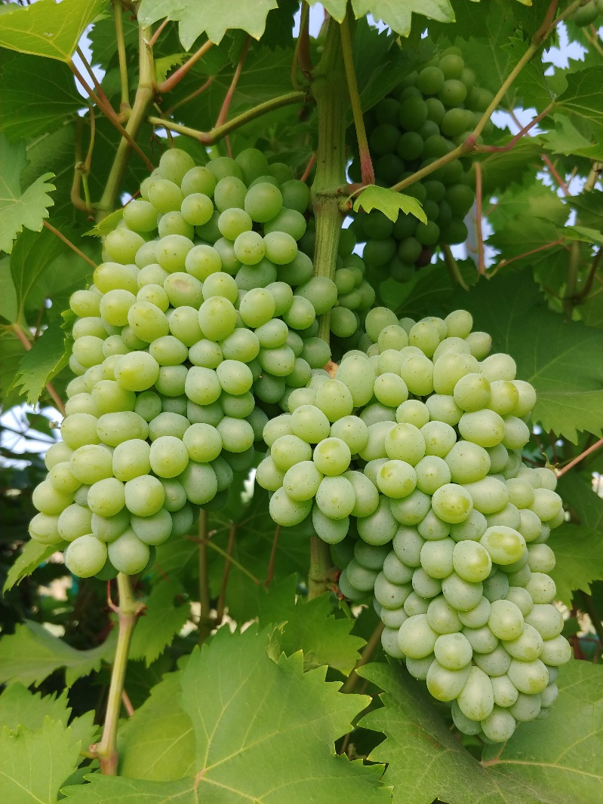
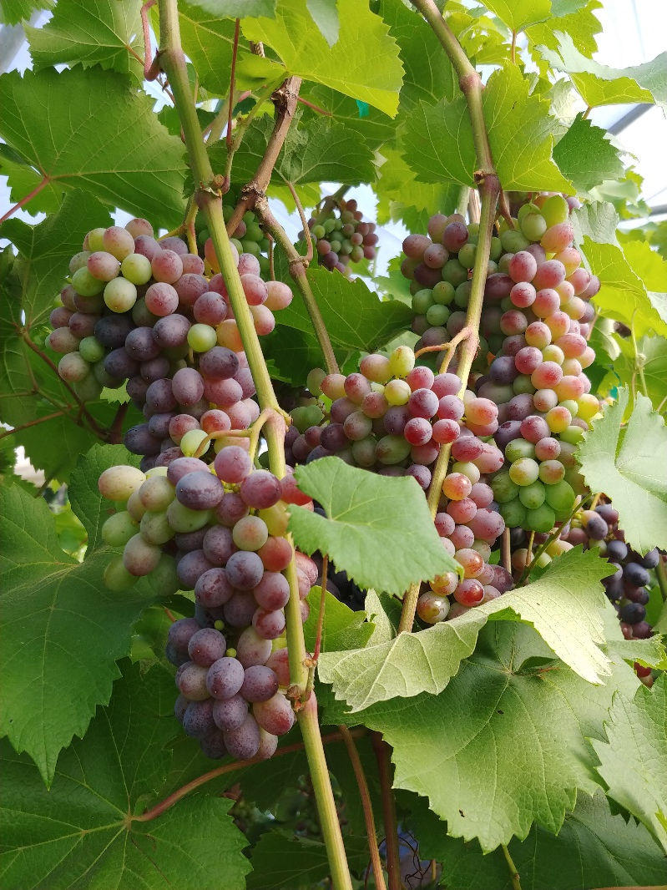
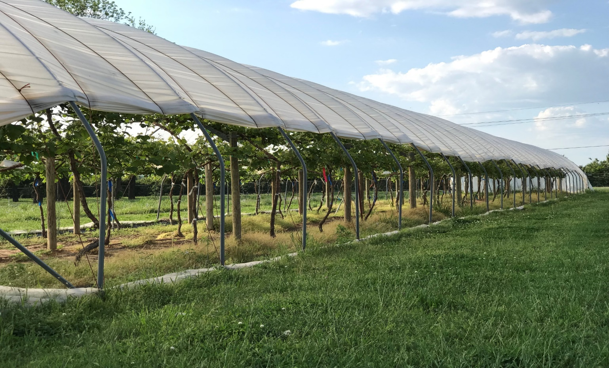
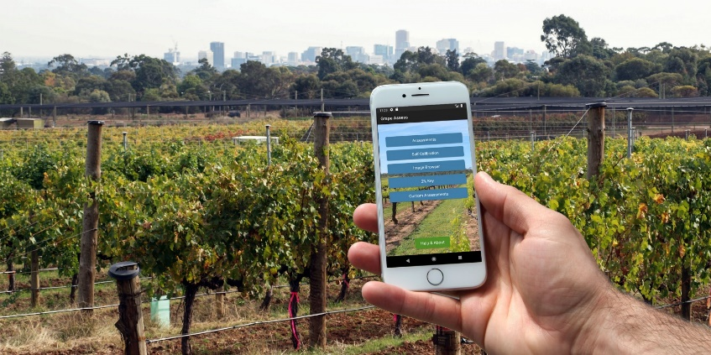
Disease Assessment of Table Grapes Grown Under High Tunnel Conditions in Arkansas
Brittany Lowery¹, Jose Hernandez², Karlee Pruitt³, and Dr. Elena Garcia⁴
¹Undergraduate Intern; ²Graduate Student; ³Program Technician; ⁴Professor
"This material is based upon work that is supported by the National Institute of Food and Agriculture, U.S. Department of Agriculture, under award number (LS-17-282) through the Southern Sustainable Agriculture Research and Education program, under subaward number (LS-17-282). USDA is an equal opportunity employer and service provider. Any opinions, findings, conclusions, or recommendations expressed in this publication are those of the author(s) and do not necessarily reflect the view of the U.S. Department of Agriculture."
Introduction
Results (cont. )
Table grapes (Vitus vinifera L. ) are one of the most popular and widely produced fruits. Marketing efforts from the California Table Grape Commission, and the USDA have encouraged U.S. retailers to handle more varieties of table grapes, as well as to increase international demand of U.S. table grapes. Over the last three decades U.S. consumption of table grapes has increased from 2.9 pounds per capita in 1970 to 7.5 pounds in 2003. Due to the increased demand for table grapes, the U.S. remains a net importer; importing roughly $732 million worth of fresh grapes in 2004 (Kreith, 2006). Increasing production of U.S. table grapes could offset the need to import. However, table grapes grown in the Southeast require intense pest management due primarily to biotic factors prevalent in the region. In 2014 a project was initiated at the University of Arkansas (UA) to determine the feasibility of growing table grapes in high tunnels (HT’s) which provide environmental protection i.e., frost and rain.
The SSARE James Harrison Hill, Sr. Young Scholar Enhancement Grant is designed to provide funds to an open Research and Education project to hire a college student for the summer to participate in the research program in sustainable agriculture. Work of the Young Scholar is experiential learning intended to heighten the Young Scholars interest in these fields of study related to sustainable agriculture.
There were significant differences between cultivars for yield, cluster number and weight, and black rot incidence between cultivar and black rot. ‘Gratitude’ showed the highest incidence of black rot .There were no significant differences between ‘Jupiter’ and ‘Faith’ (Table 1).
Trellis system significantly affected yield, cluster number, and black rot incidence There were significant differences between the trellis system and black rot. GDC had the highest incidence of black rot. MDHCE and MDHCW had the lowest incidence of black rot respectively (Table 1).
There was a significant interaction between trellis system and cluster thinning in the incidence of black rot. The MDHCW had the lowest incidence rate with both thinning treatments: control and pea-size. The GDC at pea-size thinning had the highest incidence of black rot Fig 3).
a
b
c
Fig 3. Left to right: (a) Healthy Gratitude cultivar cluster; (b) measuring total weight (kg) of fruit harvested from one plant; (c) Black rot (Guignardia bidwellii) on Hope cultivar cluster.
Research Methods
Research was conducted at University of Arkansas Agriculture and Research Center, Fayetteville. Three table grape cultivars: Faith, Gratitude, and Jupiter (Fig. 1) released from the UA Fruit Breeding Program were planted in 2014 under a HT (Haygrove Super Solo - 200’ x 25’) at UA Agriculture and Research Center, Fayetteville (Fig. 2). There three trellis systems were established: Modified Double High Cordon East (MDHCE) located on the east side of the tunnel; Geneva Double Curtain (GDC) located in the center of the tunnel; and Modified Double High Cordon West (MDHCW) located on the west side of the tunnel. The experimental design was a complete block with six vines per cultivar per trellis system. Two cluster thinning treatments were implemented: Control- no clusters were removed) and cluster thinning when berries were at at pea-size) to manage crop load.
Data collection was conducted to determine vine performance included: total yield per vine, berry weigh, and total number of clusters, weight and length. Disease incidence for black rot and powdery mildew of clusters was conducted weekly during the growing season. A scale of 1 to 6 was used to rate disease (1-6, 1= no disease, 6=whole cluster infected). Data was analyzed using JMP® (version 14.0 Pro; SAS Institute) with Tukey Honest Significant Difference for mean separation.
Conclusion
Based on the data collected some cultivars of table grapes performed better under high tunnel conditions than others. It was determined that Gratitude had the highest incidence of black rot. Jupiter and Faith had lower incidence of black rot. The higher incidence of black rot on Gratitude could be attributed to the tight cluster formation.
Grape vines that remained on the edges of the tunnel performed better than vines grown in the middle of the tunnel. MDHCW had the lowest incidence of black rot. The lower incidence of black rot could be attributed to increased air circulation.
Jupiter performed best under the high tunnel environment. This cultivar had the highest total yield per vine and the highest number of clusters per vine
More research would need to be conducted to determine the effects of black rot on table grapes grown under high tunnels, trellis systems, and thinning treatments.
Objectives
The objective of the Young Scholar Enhancement Program (LS-17-282) was to provide the scholar with practical experience in multiple management areas and facets of table grape production under high tunnel conditions and to enhance the student’s knowledge of scientific research. To accomplish this objective, the young scholar participated in the following research objectives:
Assessment of yield performance of different grape cultivars grown under HT’s within the pesticide management program.
Assessment of disease and insect incident with a pesticide management program in place in HT’s
Results
Table 1. 2018 yield for table grape performance under high tunnels at Fayetteville, AR
Cultivar | Total yield (kg) | No. clusters/vine | Cluster wt. (g) | Black rot rating^{Z}
Faith | 10.97b^{Y} | 59.69b | 229.39b | 1.6a
Gratitude | 9.88b | 29.44c | 523.24a | 2.7b
Jupiter | 21.82a | 89.67a | 274.96b | 1.6a
Trellis System | Total Yield (kg) | No. clusters/vine | Cluster wt. (g) | Black rot rating
MDHCE | 18.69a | 74.06a | 328.56a | 2.1b
GDC | 14.84a | 36.81b | 382.01a | 2.9c
MDHCW | 9.15b | 67.94a | 317.01a | 1.3a
^{Z}Rating scale 1-6 (1= no disease on cluster’ 6=the whole cluster was diseased) ^{Y}Means with different letter(s) for each column are significantly different (p<0.05) using Tukey's Honest Significant Difference.
Knowledge and Skills Learned
The knowledge and skills gained through the S-SARE Young Scholar enhancement internship provided work experience in many facets of vineyard management that could not be reproduced in a classroom.
Pruning and training methods for young grape vines
Mixing and application ratios for pesticides and fungicides
Operation of scientific instruments including: PAR meter, refractometer, tensiometer, spectrophotometer, and watchdog weather station
Collection and interpretation of scientific data
Operation of heavy farm machinery
a
b
c
Fig 1. Left to right: (a) Faith cultivar; (b) Gratitude cultivar; (c) Jupiter cultivar
Resources
Adelaide Research & Innovation. (2018). Grape Assess (1.2) [Mobile application software]. Retrieved from https://itunes.apple.com/au/app/grape-assess/id1342167843
Literature Cited
Fig 2. High tunnel located in Fayetteville, AR at the Agricultural Research and Extension Center
Fig 3. Interaction of trellis system and thinning treatment in the incidence of black rot
Boriss, Hayley, et. Al. Commodity Profile: Table Grapes. Agricultural Issues Center. University of California, 2006

