Slide 1
Adapting Cover Crops to Northern Climate Conventional Cropping Systems
Abe Mach - Mach Angus Ranch, Sturgeon Lake
Troy Salzer – Sandy Hills Ranch, Barnum
Scott Peterson-Floodwood
FNC13-010
NCR-SARE’s Farmers Forum, 2016

Slide 2
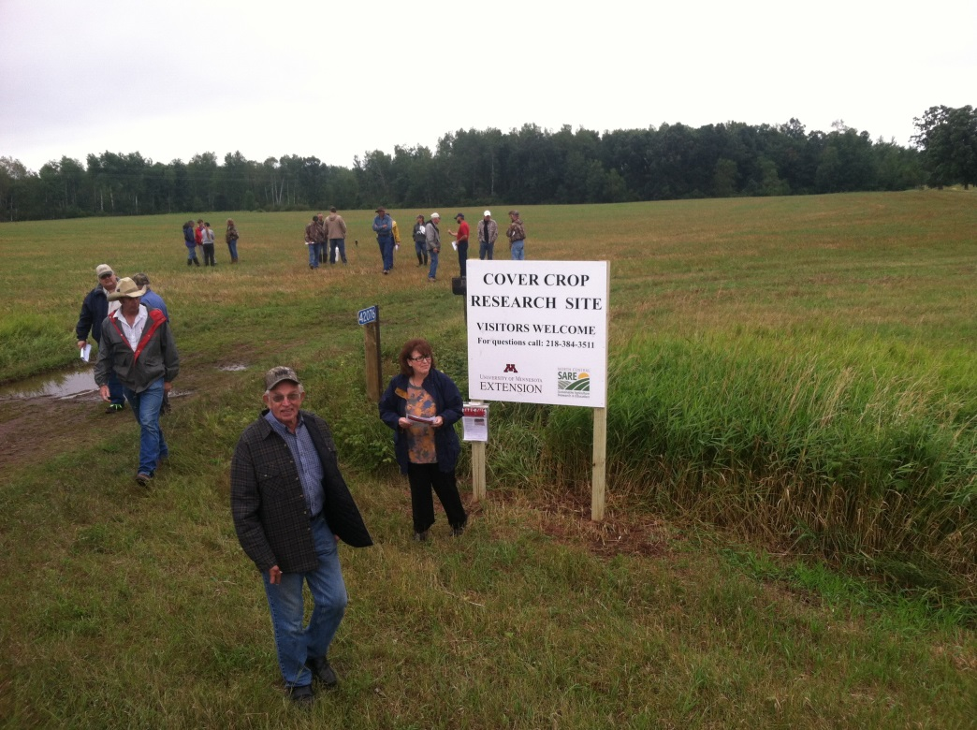
Cover Crop Research
2 year study funded by Sustainable Agriculture Research and Education (SARE) Farmer/Rancher Grant
3 participating farmers
Small grain > cover crop mix
Fall grazing

Slide 3
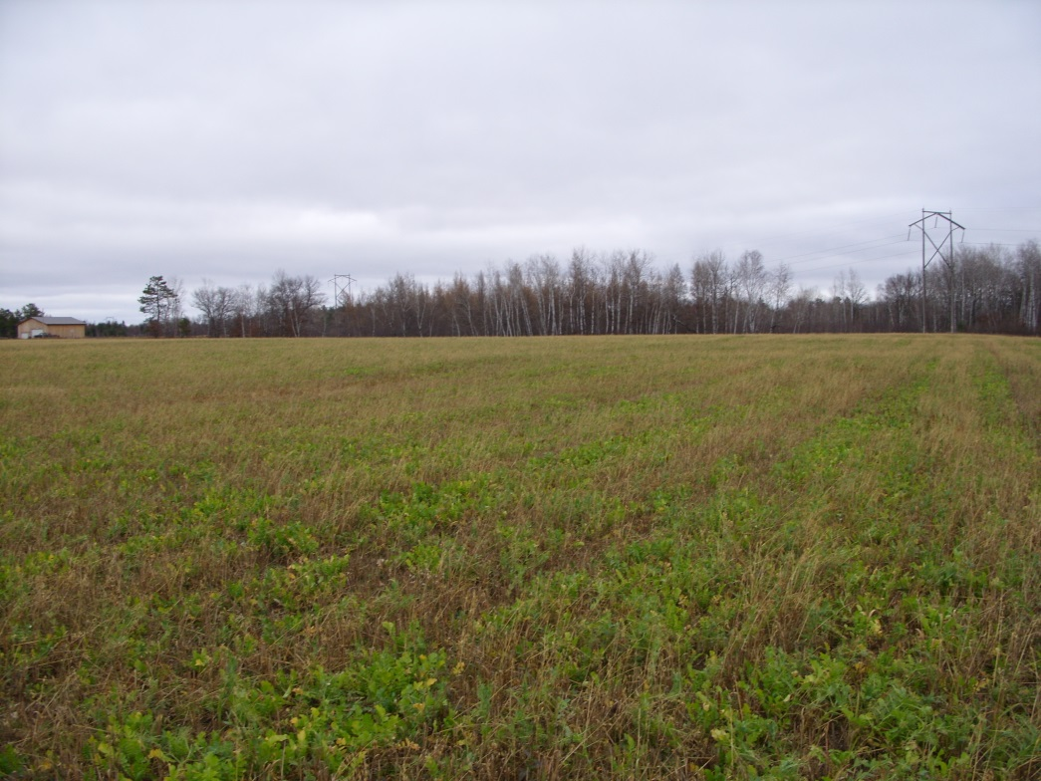
Cover Crop Data Collection
Soil Sampling
Nutrients, Biology
Forage Sampling
Yield, Quality
Cost analysis
Farmer Surveys

Slide 4
Treatments
Annual Crop of Peas and oats or wheat harvested as balage, hay, grazed or grain
No till seeded Turnips/peas and Winter Rye August
2014
3 lbs Turnips
¾ bushel of winter rye
¼ bushel of peas
2015
3 lbs Turnips
¾ bushel of winter rye
Collected yield data on growth before first snow or when the Cover Crop was to be grazed

Slide 5
7/14/2015

Slide 6
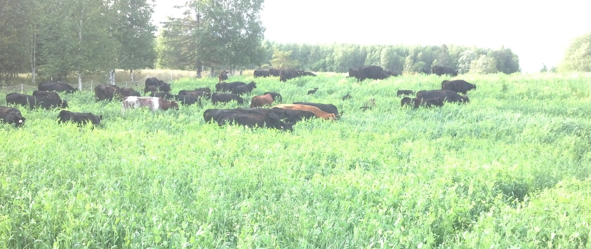
Mob Grazing Peas and Oats 2014

Slide 7
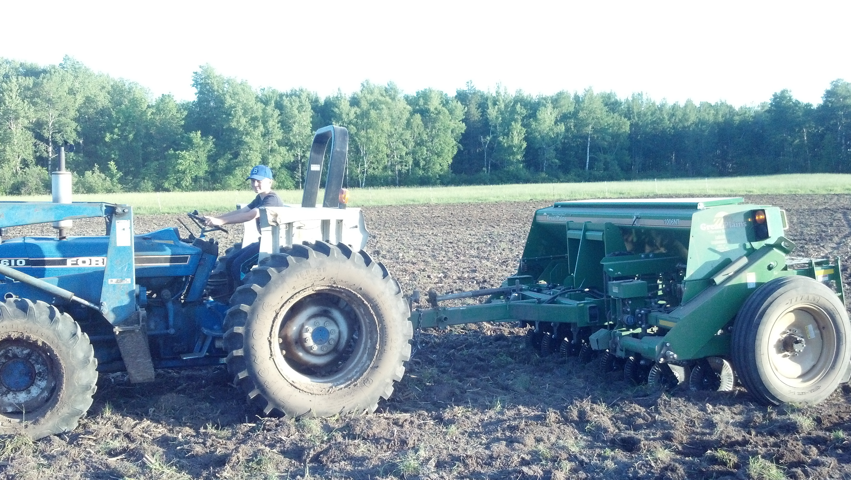
August 2014
August 2014

Slide 8
8/30/2015

Slide 9
9/21/2015

Slide 10
10/10/2015

Slide 11
10/10/2015

Slide 12
11/23/2015 Started Grazing

Slide 13
2014 Yields
 | 2014 T DM/acre |  | TOTAL 2014
Salzer (oats/peas) | 2.32 | 1.14 | 3.46
Mach (oats/ peas) | 1.58 | 1.19 | 2.77
Peterson (wheat) | 1.18 | 0.3 | 1.48

Slide 14
2015 Yields
 | 2015 T DM/acre |  | TOTAL 2015
Salzer (oats/peas) | 2.66 | 2.28 | 4.94
Mach (winter rye) | 1.71 | 1.34 | 3.05
Peterson (corn) | 3.39 | 0 | 3.39

Slide 15
Economics 2014
 | 2014 T DM/acre | Cost/acre | Cost/T DM
Salzer | 1.14 | $43.40 | $38.07
Mach | 1.19 | $53.99 | $45.37
Peterson | 0.3 | $43.40 | $144.67
Average w/Peterson | 0.88 | $46.93 | $76.04
Average w/o Peterson | 1.17 | $48.70 | $41.72

Slide 16
2014 Cost Analysis
Cover crop had estimated standing forage value of $80/ton DM
0.88 tons produced, gross value=$70.40/acre
Costs: $31.40/acre (seed), $12/acre (seeding) Total costs= $43.40/acre
Net Revenue= $27.00/acre
Soil Health Benefits
Environmental Benefits

Slide 17
Economics 2015
 | 2015 T DM/acre | Cost/acre | Cost/ T DM
Salzer | 2.28 | $32.70 | $14.34
Mach | 1.34 | $42.50 | $31.72
Peterson | 0 | $32.70
Average w/Peterson | 1.21 | $35.97 | $23.03
Average w/o Peterson | 1.81 | $37.60 | $15.35

Slide 18
2015 Cost Analysis
Cover crop had estimated standing forage value of $80/ton DM
1.21 tons produced, gross value=$96.80/acre
Costs: $23.97/acre (seed), $12/acre (seeding) Total costs= $35.97/acre
Net Revenue= $60.83/acre
Soil Health Benefits
Environmental Benefits

Slide 21
2015 Soils Data
ID | Treatment | Nitrate/lb ac | Sulfur/lb | CCE | OM | Solvita | Salt1 | Bulk Density | C:N | pH | K ppm
F9 | Trt | 41 | 34 | 17.9 | 11.2 | 703.2 | 0.26 | 0.9 | 14 | 7.3 | 516
F9 | Ctrl | 56 | 44 | 13.9 | 10.3 | 441.1 | 0.3 | 0.94 | 14 | 6.9 | 528
EH | Trt | 2 | 14 | 8 | 2.3 | 60.9 | 0.11 | 1.3 | 12 | 7.5 | 113
EH | Ctrl | 3 | 20 | 8.7 | 2.4 | 69 | 0.16 | 1.35 | 12 | 7.4 | 112

Slide 22
The End
Questions

Slide 23
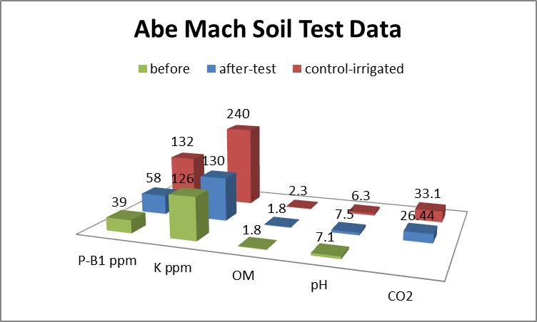
Soil Testing 2014

