Slide 1
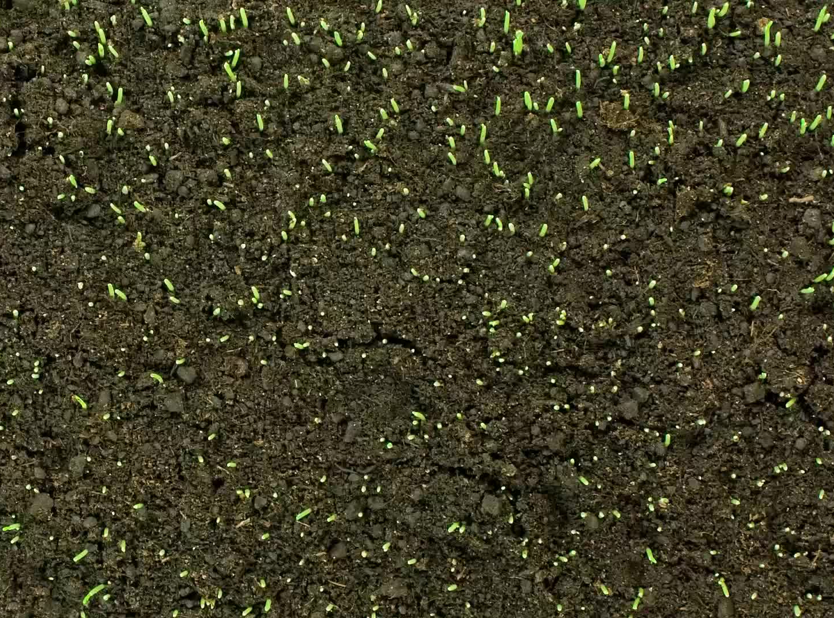
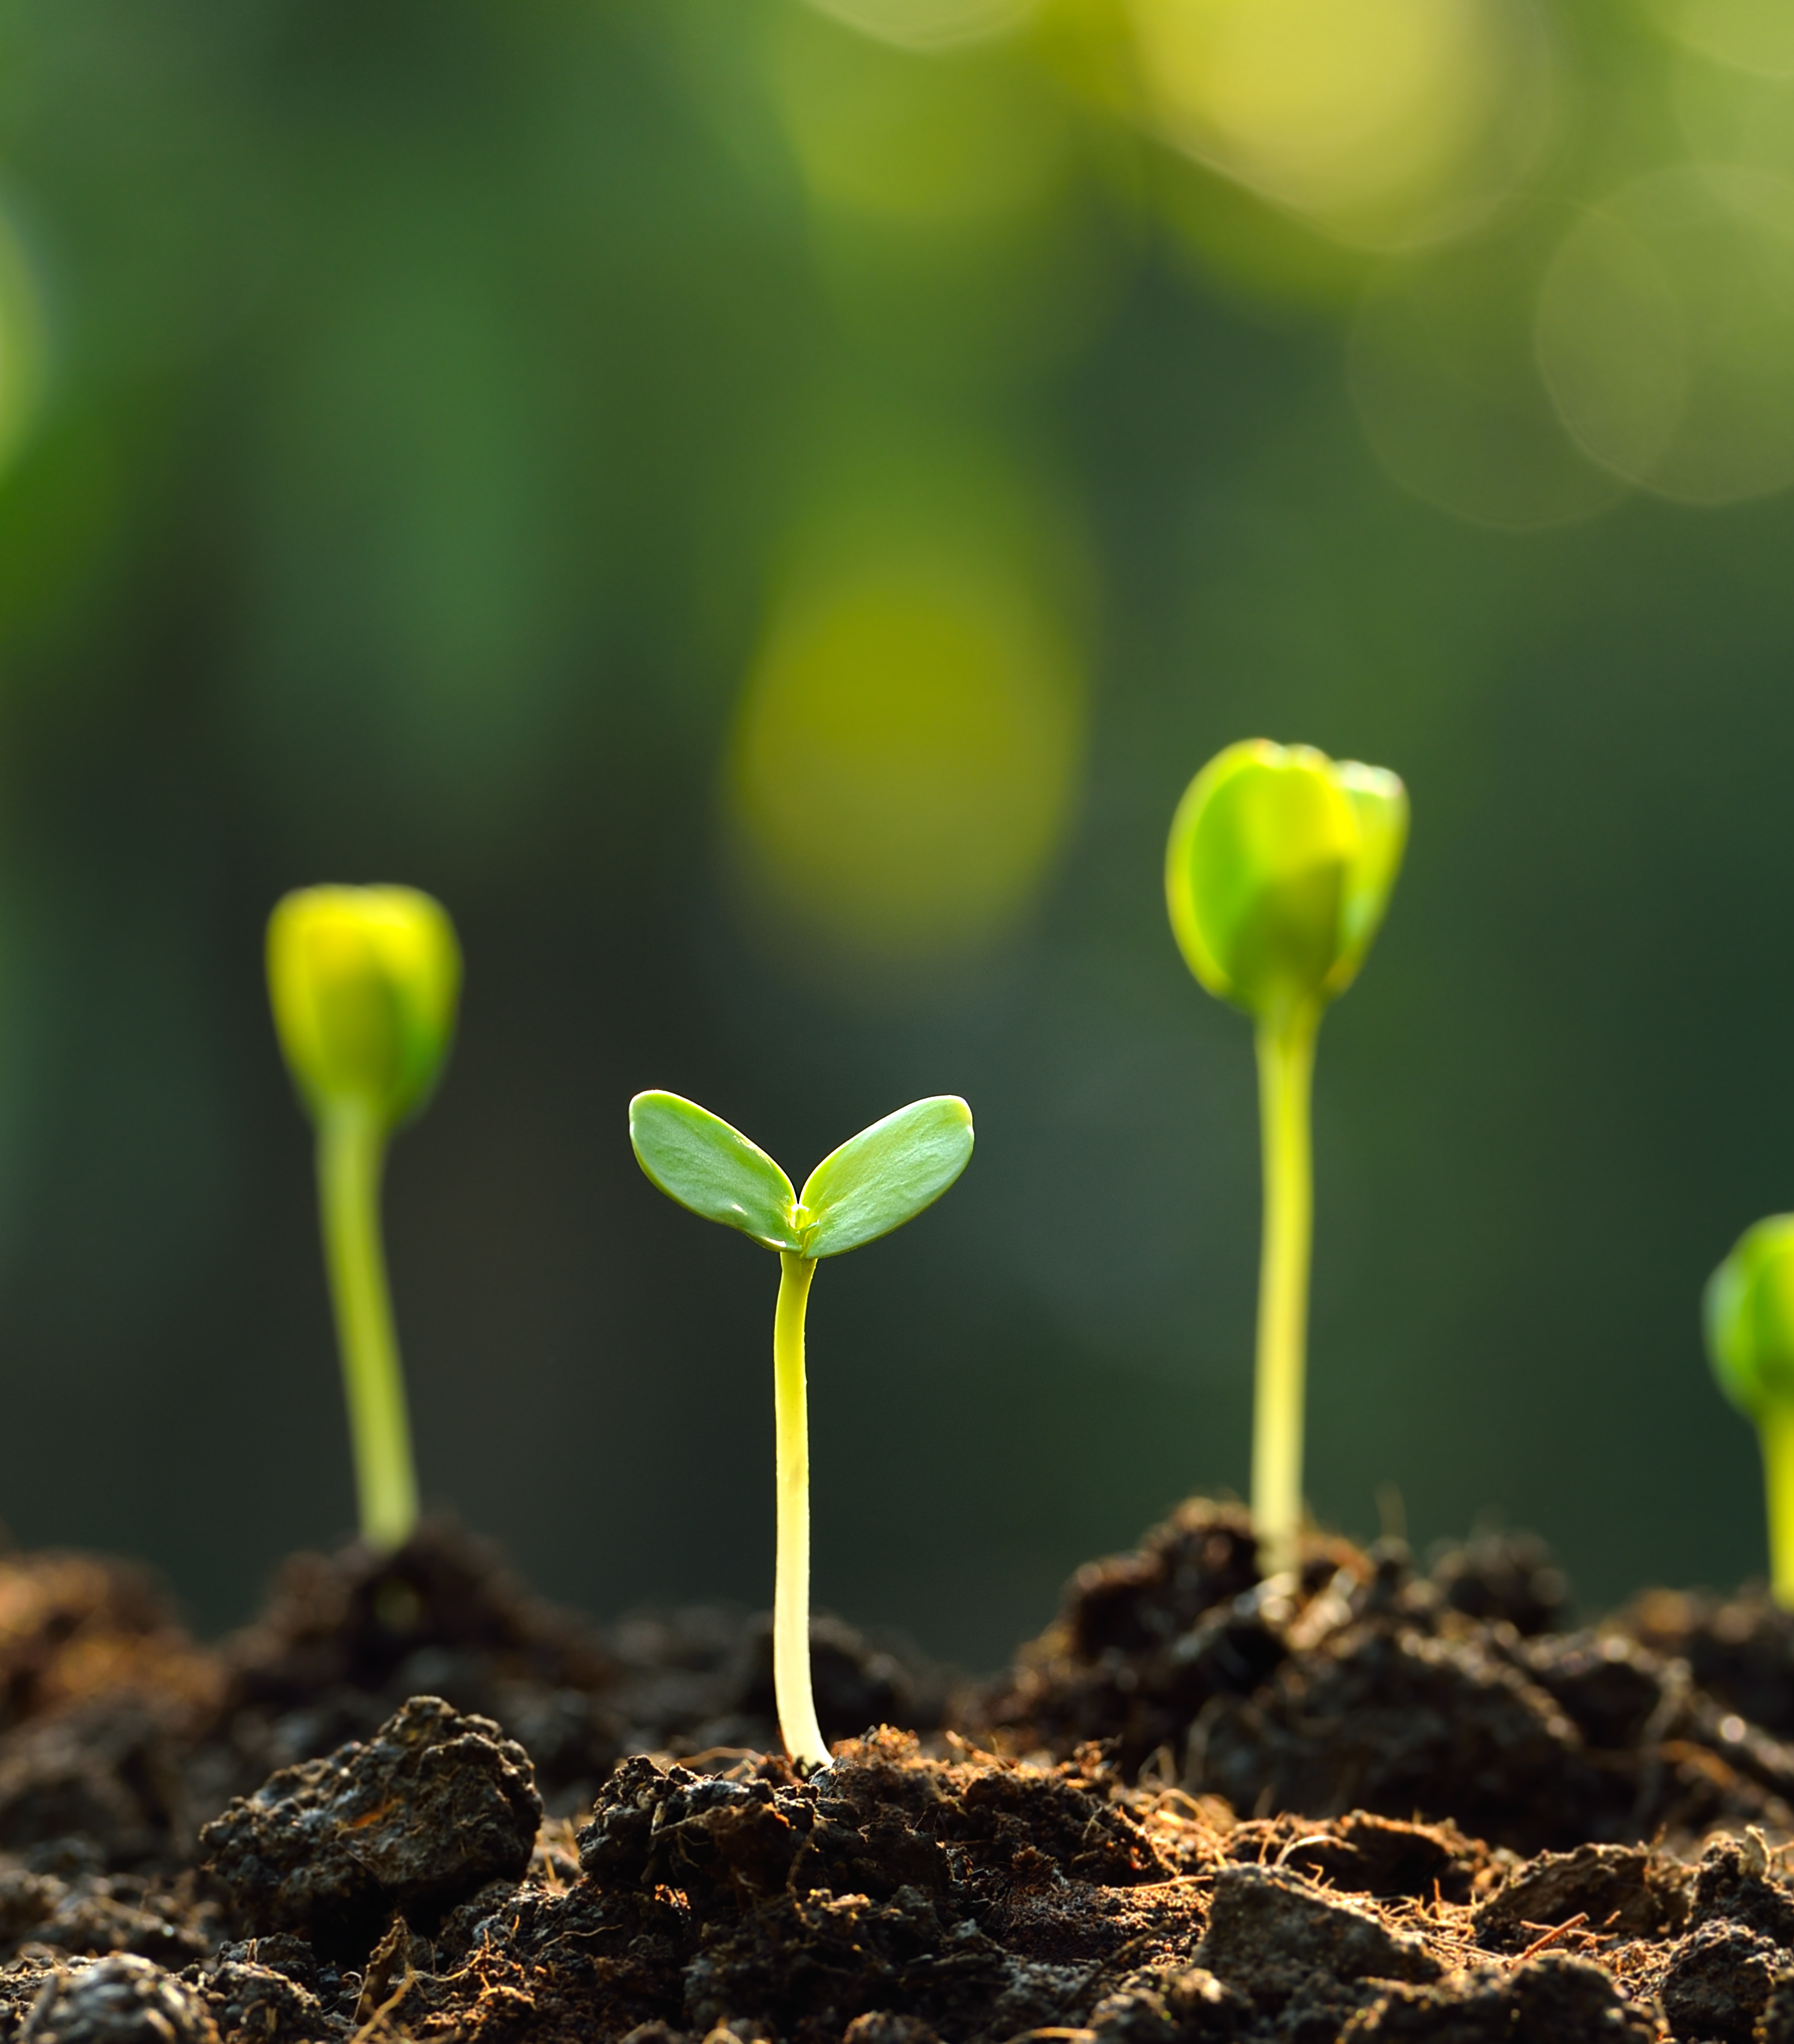
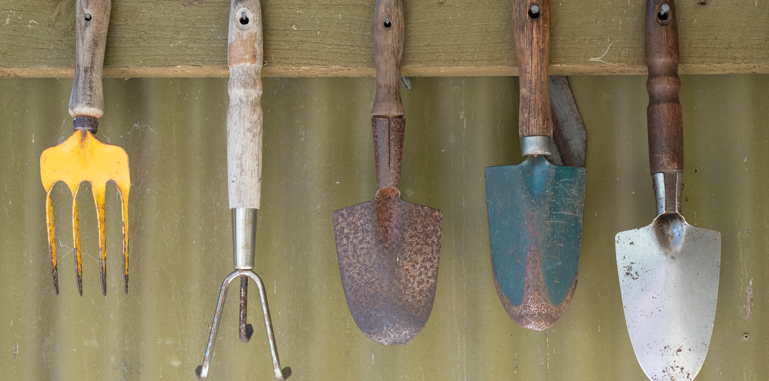
Soils and Home Gardening
Three Sisters Project, Iowa State University
Valeria Cano Camacho & Susana Cabrera-Mariz
Notes:
Introductions
Introduce the project
Talk about previous workshops with NICC (Compost and intro to soil health kits)

Slide 2
Recap Of Previous Workshops
What are soils ?
What are healthy soils?
Why do we care about soils?
Multiple services soils provide

Slide 3
A soil is composed of…
5% Soil Organic Matter
Mineral Particles
Soil Organic Matter
Decomposed
SOM
Air
Water
10%
Roots
10% Organisms

Slide 4
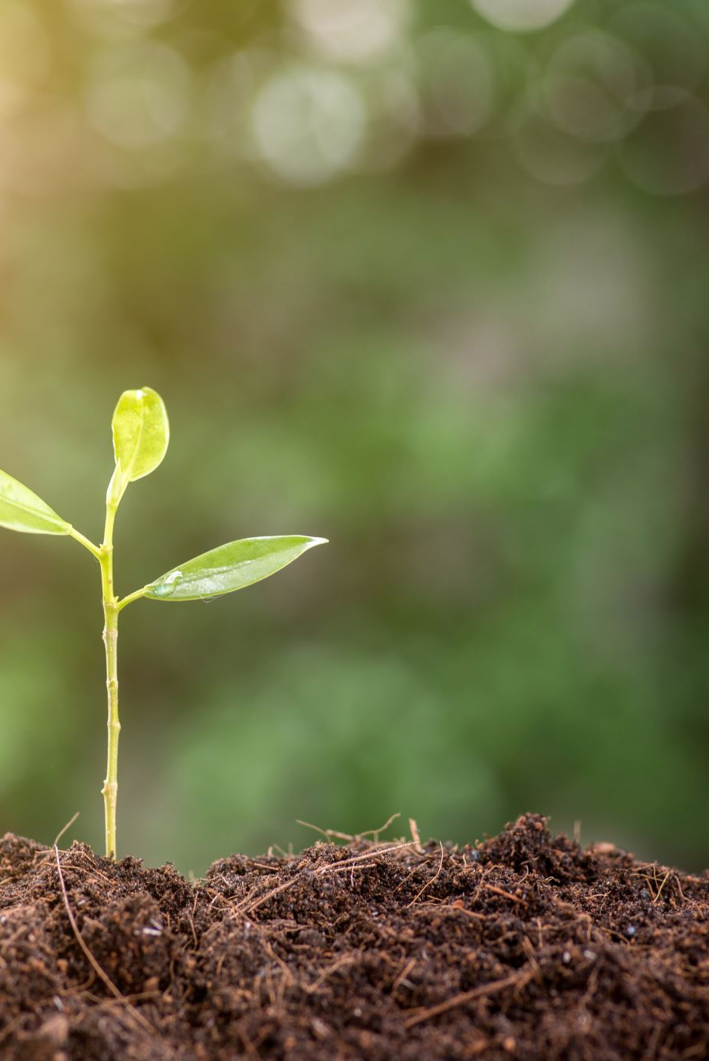
Soil Health Definition
“Soil health, also referred to as soil quality, is defined as the continued capacity of soil to function as a vital living ecosystem that sustains plants, animals, and humans.”
- Natural Resource Conservation Service

Slide 5
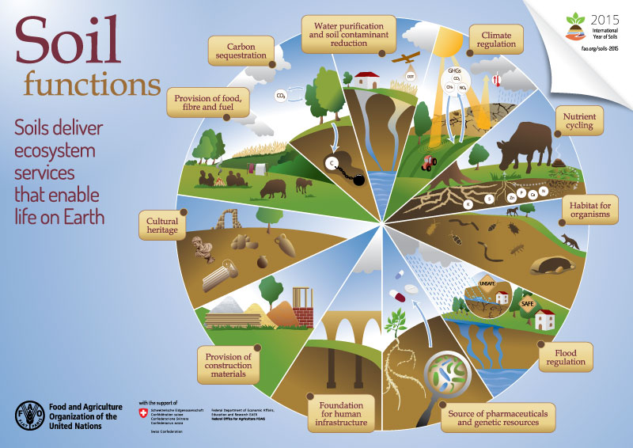
Notes:
HIGHLIGHT:
Cultural heritage: soil is more than AgriCULTURE, there’s a reason culture is in the word.
Some examples include: clay pots used for cooking, infrastructure within earth lodges
Pharmaceuticals: I learned from Brenda at Umohon school that that western medicine is really medicinal plants in a chemical compound

Slide 6

Biological Properties
Chemical Properties
Physical Properties
Microbial Activity
Organic Matter
pH
Nutrient concentrations
Structure and aggregation
Soil Health

Slide 7
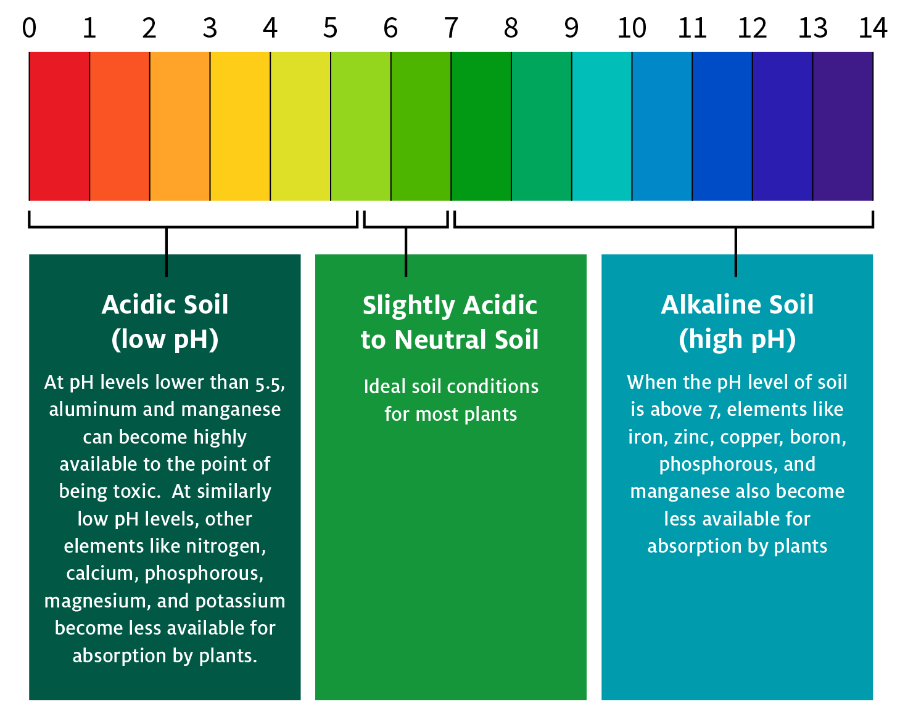
What is pH?
Measure of hydrogen Concentration in a solution
Ratio of H⁺ and OH⁻
Most vegetables grow best in slight acidic soil… around 6
Add lime to increase pH
Add OM to decrease pH (evergreen needles etc)
Soil Chemistry

Slide 8
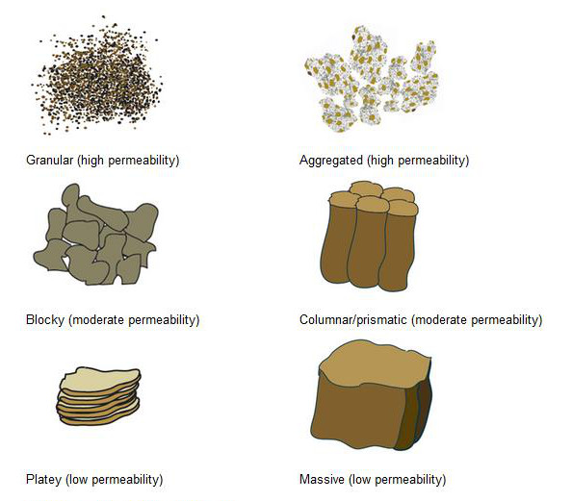
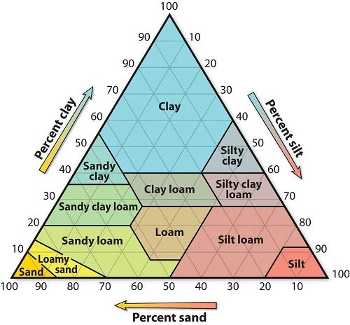
What’s the difference between…
Soil Texture
Soil structure
Soil Physics

Slide 9
Which can be changed? Texture? Structure?
STRUCTURE! BUT HOW?
Hint: What is one of the biggest struggles of gardening in this region?

Slide 10
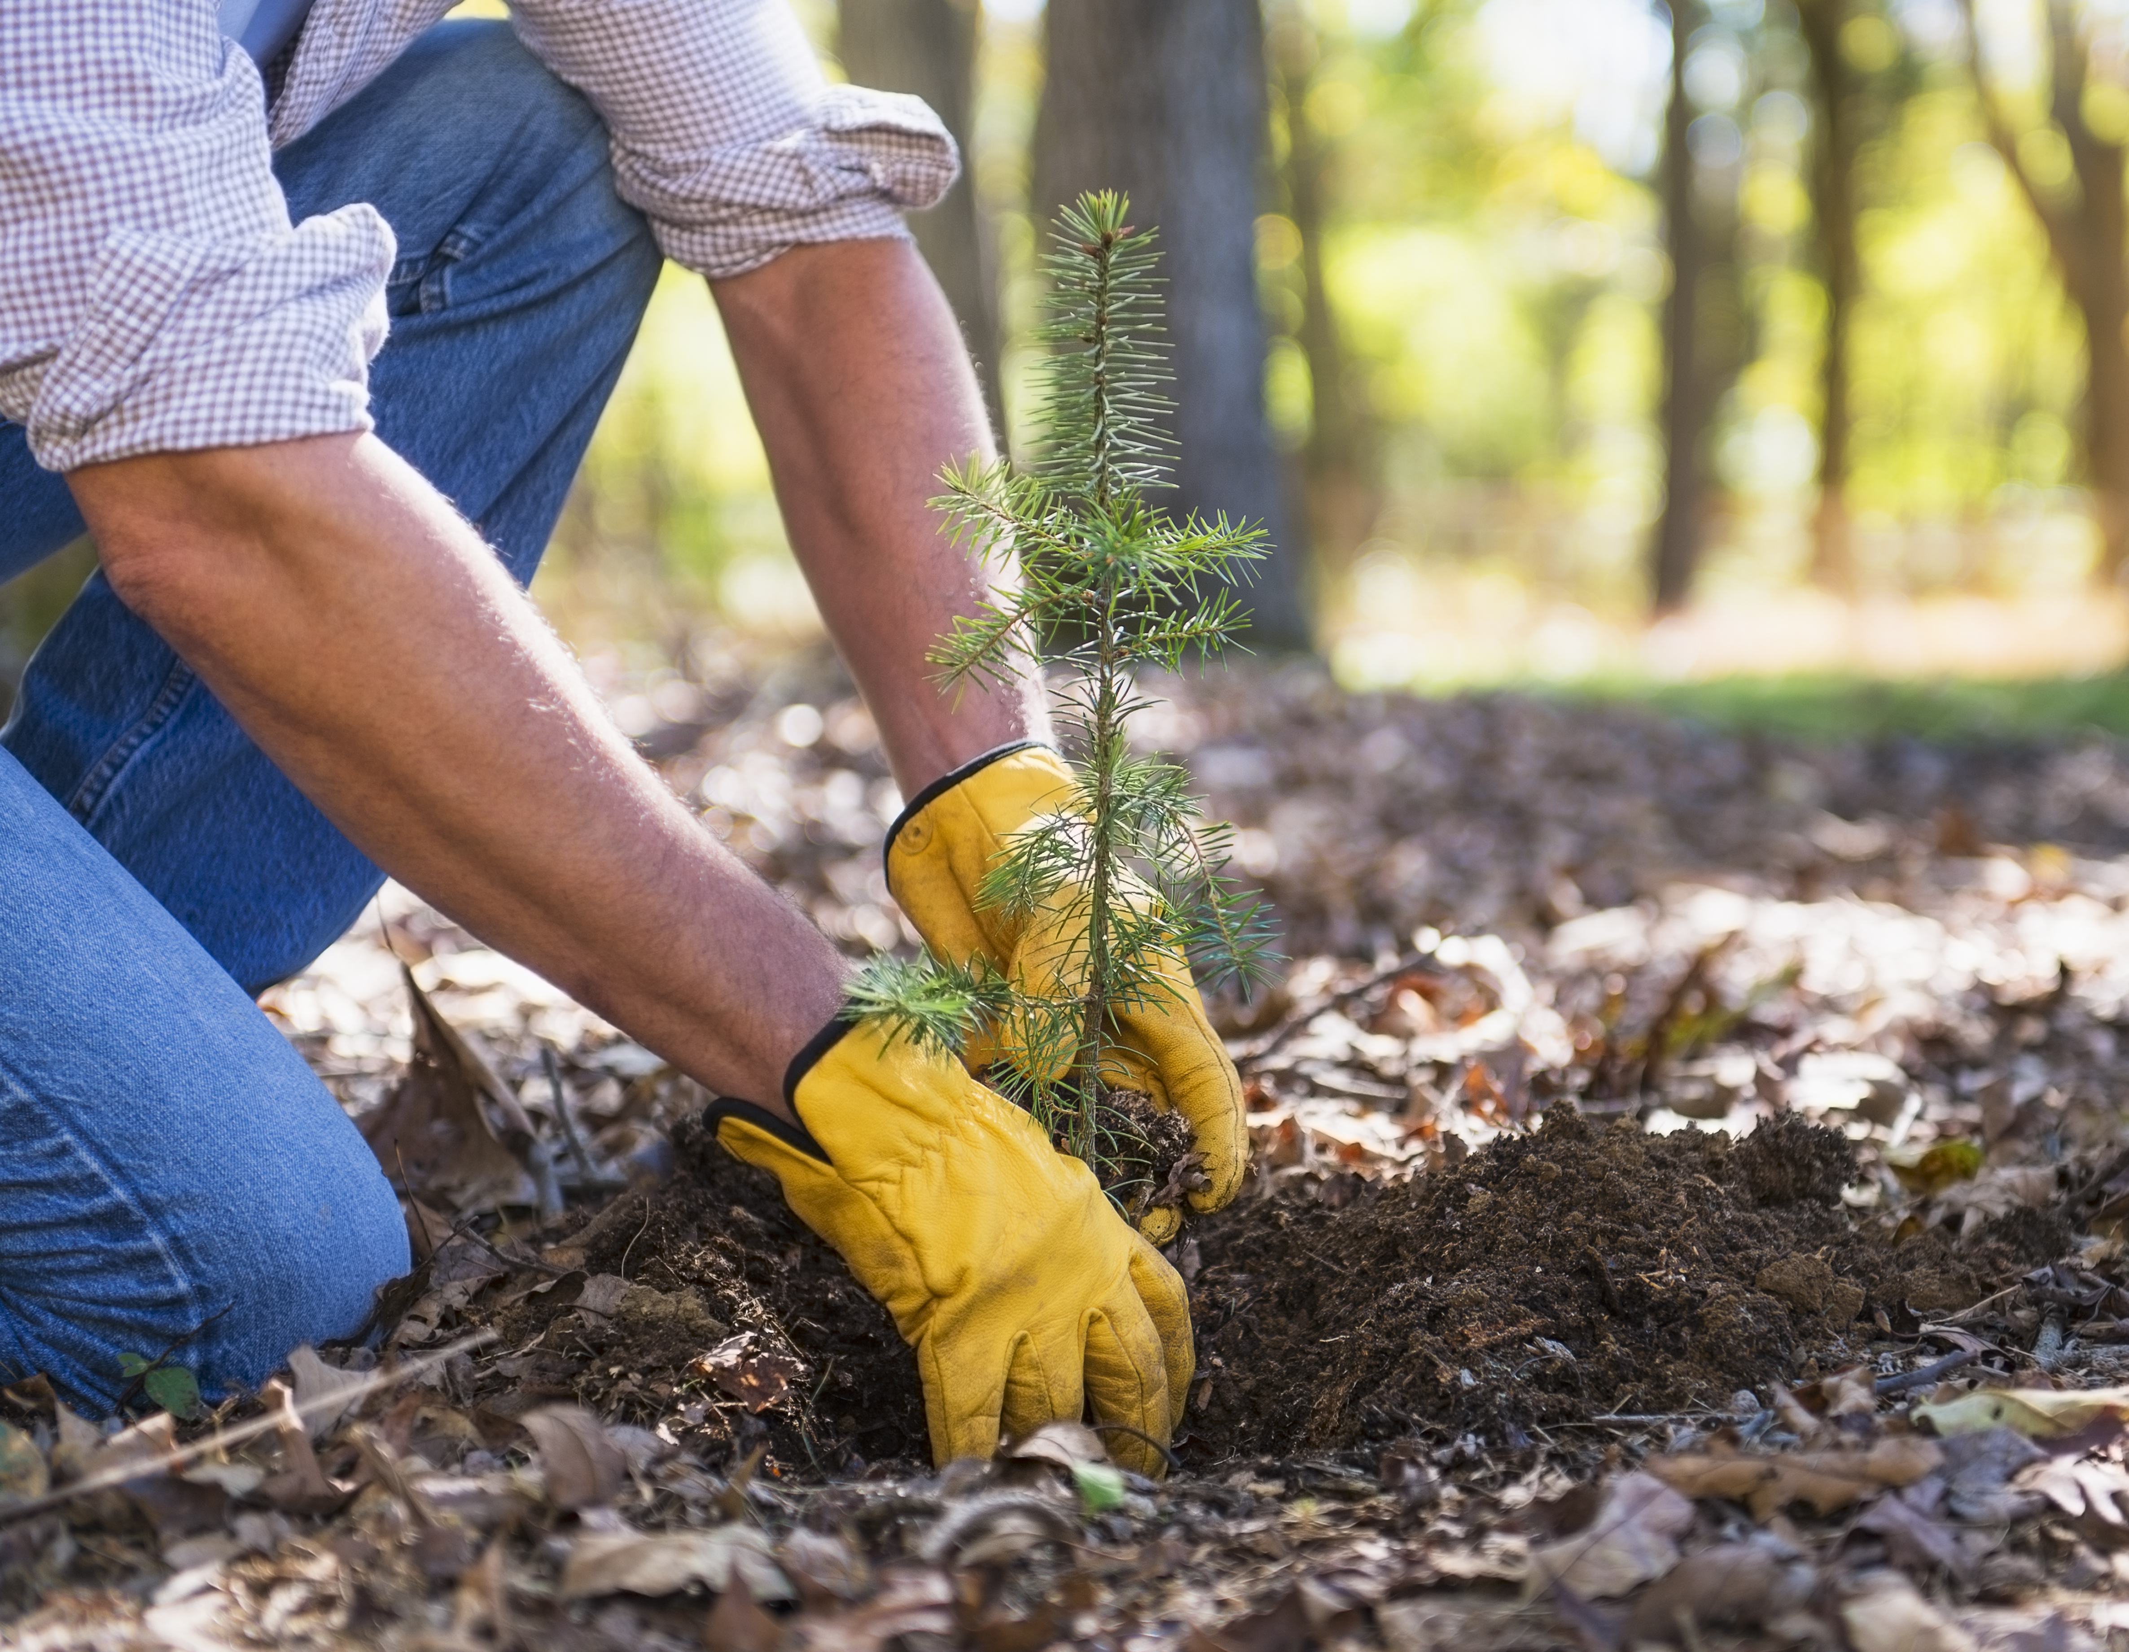
How to improve clay soils?
Bark, sawdust, manure, leaf mold, compost and peat moss are among the organic amendments commonly used
Not a one dump and one situation
Continuous care and treatment
Soil Quality Card Demo
Key Point: Observation is everything

Slide 11
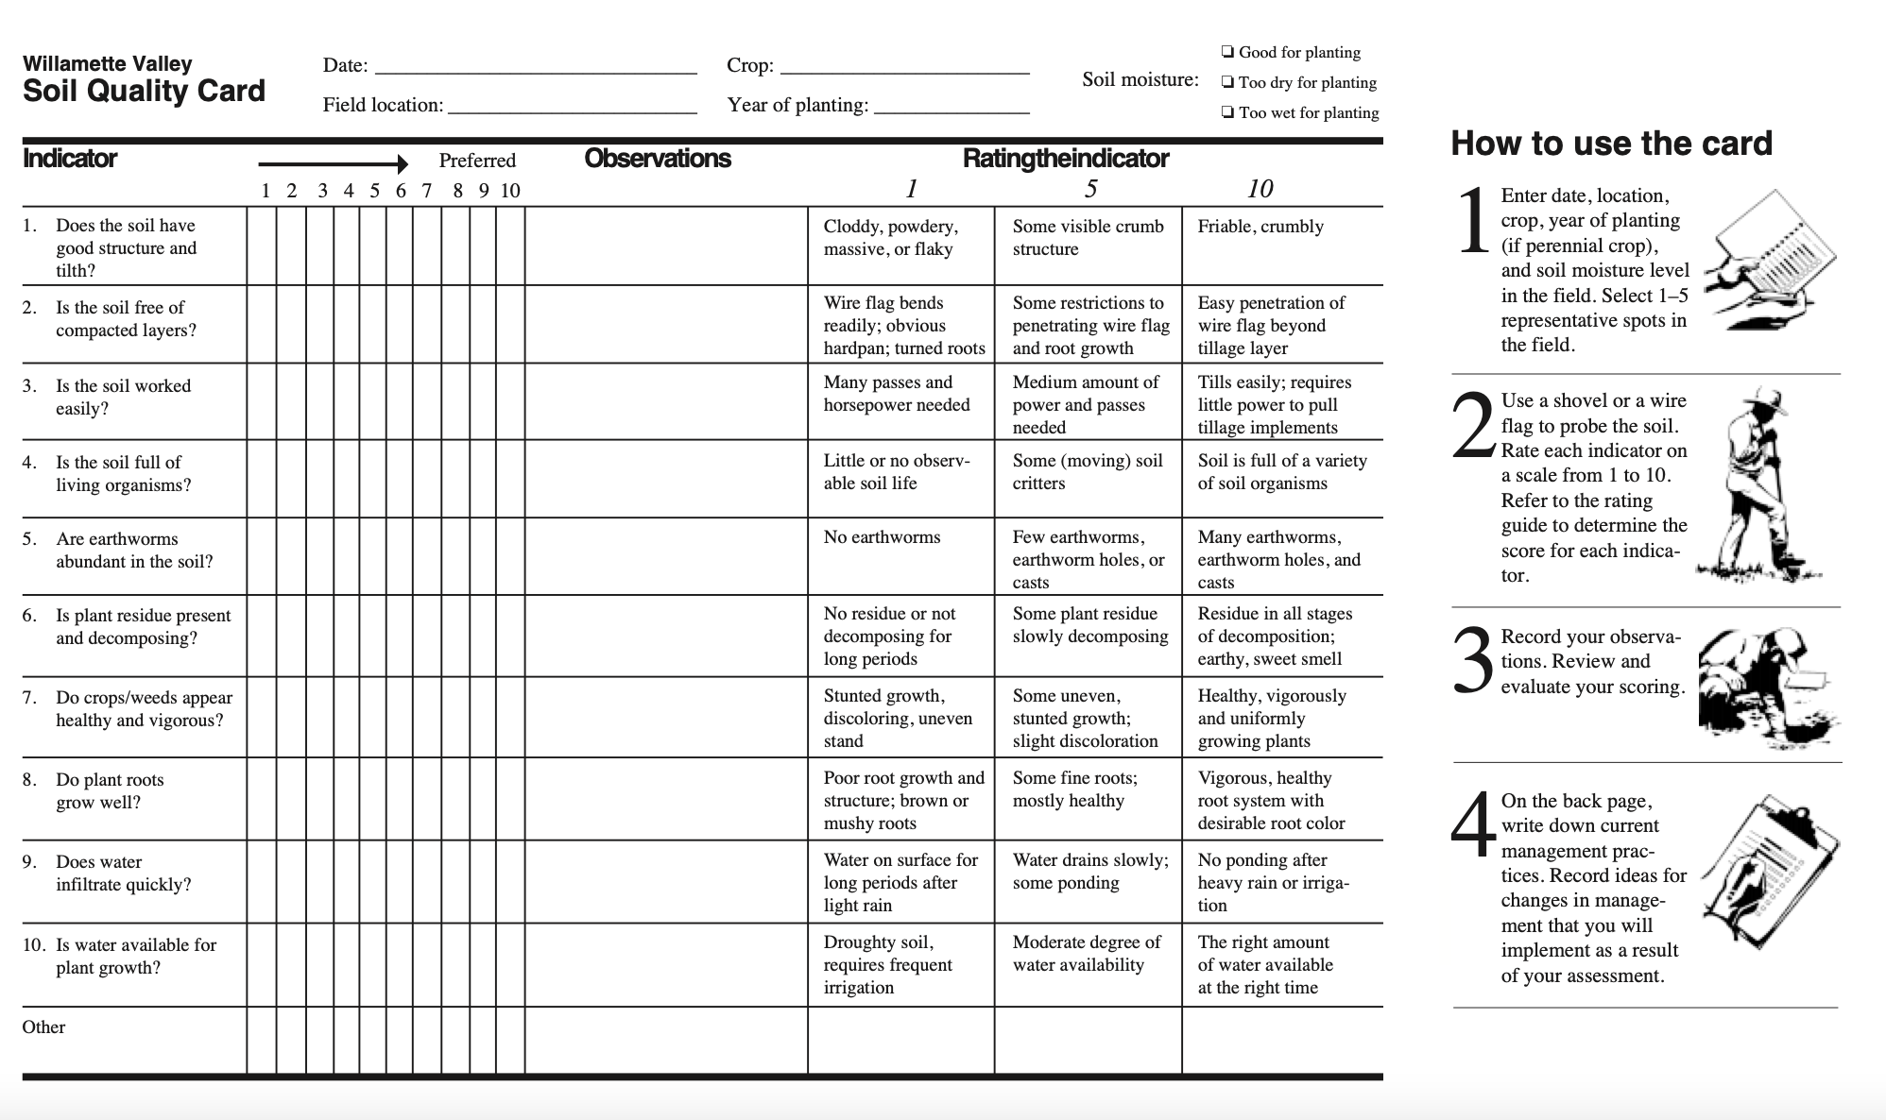

Slide 12

Review:
Getting Started Gardening
Why are plants important?
What do plants need to be healthy?
How do we best care for plants?
Selecting a site & size of garden
What type of garden?
Setting up irrigation (Workshop is coming soon!)
Plant selection
How do you maintain your garden
Harvesting
Save Seeds & Share Food!

Slide 13
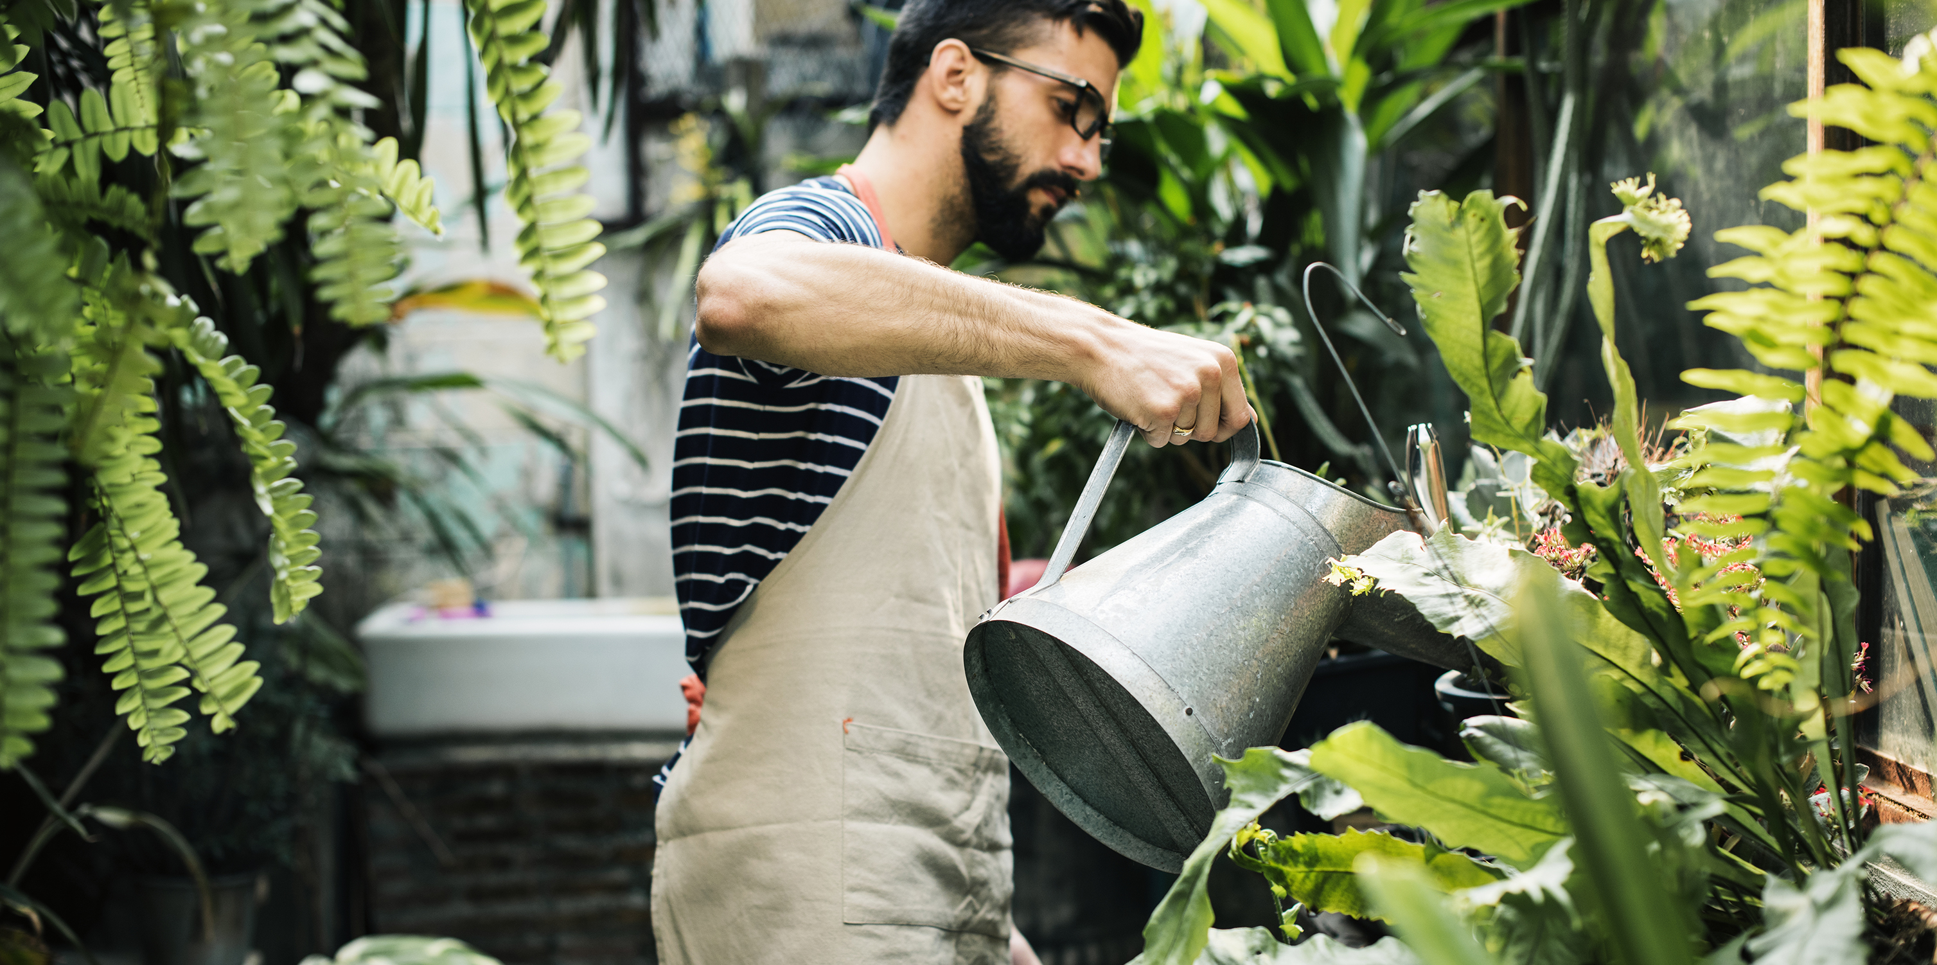
Plant Health &
Water
What impacts a plants water needs?
Signs of water stress
Solutions
Notes:
Explore: How to determine a plants watering needs, signs of water stress, and potential solutions to water issues

Slide 14
Signs of Water Stress
Greying leaves
Change in leaf color from a vibrant green to a dull grey green/blue tinge
Loss of sheen
Plant leaves change from glossy to dull
Insect damage
Especially aphids on Brassicas
Damage to the root system via pest predation
Plants that look dry even after watering often have root damage from a pest especially symphylans.
Red or purple leaf color
Can indicate dry conditions, or saturated conditions (lack of oxygen), or root damage.
Development of small spines on the leaf margin or stems
Especially true for Lettuce
Wilting in the cool of the day
Not a plant protective strategy
Our dramatic sister: the Squash!
Slower than expected growth

Slide 15
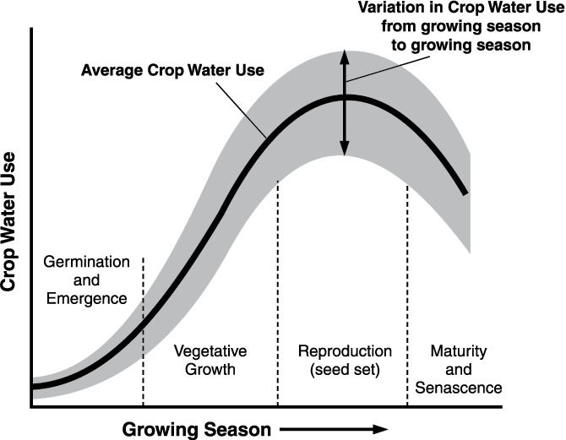
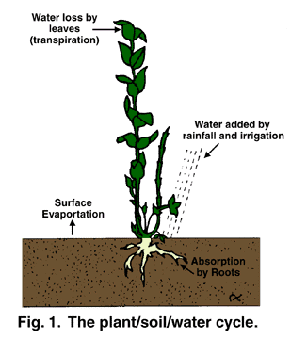
Water Use
Evapotranspiration=Water loss from Transpiration + Water loss from Surface Evaporation
Watering: Replenishes Evapotranspiration

Slide 16
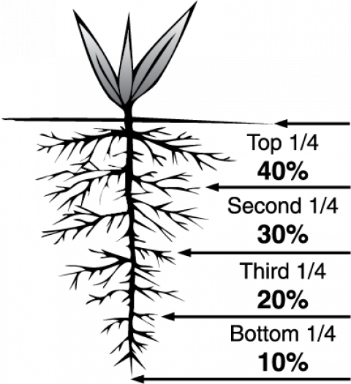
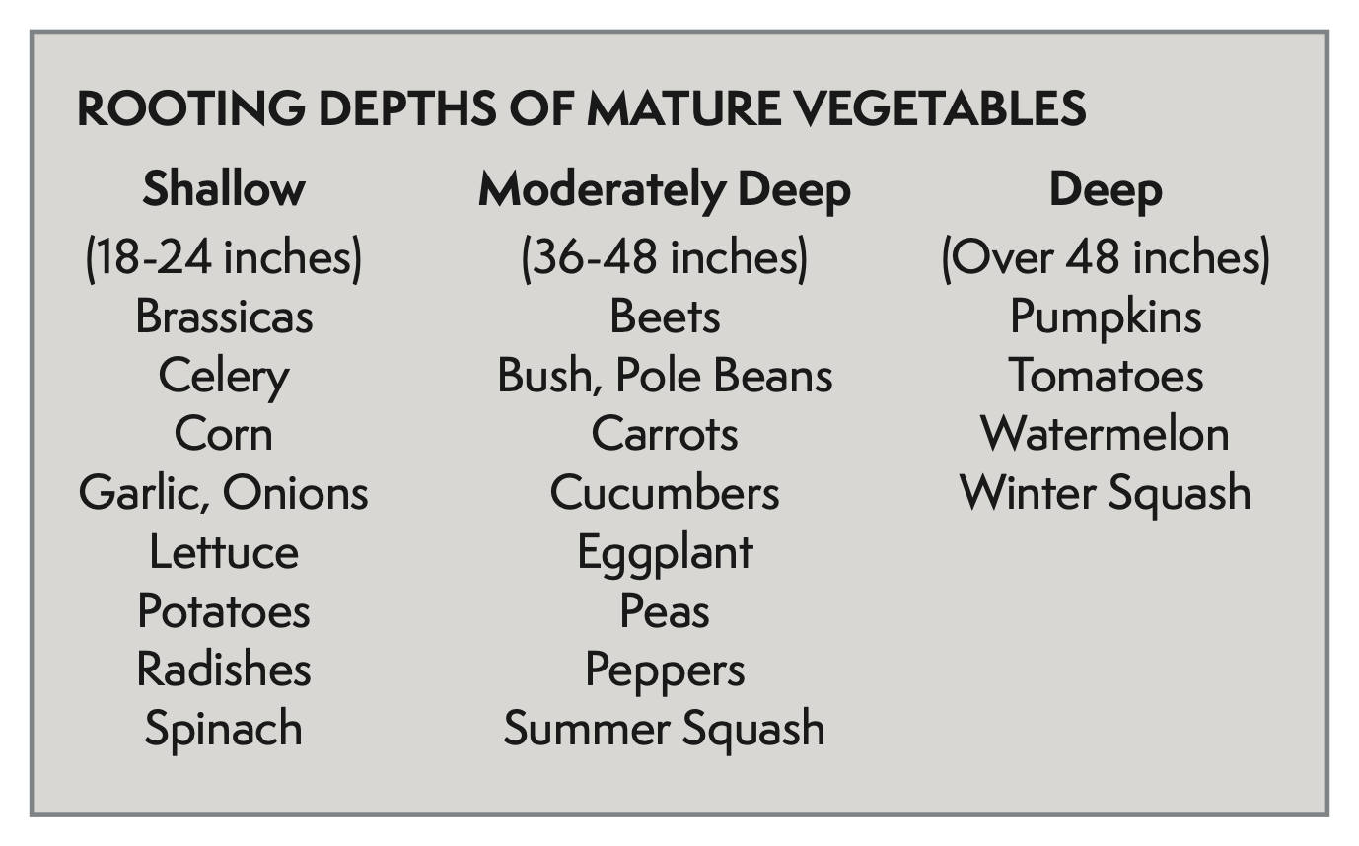
Notes:
Consistent deep watering over the lifespan of the plant
Increase in water time in order to ensure water is moved down through the soil profile

Slide 17
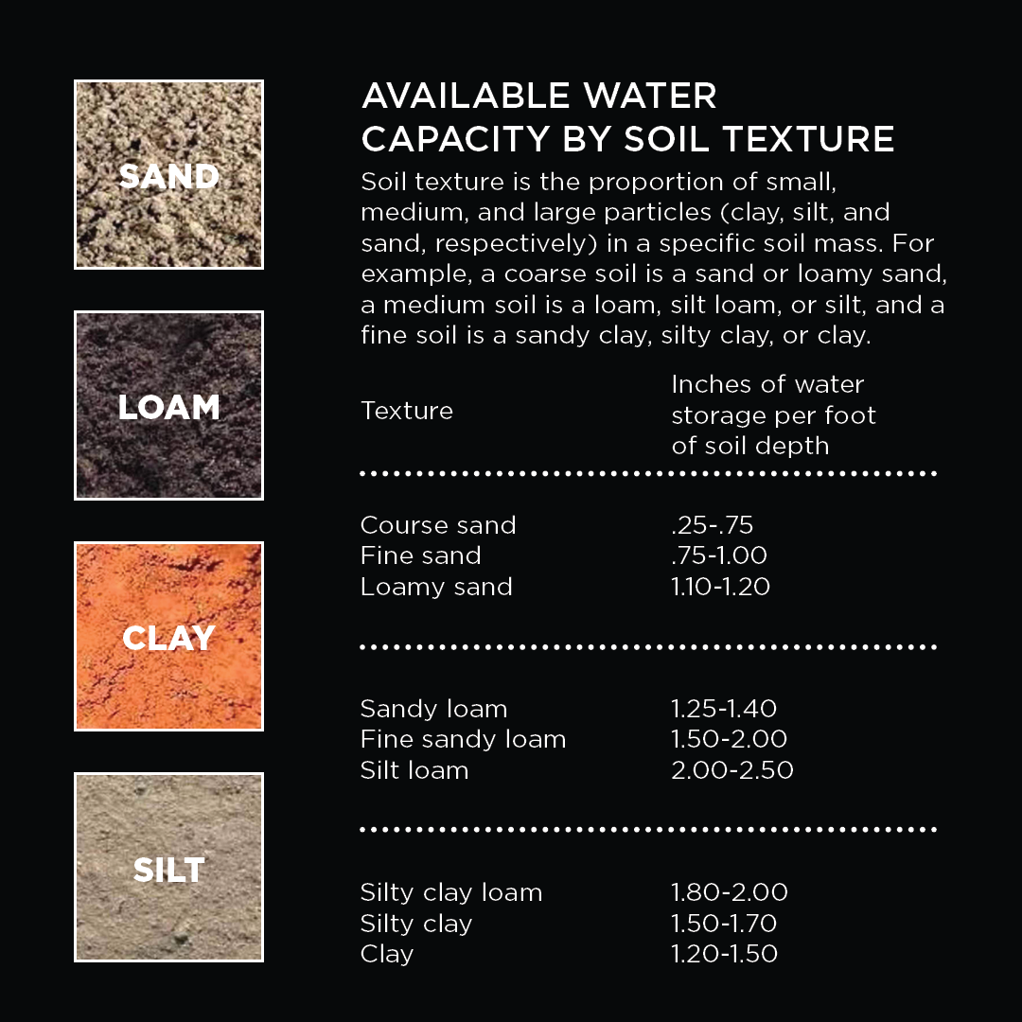
Soil Type
Soil type can have a major impact on water availability
Soils with a high clay content drain slowly - 2 weeks
Adding compost, improves drainage
Sandy soils drain quickly -1-2 days
Adding compost, improves holding capacity

Slide 18
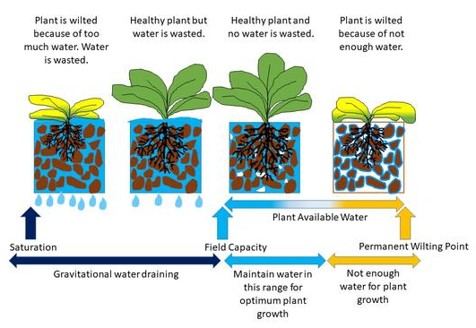
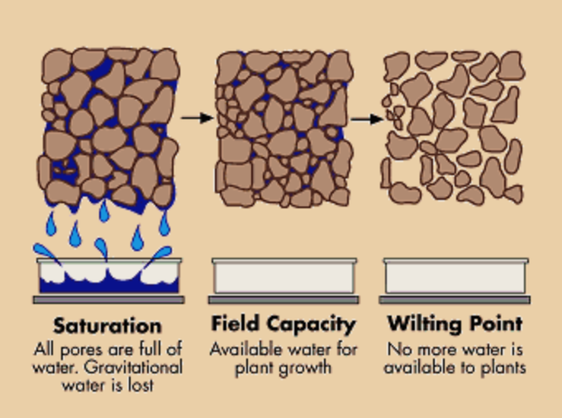
Garden Watering Goals
Notes:
PORE SPACE
Water until we reach Field Capacity
We don’t want to reach the Wilting point!
Going beyond the saturation point, means that we are creating unnecessary runoff & waste
Slowly stretching plant root growth by watering along root growth
Taste Considerations

Slide 19
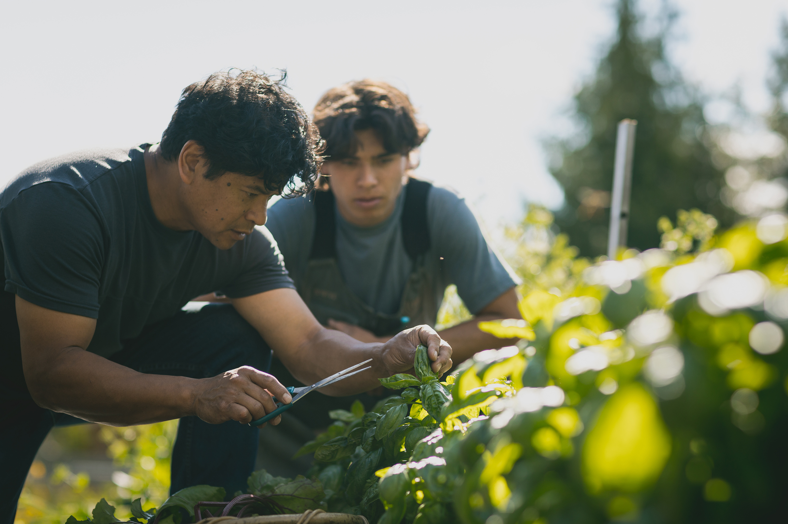
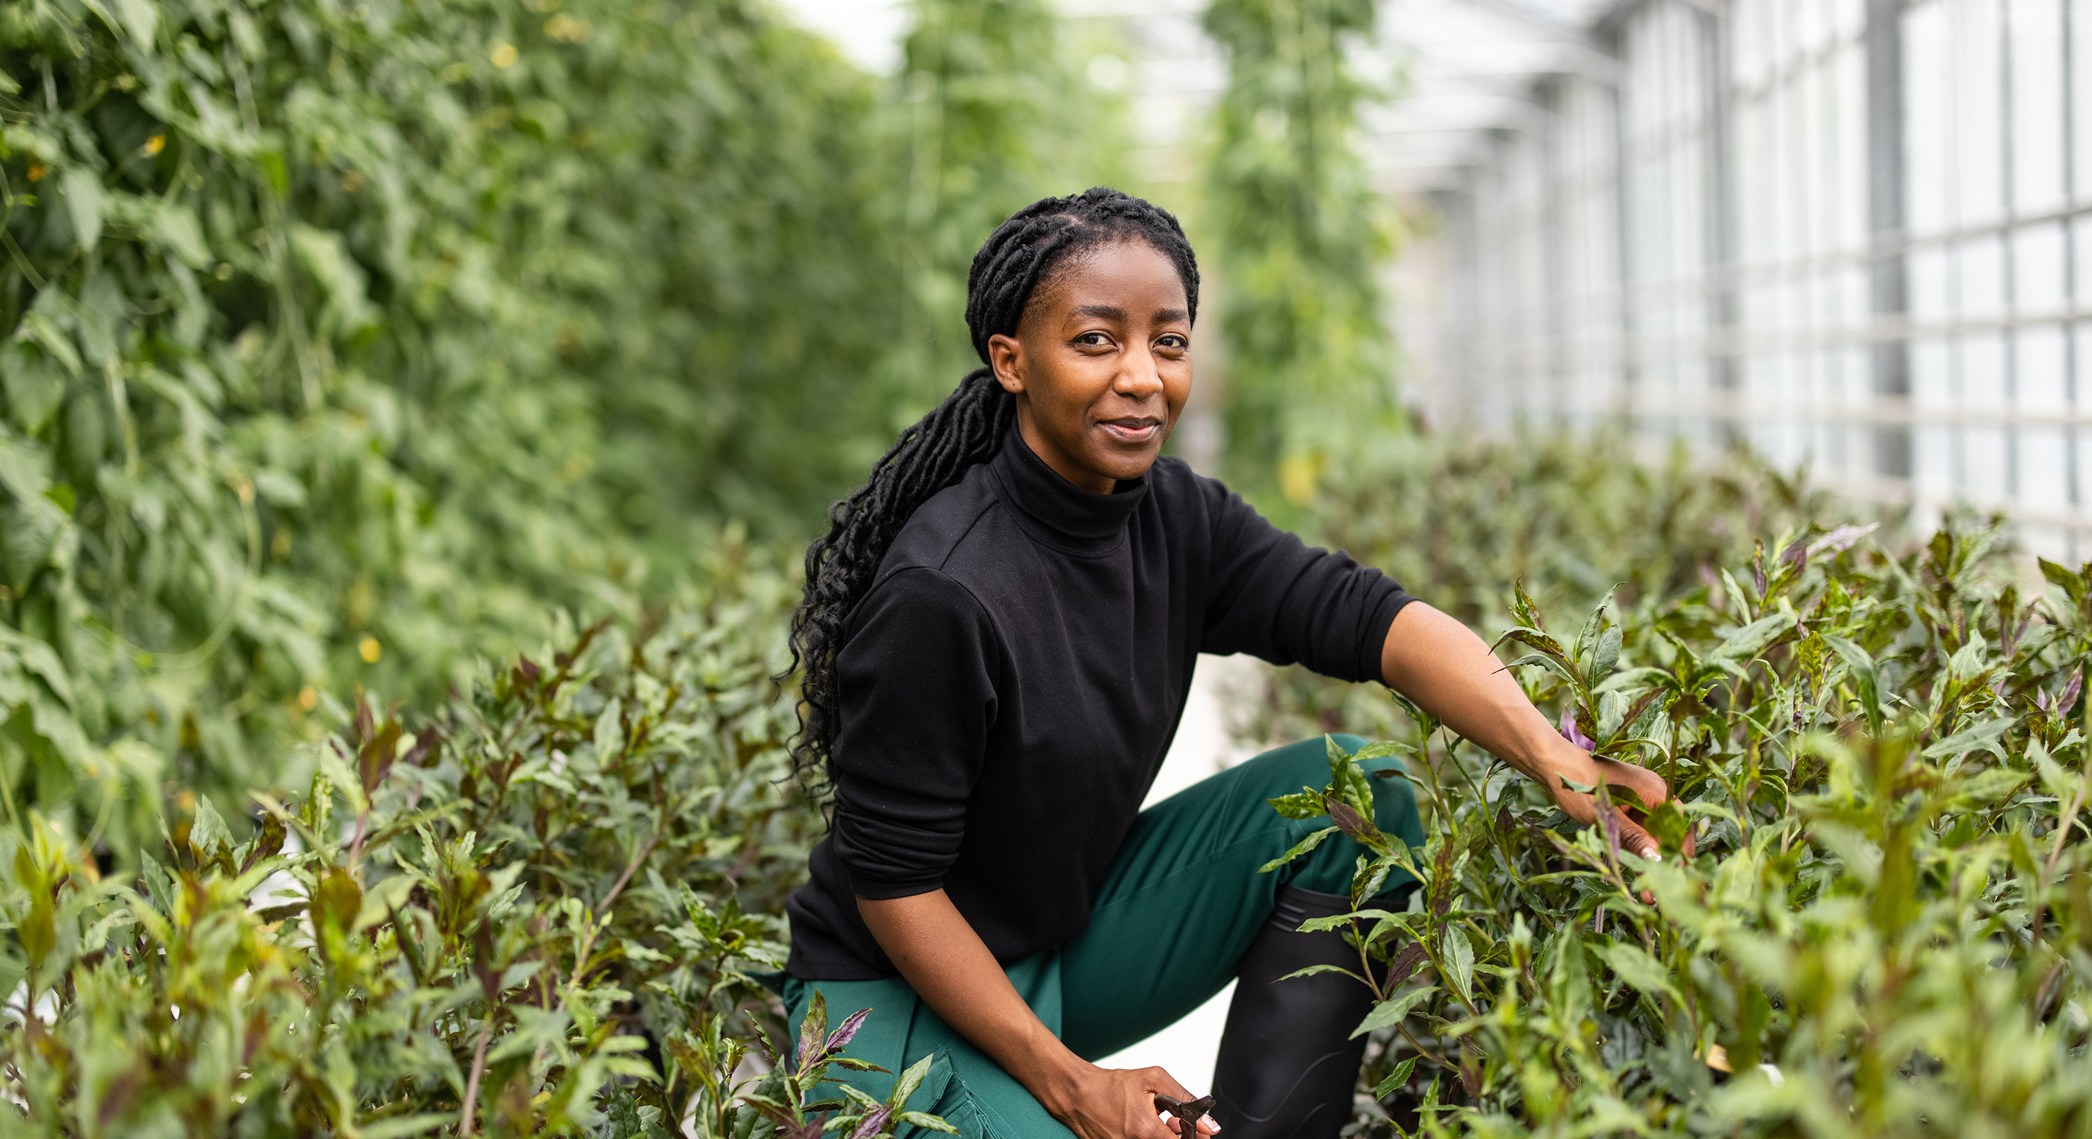
Pro Tips
Water in the mornings, when cooler temperatures and calm conditions slow evaporation
Allow enough time for plants to dry out before the evening to prevent fungus and mildew problems
Watch the weather, clouds/rain/wind will change how you water
Watch where you water
Calculators

Slide 20
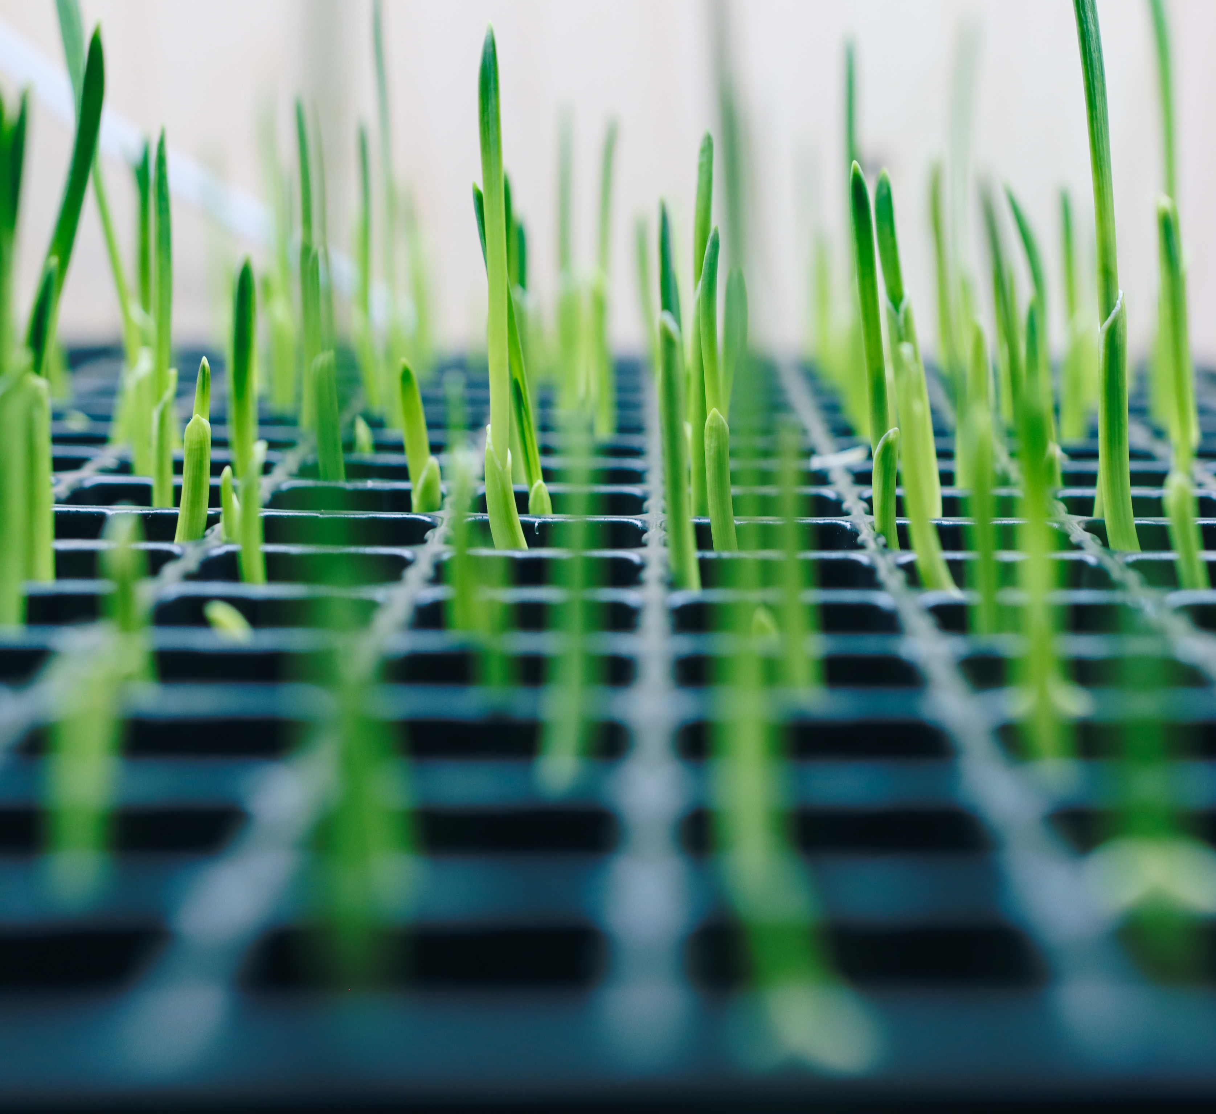
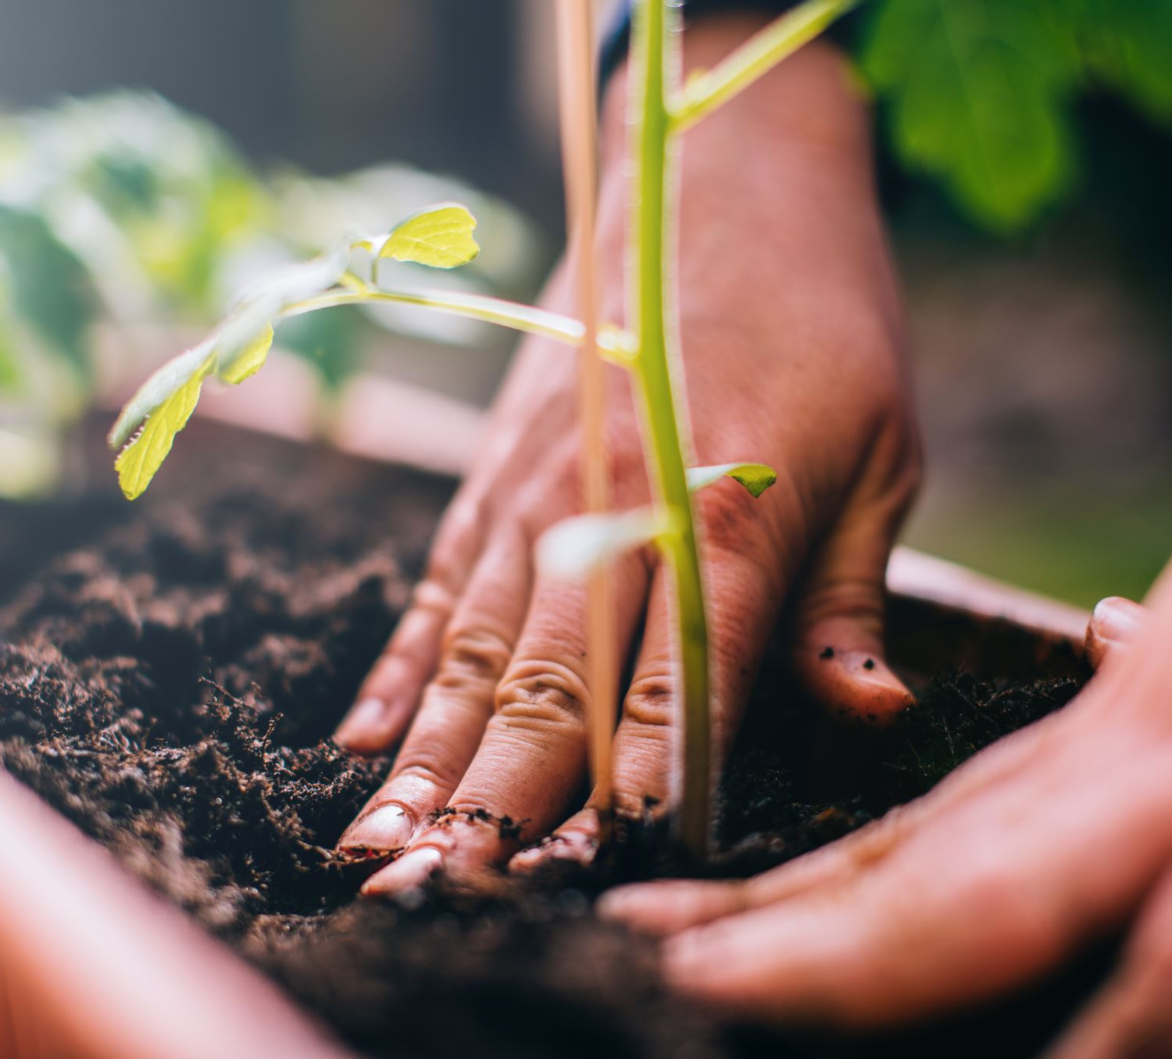
Seeds & Starts
Consistent soil moisture during germination
As they grow up, allow for periods of dry down
Be careful not to overwater
Add amendments
Transplants: Let dry the day before transplanting then Water in!

Slide 21
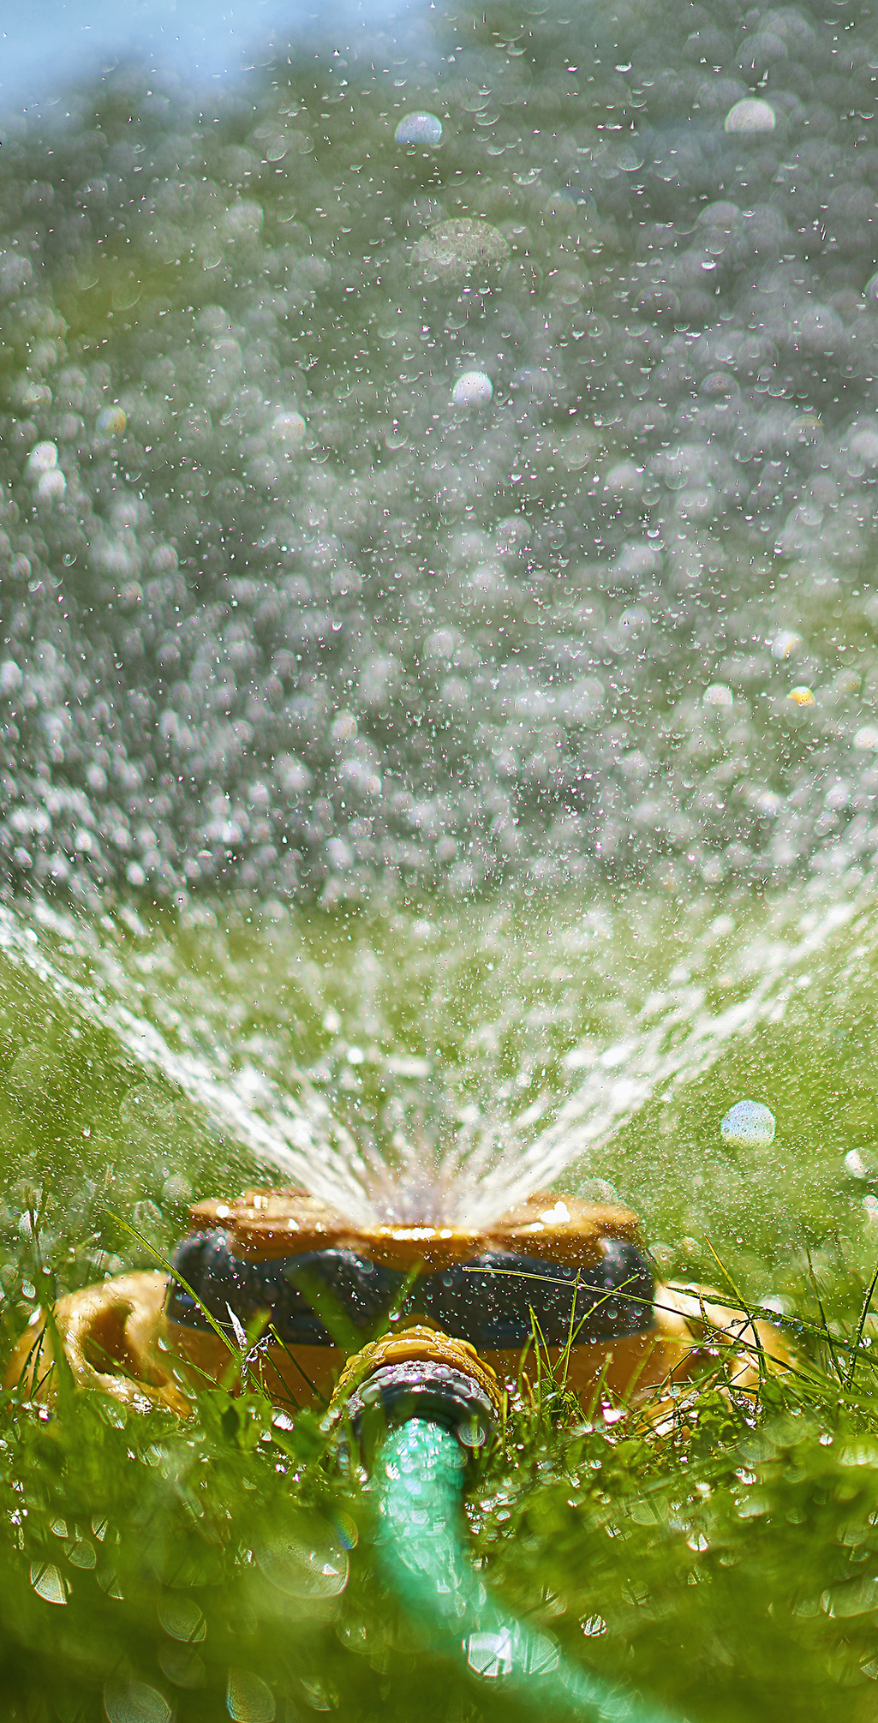
Drip Irrigation
Overhead Irrigation
Flood Irrigation
Furrow Irrigation
Rainwater gardens
Swales
Rain Barrels/Catchment systems
Water Management Systems

Slide 22
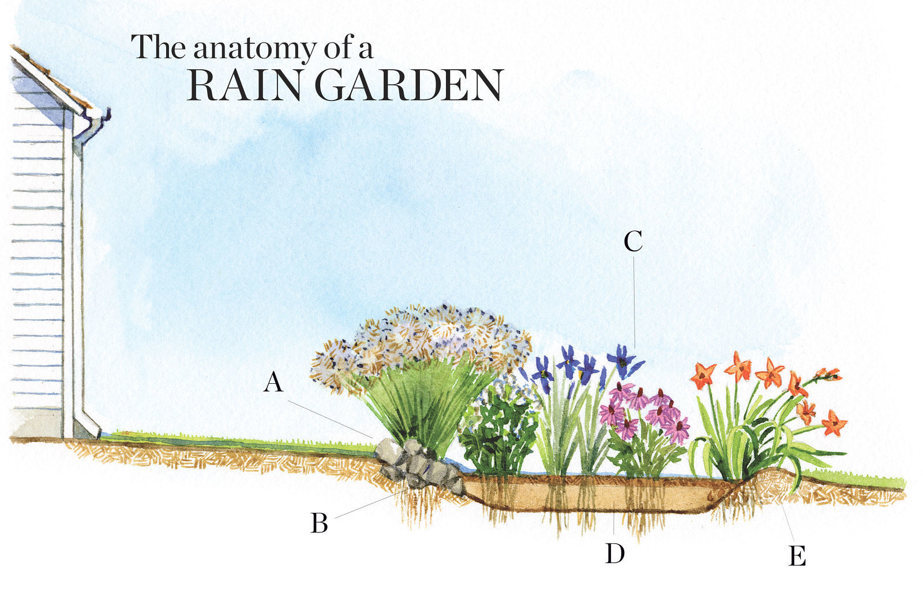
A. Stones or heavy material to slow the pace of runoff
B. 3-6 inch depression
C. Plants which withstand 2 days of flooding
D. 6-12 inch filter bed with coarse soil/compost
E. Berm of soil to hold water in
Notes:
Pollinators, Herbs, and Flooding

Slide 23
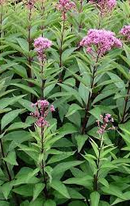
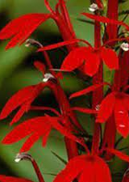
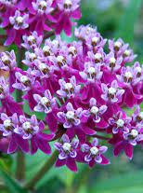
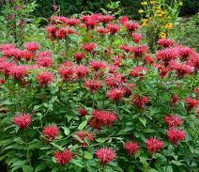
Raingardens In Nebraska: Plant Varieties
Bee balm, Monarda didyma
Resistant to powdery mildew: Grape Gumball or Raspberry Wine
Swamp milkweed, Asclepias incarnata
Joe-pye weed, Eupatorium maculatum
Cardinal flower, Lobelia cardinalis
Brown fox sedge

Slide 24
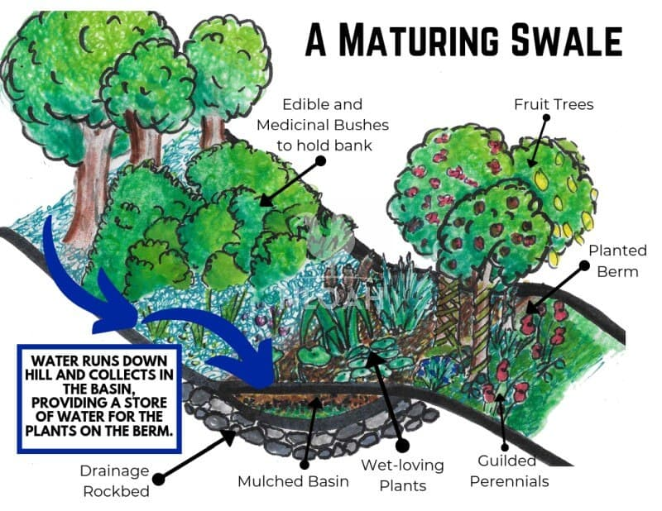
Swales
Divert Water
Store Water
Catch Water, Soil, and Nutrients
Prevent Erosion
Water edible and medicinal plants
Aesthetic Beauty!

Slide 25
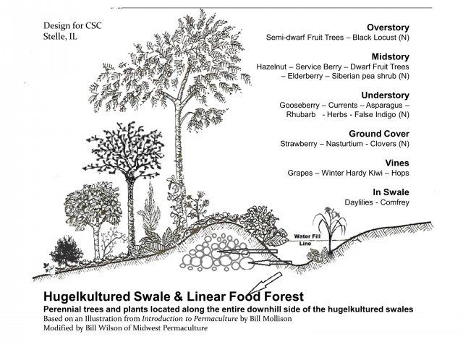

Slide 26
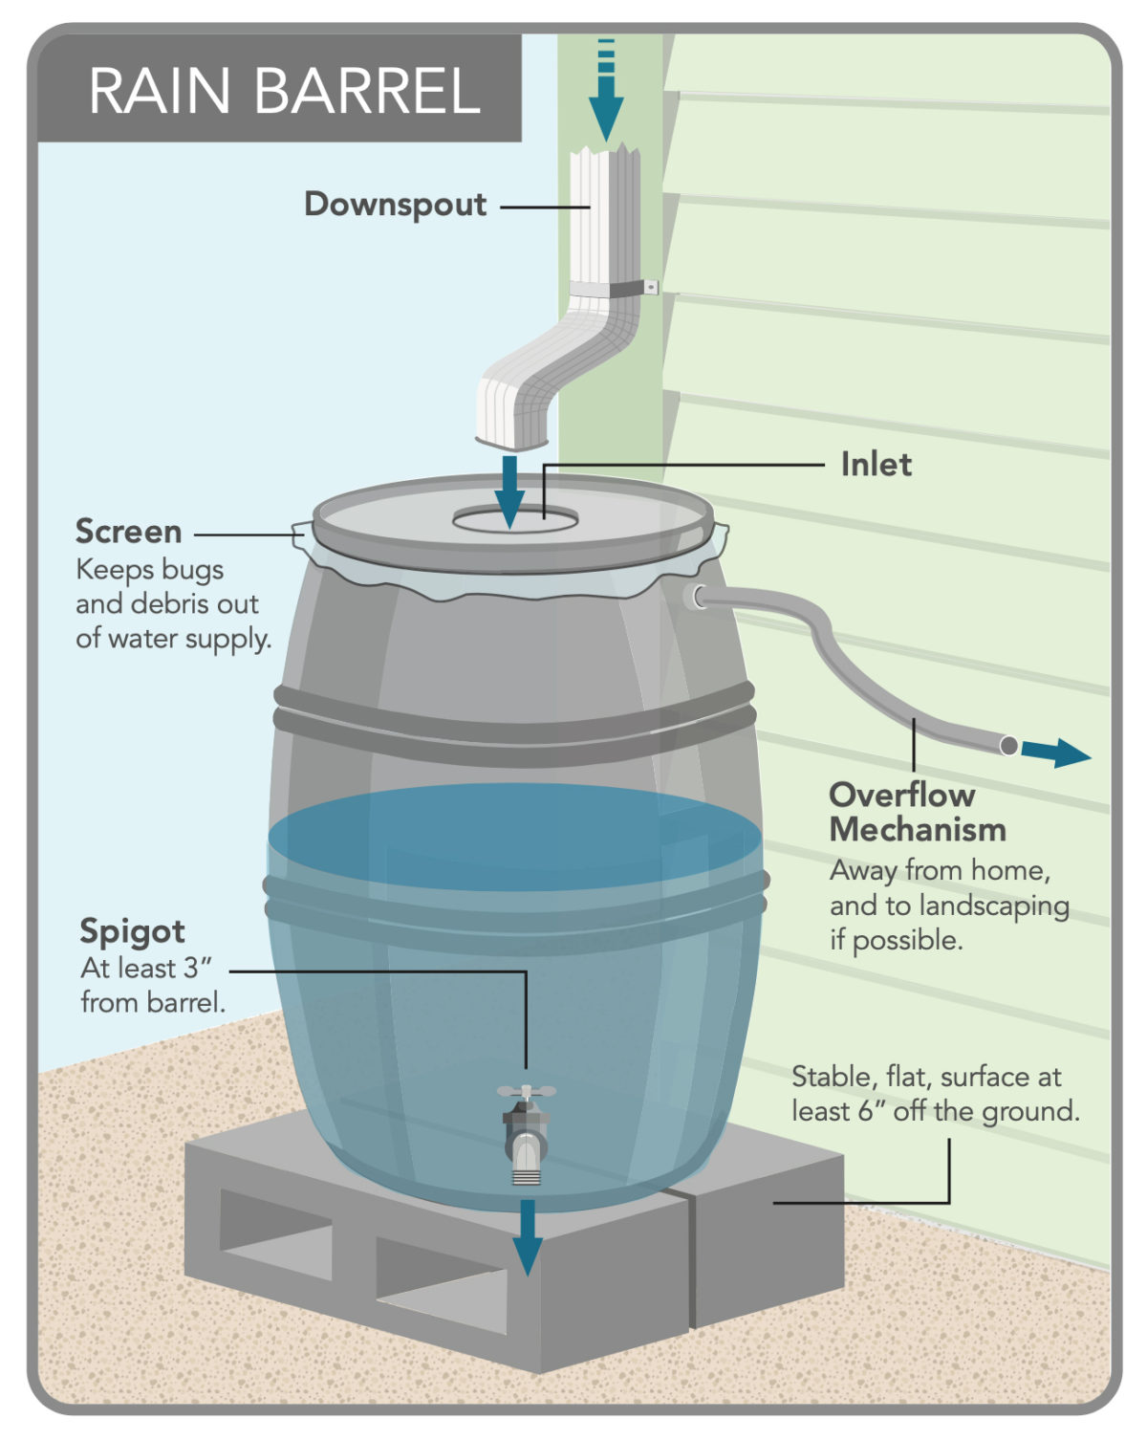
Rain Barrel
Activity
Capture Rain from your roof
Save Water
Reduce Pollution
Water is free from additives that come in drinking water

Slide 27
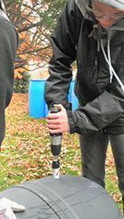
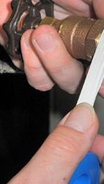
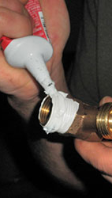
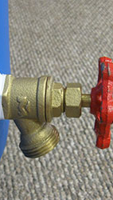
1. Drill a 1” hole six inches up from the bottom of the barrel
2. Wrap two thirds of the faucet threads with two layers of the thread seal tape. Leave the bottom third of the threads uncovered so it will be easier to start threading into the barrel.
3. Apply a layer of sealant over top of the tape and threads. Use latex-free gloves when using silicone sealant (caulk).
4. Line-up the threaded portion of the faucet with the hole in the barrel, and applying pressure, screw in the faucet.

Slide 28
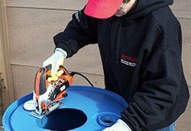
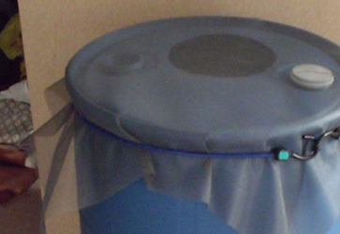
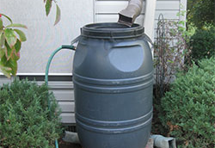
5. Cut a hole in the top of the lid, a 6” radius is recommended.
6. Drill an additional hole 6” from the top of the barrel for overflow
Alternatively : Cover over the entire top of the closed-top rain barrel aluminum window screen that is 36 x 36 inches.
7. Use a 48-inch bungee cord to secure the screen. Trim excess screen as desired.
8. Place the rain barrel under a downspout.

Slide 29

Questions or Comments?
Thank you !
Vcano@iastate.edu
SCCM@iastate.edu

