Slide 1
Lutheran Services in Iowa

Slide 4
Who is a Refugee?
People who have fled war, violence, conflict or persecution and have crossed an international border to find safety in another country.
UNHCR (the UN Refugee Agency)
Well-founded fear of being persecuted for reasons of:
Race
Religion
Nationality
Membership of a particular social group
Political opinion
Notes:
https://www.unhcr.org/en-us/what-is-a-refugee.html

Slide 5
Resettlement
Referral by UNHCR and pre-screening by the U.S.’s Resettlement Support Centers
Refugee status determination interviews conducted by DHS and USCIS
Additional medical and security checks
Sponsorship by U.S. resettlement agencies for assurance and travel arrangements
Pre-departure cultural orientation facilitated by Resettlement Support Centers and arrival assistance through the assigned resettlement agency
Notes:
https://rcusa.org/resettlement/resettlement-process/
Note that refugees often times spends YEARS – DECADES living in camps before the opportunity of resettlement comes along.

Slide 6
New Beginnings

Slide 7
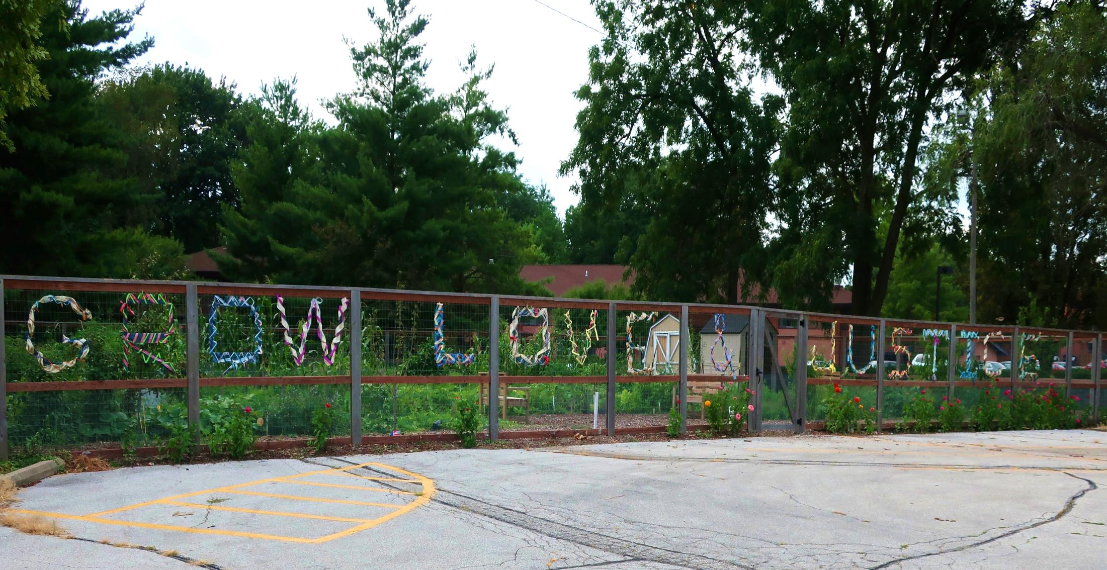
“If you have come here to help me you are wasting your time, but if you have come because your liberation is bound up with mine, then let us work together.”
- Lilla Watson

Slide 8
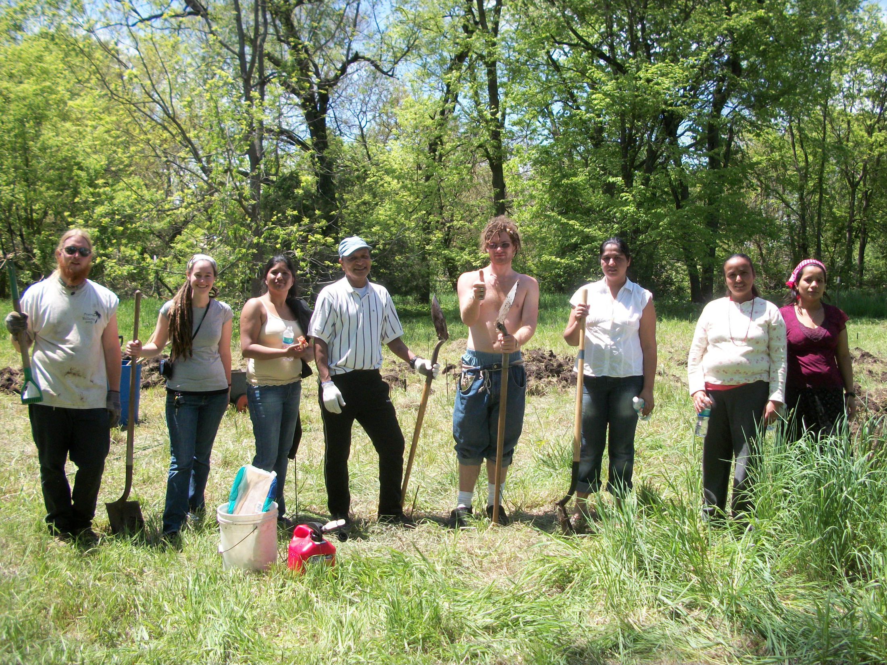

Slide 9
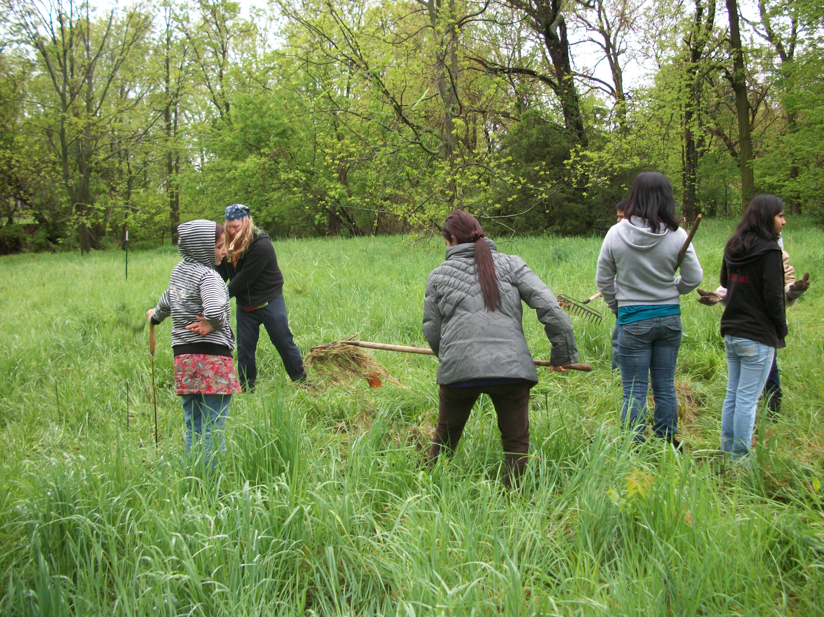

Slide 10
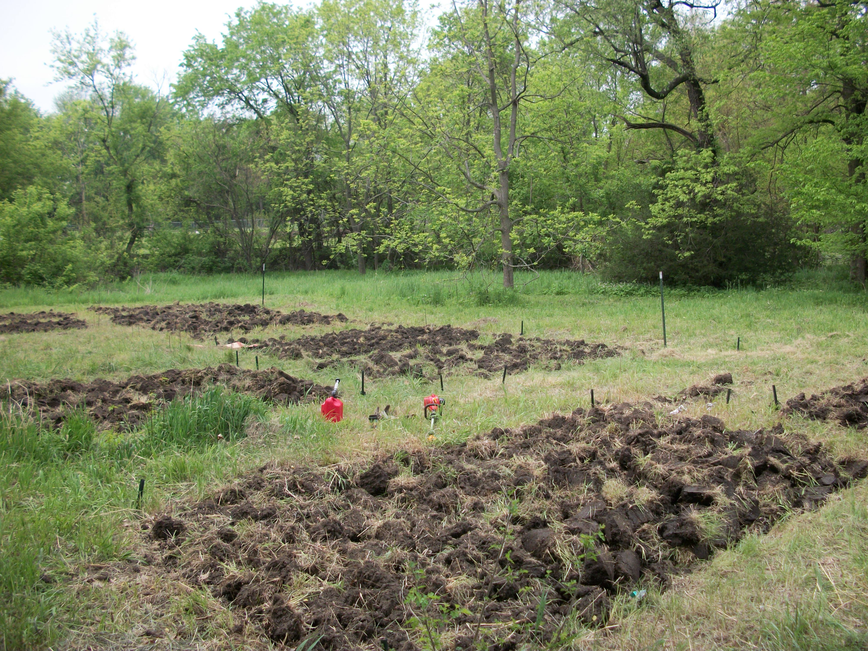

Slide 11
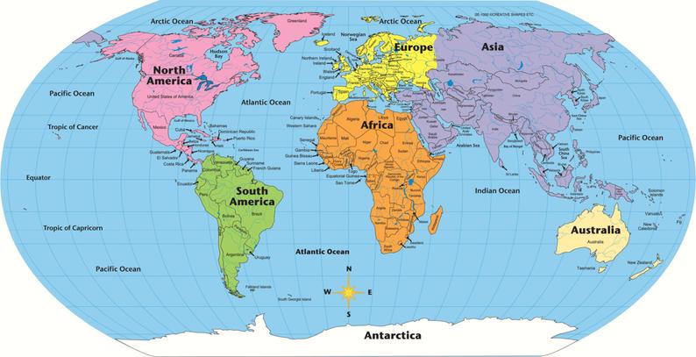
Community Garden Clients
Dem. Rep. of the Congo (Congolese)
Burundi (Burundian)
Burma/Myanmar (Burmese)
Bhutan (Bhutanese)
Ethiopia (Ethiopian)
Liberia (Liberian)
Notes:
Could have people guess where they think these countries are on the map before flipping to next slide
Note the different languages spoken across the pool of clients and which country of origin they pair with.
Number of clients in the community gardens

Slide 12
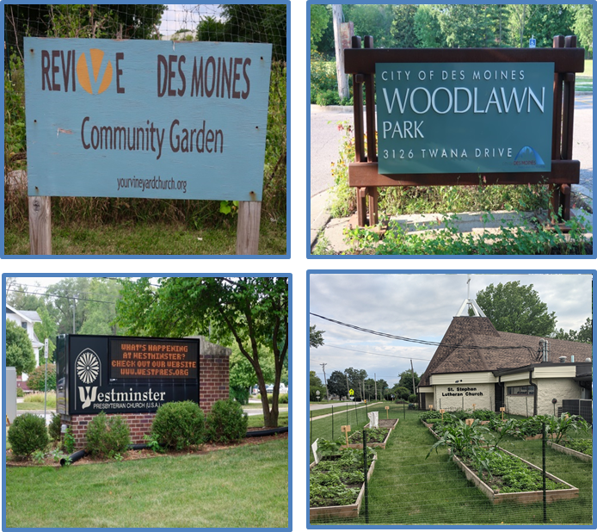
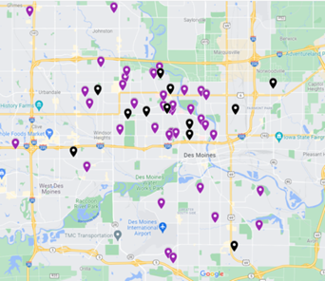
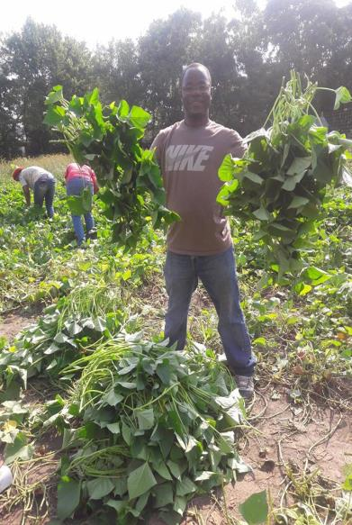
>200 Families
20 Different Gardens
NOW
Notes:
2011- 80 families, 2013- 150 families; 2019- >200; now down to ~150 this year because we lost three gardens
Promote healthier neighborhoods and communities through the creation of community gardens in low income neighborhoods with high concentrations of refugee individuals

Slide 13
Market Farming Pathway
Community Gardener
Beginning Market Farmer (BMF), 50x50 ft. plot
Advanced Market Farmer (AMF), ¼ acre plot
Partial Transition:
¼ acre at GG Farm, some land on another site
Full Transition
no land at GG Farm, transitioned onto individual land

Slide 14
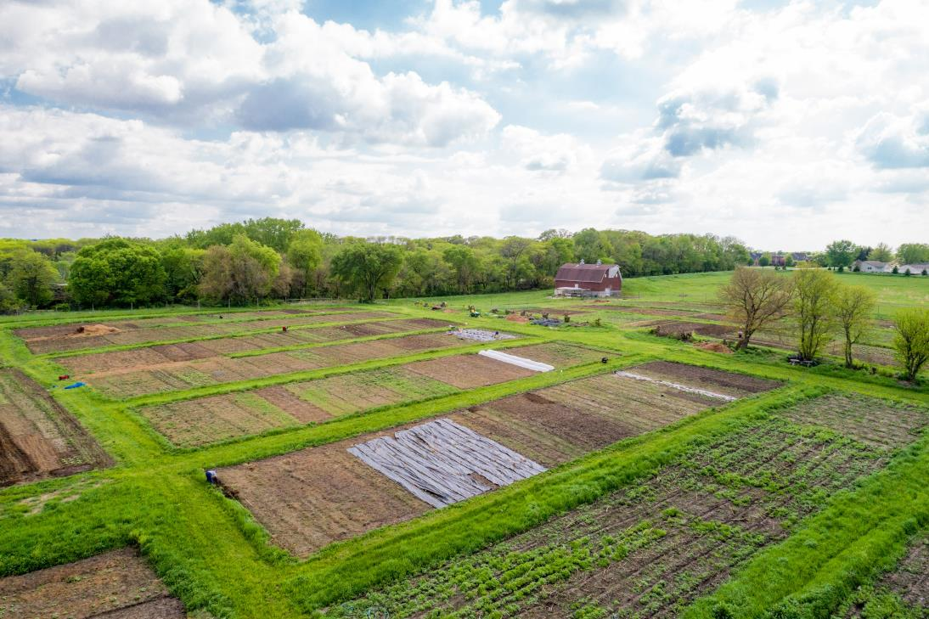
Global Greens Incubator Farm
Valley Community Center, West Des Moines, Iowa
8.5 Acres
20 “Beginning” Farmers
Plot size from 1/8 Acre – ¼ Acre
11 Graduates on ~50 total acres (DSM Metro)
Estimated >1,000,000 pounds of produce annually
Notes:
23 Farmers at GG farm
8 new farmers this year
8 Advanced market farmers
Shared infrastructure for a fee
4 transitioning or graduate farmers

Slide 15
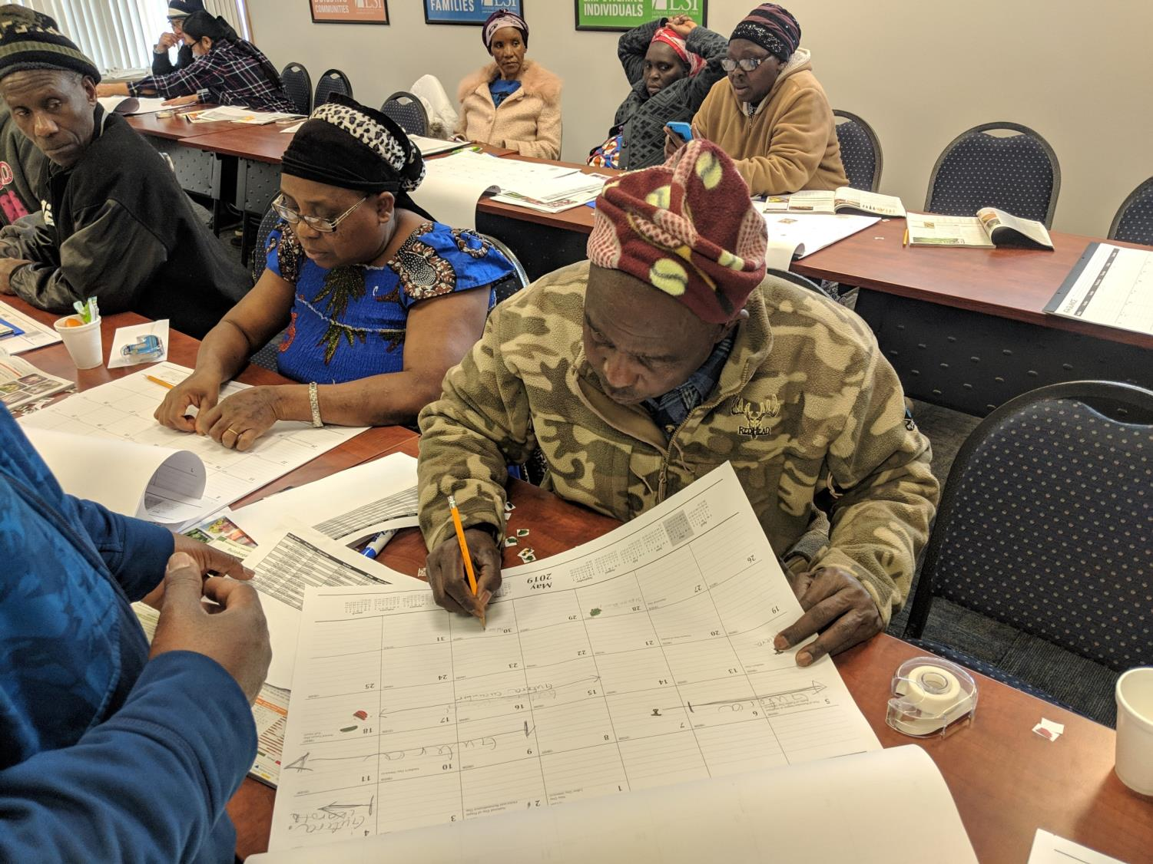
Business Planning and TA

Slide 16
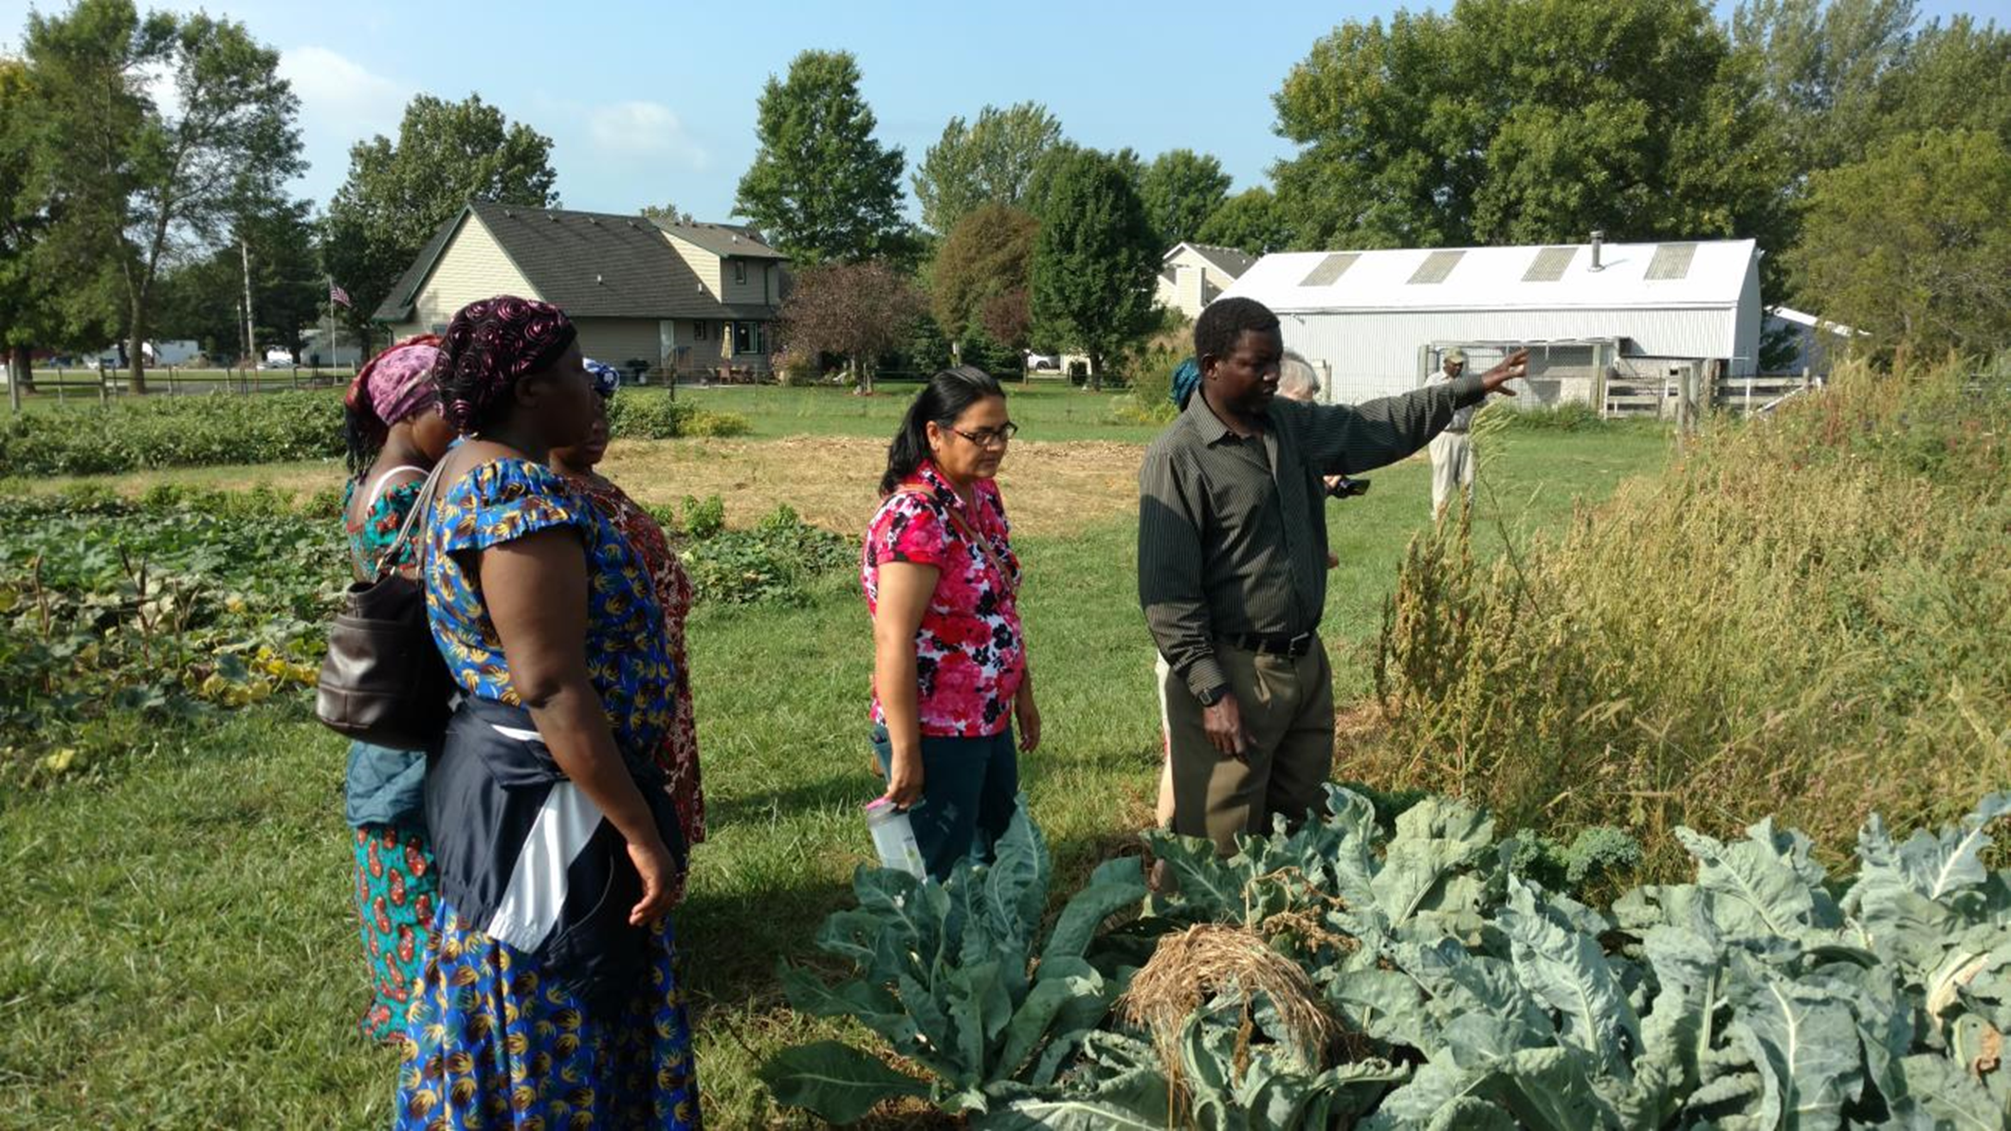
In-field Education
and Farmer Mentoring

Slide 17
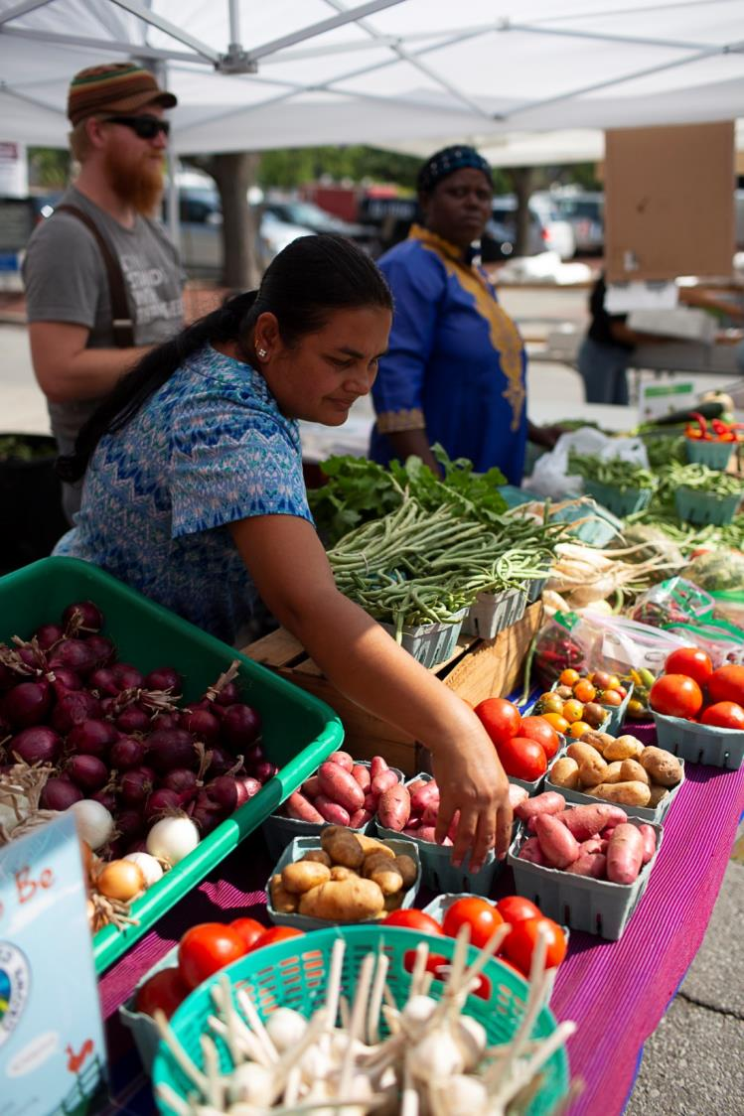
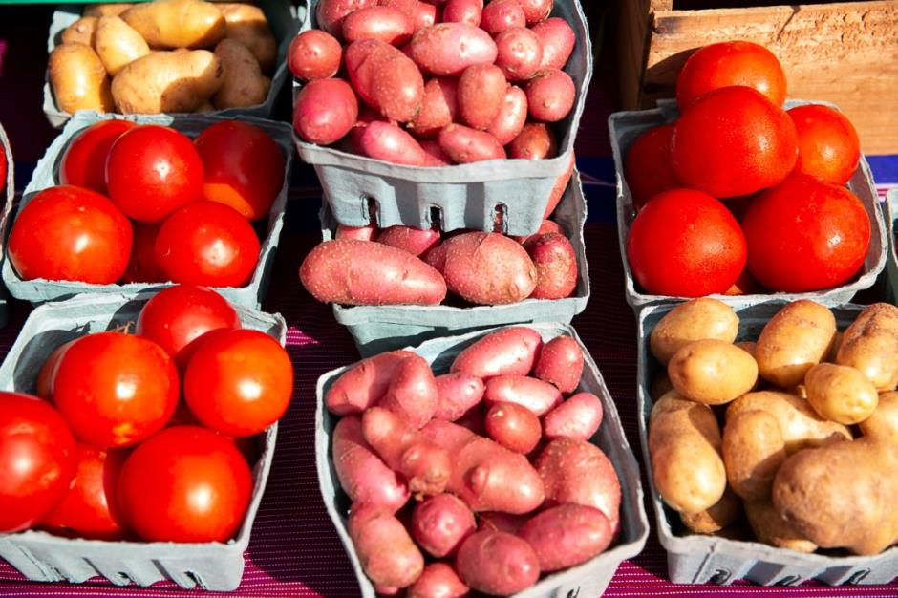
Market Access

Slide 18
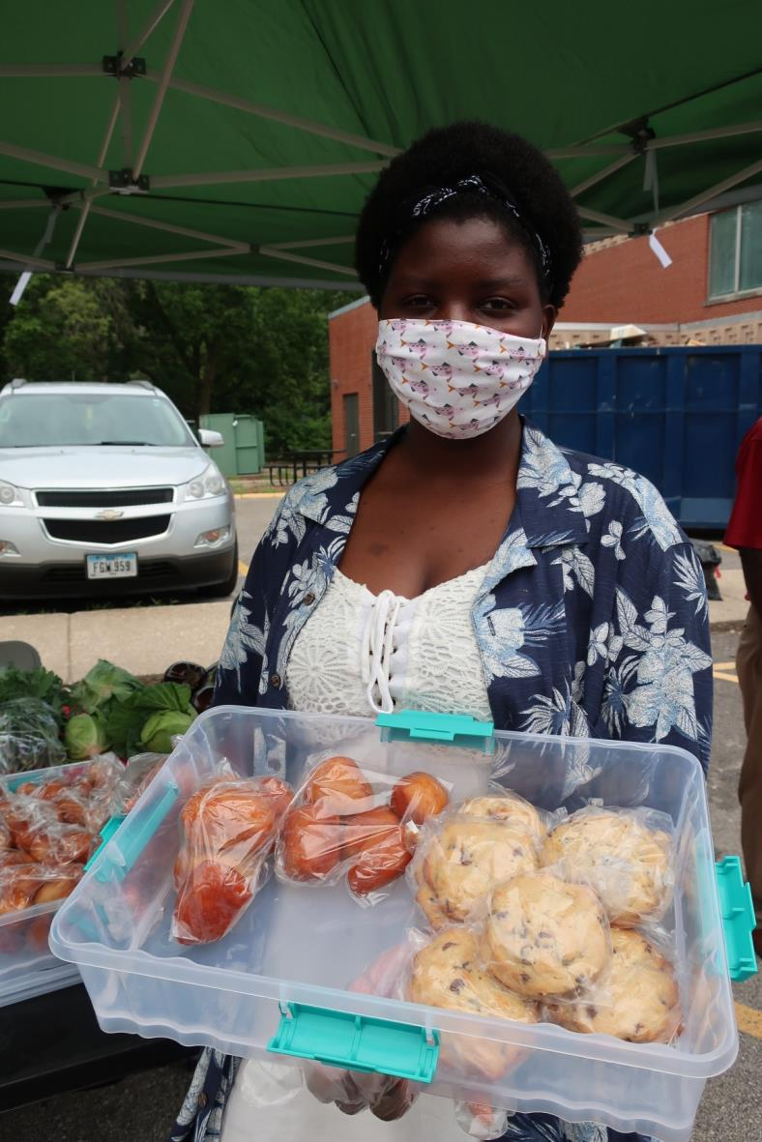
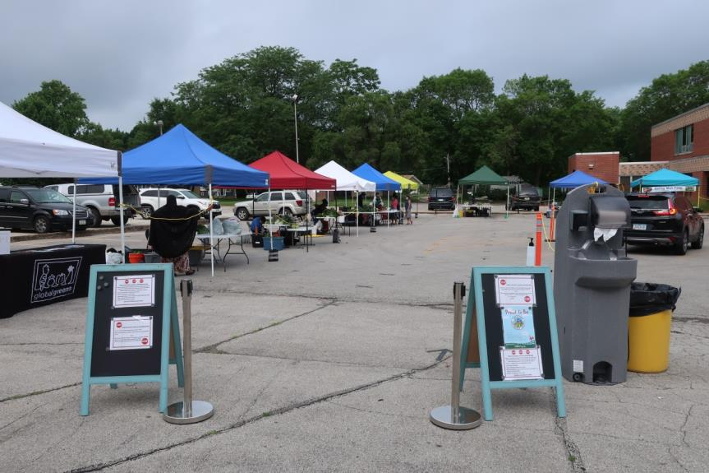
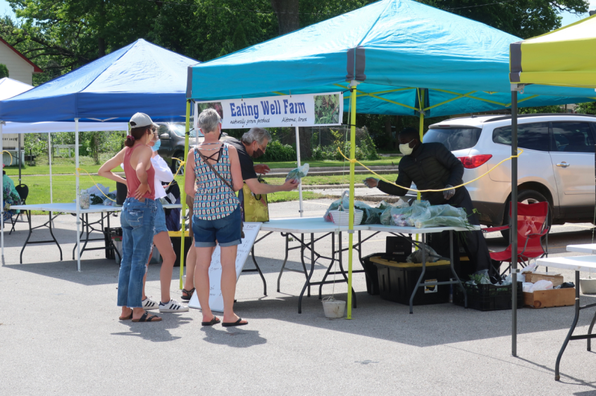
Global Greens Farmers Market

Slide 19
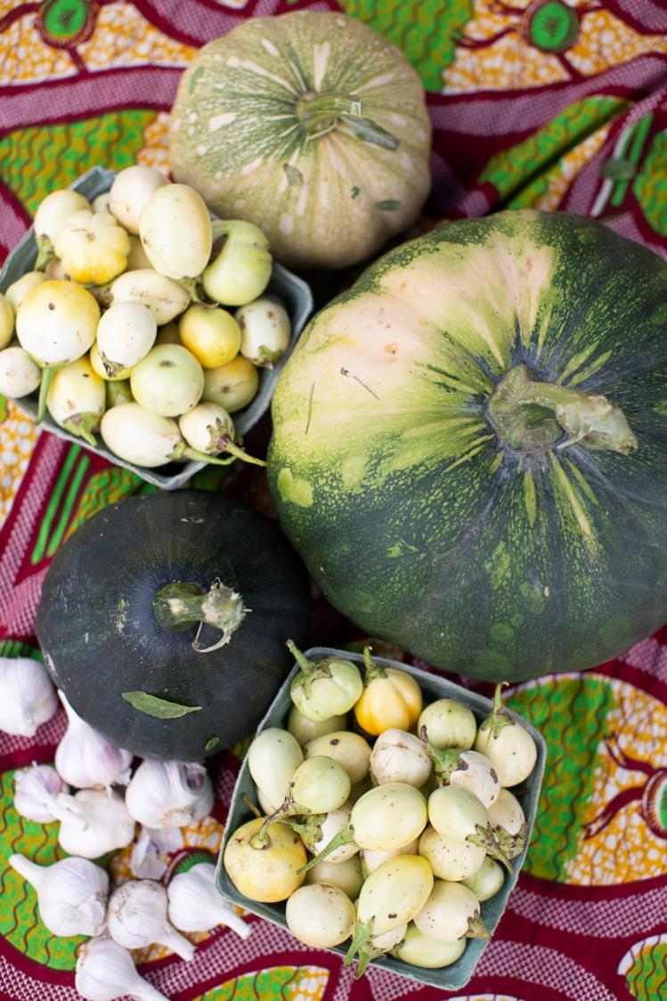
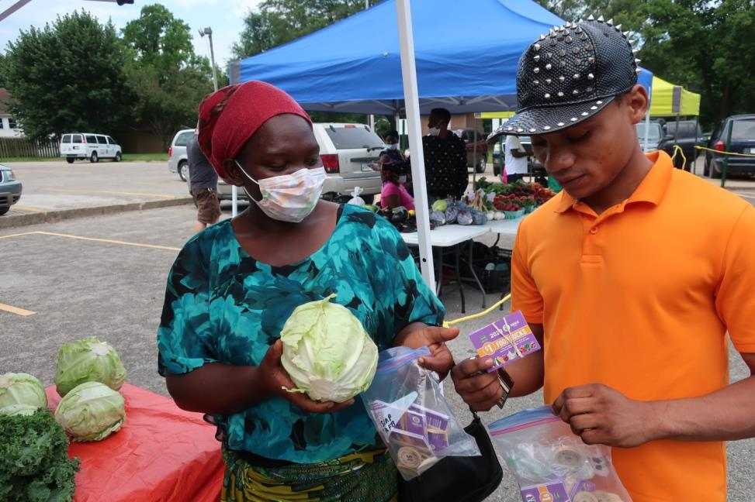
SNAP/DUFB 2021,2022 Average $300k/year

Slide 20
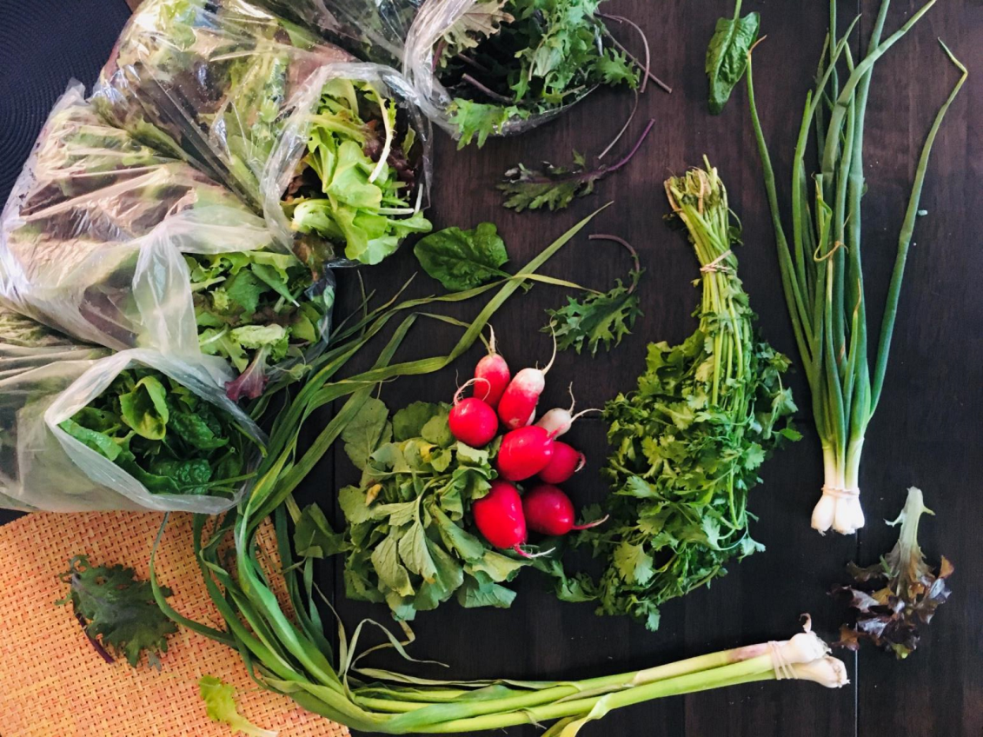
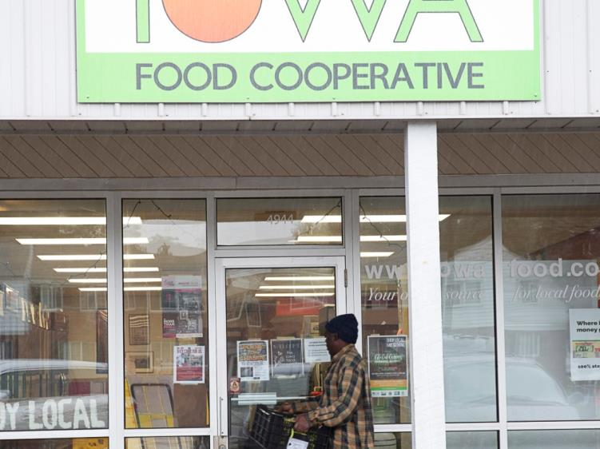
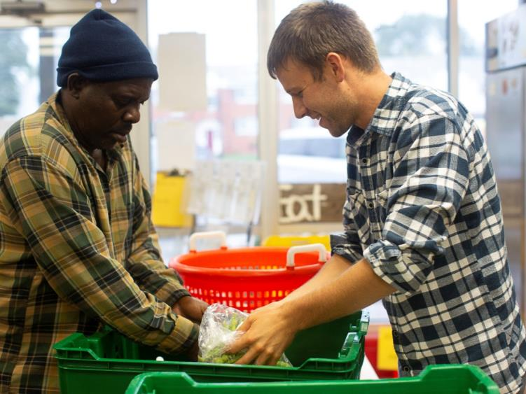
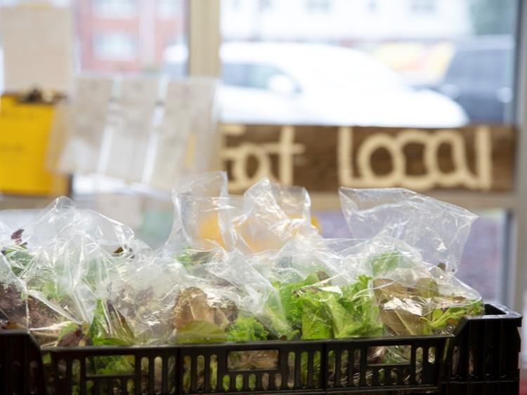
Community Supported Agriculture
Notes:
2019: CSA paid to farmers: $54,285.50 116 weekly boxes 2020: CSA estimated to farmers: $72,386.12 157 weekly boxes
https://www.youtube.com/watch?v=8hW_cJ2Yvkg&feature=youtu.be

Slide 21
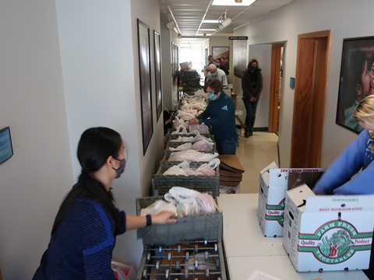
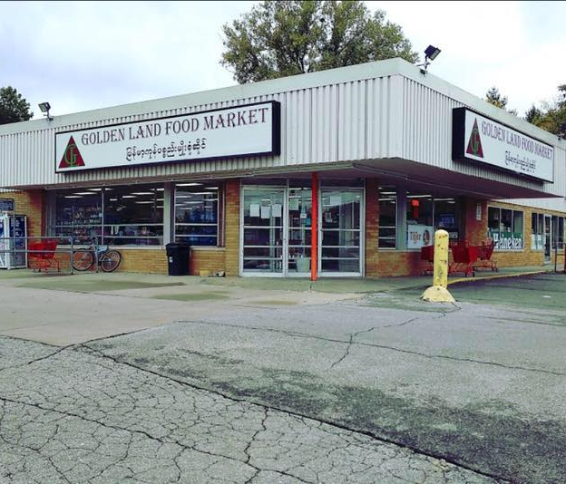
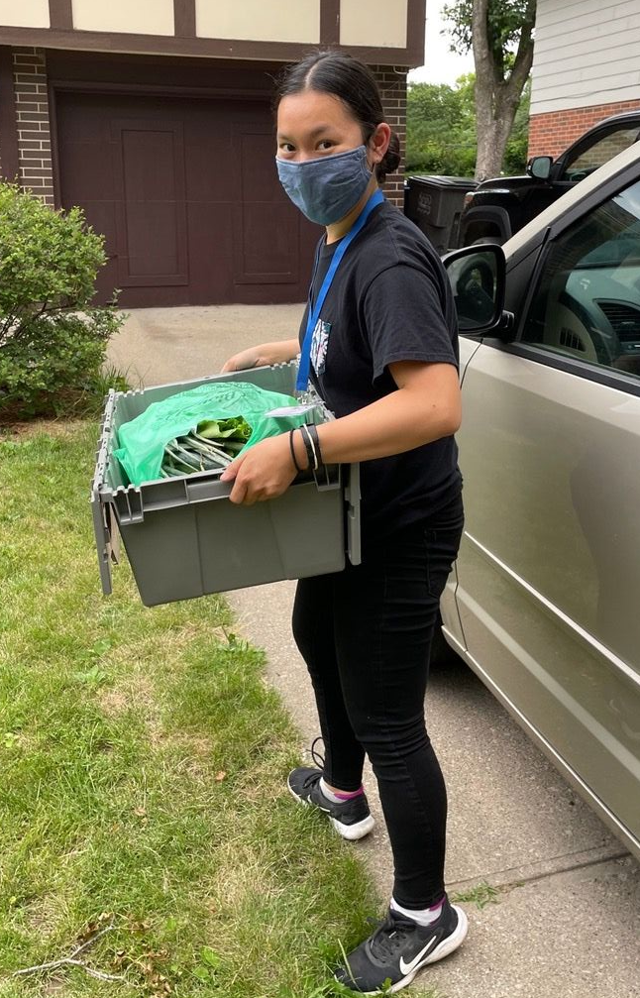
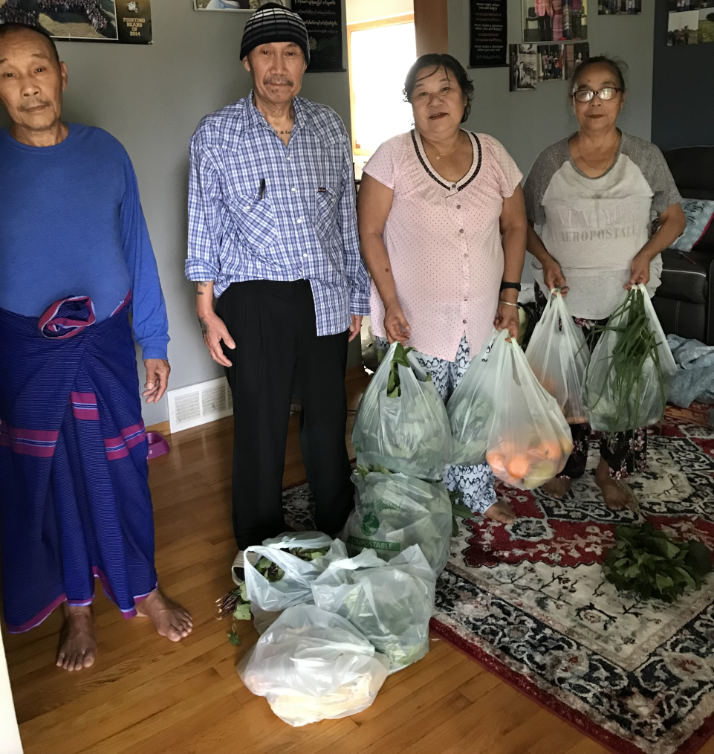
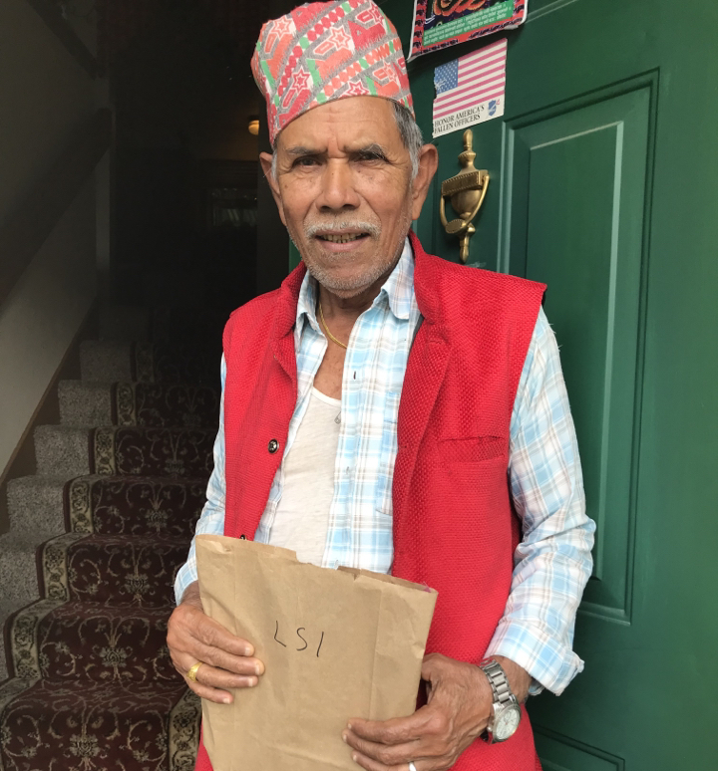
150 Elder Food Boxes/month

Slide 22
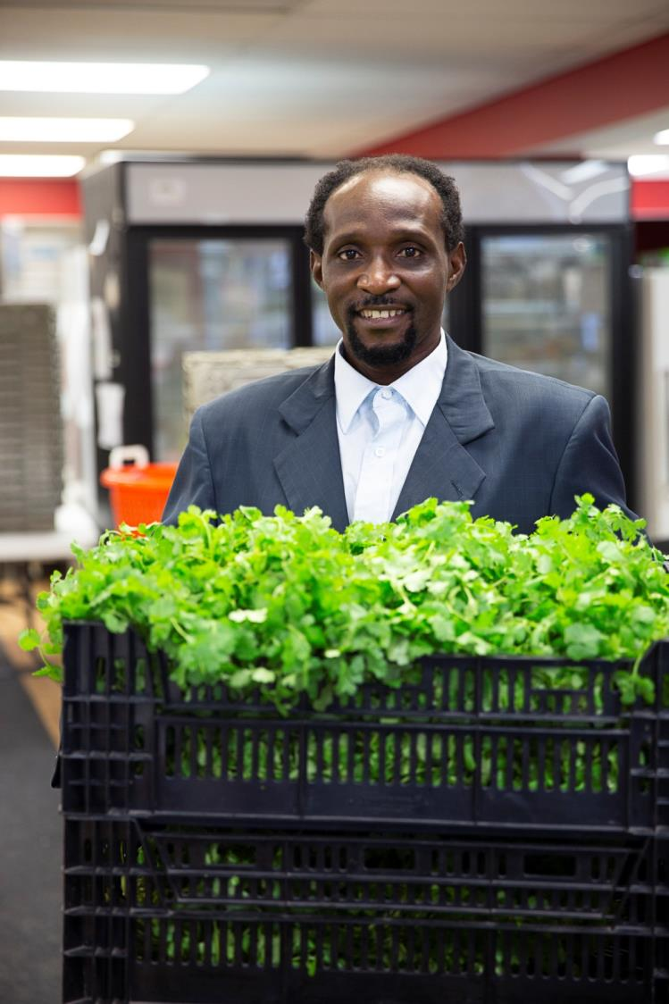
Beyond the Incubator

Slide 23
Global Greens Program
Reconnecting people with the land to achieve physical, mental and financial health.
Community Gardens
Incubator Farm & Land Access
Education & Business Development
Elder Food Box
Regional Program Support & Network Building
Market Access & Technical Assistance

Slide 24
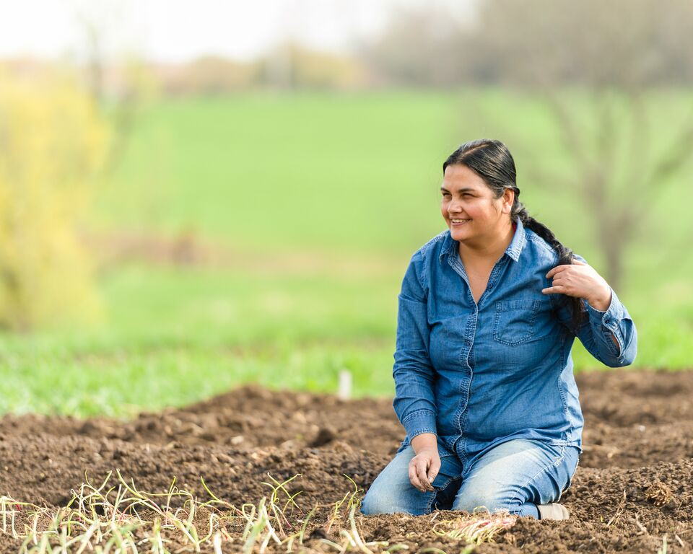
Our “Why”
Growing and accessing culturally appropriate foods increases resilience and equity.
Physical and mental health are improved through gardening activities.
Reconnect to land and pass along cultural practices related to agriculture and cuisine to next generation.
Provide a source of income and off-set grocery costs.
Green spaces in urban areas are better for biodiversity and climate than lawns and parking lots.
1. Local Healthy Food
2. Reconnect with Land and Heritage
3. Community Connections
4. Healing and Mental Health
5. Economic Growth and Resiliency
Notes:
Mickey

Slide 25
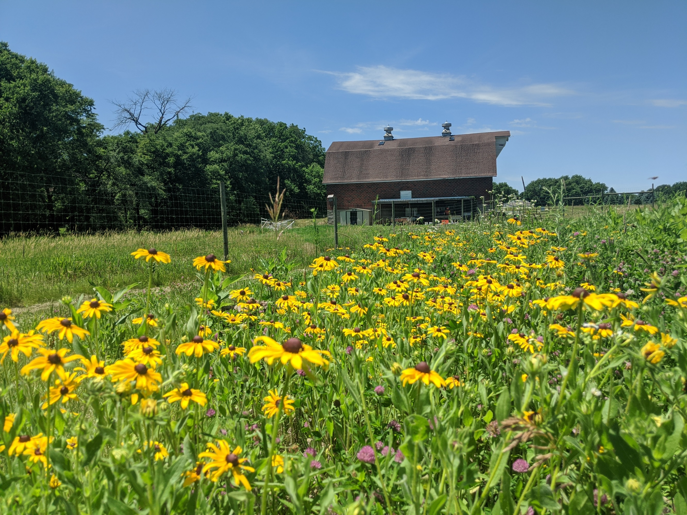
When we see land as a community to which we belong, we may begin to use it with love and respect.”. ― Aldo Leopold.

Slide 26
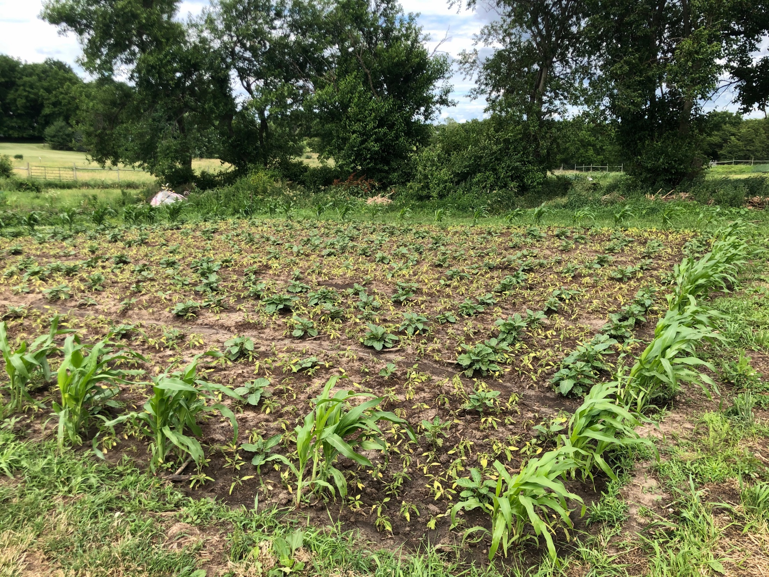
“African” Eggplant
and Lenga Lenga (Amaranth Greens)

Slide 27
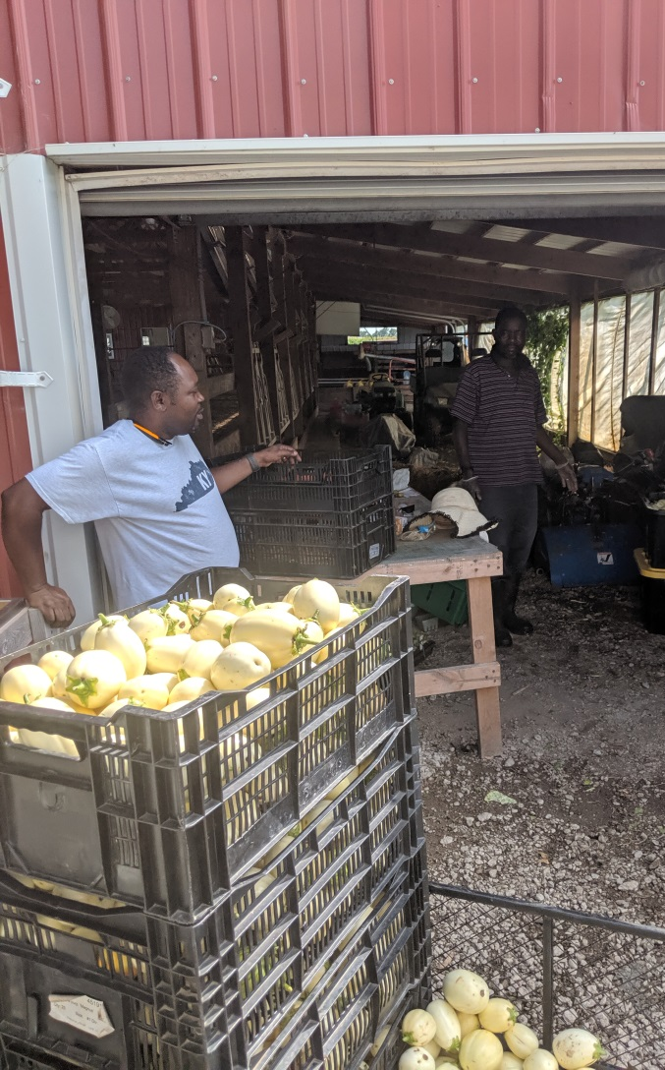
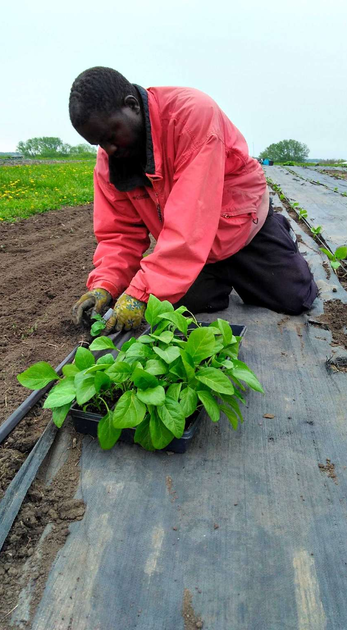
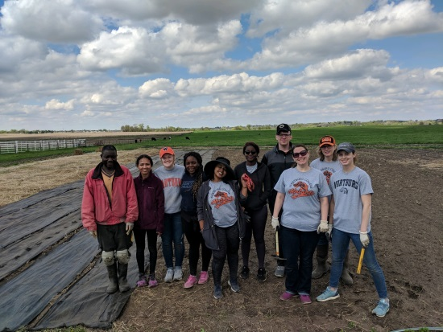
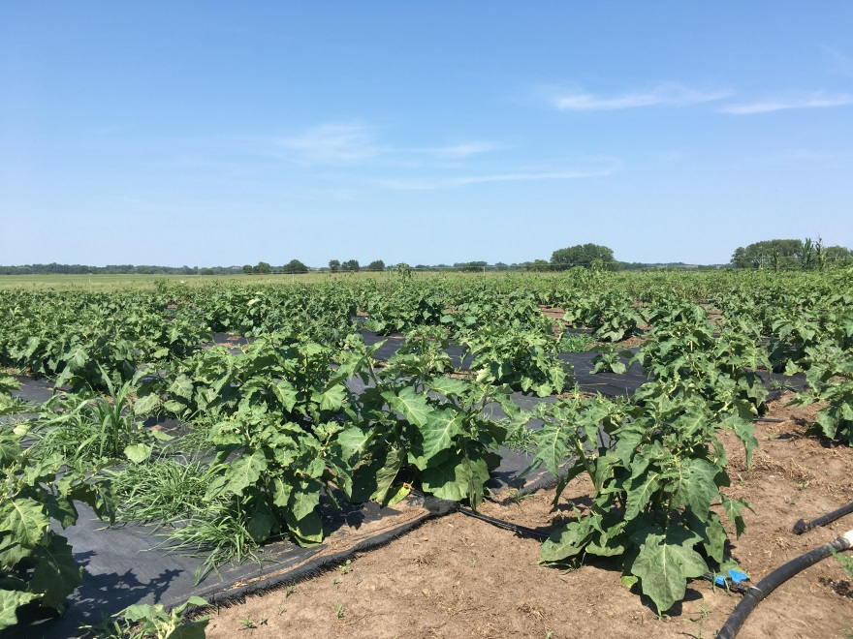
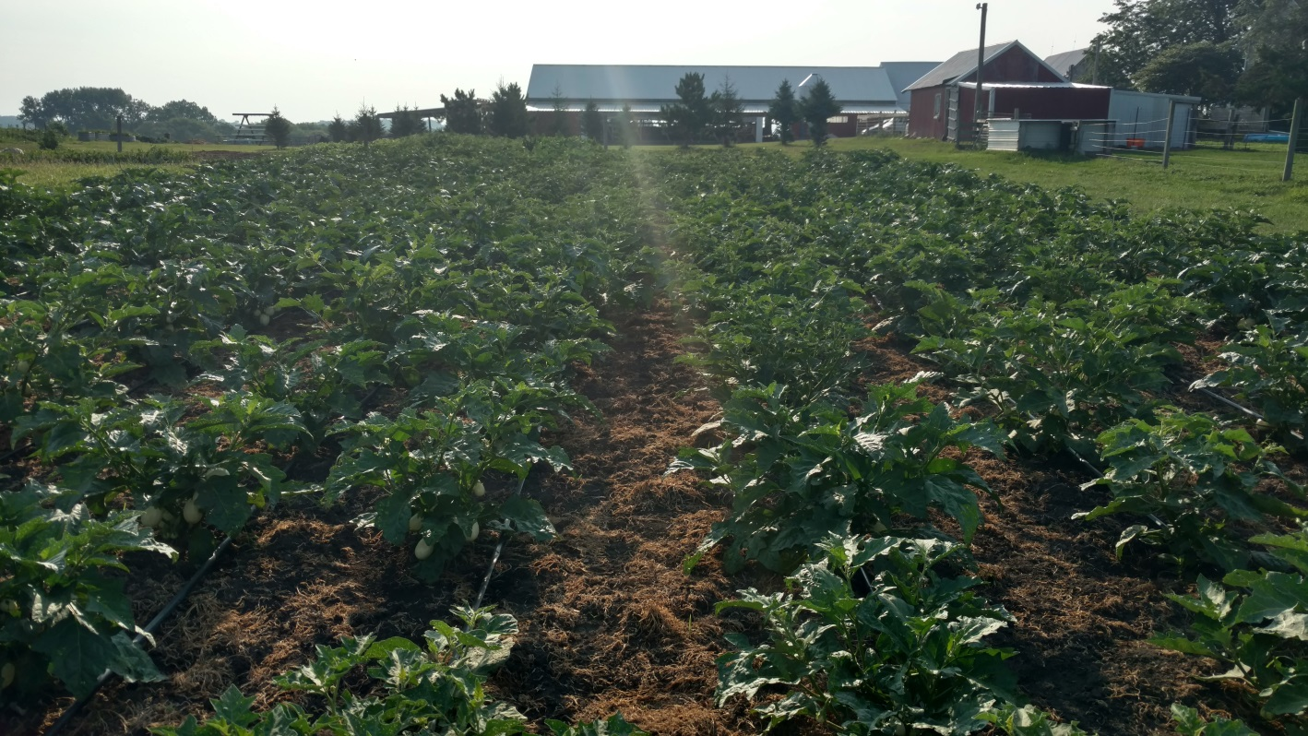
‘African’ Eggplant
Mix of traditional methods with
new technology and conservation

Slide 28
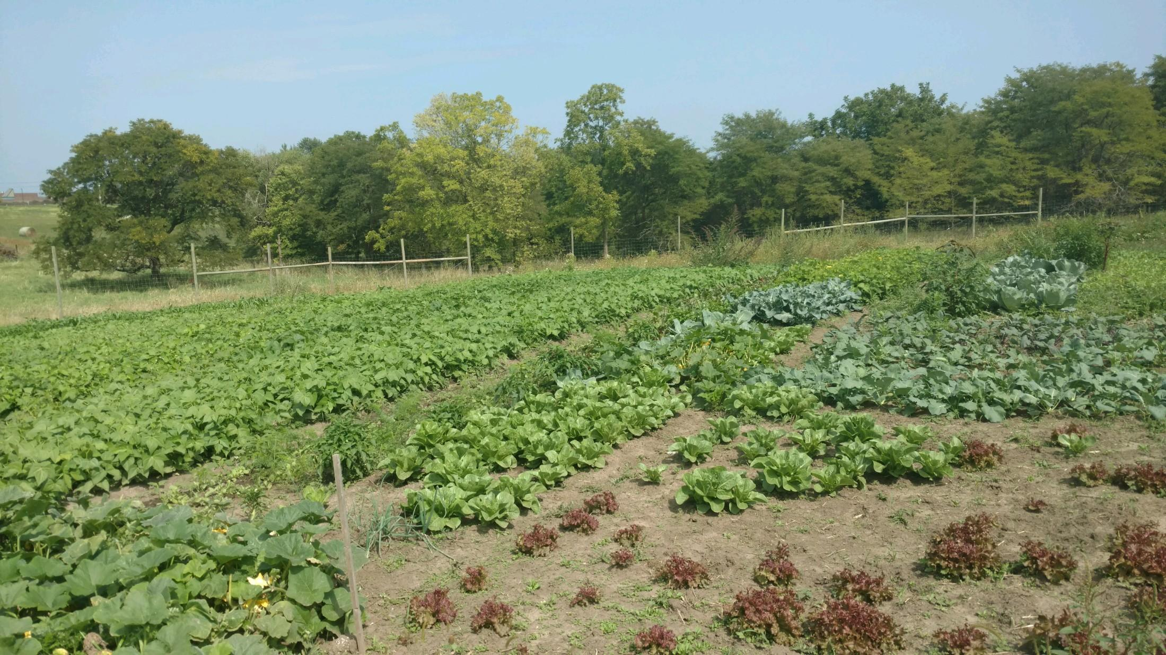
“Cover Crop Swap”
Creative conservation

Slide 29
Land Tenure... What’s that!?
On average we lose 2 garden locations per year due to development. Developing new sites are costly and time prohibitive.
-The City of Des Moines displaced 10s of gardeners when they closed the Downtown Community Garden in 2022. -Farmer Bizimana Charles had to relocate his 5 acre farm after 5 years of farming
The need for land is illustrated by the waitlist of 62 individuals(purple) with no land and 24 community gardeners looking for space in the GG incubator in West Des Moines. There is currently no space available in existing garden locations (black)
Notes:
There are many important food security initiatives in place that have a great impact for those who need emergency food assistance. However, those services do little to build equity or self-reliance for the people they serve. On the other hand, gardens and urban farms provide the necessary avenue for hard-working food insecure populations to be able to provide for themselves, improve health and well-being, and start small businesses. Therefore, it is time to look more seriously at how to invest in meaningful initiatives like urban and peri-urban land access, reduced barriers of zoning, and additional educational programming.
Specifically, concerted effort needs to be made to open new gardens in areas with significant demand and expand existing locations that have long term potential. Opening them near concentrations of identified populations of need will decrease greenhouse gas emissions and allow individuals to use public transportation to access these spaces. (See map of waitlisted gardeners above and current LSI garden locations). There is huge potential for local community leaders, organizations, and private land owners to step up and fill this need.
DOn't have much on education in the following sections - that could be a big draw for some - so maybe add a few paragrahphs on possiblities there.
Also makes me wonder (an maybe we discussed) tapping into DMPS land for farming and using it for education too. Double-dipping for efficiency. ;)

Slide 30
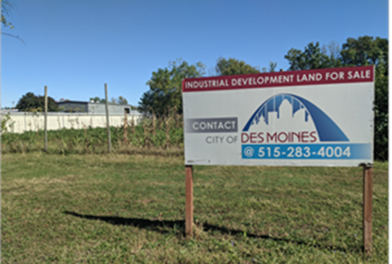
Zoning Restrictions Prevent urban farmers from growing food- perennials out of the question!
(right) City of Des Moines changed rules that “re-line” urban farmers from renting commercially zoned city land
(below) Greenhouse structures needed for off-season production don’t fit into zoning laws and cause undo cost or barriers to construct. This one in West Des Moines was deconstructed to make room for more gardens to grow in ground
Notes:
In addition, there are several zoning rules that make it difficult for urban farmers to build relevant structures like wash stations (which improve sanitation), high tunnels so growing seasons can be extended, and garden sheds for secure on-site tool storage. A greenhouse might normally cost 30,000 would be 80-100k a high tunnel that might cost 2-3k costs 8-10k and all require lengthy and expensive site plans.
say their names
I'd list out the zoning and code barriers. Start engraining those in their minds.

Slide 31
“If you have come here to help me you are wasting your time, but if you have come because your liberation is bound up with mine, then let us work together.”
- Lilla Watson

Slide 32
The Need for Systems Solutions
The first step is awareness of what is happening in our food system. Educate on importance of gardens, buying local and organic, climate change.
Our Priorities:
More investment and reduced barriers for Urban Farmers
City Planners to include Gardens in Development, private non-profit and government partners prioritize setting aside land to be used as gardens
Reduce Zoning Restrictions for Urban Farmers and Increase the Priority of Gardens as Green Spaces
Improve pathways and programs for urban farmers to have equity in land and thriving rural businesses
Permanent land tenure and physical infrastructure
Continue subsidies for low income earners while also looking to long term food security
DUFB is great! But falls short in sustainability.
Need increased investment of current “nutrition” dollars to programs that recognize the ability for people to grow food for themselves
Need sustainable market infrastructure (see next note)
Increase amount of accessible local market infrastructure and wholesale markets
Increased institutional buying- “Good Food” in schools, govt contracts
Investment in Food hubs, aggregators, distributors
Small Scale value added and processing
Notes:
Specifically, concerted effort needs to be made to open new gardens in areas with significant demand and expand existing locations that have long term potential. Opening them near concentrations of identified populations of need will decrease greenhouse gas emissions and allow individuals to use public transportation to access these spaces. (See map of waitlisted gardeners above and current LSI garden locations). There is huge potential for local community leaders, organizations, and private land owners to step up and fill this need.
DOn't have much on education in the following sections - that could be a big draw for some - so maybe add a few paragrahphs on possiblities there.
Also makes me wonder (an maybe we discussed) tapping into DMPS land for farming and using it for education too. Double-dipping for efficiency. ;)

Slide 33
Resources and References
Contact: Zachary.couture@lsiowa.org
Gauging food provisioning, social and economic benefits of community farms for Iowa's immigrant community by Thanh Ngoc Nguyen
Des Moines Register article- Land Access Barrier for Refugee Farmers
Bizimana losing land article in DSM Register: https://amp.desmoinesregister.com/amp/7998745002?__twitter_impression=true-
Municipal Zoning for Local Foods in Iowa: A Guidebook for Reducing Local Regulatory Barriers to Local Foods by Andrea Vaage and Gary Taylor ISU Leopold Center for Sustainable Agriculture
Learn more at our website: https://lsiowa.org/globalgreens

