Slide 1
Saving the Land with
Pawpaws and Mulberries
Moving Towards a Regenerative Agriculture

Slide 2
Outline
-Soil Formation -Soil Degradation -Strategies for conserving and building soil -Vision for the Future -Tree crops of interest -Pawpaws -Mulberries -Other great trees: persimmon, chinese chestnut, hickory, walnut, oak, apple

Slide 3
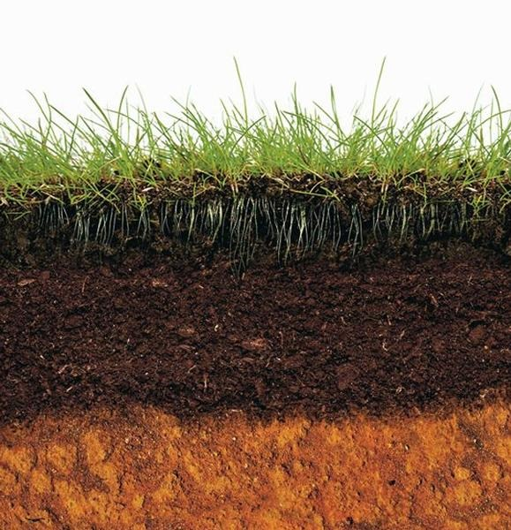
Soil Formation
-mechanical and chemical weathering -interactions with living organisms -organic matter accumulation -slow and steady wins the race

Slide 4
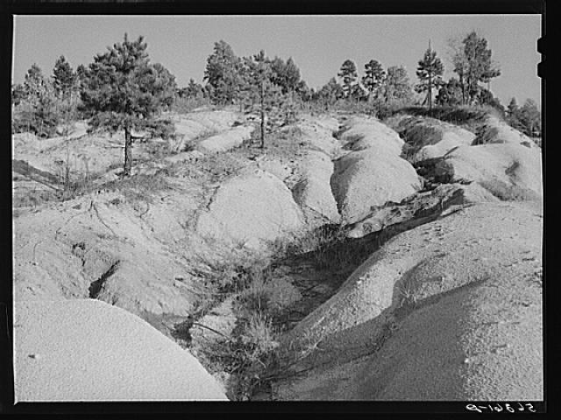
Recipe for Soil Loss
Land Conditions -Sloped -Bare -Dry/Unprotected Contributing Factors -Heavy rains -High winds -High chemical application

Slide 5
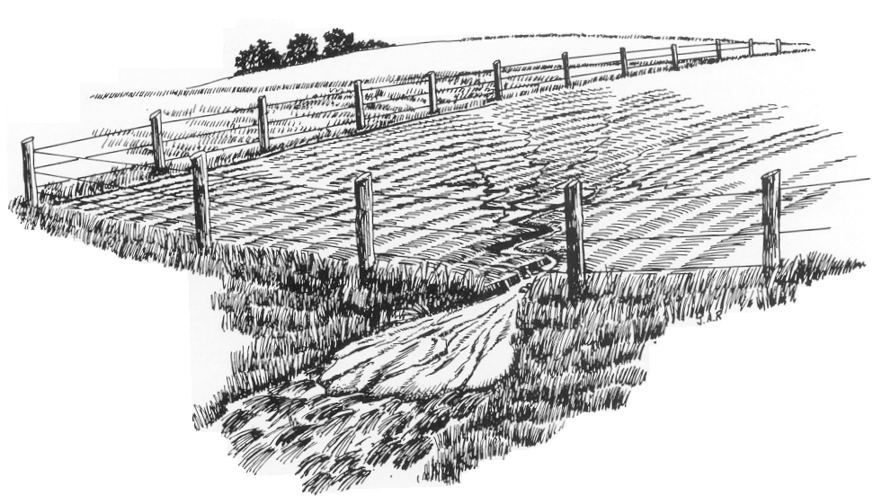
Soil Loss
Erosion -Wind -Water -Sheet -Rill -Gully

Slide 6
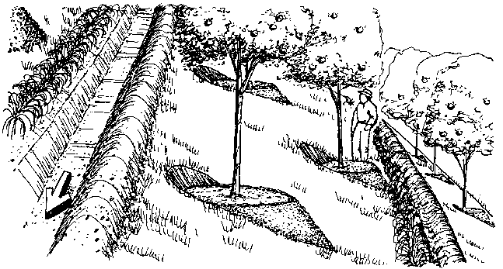
Soil Conservation Practices
-Contour planting -Terraces and earthworks -Cover crops -Mulch -Riparian buffers -Rotational grazing -No till -Perennial Agriculture

Slide 7
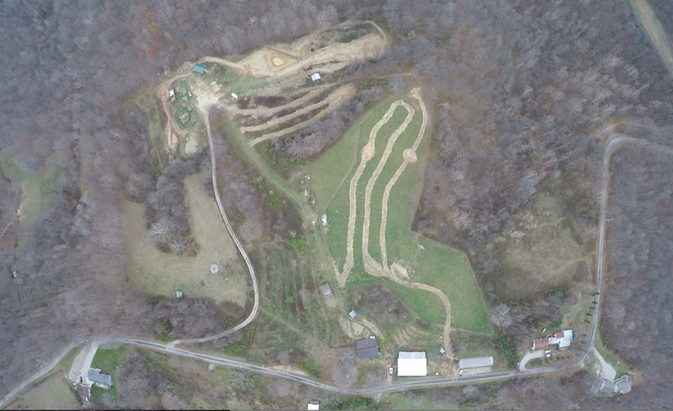
Soil Conservation in Practice at Solid Ground Farm

Slide 8
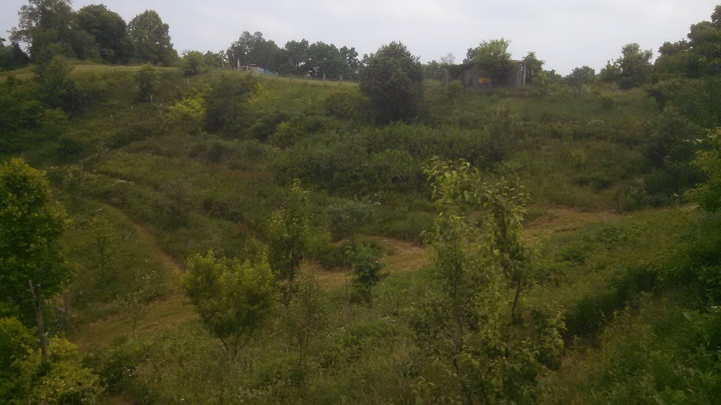
Soil Conservation in Practice

Slide 9
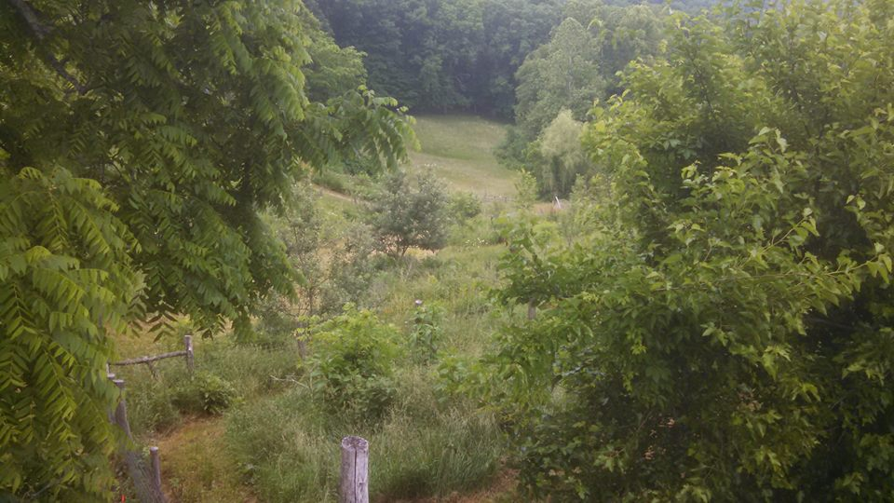
Soil Conservation in Practice

Slide 10
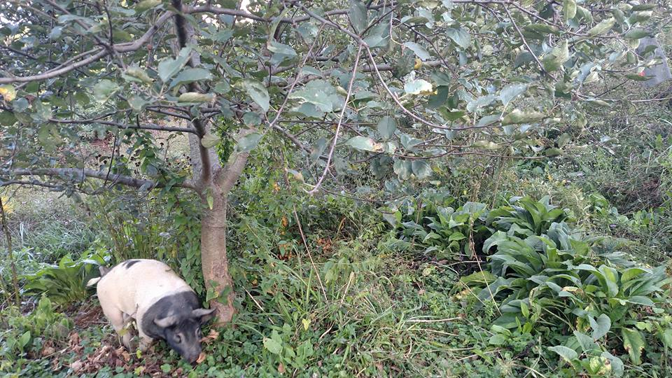
Soil Conservation in Practice

Slide 11
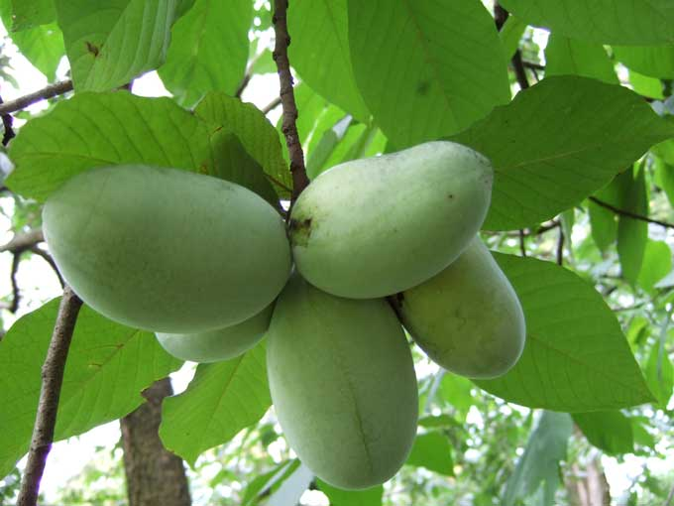
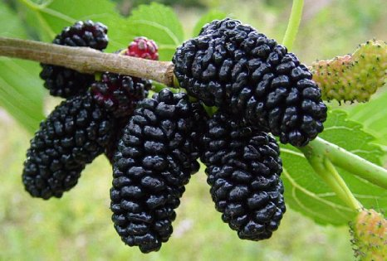
Basis for a new economy: Pawpaw and Mulberry

Slide 12
Why Pawpaw and Mulberry
-and not apples and peaches?
https://www.facebook.com/SolidGroundFarm/videos/873303892765246/ -Integration Acres and the Pawpaw Fest

Slide 13
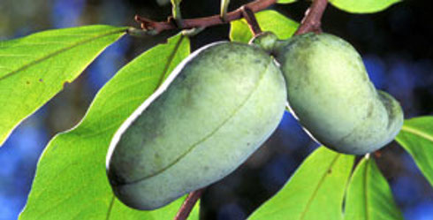
Why Pawpaw
-Native and adapted to our region -Few pests and diseases -Leaves unpalatable to grazing/browsing animals -Largest native fruit -Propagated by grafting -Many established varieties -Produce in sun and shade

Slide 14
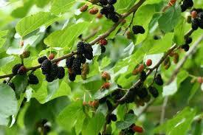
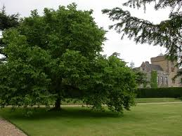
Why Mulberry?
-Some native varieties, many naturalized -Few pests and diseases -Tolerates wide range of soils and moisture requirements -Easy to grow, transplant, and propagate -Wood good for fence posts and firewood -Leaves are high quality livestock feed -Bear fruit early and consistently -Produce in full sun and partial shade

Slide 15
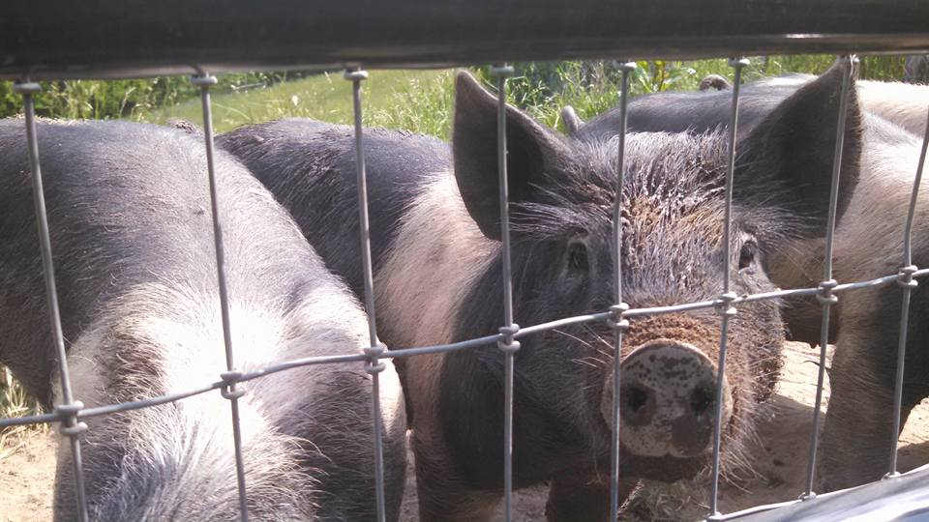
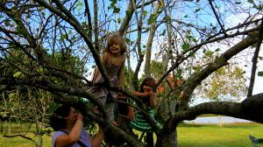
Why not Mulberry?
-Very short shelf live -Labor intensive to harvest -Ripen over a long period instead of all at once -Birds love them

Slide 16
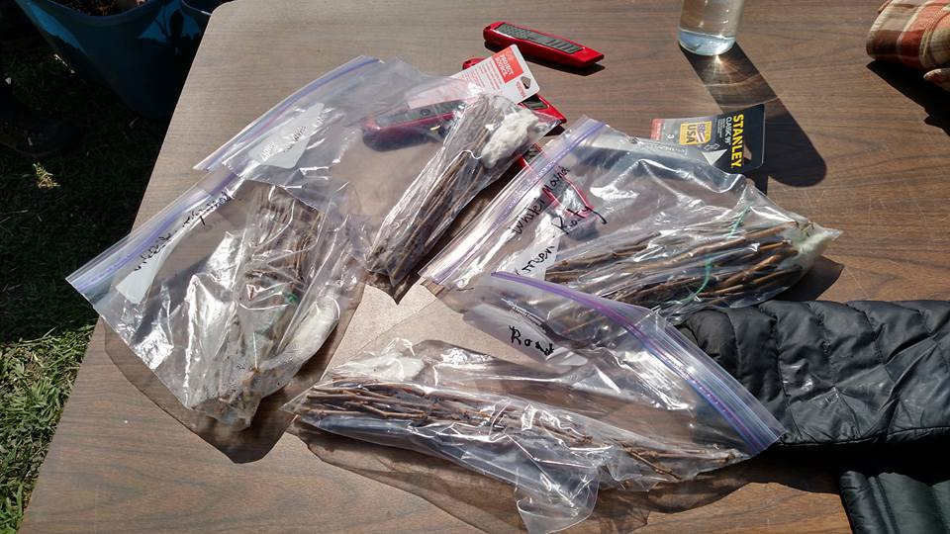

Slide 17
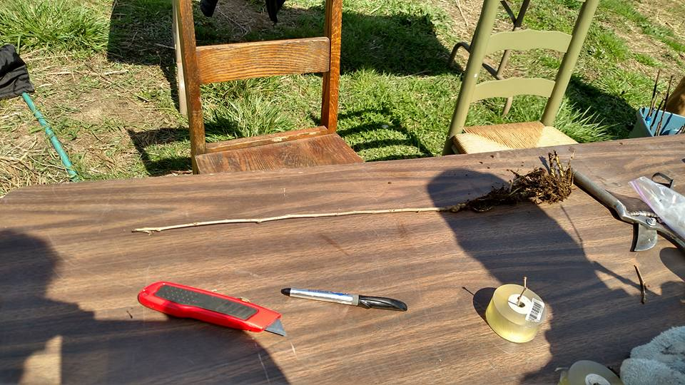

Slide 18
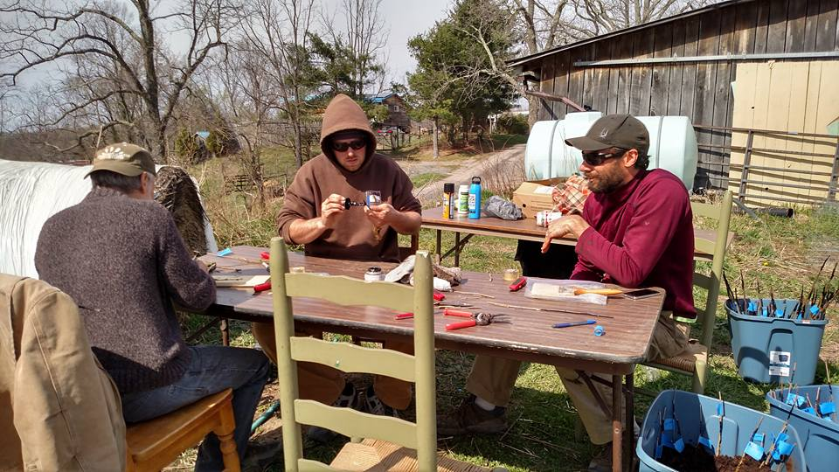

Slide 19
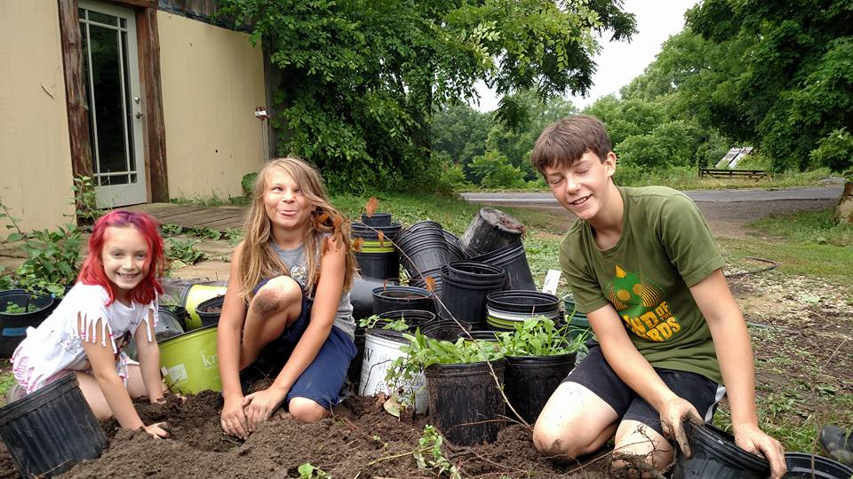

Slide 20
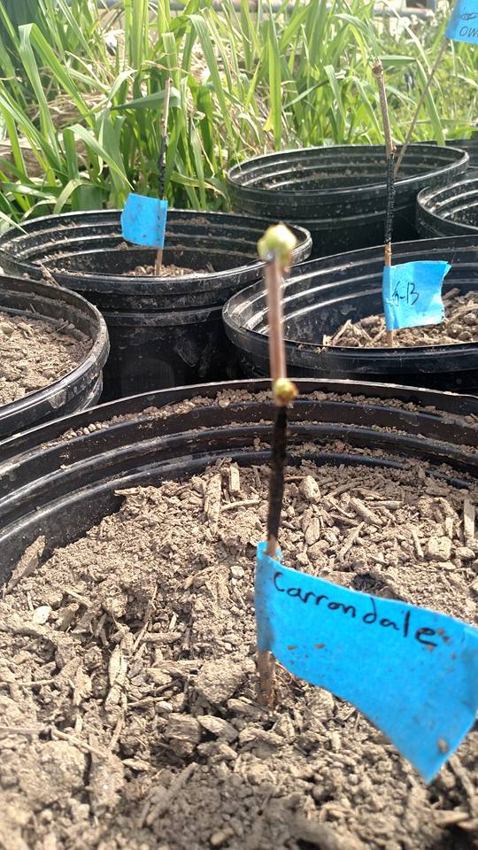

Slide 21
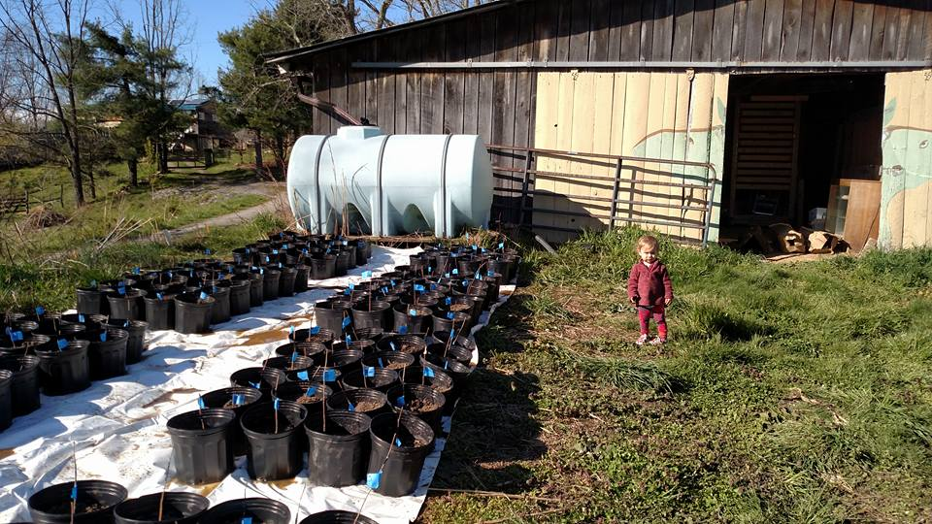

Slide 22
