Slide 1
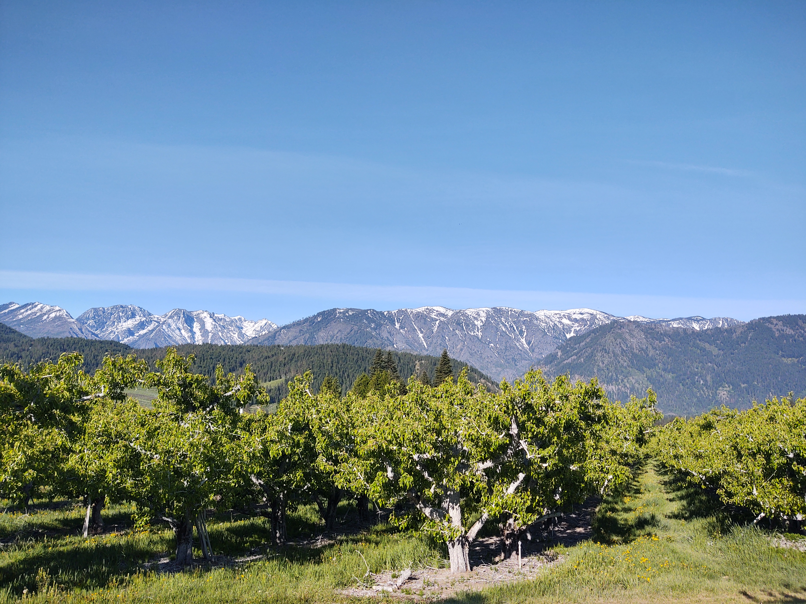


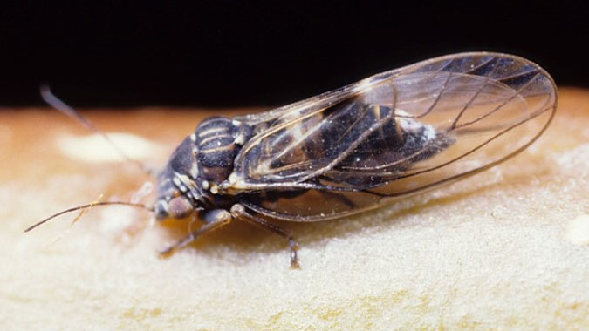
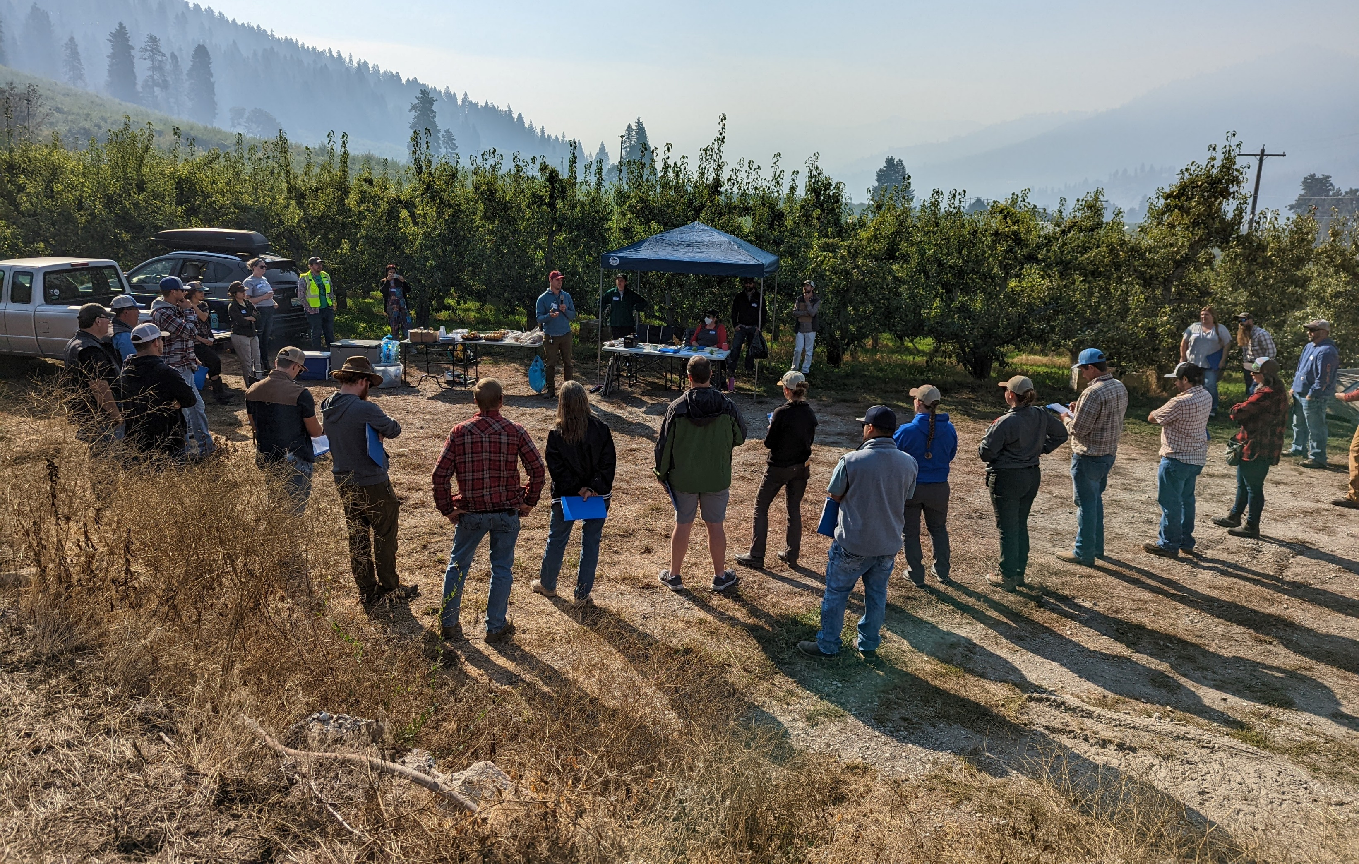
Pear psylla Pheno-IPM: Year 2 success and areawide vision
Molly Sayles, Robert Orpet & Louie Nottingham
Washington State University, Tree Fruit Research and Extension Center
PBESA 2024

Slide 2
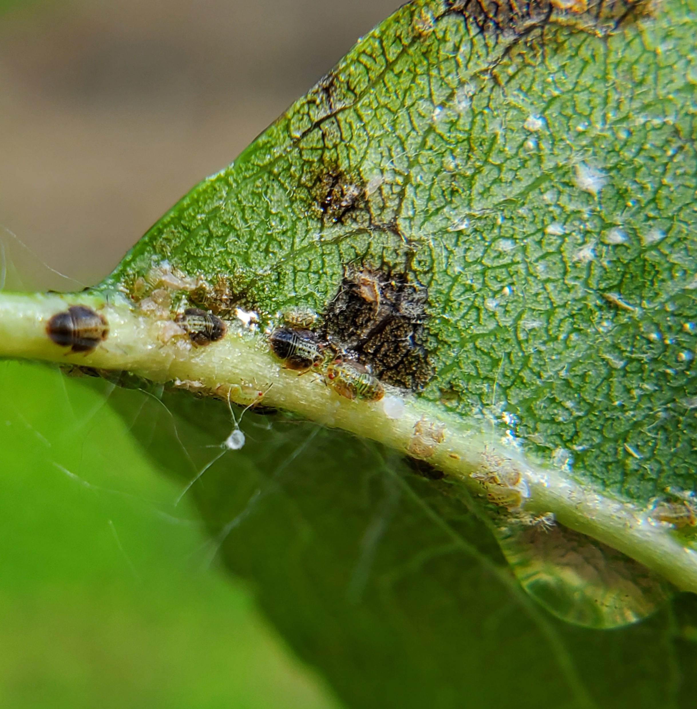
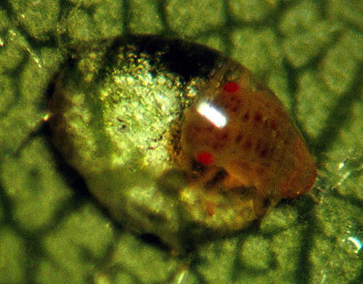
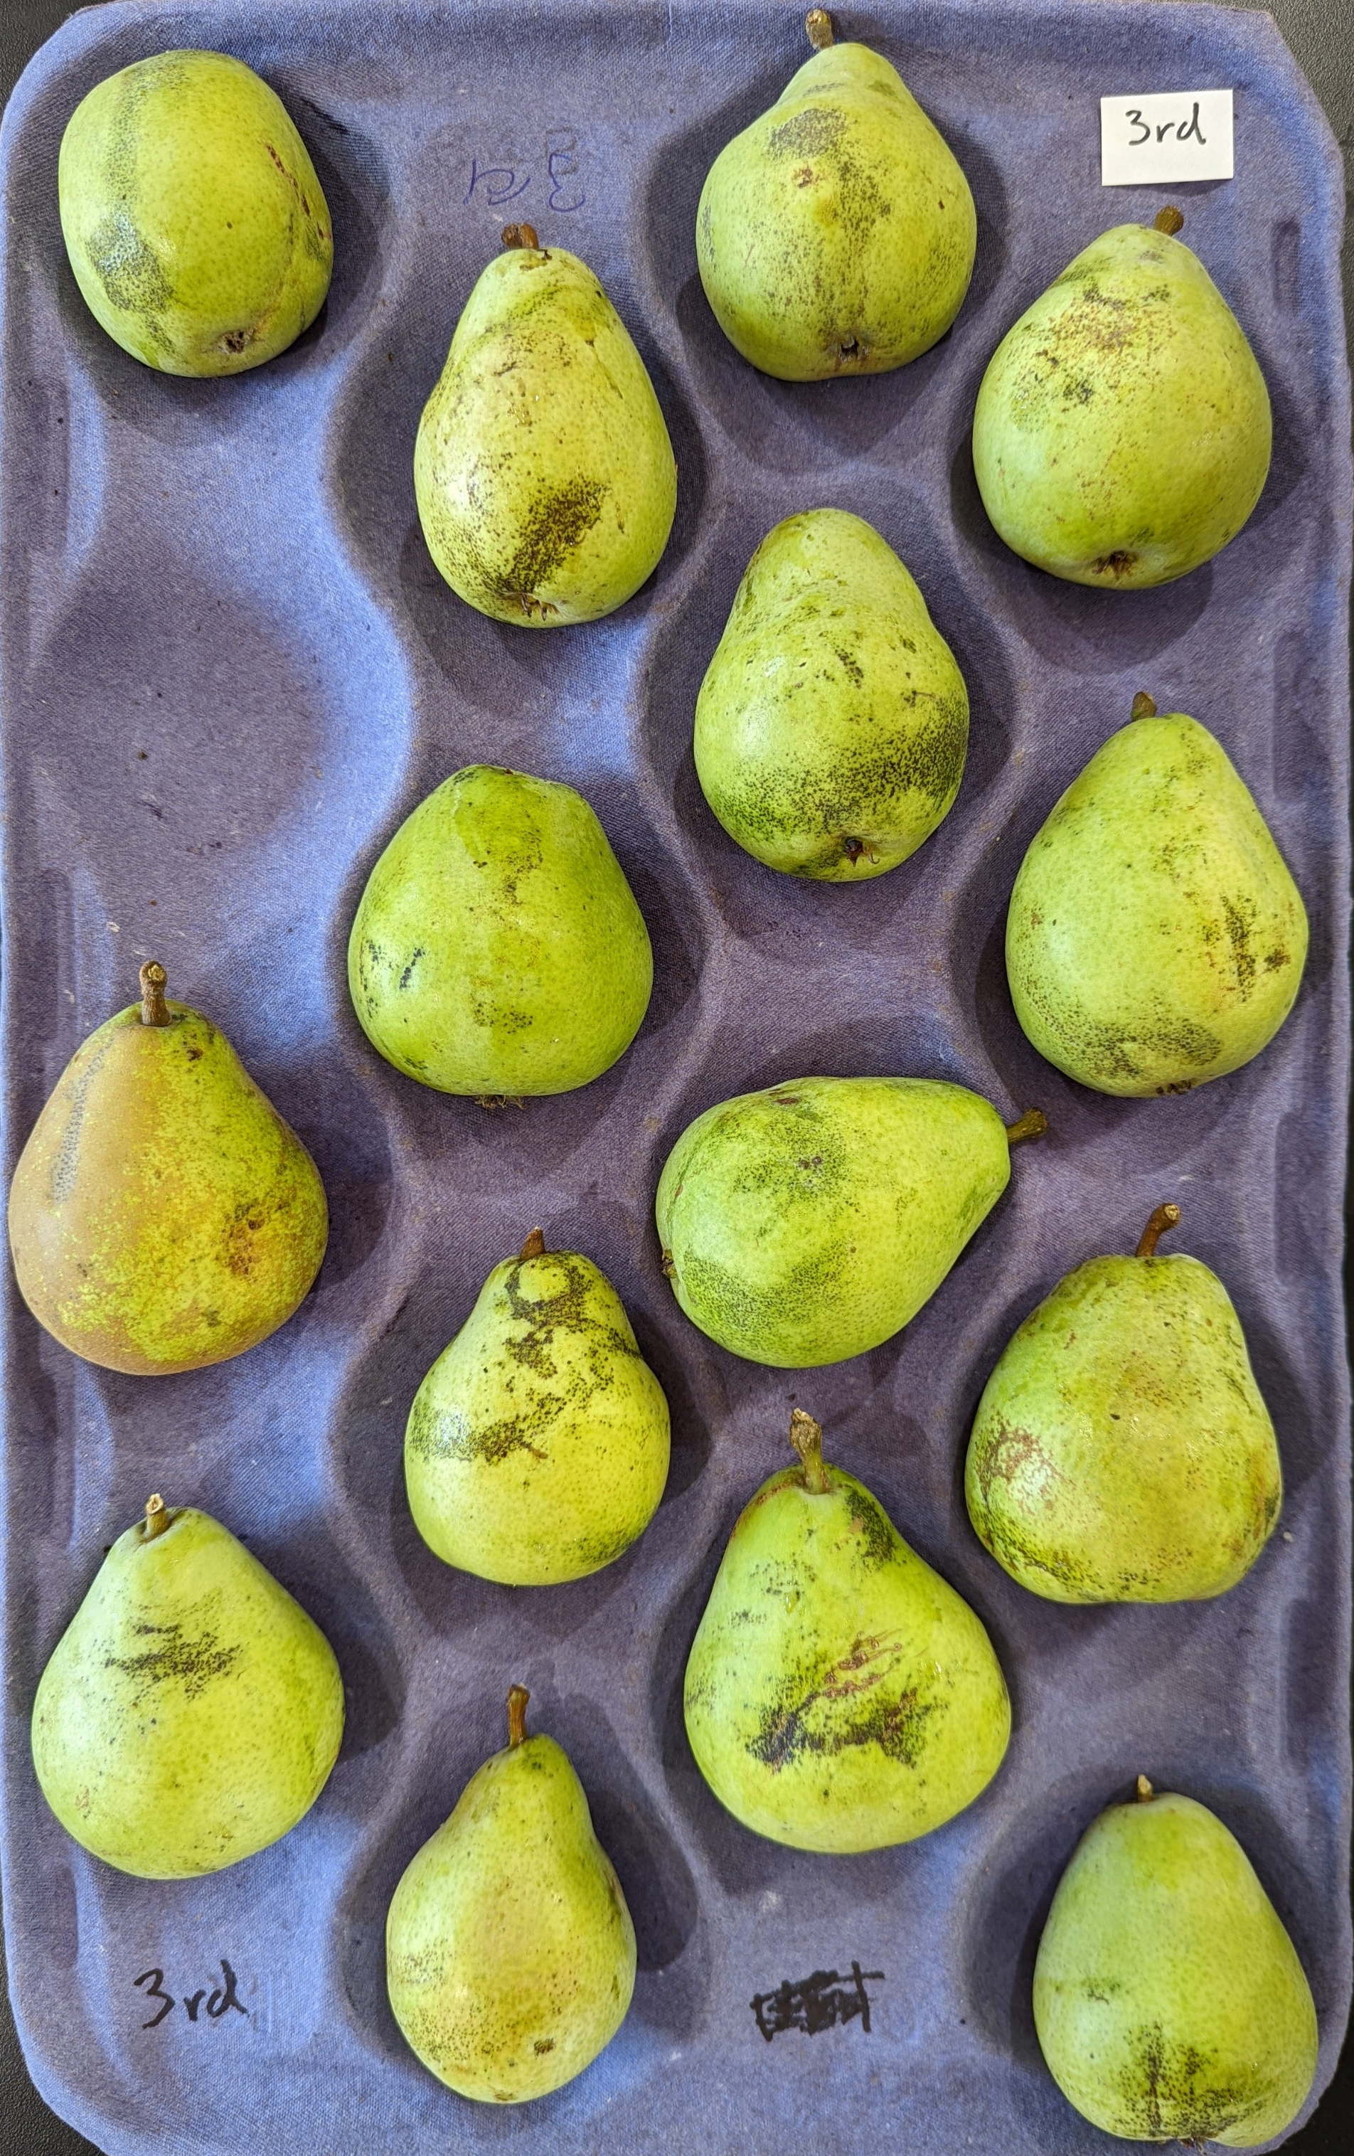
Pear psylla – A struggle in Wenatchee
msu
WA – largest pear producer
Pear psylla is # 1 pear pest
André
Notes:
WA is the largest pear producer and Wenatchee is the largest regions in the stateand pear psylla is the top pear pest. Pear psylla nymphs produce honeydew, which drops on to the fruit causing black russet, shown here.

Slide 3
A “Conventional” Wenatchee Valley Spray Program
10 sprays, $1,800/acre materials
Broad-spectrum tank mixes
Outcome: Sticky harvest, 4% downgraded (Anjou field check 2022)
Date | Spray
3/16 | Kaolin
3/28 | Kaolin, sulfur, malathion, oil
4/6 | Kaolin, novaluron, acetamiprid, oil
5/8 | Spirotetramat, novaluron, acetamiprid, abamectin, oil
5/31 | Spirotetramat, tolfenpyrad, abamectin, oil
6/22 | Tolfenpyrad, spinetoram, cyflumetofen, oil
7/14 | Buprofezin, thiamethoxam, bifenazate, oil
7/28 | Spinetoram, spirotetramat, spirodiclofen, oil
8/16 | Spinetoram, acetamiprid, cyflumetofen, oil
9/14 | Imidacloprid
Notes:
Here is an example of a real conventional, pp management program that uses many broad spectrum insecticides throughout the season, costing around $1800 acre. And even with spending so much $ on management its not particularly effective, having 4% downgrades and quite a sticky harvest which orchard workers do not like

Slide 4
IPM example
Timing | PPDD (Cashmere) | Date | Materials
Delayed dormant | 159 | 31-Mar | Surround CF
Tight cluster | 244 | 14-Apr | Pyriproxyfen, Surround CF, Oil
Popcorn | 386 | 27-Apr | Centaur, Oil
(PP gen 1) | 743 | 13-May | Oil, mancozeb
PP gen 2 | 1055 | 24-May | Etoxazole, Esteem, Ultor, Oil
PP gen 2 | 1469 | 7-Jun | Centaur, Ultor, Oil
PP gen 3 | 2523 | 11-Jul | Nealta, Cinnerate, Oil
Notes:
Example IPM program, you can see that there are not only fwer sprays kmcuh fewer and softer matierals

Slide 5
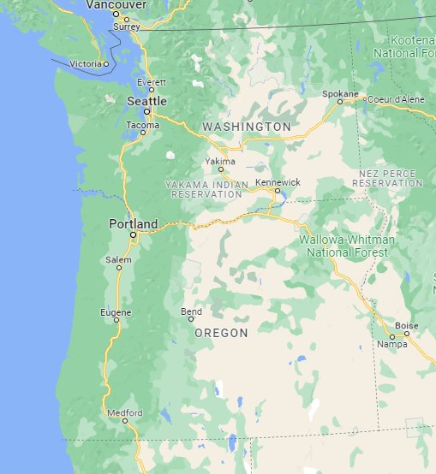
Other pear regions
BC
Seem to have more IPM and less psylla pressure
Wenatchee
Yakima
Hood River
Medford
Lake Co
Notes:
Ive done some interviews with pear stakeholdesr in other regions and compared to Wenatchee, other pear growing regions in pnw seem to experience less pear psylla pressure, though its still the top pear pest. Other regions also seem to implement more IPM. It really seems that out of all these major regions, Wenatchee is struggling the most to manage pear psylla

Slide 6
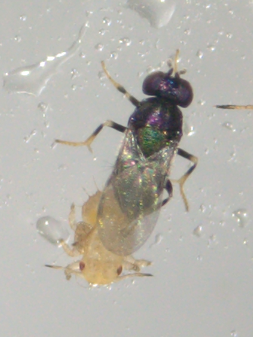
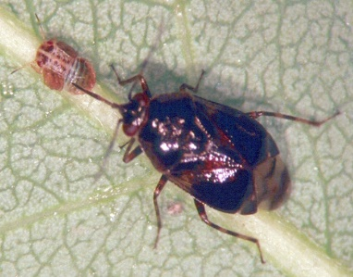
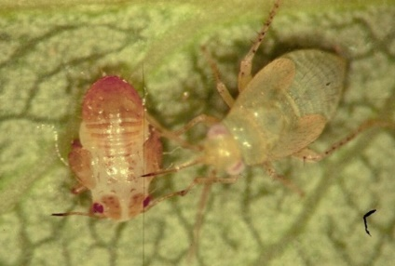
Biocontrol is necessary
Provide late season control
Mitigate insecticide resistance
Free!
Higbee, Schmidt-Jeffris
Notes:
One of the reasons that many regions have turned away from conv management is that biocontrol plays a critical role in pear psylla management, but is eliminated in conv spray programs. Biocontrol is so important for pp because because it provides late season control that chemicals cannot, due to long REIs. Relying on biocontrol also contributes to resistance mitigation, because you can spray less and can be more effective due to resistance that has already evolved. Biocontrol is also free. The importance of biocontrol for pp management is why ipm is necessary

Slide 7
Phenology based management guidelines
Kaolin
Scale/Mealy bug
Cultural
Adults/Eggs
Young nymphs
IGR
Mites
Codling moth
Old nymphs
Mating disruption
Wash
Wash
Relative Development
Prune
Psylla Degree Days (PDD)
Notes:
This si the pear psylla phenology model which was created by Vince Jones in 2019. it preducts the life stage of the pest based on degree days her on the x axis. In 2012 Nottingham and Orpet added management guidelines to the model, showing where to use cultural controls, like washing and pruning, pbased on effectiveness in the season. It also includes when to spary kaolin slay to deter adults and egglay and sprays for other pests, like codling moth, scale and mealybug. The dotted lines are optionsal sprays. The Wenatchee valley is comprised of many small individual growers so this model is a good tool to get everyone on board

Slide 8
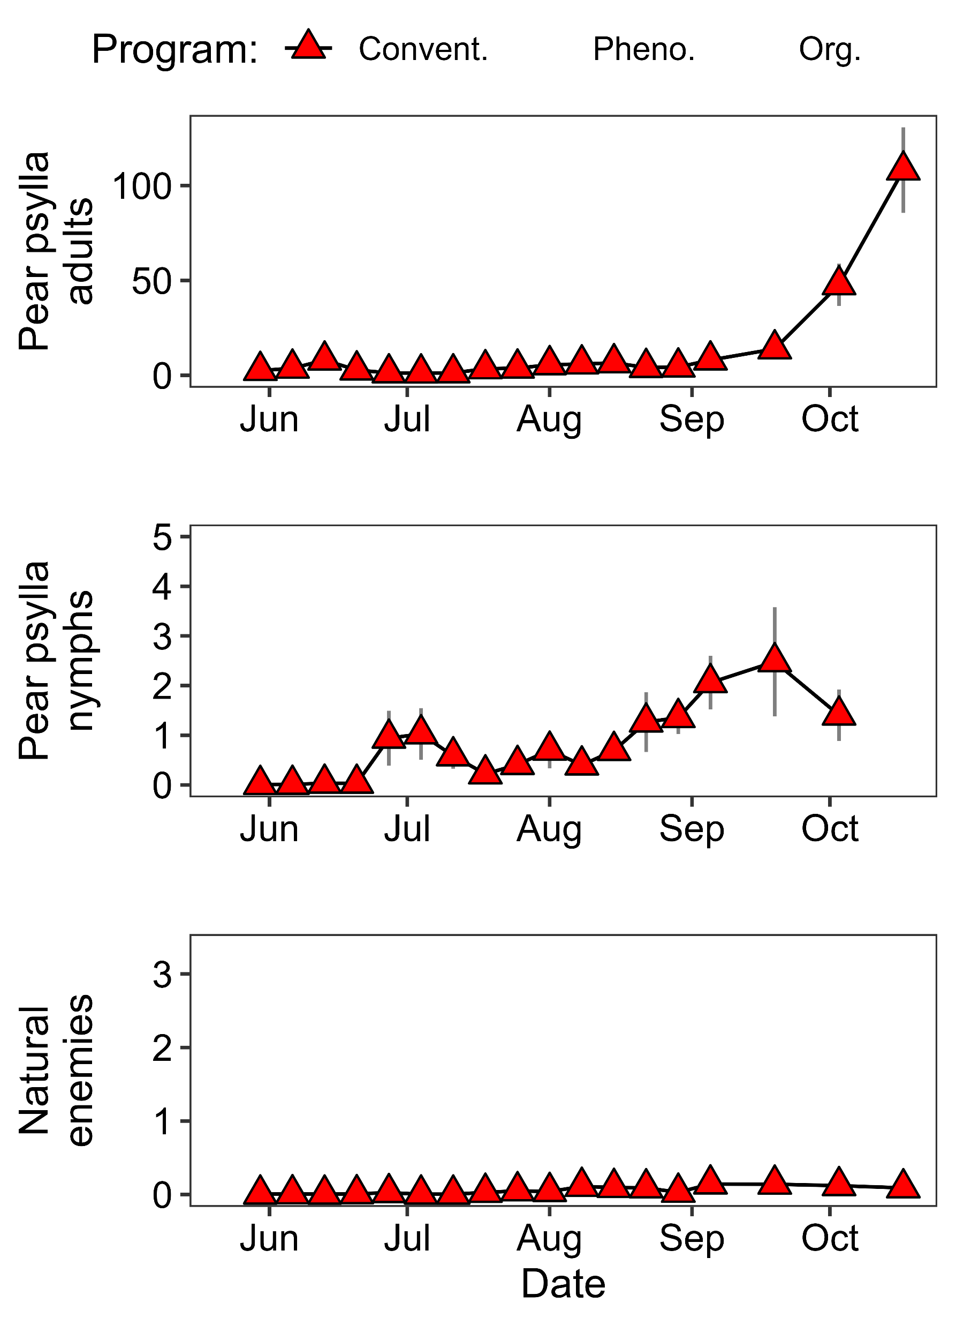
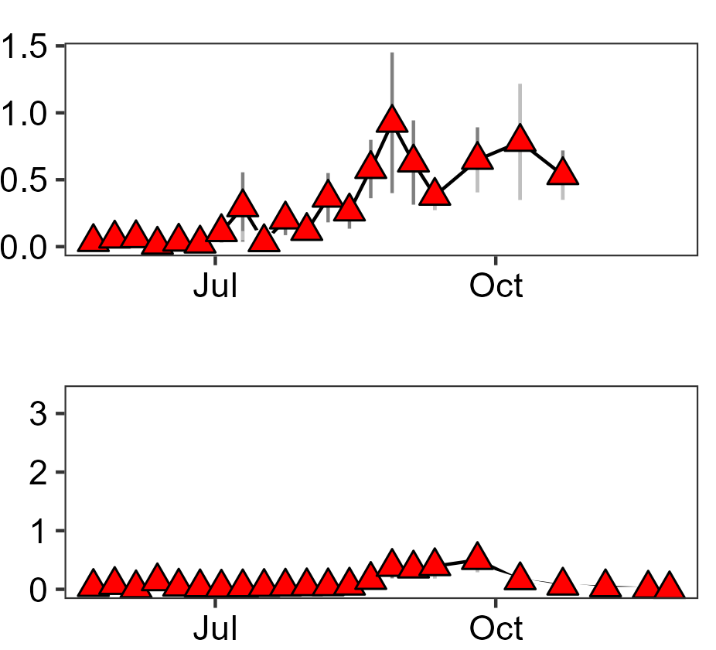
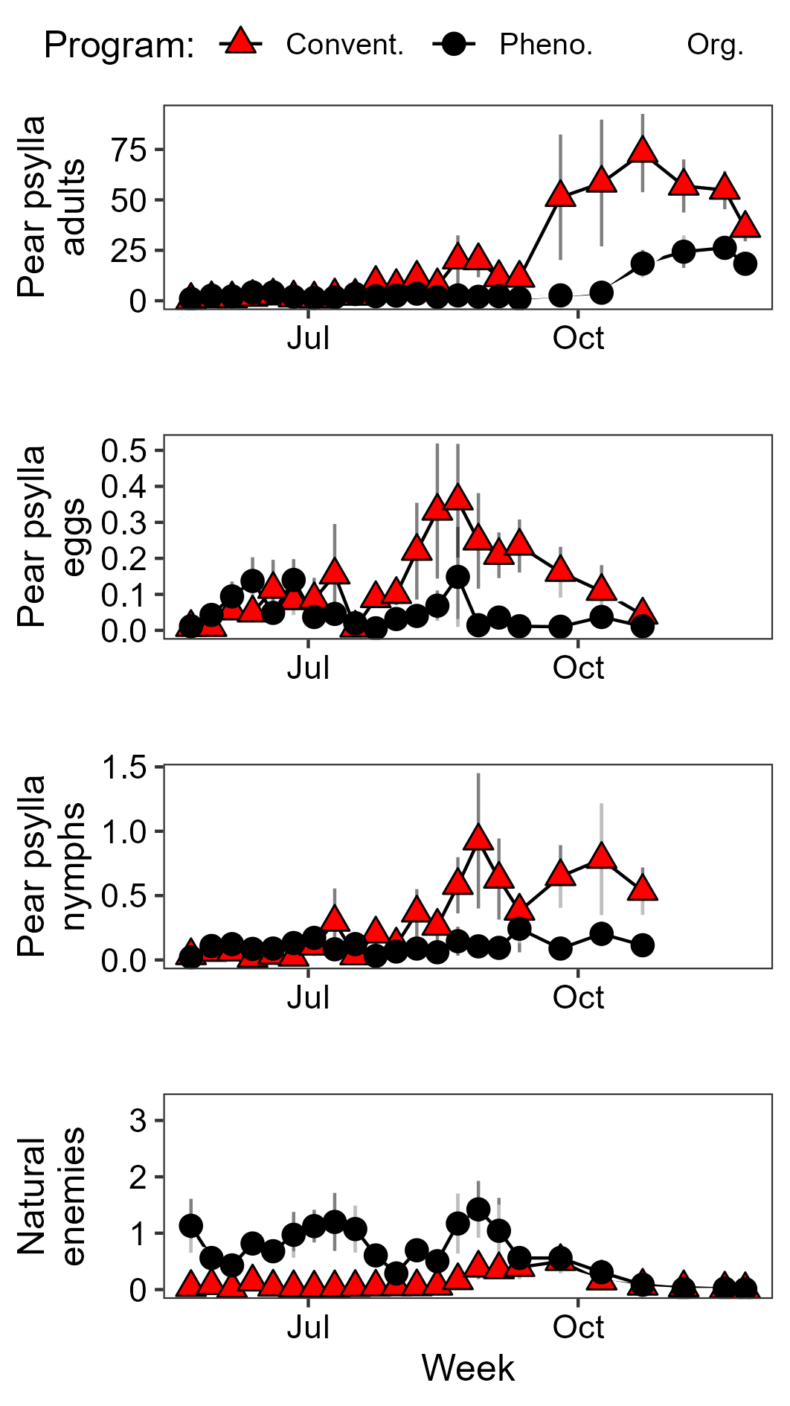
Pear psylla and biocontrol in conventional orchards
2022
2023
Conventional
Average data from 7 orchards
Notes:
These are data from the conventional block from the first 2 years of the project. The top figure shows pear psylla nymphs and the bottom shows natural enemies. As you can see there are barely any natural enemies throughout the entire season both years. This is reflected in the uptick of psylla in both years towards the end of the season. This is the general patterns of what we see in conventional orchards in Wenatchee.

Slide 9
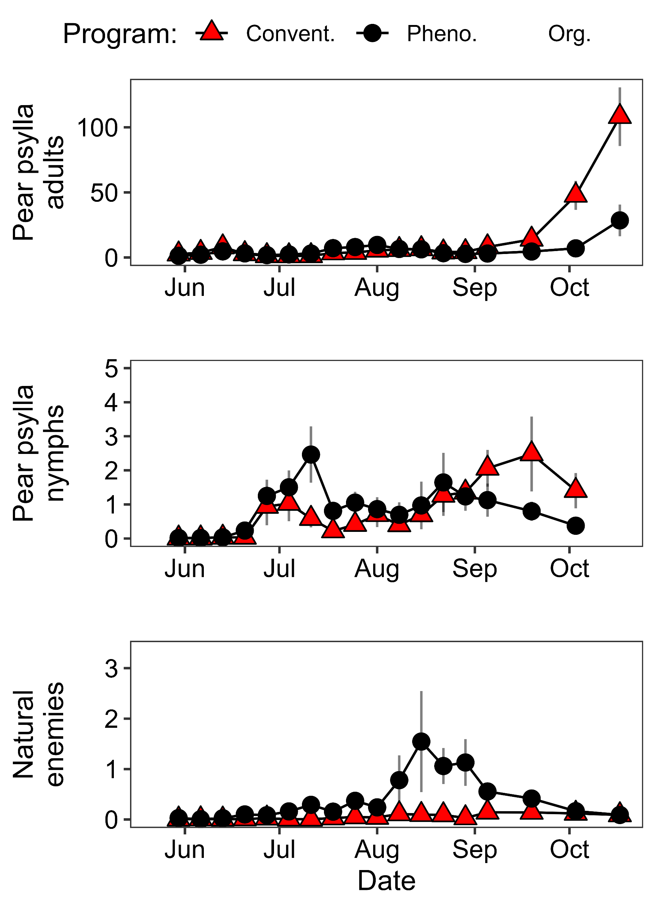
IPM orchards conserve biocontrol agents
2022
(IPM trial year 1)
2023
(IPM trial year 2)
Conventional
IPM
Average data from 7 pairs of orchards
Notes:
Adding in the phenology-IPM data, you can see that the populations of NEs increase in the later season, after being given time to build through biocontrol compatible management

Slide 10
IPM orchards conserve biocontrol agents
2022
(IPM trial year 1)
2023
(IPM trial year 2)
Conventional
IPM
Average data from 7 pairs of orchards
Notes:
Ive added in the pear psylla nymph data for ipm blocks and you can see that in 2022 we had a bit of a spike in nymphs early in the season but it leveled out as biocontrol built. In 2023 ew were able to keep numbers low. So with the ipm data overlayed and you cnans ee it’s a reverse patternnow you can see the pattern of the status quo or conv manamgent

Slide 11
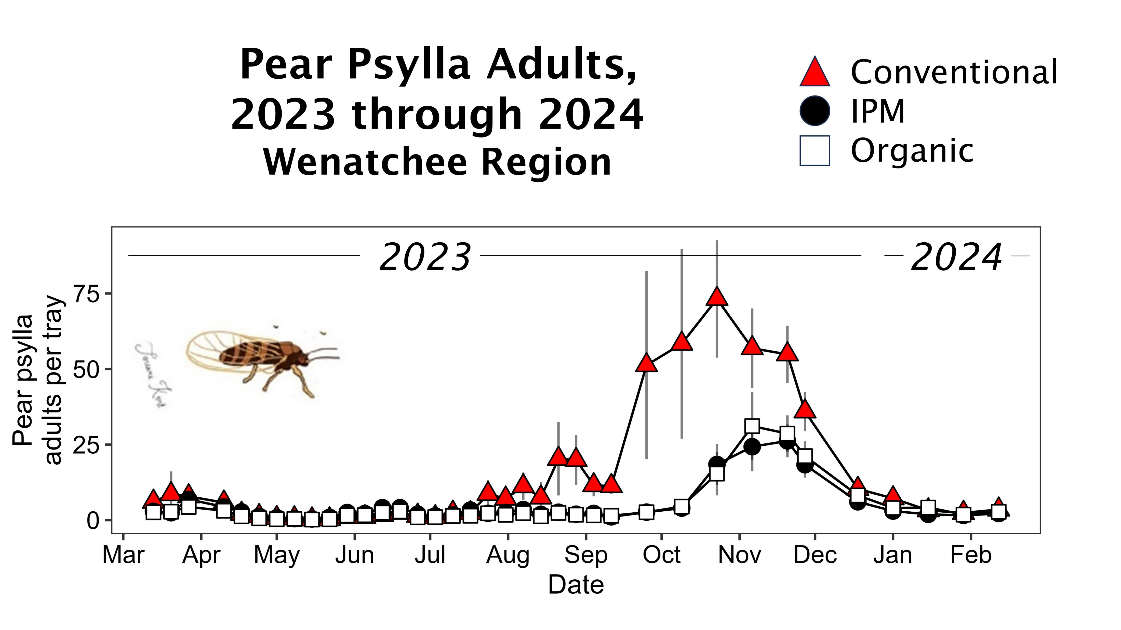
High psylla in conventional orchards late season
Average data from 7 pairs of orchards
Orpet et al
Notes:
SO the last figure I want to show you is pear psylla adults throughout the season. adults were kept low in both conventional and IPM but then later in the season, conventional spikes. This is due to the fact tht growers stop spraying due to REIs and harvest and do not have biocontrol populations built up to suppress psylla, while IPM porchards do.

Slide 12
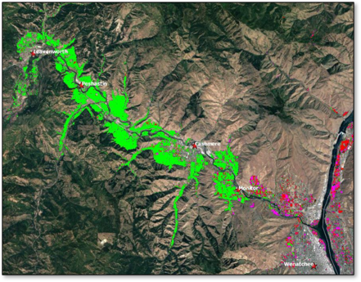
High psylla in conventional orchards late season
Pear
Cherry
Apple
Average data from 7 pairs of orchards
Notes:
This highlights the importance of pp IPM being an areawide effort in Wenatchee. These high adult numbers are problematic because winterform psylla are highly dispersive and conv programs crate this high population to move around the valley in late fall and early spring. It makes it difficult for just a few people to successfully do IPM with conv psylla pressure to deal with.

Slide 13
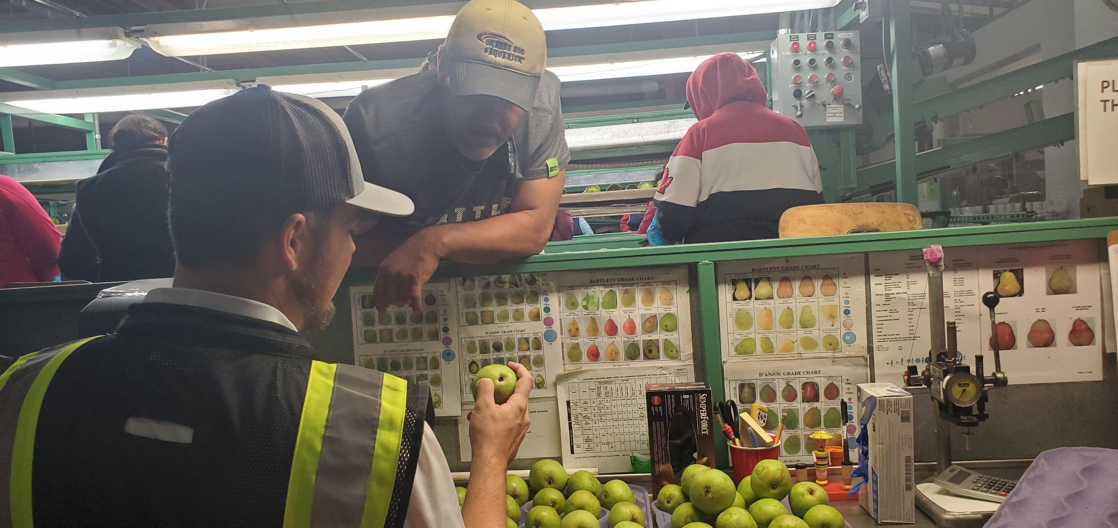
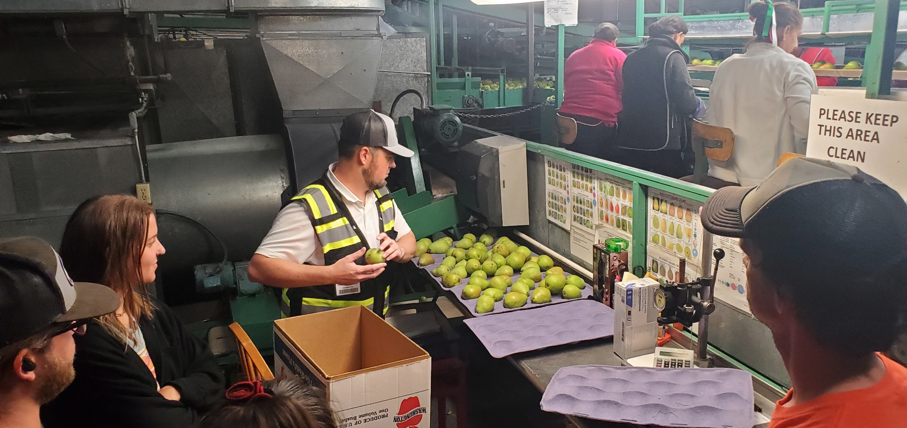
IPM orchards have earlier season damage risk
2022
2023
Mgmt. | Materials | Anjou downgrades |  | Materials | Anjou downgrades
Conv. | $1,340 | 8% |  | $1,385 | 5.0%
IPM | $1,170 | 11% |  | $1,015 | 0.6%
Notes:
Our team comducted damage ratings based on what we were taught from visits to a packinghouse. The ipm block had 11% downgrades, as compared to 8% in conventional. In 2022 IPM cost about $170 less than conventional. In 2023 however, the overall damage between both management strategies was lower, with conventional at 5% and IPM at only 0.6%. IPM was almost $400 cheaper.

Slide 14
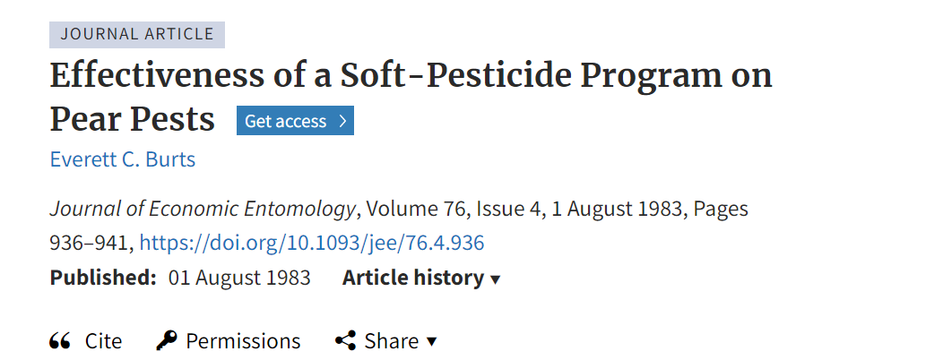
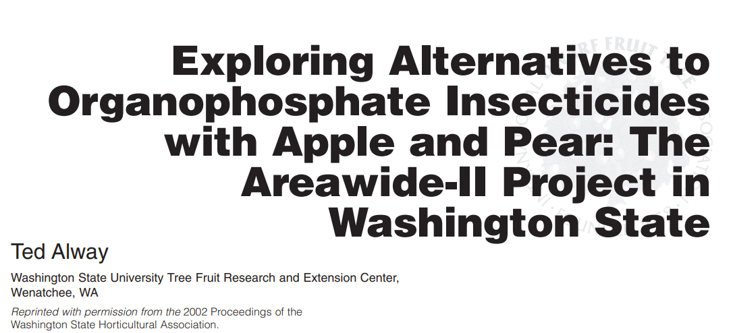
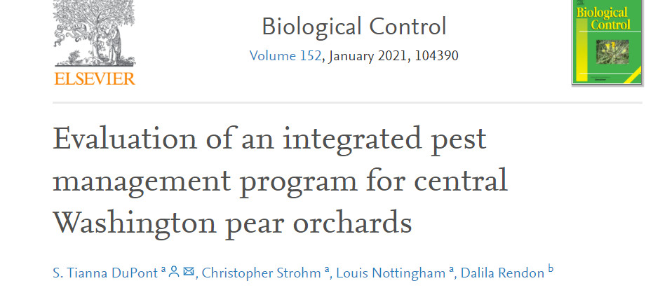
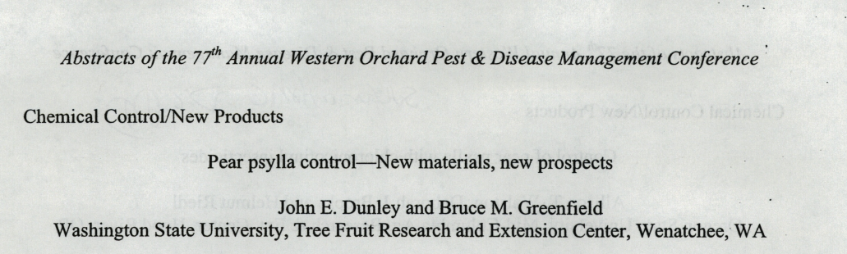
This is nothing new!
2003
Notes:
Even though IPM is not widely used in Wenatchee pears, the concept is nothing new. Since the 1980’s researchers have published studies that show that IPM can be just as if not more effective than conventional management

Slide 15
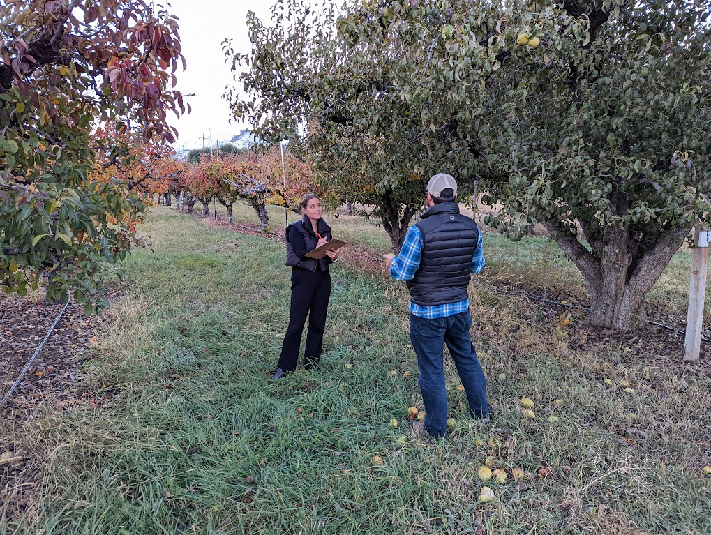
What makes our project different?
11 pear pest management decision-makers in 2022
6 growers, 5 field consultants
Approx. 2,309 acres
Will be repeated in summer 2024
Notes:
So what makes our project different? We are interviewing the cooeprators on the project, so the growers and crop consults fro the orchrds that re trialing ipm. We are learning why they are doing IPM and their perceptions of impelenting it in the valley

Slide 16
80% said that conventional pear psylla management is not effective
  “ …its the straight definition of insanity, we just can't keep banging our heads against the wall and expect to not have a headache...I think we're in a pretty poor place.”
60% perceive biological control as effective and important for pear psylla management
  “I know that there are beneficials out there. No matter what we’ve been doing. So, they’ve got to be helping but to what level I don’t know.”

Slide 17
Why isn’t IPM being adopted?
Notes:
So given that growers in Wenatchee know that conv management is no effective and biocntorl should be prioritized. So then why isn’t ipm being adopted?

Slide 18
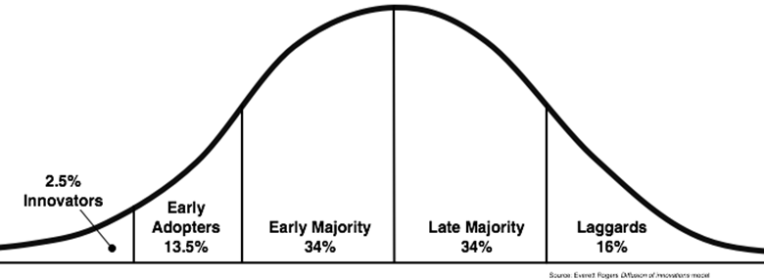
Diffusion of Innovations (DIO) framework
Rogers 1962
Notes:
So to learn more about this we turn to social science. Our work is based on the diffusions of innovations theory which was created by Everett rogers in 1962. The theory describes how an innovation gets adopted through a population over time. Its used in many fields. Describe curve.

Slide 19
Diffusion of Innovations (DIO) framework
Rogers 1962
Notes:
Our cooperators on the ipm project who are trialing ipm are the innovators and we want to get their experiences out there to jump start these early adopters

Slide 20
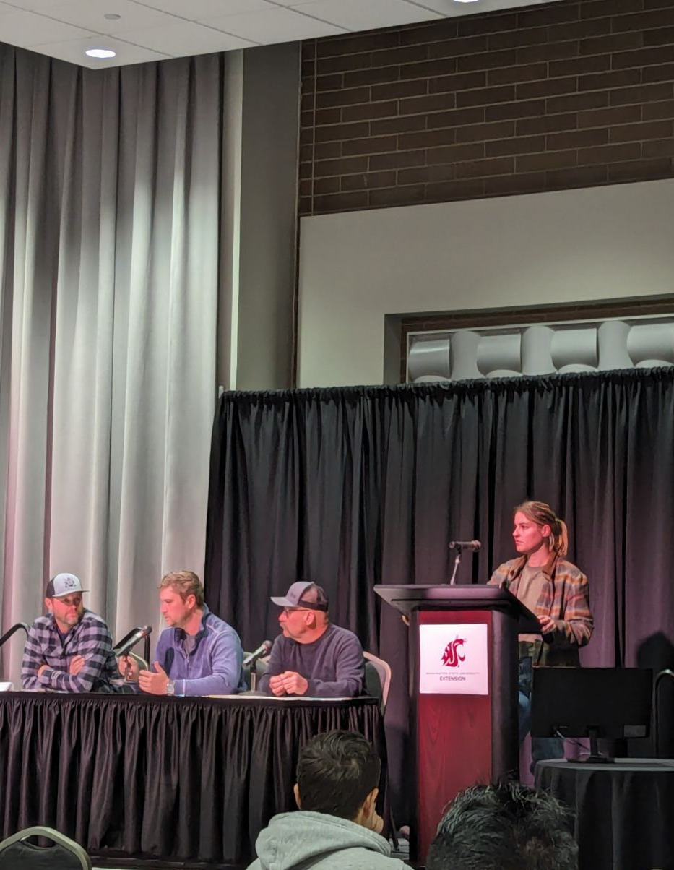
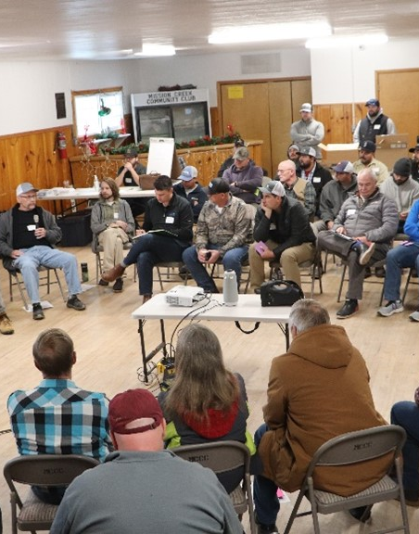
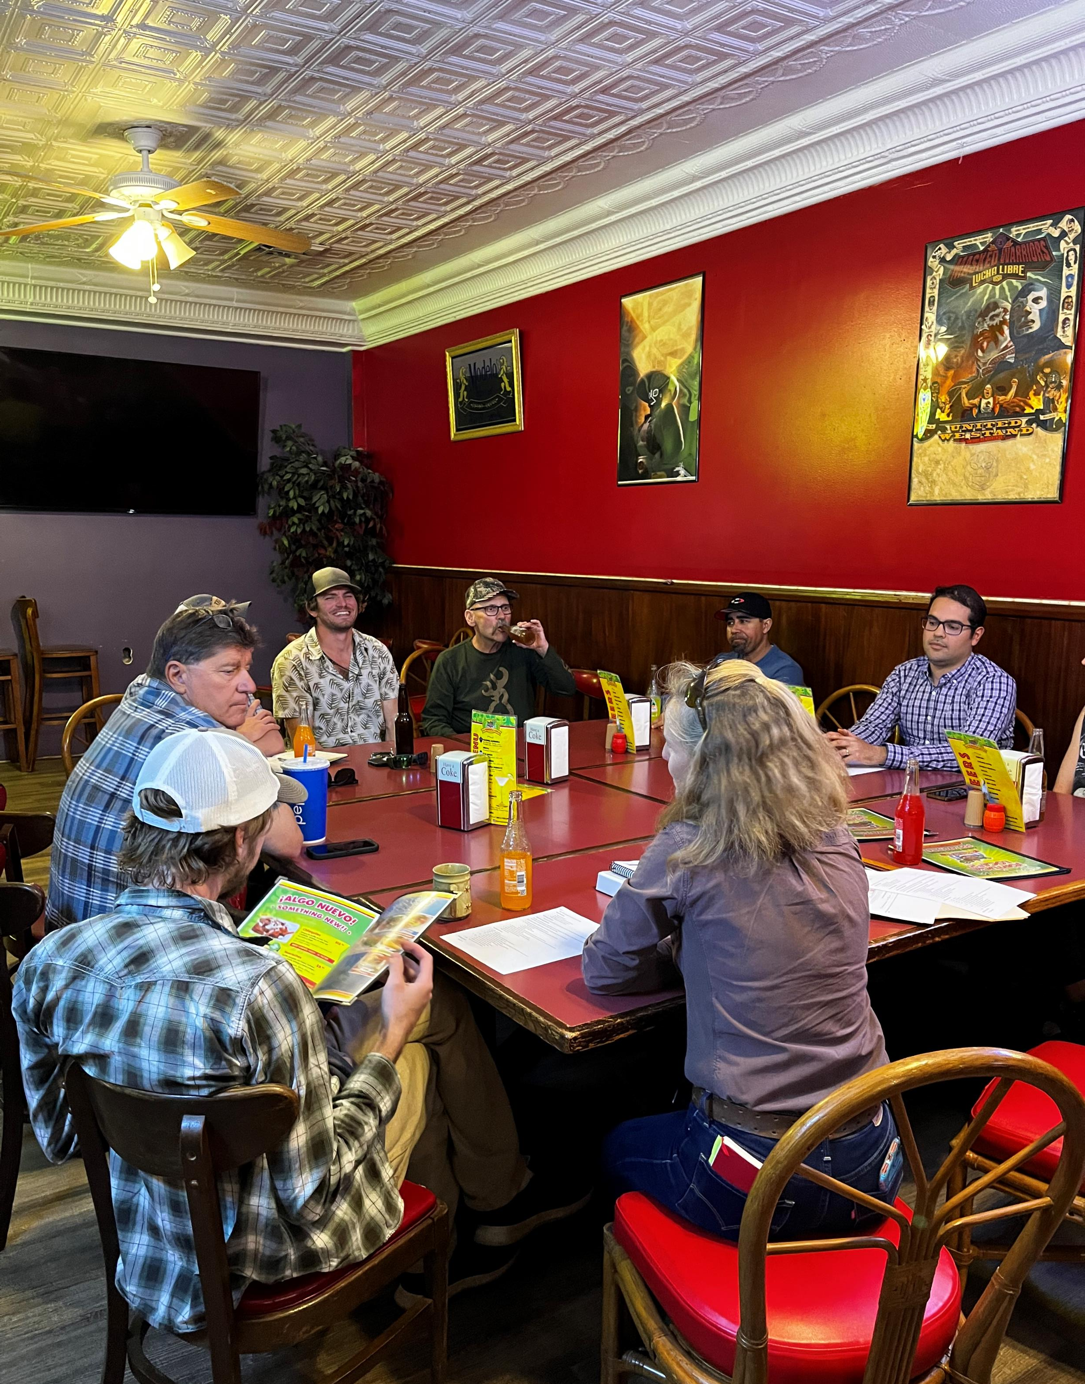
Innovators have influence
Notes:
So its important to get their voices out there, because as we all know, growers sometimes listen to other growers more than us reserachers, so we do events like cooperator panels where growers who are trialing ipm can share their experiences. This included pear day 2024 where there werew hundreds of audience members. Summer discussion groups

Slide 21
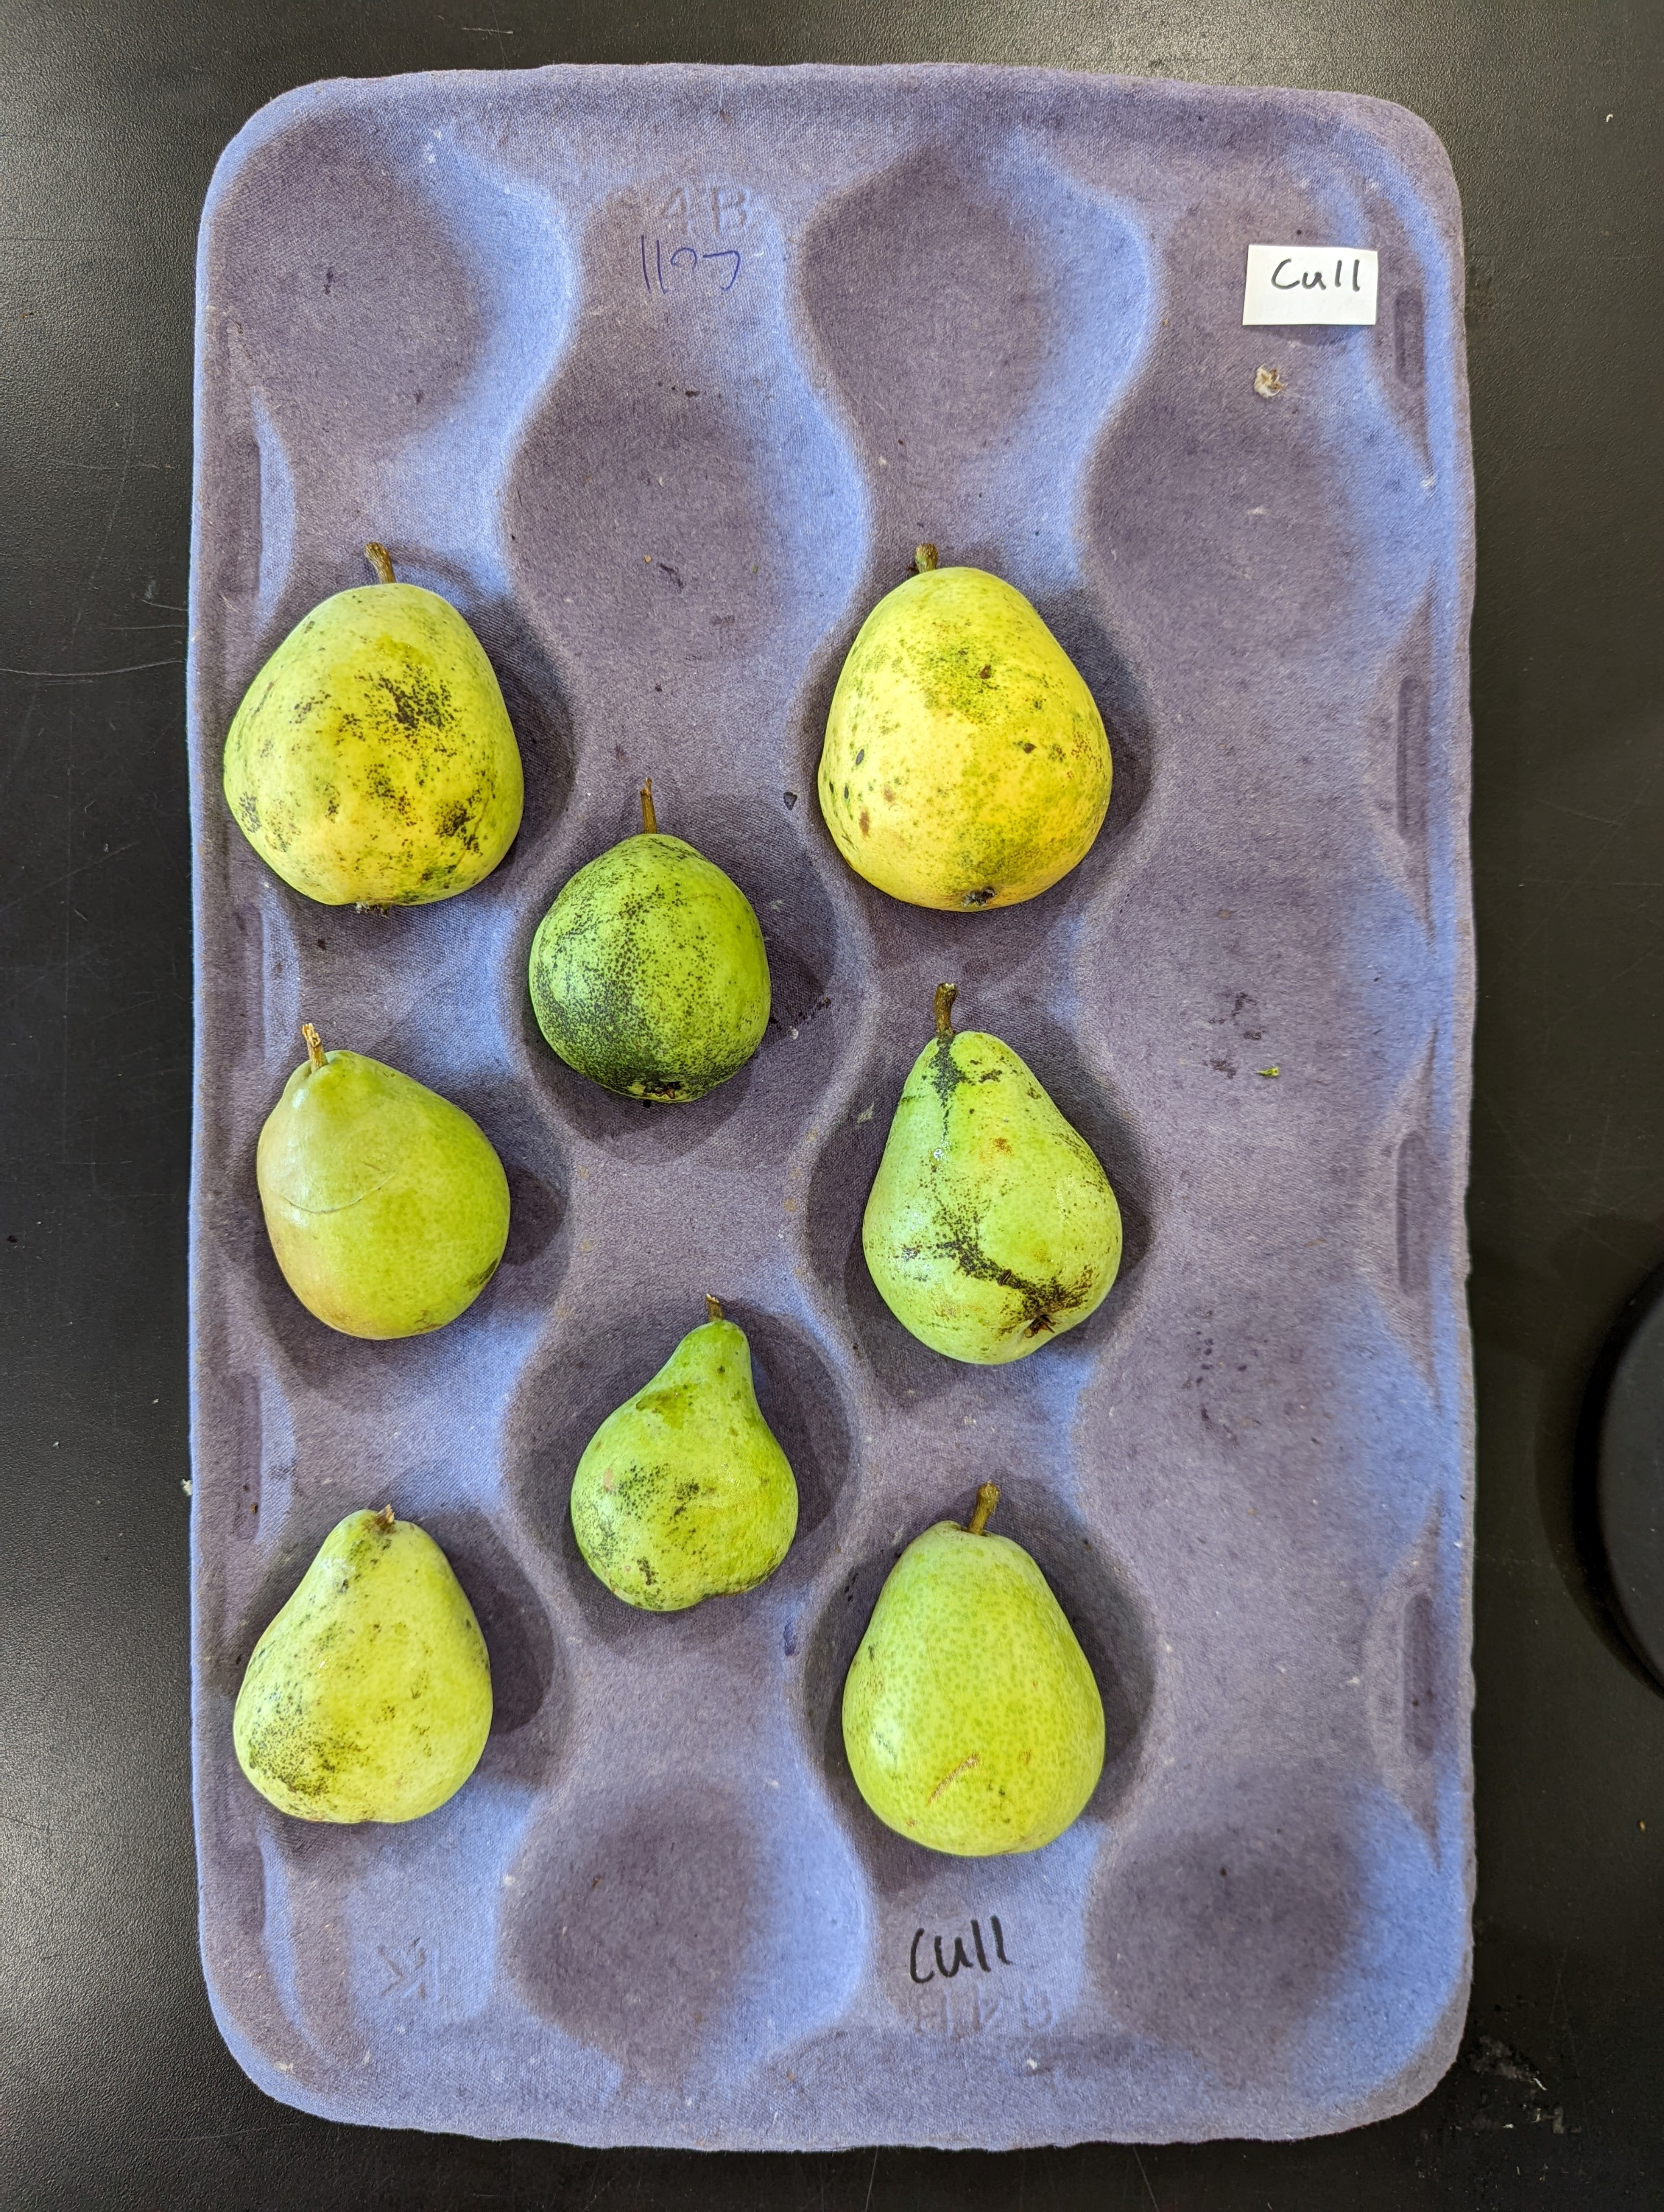
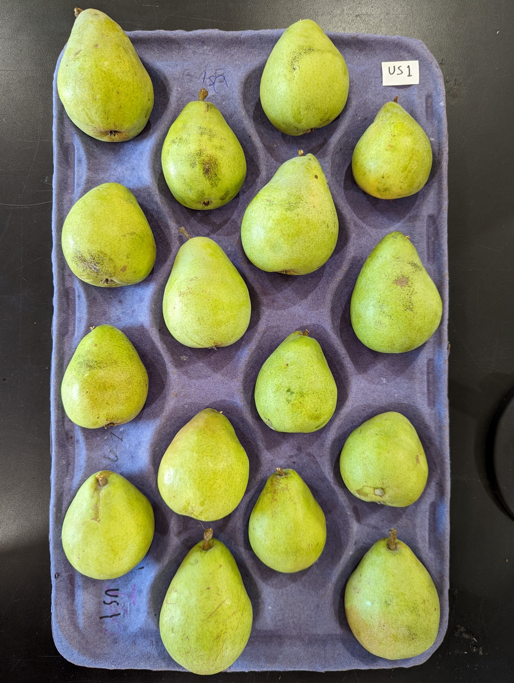
Influential Factors
Rogers 1962
Relative advantage
Notes:
An important part of the DOI is different factors that infuene the rate of adoption. One is relative advantage – is the innovation better than the status quo? Our program has shown that ipm costs less and can results in cleaner fruit. Our current project and past projects have shown this.

Slide 22
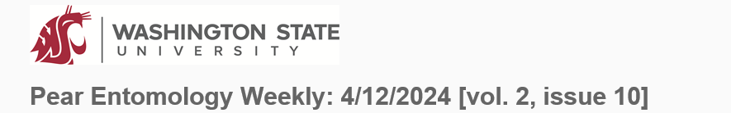
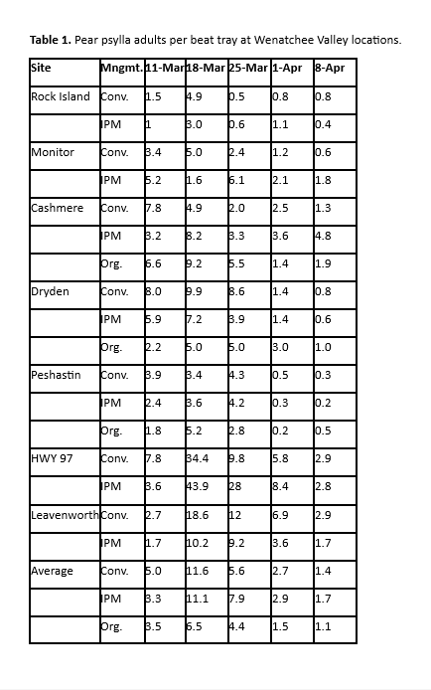
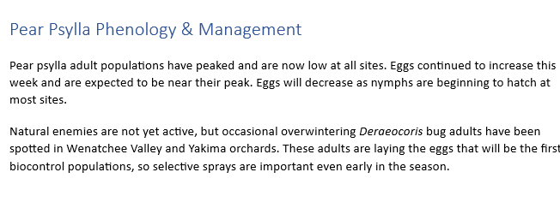
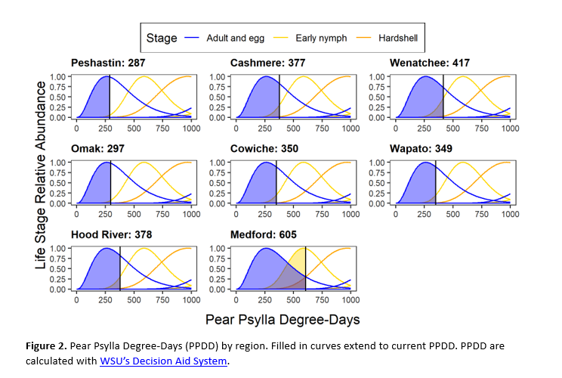
Influential factors
Rogers 1962
Relative advantage
Complexity
Notes:
Another factor is complexity. The easier to use, the faster its adopted. Often growres like to have straightforward recommendations, ipm requires scouting and more thought into the decision making process. So to help with this we send weekly newsletters

Slide 23
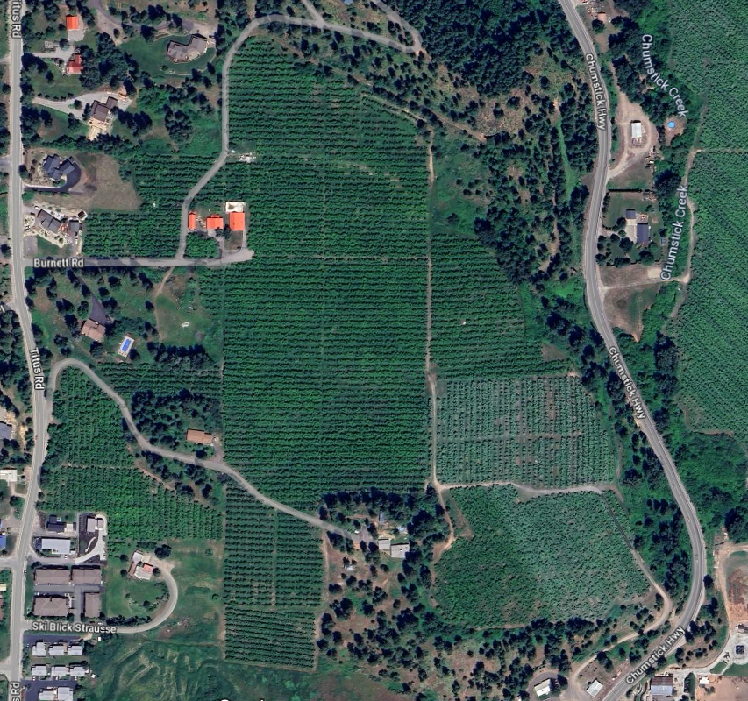
Influential factors
Rogers 1962
Relative advantage
Complexity
Trialability
Conv
IPM
Notes:
Another factor that can affect the rate of adopton is trialability, or the ability to test it on a small scale first. Can you try it before you buy it? Most of the cooperators on our program are convenitnal growers that are dedicating a couple acres to IPM. We do have a couple growers that have greatly expanded their ipm blocks, even one who went full ipm so we had to find another control.

Slide 24
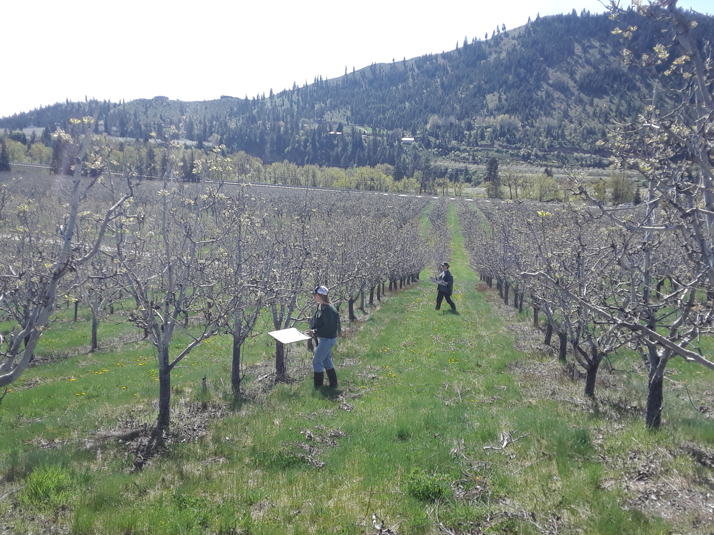
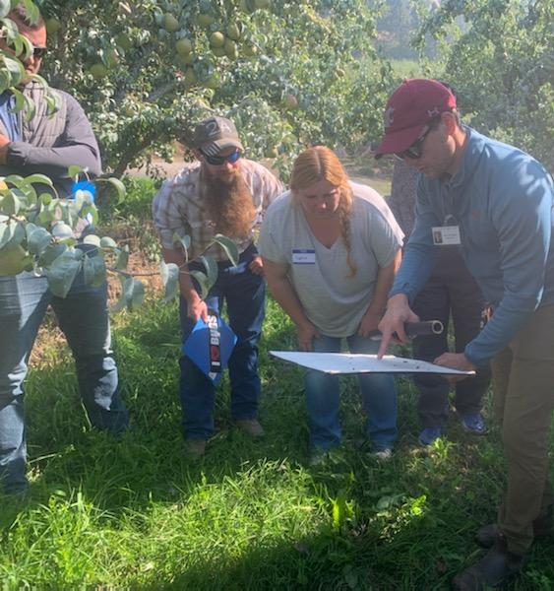
Influential factors
Rogers 1962
Relative advantage
Complexity
Trialability
Observability
Notes:
Observability is the last factor, which means the ability to see if its working. Scouting for psylla and natural enemies is the main way we do this throughout the season. We provide this for our cooperators weekly and we show them the data, like I said in the newsletter. We also hold field days where poelpe can see a conv and ipm orchard next to each other and we do scouting demonstrations

Slide 25
We need areawide pear IPM
Pear
Cherry
“Unless IPM is an area wide deal, I don’t think its feasible in [the Wenatchee River Valley]” – Pear grower
Apple
cropscape
Notes:
The Wenatchee valley is a monoculture of conventional pear orchards and the high psylla come from conv orchards are why we need areawide. We are in the beginning stages of an areawide IPM effort . The growers know too that areawide is necessary for maximum effectiveness.

Slide 26
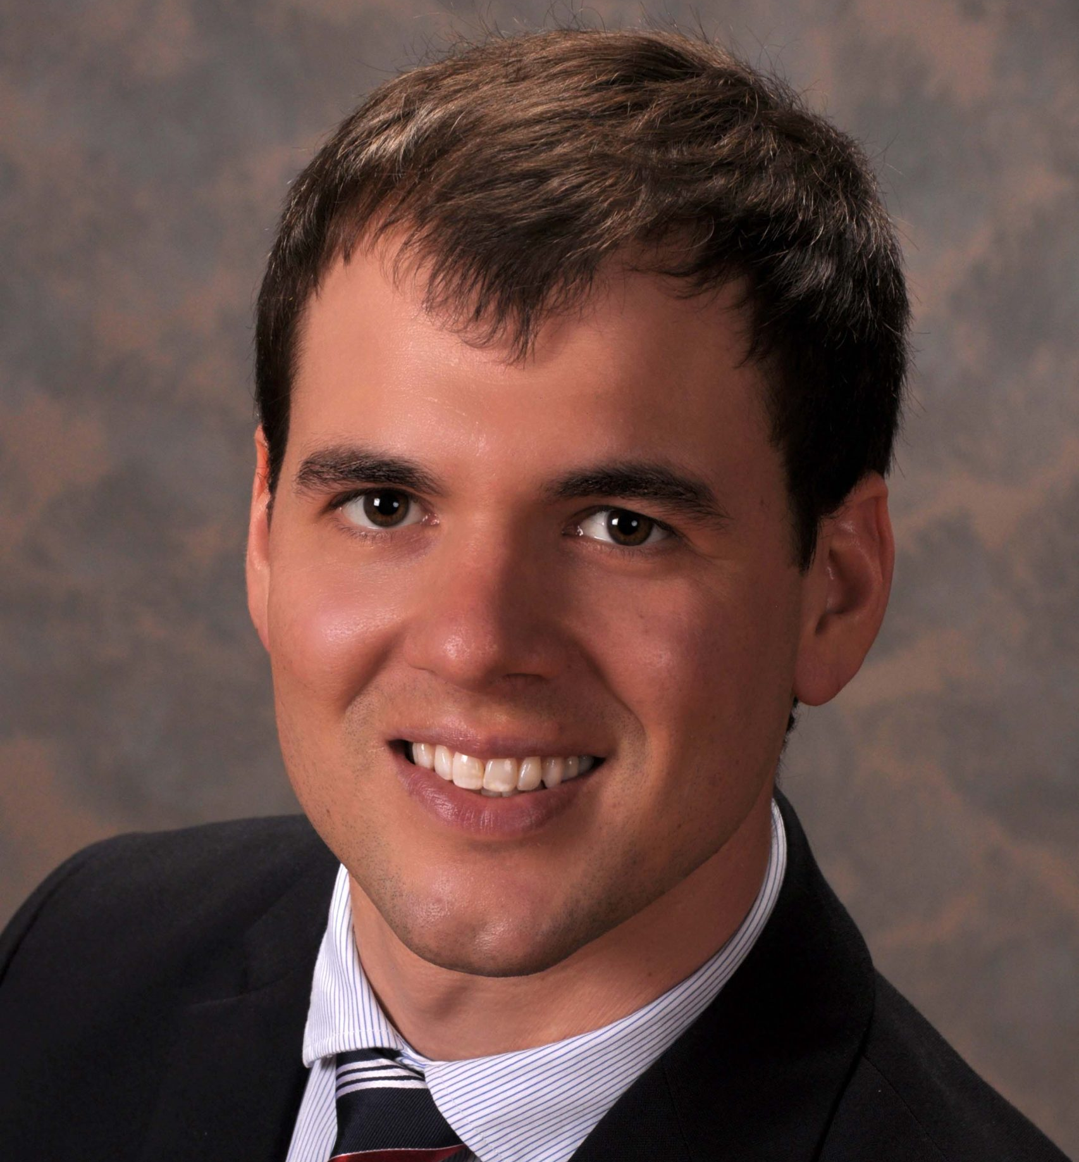
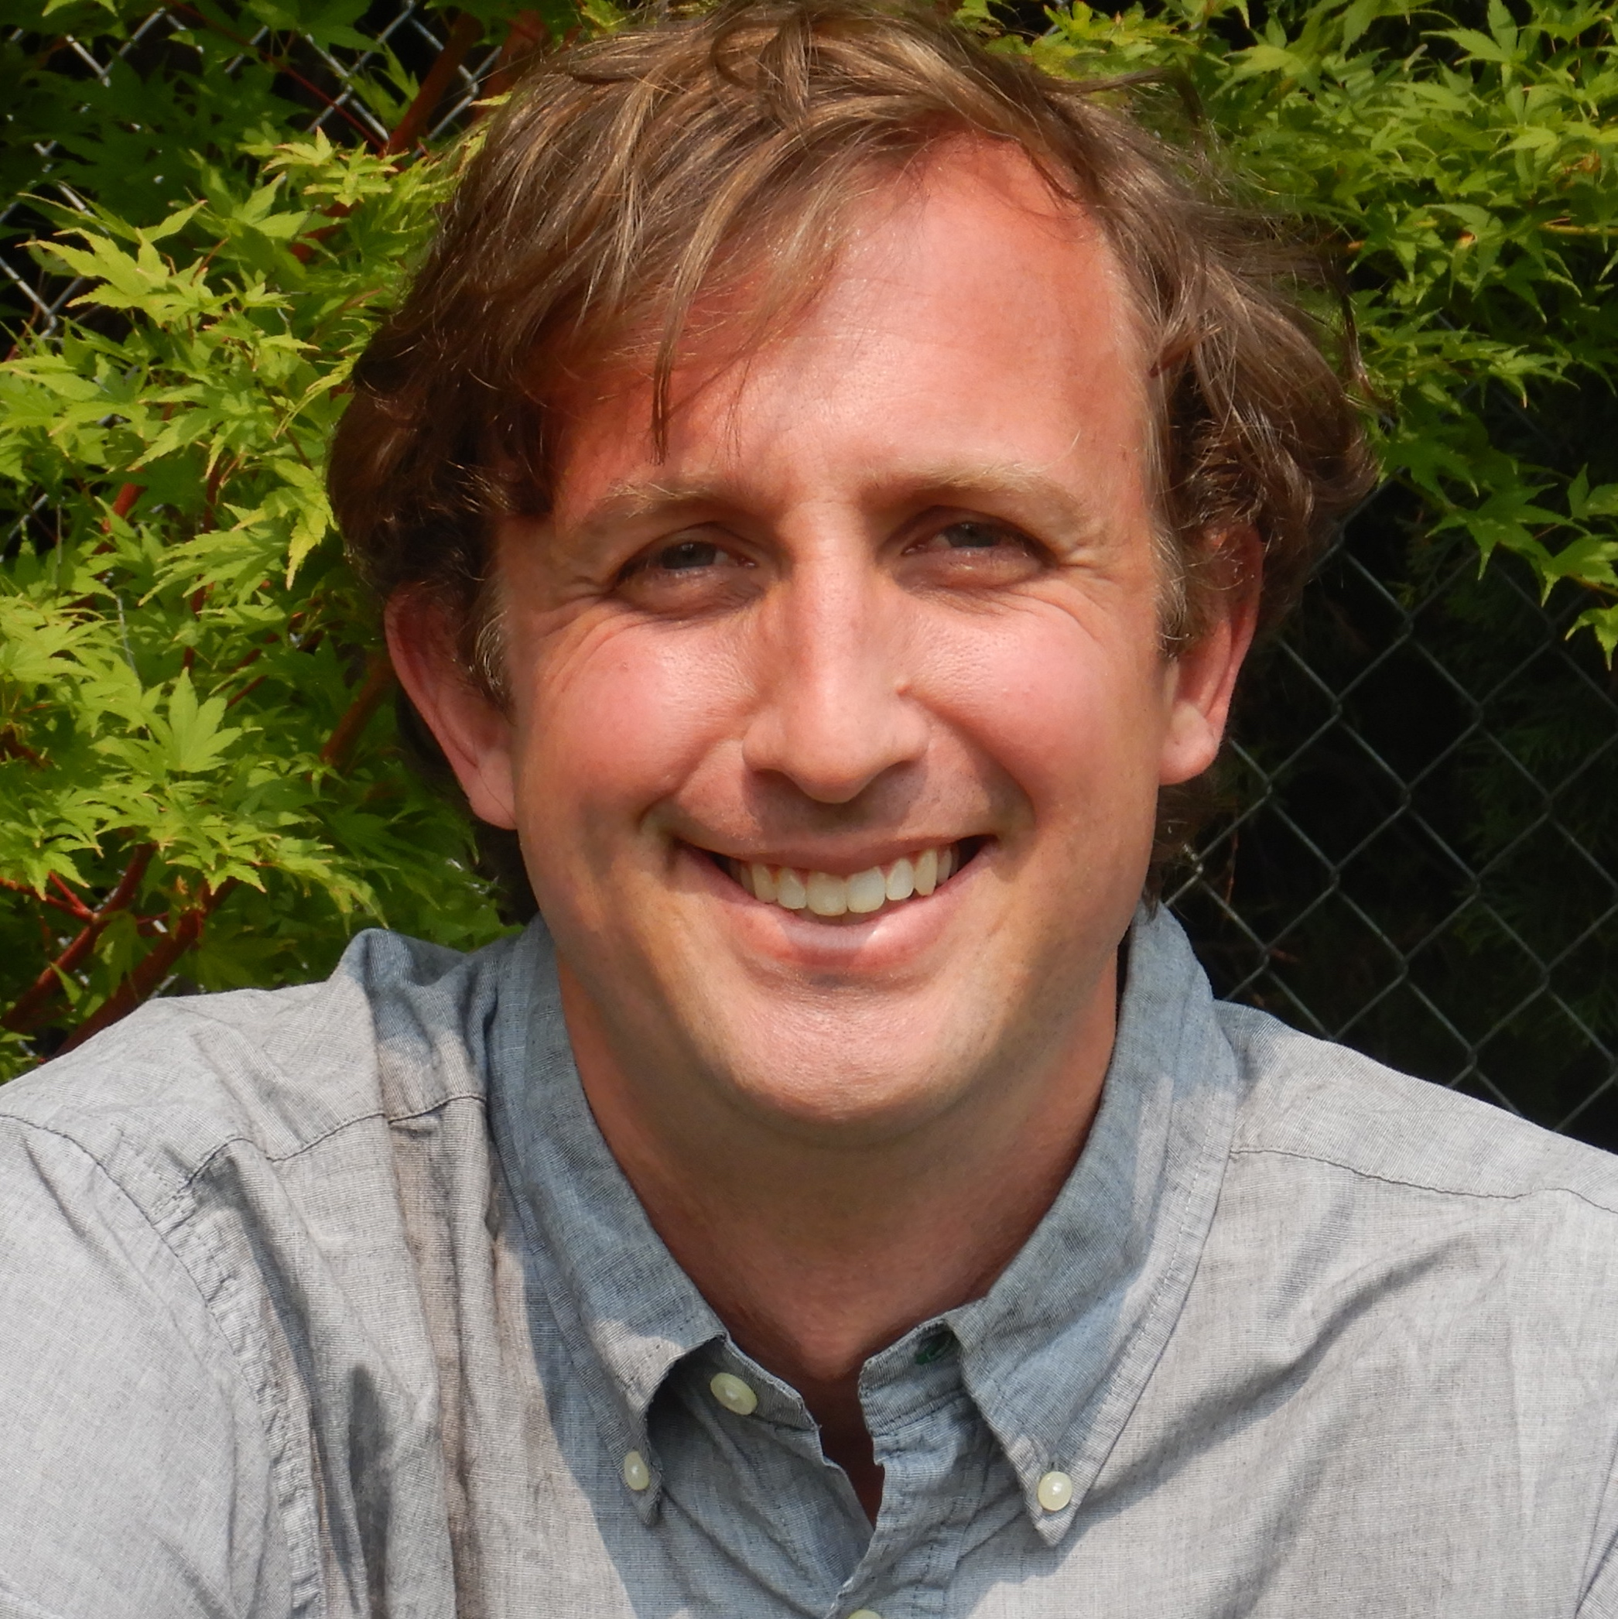
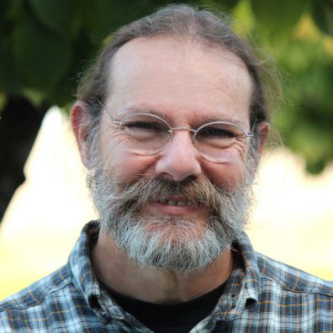
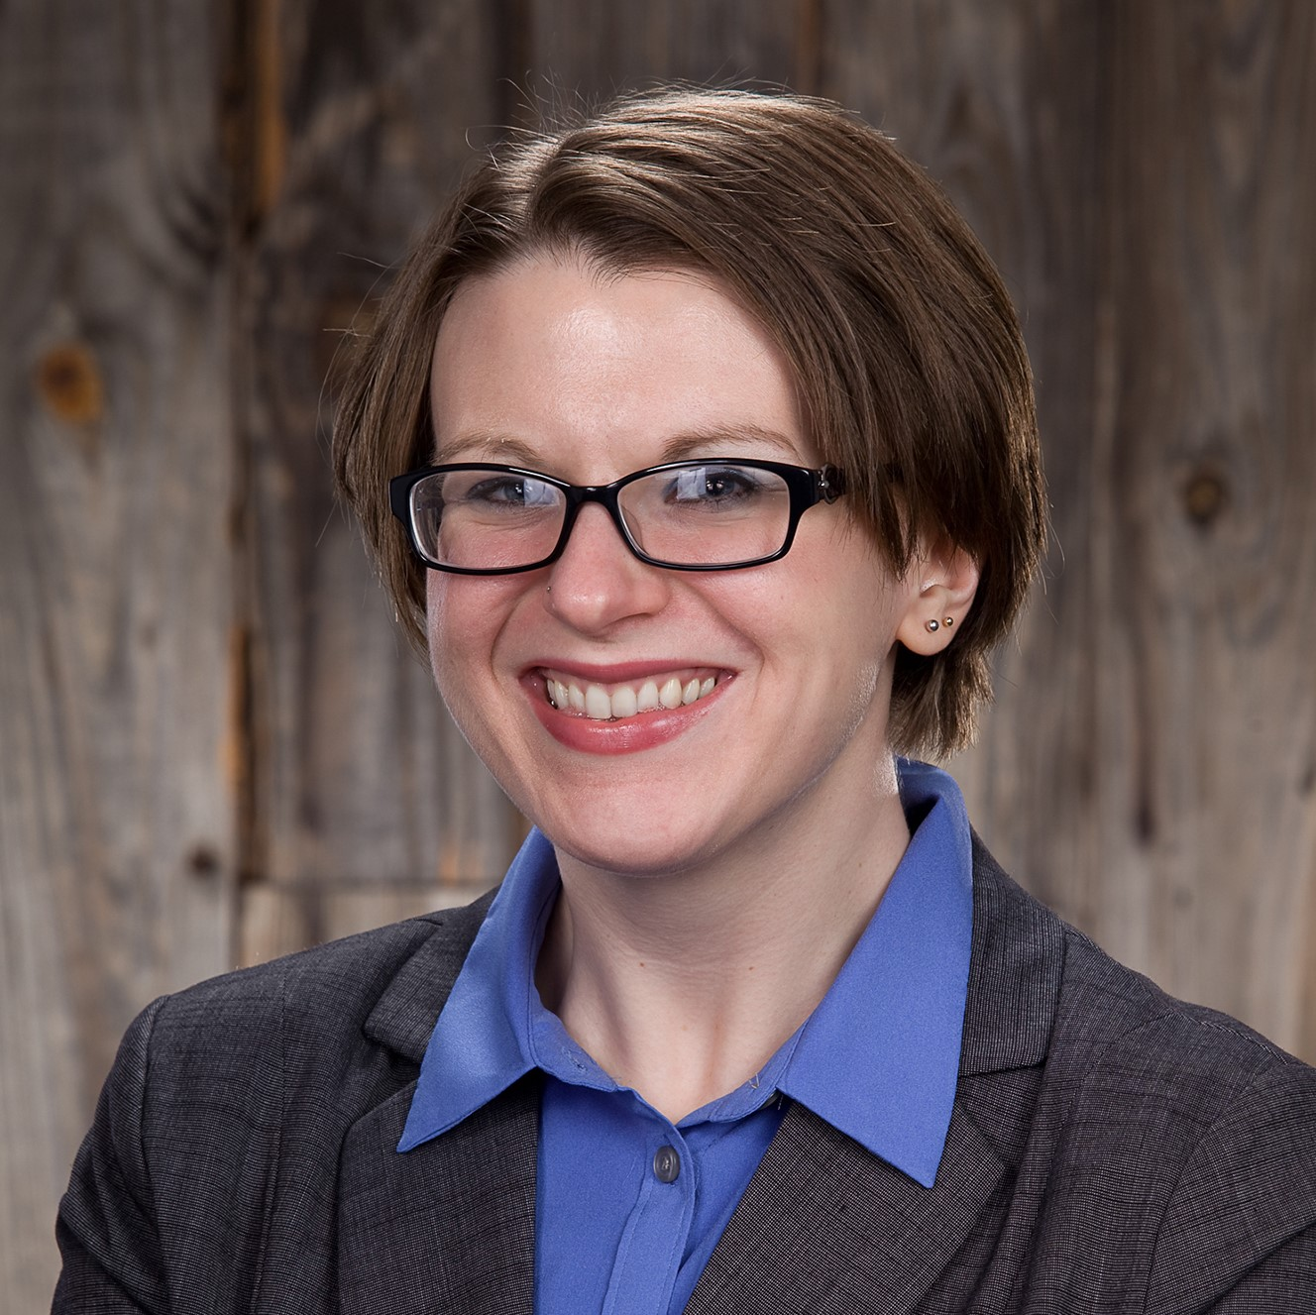
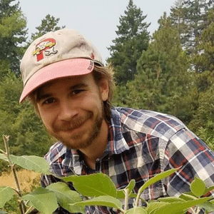


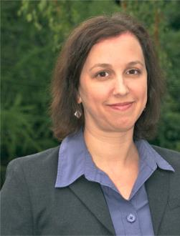
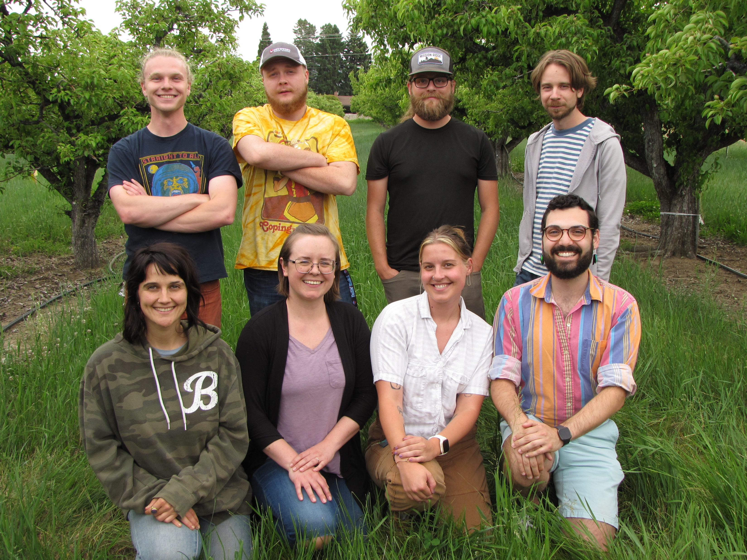




Thank you!
PhD Committee
Dr. Louie Nottingham
Dr. Tobin Northfield
Dr. Allan
Felsot
Dr. Rebecca Schmidt-Jeffris
Dr. Robert
Orpet
Dr. Jessica
Goldberger
And industry cooperators!
The Orpet lab

Slide 27
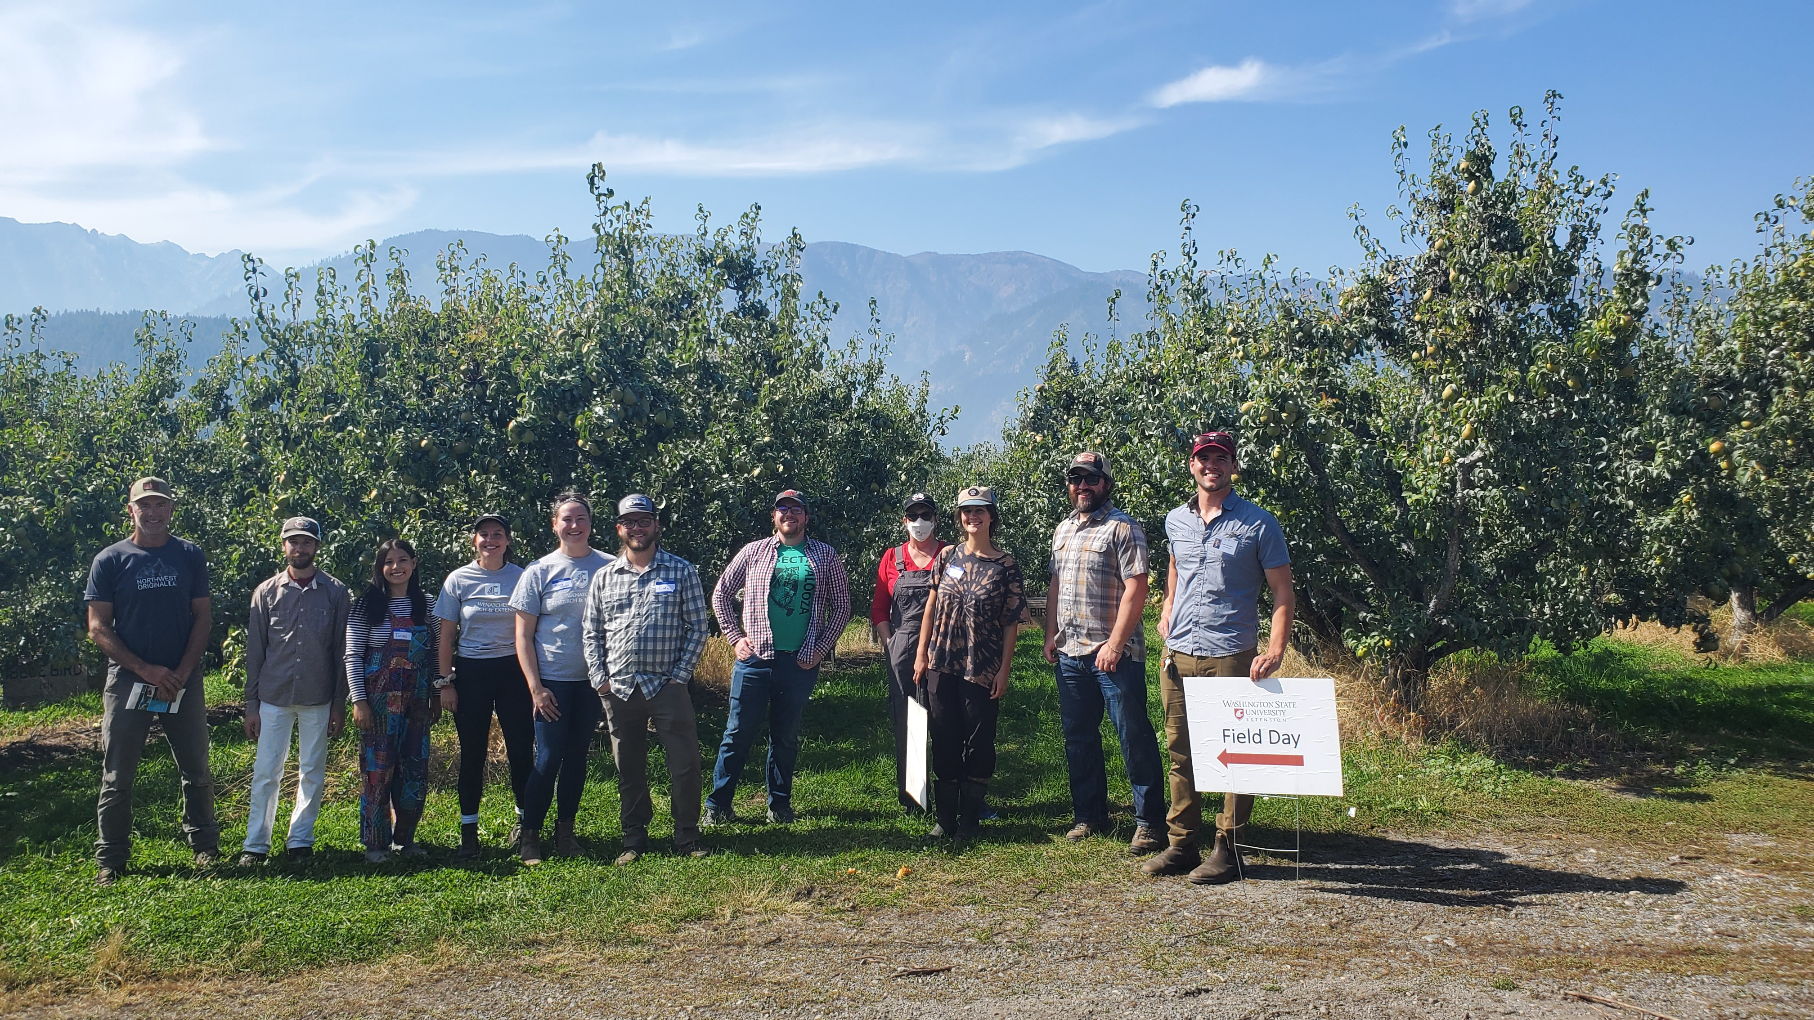
Questions?
email: molly.sayles@wsu.edu

