Slide 1
This material is based upon work supported by the National Institute of Food and Agriculture, U.S. Department of Agriculture, through the Northeast Sustainable Agriculture Research and Education program under subaward number ONE21-400.

Slide 2
Schmidt Hop Farm
Steve Schmidt
Growing NY Hops
Harvesting / Drying Hops For Local Farmers
Pelleting Hops (65% of NY Hops)
Selling Hop Yard Supplies

Slide 3
Plants
Location
Diseases
Viruses
Pests
Weeds
Soil

Slide 4
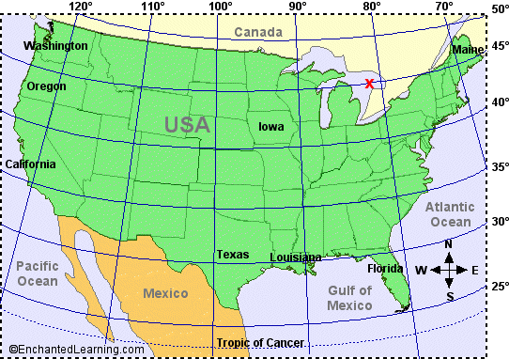
Location
Hops grow best on 45 Latitude
Plant needs on average 15 hours of daylight

Slide 5
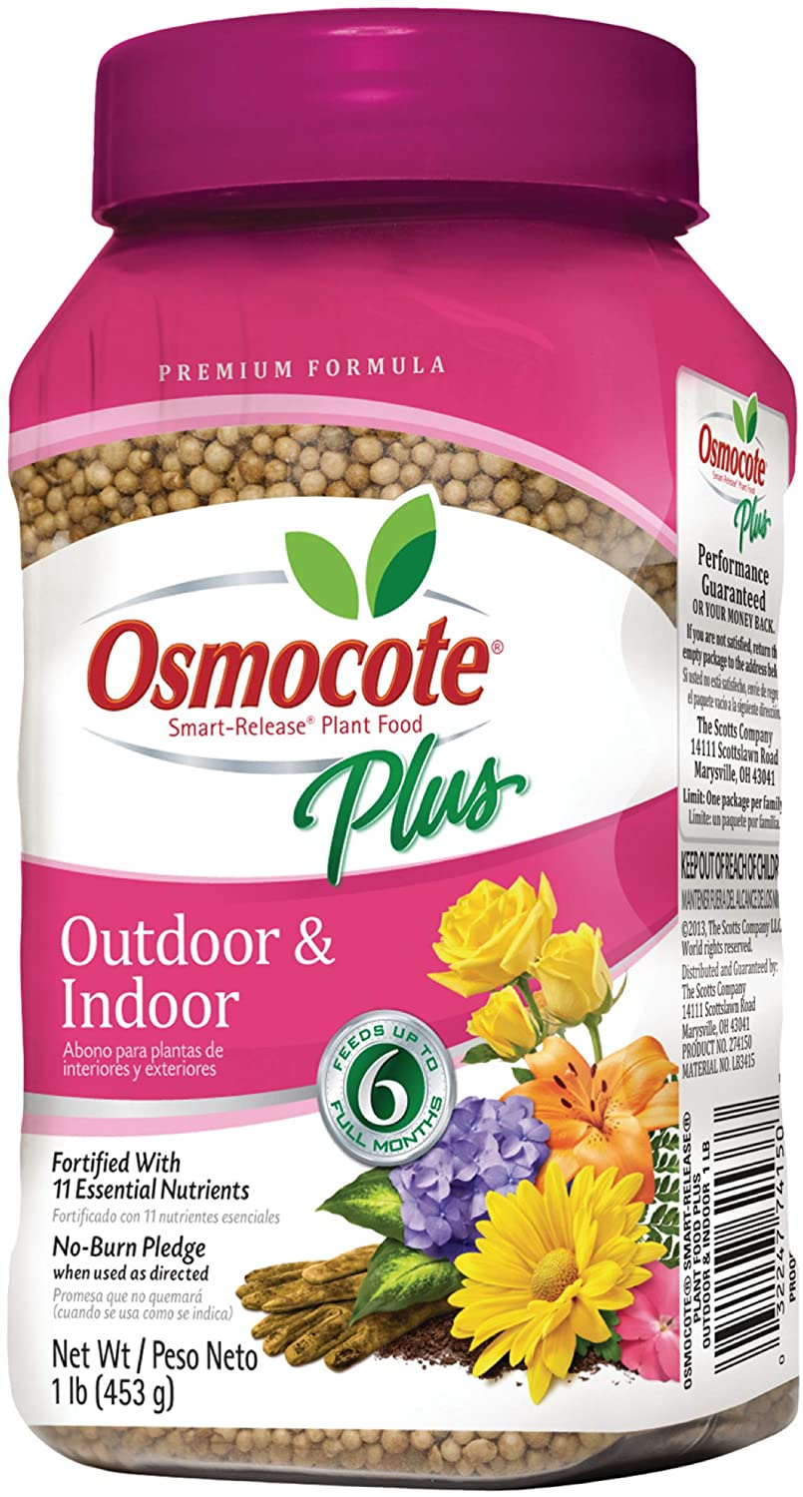
Soil
No Sloped Fields, Run rows E/W But N/S Fine.
Generally, hops produce best on a well-drained sandy loam or silt loam.
Avoid Heavy, poorly Drained Soils (Increased disease and pest problems).
Have soil tested (dairyone.com) (PH 6.5 – 7).
Amend soil before planting and trellis.
Plow, Till, Compost, Manure, Organic Matter.
1st Year: Use Osmocote, Lots, 6 Months
2nd Year: Plants require high nitrogen (200# Acre)
Urea 46%
Ammonia Nitrate

Slide 6
Diseases / Viruses
Downy Mildew
Can Kill Bines, Prevents from Climbing and cone development
Powdery Mildew
Reduce Cone Size, quality and yield
Apple Mosaic Virus
Hop Mosaic Virus
Hop Latent Virus
American Hop Latent Virus
Reduce Cone Weight
Reduce Aplah Acids
Reduce Yields

Slide 7
Pests
Year 1
Nothing Major
Japanese Beetles
Year 2
Substantial Growth
Potatoe Leaf Hopper
Two Spotted Spider Mite
Japanese Beetles
Aphids

Slide 8
Weeds
Year 1
Very Important
Establish Roots
Reduce weeds
Yield
Year 2
Important
Yield, Yield, Yield
Fabric / Plastic
Round up
Sheep

Slide 9
Wet vs Dry
Wet
Most Profitable
Pick and deliver within hours
Brew within 24 – 48 hours
Cold Storage
Not enough demand
Dry
4lb wet = 1lb dry
Whole Leaf
Pellets
Wet = $5 - $10 lb on average
Dry = $6 - $18 lb on average
4 lbs wet = $40
1 lb dry = $12

Slide 10
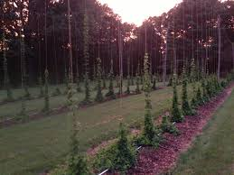
Trellis System

Slide 11
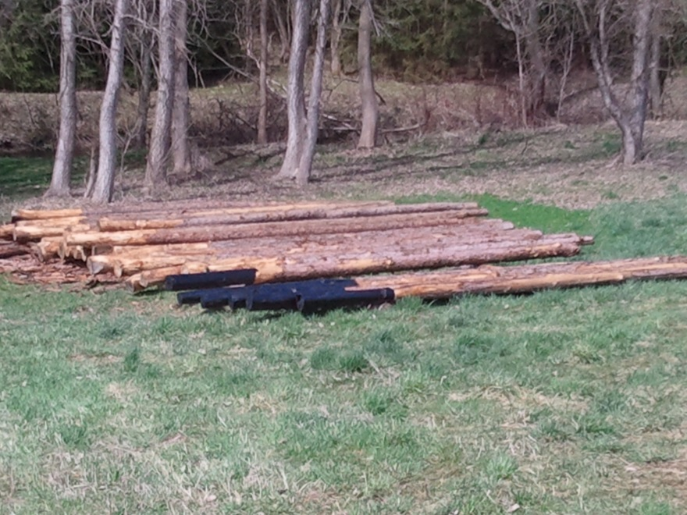
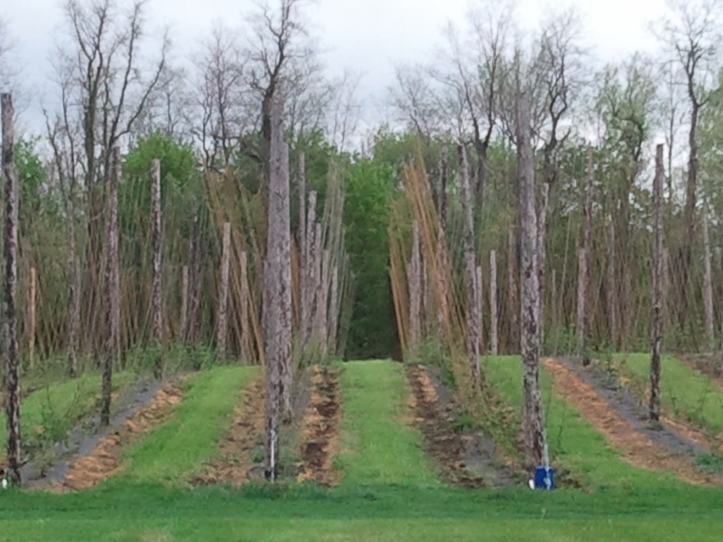
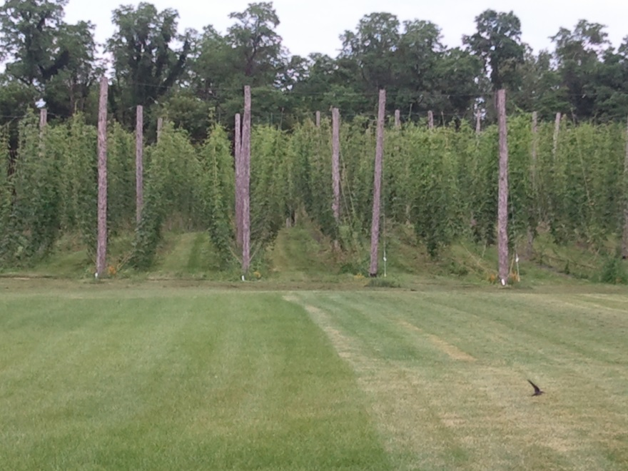

Slide 13
Harvest
Hand Picking
Machine Picking
Wet/Dry
Wet
Drying (Oast)
Packaging
Vacuum Seal
Nitrogen Flush
Selling
Micro Brewery
Home Brewer
End Product
Whole Leaf
Pellets

Slide 14
Post Growing Costs
Harvester ($25,000 - $40,000)
Dryer ($100 - $5,000)
Pelleting Equipment ($100,000)
Vacuum Seal ($250)
Nitrogen Seal ($3,000)

