Slide 1

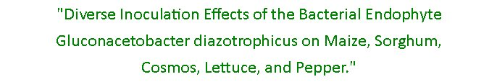




Slide 2
Outline
Background information
Early research projects
  Results, expected and peculiar
New avenues of investigation
  Novel crops
  Expanded interactions
  Impacts on applied agriculture
Questions and comments

Slide 3
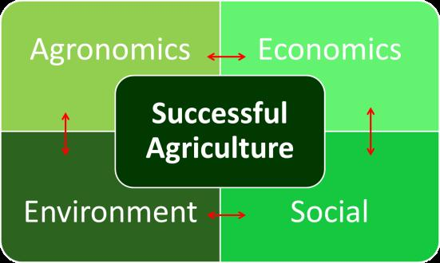
Microbe-Assisted Agriculture

Slide 4
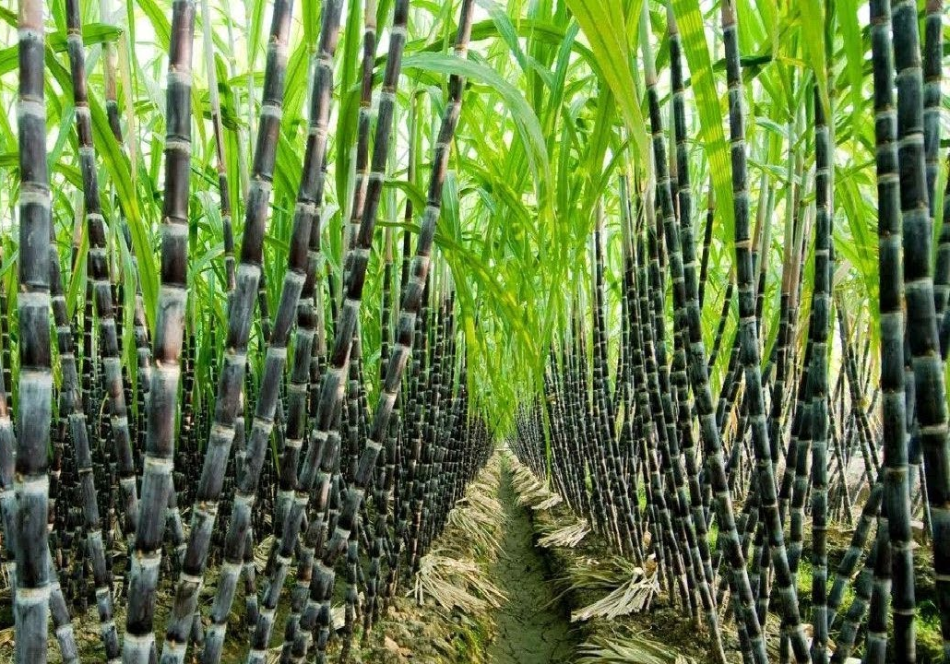
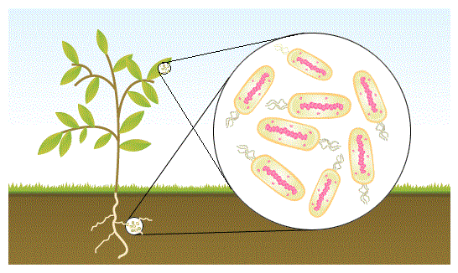
Gluconacetobacter diazotrophicus
(Vladimir A. Cavalcante, J. Dobereiner 1988)
G. diaz
Fixes atmospheric nitrogen, ~200 kg N /ha /year
Non nodulating
  Roots, stems, leaves, fruit

Slide 5
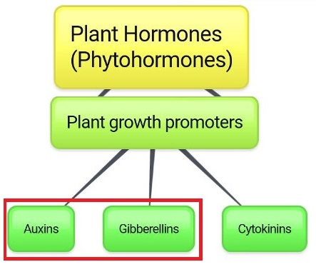
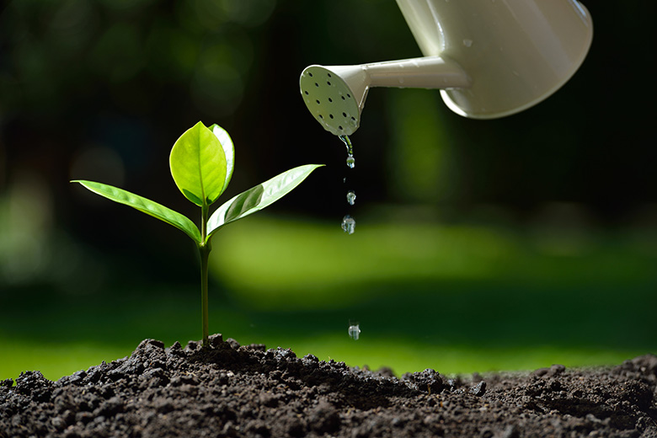
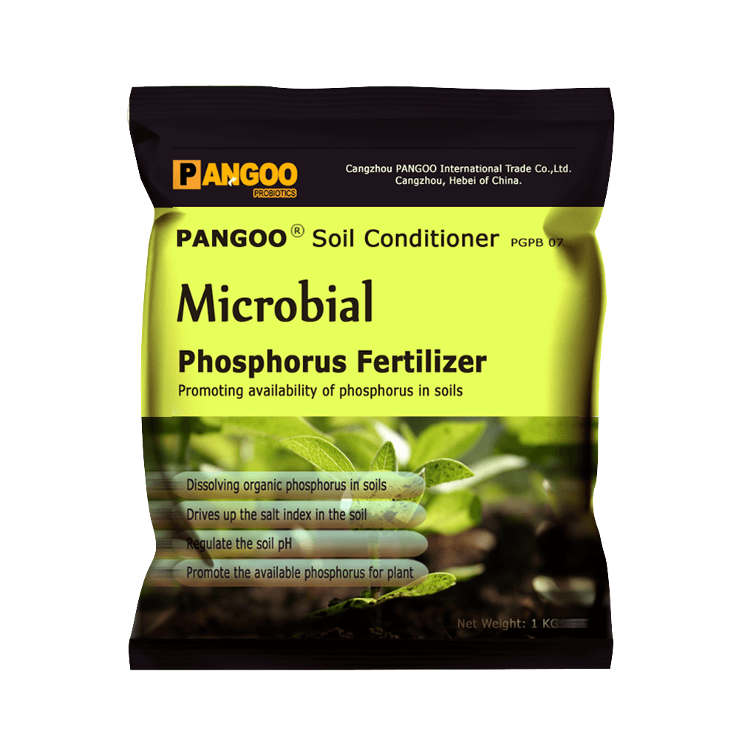


G. Diaz – Other known Benefits
+

Slide 6
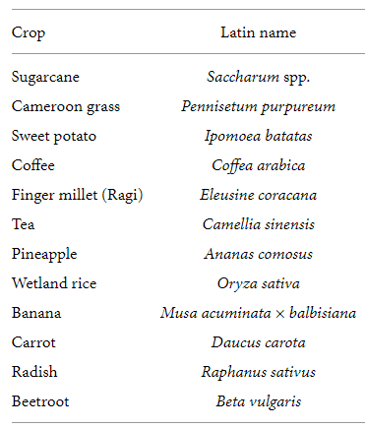
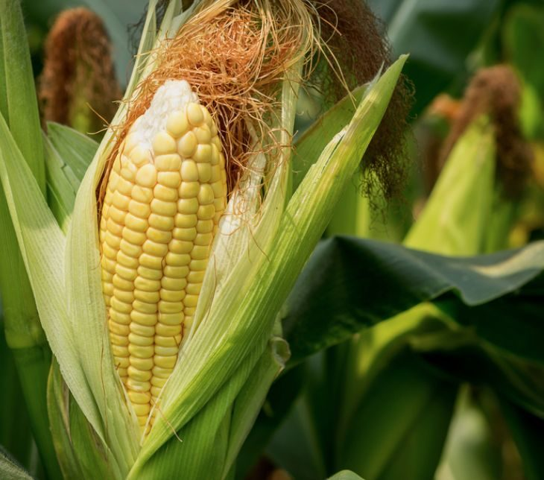
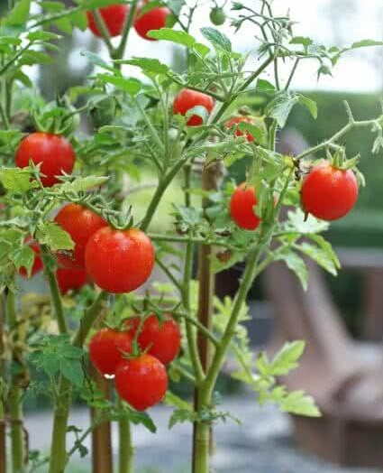
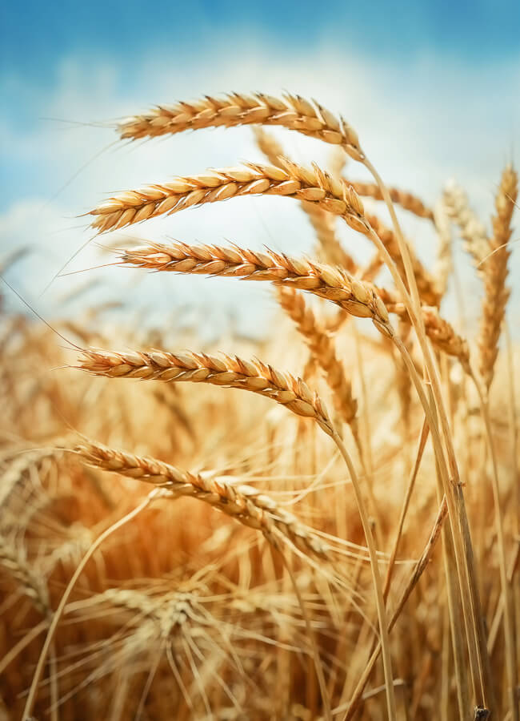

G. diaz – What can it colonize?
+

Slide 7
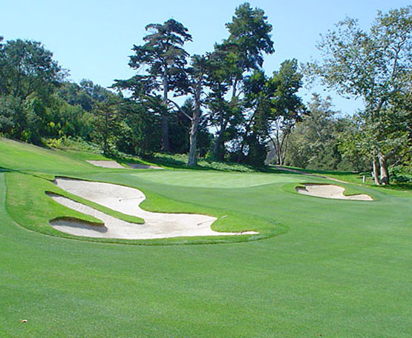


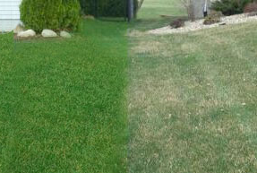
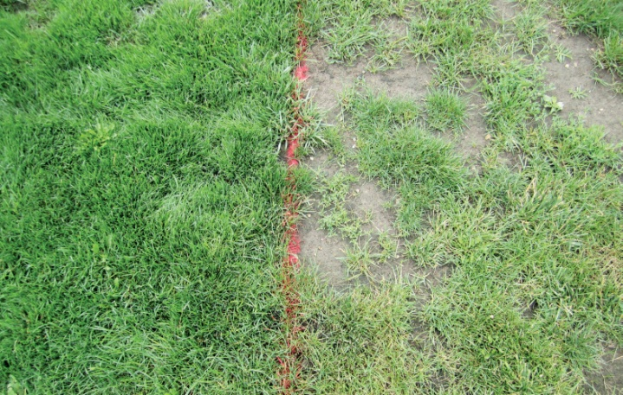
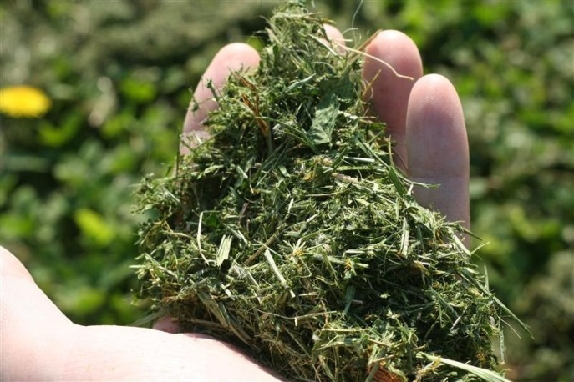
Early Research – Kentucky Bluegrass
Inoculation
Sugarcane
Amenity Turf
Nitrogen Rate Study
+
Color
Density
Biomass

Slide 8
Early Research – Bluegrass
Inoculation – Positive via seed soak
Color and Density Improved
Color
*
+
Density

Slide 9

Early Research – Bluegrass
Area of expected Impact – No effect
0-120 kg N/ha, Deficient
Color
*
+
Density

Slide 10
Early Research – Bluegrass
Excess nitrogen = Significant impact
240 kg N/ha, beyond Luxury
Color
*
+
Density

Slide 11
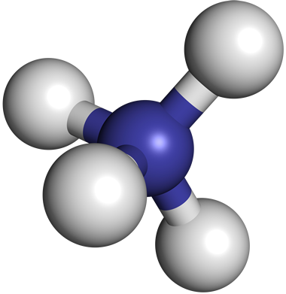

Alternative Microbial Activity?
High Nitrate levels inhibit Nitrogenase

Slide 12
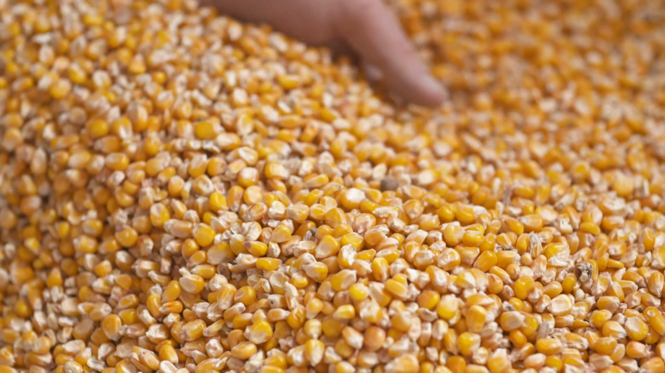
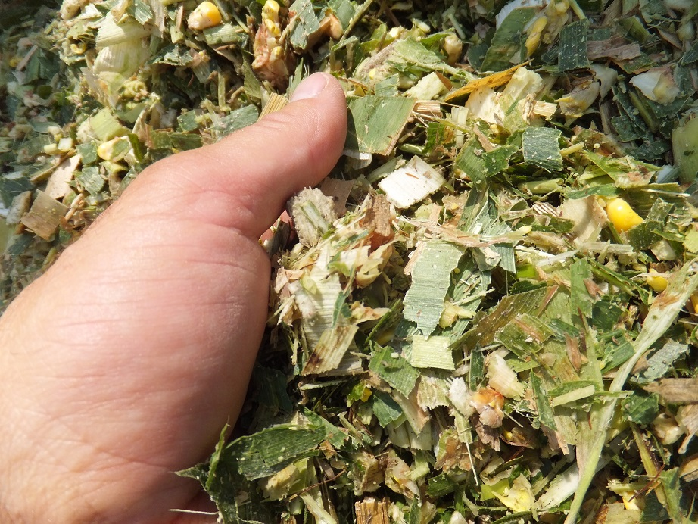
Maize 2015 – Additive benefit?
Treated versus Untreated seed
Grain: + 6 bushels/acre
Silage: No Yield Effect
Increased: Soluble, Degradable Protein;
Simple Carbohydrates; Lignin; Magnesium
Decreased: Potassium; Sulfur; Chloride;
Total Digestible Nutrients

Slide 13
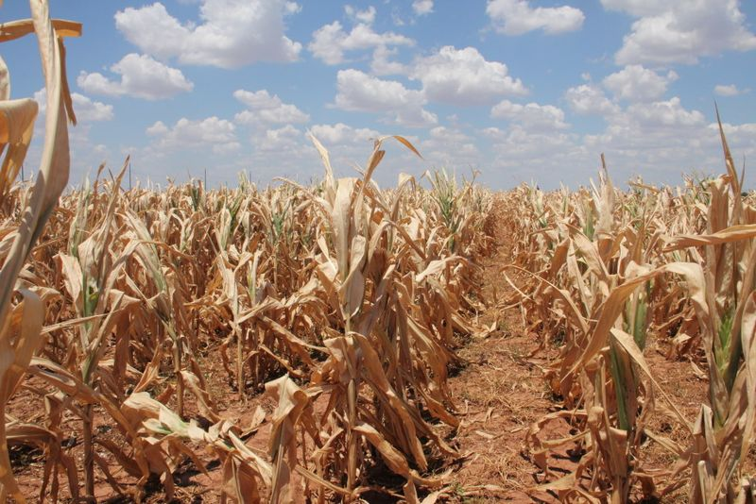
Maize 2016 – Additive + N Replacement
Two treatment levels, 6 Nitrogen levels
Grain: No Difference at any level
Silage: No significant yield or nutritive effects
Excellent silage quality overall
Inoculation tests positive – drought hardy

Slide 14
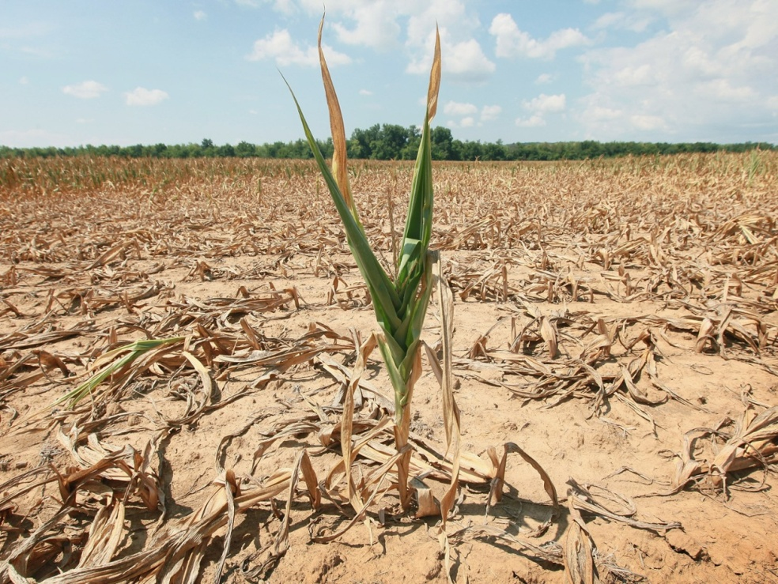
Maize 2017 – Additive + N Replacement
Two treatment levels, 6 Nitrogen levels
Grain Failed
Silage: Suggestive Yield Decrease ( p =0.08)
Increased Lysine, Methionine (amino acids);
Total Digestible Nutrition
Decreased Carbohydrates
Contrary to Previous Findings!

Slide 15
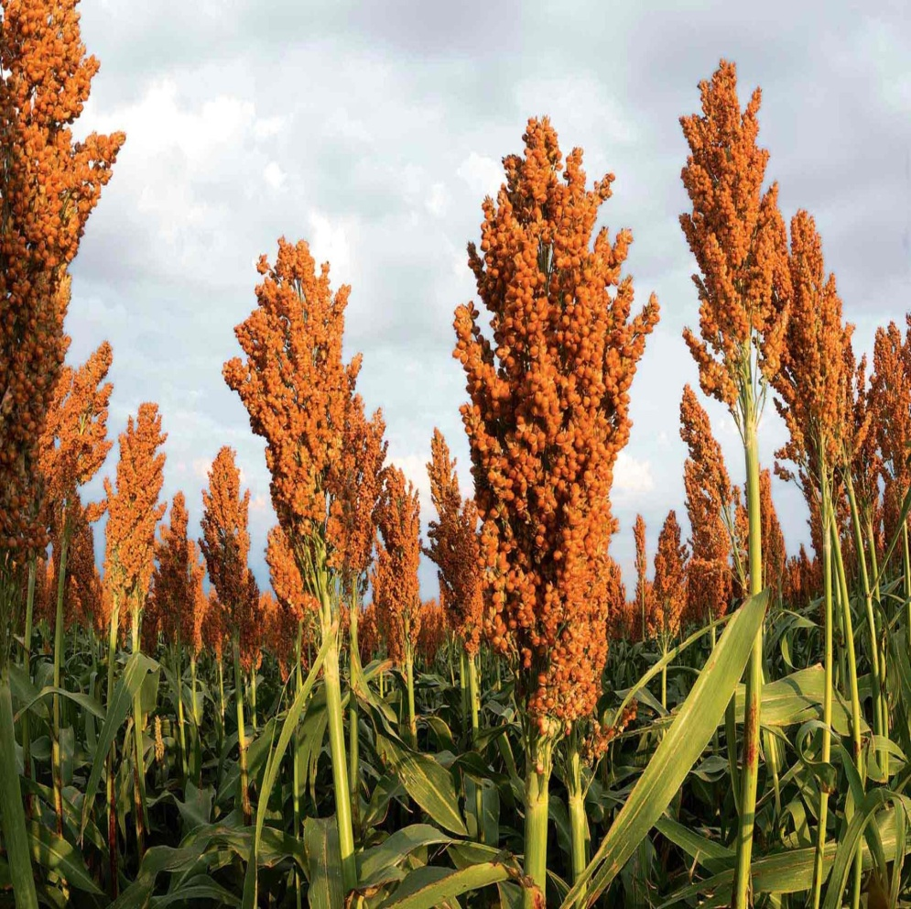
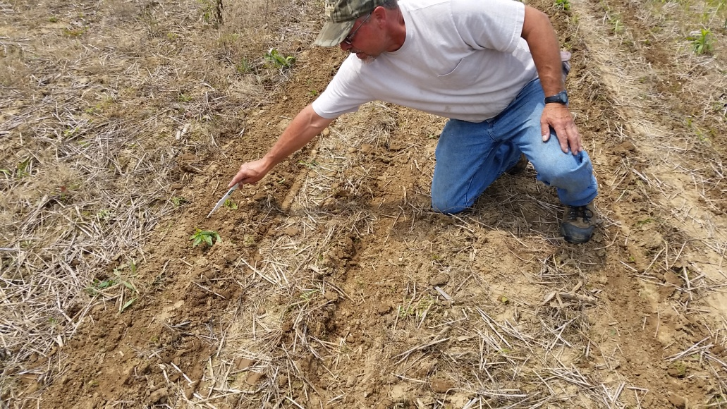
Sorghum 2018– The Last Grainy Season
Dry Weather was a concern
Proven inoculation in Sorghum from Literature
64 plots, 2 Inoculation levels, 6 nitrogen levels
Never got to the N rate trials, but not due to the torrential rains…

Slide 16
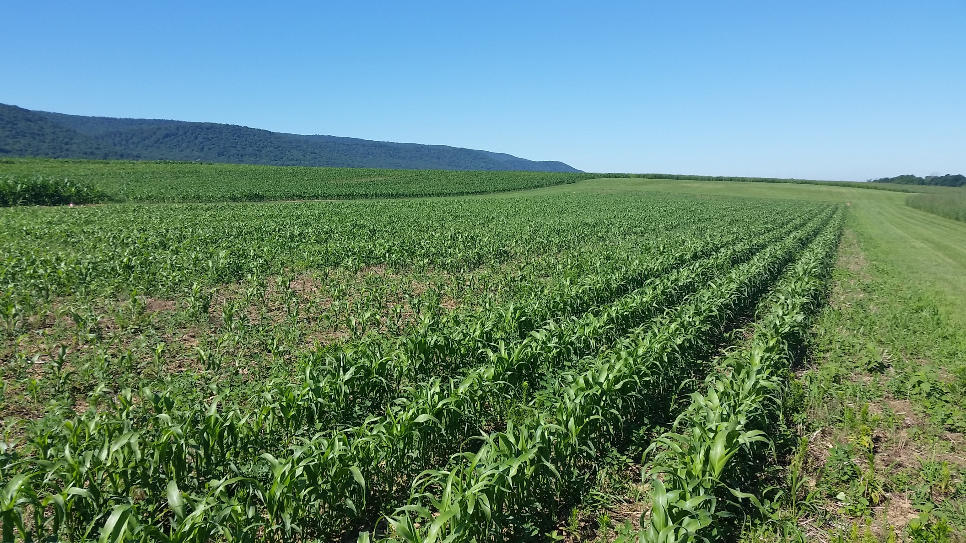
Sorghum 2018– Universal Suppression

Slide 17
Sorghum 2018– Universal Suppression
Germination suppression on treated seed 18-27%

Slide 18
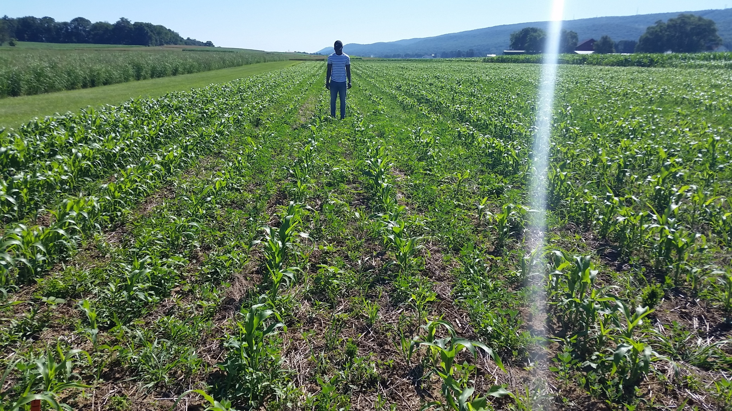
Sorghum 2018– Universal Suppression

Slide 19
Sorghum 2018– Universal Suppression
Growth delayed and/or stunted ~1 growth stage

Slide 20
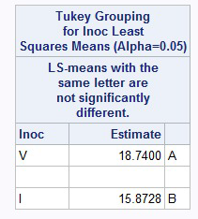
Sorghum 2018– Yield
~ 3 lbs / 40’ plot decrease
(15% loss in yield)
Tested and proven to not
be seed treatment effected
Inhibitory? Parasitic?

Slide 21

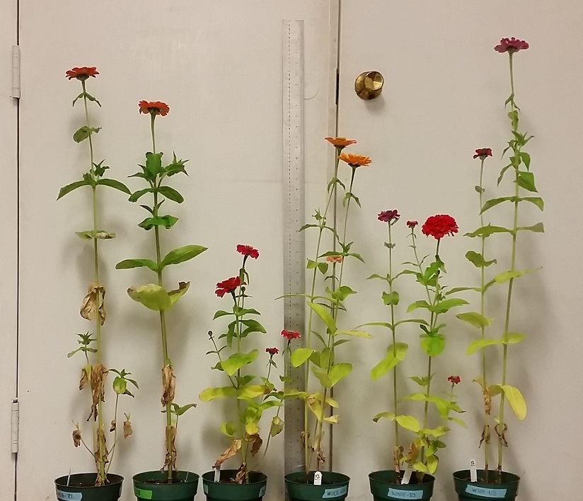
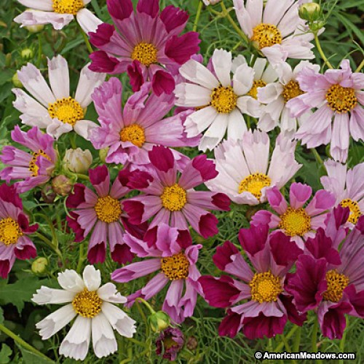
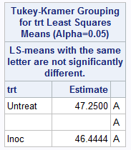
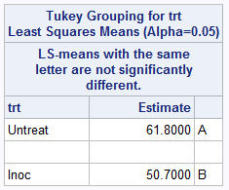
Cosmos – Dwarfism through Inoculation
Sensation
Seashell
Identical nutrients, lighting, watering
Cultivar Sensation – No effect
Cultivar Seashell – Significant stunting
Phytohormone interactions
Shortened Internodes
(mm between nodes)

Slide 22
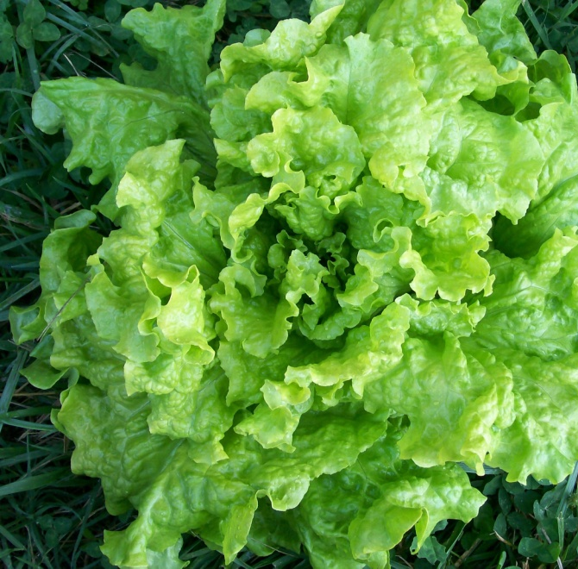
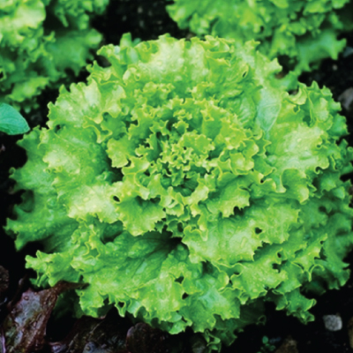
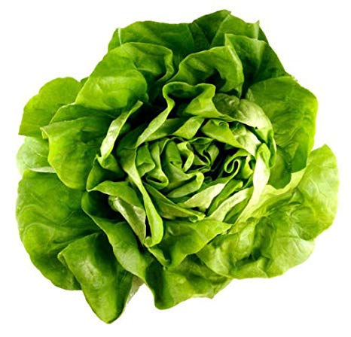
Lettuce – 3 Different Responses
Black Seeded Simpson
Green leaf
Grand Rapids TB Resist
Green leaf
Bibb (Limestone)
Green butterhead
All three grown in sealed, identical hydroponic Kratky jars
Nitrogen Rate trial, 5-7 N levels, 2 Inoculation levels, 3-4 reps
Harvest weight as Dry Matter leaf, Dry Matter root
Nitrogen Mass Balance data is pending

Slide 23
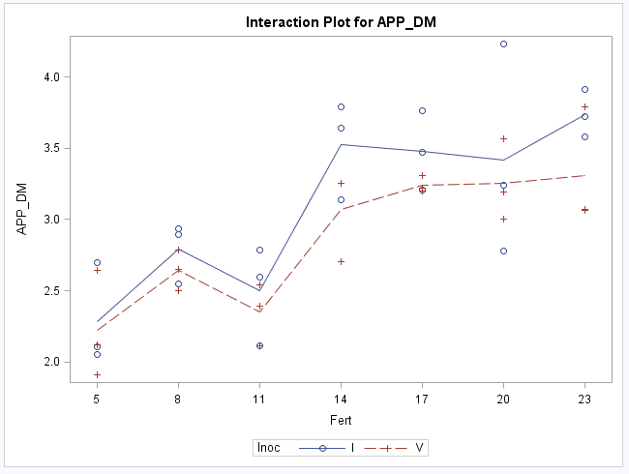
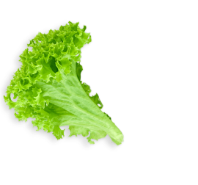
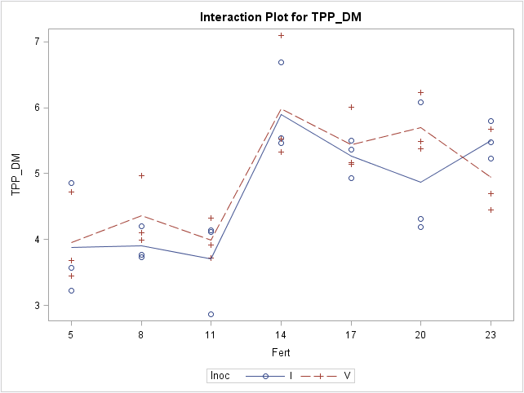
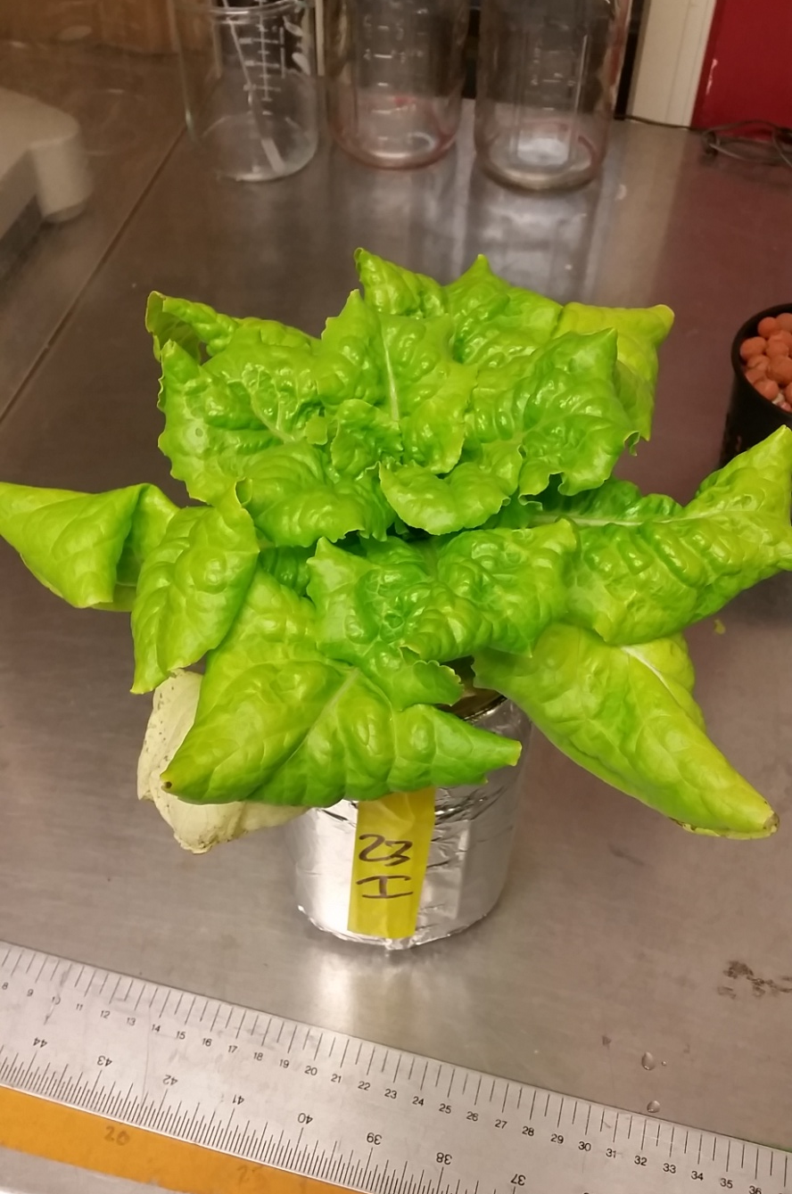
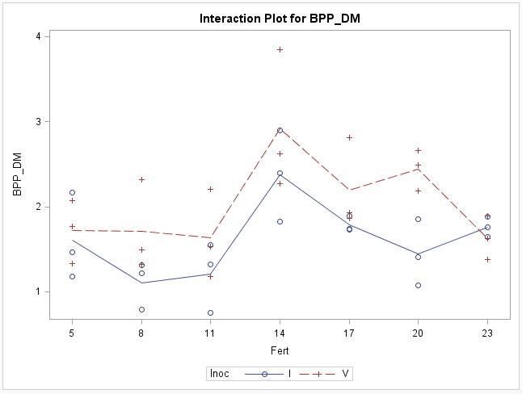

Lettuce – Black Seeded Simpson
No net change in total biomass NS

Slide 24
Lettuce – Black Seeded Simpson
Increase in leaf biomass * (+ 4.7g fresh)
No net change in total biomass NS
Decrease in Root Biomass ** (- 8.5g fresh)

Slide 25
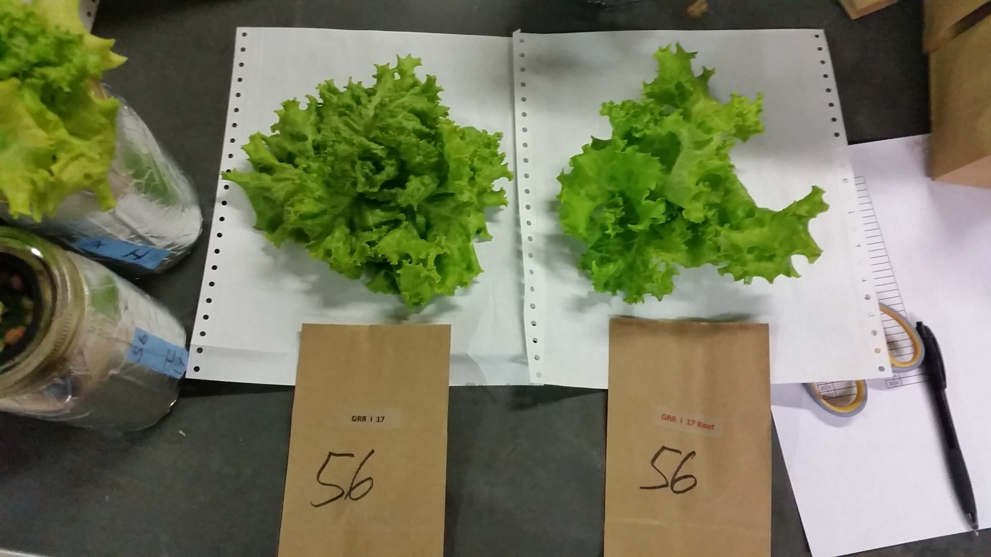
Lettuce – Grand Rapids Tipburn Resistant
Inoculated
Untreated

Slide 26
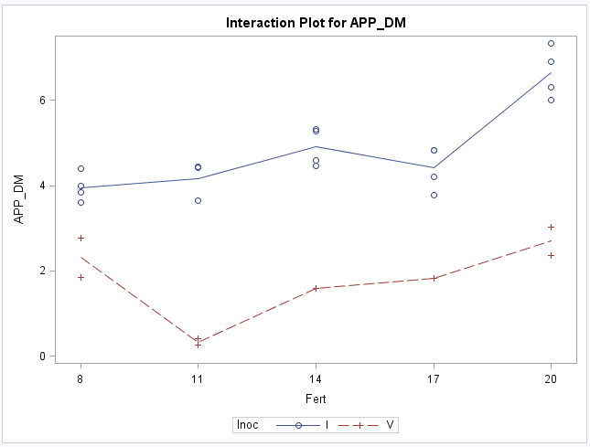
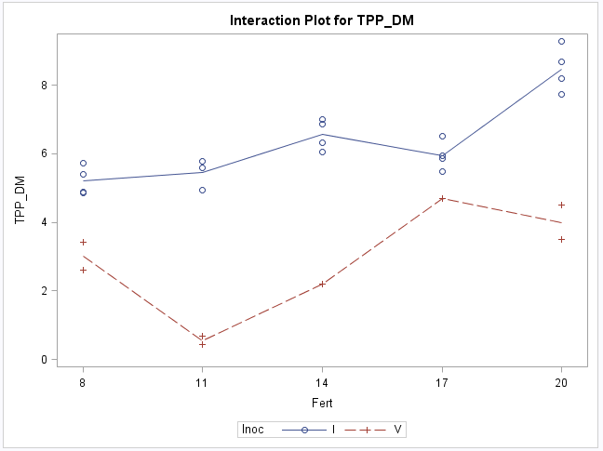
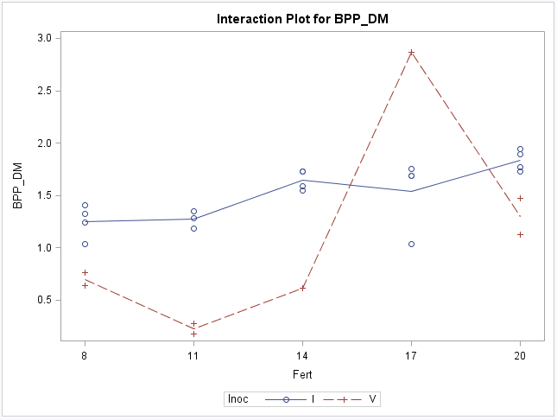
Lettuce – Grand Rapids Tipburn Resistant
Increase in leaf biomass ** (+ 61g fresh)
Increase in total biomass ** ( + 68.6g)
Increase in Root Biomass ** (+ 7.5g fresh)

Slide 27
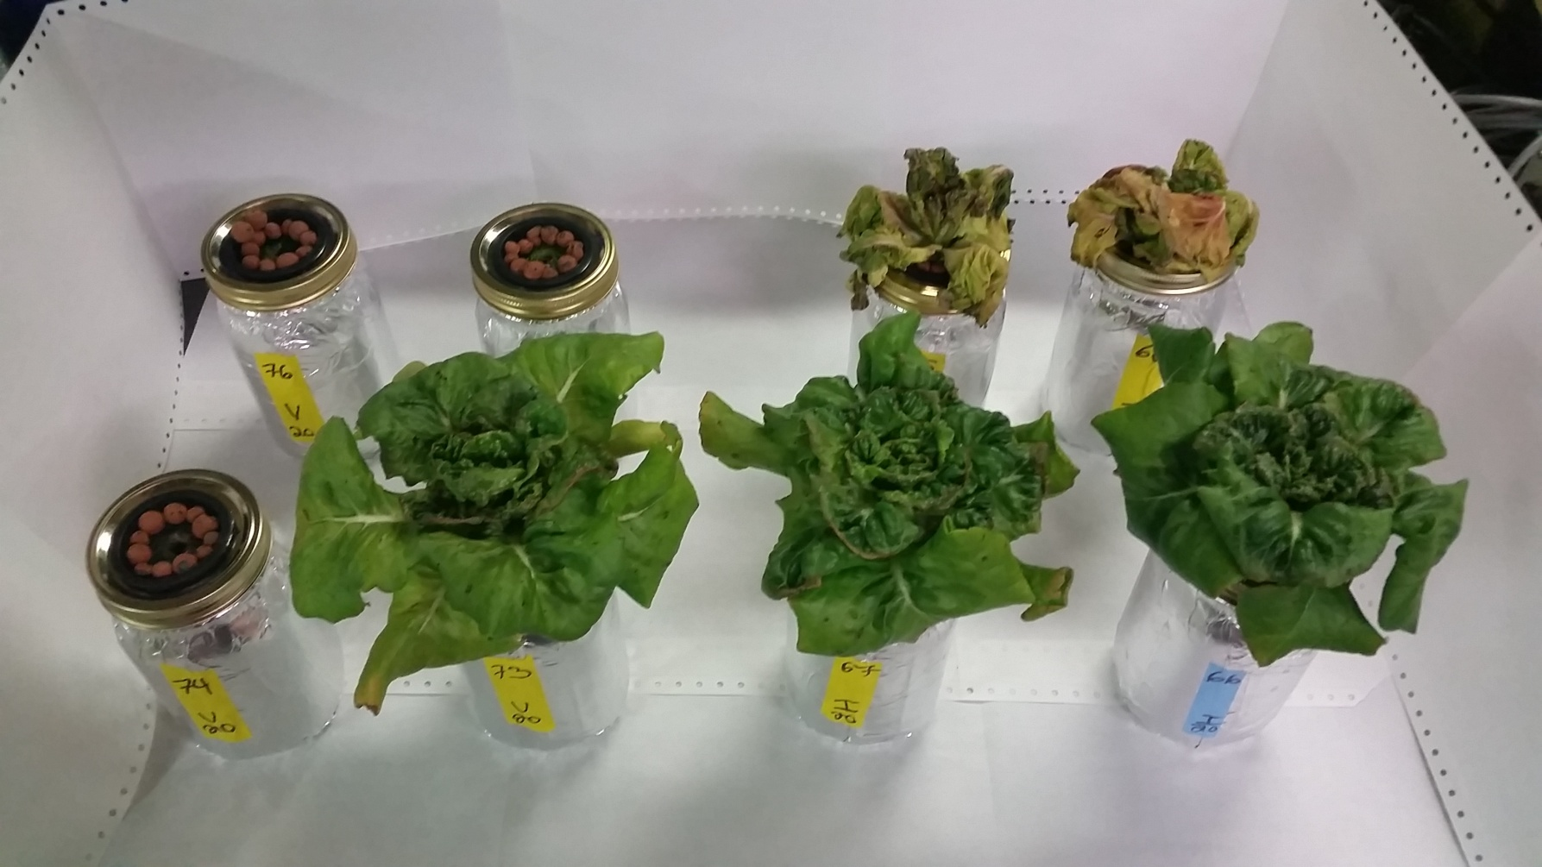

Lettuce – Bibb (Limestone)
Turns out lettuce doesn’t care about politics
20/20 Inoculated plants survived post transplant
7/20 Untreated plants survived
Drought stress tolerance
in seedlings

Slide 28
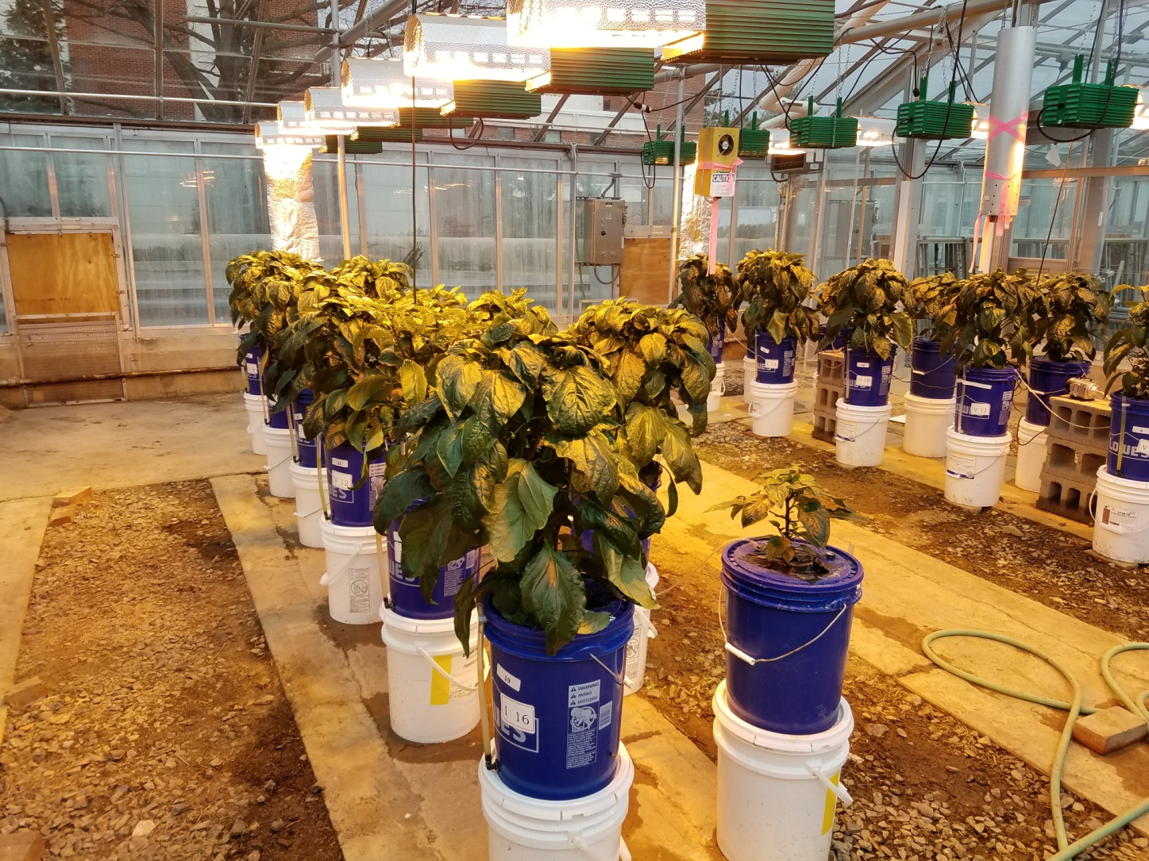

Pepper – Preliminary Results
Nitrogen rate trial
6 levels N
2 Levels Inoculation
4 Reps
Examining:
Crop quantity
Crop quality
Nutritive differences in
secondary metabolites
Sweet pepper
“California Wonder”

Slide 29
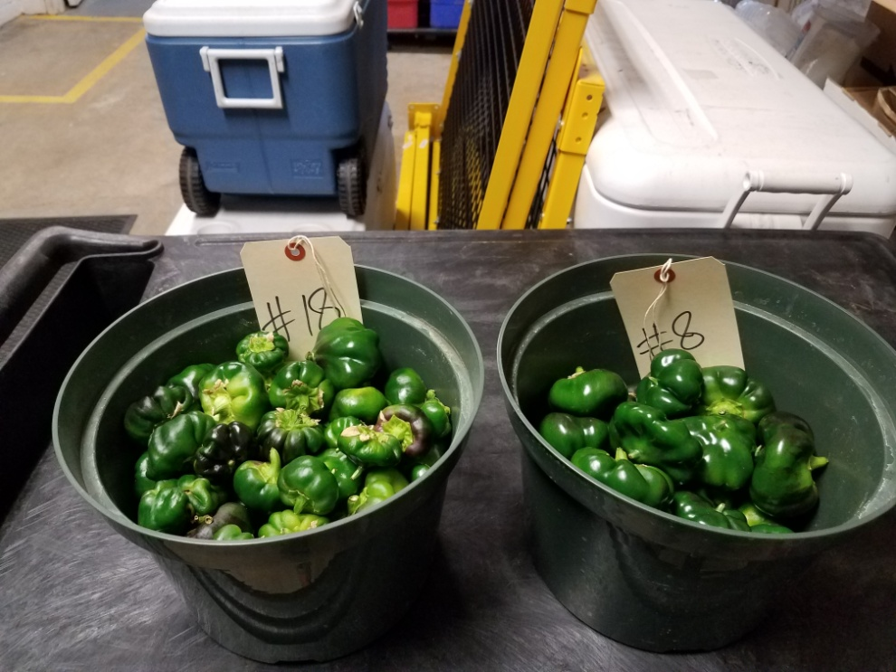
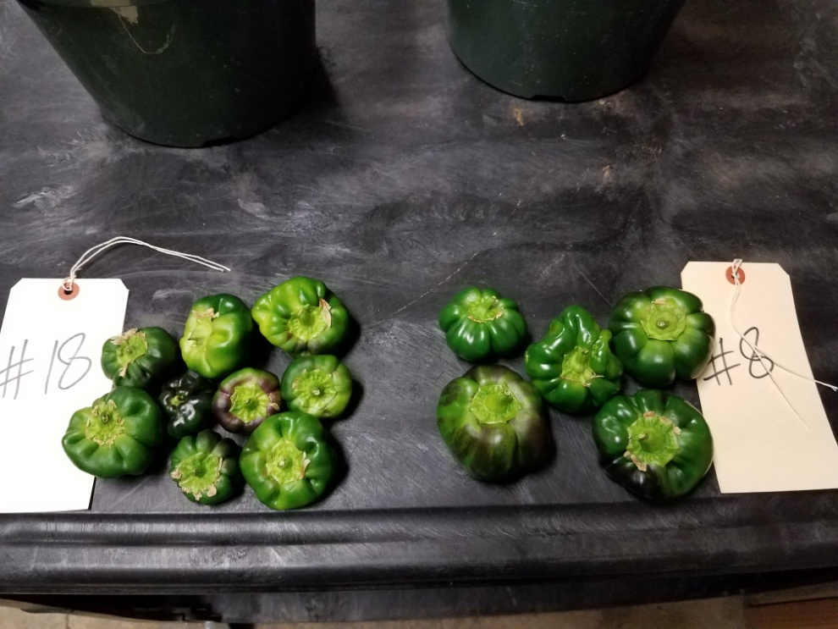
Pepper – Preliminary Results
#18 Inoculated
#8 Untreated
Inoculated producing ~ 7.9 more peppers per plant
Inoculated peppers are smaller than Untreated by ~ 9 grams
Inoculated plants have more ‘aberrant’ shapes
Overall – Inoculated biomass is ~11% greater than Untreated
N effect? Phytohormones? Next Seminar for the full story.

Slide 30
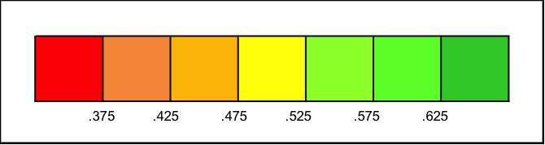
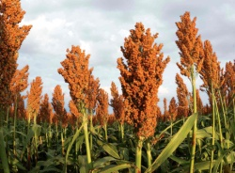



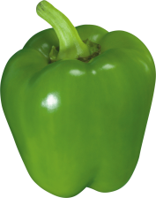
Bacterial Symbiosis is Hit or Miss
Detrimental Beneficial
Sorghum – Phytohormones?, parasitism?
Maize – Environmental factors, final product and usage
Lettuce – Nitrogen fixation, phytohormones, drought tolerance
Phytohormones, but are dwarf plants important?
Are smaller, more numerous peppers marketable?
Will nutritive differences emerge?

Slide 31










A lot of questions to be answered
Thank You!!

