Slide 1
Comparison of Annual Forages for Grazing Lambs on Previously-Cropped Ground
Michael Seipel, SARE Grant Number FNC 13-931
NCR-SARE’s Farmers Forum, 2016

Slide 2
Background
Hickory Hollow Farm – Callao, MO, 230 ac.

Slide 3
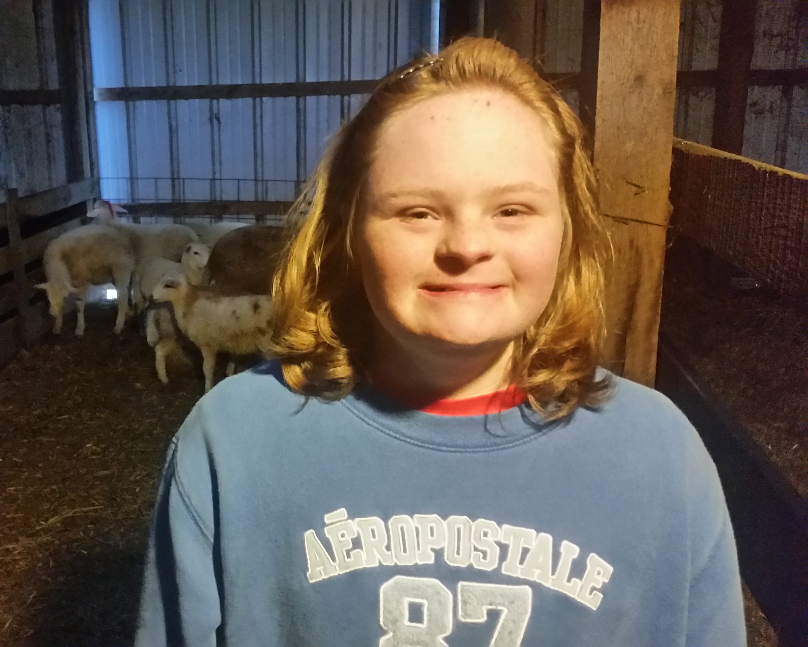
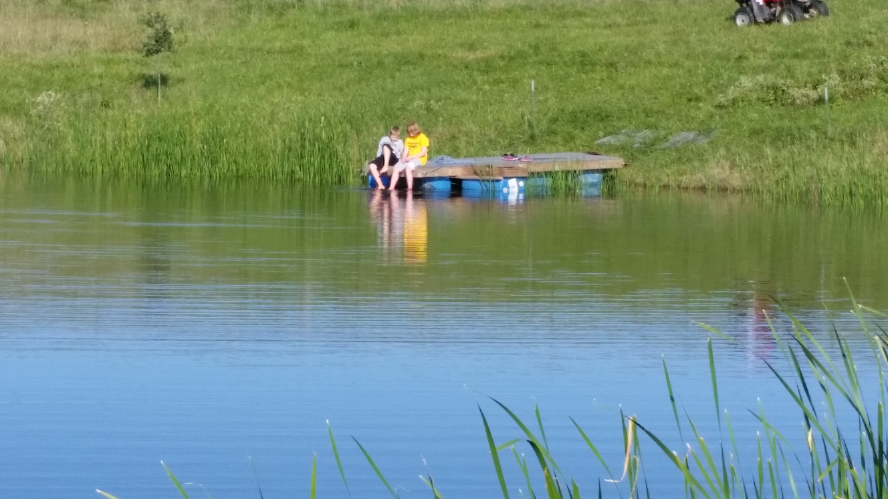
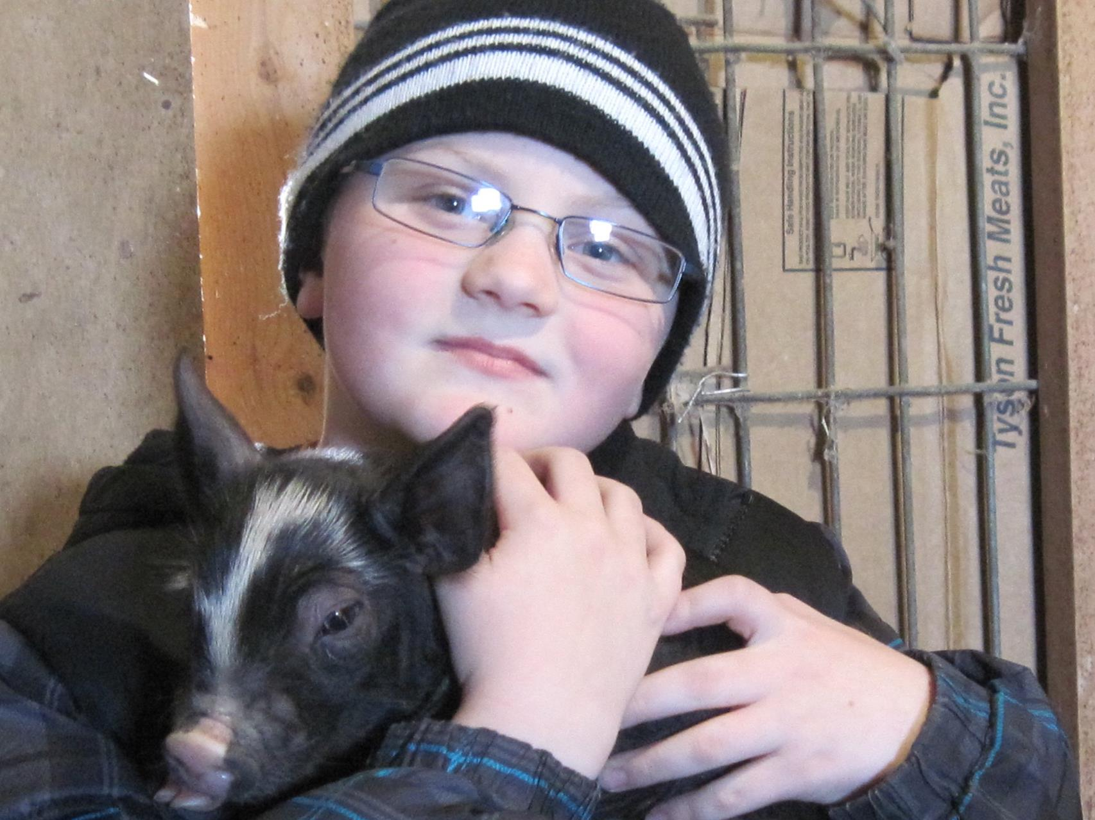
Background
Michael, Cherie’, Abby, Rebekah, Gregory

Slide 4
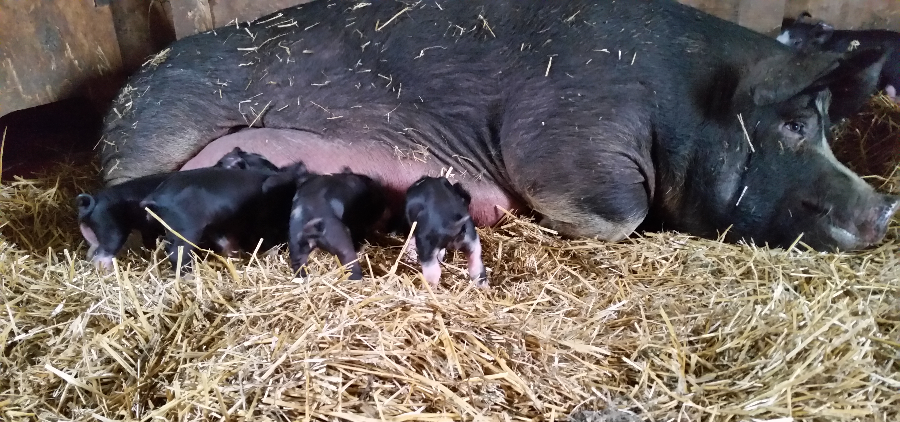
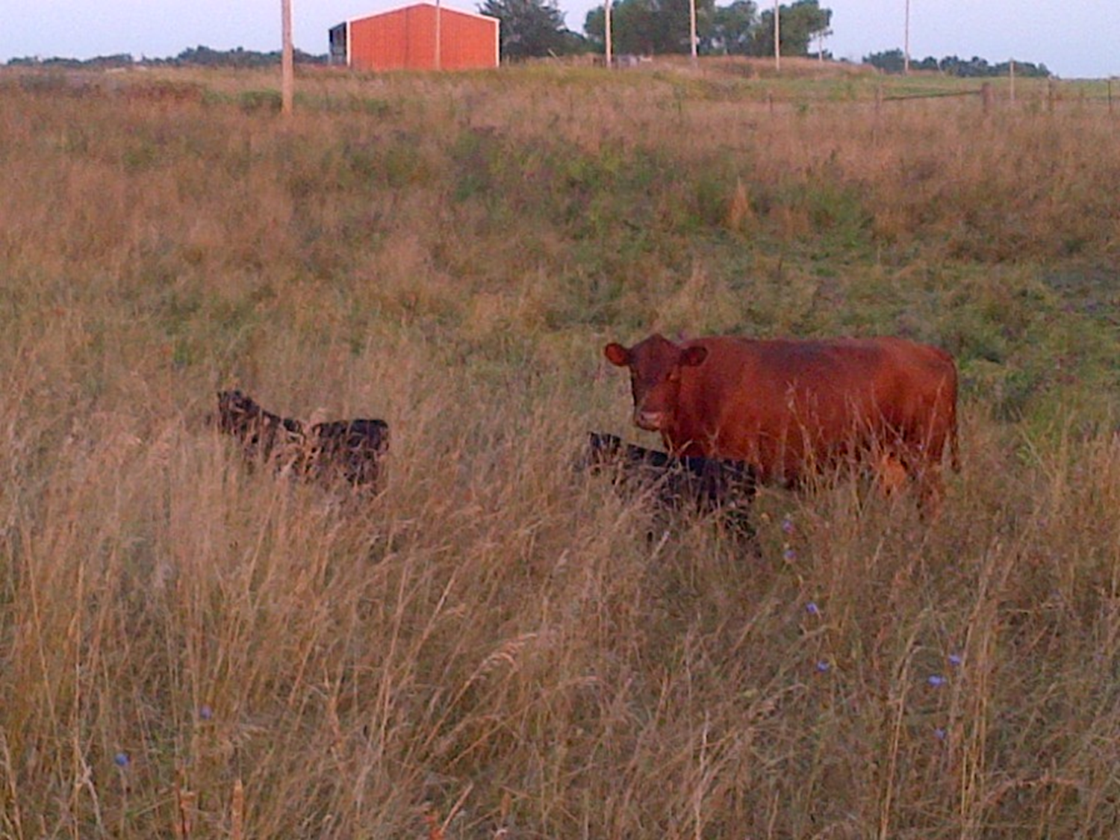
Background
Raised on a dairy farm near Maryville, MO
Have raised sheep since 1996; on present farm since 1998
Have had commercial cow/calf; Berkshire hogs (4-H)

Slide 5
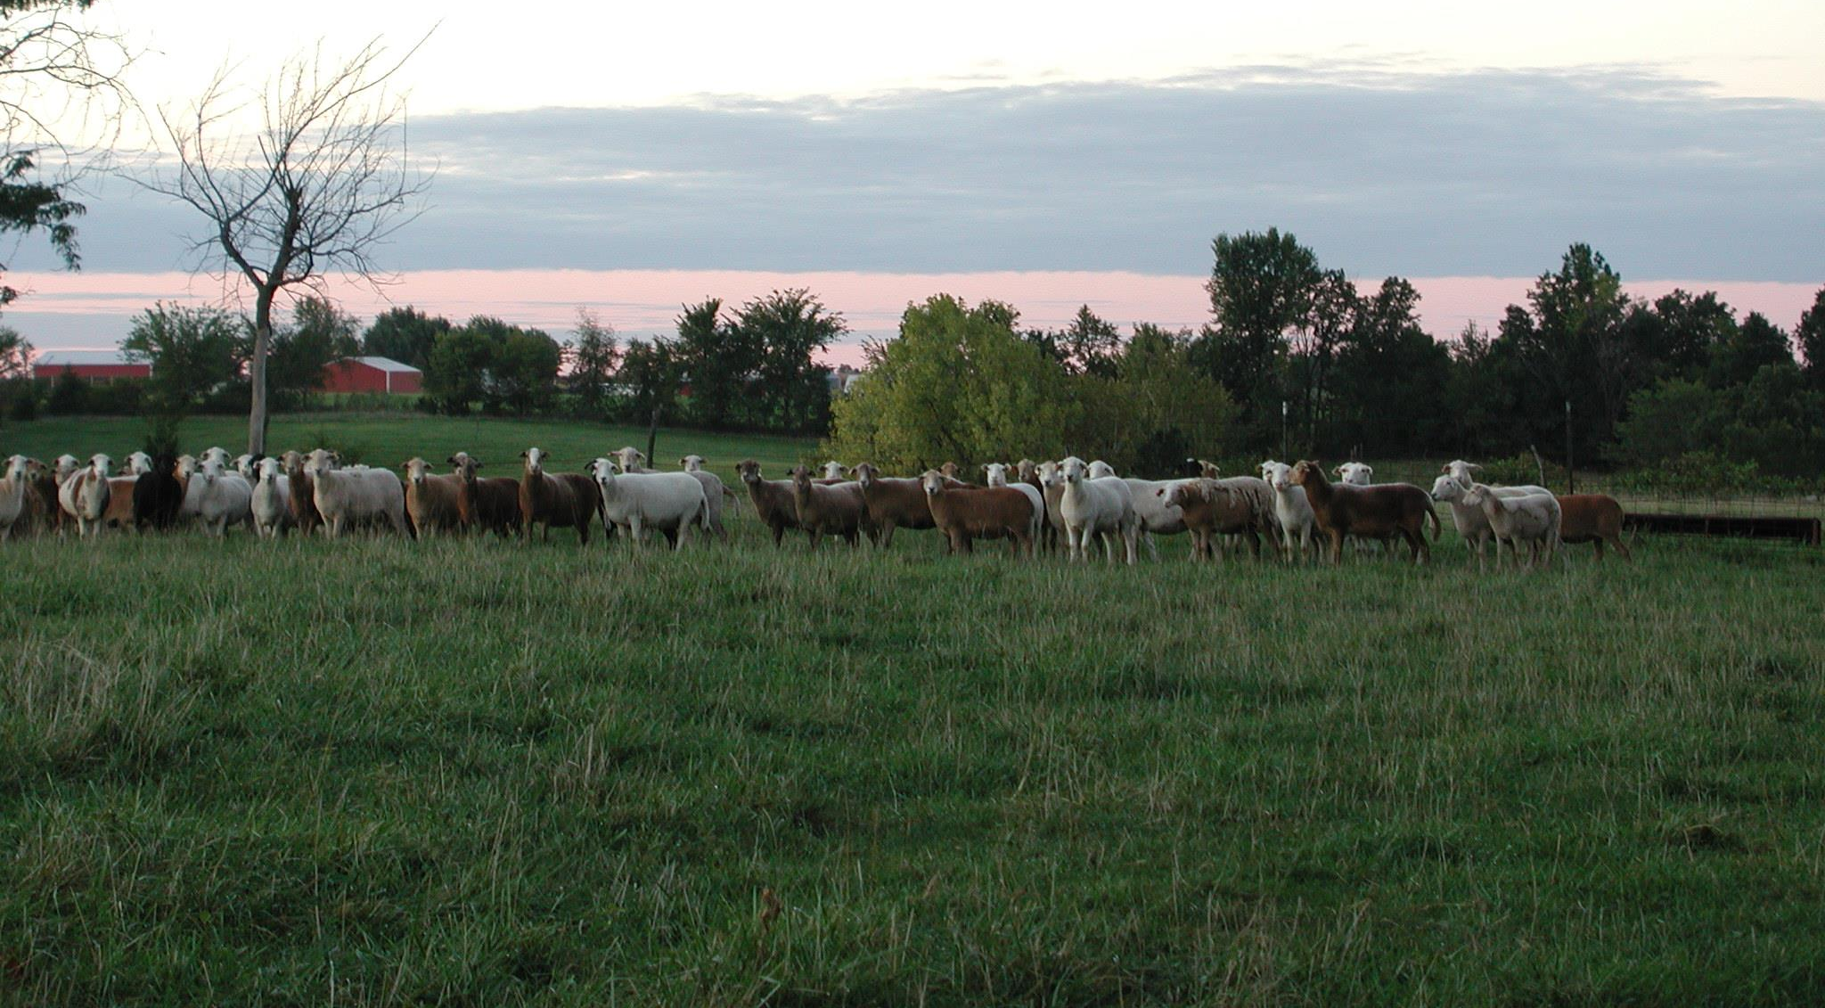
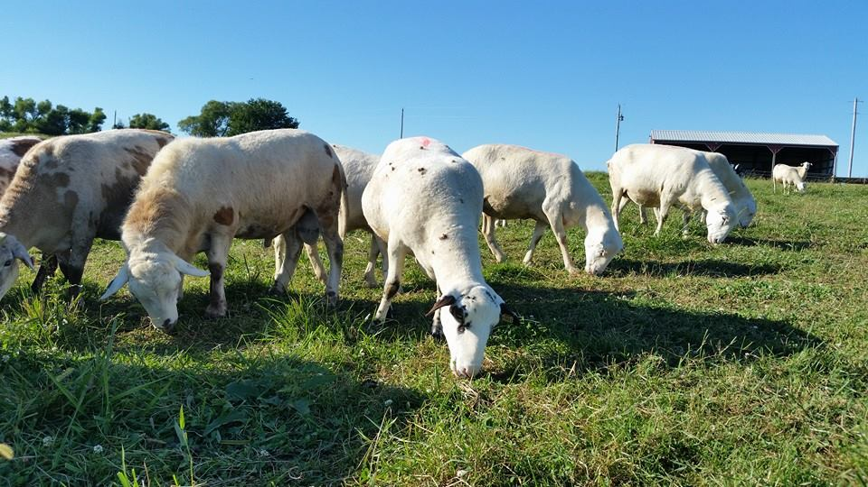
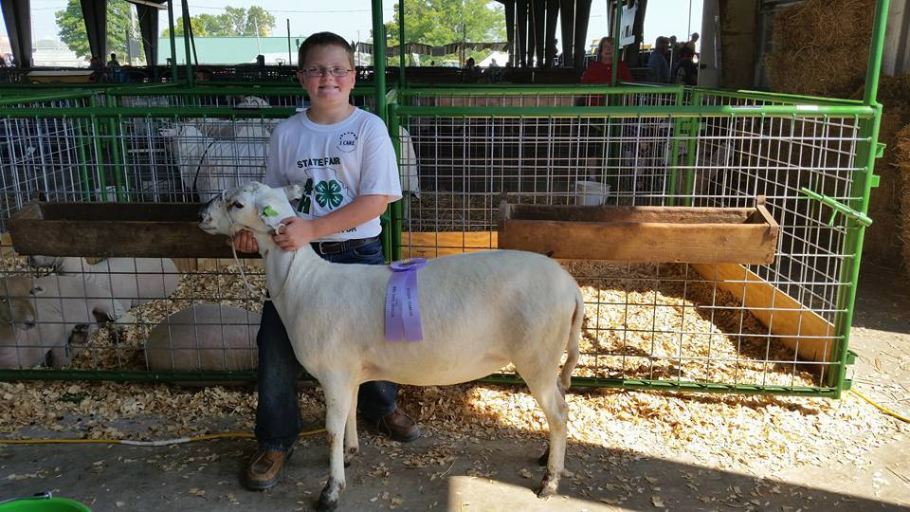
Background
Katahdin hair sheep (50 to 100 ewes)
Lamb January to March
Lambs may be sold as feeders (auction or direct to a grass-finisher) or finished for direct-marketing (combination of forage and concentrate feed)

Slide 6
Overview
Philosophy of forage utilization
Motivating opportunity
Two questions:
What forages can support nutritional needs of rapidly-growing lambs, esp. in “summer slump”?
Can economic returns from grazing livestock be sufficient to keep marginal, highly-erodible cropland in sod-forming forage crops?

Slide 7
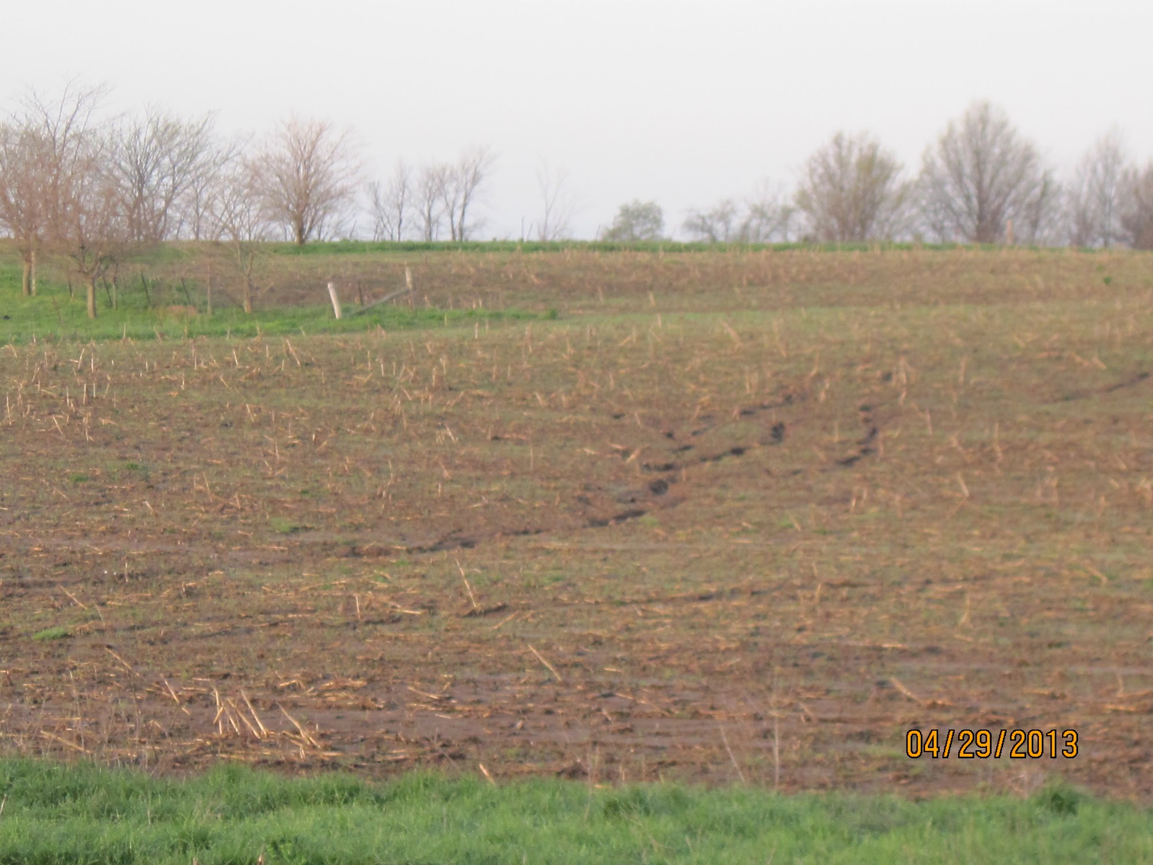
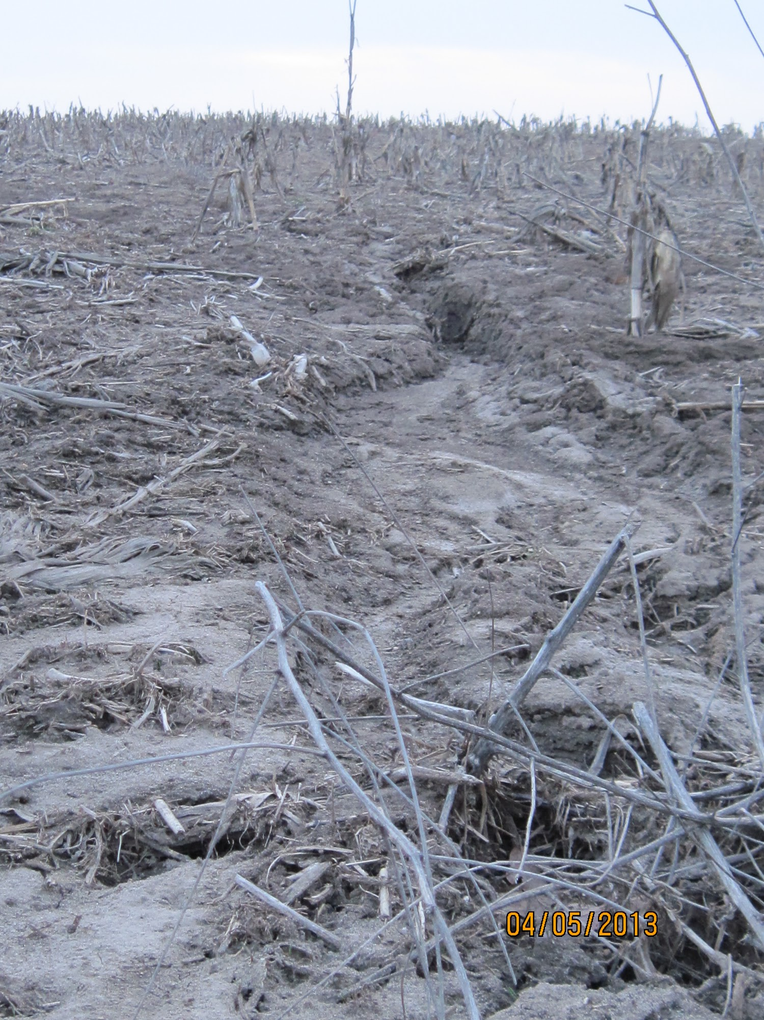
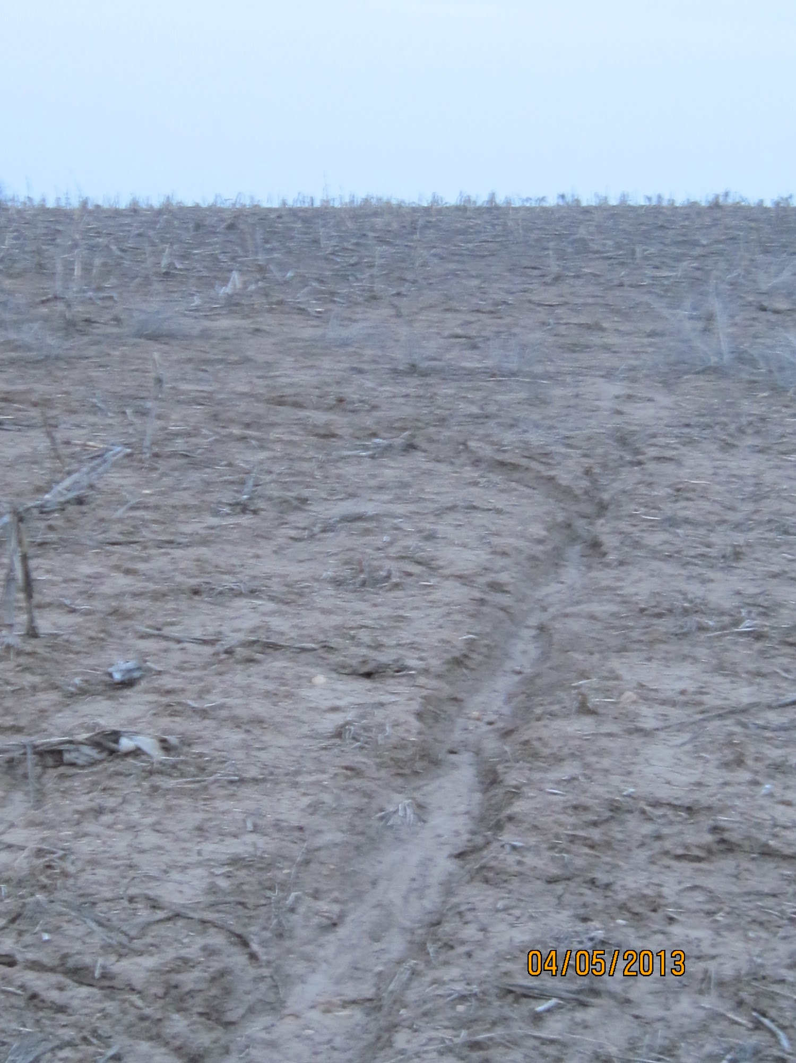
Overview
Our area is dominated by HEL, heavily weathered glacial till
High crop prices have furthered pastureland conversion and increased rental rates (corn acres + 36%, soy acres +3% in Macon Co., 2000 to 2010)

Slide 8
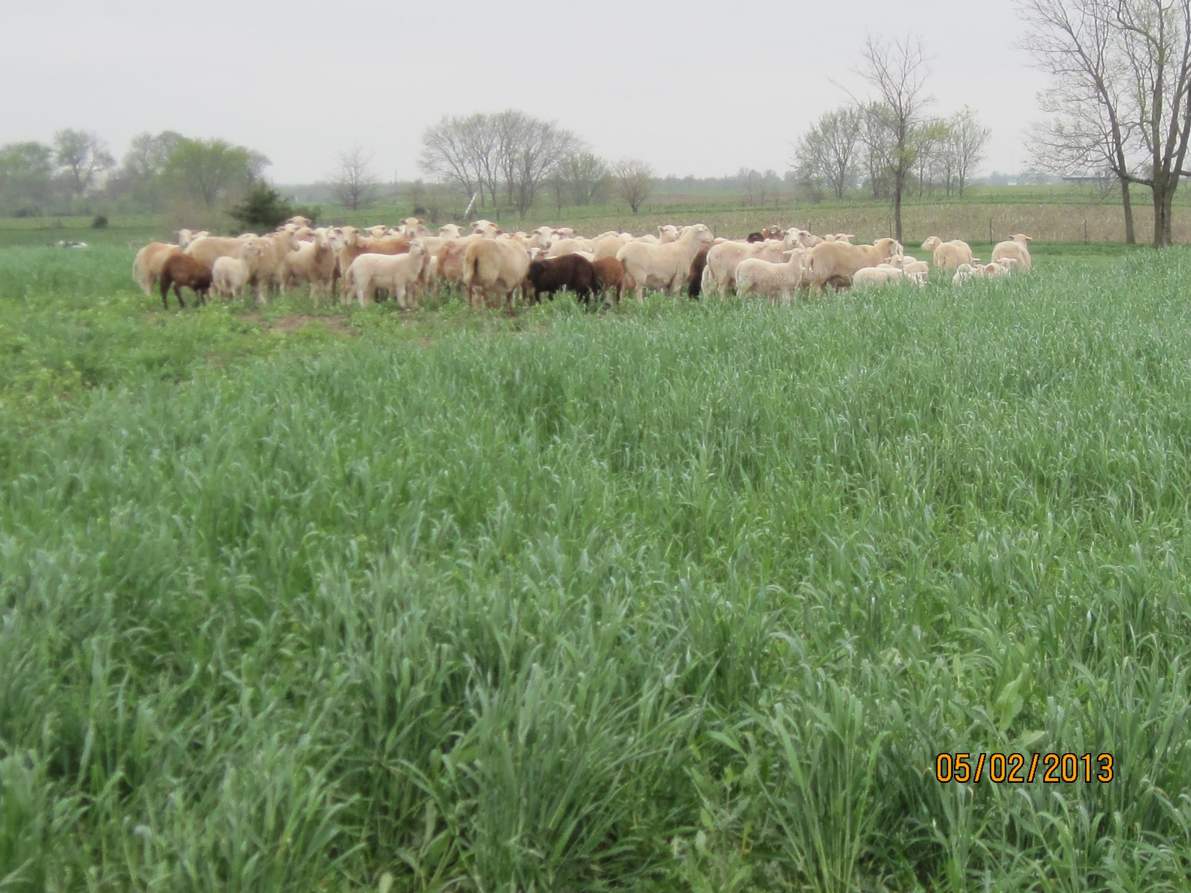
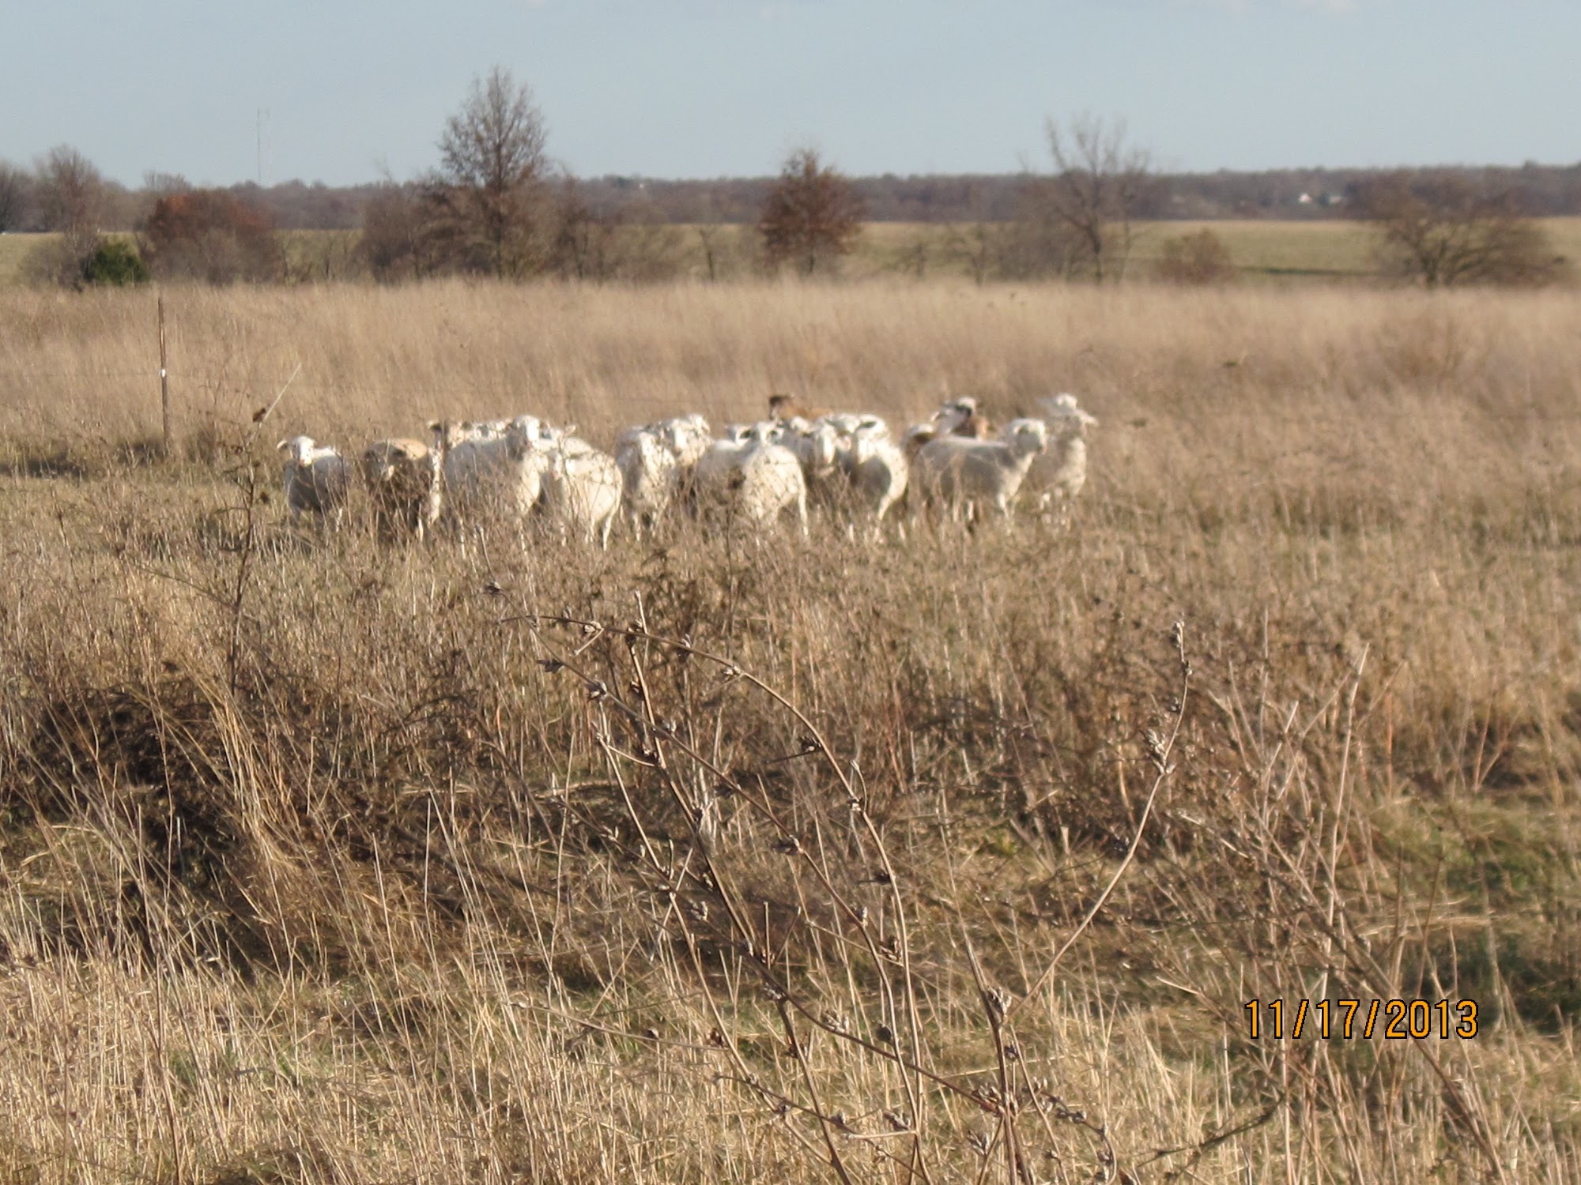
Overview
- unique challenges of raising lambs on forage
Notes:
Rainfall, timing of forage growth; grazing patterns; parasitism; avoid tall; predation; fencing

Slide 9
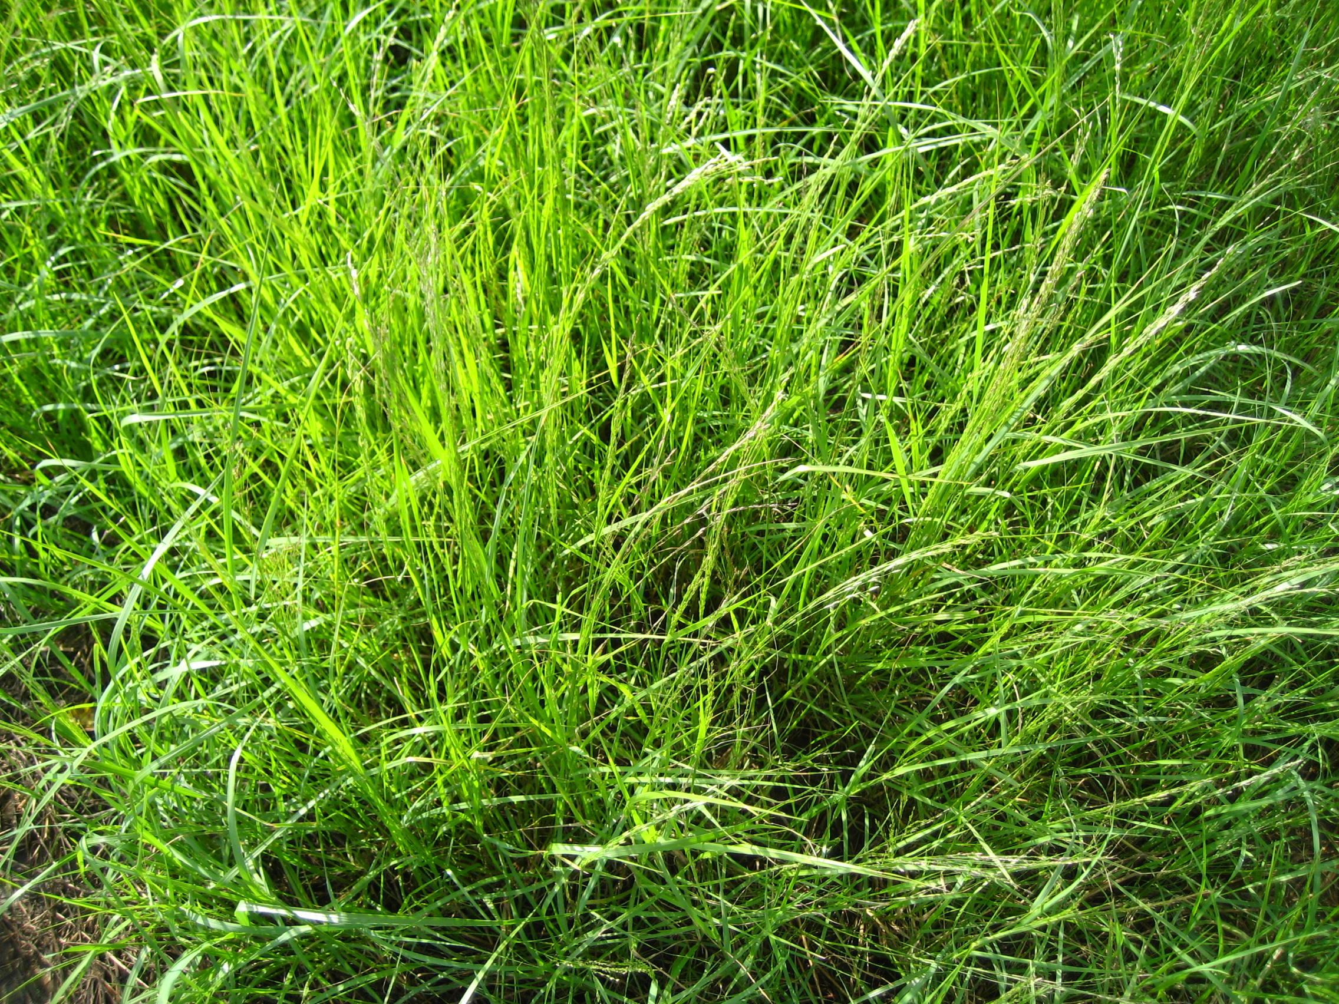
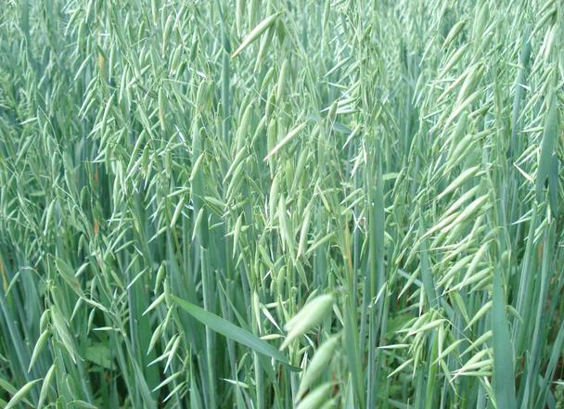
Overview
Planned to compare multiple annual forages; due to weather challenges, focused primarily on oats and to a limited extent on teff grass
At the conclusion, will share some experiences with other annual forages
Teff Grass
Oats (small grain)
C4, warm season, annual grass
can be planted through June
quality comparable to Timothy hay
Grown in Ethiopia for grain

Slide 10
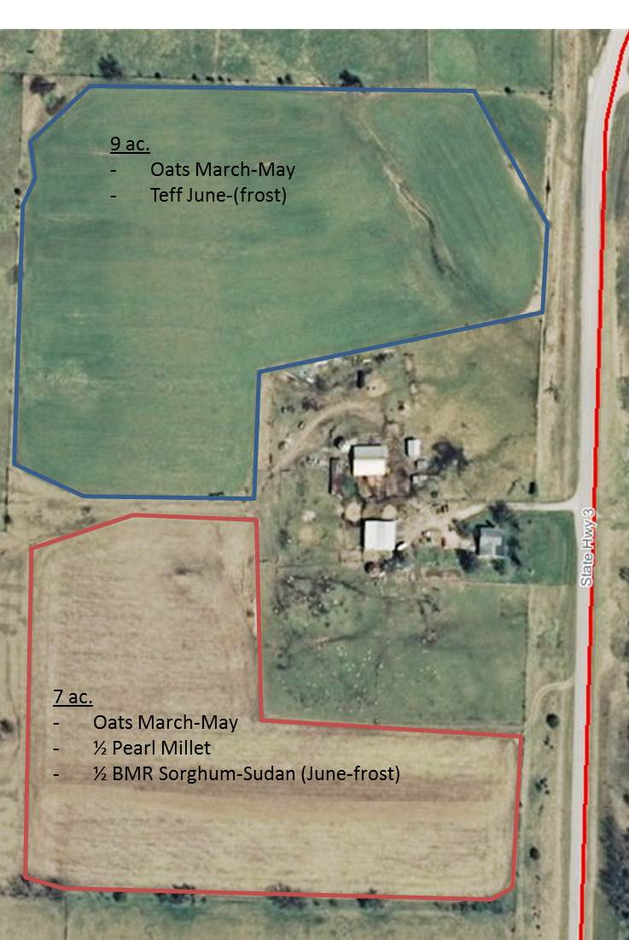
Overview
lease not obtained until December 2012
plan was to plant oats as early as feasible
then follow oats w/ alternate warm-season annuals

Slide 11
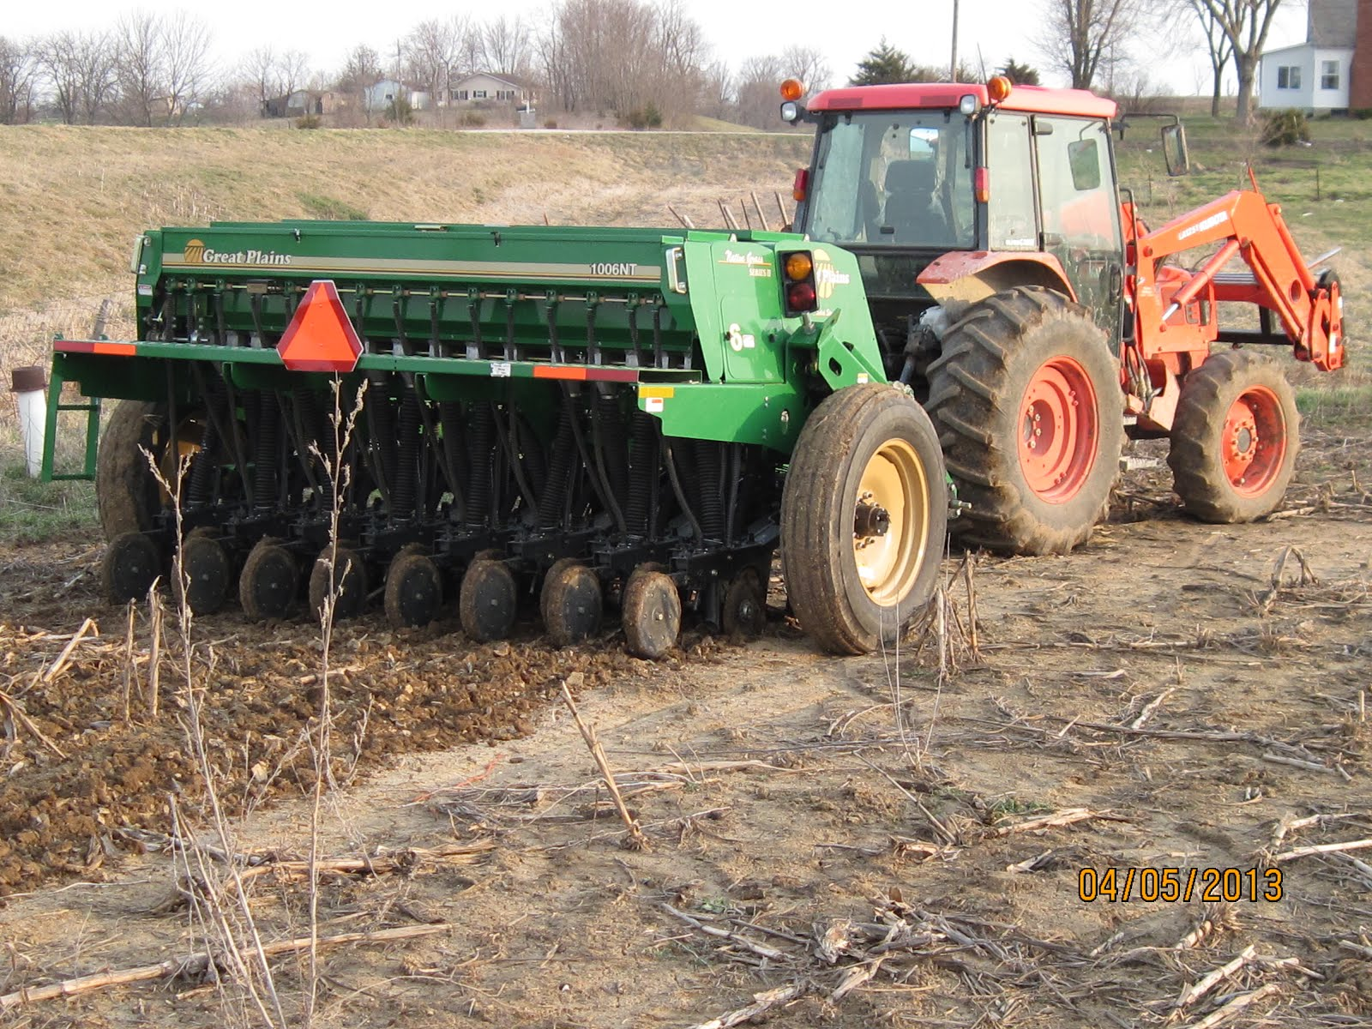
Timeline
Oats planted Apr. 5 with no-till drill

Slide 12
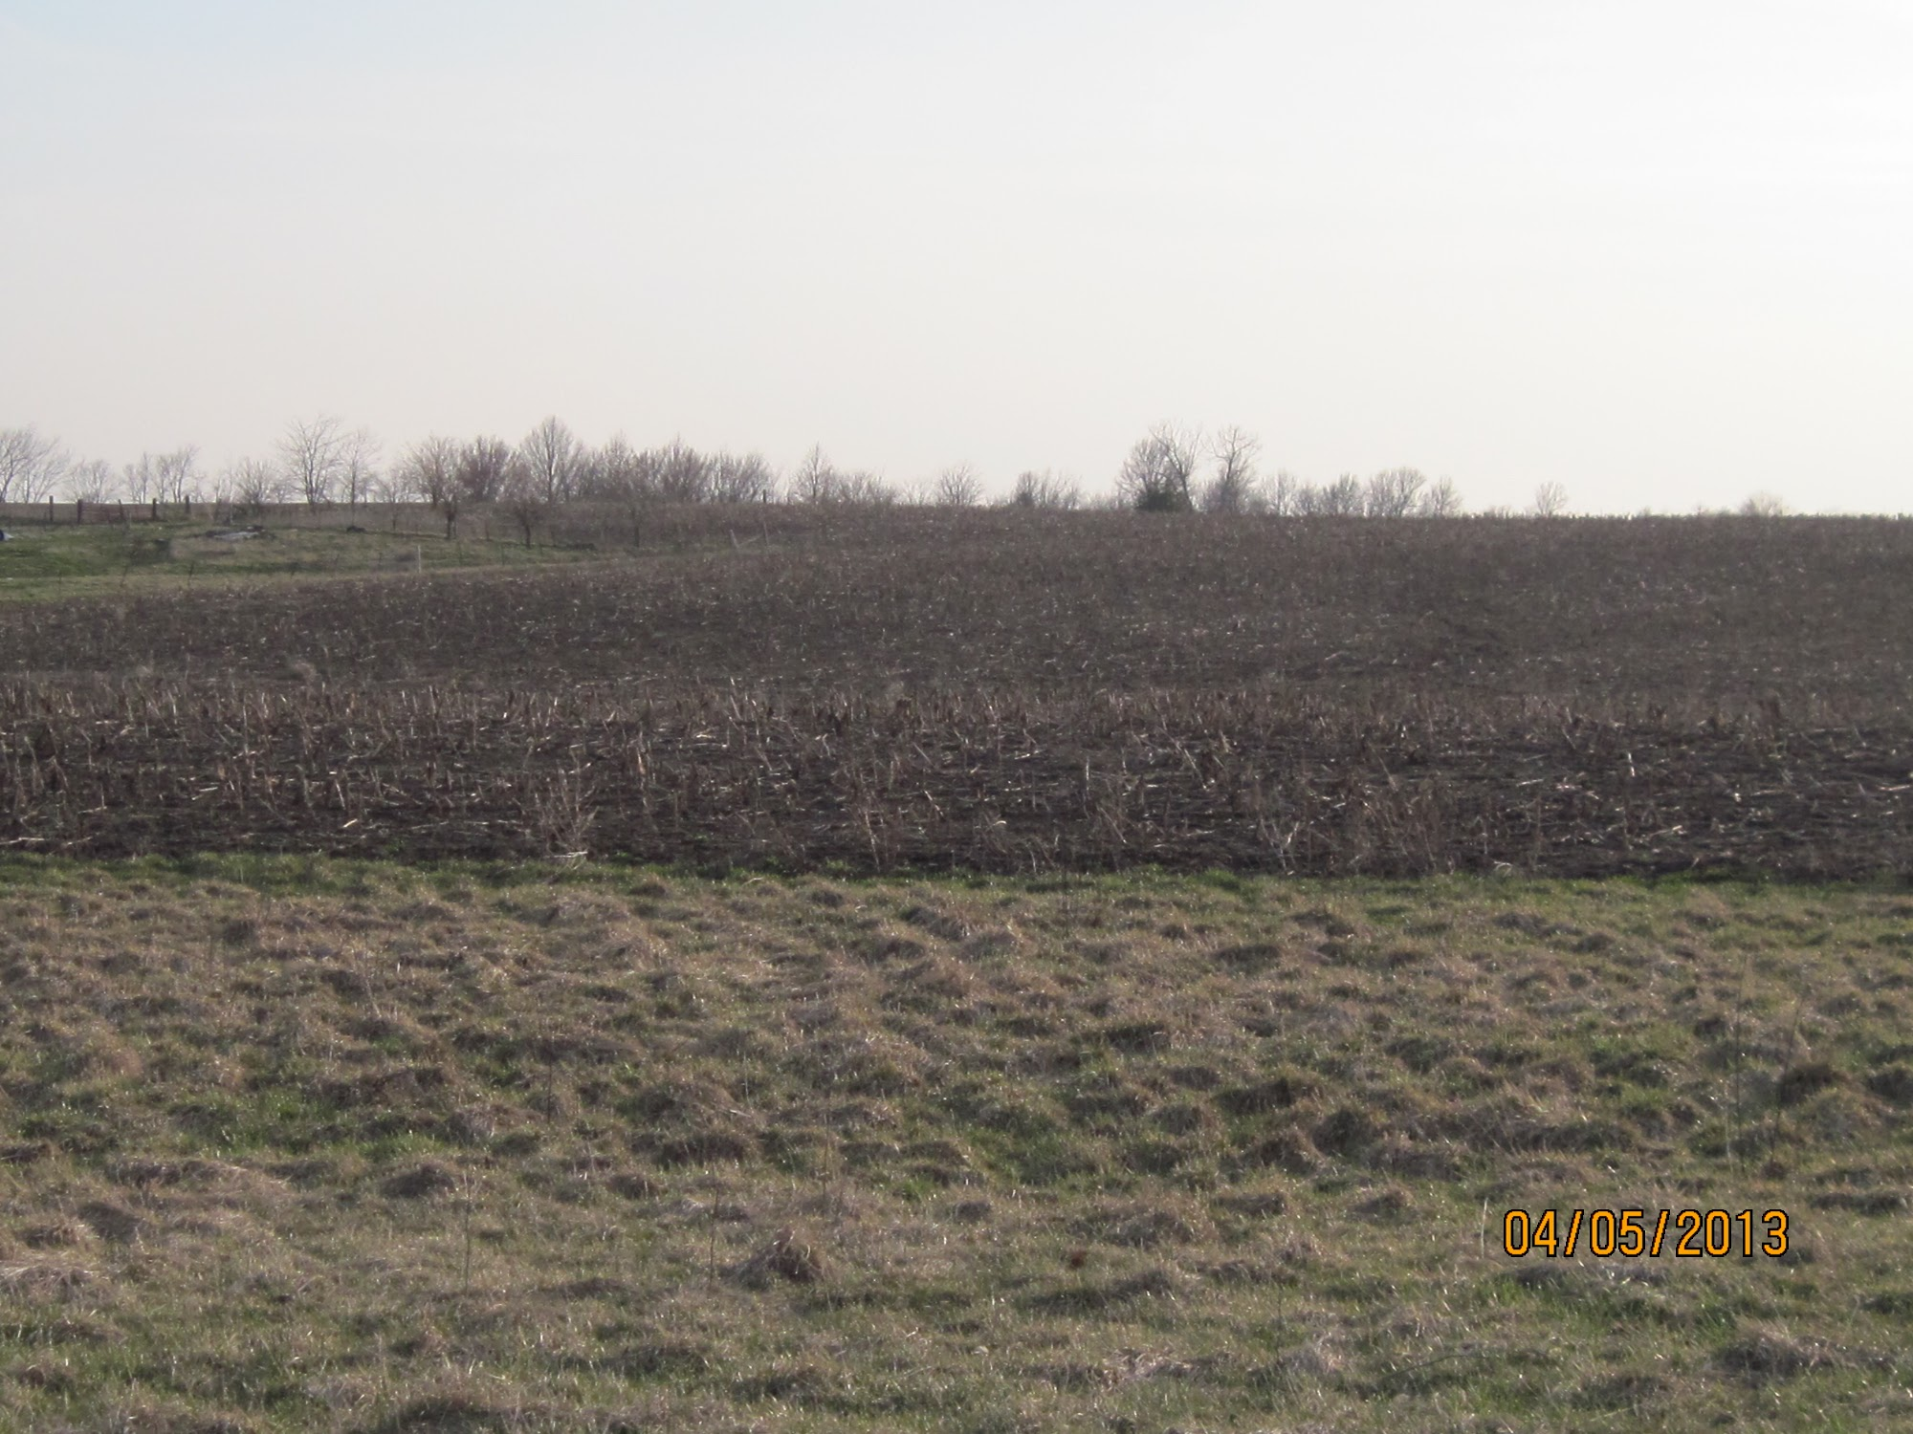

Slide 13
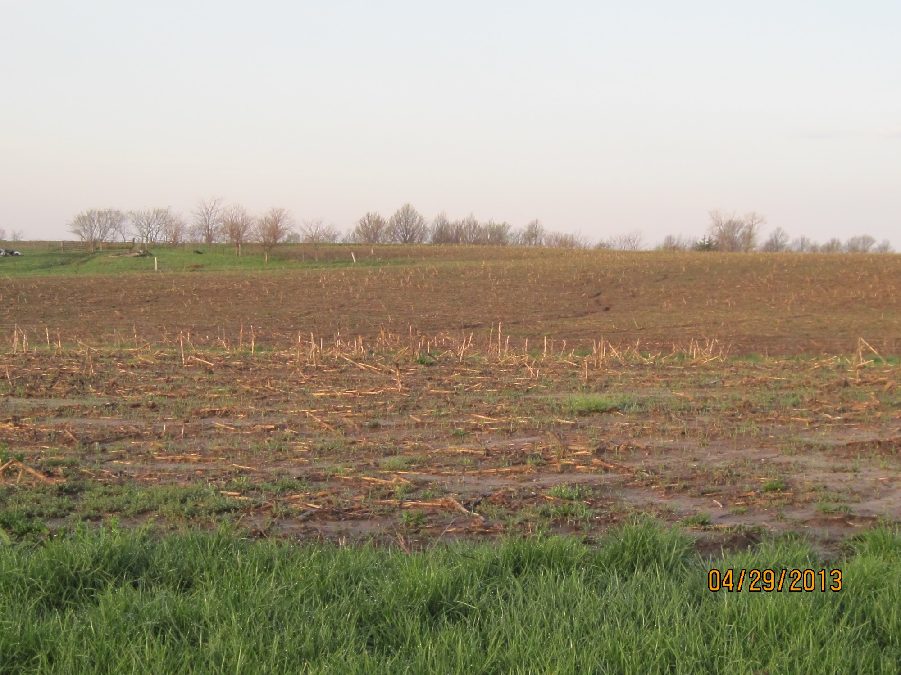

Slide 14
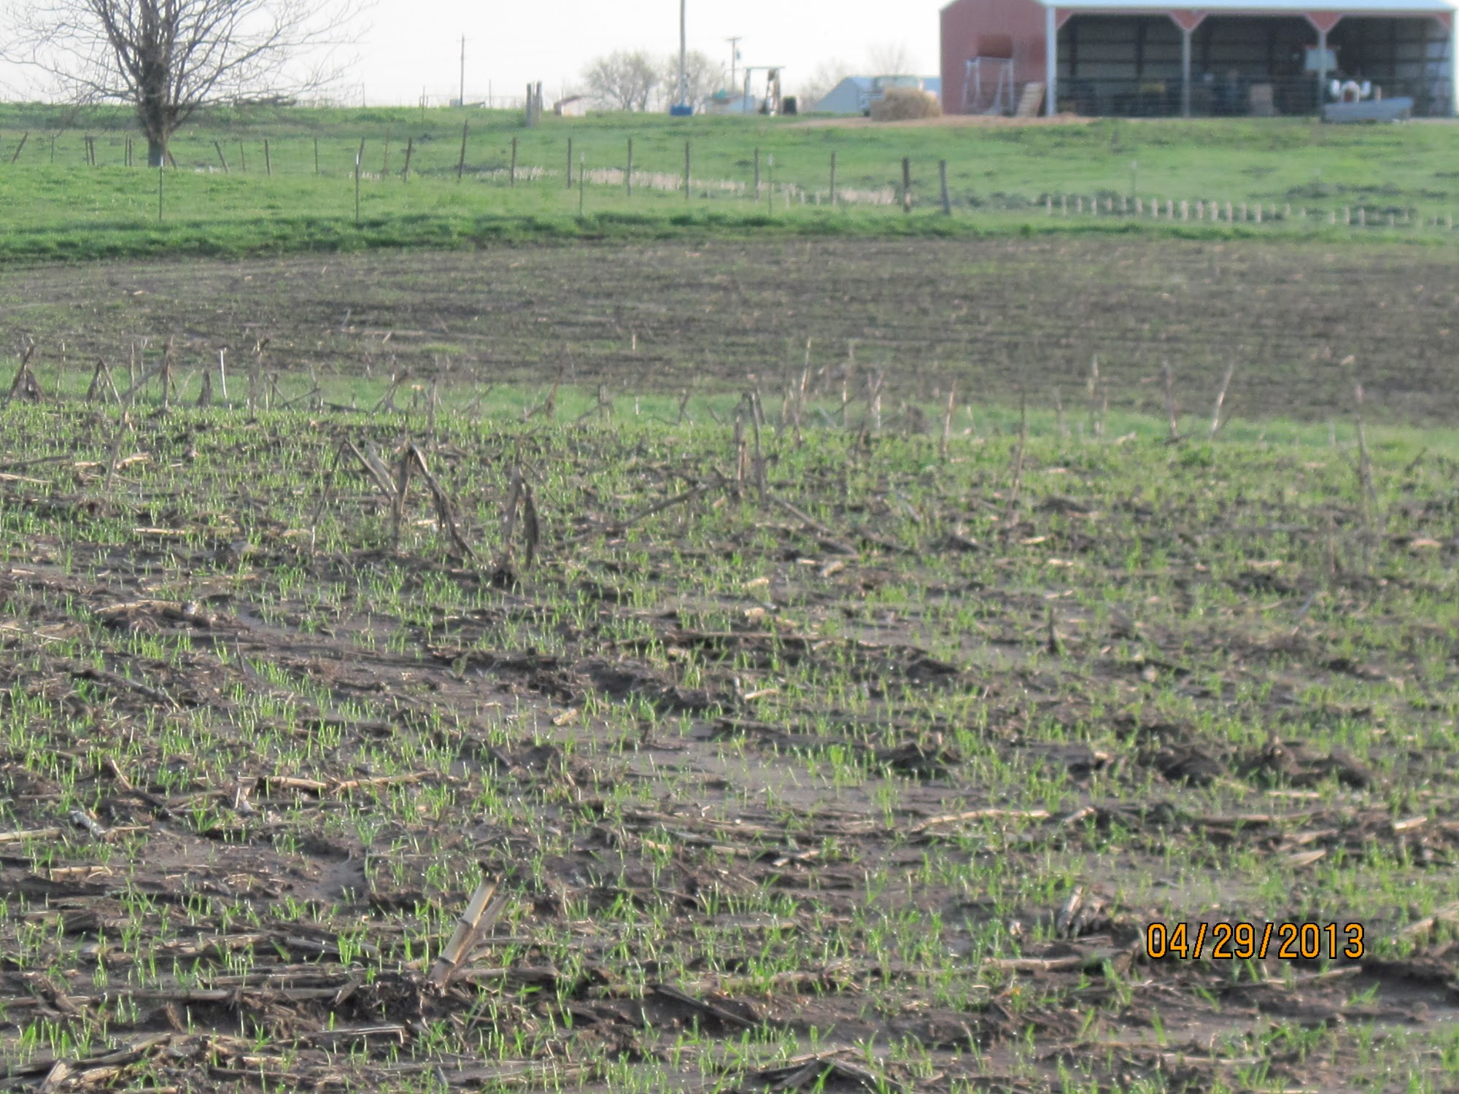

Slide 15
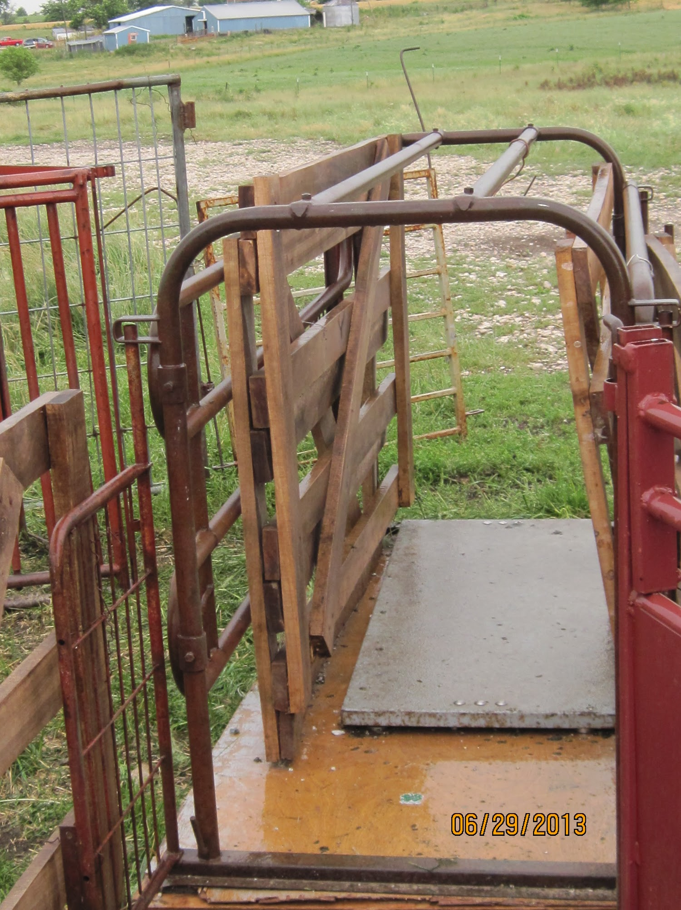
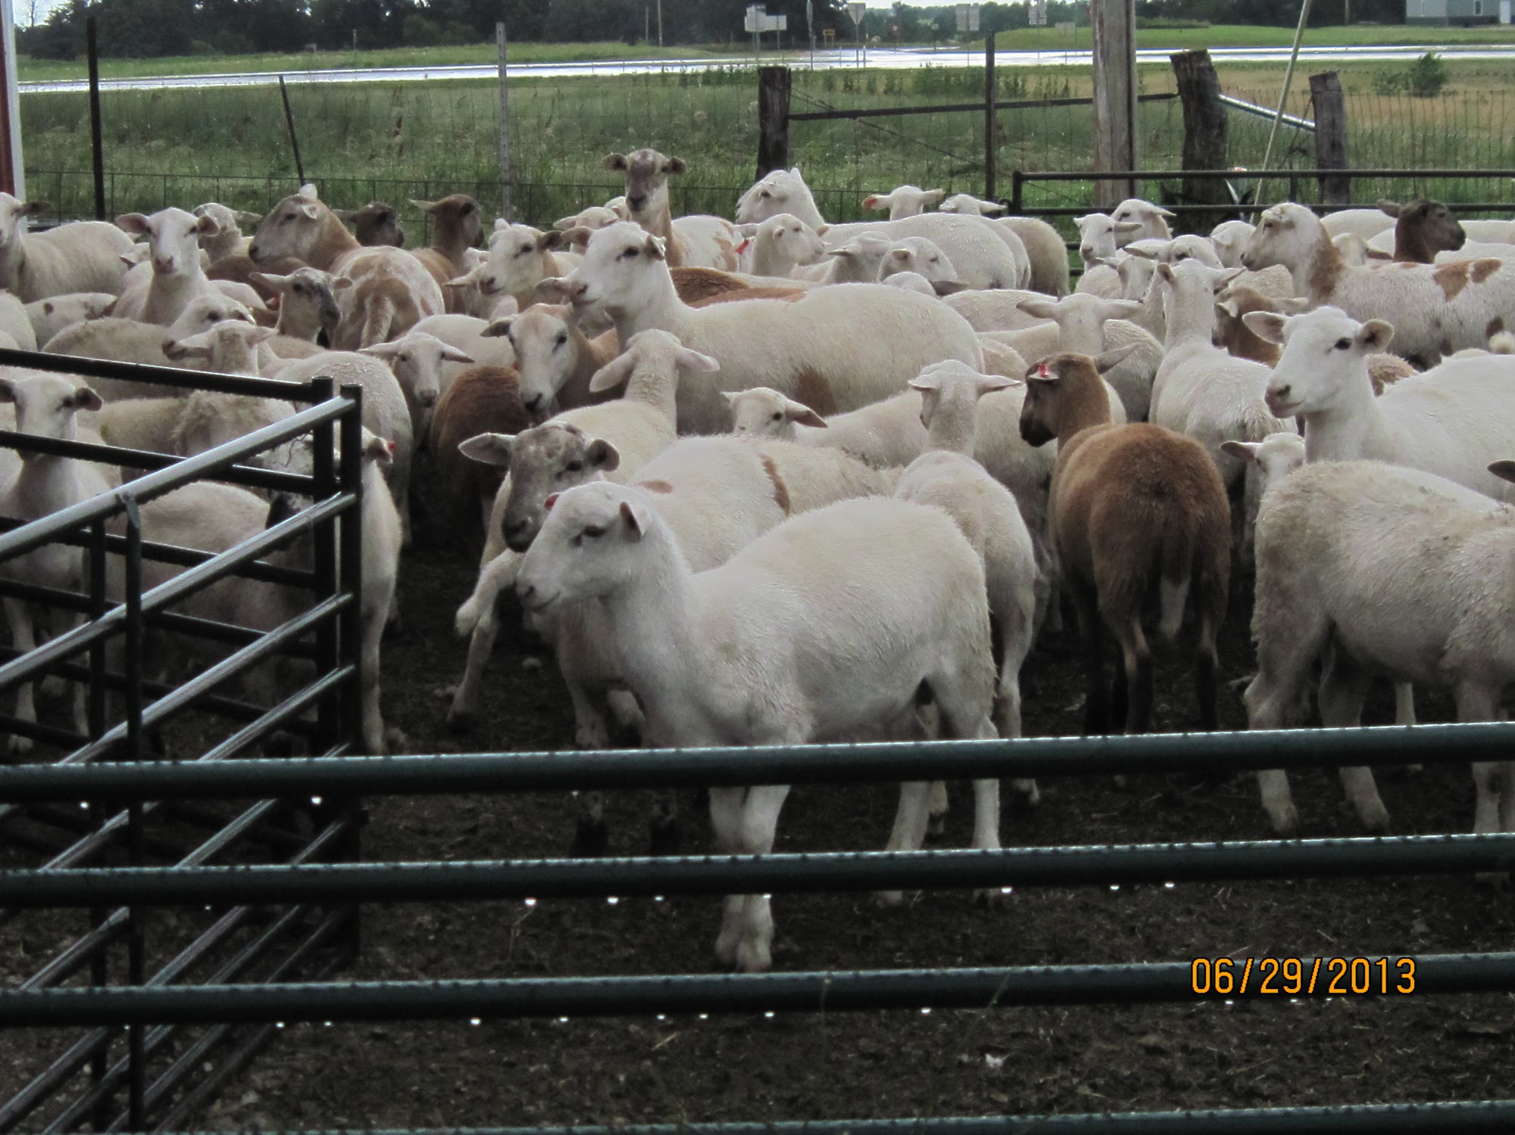
Timeline
Pre-grazing weights taken on May 22

Slide 16
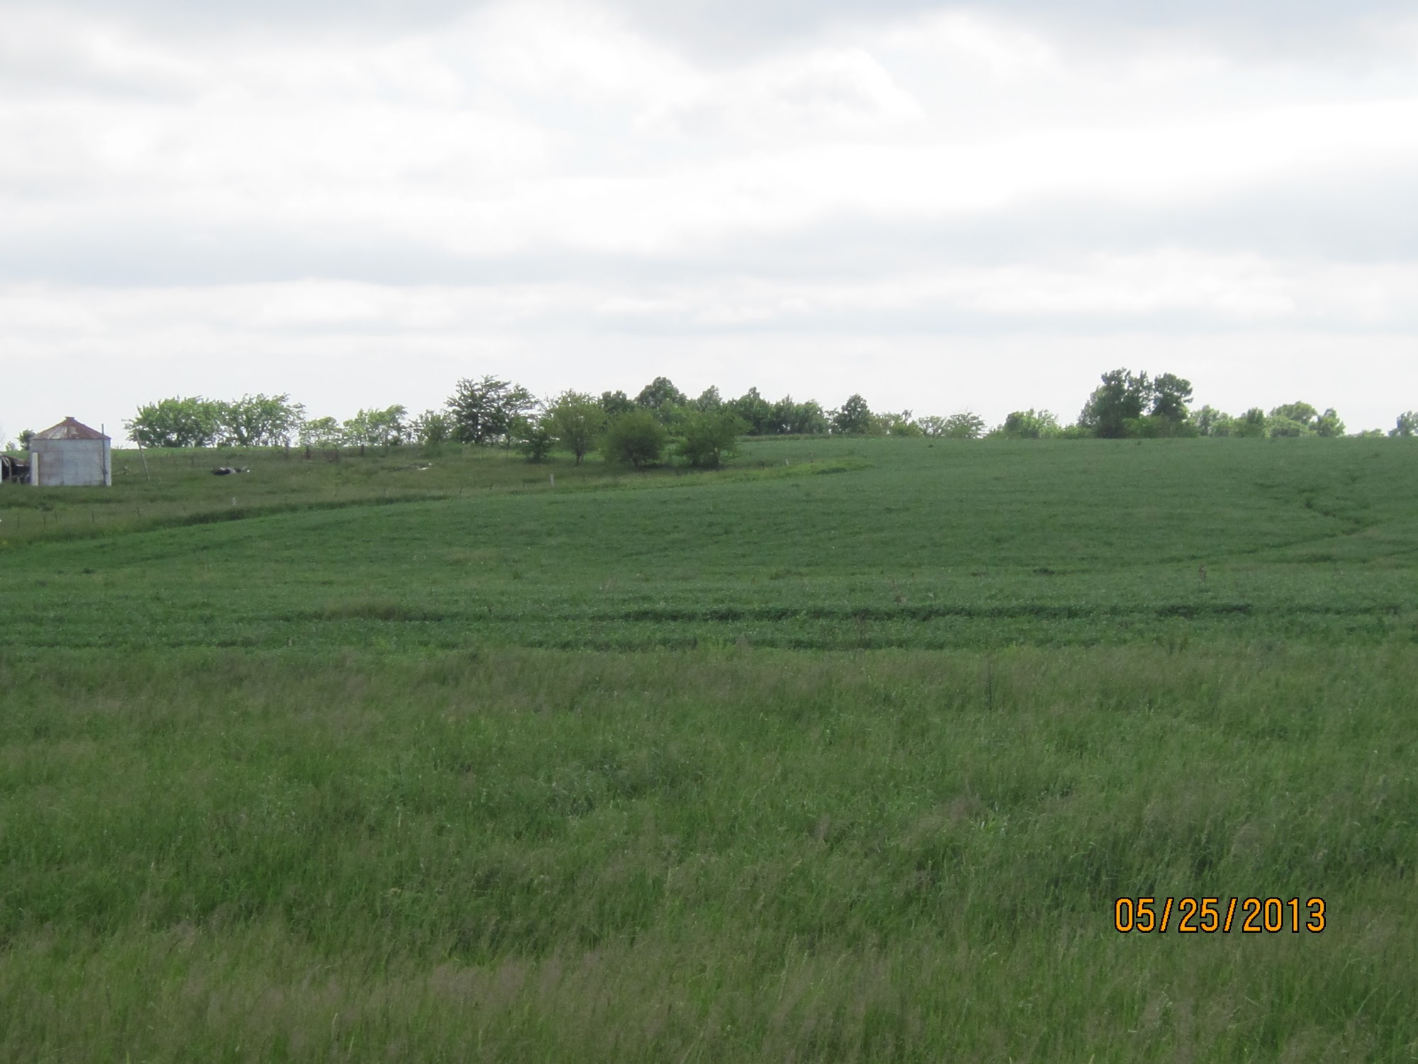
Timeline
Grazing of oats began on May 25

Slide 17
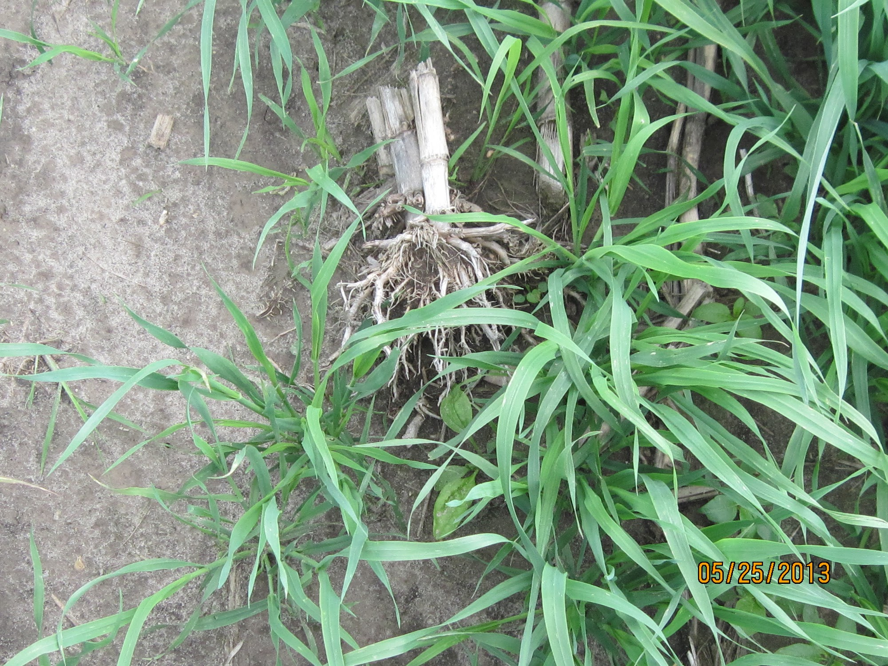

Slide 18
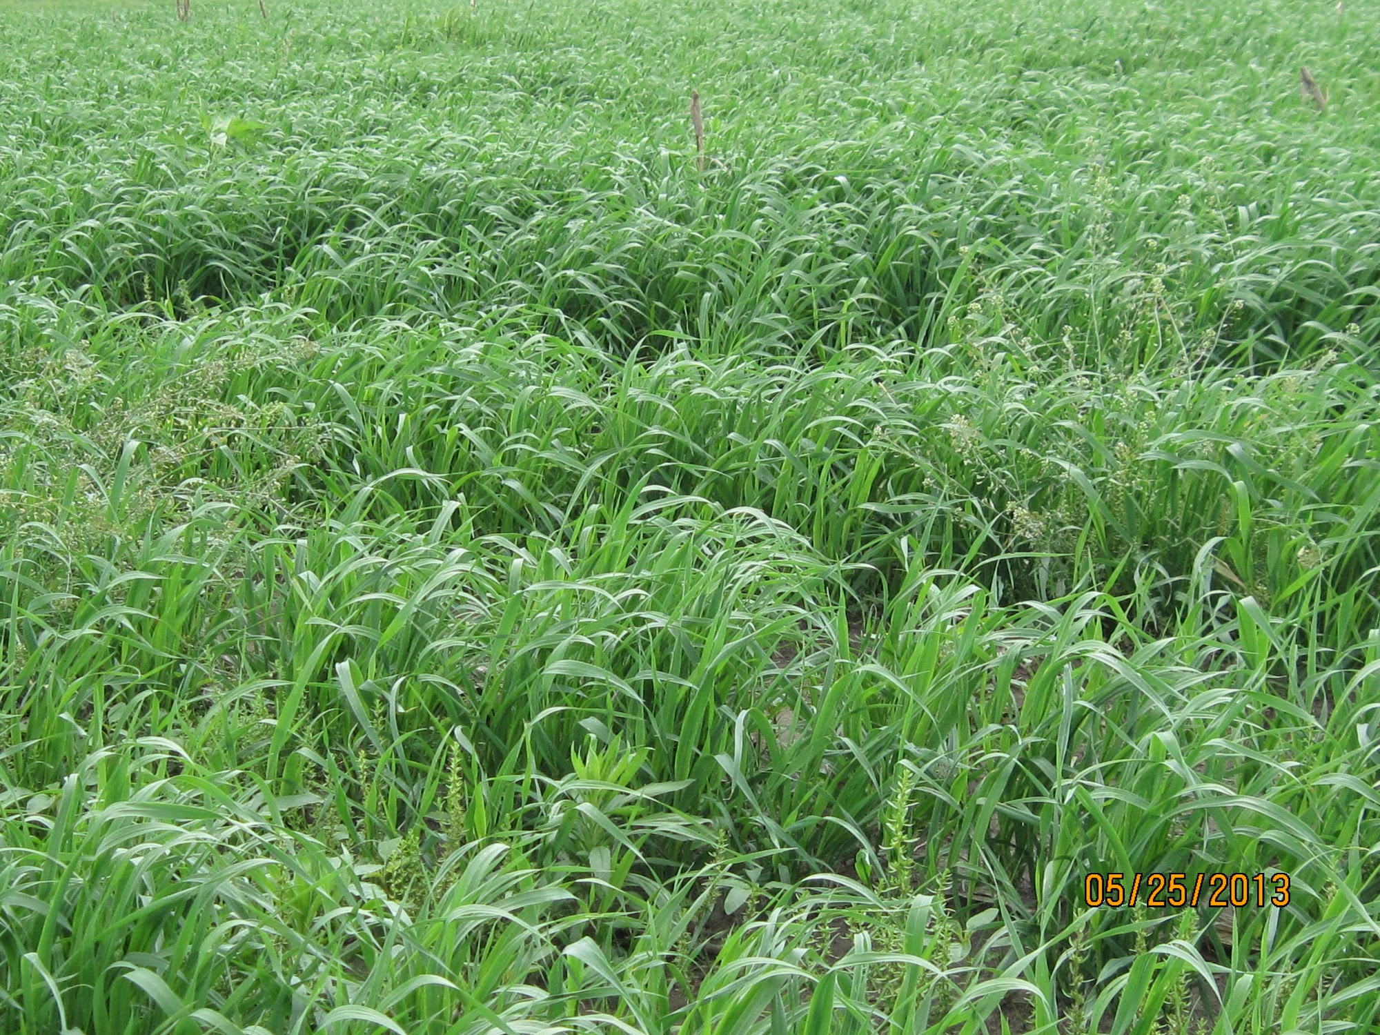
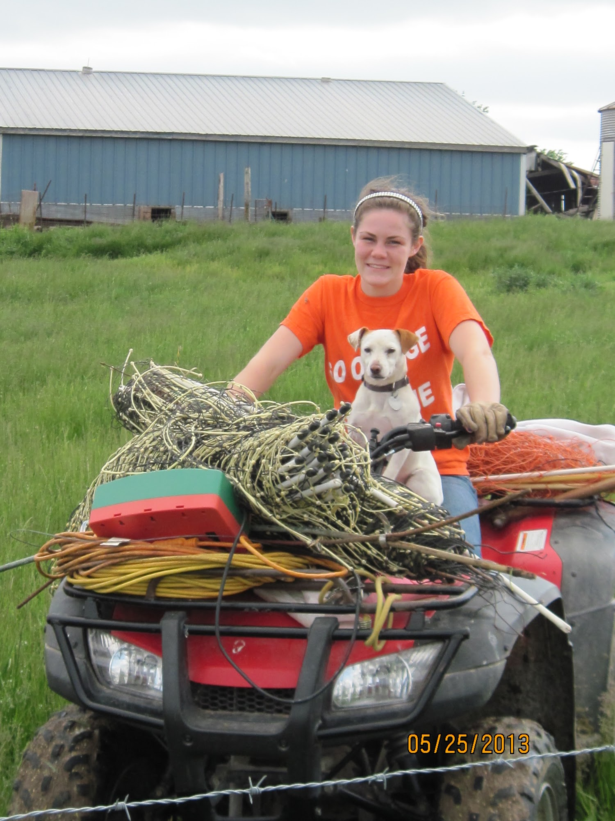

Slide 19
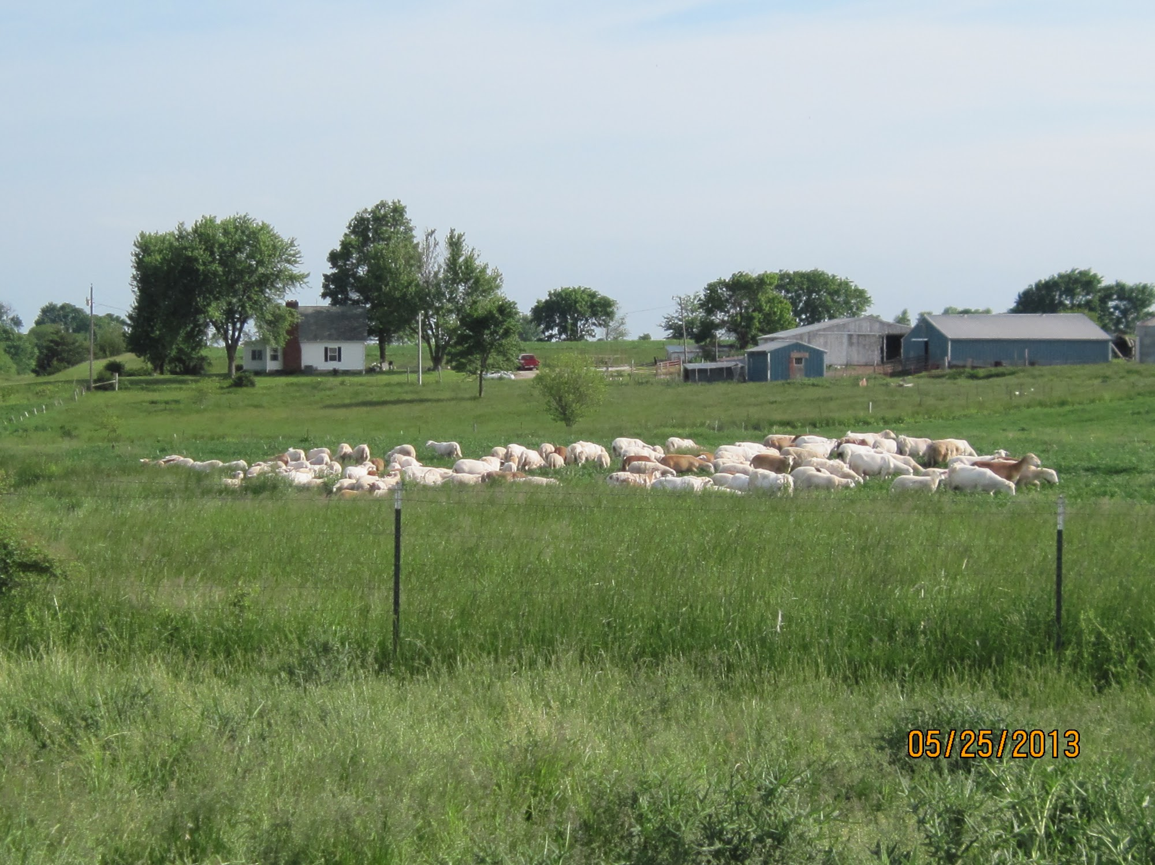

Slide 20
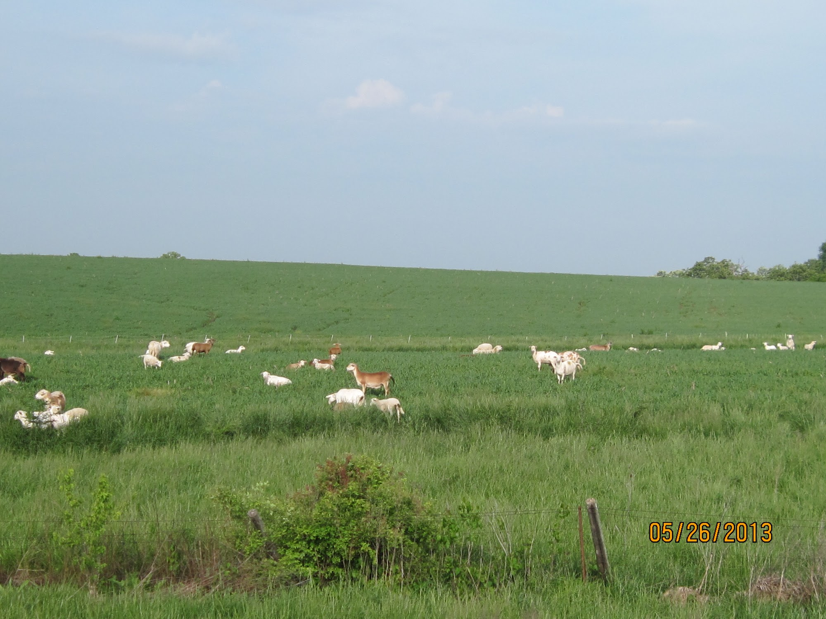
Grazing Plan
48 lactating ewes, with 85 lambs (77 days old, 49 lbs.) at side, plus 18 head yearlings strip-grazed for 35 days (on 9 ac.)
13,408 lb. live weight (21.9 animal units)

Slide 21
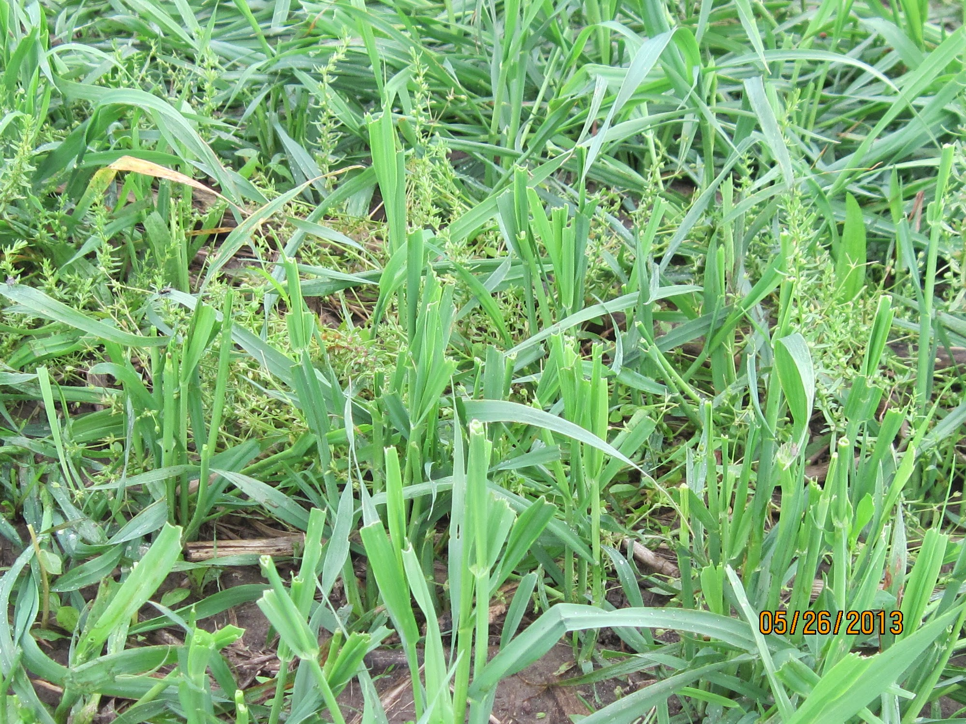

Slide 22
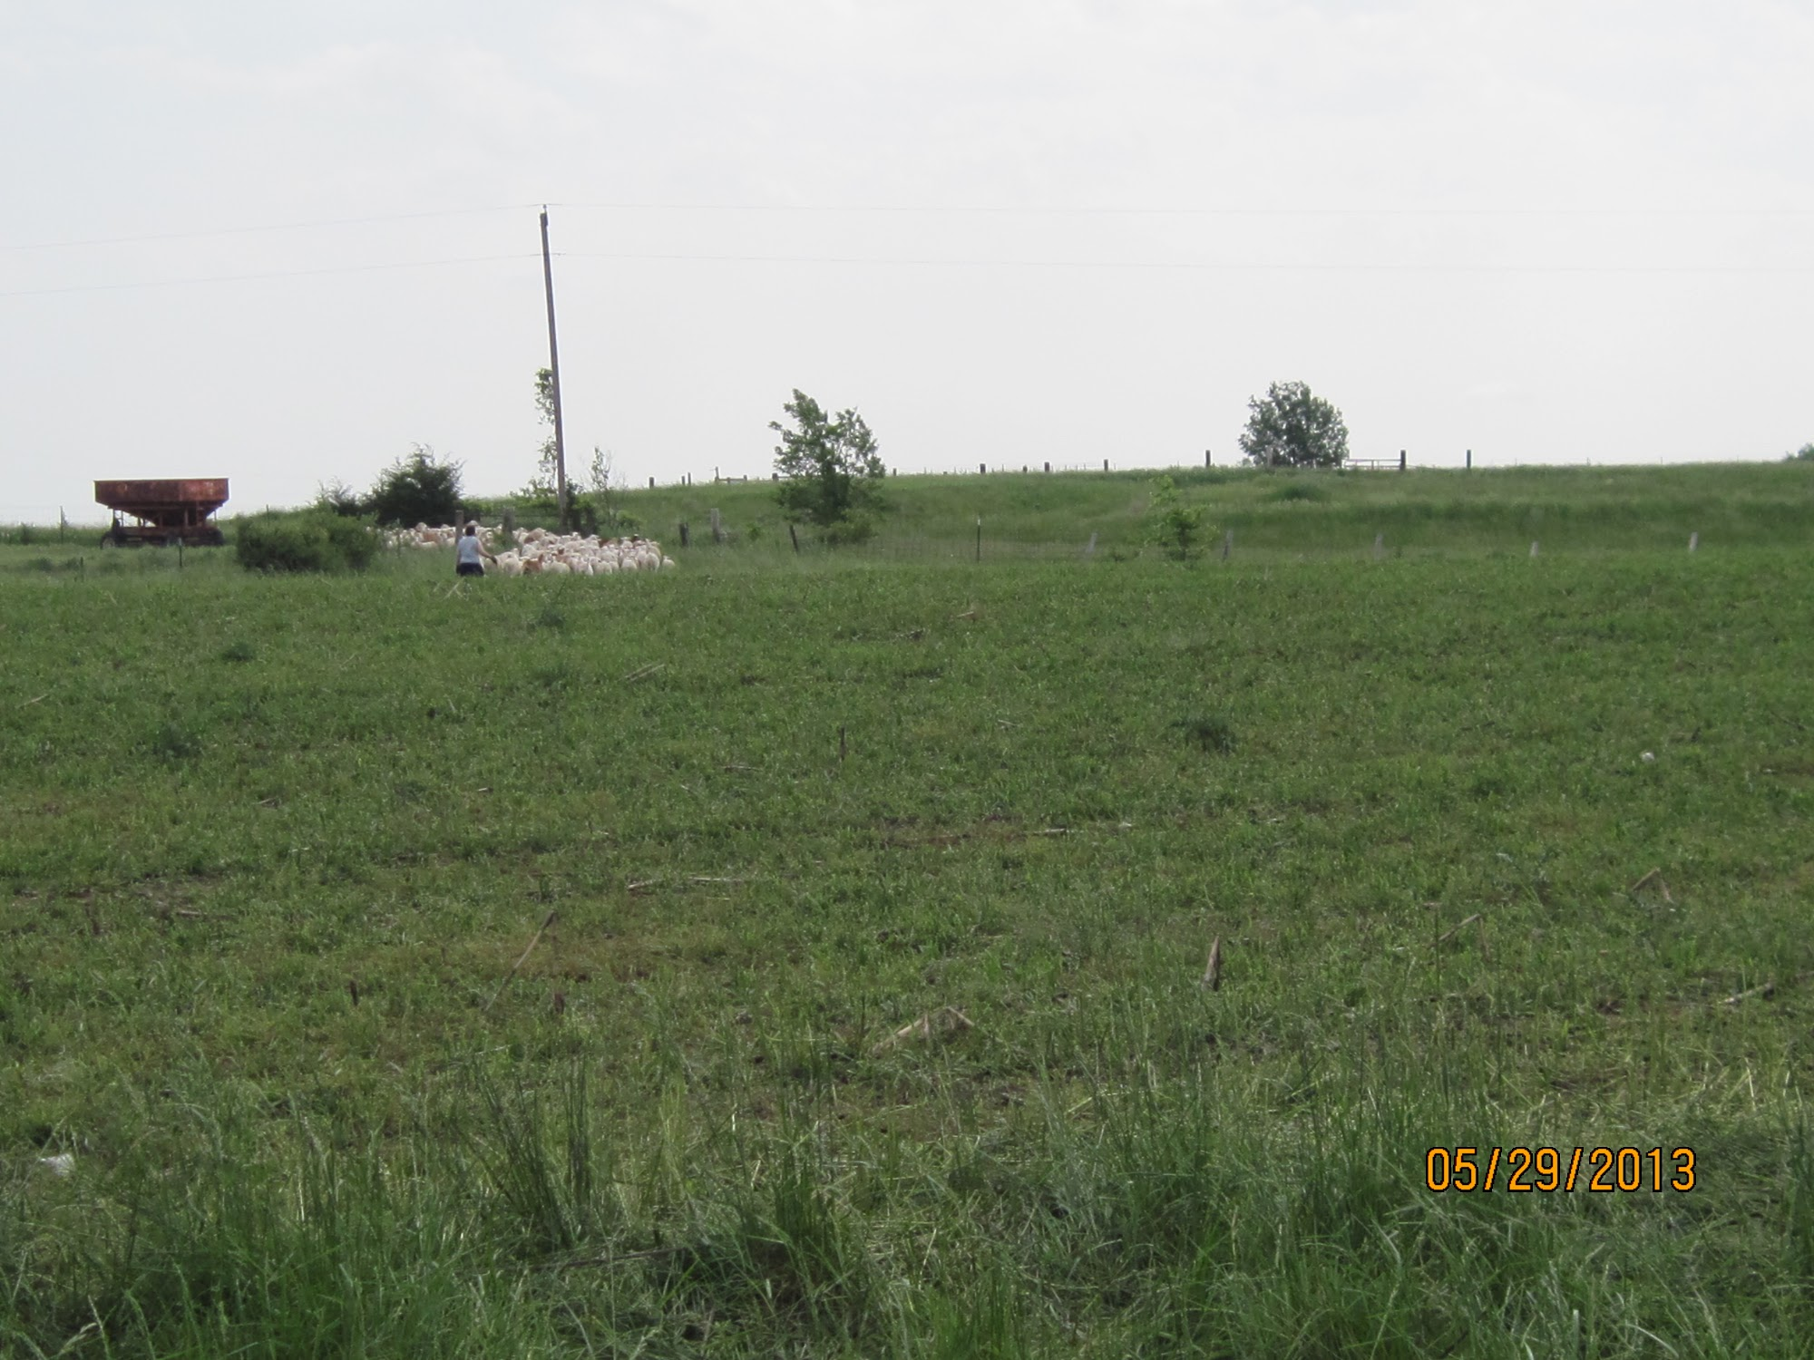

Slide 23
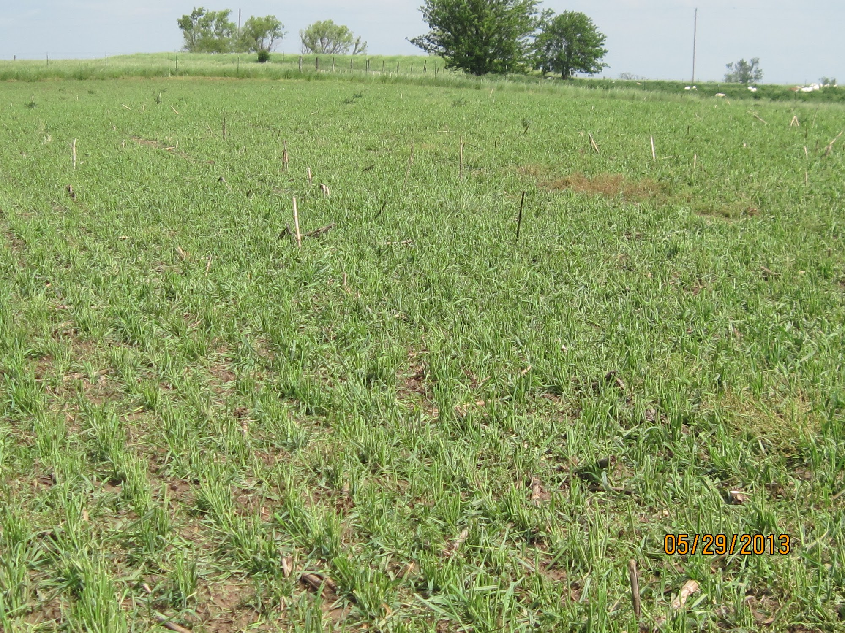

Slide 24
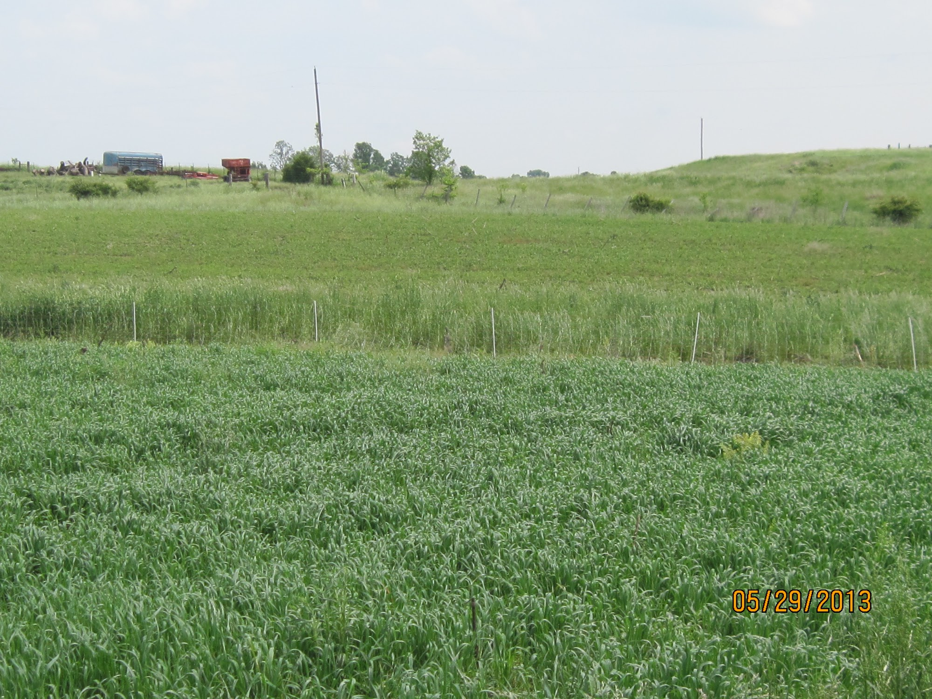

Slide 25
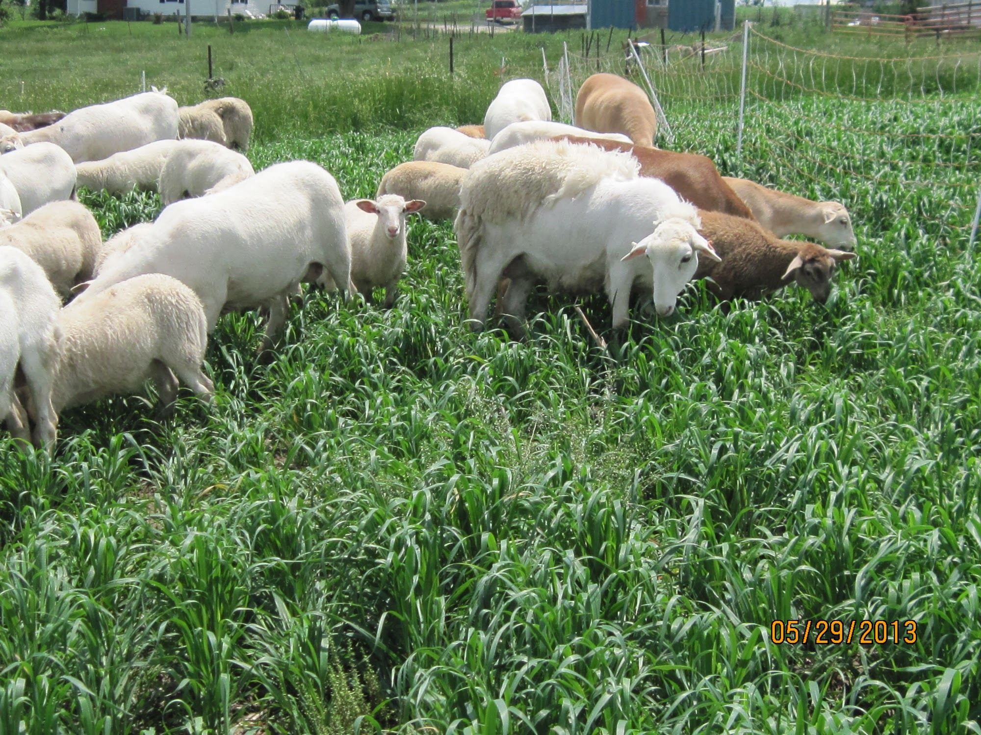

Slide 26
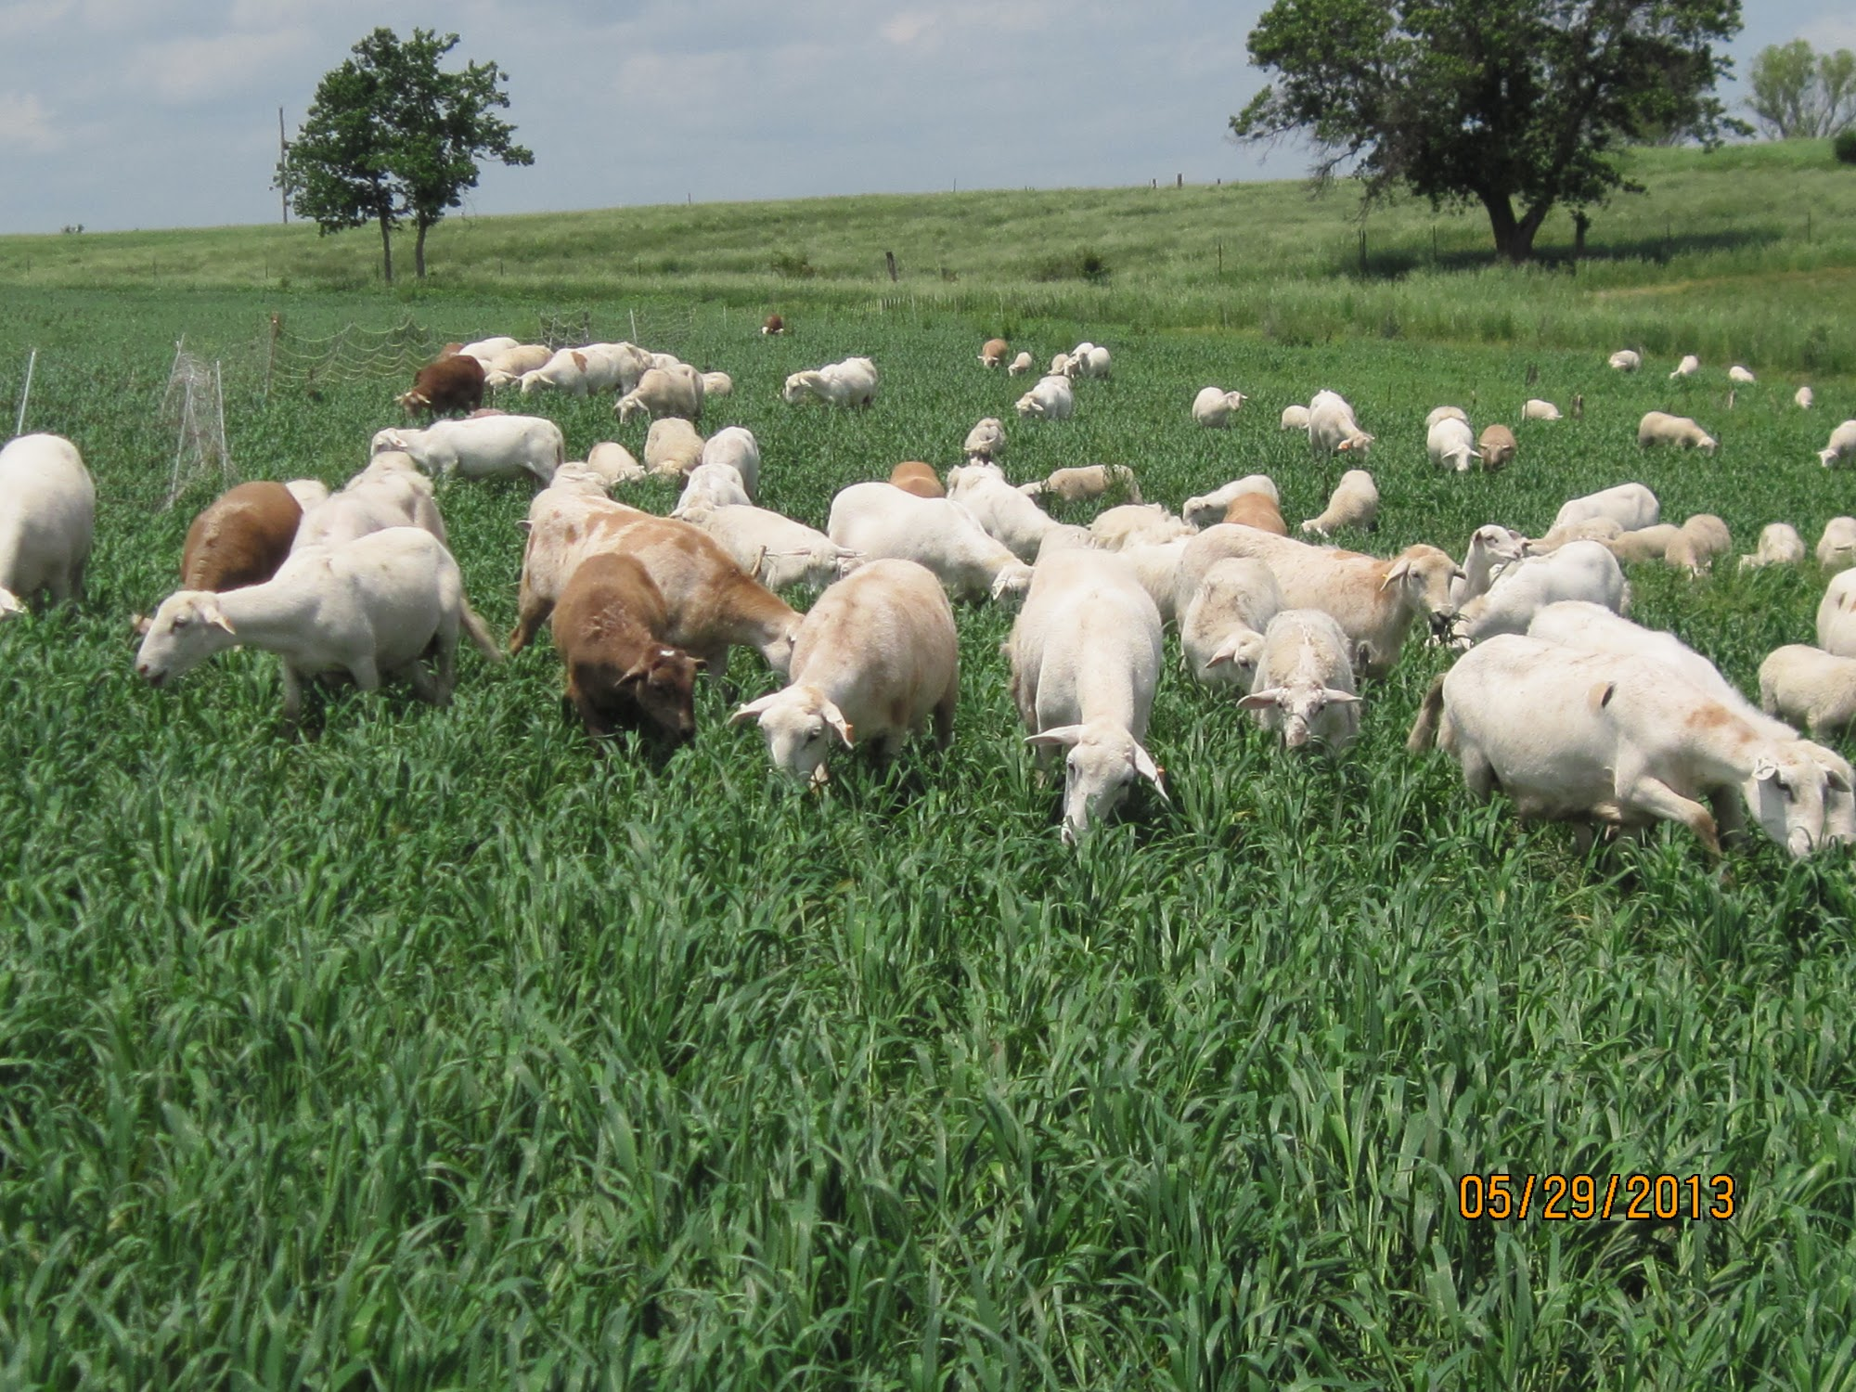

Slide 27
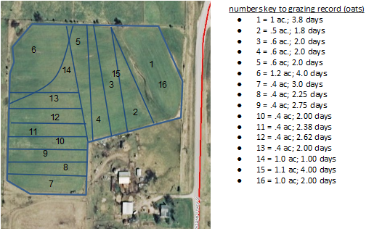

Slide 28
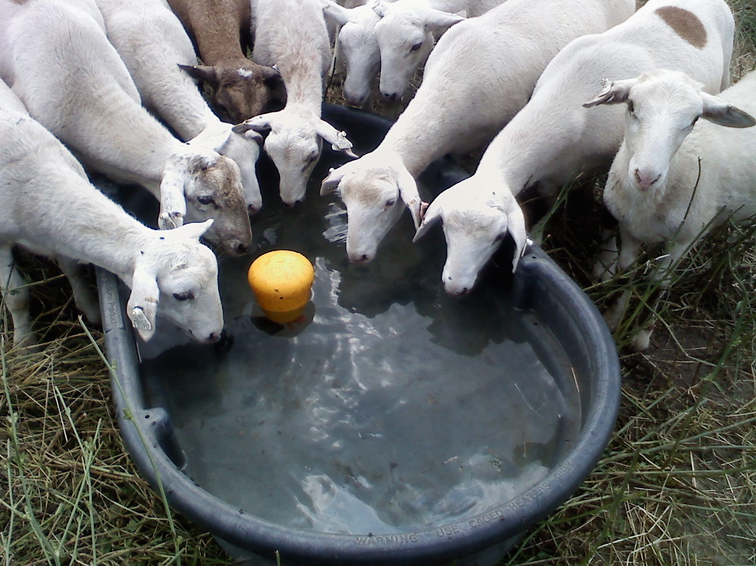
Water was piped or hauled to portable tank, depending on location within the field

Slide 29
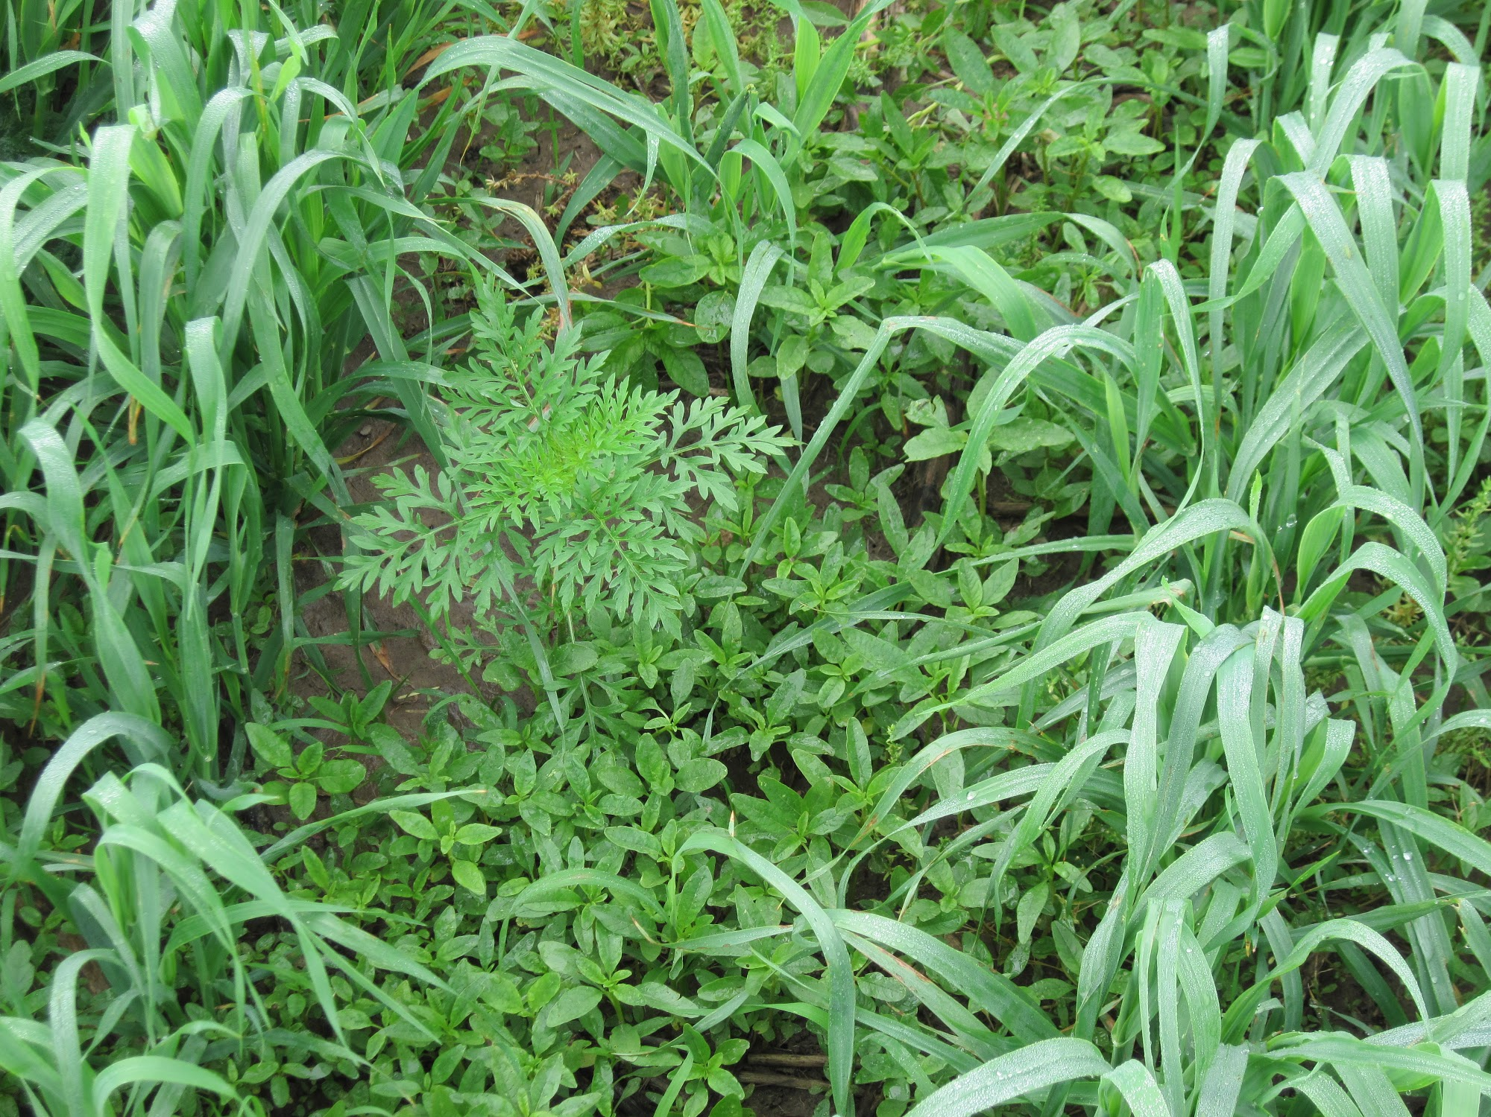
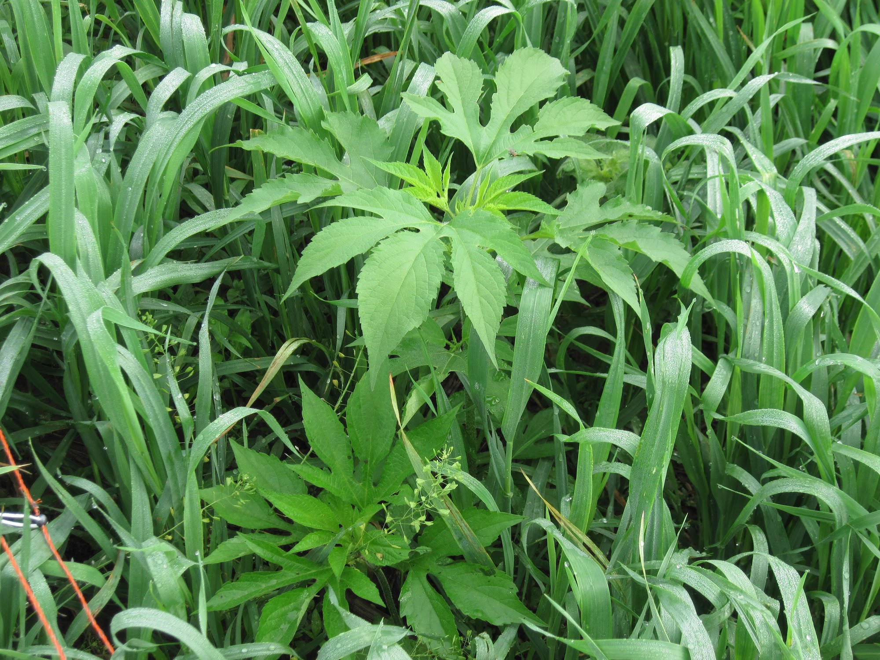
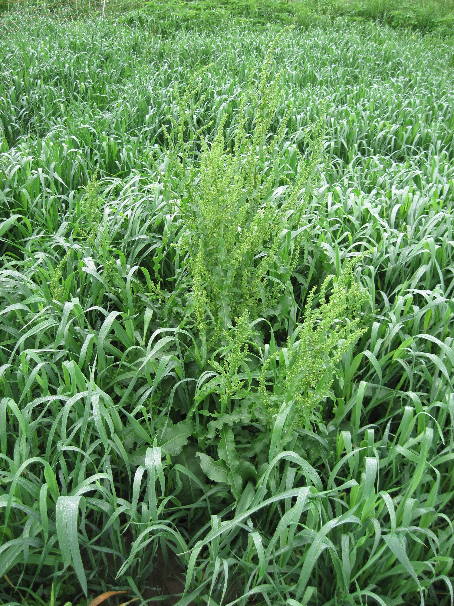
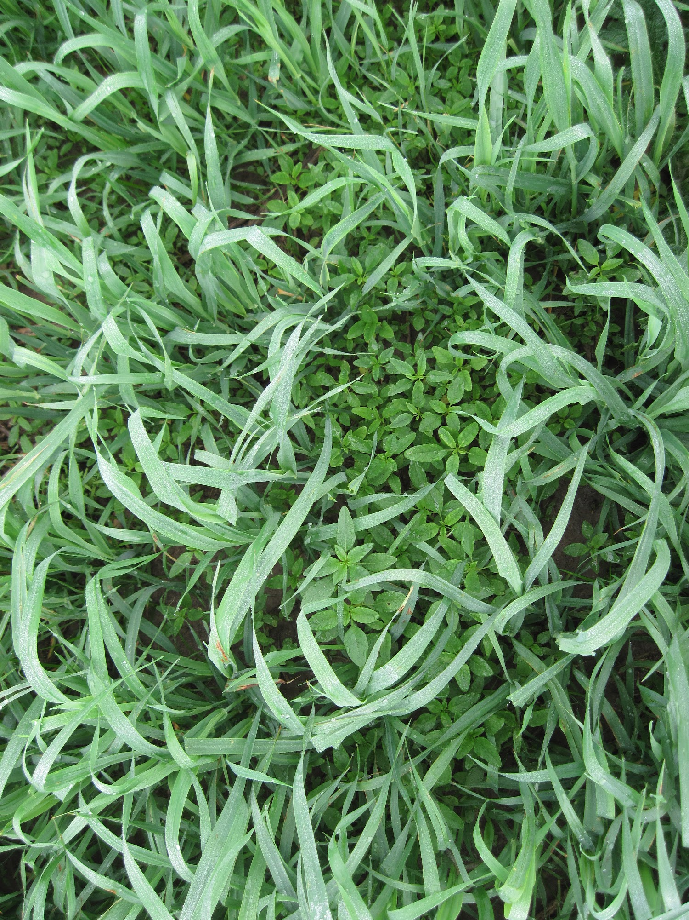
Annual “weeds” were present but highly palatable to sheep

Slide 30
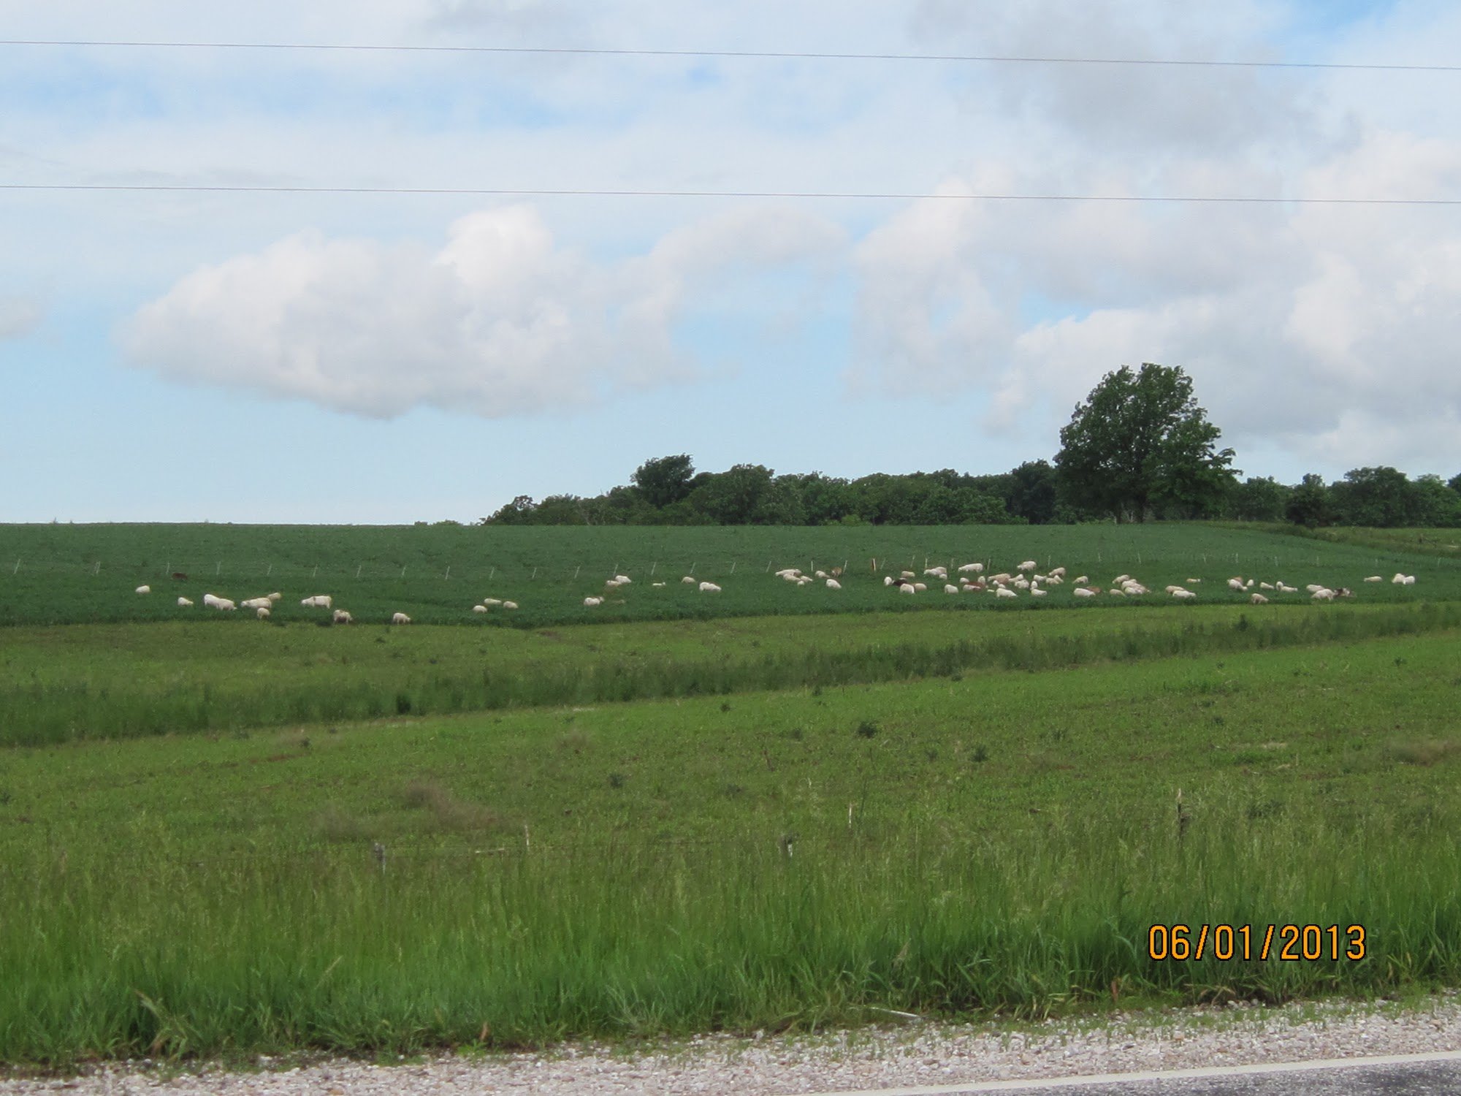

Slide 31
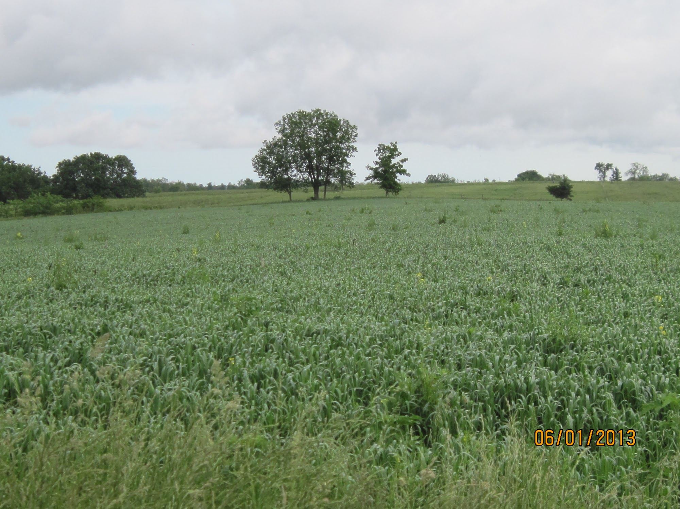

Slide 32
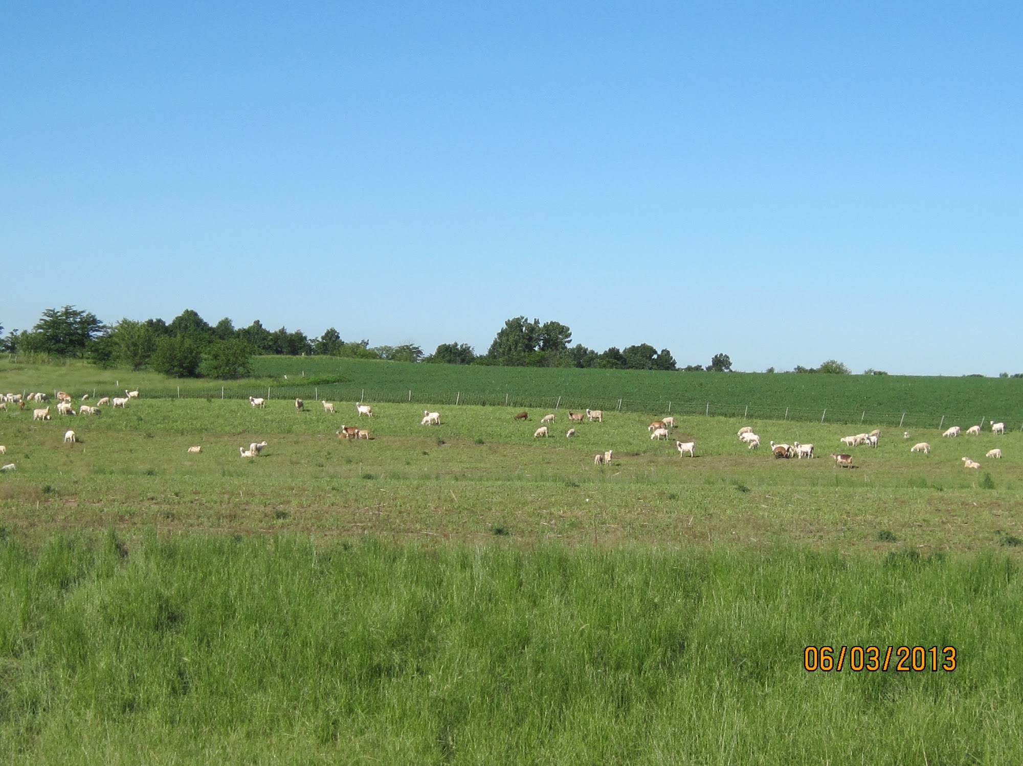
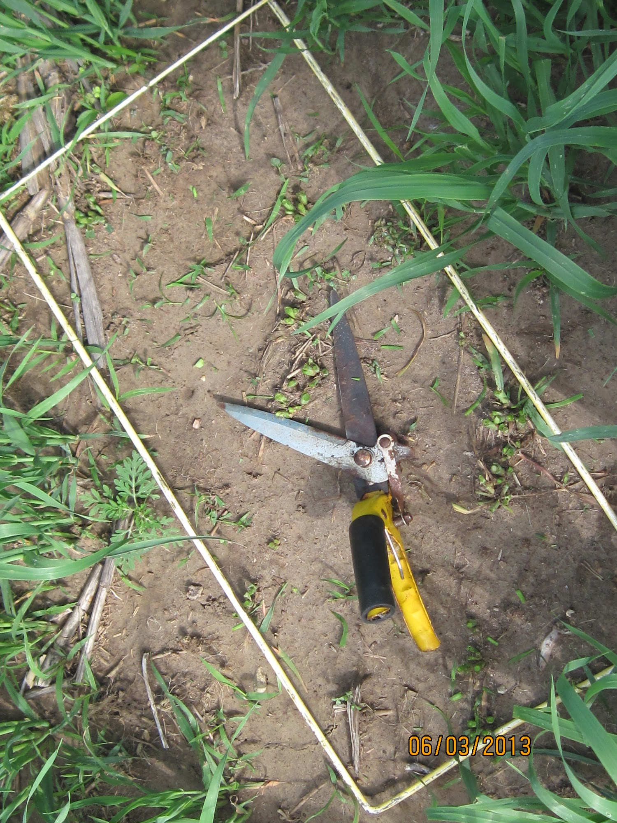
Forage (DM) Production from Oats
Estimated DM/ac by date:
(north field)
May 24: 1,667 lbs/ac
June 3: 2,200 lbs/ac
June 21: 9,133 lbs/ac
(south field-hay)
June 23 6,105 lbs/ac

Slide 33
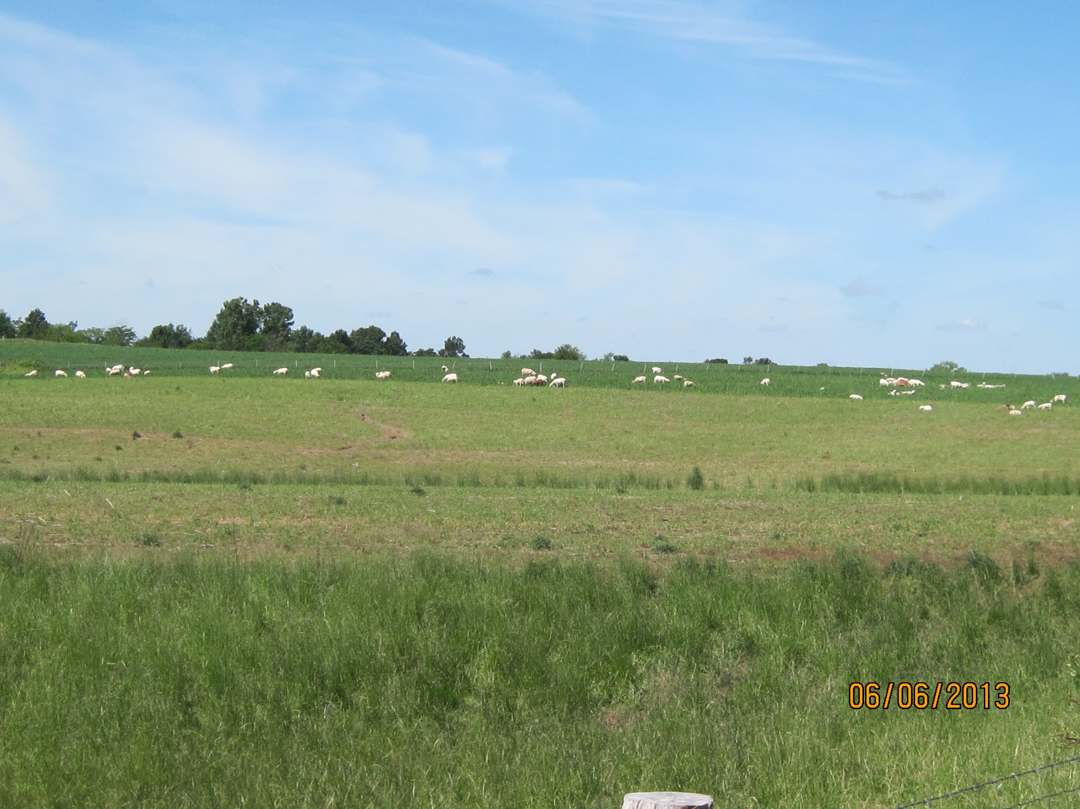

Slide 34
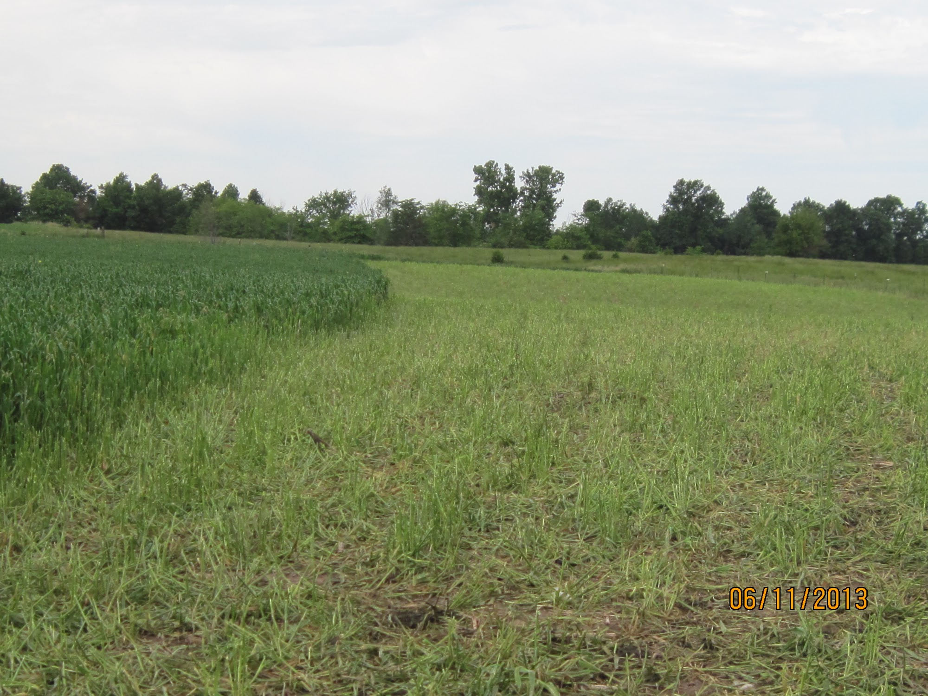
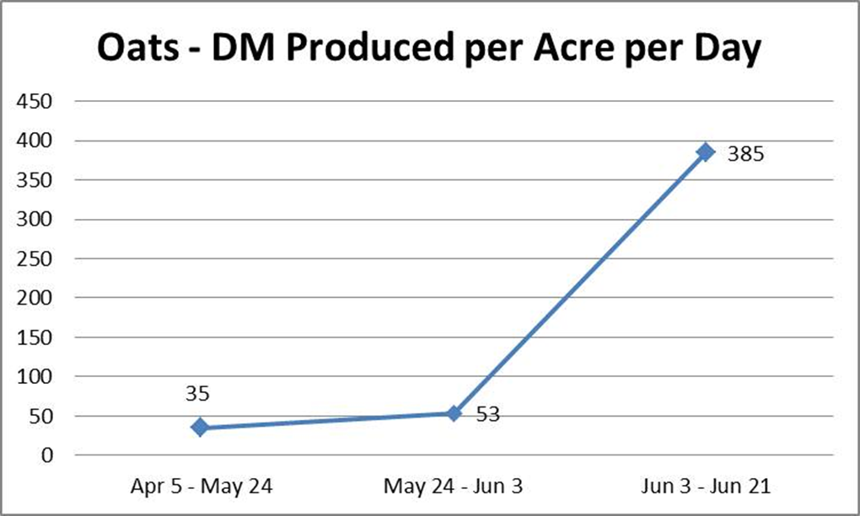
Forage (DM) Production from Oats

Slide 35
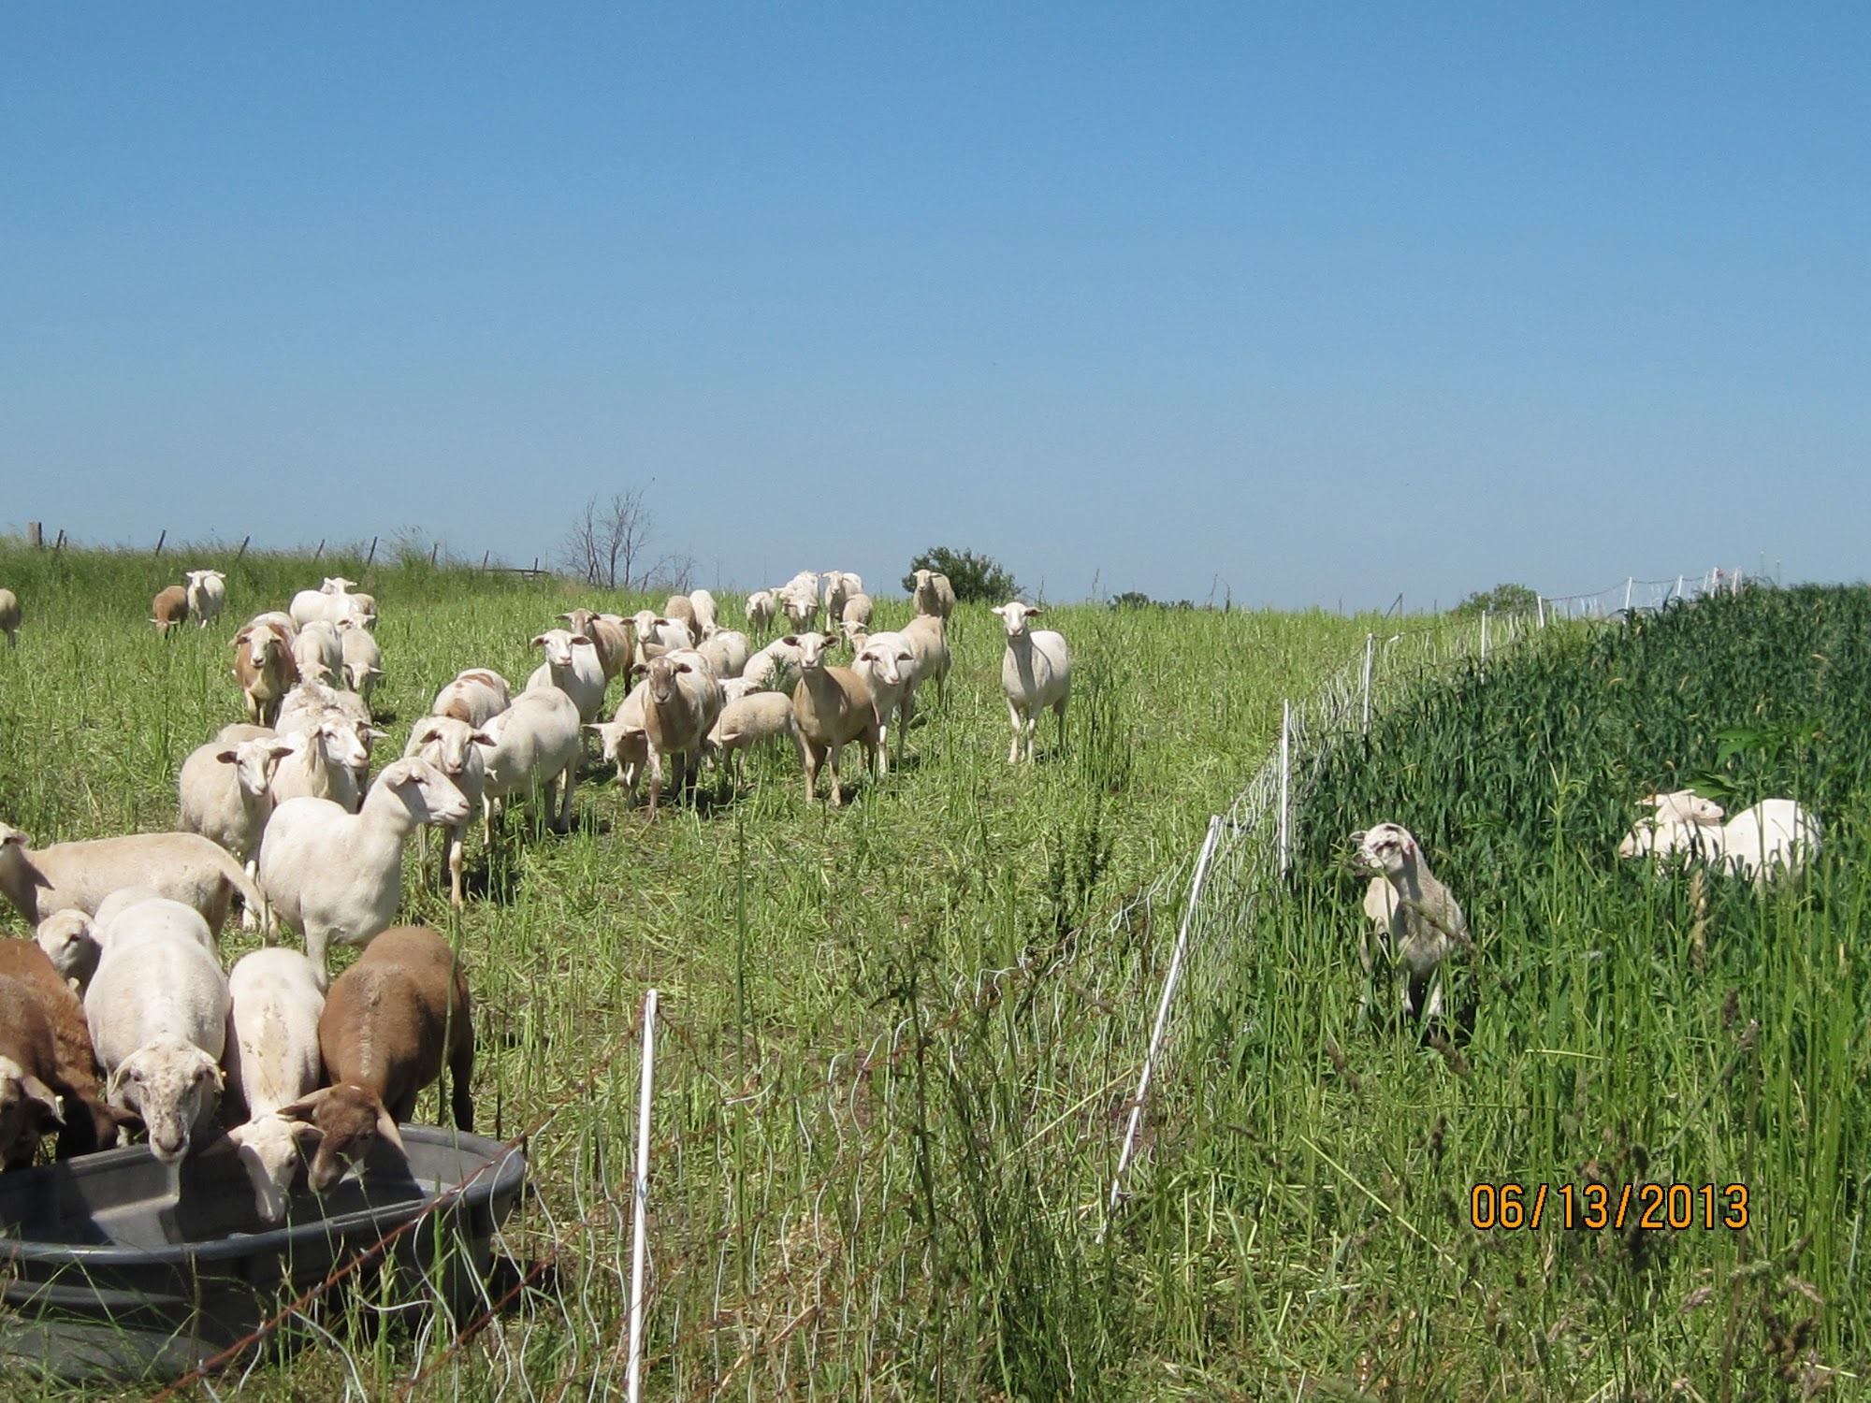

Slide 36
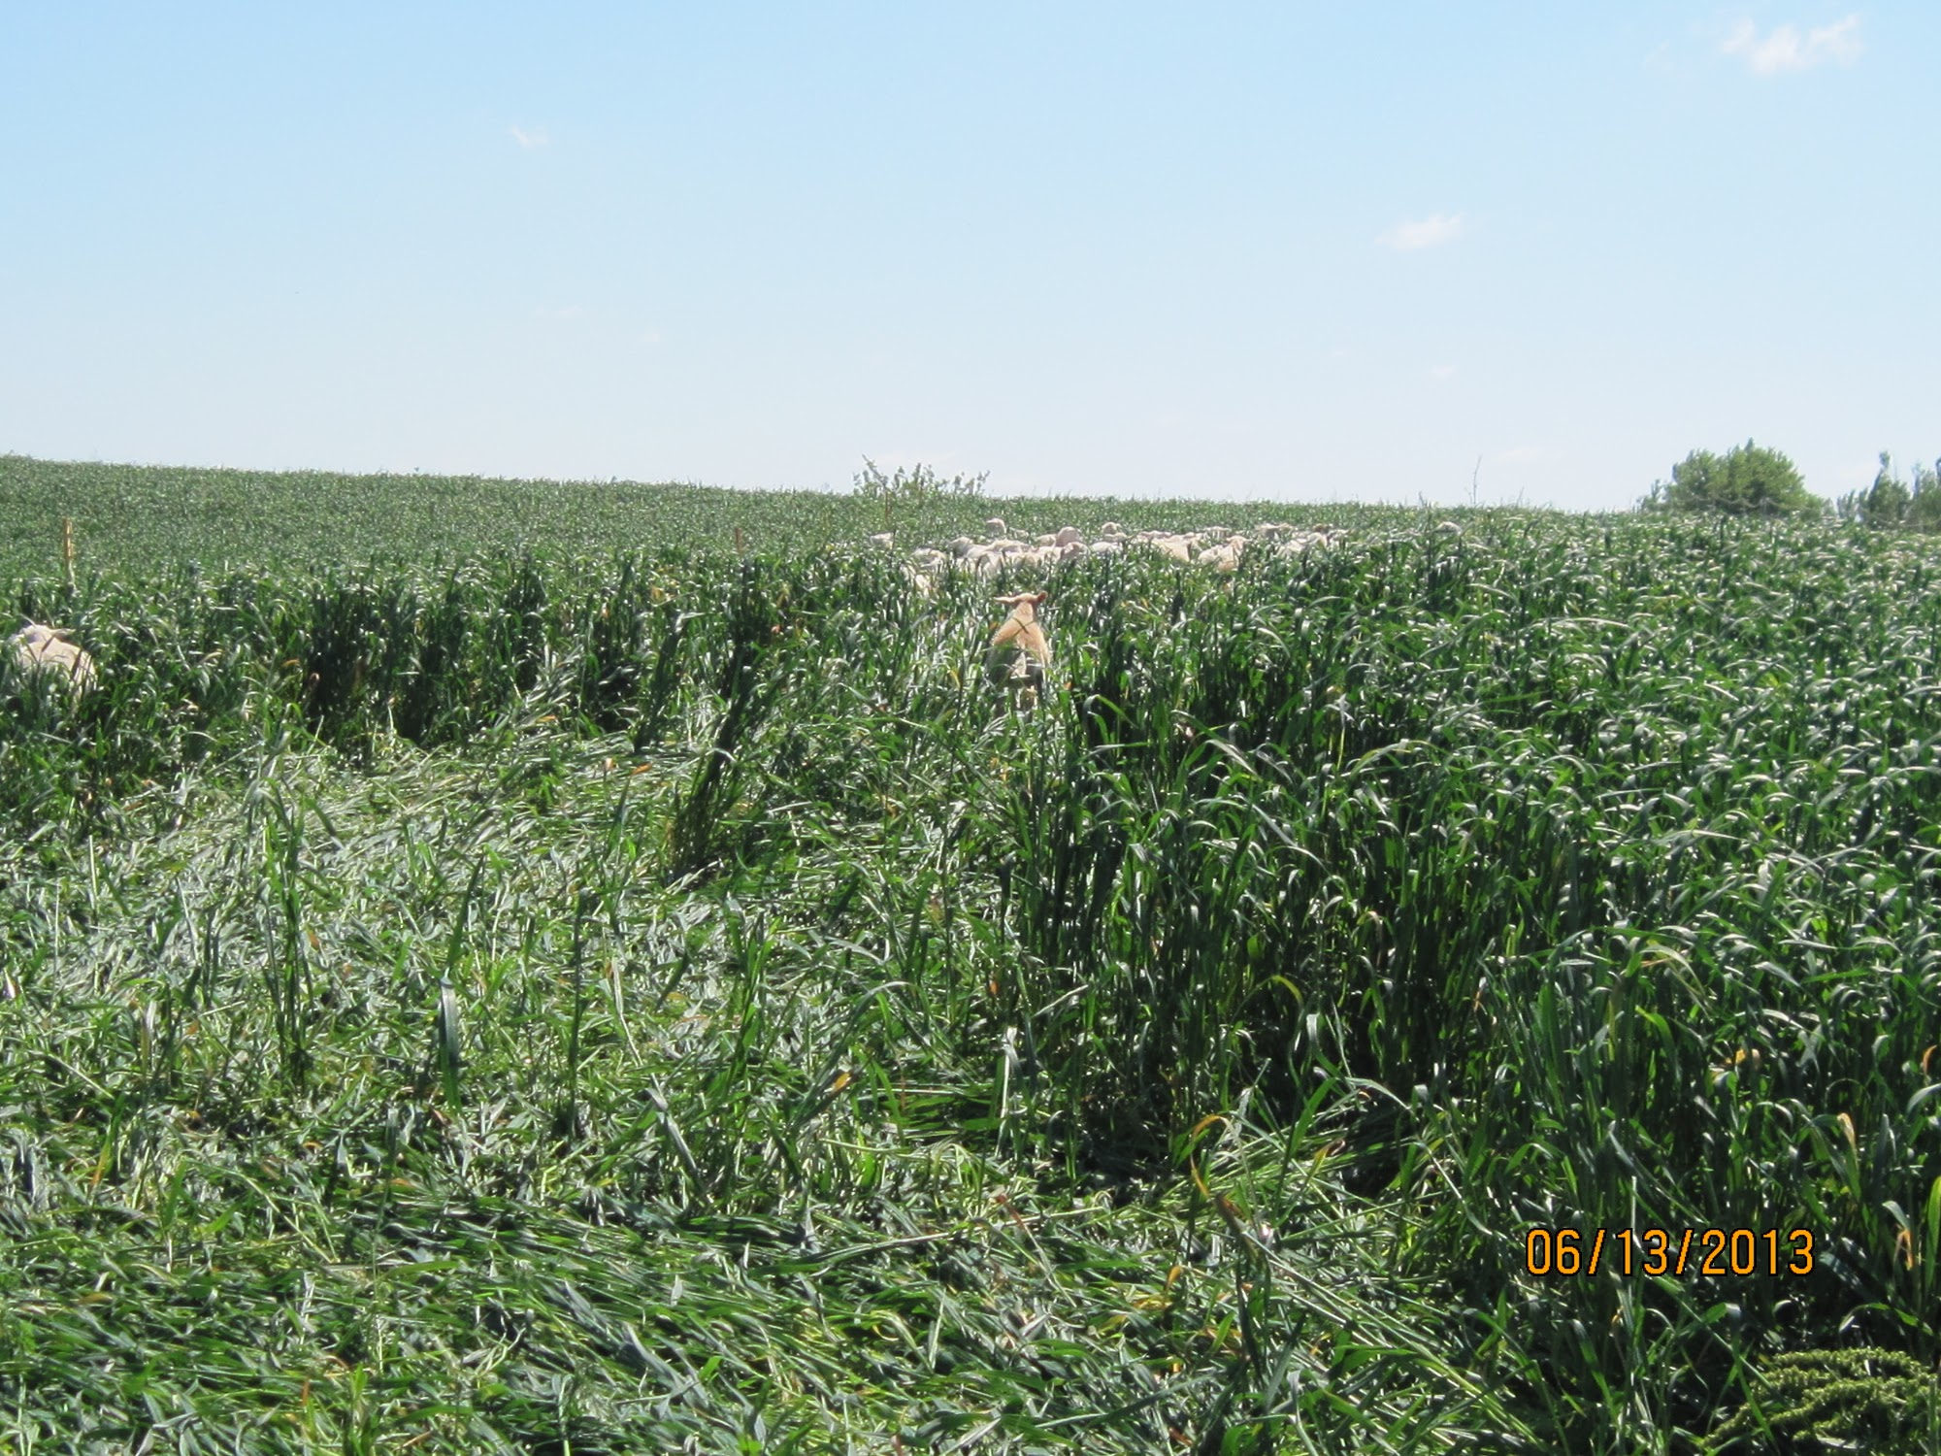
Weight Gain Data
38-day period (5/22/13 - 6/29/13)
Ewes & lambs grazing oats together
Lambs (n=85)
Ewes(n=48)
 | average | Std. Dev.
Begin weight | 49 lbs | 15.6
Gain | 16.3 lbs | 4.4
Gain as % BW | 38.4% | 20.1%
ADG | 0.43 lbs | 0.12
 | average | Std. Dev.
Begin weight | 140 lbs | 23.3
Gain | -4.4 lbs | 6.5
Gain as % BW | -2.8% | 4.8%
ADG | -0.11 lbs | 0.17

Slide 37
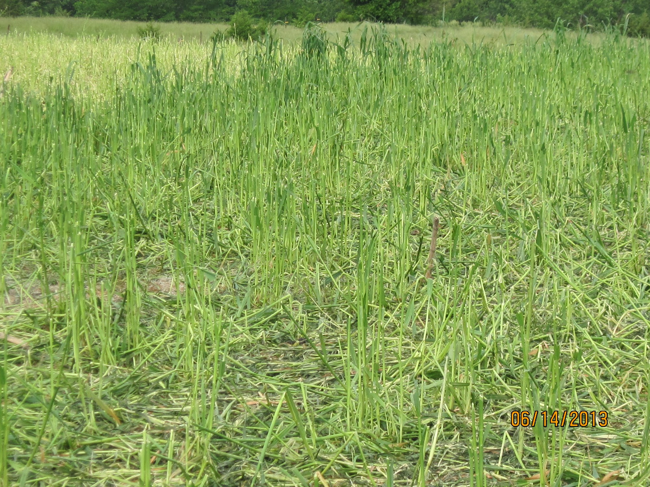
Weight Gain Data
38-day period (5/22/13 - 6/29/13)
Yearlings not raising lambs (n=18)
 | average | Std. Dev.
Begin weight | 131 lbs | 11.6
Gain | 4.8 lbs | 3.8
Gain as % BW | 3.7% | 3.1%
ADG | 0.13 lbs | 0.10

Slide 41
We estimated that the sheep consumed 21,864 lbs DM over 35-day period, or 2,429 lb/ac.
If we take lbs of hay harvested from other 8 acre plot (5,342 lb/ac) as total DM production, then forage utilization rate of the sheep was approx. 45%

Slide 47
Overall, the grazed oats provided 25.55 Animal Unit Months (AUMs) of grazing, or 2.84 AUM/acre
This calculation is based on a 35-day grazing period in which 21.9 AU grazed on 9 acres

Slide 48
By the time the sheep grazed the first 9 acres, the second, 8-acre field, was in full flower;
It was cut for hay on June 23
Total baled (dry) hay harvested was 42,735 lbs, or 5,342 lbs./ac
When cost of mowing, raking, baling considered, haying was less attractive than grazing, but did provide way to utilize forage at a later time

Slide 49
Medium tillage (disking and field cultivating) was performed to prepare a seedbed for Teff grass establishment on 17 acres (Teff has a very small seed that requires a prepared seedbed)

Slide 50
Seeding completed using Brillion seeder on July 1

Slide 51
Oats had depleted soil moisture by end of June
After a very wet April, a wet May, and a slightly dry June, no measureable precipitation was recorded on the farm in July or August (after Teff planting on July 1)
Even a drought-tolerant grass like Teff needs moisture for germination

Slide 53
Challenges: fencing sheep vs. cattle

Slide 54
Challenges: erosion is still a major concern on our ground if using annuals

Slide 55
Economics of Grazing Annuals
Revenue
lamb weight gain | 1382
value per pound | $1.50
Total value of gain | $2,073.00
Value per acre | $230.33
Expenses (per ac)
Cash rent | $130.00
Drill rental | $8.00
Fertilizer (40-0-0) | $29.22
Tractor | $8.00
Oat seed | $19.62
Subtotal | $194.84
Net gain of oats (per ac) | $35.49

Slide 56
(Potential) Marginal Benefit from Teff Grass
Revenue
lamb weight gain | 1382
value per pound | $1.50
Total value of gain | $2,073.00
Value per acre | $230.33
Expenses (per ac)
Cash rent | --
Drill rental | $8.00
Fertilizer (40-0-0) | $29.22
Tractor | $8.00
Teff seed | $26.40
Subtotal | $71.62
Net gain of Teff(per ac) | $158.71
Grazing oats followed by warm-seasonal annual, without labor cost considered, using lambs, could net:
$194.20 / acre

Slide 57
Grazing annuals vs. corn production (no labor)
The land used is 125 bu./acre corn ground
Corn costs | Per-acre
Pre-hvst machinery | $30
Seed, chem, fert | $290
Rent | $130
Harvest | $60
Cost per acre | $510
Gross & Net Revenue from Corn
Corn price/bu. | Gross/ac. | Net/ac.
$3.00 | $375 | -$135
$4.00 | $500 | -$10
$5.00 | $625 | $115
$6.00 | $750 | $240
Grazing oats followed by warm-seasonal annual, without labor cost considered, using lambs, could net:
$194.20 / acre

Slide 58
Other Annual Forage Alternatives
Cereal Rye

Slide 59
Sorghum-Sudangrass
warm season annual grass known to be drought resistant and thrive during summer slump
sudden changes in conditions causes it to produce prussic acid more rapidly - high levels are lethal to cattle
difficult to hay but provides high yields of
silage, green-chop and pasture
quality comparable to alfalfa and corn
Heighth is problematic with sheep
Notes:
http://www.omafra.gov.on.ca/english/crops/facts/98-043.htm
http://www.plantmanagementnetwork.org/pub/fg/research/2006/broiler/image/sorghumsudan3.jpg (picture)

Slide 60
Brown Midrib (BMR) Sorghum
reduced lignin associated with BMR gene
provides forage during summer slump planted in early June or late May
double the protein than in corn silage
often hybridized with Sundangrass
warm season annual
requires ⅓ less water than corn
more digestible than conventional forage
sorghums
Notes:
http://alfalfa.ucdavis.edu/+symposium/proceedings/2003/03-143.pdf (first one)
http://www.theagguy.com/2012/BMR_fact_sheet.pdf (the second three)
http://www.agweb.com/article/Not_Your_Daddys_SorghumbremBMR_rivals_corn_silageem_194104/ (4th and 5th one)
http://www.alliedseed.com/forage-sorghums/bmr-106-forage-sorghum/ (6th and 7th one)
http://agnation.com/BMRsor2.jpg (picture)

Slide 61
Pearl Millet
warm season annual forage that tolerant of low soil pH
contains more protein, including more lysine than corn and less tannin than sorghum
similar in management to sorghum
planted mid-May to mid-June
sold as hybrid that must be rebought every
year
one of the most drought resistant grains
Notes:
http://www.hort.purdue.edu/newcrop/articles/ji-millet.html (first 5)
http://www.caes.uga.edu/publications/pubDetail.cfm?pk_id=7172 (6th and picture)

Slide 62
Conclusions
Grazing annuals can provide a profitable alternative to row-crop production, but raises challenges as well
Timing (esp. relative to soil moisture) is critical
Labor is increased
Can offer erosion reduction on highly erodible ground
Consider grazing of annuals to fill niches or on small acreages
Sometimes simple is better with annual forages
Small grains like oats, wheat, rye are relatively inexpensive, easy to establish, can be no-tilled; brassicas can be added
“hot” cover crops may not be worth higher seed costs

Slide 63
Thank you! Any questions?
Michael Seipel, SARE Grant Number FNC 13-931
mseipel@truman.edu
https://www.facebook.com/HHFlambs/
NCR-SARE’s Farmers Forum, 2016

