Slide 1
Seven Trees, Seven Practices
Starting you forest garden with seven fast to fruit trees
Mark Acosta, Bob Barber, & Frank Cruz

Slide 2
Fast to fruit trees
Fruit trees bearing fruit in 3-4 years.
For many new farmers establishing agroforestry or fruit tree plantings
Provides a quick economic return and local market impact than fruit trees taking 5-7 years or longer to fruit.
In recent years chefs on Guam have expressed the desire for more variety in local fruits.
Offers the potential of commercial quantities of fruit in only a few years.

Slide 3
Land Preparation
If planting on new or overgrown land, clear unwanted vegetation but do not remove topsoil
If using heavy equipment, do not scrape the soil
Steeply sloping land should not be stripped of plant cover due to susceptibility to erosion
Consider using sheet mulching
Do not operate any machinery on wet soil; this can compact the soil and negatively impact plant growth and development and also increases soil erosion

Slide 4
Planting Preparation
Break up and prune any of the roots that are circling the root ball - “pot bound roots”
Inspect roots for “j” root; make sure tap root is straight
“Its better to plant a $1 plant in a $10 hole than it is to plant $10 plant in a $1 hole”

Slide 5
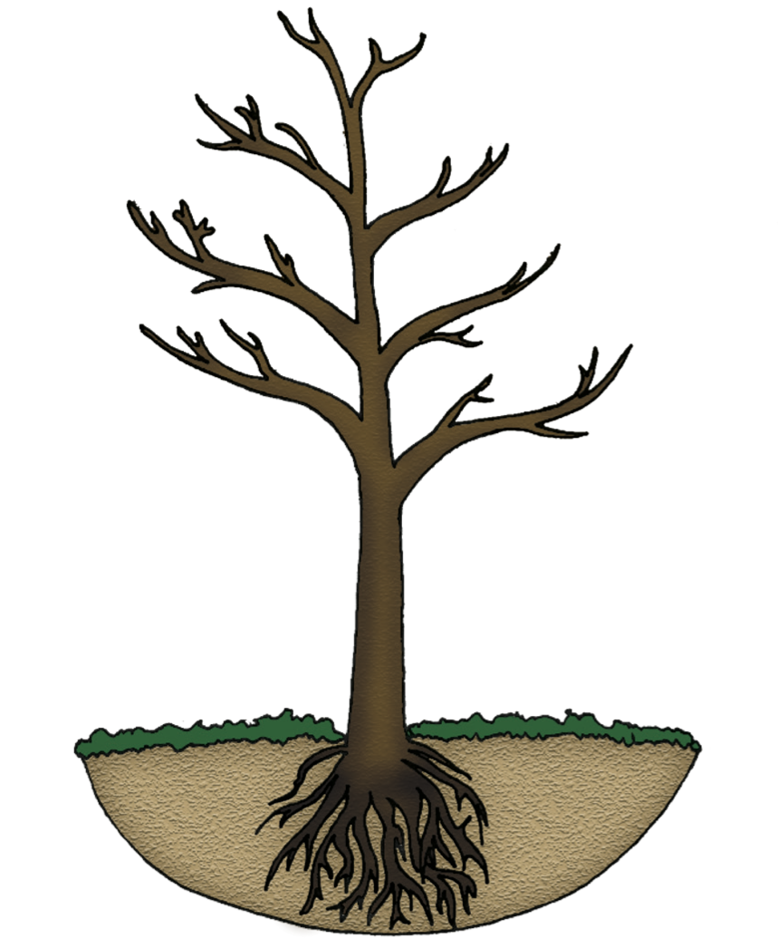
Planting and Care
Minimum:
Dig a hole at least the same depth and twice as wide as the root ball
The crown (point where root & stem meet) should be level with the ground surface
Except with citrus where the crown should be above ground level

Slide 6
Mulch and Sheet Mulch
Mulch or Sheet Mulch Your Plants
Acts as a weed barrier
Provides slow release of nutrients
Conserves water
Protects your plants from bushcutters
Bushcutters
Often damage desired plants
“Bushcutter disease” - careless cuts can girdle tree; kills many trees on Guam
Throw up clippings and soil/rocks which can damage trees and spread disease
Keep soil and mulch away (several inches) from the base of the stem to avoid rot.

Slide 7
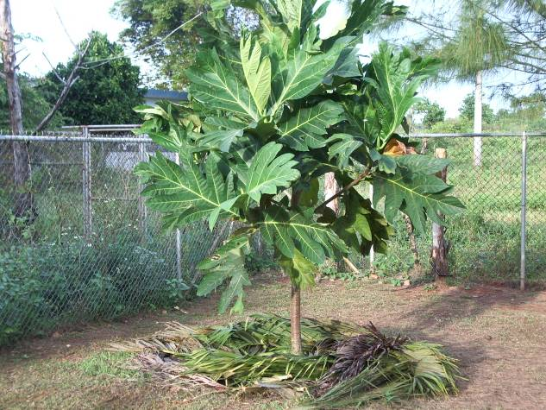
Young breadfruit tree with mulch around base

Slide 8
Common Causes of Plant Death
Bushcutter damage
Planted too deep
Mulched too deep
Over-watered or under-watered
Improper shoot-to-root ratio in transplanting

Slide 9
Species Height
Short Species: 20 feet and under
Calamansi
Key lime
Pomegranate
Fig
Medium to Large Species: over 20 feet
Soursop
Mulberry
Breadfruit

Slide 10
Spacing
Fruit Trees: | Windbreak: | Orchard:
Calamansi | 8-10 feet | 10-14 feet
Soursop | 8-12 feet | 12-15 feet
Pomegranate | 6-8 feet | 10-15 feet
Key Lime | 8-10 feet | 10-14 feet
Fig | 8-14 feet | 12-18 feet
Breadfruit | 12-16 feet | 15-40 feet
Mulberry | 8-12 feet | 10-20 feet

Slide 11
Propagation
Fruit Trees: | How to Propagate:
Calamansi | Seed, Air Layering, Grafting
Key lime | Seed, Air Layering, Grafting
Soursop | Seed, Air Layering
Pomegranate | Seed, Cutting, Air Layering, Grafting
Mulberry | Cuttings, Air Layering
Breadfruit | Root shoot & root Cuttings, Air Layering
Fig | Cuttings, Air Layering

Slide 12
Calamansi
Citrofortunella microcarpa
Also known as Calamondin
Drought tolerant
Cannot tolerate waterlogged soils
Can tolerate a wide range of soil types
Keep crown clear of soil
Can be used as a living fence

Slide 13
Calamansi
Prune water suckers/sprouts
Prune to an open center to improve airflow through canopy and increase light to branches
Flowers and fruits most of the year if irrigated
Peel can be used in animal feed mixes
Juice can be used as a lemon or lime alternative
Used in keleguen, finadene, jams, jellies, marmalades, teas, juices, and soups

Slide 14
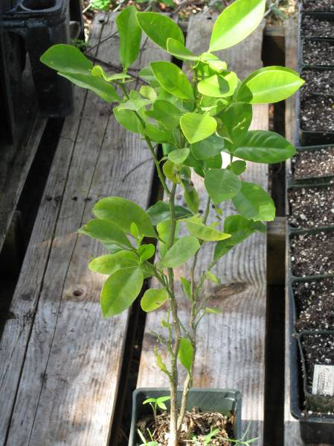
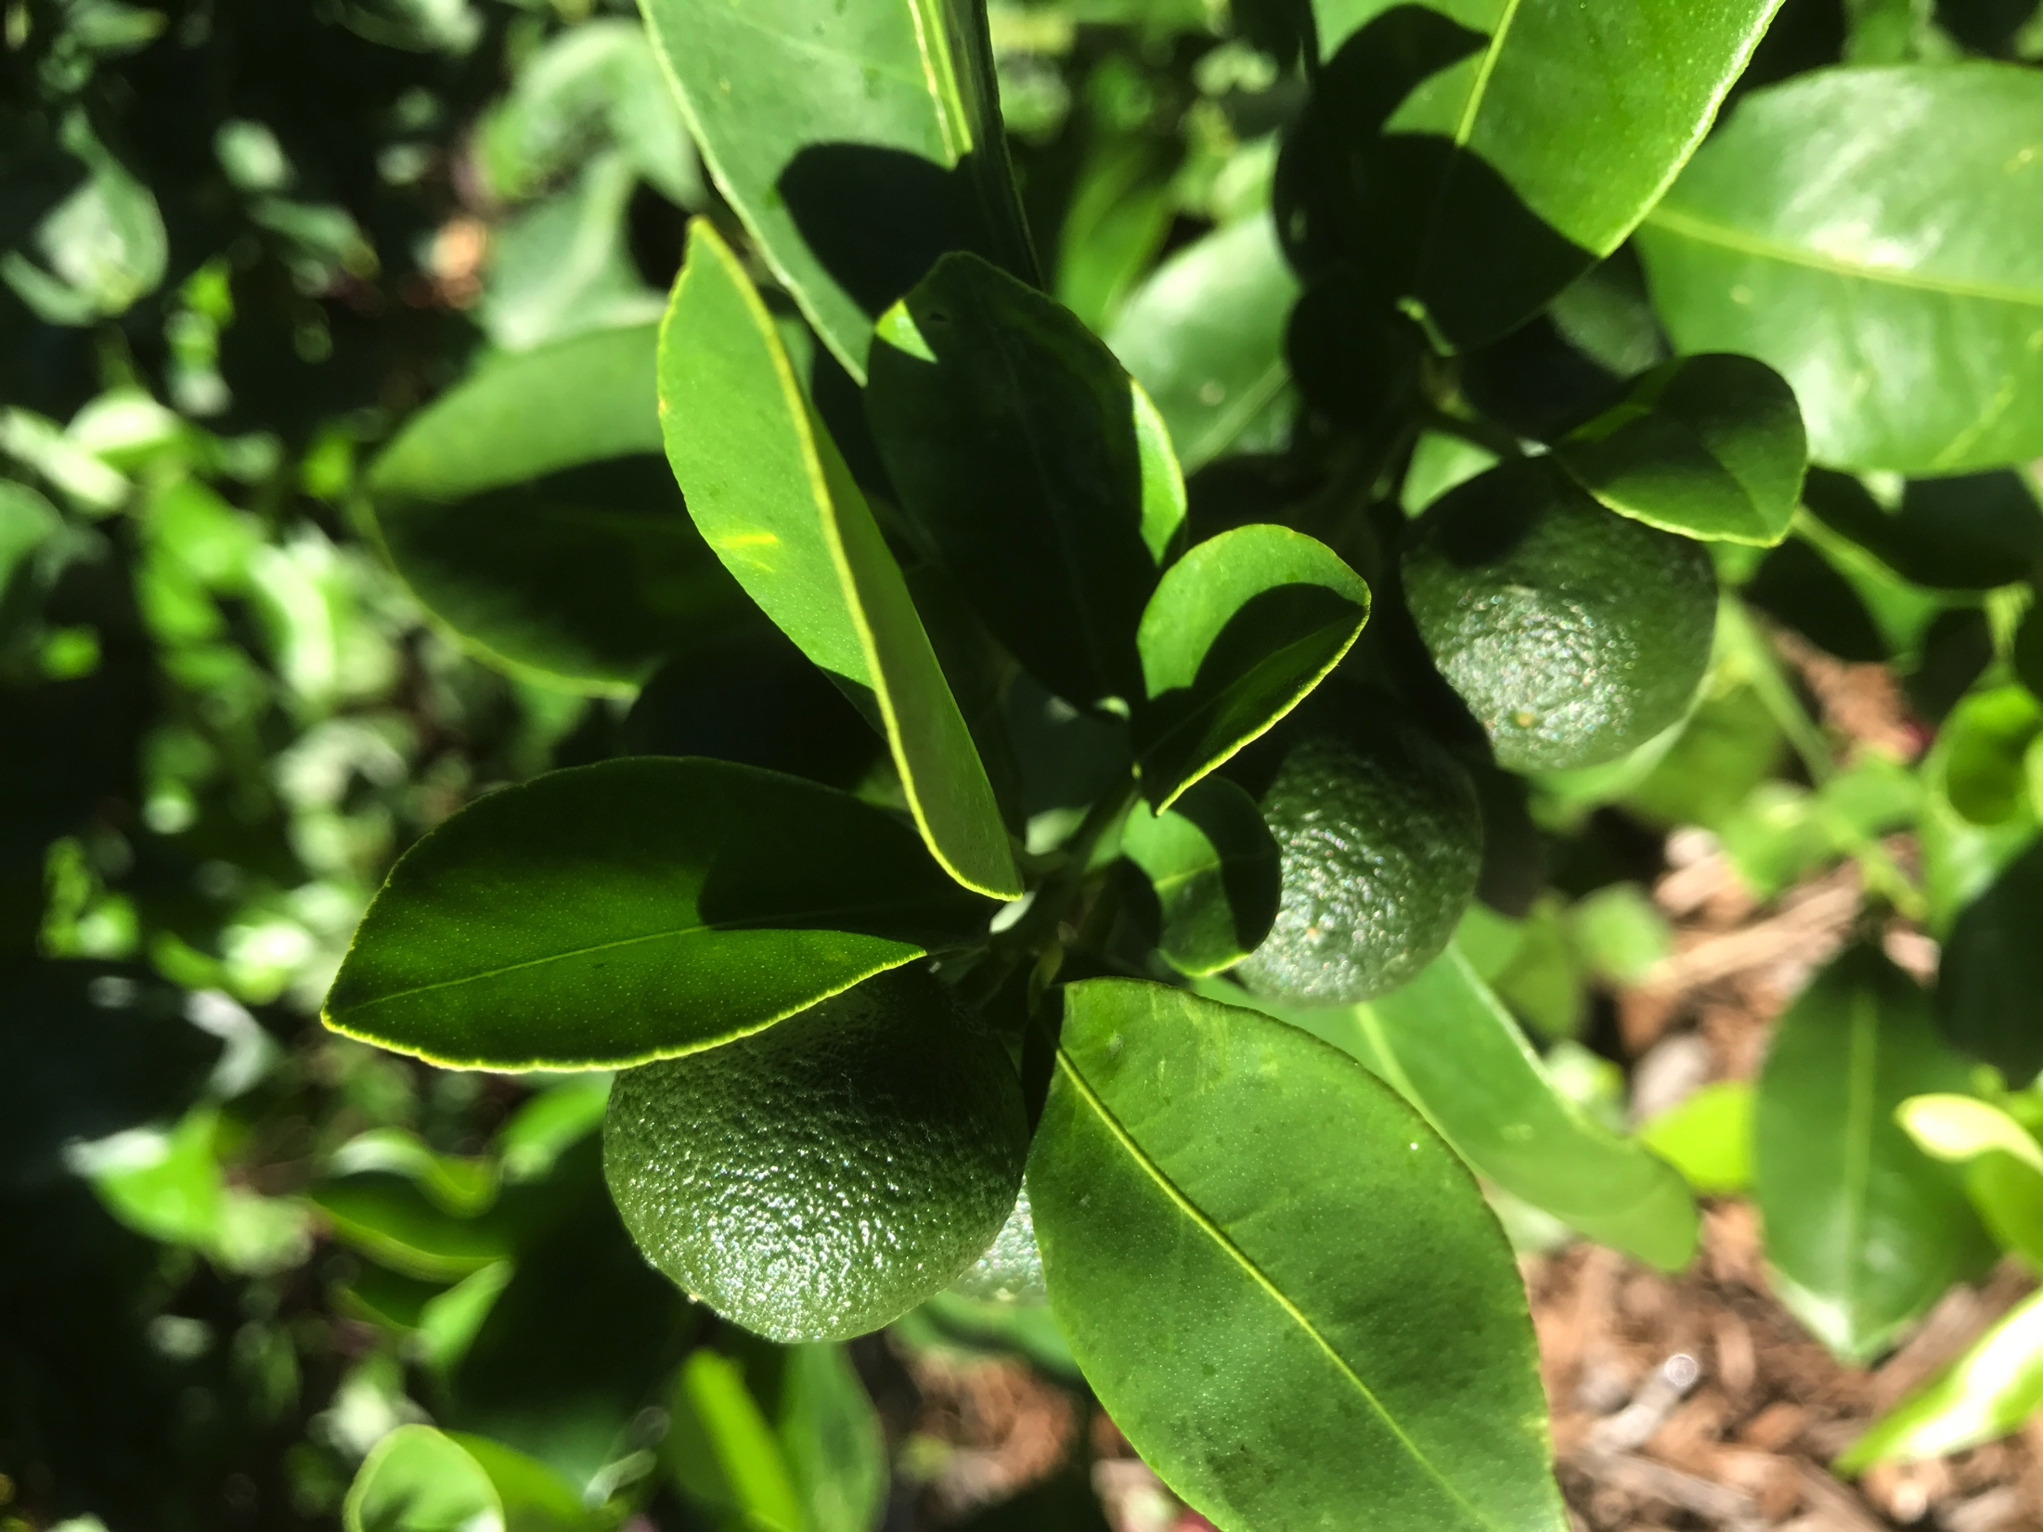
Calamansi

Slide 15
Key lime
Citrus aurantifolia
Also known as Mexican key lime
Cannot tolerate waterlogged soils
Keep crown clear of soil
Can be used as living fence
Prune to an open center to improve airflow through canopy and increase light to branches

Slide 16
Key lime
Harvest when the color has changed from dark to light green, the surface is smooth and the fruit feels slightly soft to the touch
Commonly the fully ripe, yellow limes are gathered from the ground
Fruit is fragrant and acidic
Used in kelaguen, finadene, jams, jellies, marmalades, and juices
Caution: Key lime has sharp spines or thorns

Slide 17
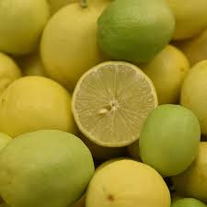
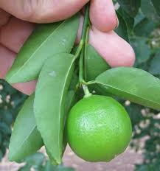
Key lime

Slide 18
Soursop
Annona muricata
Also known as guayabano (Tagalog) and laguana (Chamorro)
Tolerates a wide variety of soil types
If soil is too dry, the tree will drop all its leaves; mulching and irrigation are recommended
Plant can be easily shaped by pruning
Flowers and fruits more or less throughout the year

Slide 19
Soursop
Harvest fruit when full grown and still firm but slightly yellow-green
If allowed to soften on the tree for too long, it will fall and break open
Juice and pulp can be used in drinks or fruit can be dried
Fruit and pulp may be used as animal fodder if seeds are removed
Caution: Seeds are poisonous and the oil can cause eye inflammation

Slide 20
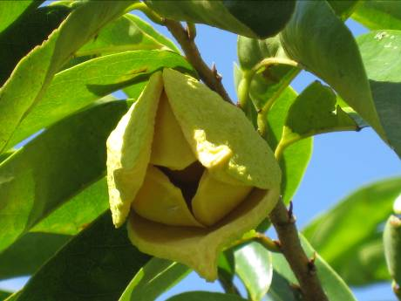
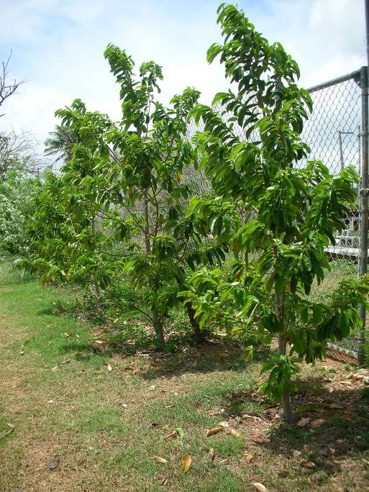

Slide 21
Mulberry
Morus nigra
Commonly known an black mulberry
Tolerates most soil types
Drought and flood tolerant
Agroforestry uses include shade, shelter, animal fodder, as a windbreak, and as a living fence
Year-round fruit production with irrigation

Slide 22
Mulberry
Fruit is ripe when the color darkens to a deep red or purplish black
Short shelf life
Used in jams, jellies, marmalades, juices, sauces, and desserts
Can be dried into a powder

Slide 23
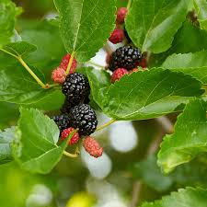
Mulberry
yougarden.com

Slide 24
Breadfruit
Artocarpus altilis
Lemmai (Chamorro)
Trees are salt and drought tolerant
Adapted to most soil types
Trees can be “kept low” by regular pruning
Does well inter-planted with other species
Fruits can weigh 0.5 – 3 lbs

Slide 25
Breadfruit
Indicators of fruit maturity: sap dripping from fruit, bumps on surface become smooth, and color change from green to yellow
Caution: Roots can damage structures if planted too close and can be easily damaged by mowers and other equipment (heavy mulching recommended)

Slide 26
Breadfruit

Slide 27
Pomegranate
Punica granatum L.
Overall a tough, dense, low growing plant ideal for barrier plantings and windbreaks
Tolerates a wide range of soil types
Drought tolerant
Irrigation needed for fruit production during extended dry periods
Fruits forms only on tips of new growth

Slide 28
Pomegranate
Fruits are harvested once they turn color
Fruits should be cut from tree – not pulled off.
Over mature fruits will crack
Fruits do not continue to ripen after harvest
Flesh around seeds is eaten fresh
Processed for juice or syrup
Caution: Pomegranate has many spines or thorns

Slide 29
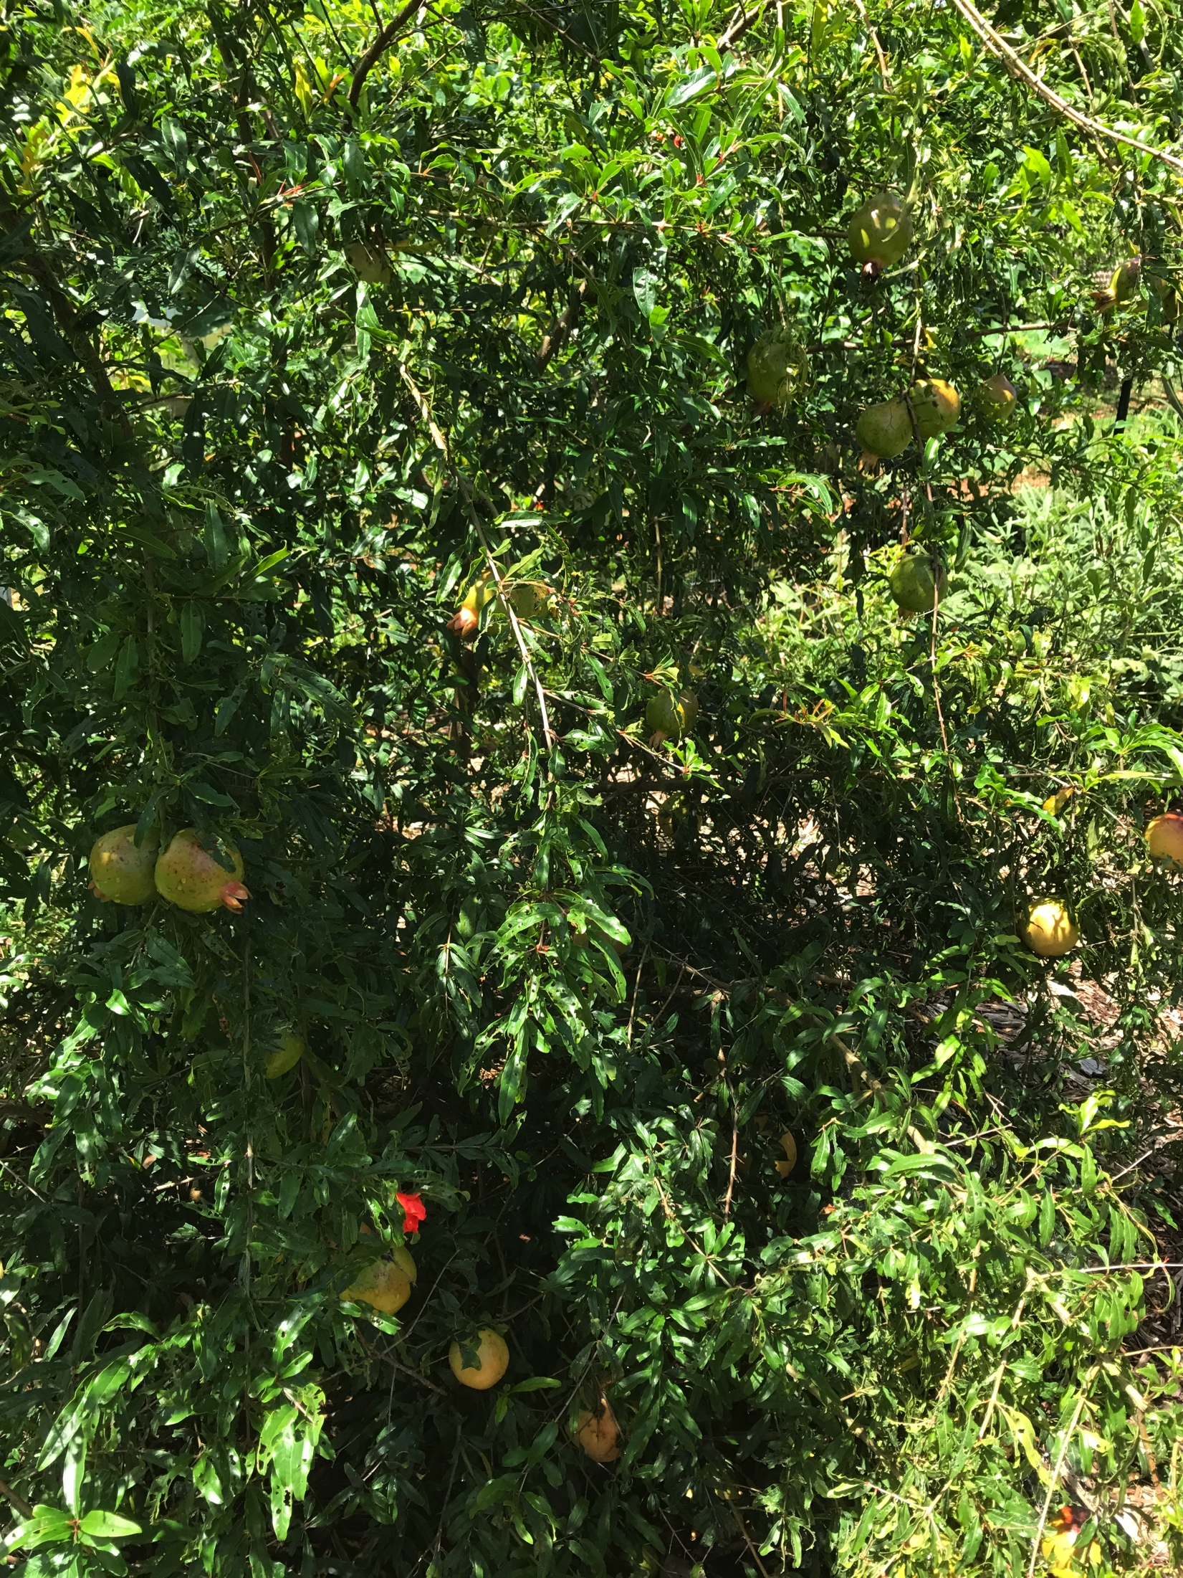
Pomegranate

Slide 30
Fig
Ficus carica
Over 1,000 cultivars of fig
Brown Turkey and White Kadota on Guam
Grows well in moist, but not saturated soils
Requires frequent watering during dry season
Advisable to prune trees to facilitate harvesting

Slide 31
Fig
Can tolerate severe pruning
Can be pruned as an espalier or kept very low to the ground
Harvested fruits are fragile and should be placed in a container so they do not damage each other
High in fiber
Caution: Contains latex which may cause skin rash

Slide 32
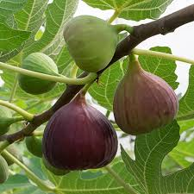
Fig
yougarden.com

Slide 33
For More Information
For more information contact your local Cooperative Extension Service at 735-2080

