Slide 1
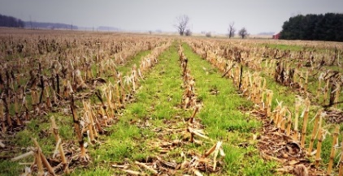










COVER CROPS in Shatto Ditch Watershed
Laboratory of Jennifer L. Tank, Dept. of Biological Sciences, University of Notre Dame
The OPPORTUNITY: Reducing nutrient loss from soils and tile drains
Cover crops reduce soil erosion, decrease soil compaction, and suppress weed growth while also increasing soil organic matter and soil water-holding capacity. They can also reduce nutrient loss through subsurface tile drainage.
Our STRATEGY
GOAL: Retain nutrients/soils on fields and reduce stream export. Cover crops are planted after cash crop harvest and their growth coincides with critical times for nutrient export from tiles to streams/ditches. We are measuring cover crop impact on soil health and tile drain nutrient loss.
RESULTS (2016 to Present)
Soil Nitrate-N and Test P concentrations are lower in cover crop fields than those without.
Bioavailable-N and P are tied up by active cover crop growth during the Fall and Spring seasons.
Soil nitrate-N was 48% lower in cover cropped fields, and soil test P was 32% lower on average in cover cropped fields.
SOILS
CC fields
Same field changed to NoCC
Soil Organic Matter (OM) increases 0.1% per year with winter cover crop adoption.
Cover crops increase SOM through reducing erosion and adding biomass to the soil.
When cover crop planting ceases, the pattern disappears.
NoCC field
Nitrate-N and Soluble Reactive Phosphorus (SRP) losses are lower from tile drains draining cover cropped fields.
Cover crops retain nutrients and reduce leaching from agricultural fields.
Nitrate-N and SRP losses were on average 39% and 56% lower in cover cropped fields than non-cover cropped fields, respectively.
TILE DRAINS
CONCLUSIONS: Cover crop fields and tile drains had lower nitrate-N and P than fields without cover crops. Planting cover crops in winter increases soil organic matter over time.
Contact: Dr. Jennifer Tank (jtank@nd.edu) Version: August 2023

Slide 2
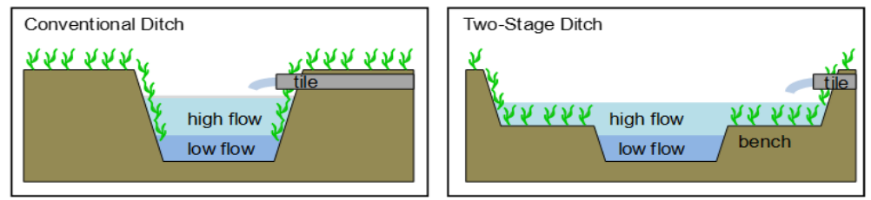
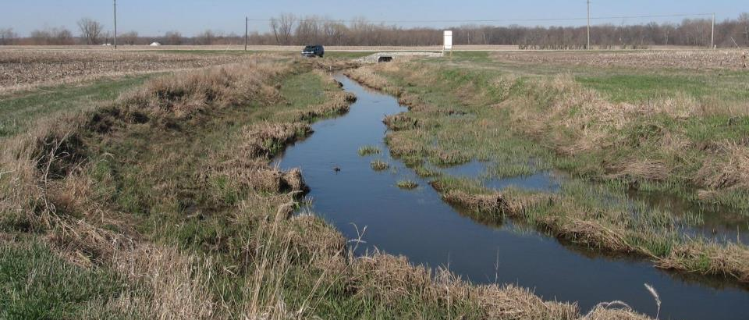
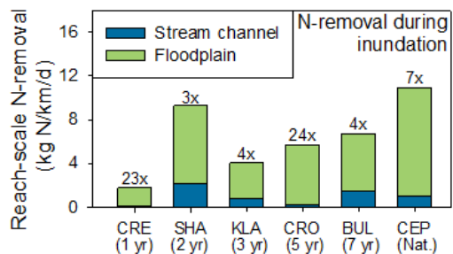
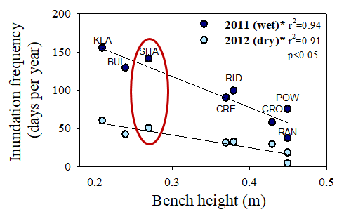
TWO-STAGE DITCH in Shatto Ditch Watershed
Laboratory of Jennifer L. Tank, Dept. of Biological Sciences, University of Notre Dame
The OPPORTUNITY: Reducing nutrient and sediment export
Channelized ditches export excess nitrogen (N), phosphorus (P) and sediments. Excess nutrients contaminate drinking water, fuel algal blooms and harm fish. Excess sediments can impair fish spawning and suffocate mussels.
Our STRATEGY
GOAL: Maximize sediment, N and P removal before downstream export using the two-stage ditch.
RESULTS to date
Two-stage ditch reduces turbidity and sediments.
Floodplain inundation slows water during storms, promoting sediment retention.
October
February
N removal capacity increases as the two-stage “matures”.
During flooding, increased surface area (from the two-stage) enhances nutrient retention.
Floodplains increase N removal by 3-24 times that of channelized ditches.
Storm flows inundate two-stage floodplains, but duration varies among wet and dry years.
Two-stage floodplains slow water velocities during storms.
CONCLUSIONS: Two-stage ditch consistently improved N removal, reduced turbidity and sediment export and improved channel habitat. These positive outcomes were consistent across a range of streams that varies in two-stage age.
Contact: Dr. Jennifer Tank (jtank@nd.edu) Version: August 2023

