Slide 1
Caseous Lymphadenitis (CL): Alternative Treatments
Maine Sheep Breeders Association, Nov. 10, 2018, Bangor ME
Sarah Paluso
School of Food and Agriculture
University of Maine, Orono ME

Slide 2
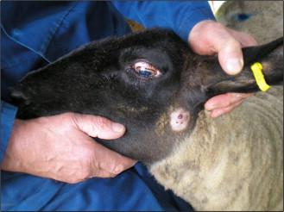
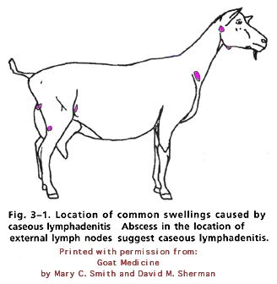
Caseous Lymphadenitis (CL)
Highly contagious bacterial infection of small ruminants (sheep and goats)
Caused by Corynebacterium pseudotuberculosis
Causes internal or external abscesses
Baird & Fontaine, 2007

Slide 3
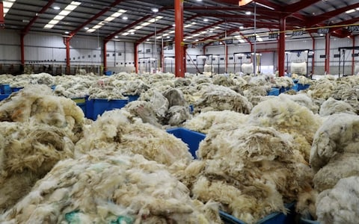
Prevalence
Approximately 22% of Maine sheep and 43% of Maine sheep farms tested positive for CL in 2012
In Western U.S., CL incidence rates have reached 42%
Can result in weight loss and decrease in wool, meat, or milk production
https://www.telegraph.co.uk/business/2016/11/20/british-wool-a-thriving-industry-thanks-to-running-the-last-mark/

Slide 4
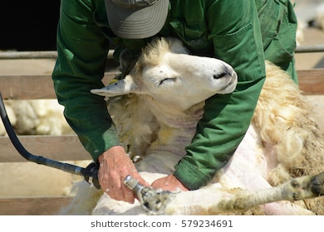
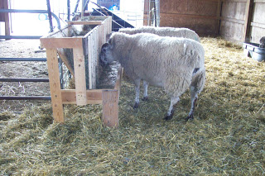
Transmission
Often transmitted through direct contact with ruptured abscesses
Sheep often acquire the disease through minor skin abrasions due to sheering, ear tagging, etc.
C. pseudotuberculosis can survive up to 2 months on inanimate surfaces (plastic, wood, steel) and over 6 months in cool, damp conditions such as soil or bedding
http://midlandagrarian.blogspot.com/2009/01/sheep-feeder-project.html

Slide 5
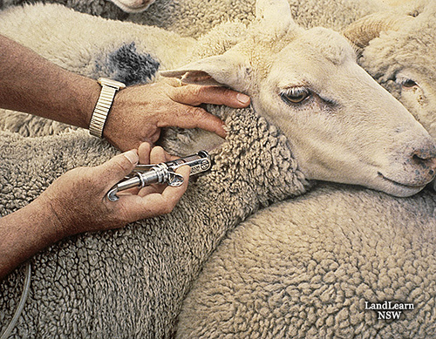
Prevention
CL is usually introduced to a naïve flock through introduction of an infected animal
Can be prevented by enforcing strict biosecurity measures (i.e. test and quarantine all new animals, regular testing of flock, disinfecting farm surfaces)
Difficult to treat with antibiotics
Currently no completely effective vaccination method available – interferes with diagnostic testing

Slide 6
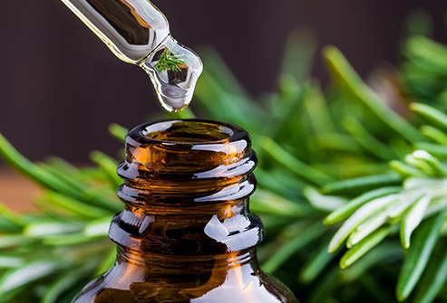
Essential Oils as Antimicrobials
Oil made up of specific chemicals that give the plant its “essence” (odor, flavor, etc.)
Several essential oils have been found to have antimicrobial properties against even highly pathogenic and antibiotic resistant bacteria such as Mycobacterium tuberculosis (causes tuberculosis in humans and related to C. pseudotuberculosis)
Antibacterial mechanisms vary greatly between EOs (inhibit bacterial communication, movement, energy sources, etc.)
Our project is examining some of these oils and their ability to kill or prevent growth of C. pseudotuberculosis

Slide 7
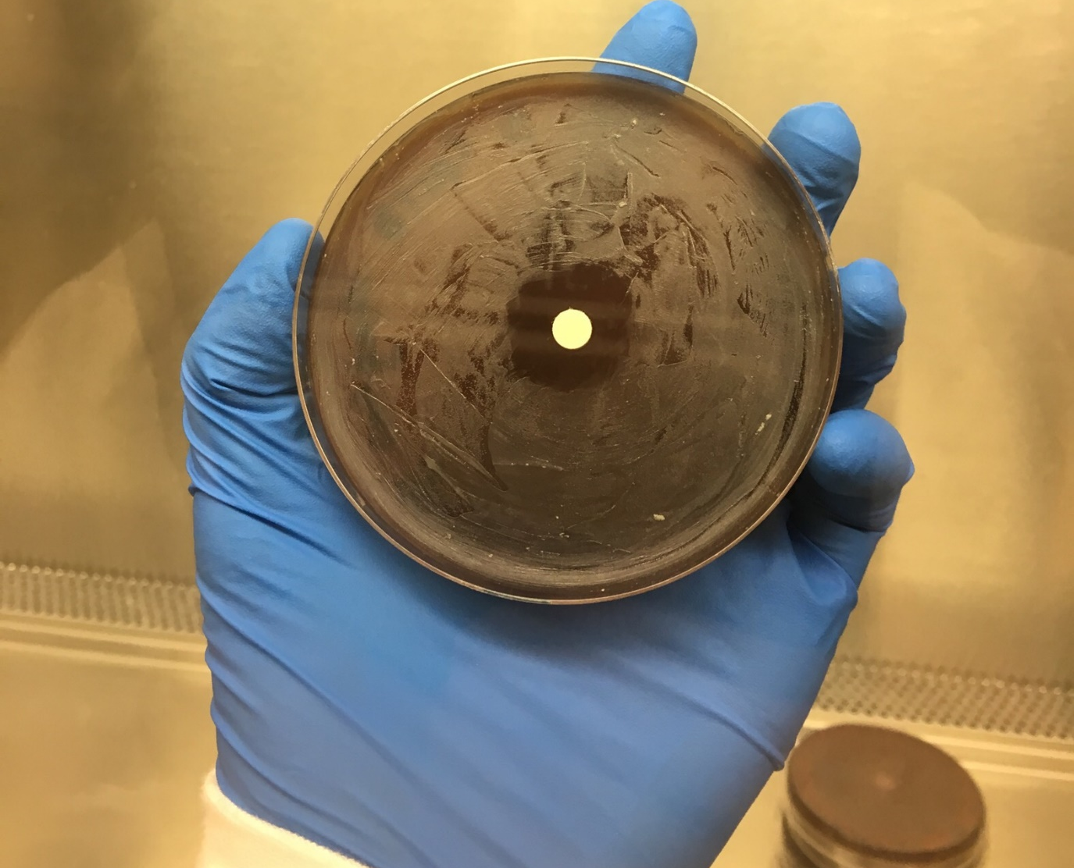
Project Phase 1
Purpose: Evaluate antimicrobial potential of chemicals commonly found in essential oils
Find the minimum concentration needed to inhibit growth of C. pseudoTB for each chemical (Minimum Inhibitory Concentration)
Disk Diffusion Assay
Essential Oil Components
Cuminaldehyde
Cinnamaldehyde
Cinnamic acid
a-Terpinene
B-citronellol
B-Pinene
p-Anisaldehyde
Thymol
Terpinolene
Carvacrol
10 ug gentamicin C. psTB

Slide 8
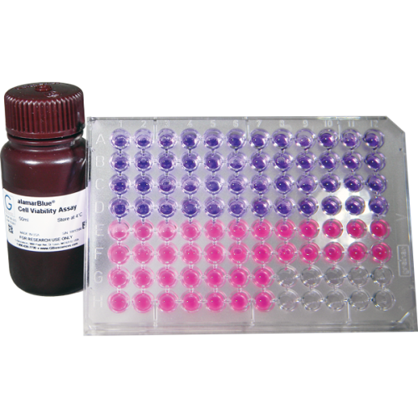
Project Phase 2
Purpose: Evaluate the toxicity of essential oil components
Use mouse immune cells as model for sheep/goat immune cells
Use Alamar Blue cell viability assay to determine if EO chemicals damage the cells
Alamar Blue Cell Viability Assay

Slide 9
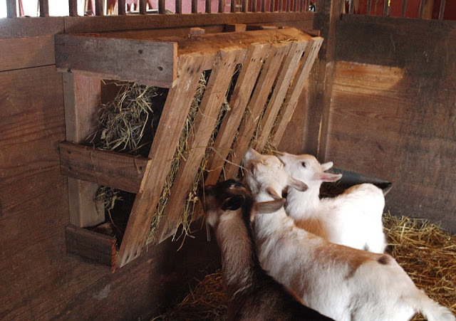
Future Directions
Use essential oils as disinfectant of contaminated farm surfaces
Use essential oils as oral antibiotic (alone or in conjunction with standard antibiotics)

Slide 10
Acknowledgments
Funding: NE SARE Graduate Student Grant
Advisor: Anne Lichtenwalner DVM PhD
Technical assistance: Ann Bryant
Undergraduate colleague: Cassie Miller
Facilities: School of Food and Agric.

Slide 11
Thank you
Questions?

