Slide 1
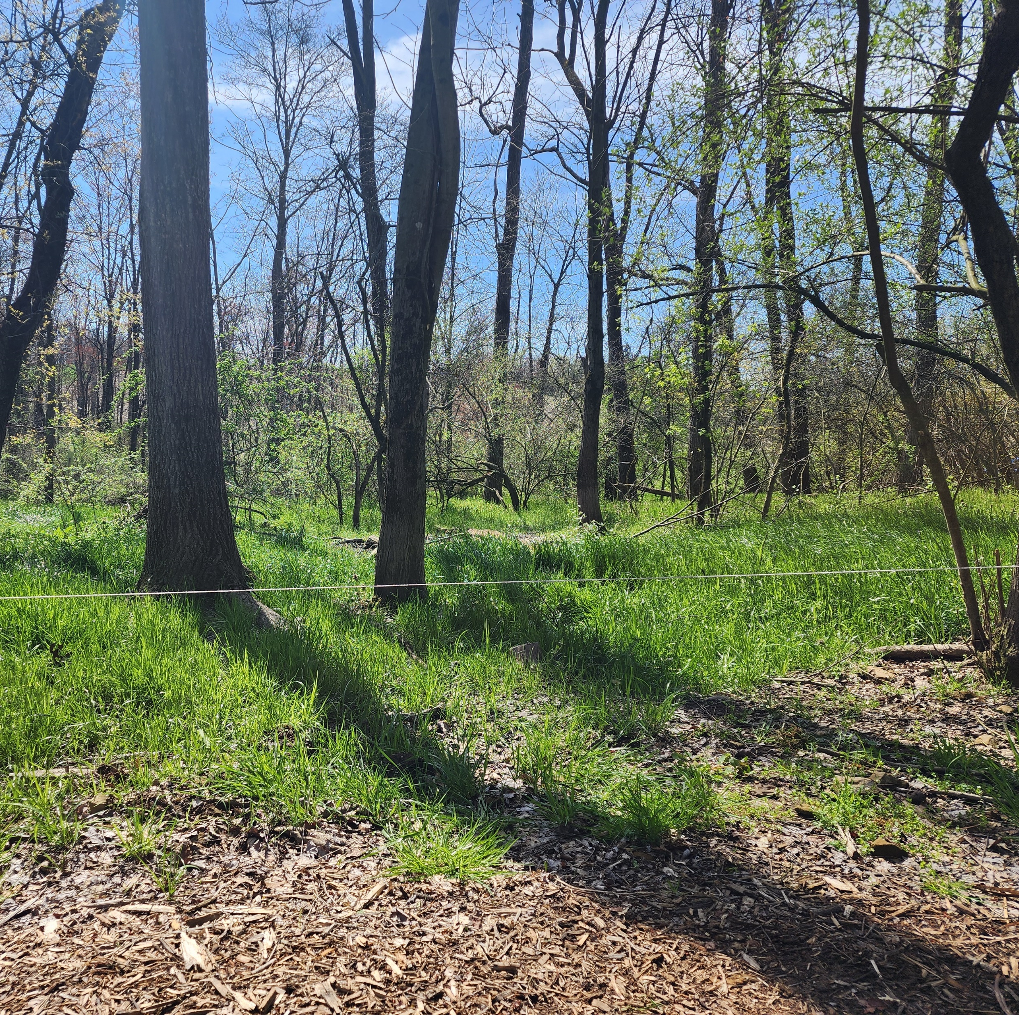
Silvopasture Pigs NE SARE Project FNE-053
Profitably and Sustainably Converting Underutilized Forested Areas to Fertile Perennial Silvopasture Systems Using Swine

Slide 2
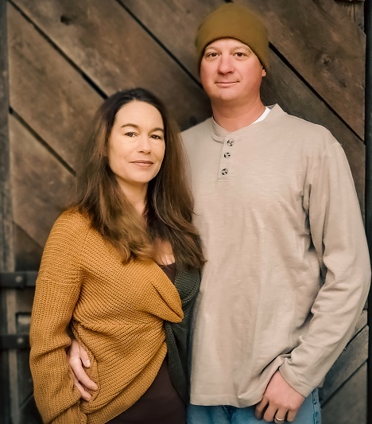
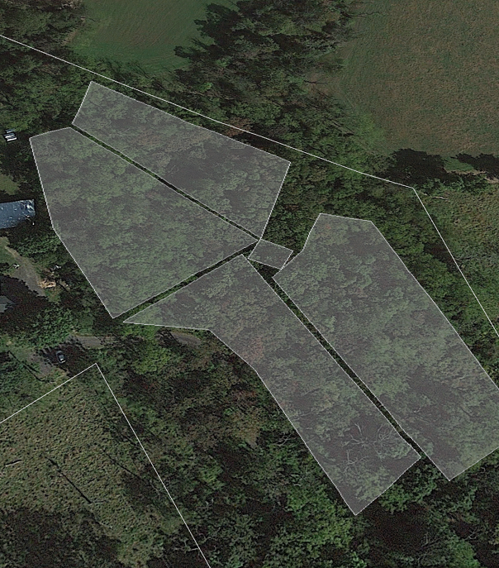
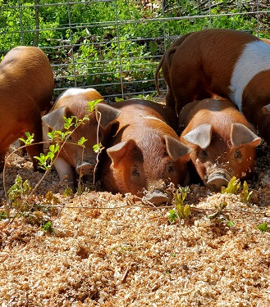
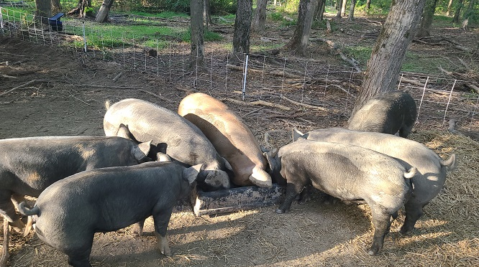
Skyline Pastures
Skyline pastures is a regenerative-focused pastured meat farm specializing in pastured broilers, pastured turkeys, forest-raised pork, and grass-fed, grass-finished beef. We are located just outside of Hamburg, PA and have been farming commercially for 5 years. The farm is a family operation with myself doing the lion’s share and my wife and 2 kids helping when needed. Visit us at https://skylinepastures.com

Slide 3
What is SARE (Sustainable Agriculture Research and Education)
The Purpose of SARE, and thus Northeast (NE) SARE and its grant programs is to “explore new concepts in sustainable agriculture conducted through experiments, surveys, prototypes, on-farm demonstrations or other research and education techniques. Farmer Grant projects address issues that affect farming with long-term sustainability in mind”
Visit https://northeast.sare.org for more information

Slide 4
About NE SARE Farmer Grants
“typically range from $5,000 to $30,000, depending upon a project’s complexity and duration”
“Applicants should only request the amount of funding that is clearly necessary for the success of their project”
One thing that is unique about NE SARE Farmer Grants is that you can factor in your labor for conducting the grant research.
Ask yourself “What could I test on my farm that will increase viability / sustainability / profitability / animal welfare / etc.”, and then determine everything required, including your time, to get it done. All of this data will be used to build your grant application and budget worksheet.
Grants are highly competitive and highly monitored. Put in the work to reap the benefit.
If awarded a NE SARE Farmer Grant, “Funds can be used to conduct the research project including paying farmers for their time, for project-related materials, for project costs like consulting fees or soil tests, and any communications or outreach expenses associated with telling others about project results.”

Slide 5
Our Silvopasture Pig Project
We aim to test and demonstrate that raising pigs in the woods is a net positive for the land as well as for the farmer
Using otherwise wasted space
Producing a highly profitable and easily marketed meat yield
Increasing grazable acreage without the use of heavy equipment
Minimal financial and time invested
Significant effort put into the grant application process
Approximately 80 hours of work over 2 months
Many additional hours of online research (reading proposals/watching videos)
Coordinating with Technical Advisor and Key Cooperator
Proofreading and Rewriting
Reporting Requirements
Annual reporting required
Reimbursement submission is best done quarterly

Slide 6
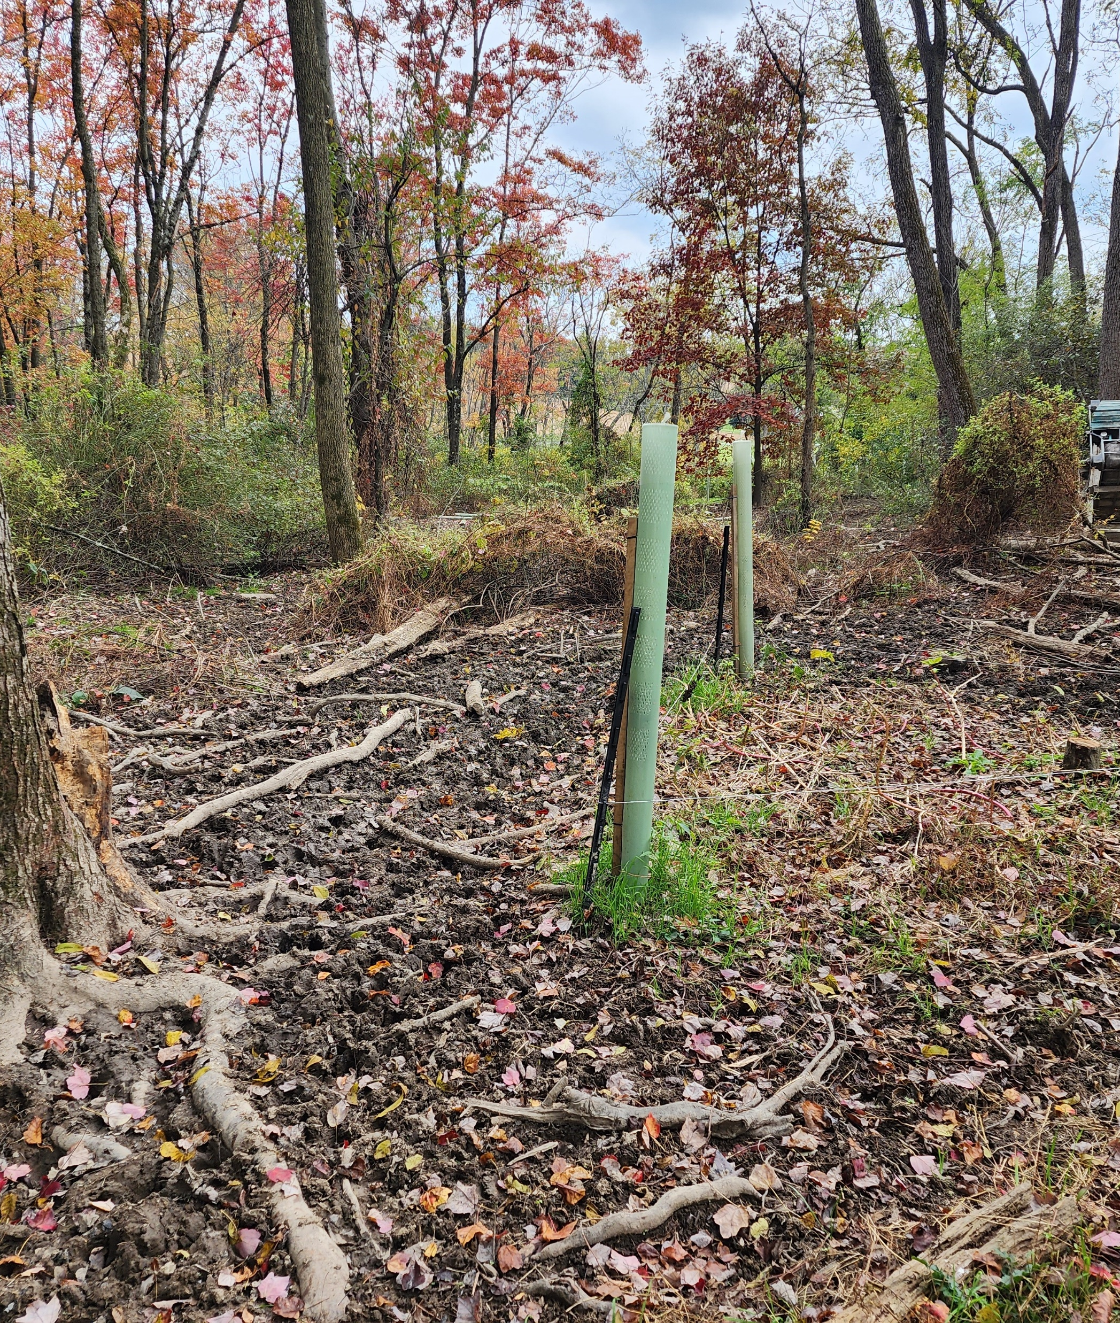
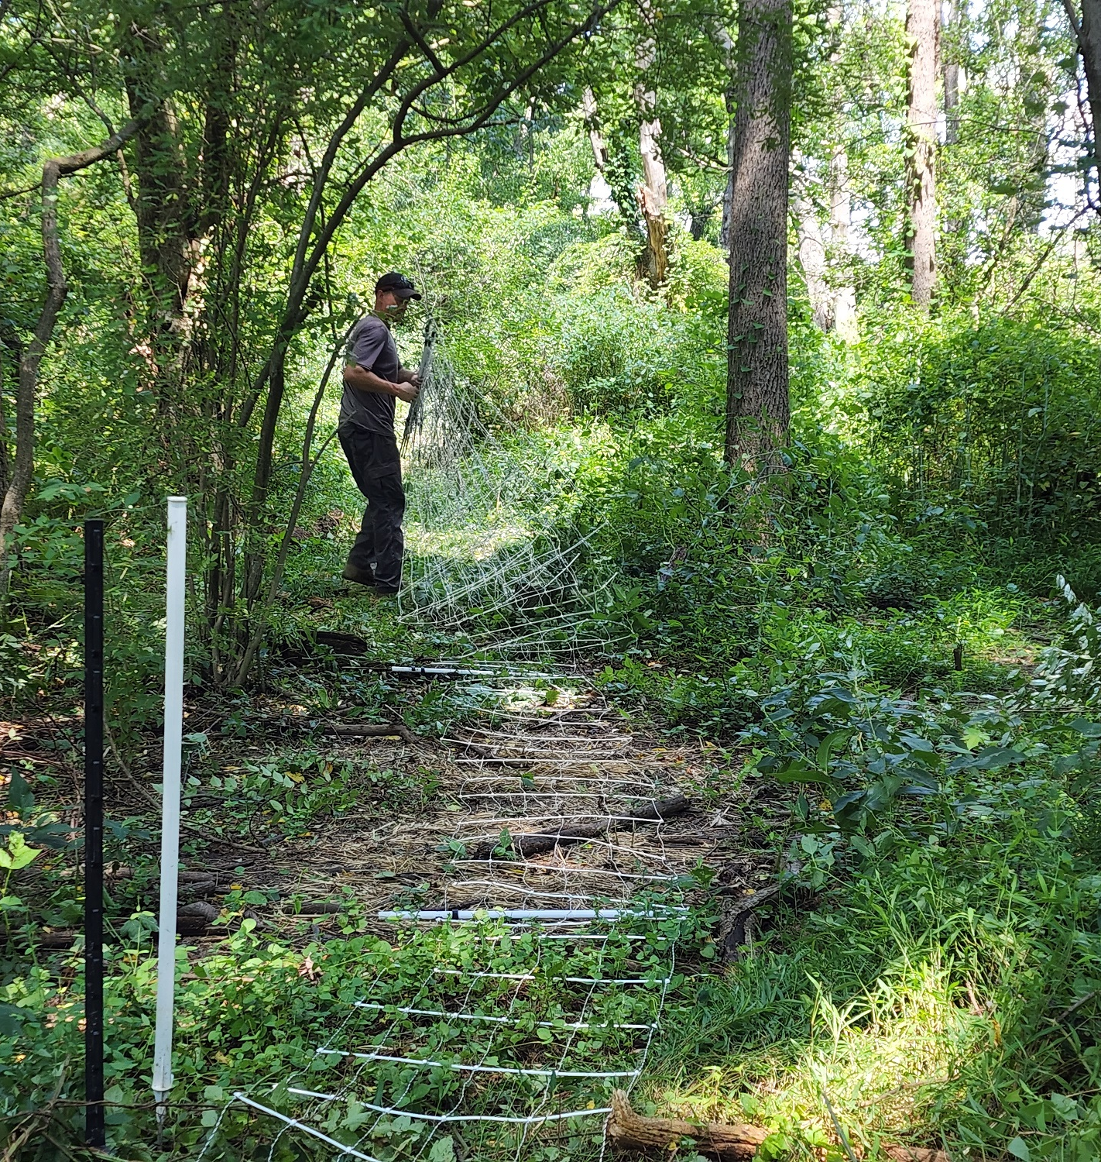
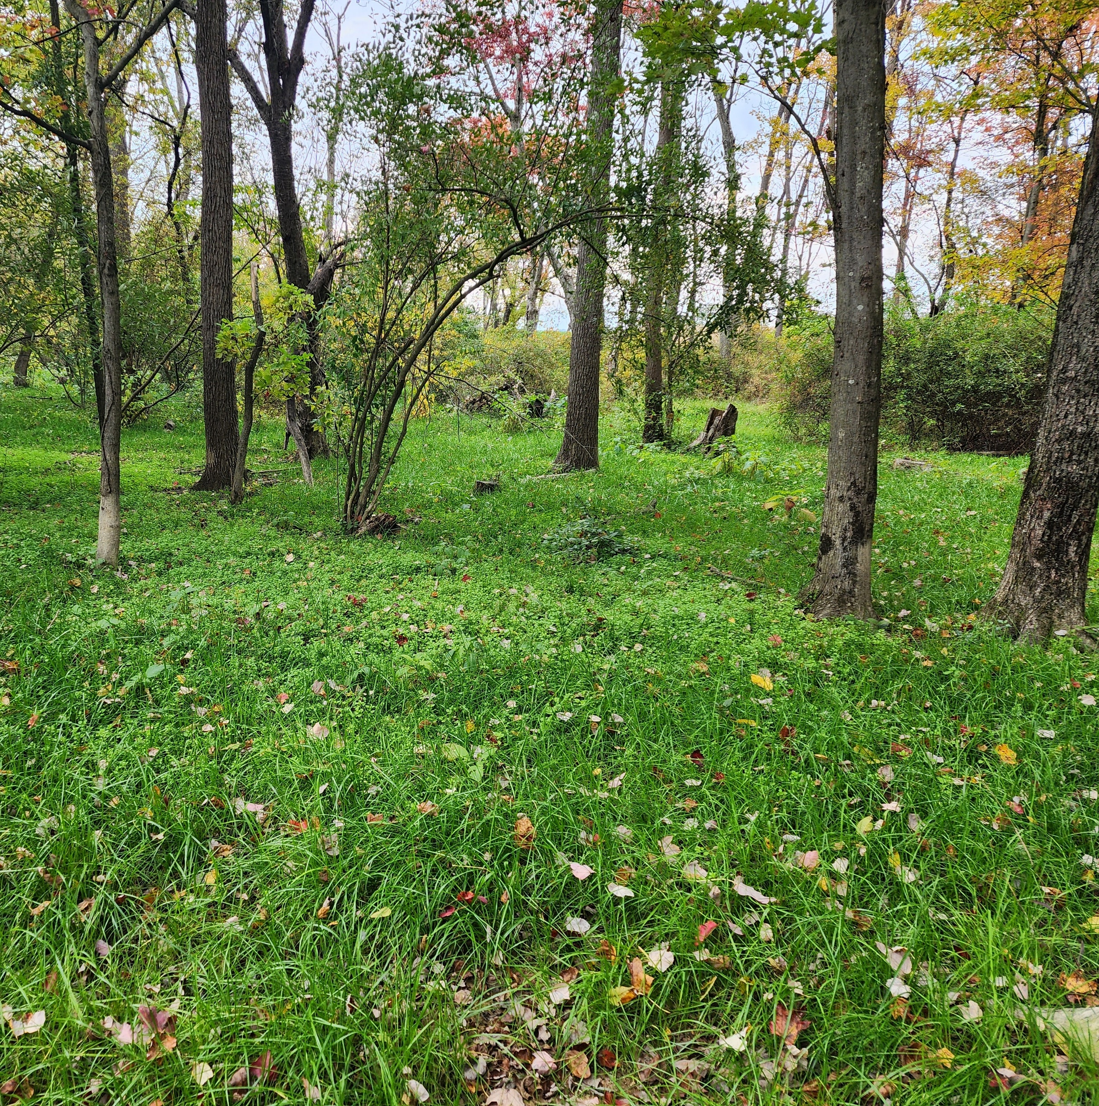
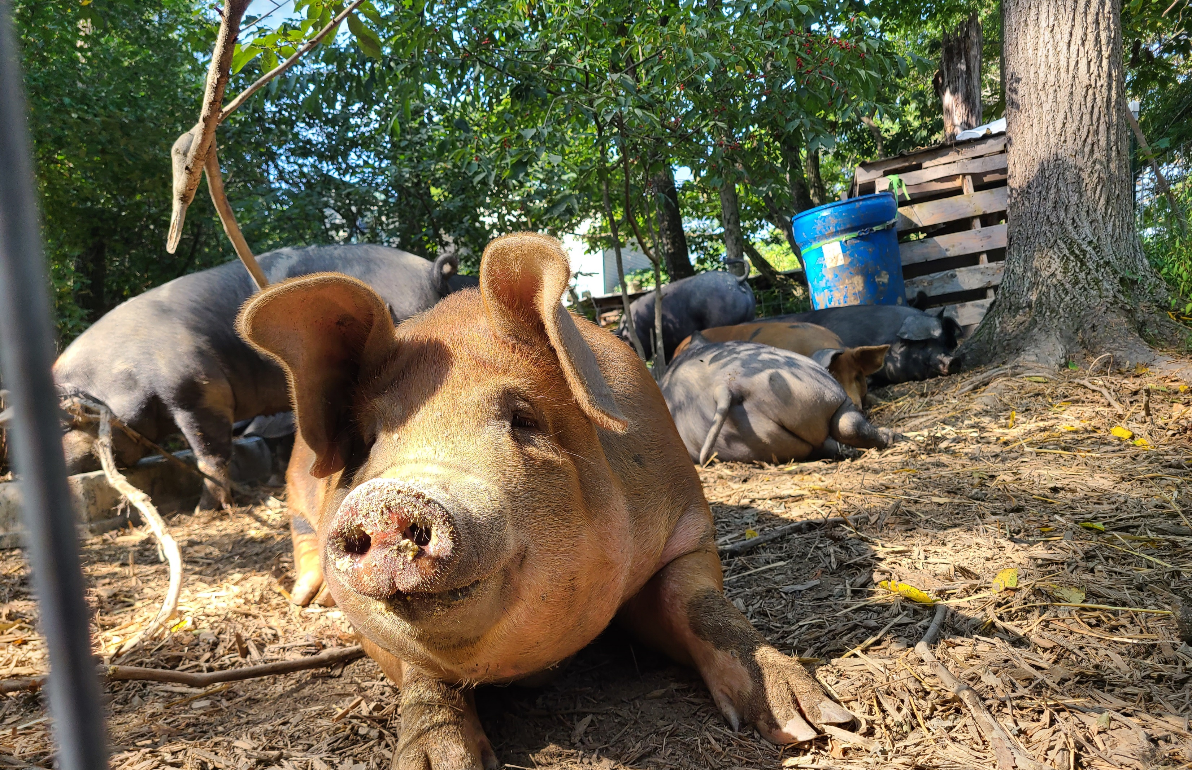
PICS and Data on our project
Lots of YouTube records at:
@skylinepastures8445 or just search Skyline Pastures

Slide 7
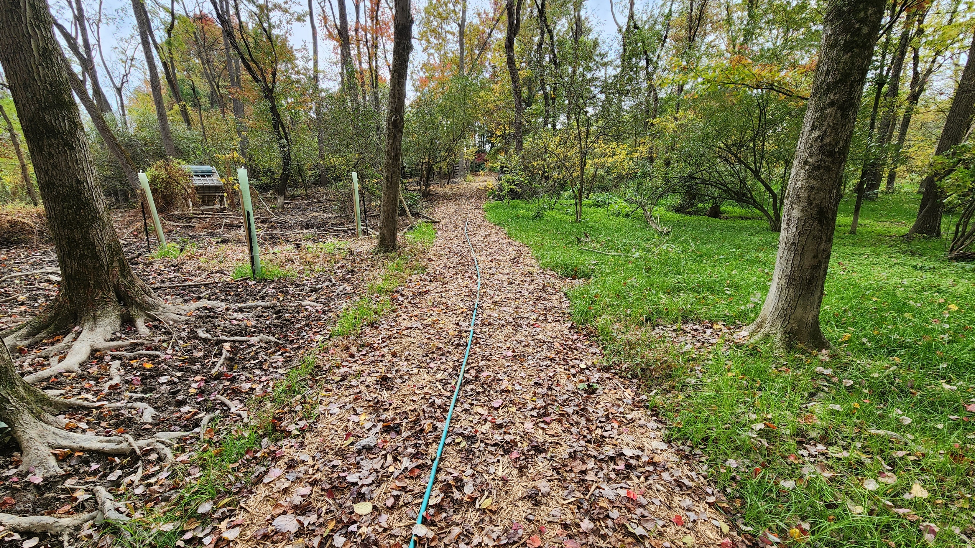
Good Shot of Before and After Pig Rotation

Slide 8
GRANT WRITING reference: Presentation by Mike Mitchell for FSU

Slide 9
Important factors in research prior to writing
Do your research
Talk to and research the agency funding the grant
Talk to (if possible, and it likely is possible) someone who has previously received the specific grant you are applying for.
Look at as many similar funded grants or projects associated with what you are looking to do and take all of the best parts of each. Discard what you think is ineffective from your own writing and processes.
Look at the stated goals of the grant, and then next your project to meet those goals. Write your proposal so that the selection board views your project as a perfect fit.
When searching for grant opportunities, prioritize the ones that include you in a limited population (veteran, beginning farmer, underserved demographic, urban, etc.)

Slide 10
Important considerations while writing
Write confidently. For a research grant, If you have evidence that your project is likely to succeed based on experience or other evidence, then specify that.
Use the allotted space but don’t use fluff. Take your time and fill the word count with useful and persuasive data that furthers your goal.
Set deadlines and adhere to them. It’s a terrible shame to put forth the effort of writing a winning proposal and then be disqualified for a late submission.

Slide 11
While writing cont.
It is vital to use clear concise language. The person or panel reading your proposal is likely reading hundreds of them in a week. They are likely not an expert in your particular interest and will not understand jargon or industry-specific terms. Write your proposal like you were explaining it to a friend at a BBQ.
Be compelling and excited in your language. Reviewers likely want to award someone who is motivated, informed, and intelligent so that they have the highest probability of the funds furthering the goal of the program.
Never assume that the reviewer knows what you are talking about. Explain processes, goals, etc. in terms that create a picture in the mind.
Write your proposal so that it is visually pleasing (bullets, Bold Headings, italics for necessary jargon with explanations)

Slide 12
While writing cont.
After you have drafted your proposal structure, re-read the rules and requirements and then validate that your proposal follows them.
Have multiple disinterested and highly critical friends or associates read your proposal from an editorial viewpoint.

Slide 13
Budget Considerations
Work through the entire project in your mind, over and over again, identifying ALL expenses
Use excel to document individual line items, no matter now trivial, and add a link to the most economical or appropriate place to purchase them.
Depending on the grant, you may be able to factor in labor. Compensate yourself fairly for your time, but do not over inflate your value.
Some grants want you to create one line for incidental small purchases (nuts and bolts, rope, lubricants, etc.)

Slide 14
Set expectations
Many grants are reimbursement based, so you do the work out of pocket, or with borrowed funds, then prove the work has been completed, provide receipts, and receive a check. Others give you part of the money up front, and the remainder upon completion.
It is beneficial to have a business for a variety of reasons:
You can expense the grant funds within the business to avoid or limit taxes
Many grants (especially agricultural grants) require a business plan, proof of Schedule F filing, etc. to apply.

Slide 15
Agricultural Grant Opportunities
SARE Grants - Farm Grants – SARE
Once on the site select your region and then click on “get a grant”
For instance, NE SARE has six grant categories depending on your goals and organizational level. I received a Farmer Grant of over 11k. To create and document a silvopasture on about 4 acres of woods using swine
PAVFN Force Multiplier Grant PA Veteran Farming Network | PAVeteranFarms (pavetfarms.org)
The PA Veteran Farming Network offers several grants to PA Veterans for farm improvements and business improvements. Their site also serves as a bulletin board for a variety of other opportunities (Grants, reimbursements, education, outreach) to better serve the Pennsylvania Veteran Community
FACT ADD LINK

Slide 16
American Farmland Trust Home - American Farmland Trust
Focused on Regenerative Agriculture, they offer a yearly grant called the Brighter Future Fund, which helps farmers purchase equipment to improve animal welfare, land stewardship, and farm vitality.
Farm Vet Co https://farmvetco.org/
Nationwide veteran organization aiming to help veterans transition from military service to farming. They offer a Fellowship which allows beginning farmers to fund equipment and infrastructure to help get their businesses off the ground.
Home Grown By Heroes: Enables veteran farmers to clearly brand their items as veteran produced to help with market differentiation.
Dept of Ag
Tons of different opportunities depending on your business and the state you live in

Slide 17
10 QUESTIONS
1. What are some available grant opportunites for established farmers?
Slide 15-16
2. Are there grants for farmers who are under the table or just getting started? ie: never filed a schedule F
These are limited but searching can yield results. You likely need some sort of distinguishing affiliation. Typically there aren’t grants for homesteaders/hobbyists, etc. The grants are for growing businesses and usually the panel wants to see some sort of history to prove they are not throwing money away.
Have a valid, well thought out, and refined business and marketing plan in PDF format.
3. What benefits do veterans have over non-veterans when applying for agricultural grants?
There are MANY agricultural grants that are specifically tailored and limited to “underserved communities”. Fortunately, Veterans are lumped in with them so we are able to capitalize on that classification. Additionally, veterans are typically more likely to follow through on plans, adapt to challenges, and achieve positive results. (not all…but a good many of them…every population has its duds).

Slide 18
4. What is unique about grants offered through Sustainable Agriculture Research and Education (SARE)?
One major benefit of SARE grants is that the application can factor in labor for the project. Typically, this is not a component of other grant programs.
Another benefit is, depending on the project, you can have a longer time horizon of 2 years to conduct more detailed research.
5. What are some potential drawbacks regarding livestock farms and grants through agencies such as NRCS?
Depending on your opearation, certain governmental agencies may be less interested in working with you. For instance, NRCS is not a fan of pastured or forest raised pork, so while I have worked with NRCS, they are only willing to participate with my poultry and ruminants.
6. How can people put their best foot forward when submitting a grant application?
Do the work – No such thing as free money
Know your audience and cater your presentation to them. Write and re-write your proposal until it shines
Set yourself up for success by focusing your efforts where you are most likely to succeed.

Slide 19
7. How do you go about researching grants, and how do you spot grants that are likely to be worth your time?
Google is a great tool. Search for organizations that are focused on your particular interests and communities. Then search for opportunities within those narrowed scopes. Find grants that are supported by your unique strengths to maximize your chances for success.
Read about the results of previous awardees and see if those outcomes are similar to what you are looking to achieve.
8. What is the Pennsylvania Veteran Farming Network, and how does it help PA Veterans and their families with grants and other agricultural opportunities?
I am proud to serve on the board of PA Veteran Farms. The organization works hard to provide information and opportunity to PA Veteran farmers, would-be PA veteran farmers, and their families. It is a growing and valuable community and I would encourage anyone that is eligible to apply to join and participate.
We publish a detailed monthly newsletter highlighting member businesses and grant opportunities.
We host an annual, free to participants, workshop with many knowledgeable speakers. It is a great networking opportunity as well.
9. What have you been able to accomplish with grant funds that you otherwise would not have gotten done in as short a period of time?
Most recently I have been able to purchase a commercial hog feeder and calf shelters that I use as pig houses. Not only do these infrastructure improvements save me time, but the cost savings in the form of non-wasted feed will pay off the feeder in less than 2 years.
I have run over 1000 feet of waterline and installed 3 frost free hydrants and one DRINKING POST to distribute water across my farm. Before that we were running hundreds of feed of garden hose and carrying buckets.
I have purchased hundreds of feet of electric net fencing, posts, chargers, waterers, feeders, etc.
Land survey and fence installation
Silvopasture research project resulting in silvopasture development, marketing opportunities, forestry consultation, and hundreds of tree and shrub plantings.

Slide 20
10. What are your thoughts on the grant application review process and what are some tips for farmers or homesteaders looking to try their hand?
Slides 9-12

