Slide 1
Site Selection and Cages

Slide 2
Preface
MERIP is an NGO focused on betterment of rural communities in Micronesia
All of our research is based around this final goal
Everything we have developed to date is designed so that rural residents of Micronesia might easily adopt and use these methods

Slide 3
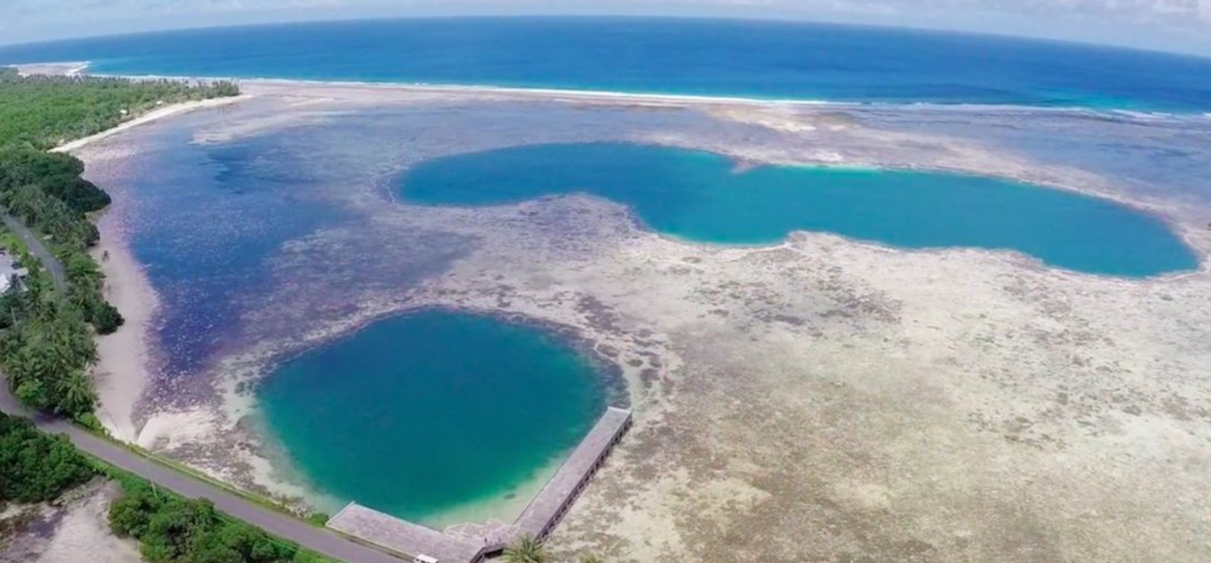
Site Selection
#1 reason for farm failure or success – Proximity to the farmers house
#2 reason – everything else
Most areas of Micronesia have sheltered lagoons, bays or blue holes which are ideal for farming

Slide 4
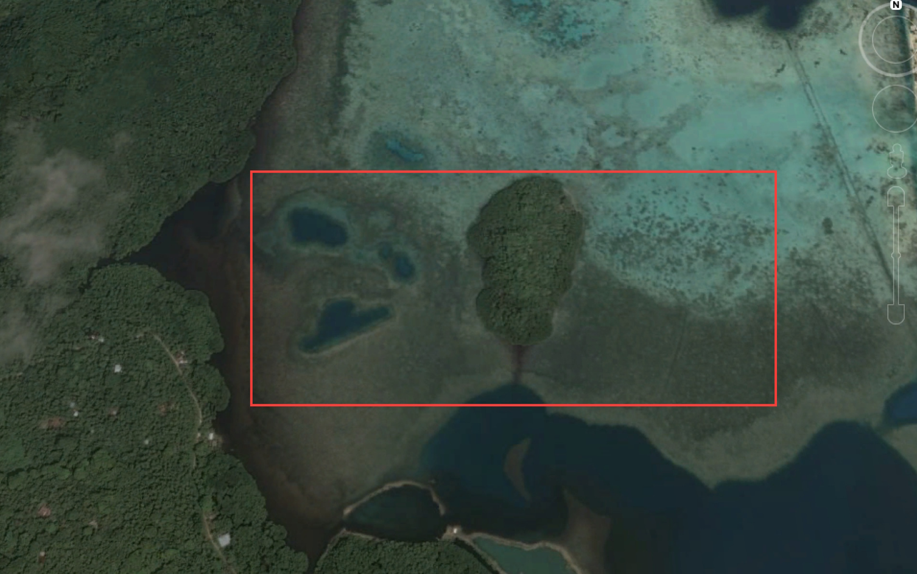
Optimal Sites
1 minute paddle from the farmers house
Salinity above 12 ppt so not too close to rivers
Good flow of water exchange
Sheltered from heavy winds
Areas close to seagrass
Areas where you see rabbitfish

Slide 6
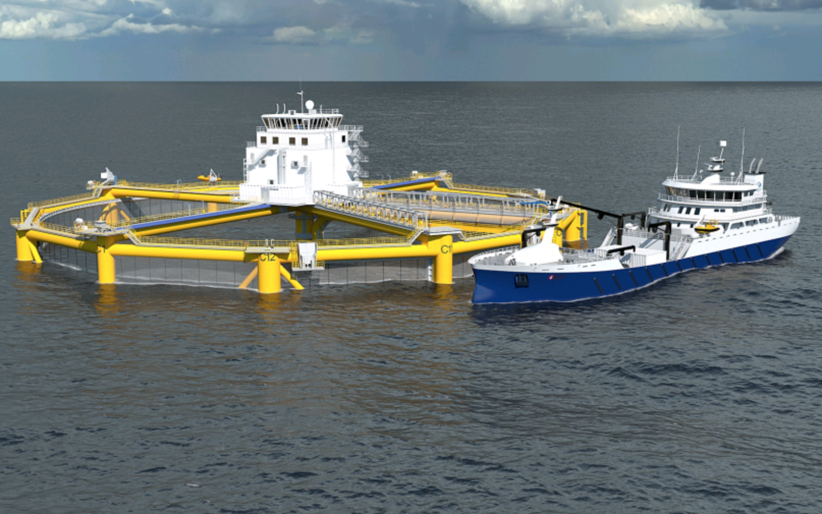
Cages
The more exposed your site is to current and wind the stronger your cages must be.
Open ocean cages

Slide 7
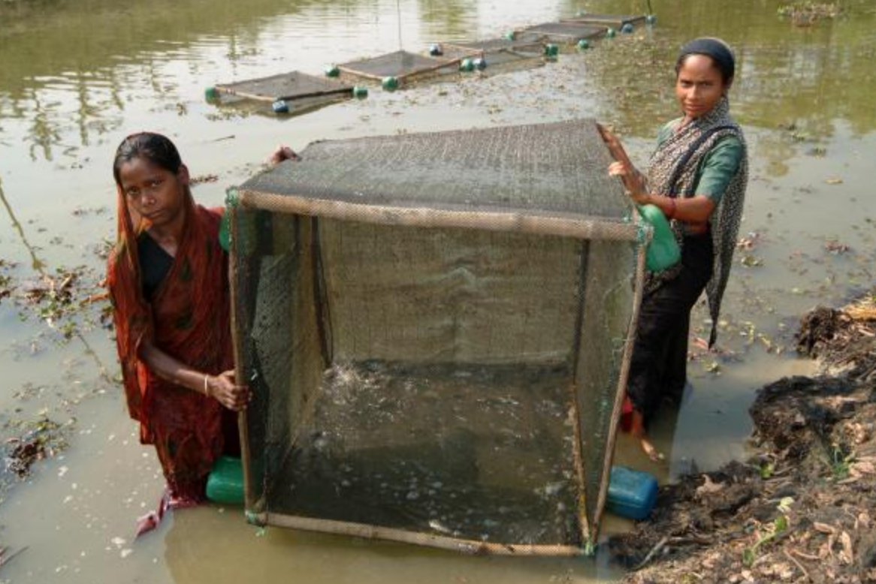
Sheltered Condition Cages

Slide 8
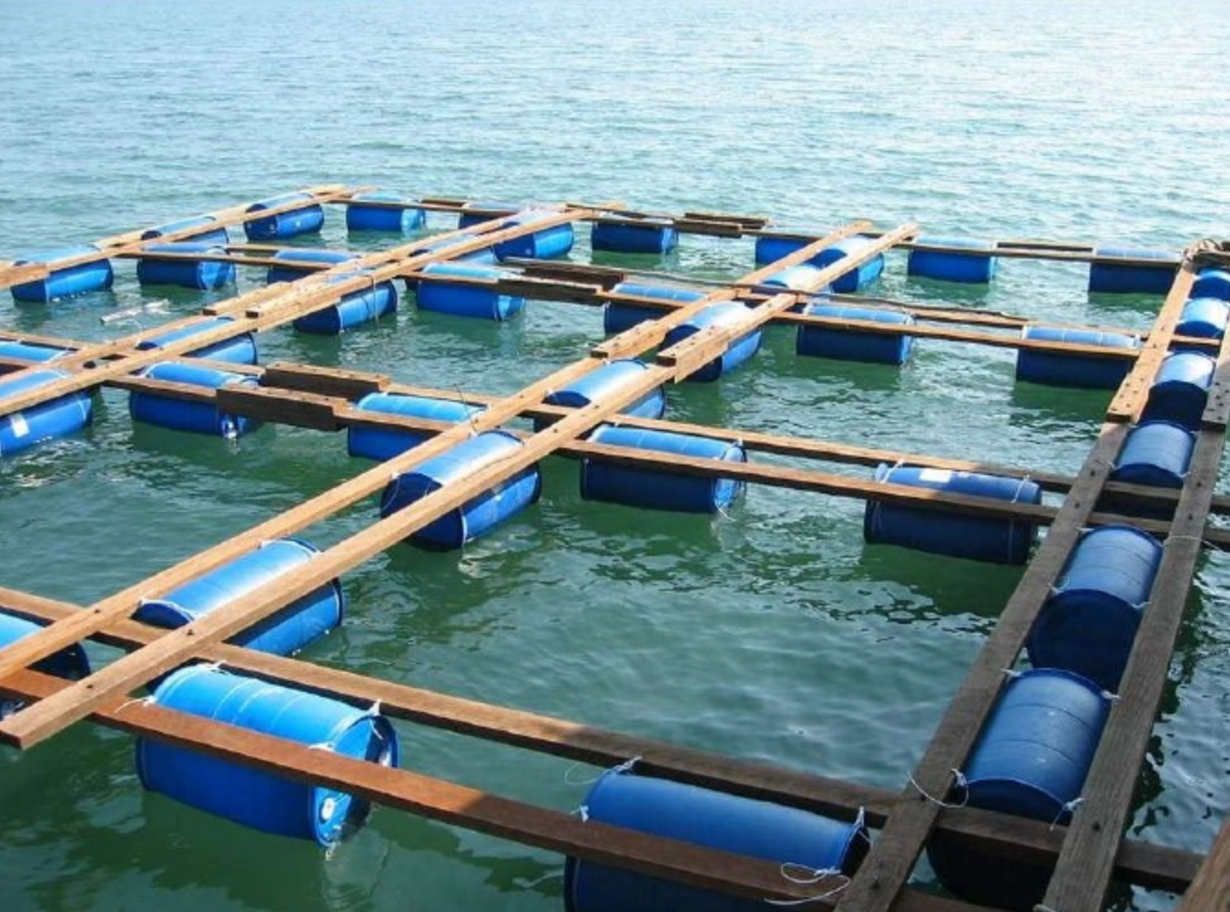

Slide 9
Palau Milkfish

Slide 10
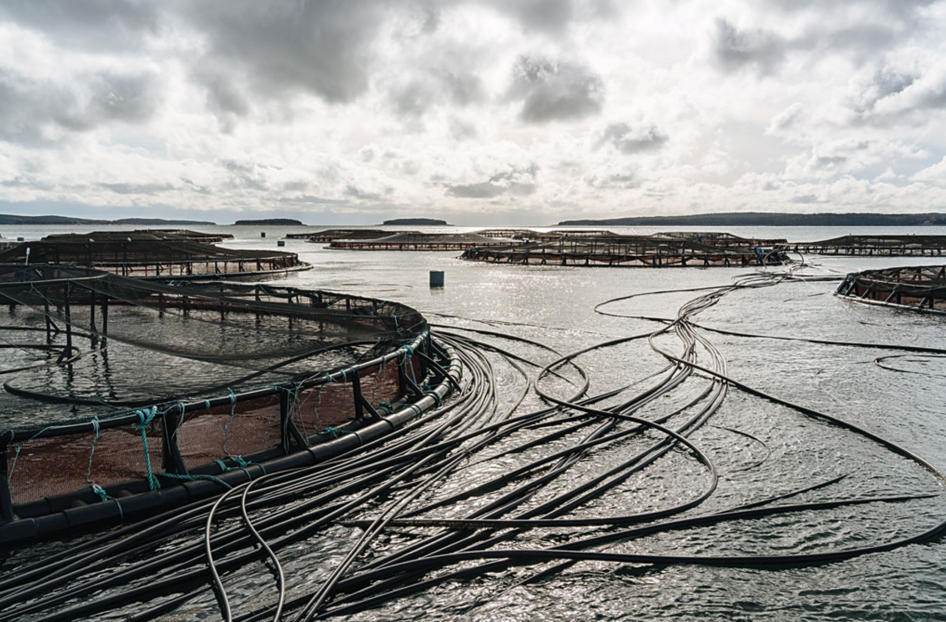
Cage Basics 101
Mesh to keep fish in and predators out and allow for water flow
Moorings or posts to keep it in place
Floatation or posts to stop it from sinking
Accessibility for feeding your fish
– walkways, boat access,
automatic feeders

Slide 11
MERIP Cages
Designed so that coastal farmers can construct and move them around easily
Hold 100-200 fish and should yield about 100 lbs per year or harvest. Literature reports stocking 250 fish/m³
Constructed of 2” PVC and thick rigid mesh
Suitable only for calm conditions (1-2 ft seas)
All materials available locally except the mesh

Slide 12
Easy to transport

Slide 13
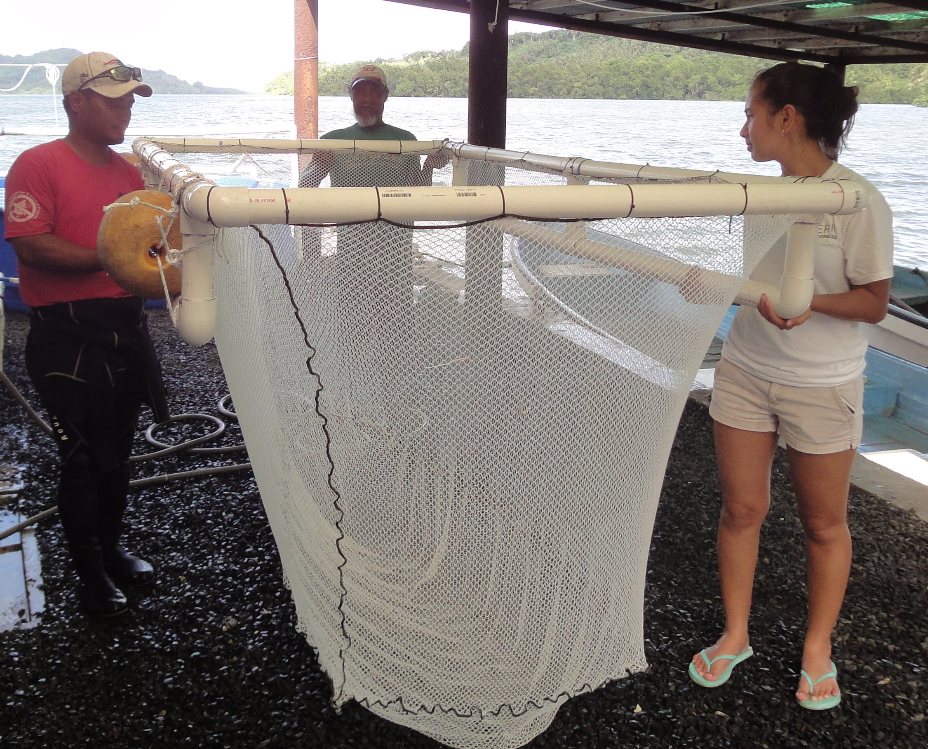
Prototype – soft mesh

Slide 14
Rigid Mesh Cage

Slide 15
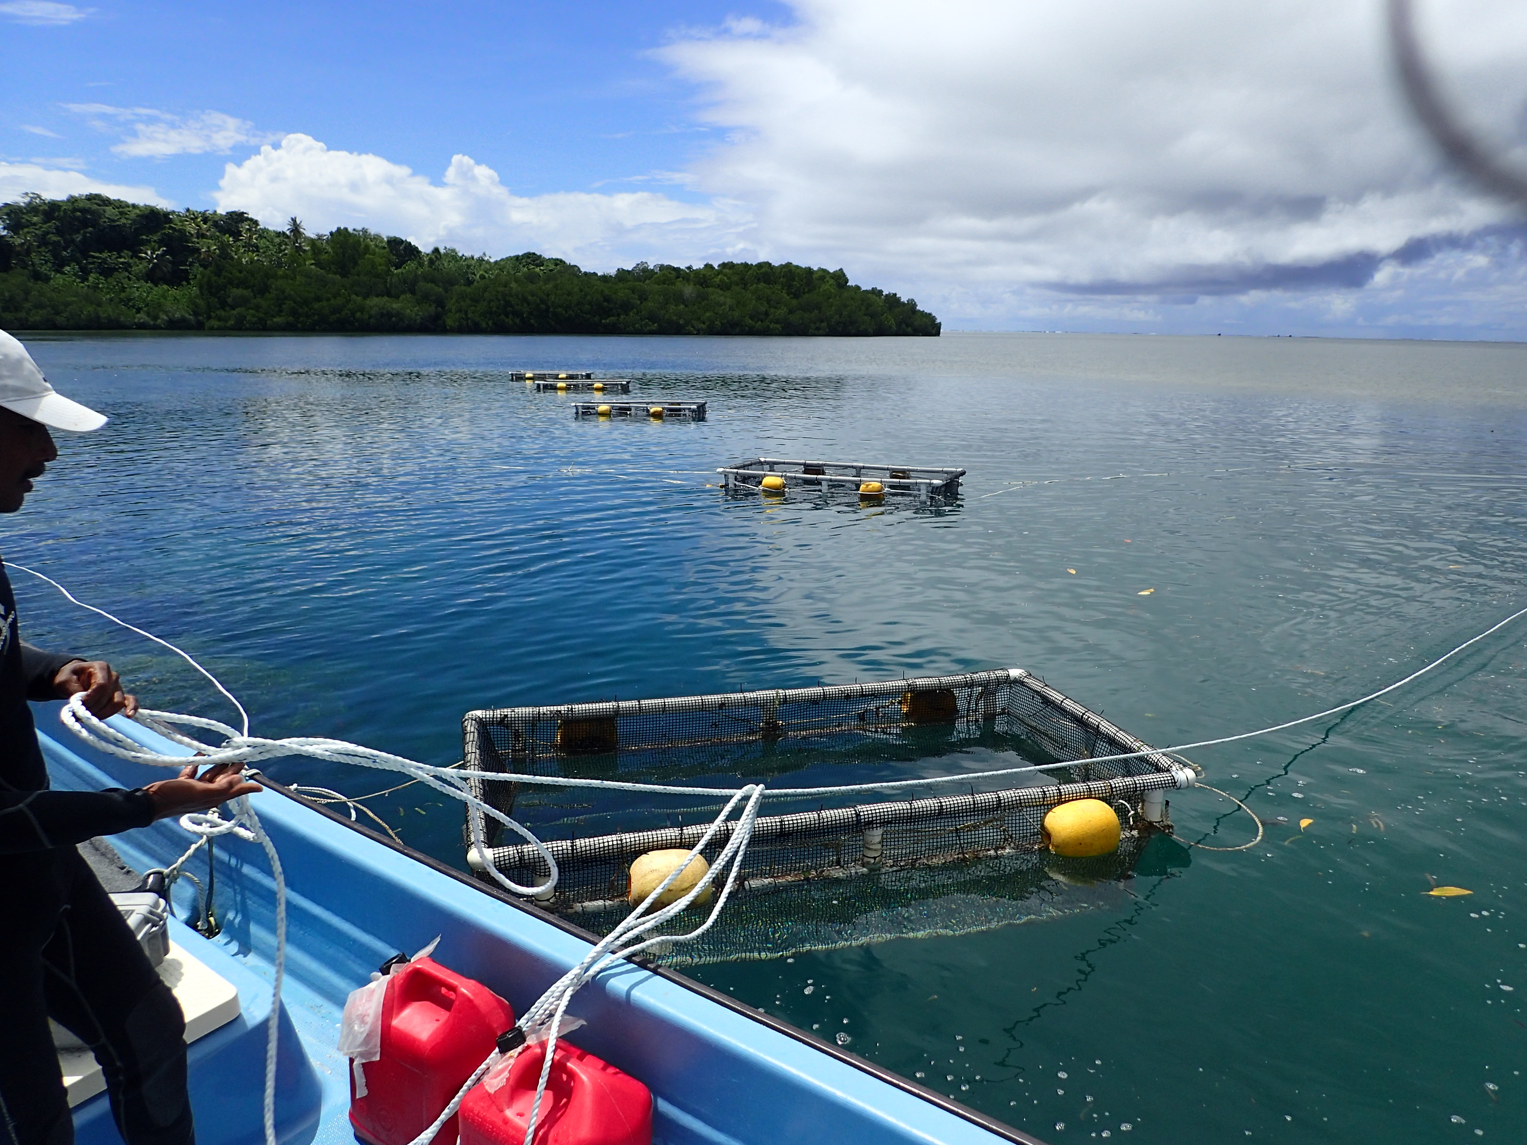

Slide 16
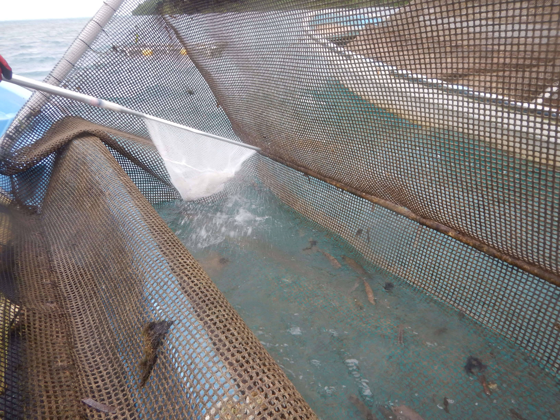

Slide 17
Results
Overall design is durable
Some cages over one year without removal and only hand cleaning
PVC joints can leak if not properly primed and glued
No predation
Coral growth on mesh needs removing periodically
Cost per cage approx. $200 each
Durability of mesh and PVC at least 5 years, probably more like 10

Slide 18
Summary
Sites with good flow and shelter close the farmers house are best
Any kind of cage that keeps predators out and fish in can work
MERIP cage design for small farmers is working so far in Pohnpei
More exposed locations may require something more sturdy

