Slide 1
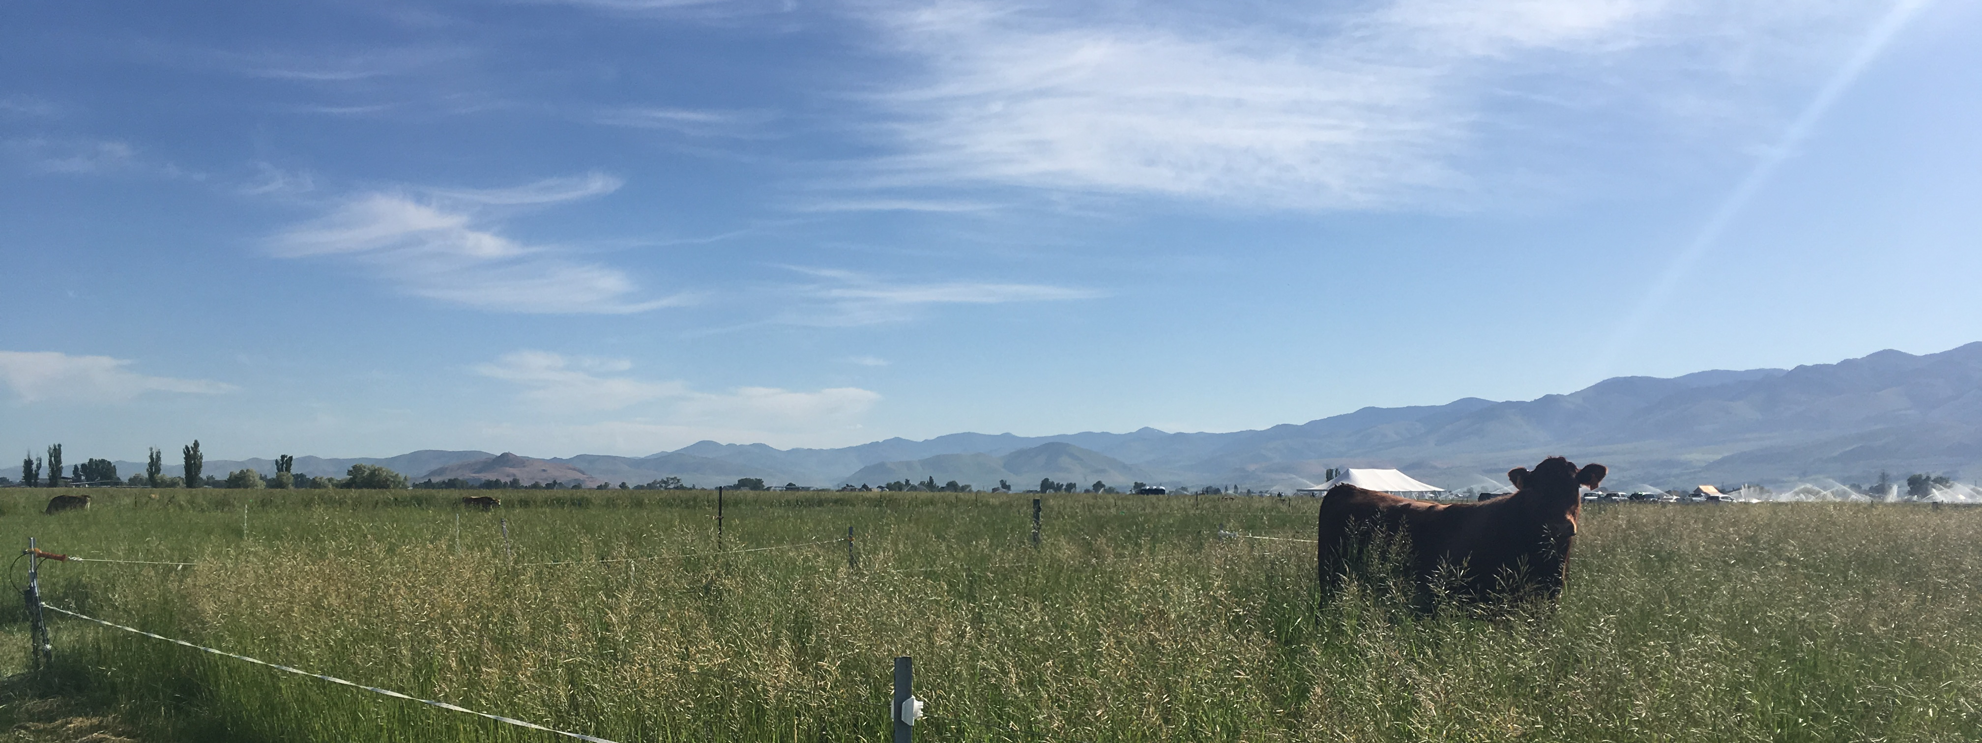
Using phenolics to increase soil Nitrogen retention
Katie Slebodnik
Jennifer Reeve, Ph.D.
Jeanette Norton, Ph.D.
Jennifer MacAdam, Ph.D.
Karen Beauchemin, Ph.D.

Slide 2
Contents
Introduction
Incubation Experiment
  Methods
  Results
  Discussion
Conclusion

Slide 3
The problem:
Increasing demand for pasture-finished beef
Notes:
Actually a good thing: people are thinking about where their food comes from
People are trying to keep up and be informed
But there is a lot to keep up with, lots of conflicting headlines
Hard to know what’s what

Slide 4
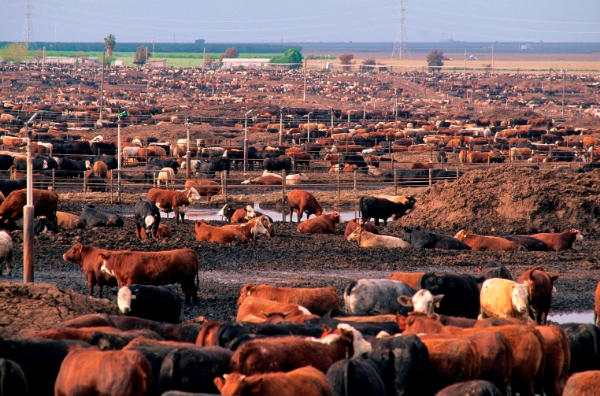
http://www.uppermissouriwaterkeeper.org/talking-points-public-comment-on-the-draft-cafo-general-permit/
Notes:
A lot of times people hear:
Feedlot finished beef has own issues
N losses from manure mgmt., surface water contamination, GHG prod, competes for cereal grain production, CAFOs

Slide 5
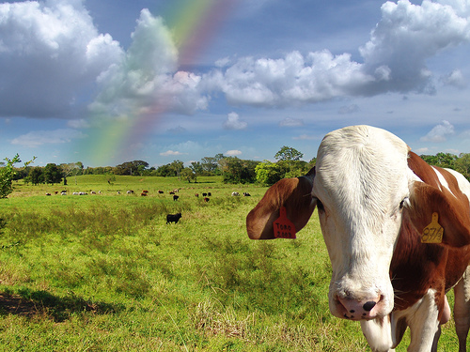
http://www.thesleuthjournal.com/why-eat-grass-fed-beef/
Notes:
The alternative: pasture finished beef
Has an appearance of being natural and sustainable
Literal sunshine and rainbows

Slide 6
The problem:
Increasing demand for pasture-finished beef
Feedlots pose environmental challenges
But… so do pastures

Slide 7
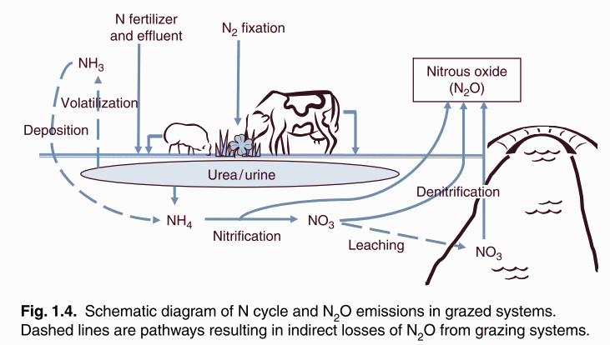
Pastures
Pastures subject to nitrogen (N) leaching and nitrous oxide (N₂O) production
16-33% agricultural N₂O emissions
From de Klien, Pinares-Patino, and Waghorn (2008) Figure 1.4.
Notes:
N inputs from fertilizers (need for grass), and animal excreta
Combined these inputs represent (16-33%) of all agricultural N2O emissions

Slide 8
The reality:
Grass fed beef requires more cows, grazing for a longer period of time to produce the equivalent amount of feedlot-finished beef.
Notes:
This is due to a lower quality diet
So, just to picture this a little bit clearer, more cows means a higher volume of N being excreted and GHGs being produced.
This happens over a longer period of time.
Your N losses are being increased in two different ways.

Slide 9


For 1,000 kg of beef:
Feedlot:
emissions per kg beef
emissions per area of land
Pasture:
emissions per kg beef
emissions per area of land
Notes:
So, we end up with this very interesting problem:
To calculate GHG footprint of beef, total all emissions assoc. w/ prod, divide by total wt. beef of land area
Feedlot: high quality diet, gain wt quickly, fewer cows needed to produce 1000 kg (decreasing your numerator)
Small area of land, (decreasing your demoninator)
Pasture: lower quality diet, more cows, longer time, (increasing your numerator)
Larger area of land (increasing your denominator)

Slide 10
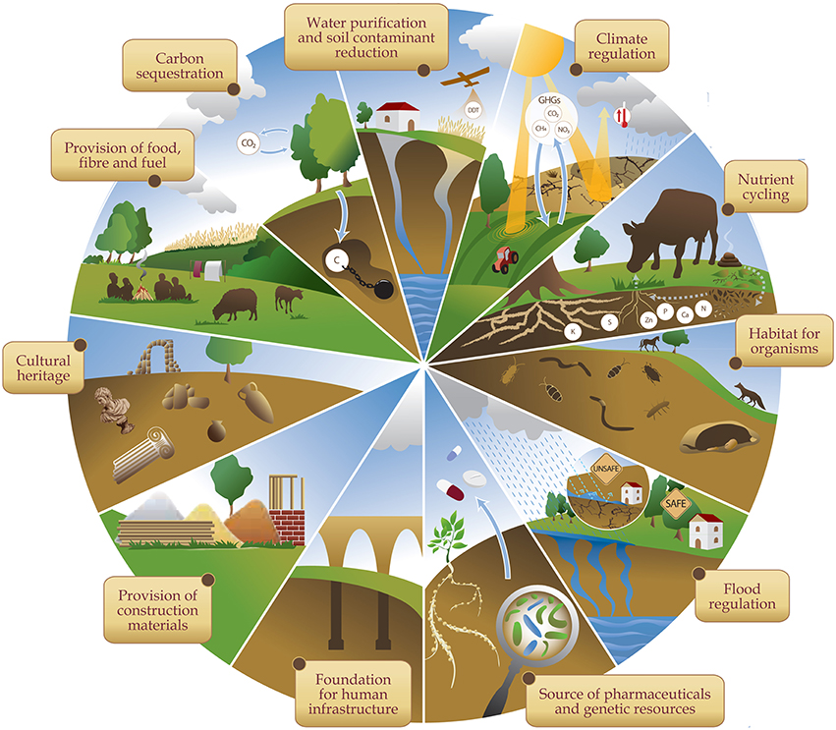
Which is better?
Complex problem
Hope for pasture-finished beef
Ecosystem services
Soil is a regulator
From Baveye et al 2016
Notes:
So then people say, “well which is better? Feedlot or grass-fed?”
My very unsatisfying answer is “its hard to say”
But, we don’t want to give up on pasture-finished just yet!
Pastures provide us with ecosystem services that feedlots can’t
If we can alter what’s happening to N in the soil, we may be able to reduce N losses in air and water

Slide 11
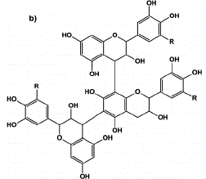
phenolics
Secondary plant compounds
Tannins increase N retention in forest systems
In soil:
  Sorb to soil OM
  Bind proteins
  Microbial toxicity
In cow:
  Decrease NH₃ production
https://www.researchgate.net/figure/Chemical-structure-of-a-hydrolysable-tannin-HT-and-b-condensed-tannin-CT-when-R_fig8_265556106
Notes:
Limit N availability by forming tannin-protein complexes
Reduce N mineralization and denitrification via microbes
(Binds with excess protein in cow rumen to reduce NH3)

Slide 12
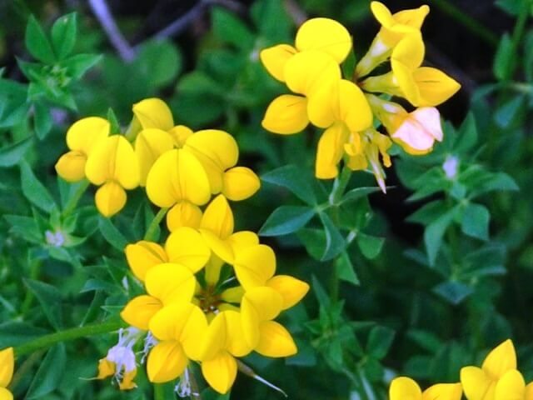
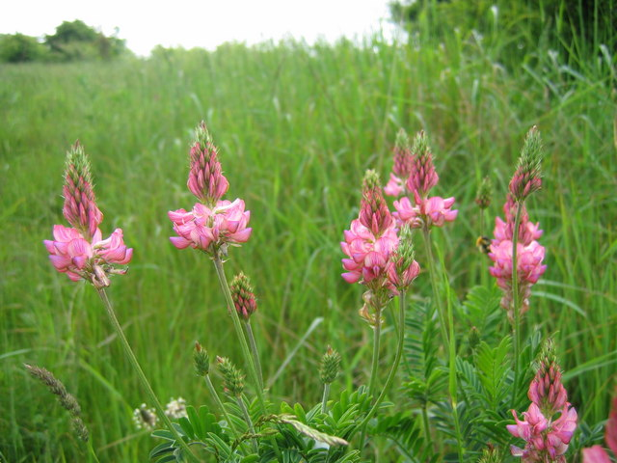
phenolics
https://www.elkmoundseed.com
Tannins:
  Birdsfoot trefoil and sainfoin
Saponins:
  Alfalfa
https://www.mountvernon.org

Slide 13
Our project
Questions:
How do tannins affect soil N cycling processes?
How does these changes affect overall GHG intensity of pasture-finished beef?
Objectives:
Field study
Manure/soil/tannin incubation
Soil/phenolic incubation
Whole-farm GHG modeling

Slide 14
Incubation Experiment
Question:
How does forage phenolic type and concentration affect various N cycling processes in a controlled environment?
Hypothesis:
Phenolics will immobilize N via sorption and complexation, protecting N from microbial activity

Slide 15
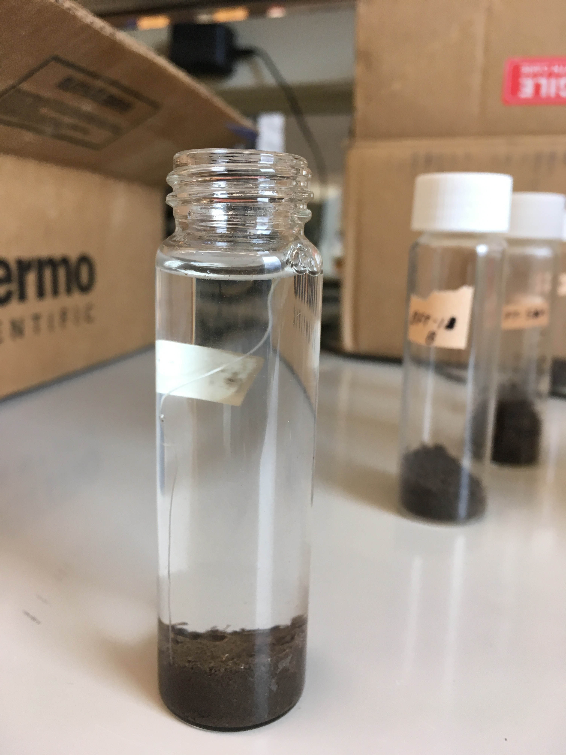
methods
84 day soil/phenolics incubation
Treatments:
  Birdsfoot trefoil (BFT) tannin (Low/High dose)
  Sainfoin (SFN) tannin (Low/High dose)
  Alfalfa (ALF) saponin (Low dose)
  Control soil
Uniform pasture soil
3 replicates/time point
Notes:
Added phenolic compounds purified from the respective plants
Uniform grass pasture soil (0-15cm) (5 g)
Only added a low dose of alfalfa saponins (only found in low concentrations, unlike tannins)
Low = 3 mg/g soil High = 15 mg/g soil
3 replicates per time point per treatment

Slide 16
methods
Measured:
  Soil ammonium (NH₄⁺) and nitrate (NO₃⁻)
  Carbon dioxide (CO₂) and nitrous oxide (N₂O) production
  Ammonia (NH₃) volatilization
  Autoclaved citrate extractable protein (Days 0 & 84)
  Soluble C & N (Days 0 & 84)
  Total phenolics in solution (Days 0 & 84)
Modeled after Halvorson et al 2009
Notes:
N&A: monitor size of inorganic N pools
CO2/N2O: microbial activity, GHG production
NH3 volatilization
ACE protein: monitor proteins (source of org. N)
Cold/Hot washes: how much C and N can we readily extract from soils? (not sorbed)
Total phenolics: are we washing phenolics out in water washes?

Slide 17
RESULTS
Hypothesis: Increasing doses of phenolics will create corresponding decrease in total C extracted.
Notes:
D0:
High trts we are seeing C washed out
If SFN & BFT have same C, BFT might be sorbing more
See evidence for sorption with low treatments
D84:
SAP sticking around
Other trts may be sorbing to soil OM

Slide 18
RESULTS
Hypothesis: Increasing doses of phenolics will create corresponding decrease in total N extracted.
Notes:
D0:
SFN H high N washing out
Evid. Complexation with prot. in other trts.
D84:
Working on stats
All treatments appear to lower ext. N
Evd. That phenolics are reducing soluble N

Slide 19
RESULTS
Hypothesis: Control, low phenolic, and high phenolic treatments will have decreasing ACE protein, respectively.
Notes:
Less phenolics = potential for microbial inhabitation and protein precipitation
D0:
Might be flooding system with phenolics, not enough proteins to bind with
D84:
Fewer proteins later
May be degraded

Slide 20
results
Hypothesis: Control, low phenolic, and high phenolic treatments will have decreasing nitrate concentrations, respectively.
Notes:
more phenolics = more potential for microbial inhabitation and protein precipitation
Normal general trend (immob -> min, denit)
Suggests microbial activity
Sig int btwn trt*day (diff curve shape for SAP)
SFN high seems to have a much higher N, or contam., or nitrifiers like
By the end, most trts don’t look diff from ctrl (no conclusions though)
May be evd for N retention

Slide 21
Results
Hypothesis: N₂O production will increase from high phenolic treatments, low phenolic treatments, and the control, respectively.
Notes:
SFN High and SAP Low highest
All others (SAP included) not diff from ctrl
Log trans causes discrep.
Whatever caused high NO3 carried over to N2O

Slide 22
results
Hypothesis: CO₂ production will increase from the control, low phenolic treatments, then high phenolic treatments, respectively.
Notes:
BFT and SFN High trts higher than all others.
All low trts not sig diff from ctrl.
Add C-rich sub, mic work to break down/build biomass
Trend in prod follows dose
Evd for sig microb. Activity
Phenolics sorbing? Or being degraded?

Slide 23
FUTURE WORK
Check for contamination
Analyze treatment C&N
Quantify total phenolics extracted
Analyze NH₃ volatilization
Continue researching tannin chemistry

Slide 24
Preliminary conclusions
Soluble C & N suggests phenolics are sorbing to soil OM
Nitrate & GHG data suggests significant microbial activity
Halvorson: sorption under abiotic conditions
Microbes may play a role under ambient conditions
Phenolics may increase N retention

Slide 25


acknowledgements
Committee members:
  Jennifer Reeve PhD
  Jennifer MacAdam PhD
  Jeanette Norton PhD
The MacAdam Lab
Karen South
Stephen Lee PhD
USDA-ARS Poisonous Plants Research Lab
WSARE Grant #GW18-156

