Slide 1
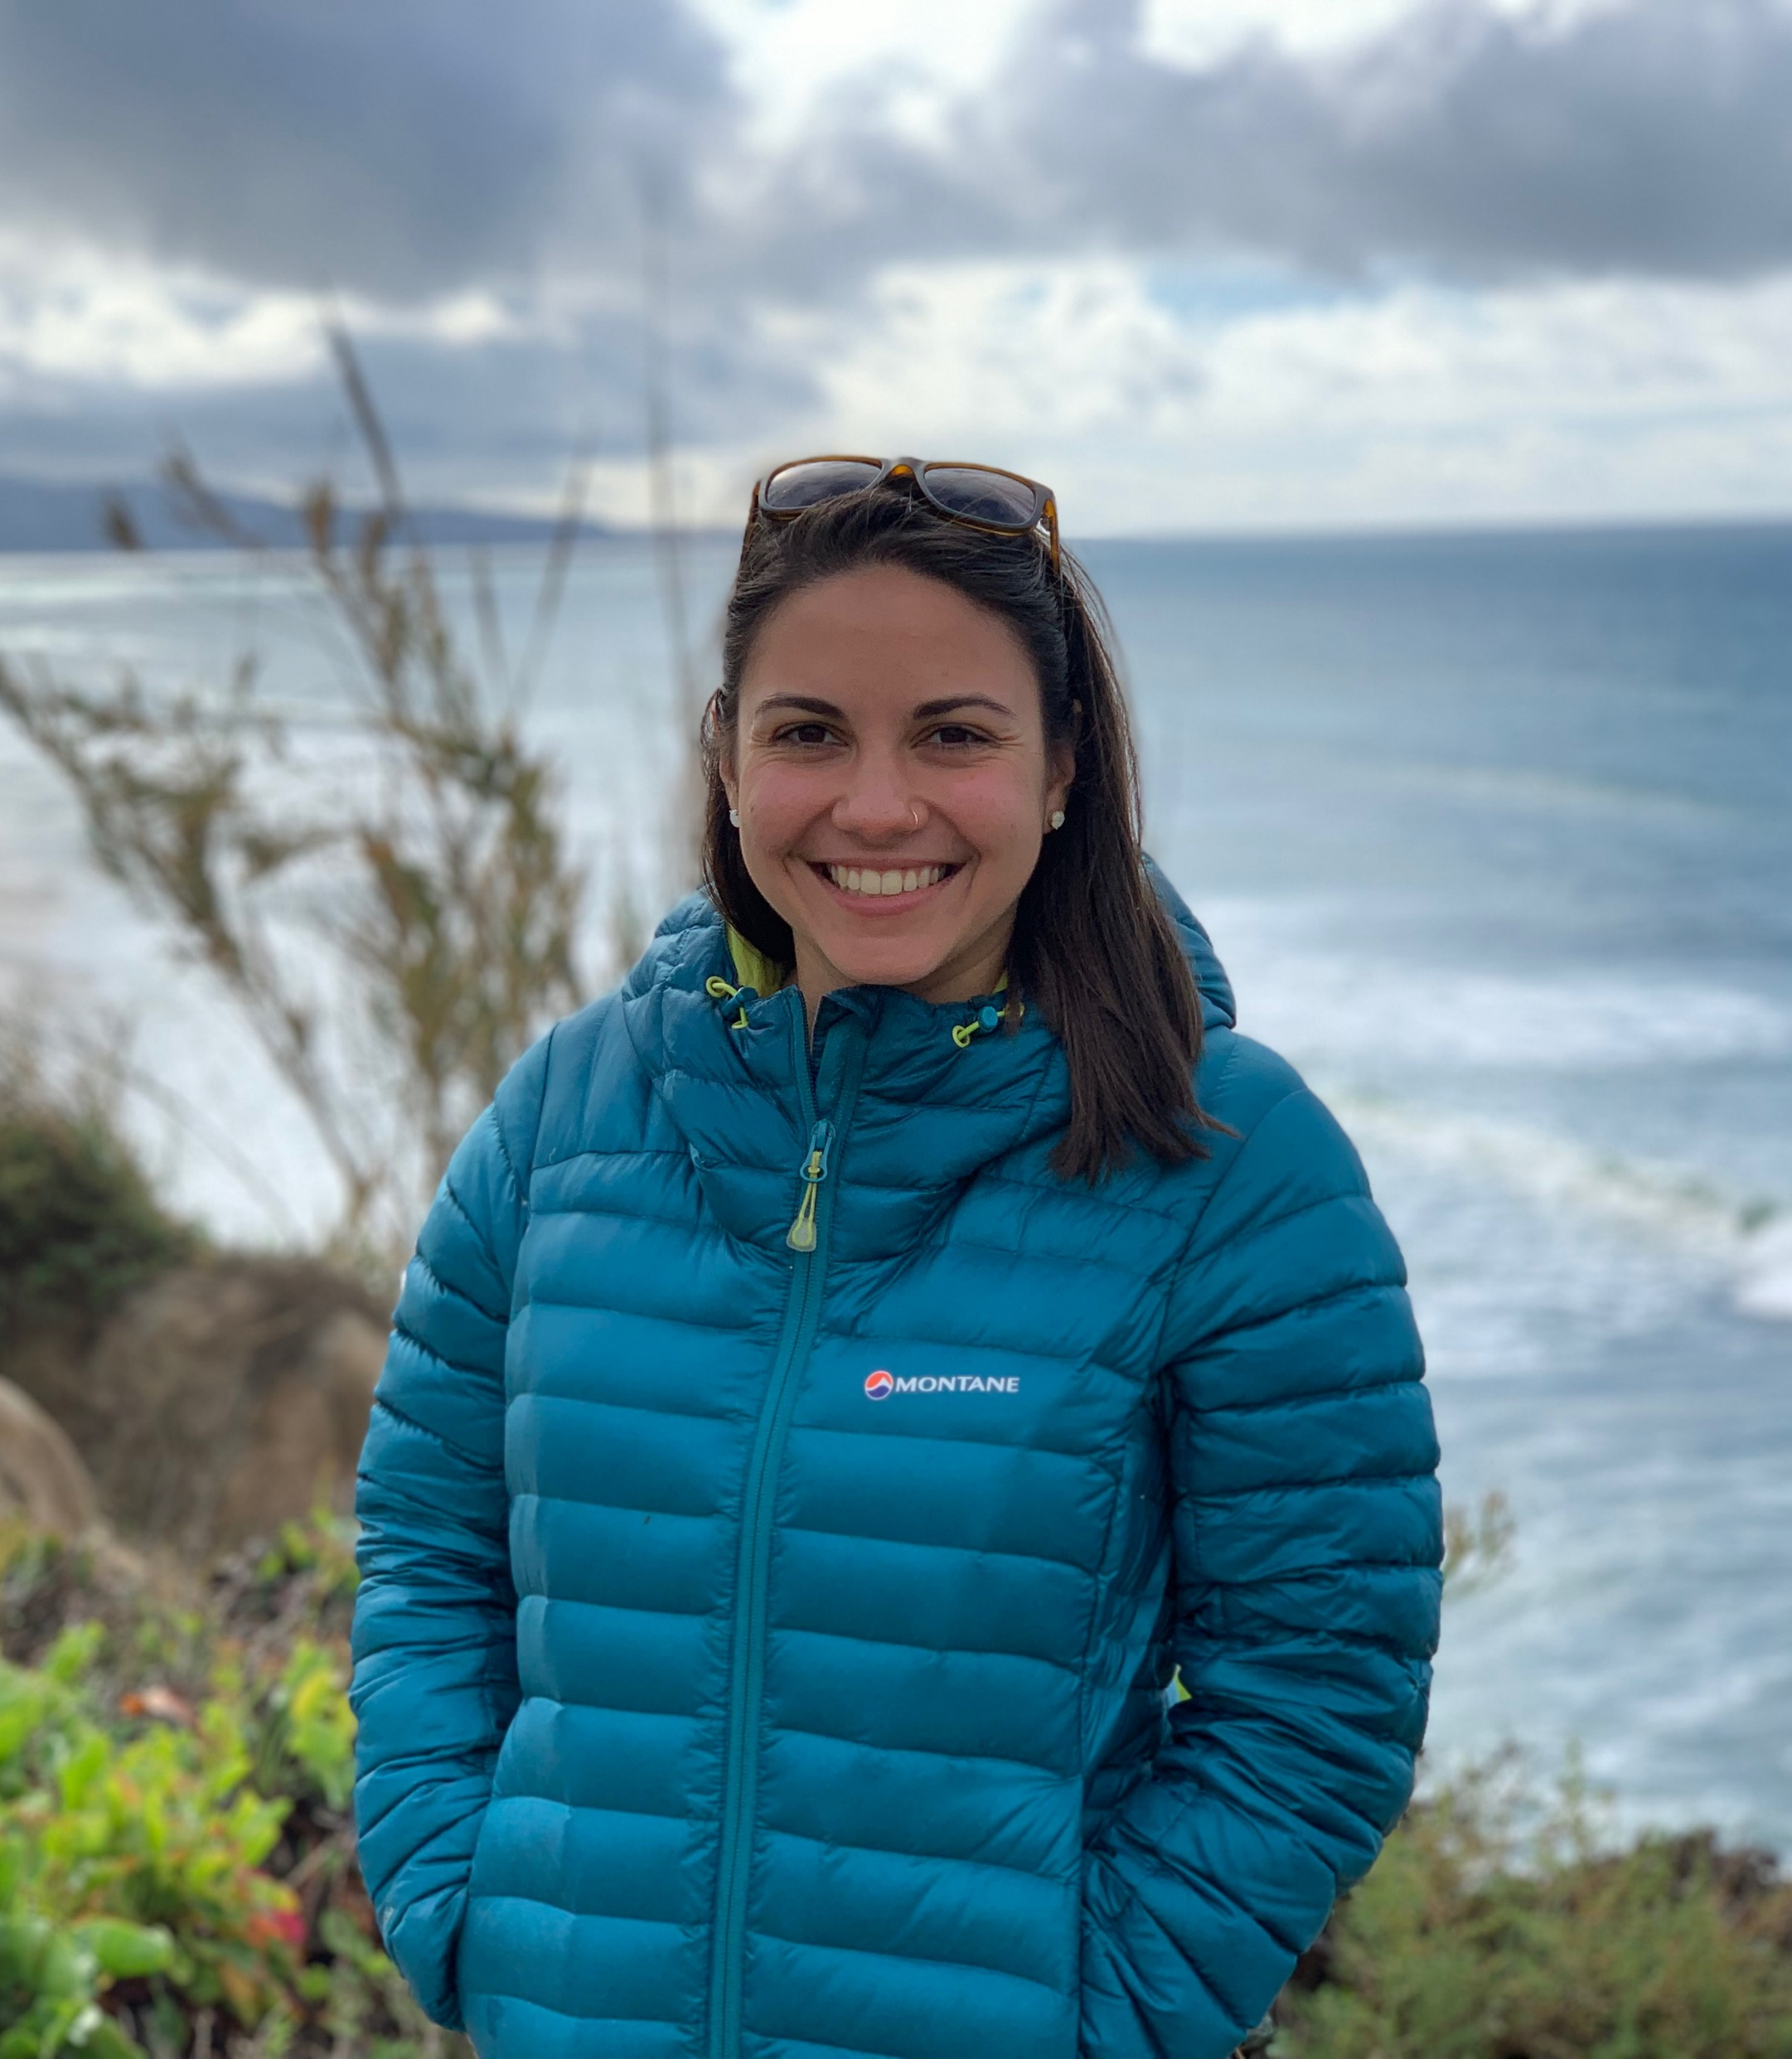
Utilization of Tannin-Containing Forages For Sustainable Beef Production in the Intermountain West
Kathryn Slebodnik¹
Jennifer Reeve PhD¹, Jeanette Norton PhD¹, Jennifer MacAdam PhD¹, and Stephen Lee PhD²
Department of Plants, Soils and Climate, Utah State University, Logan, UT, USA
2. USDA ARS Poisonous Plant Research Laboratory, North Logan, UT, USA
Introduction
Results
Ruminants and pastures contribute significant amounts of nitrous oxide (N₂O), and carbon dioxide (CO₂) to the atmosphere and nitrogen (N) to waterways. Tannins and saponins are secondary plant compounds which have been shown to reduce N cycling in forest systems by binding proteins and alkaloids (Waghorn et al. 2008). We hypothesized that finishing beef cattle on tannin-containing legumes such as birdsfoot trefoil (Lotus corniculatus) and sainfoin (Onobrychis viciifolia) or saponin-containing legumes such as alfalfa (Medicago sativa) would reduce soil N mineralization, increasing overall N retention in pastures.
A
a
B
d
c
b
ab
c
a
Figure 1: We concluded that additions of condensed tannins (BFT and SFN) and saponins (SAP) purified from legume forage species decreased soluble total N (panel A) and N mineralization rates, and condensed tannins decreased soluble organic C (panel B) in a pasture soil, suggesting complexation reactions with organic matter and microbial inhibition.
d
d
b
a
e
Experiment 1
Figure 1
Figure 2: We concluded that fecal treatments containing secondary compounds from legumes (alfalfa, birdsfoot trefoil, sainfoin) had lower nitrate concentrations than legumes without these compounds throughout the incubation (panel A), but C:N ratio was also important. None of the treatments had significantly higher total nitrous oxide production (panel B).
A
*
B
Experiment 2
*
*
*
*
*
Objective
*
Determine if condensed tannins and saponins found in legume forages can increase soil C and N retention in laboratory and field settings.
Figure 2
A
a
B
ab
b
a
Figure 3: We concluded that rates of potential aerobic N mineralization were significantly lower in pasture soils under condensed-tannin containing sainfoin (panel A) and birdsfoot trefoil (panel B), producing a similar effect to high C:N grass.
Methods
b
b
Experiment 1:
Purified condensed tannins and saponins are incubated with a pasture soil
Experiment 2:
Secondary compound-containing feces are incubated with a pasture soil
Experiment 3:
Sampled pasture soils under forages with varied secondary compound content
Experiment 3
Figure 3
Conclusions
Substrate C:N ratio was the primarily influence on soil N cycling, but secondary compounds also played an important role in limiting N mineralization.
The effect of secondary compounds tends to decrease as system complexity increases.
Future studies should continue to assess the implications of secondary compounds at the farm level.
Contact
Katie Slebodnik
kathryn.slebodnik@aggiemail.usu.edu
Acknowledgements
This work was funded by Western Sustainable Agriculture Research and Education Graduate Student Grant GW18-156 and USDA NIFA grant 2016-67019-25086.
References
Waghorn, Garry et al. “Beneficial and Detrimental Effects of Dietary Condensed Tannins for Sustainable Sheep and Goat production—Progress and Challenges.” Animal Feed Science and Technology Waghorn / Animal Feed Science and Technology 147.147 (2008): 116–139. Web. 25 July 2017.

