Slide 1
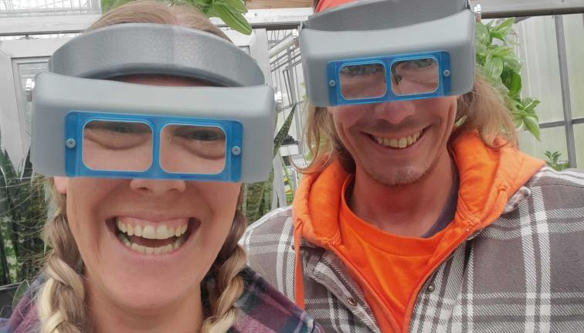
Greenhouse Scout School Certificate Program February 13-March 27
Learn to scout with this on-line and hands-on program
With the certificate program, you receive:
A box of equipment to help in your scouting
7 weekly live sessions on scouting and pest id
Hands-on scouting activities in your region
On-line panels
A certificate of completion
For more information and to register:
https://cals.cornell.edu/new-york-state-integrated-pest-management/outreach-education/events/greenhouse-scout-school
Or contact Betsy Lamb eml38@cornell.edu

