Slide 2
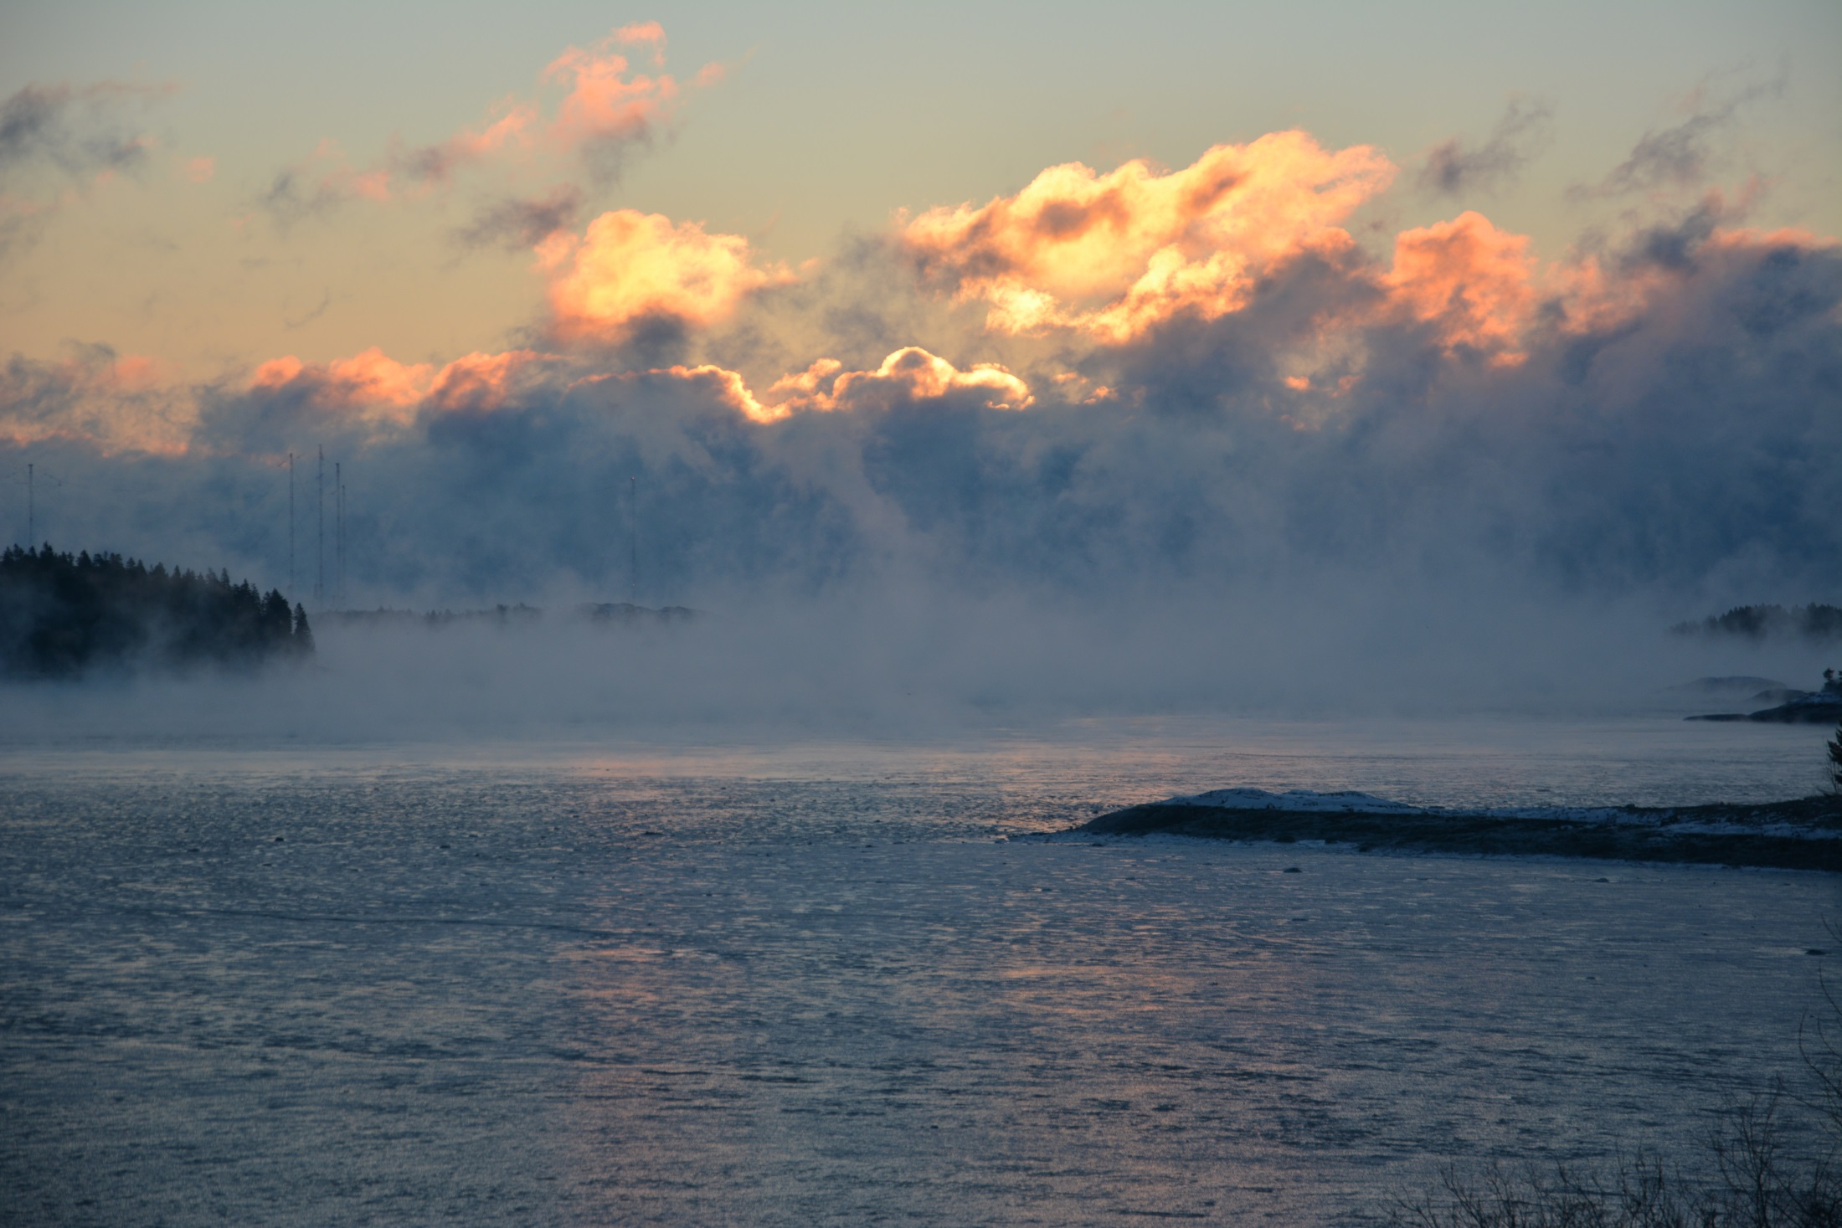


Arctic Surfclam, Mactromeris polynyma,
Culture in Eastern Maine: Comparative Field Experiments to Assess Growth and Survival
B. Beal^{1,2}, K. Pepperman², B. Salter², and T. Houston²
University of Maine at Machias
Downeast Institute

Slide 3
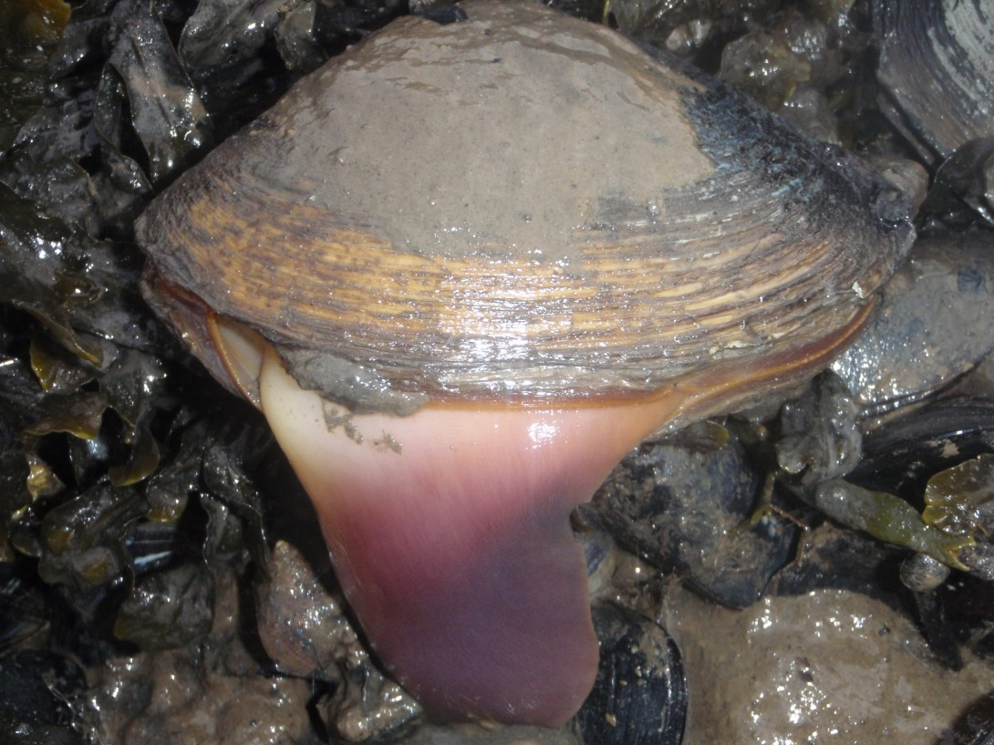
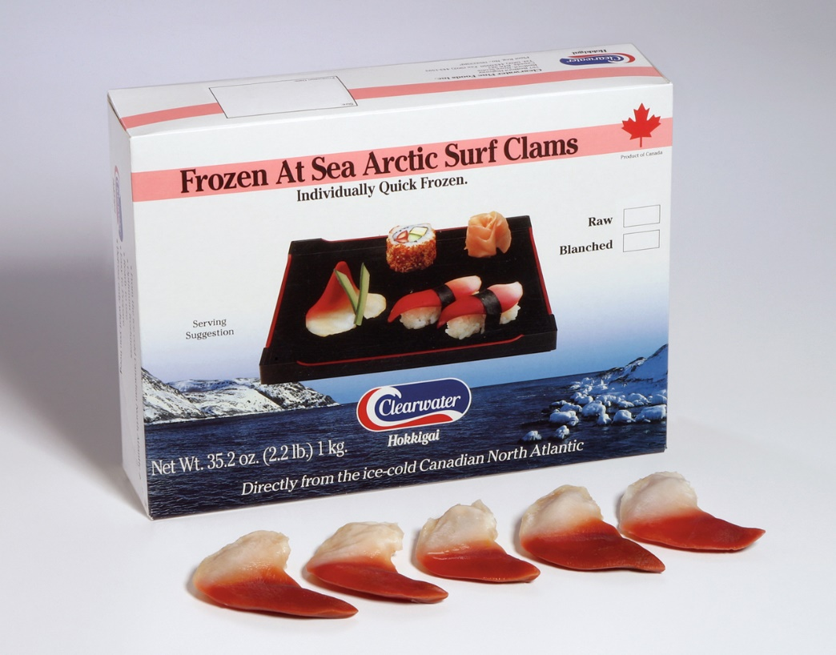
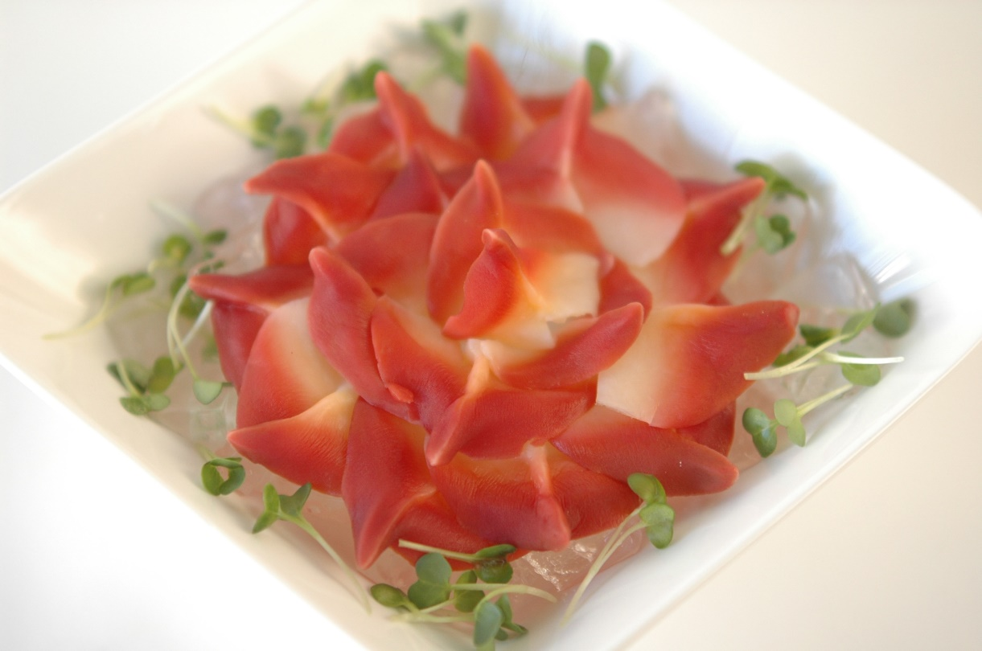
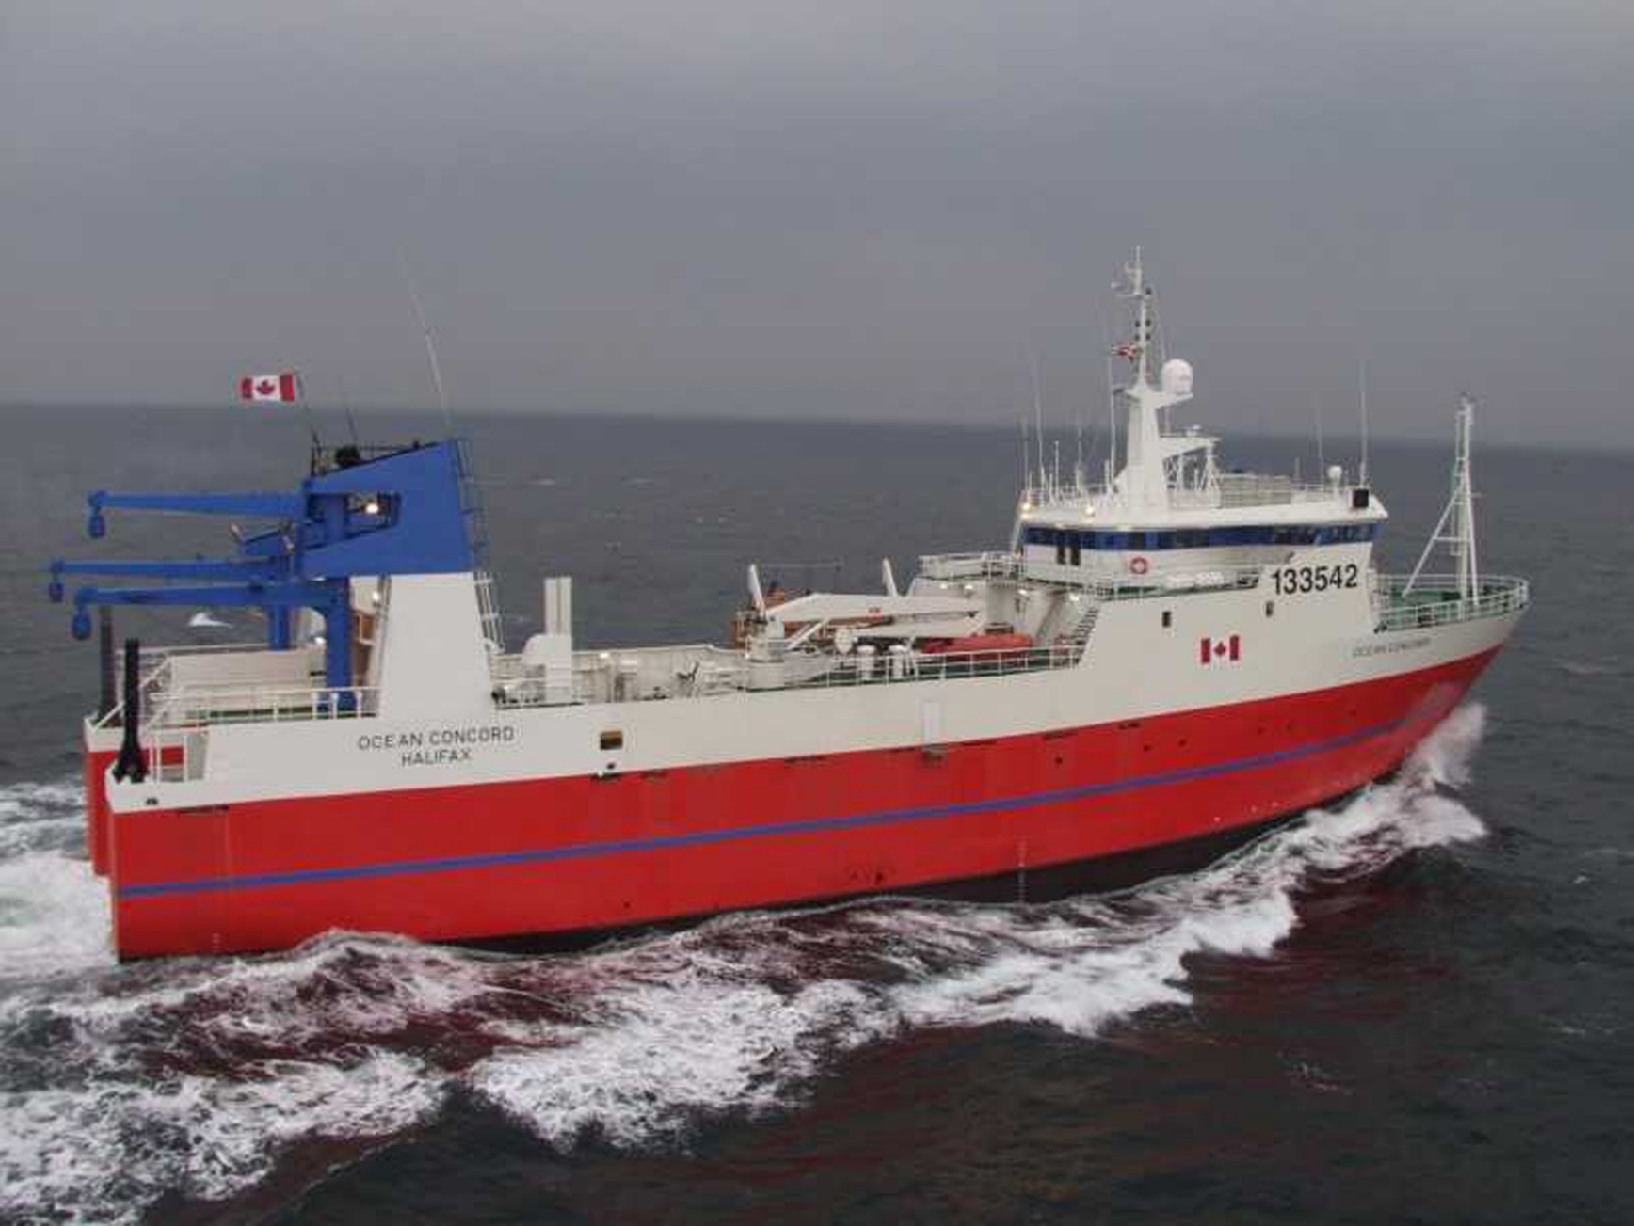
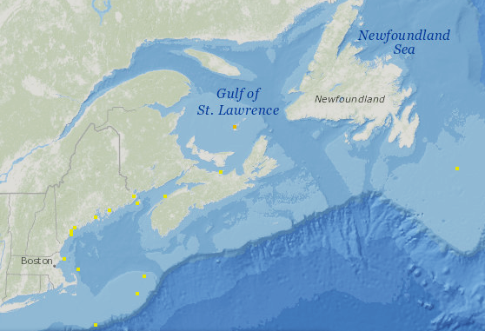
Mactromeris polynyma
Arctic Surf Clam
Natashquan, QC

Slide 4
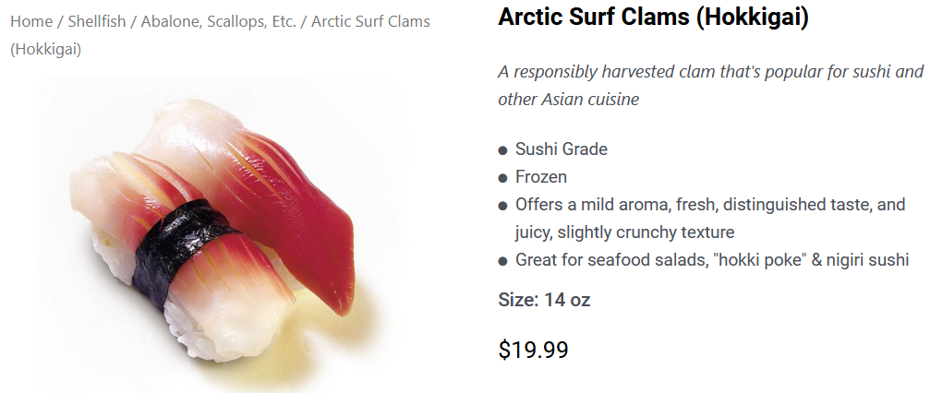
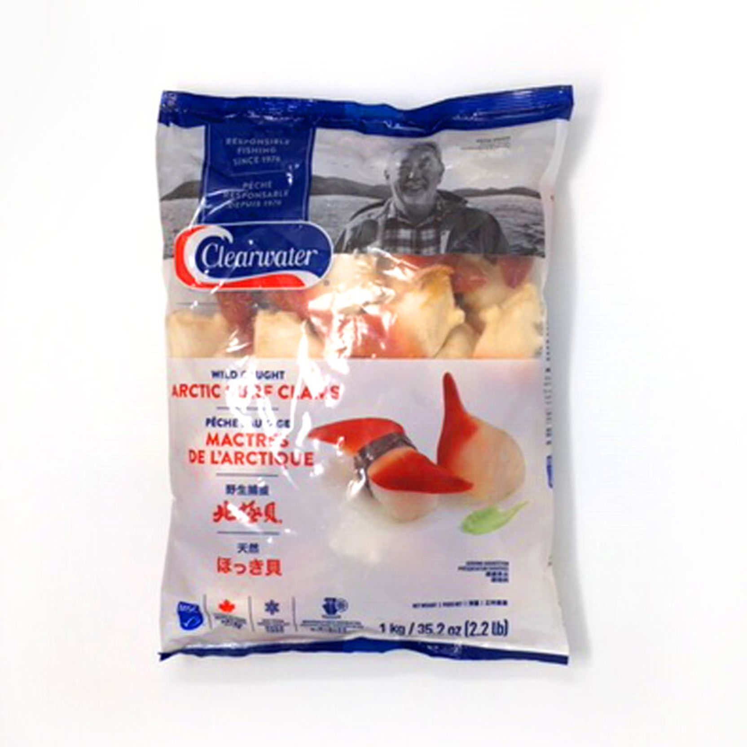

Why Arctic surfclams, and why intertidally?
Relatively expensive, niche-market species with great flavor and visually appealing
Maine Soft-Shell Clam Landings (1950-2022)
-84%

Slide 5
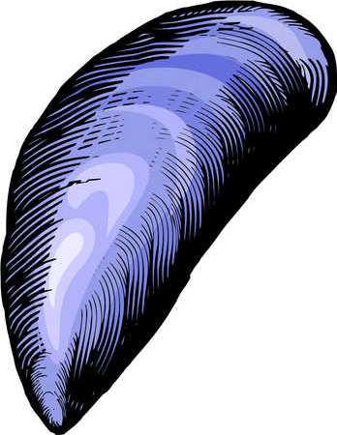
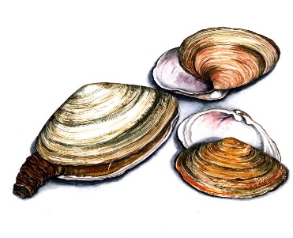
Why Arctic surfclams, and why intertidally?
Initially, we thought it possible to diversify commercial species harvested in the intertidal
zone: soft-shell clams; blue mussels; northern quahogs (hard clams); razor clams
Maine Soft-Shell Clam Landings (1950-2022)
Maine Blue Mussel Landings (1950-2022)
-84%
-85%

Slide 6
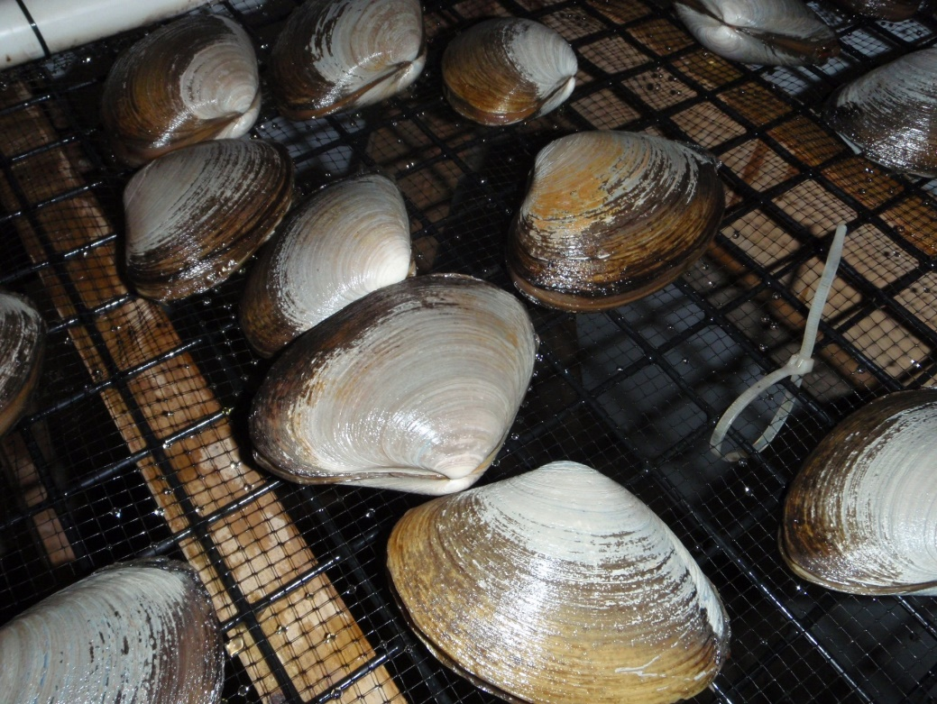
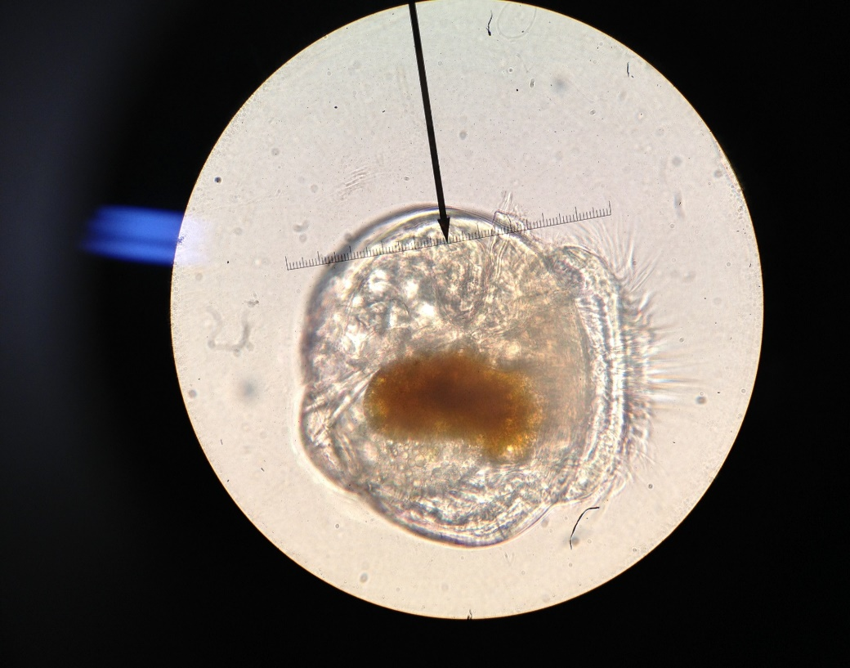
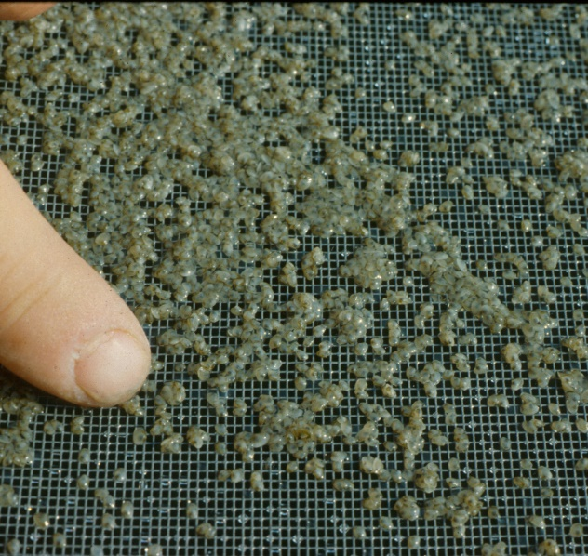
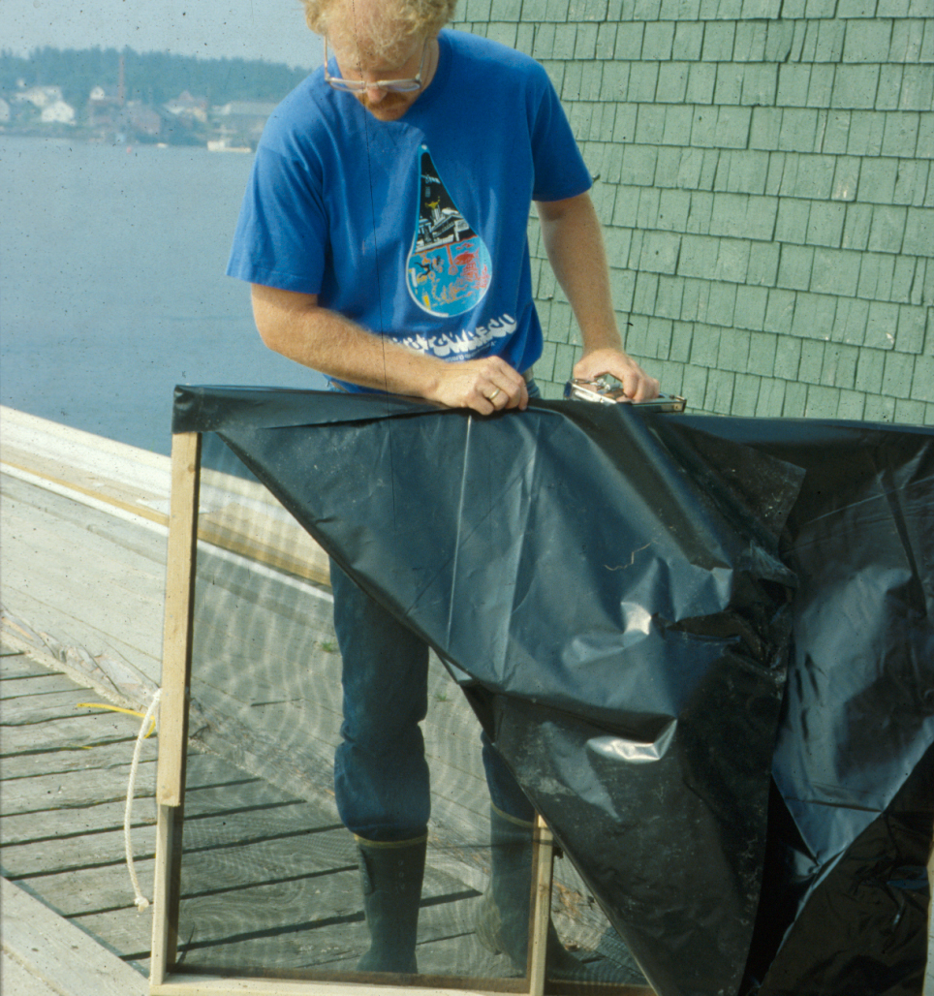
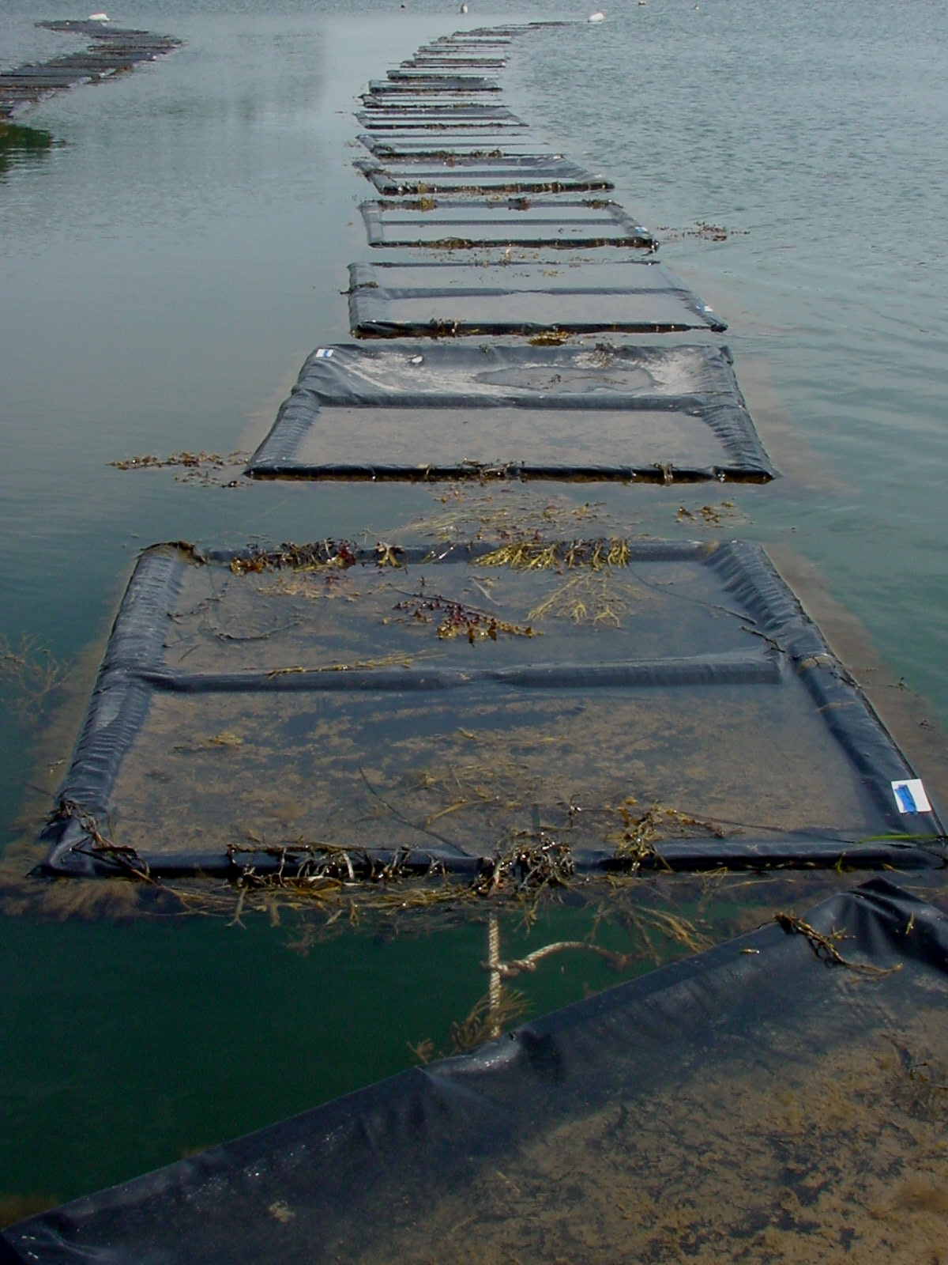
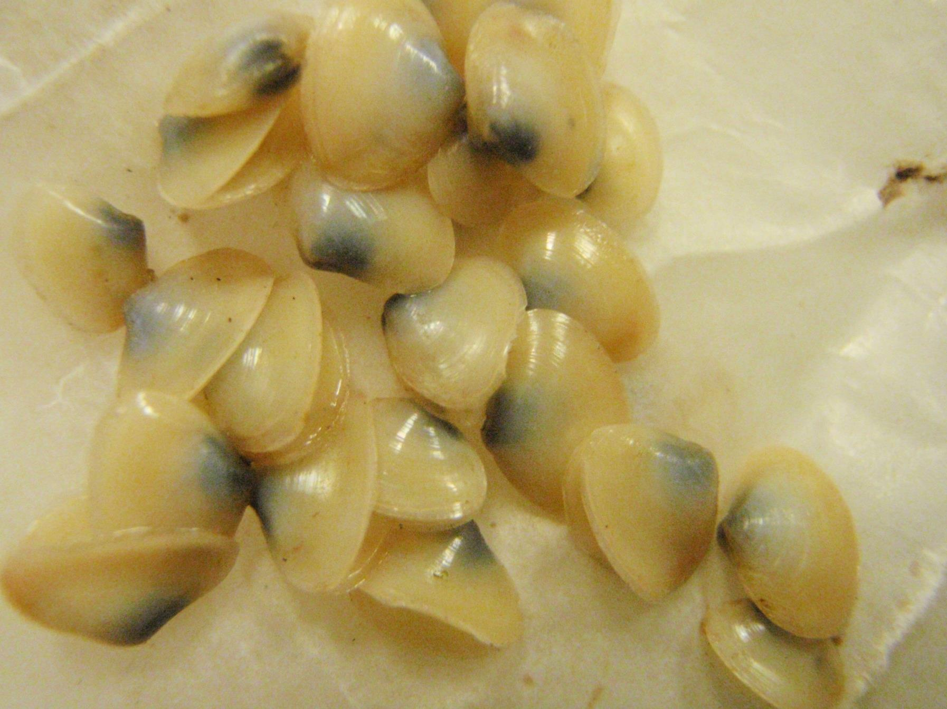
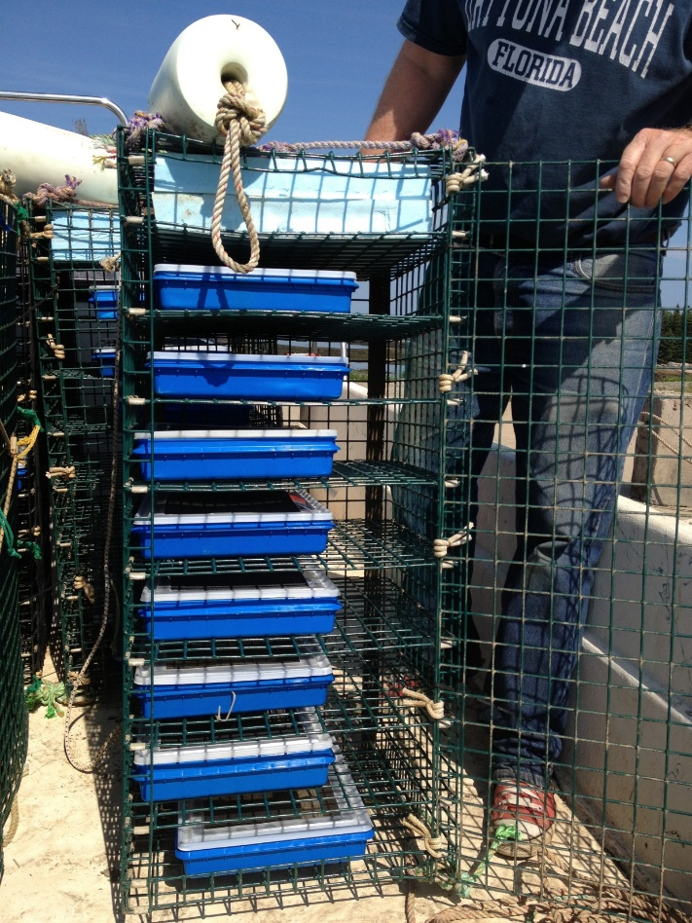

Slide 7
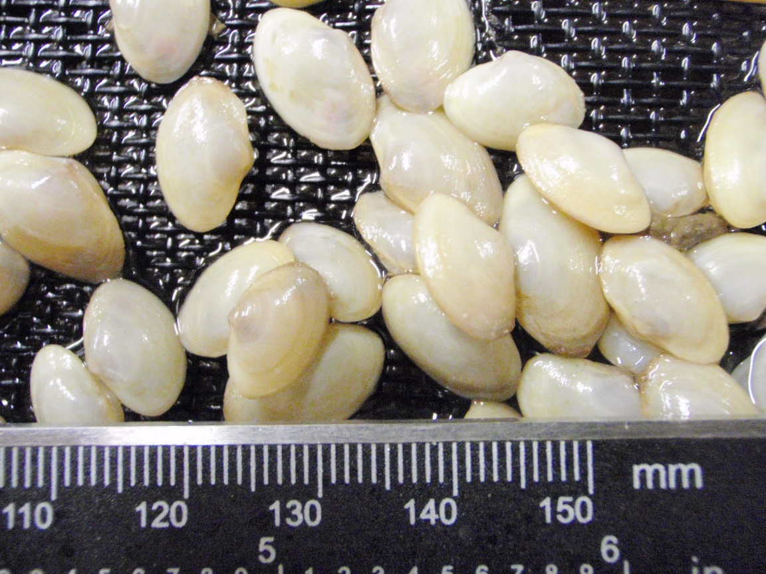
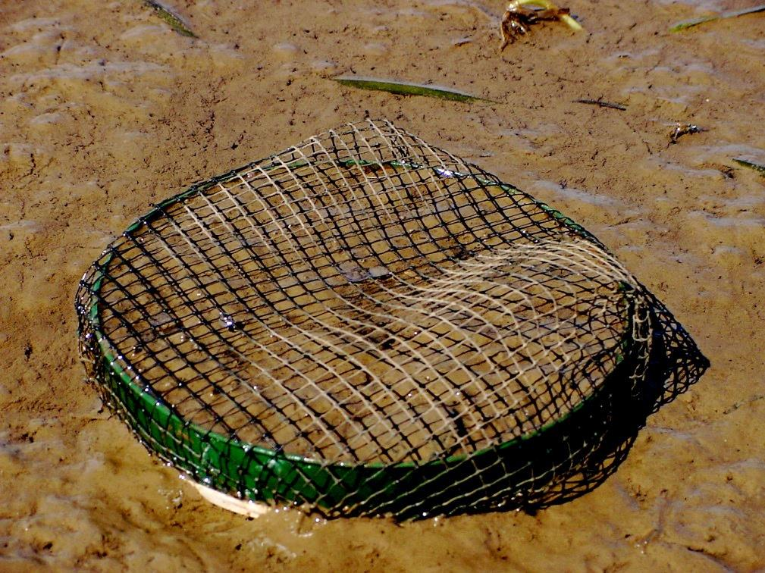
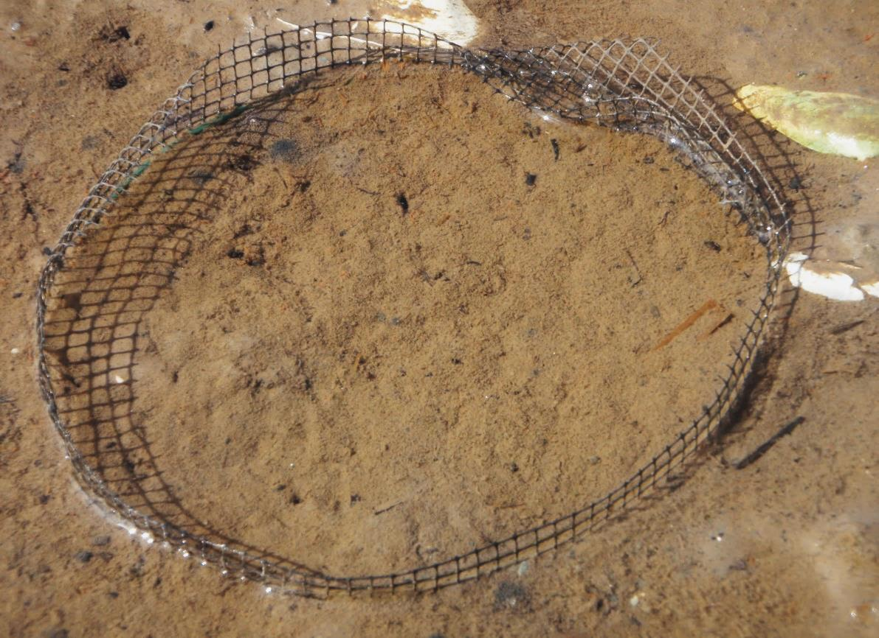
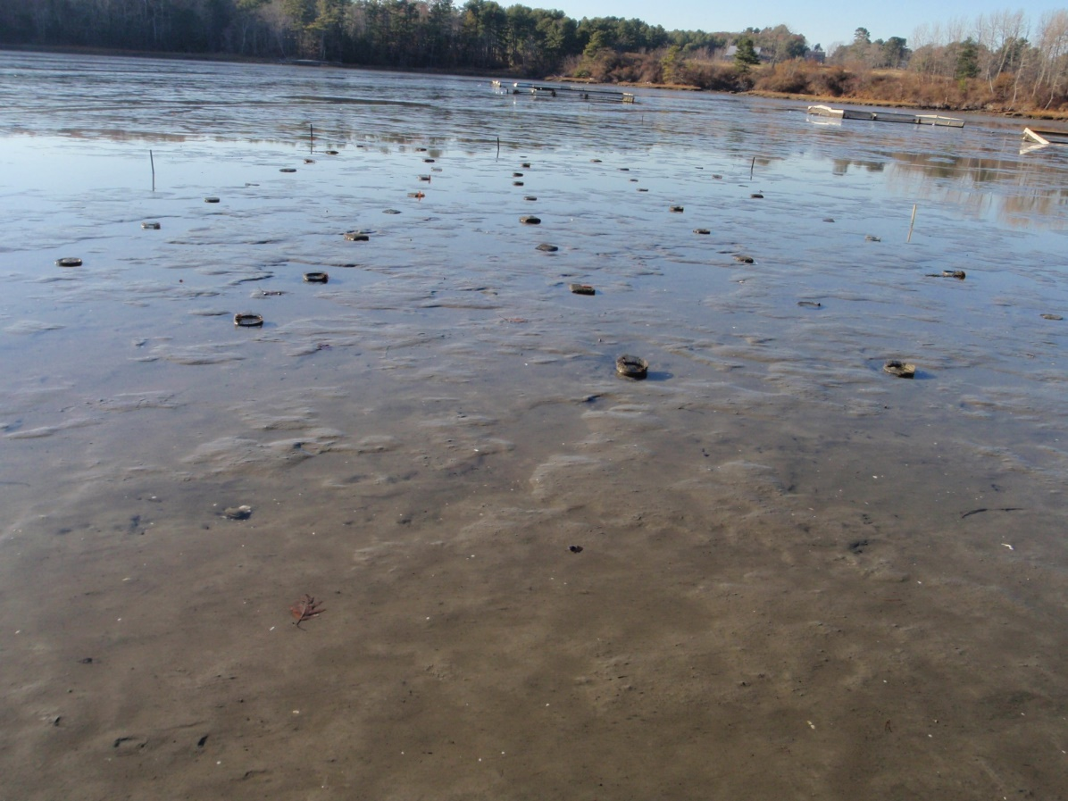
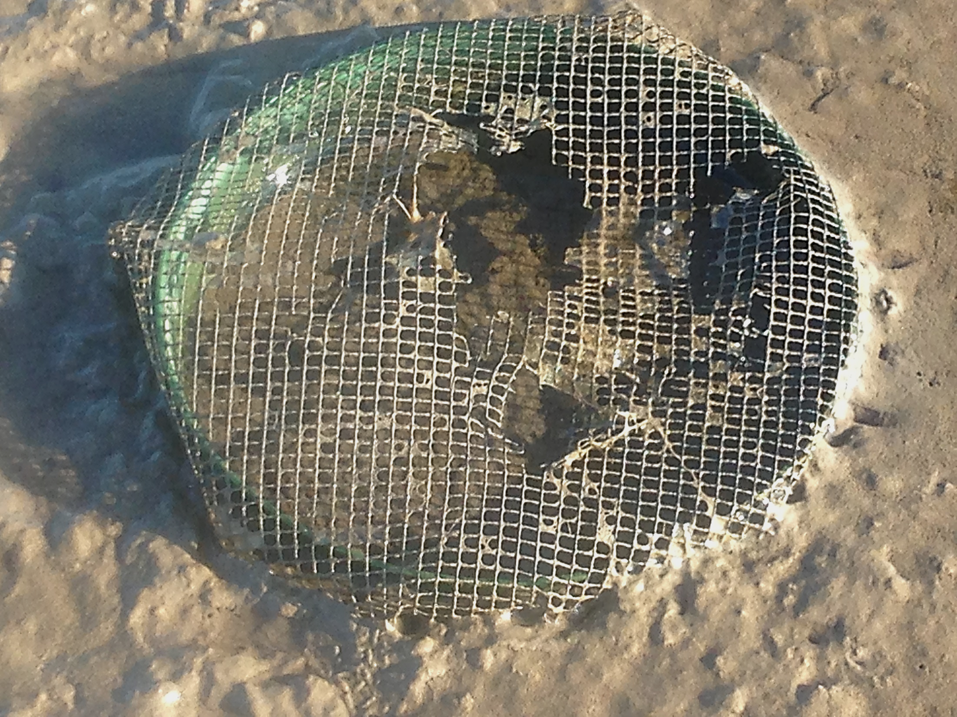
7/5/2013
to
11/8/2013
126 days

Slide 8
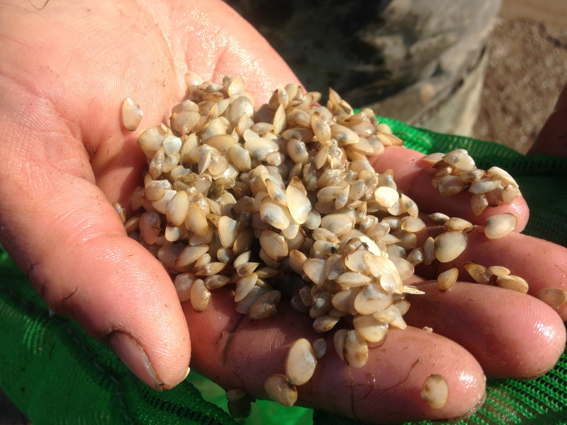
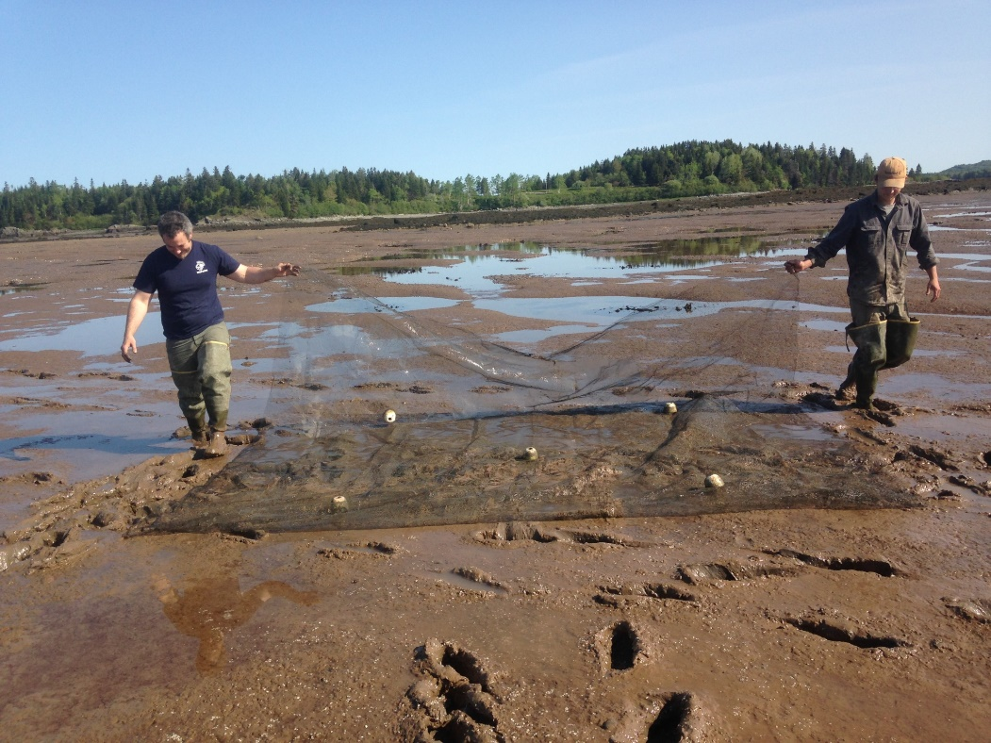
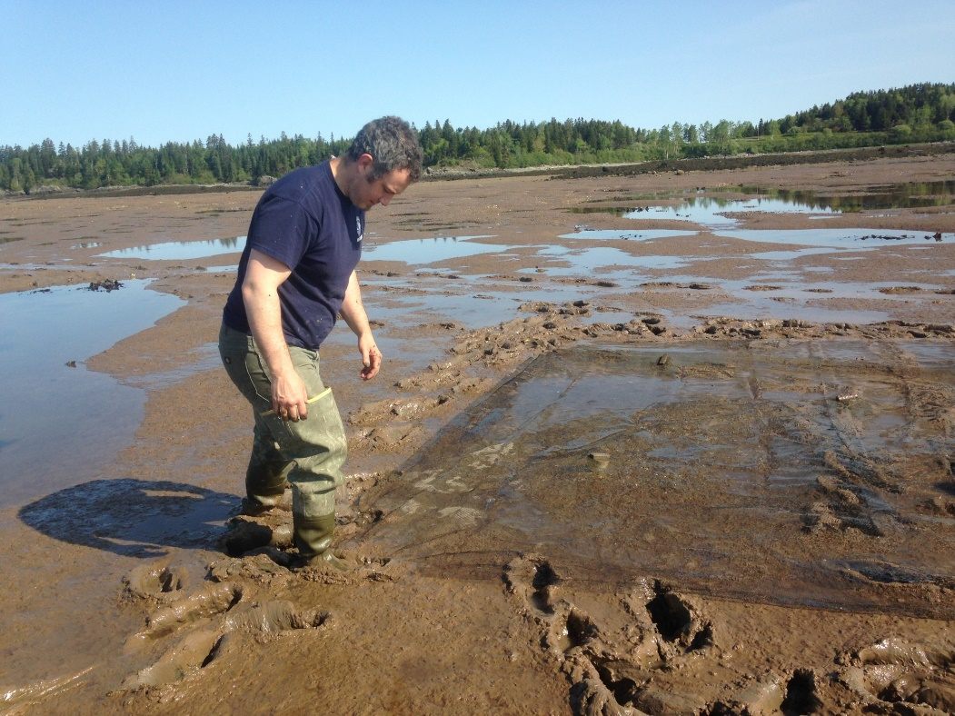
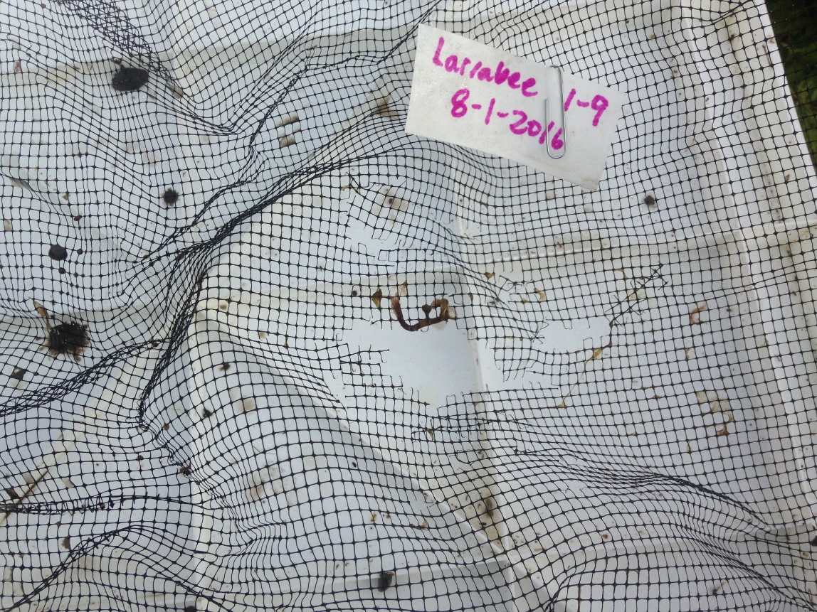
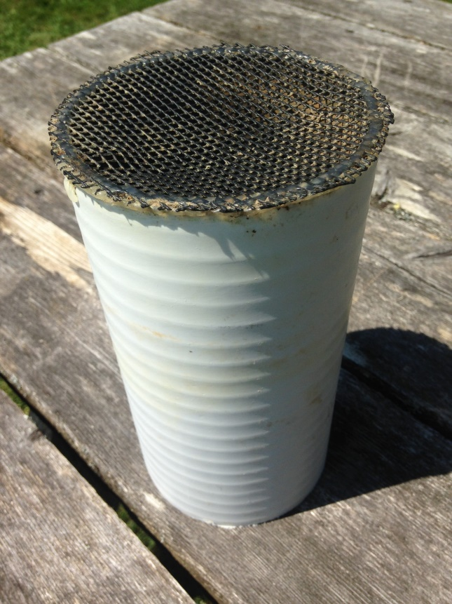
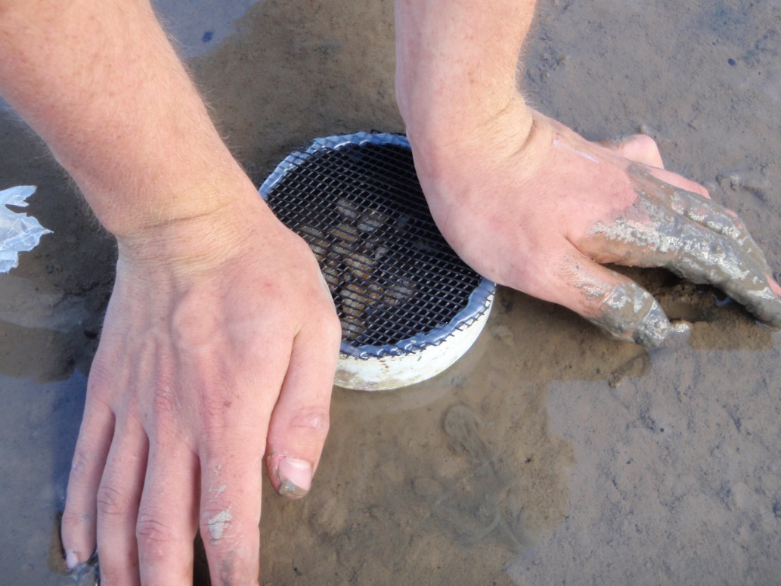
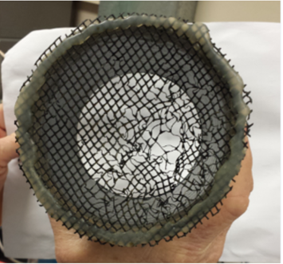

Slide 9
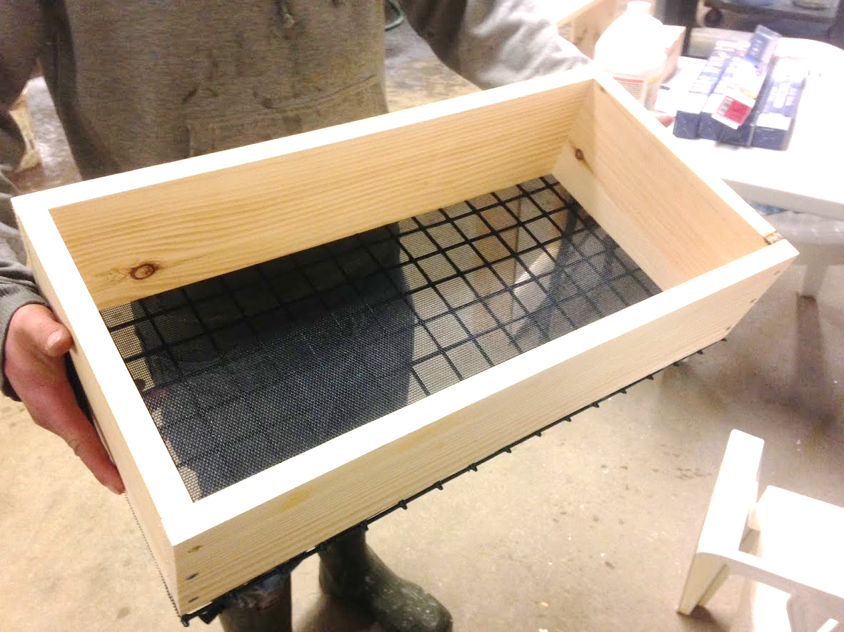
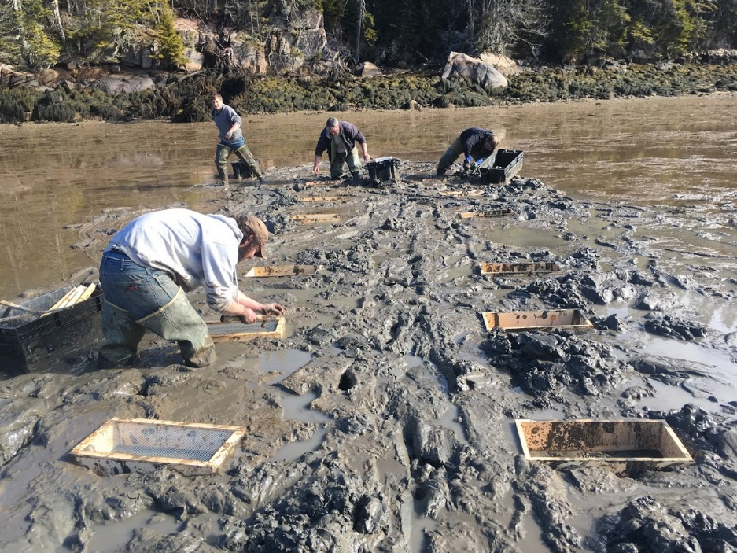
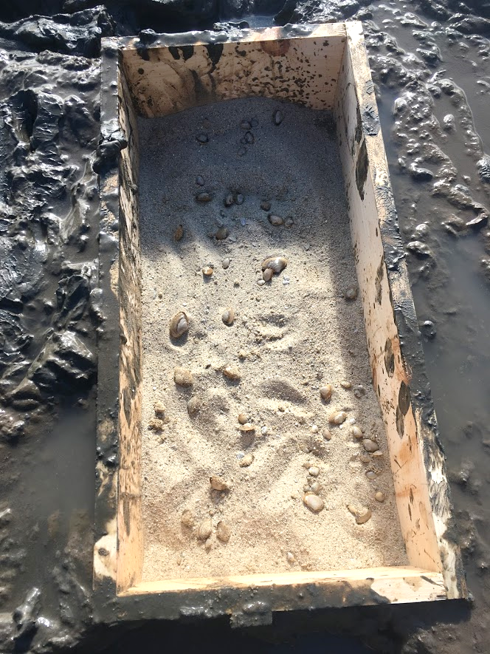
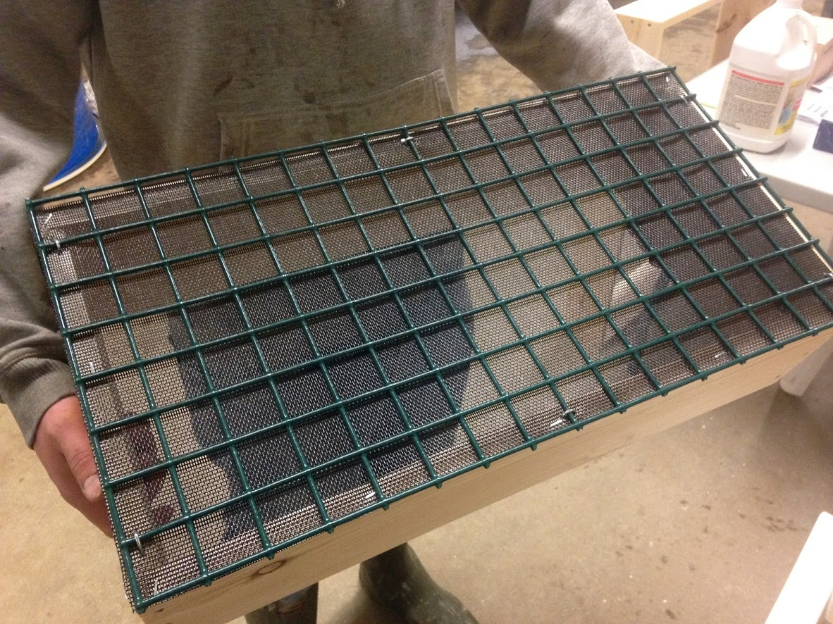
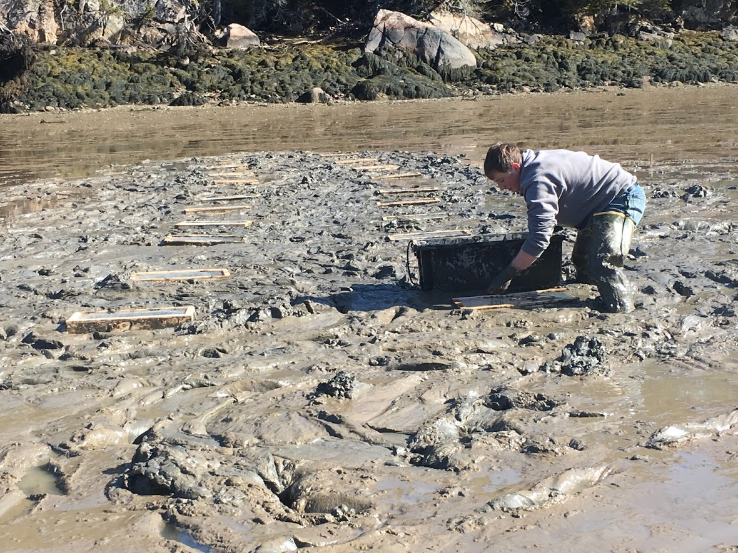
18 April to 29 September 2019

Slide 10
Towards Shore
Towards Shore
100
200
50
100
200
200
50
100
50
100
10.1 ± 0.2 mm
N = 120
# Surfclam
juveniles per box
50
50
200
100
200
Notes:
We used five replicates of each stocking density treatment

Slide 11
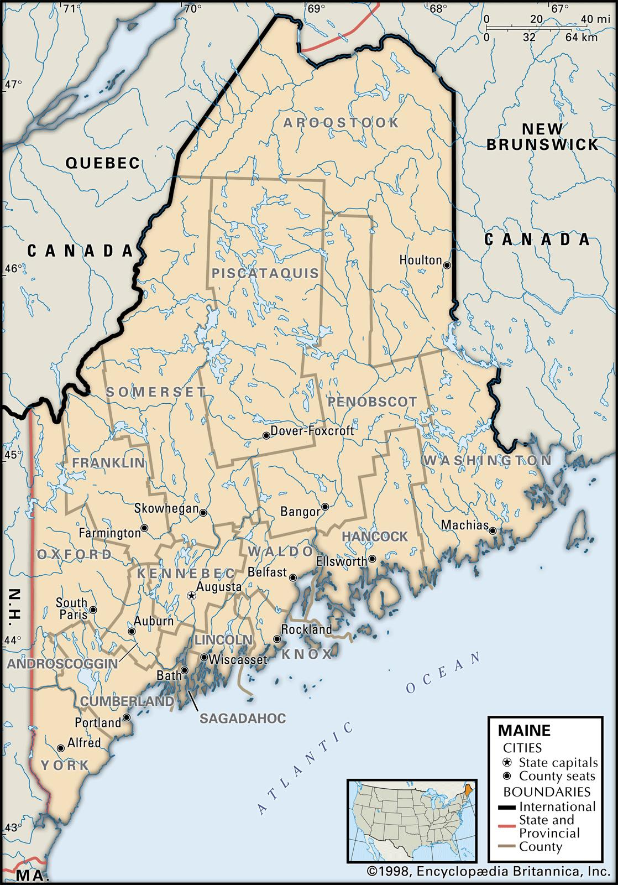
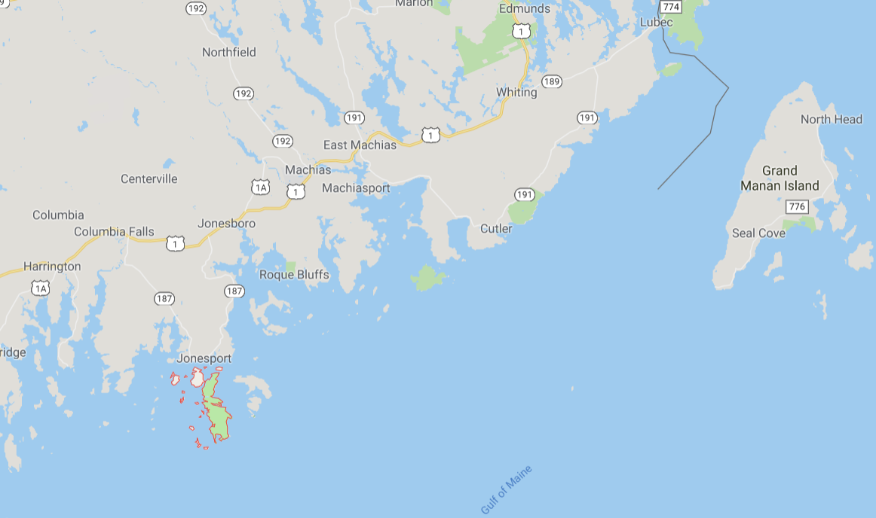
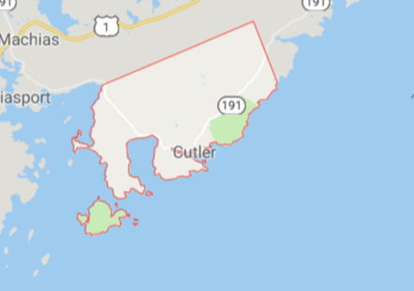
Duck Brook Cove
Cutler, ME
April 18-19 2019
to
Sept 29/Oct 1 2019
Mud Hole Cove
Beals, ME
Notes:
And added the boxes to the mean low water mark at the same two sites that we had used in previous field trials – Mud Hole Cove in Beals, and Duck Brook Cove in Cutler.

Slide 12
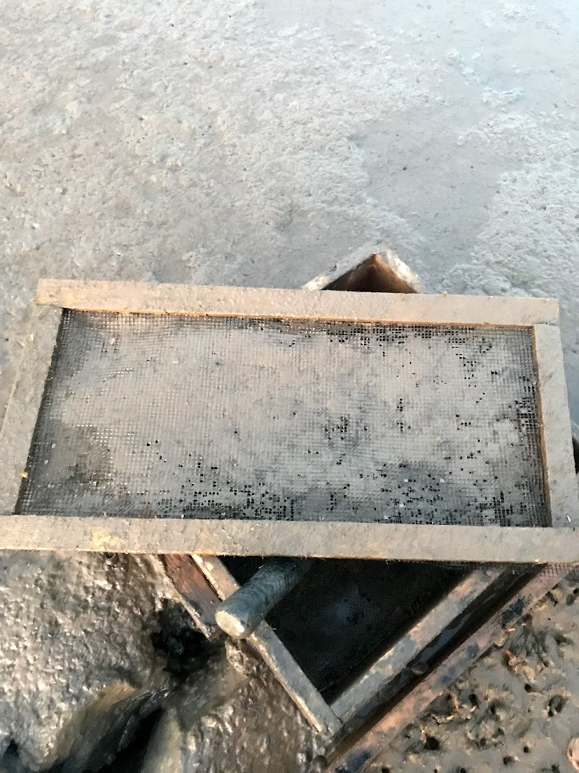
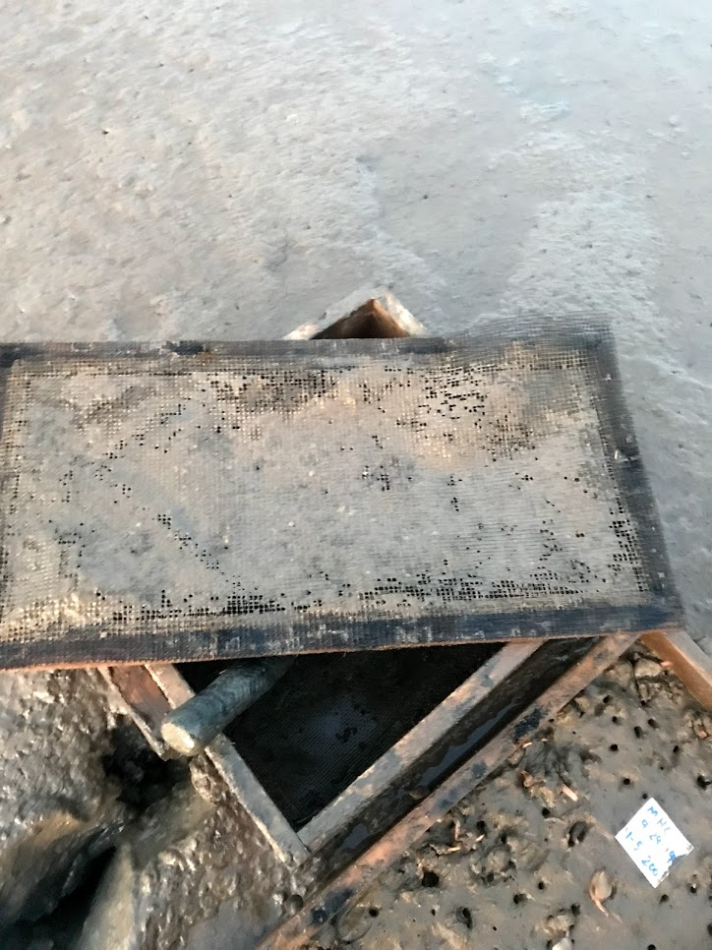
Top of Net
Underside of Net

Slide 13
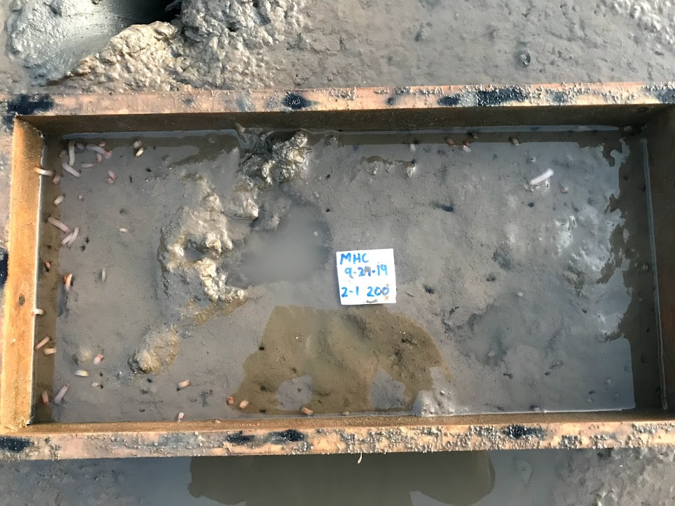
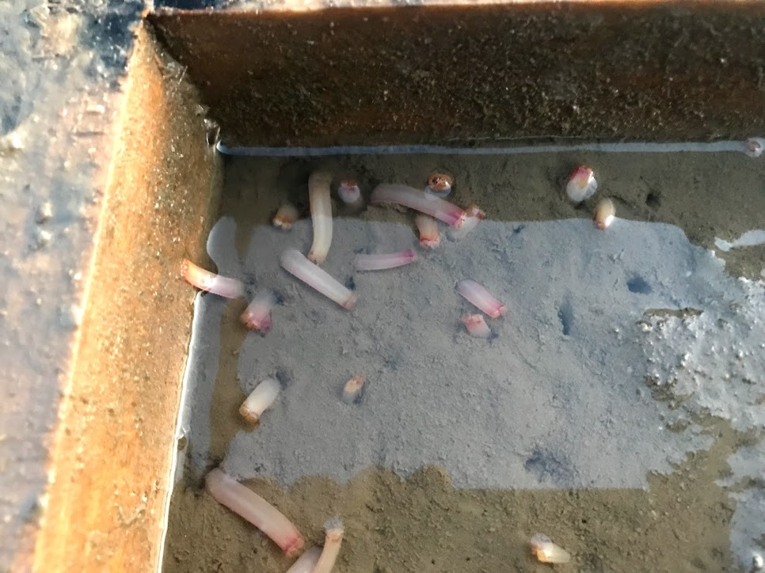
Mud Hole Cove (29 September 2019)
Notes:
Many of the red-colored siphons sticking up out of the sediments….it is easy to see why these would present an easy target for so many predators (whether they be fish, birds, or crustaceans)

Slide 14
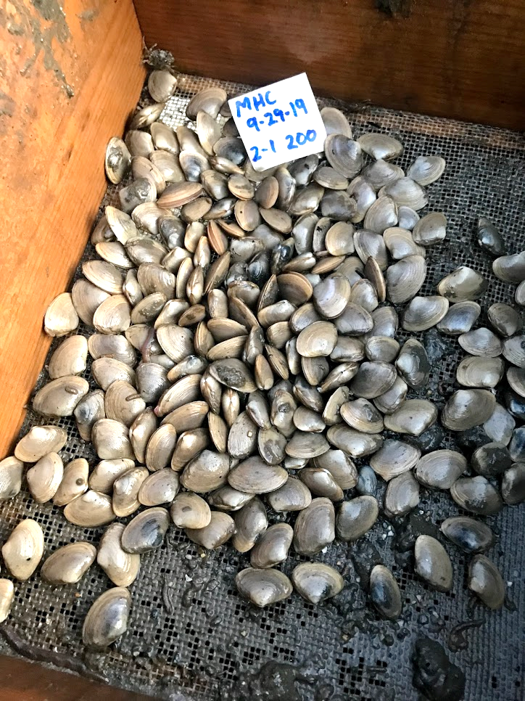
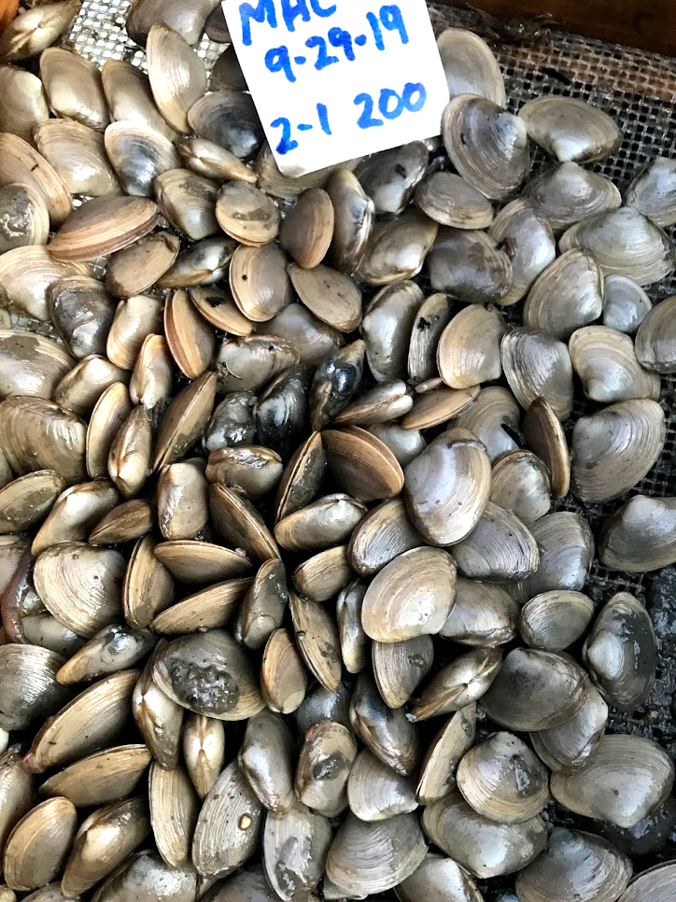
Notes:
In some of the replicate boxes that had been seeded with 200 clams, we got back 200 live clams!

Slide 15
Mud Hole Cove - Beals
98.8%
98.2%
99.1%
N = 5
N = 5
N = 5
48
50
50
50
49
99
100
97
98
97
199
200
199
200
193
Notes:
This shows the mean percent survival, and the white numbers in each bar represent the actual number of survivors for each replicate, which is why the error bars are so tiny.

Slide 16
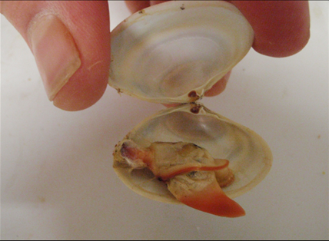
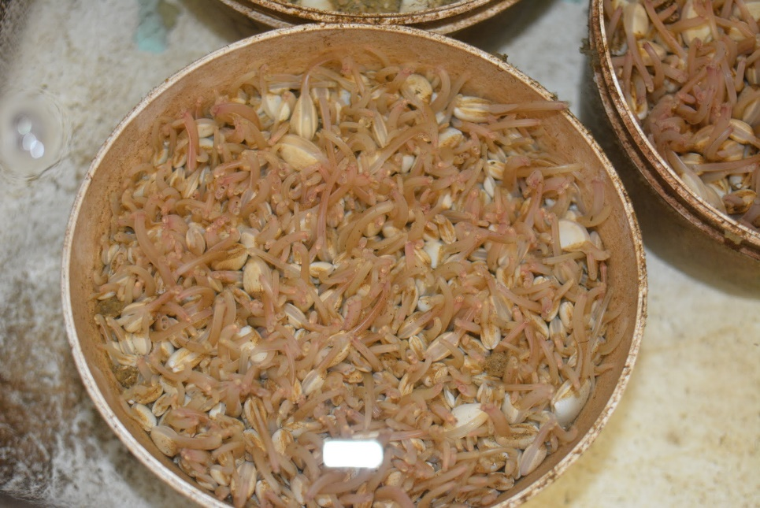

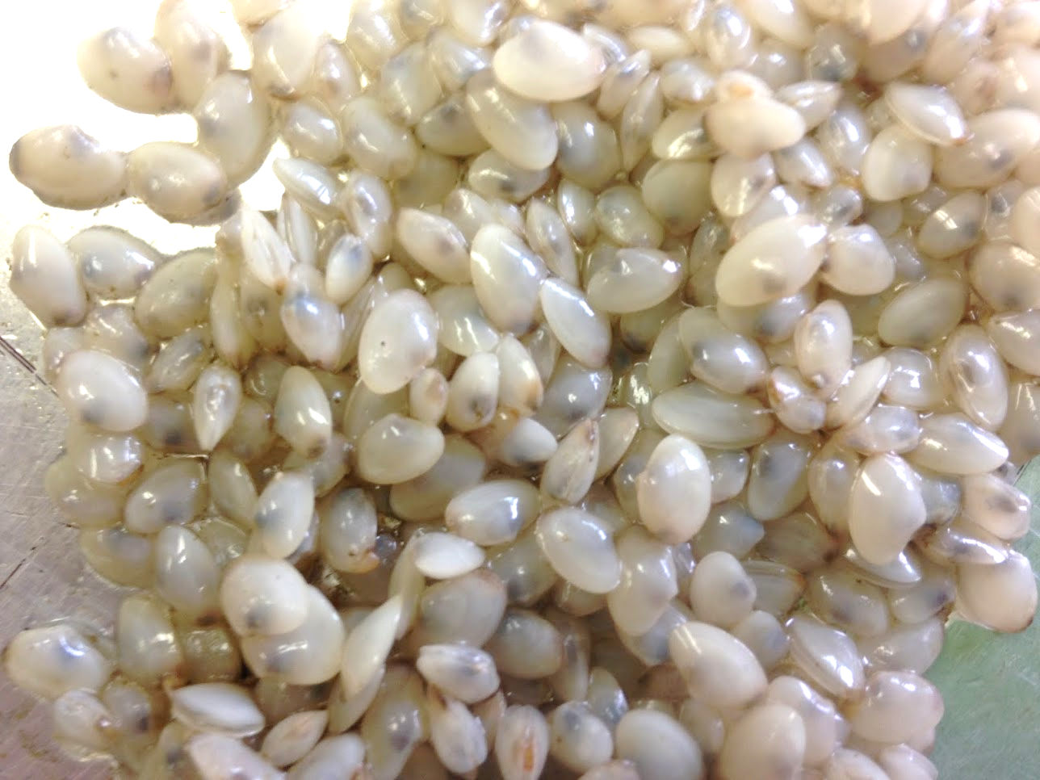
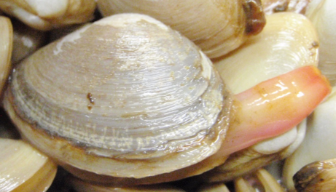
18 April 2019
N = 40
29 Sept 2019
N = 100
32.1 ± 0.6 mm
A slight growth penalty
with increasing stocking
density, but not statistically
significant (P = 0.162)
30.3 ± 0.6 mm
Percent Frequency
30.2 ± 0.6 mm
Shell Length (mm)

Slide 17
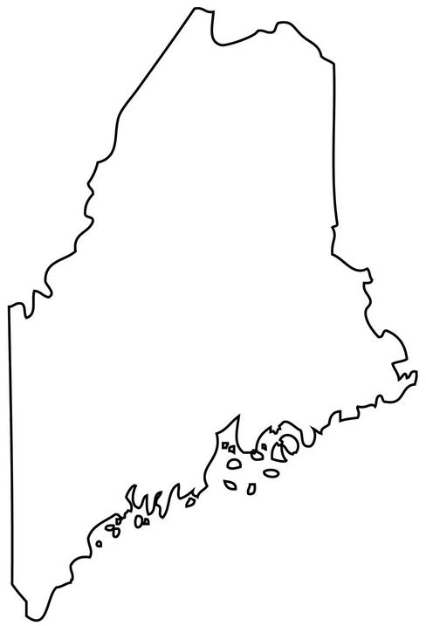
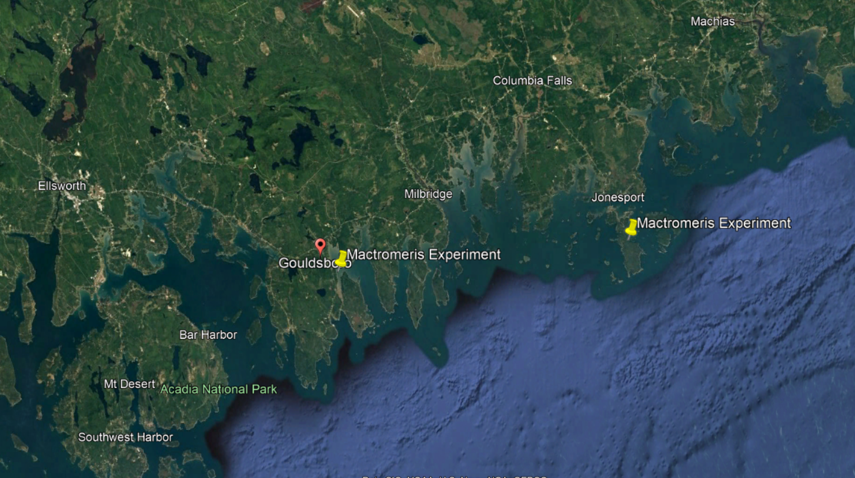
Beals

Slide 18
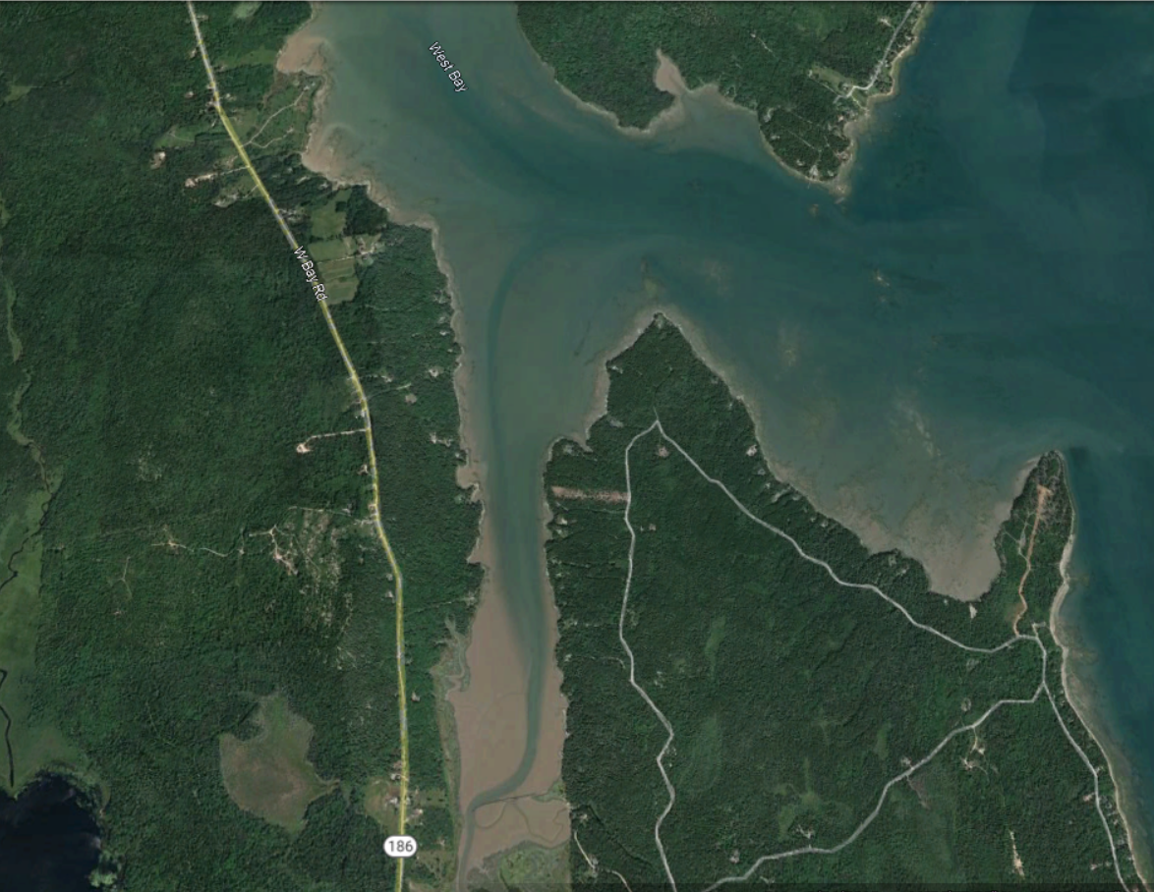
Gouldsboro
Grand Bay Marsh

Slide 19

Beals

Slide 20

Three factors (n = 5)
A = Density (25, 50, 100/ft²)
B = Box Size (2 ft² vs. 4 ft²)
C = Top thickness (1-in vs. 2-in)
3 x 2 x 2 x 5 = 60 boxes
Factorial design

Slide 21


Slide 22


Slide 23


Slide 24

2-inch top
2ft² box

