Slide 2
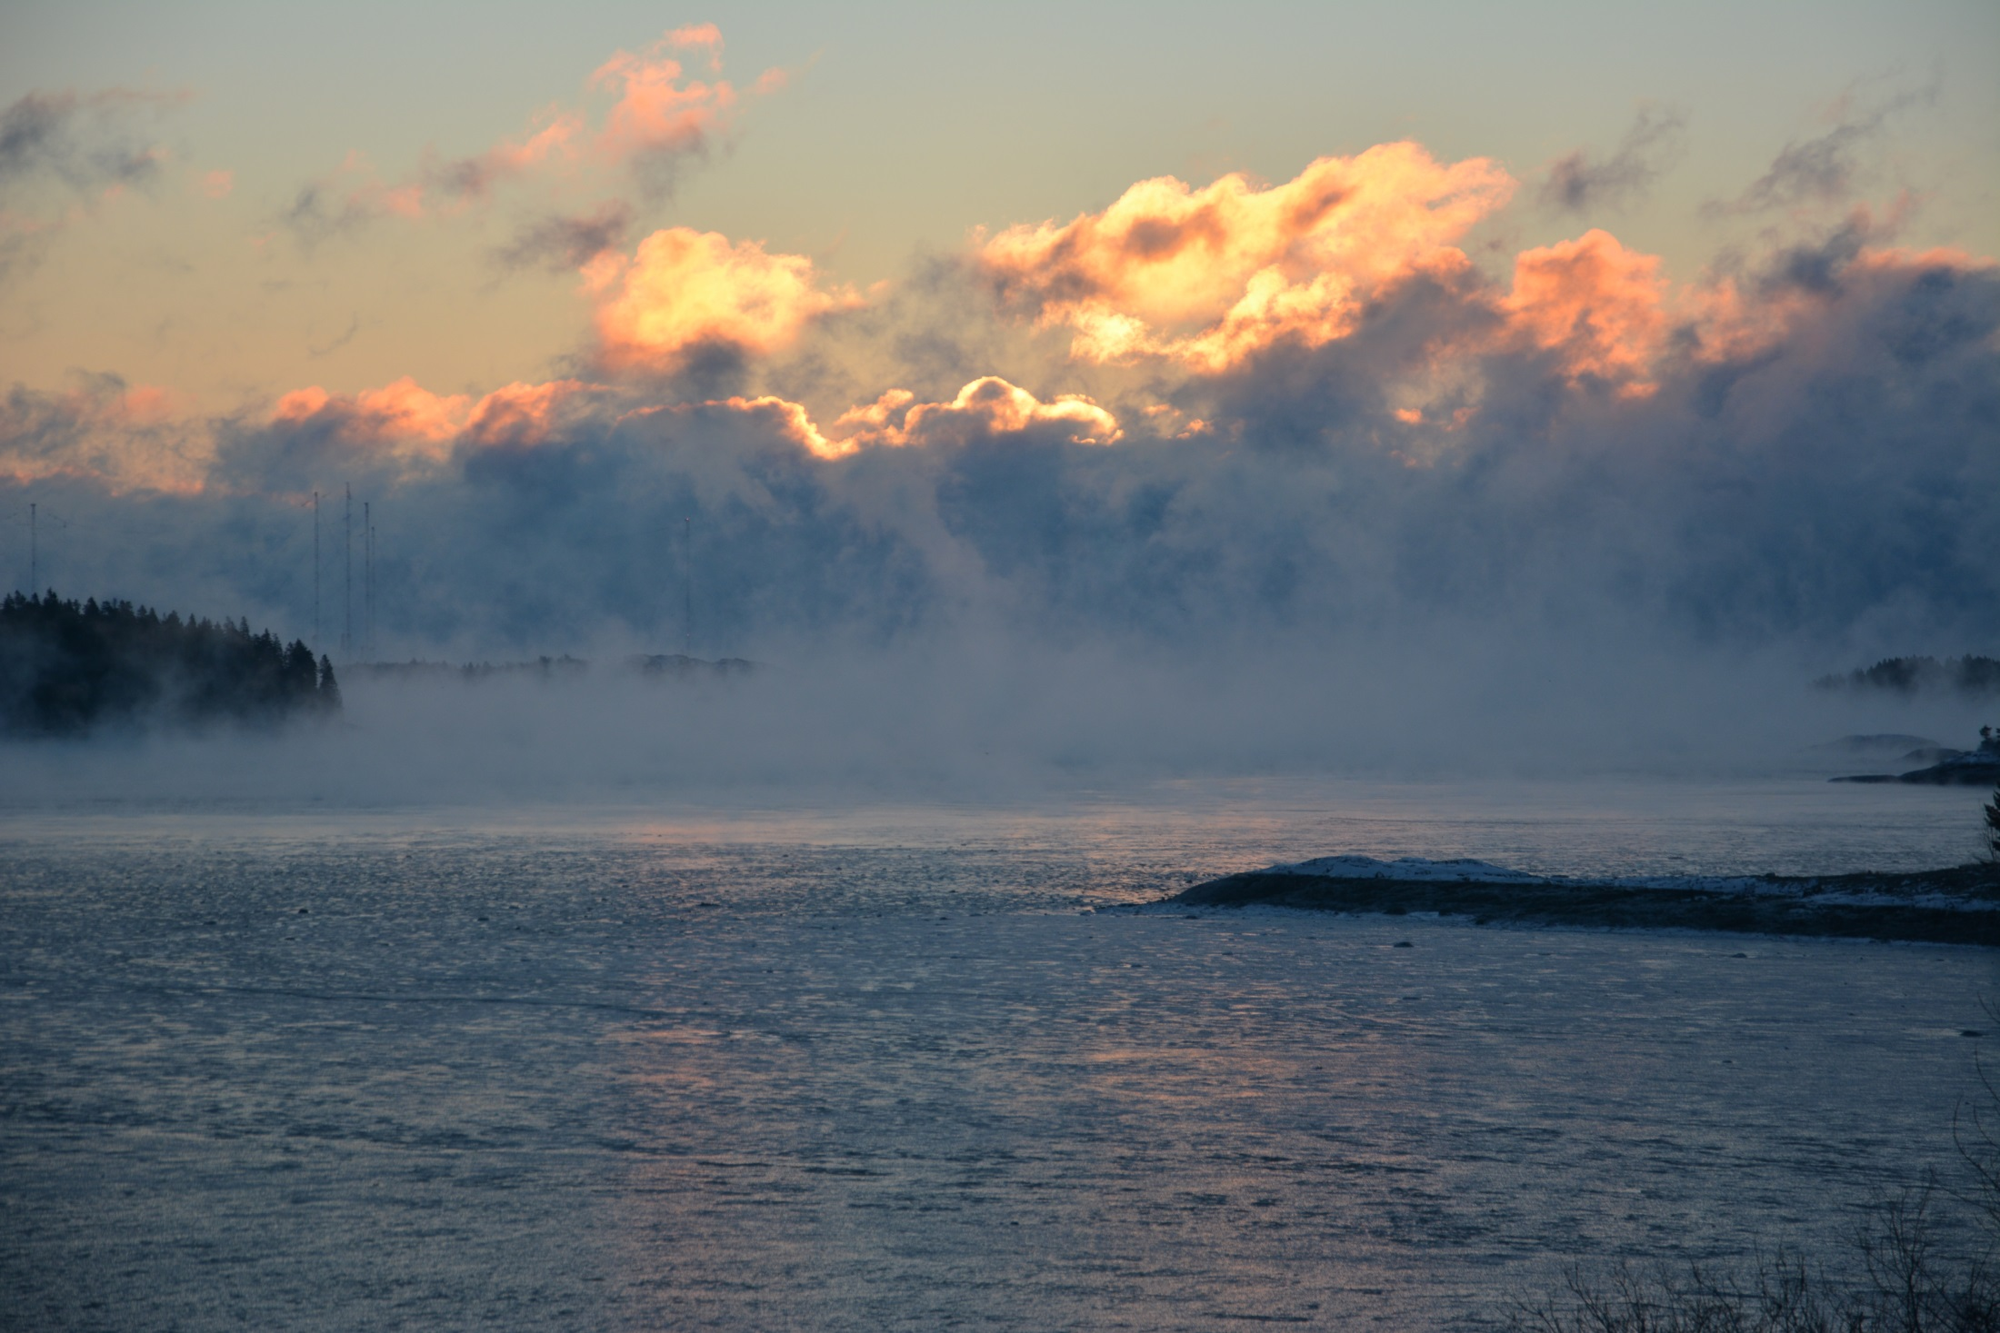
Interactive effects of size and intraspecific density on growth and survival of cultured juvenile Arctic surfclam Mactromeris polynyma
in two eastern Maine intertidal flats
B. Beal^{1,2}, K. Pepperman², B. Salter², and T. Houston²
University of Maine at Machias
Downeast Institute

Slide 3
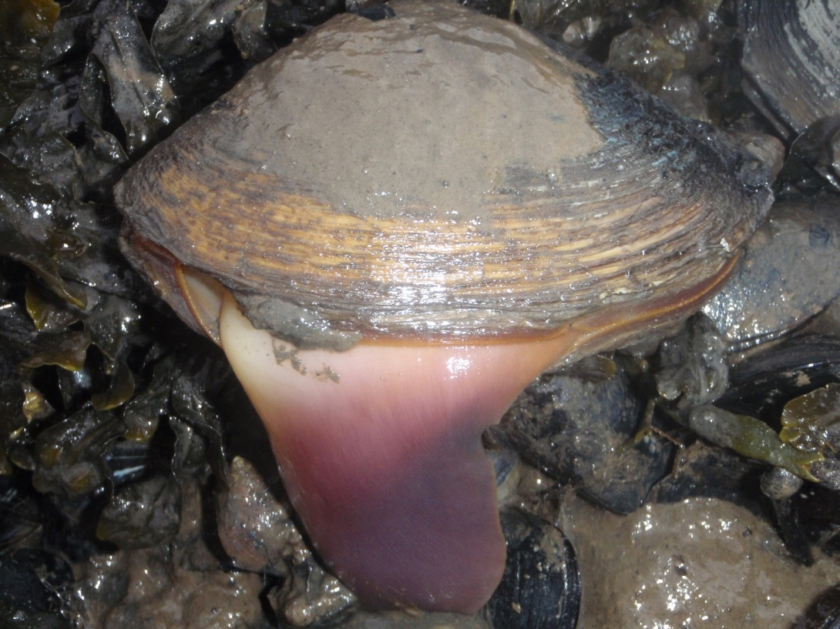
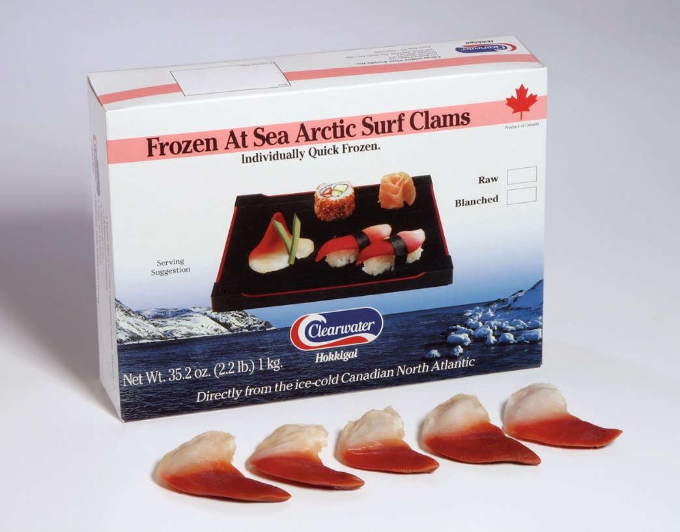
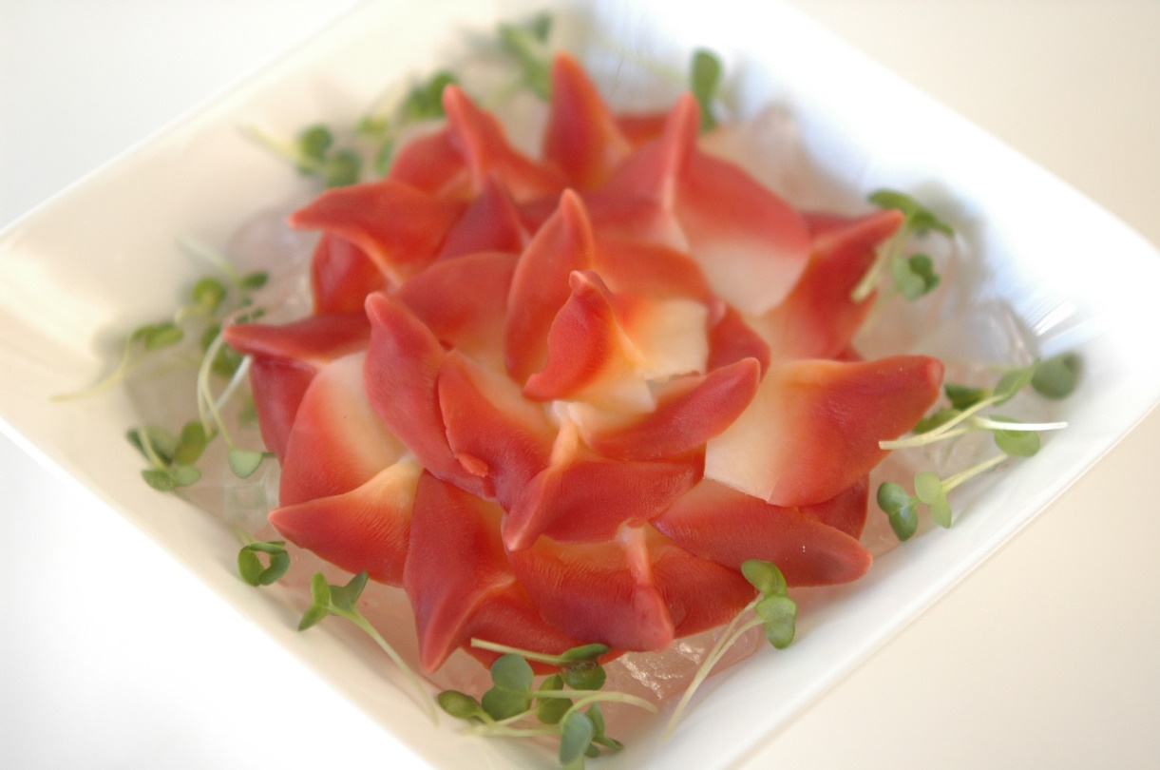
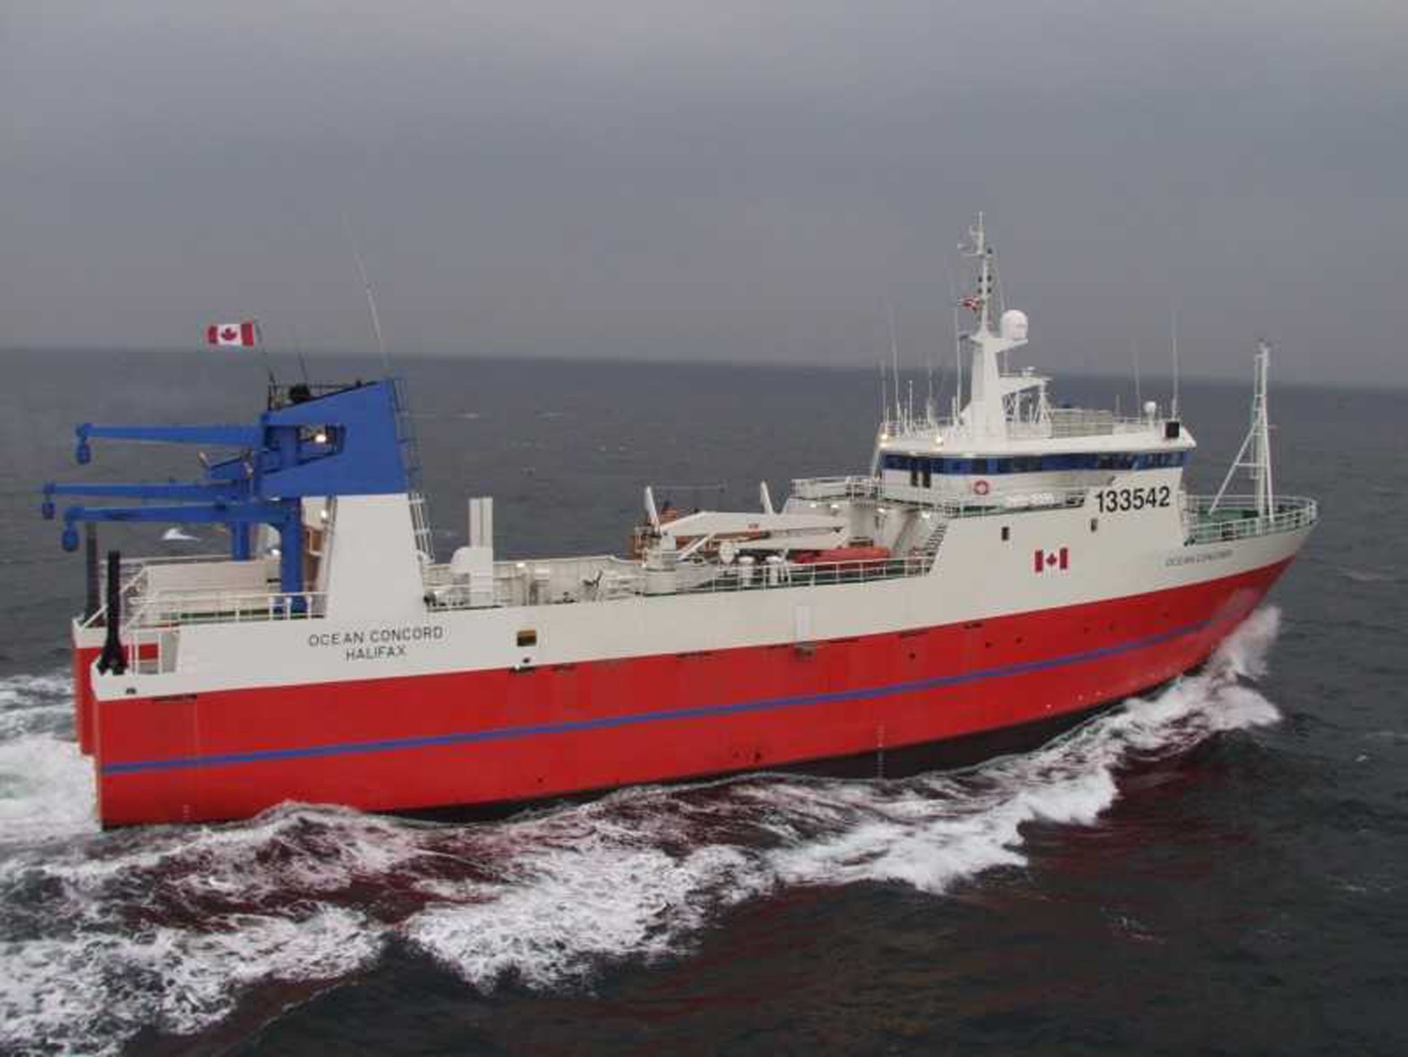
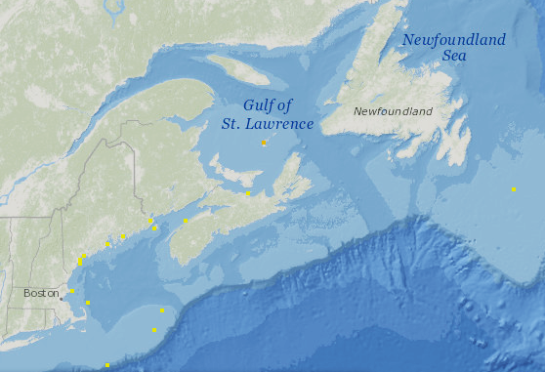
125 mm
Mactromeris polynyma
Arctic Surf Clam
Natashquan, QC

Slide 4
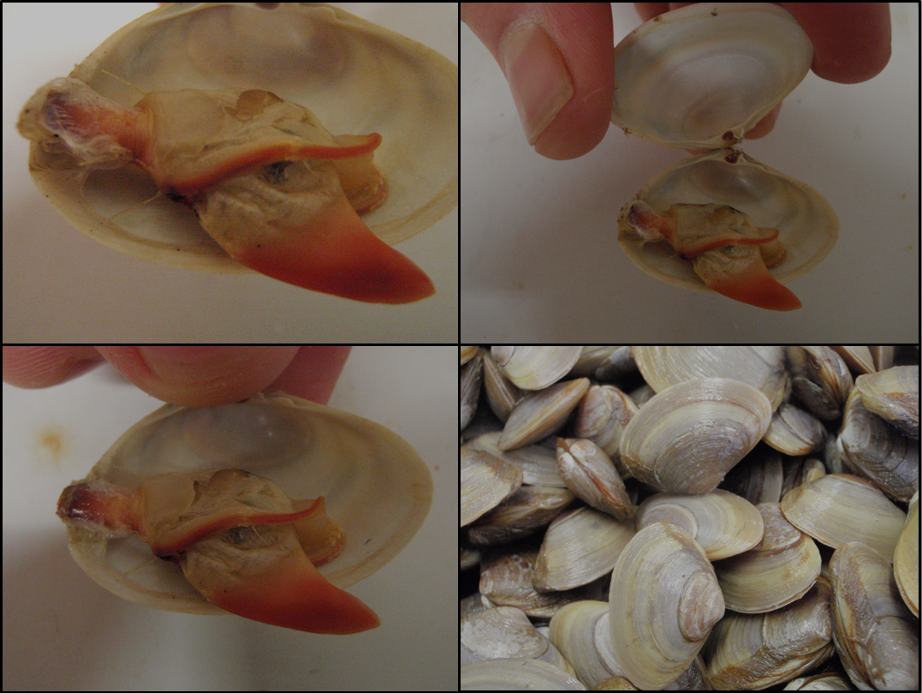

Slide 5
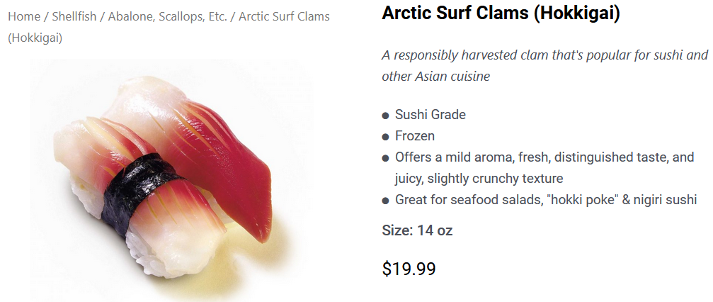
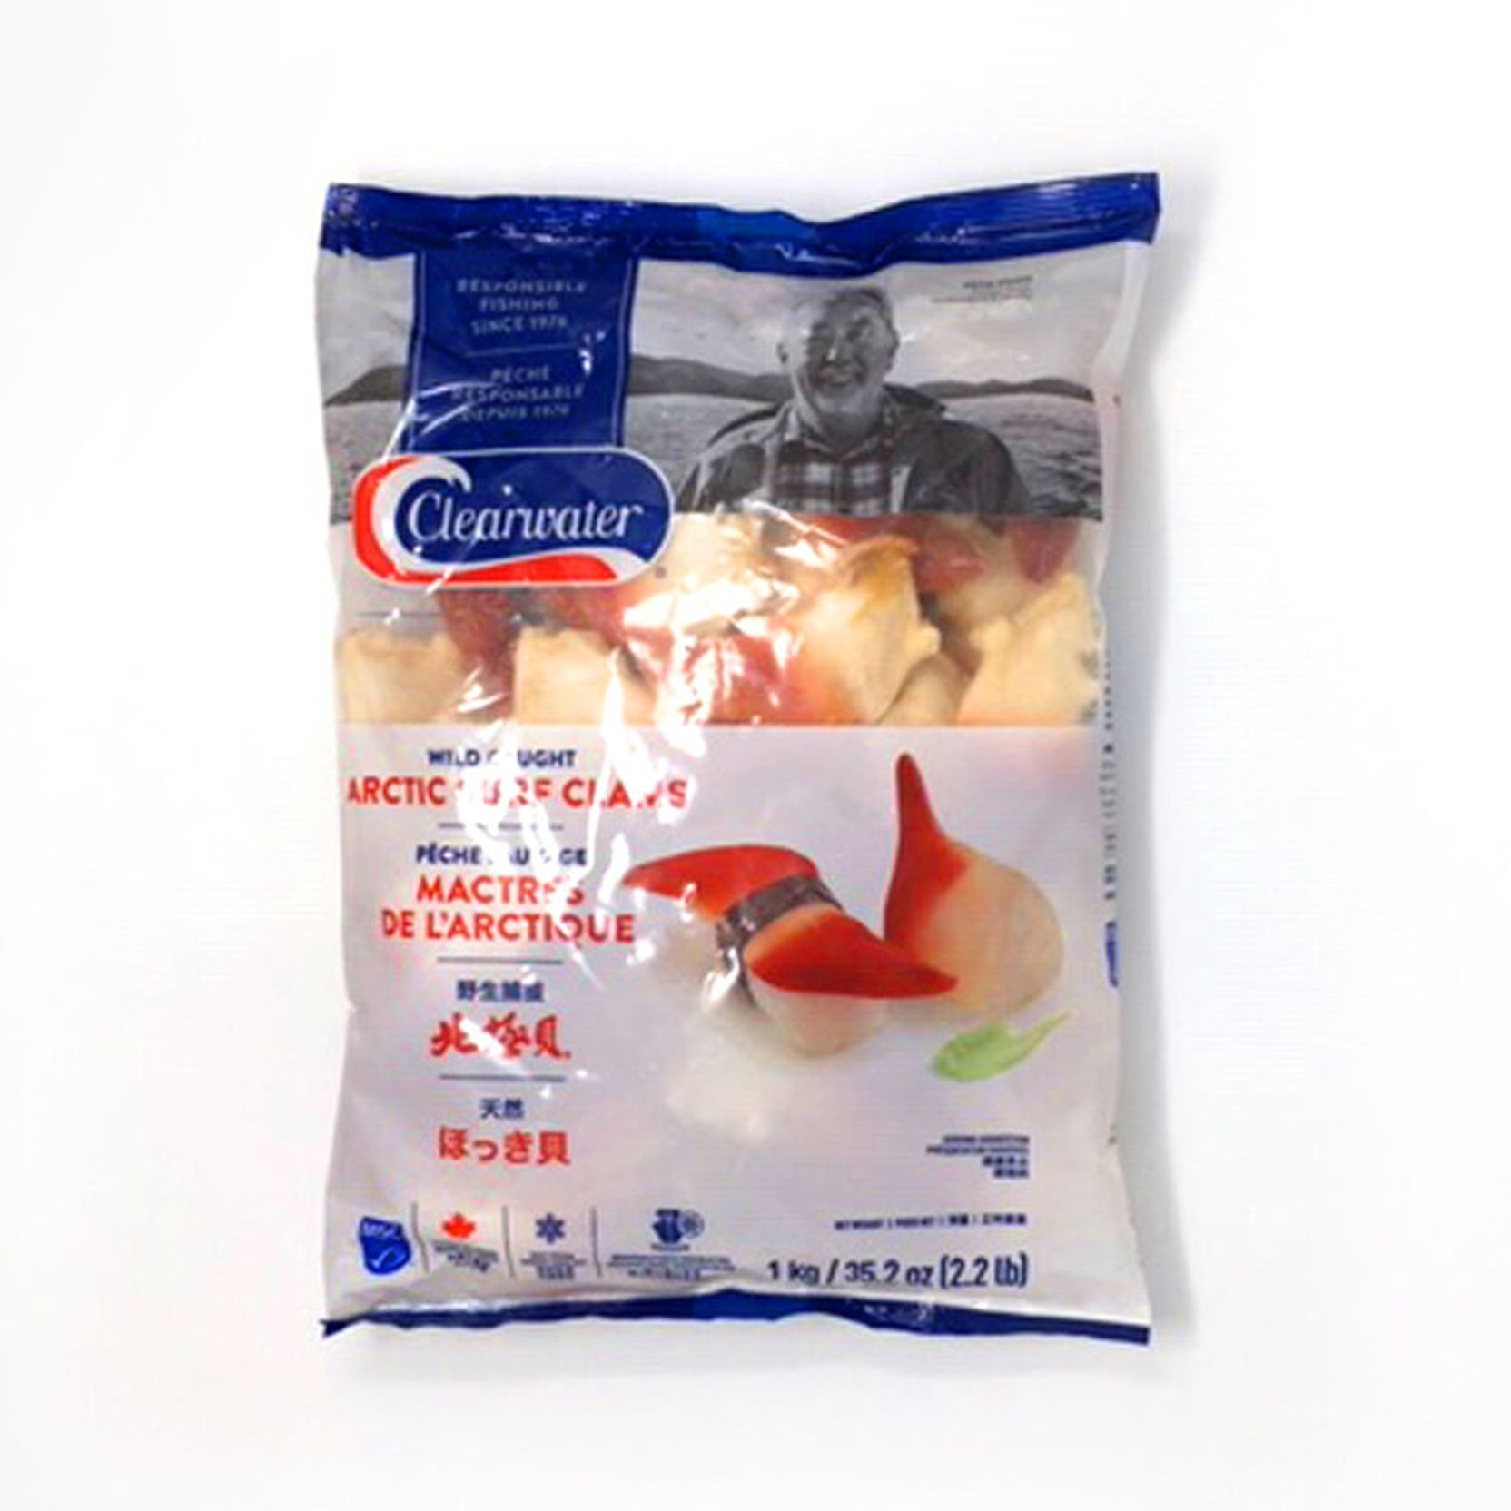
Why Arctic surfclams, and why intertidally?
Relatively expensive, niche-market species with great flavor and visually appealing
Maine Soft-Shell Clam Landings (1950-2022)
-84%

Slide 6
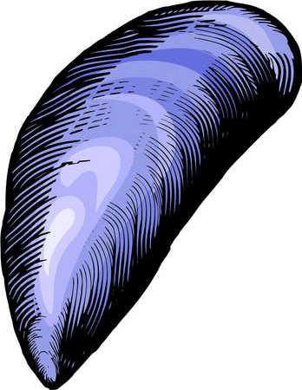
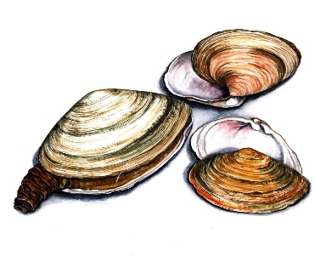
Why Arctic surfclams, and why intertidally?
Initially, we thought it possible to diversify commercial species harvested in the intertidal
zone: soft-shell clams; blue mussels; northern quahogs (hard clams); razor clams
Maine Soft-Shell Clam Landings (1950-2022)
Maine Blue Mussel Landings (1950-2022)
-84%
-85%

Slide 7
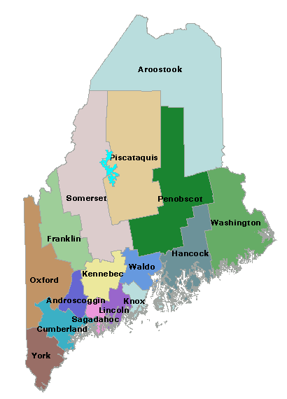
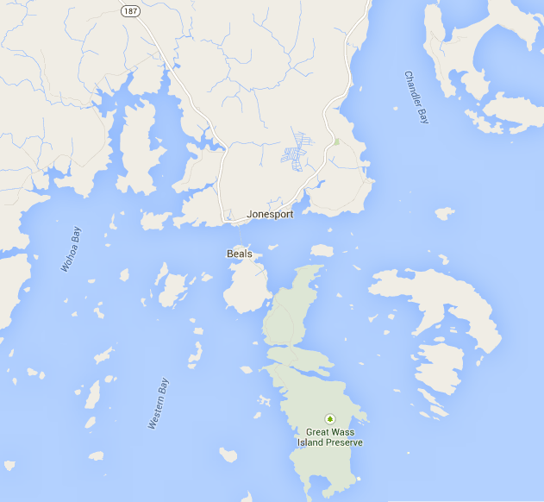

Slide 8
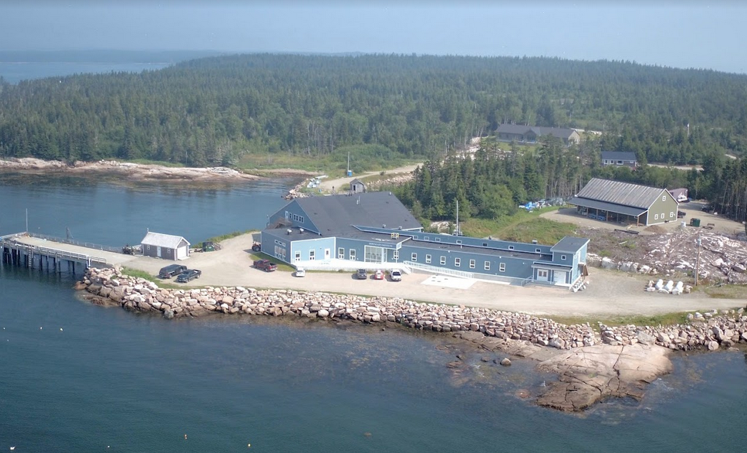
30-bed dorm
Guest
House
Fabrication Shop
Shellfish Hatchery
Conference
Room
Classroom
100-ft deepwater pier
Ecology Wet Lab

Slide 9
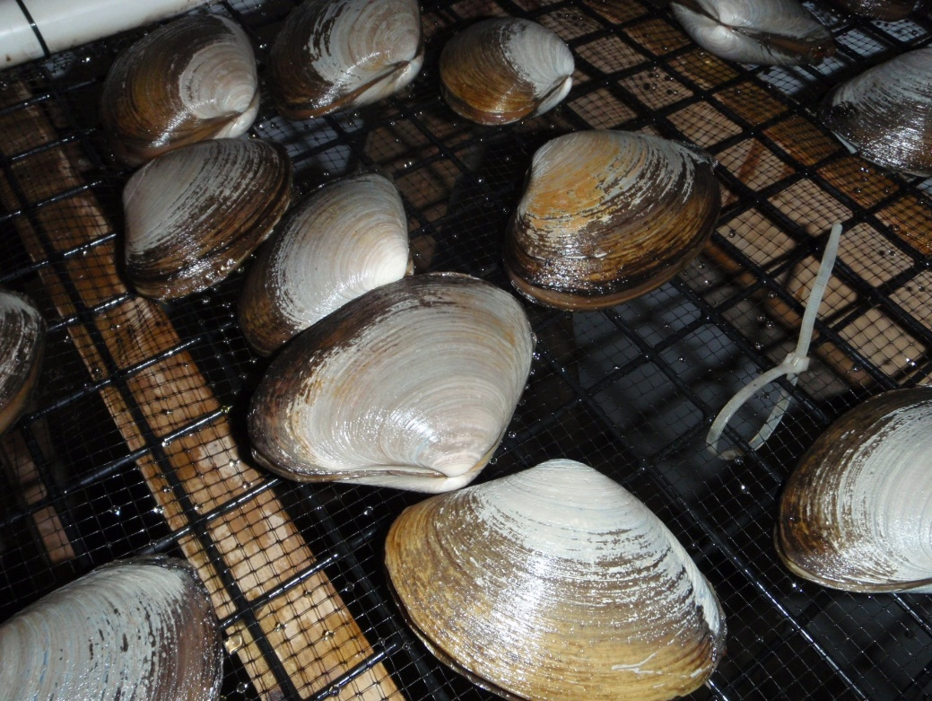
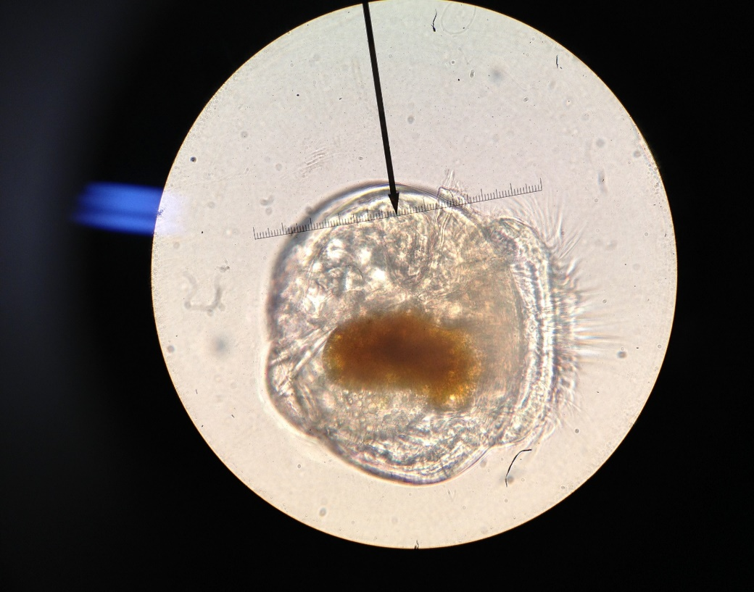
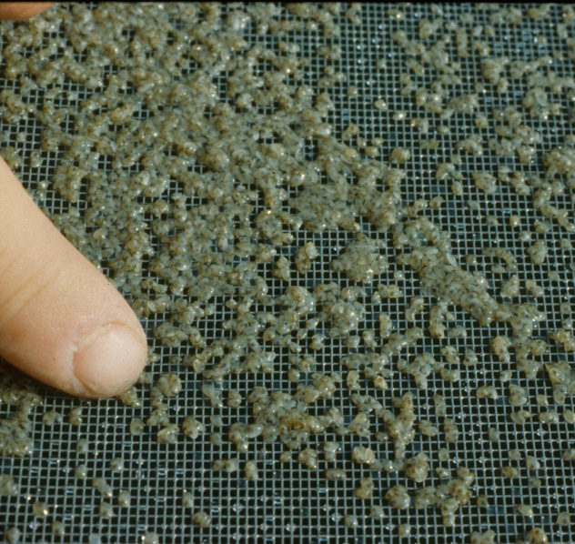
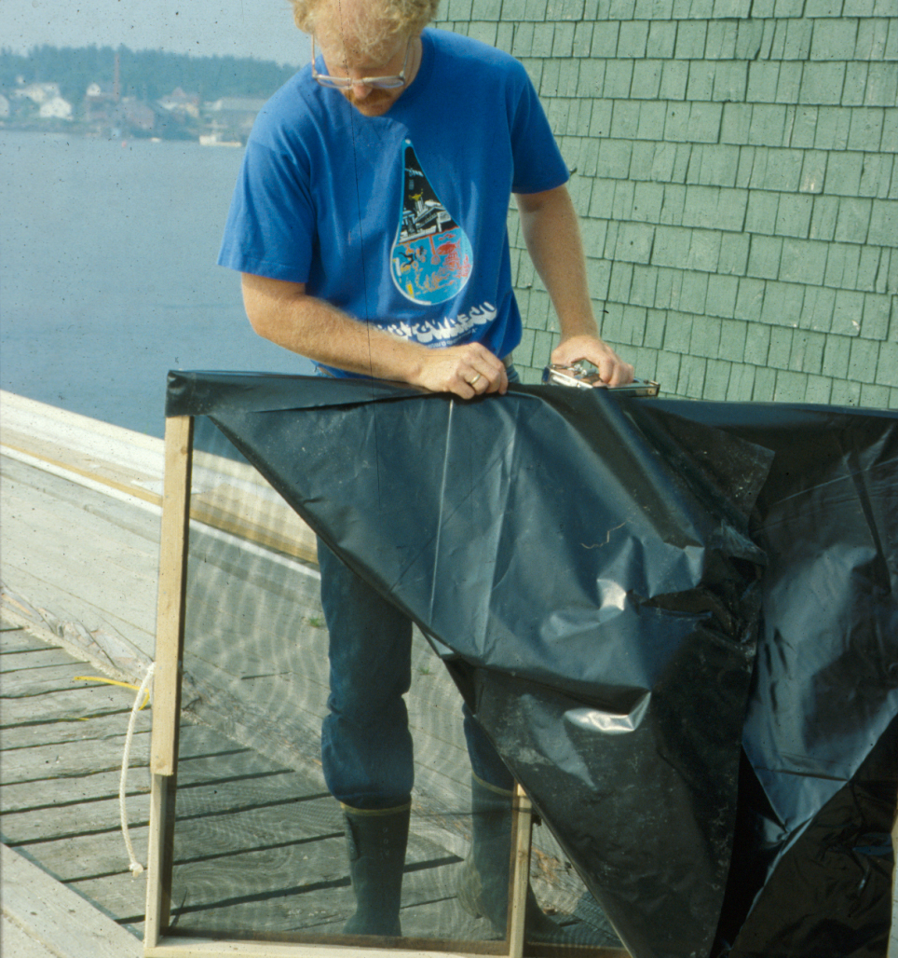
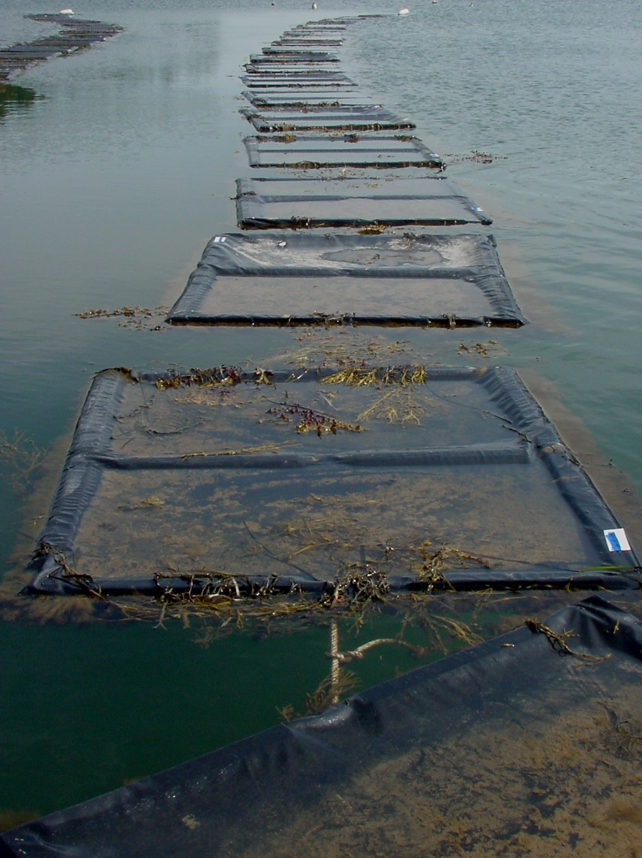
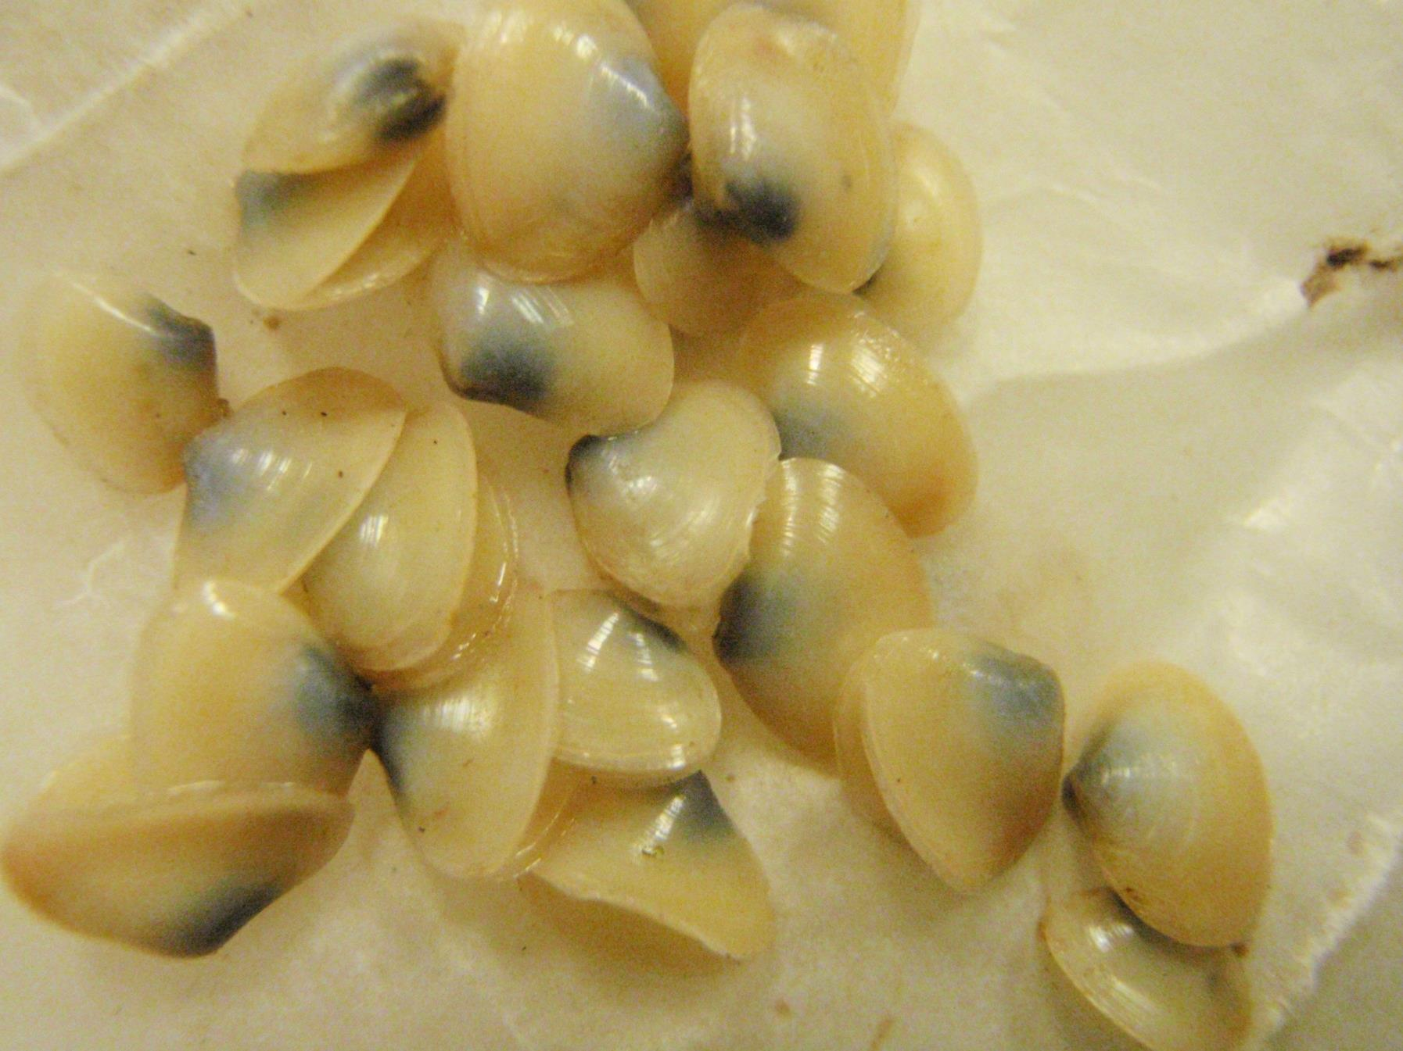
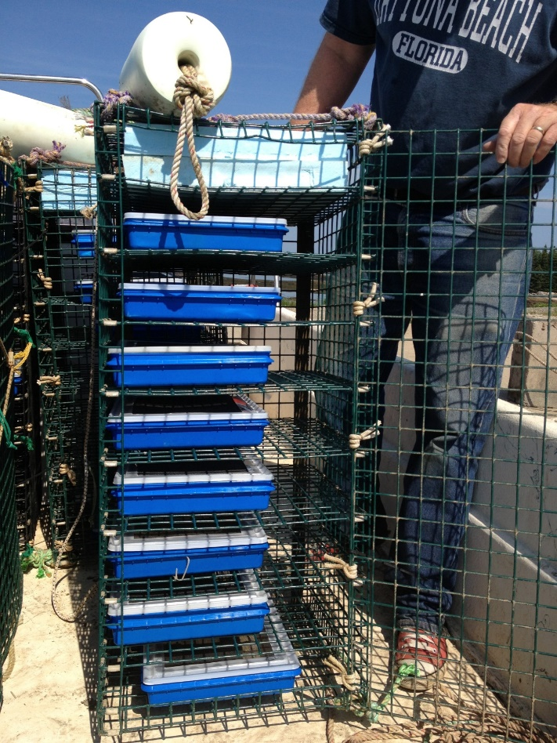

Slide 10
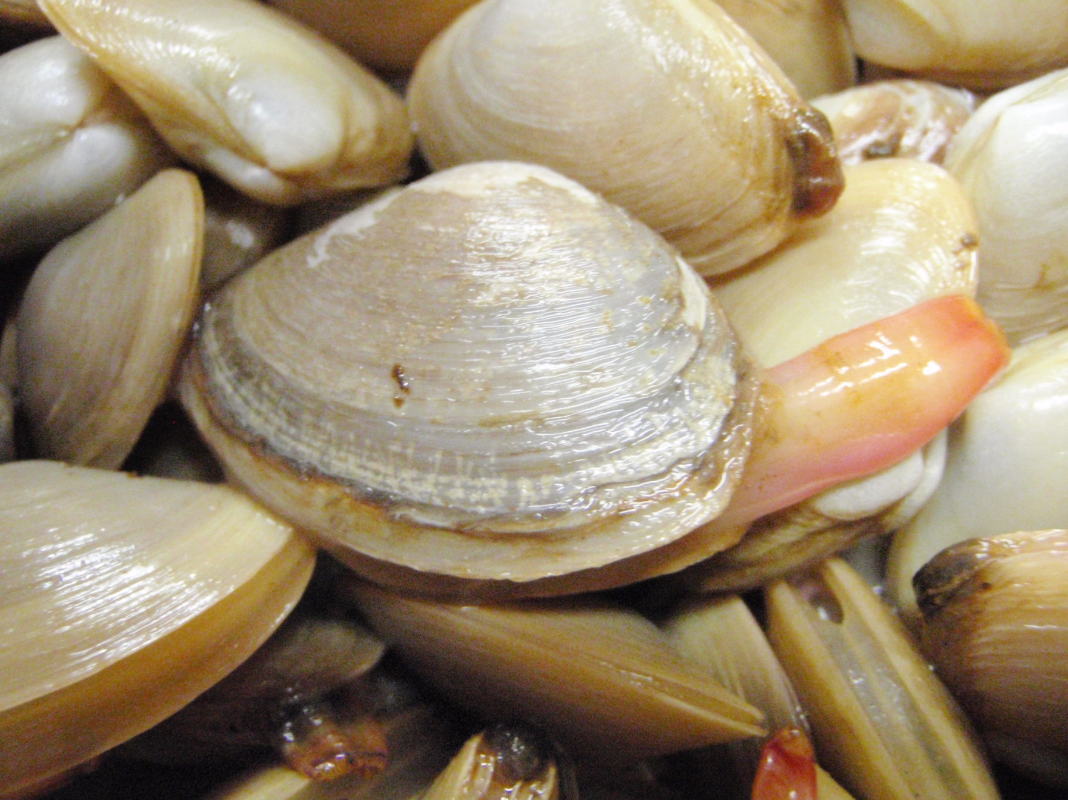

Slide 11
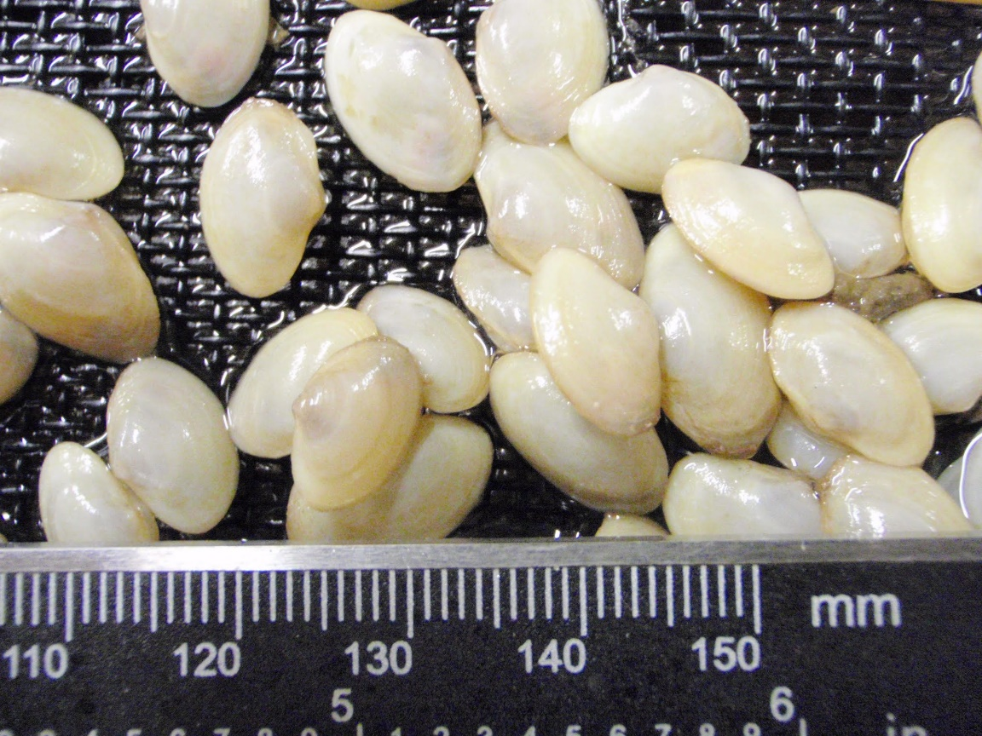
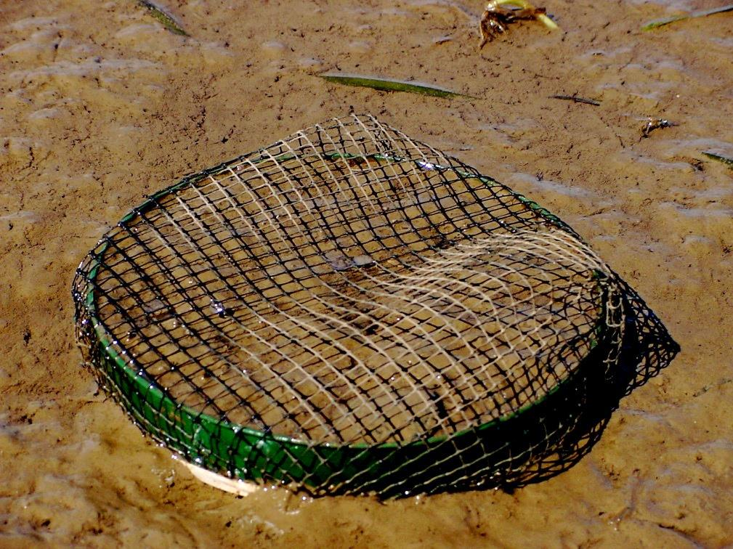
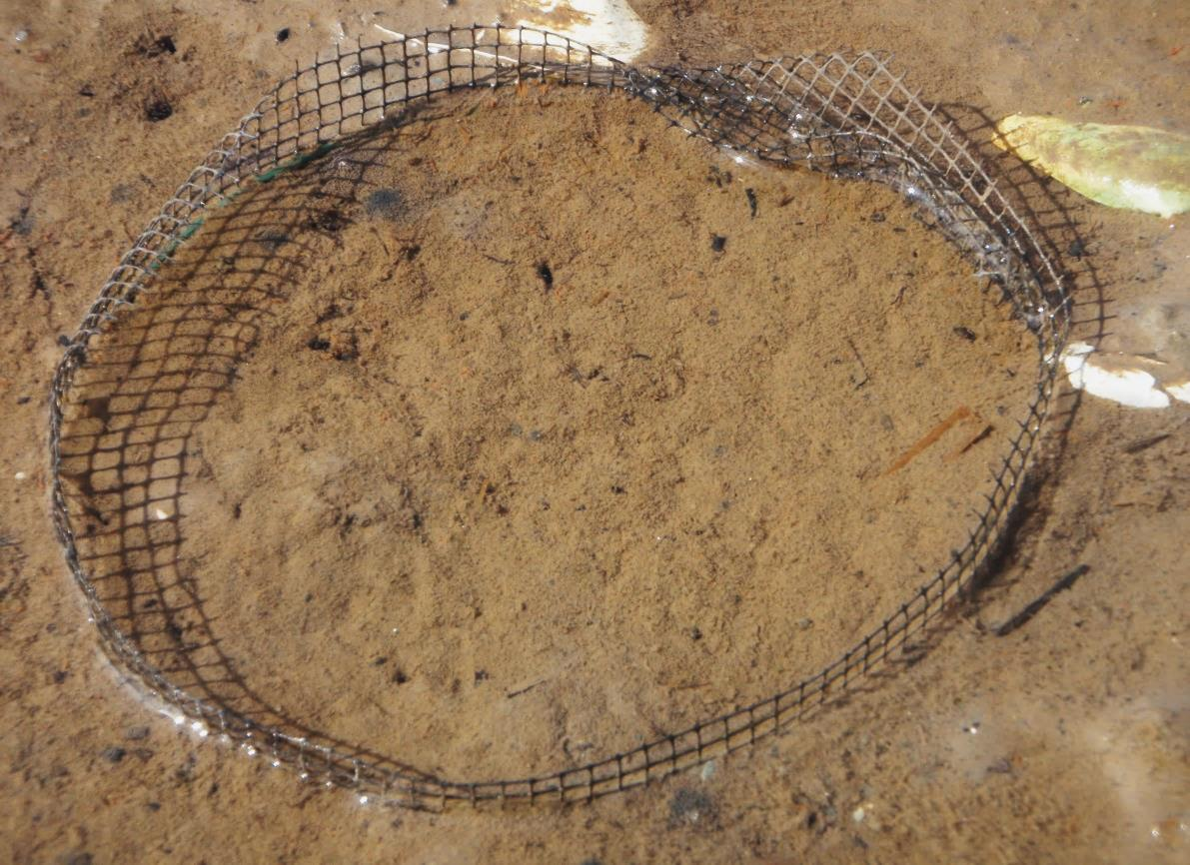
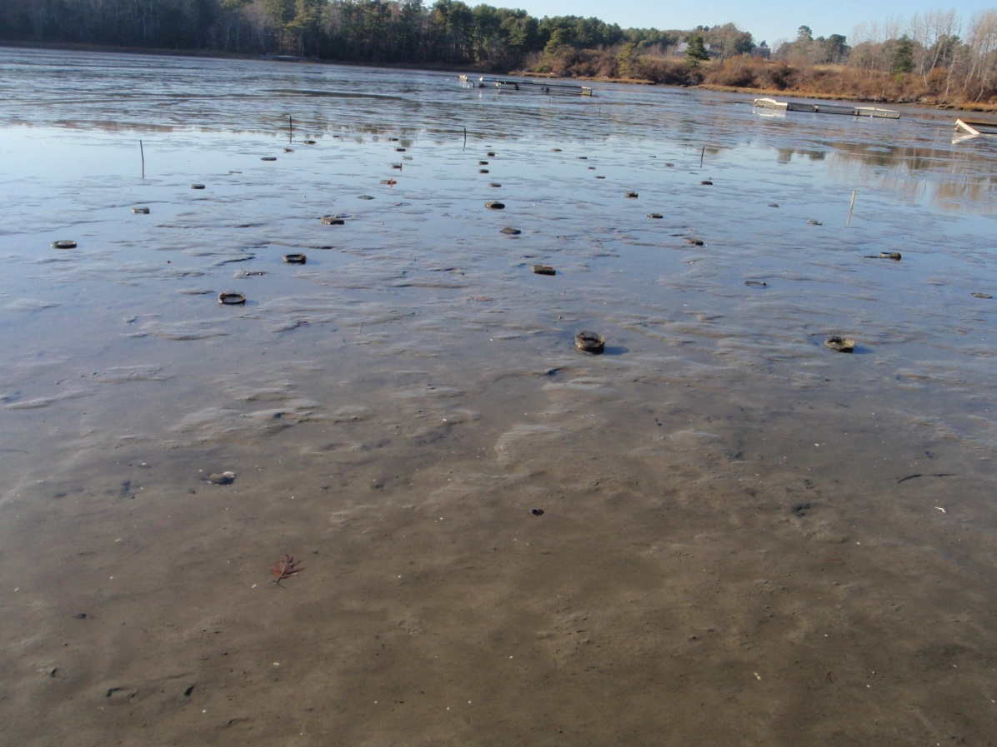
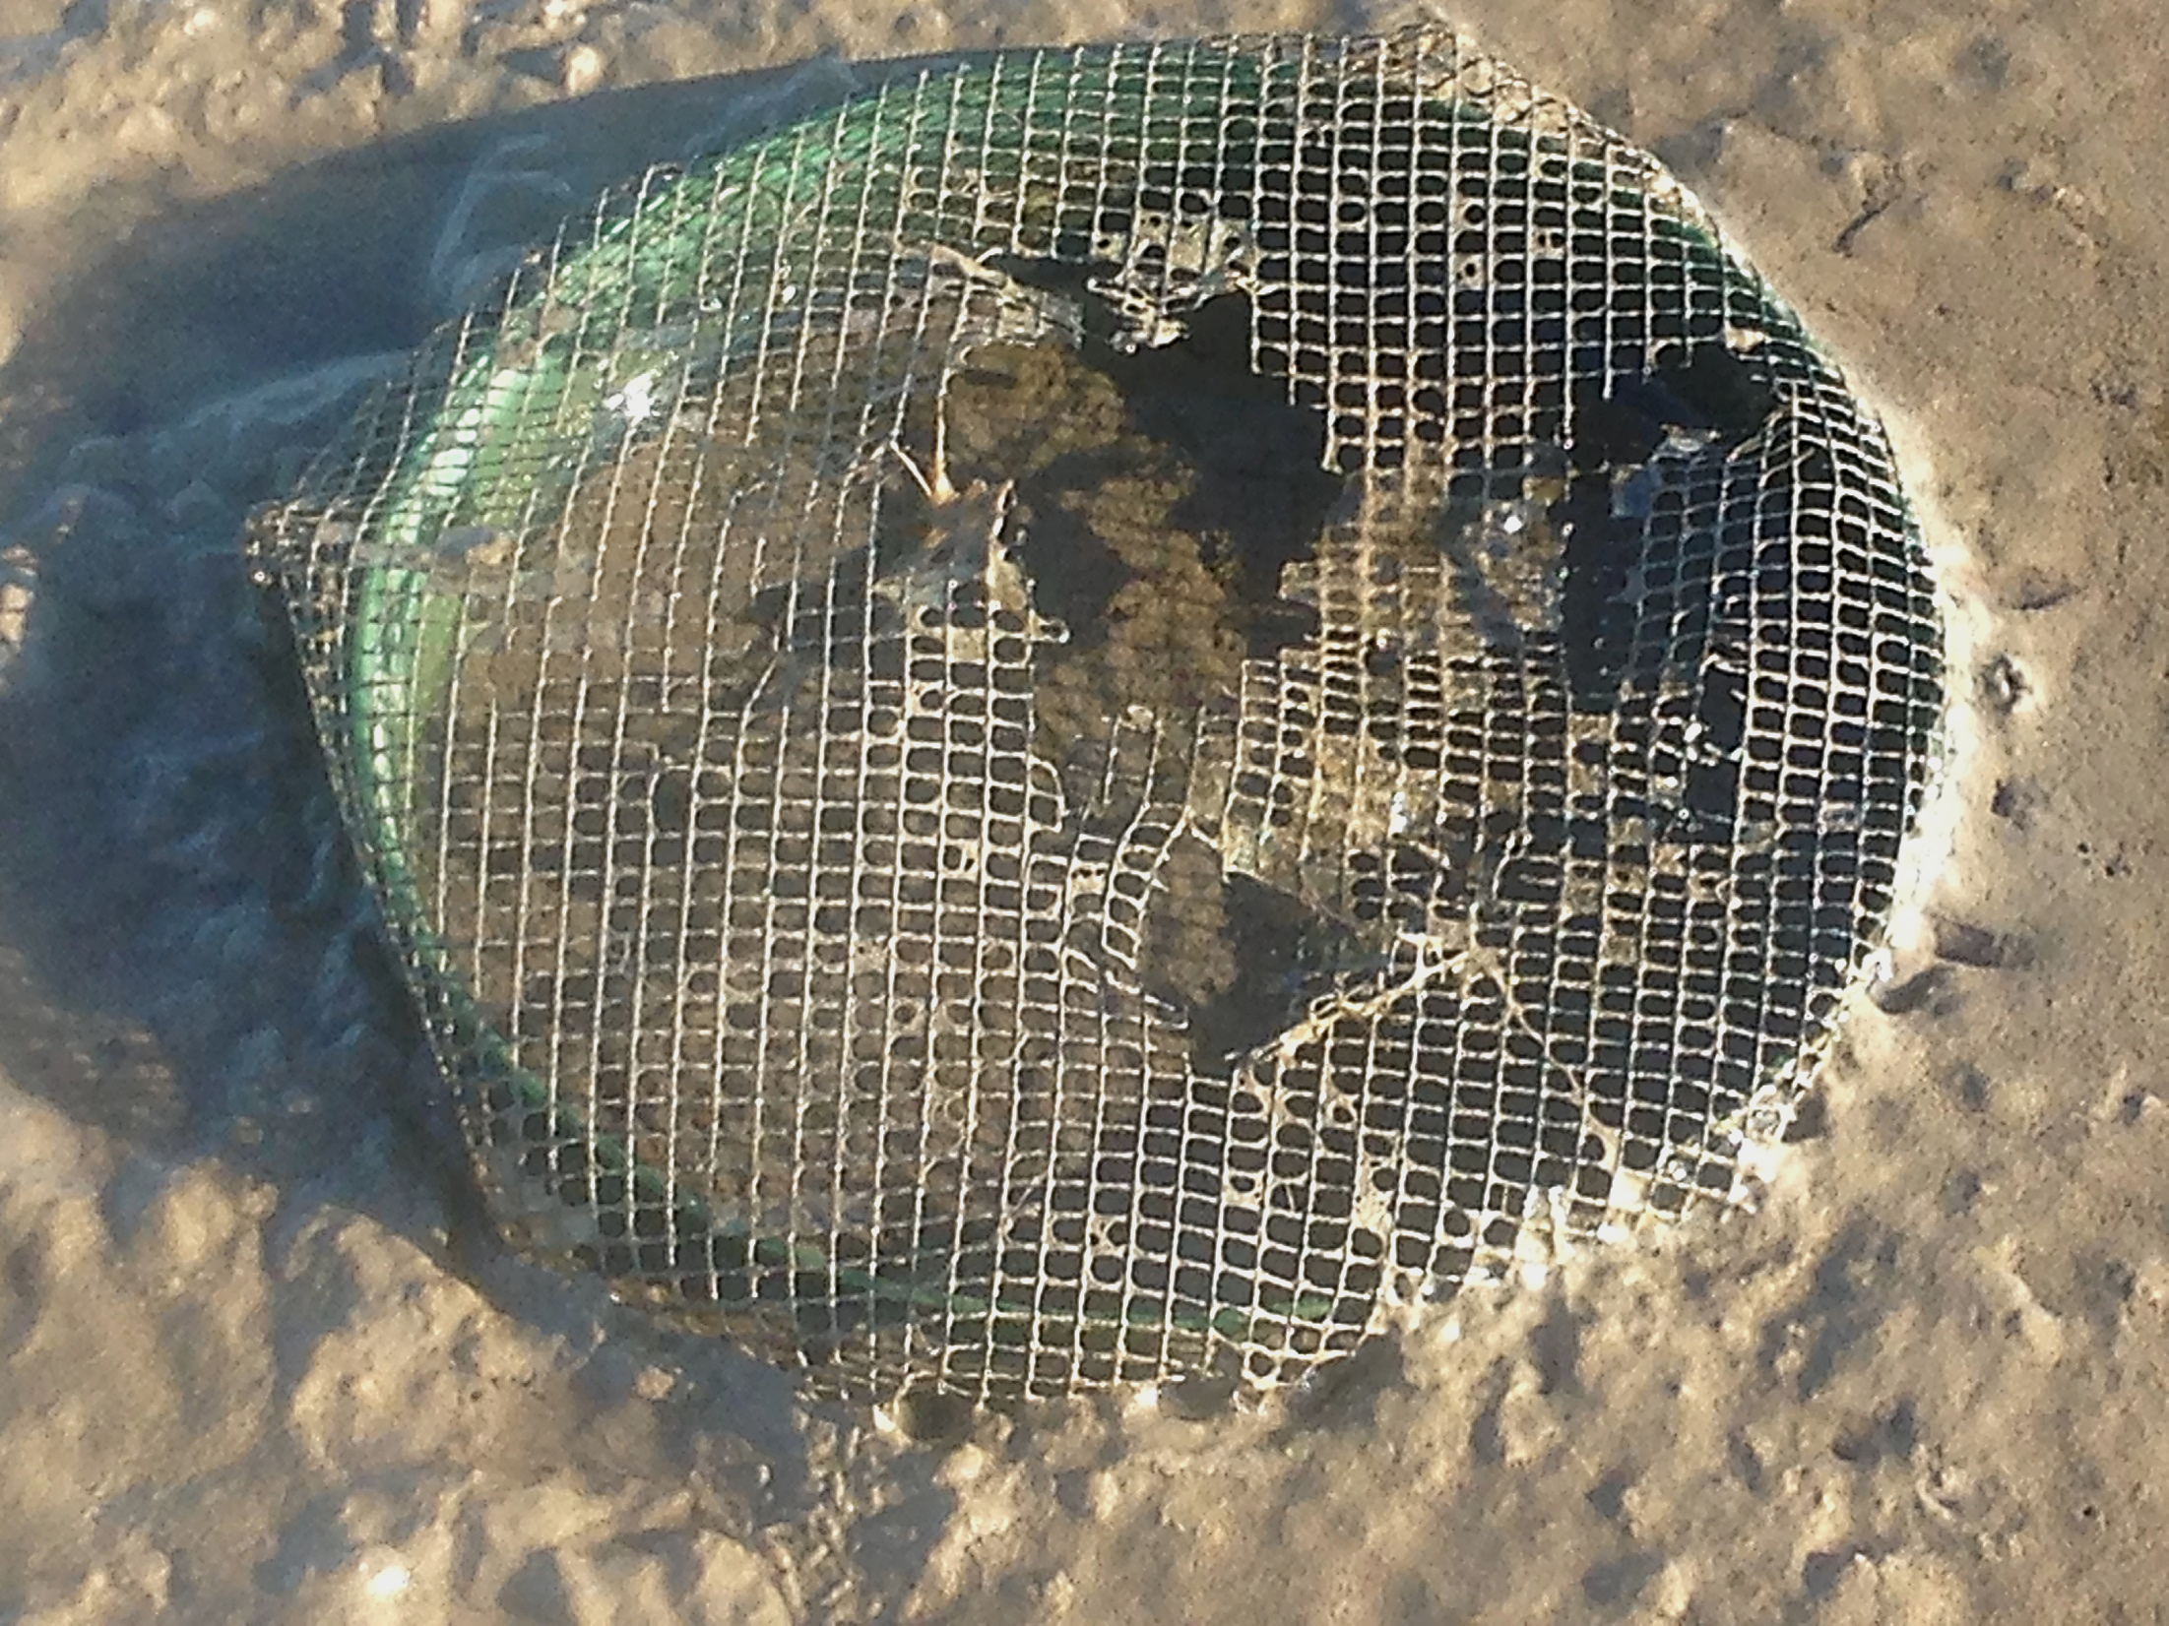
7/5/2013
to
11/8/2013
126 days
[+7.3 mm]

Slide 12
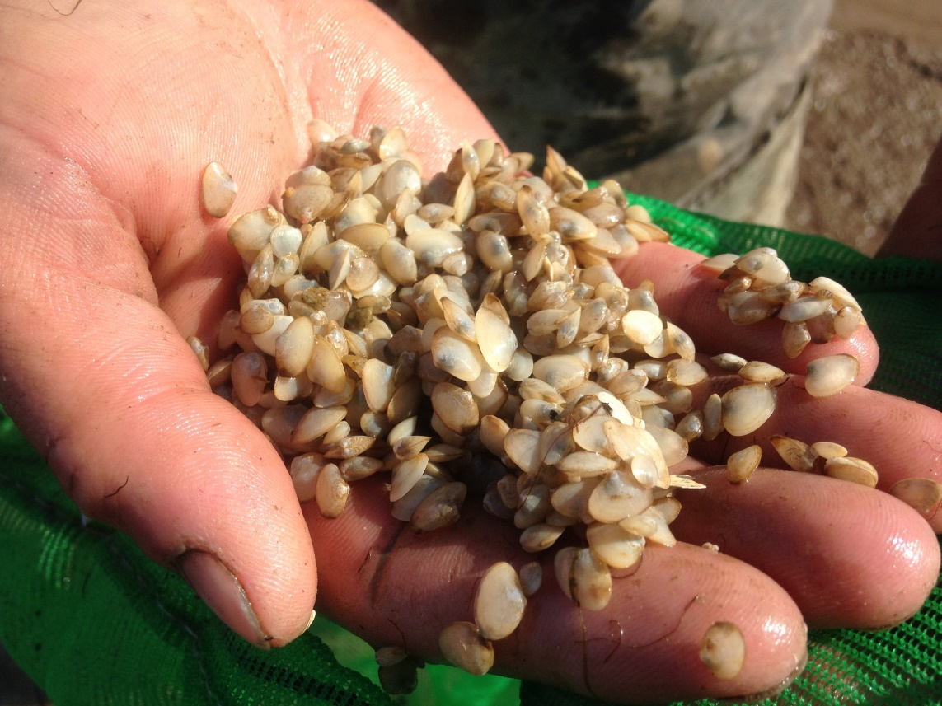
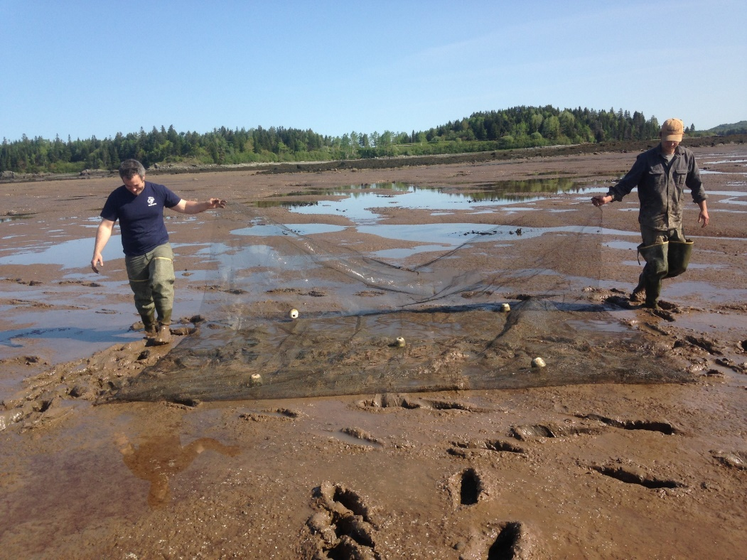
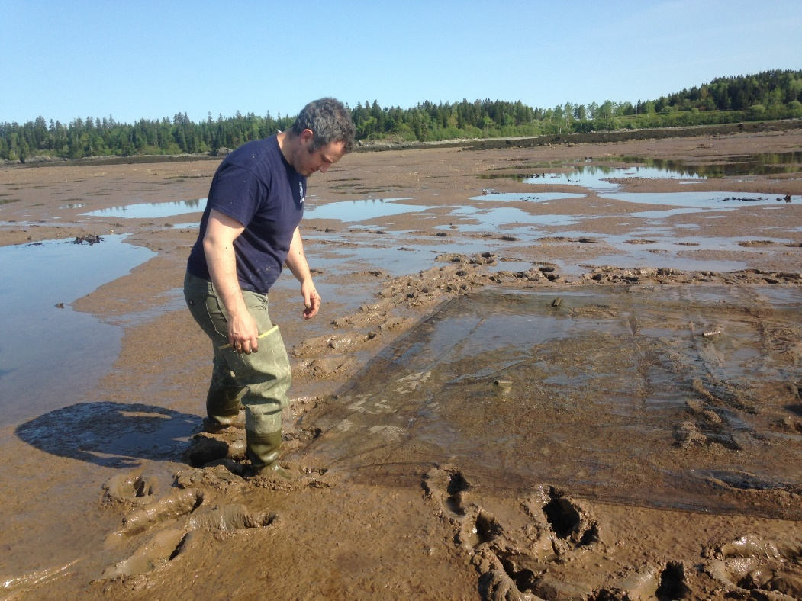
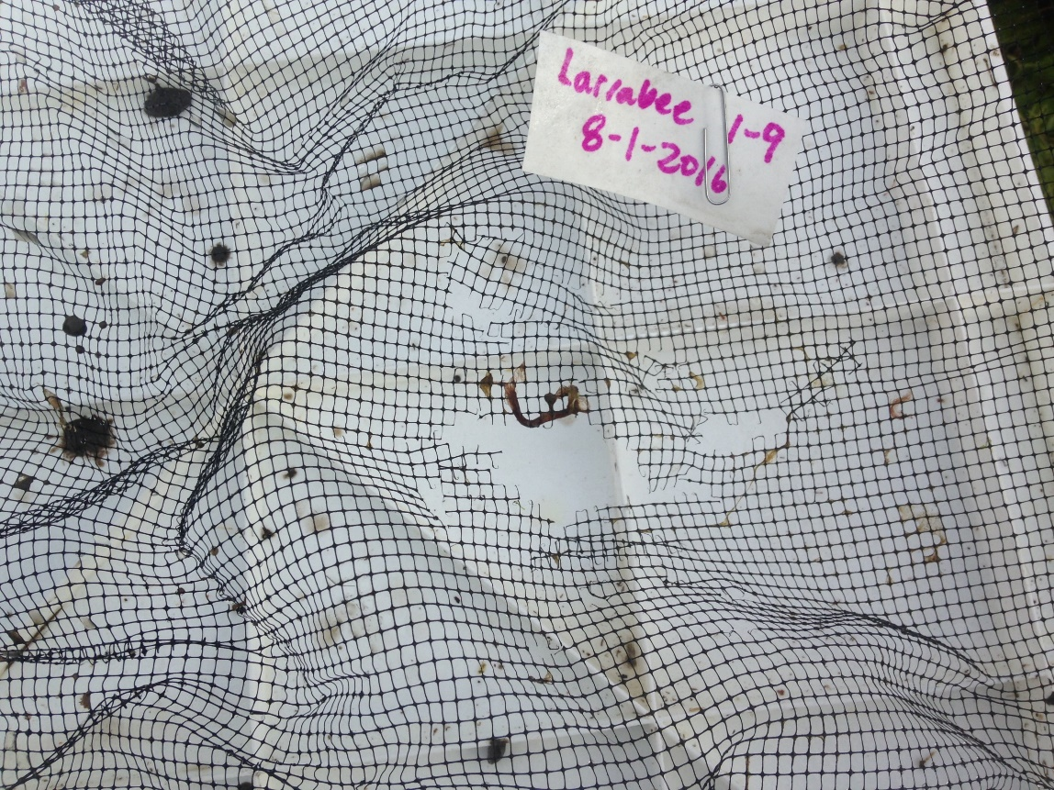
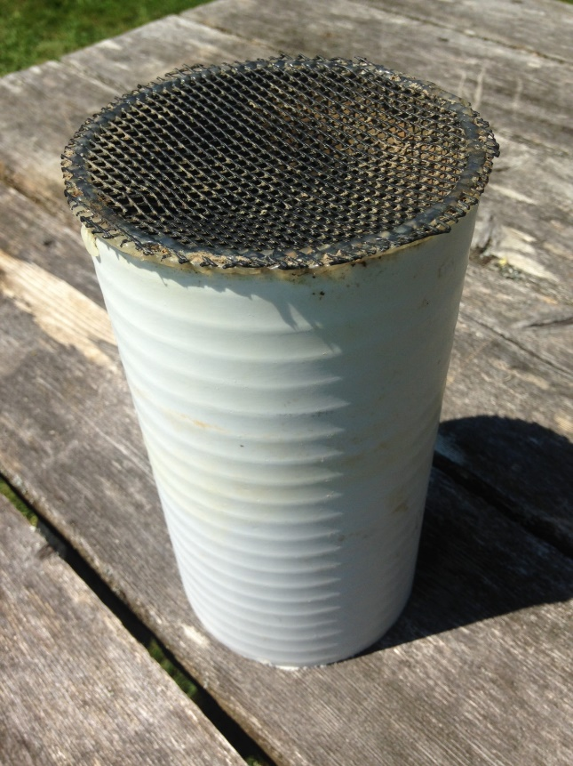
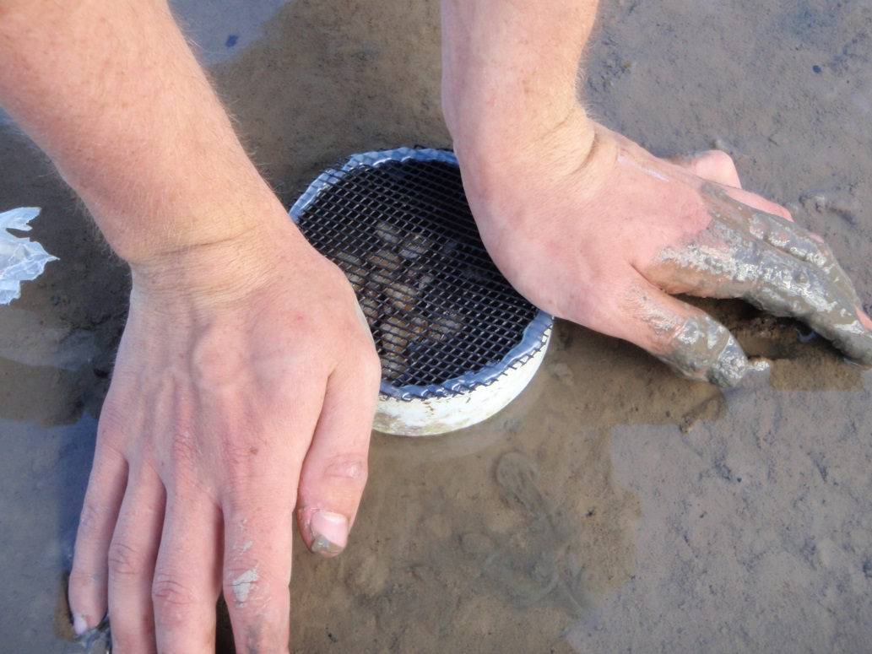
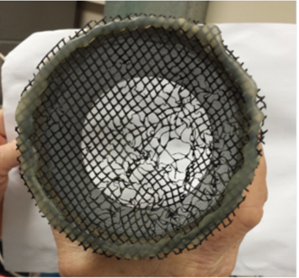

Slide 13
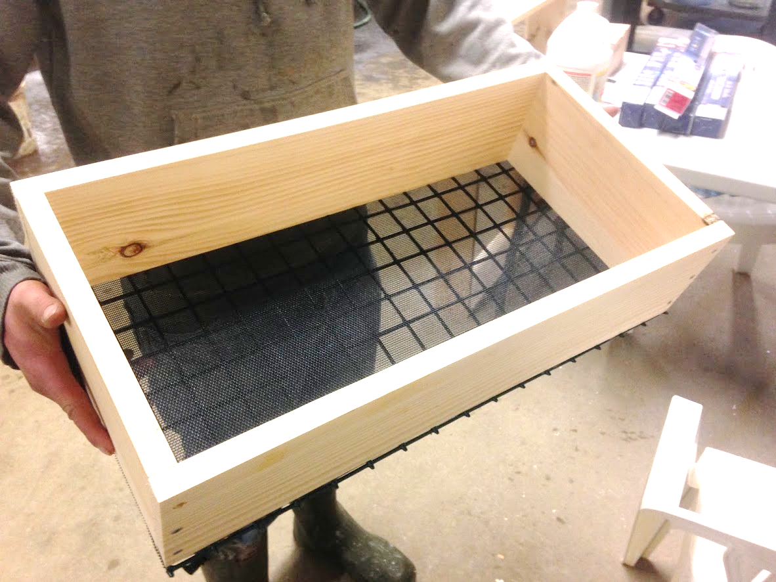
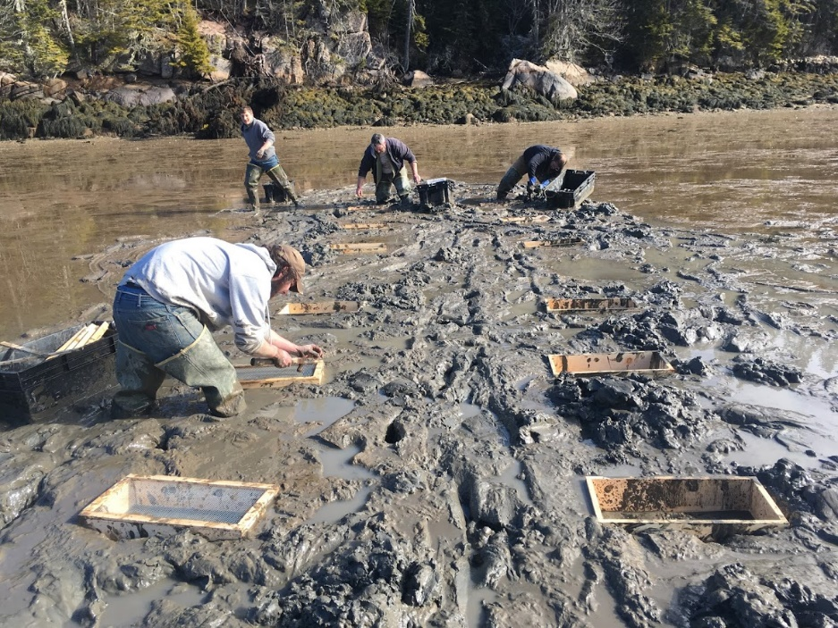
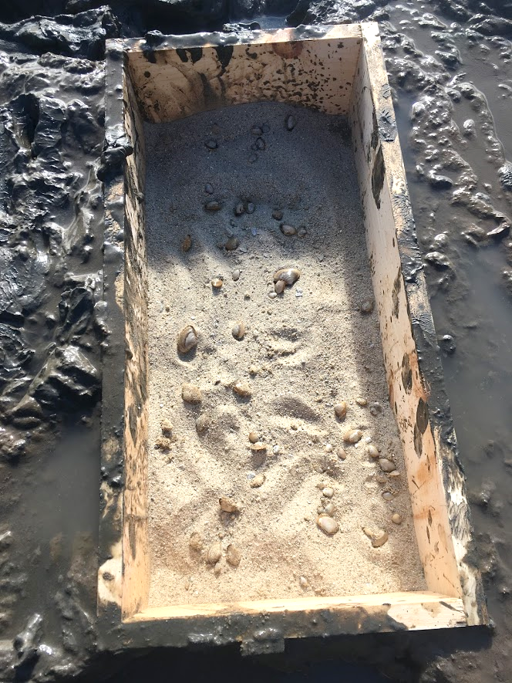
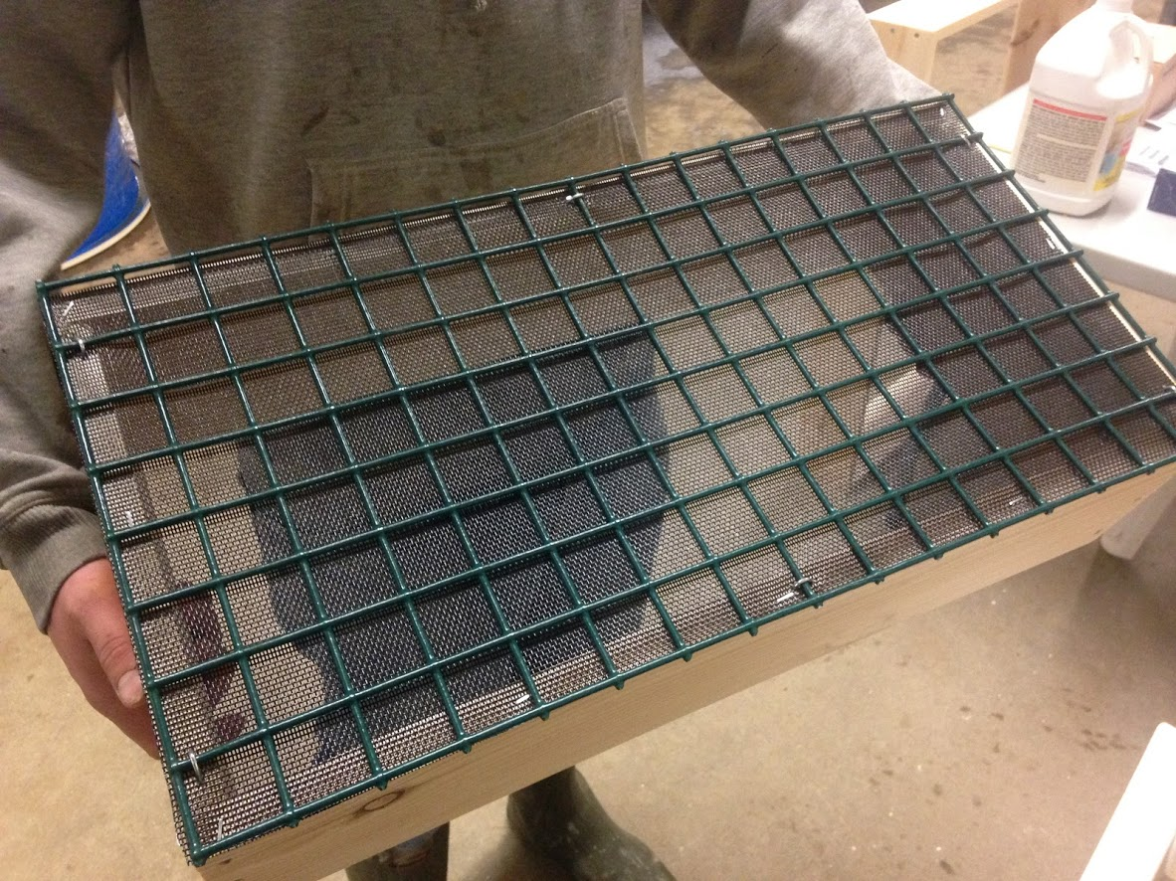
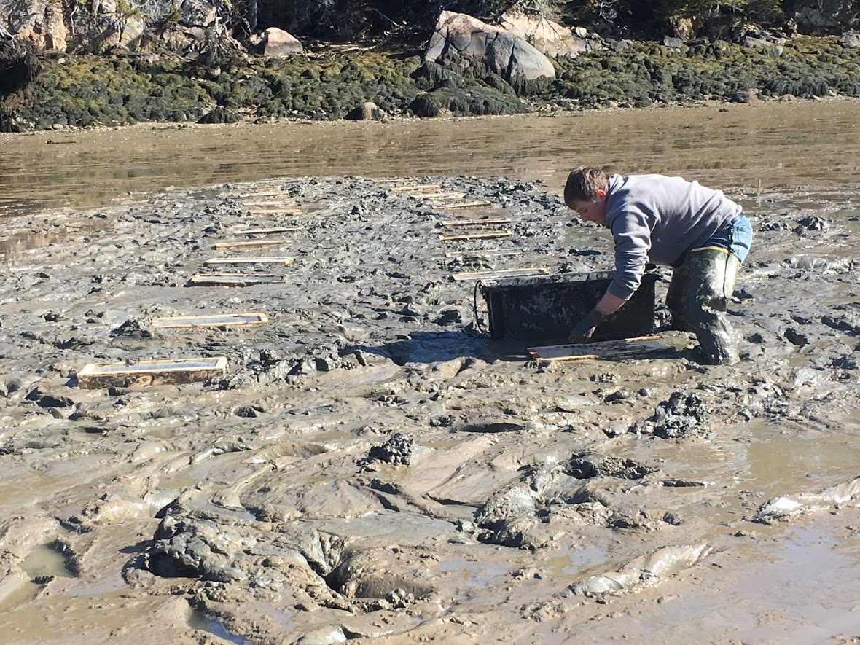
PetScreen® bottom
0.9mm x 1.7mm
18 April to 29 September 2019

Slide 14
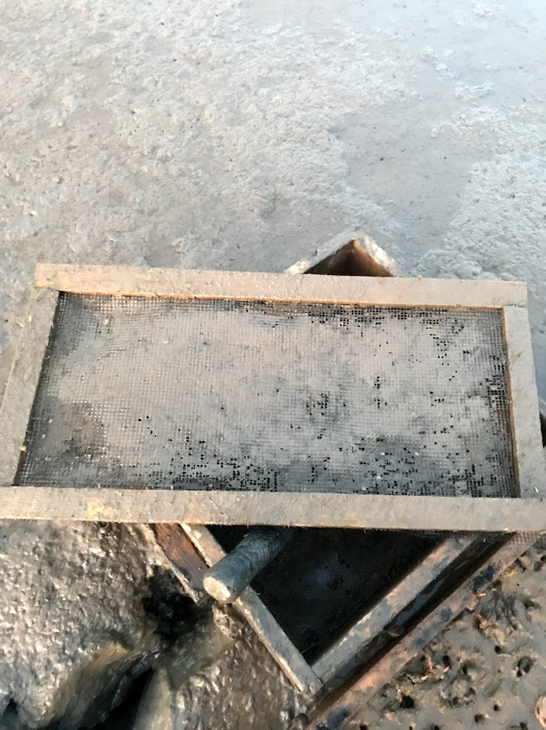
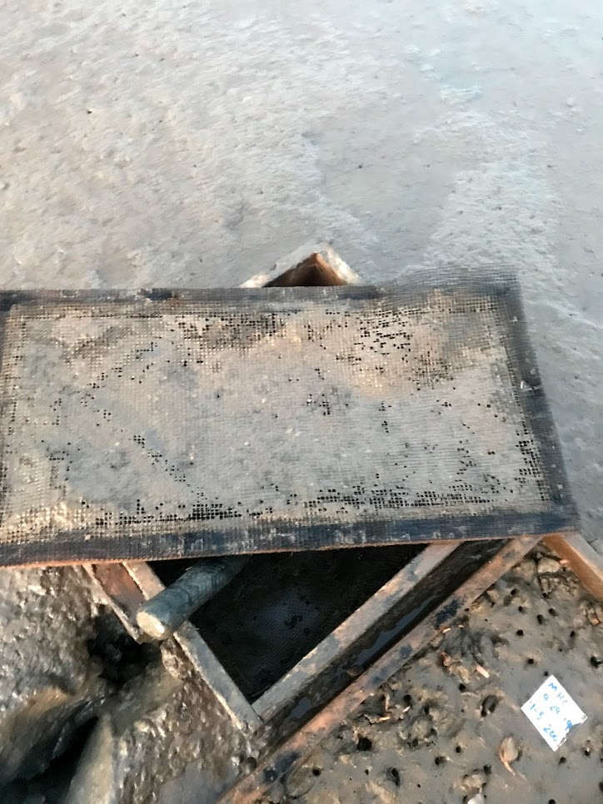
Top of Net
Underside of Net

Slide 15
Towards Shore
Towards Shore
100
200
50
100
200
# Surfclam
juveniles per box. n=5 replicates/trt
200
50
100
50
100
10.1 ± 0.2 mm
N = 120
50
50
200
100
200
Notes:
We used five replicates of each stocking density treatment

Slide 16
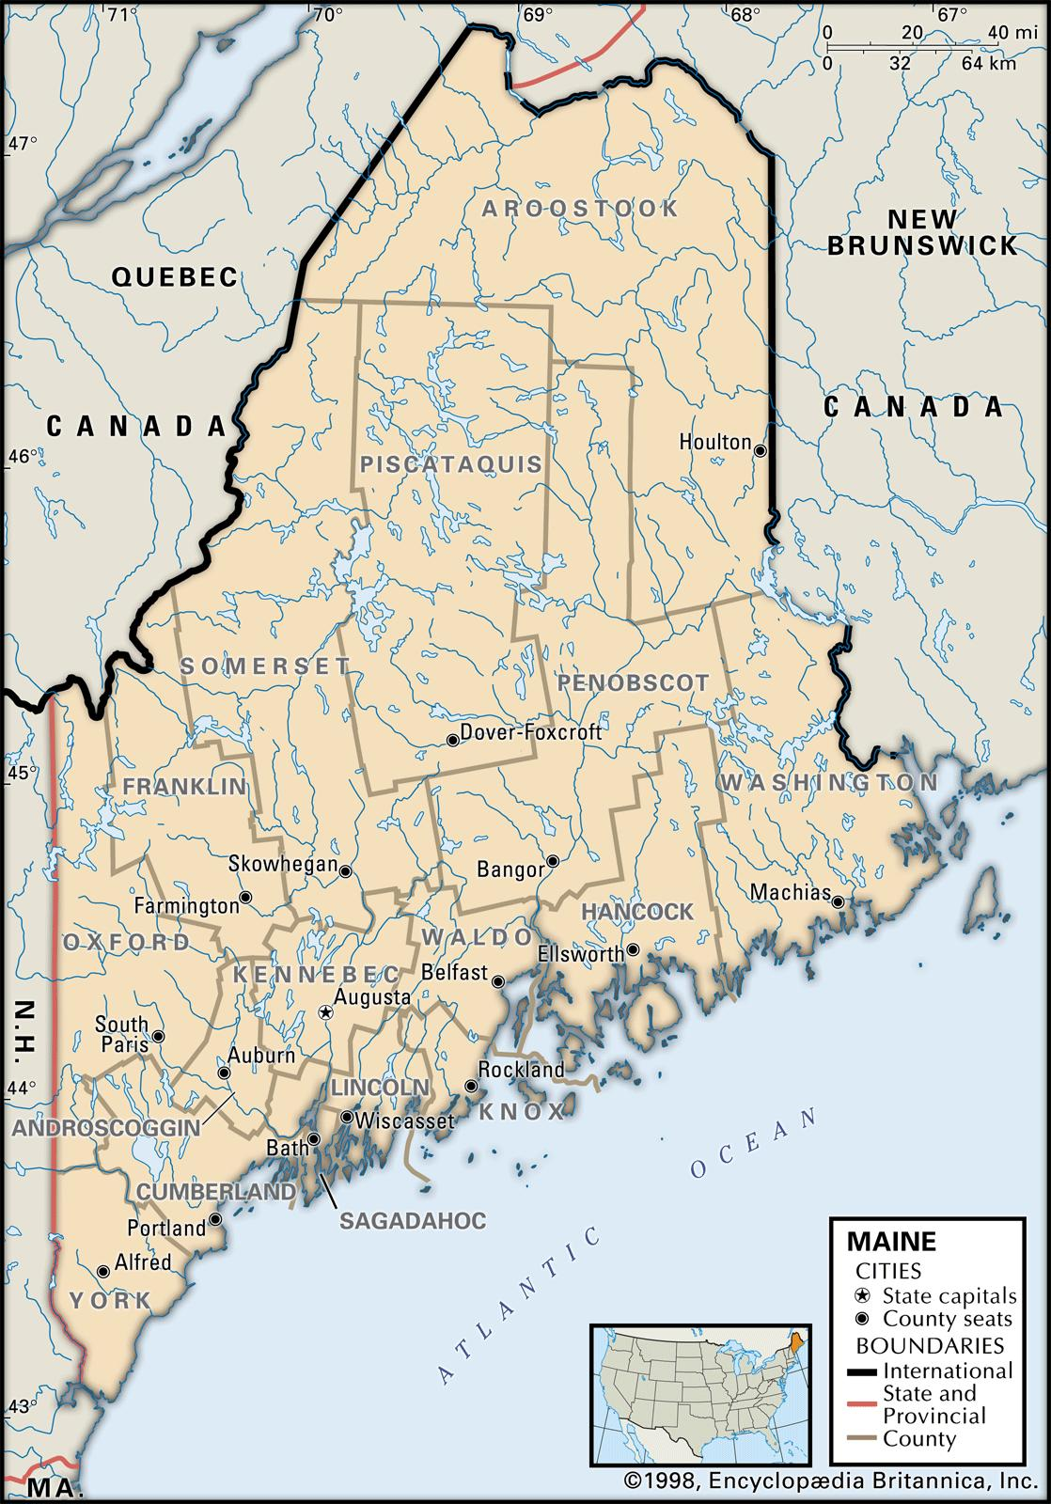
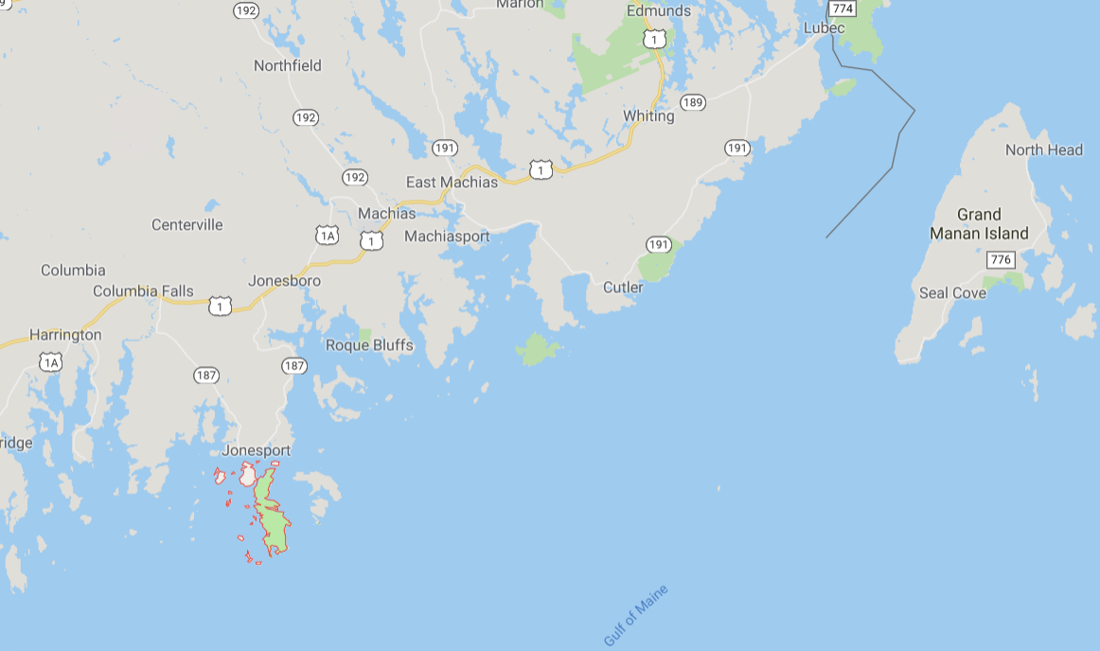
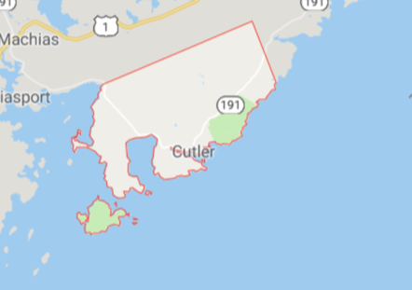
Duck Brook Cove
Cutler, ME
April 18-19 2019
to
Sept 29/Oct 1 2019
Mud Hole Cove
Beals, ME
Notes:
And added the boxes to the mean low water mark at the same two sites that we had used in previous field trials – Mud Hole Cove in Beals, and Duck Brook Cove in Cutler.

Slide 17
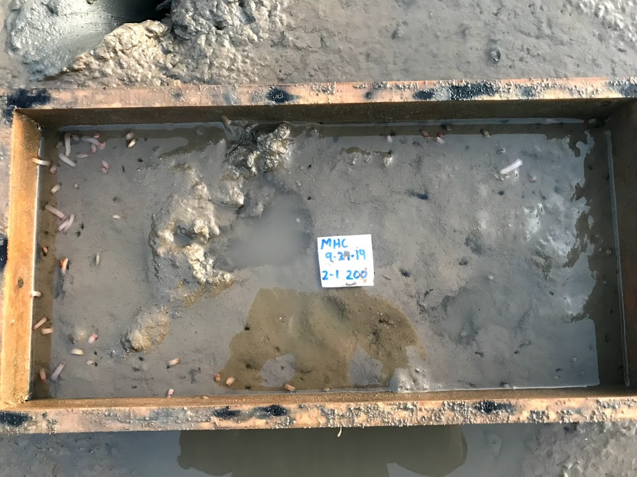
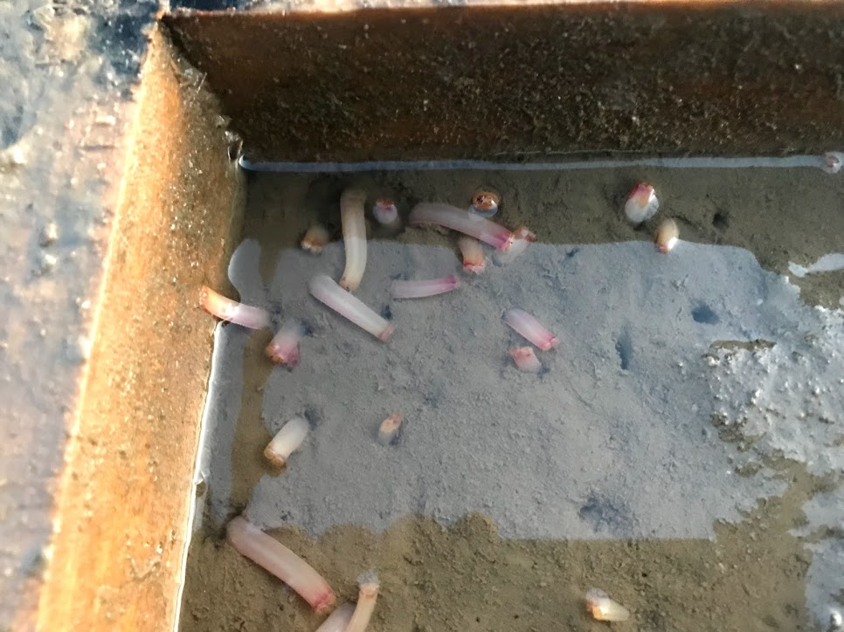
Mud Hole Cove (29 September 2019)
Notes:
Many of the red-colored siphons sticking up out of the sediments….it is easy to see why these would present an easy target for so many predators (whether they be fish, birds, or crustaceans)

Slide 18
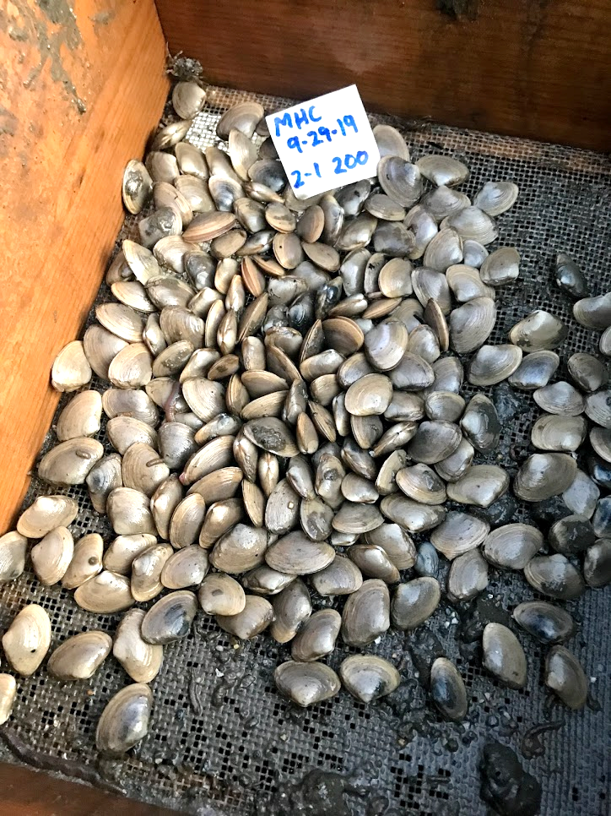
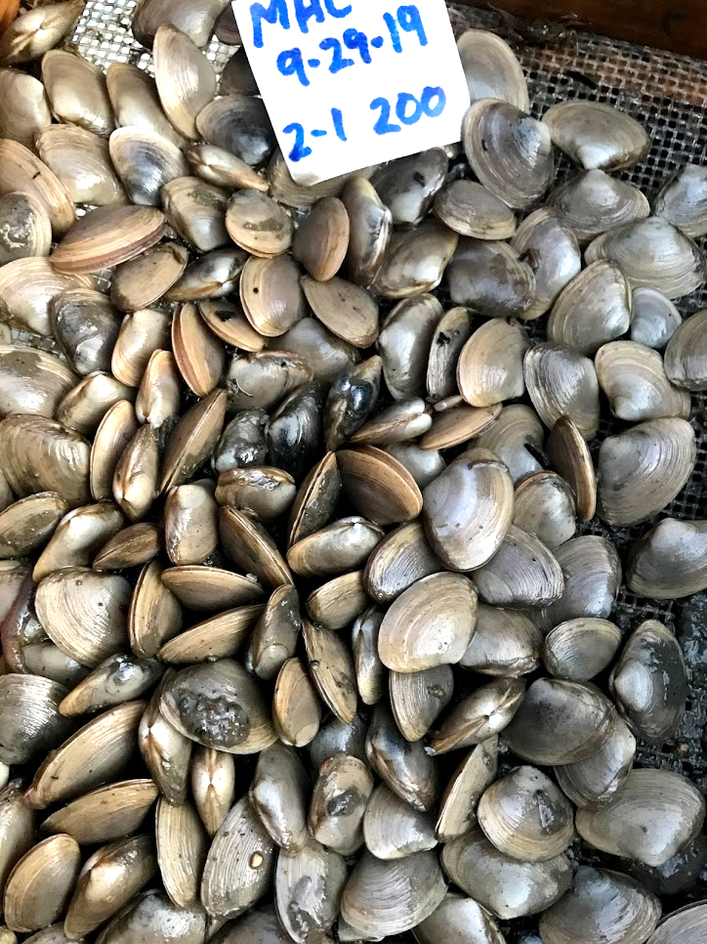
Notes:
In some of the replicate boxes that had been seeded with 200 clams, we got back 200 live clams!

Slide 19
Mud Hole Cove - Beals
98.8%
98.2%
99.1%
N = 5
N = 5
N = 5
48
50
50
50
49
99
100
97
98
97
199
200
199
200
193
Notes:
This shows the mean percent survival, and the white numbers in each bar represent the actual number of survivors for each replicate, which is why the error bars are so tiny.

Slide 20
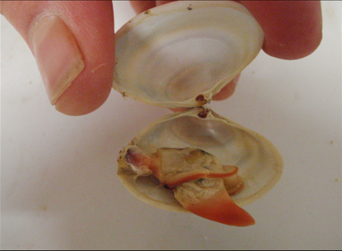
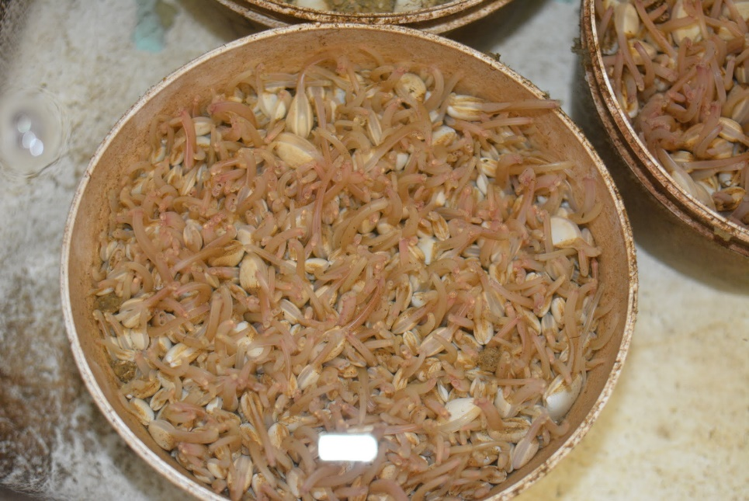
18 April 2019
N = 40
29 Sept 2019
N = 100
32.1 ± 0.6 mm
A slight growth penalty
with increasing stocking
density, but mean SL not
statistically significant
between treatments
(P = 0.162)
30.3 ± 0.6 mm
Percent Frequency
30.2 ± 0.6 mm
Shell Length (mm)

Slide 21
Beals

Slide 22
Gouldsboro
Grand Bay Marsh

Slide 23
Beals

Slide 24
Three factors (n = 5)
A = Density (25, 50, 100/ft²)
B = Box Size (2 ft² vs. 4 ft²)
C = Top thickness (1-in vs. 2-in)
3 x 2 x 2 x 5 = 60 boxes
Factorial design

