Slide 2
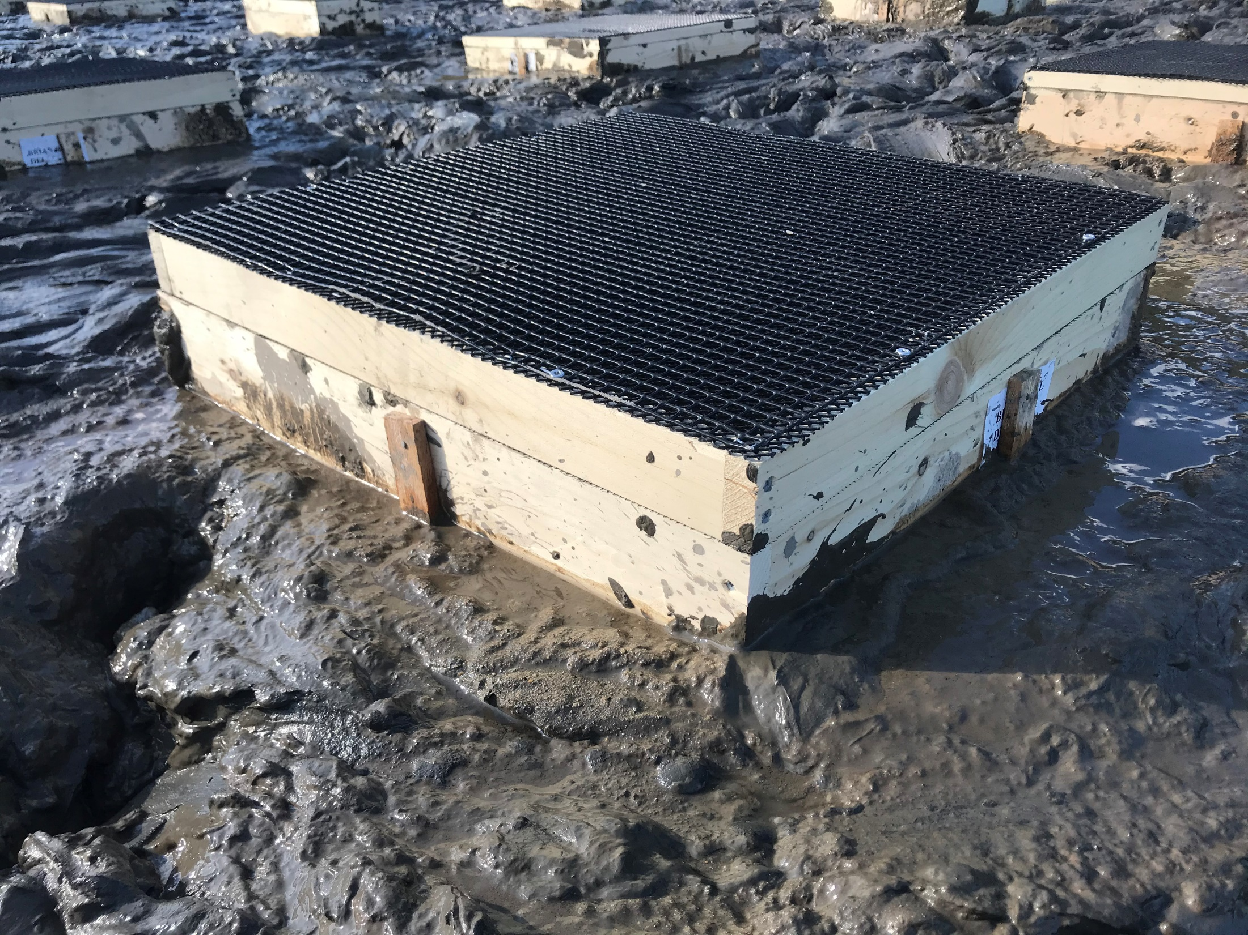
2-inch top
4ft² box

Slide 3
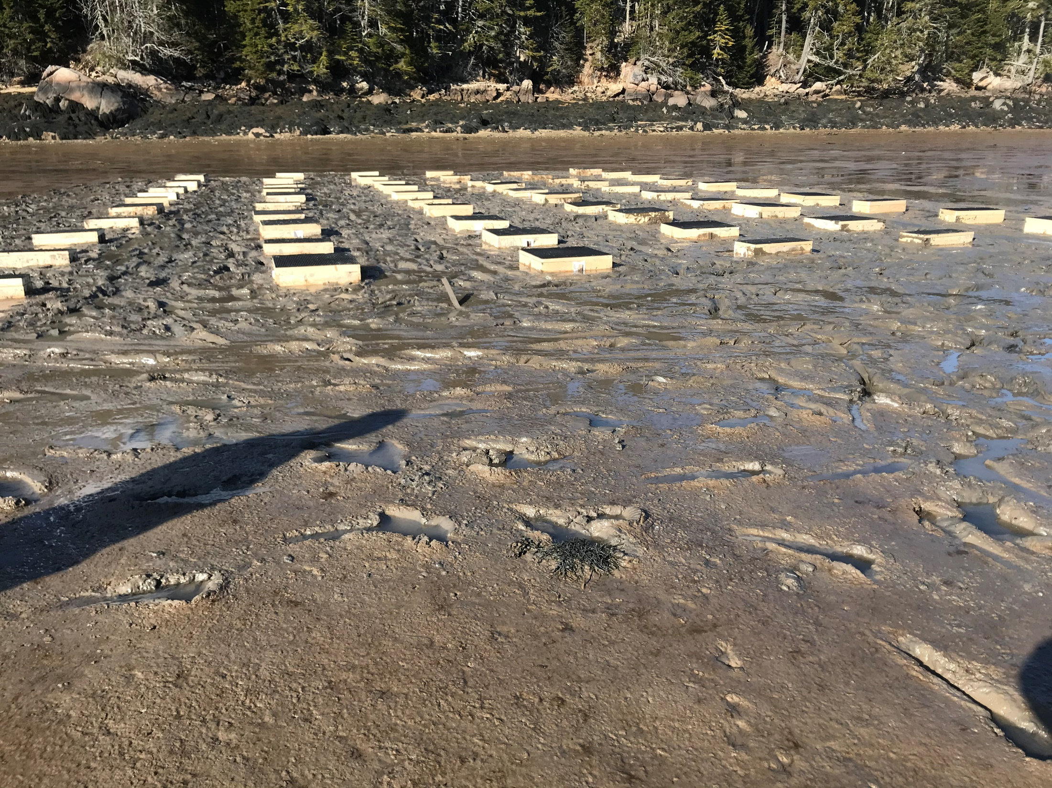
April 2, 2021

Slide 4
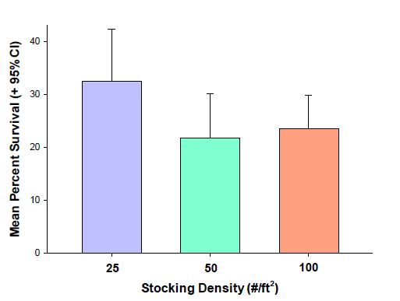
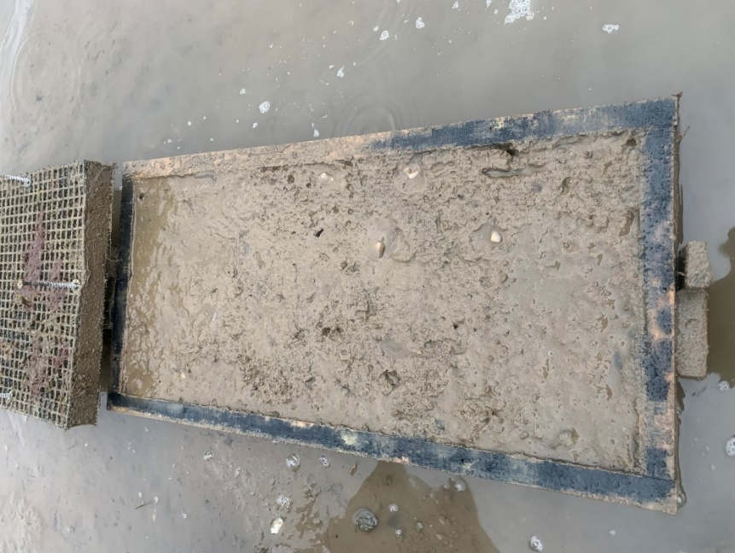
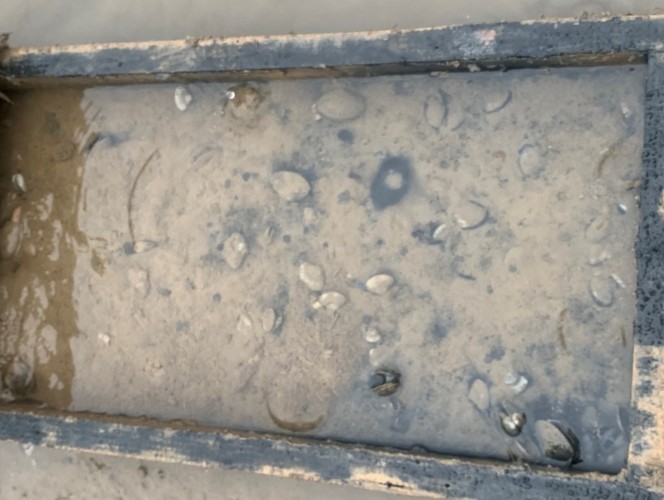
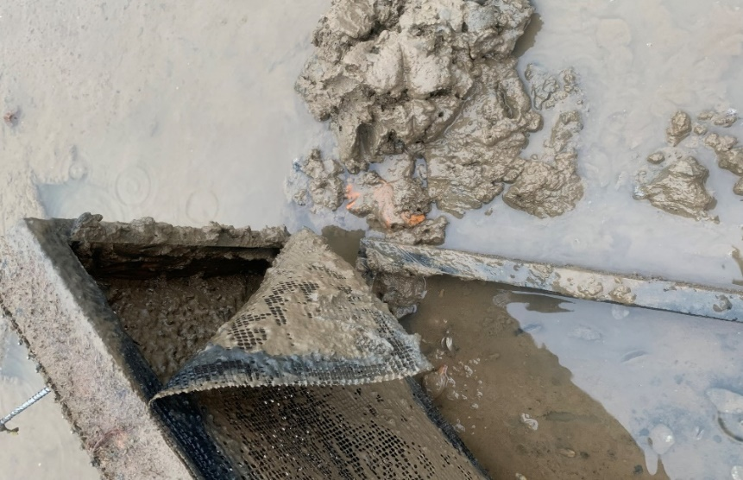
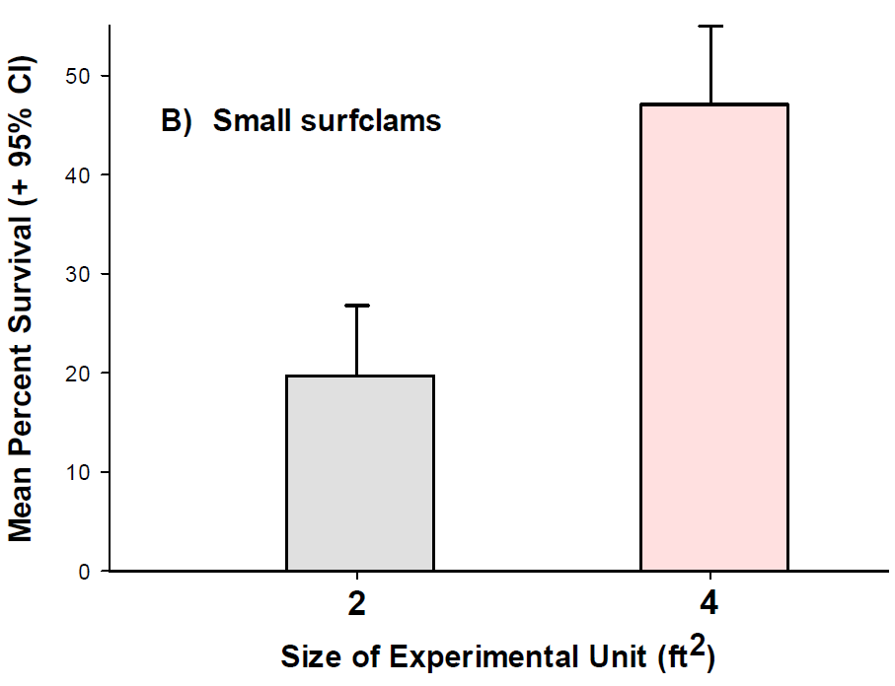
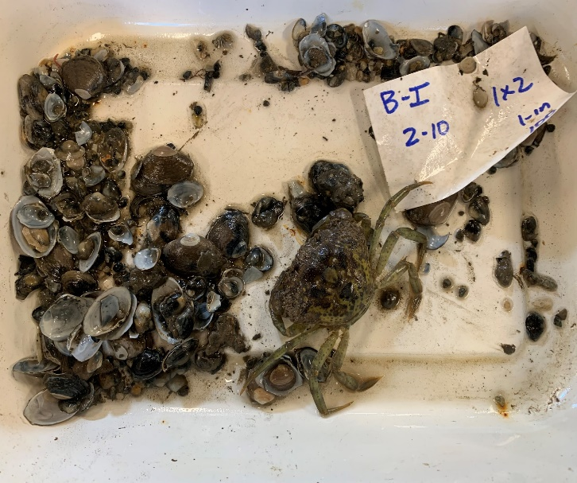
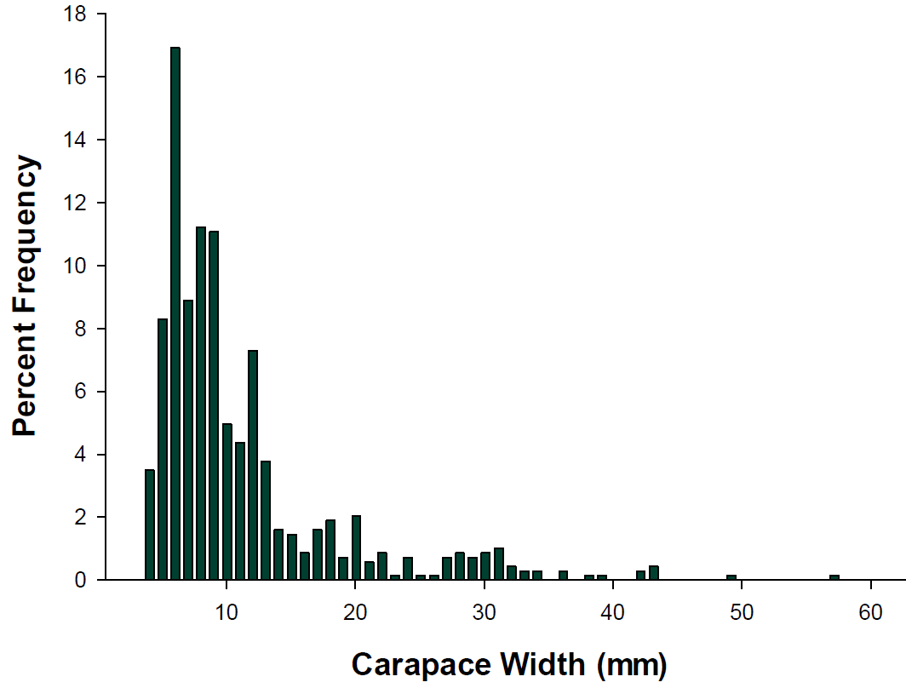
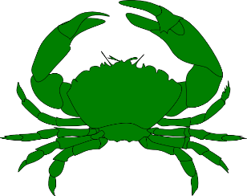
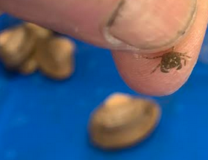
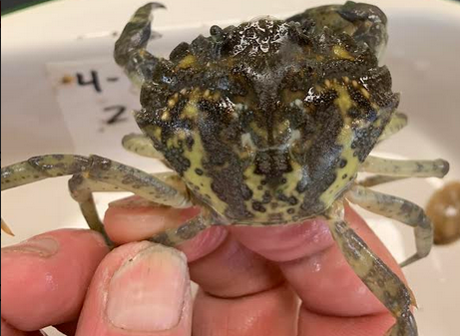
27 March to 1 December 2021
Gouldsboro
n = 20
P = 0.052
Gouldsboro
n = 30
P < 0.001
N = 686
3x more in LG v SM boxes (P < 0.01)

Slide 5
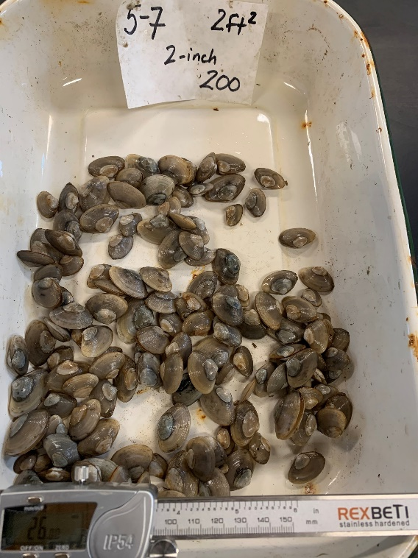
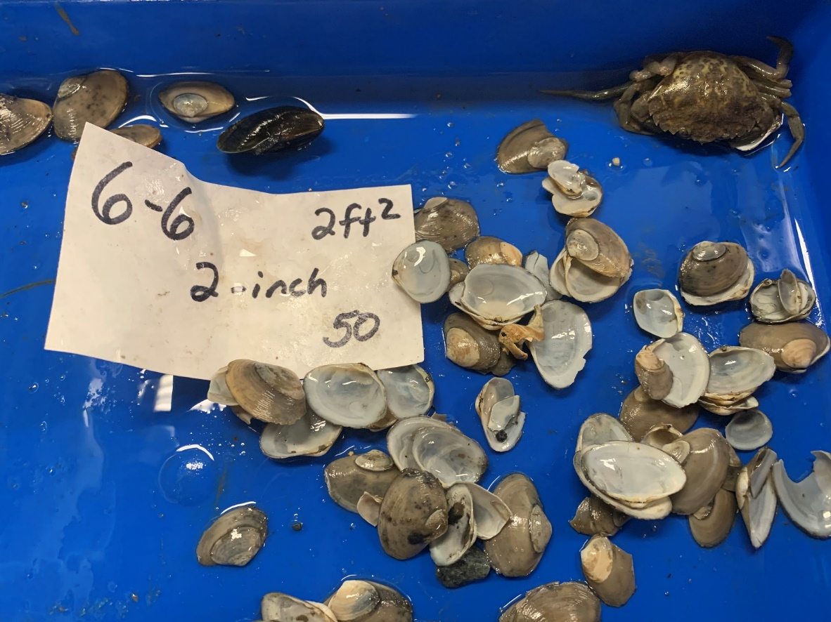
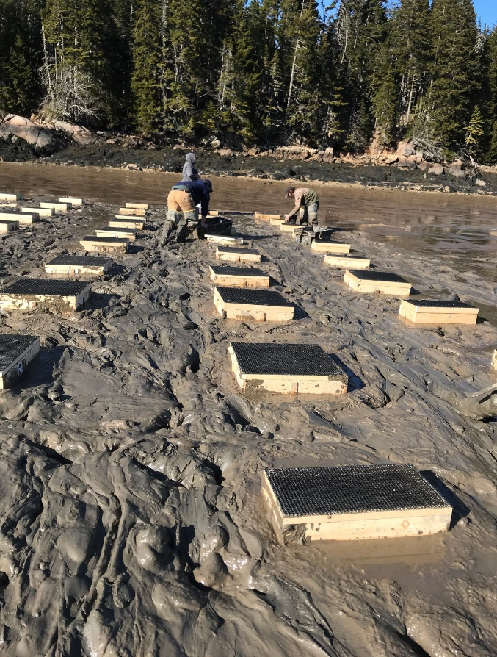
2 April to 3 December 2021
Beals
n = 20
P = 0.259
N = 47
25
50
100
Beals
n = 30
P = 0.003

Slide 6
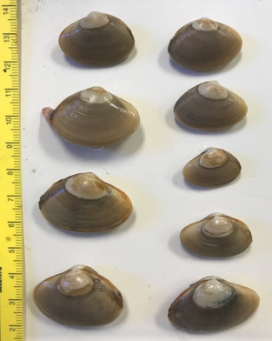
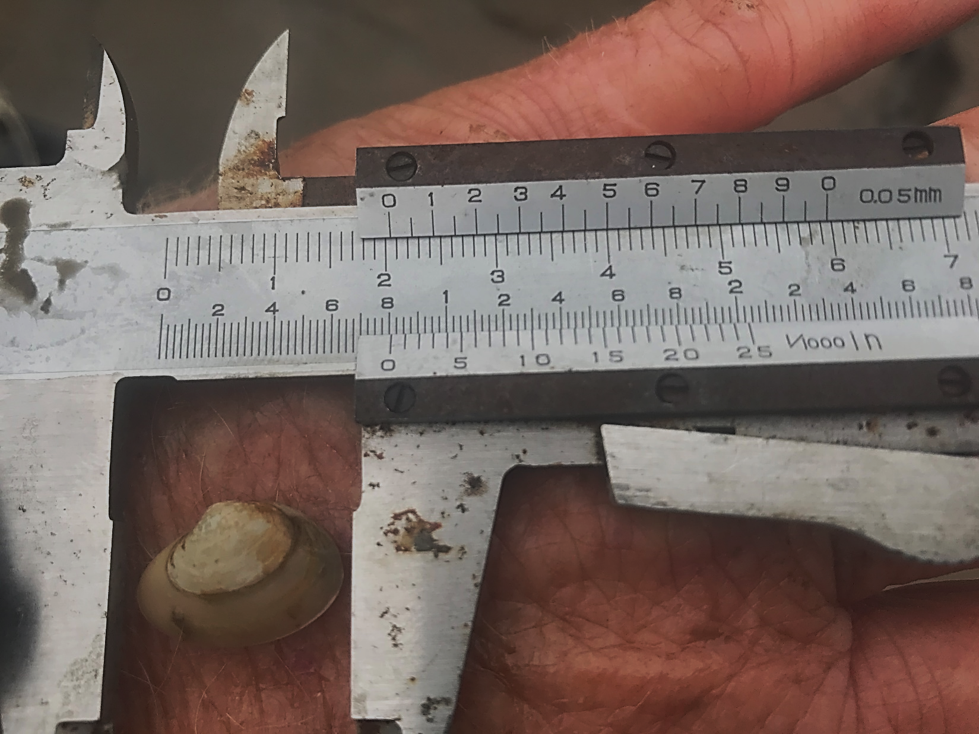
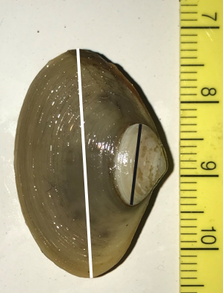

Slide 7
Gouldsboro
G = 27.7
df = 10
P = 0.002
G = 36.6
df = 10
P < 0.001
$$\overline{x}$$
$$\overline{x}$$
= 8.5 ± 0.3 mm
= 12.9 ± 0.2 mm
$$\overline{x}$$
= 20.9 ± 0.5 mm
$$\overline{x}$$
$$\overline{x}$$
= 8.7 ± 0.4 mm
= 21.9 ± 0.4 mm
$$\overline{x}$$
= 21.0 ± 0.2 mm
$$\overline{x}$$
= 20.4 ± 0.4 mm
$$\overline{x}$$
= 7.6 ± 0.3 mm

Slide 8
Beals
G = 27.7
df = 10
P = 0.002
G = 52.9
df = 10
P < 0.001
$$\overline{x}$$
$$\overline{x}$$
= 23.4 ± 0.9 mm
= 14.0 ± 0.4 mm
$$\overline{x}$$
= 10.1 ± 0.8 mm
$$\overline{x}$$
= 22.3 ± 0.9 mm
$$\overline{x}$$
= 7.8 ± 0.8 mm
$$\overline{x}$$
= 22.1 ± 0.5 mm
$$\overline{x}$$
= 20.9 ± 0.6 mm
$$\overline{x}$$
= 6.7 ± 0.6 mm

Slide 9
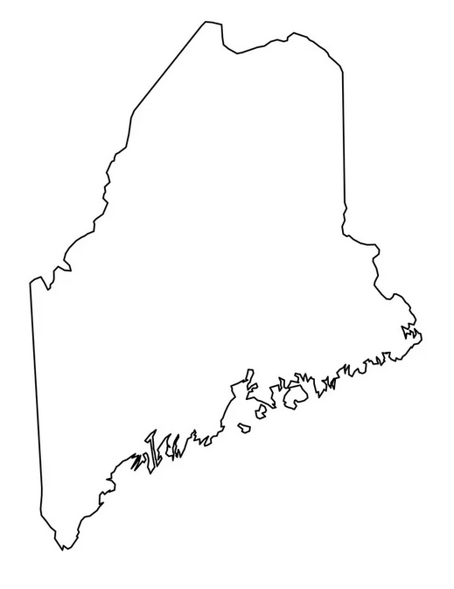
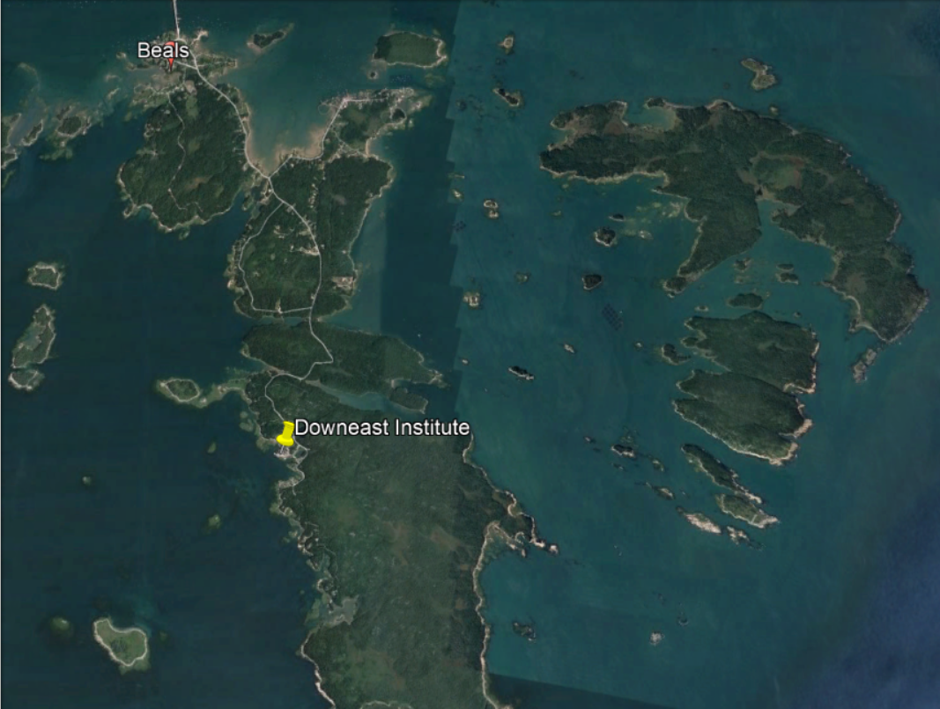
16-17 June 2022
20 January 2023
&
3 Aug 2023
Mud Hole Cove

Slide 10
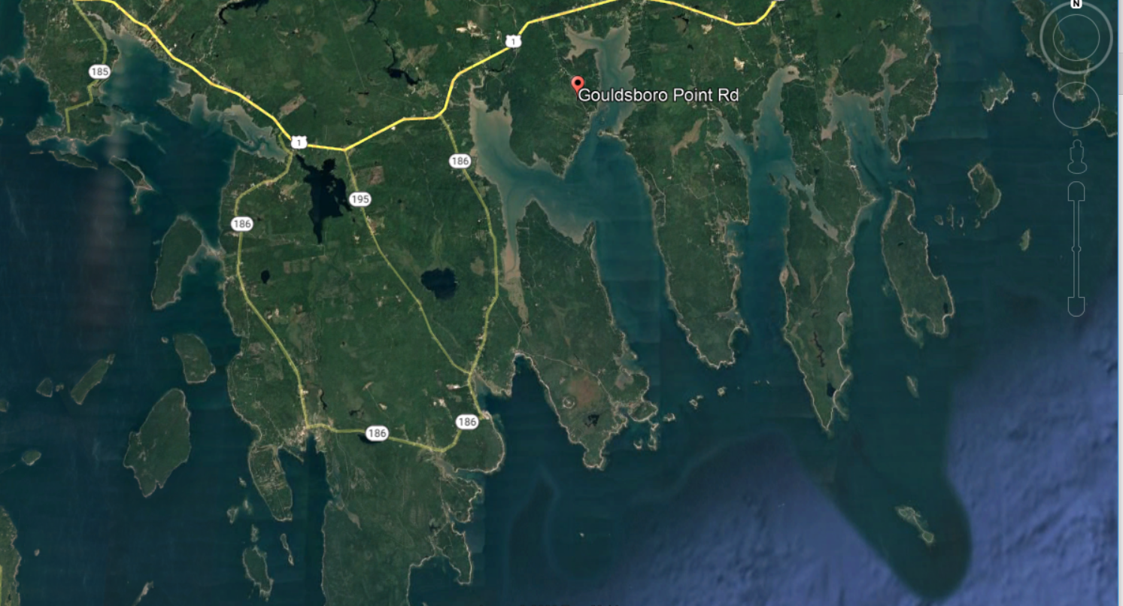
2022-2023
18-19 June 2022
21 January 2023
&
4 Aug 2023
Timber Cove

Slide 11
Three factors (n = 5)
A = Density (7.5 - 90/ft²)
B = Box Size (2 ft² vs. 4 ft²)
C = Clam Size (SM vs. LG)

Slide 12
CLAM DENSITY (#/ft²)
SMALL Clams LARGE Clams
9.6 ± 0.4 mm
4 ft²
30
45
60
7.5
30
50
Density is unique (nested within) to a given Box Size
12.9 ± 0.4 mm
30
60
90
30
50
80
2 ft²

Slide 13
Aug 8, 2022
18.8ºC
Jul 26, 2023
18.1ºC
Aug 7, 2022
15.6ºC
Jul 30, 2023
14.4ºC
Feb 4, 2023
-1.68ºC
Feb 4, 2023
-0.01ºC

Slide 14
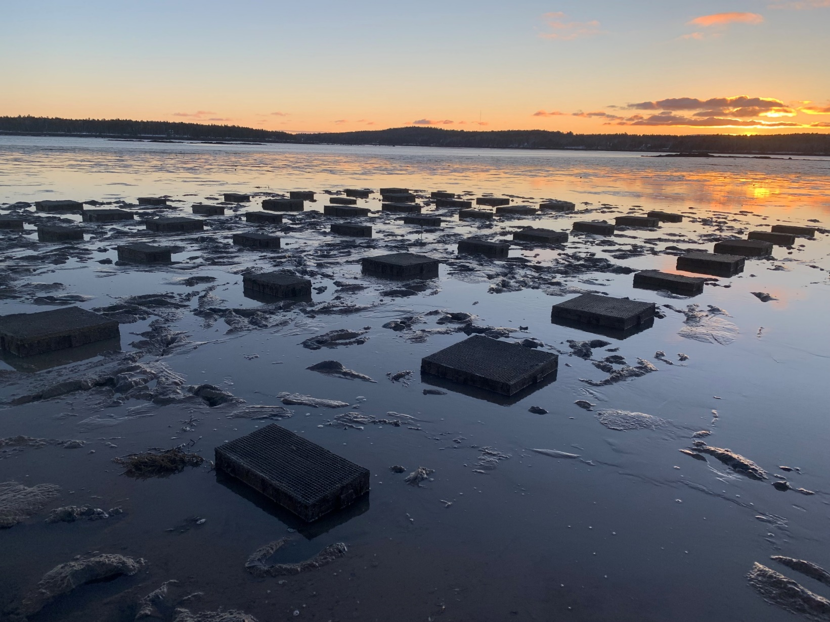
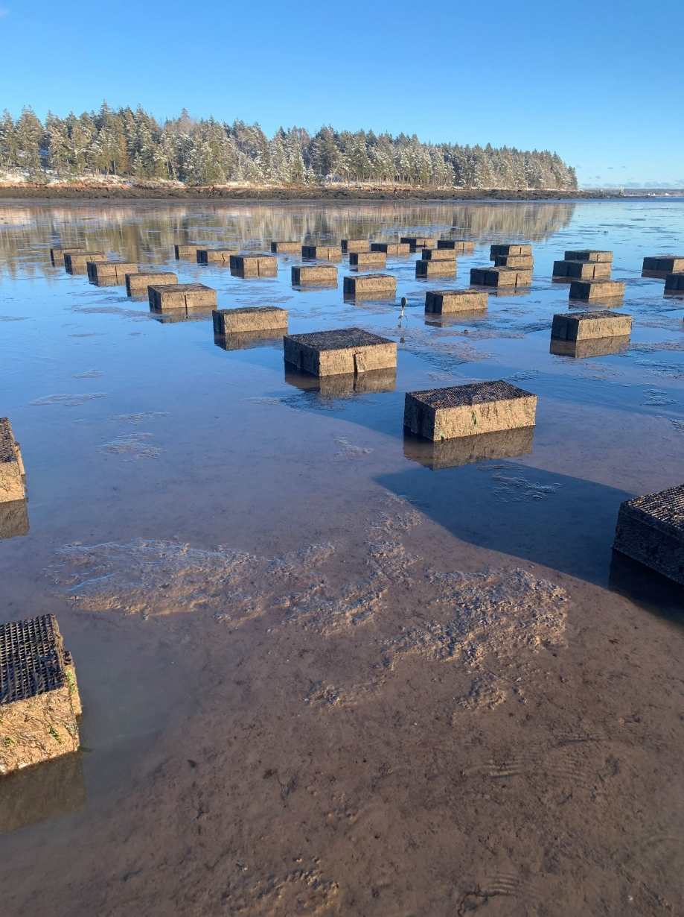
First Sampling (Gouldsboro - January 2023)

Slide 15
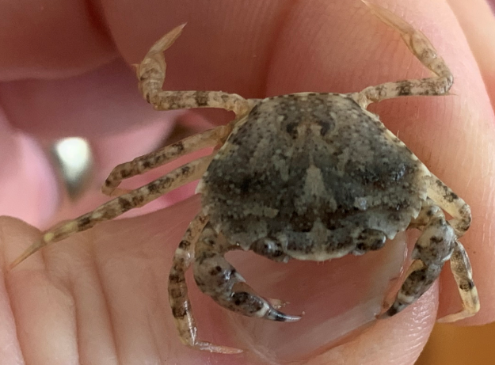
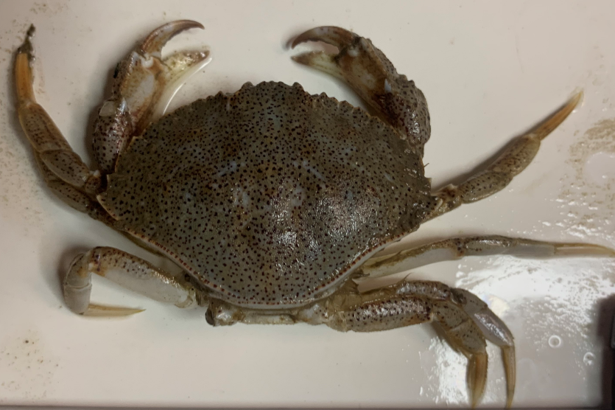
Gouldsboro – Jan 2023
6.9 ± 2.4/box
Carcinus maenas
Crabs occurred in 58
of 60 boxes.
Live clams occurred in
27 of 60 (45%) of boxes
16.4 mm
0.5 ± 0.2/box
Cancer irroratus
$\overline{x}$ = 51.5 ± 4.0 mm
N = 32
65.5 mm

Slide 16
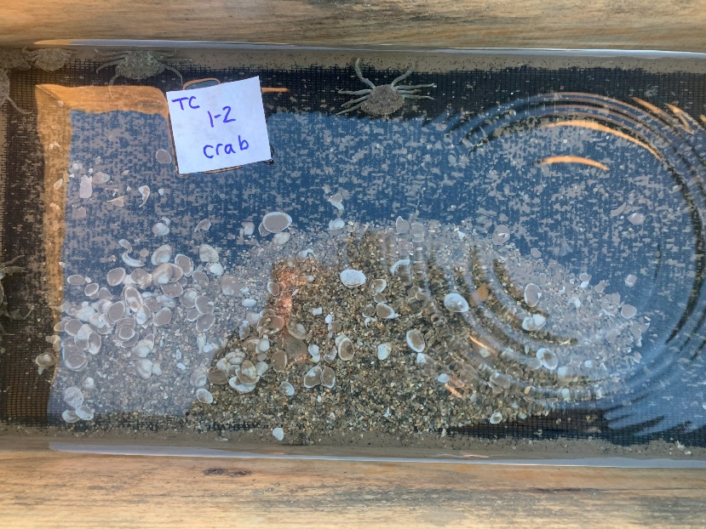
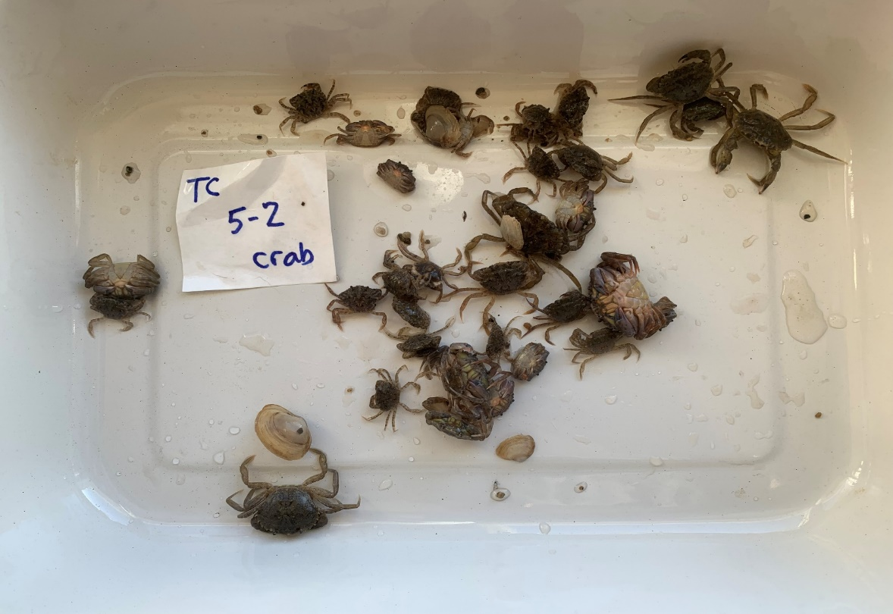
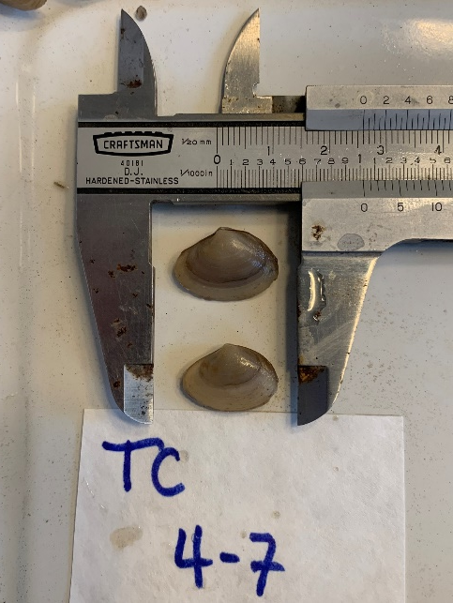
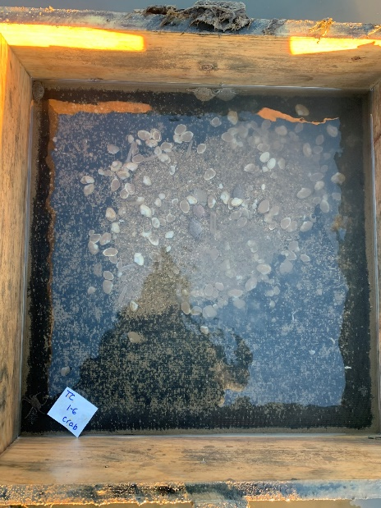
P < 0.01
9.6 ± 0.4 mm
12.9 ± 0.4 mm
20.8 ± 0.8 mm
22.4 ± 0.7 mm

Slide 17
Second Sampling (Gouldsboro - August 2023)
Live surfclams occurred in 2 of 60 boxes;
Mortality rates exceeded 99.5%
Green crabs occurred in 42 of 60 (70%) of boxes
1.7 ± 0.6 crabs/box

Slide 18
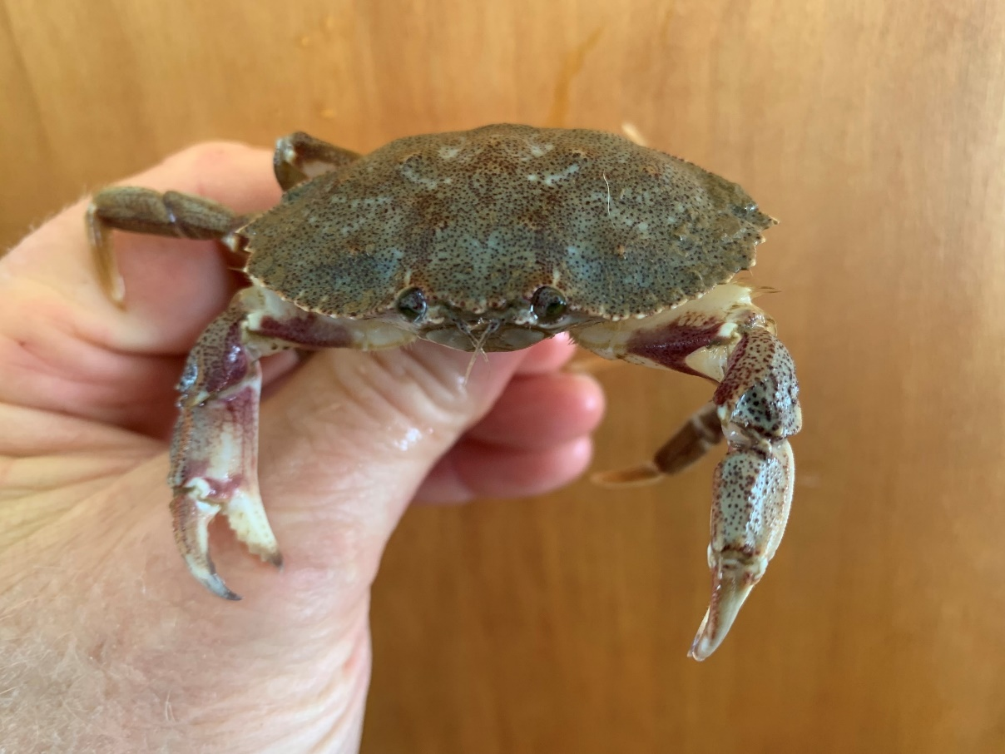
First Sampling (Beals - January 2023)
Rock crabs occurred in 3 of 60 (5%) boxes
45.7 mm
46.5 mm
11.0 mm
Green crabs occurred
in 6 of 60 (10%) boxes
Live surfclams were found in all 60 boxes (n = 2 for growth rate analysis)

Slide 19
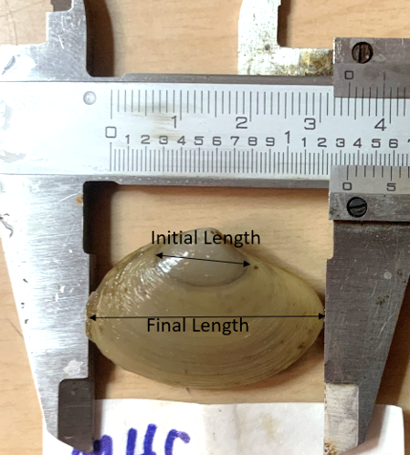
P = 0.03
9.6 ± 0.4 mm
12.9 ± 0.4 mm
28.7 ± 1.2 mm
30.4 ± 1.1 mm
Growth rates of both sizes of
surfclams were ~ 35%
greater at Beals vs. Gouldsboro

Slide 20
Second Sampling (Beals - August 2023)
S
S
SMALL BOXES (2 ft²)
LARGE BOXES (4 ft²)
4.8 ± 1.4
n = 30
8.8 ± 2.4
n = 30
52.1 ± 10.9%
29.3 ± 11.7%
Live clams occurred in 44 of 60 (73.3%) boxes

Slide 21
Size-frequency distributions are
not significantly different
G = 6.25 df = 4 P = 0.18
Box Size = 2 ft²
Mean CW are
not significantly different
F = 1.54 df = 1, 45 P = 0.22
Box Size = 4 ft²

Slide 22
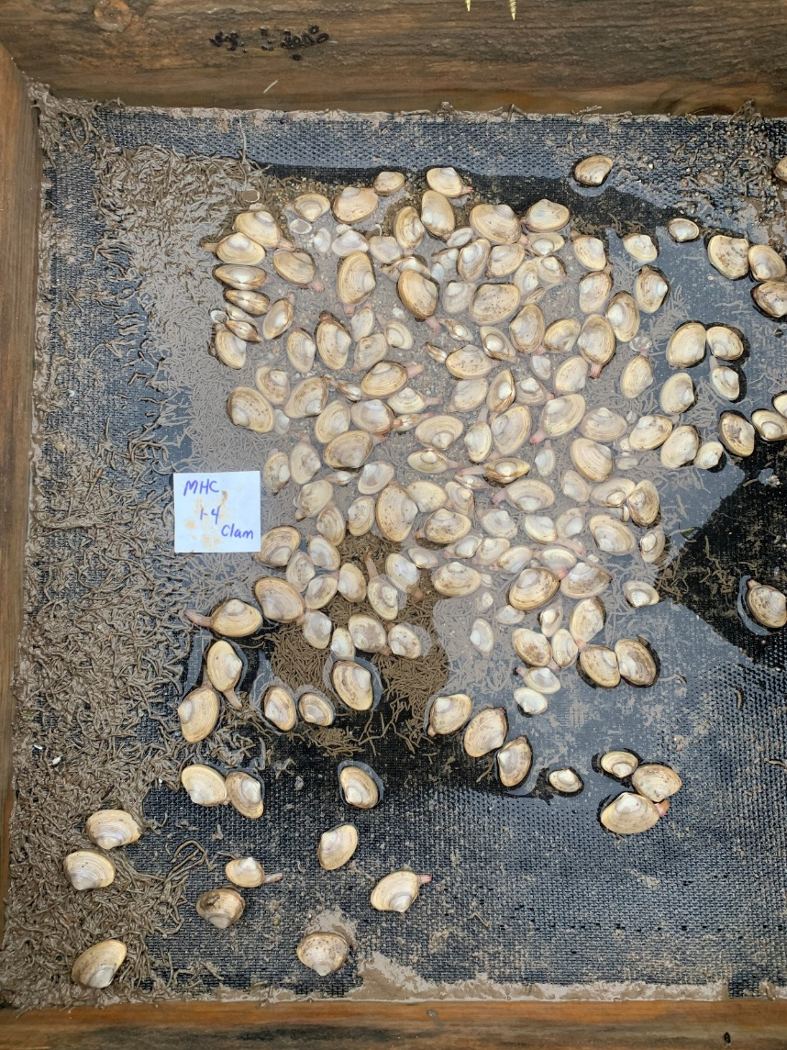
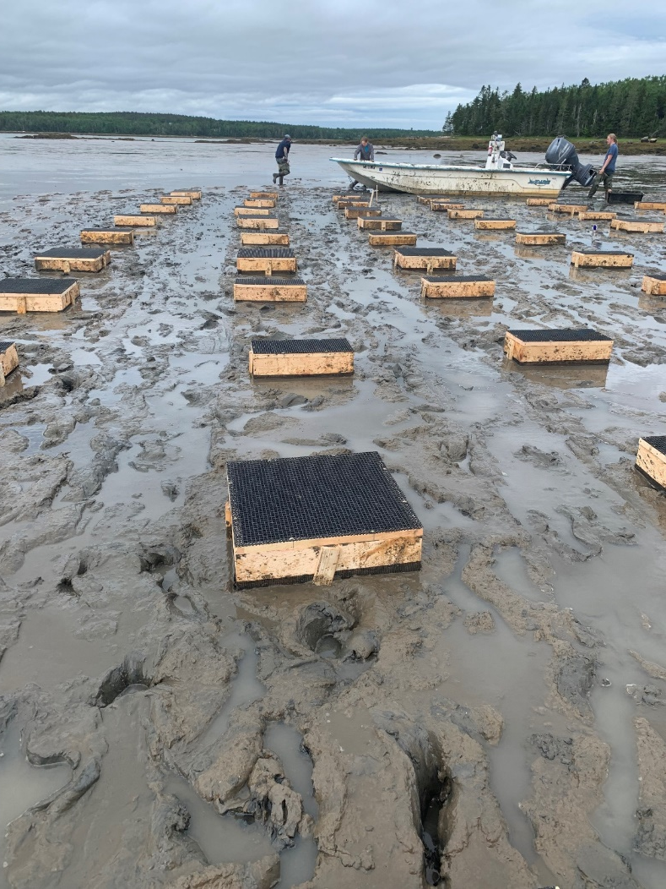
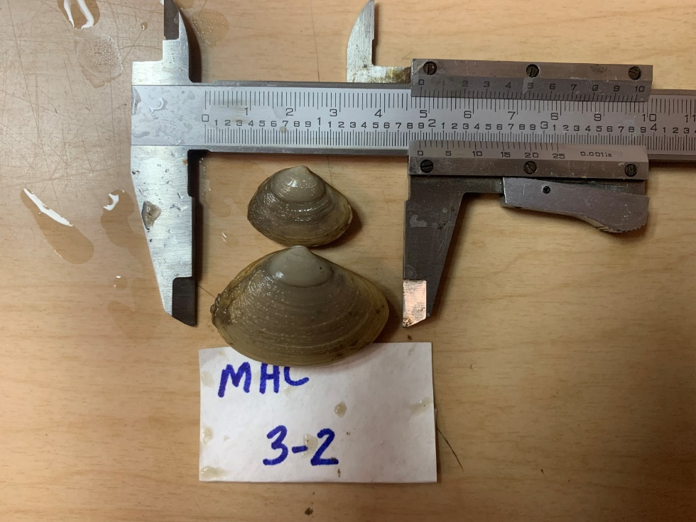
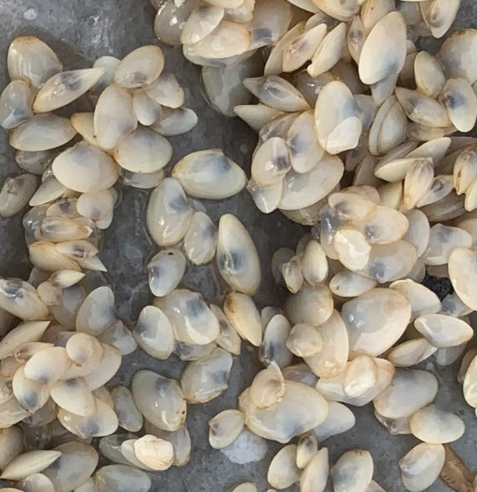
$$\overline{x}$$
= 29.2 ± 0.6 mm
Small clams
$$\overline{x}$$
Large clams
= 29.2 ± 0.6 mm

Slide 23
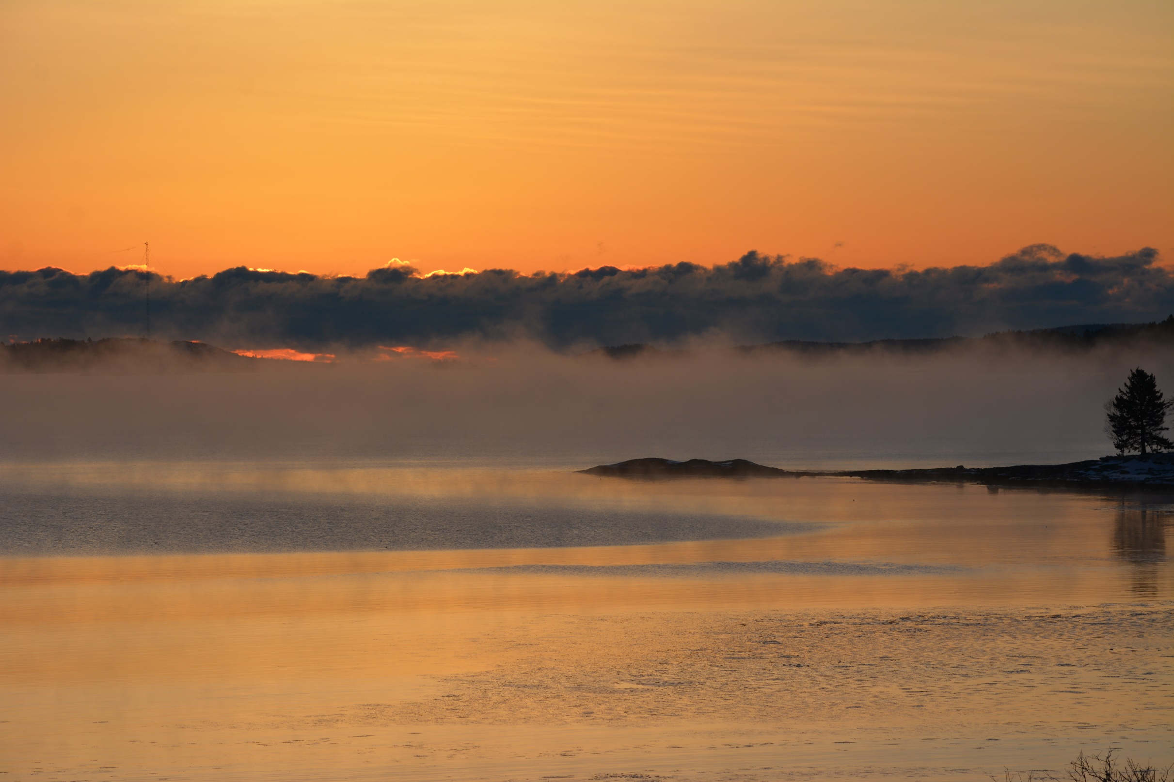
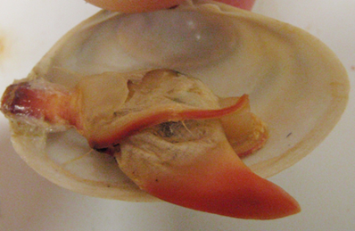
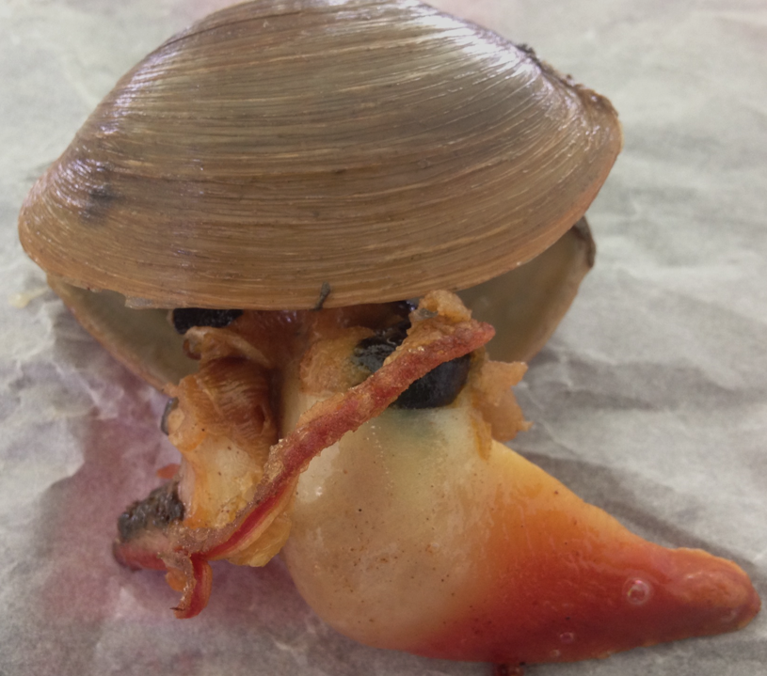
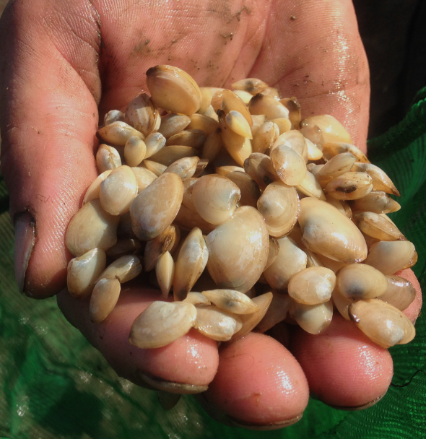
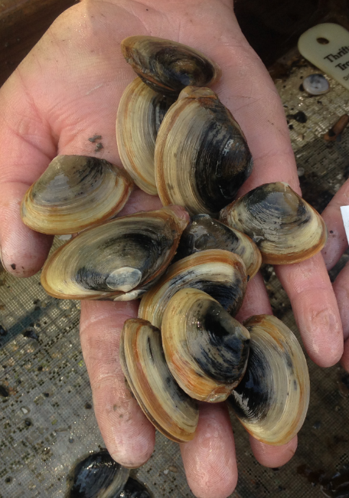
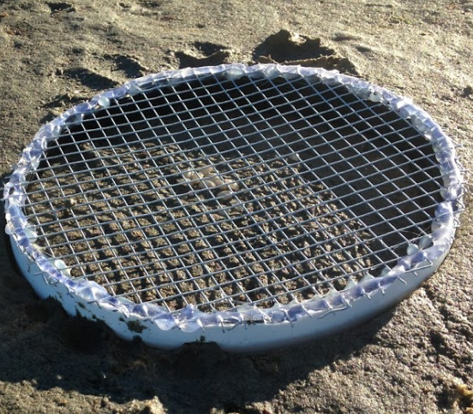
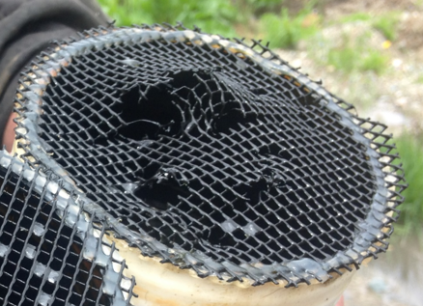
SUMMARY
Soft-shell clams and other commercially-important intertidal bivalve populations
in Maine are at/near record lows, due mostly to warming ocean conditions that have
resulted in heightened predation rates by both endemic and invasive species.
Arctic surfclams are a circumboreal species that can survive and grow in the low intertidal
zone, but cannot tolerate seawater temperatures exceeding ~ 20ºC, which makes them
suitable, physiologically, for the environmental conditions that exist in eastern Maine.
Refining techniques first attempted in the mid-1990s at the Darling Center (Davis &
Shumway), the hatchery and nursery phase of Mactromeris is established.
Attempts to grow this species in the field using a variety of techniques have been frustrated
repeatedly by crustacean predators - - mainly green crabs, but also rock crabs.
Future efforts (!) to rear surfclams in the field will focus on areas in far eastern Maine and
alternate methods to exclude crabs.

Slide 24
Acknowledgments

