Slide 1

Welcome!
We’ll begin at 6:04pm.
Please drop into the chat the following:
Name
Pronouns, if you would like to share
What does a global social movement for agroecology look like to you?
Global Social Movements for Agroecology and Food Sovereignty

Slide 2

Class Outline:
6:00-6:03 Arrival
6:04-6:07- Welcome Grounding
6:07-6:10- Introduction to topic and speakers
6:10-6:20 Panelists Presentations
7:35- 8:05 Panel Questions Led By AC
8:05- 8:20 Open Questions and Discussion
8:20-8:25: Thank you and Updates
8:25-8:30 Evaluation Dance Party and Close

Slide 3
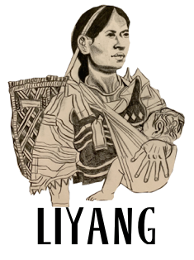
Joseph Centeno:
Liyang Network, US/Philippines
Notes:
Thank you so much! And thank you to the organizers of this space for bringing us all together today. Again my name is Joseph, I’ve been doing grassroots and nonprofit international filipinx organizing work for a few years now, and I got involved with Liyang Network over 3 years ago after I participated in an integration trip to the Philippines to meet and learn from Indigenous Lumad youth and teachers. I am the national finance officer and the regional coordinator for the Massachusetts committee of Liyang US.
I am so excited to make this connection, across the pacific ocean, and tell you all about what is happening in the Philippines.. We’ve prepared some slides to hopefully make me speaking a bit more engaging for the audience, so can we please go to the next slide?

Slide 4
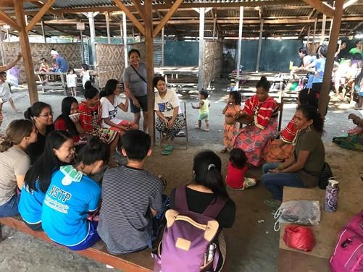
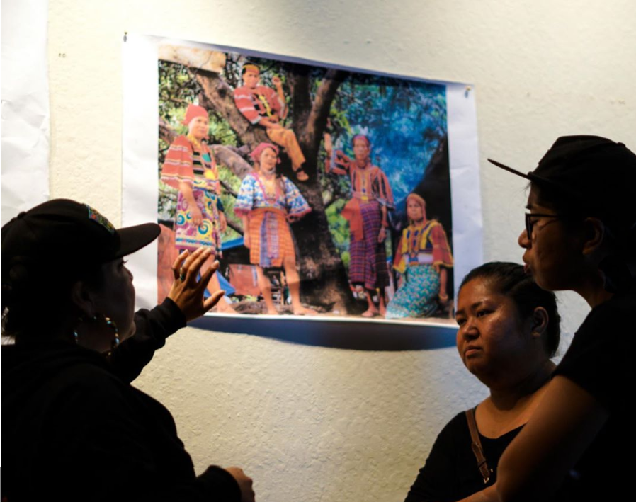
LIYANG NETWORK
a local-to-global advocacy network
We amplify the calls-to-action of environmental
and human rights defenders in the Philippines.
Notes:
I’m here with the US chapter of Liyang Network, a local-to-global advocacy network that supports the struggles of environmental and human rights defenders in the Philippines from across the world via international advocacy, fundraising and community education, taking direction from our community partner organizations in the Philippines.
As members of the international community, we understand that all struggles for land and environmental protection are interconnected, and that global movements for land sovereignty and self-determination can draw inspiration from grassroots struggles in the Philippines.

Slide 5
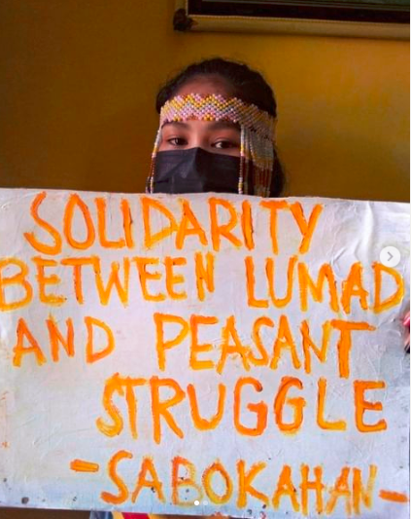
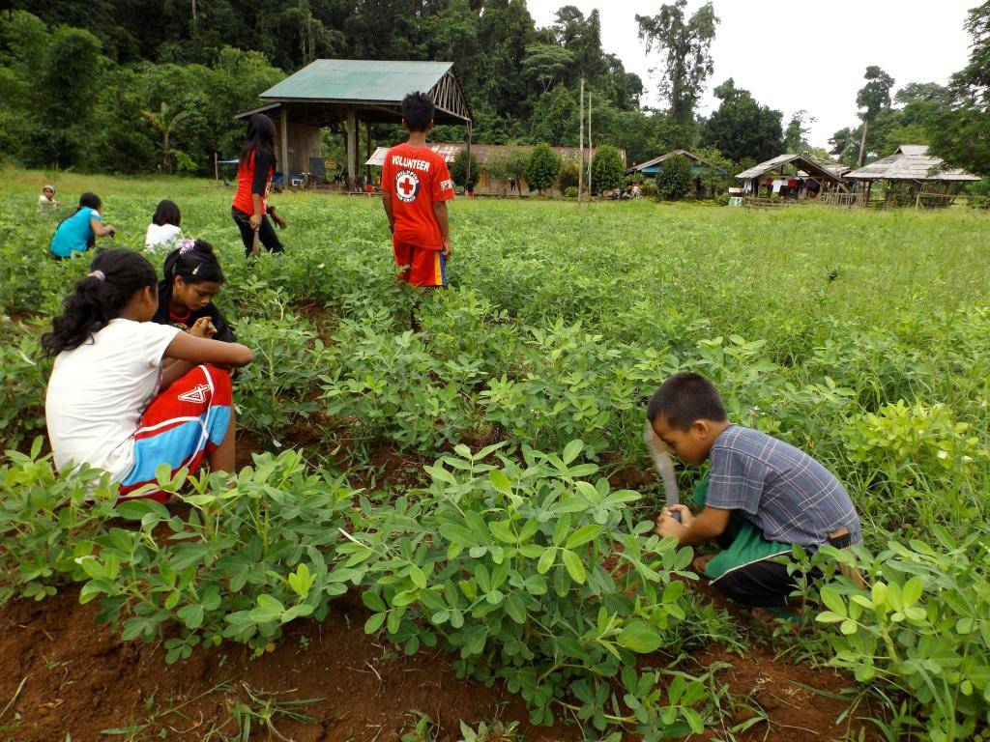
Notes:
Liyang started in 2019, responding to calls from Sabokahan, a grassroots organizations run by and for Indigenous Lumad women and LGBTQ folks, in Mindanao, Philippines. As we grew, we expanded our focus to serve other communities such as peasant farmers, plantation workers, and the urban poor - all of which are different sectors unified in their struggle against imperialism and for land reform
And that’s part of what we’re going to talk about today. However, in the context of this panel, we’re going to focus on peasant farmers and how they’re organizing themselves and working with other groups to reclaim their right to land, food sovereignty, and self-determination.

Slide 6
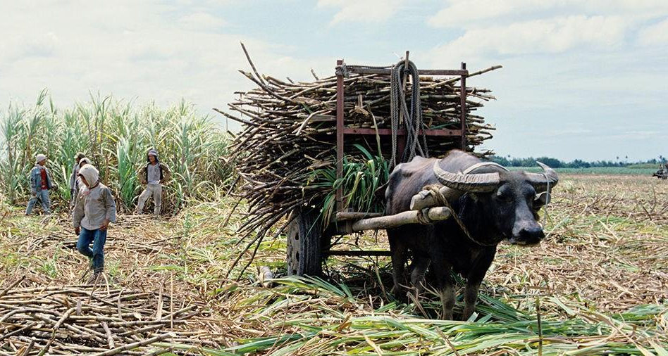
PEASANT FARMERS in the PHILIPPINES
Peasants: Farmers who do not own the land they till
Face: high land rent, backbreaking conditions, taxes, low prices on their goods, insufficient govt support
70-75% of Filipinos are peasant farmers
Notes:
So who are peasant farmers in the Philippines? What’s their situation?
Peasants are farmers who do not own the land they till or cultivate.
Peasant farmers make up about 3/4 of the Filipino population, so about 75 million people. But even with this massive majority, they’re the most vulnerable sector to food insecurity, resource grabbing & human rights violations.
Peasants in the Philippines are also one of the most exploited groups. After they till the land, they have to pay between 70 and 90% of it in rent to their landlords, being left with barely enough to survive. They also have to pay exorbitant taxes, severely undercut prices, are not subsidized by the government, and do not have the benefits of agricultural industrialization, so they work under back-breaking conditions with access only to crude tools.

Slide 7
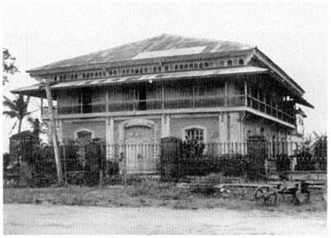
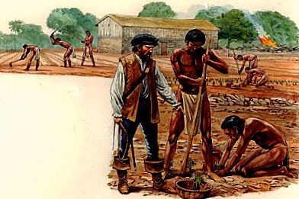
Historical Context
Spanish & US Colonialism
Hacienda system & agribusiness
plantations
1970s & 1980s
1970s & 1980s
Notes:
I want to take a step back, though, for some historical context. A lot of the other ppl we’ll hear from in the panel work with farmers’ movements and land struggles in Latin America–people are sometimes surprised to learn that the Philippines and much of Latin America shares a very similar and at times interconnected history and even current struggles, due to very similar and parallel histories of colonization–first under Spanish colonialism, and then under US imperialism.
In the Philippines, before being colonized the people had a variety of different social & economic systems, but most of them practiced forms of self-reliant, diversified agriculture, which were responsive to the needs of the ppl. So most households and communities had food secu as a result, and had sustainable, reciprocal relationships to the land they tilled
The Spanish forced a lot of the archipelago into a feudal system when they colonized the Philippines from the mid-1500s until the end of the 19th century, and ppl were dispossessed of their land and forced to work the land of landlords, and subjected to extreme exploitation and abuses. Under the feudal hacienda system, these lands were turned increasingly towards production for export and for profit, leading to intensified exploitation of peasants.
At the end of the 19th century, the Filipino people, MOSTLY peasants, took up arms in a revolution to liberate themselves from Spanish colonial. As a part of this, they waged apowerful anti-feudal struggle in the countryside where as the revolution gained ground, they confiscated and redistributed the lands of the landlords tothe peasants. The revolution was successful in defeating the Spanish colonizers, however at the last minute the US, disguised by the lie of supporting their war against Spain and with aid from Filipino elites, turned around and struck a deal with Spain to gain control of the Philippines, and basically committed genocide against the Filipino people in an attempt to extinguish their revolution. Soon after taking power, the US returned much of the liberated land to the old landlords, and although in words they promised peasants land of their own, in practice they only maintained feudalism in the country and exploited it in order to keep the people subjugated, and make a profit for their corporations.

Slide 8
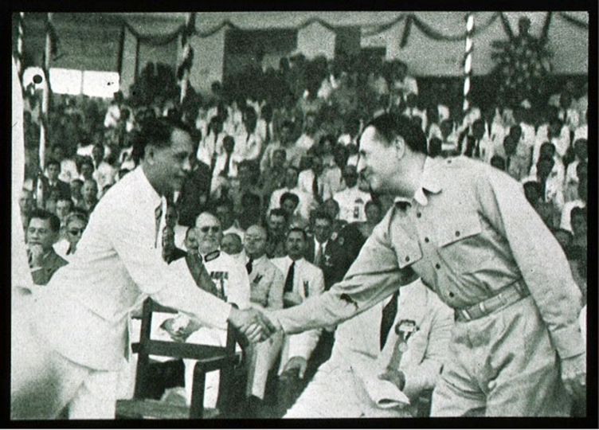
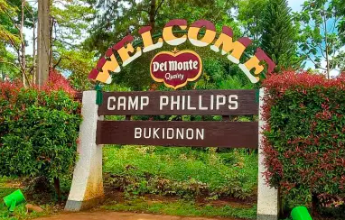
Contemporary Neocolonization
Notes:
After WWII, the Philippines was given nominal independence. Which we understand as a tactic to quell rebellion against US colonialists while maintaining control of and access to the archipelagos resources. Basically, when direct colonial rule became unsustainable bc ppl’s movements rose up in response, the colonial capitalist system came up with neo-colonialism as the alternative that would maintain the same power & economic structures, and distract ppl’s energy away from genuine decolonization.
Today, although the Philippines is no longer a direct colony of the US, we can consider it a neo-colony because the US continues to control its economy, politics, culture and even military. From the time of superficial or fake independence, the US has coerced it to sign a number of treaties and pass policies that maintain its neocolonial or imperialist rule over the archipelago, and allow it to continue to be exploited by foreign corporations. Land also has predictably become more concentrated into the hands of a few families and of multinational corporations, and the same feudal relationships where most people own no land and must rent it from landlords or become workers on plantations are still maintained.
The image in front of you shows the Del Monte Plantation and two of the initial 17 camps set by Americans in the 1920s. As you can see, the entrance to Camp Phillips has a Del Monte sign. These camps are continued to be operated by the wealthy landlord class.

Slide 9
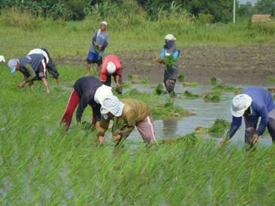
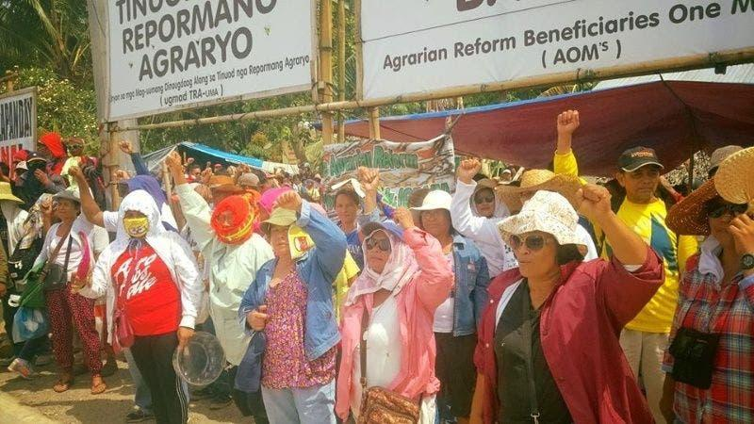
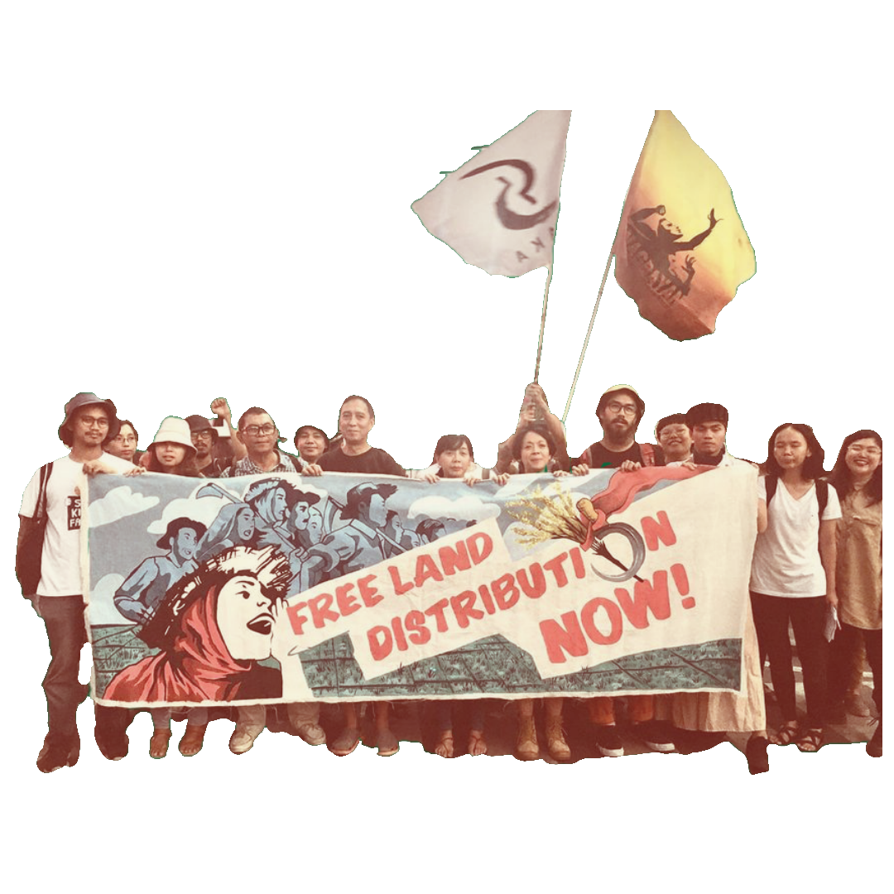
PHILIPPINE
PEASANT MOVEMENT
1970s & 1980s
1970s & 1980s
Notes:
So i already said that peasants make up the largest sector of the Philippines, more than half of the people. Historically, peasant farmers have also held the most mass power of any sector in the Philippines–from their successful resistance against Spanish and American colonialism, to present-day, where they have a powerful nationwide movement that is organizing for genuine land reform, and resisting imperialism.
This movement brings together peasant orgs from across the country at every level, from associations of peasants and agriworkers in a specific hacienda, to broad regional orgs, to huge organizations of peasant women. It’s also not just made up of peasants, there’s organizations for artists who support agrarian reform, there’s groups of lawyers and human rights advocates who also support the peasant struggle. And the peasant movement doesn’t act on its own, it’s in active solidarity with other sectors in the Philippines like Indigenous people, workers, urban poor, and more.
So peasants in collaboration with all different types of groups in the Philippines have developed, through decades of active struggle, a powerful struggle unified in their calls to end imperialism, enforce indigenous self-determination, and redistribute land from landlords back to the peasants

Slide 10
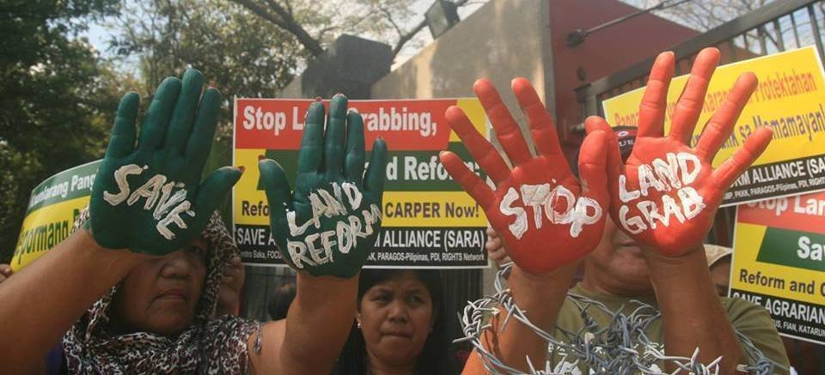
Sham Land Reform
Notes:
So the peasant movement is organized and powerful! But every time their organized resistance gains ground, the Philippines government passes bogus laws to try to derail the progress of these movements. We refer to these laws as Sham Land Reform. Even when they are in the name of redistribution, these laws are deceptive and used to further dispossess people.
The Comprehensive Agrarian Reform Program, also known as CARP, passed by President Cory Aquino in 1988, is a prime example. Cory Aquino is part of the biggest landowning families in the Philippines. Although CARP was written with the promise to distribute land to peasants, in reality it is rarely implemented this way, and often makes farmer beneficiaries pay for the land that’s being “redistributed” to them at prices they cant afford, and provides no support afterwards. In many cases the law is even used by big landlords to consolidate their power and dispossess small farmers of the land owed to them.
Today, the peasant movement in the Philippines has learned from and responded to this type of constant deception on behalf of the Philippine government run by the landlord class. They have a variety of strategies and tactics, but today we’ll focus specifically on the strategy of bungkalan.

Slide 11
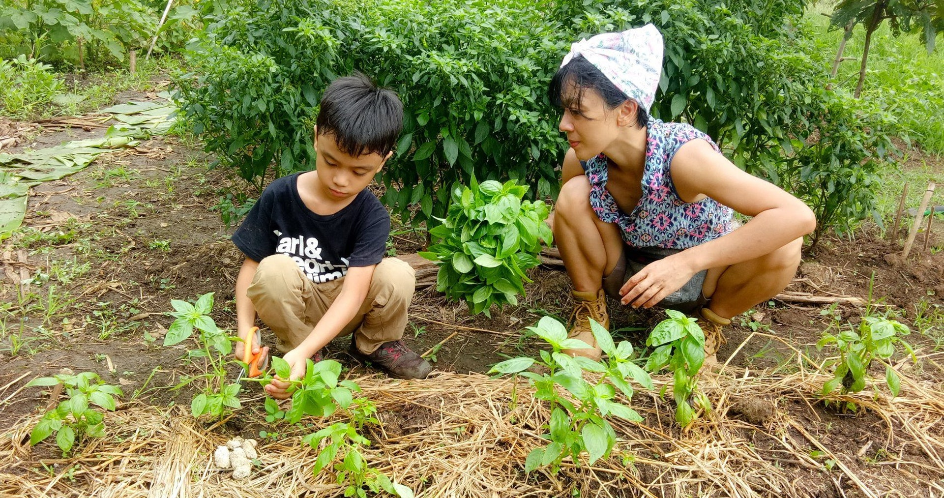
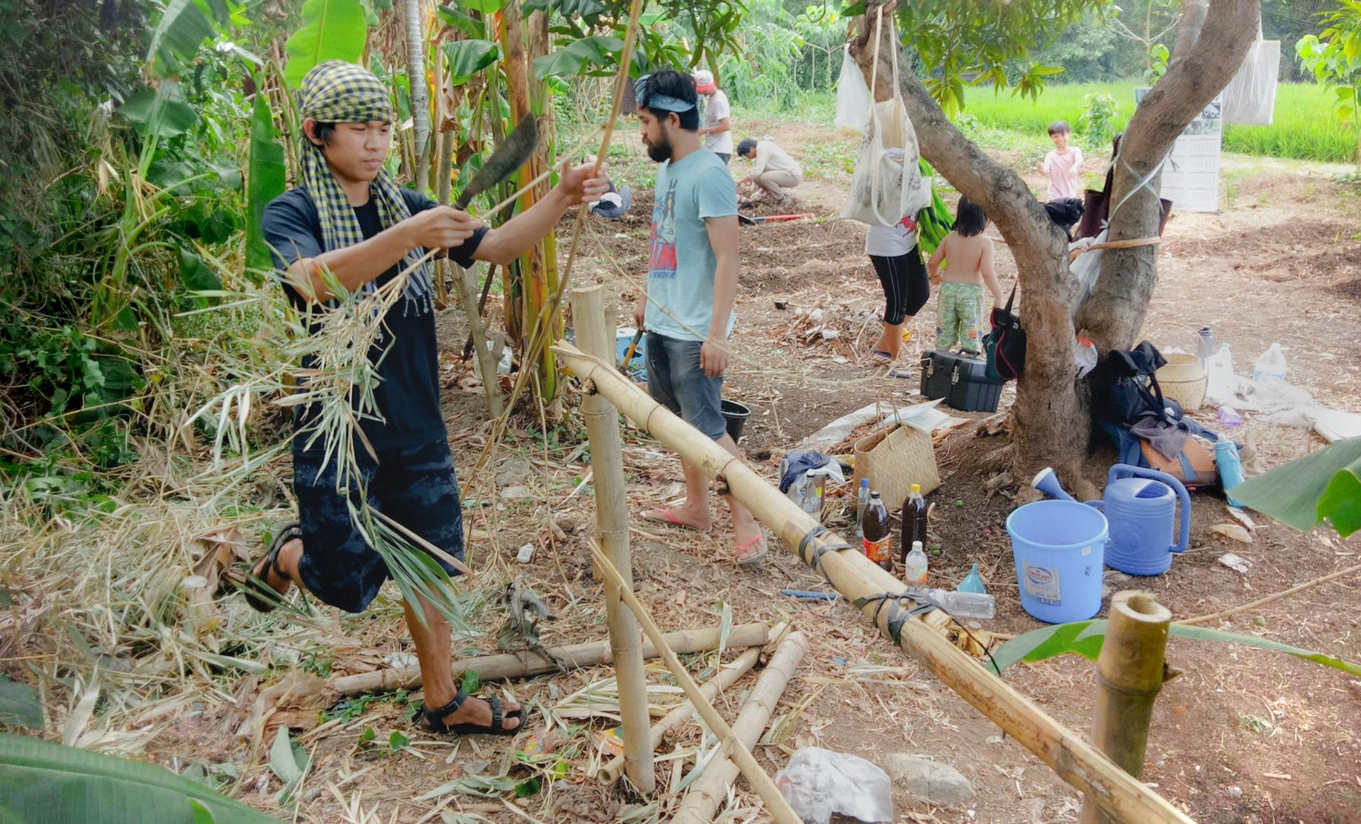
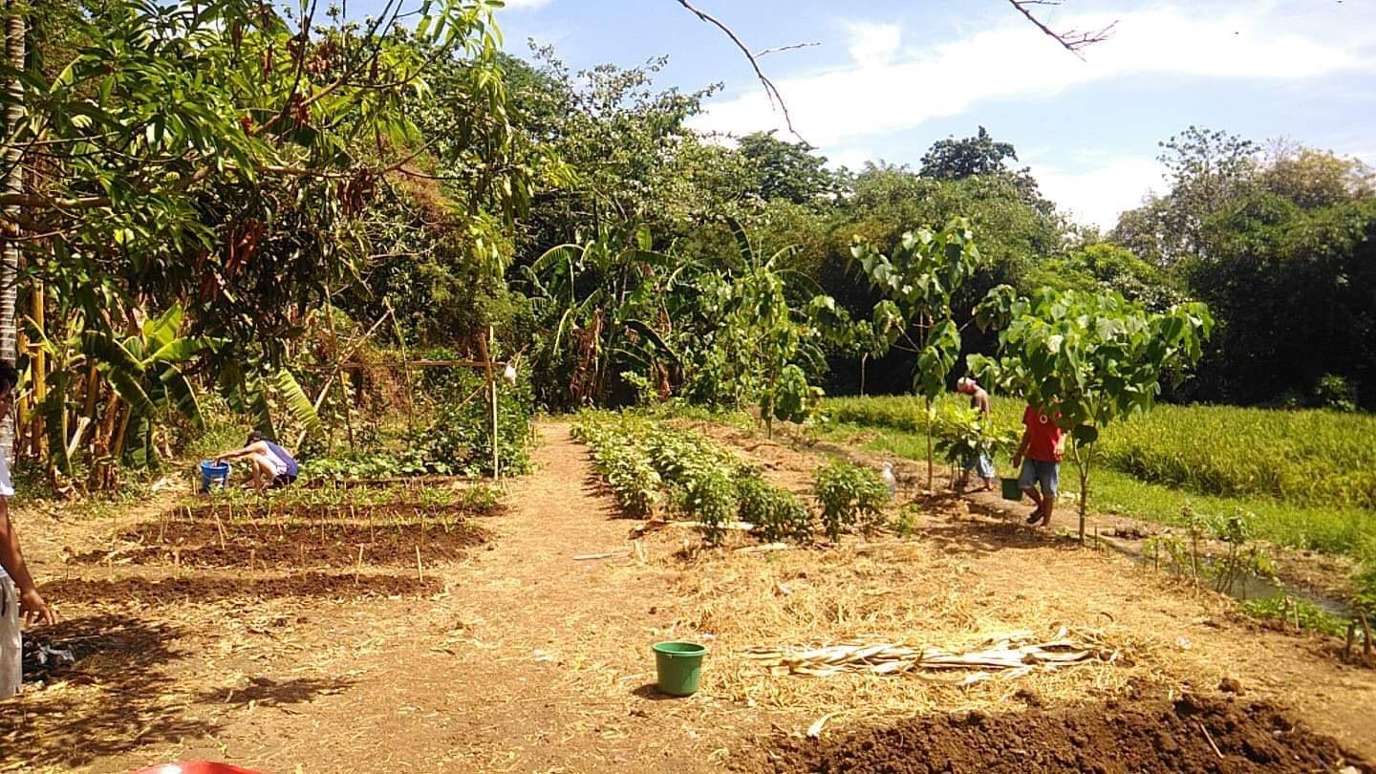
BUNGKALAN:
Peasants asserting their rights to land, food sovereignty & self-determination
Notes:
Peasant farmers have been taking genuine land reform and sustainability into their own hands, through a practice and movement called bungkalan.
So let’s dissect this word: Bungkalan comes from the Filipino word ‘bungkal’ meaning “to till.” It is a peaceful land occupation of farmers asserting their legal right to the land.
With the passing of land reform laws like CARP, land owned by big landlords and corporations was portioned and designated for redistribution to the farmers who worked it. Some properties even awarded legal land titles as paper documents to peasants, but because landlords have so much political power and money, the keep peasants from actually being installedo n their land and put off the process by which this happens for as long as they can. Then, when a landlord disputes a peasant’s claim to the land, the courts often side with the landlords rather than the beneficiaries of the agrarian reform policies.
With all these deceptive, greedy tactics and with food insecurity so rampant and peasants’ survival at stake, peasants began to peacefully re-claim and collectively farm the land they were awarded in name, using sustainable practices of agroecology to feed their communities and their protest.
This practice of communal farming, known as Bungkalan, is encouraged by the Philippine peasant movement as a peaceful demonstration of their rights to land, food sovereignty and self-determination. It is an example of peasant farmers taking their rights into their own hands, recognizing that they won’t be enforced by the reactionary government.
—
Bungkalans also exist to educate others outside peasant communities to build solidarity between their struggles.
The pictures on this slide are from a bungkalan near the capital of Manila, stewarded by SAKA, a collaborative organization between a union of agricultural workers and a collective of artists fighting for land reform.
On top of farming alongside each other, the communities host regular workshops for people from the city to come learn practices of agroecology, the situation of peasants, and why the Philippines needs land reform.
In this way, the Bungkalan is a form of integrated education - while people farm the land together, they learn about and discuss issues of land occupation and the necessity of agroecology and food sovereignty.
Bungkalan involves peasants collectively educating themselves about agroecology, with support from allied scientists, because a lot of peasants are new to these practices.
This means the practice is an experimental one, trying new techniques and observing what's best for the land.
In the process of learning and developing agroecology practices local to their land, communities also develop their unity and level of political organization.
~~~
They are occupations of land of big landlords & multinatls by the ppl that work the land. They then begin to farm it collectively, using practices of agroecology, takes a lot of unity and organization. Lands usually that the government is supposed to distribute under the current agrarian reform policy, but they aren't.
The way they function is that most bungkalan are communal farms. This is something encouraged by the Peasant movement in the Philippines.
~~~~~
[DID ANGIE IPONG SPUR BUNGKALAN? https://www.agriworkers.org/2019/10/03/hands-off-angie-ipong-stop-the-persecution-of-peasant-advocates/]
In the face of government inaction, peasant farmers are taking genuine land reform and sustainability into their own hands, through a practice (and movement) called bungkalan. Bungkalan comes from the filipino word ‘bungkal’ meaning to till. They are occupations of land of big landlords & multinatls by the ppl that work the land. They then begin to farm it collectively, using practices of agroecology, takes a lot of unity and organization. Lands usually that the government is supposed to distribute under the current agrarian reform policy, but they aren't.
The way they function is that most bungkalan are communal farms. This is something encouraged by the Peasant movement in the Philippines.
In communal farming, the equipment and tools, the land, and the harvest are collectively owned. After consuming the produce, the excess is sold, and they use the earnings go towards health, education, and social programs for the farming community.
Bungkalans are also avenue to educate others outside peasant communities and build solidarity w peasant struggle. Pictures are from a bungkalan in QZ close to Manila, organized jointly by the union of agricultural workers, and a collective of artists fighting for land reform. They host regular workshops on practices of agroecology, the situation of peasants, & why the philippines needs land reform. They set up this bungkalan to buid solidarity btw their orgs, and also host ppl from the city to learn about their struggles through joint workshops and working the land alongside them. Integrated education, while theyre farming the land theyre being educated on & discussing all these issues of why these land occupations and practices of agroecology for food sovereignty are necessary.
https://ipam-global.org/fls/saka-bungkalan-project
https://iboninternational.org/resources/books/
https://atlasofthefuture.org/project/masipag/
https://walkerart.org/magazine/amy-lien-enzo-camacho-bungkalan-peasant-resistance-phillipines-artist-op-ed

Slide 12
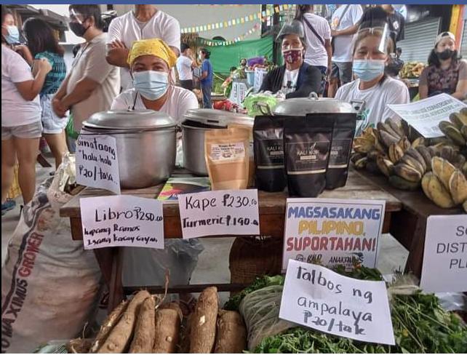
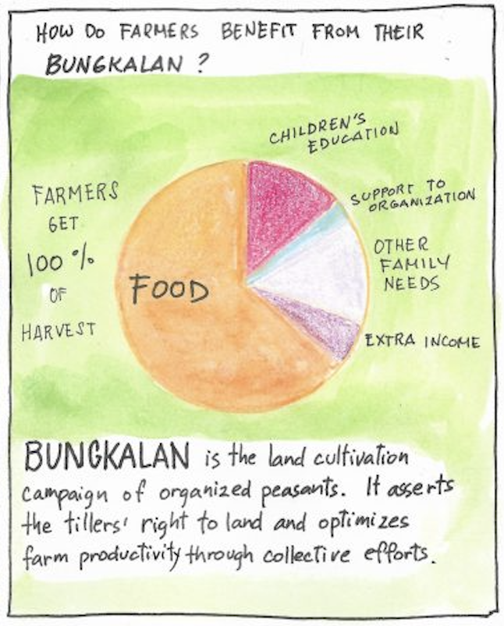
BUNGKALAN HARVESTS!
Notes:
So what do Bungkalan look like? They take a lot of unity and organization.
The land, the equipment and tools and the harvest are all collectively owned.
And this is an intentional practice of departing from decades and centuries of feudal modes of agriculture.
In the current feudal mode of agriculture, even though peasants do 100% of the work, they only receive 10 to 30% of the harvest while the 90% goes to the landlord
However in bungkalan, the farmers receive 100% of their harvest, eating a diverse array of produce and selling what they don’t eat to pay for family and community needs such as education and organizations.
The chart on the right shows how they may use the harvest, eating most of it then using the rest to support the health, education and social programs for the farming community.
Fundamentally, bungkalans are about peasants peacefully asserting their rights to land and food sovereignty, in the face of a system run by and for big landlords and multinational corporations.

Slide 13
“The bungkalan is the epitome of genuine agrarian reform, crafted and continuously being defended and developed by no less than the peasants themselves. It is changing the old oppressive system using the people’s immutable will to free themselves from bondage and collectively assert their right to land and to life. While democratic governments such as that of the Philippines claim that their power emanates from the people, and that the government thus exists to exercise the people’s will, in practice that is rarely the case. The people can and must ensure their own rights for themselves, no matter how many decades or lives it may take."
Notes:
Since it's important to hear these things in people’s own words, this quote from peasant organizer sums it up. It says, READ IT
Transition
So we see that Bungkalan is a powerful, beautiful strategy of the peasant movement. But in the Philippines, they’re being threatened by police and military, and bungkalans are systematically attacked and harassed.
So why is this peaceful practice of communal farming that is also a form of protest actively repressed by the Philippine police and military?
Because this practice threatens the power of landlords and multinational corporations, the same class that’s controls the government.

Slide 14
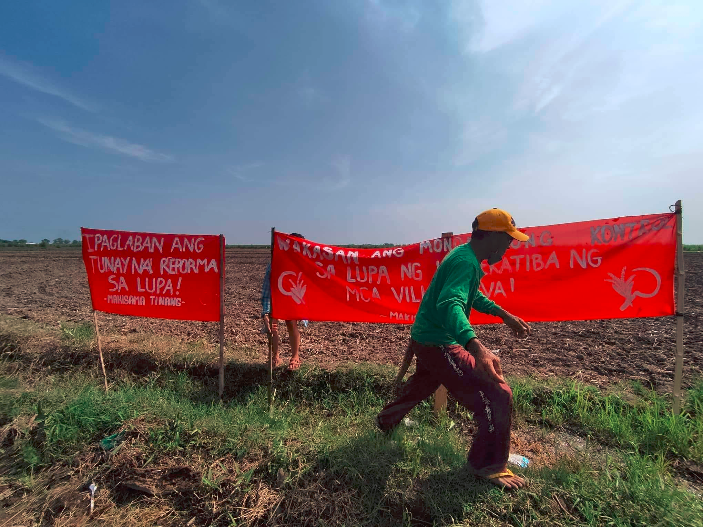
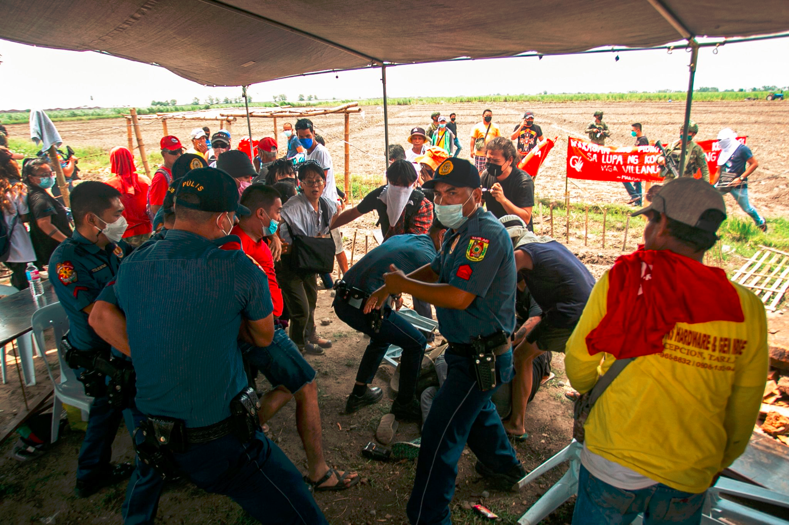
TINANG 83
Notes:
We’d now like to share a recent example of this, where almost 100 peasant organizers and advocates were violently arrested while engaging in a bungkalan in Tinang, northern Philippines.
On June 9th, peasants were doing peaceful, communal farming in the town of Tinang, Tarlac when 20 police officers arrived. The police harassed the farmers as well as various supporters from mass organizations who had joined the bungkalan that day. This bungkalan was just the most recent development in a decades-long struggle of the farmers to secure the land that they have a legal right to under the agrarian reform program. the peasants launched the bungkalan to increase the pressure for their demands to be heard as well as feed their families and communities.
In response to the peasants’ action, the mayor who is also effectively the landlord, led a group of 20 armed police into the bungkalan to try to find the leaders of the peasant groups.
The farmers and advocates formed a human barricade preventing their entry, and the police left as they had no warrants and could not justify their raid.
However, they came back soon after and proceeded to violently harass, grab, and interrogate people.
[point to image on the right]
They arrested and took almost 100 individuals, including farmer-leaders, advocates, and human rights groups to the police station.

Slide 15
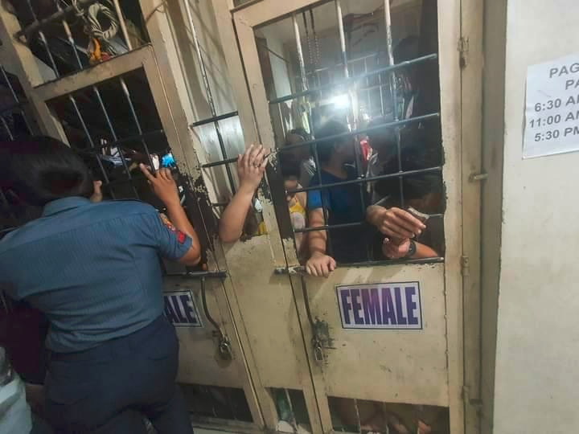
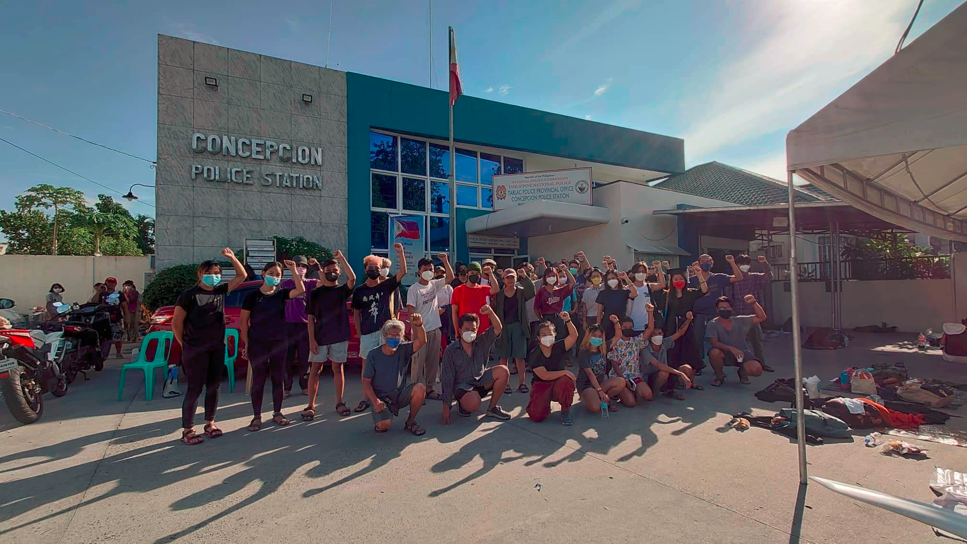
TINANG 83
Notes:
After farmers and advocates were arrested and brought to the police station, they were forced to sleep outside of the precinct.
[see image on right]
They were kept in unsanitary and degrading conditions while waiting for their charges to be dropped and to be released.
After one night in holding, a handful of students and researchers were released.
The remaining 83 were held for over 72 hours.
The day before they were released, 53 of the farmers and advocates were forced into tiny, overcrowded jail cells with people forced all the way to the entry door.
[see image on the left]
The cramped conditions were traumatizing for many and led 4 of the women to collapse and vomit while locked in the cell.
After days of these conditions and public outcry of their advocates and supporters, they were released on bail, which you can see imaged on the right. However, they’re all still facing trumepd up charges, one of which includes the illegal occupation of their own land.

Slide 16
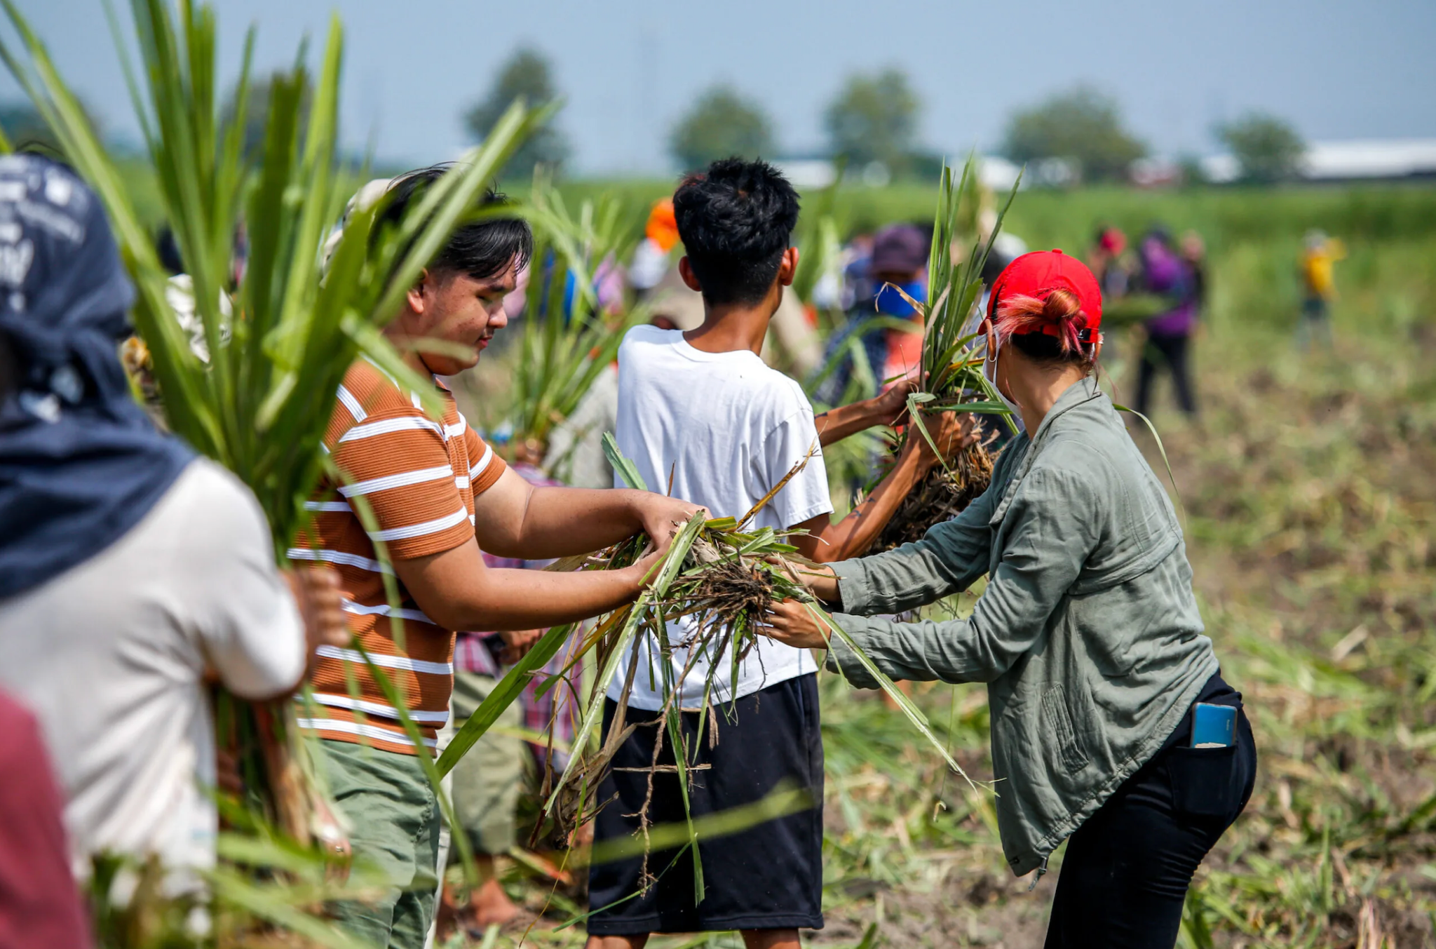
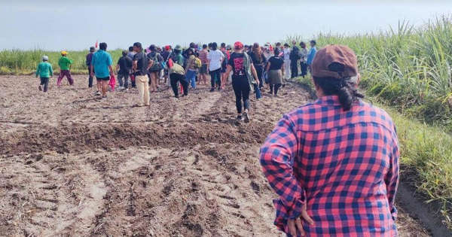
TINANG 83
Notes:
After all this, we learned that the Department of Agrarian Reform (DAR) decreed that 177 Tinang farmers will get land ownership certificates.
This is a major victory! The peasants of TInang successfully called attention to this injustice, and through their action and that of their allies and advocates, they’ve taken a huge step towards getting their land back.
However, this is not a final victory., after CARP, a land reform bill passed over 30 years ago, 236 Tinang farmers received land ownership certificates, yet none of them actually received the land.
Tinang peasants also expect this ruling by the DAR to be contested by the mayor, the Tinang 83 are also still facing trumped up charges, and there are plenty of Tinang farmers who have yet to receive these land ownership certificates.
Yes, this victory is a great example of the power of the peasant movement and that the strategy of Bungkalan really is what is necessary to reclaim land, not waiting on the reactionary government to make reforms.
However, to ensure the Tinang farmers actually receive their land, we need continued pressure.
The Tinang peasants are still organizing to make sure the DAR’s decree is enforced, and we all in the international community can help as well. We need to stay vigilant.
Liyang is also fundraising to support the Tinang 83 with their medical treatment and psychosocial trauma therapy since this was an incredibly traumatic event. I’ll send the link in the chat if you want to support.
The reason we wanted to highlight the Tinang 83 is because their Bungkalan and 3 decade struggle to reclaim their land is a prime example of how the peasant movement in the Philippines is organizing and gaining power. Their bungkalan and alliance building with Indigenous people, urban poor, workers, and agri-workers as well as professionals, artists, and more is an inspiration for those of us struggling across the globe for a future where we have a sustainable, ecological relationship to the land we all rely on to live. More concluding?
Thank you : P

Slide 17
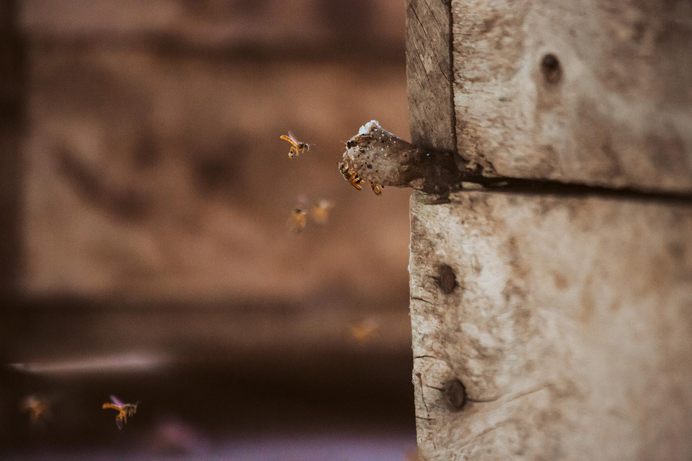
Yorlis Gabriela Luna:
Red de Melipnicultores de Nicaragua, Finca Agroecologica La Panteras, and the Cooperative Madre Tierra, Nicaragua

Slide 18
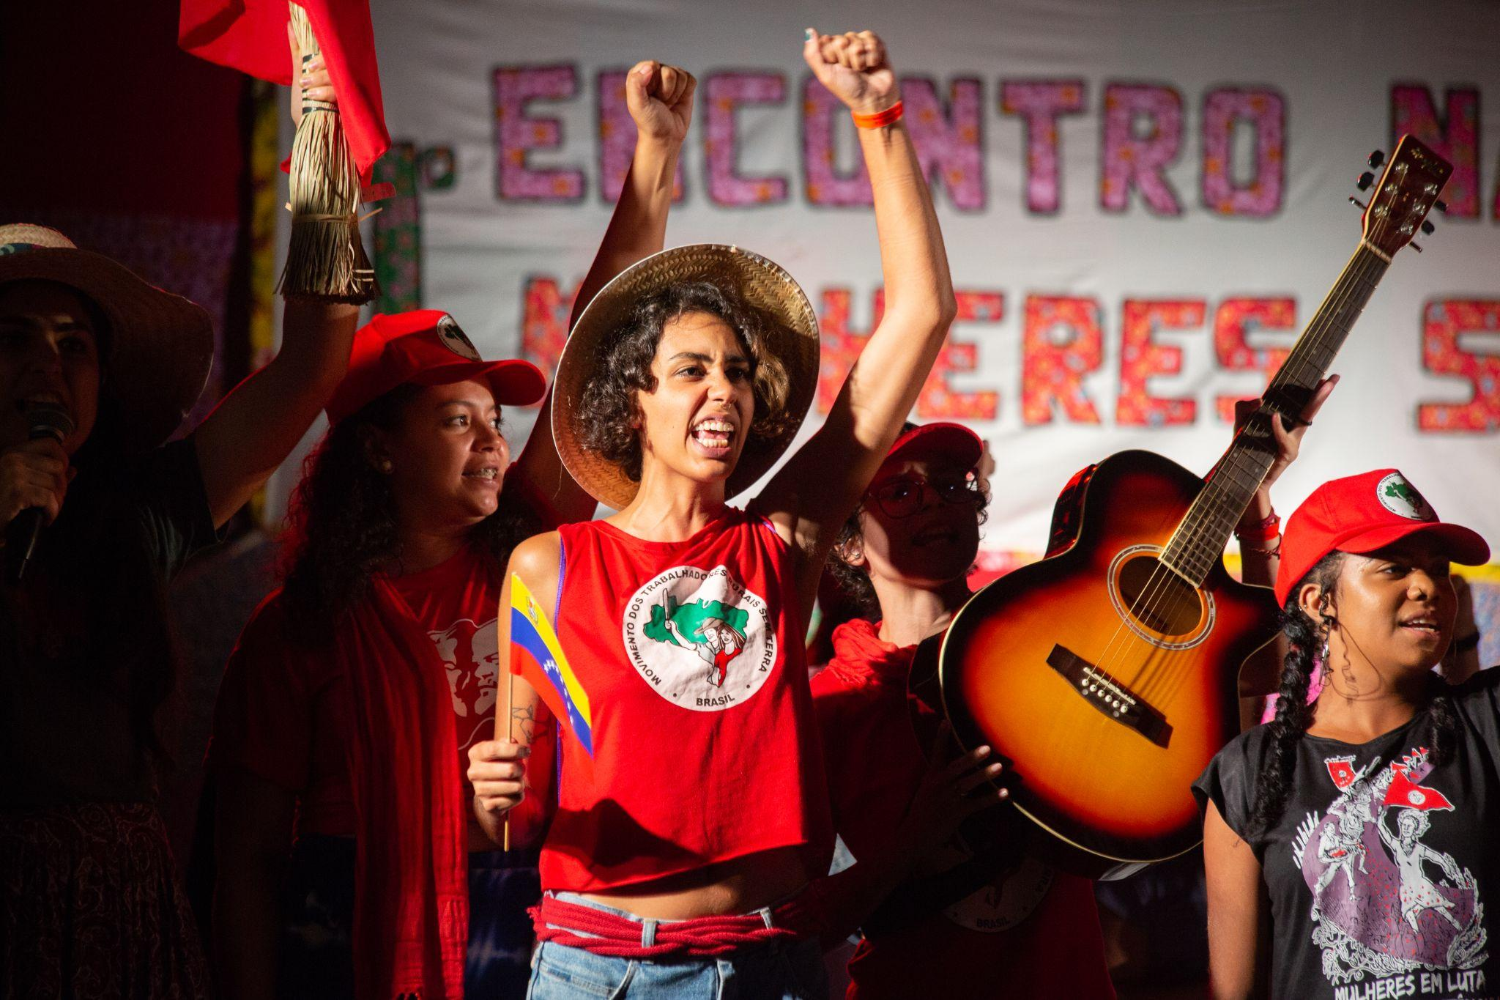
Fabetz:
Movimento dos Trabalhadores Rurais Sem Terra (MST), Brazil

Slide 19
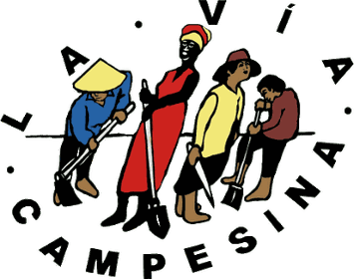

Nils McCune:
Technical staff of La Vía Campesina North America and researcher at the Agroecology and Livelihoods Collaborative at the University of Vermont, Nicaragua/US

Slide 20

Break
5 min break….Please join us back at 7:33

Slide 21
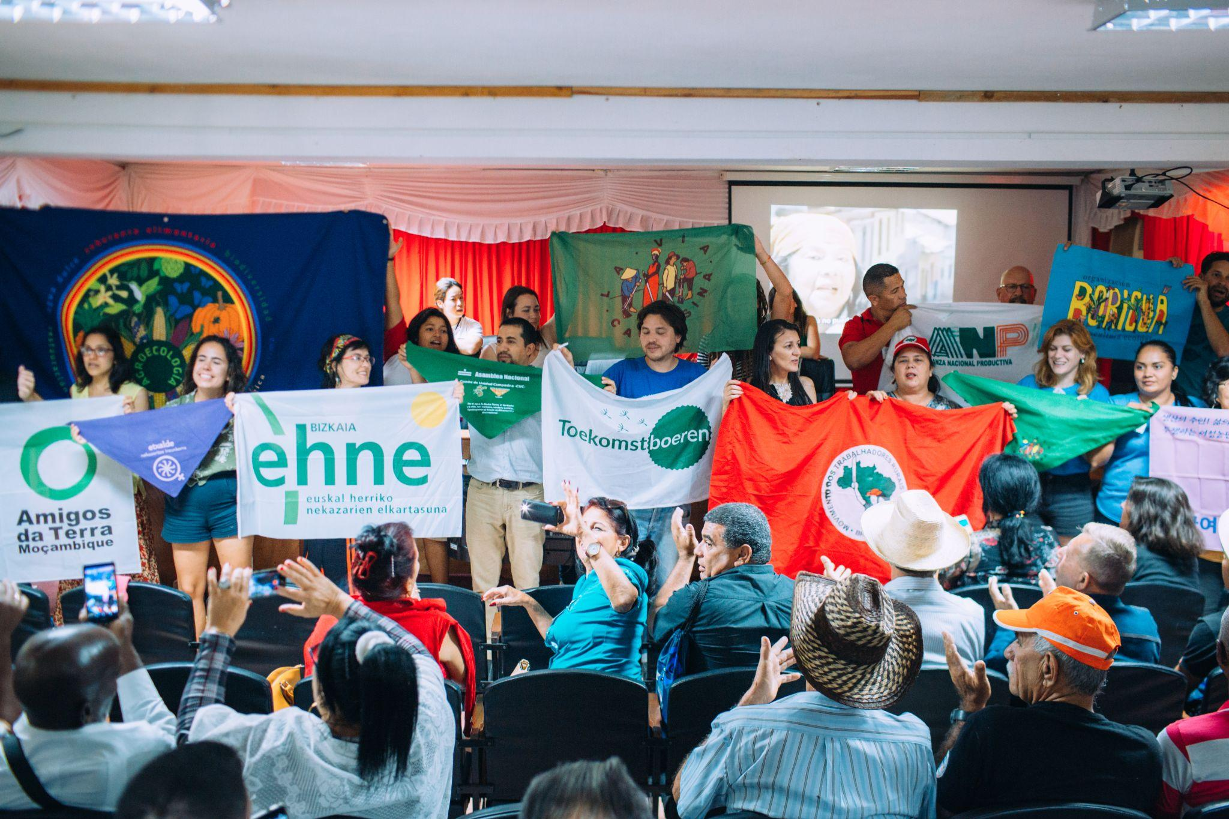
Globalize the Struggle! Globalize the Hope!

