Slide 1
Soil Health and Climate Resilience for Pasture-Based Livestock Farmers
Dave Llewellyn,
Shannon O’Sullivan
and Pat Knapp

Slide 2
SARE Partnership Grant
Project Number: ONE17-303
Increasing soil health and climate resilience education for pasture-based livestock farmers
https://projects.sare.org/sare_project/one17-303/
Notes:
Glynwood was recently awarded a Sustainable Agriculture Research and Education (SARE) Partnership Grant to support its project entitled: Increasing Soil Health and Climate Resilience Education for Pasture-Based Livestock Farmers (SARE project ONE17-303). The project is led by Glynwood, in collaboration with staff from Cornell Cooperative Extension, Natural Resources Conservation Service (NRCS), University of Massachusetts Stockbridge School of Agriculture and regional farmers from Back Paddock Farm and Grass + Grit Farm.
(This, to me, is A/E. Scientists and farmers and service providers working together to advance understanding in agriculture. That’s you, too. If you have experience in this area, please do share, appropriately. No workshop hijacking, though.)
The purpose of the project is to increase the number of practical, tangible and meaningful opportunities to educate regional farmers about soil health and adaptive management via on-site demonstrations, regional workshop presentations and a soil health field day.
Farmers learn how to:
Monitor soil health
Mitigate soil health constraints in pastures
Adapt management strategies for improved soil health and climate resilience
Improves farmers quality of life
Improves pasture plant productivity + bottom line
Improves risk management via improved productivity in times of environmental stress
Demonstration will teach the cost-effectiveness and impact of several pasture improvement approaches.
Soils that are more tolerant of extreme weather events (heavy rain events, longer stretches without rain, extreme temps).
Selection of warm season forage species to backstop against hot summers and poor mid-summer forage production.

Slide 3
Soil Health Field Day August 23rd
Notes:
Soil Health Field Day, August 23rd at the Hudson Valley Farm Business Incubator in New Paltz, NY. Registration at https://glynwood.org/calendar/farmer-training-workshop-soil-health-field-day
Fay Benson + Jason Detzel, Cornell Cooperative Extension; Paul Salon, Natural Resources Conservation Service (NRCS); Masoud Hashemi, University of Massachusetts Stockbridge School of Agriculture
Fay Benson, CCE
Cortland County Cooperative Extension, Regional Dairy and Field Crops Team
Transports the Soil Health Trailer to the site for the Soil Health Field Day
Instructs about soil aggregates, water infiltration and soil carbon testing
Paul Salon, USDA NRCS
Northeast Soil Health Specialist
Instructs at the Soil Health Field Day @ soil health overview
Massoud Hashemi, UMass
Team Leader: Crops, Dairy, Livestock, Equine; Stockbridge School of Agriculture
agronomist
advises project and reviews data
instructs at Soil Health Field Day
Jason Detzel, CCE
Livestock Educator
advises project and reviews data

Slide 4
Soil Health Testing
Cornell’s Soil Health Assessment, $50-150
http://soilhealth.cals.cornell.edu/
Woods End, $55
https://woodsend.org/soil-health-test/
Notes:
I’m going to cover things like soil quality, soil health, testing, interpretation and how to mitigate soil health constraints. Cornell’s Soil Health Assessment; How to test: procedure + cost; Definitions IDing and mitigating your limiting factors (what will have a significant impact on pasture plant performance)
Define soil quality: (Take suggestions.)
How well the soil can sustain plant and animal health.
The capacity of a soil to function.
And how does it do that? Does the soil breathe? Drain? Is it teeming with microbes? Is it nutrient-rich?
What are your soils’ characteristics?
% of sand, silt, clay
Soil depth
Drainage
Soil health: chemical, physical, biological
Read instructions for sampling; fill out Submission Form. Cornell: 3-6 cups (aggregate sample), store it cool. Read sampling instructions before sampling and shipping. Cost? Cornell ($95 for Standard)

Slide 5
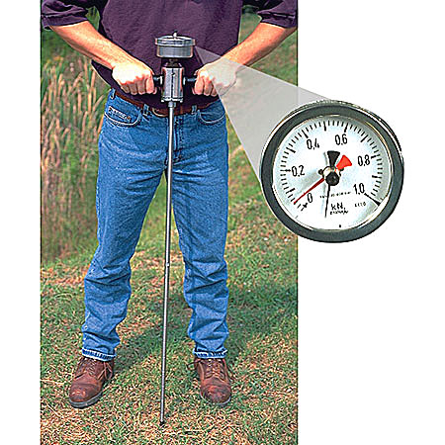
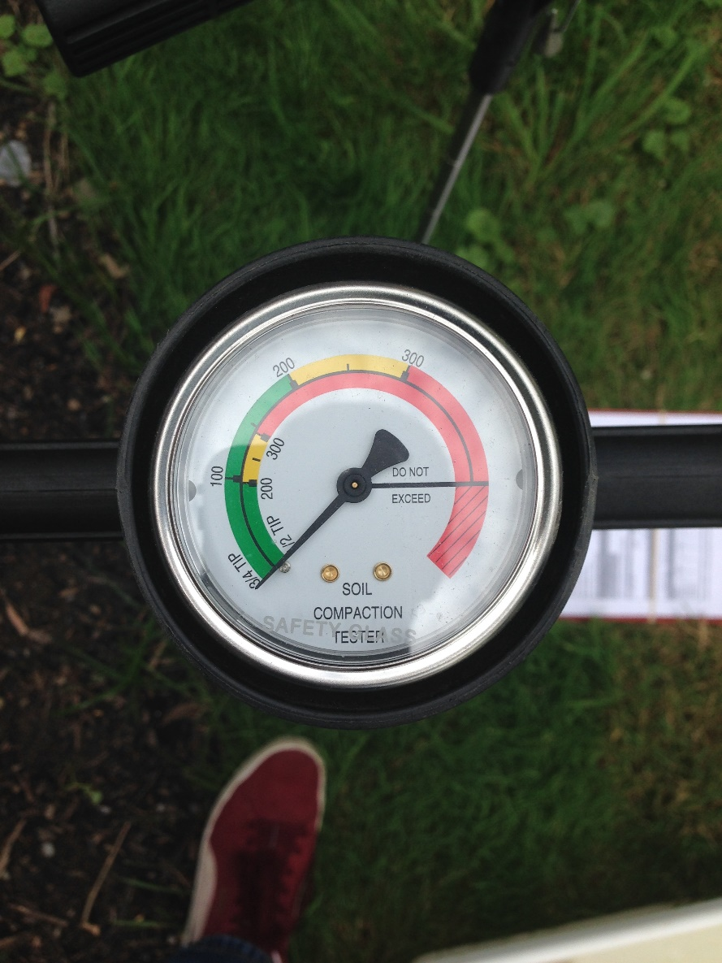
Soil Penetrometer
Soil Penetrometer
Notes:
DIY section!
Contact CCE to see where you can borrow one. Use the appropriate tip for your soil type. Record readings at surface, 3” and 6” depth. This is recorded on the Cornell submission sheet.
Use the buddy system! It is hard to push + read + record.

Slide 6
Notes:
Test result cover sheet: note the sidebar, which categorizes the indicators of soil health as physical, biological or chemical. They also provide an overall rating based on these twelve indicator, which is not pictured. In this case, it is an 87 / Optimal.

Slide 7
Physical Indicators
Available Water Capacity: measures the porosity of the soil. Indicates how much plant-available water the soil can hold.
Surface Hardness: Surface = top 6”
Subsurface Hardness: Subsurface = 6-18” depth
Aggregate Stability: how well soil crumbs hold together w/ rainfall or flooding
Notes:
What factors impact these indicators?
Particle size; biological/fungal communities; practices; roots
Ground cover; practices/timing; compaction
Practices/timing; compaction; poor soil structure/biological activity
4. Ground cover; soil structure; roots; biological activity

Slide 8
Biological Indicators
Organic Matter: OM is a measure of carbonaceous material in the soil
ACE Soil Protein Index: amount of OM present as proteins; organically bound N (ACE refers to the extracting process)
Respiration: measures the metabolic activity of the soil microbes
Active Carbon: portion of OM that’s easily used as food by microbes; influenced by mgmt. more than adding OM (diverse sources is good)
Notes:
Respiration – CO2 burst testing

Slide 9
Chemical Indicators
pH: measure of how acid the soil is; determines what nutrients a plant can take up (6.2-6.8)
Phosphorus: little soil disturbance is helpful to maintain mycorrhizal fungi (assuming you have P)
Potassium: important for yield and tolerance to temp swings
Minor Elements: get a thorough soil analysis; seek agronomic advice

Slide 10
On Physical Constraints
Available Water Capacity - build soil to hold more water via rotational grazing, add stable, finished compost (manure is ok); reduce tillage if you are in the re-seeding practice
Surface Hardness - stay off wet fields; control/minimize vehicle access and lighten loads; chisel or keyline
Subsurface Hardness - reduce/eliminate use of moldboard plow; use chisel or keyline; forage (tillage) radish
Compaction is a top constraint given the agricultural history of pasture/hayfields
-Stunts root growth
-Poor drainage
Aggregate Stability - add fresh organic materials; reduce tillage
Notes:
IDing your limiting factors (what will have a significant impact on pasture plant performance) Physical

Slide 11
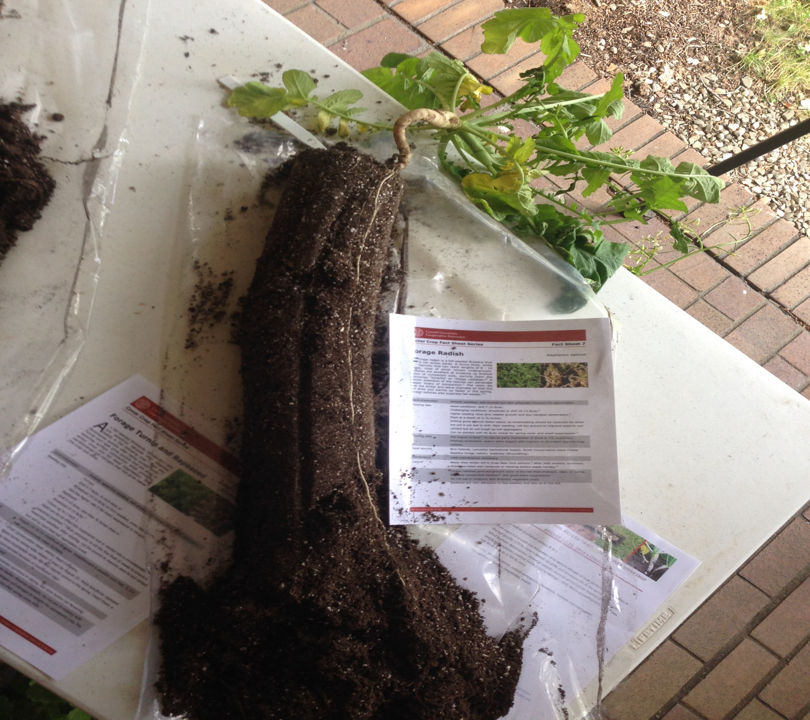
Notes:
Tillage radish – what do you notice in the picture?

Slide 12
On Biological Constraints
Organic Matter - add manure, compost; reduce tillage
ACE Soil Protein Index - make sure your N source is lower in C; manure is good; reduce tillage
Respiration - reduce compaction w/ chisel or keyline; increase diverse OM
Active Carbon - add manure, compost; reduce tillage
Notes:
C ties up N
OM feeds microbes

Slide 13
On Chemical Constraints
pH - lime, but check Mg levels first; Hi-Cal lime most likely; soil testing, get agronomic advice
Phosphorus - add P per soil test if it is low; adjust pH to 6.2 - 6.8; if it is high, stop adding OM (talk to CCE about cover crops that extract P; buckwheat?)
Potassium - add K per soil test via manure, compost or fertilizer; if it is high, extract via cover crops or hay
Minor Elements - add via fertilizer if low per soil test, get agronomic advice; build soil, reduce tillage to build mycorrhizal fungal population

Slide 14
Pasture Improvement Demonstration Design
 | A |  | B |  | C |  | D |  | E |  | F |  | G |  | H
 | amended |  | amended, grazed |  | amended, composted |  | amended, composted, grazed |  | amended, composted, grazed, keylined |  | amendeded, keylined, composted |  | amended, keylined |  | amended, keylined, grazed
1
 | control |  | grazed |  | composted |  | grazed, composted |  | grazed, composted. Keylined |  | keylined, composted |  | keylined |  | keylined, grazed
2
Notes:
Our SARE grant supports the development of a pasture improvement demonstration area at Glynwood’s Hudson Valley Farm Business Incubator, located at Mohonk Preserve in New Paltz. The demonstration showcases pasture improvement methods for common soil health constraints in our region, such as soil compaction and poor drainage. The pasture improvement treatments include application of limestone and compost, rotational grazing of ruminant animals, and the use of a keyline plow to mitigate soil compaction issues. The demonstration area includes sixteen plots with every combination of these treatments, plus a control plot. We sent numerous soil samples to the Cornell Soil Health Lab in the fall of 2016 for baseline data from which Glynwood staff and project collaborators will measure outcomes. Each fall, staff will sample soil for follow up analysis to measure the impact of the various treatment.

Slide 15
Why these treatments?
Lime application
Compost application
Rotational grazing
Keyline plow
Notes:
Lime (addresses chemical constraints to soil health) – carbonate neutralizes acid, so application will raise pH. With pH in 6.2 – 7.0 range, you will have the widest range of nutrients available to your forage.
Compost (addresses biological constraints to soil health) – increases organic matter, a feed source for soil microbes
Rotational grazing (addresses biological constraints to soil health) – increases the diversity of microbes in the soil; concentration of manures builds organic matter
Keyline plow (address physical constraints to soil health) – breaks up surface and subsurface compaction; improves soil drainage and aeration
Why look at these treatments individually and in each possible combination? To see if any of these alone have enough impact to improve soil health less expensively and with less labor. AND to see what kind of soil health impact we get from more comprehensive treatments.

Slide 16
Forage Species ID
Species | 1A | 1B | 1C | 1D | 1E | 1F | 1G | 1H
Orchard grass | 1 | 0 | 1 | 2 | 0 | 0 | 8 | 0
Timothy | 0 | 2 | 1 | 11 | 6 | 4 | 3 | 1
Smooth broome | 9 | 9 | 15 | 12 | 11 | 9 | 8 | 5
Tall fescue | 1 | 6 | 4 | 5 | 3 | 5 | 3 | 2
Sedge | 9 | 8 | 11 | 7 | 7 | 11 | 3 | 9
White clover | 0 | 0 | 0 | 0 | 0 | 0 | 0 | 0
Birdsfoot trefoil | 7 | 3 | 25 | 5 | 3 | 18 | 30 | 26
Wild strawberry | 10 | 5 | 13 | 12 | 9 | 9 | 8 | 14
Bed straw | 0 | 1 | 2 | 10 | 10 | 0 | 11 | 7
Buttercup | 0 | 0 | 0 | 0 | 0 | 0 | 0 | 0
Milkweed | 0 | 0 | 0 | 0 | 0 | 0 | 1 | 0
Plaintain | 3 | 4 | 9 | 0 | 21 | 4 | 13 | 3
Queen Anne's Lace | 0 | 1 | 0 | 0 | 0 | 0 | 0 | 1
dandelion | 0 | 0 | 1 | 0 | 5 | 1 | 0 | 0
lemon sorrel | 0 | 0 | 0 | 0 | 0 | 0 | 0 | 1
multi-flora rose | 2 | 1 | 0 | 0 | 0 | 0 | 0 | 0
onion grass | 0 | 0 | 0 | 0 | 0 | 0 | 0 | 0
red clover | 7 | 0 | 4 | 15 | 9 | 0 | 2 | 0
worm count | 17 | 19 | 23 | 11 | 22 | 32 | 13 | 18
Notes:
Since implementing the project, we have conducted forage species counts in the treatment areas to collect baseline information about the native pasture plants. Over time, we anticipate an increase in the percentage of desirable species as we improve soil health in these pastures.
What’s good…(rattle of some of the desirable grasses and forbs and why)
What’s bad…(name some of the undesirable grasses and forbs and why)
What are the early returns after grazing?

Slide 17
We dig worms!
Notes:
The team has also conducted worm counts in the sixteen demonstration plots by digging up 1’ x 1’ sample areas. The process takes about 10-15 minutes per sample, if you have a digging machine like Dave Llewellyn on your team. Worm counts in excess of 10 are considered an indicator of good soil health. Glynwood’s initial worm counts averaged 18.5 worms per square foot. We expect those numbers to climb as we mitigate soil health constraints.

Slide 18
Notes:
Why do we expect worm numbers to climb? Deeper root system (more habitat for things in the soil food web, more food sources); improved aeration + drainage (worms dig those things); higher pH (preferable to worms); increased organic matter (food for worms)
How long does this take? 10-15 min/sample, if you use the buddy system!

Slide 19
Rotational Grazing Before
Notes:
PK: overview of rotational grazing
How does rotational grazing build soil? By managing animal impact (trampling) and the distribution/concentration of manure and urine.
Estimated DM was _____ (Shannon, please fill this in).
CONTINUOUS GRAZING -- A conventional way of managing grassland is to turn livestock out into a large area for a long period of time.
RECOVERY PERIOD -- Time between grazings must change with variations in pasture plant growth rate.
SELECTIVE GRAZING -- Animals don’t graze uniformly. Given a chance, all grazing animals are selective in their diet.
MANAGEMENT INTENSIVE ROTATIONAL GRAZING -- A method of improving pasture forage production and livestock performance by rationing high quality forage, and protecting plants that have already been grazed from being eaten until they have adequately recovered.

Slide 20
Rotational Grazing During
Notes:
PASTURE MASS -- Measured in lbs DM/ acre, mass is product of AVG plant height and plant density. It’s an estimation of the total weight of forage.
NET FORAGE -- The amount of forage that can be actually harvested from a pasture.
STOCKING RATE -- The number of animals for a given property, measured by lbs/ acre (or maybe head per acre). A statement on what is, not what could/should be for a given farm.
STOCKING DENSITY -- The number of animals in an specific area for a period of time, measured in lbs/acre for a specified period of time (16000lbs/acre/12 hours).
CARRYING CAPACITY -- This number can change as management improves or worsens land.

Slide 21
Rotational Grazing After
Notes:
PK + SO
Shannon, what is the residual?
Ask the audience to describe the desirable impacts you see in the picture. Any undesirable impacts? Is this overgrazed? How do you gauge the recovery period?

Slide 22
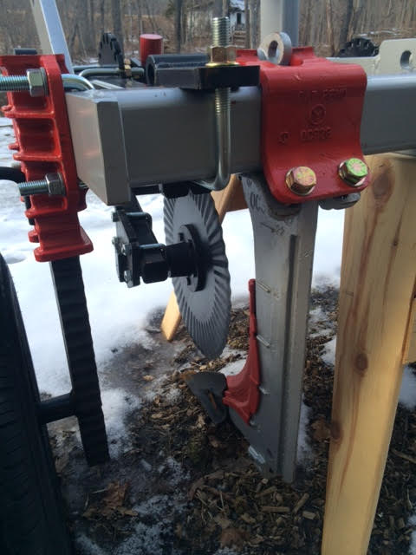
Notes:
Briefly explain the keyline plow. It is a tillage implement designed to renovate pasture and redirect groundwater without creating a lot of surface disturbance. It creates a channel or pathway for drainage and penetration of roots. P.A. Yeomans developed the plow design for enacting some of his keyline principles: in particular, contour ripping to control rainwater runoff.
We’ve done keyline design work on the property, and are pleased with the results. However, this isn’t a workshop on keyline design, nor did we write that into the SARE grant.
For the purposes of this demonstration, we will use the keyline for breaking surface and subsurface compaction. So this will be done in straight lines.

Slide 23
Notes:
Warm Season Annual Forage…in 2016 we seeded Sudex (sorghum – Sudan grass) and turnips. Pat describes experience.
Background
Farmers in our region have struggled during the hot mid-summer season with poor performance of native pasture plants. As a result, farmers have had inadequate forage for grazing livestock and many have had to feed out hay in the middle of the summer.
The warm season annual forage demonstration will highlight the use and benefits of annual warm season forage as a climate resilience/risk management strategy.
Design Process
The forage will be grazed three times by Back Paddock Farm. Back Paddock will monitor and record data related to forage output and regrowth. Glynwood staff will track total costs of production and work with Cornell Cooperative Extension to survey native forage production and associated costs and the cost of purchasing hay to feed in mid-summer.
What does it cost to produce? What is the forage value? Compare that vs. the value of native forage at that time of year/buying in hay
“Overall, warm season annual grasses have the potential to produce 6 tons of dry matter per acre.” 2010 Warm Season Annual Forage Performance Trials, Dr. Heather Darby, UVM Extension

Slide 24
Notes:
The second demonstration component of the SARE grant is the utilization of warm season annual forage as an effective strategy for improving risk management for graziers in the warm season. Glynwood staff recently seeded a mix of brown mid-rib (BMR) sorghum, pearl millet and crimson clover to be grazed by cattle during the hottest stretch of the summer. Pastures in our region are composed predominantly of cool season perennial plants, which slow down in the summer. Too frequently in recent years, intense stretches of heat have forced area farmers to purchase hay when forage has been inadequate in the summer. Production of warm season annual forage is a way to create a backstop in the event of inadequate forage. Glynwood staff and partners will compare the cost of production and value of forage against the market rate for hay in the mid summer.

Slide 25
Notes:
That’s the seeding rate we used, as recommended by Dr. Hashemi.

Slide 26
Notes:
Pat – describe your experience grazing warm season annuals. How many animals did you graze? Three times? Estimated savings?
Our intent – measure outcomes + economic benefit w/ CCE + Umass. How much feed did we produce? How much labor? Cost of seed? Value of feed?
Given our variable climate, seeding warm season annuals is a good backstop against a scorching summer. The forage will be high quality and useful, even in a mind summer, but in a hot one – this is a good climate resilience strategy. You’ll have happily grazing animals while others are scrambling to source hay in the summer.

Slide 27
Notes:
You’d be happy too.

Slide 28
Resources
Notes:
Resources:
First, SARE is great. This grant is fun – and a nice blend of public + private. This is agroecology. We’re learning together and will build on findings each year. We love our design as an educational platform for our program participants.
Glynwood looks forward to reporting on progress in Increasing Soil Health and Climate Resilience Education for Pasture-Based Livestock Farmers. For more information on pastured livestock operations, please read our report Pastured Protein: Ecological, Humane and Healthy Meat from the Hudson Valley.
Cornell Soil Health pages
Green Pastures on Your Side of the Fence – Bill Murphy
HMI + Savory
Art + Science
Resilience Agriculture
Adaptation Resources
On Pasture

