Slide 3
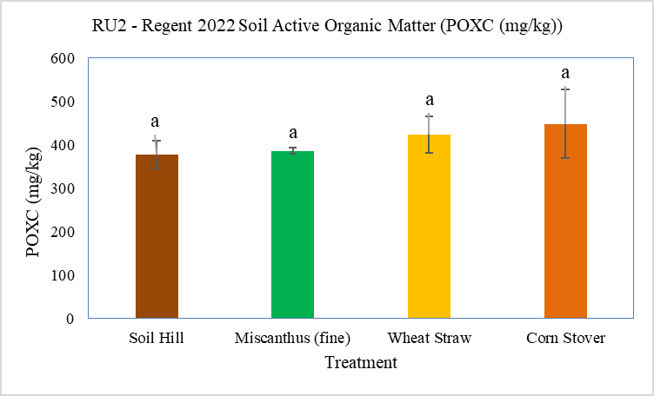
Figure 94.C: Soil POXC content (Regent) for different mulch and soil treatments at RU2 in 2022.

Slide 4
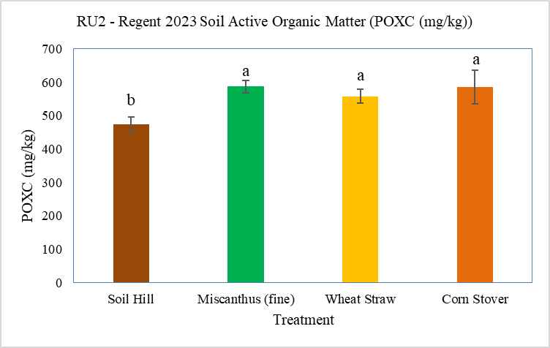
Figure 94.D: Soil POXC content (Regent) for different mulch and soil treatments at RU2 in 2023.

Slide 5
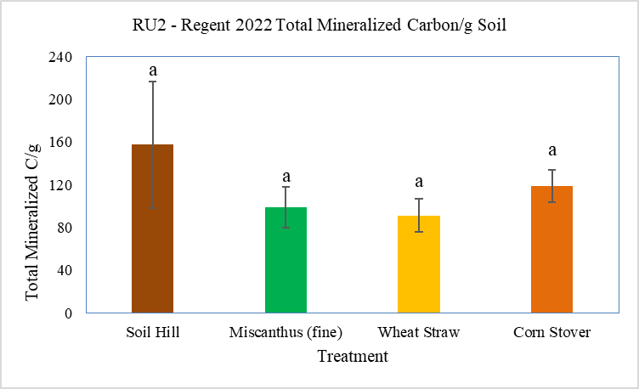
Figure 95.C: Total mineralizable carbon per gram of soil (Regent) for different mulch and soil treatments at RU2 in 2022.

Slide 6
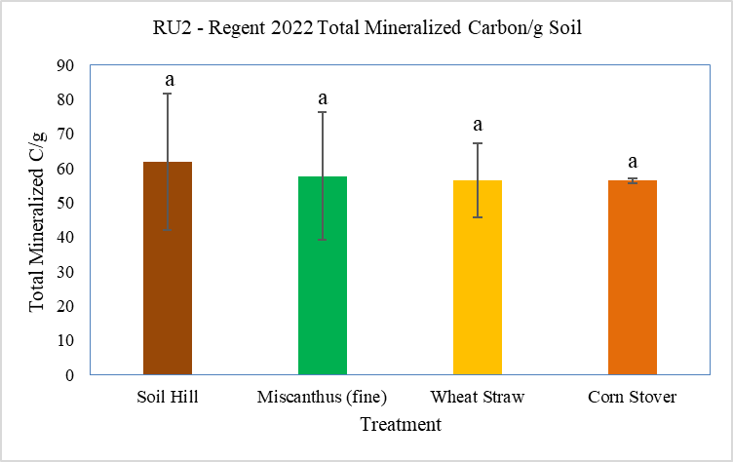
Figure 95.D: Total mineralizable carbon per gram of soil (Regent) for different mulch and soil treatments at RU2 in 2023.

Slide 7
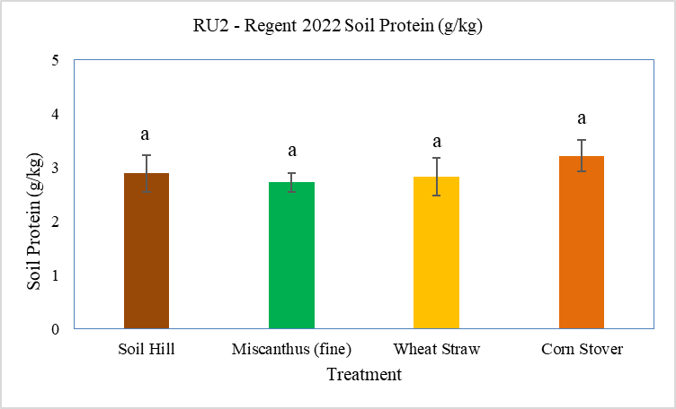
Figure 96.C: Soil protein content (Regent) for different mulch and soil treatments at RU2 in 2022.

Slide 8
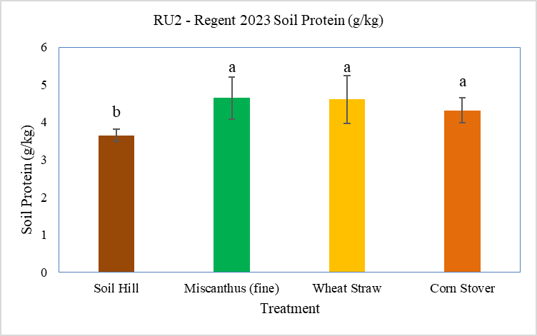
Figure 96.D: Soil protein content (Regent) for different mulch and soil treatments at RU2 in 2023.

Slide 9
Table 46.C: Effect of mulching on soil macro-nutrients in Regent variety grown at RU2 in 2022.
Means followed by different letter in the same column are significantly different from each other based on the Fisher LSD test at the 0.05 level.
Treatment | N release (lb./acre) | P (ppm) | K (ppm) | Ca (ppm) | Mg (ppm) | S (ppm)
Soil Hill | 73.33 | 121.00a | 300.67 | 1768.33 | 275.67 | 12.67
Miscanthus (fine) | 75.67 | 30.00b | 202.00 | 1406.67 | 283.00 | 9.00
Wheat Straw | 73.00 | 34.33b | 254.67 | 1557.00 | 278.00 | 13.33
Corn Stover | 76.33 | 53.67b | 248.67 | 1670.67 | 270.00 | 10.33
Significance (p values) | 0.6177 | 0.0017 | 0.2962 | 0.1624 | 0.8275 | 0.2113

Slide 10
Table 46.D: Effect of mulching on soil macro-nutrients in Regent variety grown at RU2 in 2023.
Means followed by different letter in the same column are significantly different from each other based on the Fisher LSD test at the 0.05 level (⁺ indicates that the means were significantly different at the 0.10 level).
Treatment | N release (lb./acre) | P (ppm) | K (ppm) | Ca (ppm) | Mg (ppm) | S (ppm)
Soil Hill | 71.67b | 102.00a⁺ | 184.67 | 1429.33ab | 258.33 | 13.00a
Miscanthus (fine) | 79.00a | 34.00b | 200.67 | 1213.33b | 265.00 | 9.67b
Wheat Straw | 76.33ab | 45.67b | 261.33 | 1252.00b | 250.33 | 11.67a
Corn Stover | 79.00a | 67.67ab | 252.00 | 1572.00a | 263.00 | 12.33a
Significance (p values) | 0.0251 | 0.057 | 0.3432 | 0.0331 | 0.767 | 0.0056

Slide 11
Table 47.C: Effect of mulching on soil micro-nutrients in Regent variety grown at RU2 in 2022.
Means followed by different letter in the same column are significantly different from each other based on the Fisher LSD test at the 0.05 level.
Treatment | B (ppm) | Fe (ppm) | Mn (ppm) | Cu (ppm) | Zn (ppm) | Al (ppm) | Na (ppm)
Soil Hill | 0.62a | 194.67 | 149.00 | 2.87a | 5.35a | 636.67 | 14.00a
Miscanthus (fine) | 0.41b | 189.33 | 178.33 | 1.71c | 4.22ab | 653.67 | 11.67b
Wheat Straw | 0.41b | 164.00 | 144.33 | 2.03bc | 3.47b | 566.33 | 12.33ab
Corn Stover | 0.56ab | 186.33 | 134.00 | 2.33ab | 4.38ab | 561.33 | 11.33b
Significance (p-values) | 0.0354 | 0.6171 | 0.7148 | 0.0088 | 0.0363 | 0.1313 | 0.0459

Slide 12
Table 47.D: Effect of mulching on soil micro-nutrients in Regent variety grown at RU2 in 2023.
Means followed by different letter in the same column are significantly different from each other based on the Fisher LSD test at the 0.05 level.
Treatment | B (ppm) | Fe (ppm) | Mn (ppm) | Cu (ppm) | Zn (ppm) | Al (ppm) | Na (ppm)
Soil Hill | 0.48 | 160.00 | 138.00 | 2.57b | 4.02 | 624.67 | 14.67
Miscanthus (fine) | 0.44 | 175.00 | 167.67 | 2.47b | 3.95 | 606.67 | 13.33
Wheat Straw | 0.34 | 147.67 | 120.67 | 2.45b | 3.29 | 560.33 | 14.00
Corn Stover | 0.50 | 200.00 | 139.33 | 3.13a | 3.75 | 587.00 | 14.33
Significance (p-values) | 0.2564 | 0.1631 | 0.6003 | 0.0191 | 0.5758 | 0.3985 | 0.7013

