Slide 1
Proposed soil health trial
Prairie Crossing Farm, Libertyville, IL

Slide 2
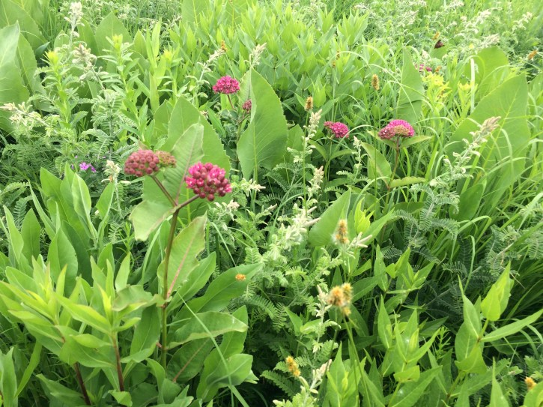
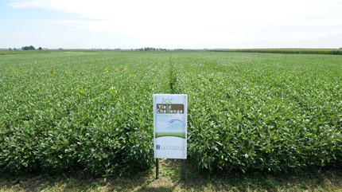
The Challenge of designing sustainable agroecosystems that meet needs of society
Illinois soybean production
Illinois prairie
Focus of this work:
Improving nutrient use efficiency in practical organic systems

Slide 3
Nutrient acquisition In no-till systems
Increased dependence on AMF to acquire nutrients
Dry zone
Organic nutrient sources perched at top of A horizon
Organic nutrient sources mixed in plow-layer
Transpiration stream
In tilled systems, organic nutrient sources are regularly redistributed in soil profile. Mineralized nutrients are swept into the plant in the transpiration stream
In no-till systems, nutrient sources become perched too high in the profile to be reliably swept into the transpiration stream upon mineralization

Slide 4
Legacy of tillage cripples AMF genetically
Manure pad
AMF spore
100 years of tillage
Prairie AMF consortium: Large expenditure of energy into hyphal extension. System selects for this, because sources of nutrients are spatially heterogeneous
After decades of tillage AMF has been selected to put energy into spore production. Why put energy into the hyphal network if it will be tore up in a month?

Slide 5
Prairie Farm Corps High School Programs
Notes:
We have over 10 years experience incorporating high school students into real-world agricultural experiences through our Prairie Farm Corps. We hire a team of 16 students to grow personally and professionally on our farm, through hard work, team building, and cooking and eating lunch daily as a team.
We are currently working to expand our educational programming with high school students to allow students to spend time on the farm during the school year.
Our partnership with Round Lake High School is a manifestation of that, utilizing a “digging into soil health” curriculum that immerses RLHS students into soil health on our farm, soil health at Valent Labs, and taking the information they learn to analyze a real-world challenge and give real feedback to our farm about steps we should take to have healthier soil. The experiment we are about to explain will be the basis for the analysis and questions they will be asking in their classroom.
Students from the Prairie Farm Corps will be actively involved in the implementation of the tomato field trial, as well.

Slide 6
Basic outline of proposed project
Genesis
Desire by the Liberty Prairie Foundation to contribute to soil health, and to integrate improved practices into the Prairie Crossing Farm, as well as interest as to the usage of AMF within sustainable farming systems.
Desire by local high school teachers to improve science education and hands on training in the soil quality area
Interest at VBC in testing AMF product in the soil health context
Design and execution
Work will be conducted at Prairie Crossing Farm, by farm personnel and student interns, with advice and assistance from VBC
Design: AMF(2) RCBD with drip-irrigated organic tomatoes
Duration: Nominally through spring 2021, but might be extended
Funding
Liberty Prairie Foundation is seeking funding through the SARE Farmer and Rancher Grant Program (Deadline December 5!)
Valent BioSciences will contribute part of the soil health testing (32 samples) at a total expenditure of $3,200 in FY2020 and $3,200 in FY2021.

Slide 7
One replication of proposed trial
No-Till, No AMF
No-Till (AMF zone)
Entry | Description
1 | No-till, compost laid on top. No AMF added.
2 | No-till, compost laid on top, AMF added
Organic tomato system
Five foot wide single row beds, 60 feet long
Drip irrigated, covered with landscape fabric
Four replications for a total of 8 plots
Sample each plot soil spring 2020
Re-sample each plot spring 2021

Slide 8
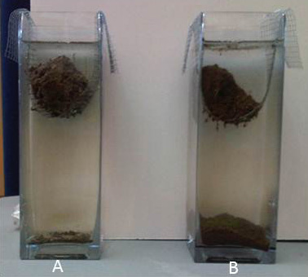
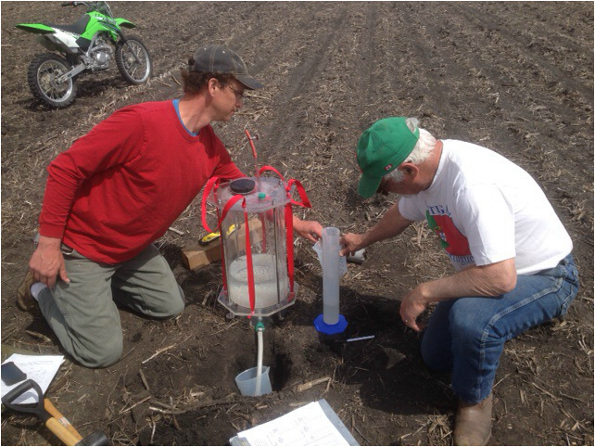
Responses to be measured
Pasture
Tilled
Productivity
Marketable yield and quality
Disease Prevalence & Onset
Brix Testing of tomatoes via refractometer
In-situ soil tests
Penetrometry, Bulk density, Infiltrometery
On-site aggregate stability (SLAKES)
Ex-situ soil tests
Cornell Standard Soil Health Package
Soil pH, Organic Matter, Extractable P, K, micronutrients
Soil Texture
Active Carbon
Wet Aggregate Stability
Soil Respiration
Autoclave-Citrate Extractable (ACE) Protein Test
Predicted Available Water Capacity
PLFA/NLFA from Microbial ID
Biological AMF exploration (?)
Staining for root colonization?
Genomics?
Trap plants?
Nutrient baits in root exclusion cassettes?
Cornell infiltrometer

