Slide 1
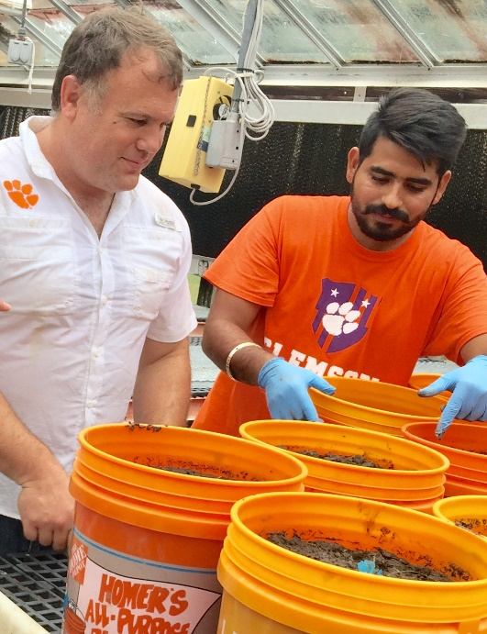
Southern SARE Update Research area- Weed and diseases management in sustainable vegetable production.
PD: Dr. Matthew Cutulle
Graduate Student: Gursewak Singh
Co-Pis: Dr. Brian Ward,
Dr. Pat Wechter
Date: July 2020

Slide 2
Overview
Academic courses progress of graduate student
Research background
Research
ASD carbon sources greenhouse experiment
ASD incorporated cover crops (carbon source) field experiment
Networking opportunities and extension
Future research and carrier goals

Slide 3
Academic courses progress
Course work completed(13 credits)
Weed Management, PES 6330
Beneficial Soil Organisms in Plant Growth, PES 6900
Statistical Methods I, STAT 8010
Design and Analysis of Experiments, STAT 8050
Seminar, PES 8250
Ongoing and planned ahead(9 credits)
Special problems in vegetable weed science, PES 8060
Analytical techniques in plant sciences
Vegetable Crops
Plant diseases diagnosis

Slide 4
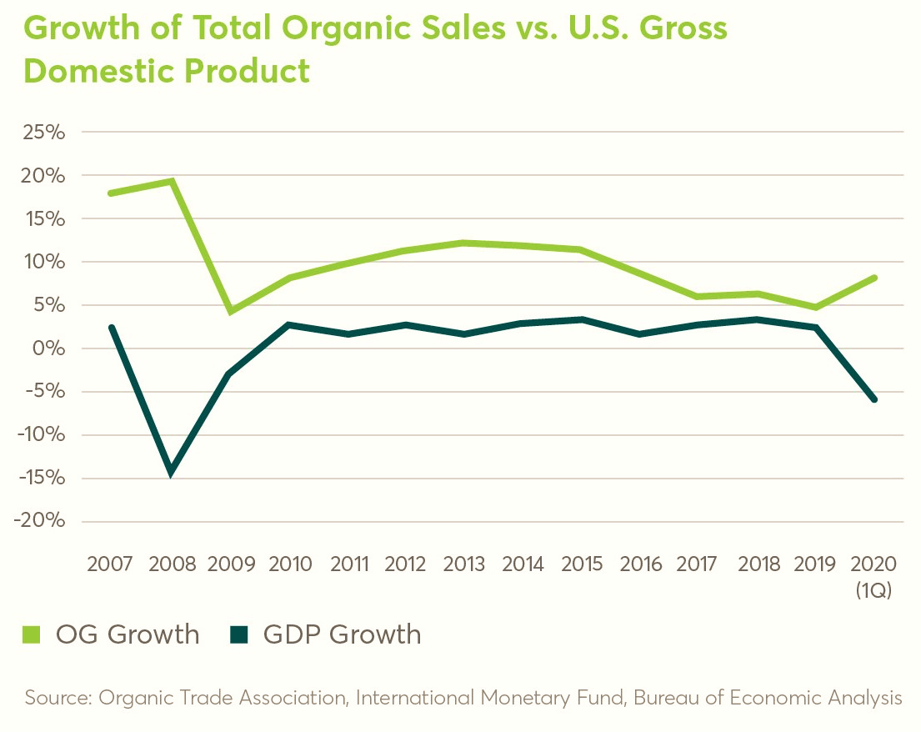
Organic Vegetables- Star of the Organic sector
Organic sales hit $55.1 billion in 2019 as the importance of organic continues to rise.
Organic vegetable and fruits sales increased by 5 percent, hitting $18 billion, as the category continues to be the star of the organic sector, and often the starting point for organic food buying.
Significant number of farmers are switching from conventional to organic production due to large consumer demands and high market cost of produce.
Source- WALMART

Slide 5
Weeds and Pathogens – Challengers of sustainable production
Management of weeds and pathogen in organic vegetable production is one of the biggest problem.
Most of the organic growers rely on hand weeding, which can be labor intensive and costly.
Weed density and biomass were found to be four times higher in the organic systems than in the conventional systems and under standard weed management practices, organic had 40% lower yield than the conventional system (Benaragama et al.,2016).
Great need to develop alternatives for sustainable vegetable management.
Source - Google

Slide 6
Background of Anaerobic Soil Disinfestation (ASD)
Pre-plant biological soil treatment.
First developed in the Japan and Netherlands (Blok et al., 2000).
ASD was initially developed to control soil-borne pathogens.
This technique has also shown the potential to control nutsedge(Butler et al., 2012)., but there is no study conducted in detail optimizing ASD as a multiple weed control technique.

Slide 7
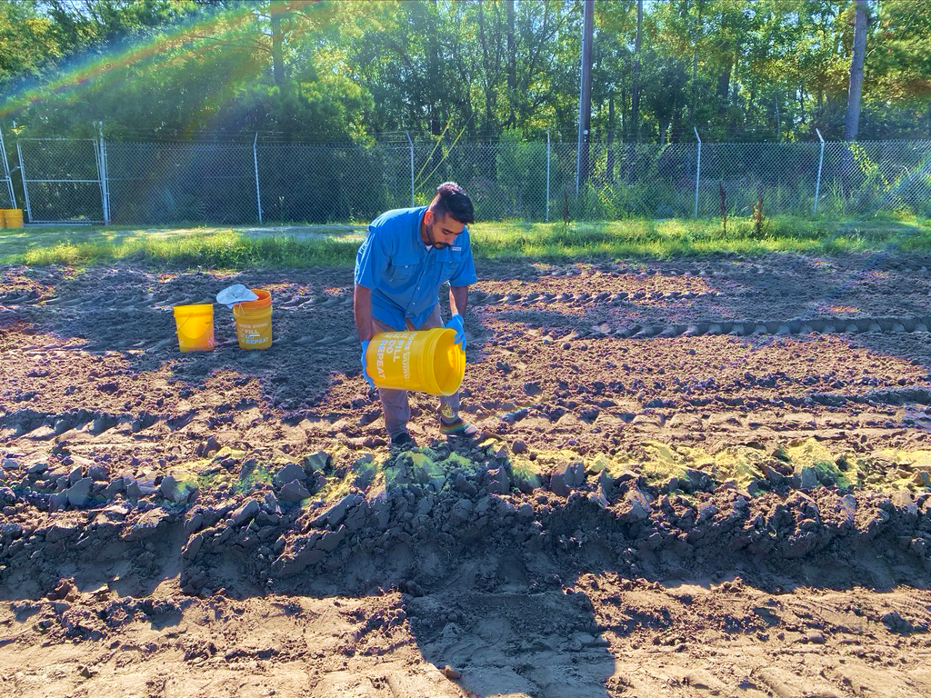
Anaerobic Soil Disinfestation (ASD)
1.Incorporate organic material
(Provide C source to microbes)
2.Irrigate to saturation
(water filled pore spaces)
3.Cover with Plastic mulch
(create anaerobic conditions and stimulate decomposition of organic material)

Slide 8
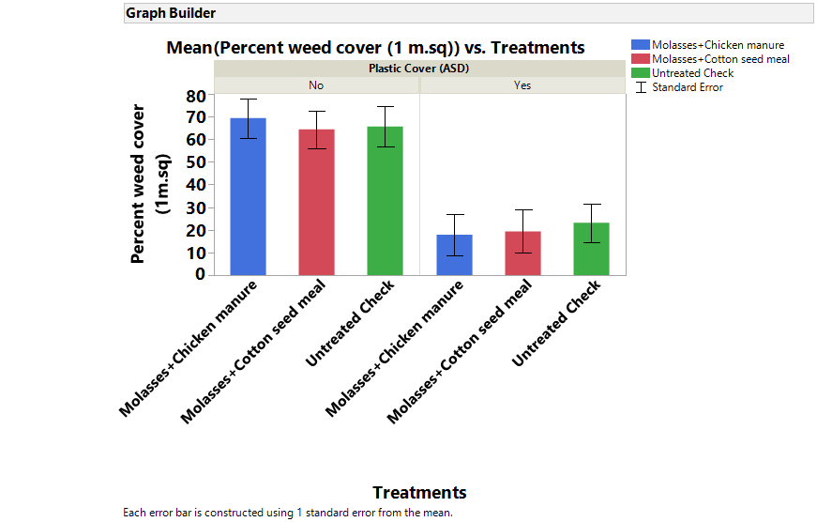
Preliminary experiment (July - September 2019)
Location: USDA ARS Vegetable research, Charleston, South Carolina.
Carbon treatments -
Molasses and Chicken manure
Molasses and cottonseed meal
No Carbon Source
Experiment unit was field plot with 40 ft. x 1.5 ft. dimensions.
Experimental design was randomized complete block split plot (plastic cover and no plastic cover) with 6 replications.

Slide 9
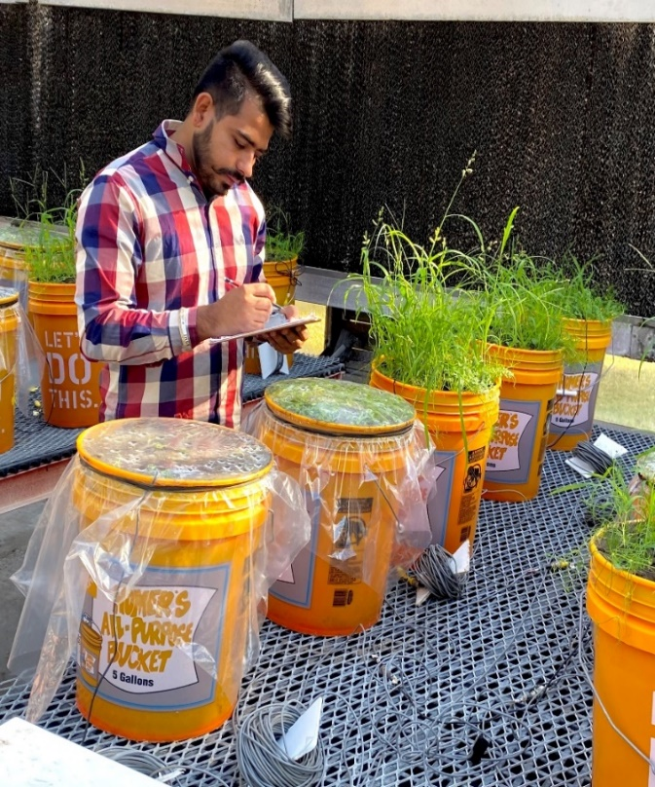
ASD Carbon Sources Study (October- December 2019)
Objective - To determine if the carbon source and allelopathic-organic herbicide treatment combinations affect weed suppression and pathogen (specifically Ralstonia Solanacearium) in an ASD environment in the greenhouse.
Treatments
Mustard meal + molasses
Chicken manure + molasses
Sweet potatoes + molasses
Corn gluten + molasses
No Carbon source
Five treatments mixtures with or without plastic mulch,
in total 10 treatments.
Experimental unit was a 5-gallon bucket.
Experimental design was completely randomized block
design with four replicates of each treatment.
Kept for six weeks in the greenhouse.

Slide 10
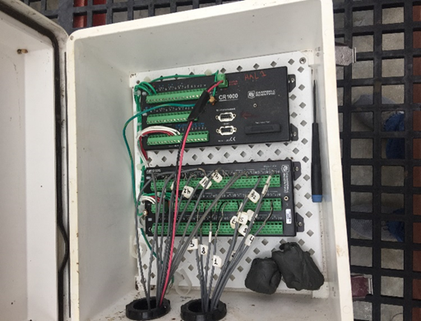
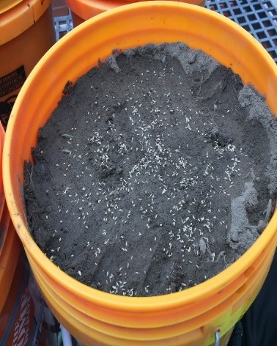
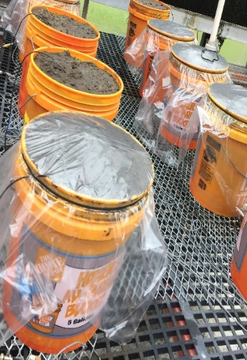
Materials and methods
Palmer amaranth,
Echinochloa crusgalli
and Digitiria sp. Seeded.
Incorporation of
Carbon sources.
Ralstonia solanacerum
Inoculated soil buried at
20- 25 cm depth and
then topped off with soil.
Oxidation reduction
electrodes were installed to evaluate soil
Anaerobic conditions.
Plots were covered
with transparent
plastic sheet.
After 6 weeks plastic cover was removed.
Data collection included total weed population, percent weed cover and each weed counts.
Ralstonia solanacearum inoculated soil mesh bags were sampled in plant pathology laboratory.

Slide 11
Results
All plots with ASD Carbon treatments reported strongly anaerobic.
Overall upt o 90% weed control reported in ASD carbon treated plots.

Slide 12
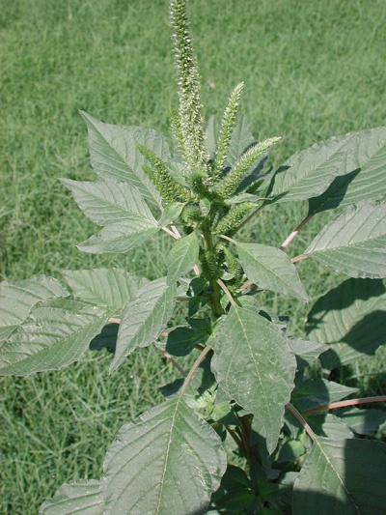
Results (continued)
Amaranth was completely suppressed in all ASD treatments.

Slide 13
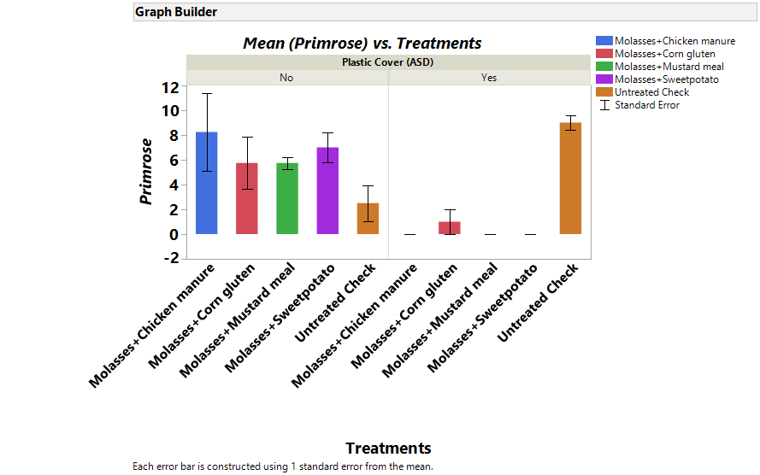
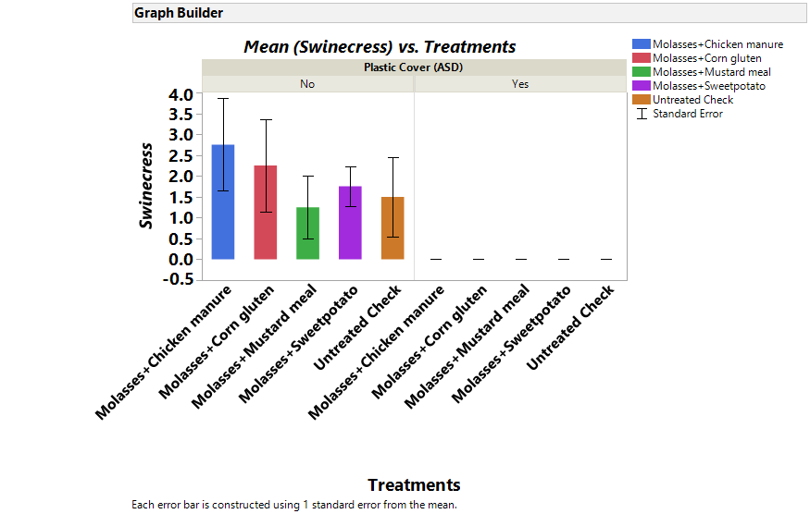
Results (continued)

Slide 14
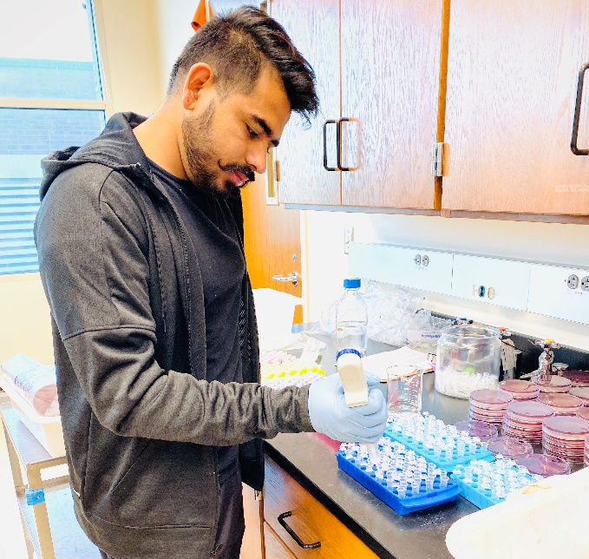
Results (continued)
ASD carbon source treatments reported effective in killing Ralstonia solanacearum.

Slide 15
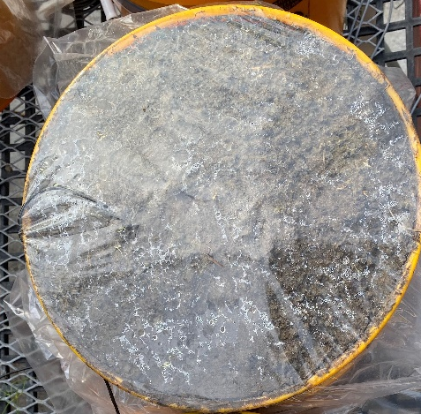
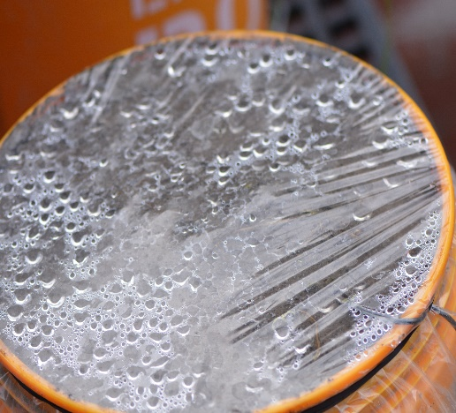
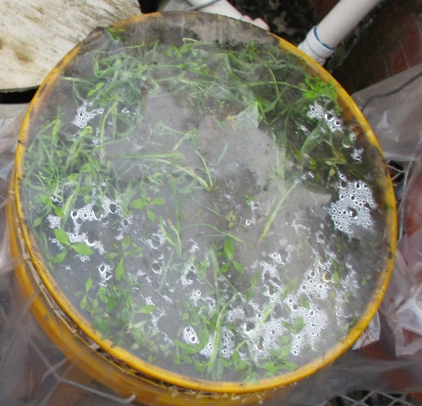
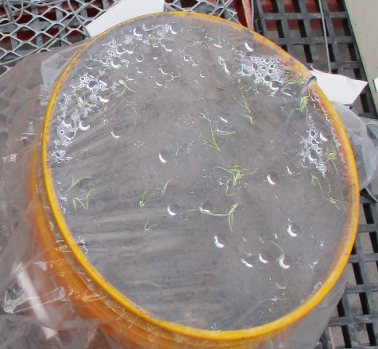
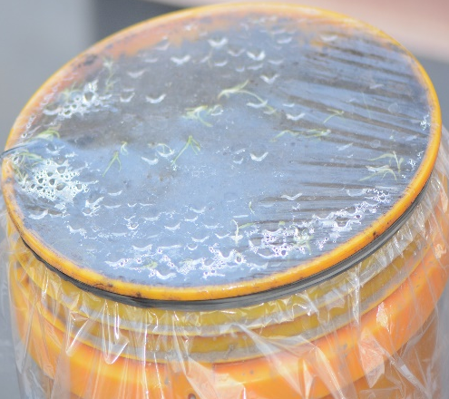
ASD treatments showing weed suppression.
Molasses + Chicken manure
Molasses + Mustard meal
Untreated Check
Molasses + Corn gluten meal
Molasses + Sweet Potatoes

Slide 16
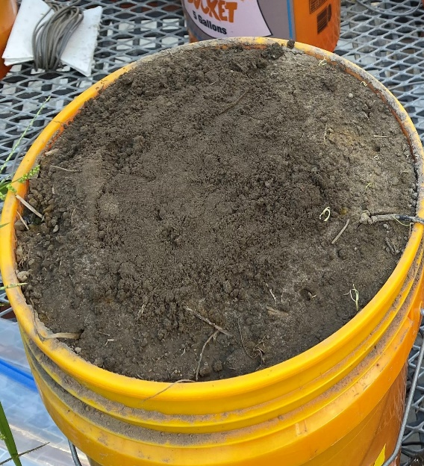
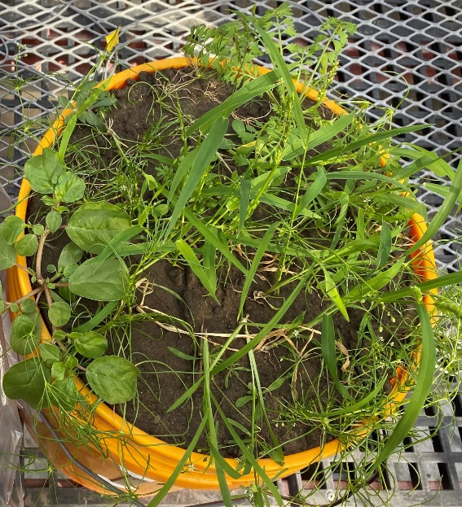
Best two treatments for weed control after removing Plastic Vs Untreated Check
Molasses + Mustard meal
Molasses + Chicken manure
Untreated Check

Slide 17
Conclusions
All ASD incorporated carbon sources treatments generated good anaerobic conditions in the soil.
All treatments showed significant contribution in suppression of weeds in ASD environment.
We got almost complete control in Broadleaf weeds.
Reported effective in killing bacterial pathogen.
We are currently evaluating mustard meal and molasses in the

Slide 18
ASD Cover Crops incorporated field study, (ongoing)
Rep 1
Rep 2
Rep 3
Rep 4
Objective-To determine if the incorporation of cover crops affect
weed suppression and disease incidence in an ASD environment
in organic tomato production
Treatments
Sunhemp
Sorghum sudangrass
Mix (Sunhemp and Sorghum sudangrass)
No cover crop
4 treatments with or without plastic mulch, in total 8 treatments.
Experiment is ongoing on CREC organic farming unit and experimental unit is 20 ft long and 4 feet wide plot.
Experimental design is completely randomized block design with four replicates of each treatment.

Slide 19
Material and methods
Cover crops sowing 28 April
cover crop will be terminated after 45-50 days depending on weather conditions and incorporated in soil
ASD will be practiced for 4 weeks by covering assigned plots with plastic mulch and ORP probes monitor the anaerobic conditions in the soil .
Tomato plants will be transplanted after 4 weeks.
After 4 weeks ASD will be ended by making holes in the plastic covered treatments and tomato plants will be transplanted.
Data collection included tomato yield, weed control ratings, diseases ratings.

Slide 20
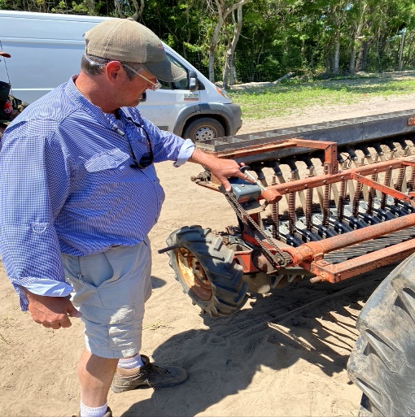
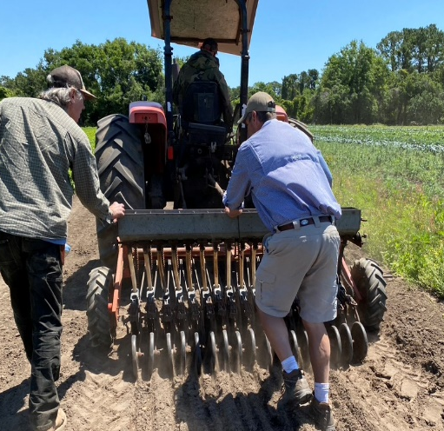
Extension work (Growers farm visits/ On farm trials)
Visited Titan farms, largest peach growers on east coast, also grows pepper and broccoli in 2000 acres.
Hosting Cover crop trials under the guidance of Dr. Brian Ward at two SC Co-operative organic growers, Harleston Towles and Sidi Limehouse, Rosebank farms (a successful vegetable grower, grows more than 50 horticultural crops annually).
Hosting ASD carbon sources trials at two grower farms, Adair Mccoy and Pete Ambrose.
Dr. ward guiding cover crop seeding
and farmers field design.

Slide 21
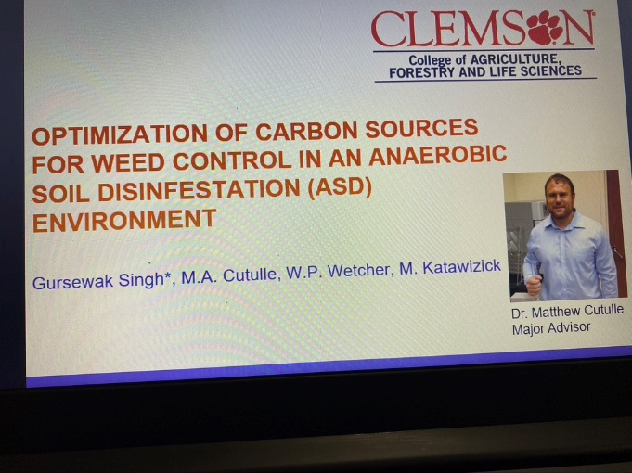
Networking opportunities (meetings/conferences)
Attended joint North and South Carolina vegetable growers meeting 2019 at Wilmington, NC.
Attended annual Soil health Conference 2019, Clemson University.
Presented the ASD studies results orally at Southern Weed Science Society meeting, January 2020 at Biloxi, Mississippi.
Registered to present orally at upcoming national ASHS, August 2020, at Orlando, Florida.
SWSS meeting Jan 2020

Slide 22
Future research and carrier goals
To increase productivity of farmers by developing integrated farming approaches which are economically profitable, while preserving land, environmental quality and maintaining desired level of biological diversity.
To extend my sincere efforts using my energy, enthusiasm and expertise in the field of agricultural research in adding value to the farmers directly.
Willing to become a successful Agricultural Scientist and make a detailed research about the new and innovative methods of farming, which would assist in generating good revenue.

Slide 23
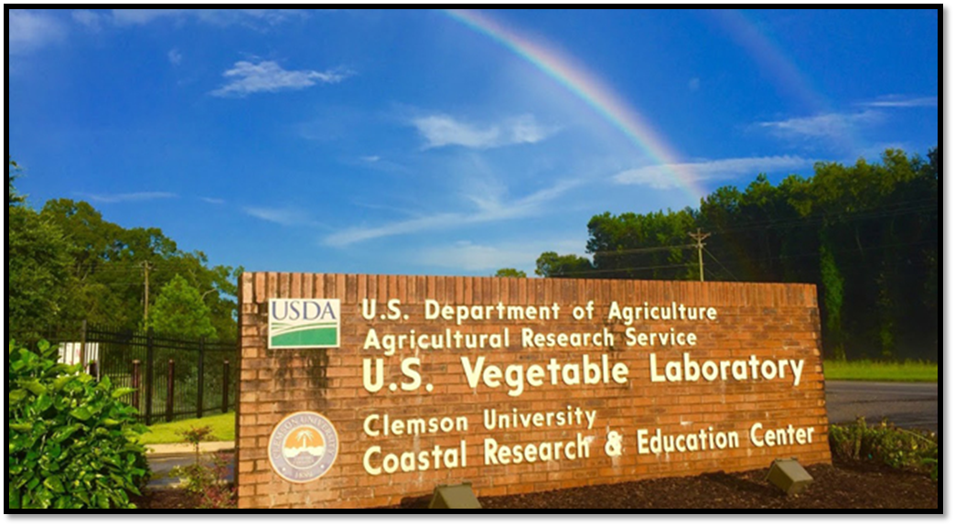
Acknowledgments
Southern SARE
USDA faculty - (Dr. W.P. Wetcher, M. Katawizick)
CREC faculty - (Tyler Campbell, Marcellus Washington, Ben, Giovanni Caputo, Tayler snipes, Glen)
Photo Credit: USDA ARS

Slide 24
Questions and suggestions!
Thank you

