Slide 1
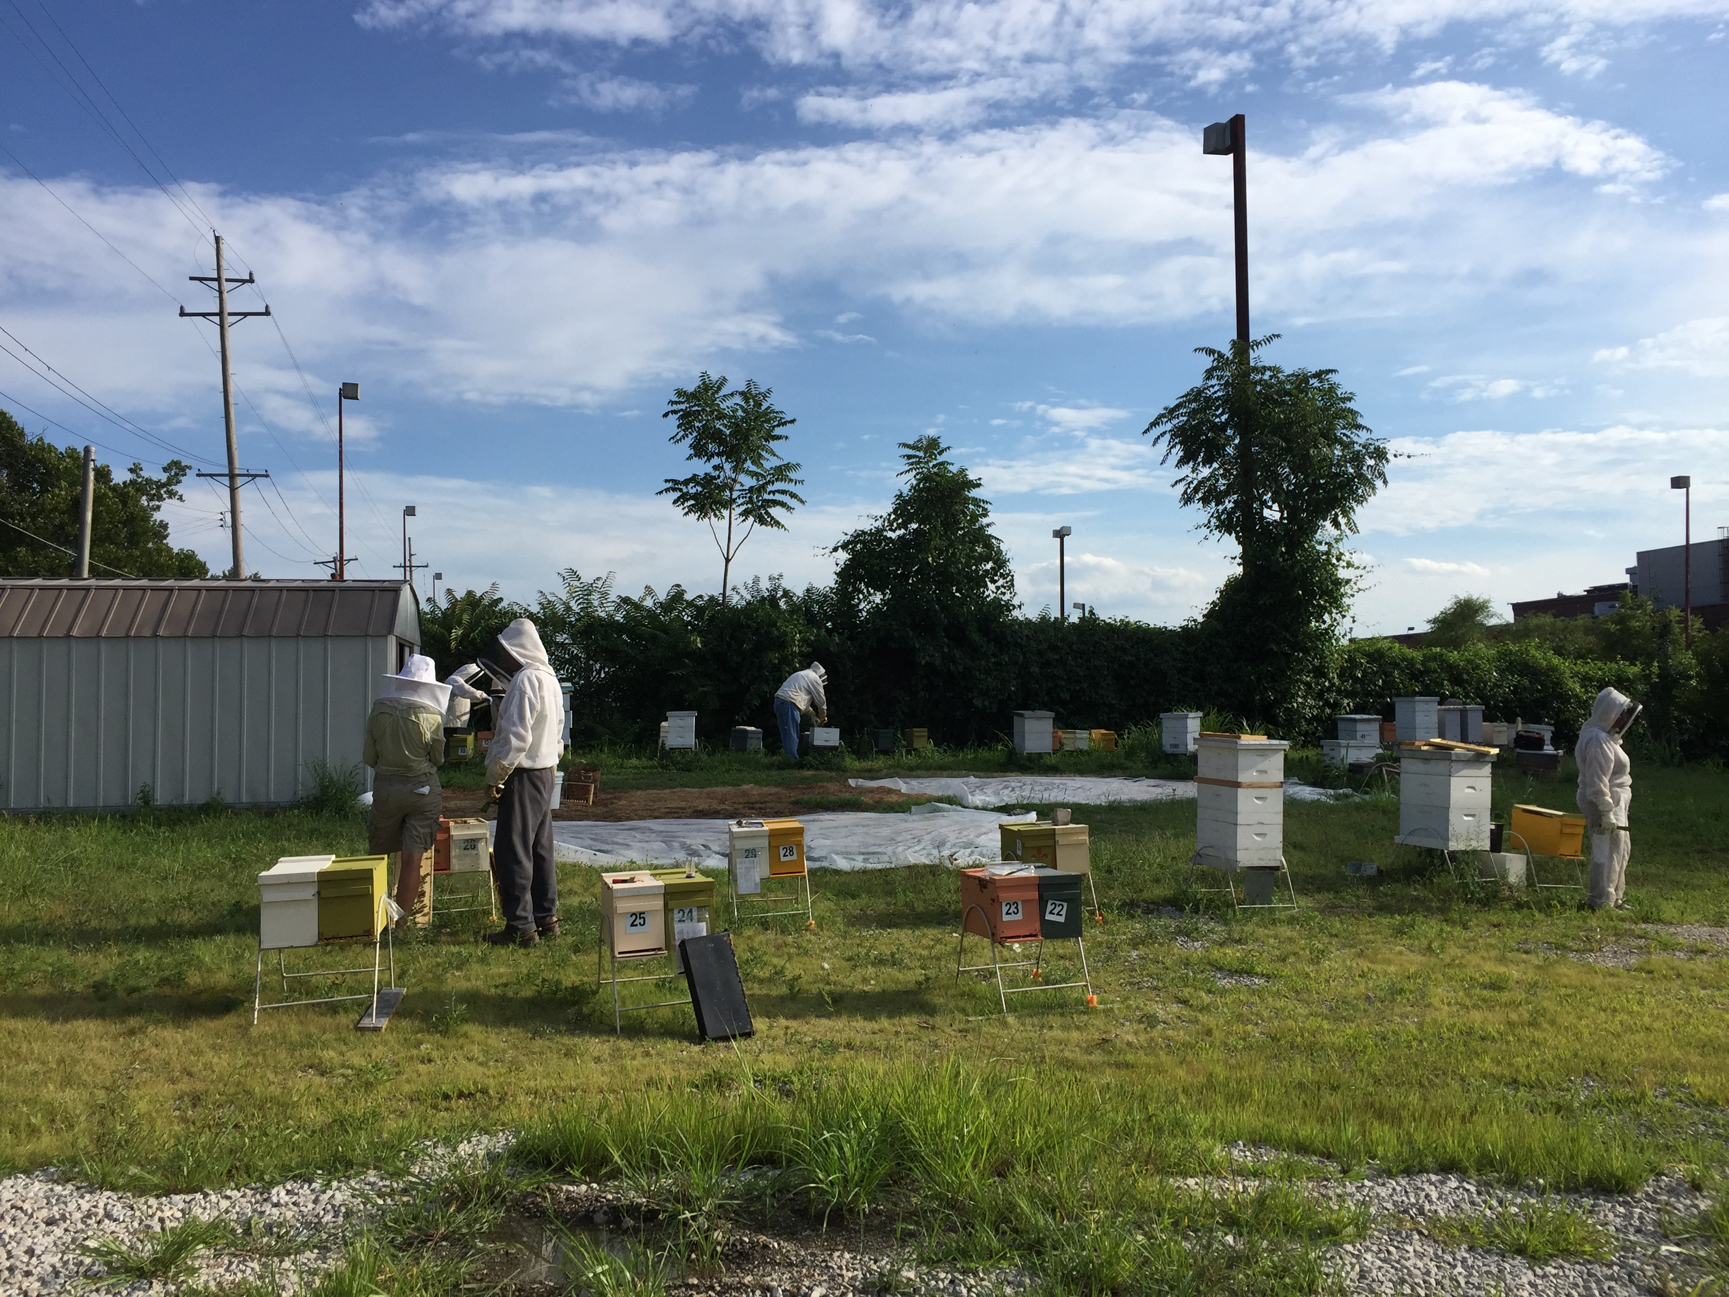
SSA Apiary

Slide 2
SAINT LOUIS BEEKEEPERS
SUSTAINABLE STOCK APIARY (SSA)
Our Mission –
Focusing on beekeeping practices, our goal is to facilitate a broad spectrum of education and promote healthy natural systems where people, honey bees and other pollinators can adapt and thrive.
Why Raise local Queens
Queen quality / drone fertility in commercial breeding operations is declining, often disappointing or quickly superseded
Local, survivor stocks are not currently available to serve the area’s growing beekeeping community
Late season local queens are good candidates for requeening “spent” or failing queens
Queen availability for off-season emergency replacement is challenging to find, often expensive to ship and stressful on the queens

Slide 3
Spring 2017
Classic Carpentry 1259 Stephen Jones Avenue. Thank You Jim and Tammy McGarry
Study by St. Louis University shows that there is evidence of large population of feral bees in North St. Louis.
2017 the effort was to bring locally raised nucs, that came from hives that showed desirable traits and survivors of at least 1 winter.

Slide 4
Guidelines
A group of beekeepers met to discuss what guidelines we would establish for hive management.
The goal was to raise hives that would be sustainable without intervention from beekeepers.
What does this mean? No chemical treatment of bees for pests. The only support we agreed to was to provide was sugar water and small hive beetle traps. The bees would need to source their own pollen.

Slide 5
September 2017 Recap of progress.
The efforts of the group resulted in fourteen colonies from splits, nucs or swarms brought to the apiary in 2017. All with new queens raised, successfully open-air mated with local (neighborhood) drones. Hoping to tap into the feral genes.
At the end of the season, these colonies were assigned to members to take from the apiary for the purpose of overwintering “at home” and returned to the SSA next season. Log books were distributed and volunteers were asked to take their assigned colonies by the end of September.

Slide 6
October 2017
Sometime after that meeting someone suggested that we should apply for a Sustainable Agricultural Research & Education grant (SARE).
SARE Vision and Mission
SARE's vision is an enduring American agriculture of the highest quality. This agriculture is profitable, protects the nation's land and water and is a force for a rewarding way of life for farmers and ranchers whose quality products and operations sustain their communities and society.
SARE's mission is to advance—to the whole of American agriculture—innovations that improve profitability, stewardship and quality of life by investing in groundbreaking research and education.

Slide 7
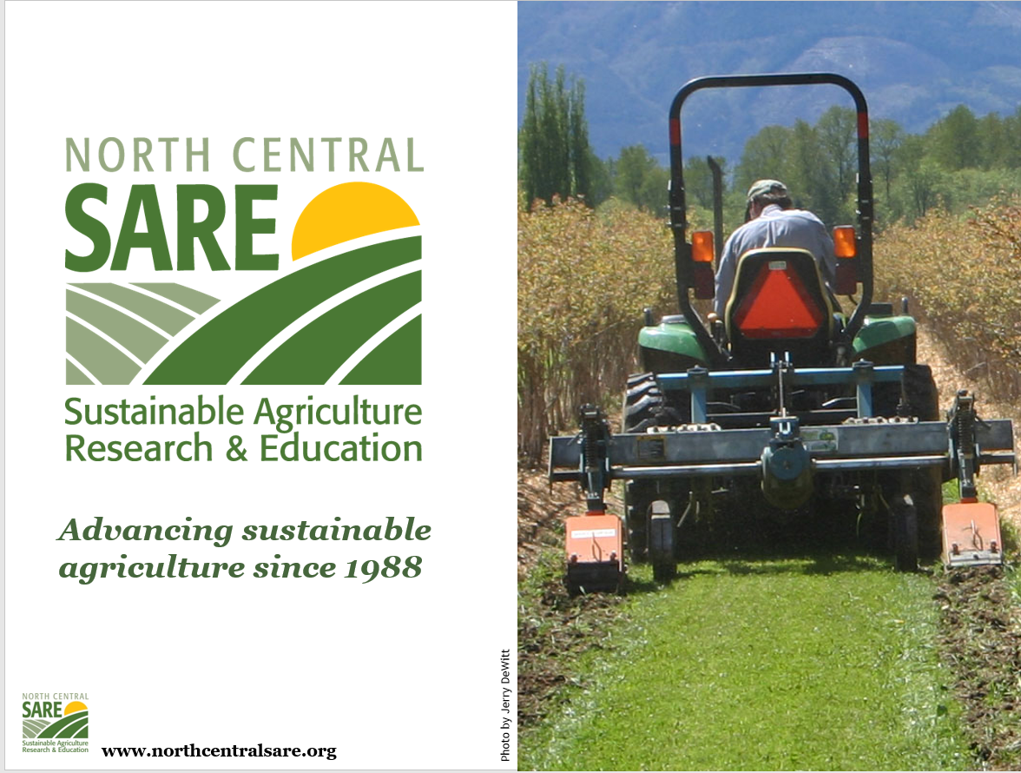

Slide 8
Sustainable Stock Apiary
Project Abstract This proposal plans to address the problem of the lack of available, local, survivor honey bee queens for beekeepers. We plan to address this problem by raising queen stock from local survivor colonies for sale to beekeepers and also to teach sustainable honeybee queen rearing practices to beekeepers. In 2017 we shared hive resources from our own apiaries at the newly formed SSA Queen Rearing Apiary and began practicing sustainable queen rearing under the direction of Jane Sueme, Certified Master Beekeeper. We tested our hives for diseases and used the pathogen-free colonies as starter stock for our queen rearing project. We had success in raising a few queens, however we need to explore methods of queen rearing that produce a higher quantity of quality queen bees and methods of “banking” those queens for availability to beekeepers throughout the beekeeping season. Providing queens from stock that successfully overwinters in our zone to local beekeepers greatly increases their springtime hive strength and honey production, while decreasing cost of stock replacement and apiary operation. The location for the apiary was selected because very few managed bee hives are in the area and it allows for easy access for field days and teaching workshops.

Slide 9
Awarded a 2 year grant by SSA
This lead to need to form a corporation, officers, bank account and insurance.
We now had funds to purchase supplies needed for project. The tasks to acquire and build those supplies begin.

Slide 10
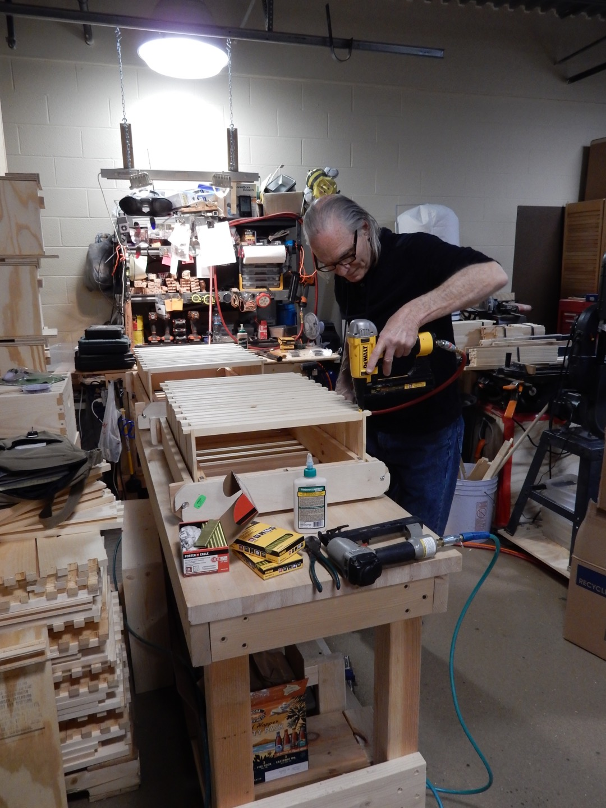
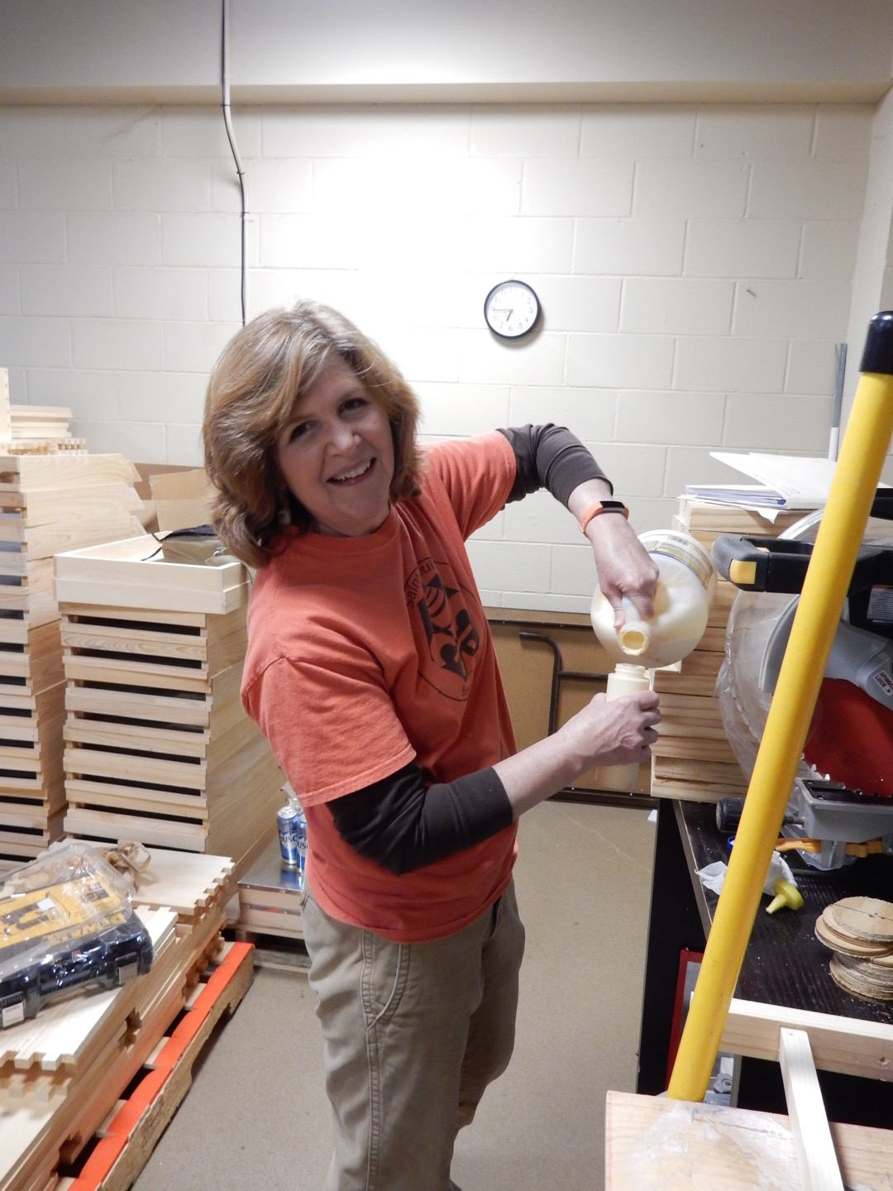
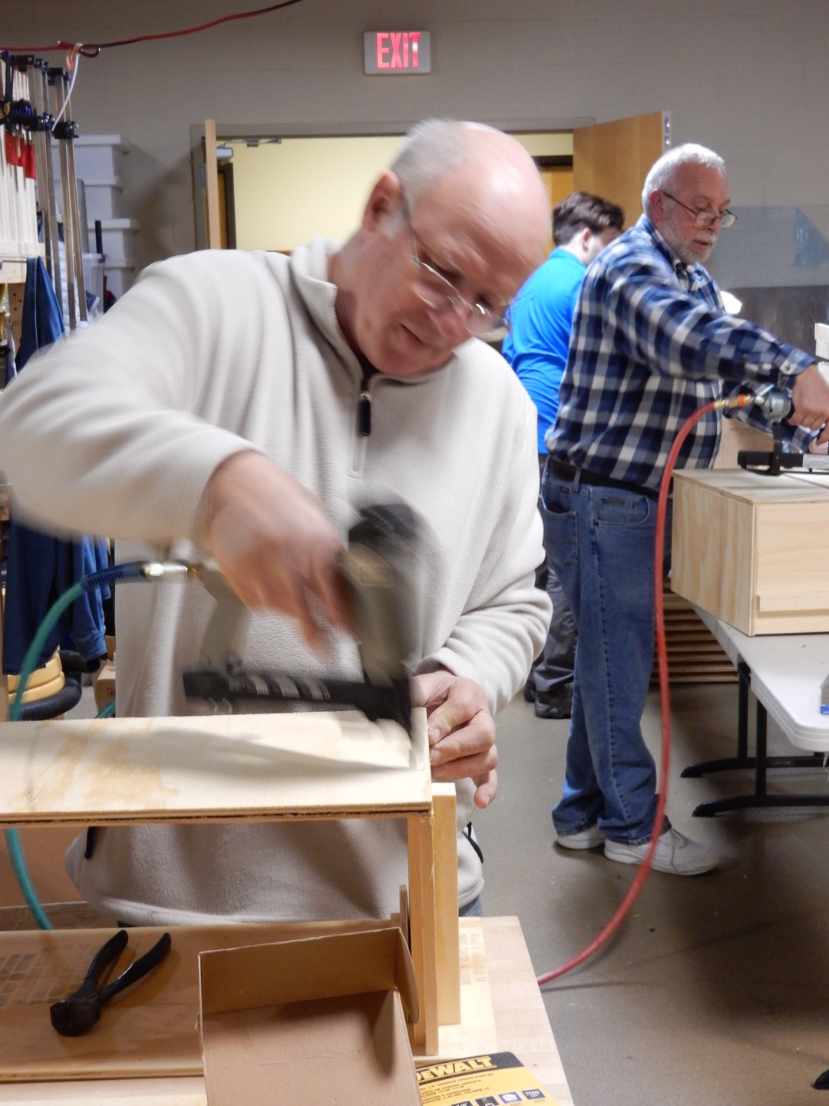
March 2018
Building mating boxes and frames

Slide 11
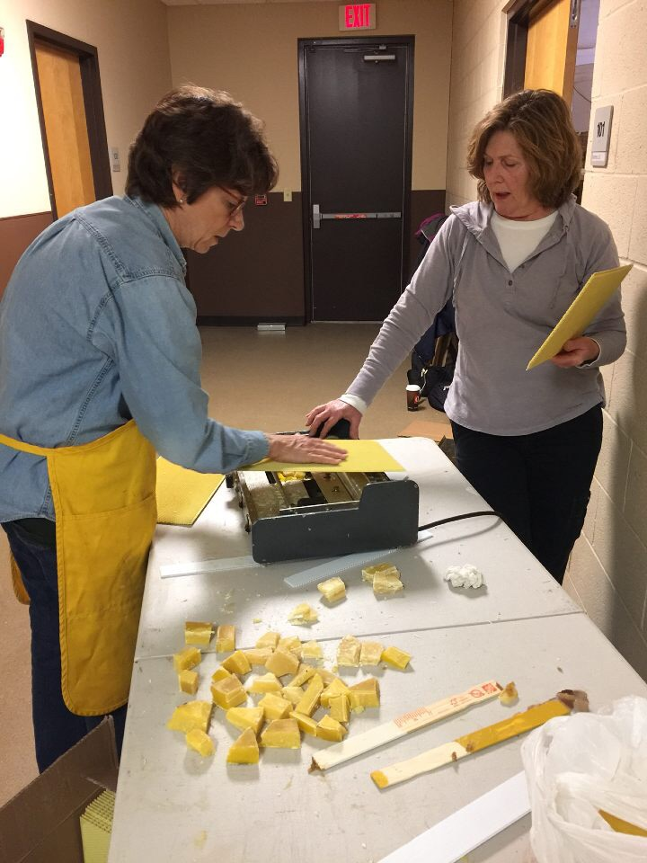
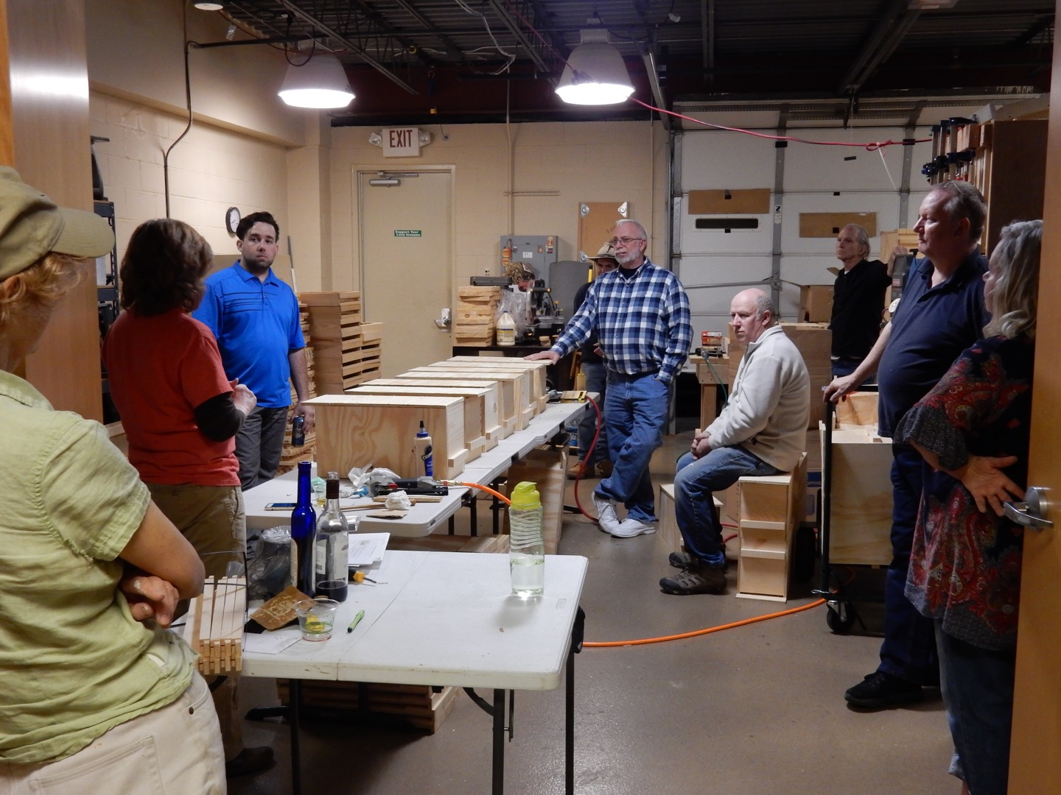
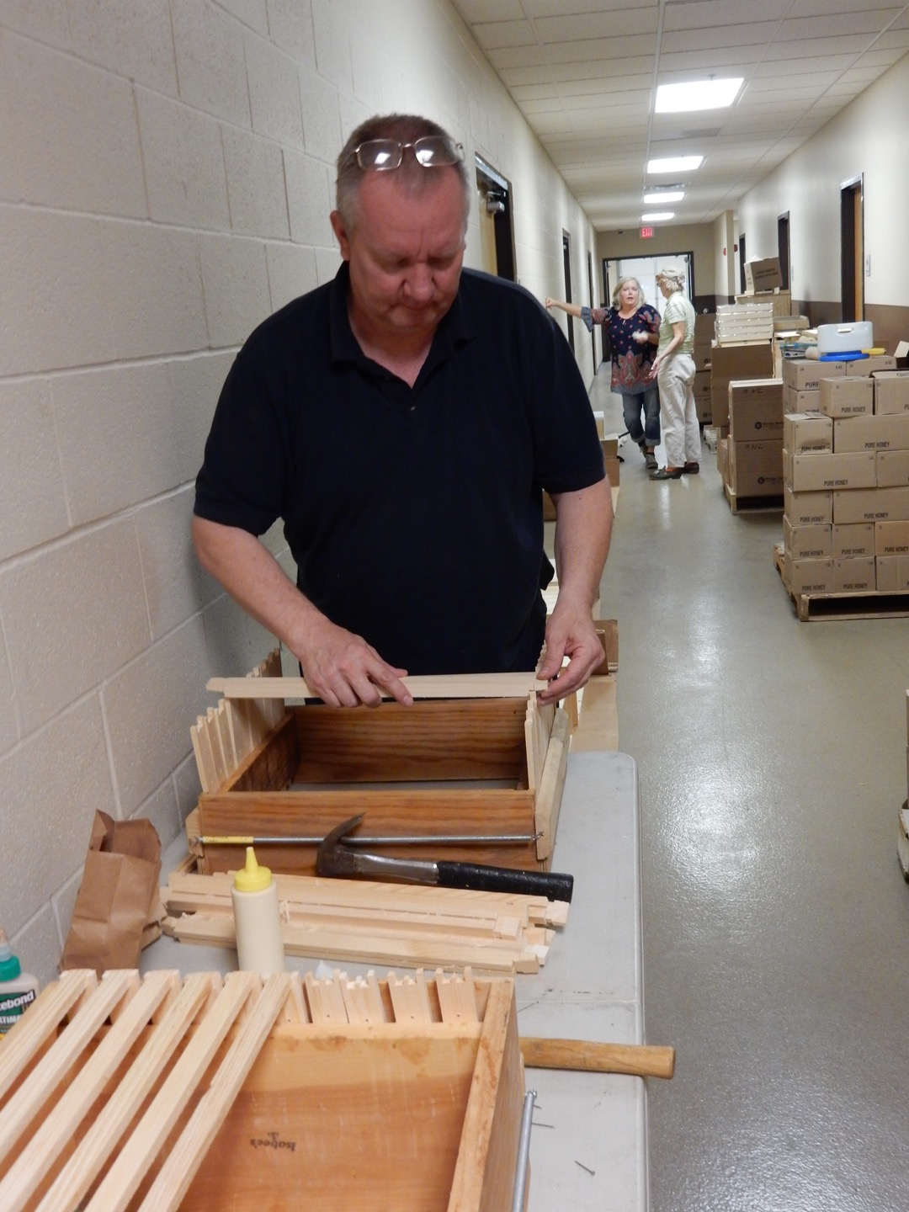
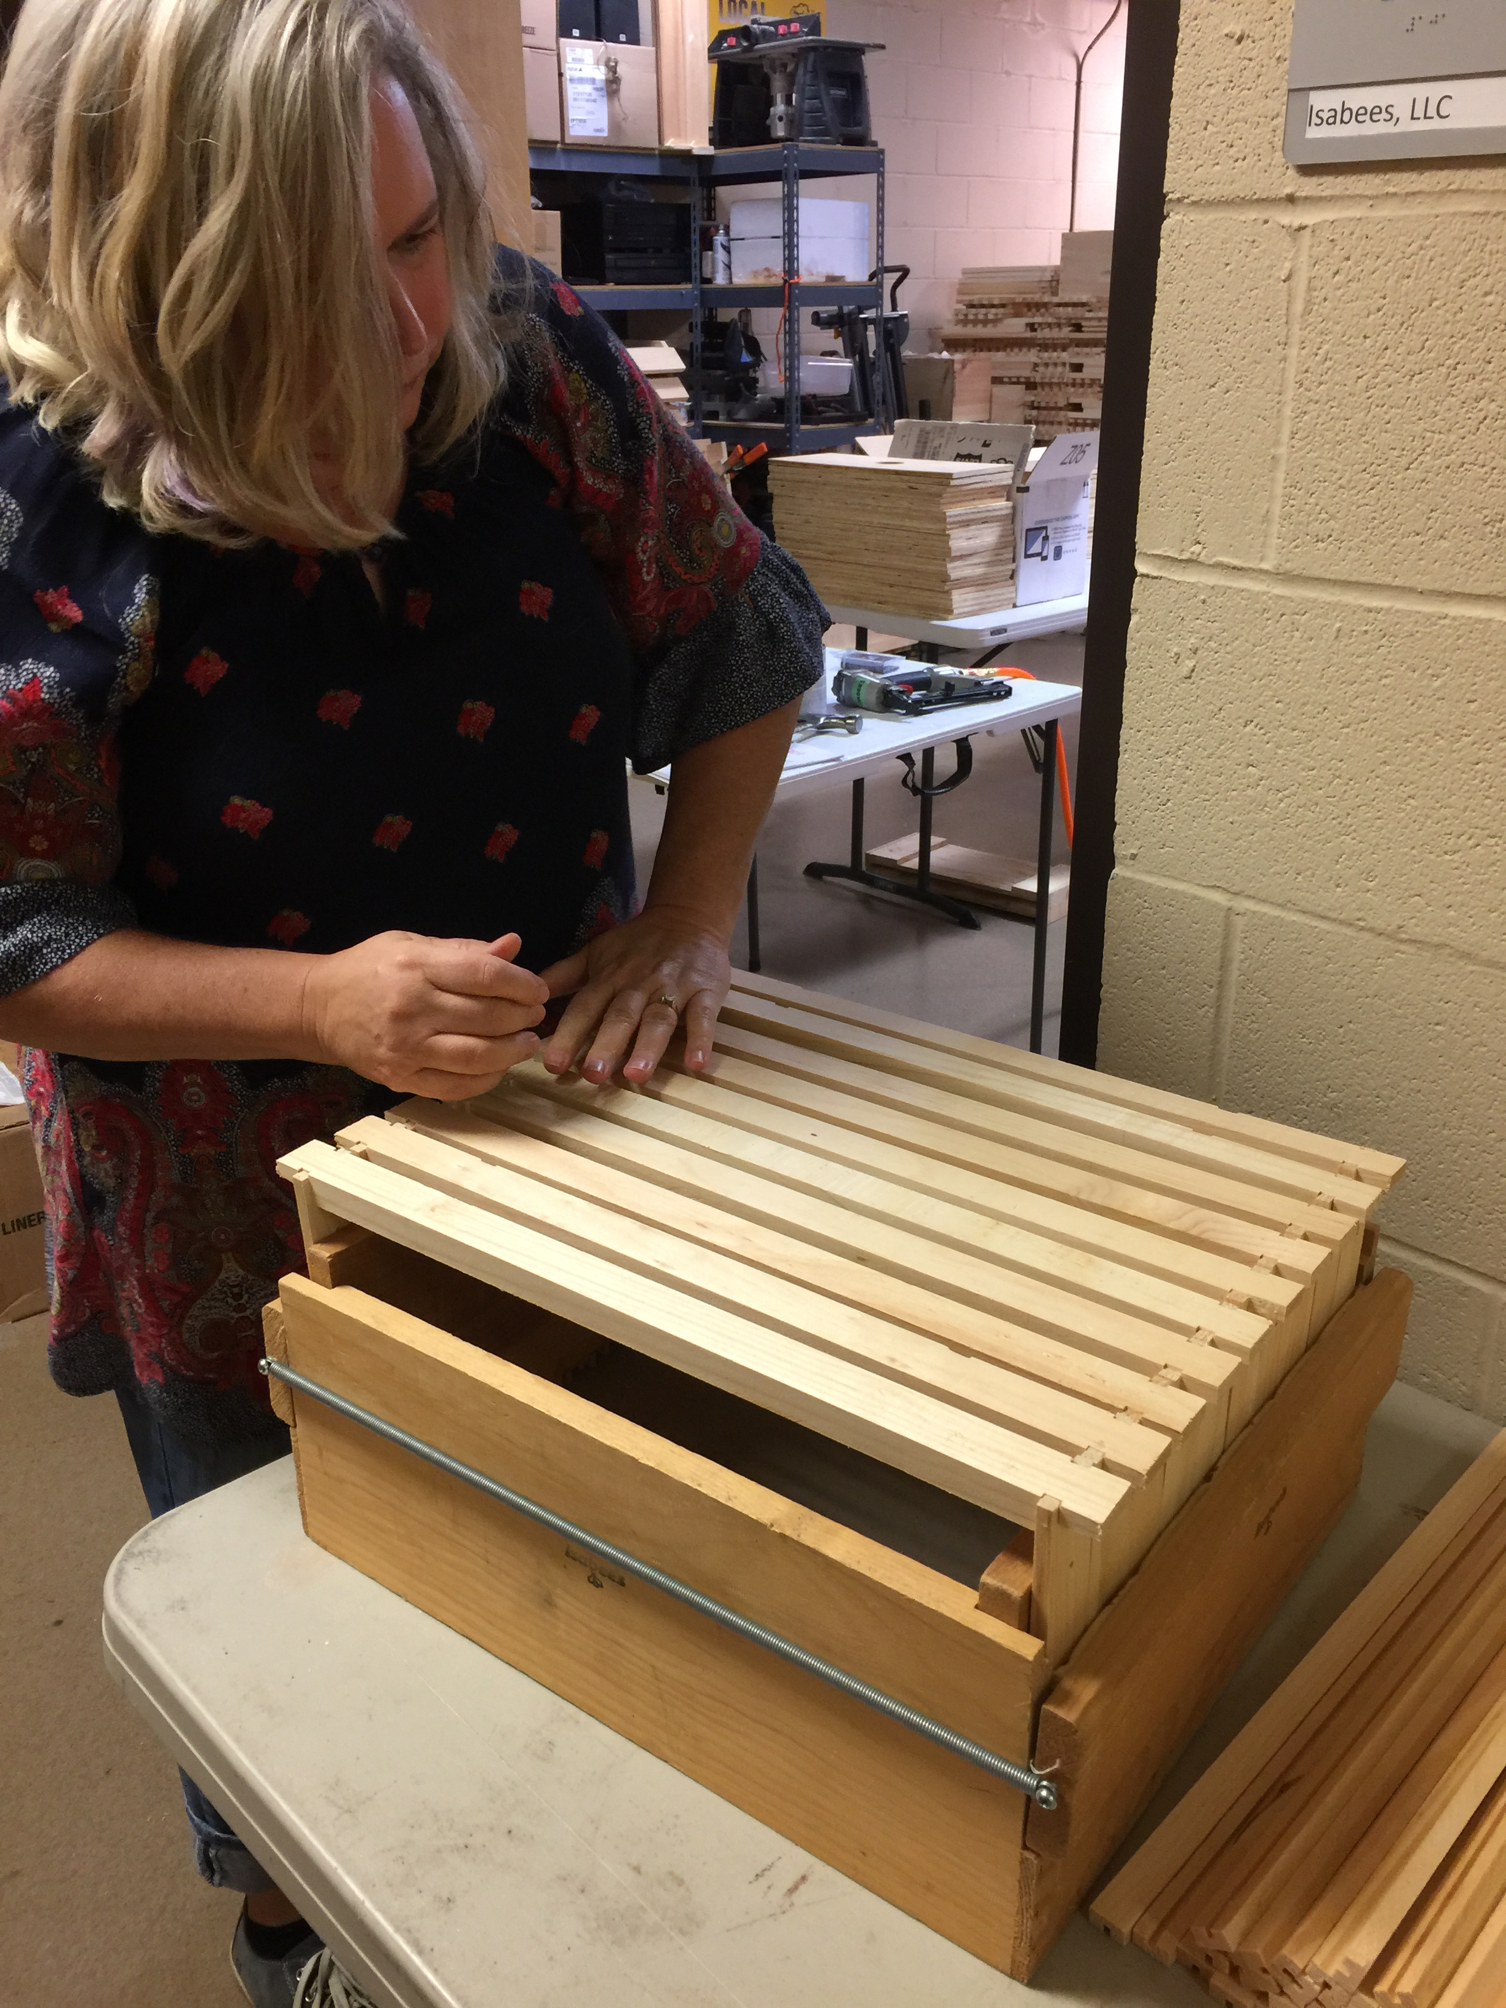

Slide 12
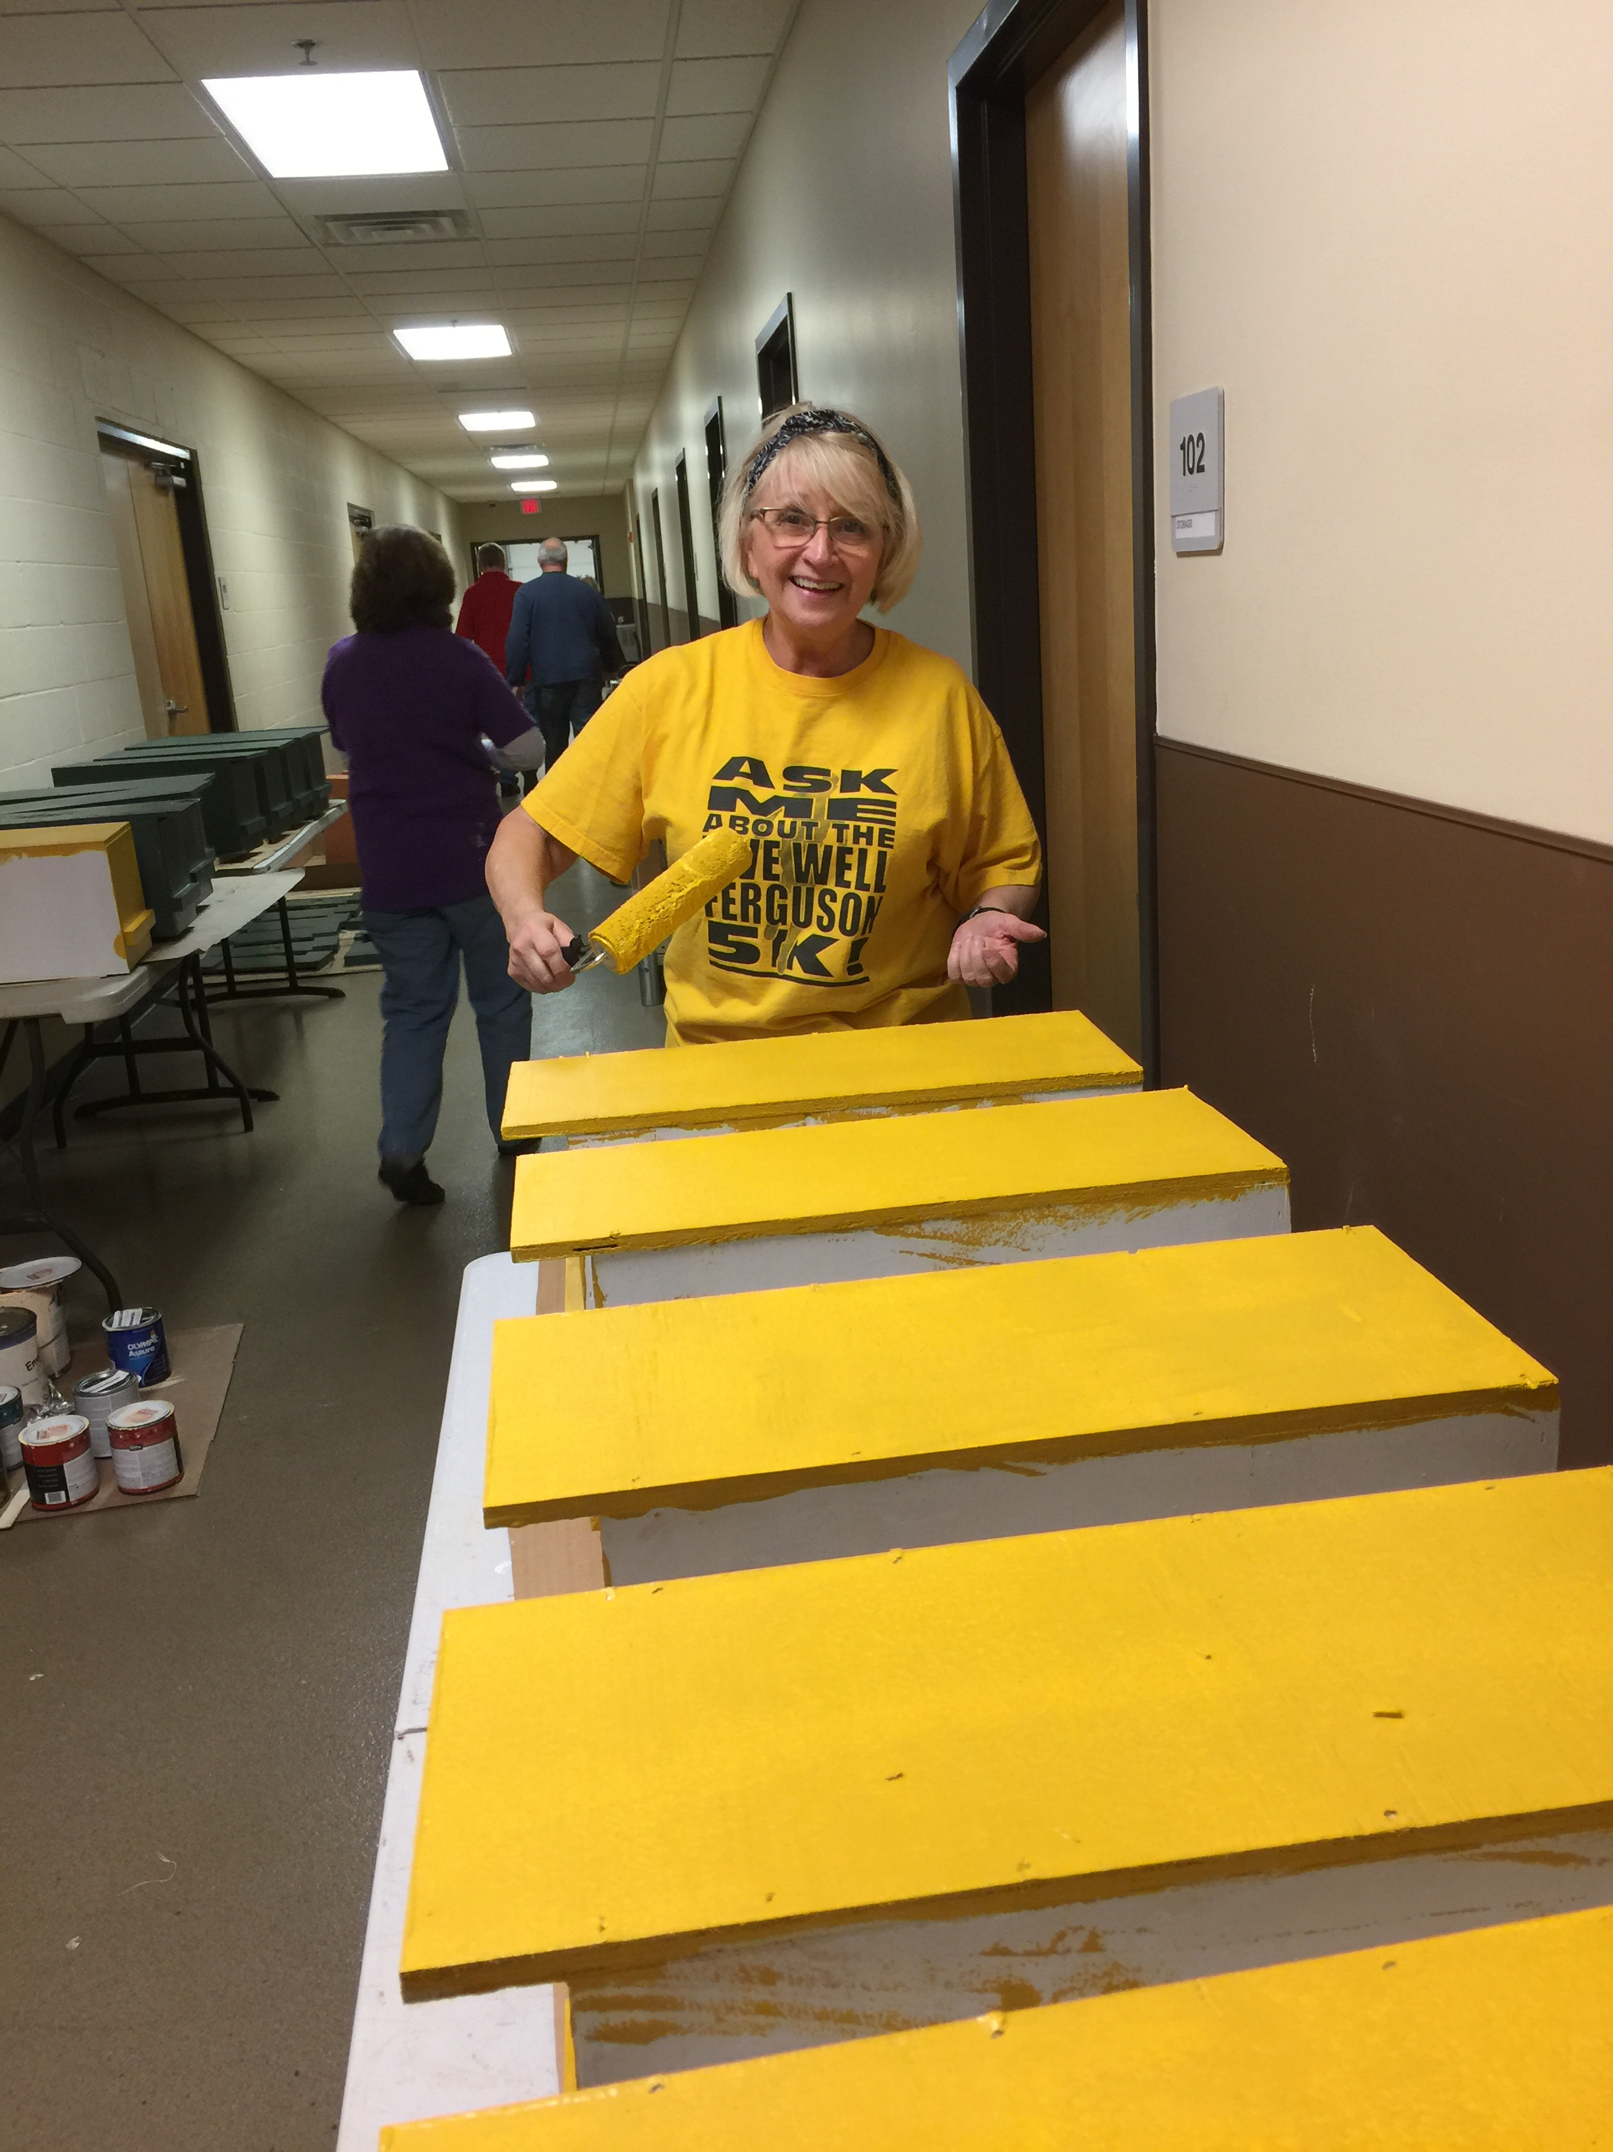
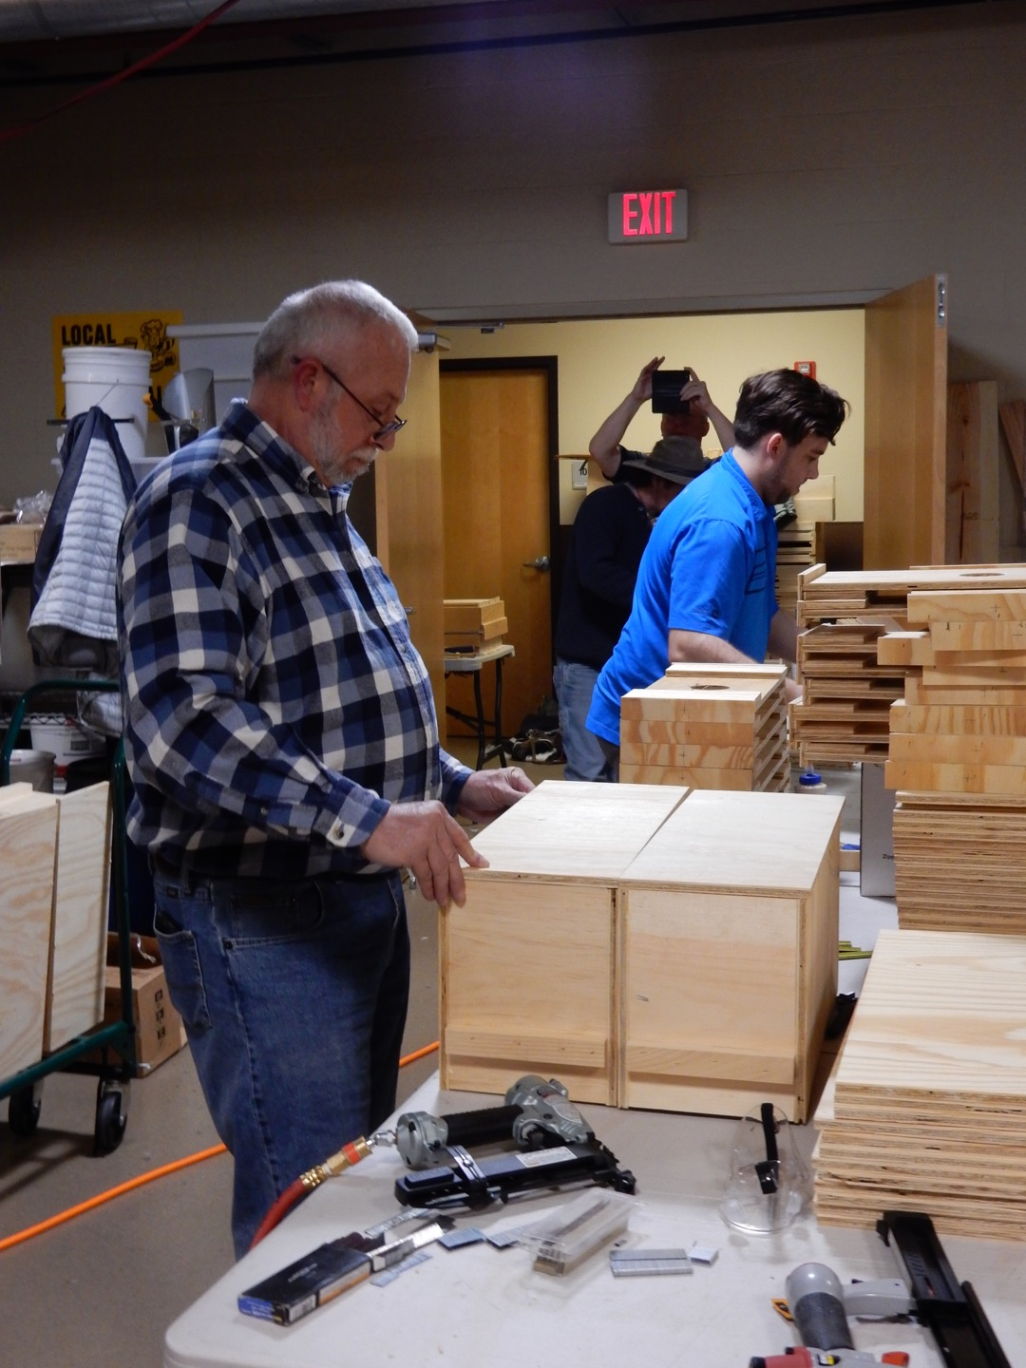
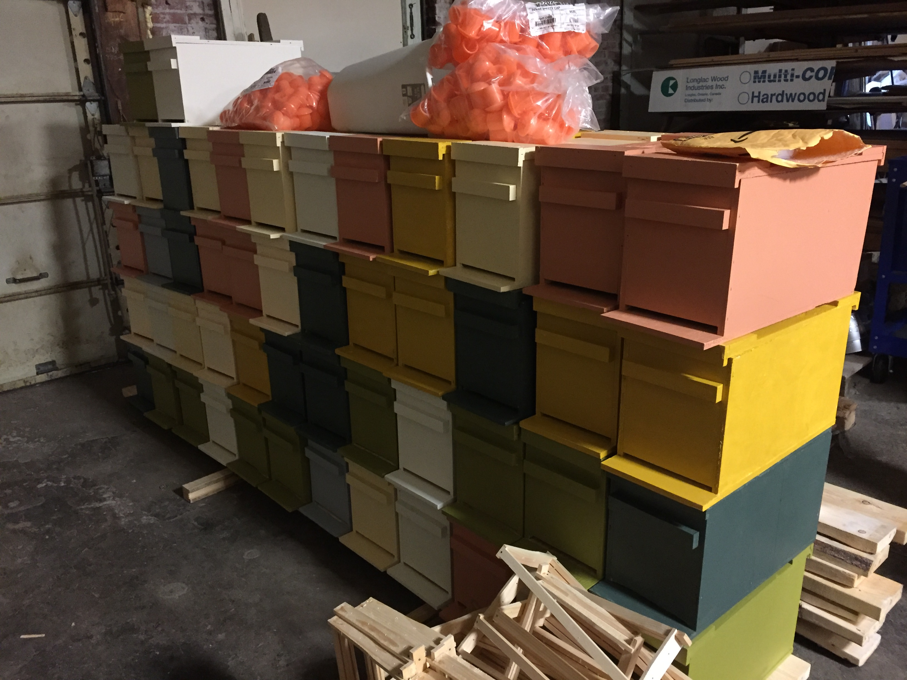

Slide 13
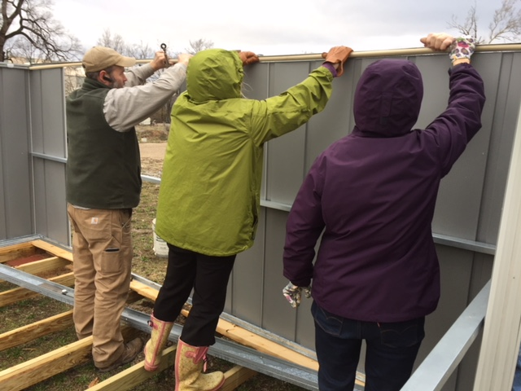
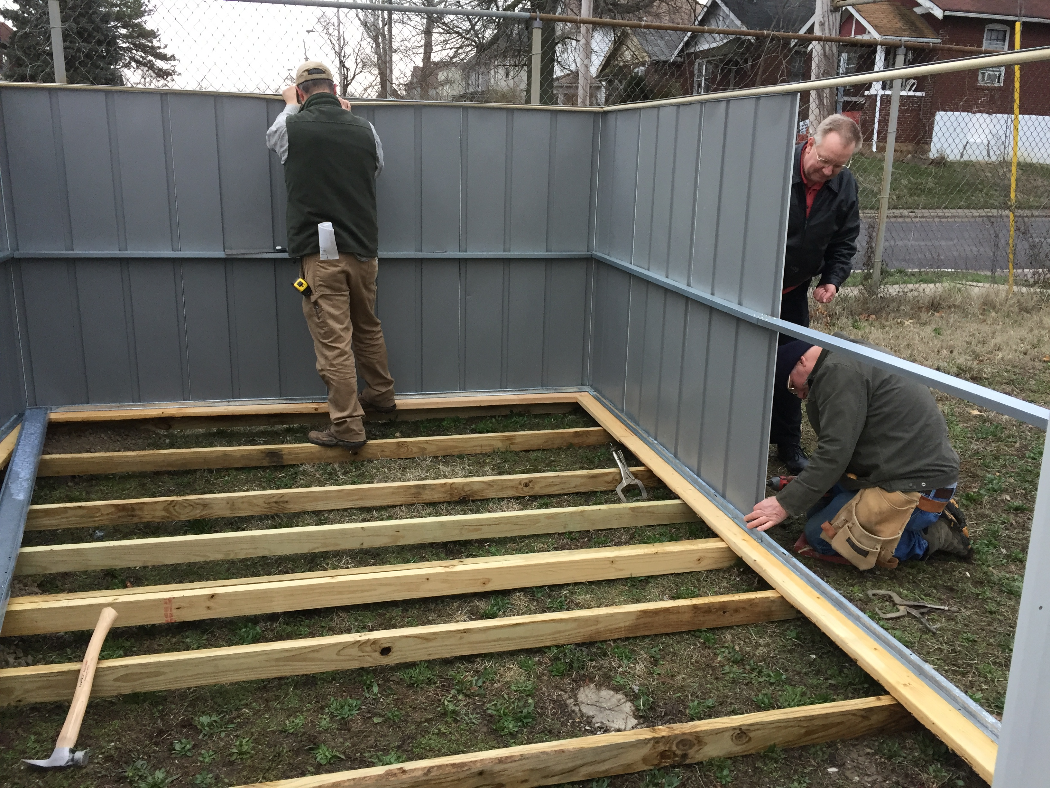
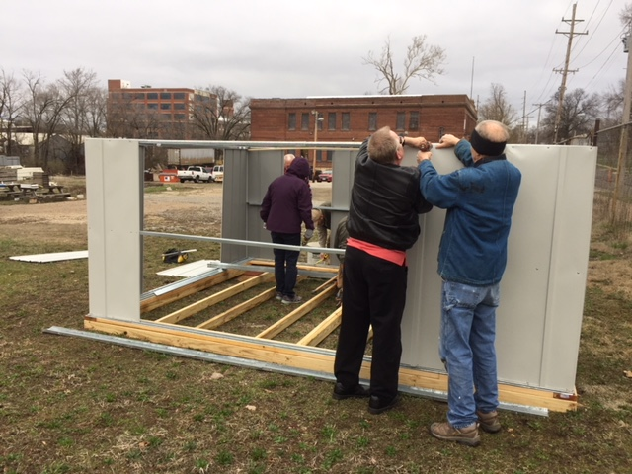
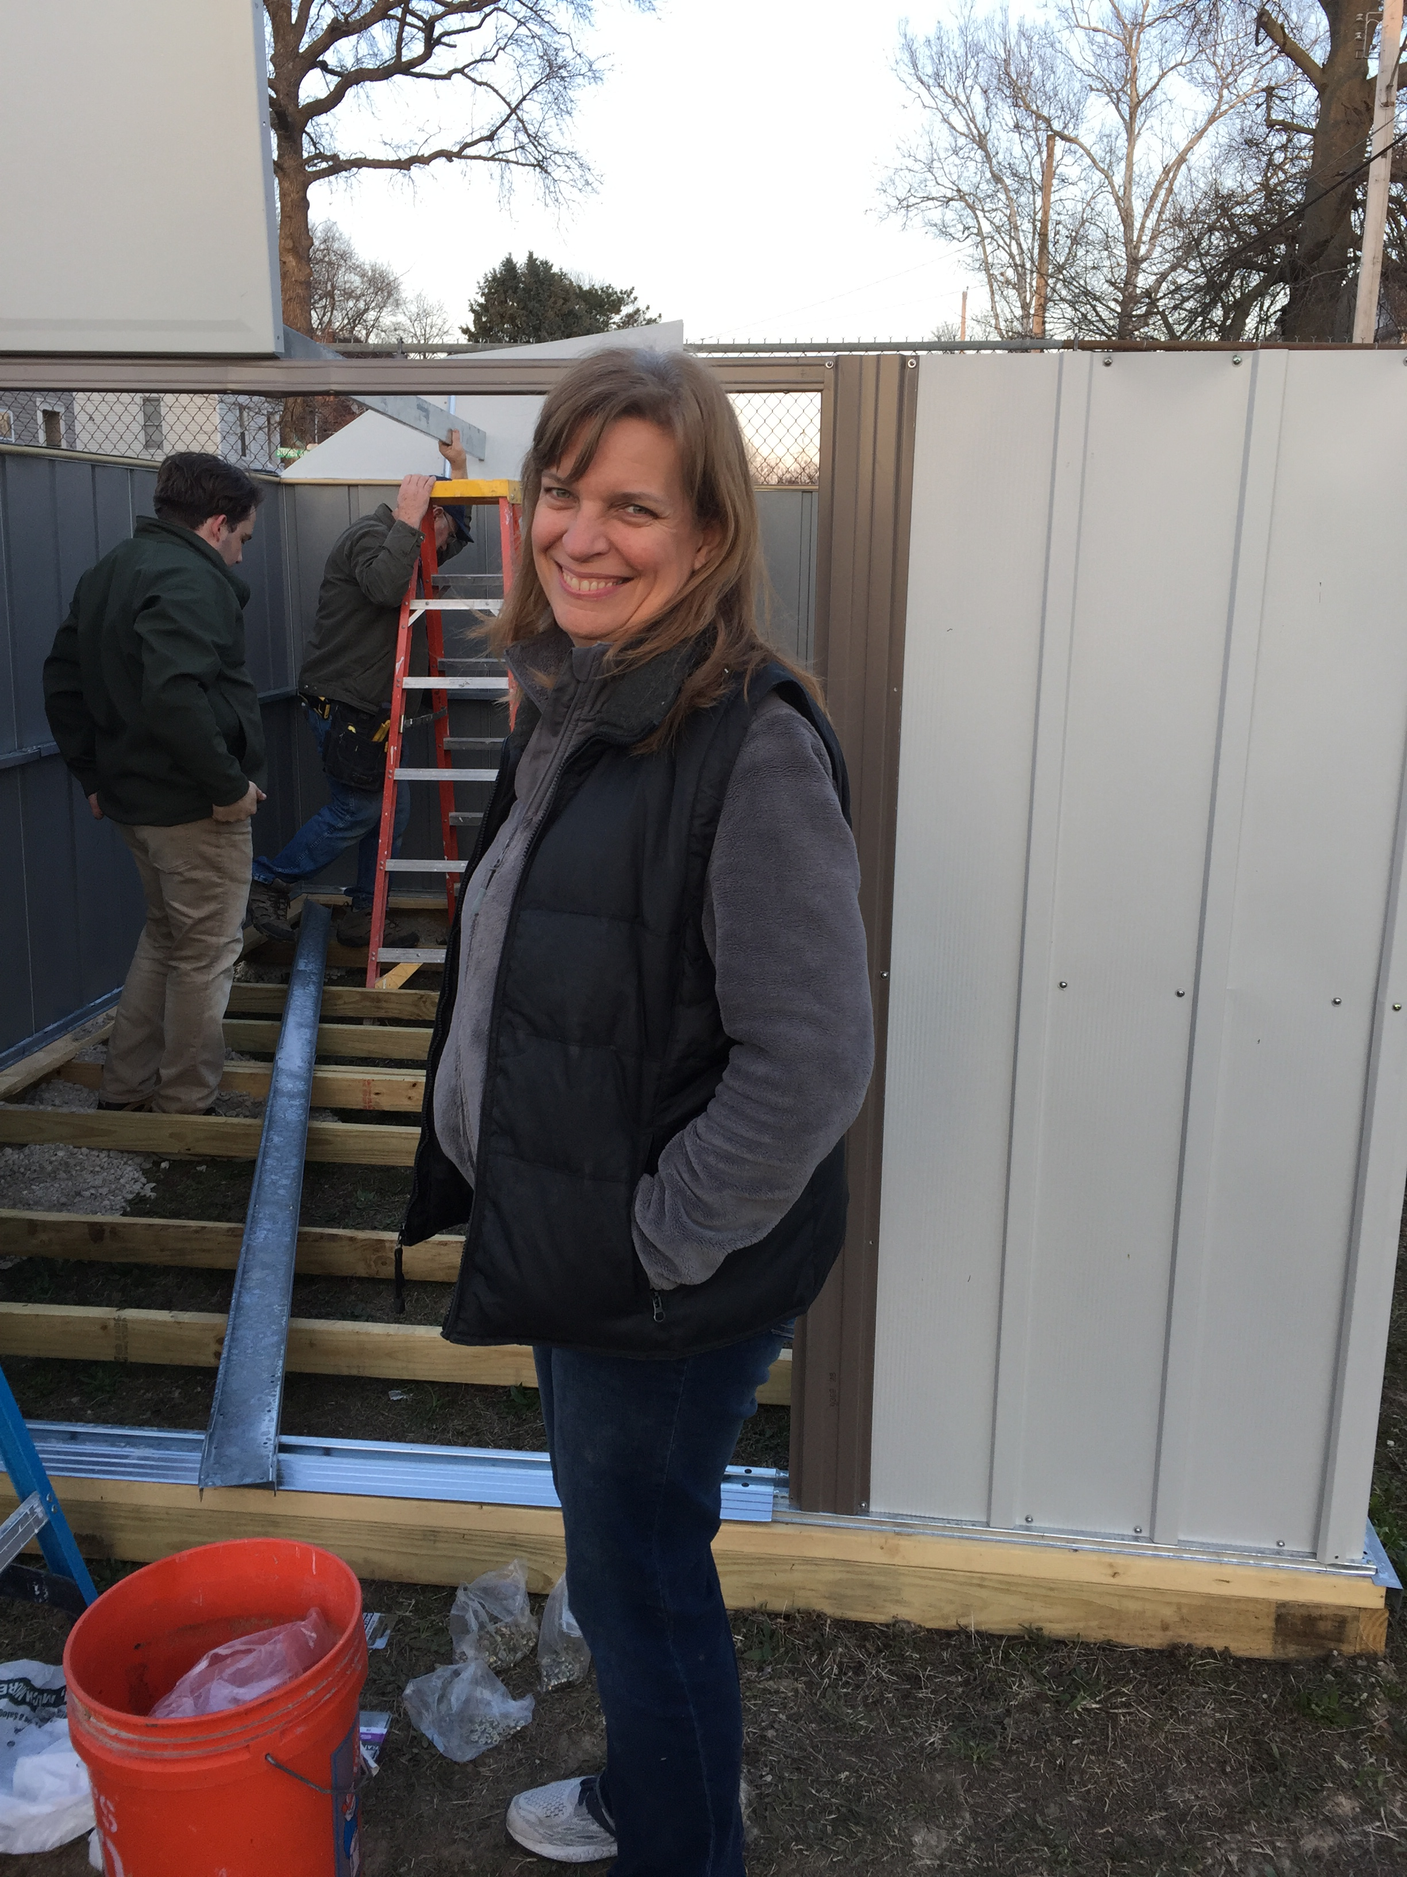
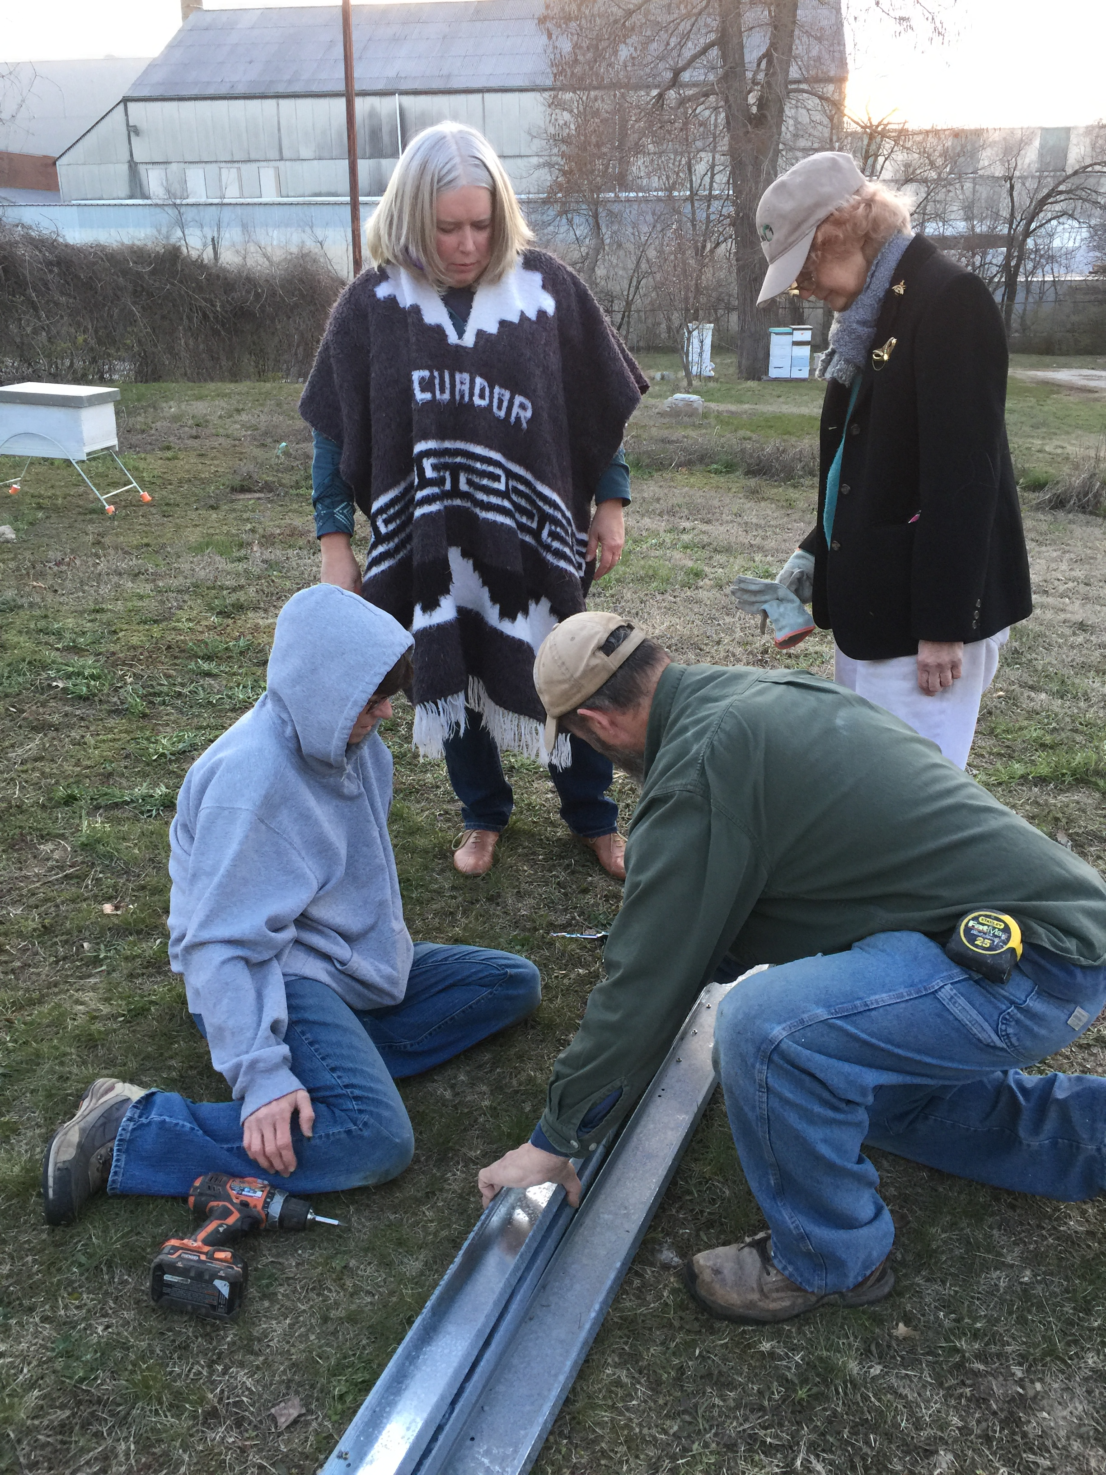
Frozen shed construction

Slide 14
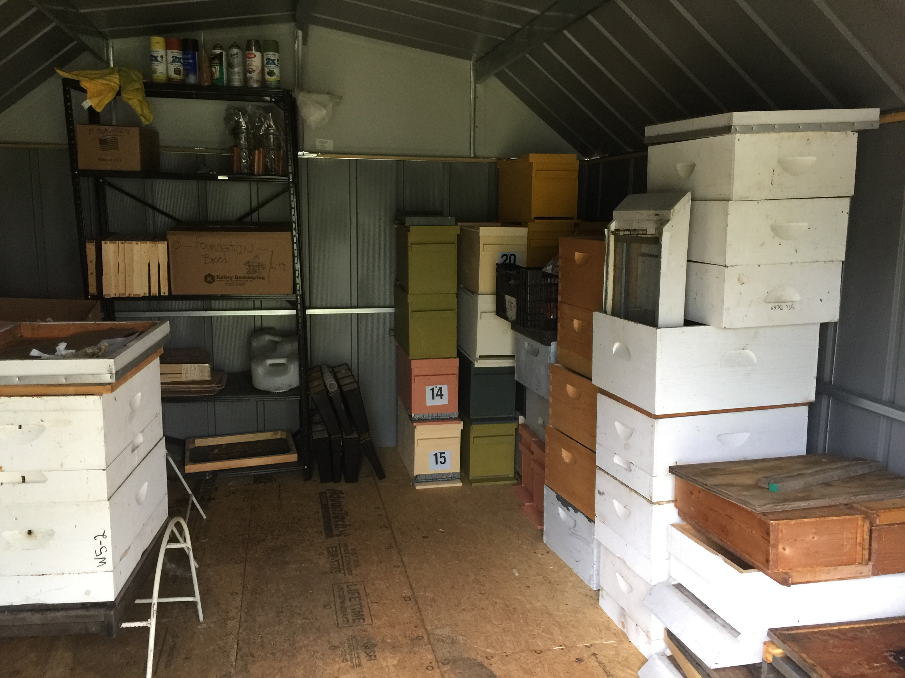
Shed

Slide 15
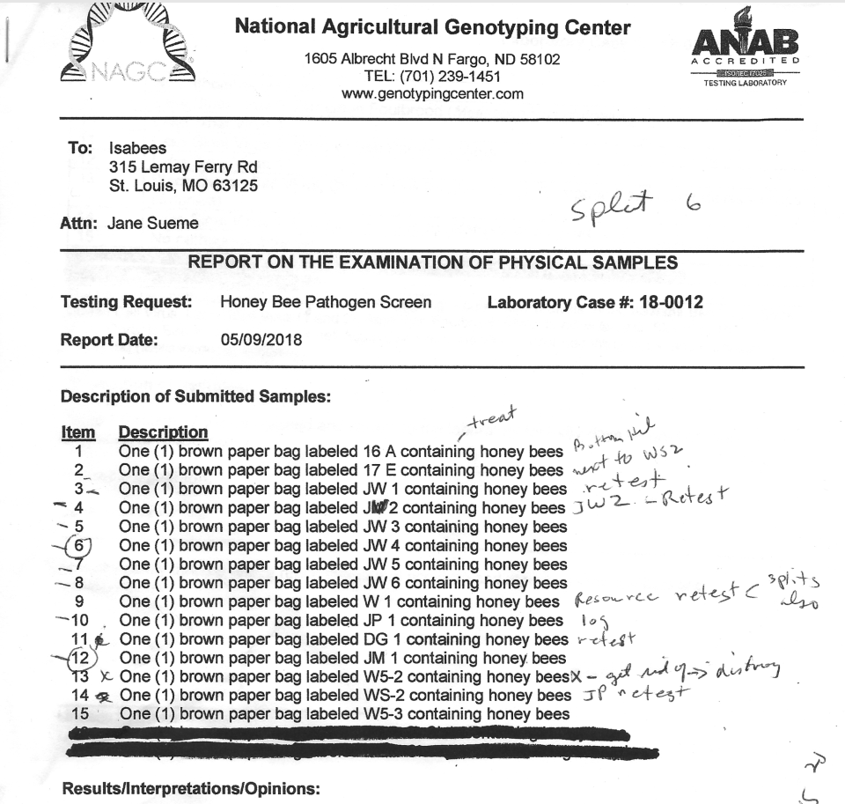
Pathogen report 5/9/2018

Slide 16
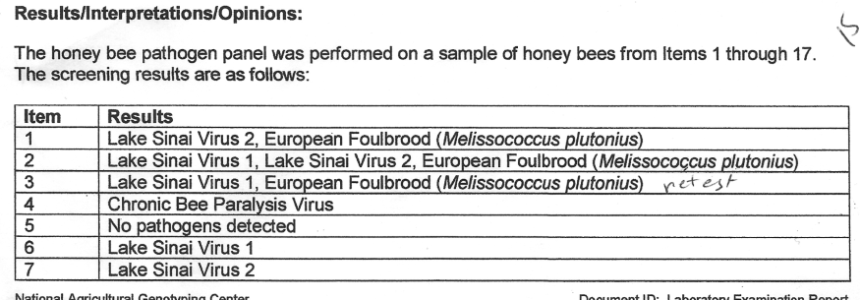
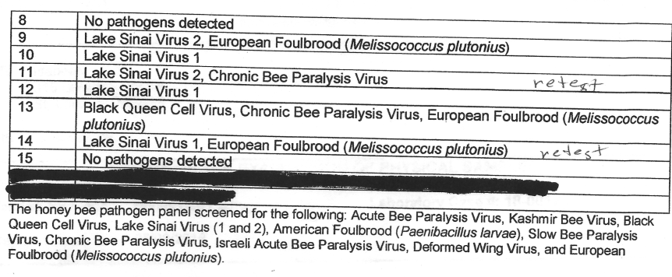
Results for 5/9/2018

Slide 17
What to do?
Summary of results of SSA hives.
Action to be taken will follow in red text. These actions were based on previous year’s criteria to accept Lake Sinai viruses as there are no known negative effects. The EFB and Chronic Bee Paralysis virus pathogens are going to be retested because suspect hives appear to have good brood patterns and no evidence of disease.
Item:
1 16 A: Lake Sinai Virus 2, European Foulbrood McGarry’s, they will treat
2 17 E: Lake Sinai Virus 1, Lake Sinai 2 and European Foulbrood McGarry’s, they will treat
3 JW 1: Lake Sinai Virus 1, European Foulbrood Retest
4 JW 2: Chronic Bee Paralysis Virus Retest
5 JW 3: No pathogens detected
6 JW 4: Lake Sinai 1
7 JW 5: Lake Sinai 2
8 JW 6: No pathogens
9 W 1: Lake Sinai 2, European Foulbrood Retest
10 JP 1: Lake Sinai 1
11 DG 1: Lake Sinai 2, Chronic Bee Paralysis Virus Retest
12 JM 1: Lake Sinai 1
13 W5-2: Black Queen Cell Virus, Chronic Bee Paralysis and European Foulbrood Destroy
14 WS-2: Lake Sinai 1 and European Foulbrood Retest
15 W5-3: No pathogens detected

Slide 18
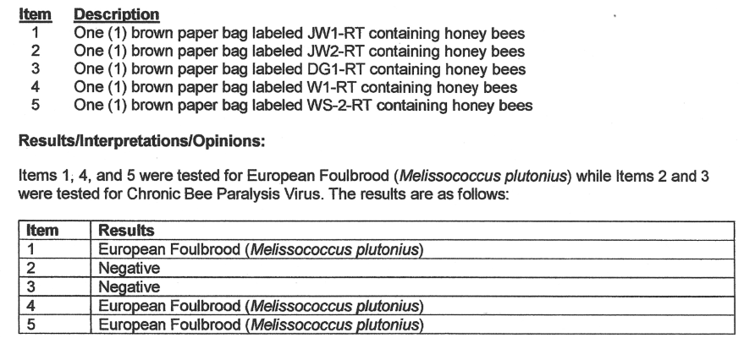
5/29/2018 Rested colony results

Slide 19
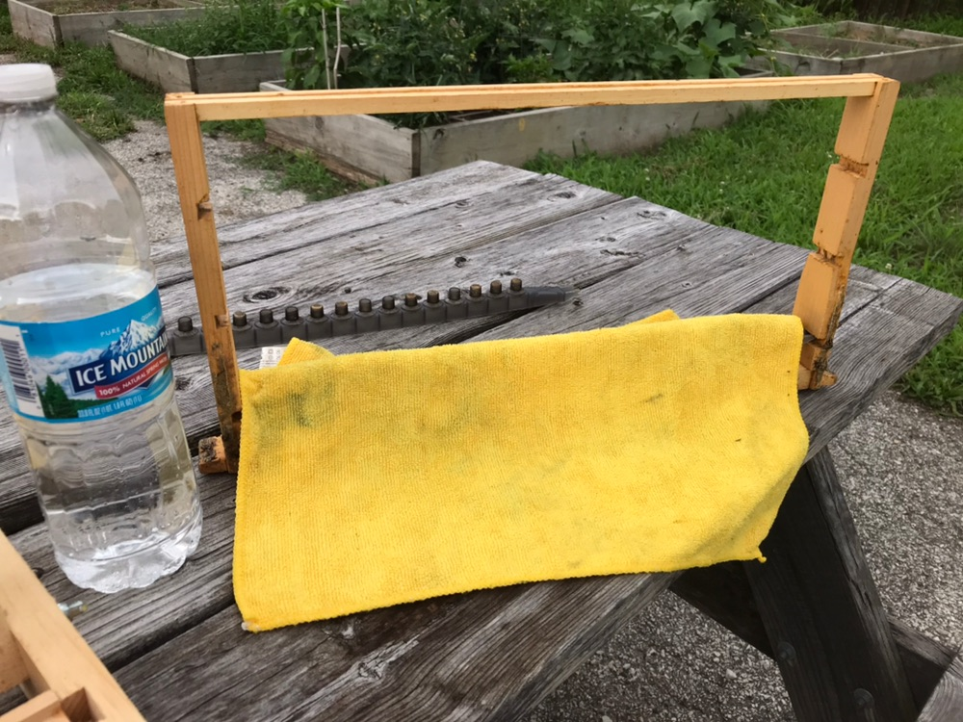
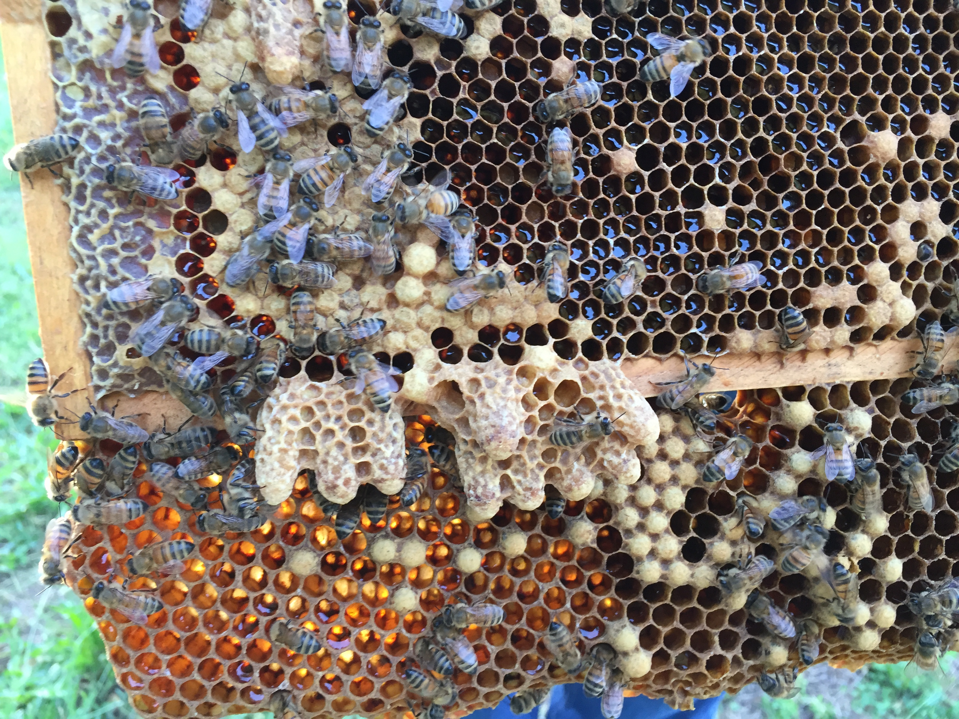
June 2018 Now we can start working beekeeping seasonal work and queen rearing

Slide 20
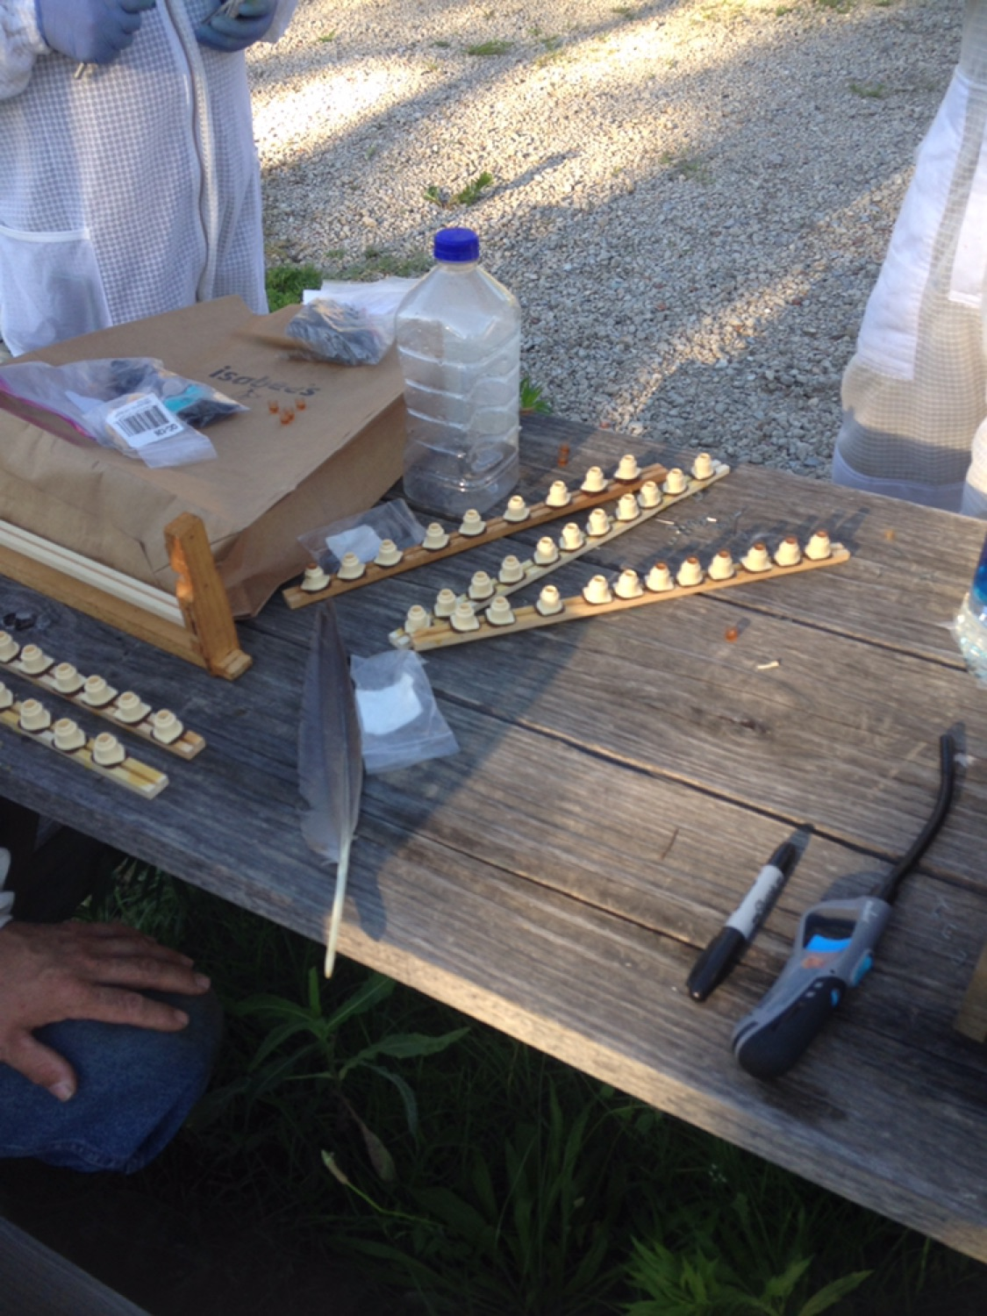
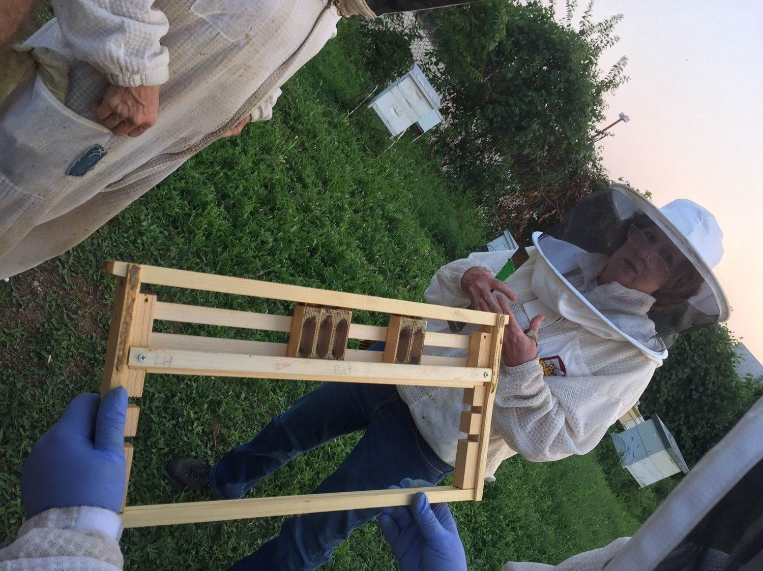
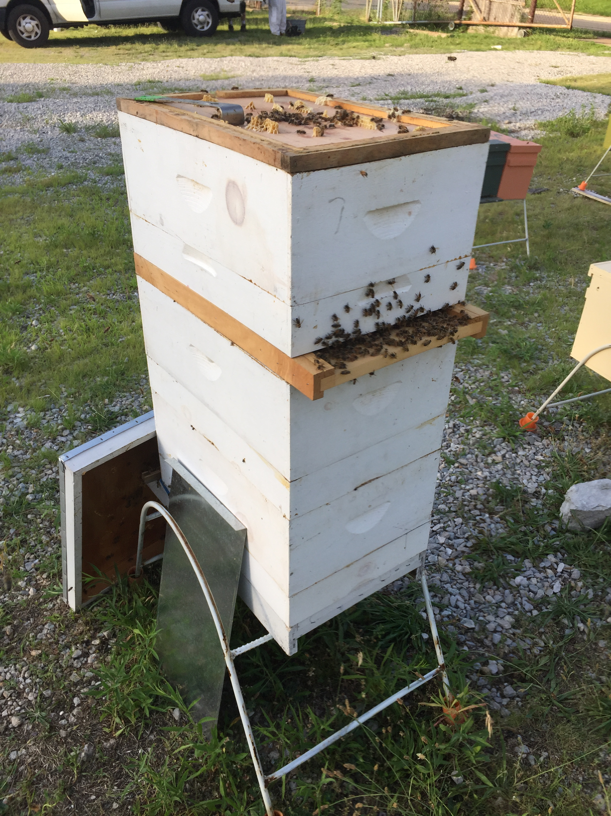
Preparing Nicot cups Queen cell protectors Cloake board

Slide 21
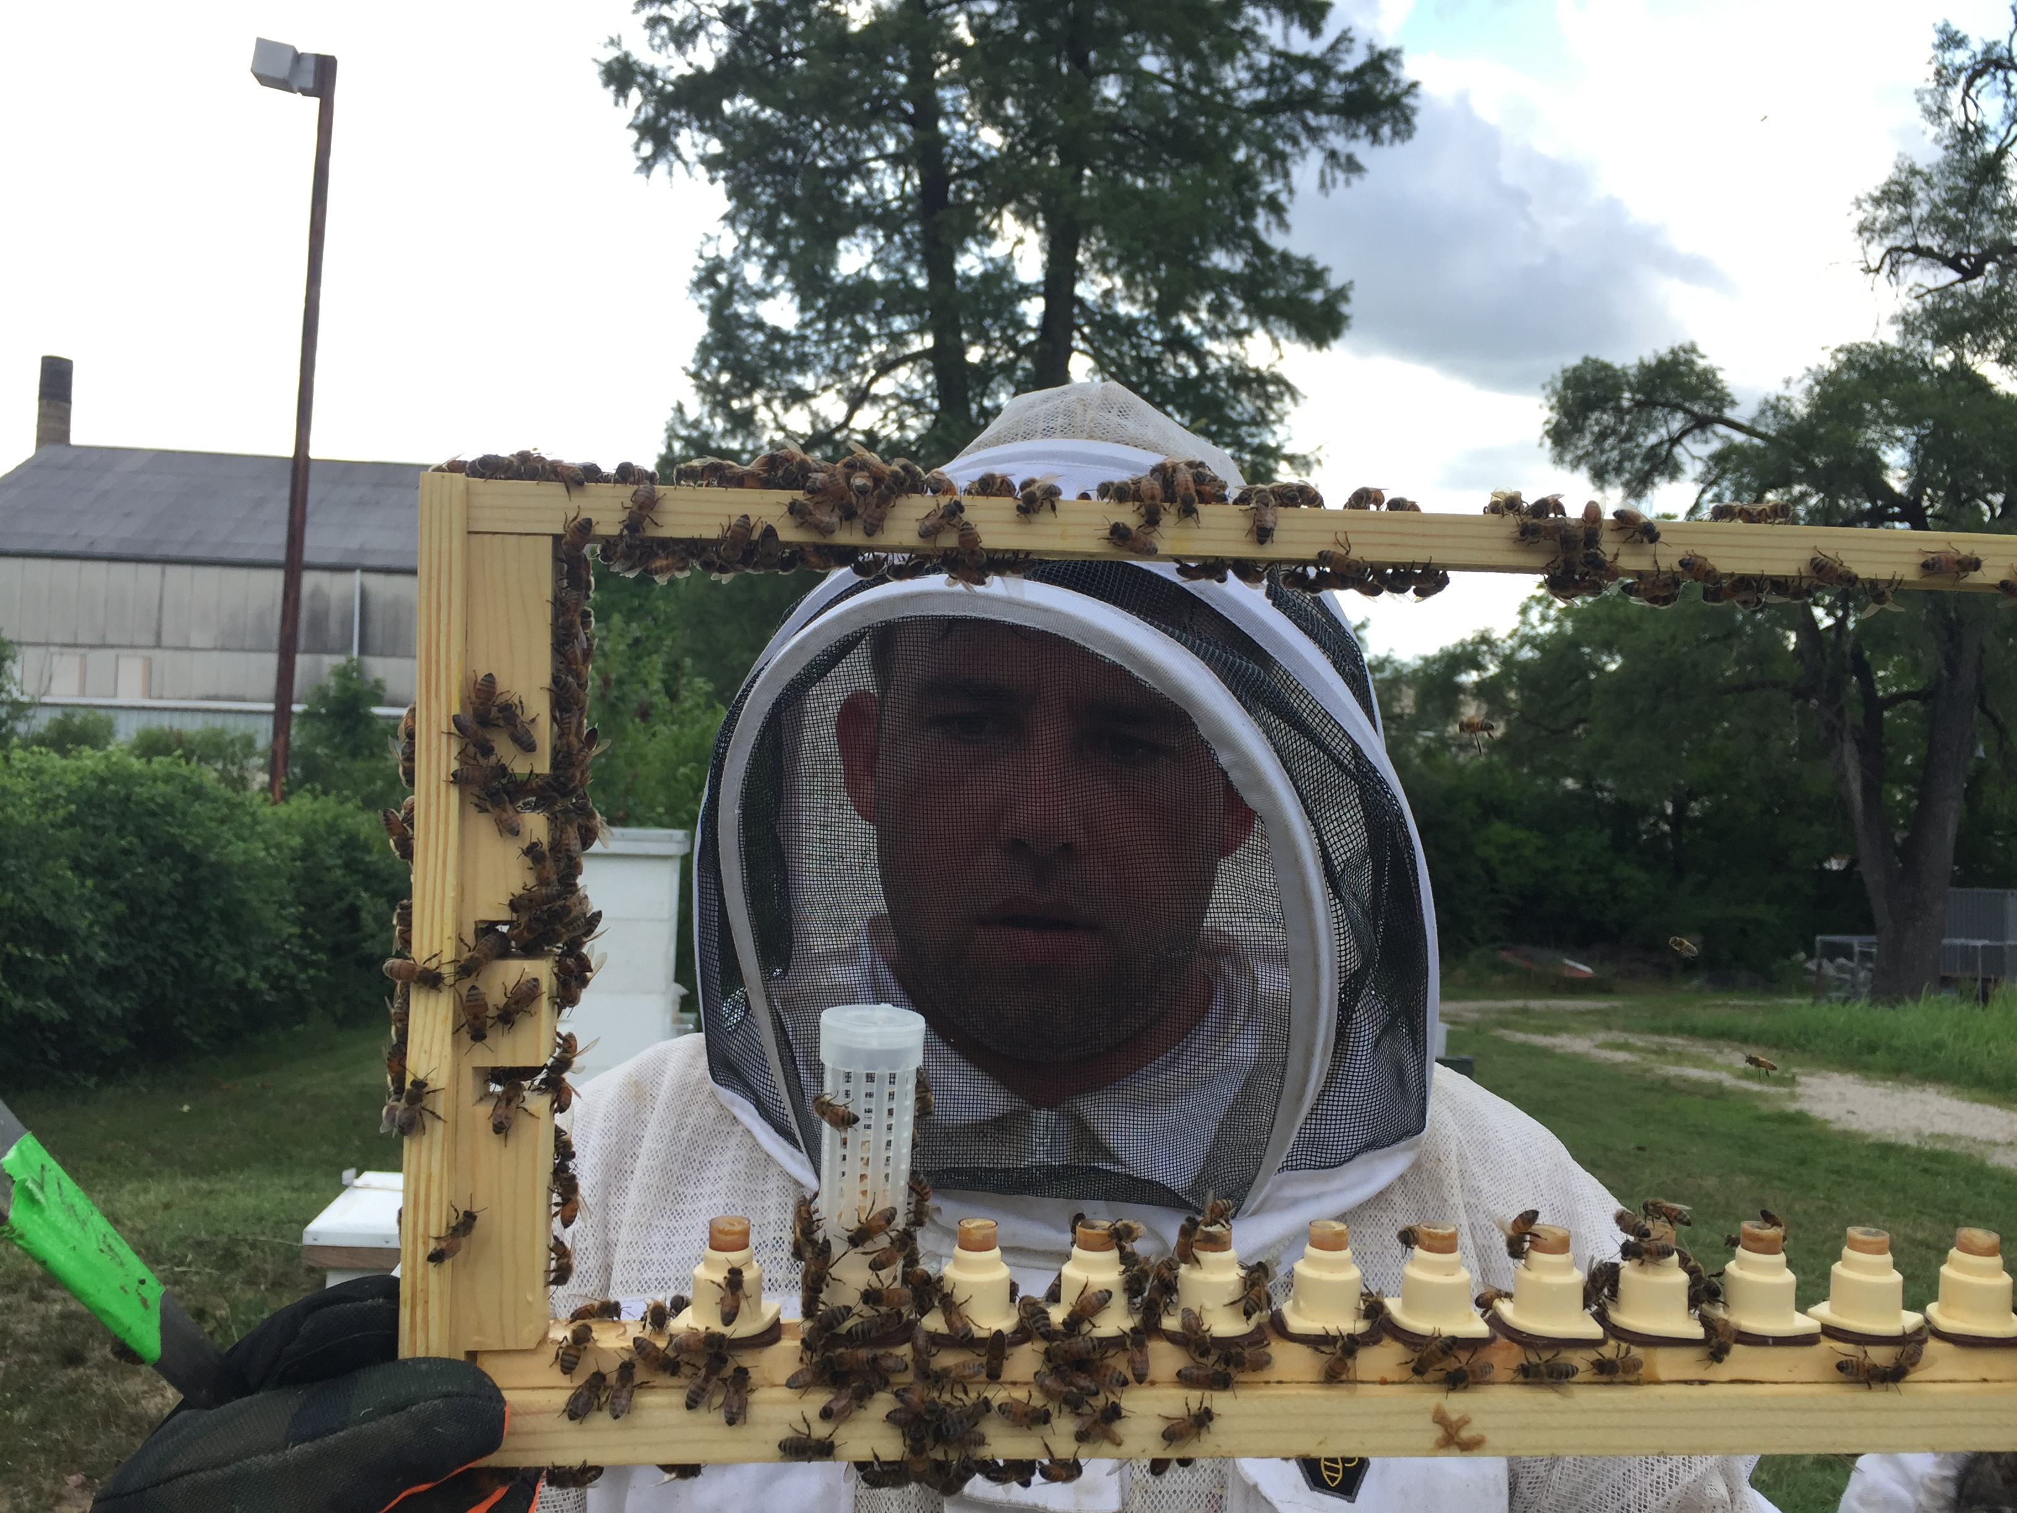
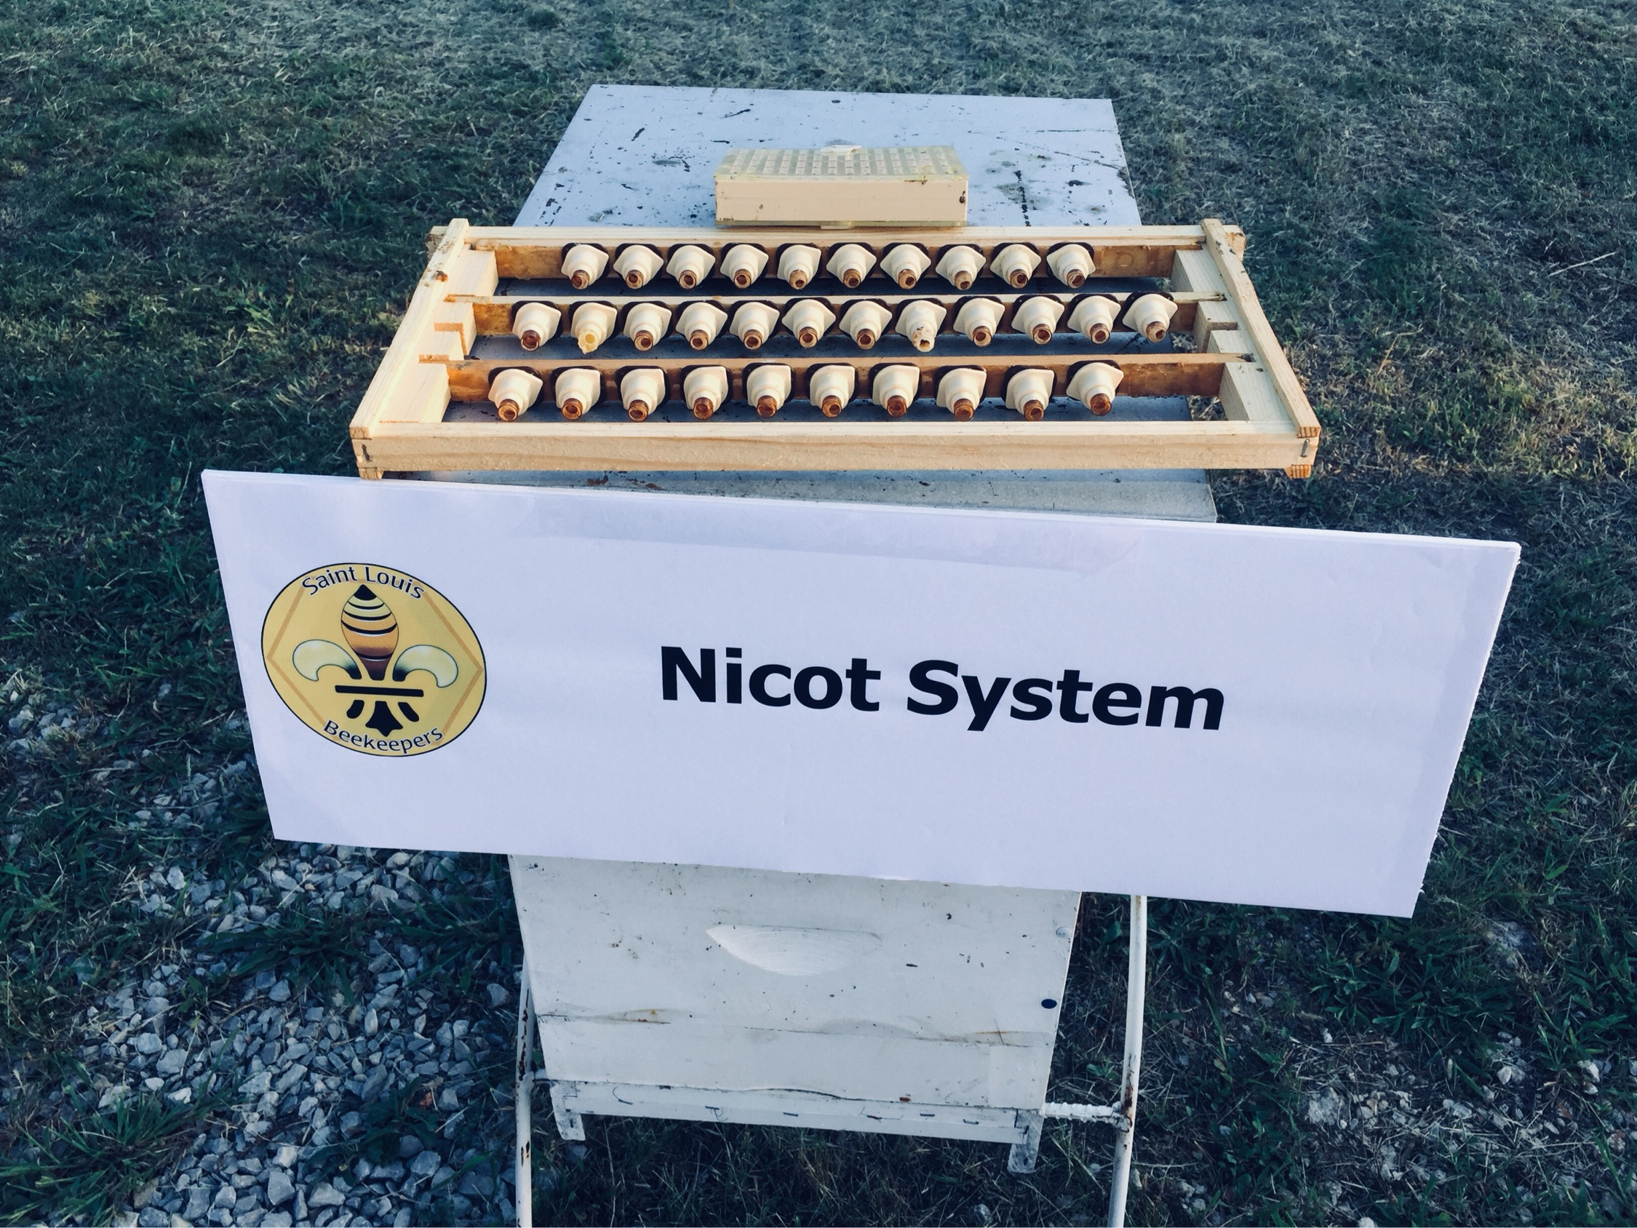
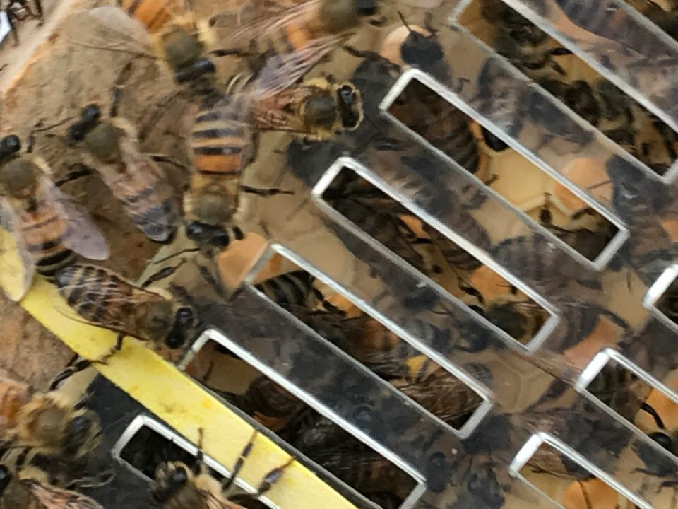

Slide 22
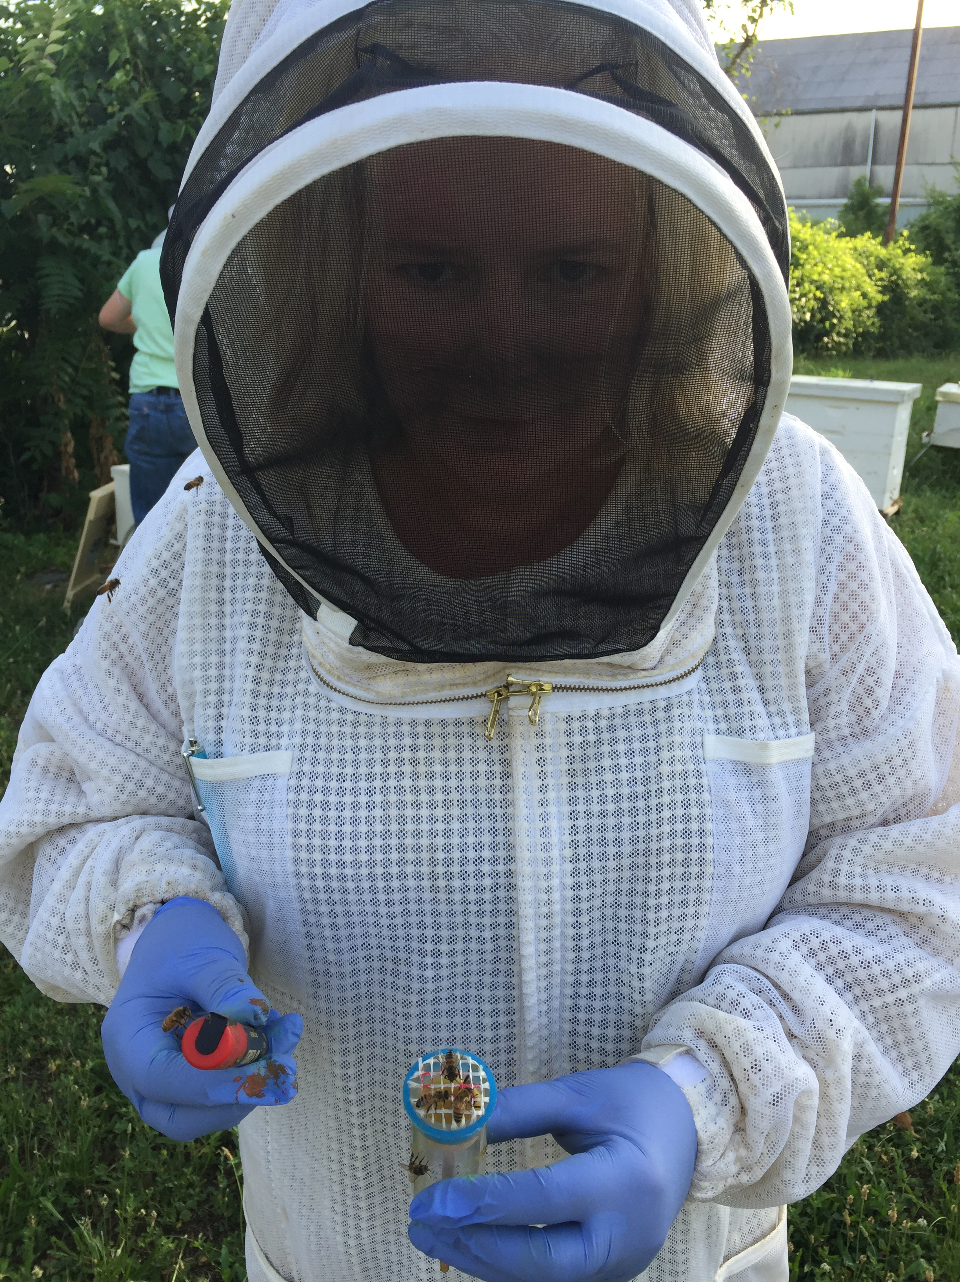
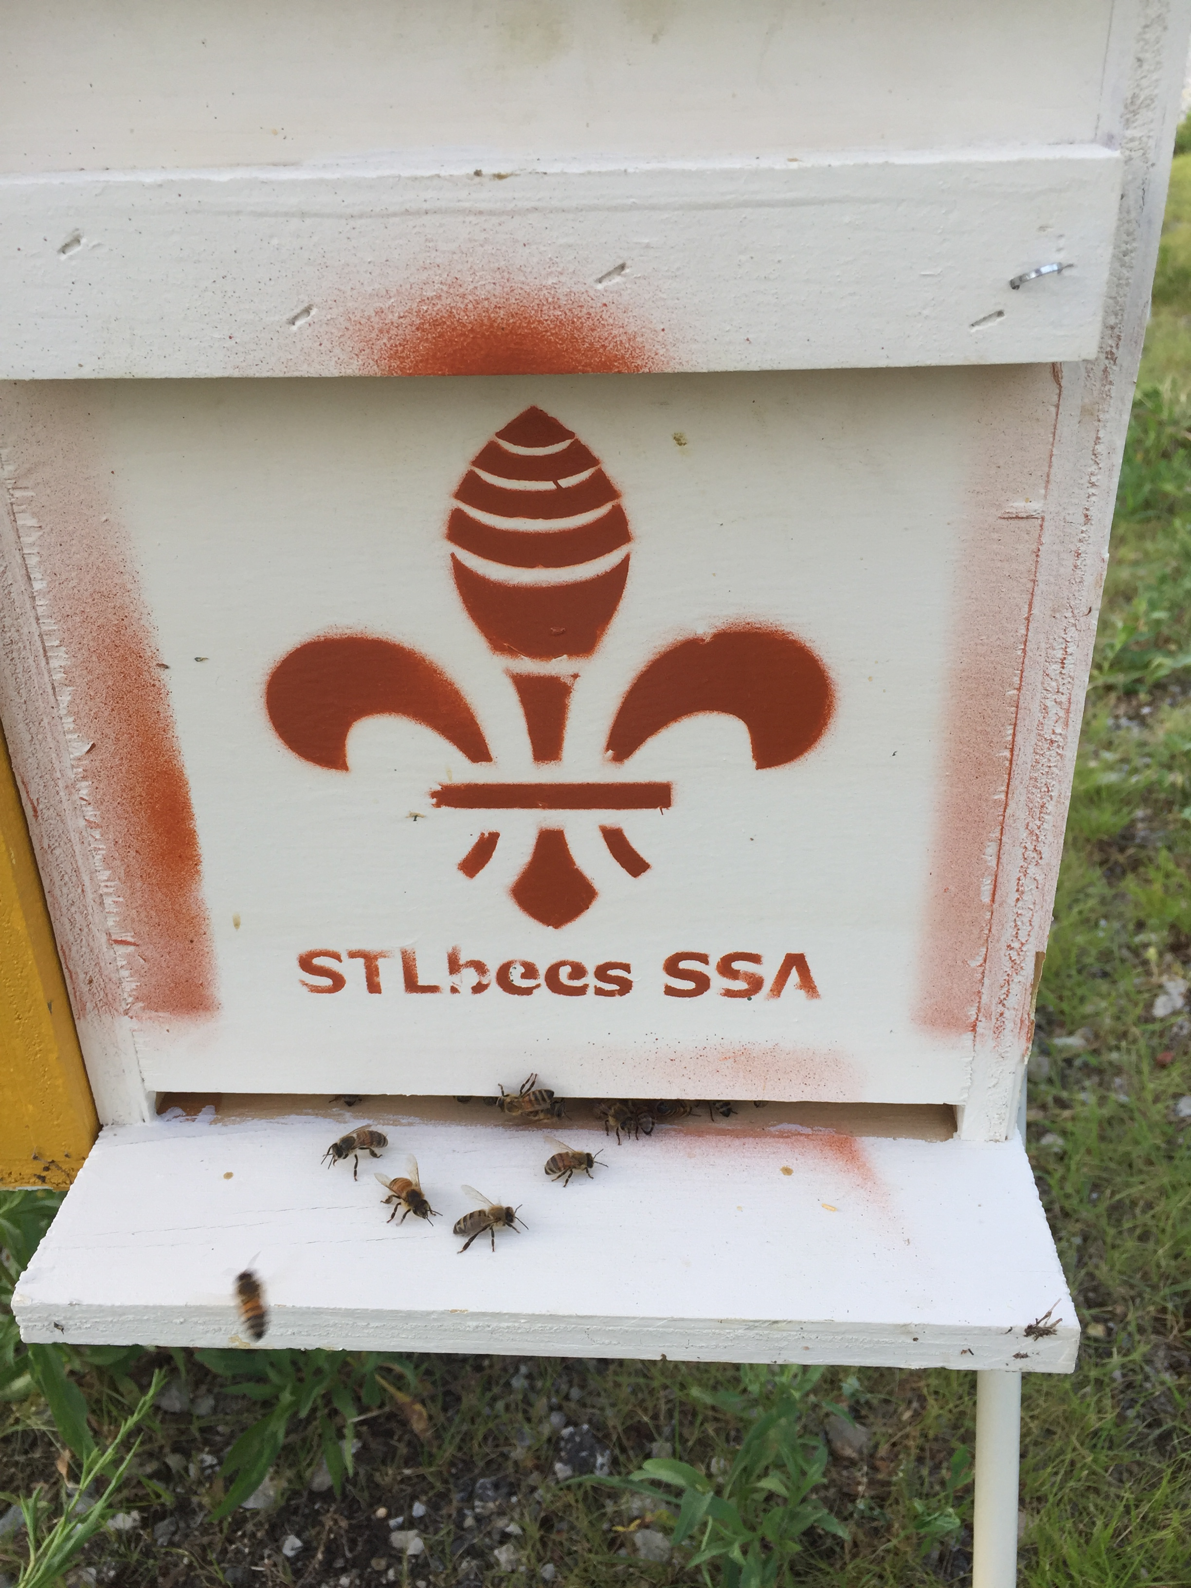
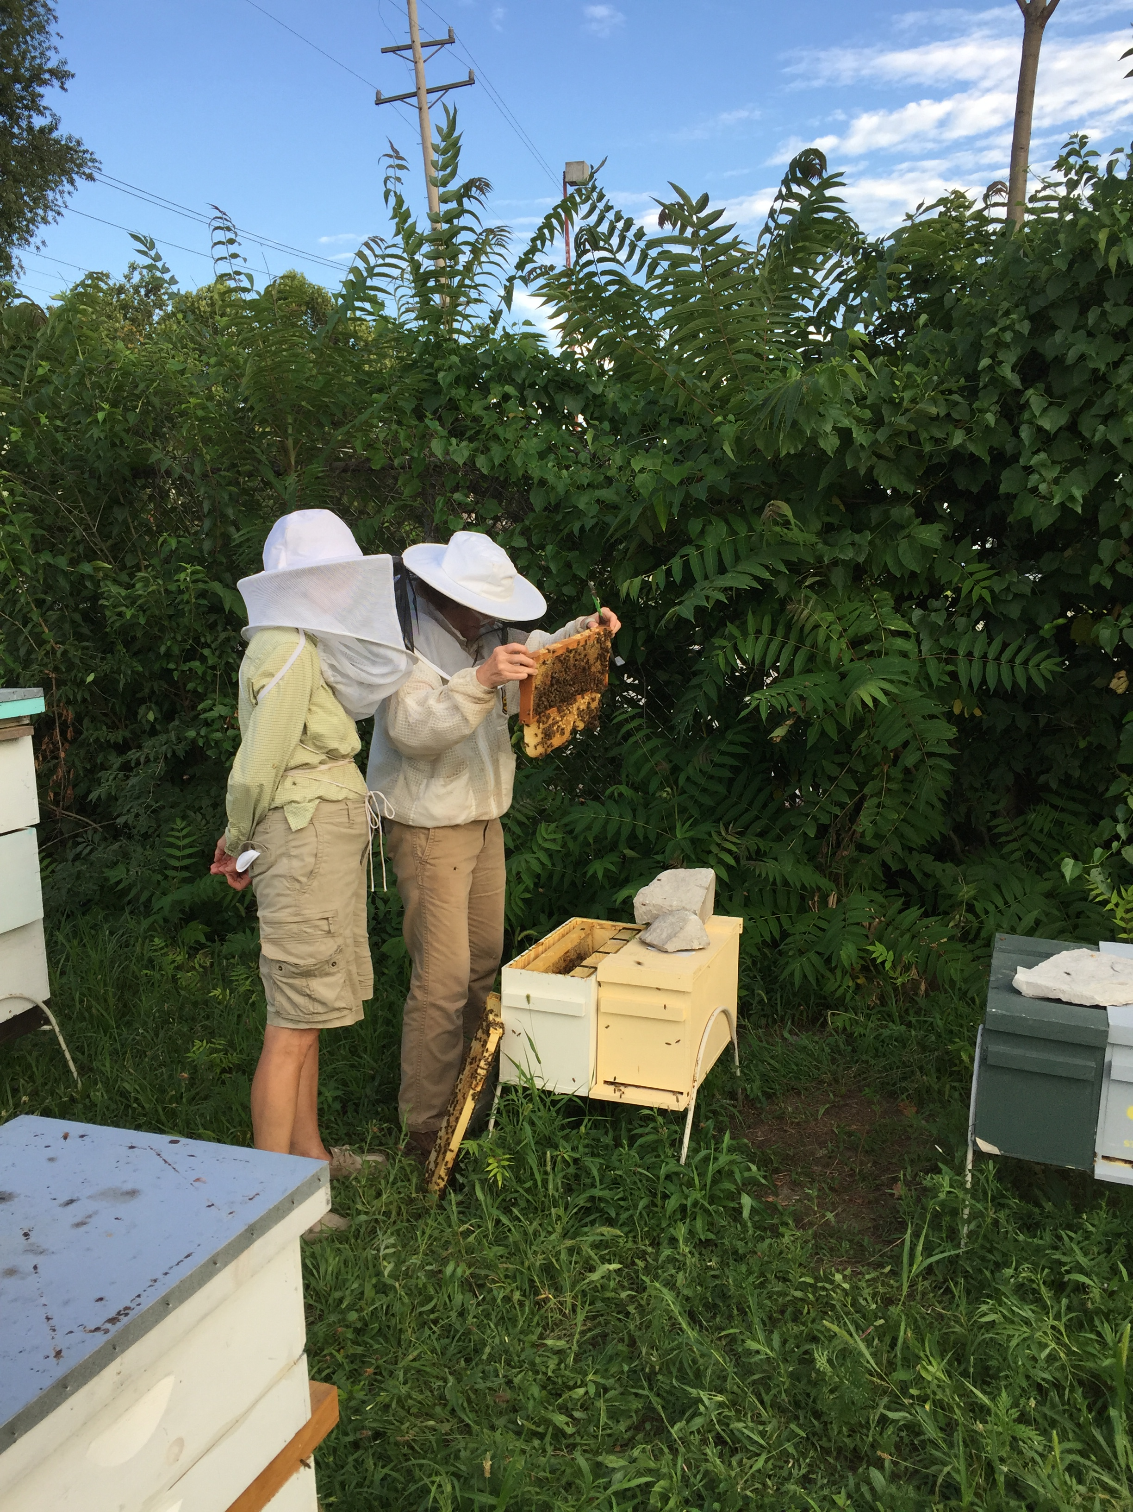

Slide 23
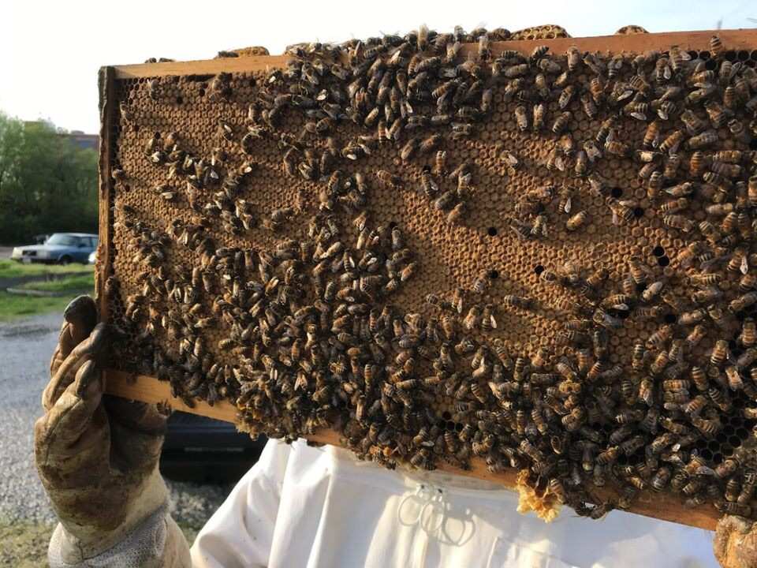
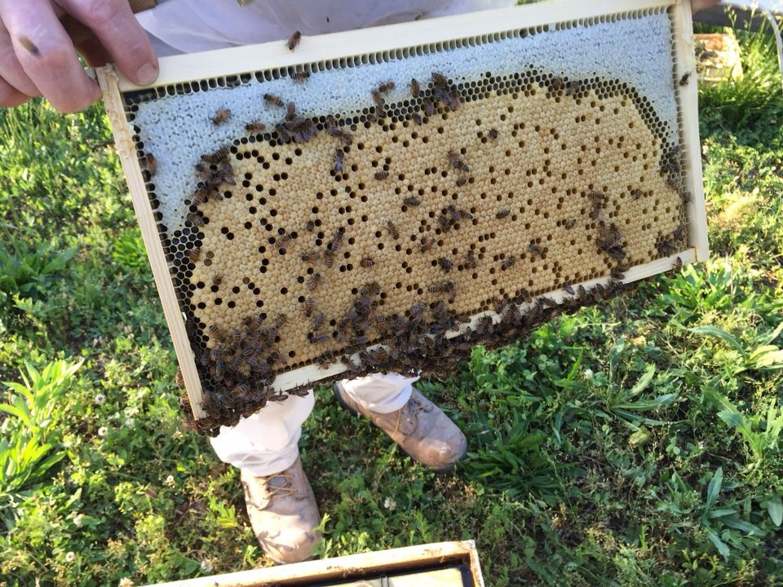
Perfect frame of brood

Slide 24
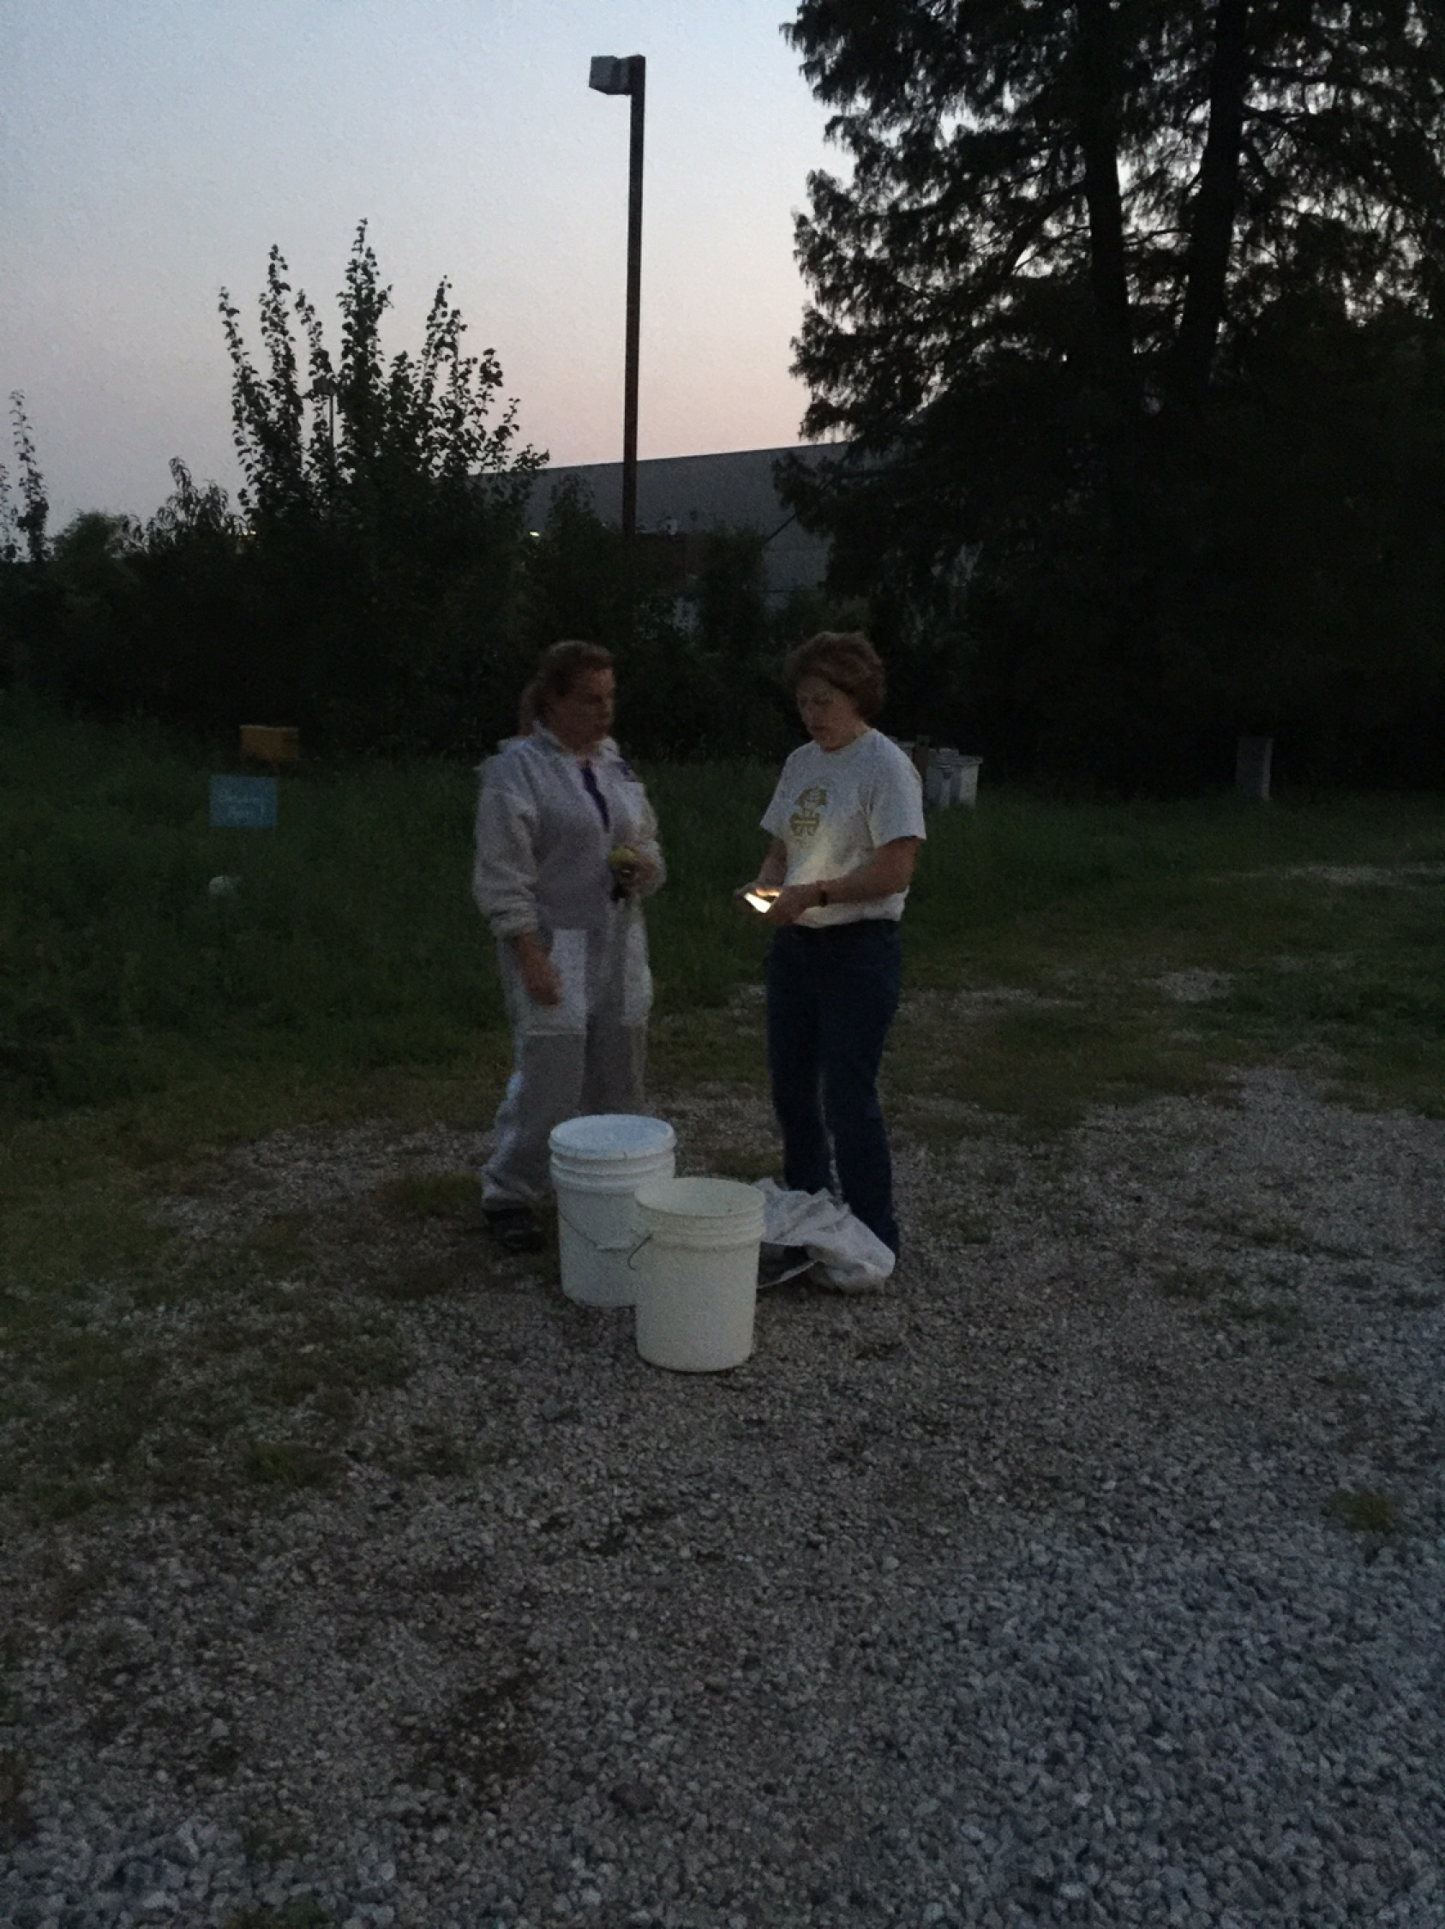
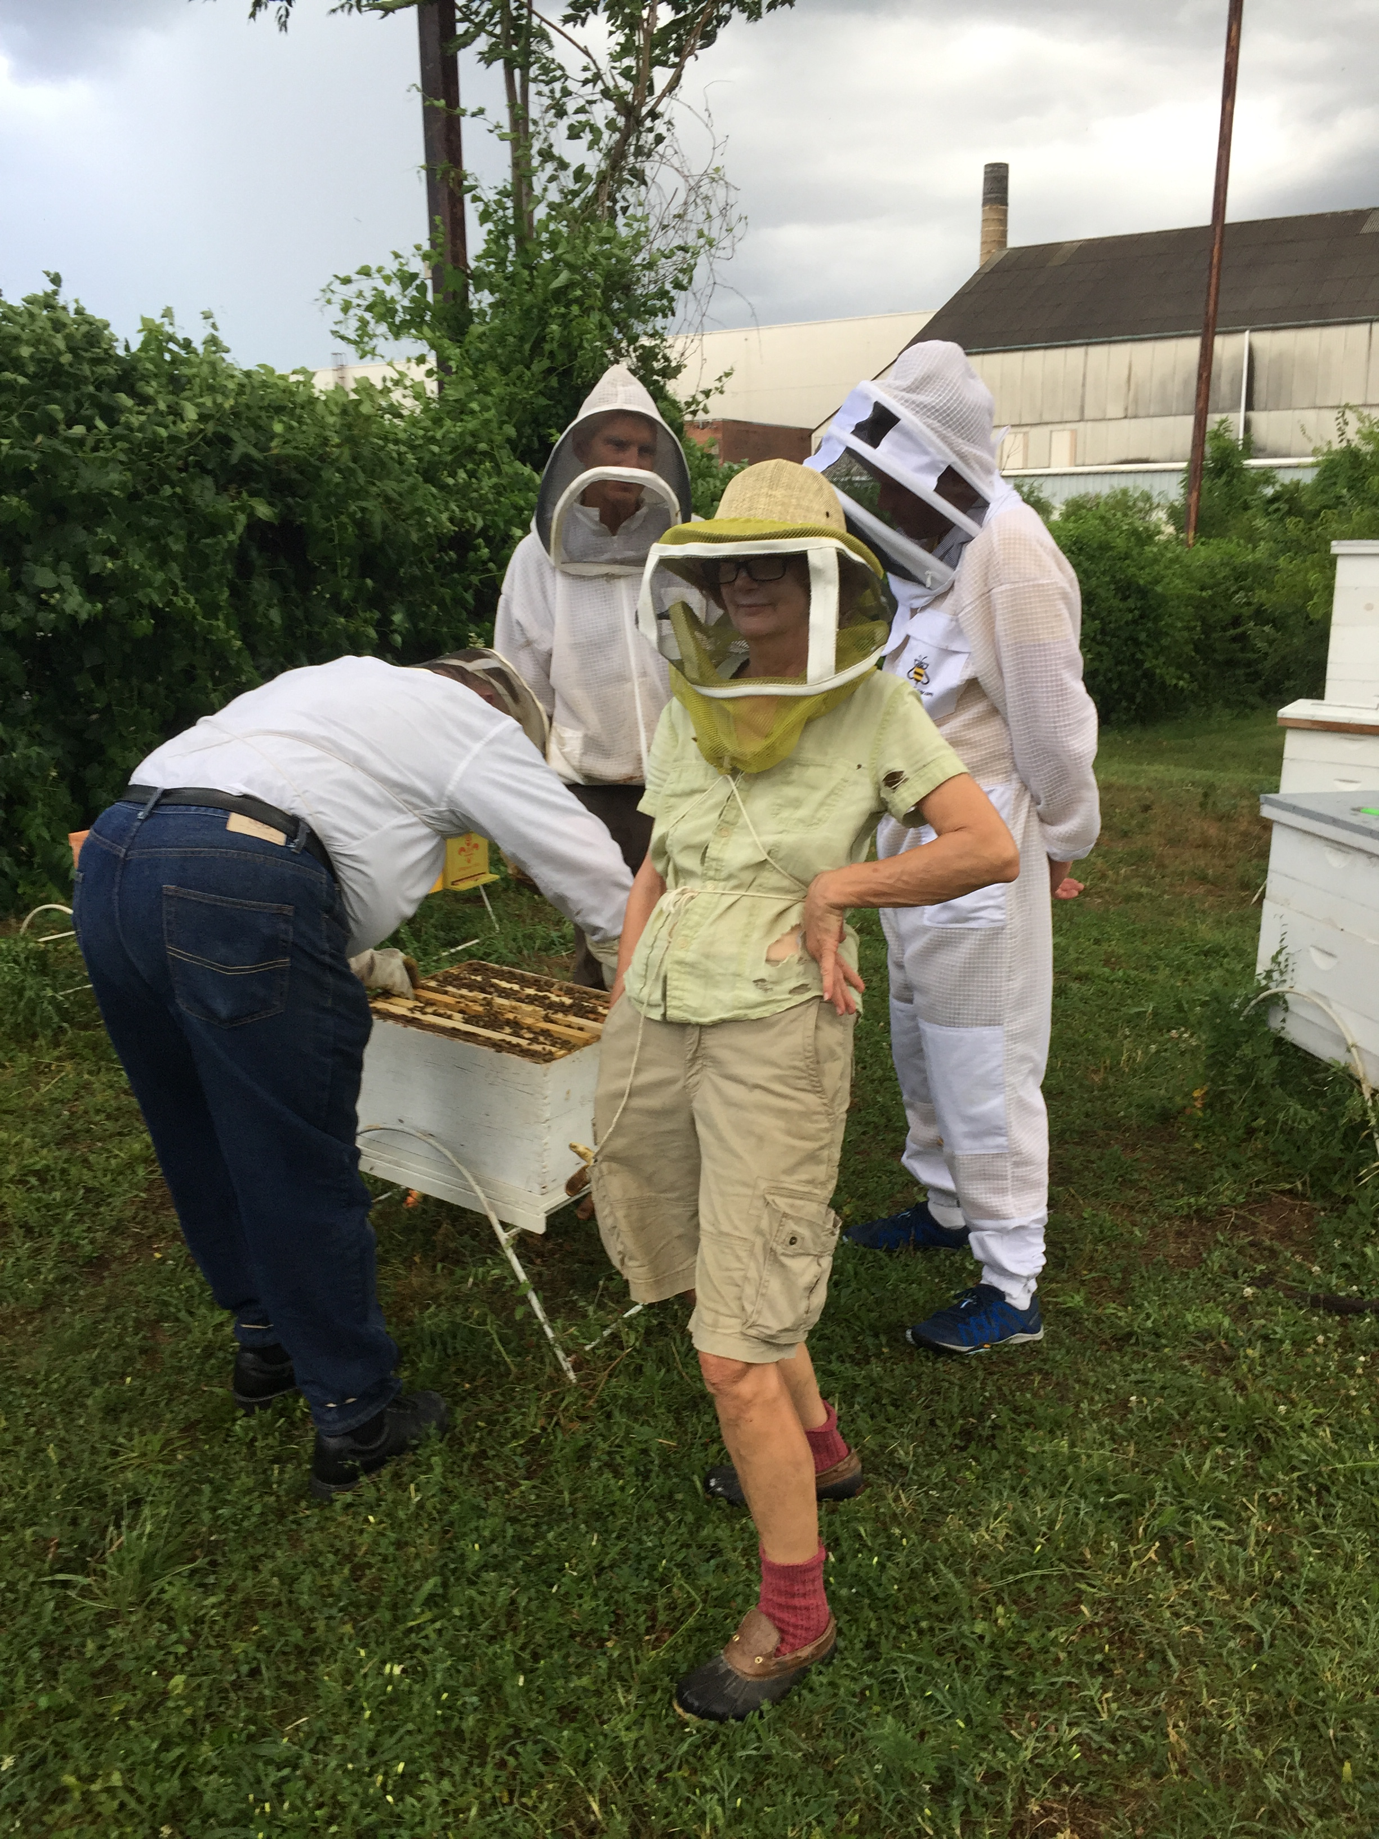
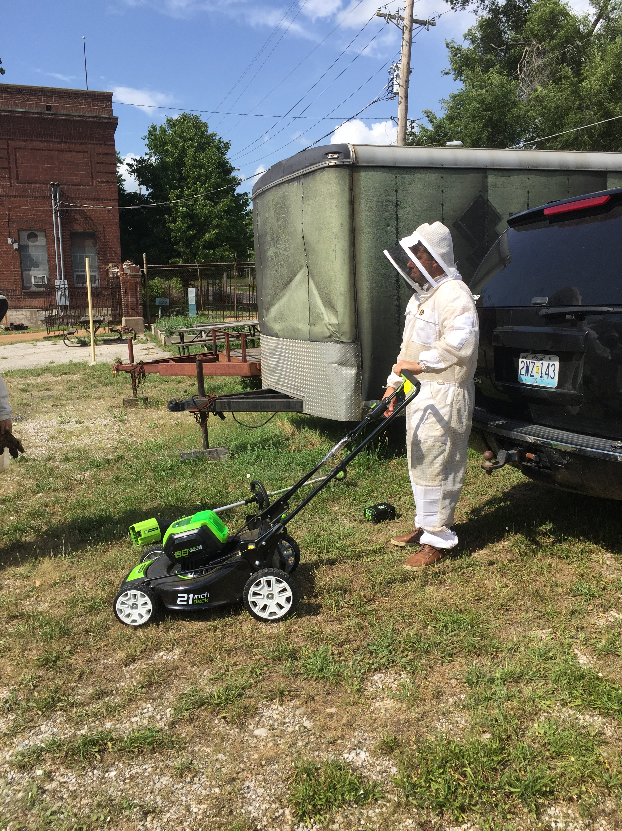
Some fun Some yard work Extending day light

Slide 25
Summarize 2018
Lots of work building and acquiring necessary equipment for the beekeeping season.
Started queen rearing in June.
5 teams of 2 beekeepers to work with 2 nucs that over wintered 2017 or acquired in 2018.
Started with 2 hives and 7 nucs. That meant that 1 group started with 1 hive only.
Tuesdays were group work days but teams worked together on queen rearing schedule that required additional days at apiary.
We needed to grow our nucs into hives. This made bee stock lower than optimal queen rearing needs.
Teams chose method of queen rearing. These included nicot, grafting using Cloake board, grafting using starter finisher, harvesting swarm cells and Mel Disselkoen’s OTS method.

Slide 26
We had some success raising some queens.
The queens from desirable stock were used to replace queens in some of the nucs that needed new queens.
Some of the queens were kept to grow apiary stock.
A few queens were sold.
A lot of knowledge was gained this year. We realized that starting with nucs limited the resource nurse bees. Raising queens require over abundance of healthy nurse bees to build out the queen cells.
One of our last group meetings at apiary we decided that to strengthen our colonies we reevaluated our rigid nutrition guidelines. We agreed to adding Honey B Healthy Super Plus, Vitamin B Healthy and Amino-B Booster.
Going into winter we have combination of 14 hives and nucs.
We need to meet yet to adjust guidelines based on 2018 results

Slide 27
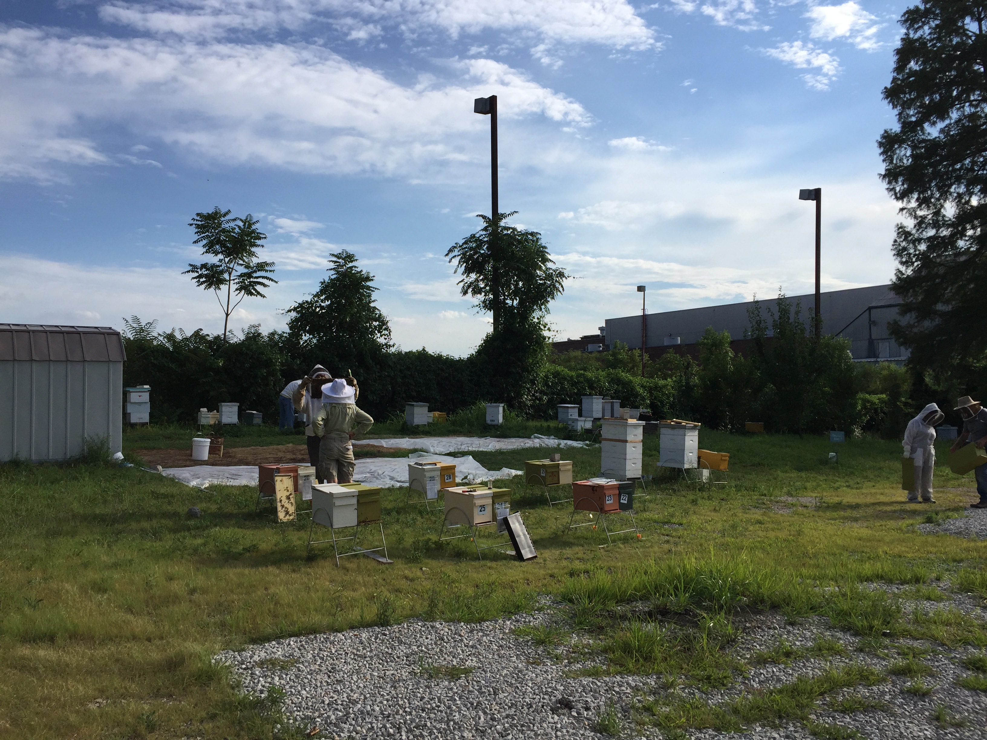

Slide 28
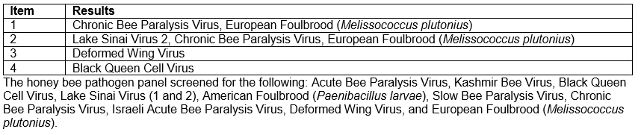
Summary 2019
Harsh winter of 2018 with Polar Vortex left us with only 4 hives. A Pathology report shows that 2 of the hives that died in January had viruses known to be transmitted by varroa mites.
We purchased 8 packages of bees to use as resources but not as stock to raise queens. This decision was based on 2018’s lesson we needed more nurse bees, honey frames and pollen for queen rearing.

Slide 29
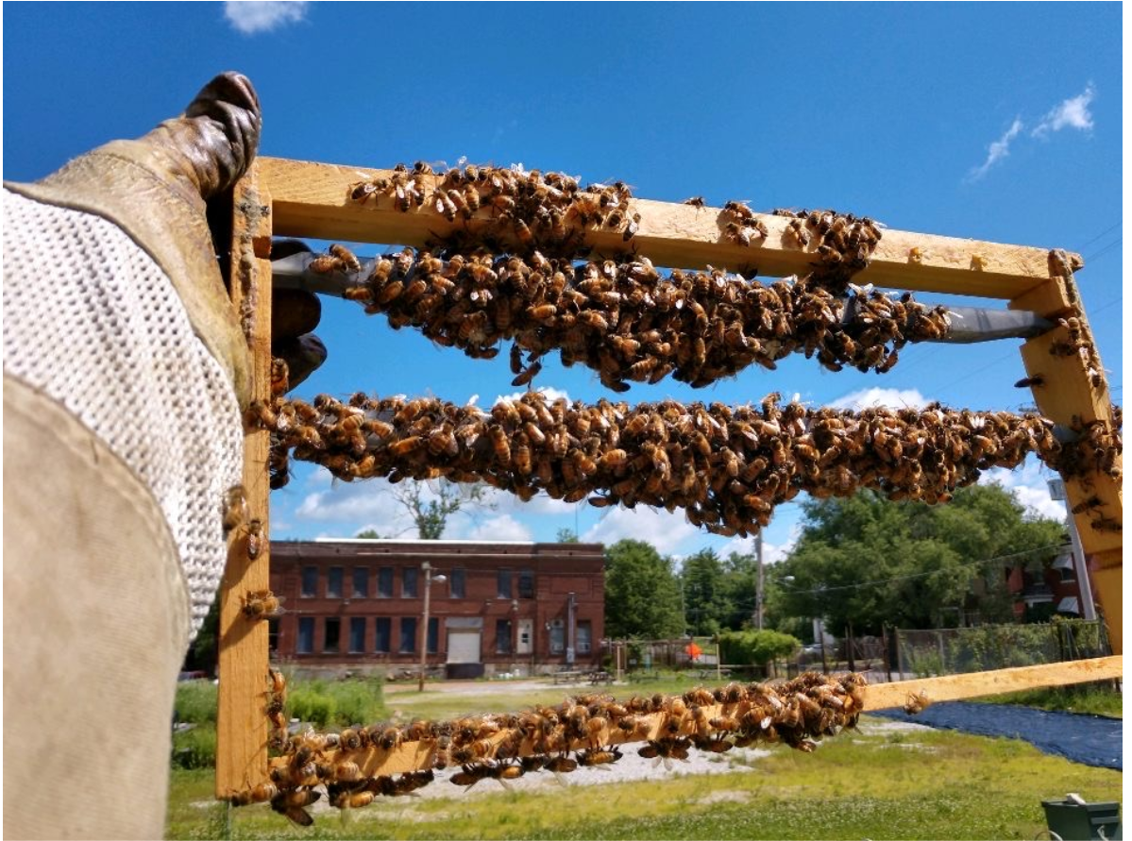
OTS used
Nicot method again without desired results.
Starter Finisher Colony Method gave us the best results.

Slide 30
35 queens were raised by grafting.
1 queen was raised from Nicot Method
3 queen was raised by OTS Method
2 of these queens were used to requeen the purchased bee packages.
1 queen was used to requeen 1 of our survival colonies with bad temperament.
6 queens went to SSA members
1 queen and nuc was raffled off at Annual Field Day.

Slide 31
Lessons Learned:
Queen rearing, while simple requires large amounts of bee resources (bees, honey and pollen)
Beekeeper needs to recognize environmental influences and plan around these influences. If rain is forecasted in queen rearing time frame, adjust the start of grafting.
Queen rearing can’t start until evidence of drones.
Graft larva that is the size of a comma and is in a good amount of royal jelly
Queen rearing is most successful when there is a nectar flow.
Making Matting Nucs for all of the queen cells that have been made takes a lot of bee resources and beekeeping labor. Most SSA beekeepers are employed full time and can only come to aoiary after work. Plan the making the Mating Nucs so that most of the SSA Beekeepers can help in this labor after working hours.
Do not check for new queen until 10-14 days. It has been determined that the new queen is more readily accepted after this waiting period.

Slide 32
Goals for 2020
Build on what we learned in 2019
Mating Nucs are challenging because of how much resources they require. Figure how to manage these more efficiently.
  Will this be learning how to use queen castles.
Coordinate efforts between teams to help manage work more efficiently.

