Slide 1
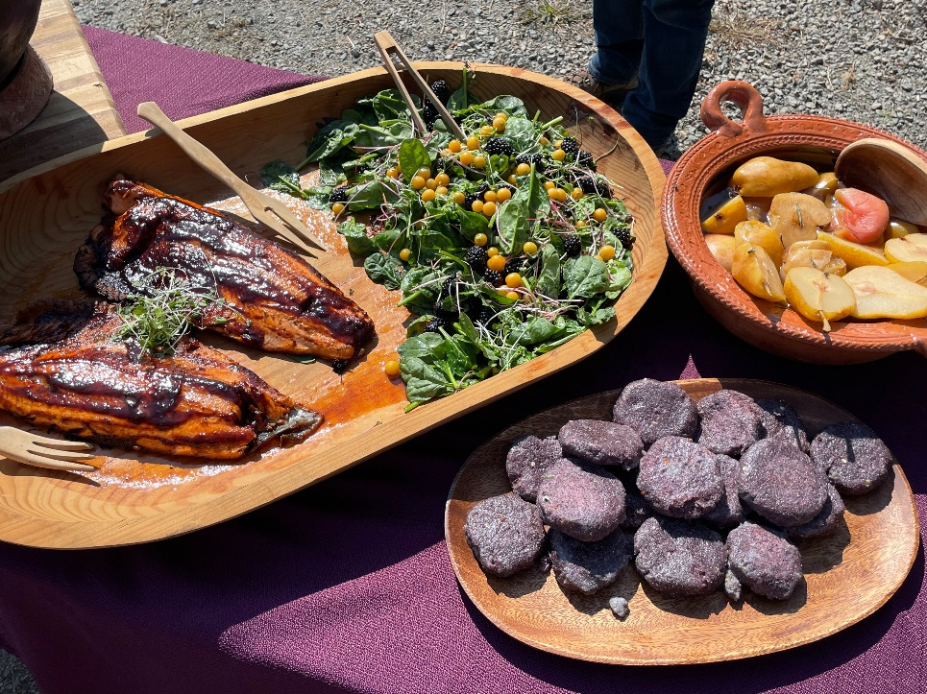
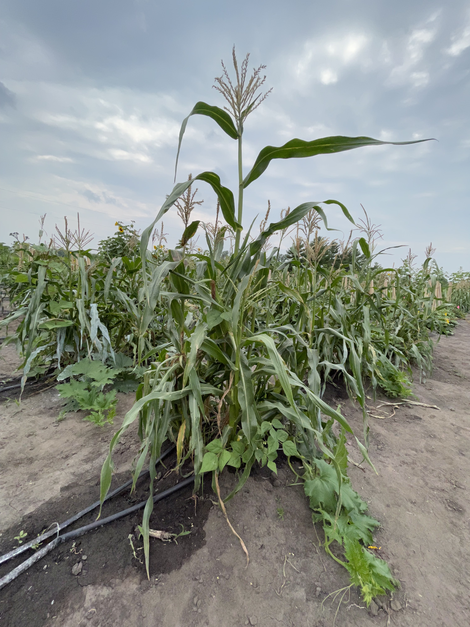
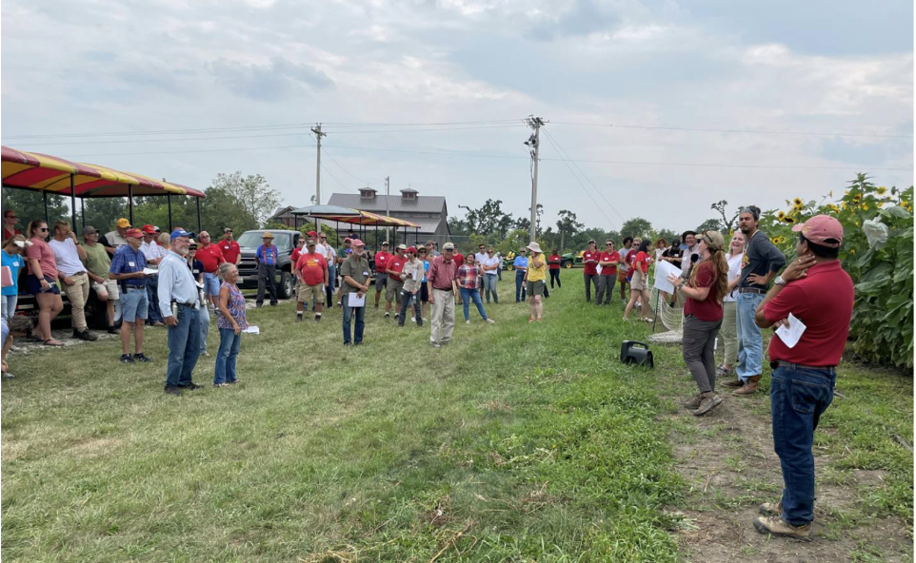
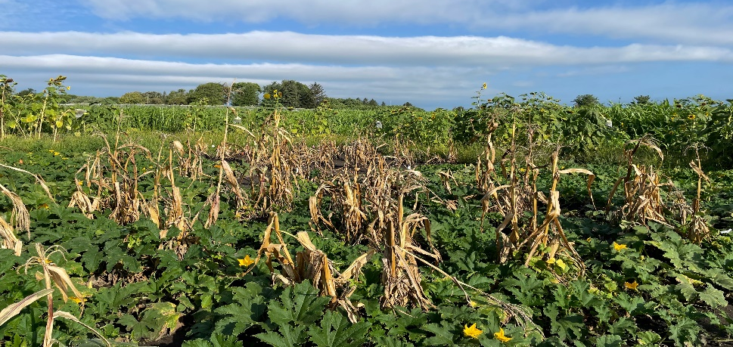
State of the Project
Iowa State Team Update
PIs: Christina Gish Hill, Donna Winham , Ajay Nair, Marshall McDaniel
Graduate Students: Emma Herrighty,
Derrick Kapayou, Kristine Micheletti, Susana Cabrera-Mariz
Staff: Valeria Cano Camacho

Slide 2
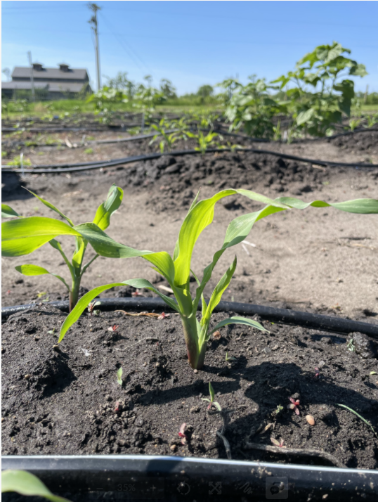
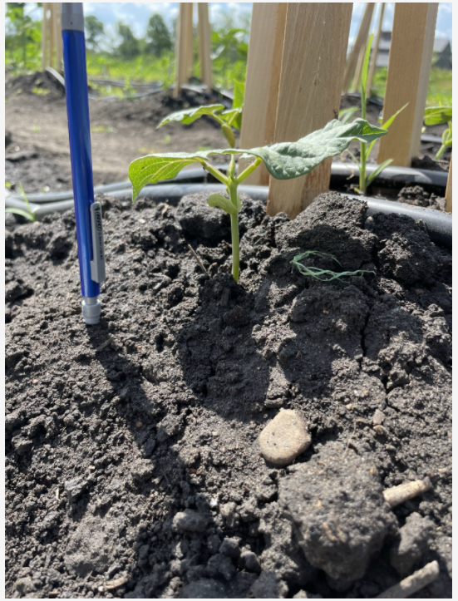
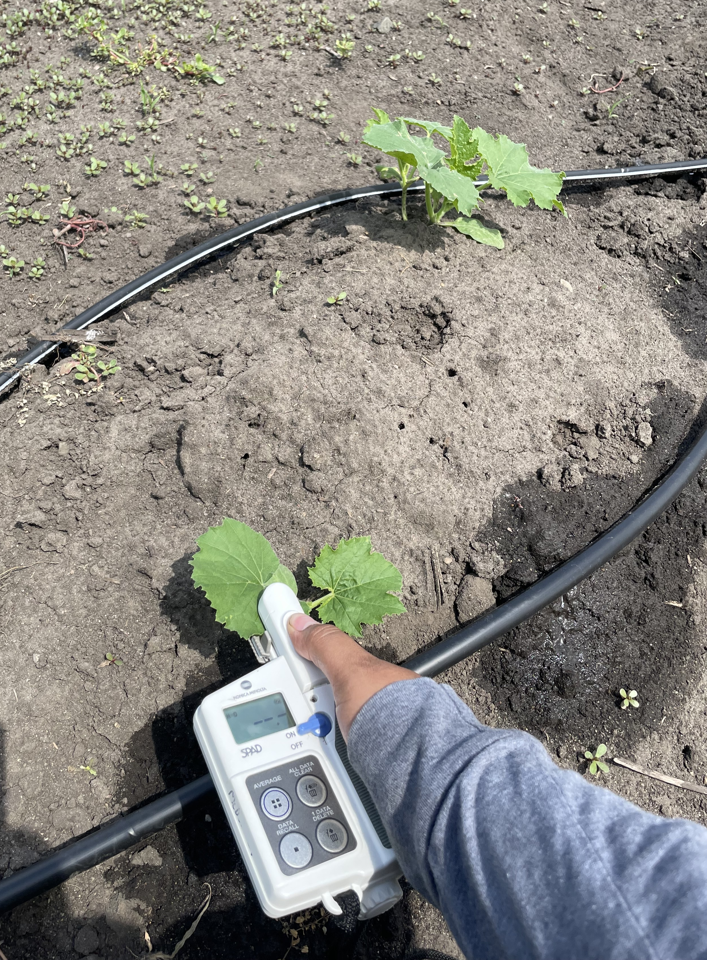
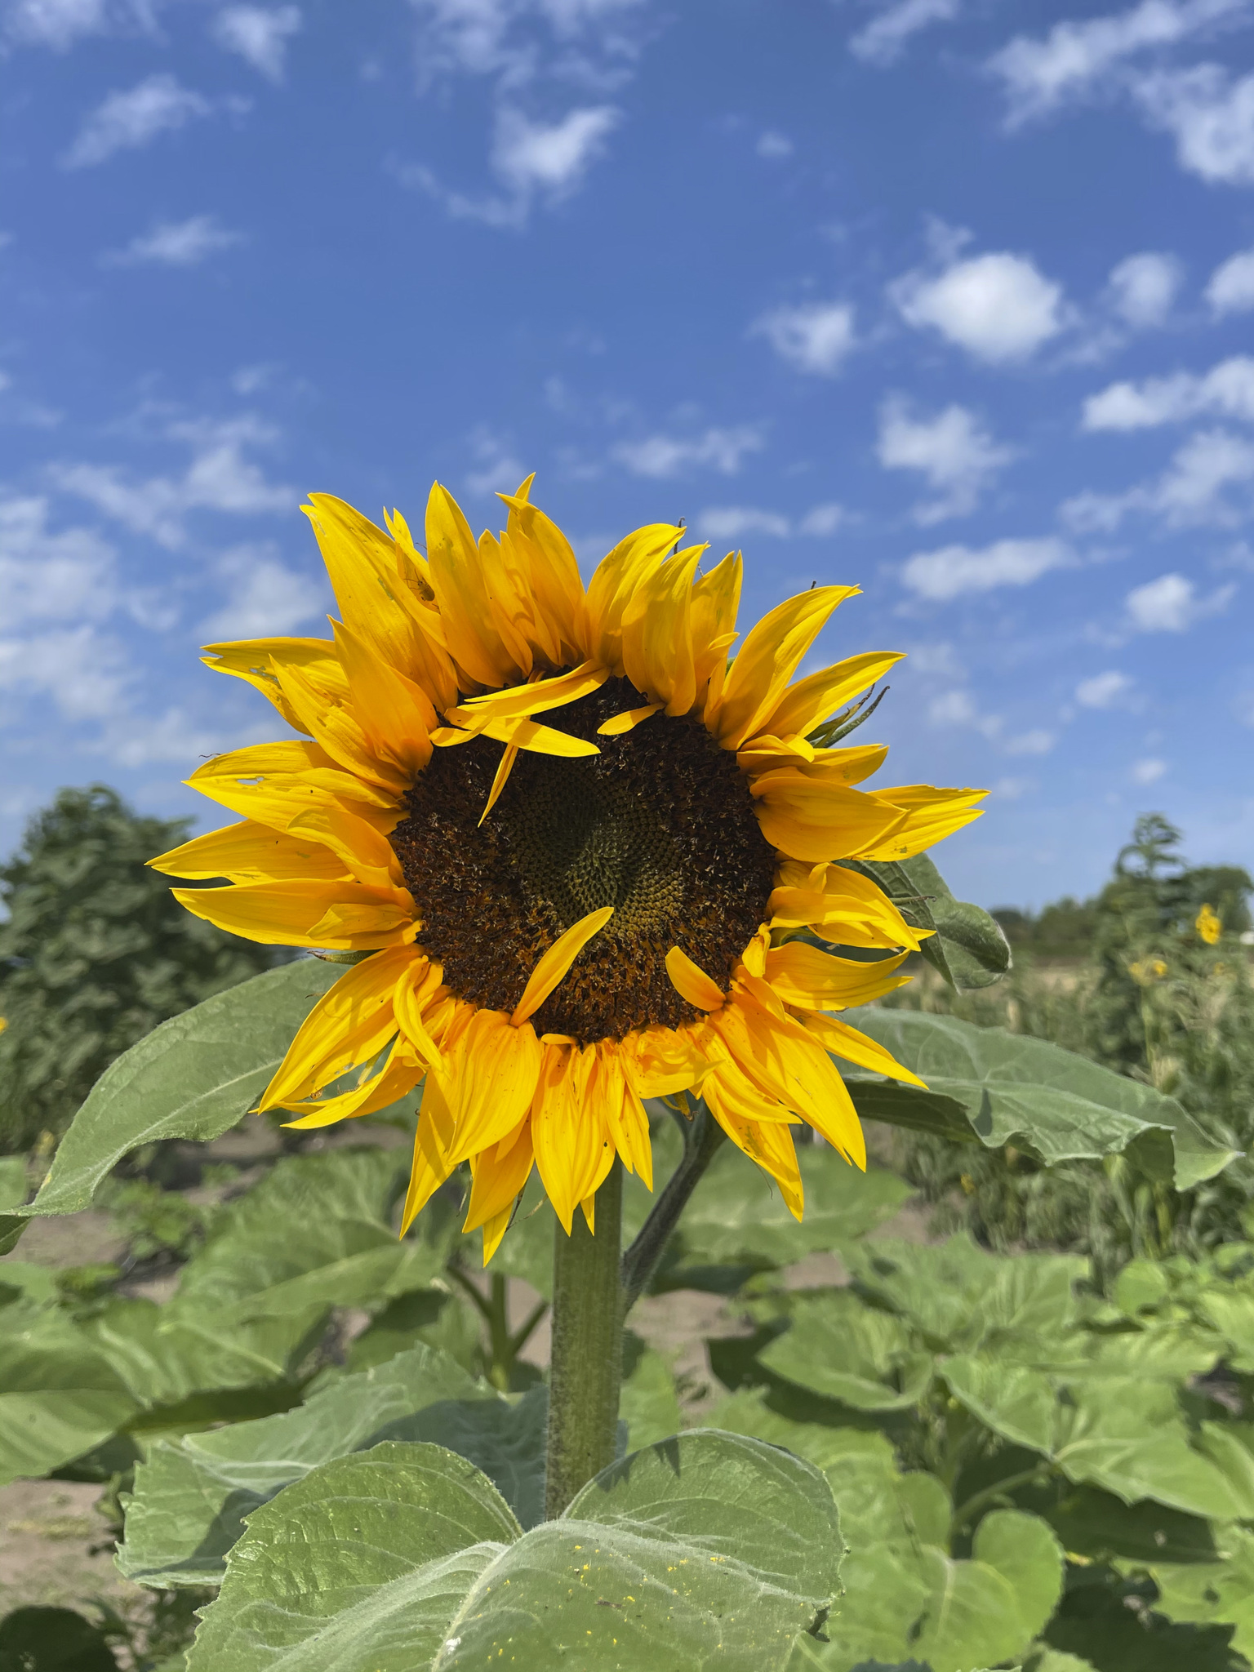
Overview
Welcome
2021 Update
  Ethnography
  Nutrition
  ISU Plots
    Plant Health
    Soil Health
  Workshops
Looking forward
Community expectations

Slide 3
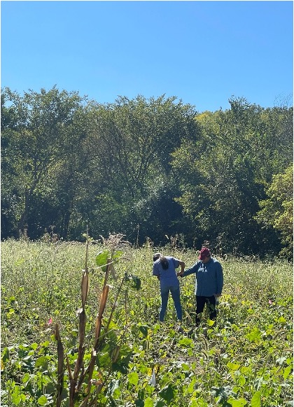
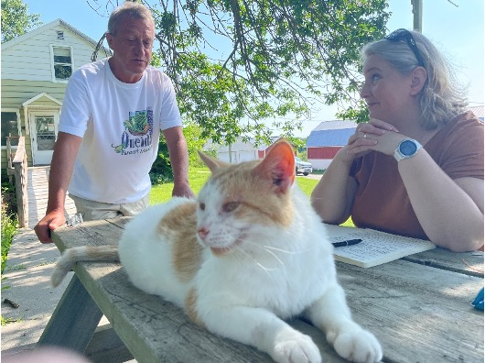
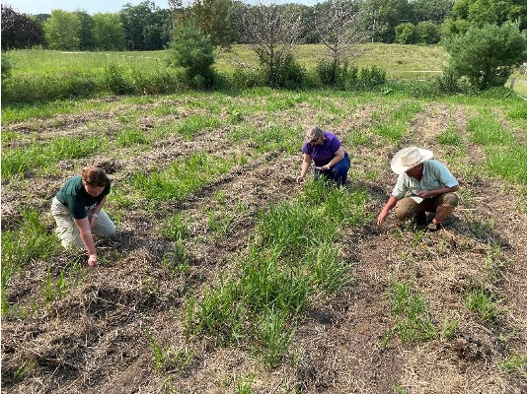
Ethnography
•Meaning of food sovereignty
•Power of growing Indigenous foods
•Importance of rematriation and seed sovereignty
•Decolonizing food systems, including the importance of networks

Slide 4
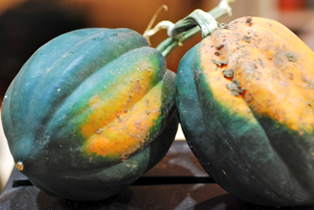
Nutrition Environment - 2022
Physical food availability and accessibility (Santee, Macy, Minneapolis)
–Store contents; prices; indigenous foods; staples
–Assessment May & November for comparisons
•Food markets – community views – interviews, short surveys
•Input from you – key people? known issues? prior information?

Slide 5
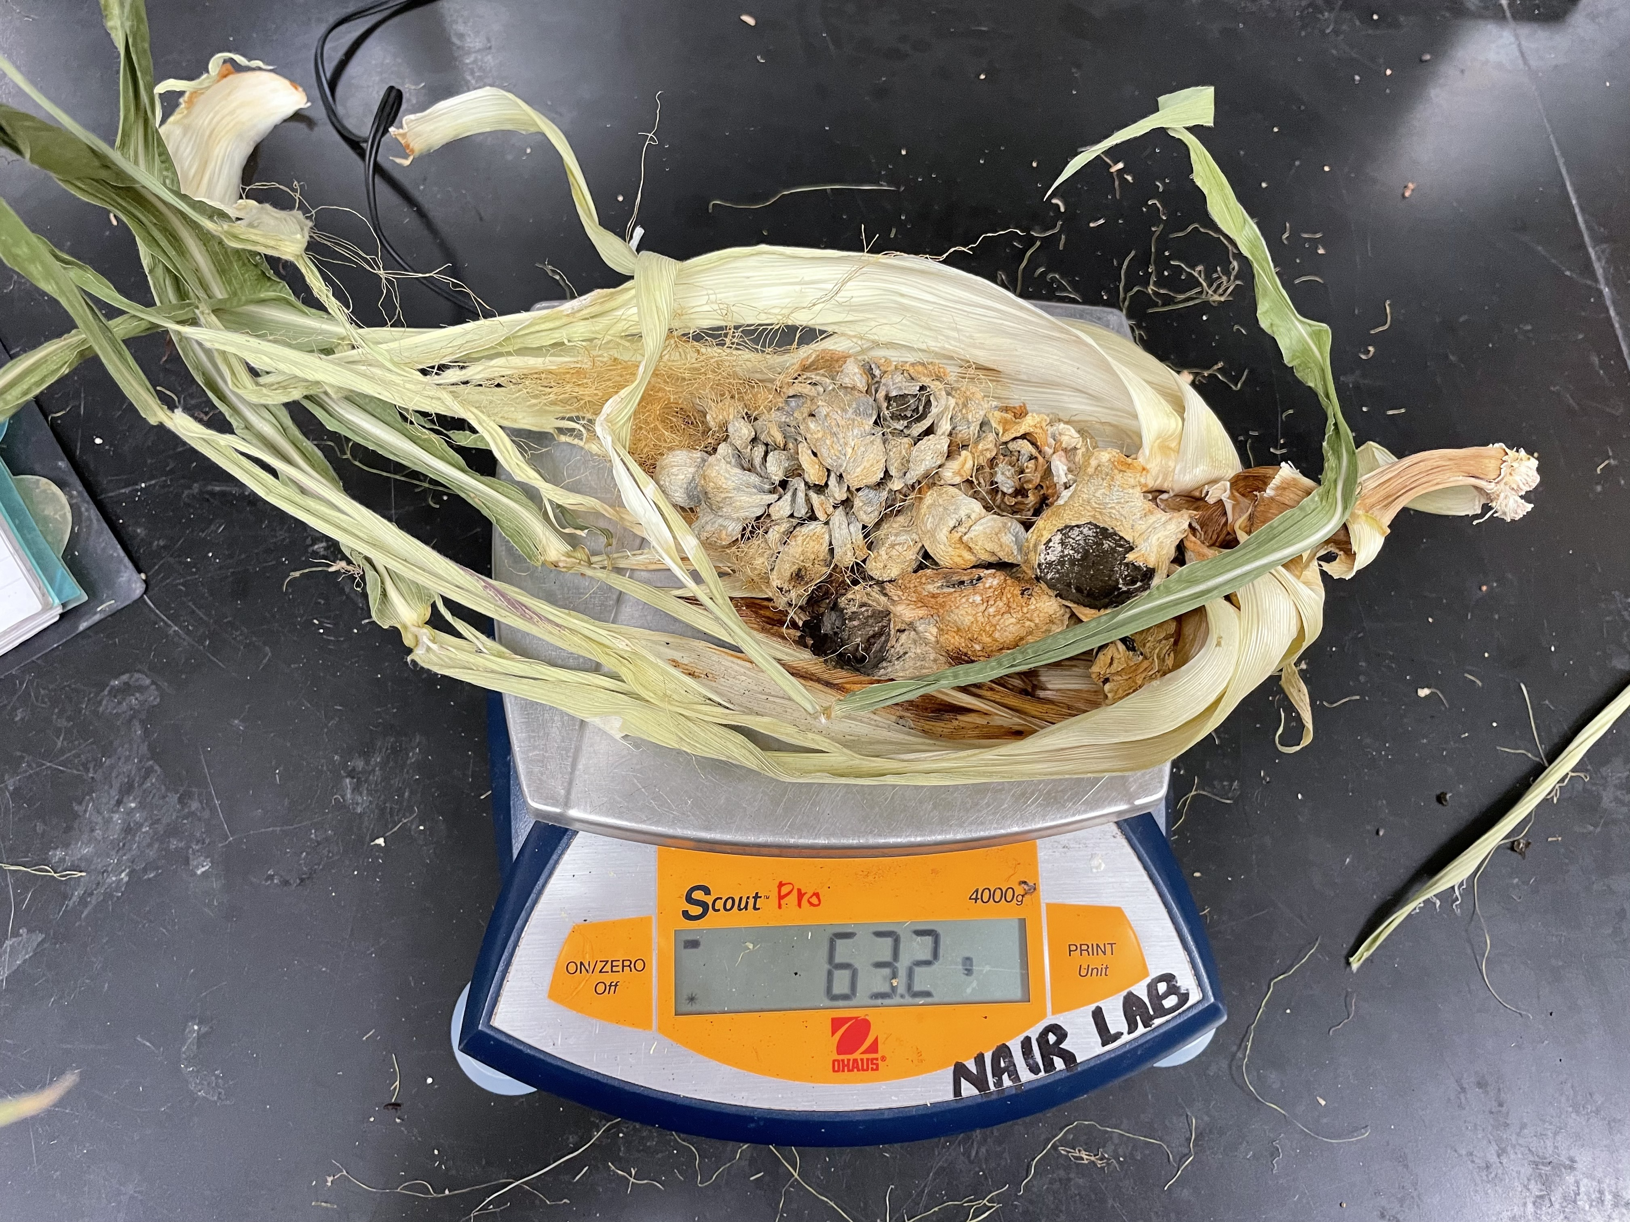
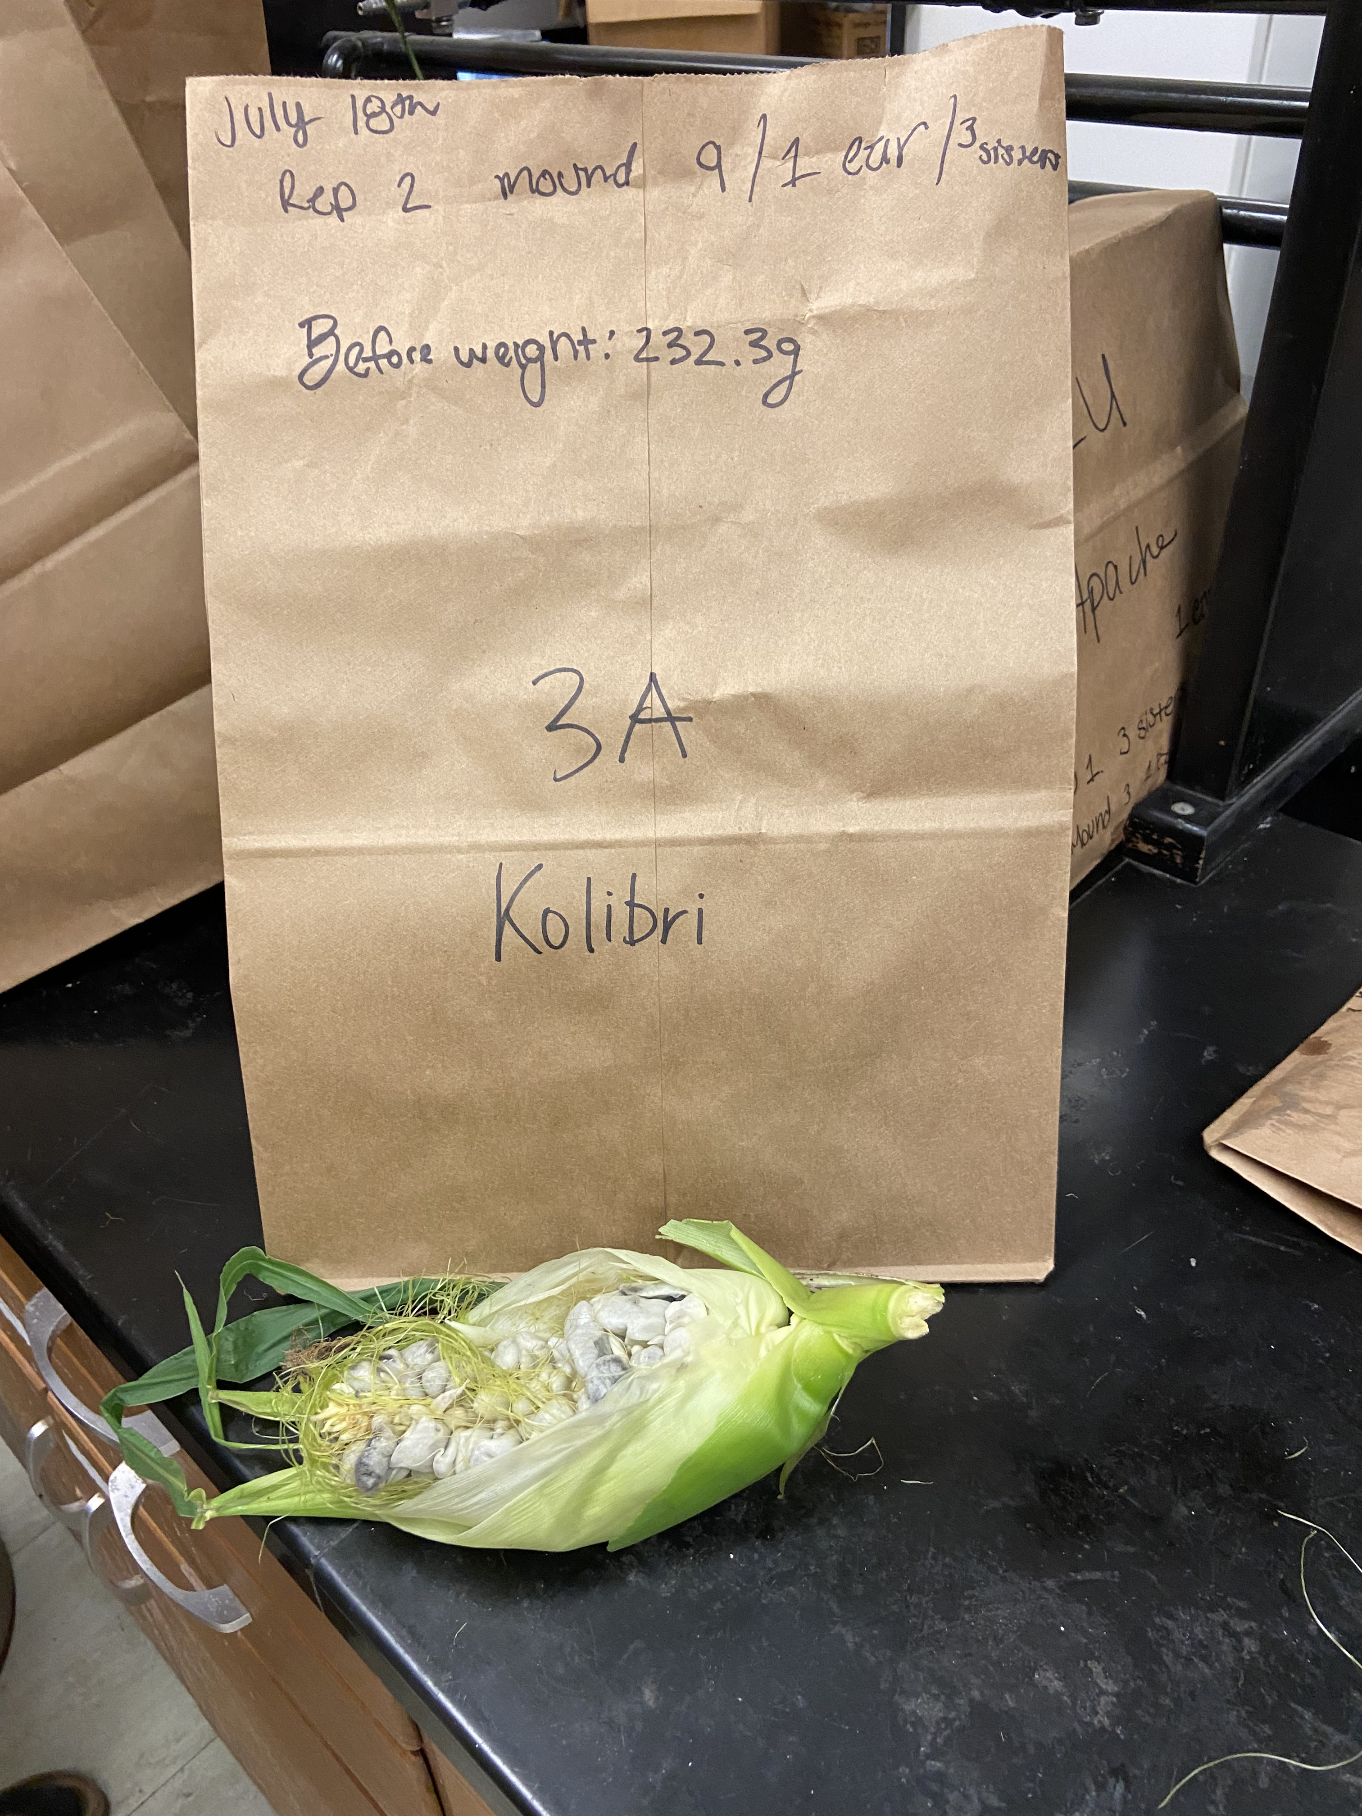
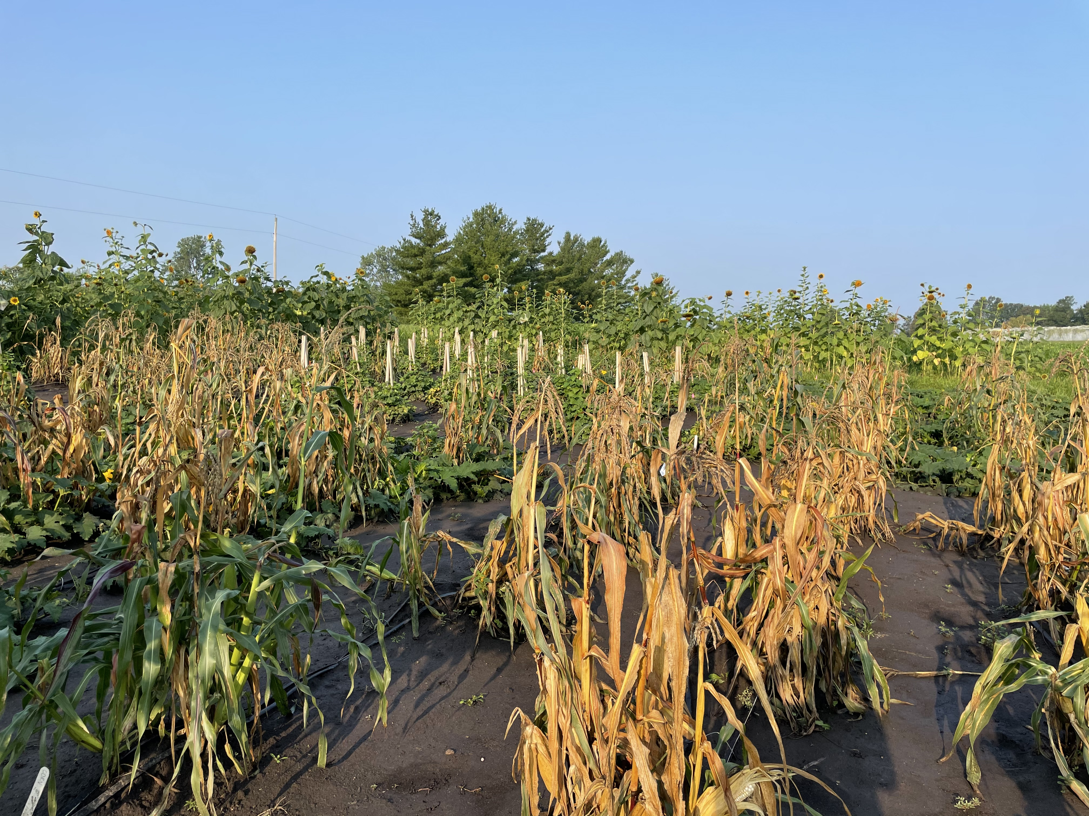
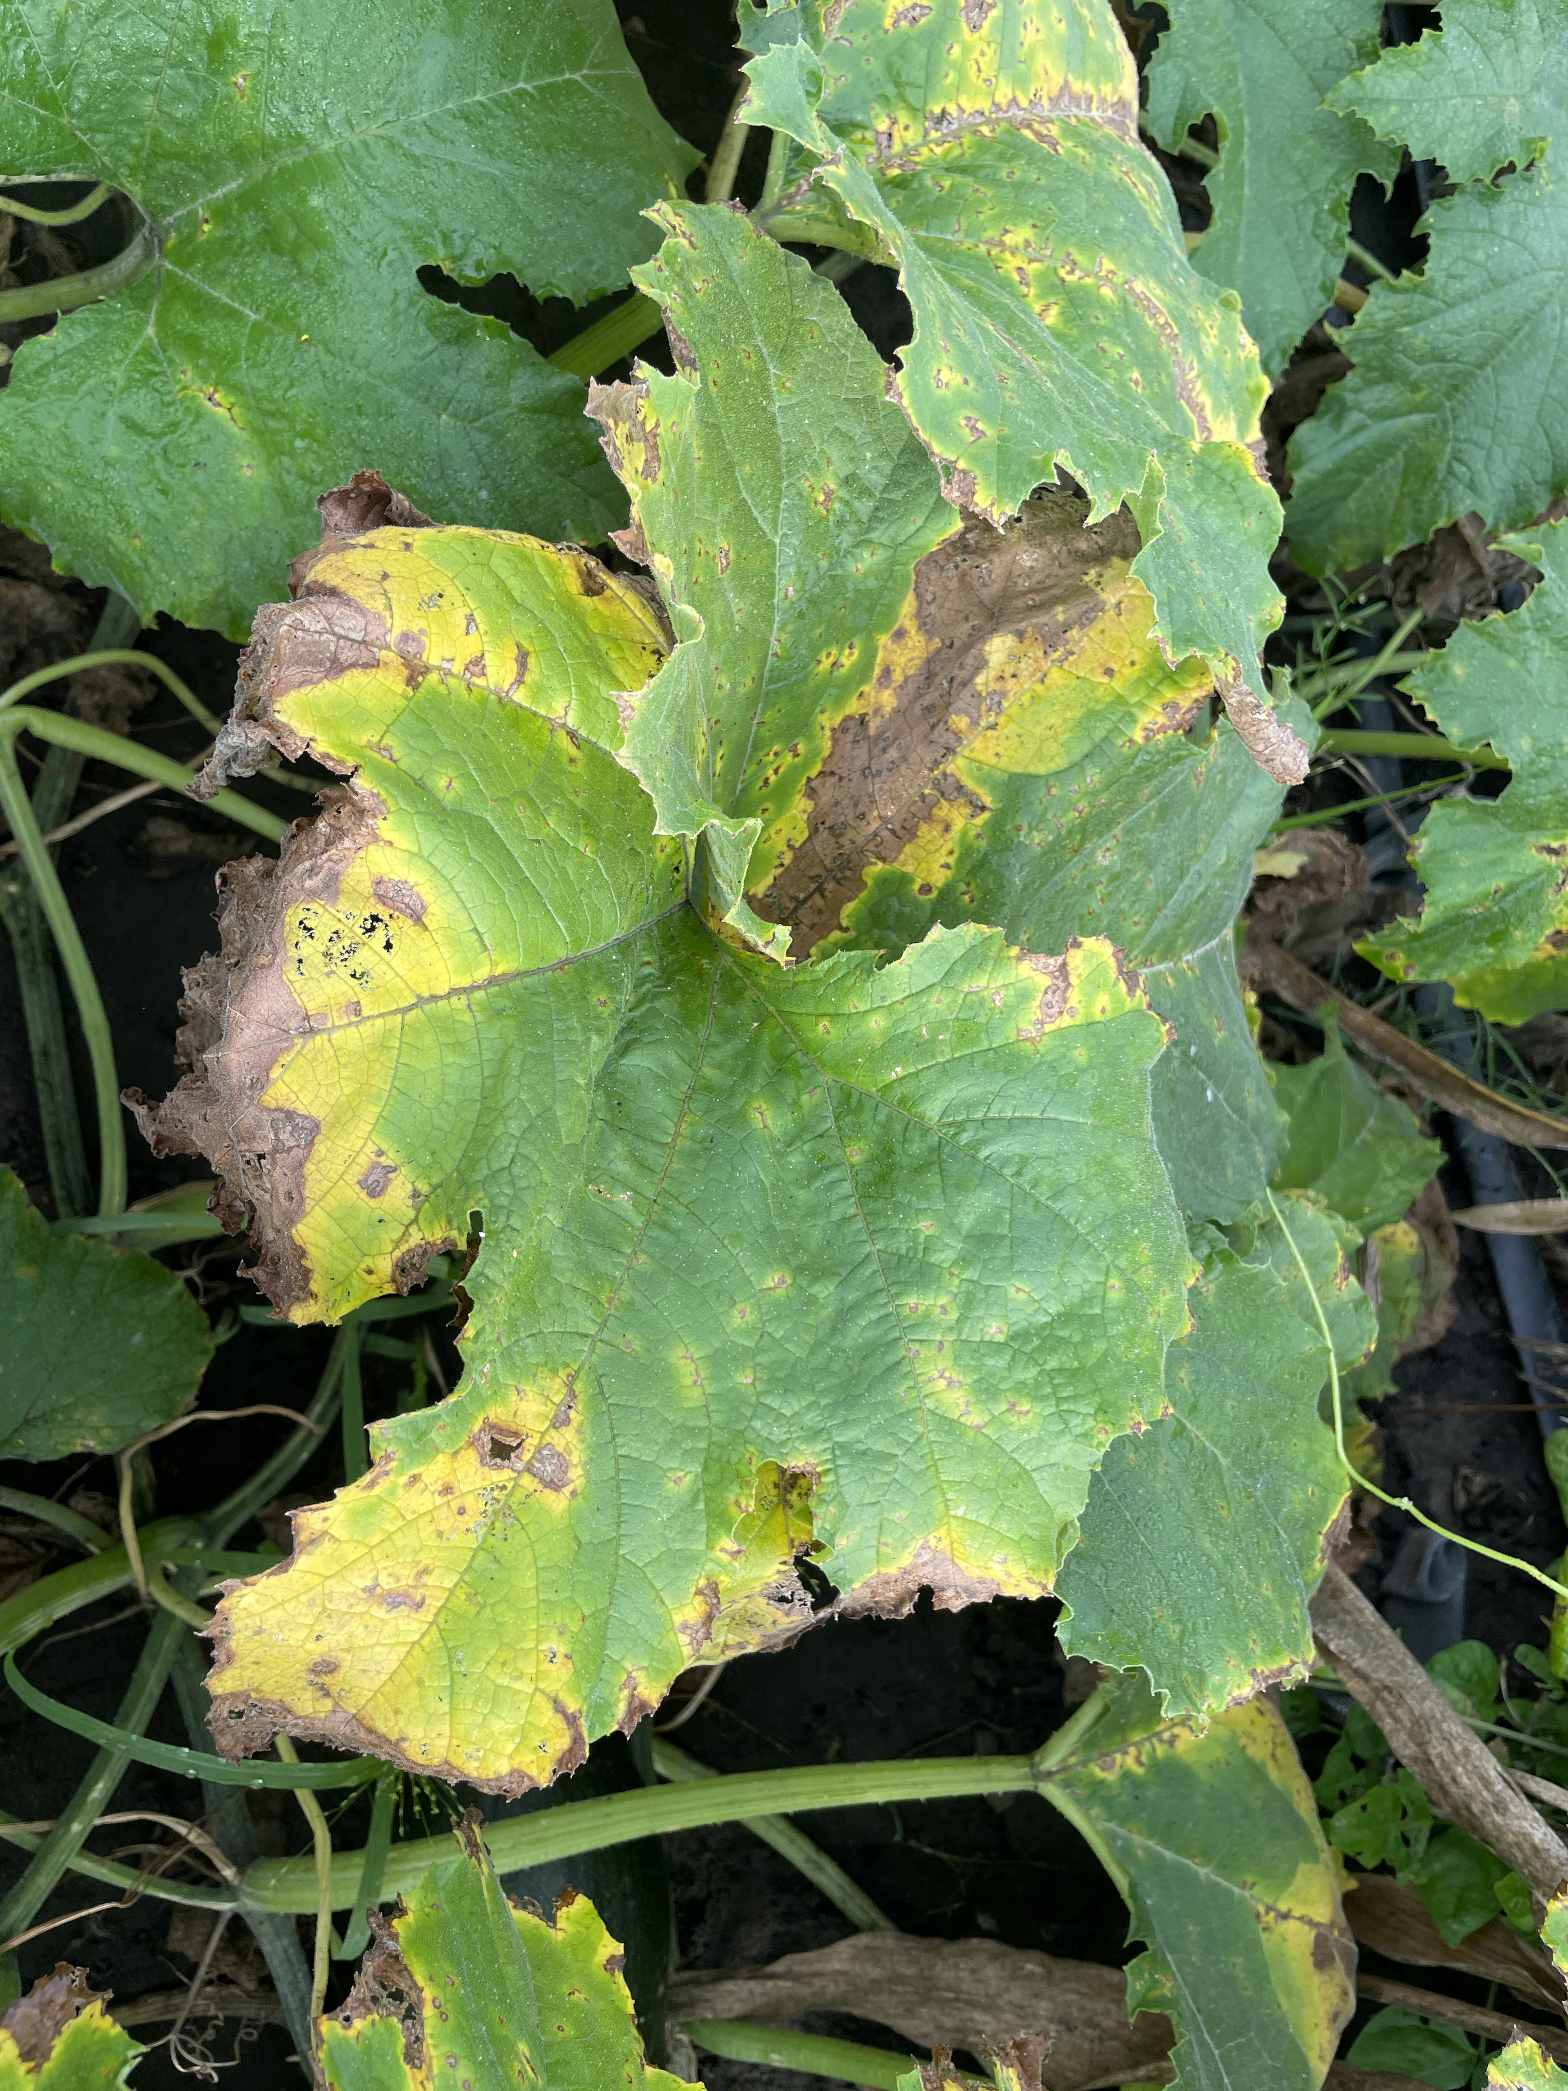
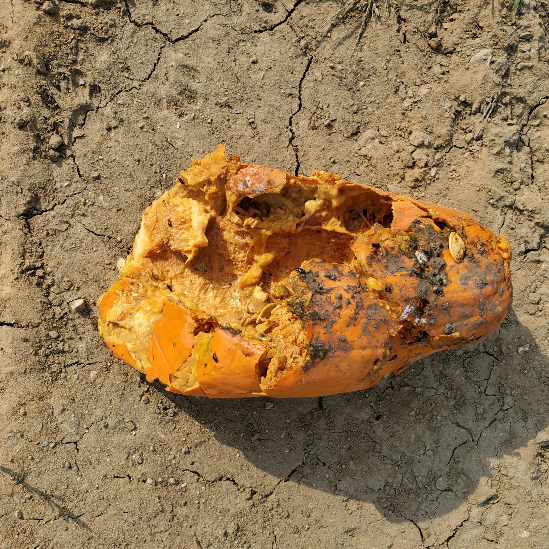
ISU Research Plot
Successful growing season!
Did experience corn smut again, but less severe than last season
  Collected additional data on smut yield
New disease issue of bacterial spot of cucurbits

Slide 6
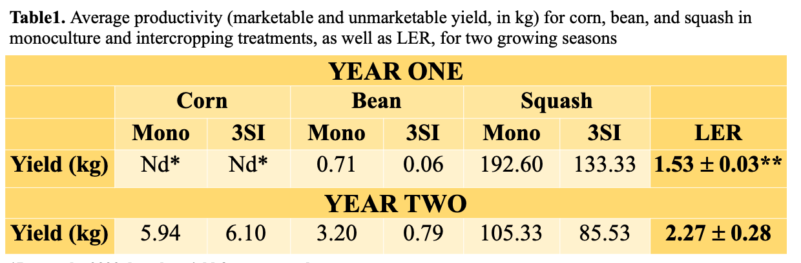
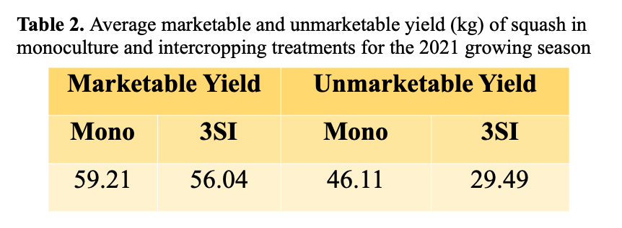
Yield Data
In 2021, on average, there was a squash yield reduction of 44% and 34% in the monoculture and 3SI treatments, respectively, due to disease

Slide 7
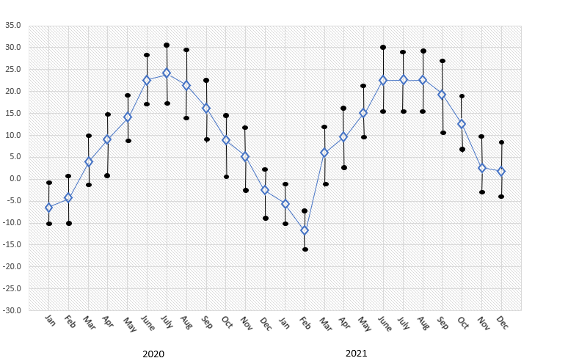
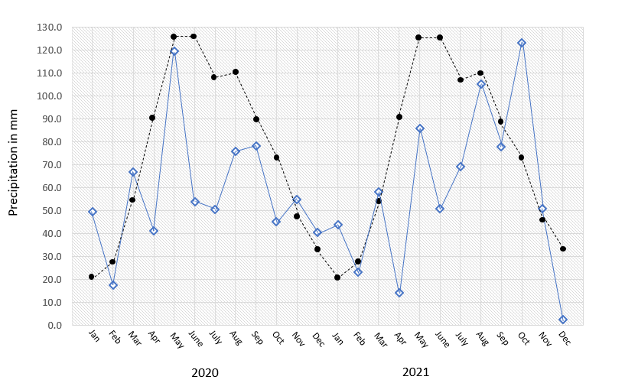
Average temperature and precipitation:
2020-2021
2020 2021
2020 2021
2020 2021
Figure 1. Recorded average monthly temperature (in C°) x 50-year average monthly high and low (left panel), recorded monthly precipitation x 50-year average (right panel). Blue lines show conditions recorded during experiment, black lines and dots show 50-year averages.

Slide 8
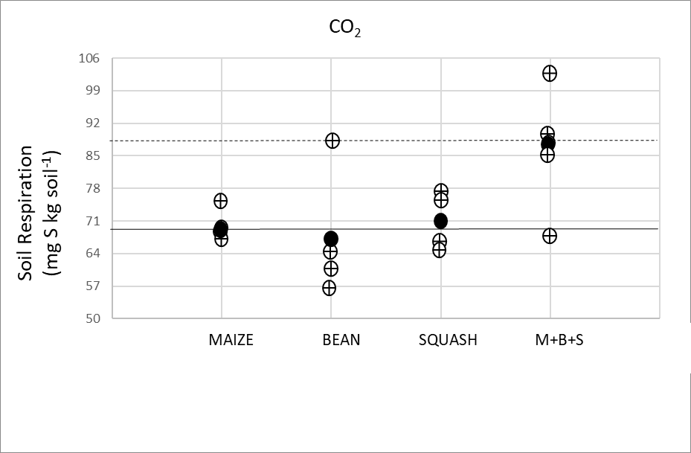
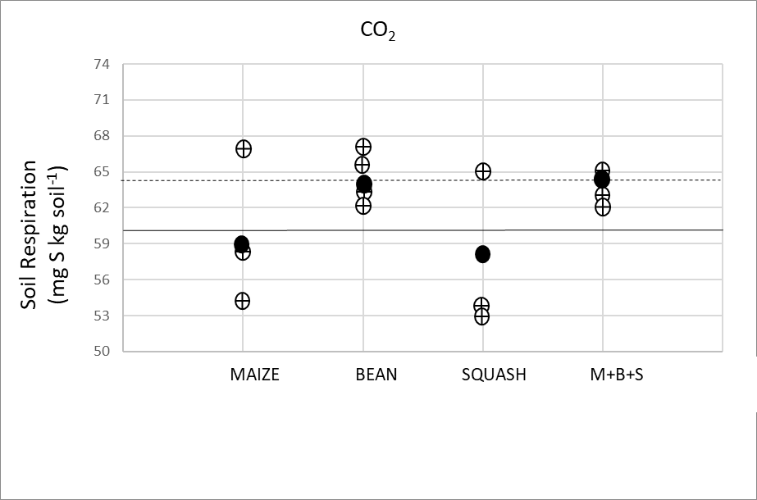
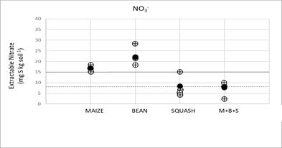
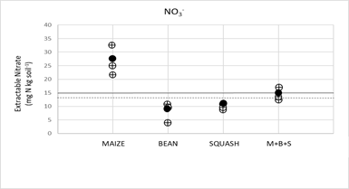
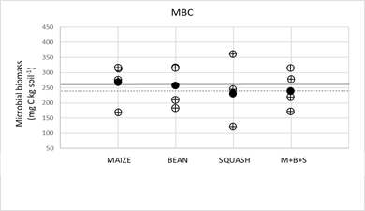
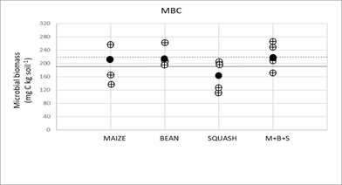
2020 2021
Soil Respiration
(mg C kg soil⁻¹)
Extractable Nitrate
(mg N kg soil⁻¹)
Microbial biomass C
(mg C kg soil⁻¹)

Slide 9
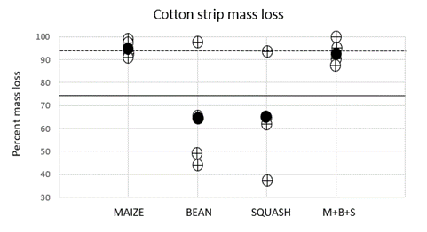
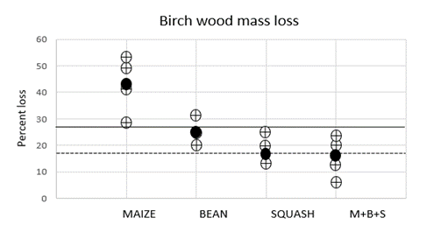
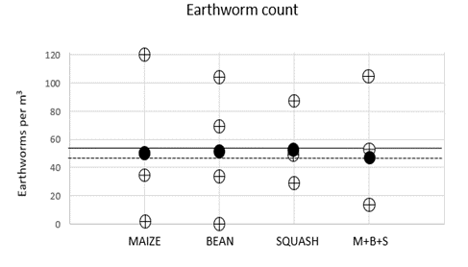
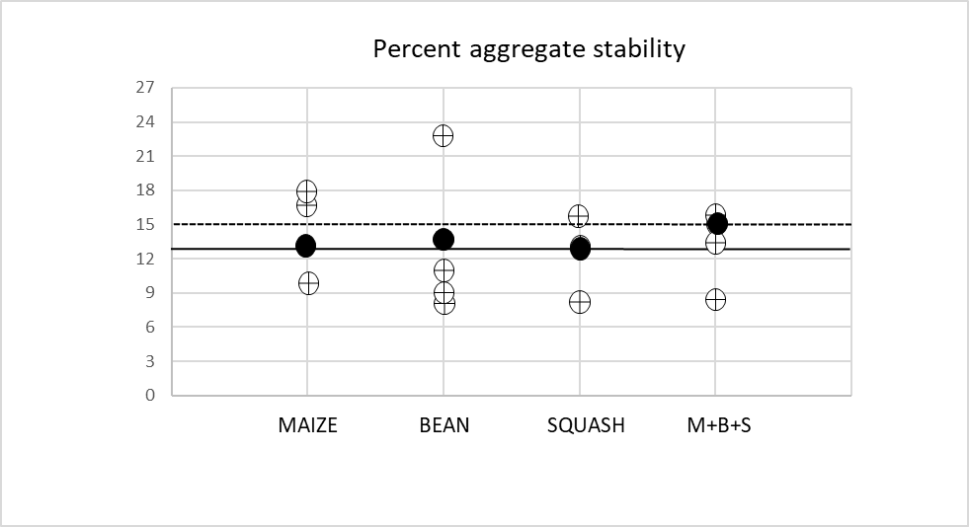
DIY soil health measurements
Cotton strip mass loss
Popsicle stick mass loss
Percent mass loss
Percent mass loss
Earthworm count
Aggregate Stability
Percent remaining

Slide 10
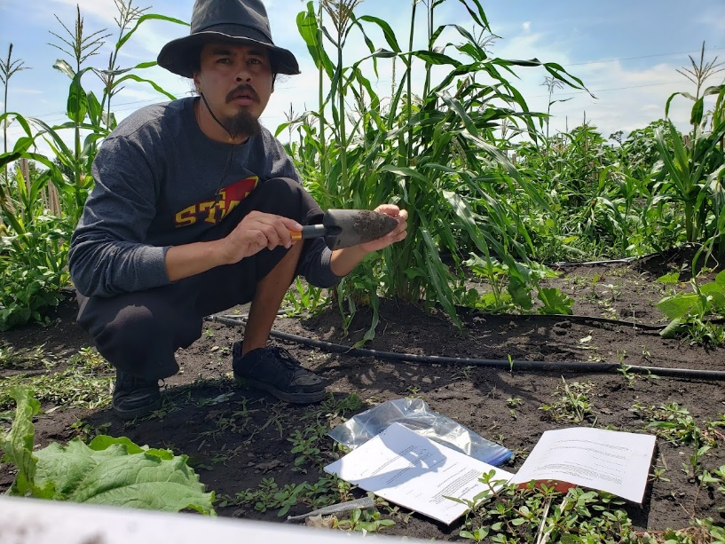
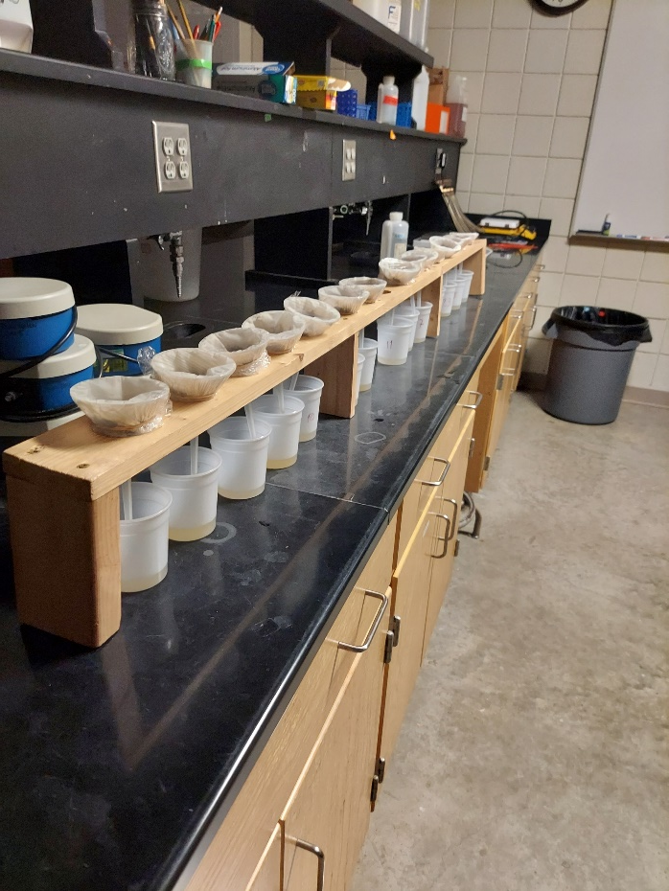
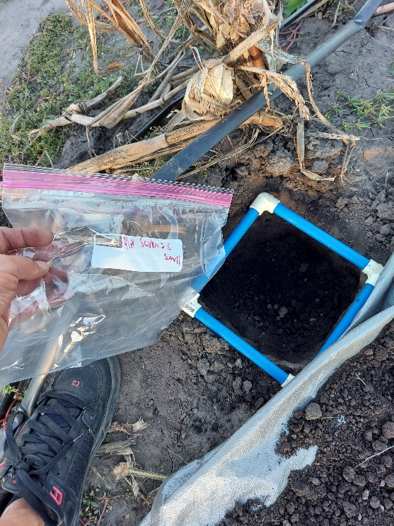

Slide 11
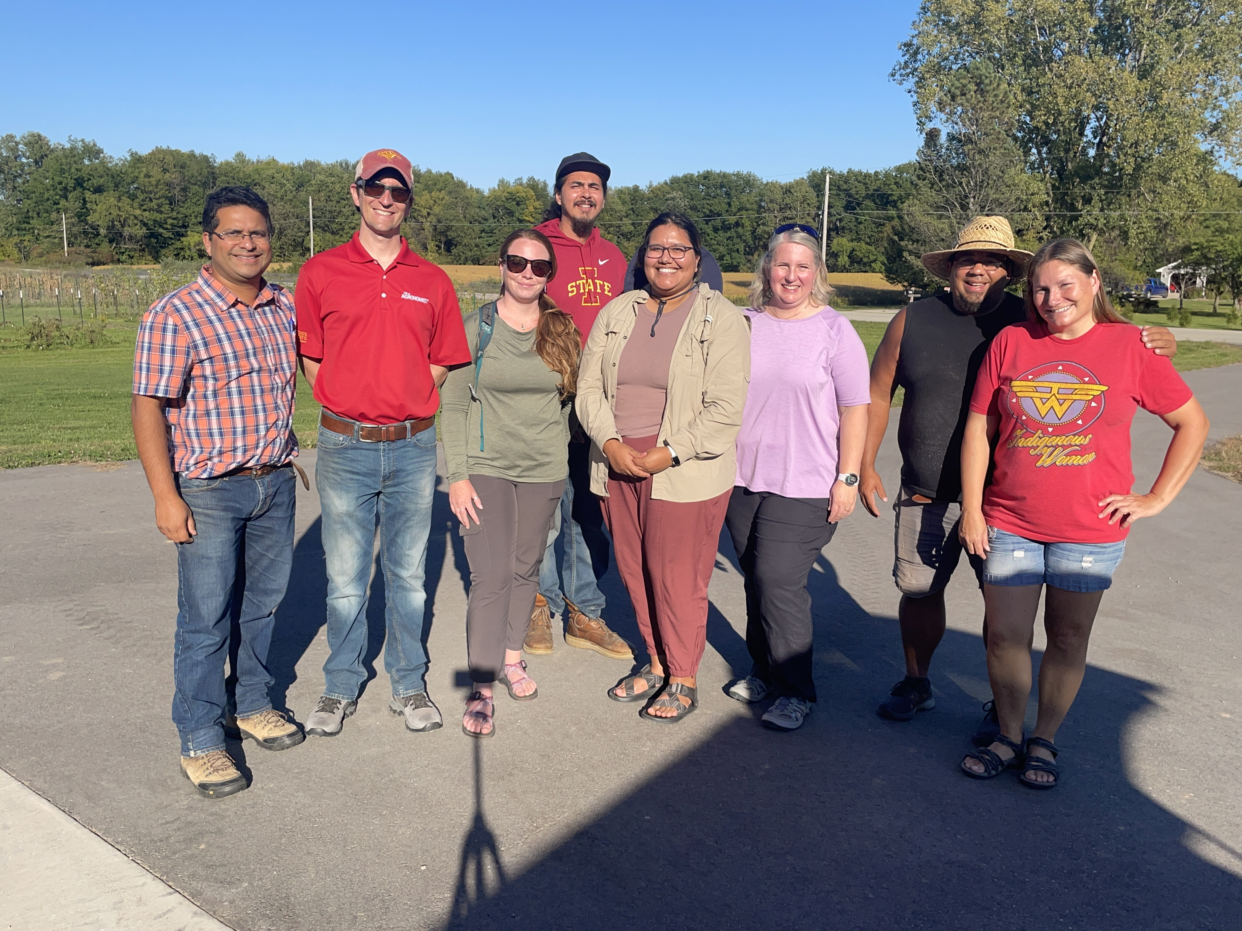
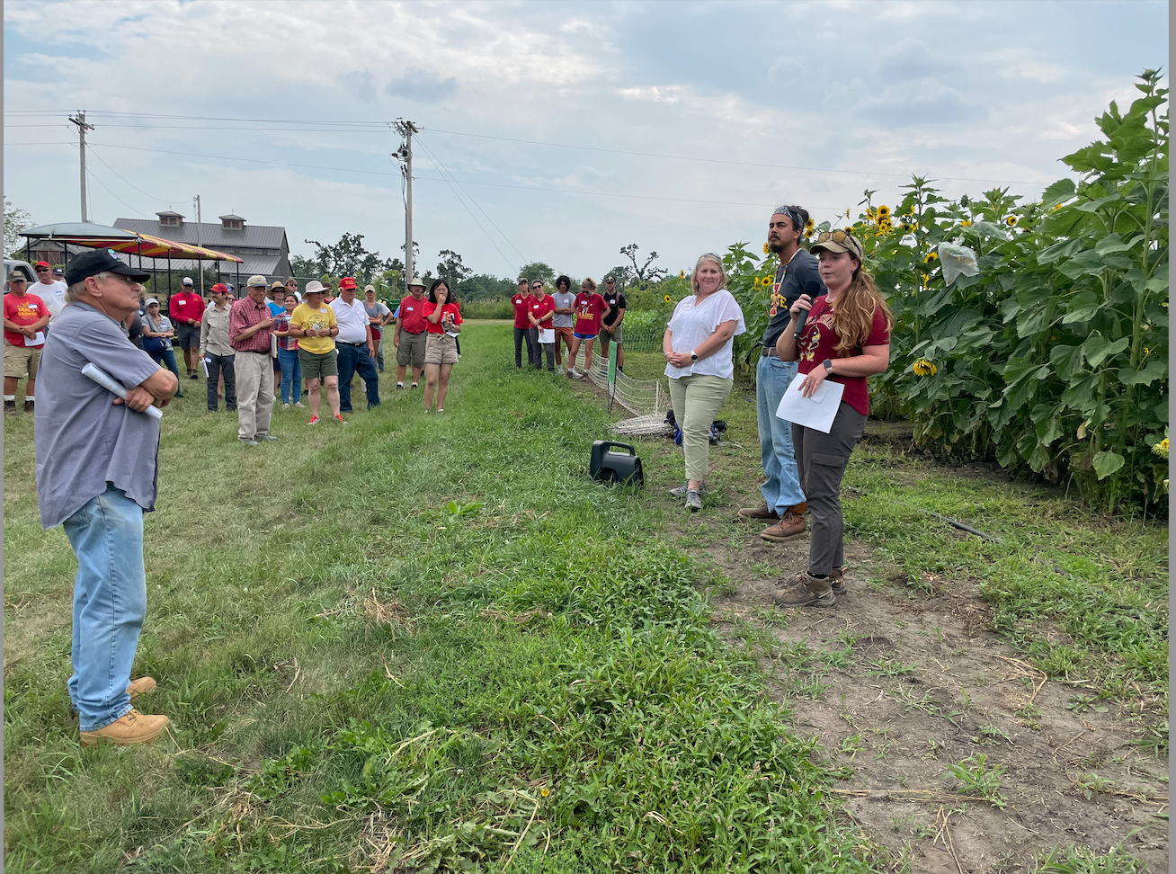
Ajay/all
Workshops/Extension

Slide 12
Looking Forward
Presentations coming up with more discussion time
  Nutrition Environment
  Seeds & Rematriation
  Community Plots and Soils
  Extension & Workshops
  Ethnography
We can begin the conversation...

Slide 13
Community Expectations & Response
What are some questions that arise with the updates?
What needs does each community have? What kinds of resources are you looking for?
Which topics below are of interest for future collaborative efforts in communities? New directions?
Floor is open!
Discussion Topics
Nutrition Environment Seeds & Rematriation Soil Health | Community Plots Extension & Workshops Ethnography

