Slide 1
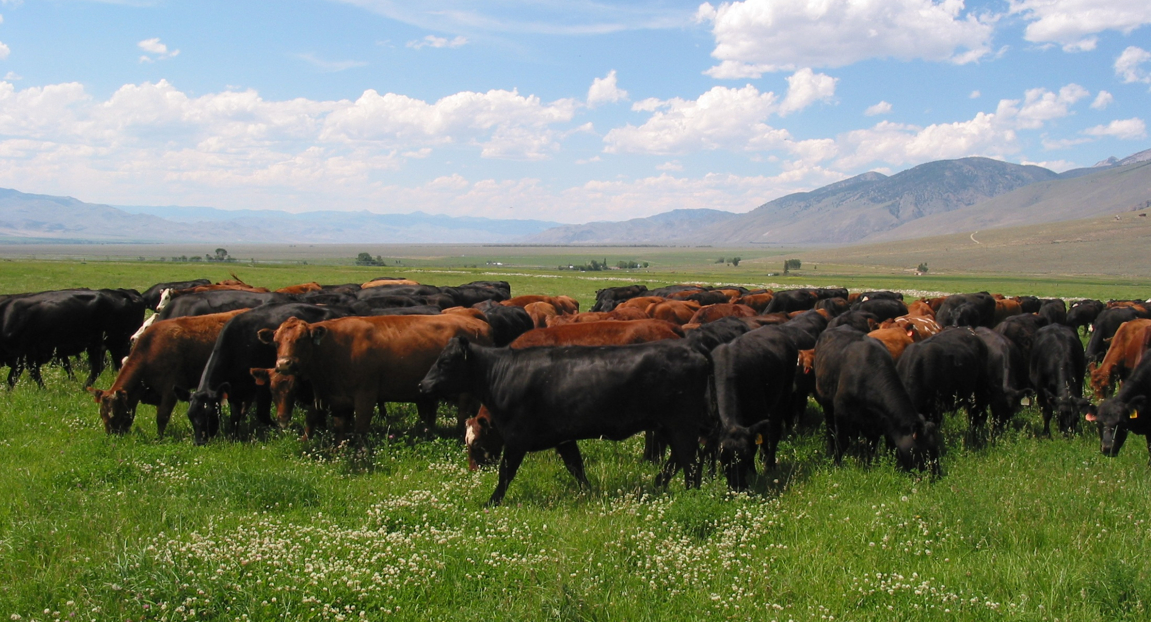
Stock Density:
The most powerful tool in the grazier’s toolbox
Revised and shared in the SARE Organic Ag Academy 8/3/20
Jim Gerrish
American GrazingLands Services LLC
May, Idaho

Slide 2
Some useful definitions
Stocking rate: The number of animals or animal live weight assigned to a grazing unit on a seasonal basis.
Notes:
One of the first things we are likely to be interested in determining is the carrying capacity of our pasture. Let’s distinguish between stocking rate and carrying capacity. Stocking rate is whatever number of animals we happen to put out on a particular pasture. It might be too many, it might be too few, or it may be about right. Carrying capacity is the number of animals we can put on a particular grazing unit and provide them with adequate nutrition while keeping the pasture or range in a healthy, productive state.

Slide 3
Stocking rate illustration
Ten head on ten acres
Stocking rate = 1 hd/acre
If cows weigh 1200 lb… stocking rate is 1200 lb/acre

Slide 4
Some useful definitions
Stocking rate: The number of animals or animal live weight assigned to a grazing unit on a seasonal basis.
Carrying capacity: The stocking rate that provides a target level of performance while maintaining the integrity of the resource base.
Notes:
One of the first things we are likely to be interested in determining is the carrying capacity of our pasture. Let’s distinguish between stocking rate and carrying capacity. Stocking rate is whatever number of animals we happen to put out on a particular pasture. It might be too many, it might be too few, or it may be about right. Carrying capacity is the number of animals we can put on a particular grazing unit and provide them with adequate nutrition while keeping the pasture or range in a healthy, productive state.

Slide 5
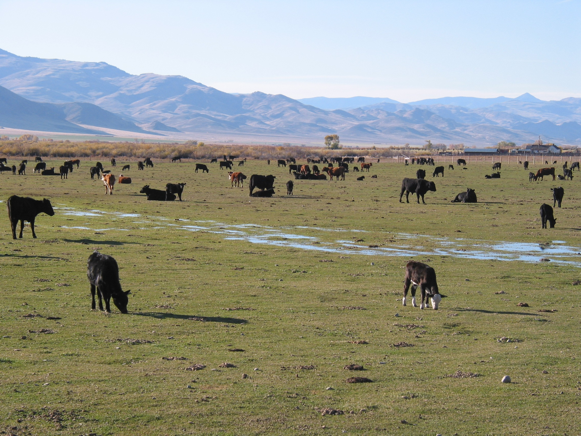
This pasture is stocked beyond its carrying capacity !

Slide 6
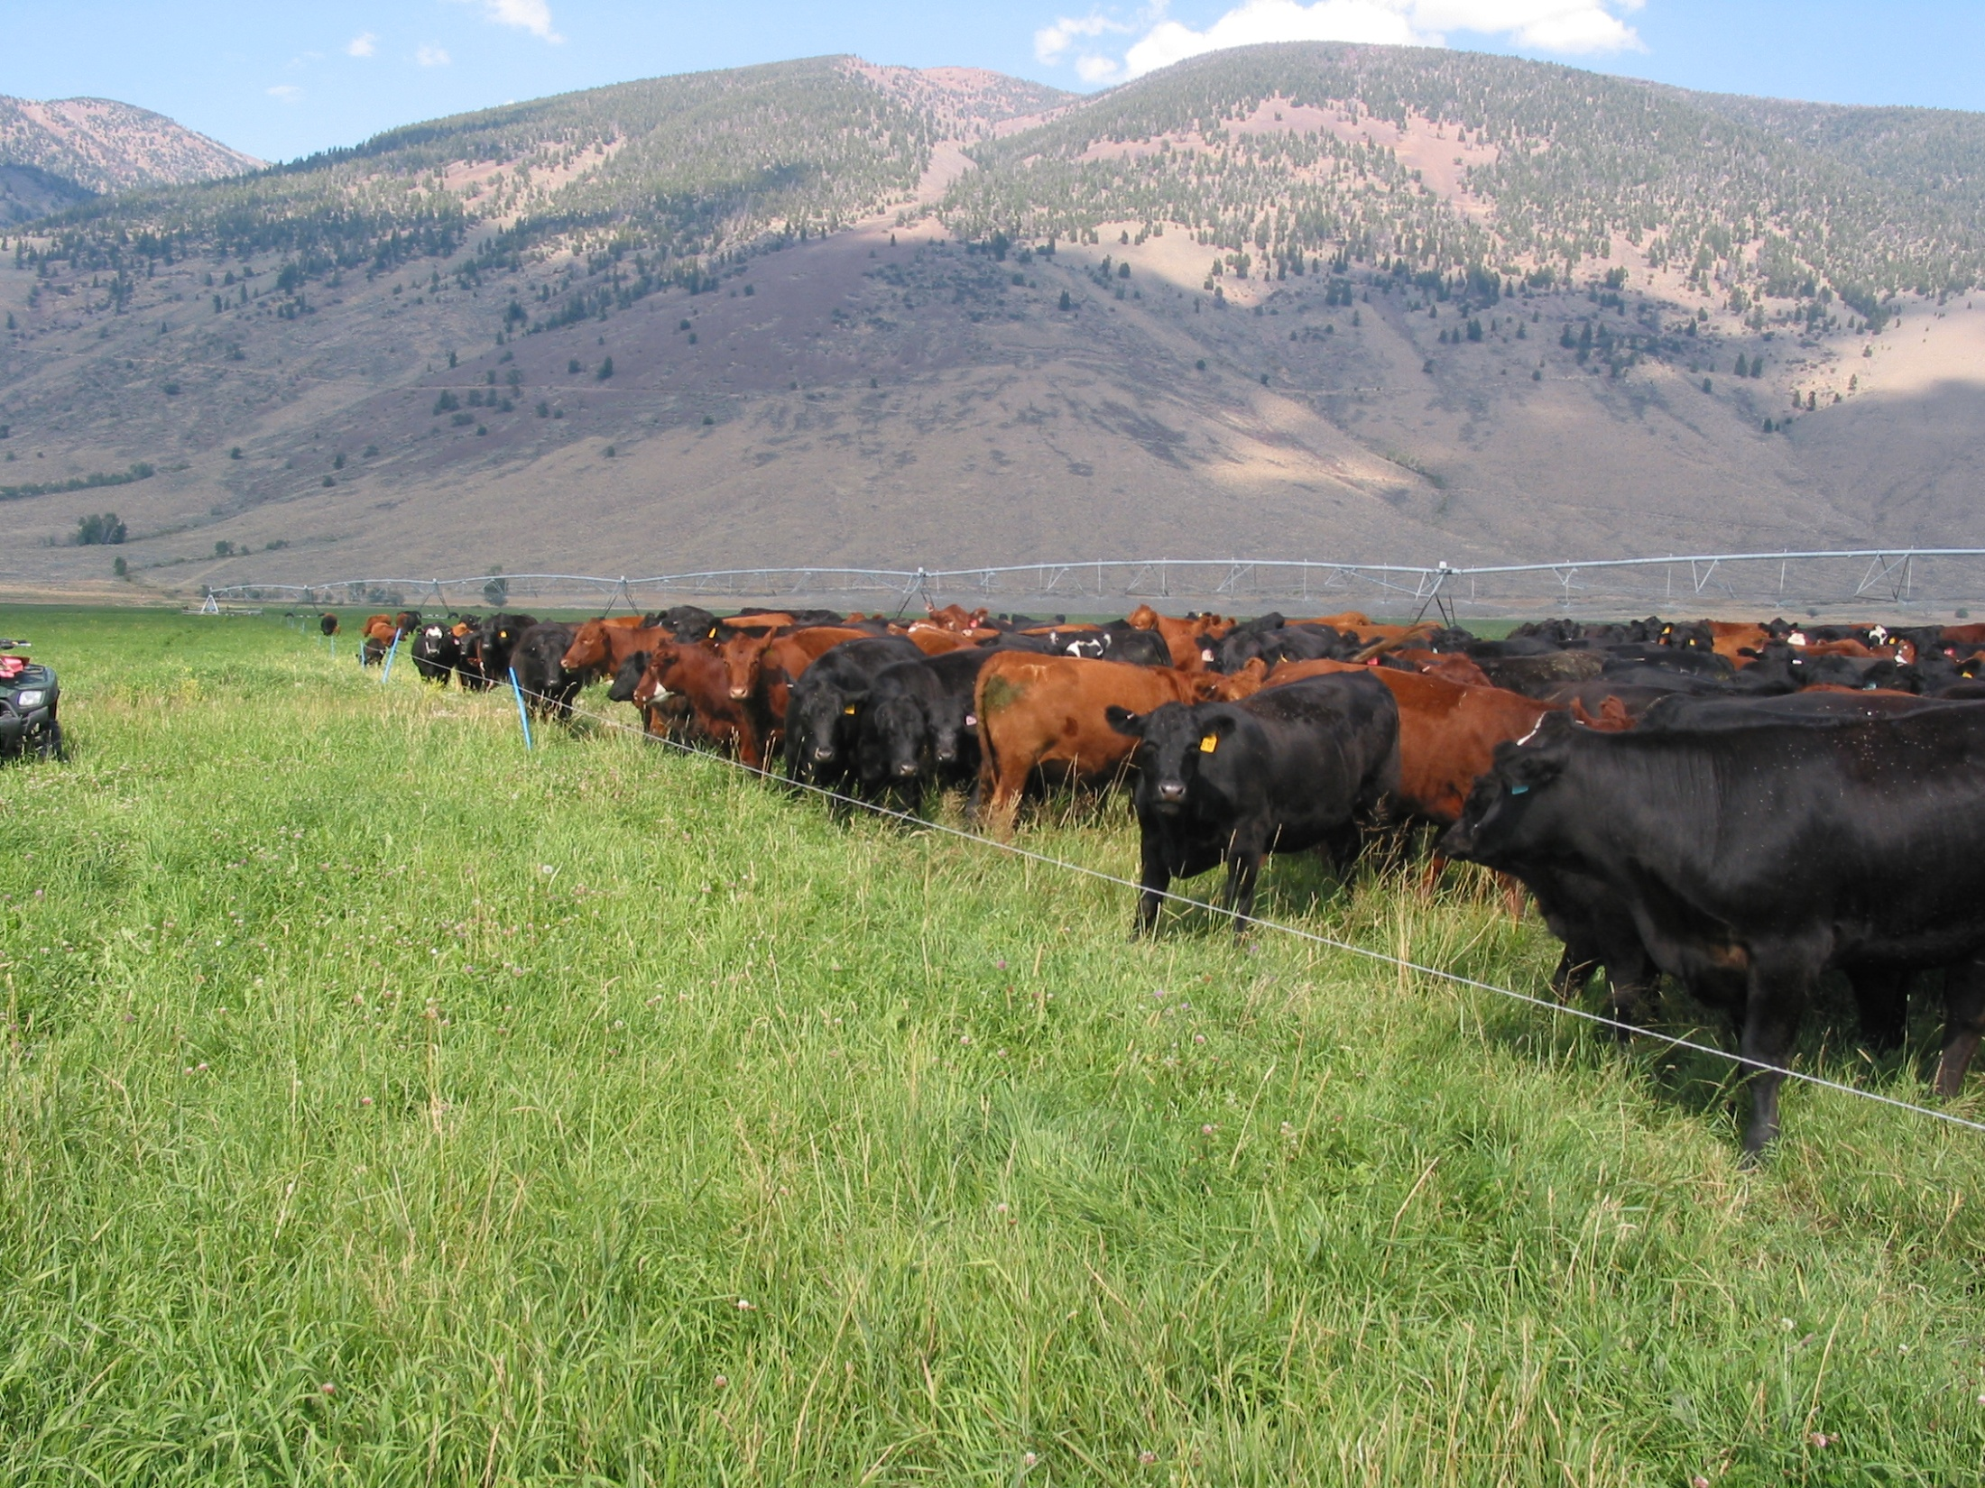
This pasture is stocked near its carrying capacity !

Slide 7
Some useful definitions
Stocking rate: The number of animals or animal live weight assigned to a grazing unit on a seasonal basis.
Stock density: The number of animals or animal live weight assigned to a specific pasture area for a specific time period.
Notes:
While stocking rate defines the number of animals assigned to a large grazing area for an extended period of time, stock density describes concentration of animals on a limited area for a limited time period.

Slide 8
Stocking rate and stock density with continuous grazing
Ten head on ten acres
Stocking rate = 1 hd/acre
With continuous grazing:
stock density = stocking rate
Both are still 1200 lb/acre

Slide 9
Pasture subdivision and stock density
With pasture subdivision stocking rate may not change but stock density does !
Stock density is 10 hd/2.5 acres or 4800 lb/acre

Slide 10
Pasture subdivision and stock density
Each level of subdivision results in higher stock density
Stock density is now 12,000 lb/acre

Slide 11
Pasture subdivision and stock density
Stock density is now 24,000 lb/acre
You’ve got it, right?

Slide 12
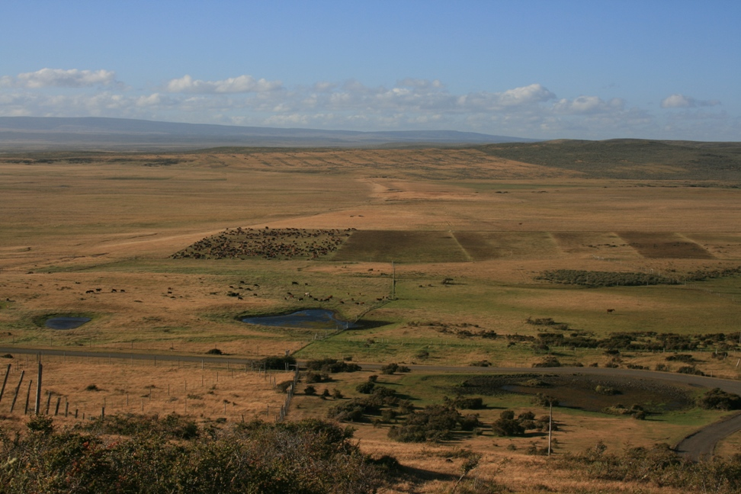
Low stock density
Low stock density
Low stock density
Low stock density
About 400 lb/acre

Slide 13
High stock density
About 300,000 lb/A

Slide 14
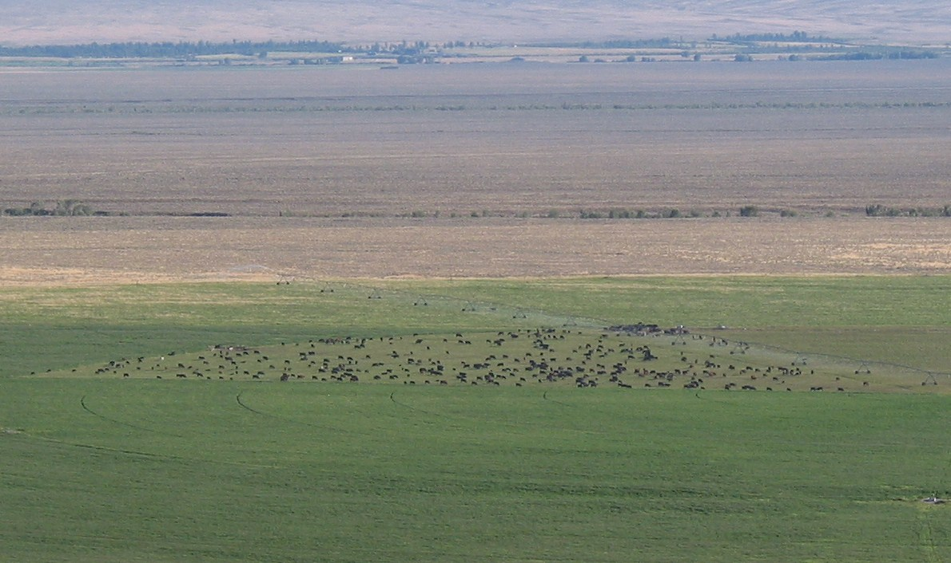
So, what’s the ‘right’ stock density?

Slide 15
Grazier’s Arithmetic
Forage
Availability
X
Temporal
Utilization Rate
Stock
Density
=
Daily
Intake
Length of the
Grazing Period
X
Notes:
The formula for stock density looks very similar to the carrying capacity equation but is actually very different. Now we are looking at available forage or what is out in the pasture today. Temporal utilization rate or how much of the standing pasture are we going to harvest during this grazing period. Daily intake is still the same daily intake. And grazing period is how many days are we going to allow the animals to be in this particular pasture.
This formula is not a simple math function where you can plug in any numbers and come up with a correct or meaningful answer. Because we are talking about living plants and animals, there are certain biological relationships that draw boundaries around some of our factors.

Slide 16
Grazier’s Arithmetic
Forage
Availability
X
Temporal
Utilization Rate
Stock
Density
=
Daily
Intake
Length of the
Grazing Period
X
Forage availability = How many lb forage dry matter / acre are standing in the field today

Slide 17
Grazier’s Arithmetic
Forage
Availability
X
Temporal
Utilization Rate
Stock
Density
=
Daily
Intake
Length of the
Grazing Period
X
Temporal utilization rate = What percentage of the available forage do you want to harvest in this grazing period

Slide 18
Grazier’s Arithmetic
Forage
Availability
X
Temporal
Utilization Rate
Stock
Density
=
Daily
Intake
Length of the
Grazing Period
X
Daily intake = What does each animal need to eat each day expressed as decimal fraction of bodyweight (e.g. .025)

Slide 19
Grazier’s Arithmetic
Forage
Availability
X
Temporal
Utilization Rate
Stock
Density
=
Daily
Intake
Length of the
Grazing Period
X
Length of the grazing period = how many days (or fraction of a day) stock will be on this paddock

Slide 20
Grazier’s Arithmetic
Forage
Availability
X
Grazing period
Utilization Rate
Stock
Density
=
Daily
Intake
Length of the
Grazing Period
X
If: Available forage = 2400 lb/acre
Temporal utilization = 50 %
Daily intake = 3% (.03 lb forage/lb liveweight)
Length of grazing period = 1 days …...
Notes:
If we make some assumptions that fall within the bounds defined by plant-animal relationships, we can come up with a meanigful estimate of appropriate stock density.

Slide 21
Grazier’s Arithmetic
Then ….
Stock Density
2400 lb/acre X .50
=
.03 lb forage/lb liveweight X 1 days
= 40,000 lb liveweight / acre
Notes:
Using these assumptions we find our pasture should be able to support about 40,000 lb of animal liveweight per acre per day.

Slide 22
Grazier’s Arithmetic
Then ….
Stock Density
2400 lb/acre X .50
=
.03 lb forage/lb liveweight X 1 days
= 40,000 lb liveweight / acre
Or about 30 1300 lb cows/acre/day
Notes:
This translates to about 30 of our 1300 lb cows…

Slide 23
Grazier’s Arithmetic
Then ….
Stock Density
2400 lb/acre X .50
=
.03 lb forage/lb liveweight X 1 days
= 40,000 lb liveweight / acre
Or about 30 1300 lb cows/acre/day
Or 57 700 lb steers/acre/day
Notes:
…. Or 57 of our 700 lb steers.

Slide 24
What is the appropriate stock density?

Slide 25
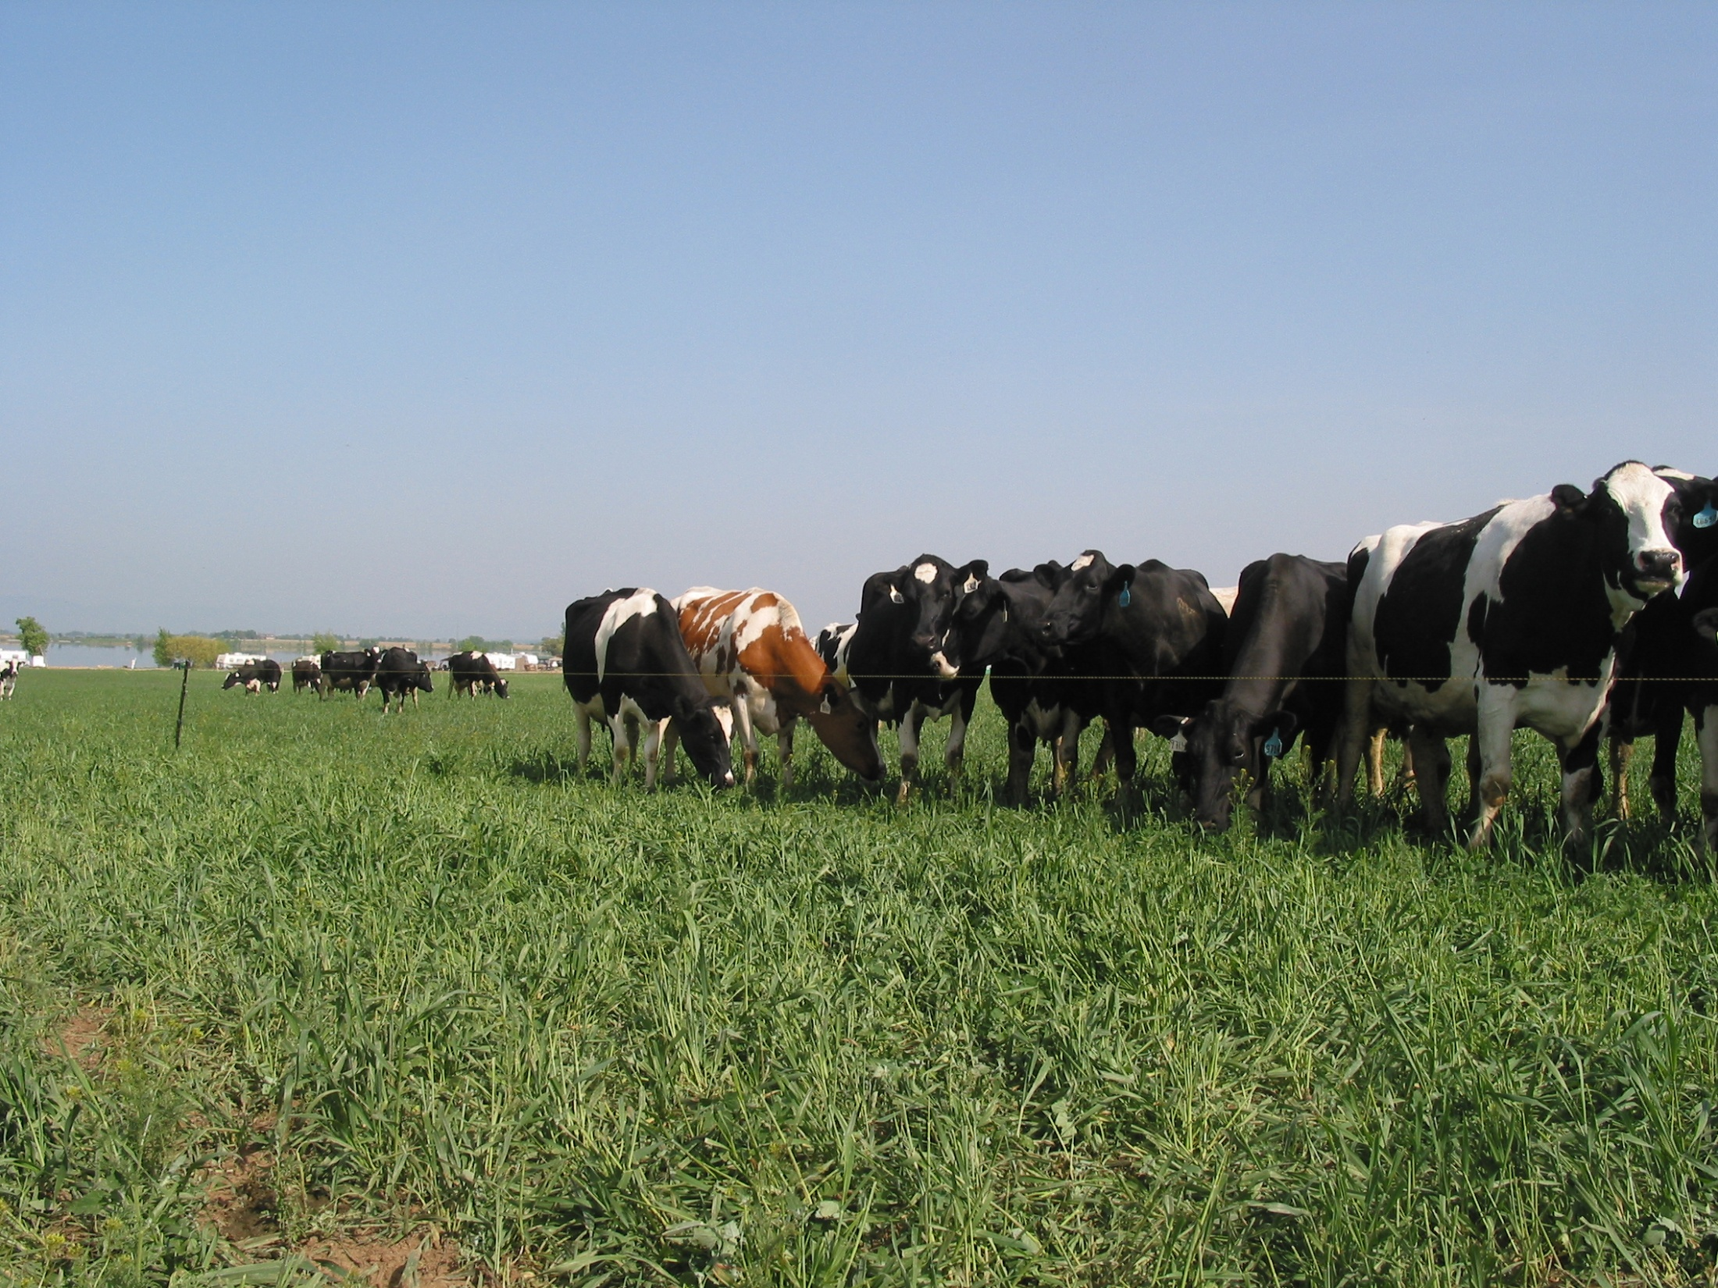
Why increasing stock density is a good thing
More consistent pasture utilization

Slide 26
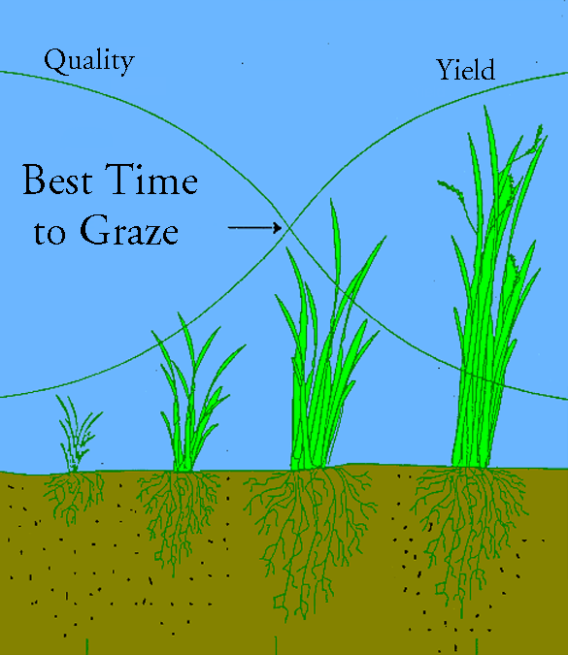
The Yield - Quality Compromise through three Phases of growth
Phase 1
Phase 2
Phase 3
Less rest More rest
Notes:
If we look at the classic diagram of 3-phase plant growth, we know Phase 2 is where plants are most photosynthetically efficient. Pastures grazed down to Phase 1 residual have little leaf area to maintain photosynthesis while Phase 3 has too much shading and requires too much energy for plant maintenance.

Slide 27
Timing of vegetative, reproductive, & elongation phases
Most perennial cool-season grasses:
Reproductive only in 1st growth
Vegetative in regrowth cycles, with or without stem elongation
Legumes:
Shift to reproductive phase in each growth cycle in a season, with stem elongation

Slide 28
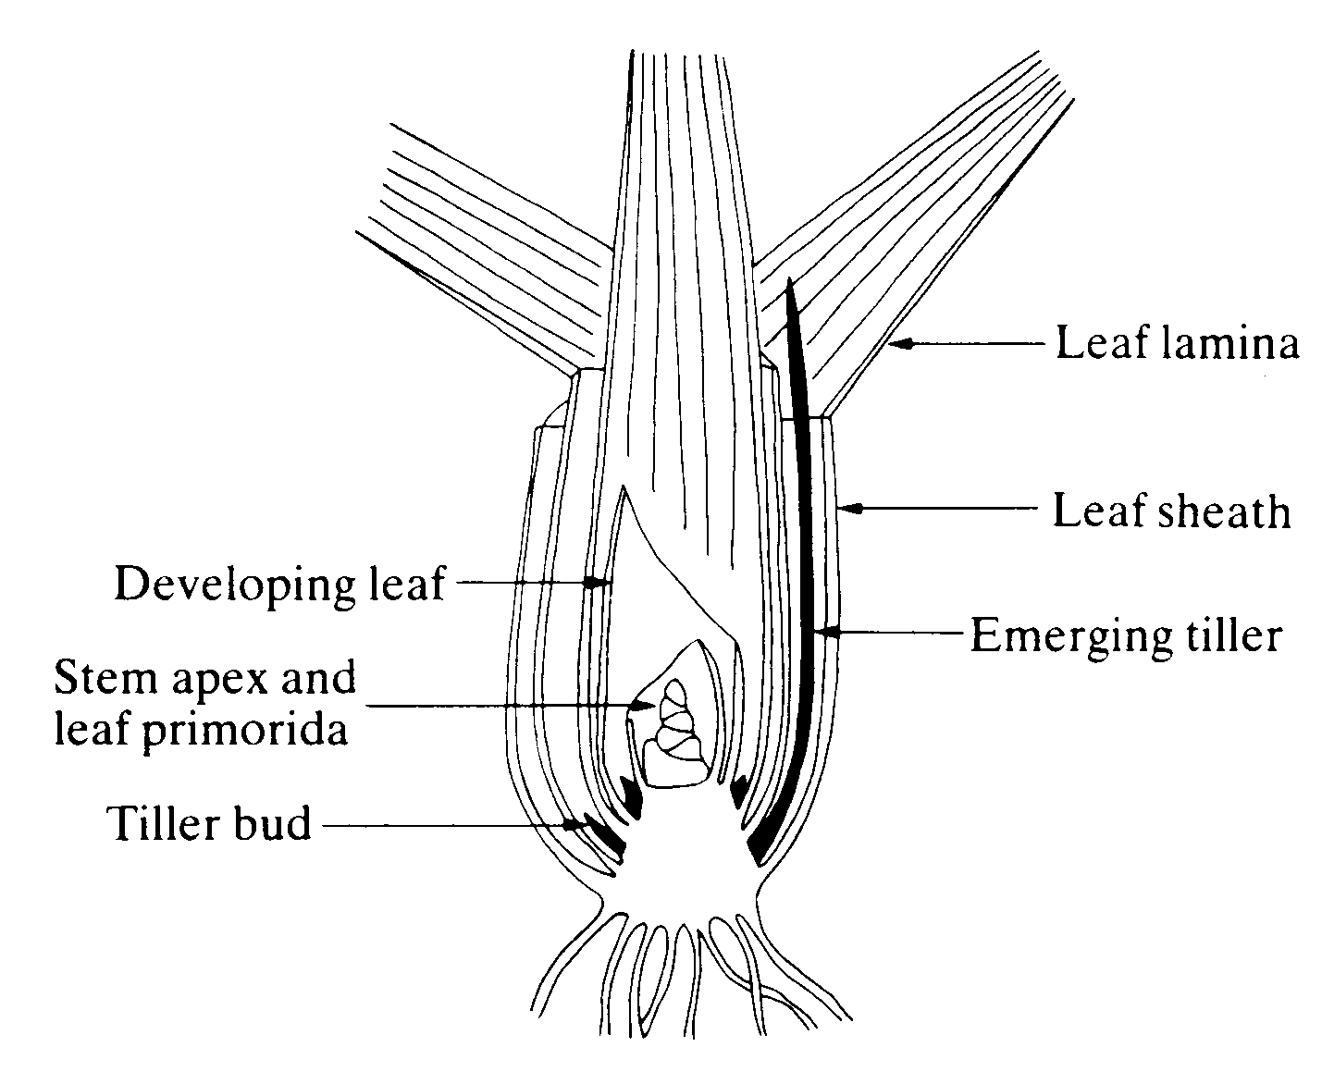
Basic grass morphology
Grazing height
During vegetative growth the growing point is at or near ground level

Slide 29
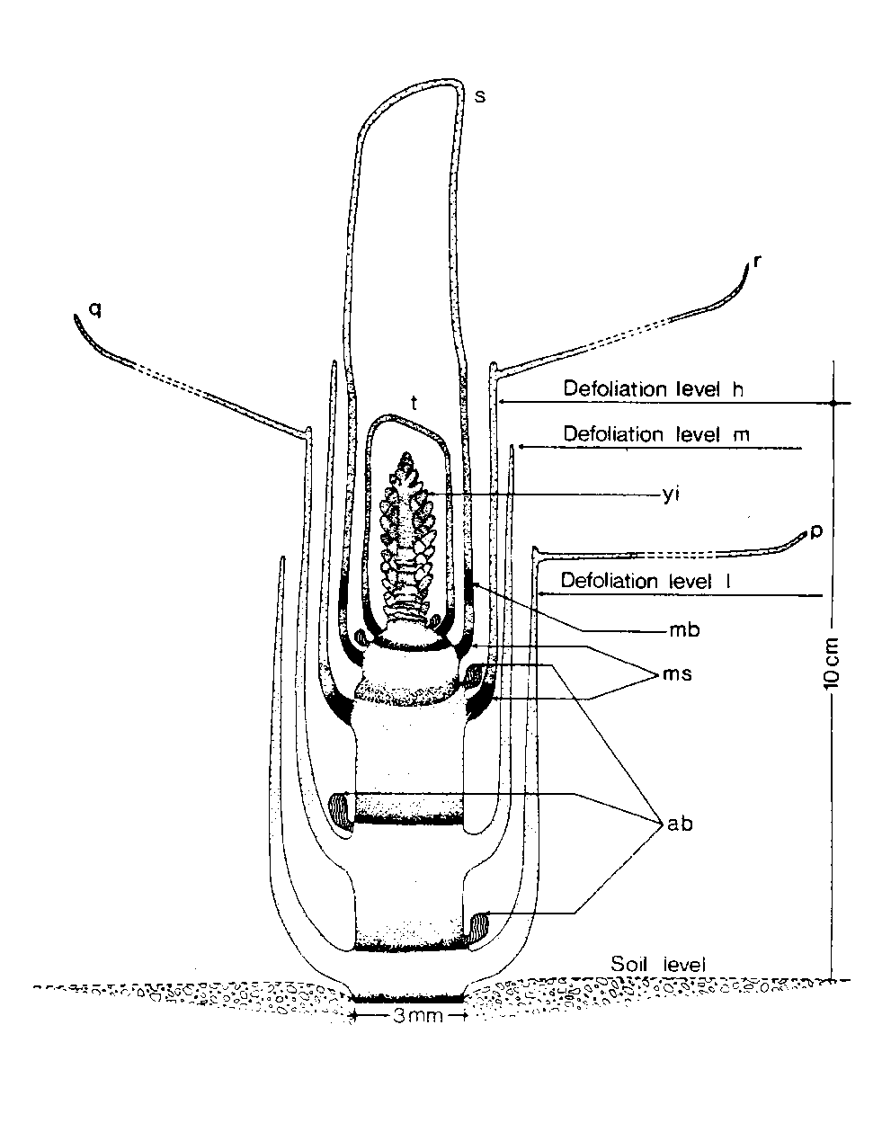
Basic grass morphology
During reproductive phase growing point begins to elevate as stem extension begins
If grazed in early elongation phase, the plant will shift back to vegetative growth

Slide 30
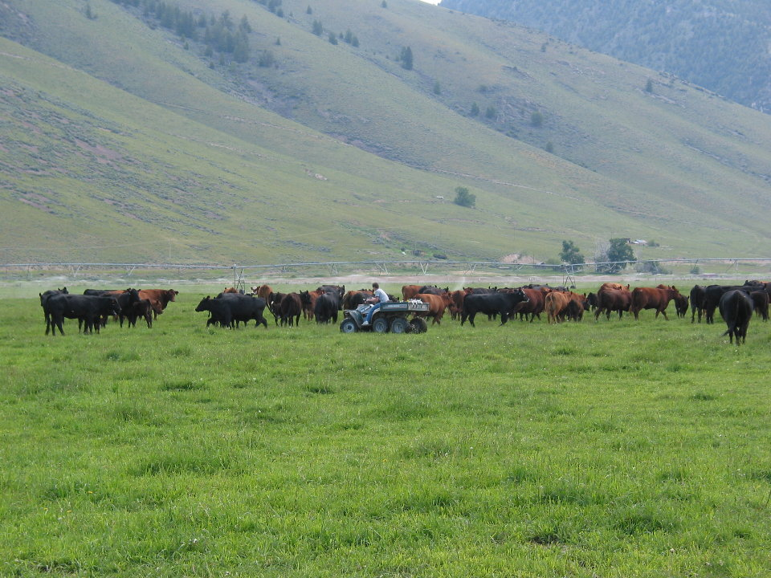
A general grazing rule for irrigated or natural rainfall pastures:
  Twice over the entire farm in the first 30 - 40 days

Slide 31
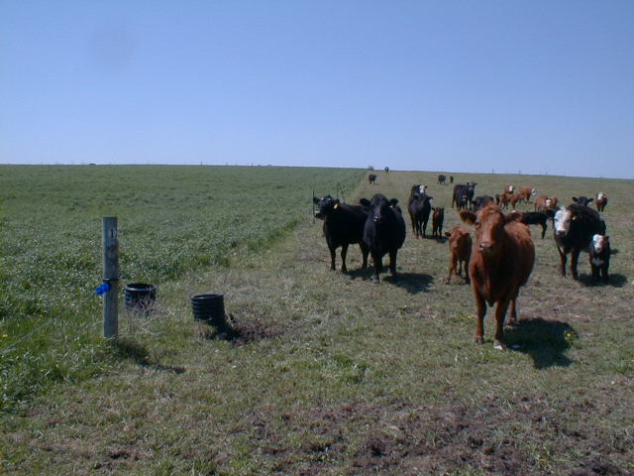
Easy to do with good clean pasture….

Slide 32
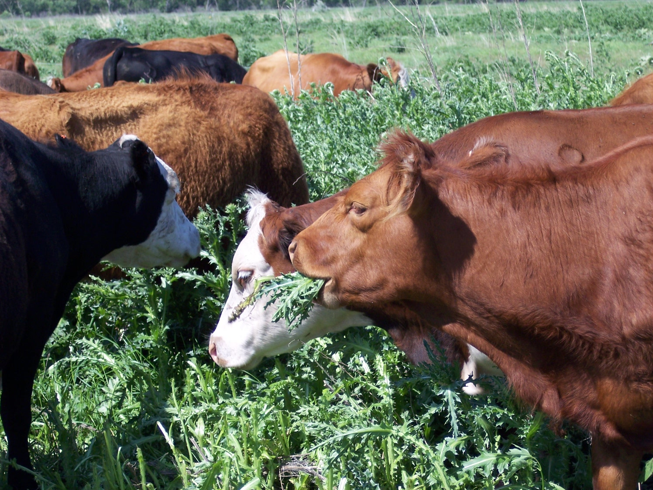
What about when it’s all Canada thistle ?

Slide 33
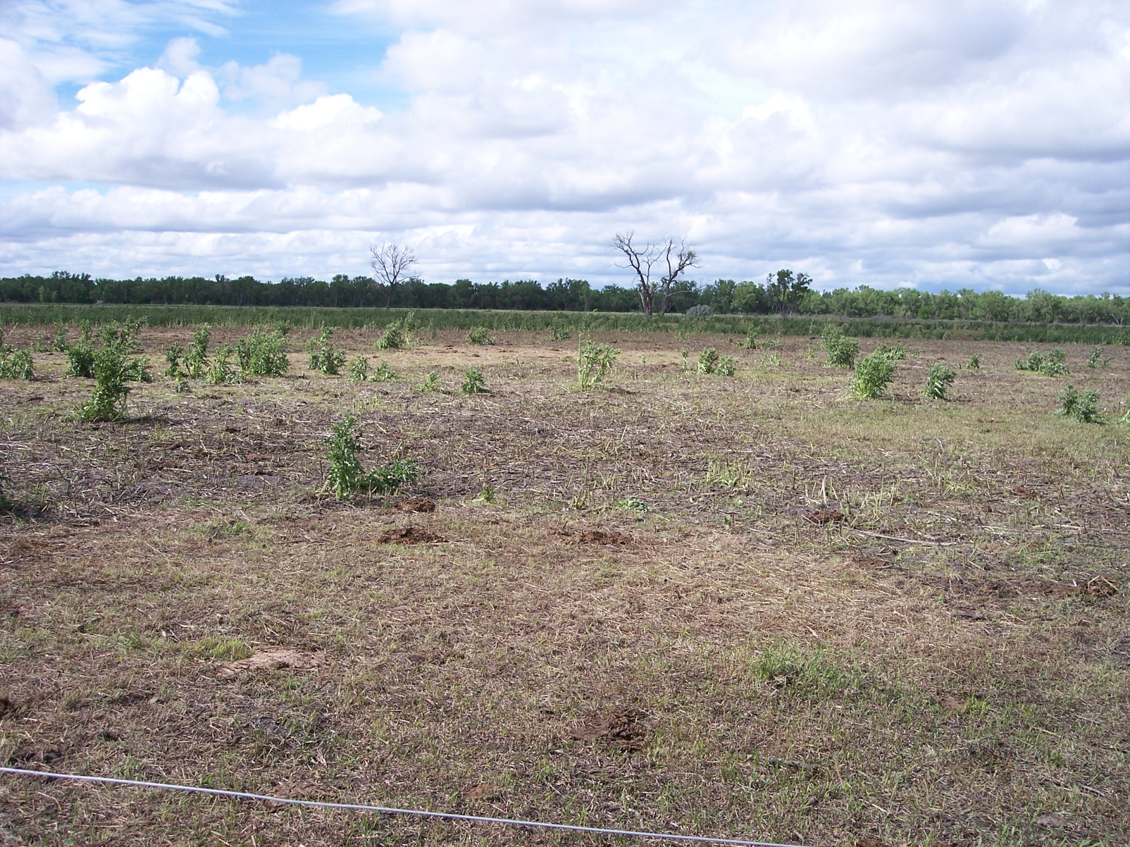
The same field after 500,000 lb stock density for 2-3 hours

Slide 34
Why increasing stock density is a good thing
More consistent pasture utilization
More uniform manure distribution

Slide 35
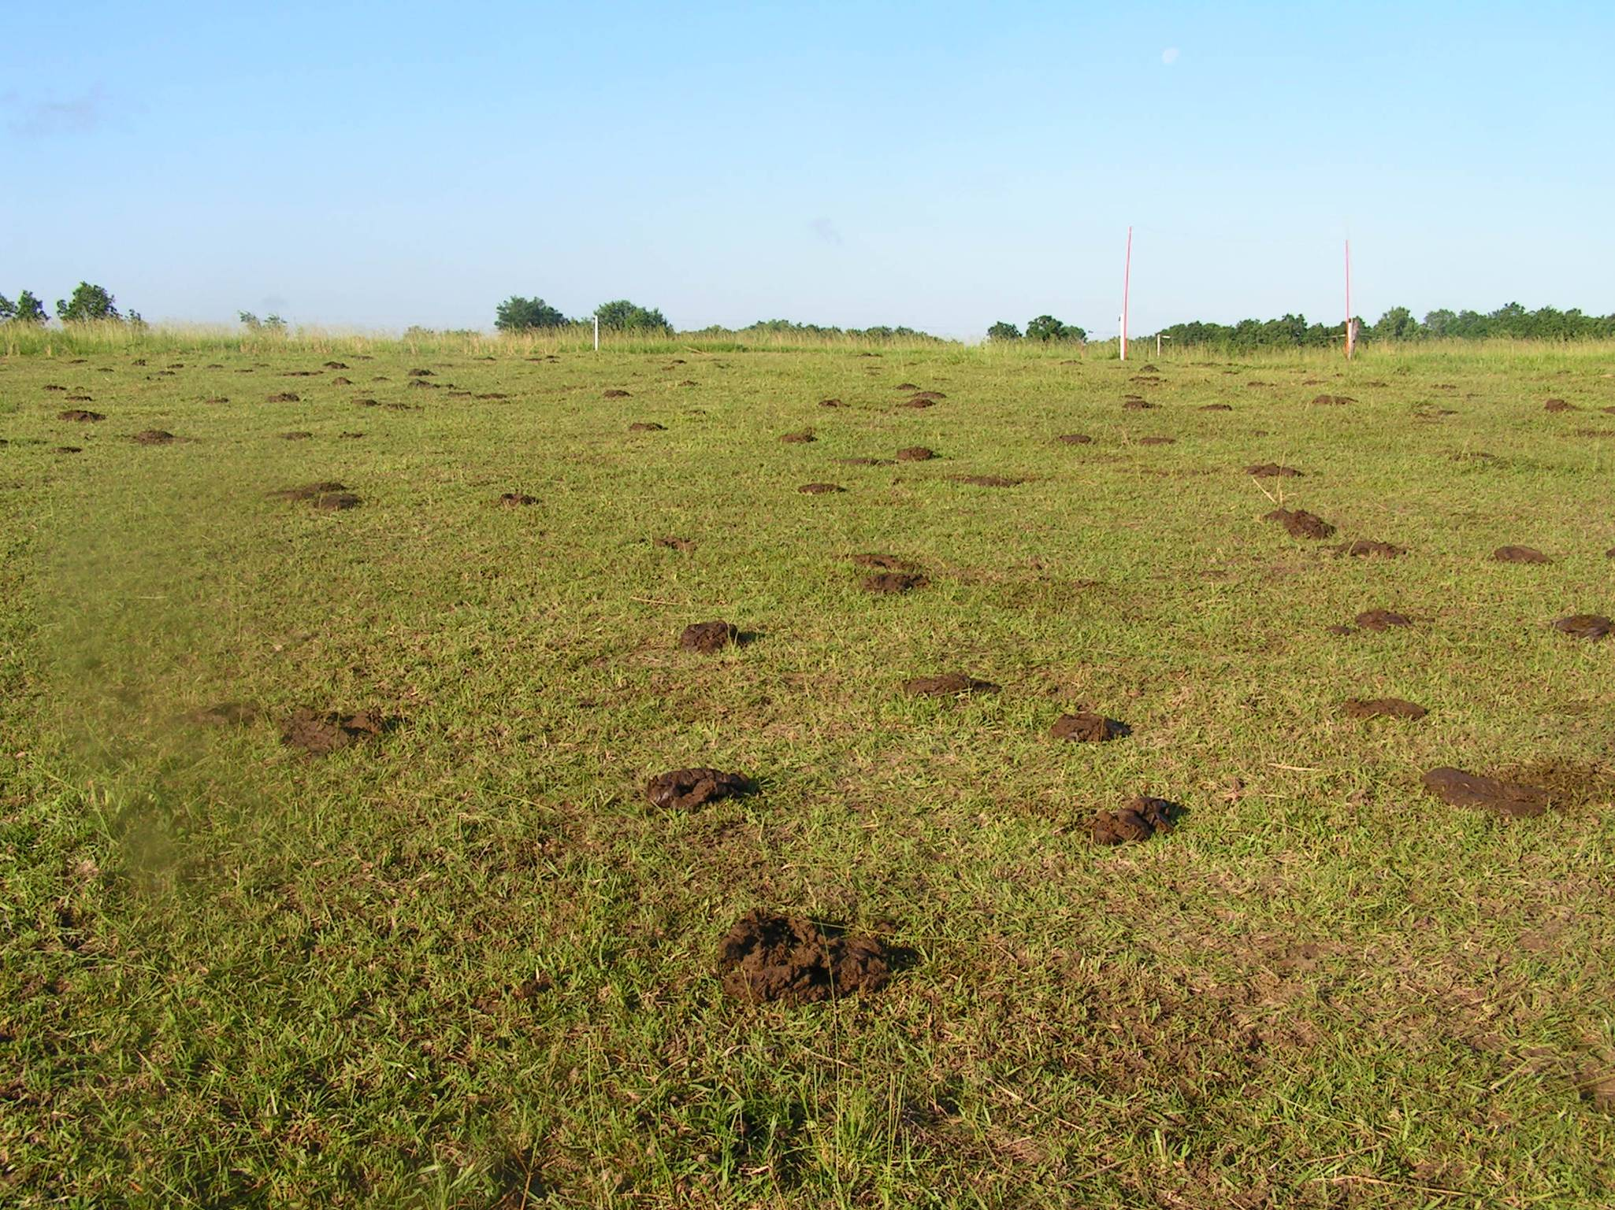
Manure distribution is one key to running a no-fertilizer-needed operation

Slide 36
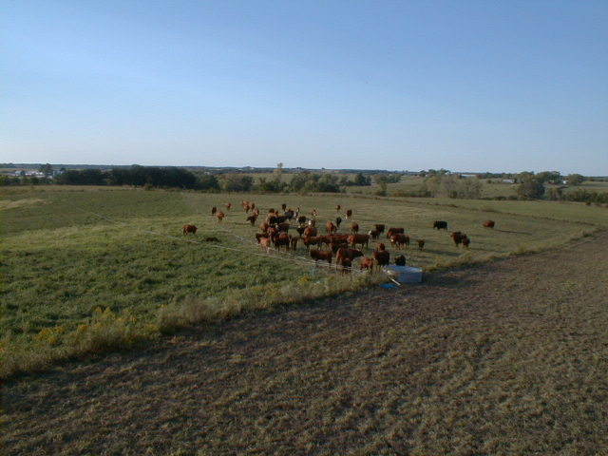
In 23 years on our Missouri farm we only used N fertilizer 3 times on a less than 20% of our total pasture acres

Slide 37
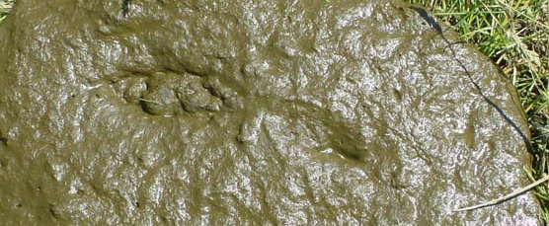
Manure Distribution
Continuous grazing versus MiG
  MiG improves manure distribution
  Missouri research
    compared 3, 12, and 24 paddock systems

Slide 38
Manure Distribution: Continuous grazing
Grazing area
Ingestion
Loafing area
Excretion
Feces
and urine
Plant
available
soil P

Slide 39
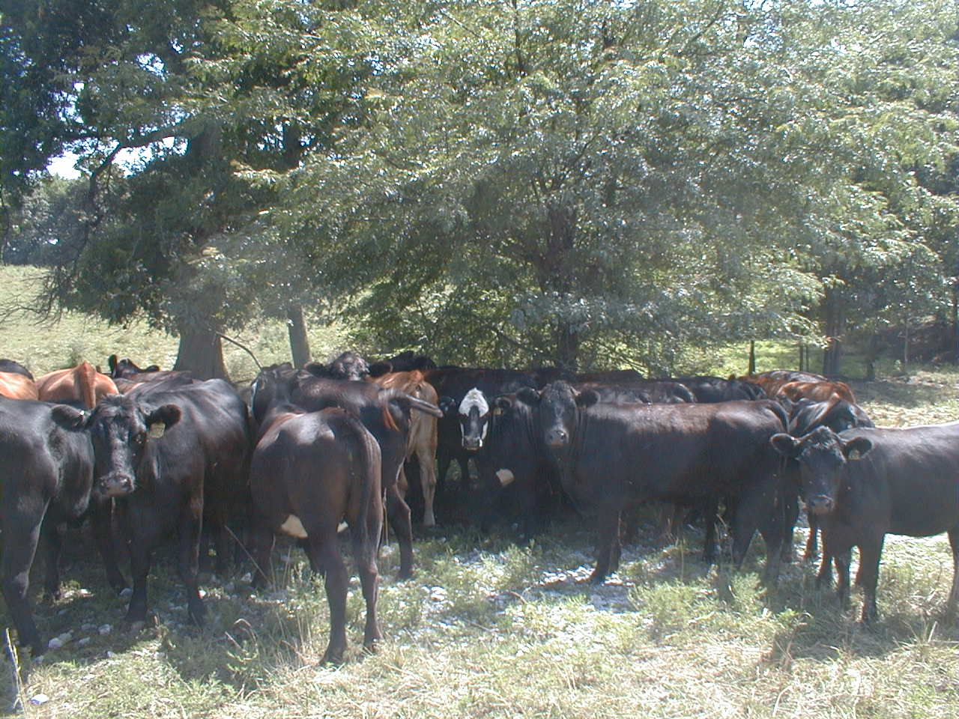
If cattle walk more than ¼ mile to water,
….. Up to 65% of manure ends up at shade and water

Slide 40
Manure Distribution
Years to get
1 pile / sq. yard
27
8
4-5
2
Rotation Frequency
Continuous
14 day
4 day
2 day

Slide 41
Effect of protein level on daily N excretion rate
* Fecal N level remains near constant, excess N is excreted as urine

Slide 42
Effect of protein level on daily N excretion rate
* Urine N is nearly all readily available on a daily basis

Slide 43
Effect of stock density on daily available N return to the soil

Slide 44
Effect of stock density on daily available N return to the soil
Management requirements for these stock densities:
  600 lb/A = continuous graze 2 acre/cow
  1200 lb/A = continuous graze 1 acre/cow
  4800 lb/A = rotational graze 10 day grazing period
  24000 lb/A=rotational graze 3 day graze period
  48000 lb/A=rotational graze 1 day graze period

Slide 45
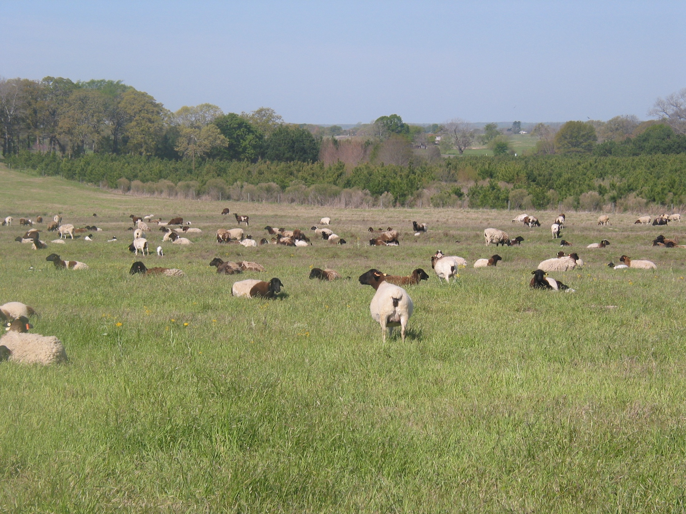
Why increasing stock density is a good thing
More consistent pasture utilization
More uniform manure distribution
High stock density usually means shorter grazing periods

Slide 46
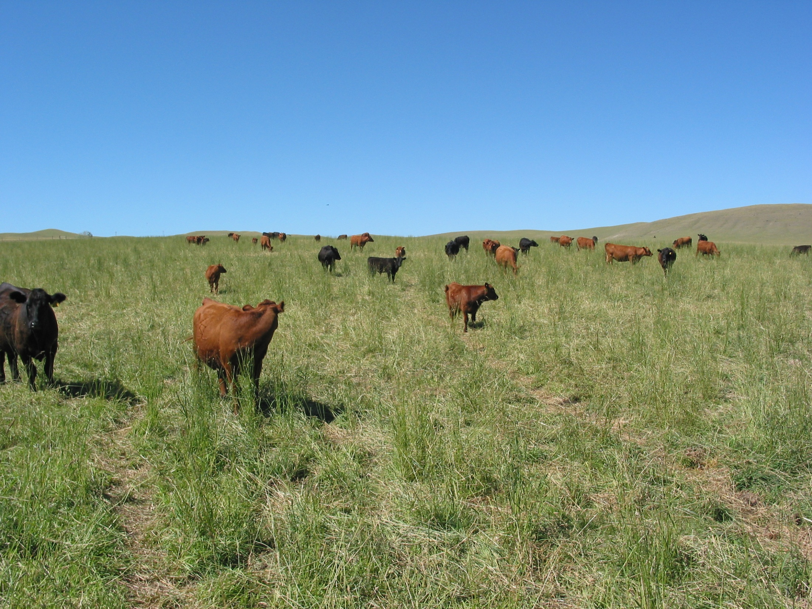
Grazing Efficiency
Set stocking: 30 – 40 %
Notes:
Generally with set stocking we expect to harvest 30-40% of the forage that grows in a year. This is assuming the nutritional needs of the animals are being met solely form pasture. Yes, animals can harvest 90% of what grows but they will either starve or you must feed them supplemental feed.

Slide 47
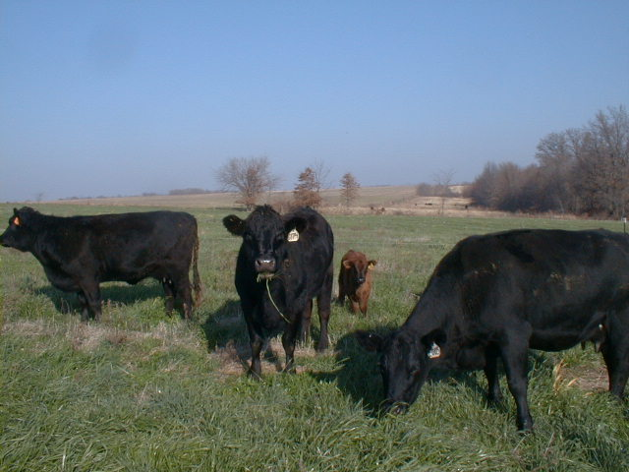
What else do livestock do on their dinner plate ?
Notes:
The big factor affecting grazing efficiency is all the other things animals do on their dinner plate.

Slide 48
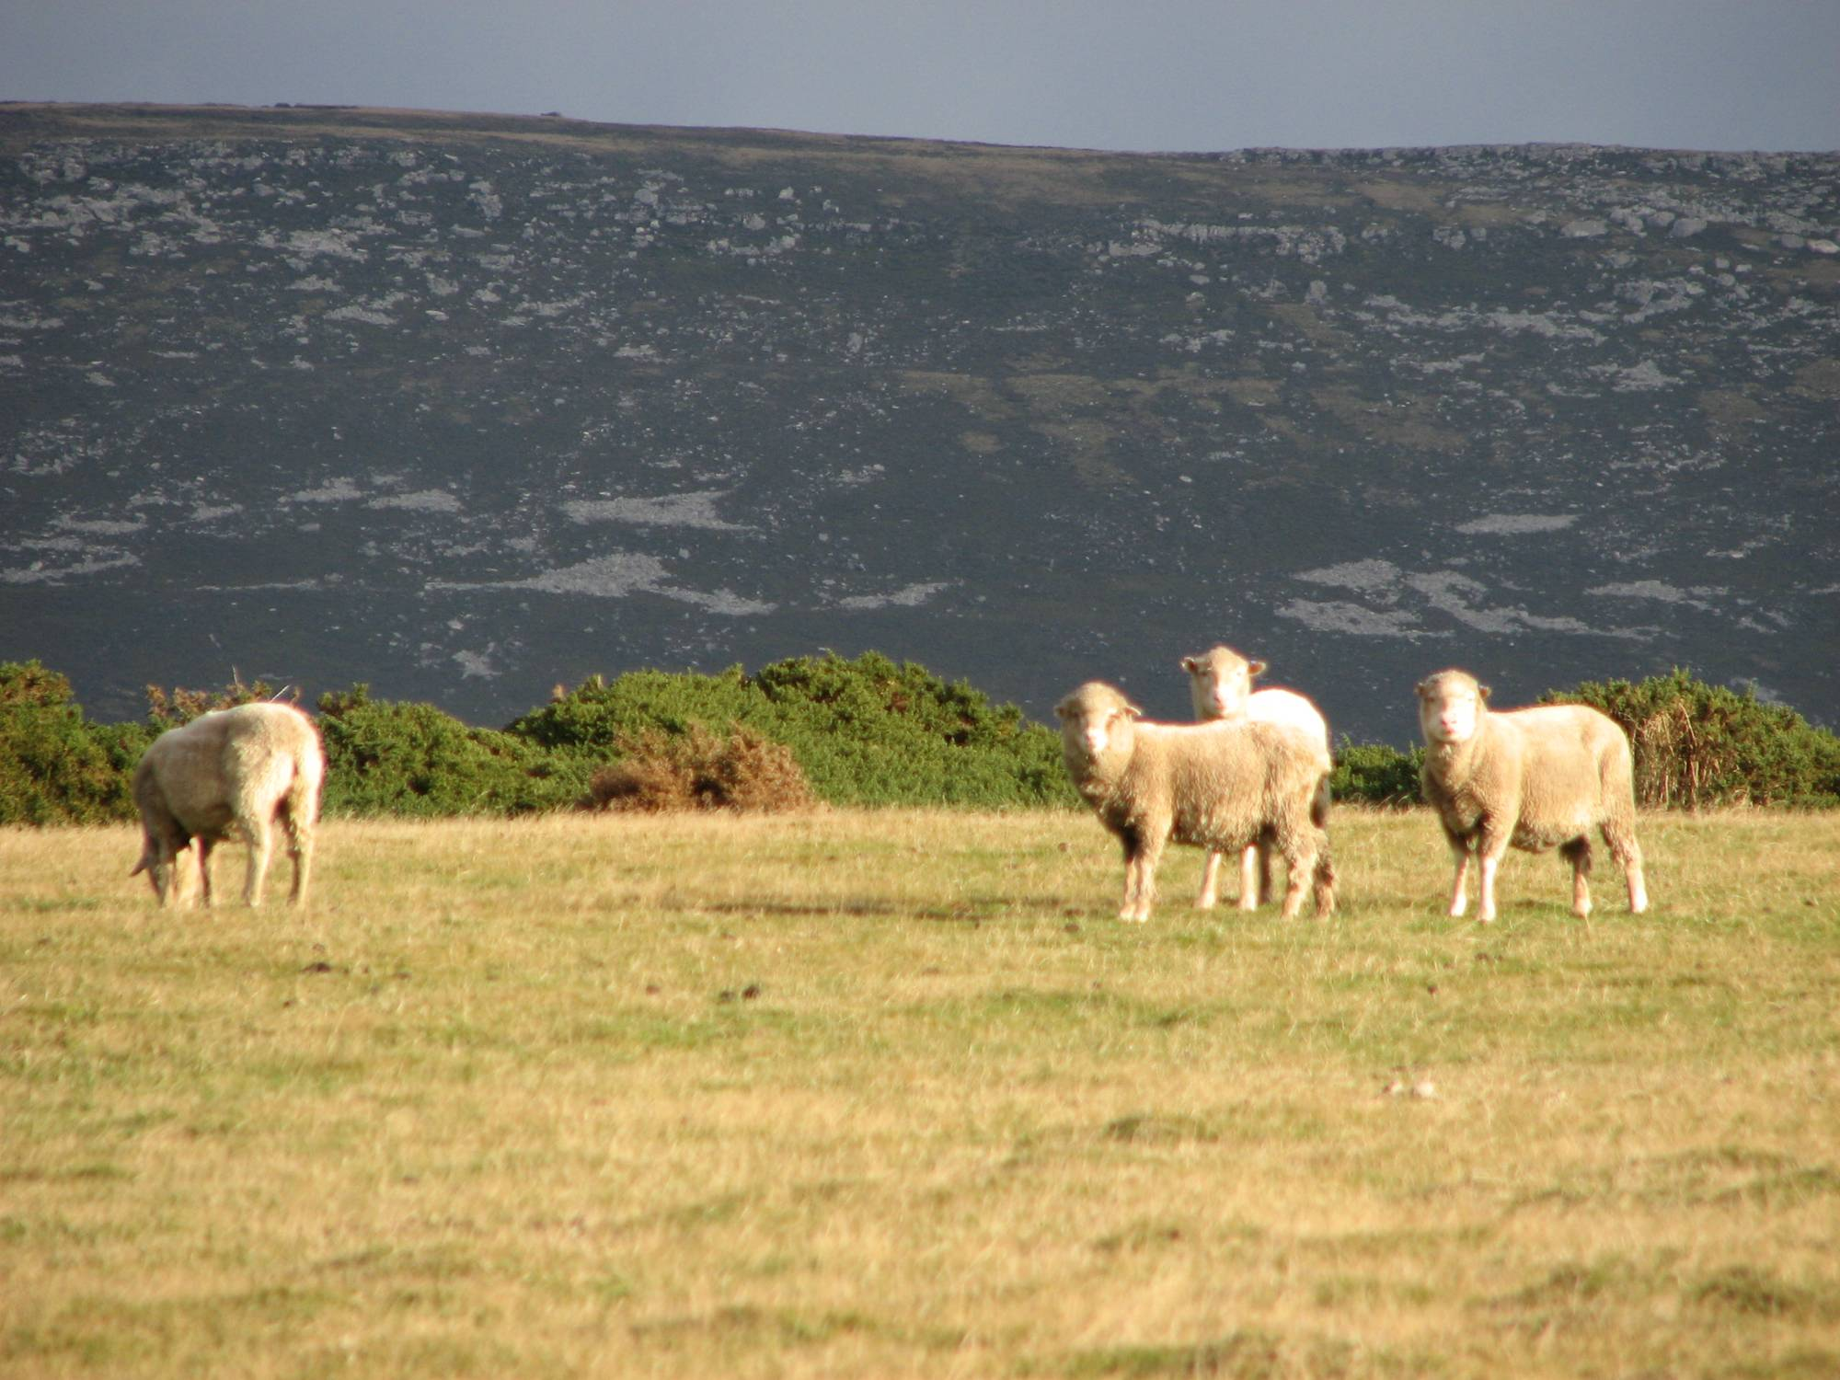
Each day spent on the same area increases:
  Waste due to fouling & camping
  Overgrazing in concentration areas
  Stresses most desirable plant species
Notes:
The longer livestock stay on the same area, the greater the percentage of area affected by manure fouling and camping. Concentration areas such as watering points or mineral feeders become increasingly overgrazed as length of stay in a pasture increases. Because of the tendency to repeatedly graze the most desirable plants, longer grazing periods lead to disappearance of the most desirable plants over time. Soon the very plants that made a particular pasture desirable at a certain time of the year becomes less and less desirable.

Slide 49
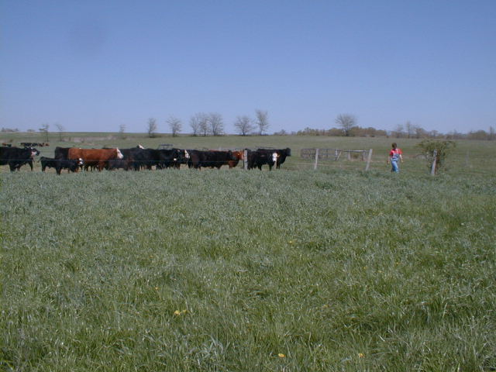
Grazing Efficiency
Set stocking: 30 - 50%
Weekly rotation: 50 - 60%
3 – 5 day rotation: 60 - 70%
1 – 2 day rotation: 80 - 90%*
* On high rainfall or irrigated pastures
Notes:
Rotational grazing systems can achieve much higher levels of grazing efficiency. This is largely due to reducing the amount of forage being wasted from fouling and keeping a large bite size in front of the animals. The efficiency of proper grazing with 1-2 day grazing periods and appropriate rest periods is equivalent to the harvest efficiency of mechanical harvest systems. This high level of harvest is only appropriate for high natural rainfall or irrigated pastures.

Slide 50
Why increasing stock density is a good thing
More consistent pasture utilization
More uniform manure distribution
High stock density usually means shorter grazing periods
Shorter grazing periods mean more days resting

Slide 51
Effect of paddock number on % of time resting
Higher stock density allows for more rest time for every paddock

Slide 52
Why increasing stock density is a good thing
More consistent pasture utilization
More uniform manure distribution
High stock density usually means shorter grazing periods
Shorter grazing periods mean more days resting
Replace mechanical tillage

Slide 53
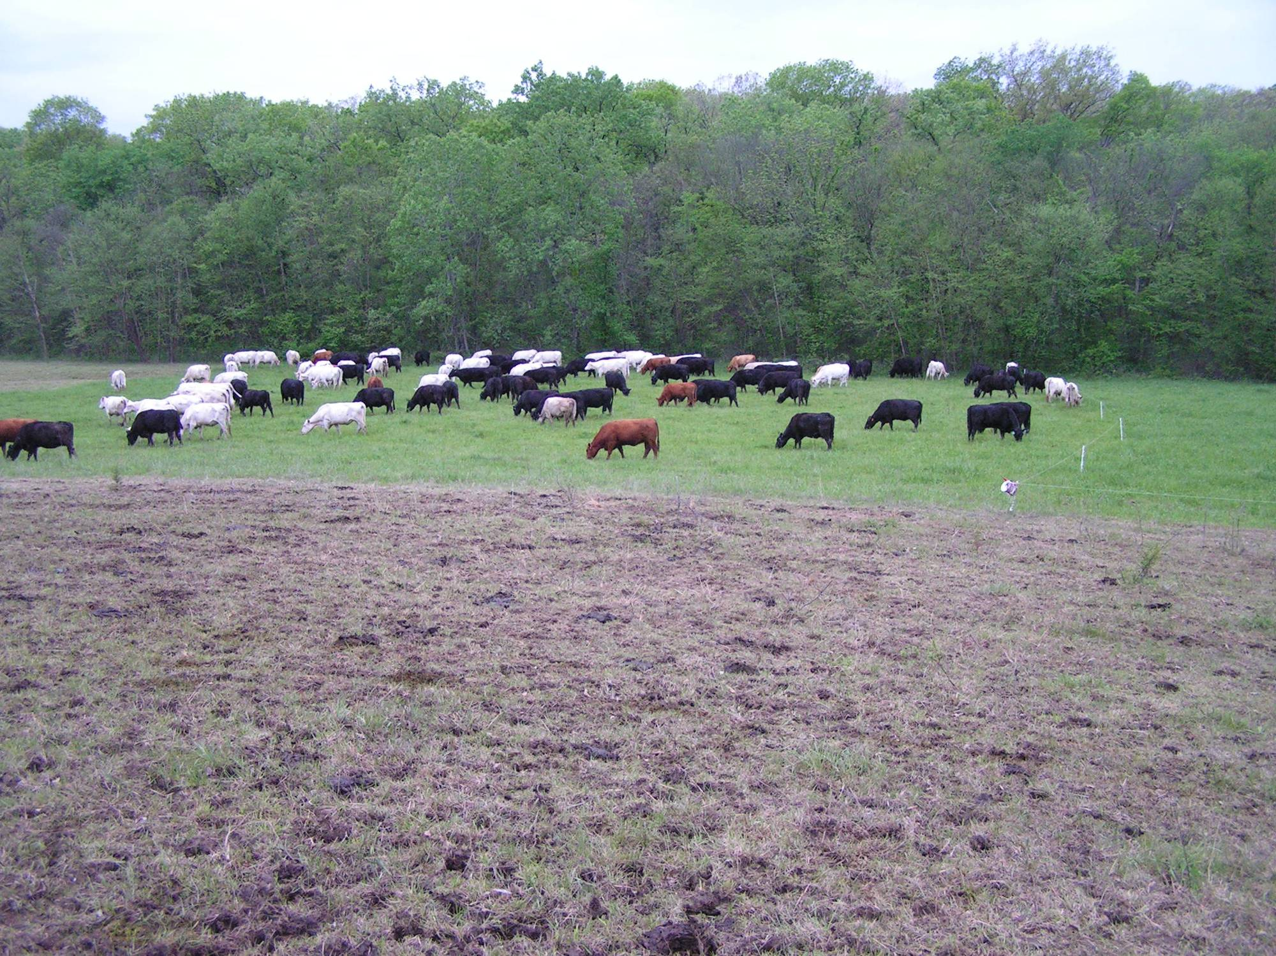
Hoof-n-tooth reseeding

Slide 54
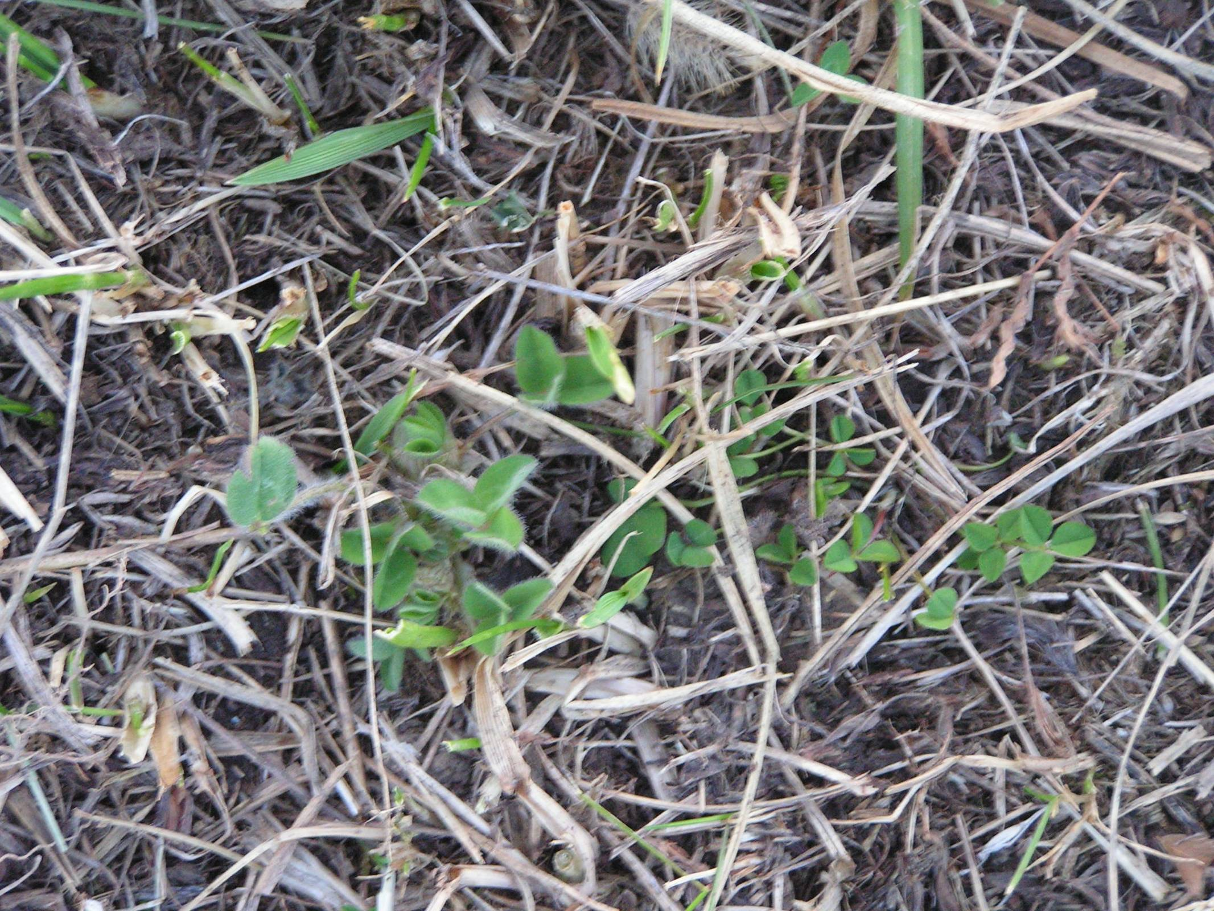
.

Slide 55
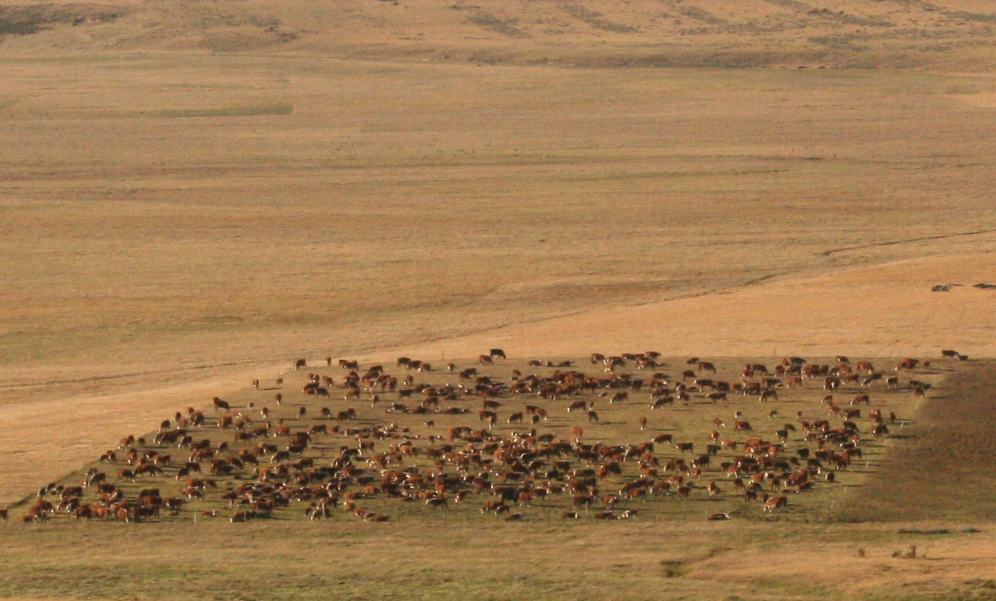
Summary
Stock density is a powerful tool
Know when and how to apply it
Monitor results and adjust as needed

