Slide 1
Organic Strawberries- plasticulture vs matted row, 2018 & 2019 SARE Farmer Trial at Red Fire Farm.

Slide 2
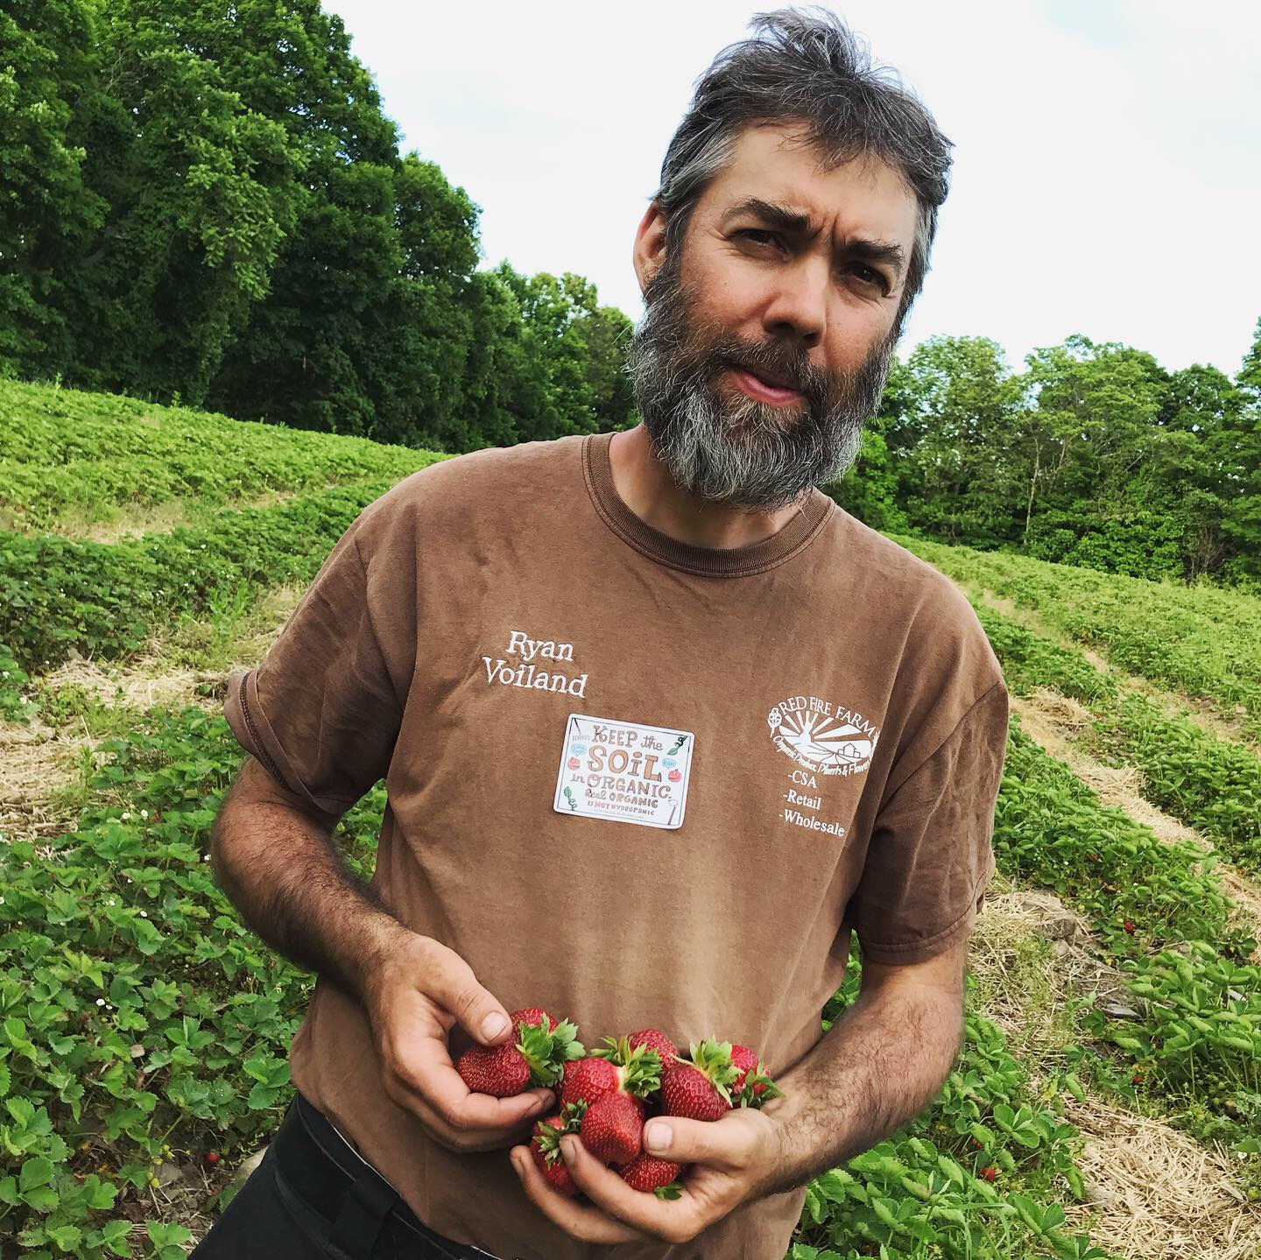
Weeds are always one of the top worries when it comes to growing organic strawberries.
Strawberries are a low growing plant that loves to be easily outcompeted by weeds.
Without herbicides, many hours of cultivating, hoeing and hand weeding can be spent, and still at harvest more often than not the weeds are on the verge of overtaking the field.

Slide 3
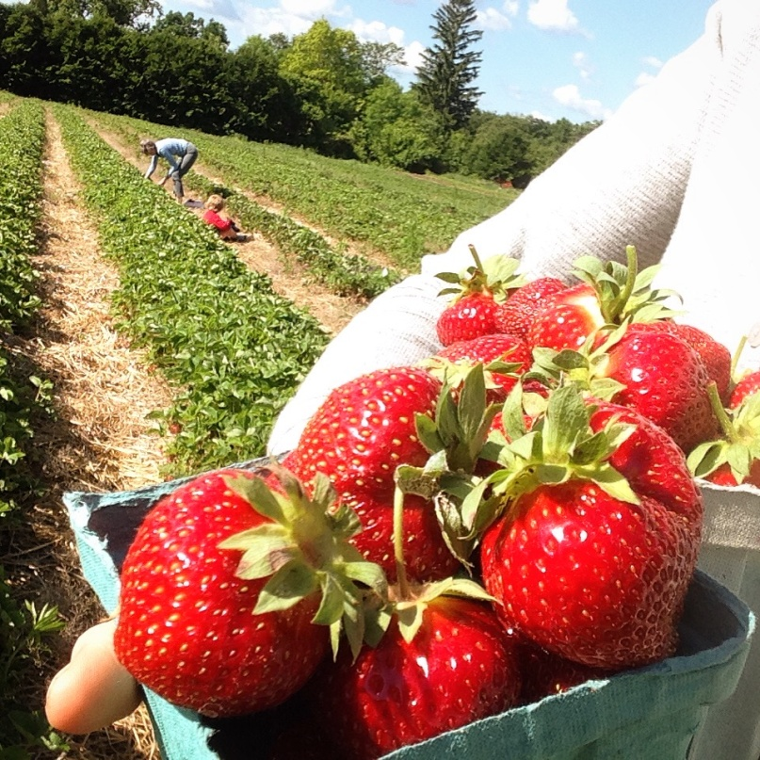
SARE Farmer Grant FNE-18-913
Project Summary:
Based on when strawberries grown with the traditional matted row system ripen, local consumers expect locally grown strawberries to be ripe all of June and extending into early July. Organic strawberry growers find that due to the low growing non competitive growth habit of strawberry plants, the matted row production system can be very costly to establish and maintain due to the need for multiple hoe & hand weeding passes. Fall planting of the Chandler variety as plugs into black plastic mulched beds, combined with winter row cover ( instead of straw mulch) has emerged as an alternative growing system for organic growers, and has proven to require much less weeding labor than matted row. However, even though Chandler is rated as a midseason variety by most strawberry plant nurseries, in this plasticulture system growers find that early ripening starting in mid May, but ending by the 2nd week of June is the norm. This schedule leaves a hole in ripe berries for late June & early July, weeks when consumers expect abundance! The goal of this project is to find ways to modify the strawberry plasticulture system both by trying different varieties to see if they will grow well and ripen later when grown with the plasticulture system, and also by using other horticultural system modifications to delay ripening in the plasticulture system. Results will be shared with other farmers at a twighlight meeting, at organic farmer winter conferences, and via newsletters read by organic produce farmers.
System Modifications and Varieties for Extending the Organic Strawberry Plasticulture Ripening Season in Massachusetts.

Slide 4
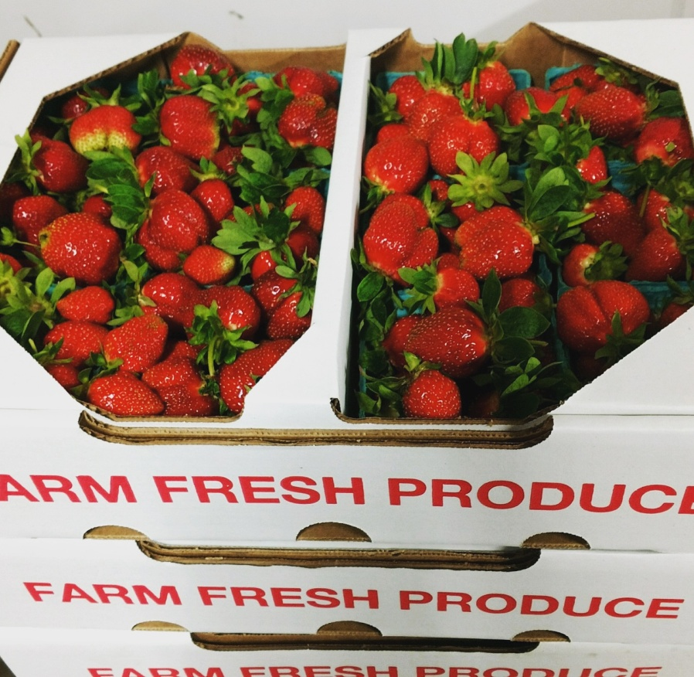
First the Basics:
June bearing strawberries can be grown in New England using two basic systems:
Matted Row is the traditional way that strawberries are historically grown in New England
&
Plasticulture is emerging as a popular alternative production system, especially for organic growers due to the weed suppression help of the plastic.

Slide 5
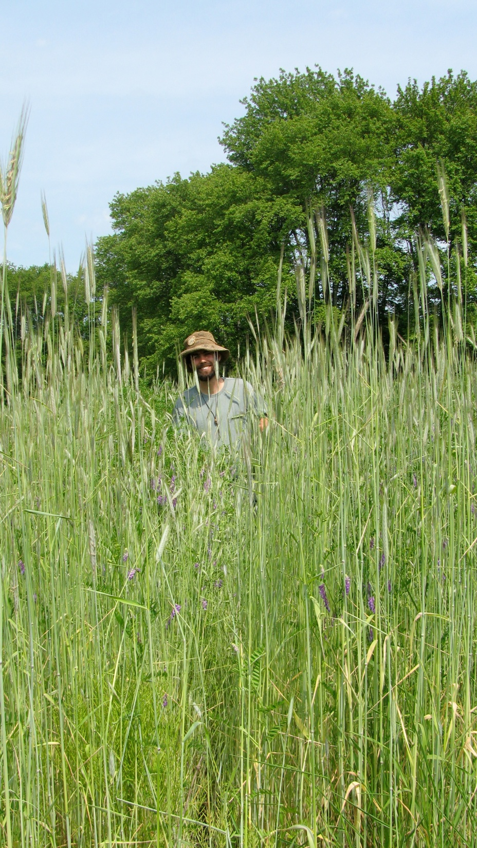
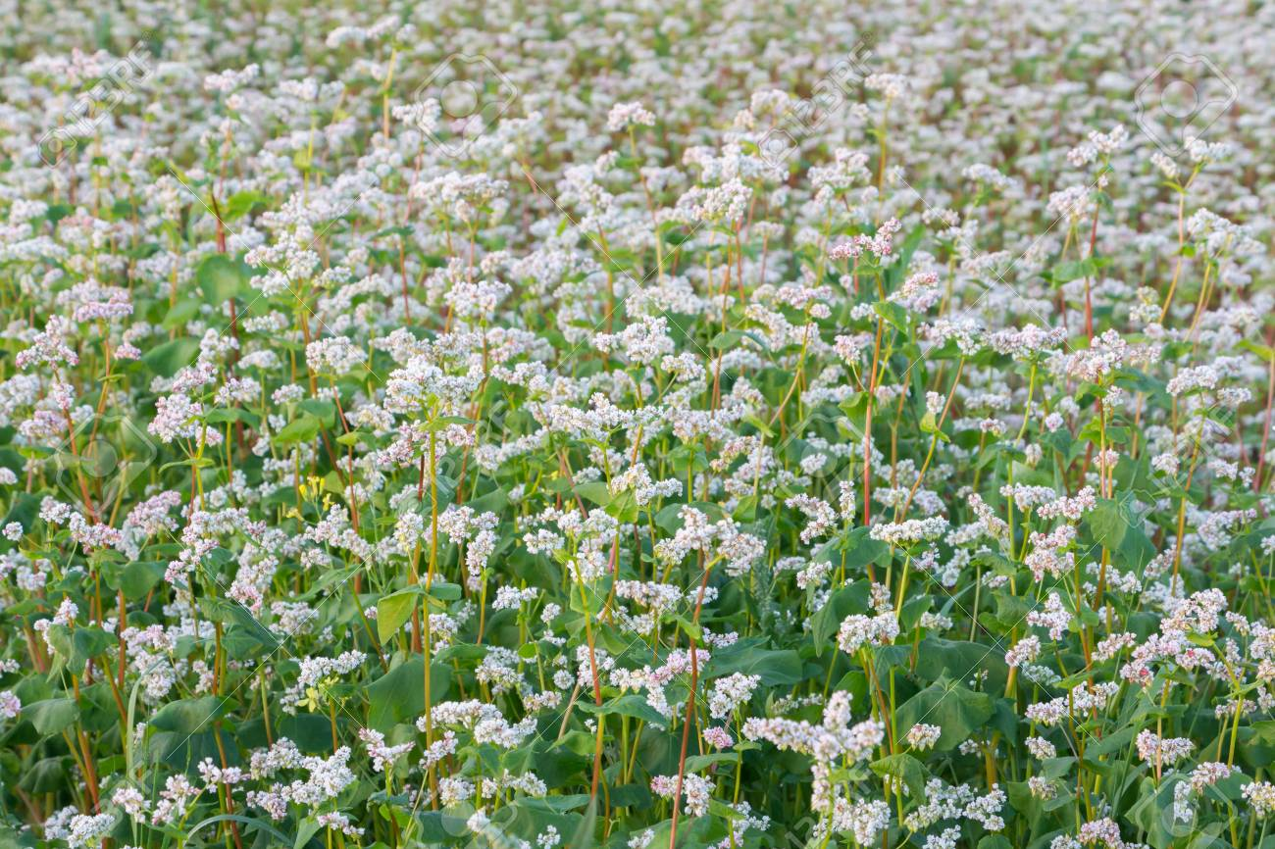
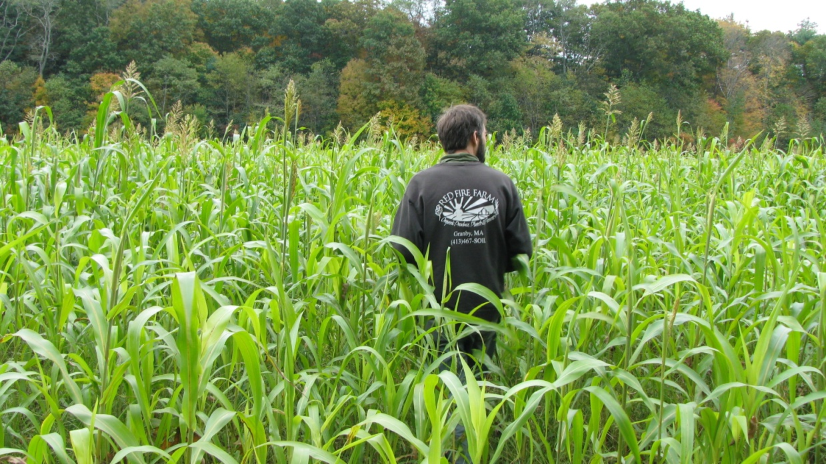
Prior to planting a field to strawberries with either system, a good weed suppressive cover crop is essential. Sorghum Sudan is believed to suppress strawberry root diseases. Buckwheat is a good catch crop to use prior to fall planted plasticulture fields. Rye with vetch is also a common option.

Slide 6
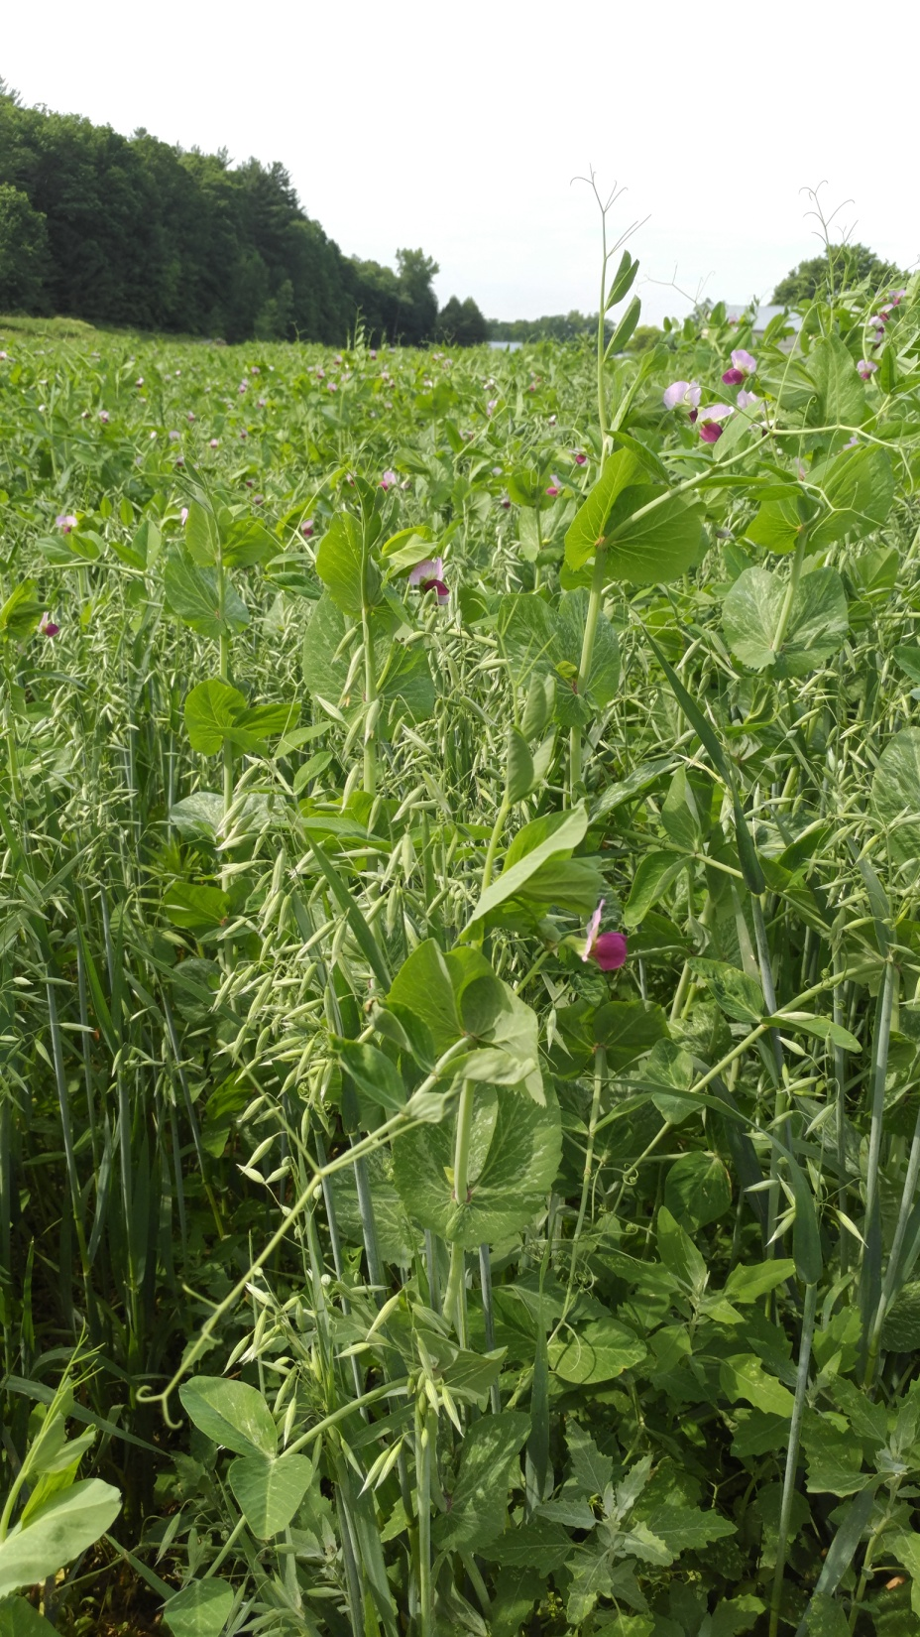
For the blocks that became the 2018 planted plasticulture blocks in the SARE trial, an early spring planted oat/ pea cover crop was established and allowed to grow to flower prior to preparing the field for planting in August.
Rotation:
Due to the build up of soil diseases, organic strawberries seem to need 6 years or longer before repeating strawberries into the same field space!
-brassicas are considered a beneficial preceeding crop for strawberries. I often follow cabbage, broccoli or salad brassicas. Mustard cover crops are also reported to be useful for biofumigation.
-Solanacious crops and raspberries are not good rotational crops for strawberries, as they share some of the same soil born diseases.

Slide 7
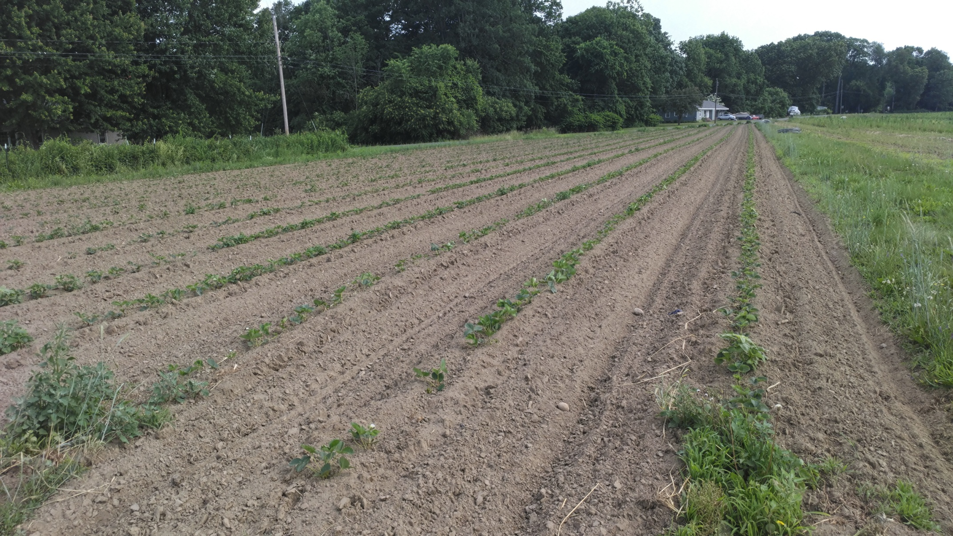
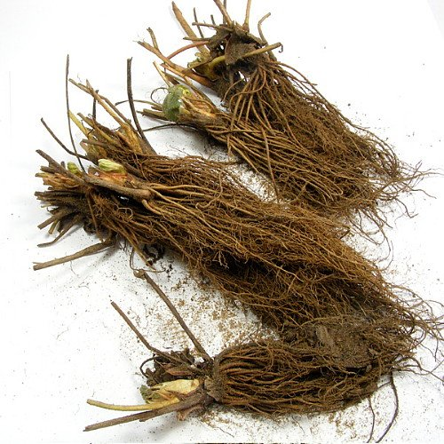
Typical Schedule For Matted Row Production at Red Fire Farm:
-bare root plants transplanted in mid May. Plants spaced with 1 row in center of bed, 12” in row spacing using water wheel transplanter.
-rows mechanically cultivated every 7 -10 days all summer and fall. First use basket weeder when plants are small for first pass, then mostly lilliston rolling cultivator as plants get bigger.
-flowers trusses pinched off of mother plants in early summer.

Slide 8
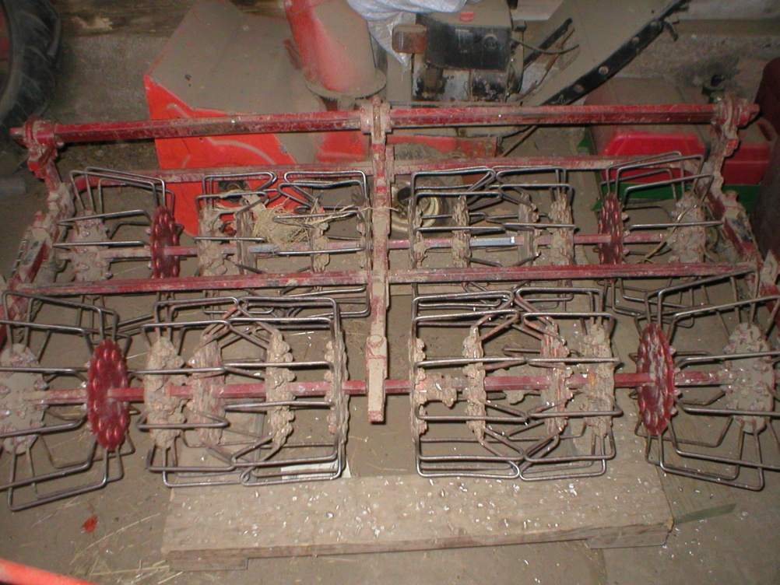
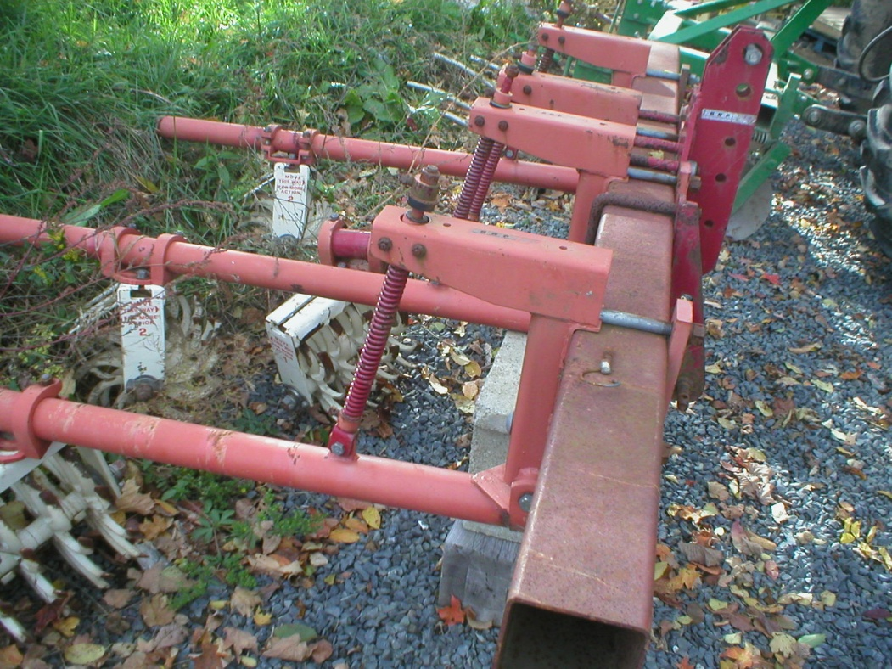
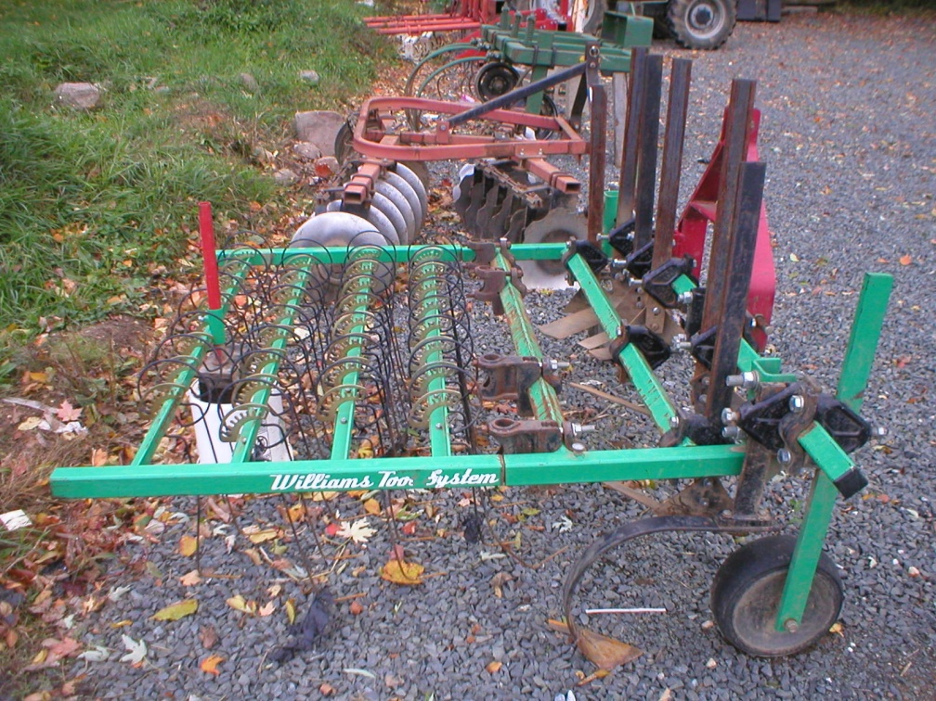
-in addition to mechanical cultivation, hoeing and hand weeding is done as needed all summer and fall (usually a pass is needed every 2 weeks.)
-runners allowed to peg down and fill out beds in late summer and fall so strips of plants are 18-24” wide.

Slide 9
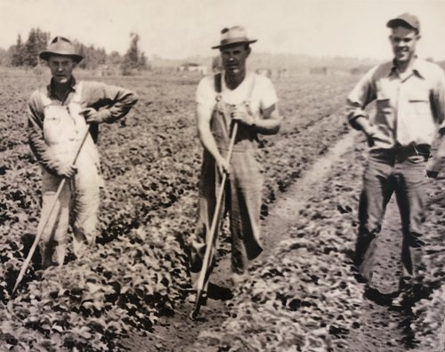
Even with Weekly Tractor Cultivation, Matted Row Strawberries require hoe or hand weed work in order to get out the in row weeds from between the runners.
In 2018 we measured the time spent hoeing and hand weeding on a matted row block. It took 5 passes over the course of the summer and fall with an average of 9 labor hours per pass, for a total of 45 hours of hand weeding labor per acre for the season.

Slide 10
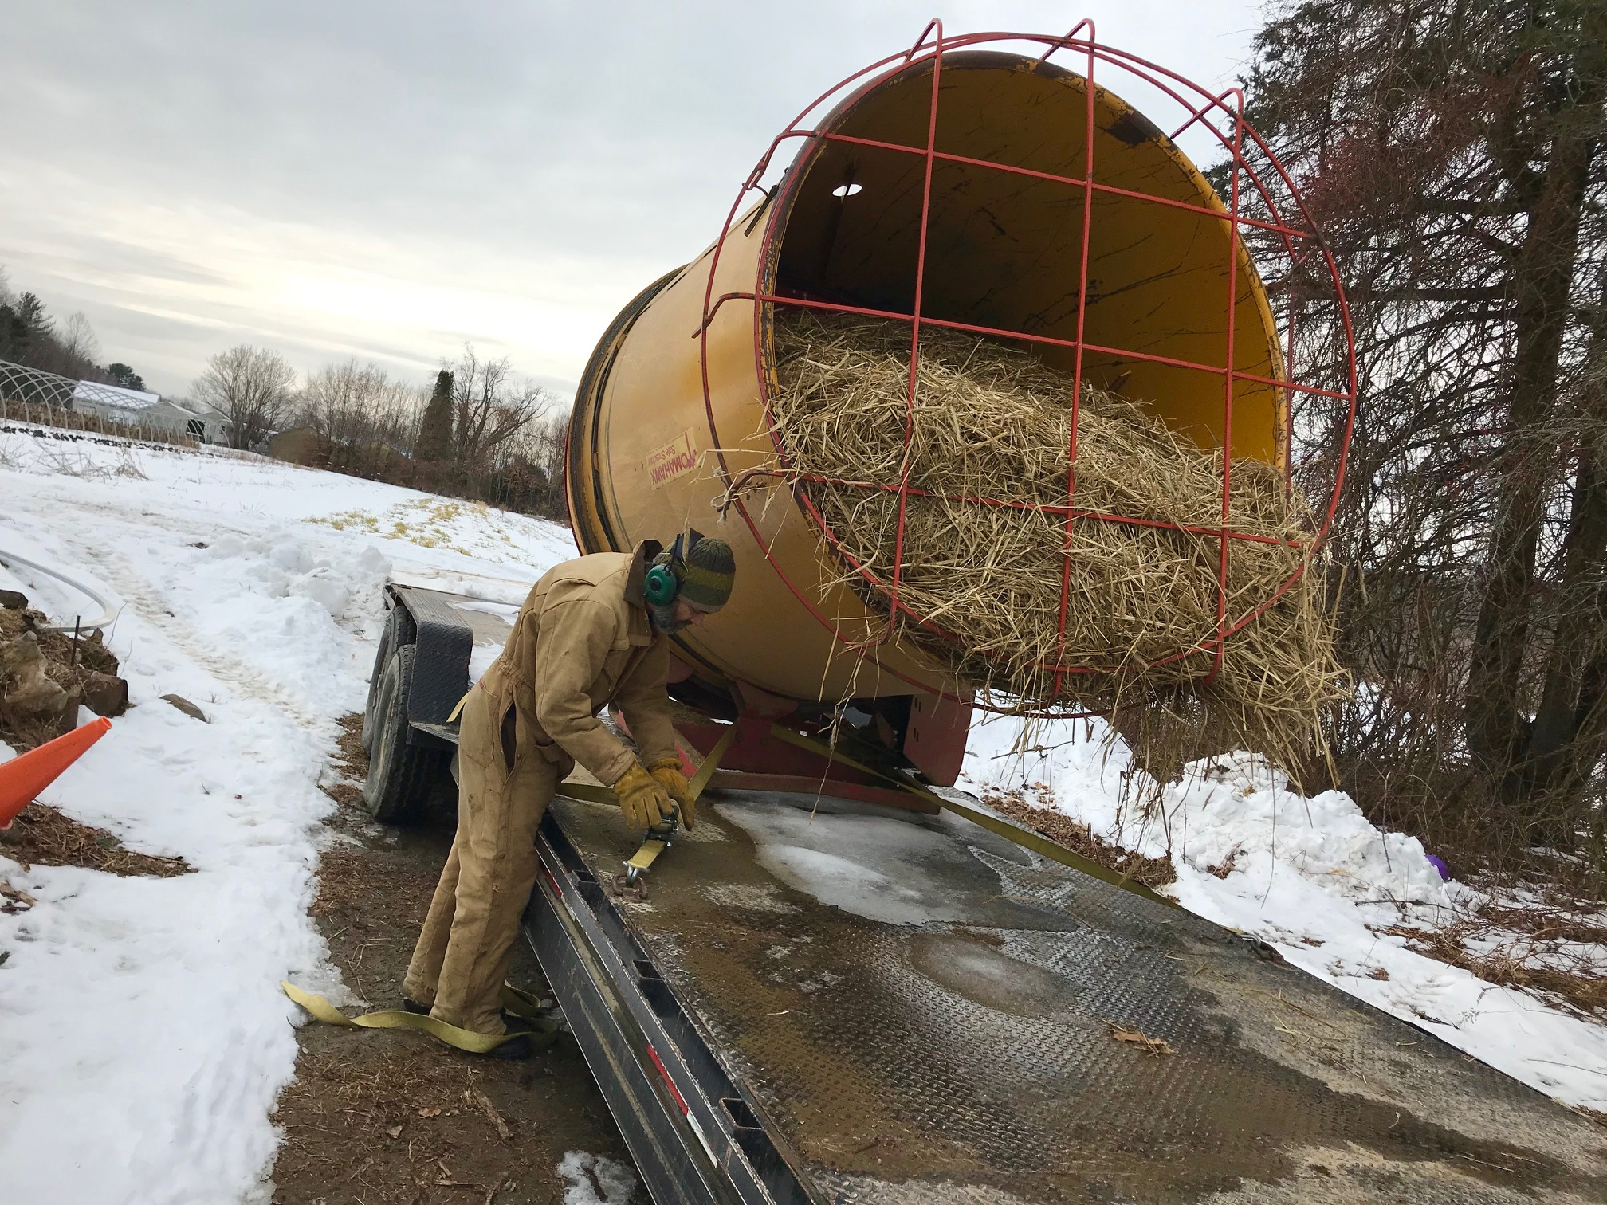
-plants are mulched with straw in Nov, Dec or January depending on the weather.

Slide 11
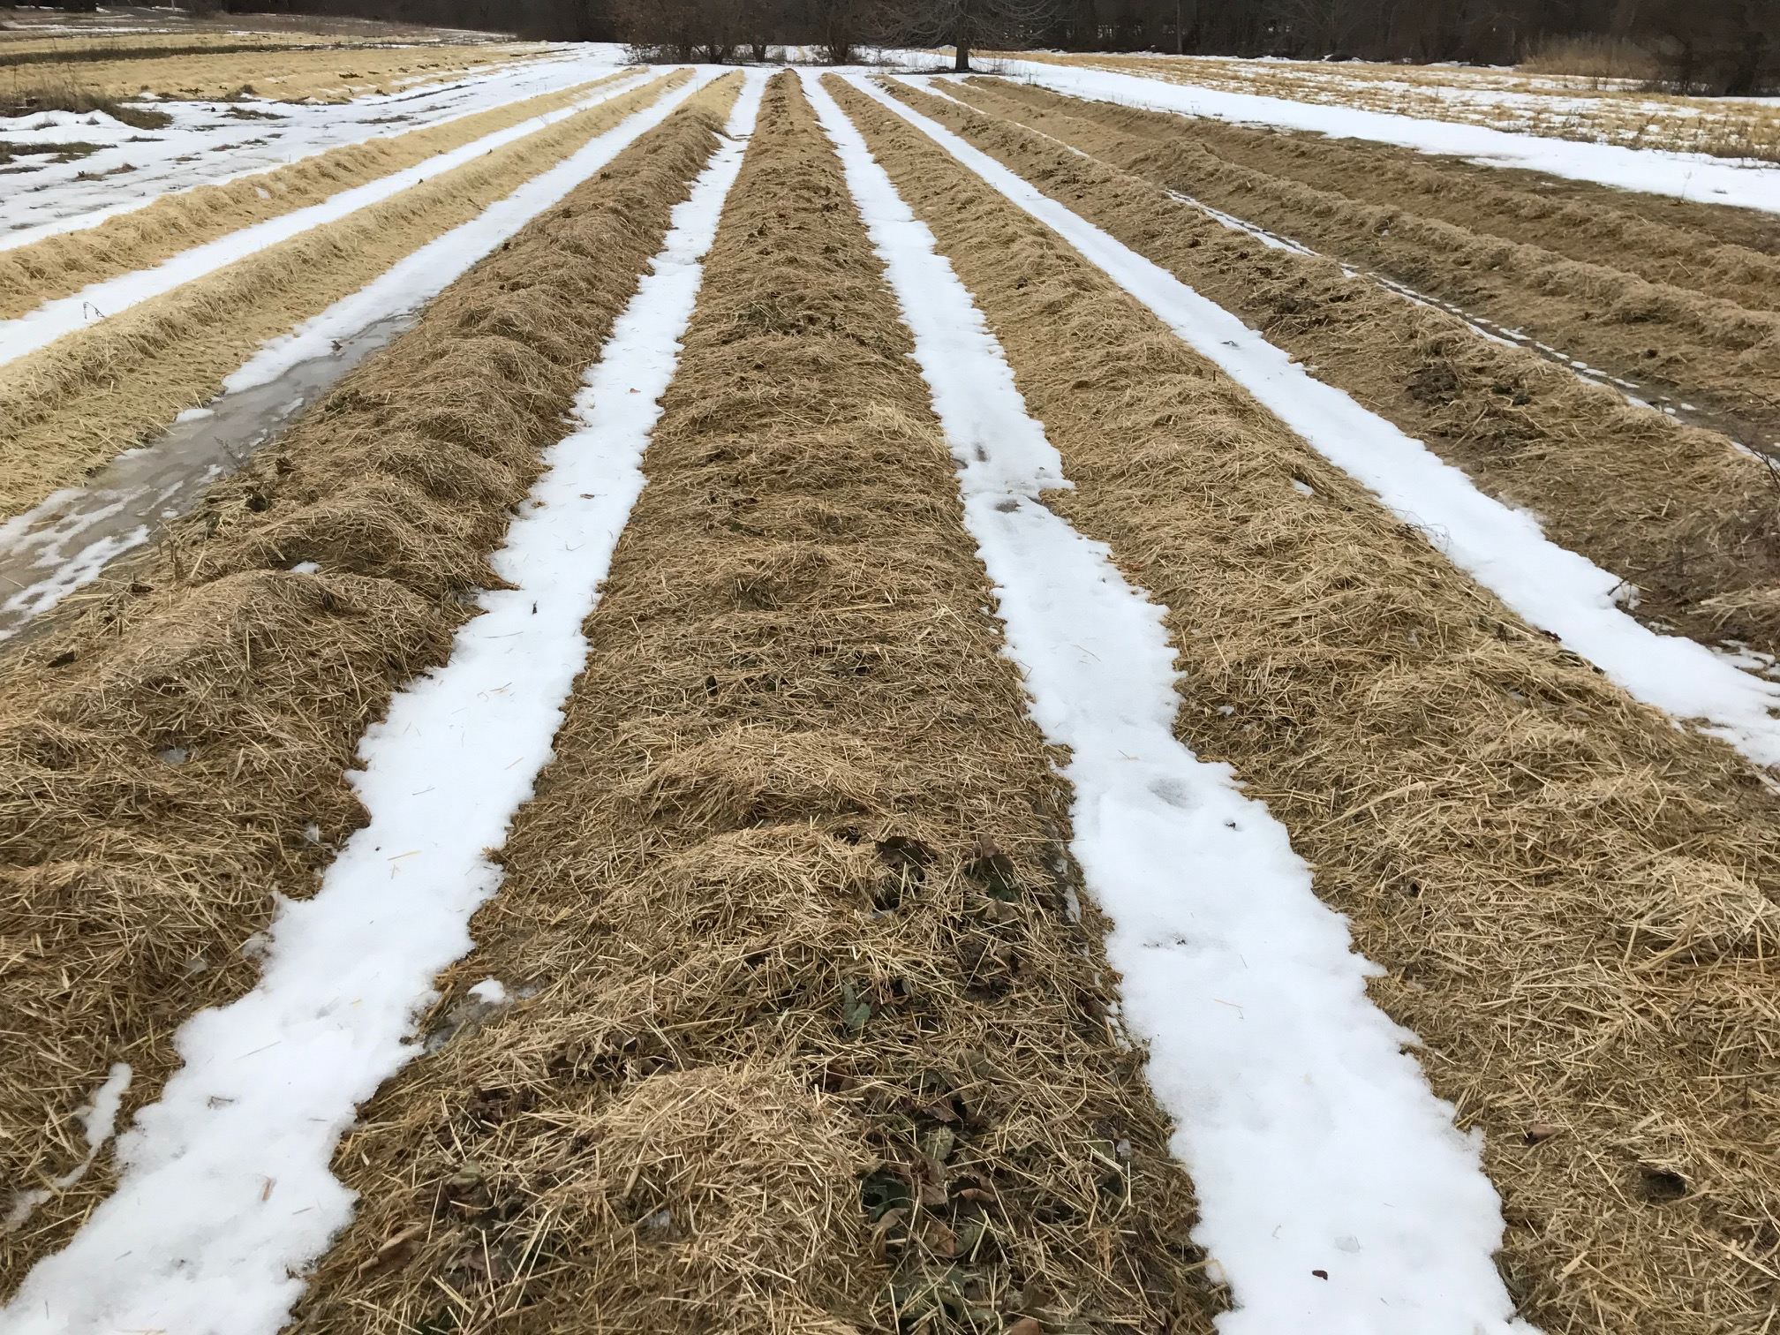
Matted Row Strawberry Block in Mid Jan

Slide 12
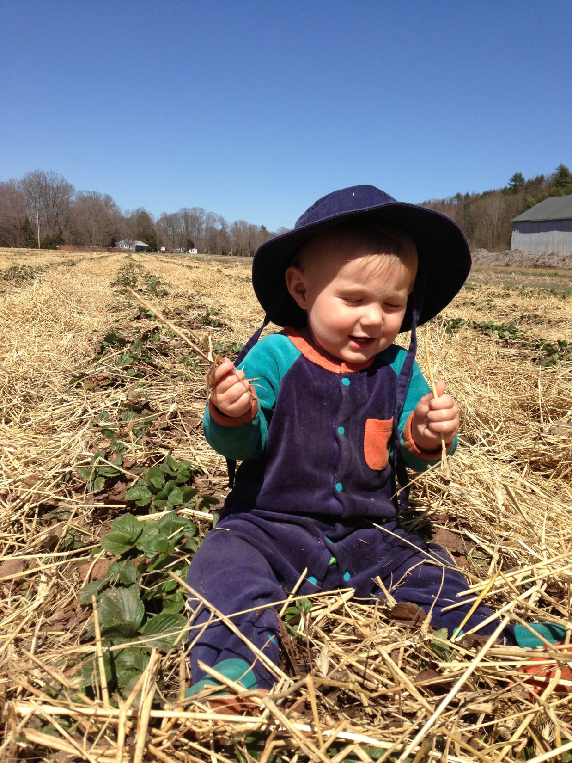
-after overwintering, mulch is pulled back from plants in early spring. Important to leave some strands of straw between plant crowns to assure that ripening fruit does not rest direct on the soil.

Slide 13
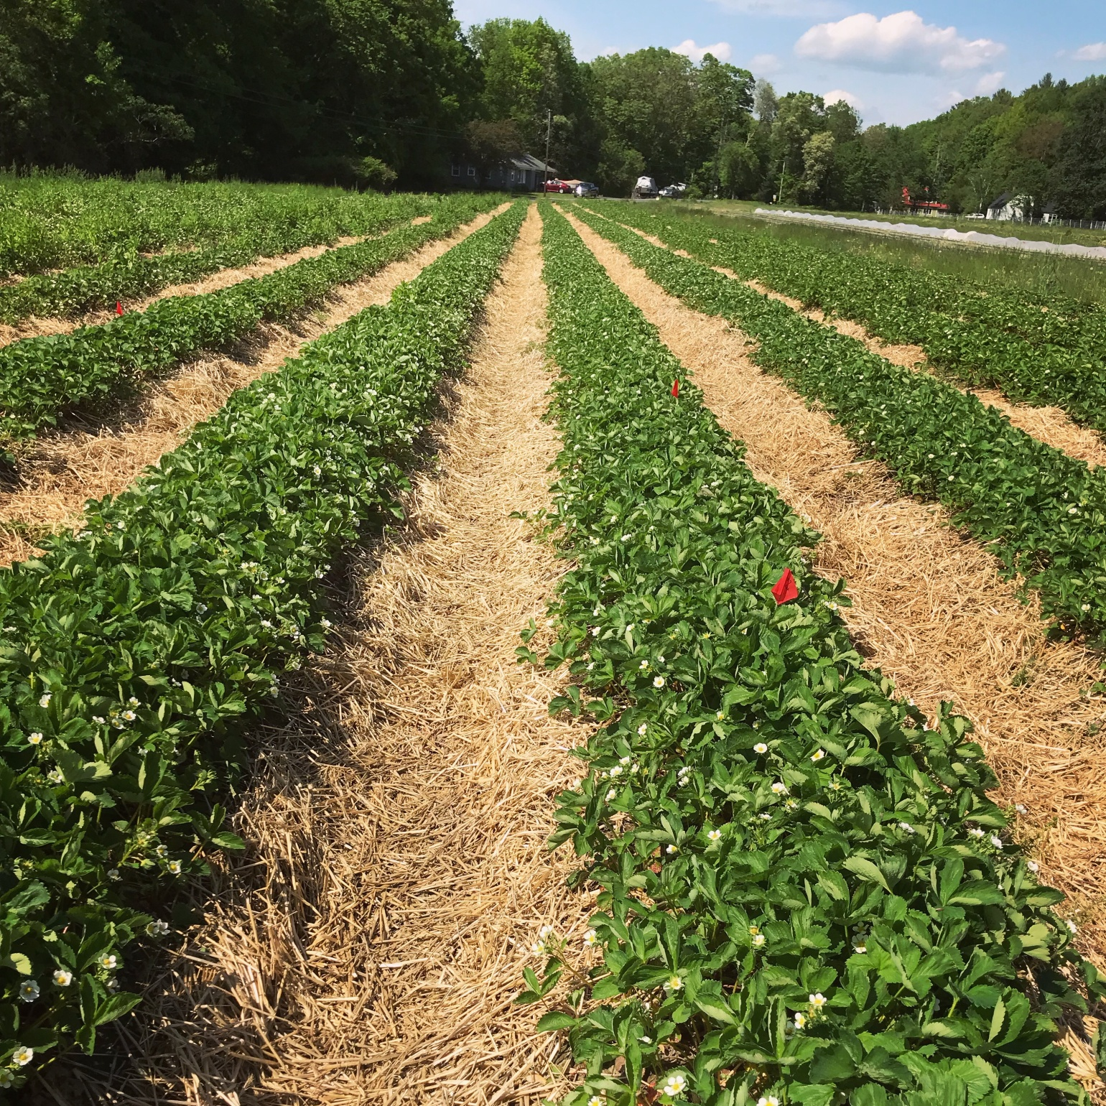
Matted row patch at bloom
-additional hand weeding is often required prior to the start of the harvest season.
-plants typically bloom heavily with concentrated sets of berries that ripen over the course of June depending on the variety.
-we frequently spray serenade optimum & pyganic in order to try and reduce botrytis grey mold & tarnished plant bug.

Slide 14
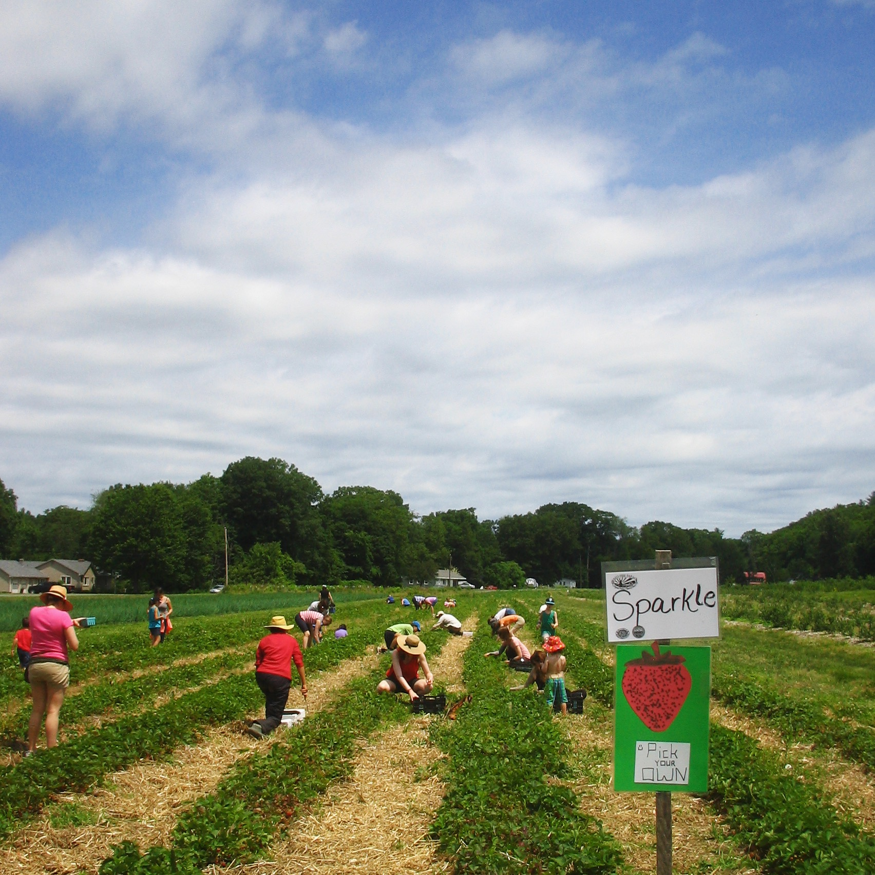
PYO Harvest Season Has Arrived on a Matted Row Field:
-after harvest is done around Mid July, we determine if plantings are good enough to attempt to renovate. Often patches have so many weeds coming in that we don’t even attempt the renovation for a 2nd year, but if patch looks like we might win, then renovation is attempted.
-Renovation involves mowing, narrowing rows, cultivating, & fertilizing.
-Often after renovation passes are made, weeds still overcome the planting, and patch is turned under in late summer.
-In recent years only about 1/3 of our matted row plantings are successfully overwintered for a 2nd season of yielding, and if they make it this far, 2nd year berry size and quality is often not very good.

Slide 15
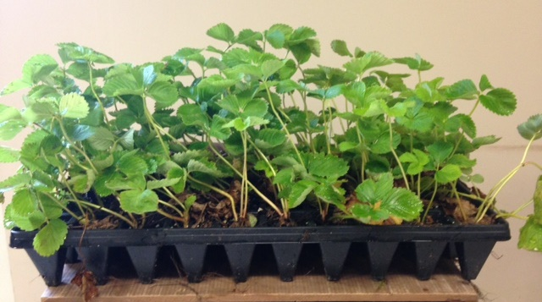
Plasticulture Strawberry Growing System Overview:
-plantings are usually started from plugs. Plugs are propagated by specialized Canadian growers who collect disease free tips from mother plants. At Red Fire Farm we grow most of our plug strawberry plants by purchasing tips and rooting them under a mist system in our greenhouse.
-For our location in western MA, I think the optimal timing for transplanting plugs into plastic beds is the last week of August or first week in Sept. Can be hard to get tips in time and get the plugs fully grown for this schedule.

Slide 16
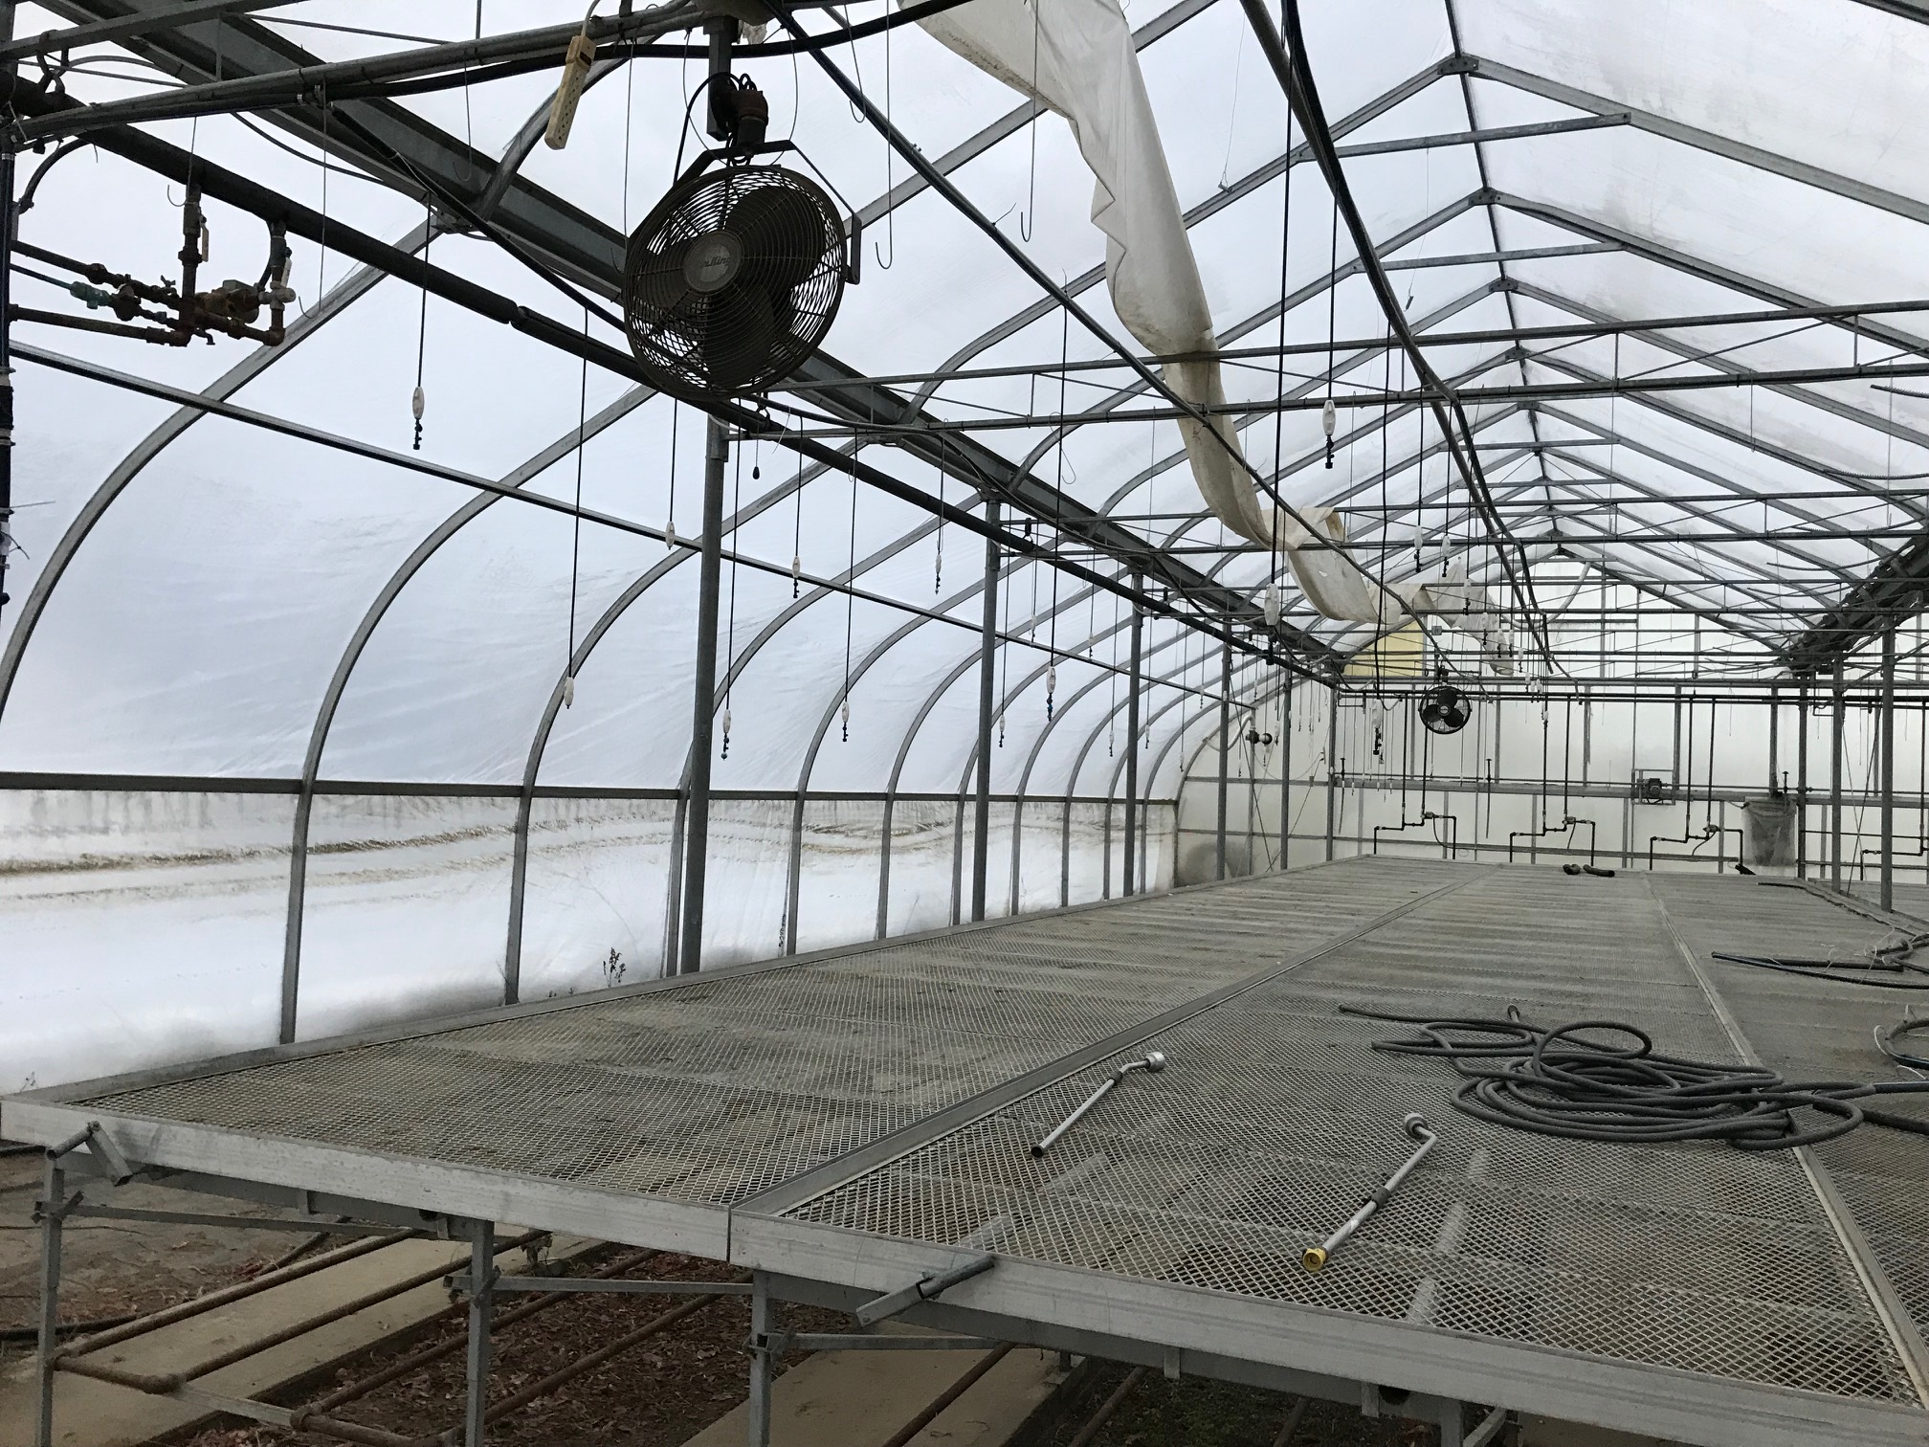
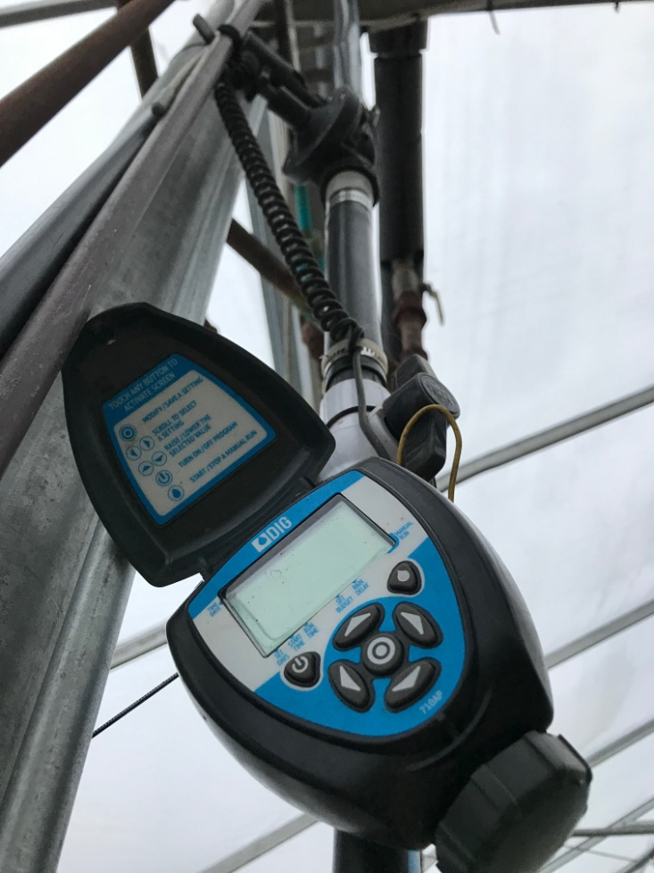
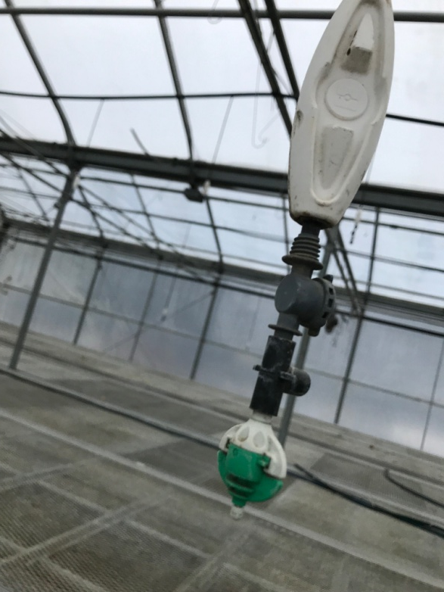
Misting Schedule:
-Stick tips into 50’s about 5-6 weeks prior to transplant date (mid July).
-Mist for 10 seconds every 5 minutes for first 4 days.
-Mist for 30 seconds every 12 minutes for days 5-15.
-After this, decrease mist duration but still every 12 minutes.
-Discontinue all mist after about 3-4 weeks and let plants harden.
.

Slide 17
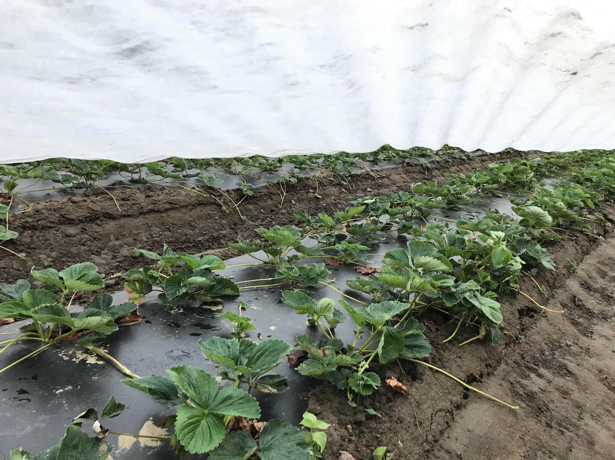
-Plasticulture plug started strawberries are spaced at 2 rows per bed with 12” in row spacing. This is twice the plant density compared to matted row.
-With plasticulture the goal is to grow the mother plants into large crowned plants, but not to allow runners to peg down. Runners should be cut or cultivated off before they root.
-Plasticulture strawberry varieties need to have lots of yield potential per plant, since yield success will relay on lots of berries or weight per plant. This is in contrast to matted row where good yields per acre can be achieved even with low or modest per plant yields, simply by having a high population density of daughter plants.
Plug started strawberry beds on 10/17/19, about 7 weeks after they were transplanted.

Slide 18
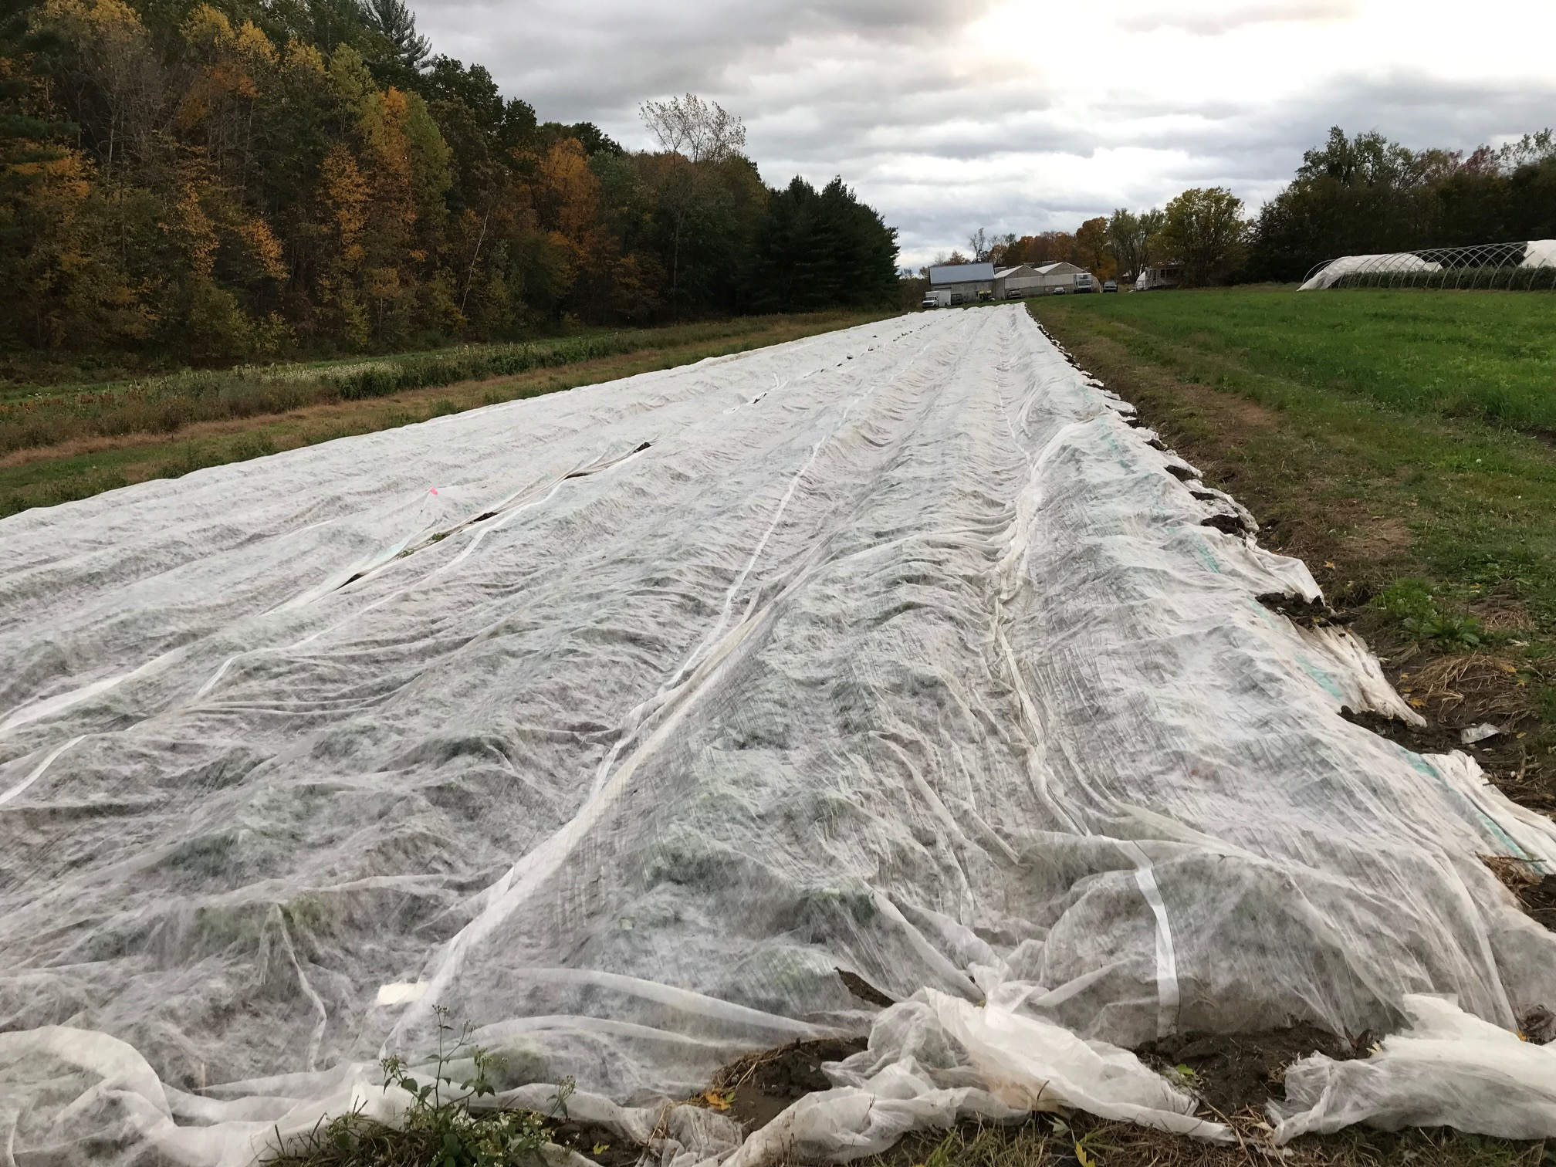
Standard practice is to cover plasticulture strawberry beds with floating row cover starting in mid or late Sept once outdoor temps begin to cool. Goal is to provide extra warmth for the plants later into the fall, as this is the time when buds are being initiated, and they will set more and larger berries with a longer amount of fall warmth. Row covers stay on all winter, usually until plants are about to flower in the spring.

Slide 19
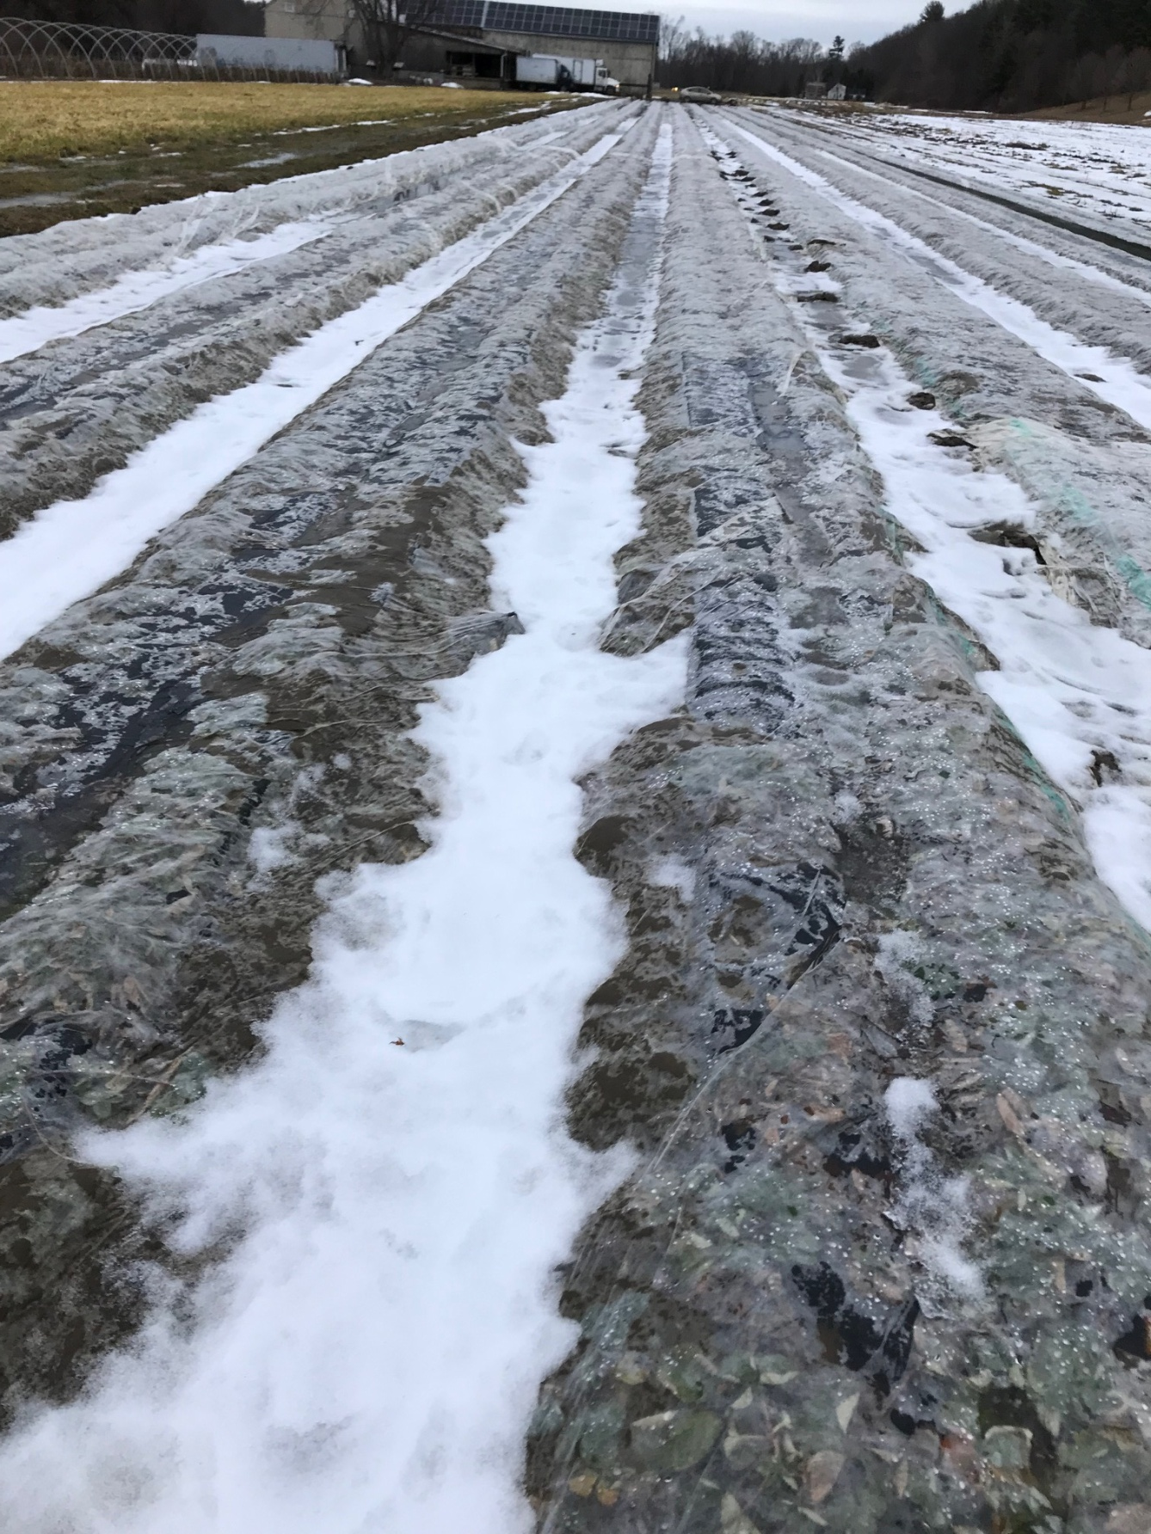
The same plasticulture strawberry block in mid winter on 1/11/20 during a midwinter thaw.

Slide 20
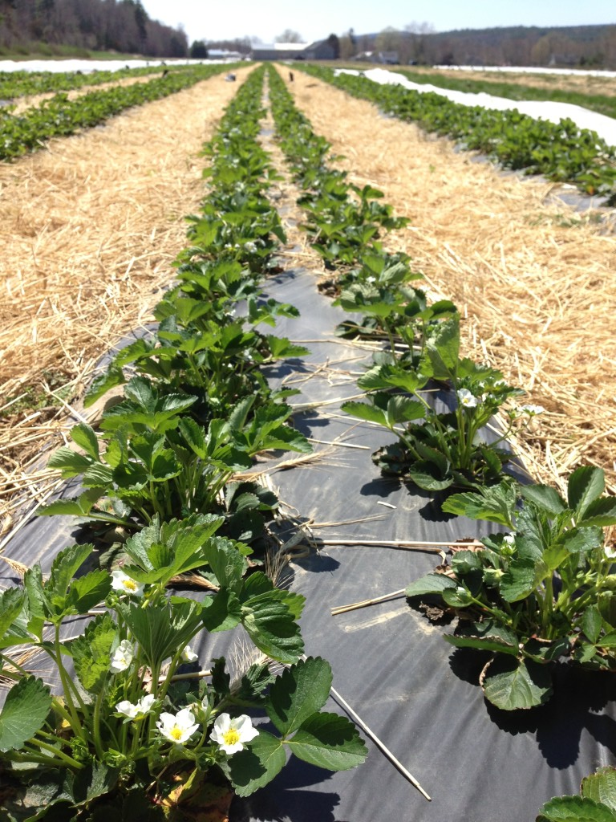
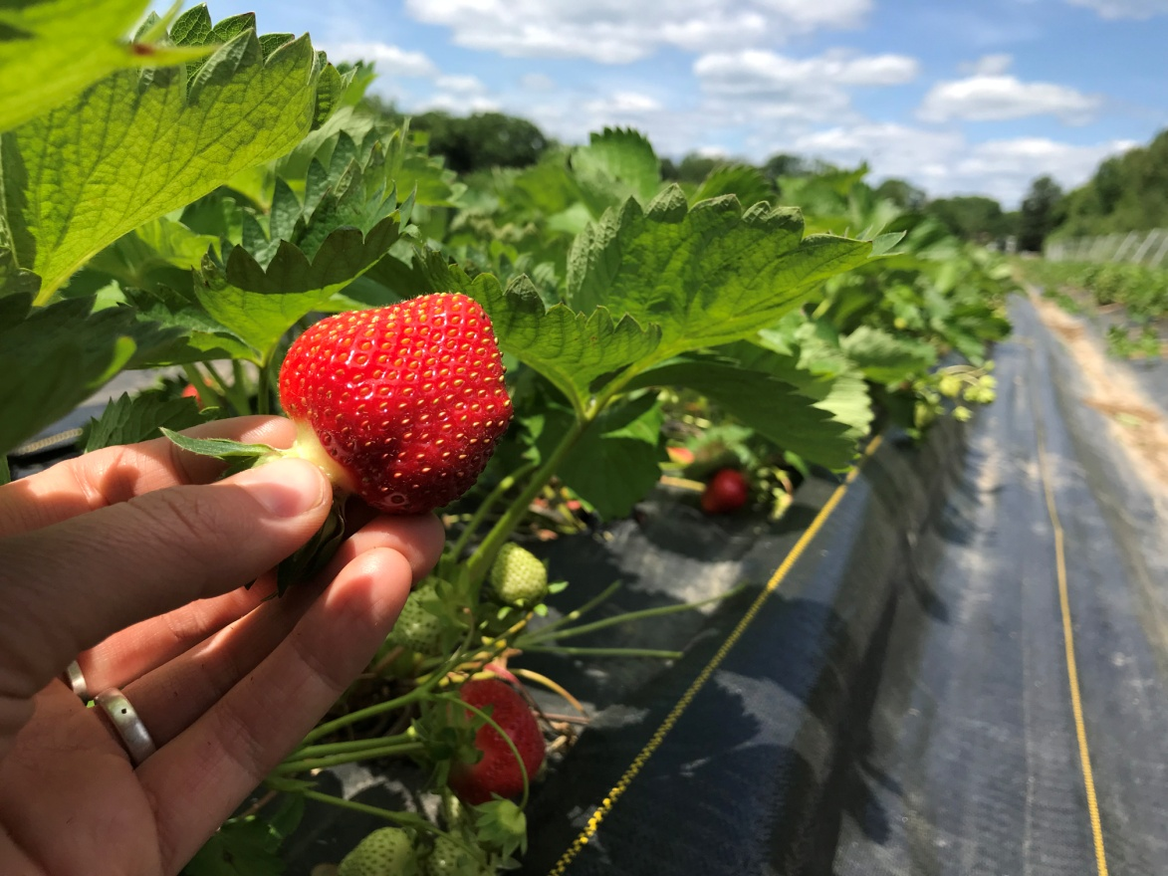
Weed Control must be maintained with the plasticulture system. Usually the holes need little if any weeding prior to harvest, but edges & isles of the black plastic beds must have a weed management strategy. Cultivation can be done in the fall after planting, or mulch can be installed. One way or another, some type of mulch needs to be in place prior to harvest season, in order to assure that berries don’t ripen onto dirt or suffer soil splash.
Mulching isles with straw or hay is one option.
Weed mat seems to provide the most reliable weed suppression, but does cost a lot to install and remove. Also puddles can form in isles as weed mat slows water drainage slightly. Also weed mat prevents using cultivators to cut away runners.

Slide 21
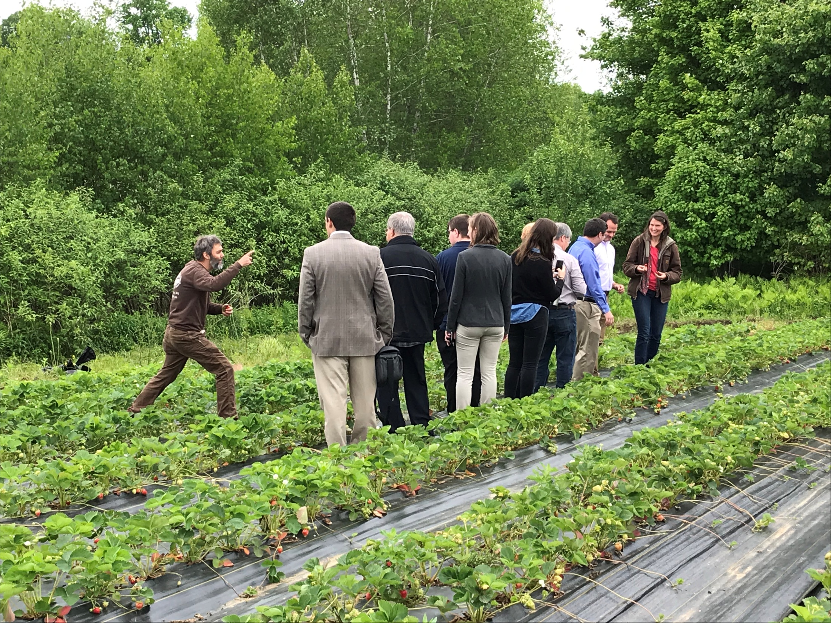
One question that we had as part of the SARE study, is if our organic seeking PYO customers would be turned off by a field full of plastic mulch. In 2019 we harvested a half acre of strawberries for our pick your own customers for the first time. We found that customers did not seem to mind the plastic one bit. This tour of politicians also was happy to see this field of easy to pick tasty berries! Basically if customers are turned into a field with an abundance of berries that taste good and pick quickly, then they will be happy!

Slide 22
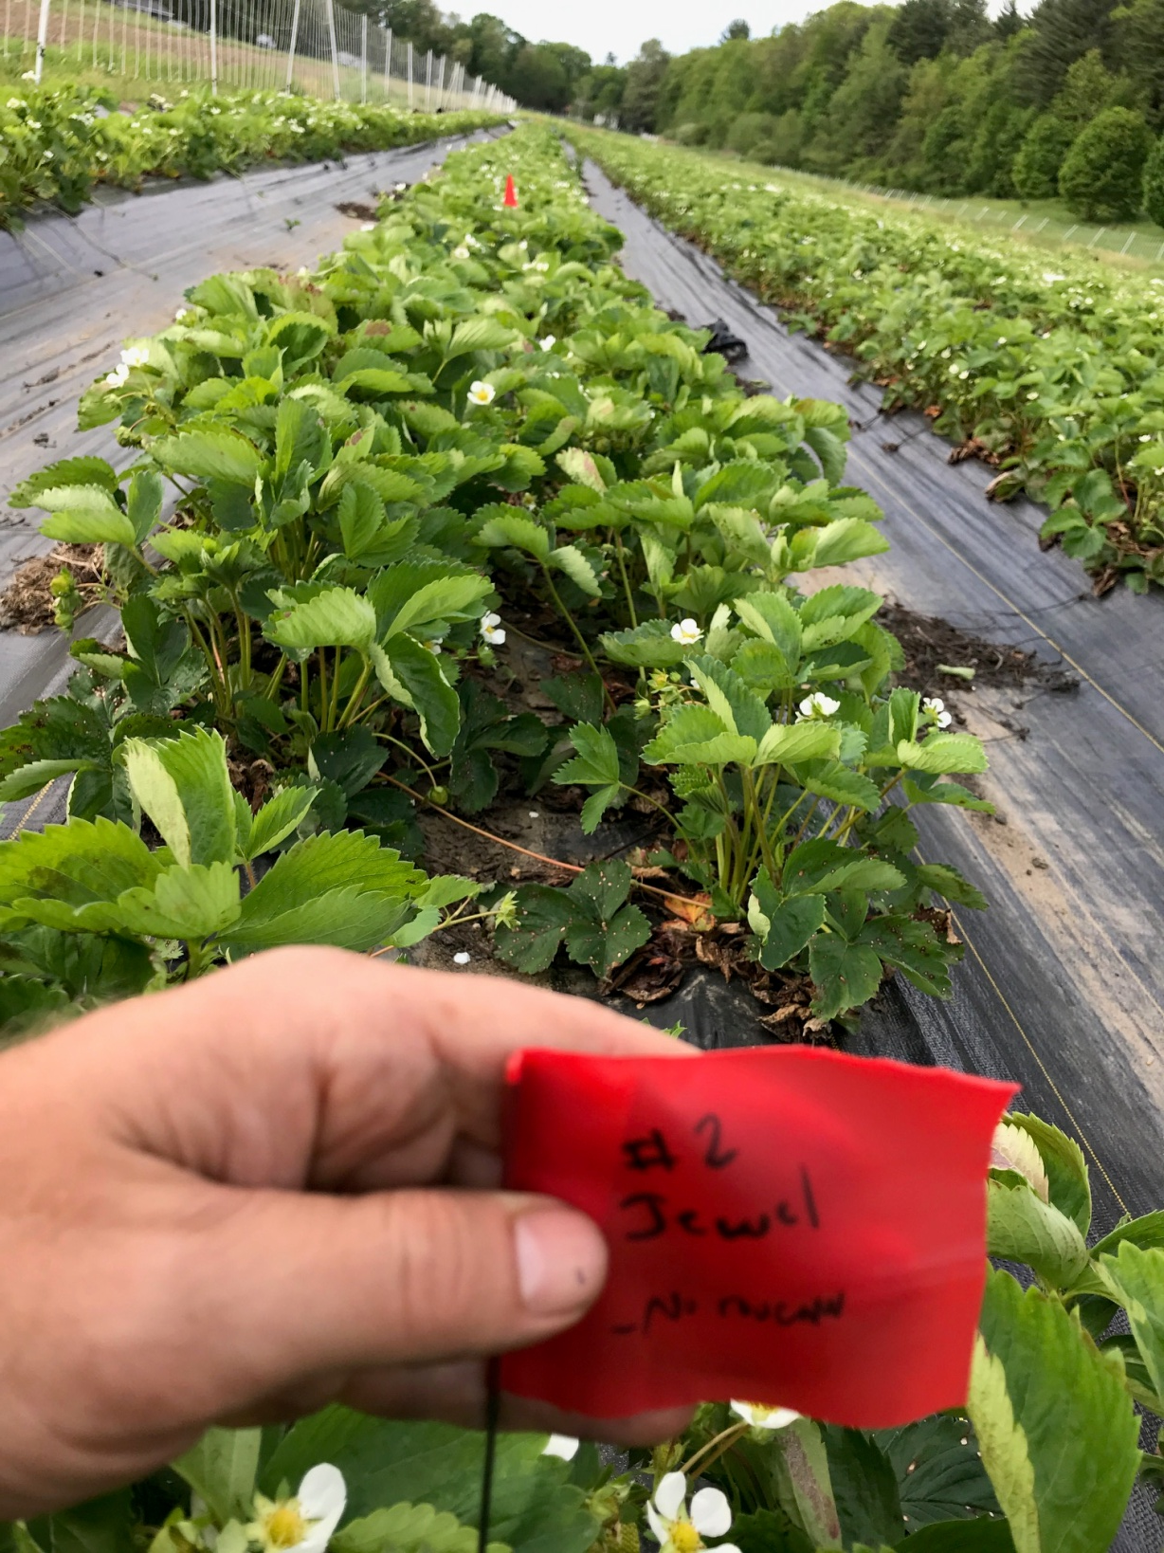
One variation on the plasticulture system is to establish plants on plastic beds using bare root plants instead of plugs. Timing for planting bare root plants onto plastic is early to mid July. At this time of year with hot weather the bare root plants may easily die if not watered enough immediately after transplanting.
Using bare root plants with this timing can result in large crowns, and bare root plants are less expensive than plugs, but plants also try to make lots and lots of runners that must be cut off.
The bed at left was established using bare root plants that were kept in storage at the nursery until July 10th 2018.

Slide 23
We kept careful data on establishment costs comparing the matted row vs plasticulture blocks in 2018. Adjusted to a per acre basis, these enterprise budgets show the costs and returns of each system.
Matted Row Establishment Costs About $13,910 per acre in year 1 (even with all the weeding and cultivating passes.)

Slide 24
Plasticutlure beds established using July planted bare root plants cost $17,240 per acre in variable costs to establish.

Slide 25
Plasticulture established with late Aug transplanted plugs cost $20,057 per acre to establish. This is when weed mat was used to mulch between the beds.

Slide 26
Original Premise of the SARE Study:
-Assumption was that growing organic strawberries using plug propagated beds planted in Late August was less trouble, much less cultivating and weeding, and thus a less expensive and more profitable system for growing berries.
-Problem was that the Chandler strawberry variety planted on plastic in this system usually ripened starting in late May (up to 3 weeks sooner than early matted row varieties), but finished ripening most seasons by mid June.
-The early berries are great, but our PYO and other Strawberry customers expect strawberry season to continue until at least the 4th of July.
-SARE sponsored study to figure out if there were viable ways to manipulate the plasticulture system to get some berries to ripen and peak in late June and into July.

Slide 27
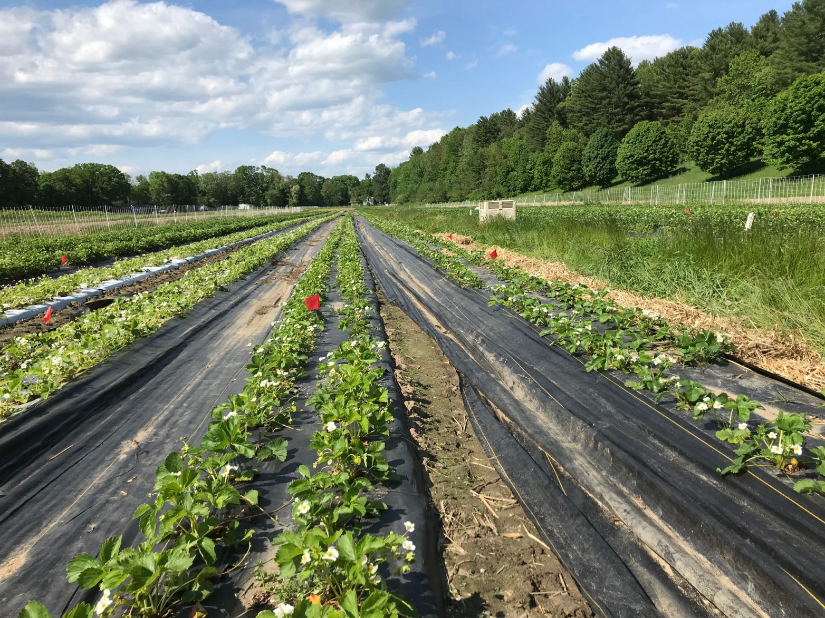
Ideas for delaying ripening on plasticulture:
-use white or silver plastic (instead of black) to keep soil cooler.
-remove row cover sooner in spring to delay early spring growth.
-use different varieties that are later to ripen
-attempt to delay spring growth by mulching over the plants with straw and removing this in later April, to delay plants from breaking dormancy and starting spring growth.
-does bare root vs plug started beds make a difference in ripening time?
We set up a trial to compare all of the above ideas, and contrasted to a matted row planting for comparison.

Slide 28
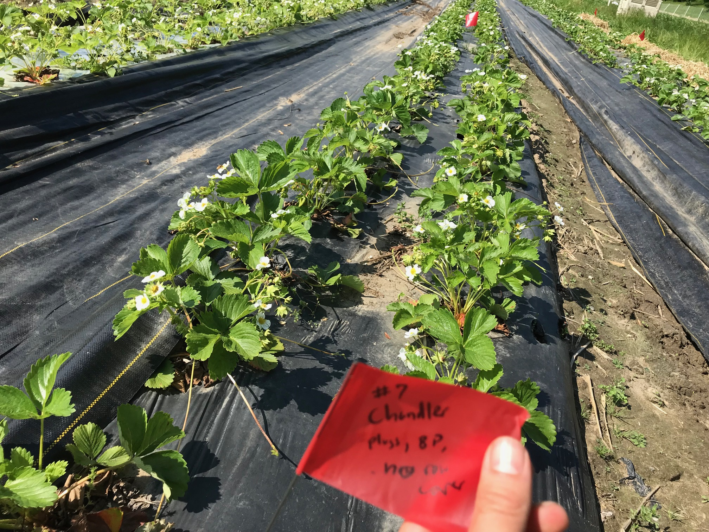
Our trial ended up with 29 different treatments. Before harvest season began a 10 bed foot section of each treatment was identified and flagged. Then at each harvest day, these sections were harvested separately, and the berry weight was recorded before adding the berries to the general harvest to be sold.

Slide 32
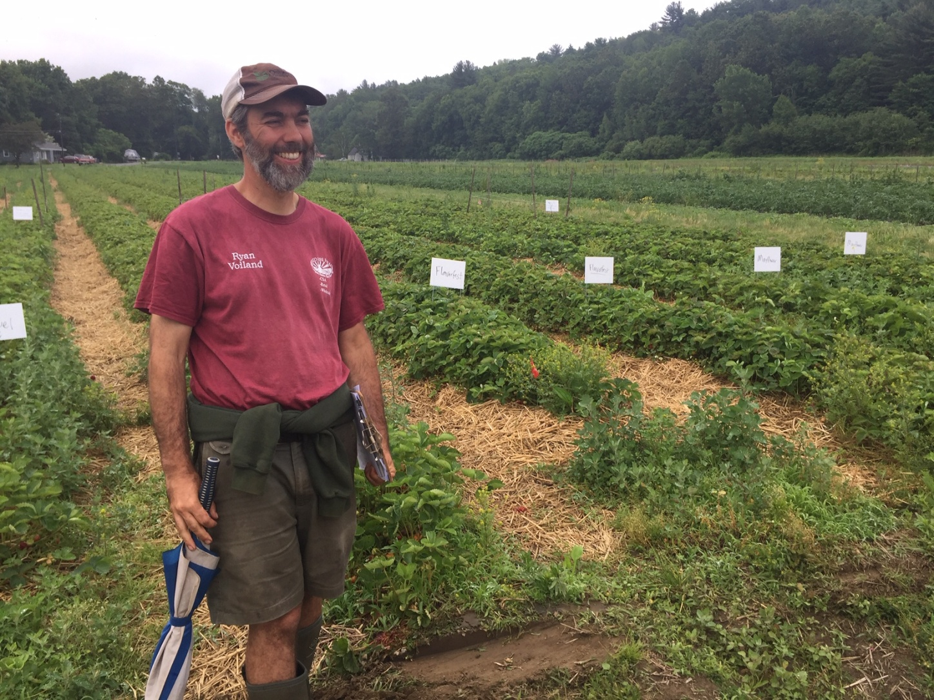
Must take the yield data from this study with a grain of salt!
1)The plasticulture field suffered fall deer browse damage when they ripped through the row cover and ate surprising amounts of leaves before I realized what was happening. (we then installed a deer fence around the patch, but damage was already done.) Yield plots were selected in spring form areas that appeared to have minimal damage.
2) Harvest crews doing the yield harvesting were stressed crew leaders that had a lot of other things to get done in June. They may have made some mistakes and did miss some trial plots on some harvest days.
3) This was not a replicated trial.

Slide 33
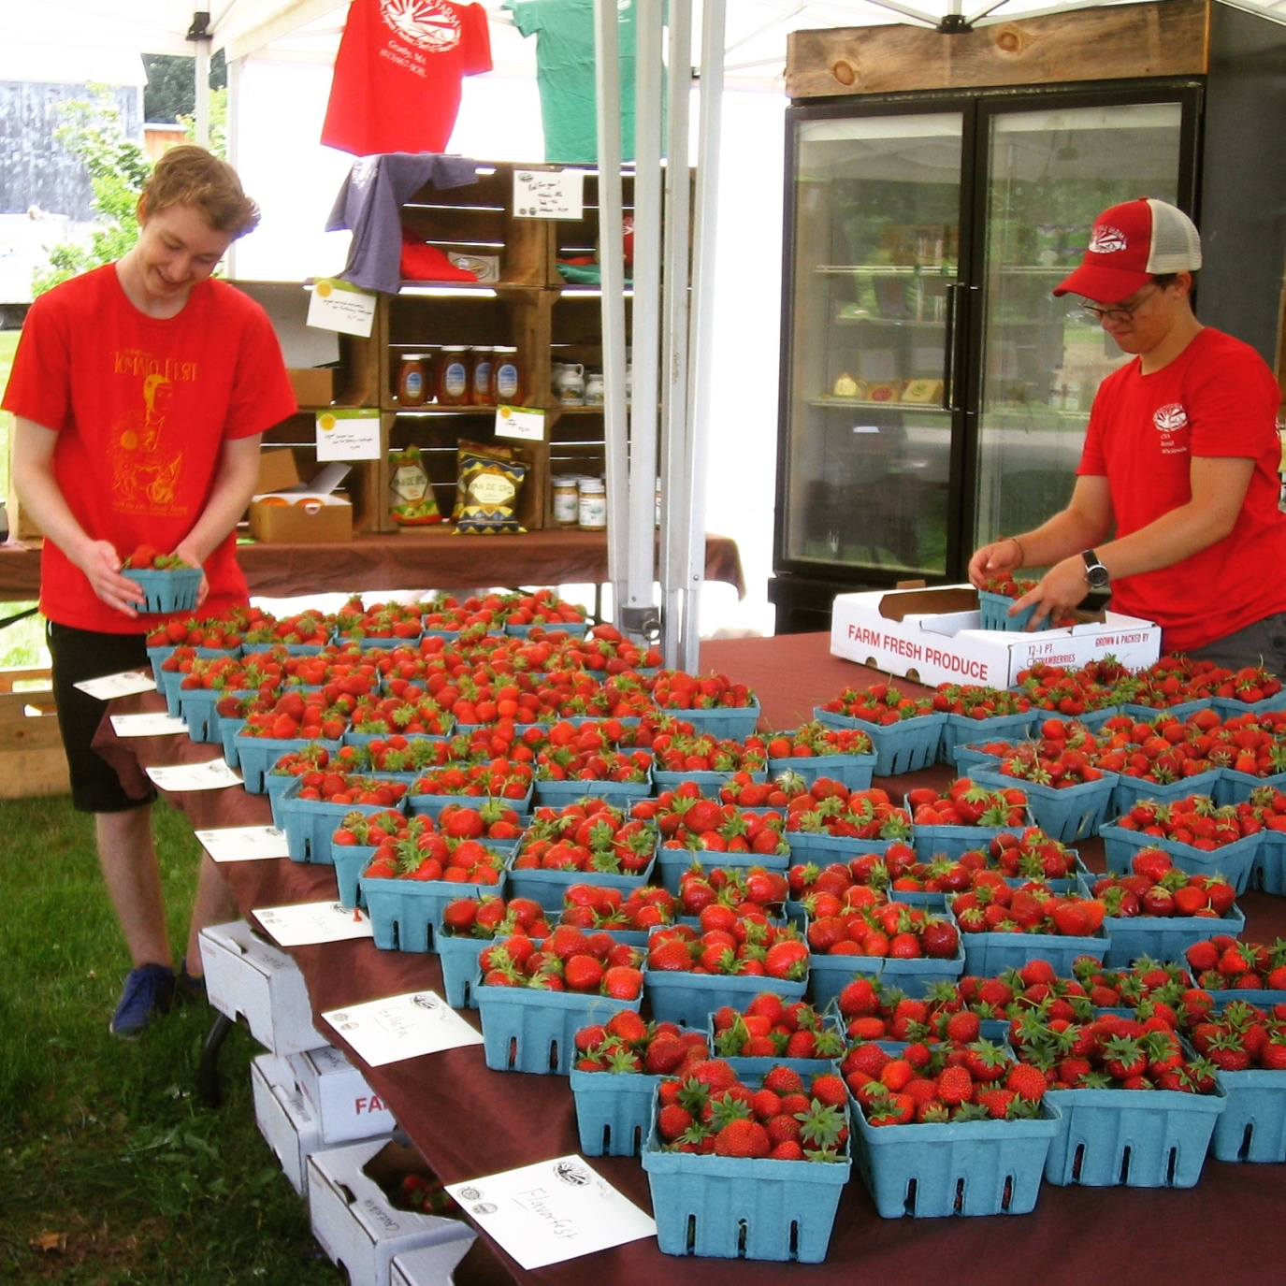
How Did The Different Varieties Taste?
We often sell berries by variety both by keeping varieties separate for on the shelf sales, and also by labeling our pick your own fields by variety.
In addition to finding varieties that grow well, we also want to keep our customers interested and let them develop their favorites.

Slide 34
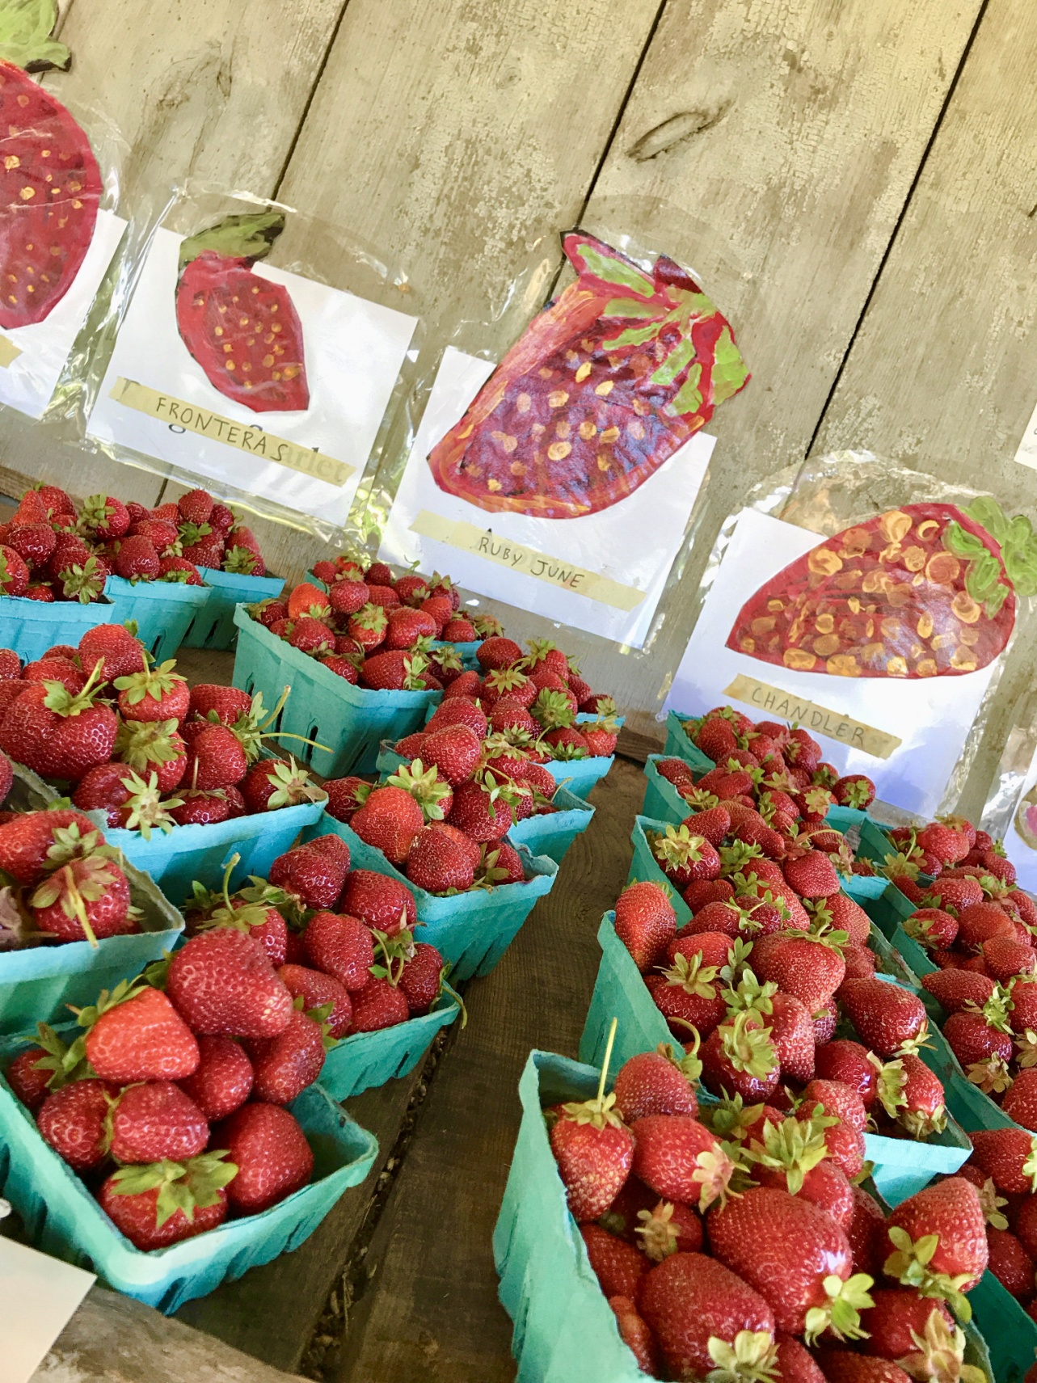
As part of the SARE study we introduced our customers to a handful of new varieties that we had never harvested prior to 2019, including:
-Ruby June
-Fronteras
-Camino Real
-Cleary Civ
Also of course:
-Chandler

Slide 35
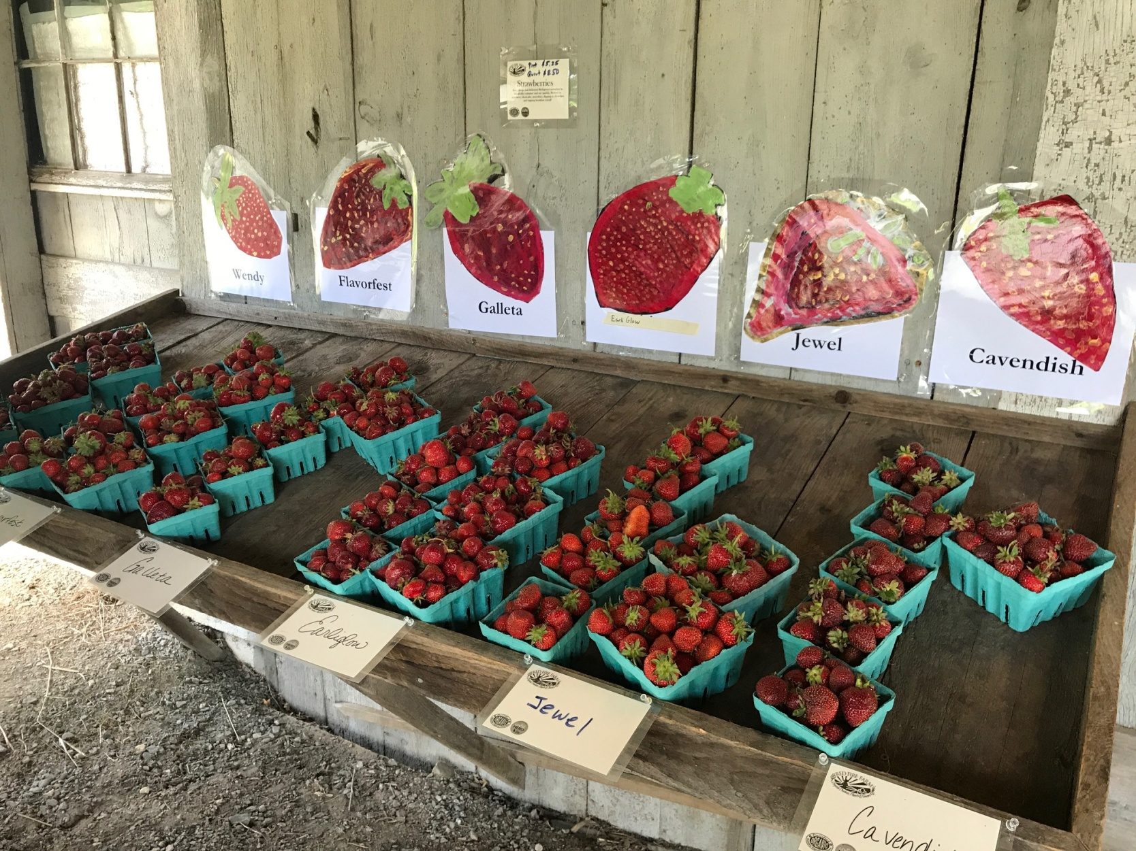
These new varieties were compared to many of our matted row standby varieties such as :
-Cavendish -AC Wendy -Jewel -Mayflower
-Earliglow -Sparkle -Flavorfest -Yambu

Slide 36
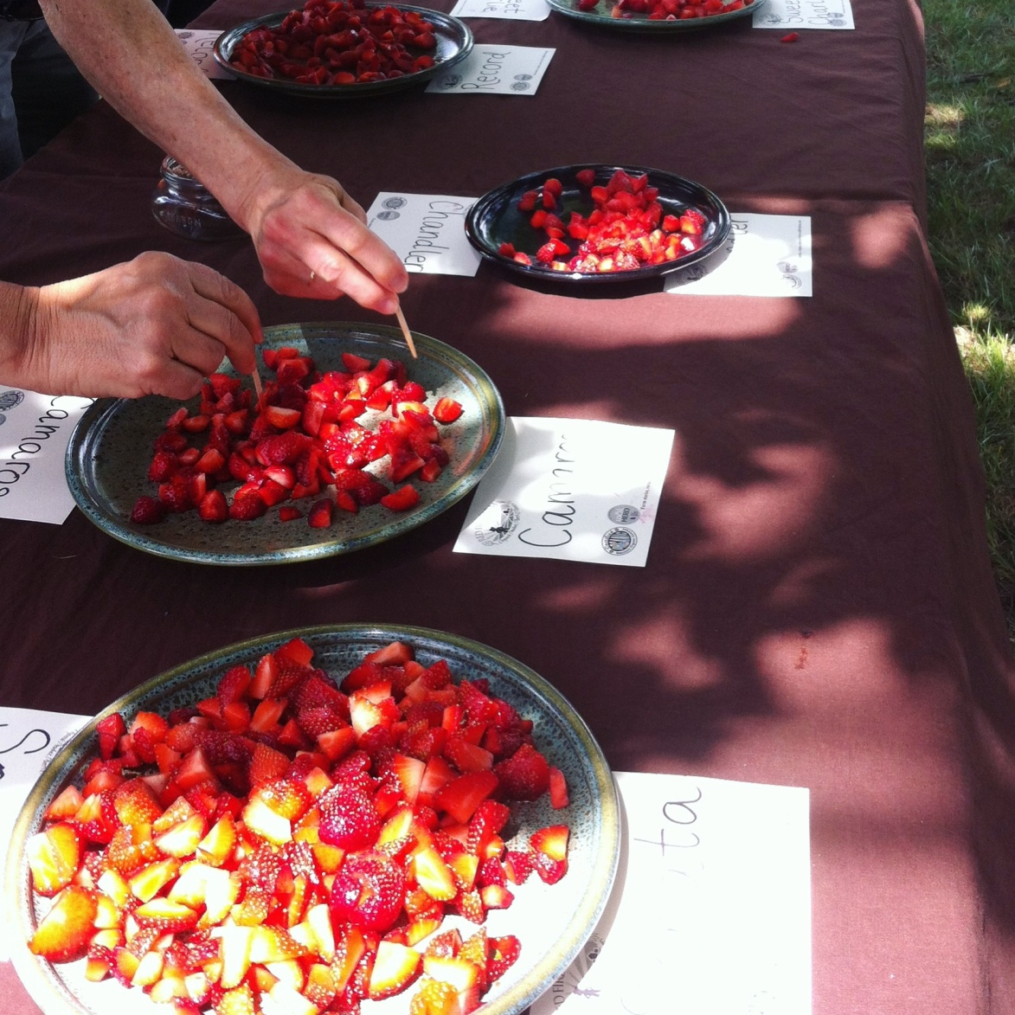
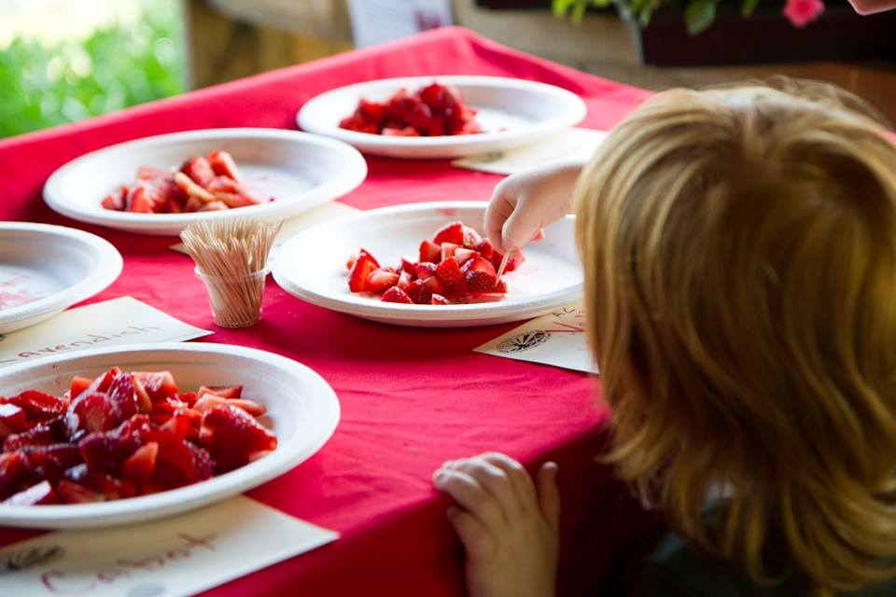
Each year we cut up all the varieties at our annual Strawberry Soiree event, and we ask people to taste them all and rate their favorites.

Slide 37
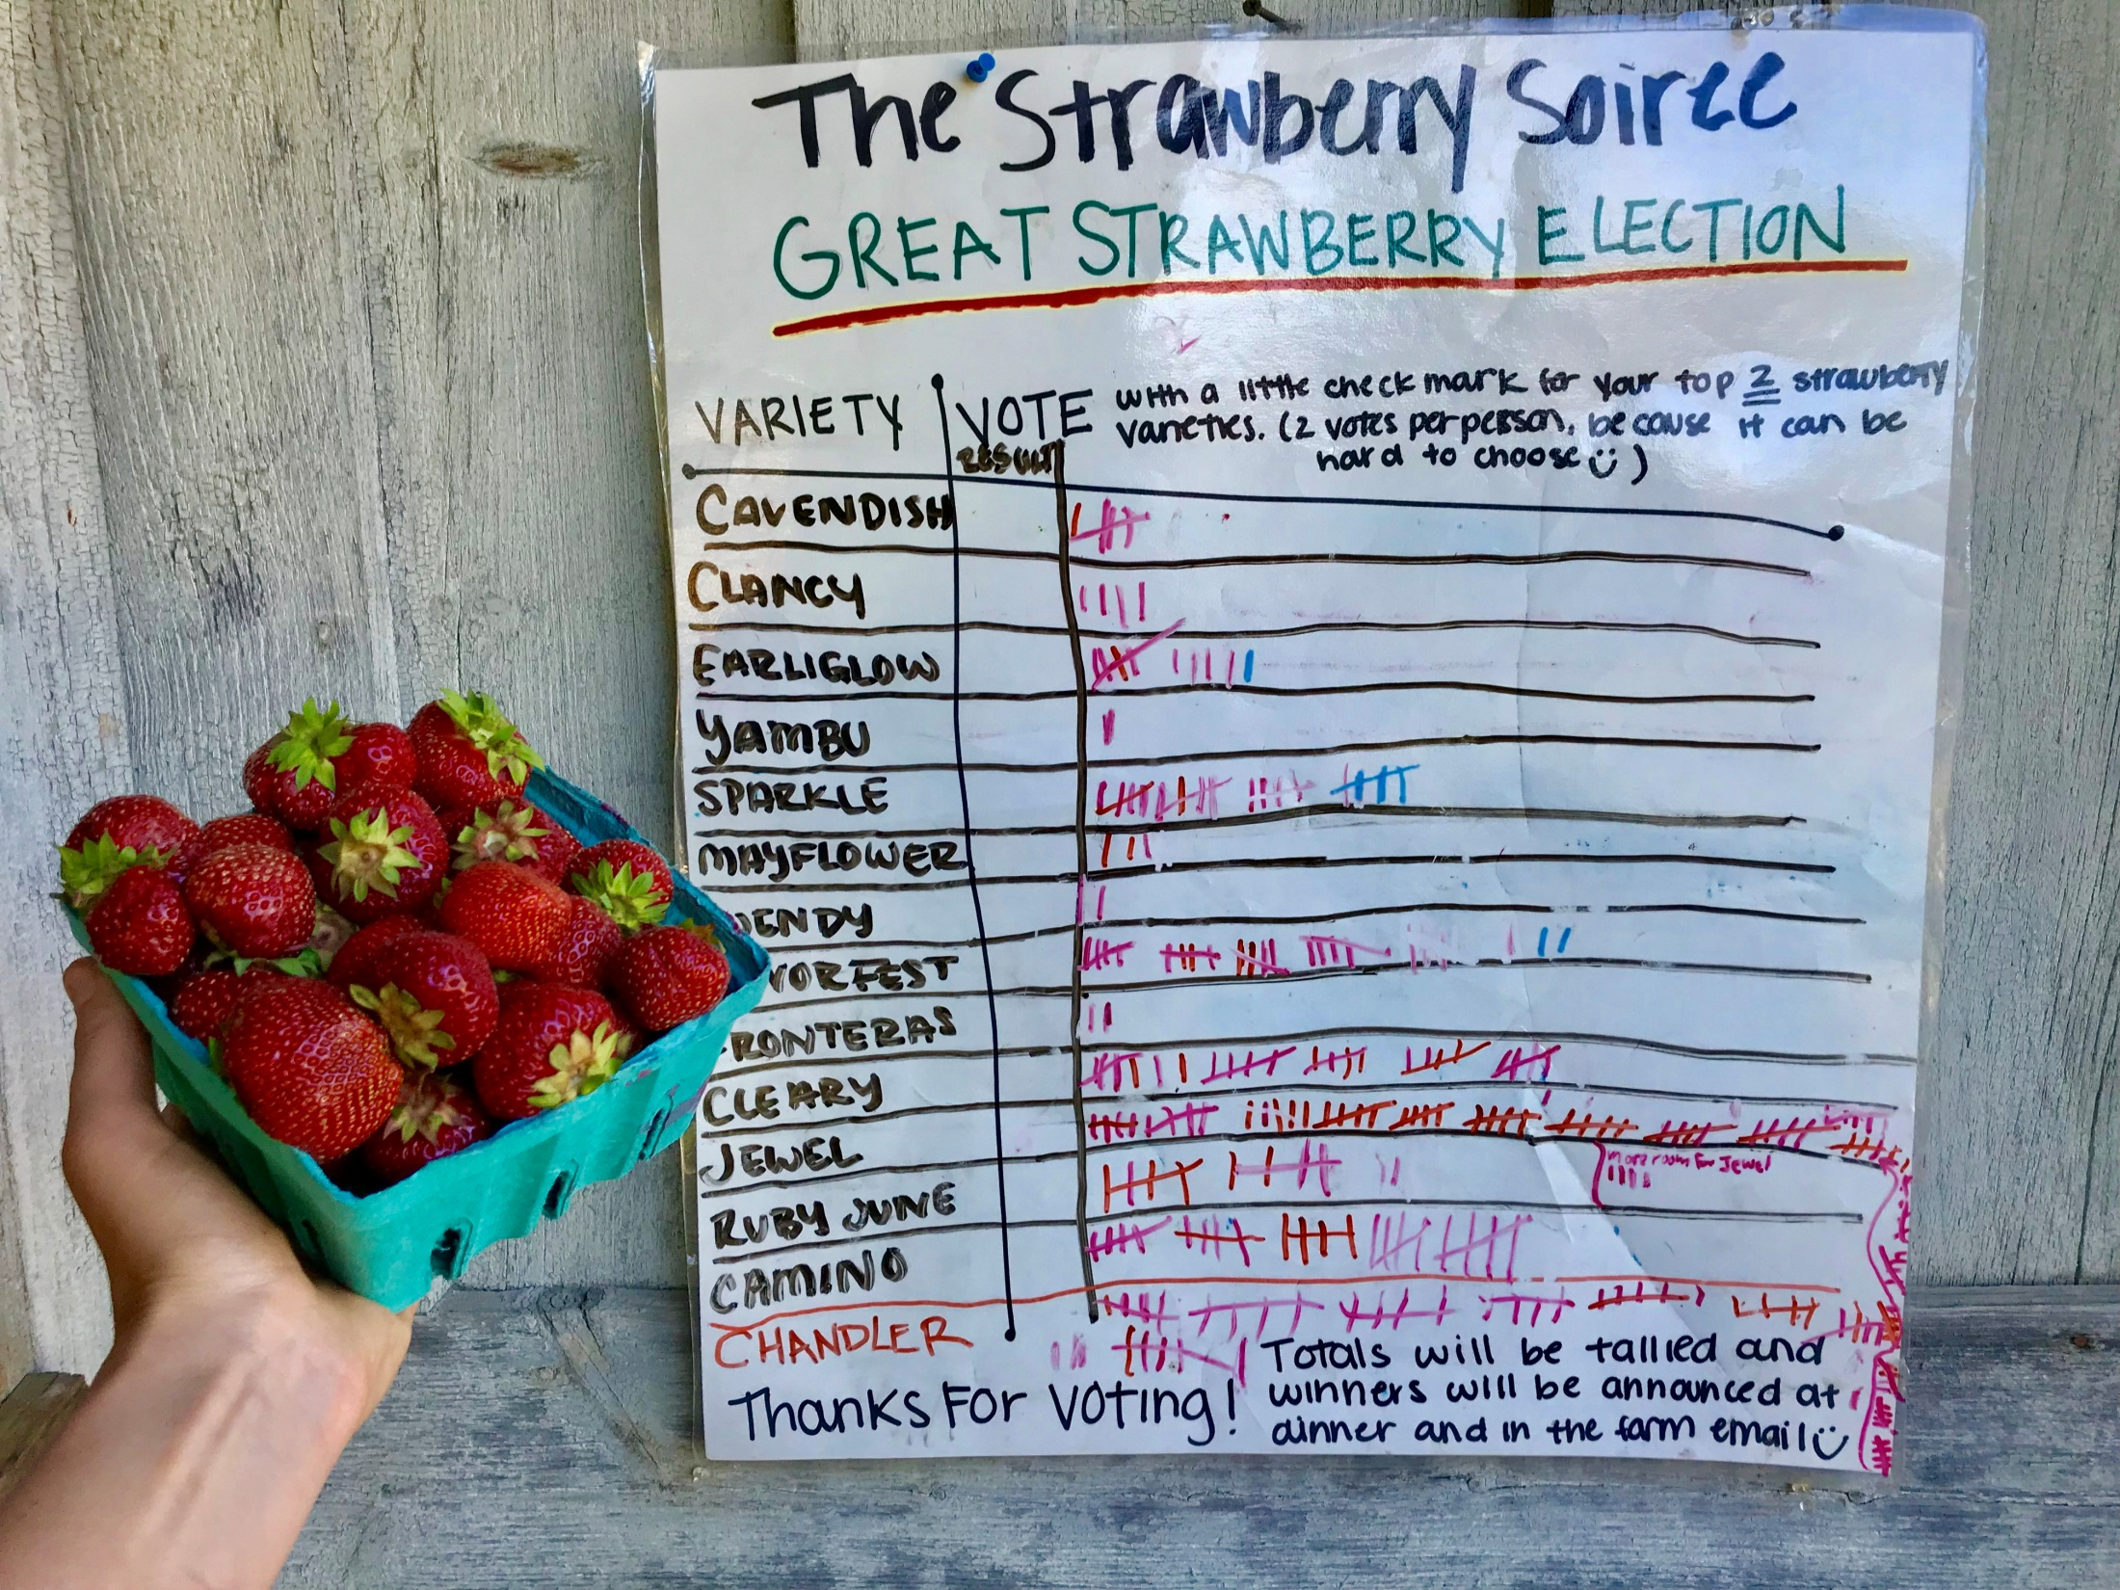
2019 results were the first year ever that Jewel rated as a major flavor winner.
All other recent years Chandler was by far the taste favorite.

Slide 38
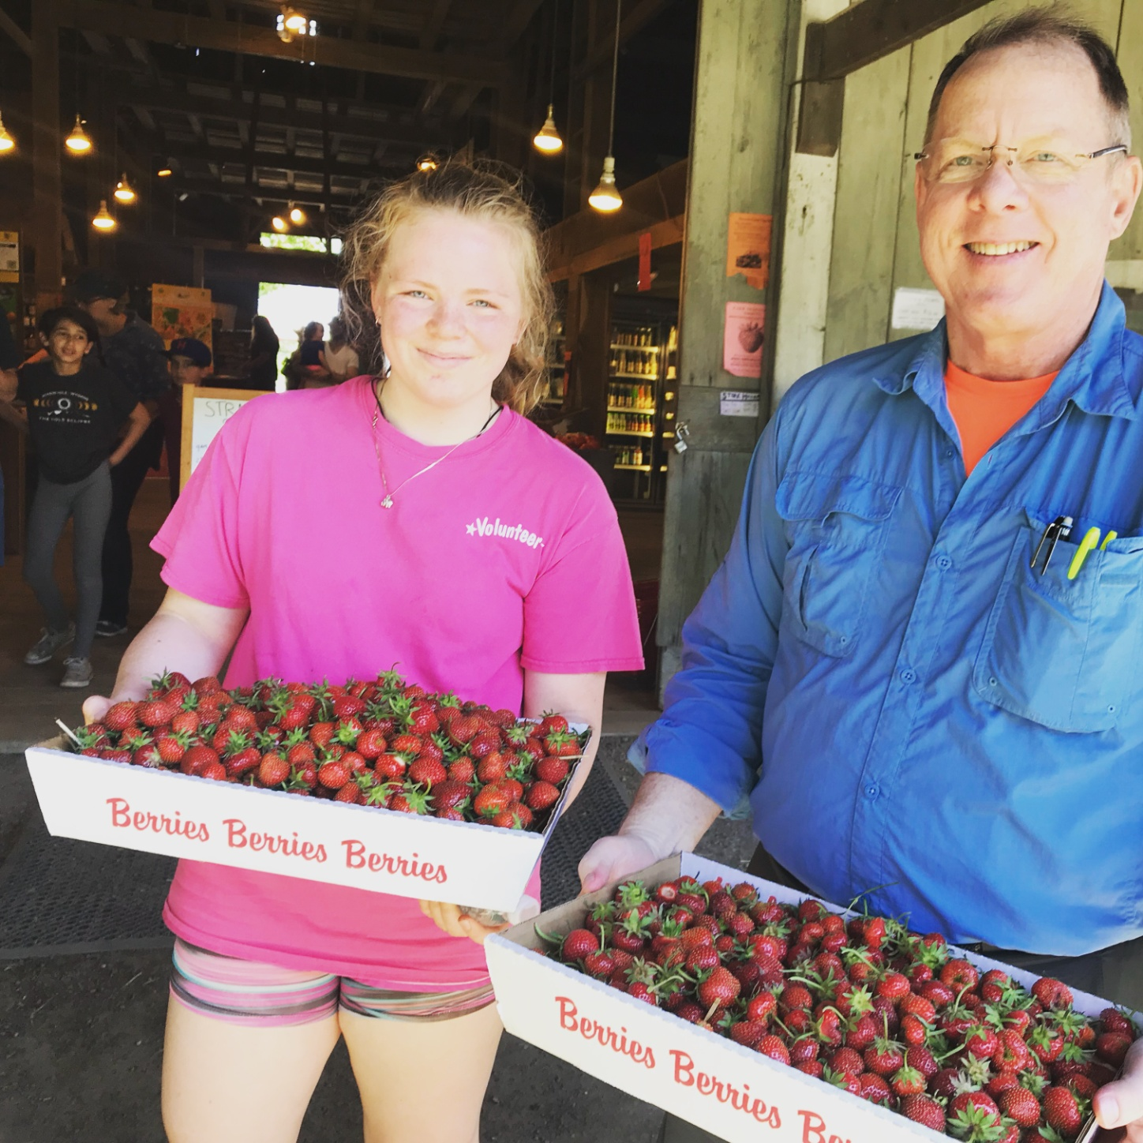
After Conducting this study, some of my major take homes are:
-Don’t give up on matted row, as there does not seem to be a good way to get lots of ripe berries in later June using the plasticulture system, despite using different varieties & manipulations.
-Besides, matted row per acre establishment is not as expensive after all (despite the weeding!)

Slide 39
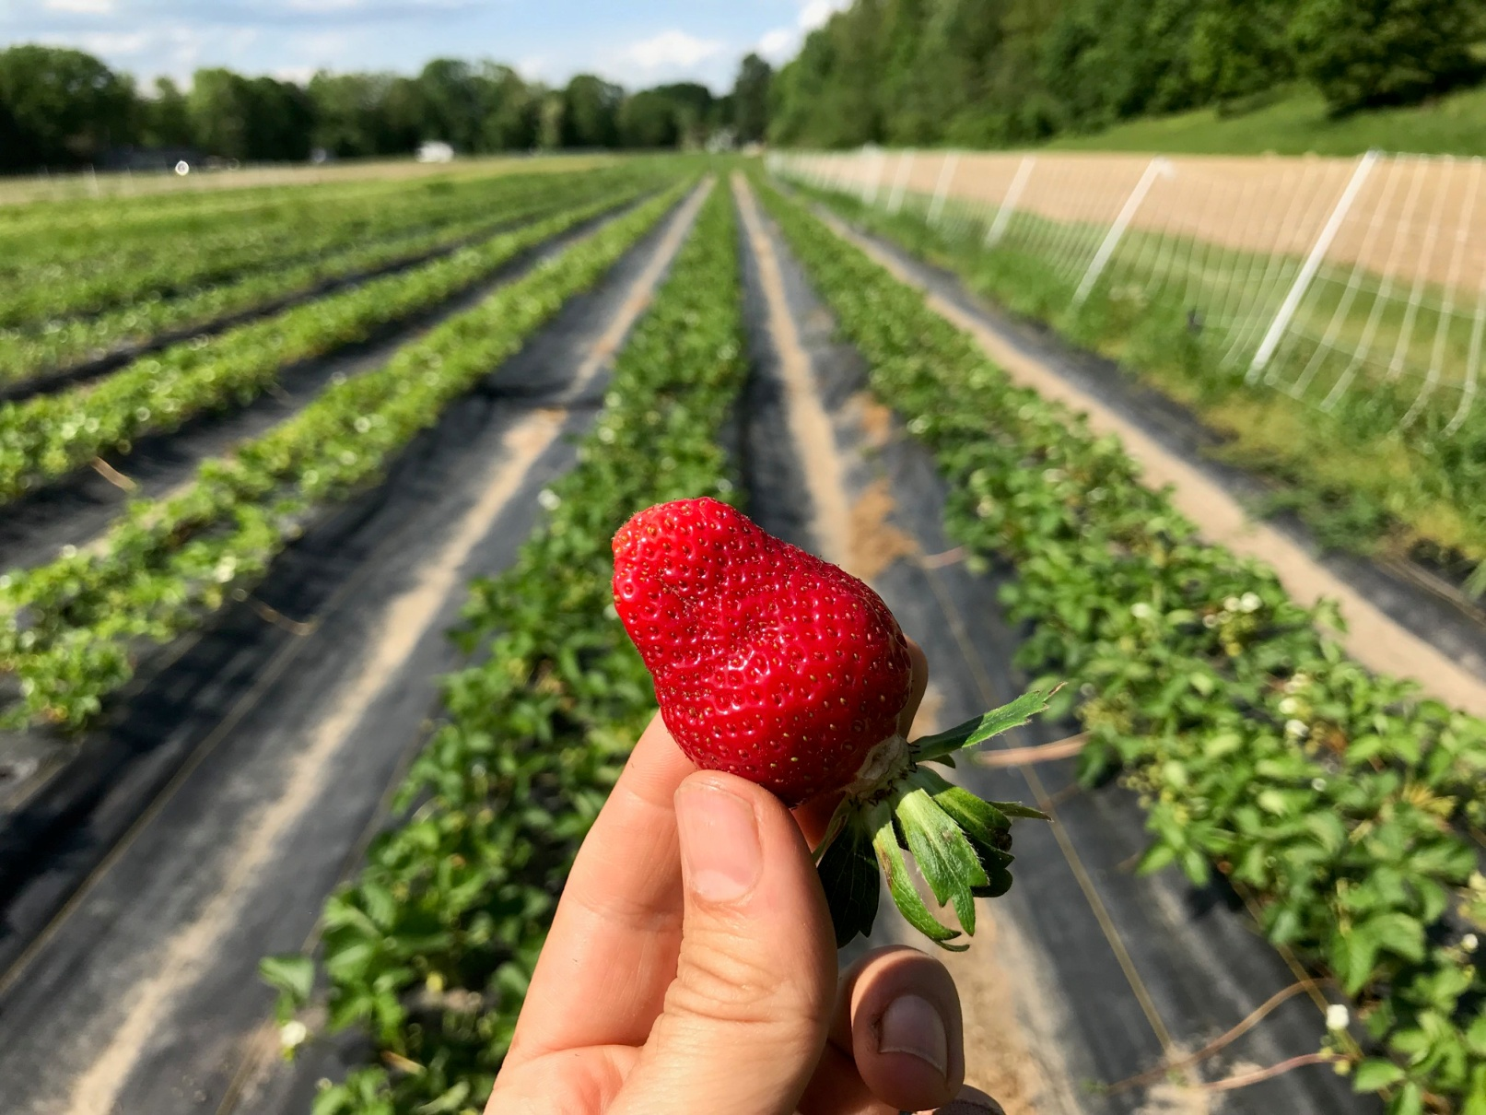
Cleary CIV
at left
-Grow more Cleary CIV. This was by far the earliest to ripen variety, and in my opinion consistently one of the very best flavored.
-Also grow even more Jewel! In both plasticulture and matted row, this appears to be a top yielding variety, and in 2019 it even tasted amazing!

Slide 40
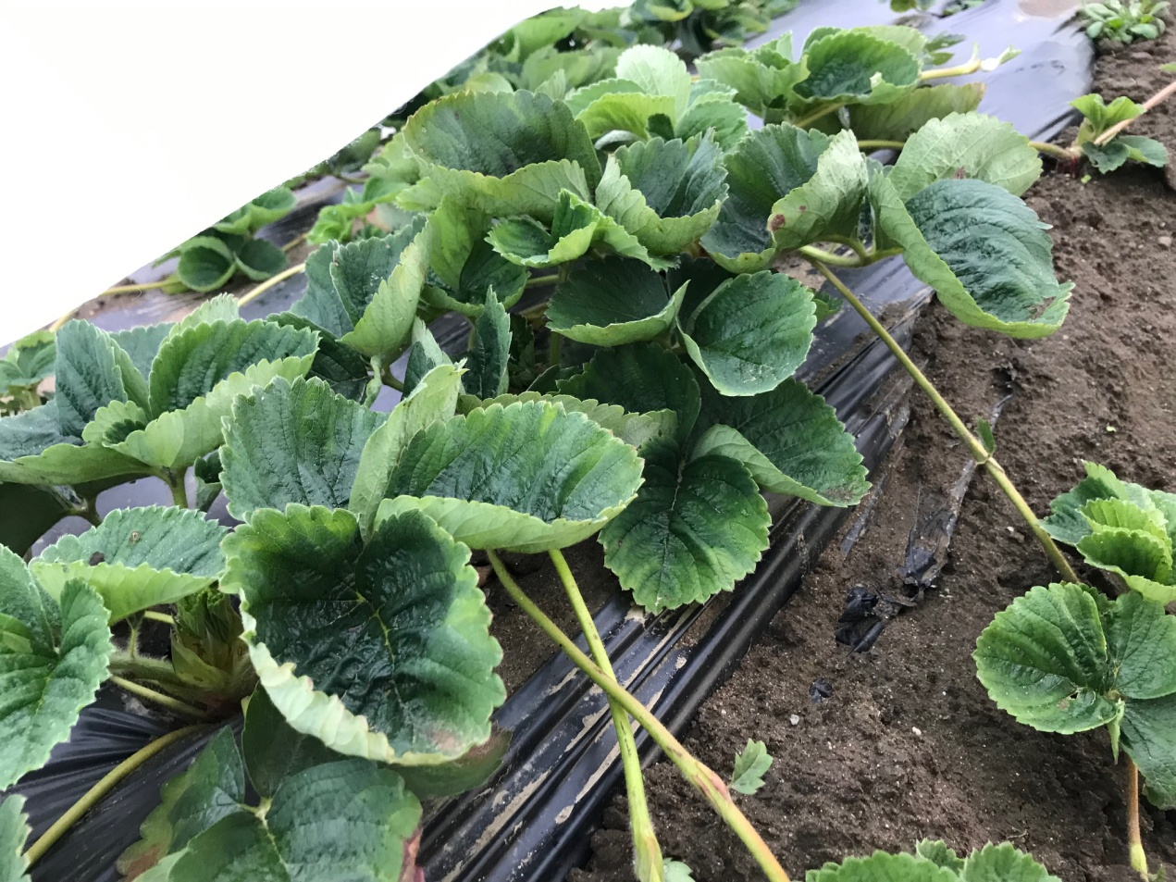
When it comes to plasticulture,
-Don’t bother with any color of plastic other than black.
-Try to figure out less expensive isle weed management than weed mat. In 2010 I went back to cultivating and will apply hay in early spring.
-Does not seem like July planted bare root into plastic is worthwhile. To busy then, plants die easily from dryness & yields not amazing.

Slide 41
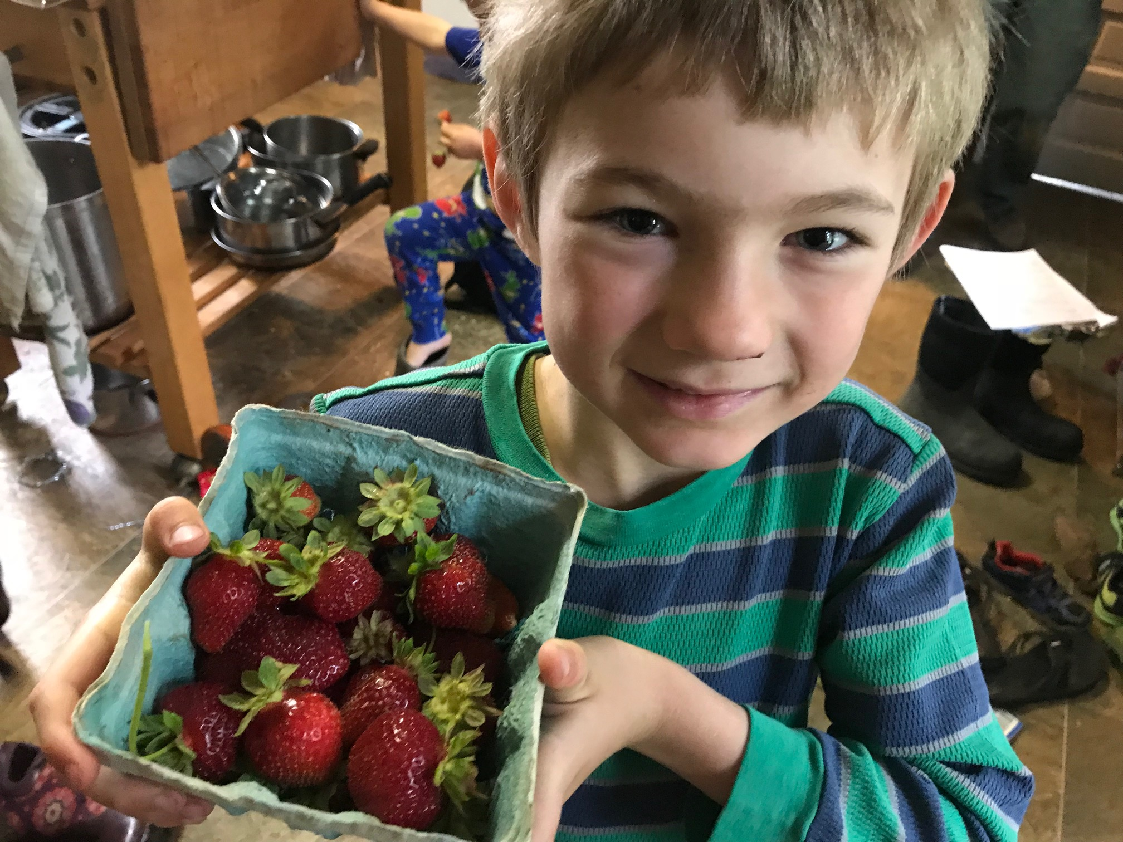

Slide 42
Thank You To Northeast SARE for Providing Farmer Grant Funding to Offset the Costs Of This On Farm Research Project!

Slide 43
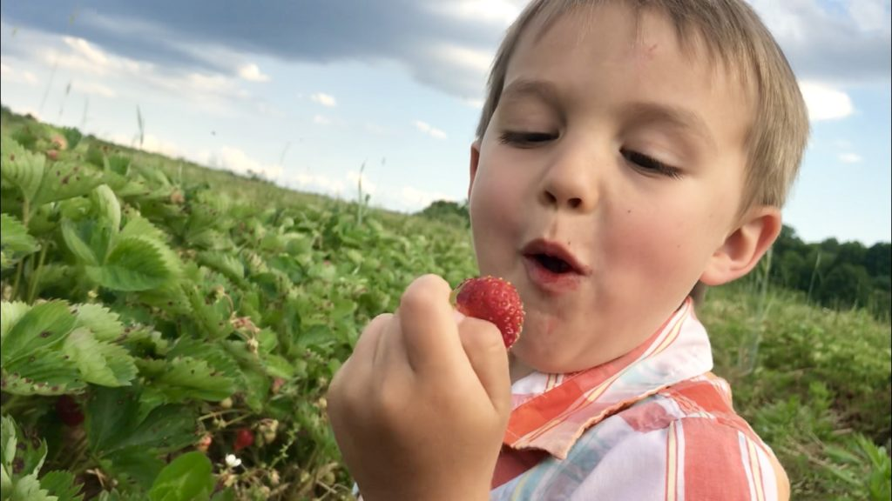

Slide 44
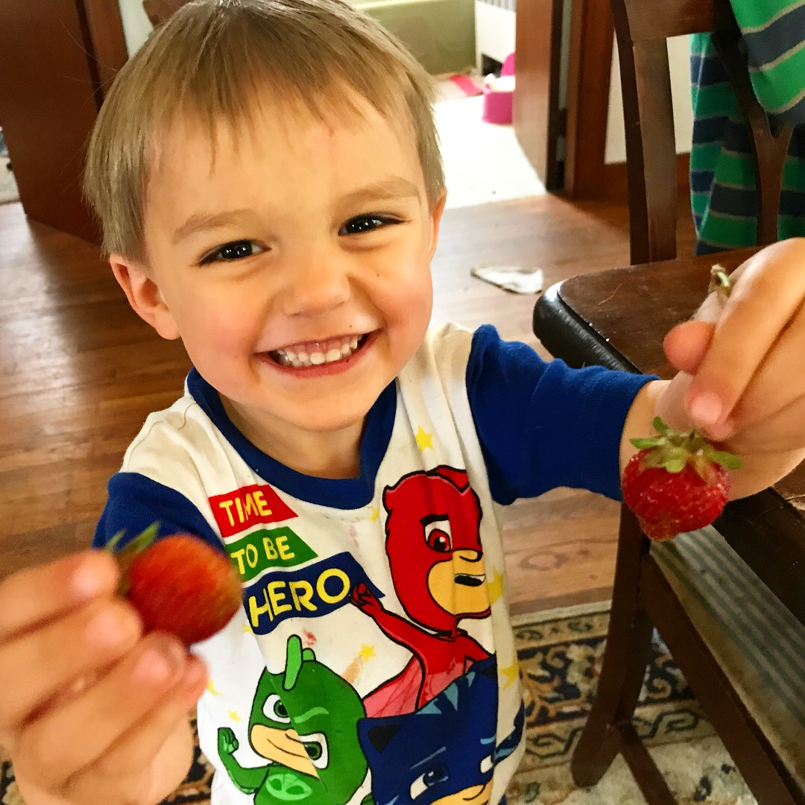

Slide 45
Keep the integrity in organic! Grow plants in soil! Lets keep hydroponics out of organic & no “organic” CAFO’s. Consider becoming Real Organic Certified & teach your customers that not all organic is the same!

Slide 46
Ryan Voiland
Red Fire Farm
Fields in Granby & Montague MA
Mailing Address: 184 Meadow Road
Montague, MA 01351
ryan@redfirefarm.com
www.redfirefarm.com
413-467-7645

