Slide 1
Evaluating soil media for vertical hydroponic strawberry production
Joseph Hannan
Merrilee Hannan
Roscommon Berry Farm

Slide 2
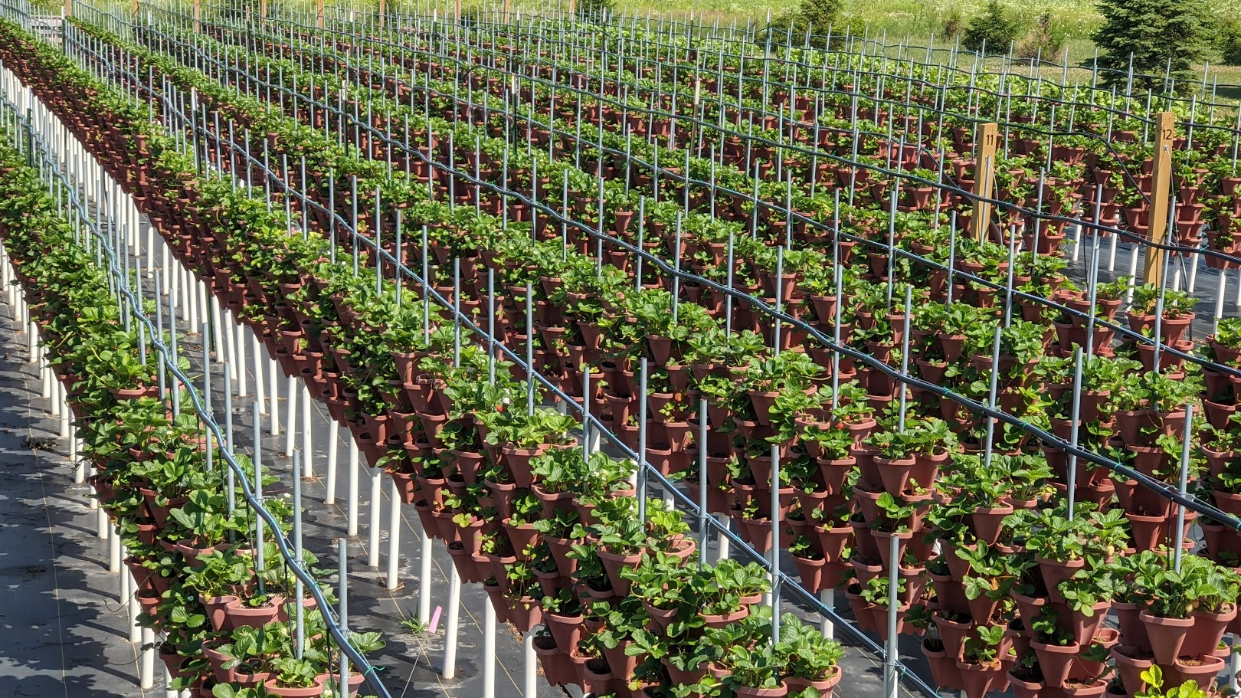
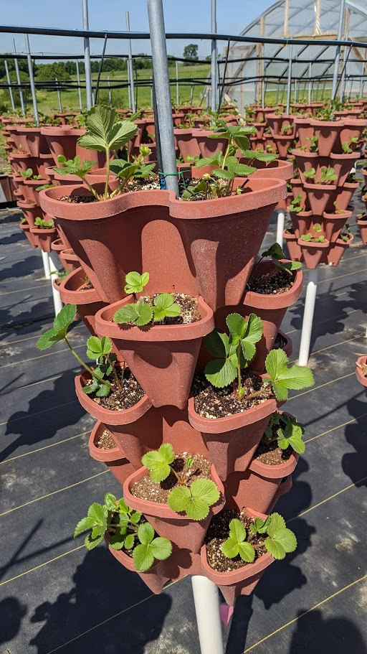
Notes:
This is our setup. Vertical stacks of strawberries.
Plastic pots stacked. ½ emt conduit down the center. Lift provided by a 1.5” pvc pipe
Top wire trellis to hold everything vertical.

Slide 3
The challenge
Water evenly throughout the tower
But not over water
Q: Can we find a better media mix?
Notes:
Struggled in the past to get peat and perlite to not be over watered
Peat and perlite is extremely prone to wind blowing when dry
Easily shows nutrient deficiency when over watered
Coir peat is difficult to hydrate and mix

Slide 4
Chlorosis
Small Plants
Notes:
Small plants from poor water distribution
Chlorosis from trying to get water to distribute (over watering)
- flush the nutrients out and get high pH (iron deficiency), B deficiency in the fruit

Slide 5
The Candidates
Notes:
We wanted something with good drainage, water movement, and from a renewable source

Slide 6
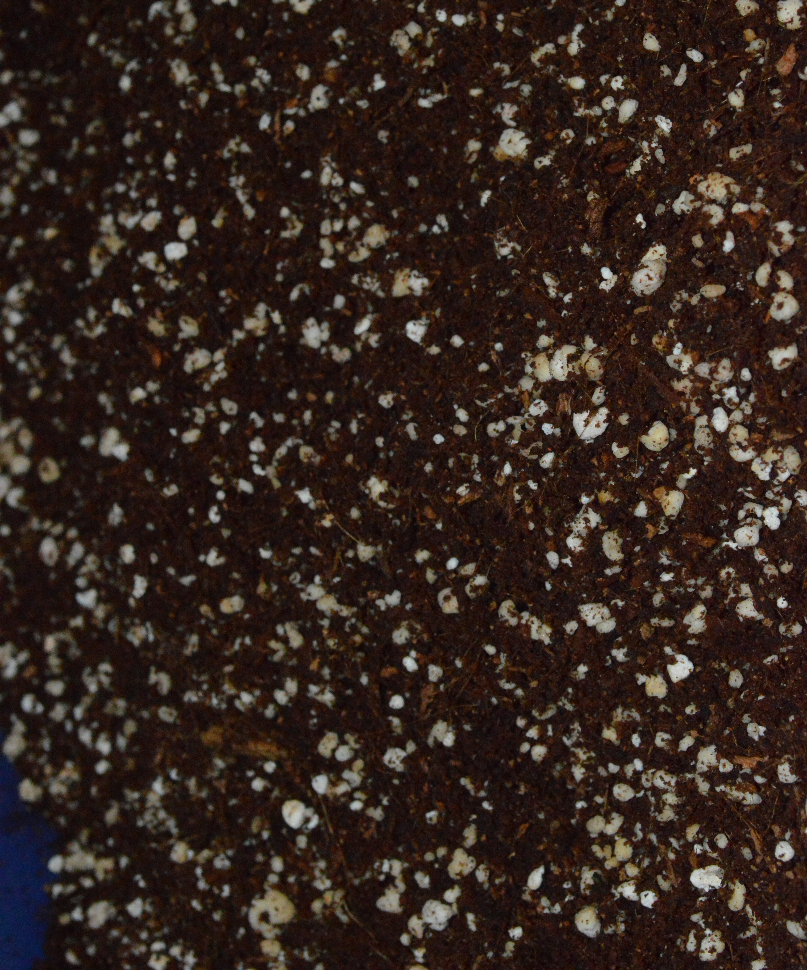
Coir Peat + Perlite
The Standard (control)
Does well under dry conditions
Wind is bad
Easy to mix (material handling friendly)
Very easy to plant into
Coir blocks difficult to hydrate
Notes:
Peat + Perlite is the standard
Has a tendency to be wet on the bottom pots or top pots depending on how you manage water. To get bottom pots wet, end up with nutrient deficiency on top
Wet somewhere and chlorosis found often
Dry and windy it blows everywhere! Absolute nightmare to get started in the spring as you are constantly watering down to keep it in place and then replanting or touching up a bit
Does well under dry conditions
Decent water distribution
Got very solid/root bound by mid season.

Slide 7
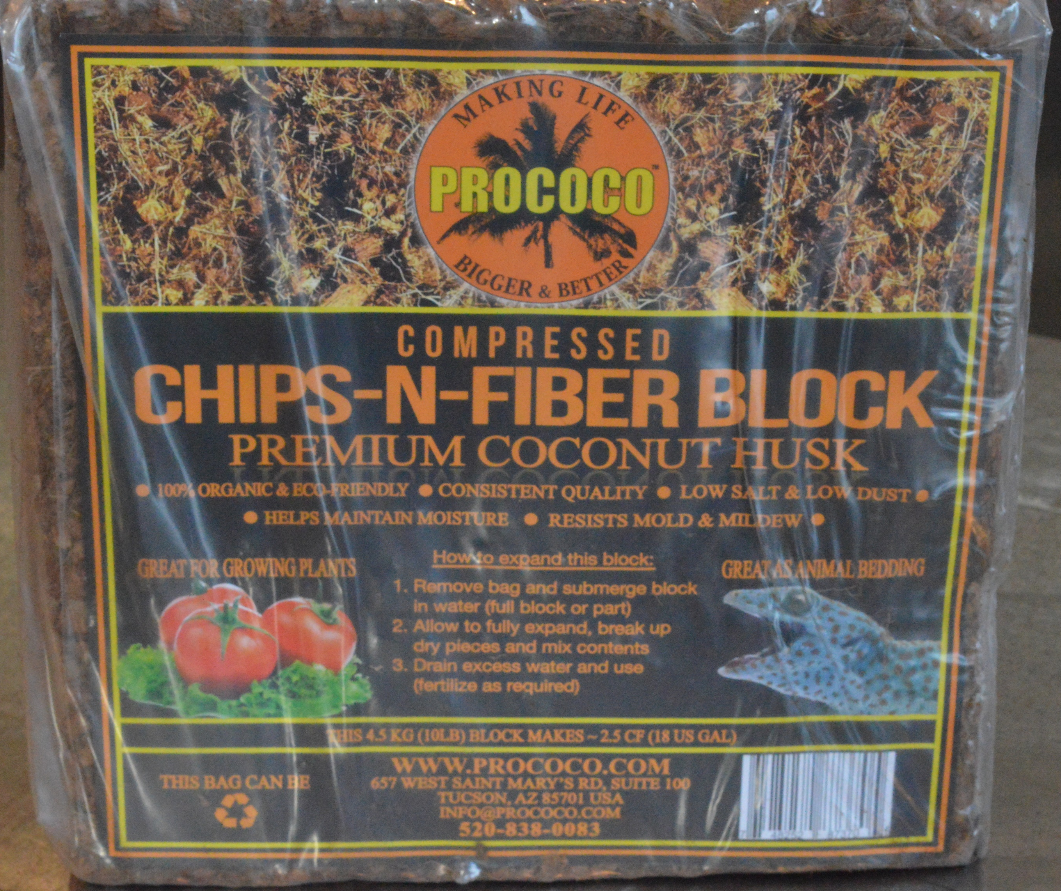
Coir Chips & Fiber (coir chips)
A replacement for perlite
Not for use alone outside
A substitute for perlite
Terrible to plant into
Notes:
Coir Chips + Fiber
Great drainage with minimal water holding capacity
Great inside hydro system but dries out too quick outside
A good replacement for perlite
The chip and fiber can blow out.
The chips are difficult to hydrate if they dry out in the field
Poor water distribution alone

Slide 8
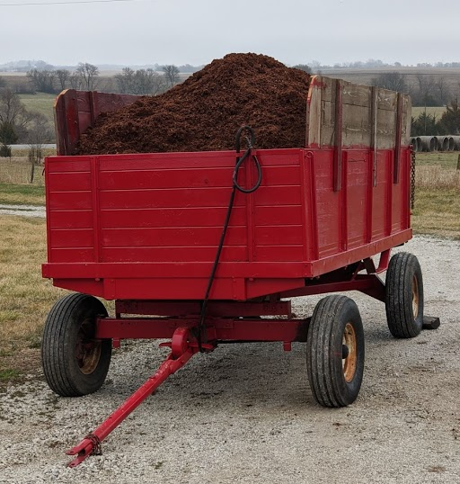
Coir Peat + Coir Chips & Fiber
Replacing the perlite in the standard
Does well under dry conditions
Less wind problems
Not quite as easy to mix as peat and perlite
Probably tolerant of material handling
Moderate ease to plant into
Notes:
Coir Peat + Coir Chips N Fiber
A renewable or alternate source for perlite
Stays in place a bit better than peat and perlite
Very similar properties as peat and perlite
Does well under dry conditions
Somewhat decent water distribution
Can separate fines from large solids if bulk mixing and storing / material handling
1 block of peat for 3 blocks of chips

Slide 9
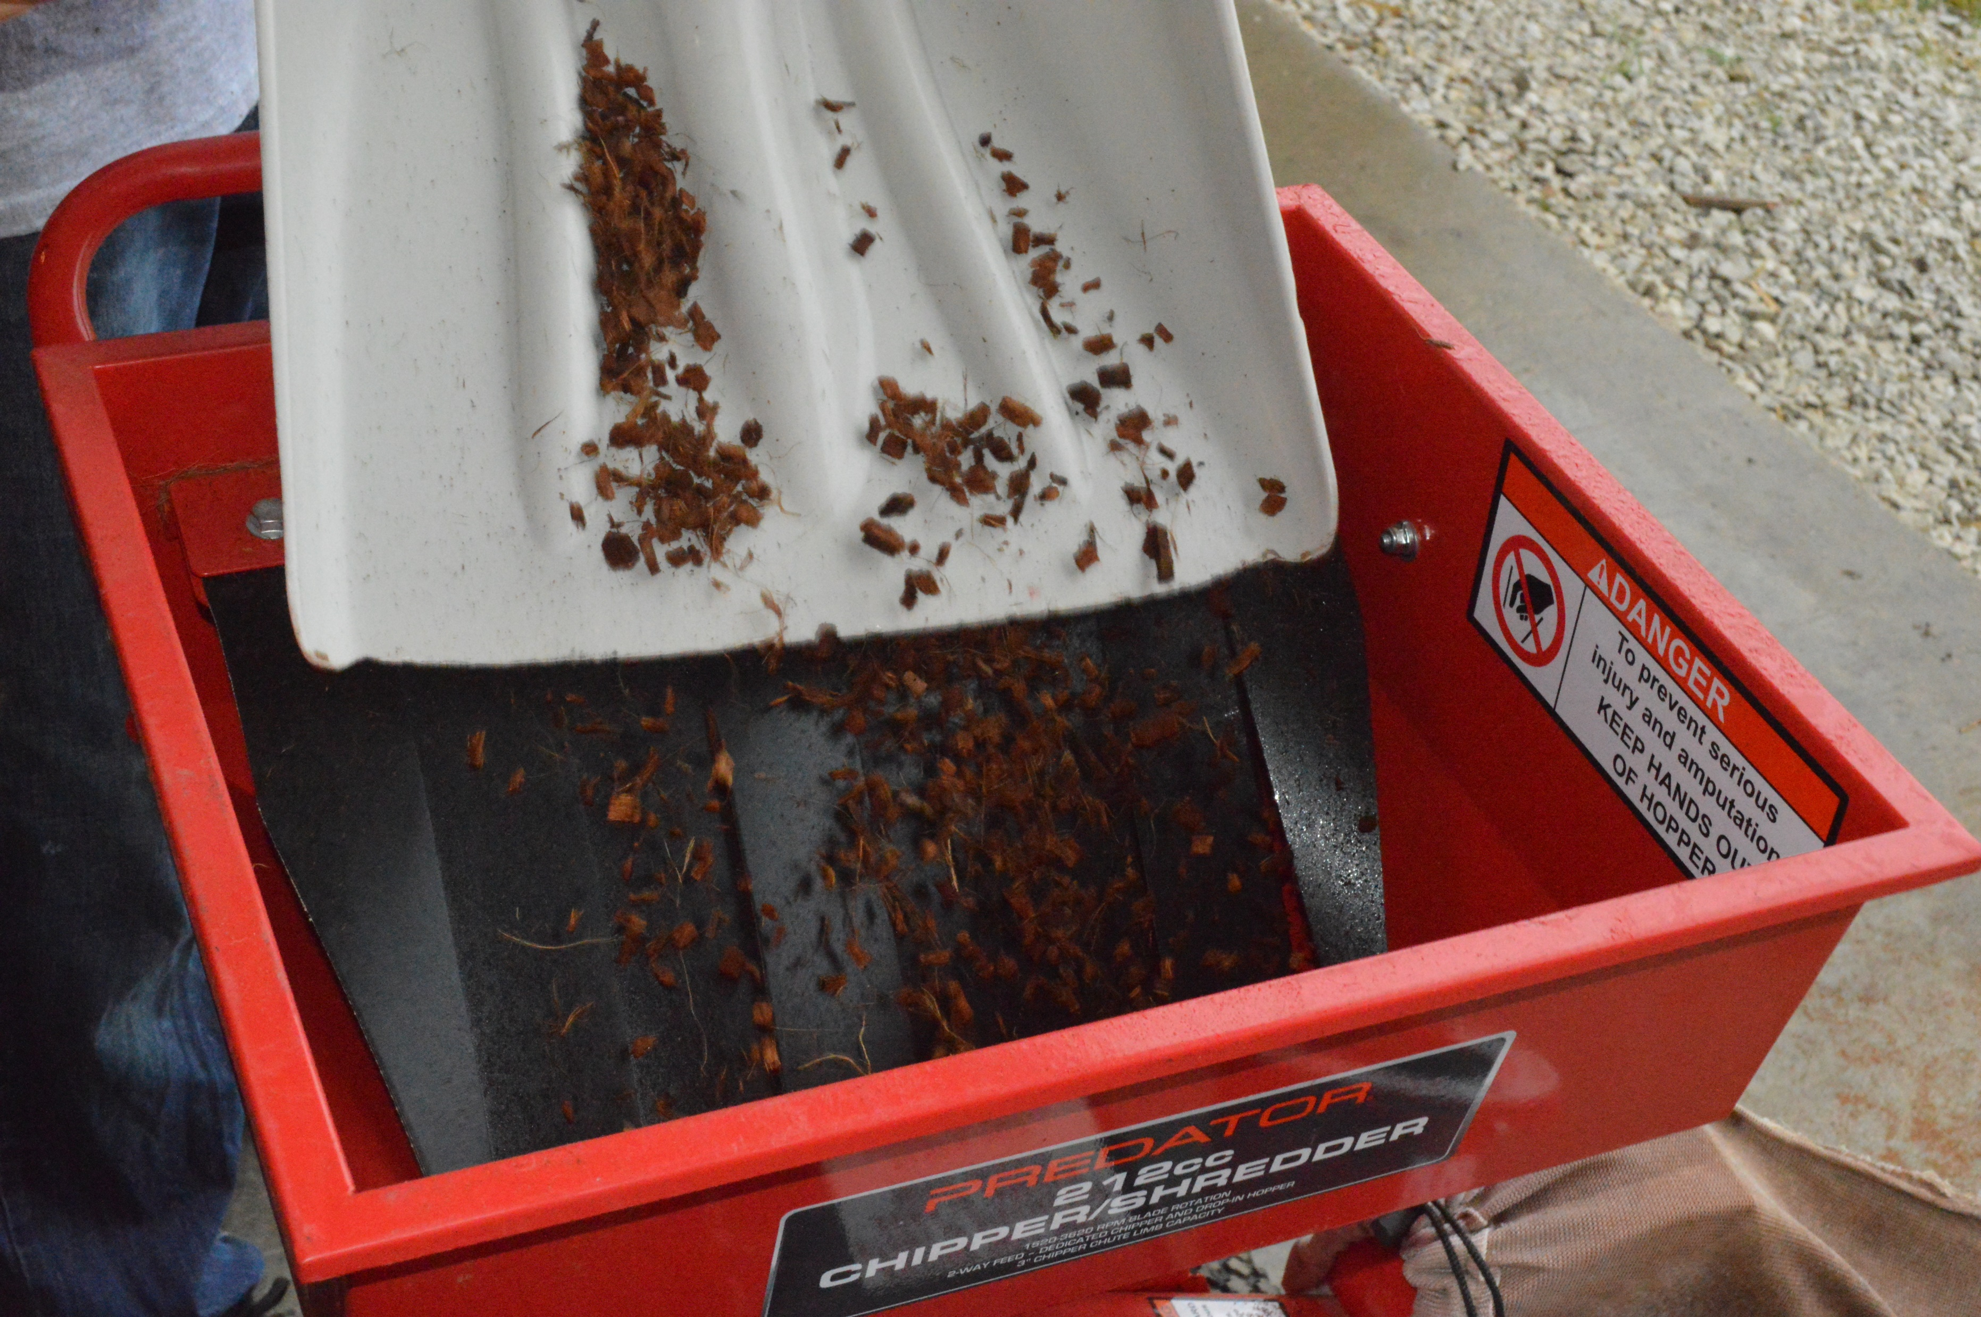
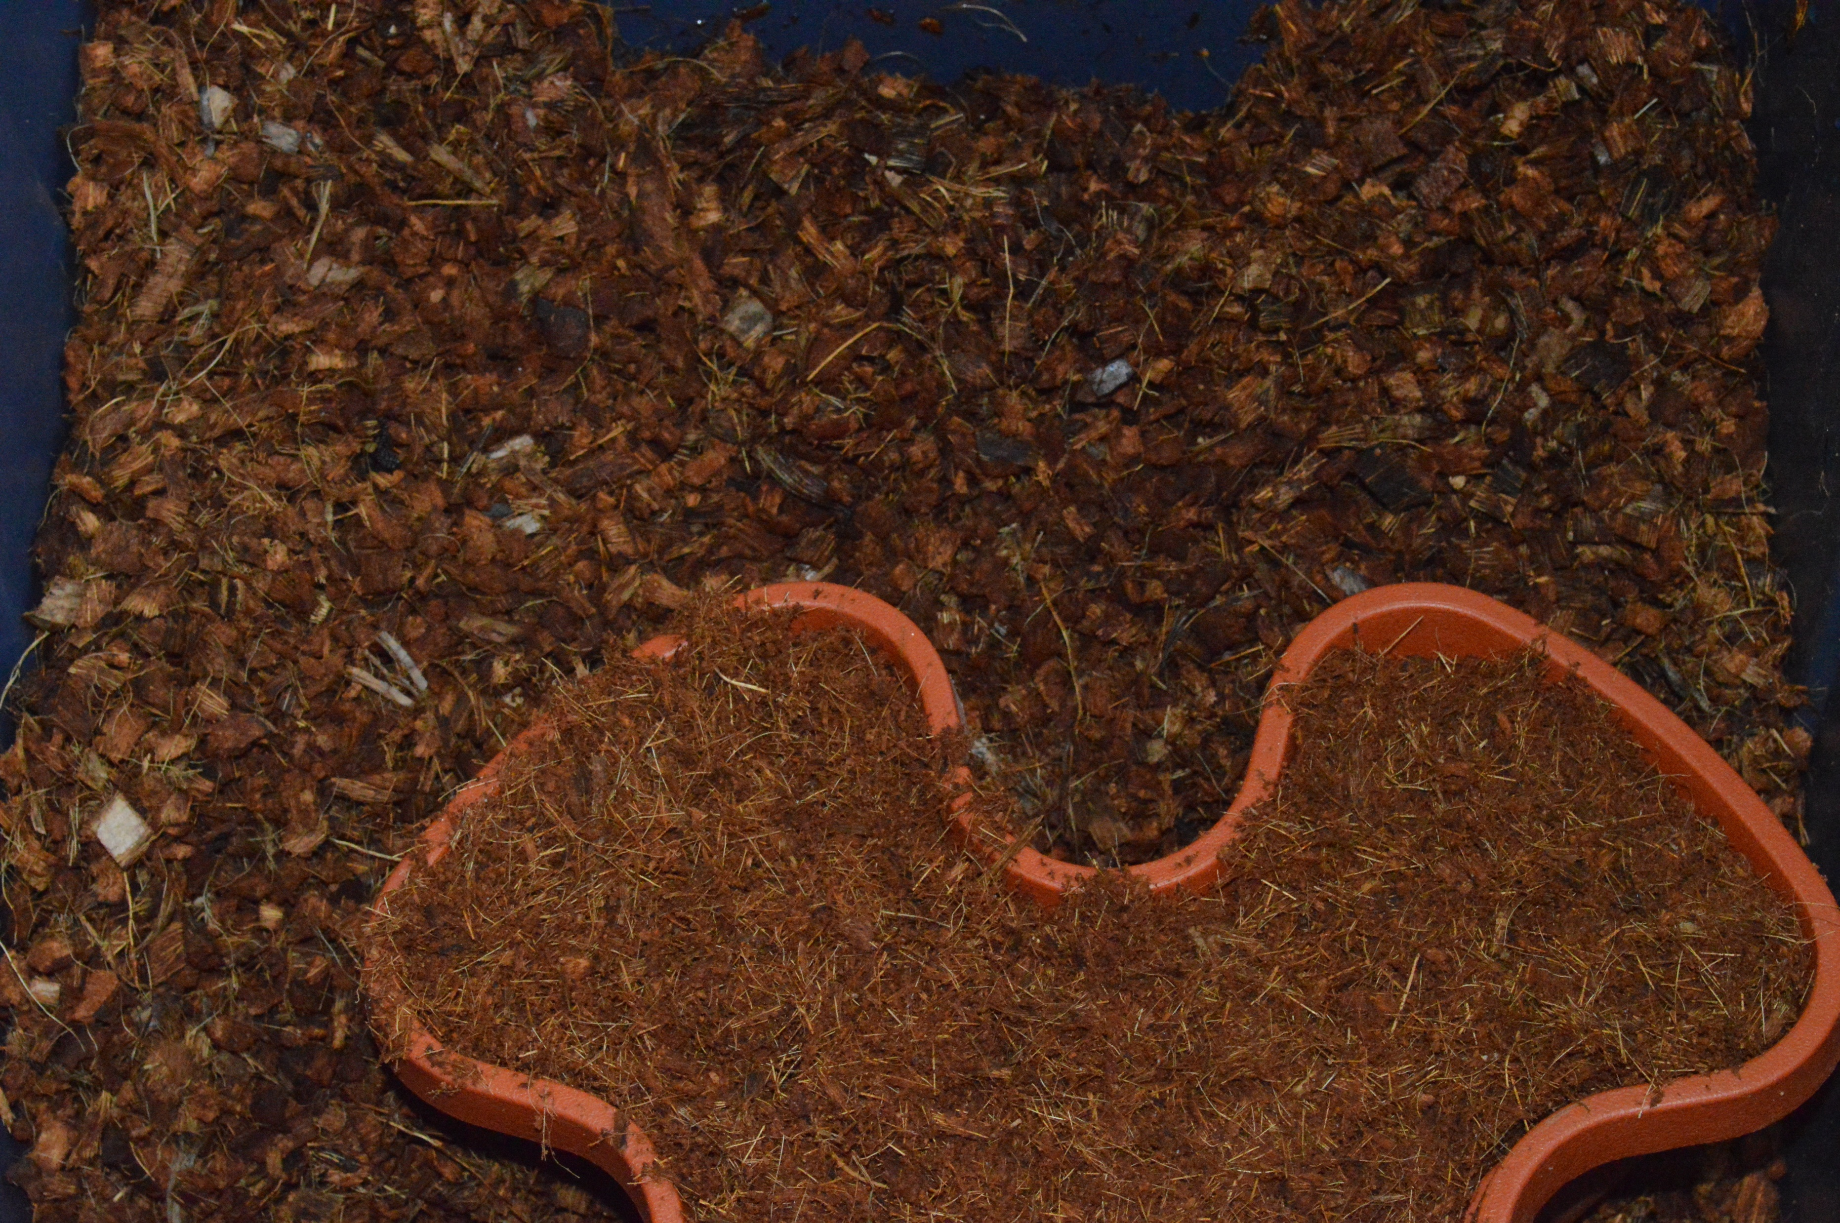
Ground Coir Chips & Fiber
For wet years
Not susceptible to wind blowing
Moderate ease to plant into
Extra step to grind chips.
Notes:
Ground Coir Chips & Fiber
In previous trials we found a product that was ground chips & fiber that is no longer on the market.
The grinding creates peat + fiber
Excellent for wet conditions
- 2019 when we were wet this did really well!
- Has a tendency to act like over watering (Iron chlorosis) and requires foliar feeding to keep things in check following a rainfall.
Not susceptible to blowing away in the wind. Needs to be packed or settled in
Does not distribute water evenly until roots develop...

Slide 10
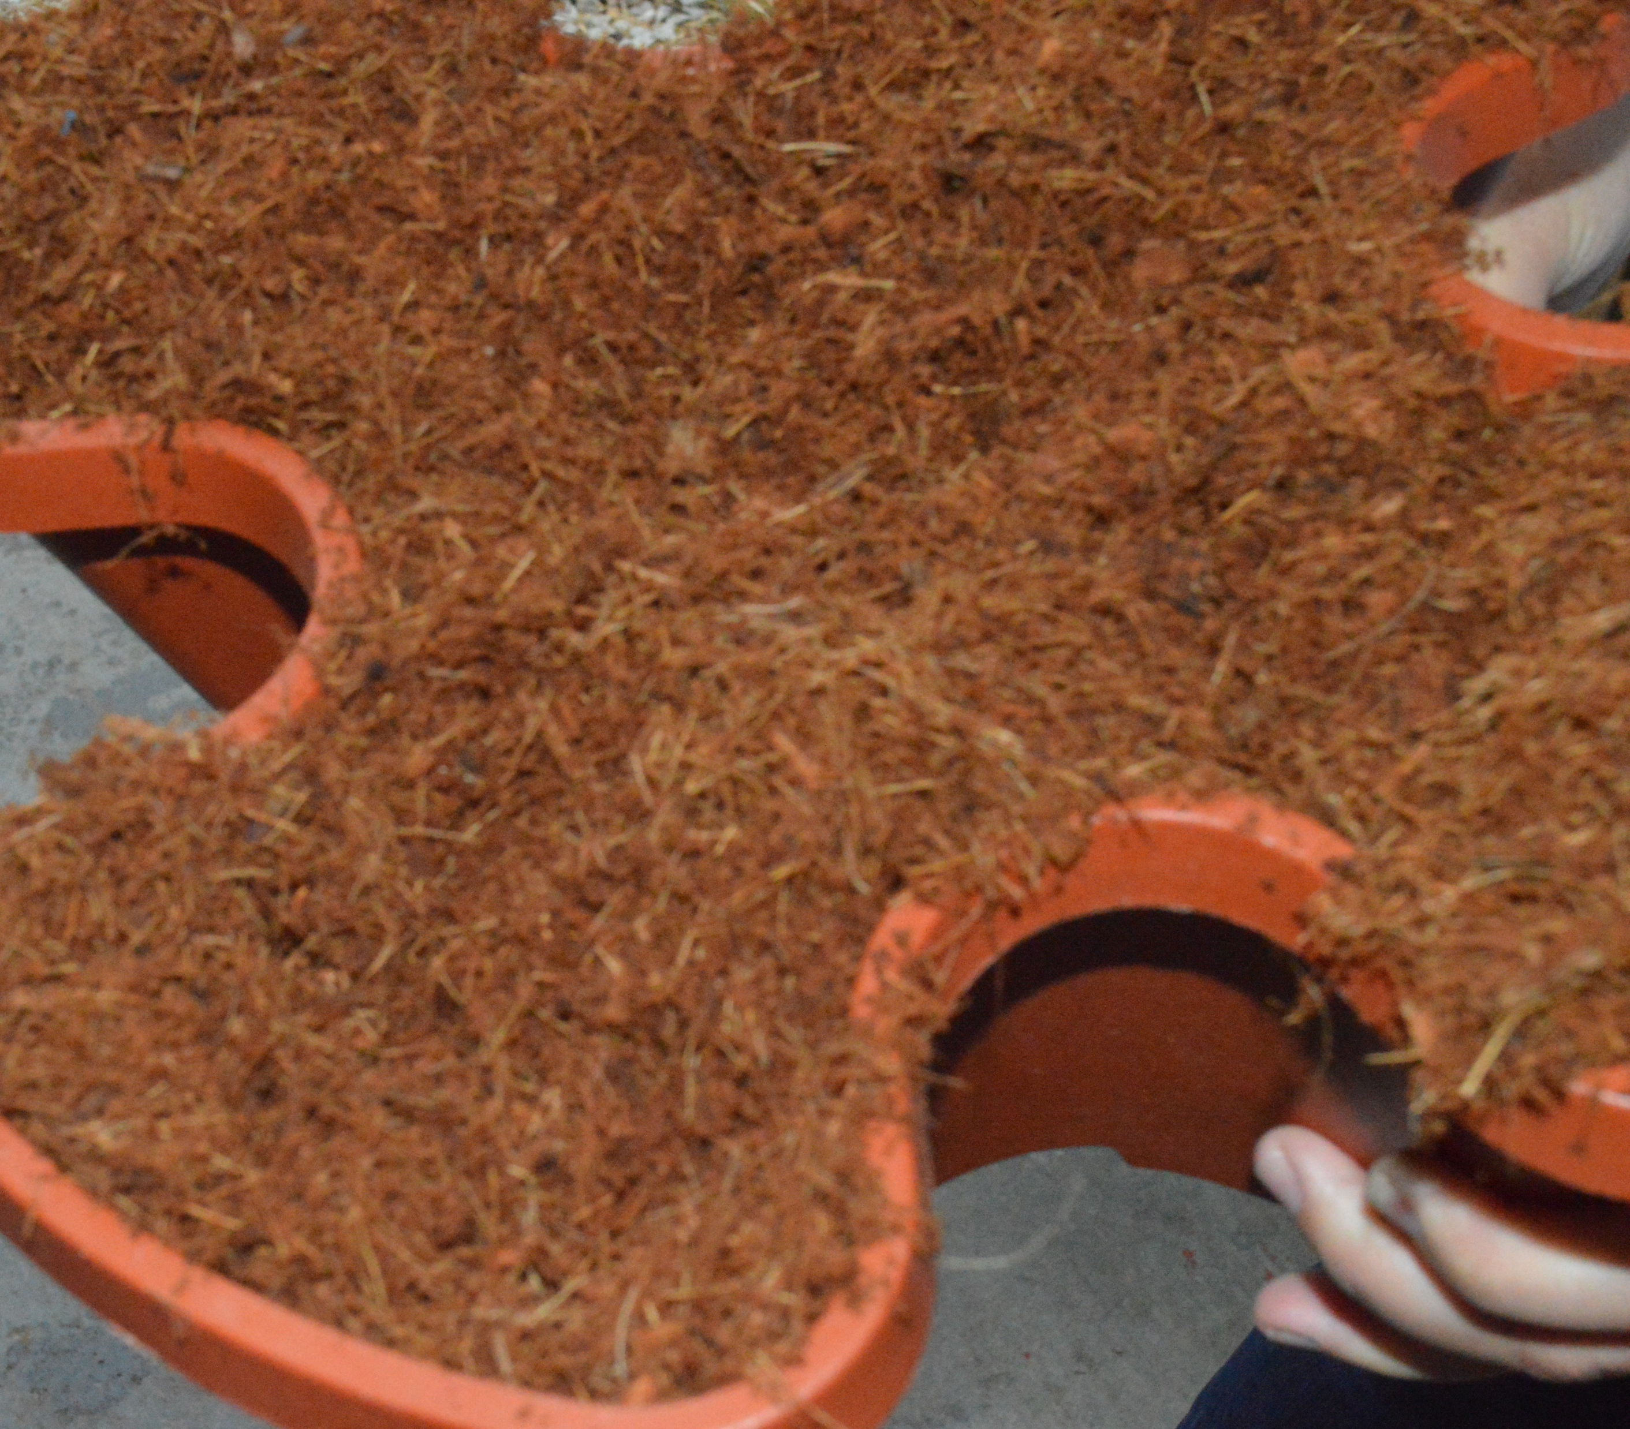
Peat + Ground Coir Chips & Fiber
For dry years
Not susceptible to wind blowing
Have to mix the peat + choir chips & fiber and then grind
Likely cannot use material handling
Somewhat difficult to plant into
Notes:
Peat + Ground Coir Chips & Fiber
Adding some peat to the ground coir chips and fiber helps with water distribution
The ground coir chips and fiber provide protection against wind for the peat
Our mix tended to be on the wet side but also had some of the best water distribution
Good for a dry season. Terribly under wet conditions
1 block of peat for 3 blocks of chips. Same ratio as our peat and chips but a bit finer.
In a wet year…just way to wet. In a dry year…still just holds more water than strawberries want.

Slide 11
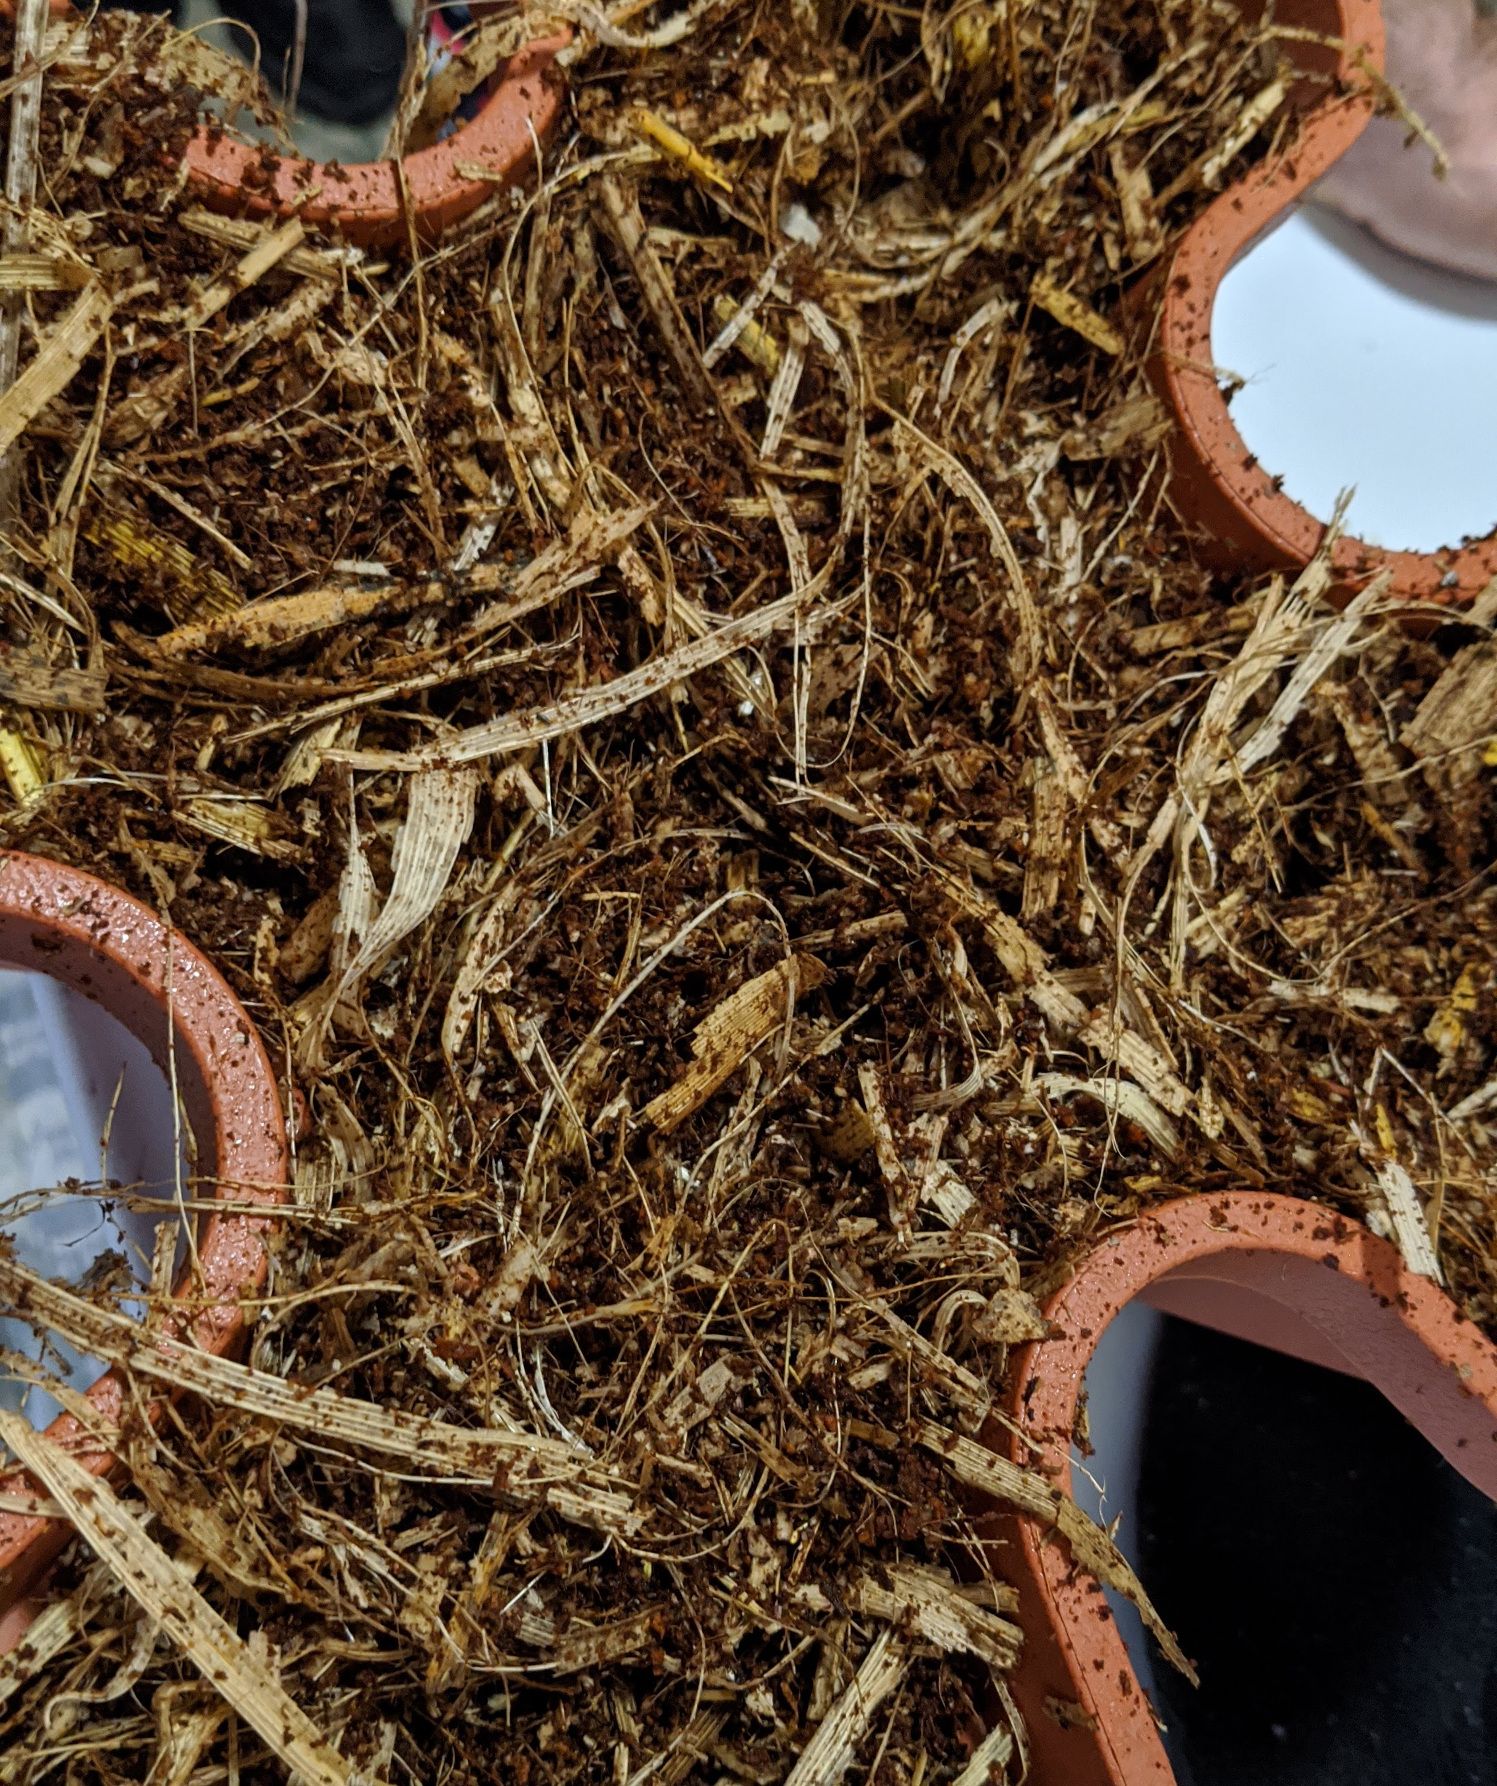
Coir Peat + Corn Stover
Other’s research didn’t like it but I think it has potential
Needed extra nitrogen
Challenge is finding something to grind it appropriately
Cheap and readily available
Notes:
Corn stover
Corn stover has been tested in hydrosystems. Negative in eyes of previous research but I disagree – can supplement back with nitrogen
It is cheap and readily available
However, expensive equipment getting it ground up! Was not worth the effort without the proper grinding equipment for us.

Slide 12
Our Season
4 weeks of nonstop rain
Our plant population took a major hit in April
17 weeks with no rain
Goodbye well
Massive insect pressure
Derecho
4 weeks of no growth
2 weeks of actual growth
Notes:
4 weeks or nonstop rain (mid April to Mid may)
- the crowns just drowned
- Had to use runners to refill a lot of the lost plants
17 weeks of drought
- we then go 17 weeks without rain (except recording day and Derecho)
- top 2 driest years in last 130+ years in my region (and windy and hot)
- trashed our well
Just got done cleaning up derecho damage, just got our market fixed after loosing our primary market (thanks covid), and we ran out of water
- we lost a lot of fruit with the derecho but…
- unfortunate as our plants looked great post derecho and had flowers larger than your thumb.
- Water distribution improves as roots size up so things we overall looking the best they had all season.

Slide 13
Results
Notes:
We had both flood this spring and drought this summer. Definitely learned a lot

Slide 14
Planting Labor
Treatment | Mix | Fill | Plant | Total (hrs)
chips+peat | 6 | 2 | 3 | 11
ground chips+peat | 7 | 2 | 3 | 12
peat+perlite | 8.5 | 2 | 2 | 12.5
ground chips | 4 | 2 | 2 | 8
Total hours per 60 tower row
Notes:
I did not include time to go back through and topdress after planting. Was the same time regardless of product.
Total hours per 60 towers. 1200 plants
Its all the same except for ground chips. So easy to hydrate and grind.
Mixing peat + perlite takes forever because peat sucks to hydrate. It is a slow process. And mixing the two is difficult. Need a mechanical mixer

Slide 15
Material Cost
Treatment | Cost per tower
chips+peat | $4.48
ground chips+peat | $4.58
peat+perlite | $2.72
ground chips | $4.67
Notes:
The standard is the cheapest (cause perlite is so cheap and readily available)
Blocks of coir peat and coir chips cost about $6.5 to $7 each plus shipping costs

Slide 16
Total establishment per tower
Treatment | Material | Labor | Total
chips+peat | $4.48 | $2.75 | $7.23
ground chips+peat | $4.58 | $3.00 | $7.58
peat+perlite | $2.72 | $3.13 | $5.85
ground chips | $4.67 | $2.00 | $6.67
Notes:
Labor for chips is so low because they hydrate so easy.
- There is almost no work to hydrating them.
- grinding is super easy
- 1 person can hydrate and grind while two plant
Even though peat and perlite is more labor, dirt cheap perlite keeps the cost down.
Labor at $15/hr

Slide 17
Average Dead Plants Per Tower
Notes:
We had both flood this spring and drought this summer. Definitely learned a lot
But some plants may have been pretty lousy in June. By August, few were.
A lot of the recovery was resetting runners.
One thing about being hydroponic…you can grow leaves fast!

Slide 18
Water Usage
Basically the same run time per day early season
Ground chips ran twice each day but half the time
Late season peat + perlite and ground chips + peat ran a bit more due to plant canopy. Just had more plant mass than the others.
Water distribution to all cells was the key differential
Notes:
The peat and chips mix was slower to recover on plant mass than the others but was catching up

Slide 19
Yield
Treatment | #1 pints | Seconds (lbs)
chips+peat | 35 | 10.19
ground chips+peat | 42.75 | 7.56
peat+perlite | 53.5 | 10.25
ground chips | 36.5 | 5.03
Notes:
Collected yield for a week…but I don’t put a lot of stock in this as the be all end all
- chips+ peat were slower to recover from losses in the spring and harder to dial in appropriate irrigation. Back and forth between too much and too little. Second are high but mostly from over watering
- peat + perlite were getting too tight and rootbound. We were starting to have difficulty getting water to go through but damn it could perform
- We were bone dry, windy, and 90F+ every day. Those are not typical conditions
Quality counts here…and peat and perlite where prime product always (except insect or disease damage).
Alive good, alive crap, dead count. Peat and perlite had most alive good plants

Slide 20
Results Coir Peat + Perlite
Peat and perlite performed
Cheap, it is difficult to prepare, easy to plant, and readily available
But…this is the only year I had it yield so well for me
Started to see some issues in August as the soil got very tight
The seconds were due to being small
Notes:
Peat and perlite performed better than I have ever had it do for me in the past. I would consider it in a high tunnel
The seconds were due to being small…not from nutrient issues

Slide 21
Notes:
The coir peat + perlite never had nutrient issues for seconds. Always due to being
- small
- thrips
- tarnished plant bug

Slide 22
Results Coir Peat + Coir Chips
Shows promise if you are looking for a fully renewable media source
I don’t know why plants did not recover as fast once the rain stopped
Plants were still improving here
Seconds tended to be mix of small, nutrient deficiency, and thrip damage
I struggled to get the water just right with this one
When the chips dry out, they are difficult to rehydrate
Deserves a second look at a 1:1 mix
Notes:
We actually had started setting up a comparison for peat + perlite to peat + coir chips (1:1) in our high tunnel for fall production before our well quit.
Plants were still improving and didn’t have the rootbound issues that we were starting to see with peat and perlite
Seconds tended to be small, not nutrient related
I think the coir peat + chips and fiber should not be overlooked. We were resetting for a fall trial at a 1:1 mix and it was outperforming peat and perlite in water distribution, water retention, and growth rate. Just could not verify due to loosing well right afterwards.
Because chips are difficult to hydrate, have to really watch these and may have to add a second irrigation application…though wasn’t the case in our 1:1 fall trial.

Slide 23
Results Ground Coir Chips
Never do ground chips in a greenhouse.
Need some occasional rain
Really intended for wet / normal precipitation years outside
Requires 2x irrigation cycles per day
Likely will require foliar feeding
Difficult to not over leach nutrients in a vertical system
Seconds tended to be nutrient deficiency
Notes:
Peat and perlite performed better than I have ever had it do for me in the past.
Have to really watch leaching. When it rains foliar feed!

Slide 24
Results Coir Peat + Ground Coir Chips
No reason to ever do this one
Marginal gains over of the other pure coir mixes but added costs
There was nothing remarkable about this one at scale

Slide 25
End of season
Remember that you have to dispose of material at the end of the season
100% coir mix can be composted and spread on other fields
Will be nutrient rich
Notes:
We put a bunch of it in our tunnels as fertilizer.

Slide 26
What’s next?
Need to come back and take a look at corn stock bales with a better grinder
Media cost per tower would be less than peat + perlite
Look at coir peat + coir chips at 1:1 mix

Slide 27
Summary
Stick with coir peat + perlite
Consider coir peat + coir chips but at a 1:1 ratio
Instead of 1:3
An occasional rain is your friend

Slide 28
Thanks
SARE Farmer Rancher Program and Iowa SARE Staff
Christa Hartsook
Kendra Myer
Olivia Hanlon
Notes:
Thank you SARE for funding this project and support from the Iowa SARE team

