Slide 1
Striving for Economically Sustainable Livestock Production
Ken Kelley
Regional Farm and Agribusiness Management Agent

Slide 2
Things Livestock Producers Cannot Control
Prices – This is the big one. While there is some room for product differentiation, it is limited. Livestock producers are a commodity driven enterprise with prices/markets driven by supply and demand.

Slide 3
Things Livestock Producers Cannot Control
Economy – Demand for beef is driven by a number of factors, not the least of which is the overall economic situation of both the domestic and international markets.

Slide 4
Things Livestock Producers Cannot Control
Weather – Livestock production (like most agricultural commodities to some extent) is driven by weather, with potential profitability often decided by weather trends and local impacts of those trends.

Slide 5
What Producers Can Control – Production Costs
Strategies for controlling Production Costs:
1.Improved Record Keeping
2. Reducing or Eliminating Mid or Long Term Debt
3.Reducing Feed Costs
4.Having a Controlled Breeding Season
5.Using Soil Testing and Forage Testing
6.Use Enterprise Budgets

Slide 6
Strategy 1- Improved Record Keeping
Your cattle operation is a business.
The only way to “keep score” on your business is to keep good records.

Slide 7
Financial Records
Financial records help you determine the health of your business and plan for the future of your business.
Short-term cash expenses (feed, fertilize, etc.)
Mid-term expenses (equipment, facilities, etc.)
Long-term expenses (land, some buildings, etc.)

Slide 8
Financial Records
Without looking at financial records from a holistic stand point you will only see a small piece of the picture. Producers can be “profitable” for the year and not be able to pay current expenses. Likewise, producers can often pay current expenses, but not have the ability to maintain long and mid term expenses.

Slide 9
Production Record
Production Records (along with financial records) help you determine changes necessary for profitability of your business.

Slide 10
Production Records That Should be Kept
There are numerous production records that can/could/should be kept by producers, sometimes dependent upon type of operation.
Examples would include: breeding dates, sire and dam information, calving dates/information, weaning weights, health protocols/issues. The more comprehensive the better.

Slide 11
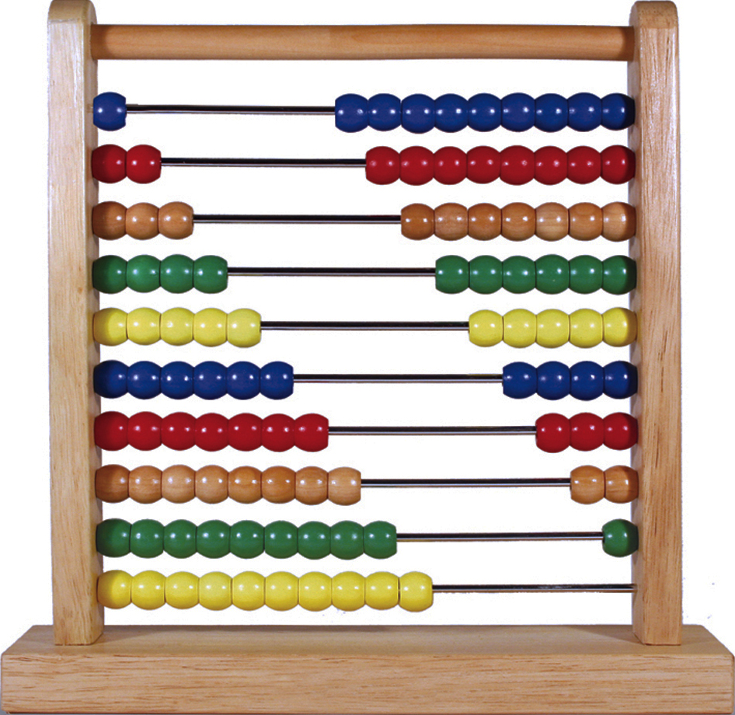
Record Keeping System
There are numerous systems for both financial and production record keeping – ranging from a notebook to elaborate software.

Slide 12
Record Keeping System
The important thing is to keep detailed and thorough records.
Keep records that allow you to make financial and production decisions that improve your operation

Slide 13
Strategy 2 - Reducing Mid-Term and Long-Term Debt
Producers should be vary wary of expecting returns from livestock operations to pay for land and equipment purchases (particularly hay equipment).

Slide 14
Strategy 2 - Reducing Mid and Long Term Debt
There are economies of scale for livestock producers (especially hay equipment), which makes it difficult for small producers to justify/pay for land and equipment purchases (particularly for hay).

Slide 15
Strategy 3- Reducing Feeding Costs
Feeding costs are typically the most significant cost for livestock producers.
The more standing forages are utilized (and thus the less they feed), the better the chance of being profitable.

Slide 16
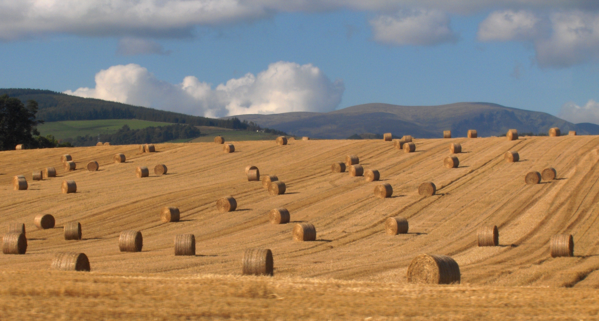
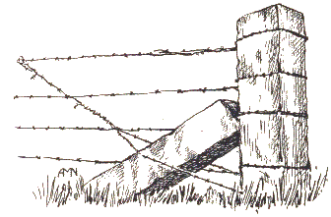
Strategy 3- Reducing Feeding Costs
Grazing strategies like rotational grazing and using winter annuals will effectively limit feed requirements (hay is feed too) and improve the chance of making a profit

Slide 17
Strategy 4- Having a Controlled Breeding Season
There are 3 major benefits to having a controlled breeding season
You can feed more efficiently. Beef cattle nutrient requirements vary so significantly between dry and lactating cows that the only way to feed to meet the requirements of lactating cattle is to overfeed dry cows.

Slide 18
Strategy 4- Having a Controlled Breeding Season
There are 3 major benefits to having a controlled breeding season
Health programs. Most producers are pressed for time in their cattle operations. By bunching calves into a defined calving season, producers can efficiently work them as a group.

Slide 19
Strategy 4- Having a Controlled Breeding Season
There are 3 major benefits to having a controlled breeding season
Marketing. Like type and quality cattle sold in groups make more money than those sold as single units.

Slide 20
Strategy 5 – Using Soil Tests and Forage Tests
Grazing is the most efficient and profitable way to feed cattle, but it is still expensive due to the need to add soil amendments (lime and fertilize) to maximize production.
NOBODY can tell you what your soil needs without a soil sample…that includes extension agents and feed store managers.
The only way to mitigate the costs of over applying and under applying (yes, that is a real cost– production and soil
health suffers) is to soil test and USE the results !

Slide 21
Strategy 5 – Using Soil Tests and Forage Tests
If hay is utilized have it tested to know what the cattle are eating

Slide 22
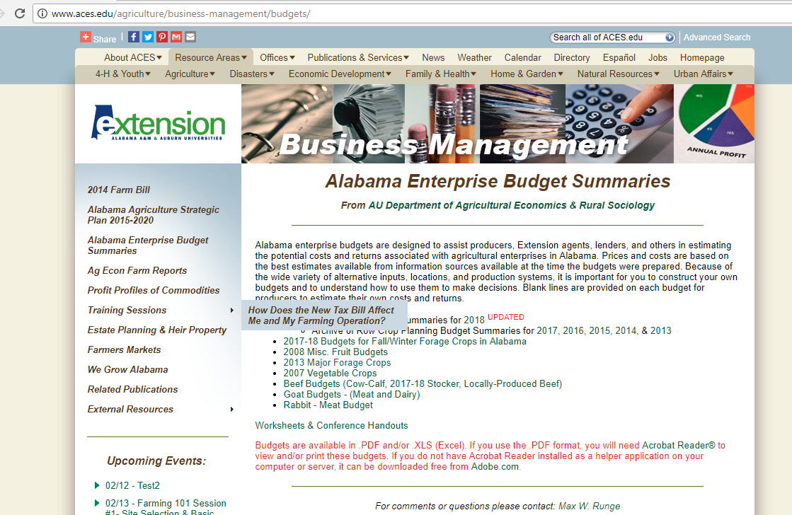
Strategy 6 – Use Enterprise Budgets
Budgets are constantly updated and available for Alabama Producers - http://www.aces.edu/agriculture/business-management/budgets/ .

Slide 23
Strategy 6 – Use Enterprise Budgets
Budgets help you plan for the future.
Budgets help you compare your operation to an “average” operation.
Budgets are interactive and can be tailored for your operation.

Slide 24
Profitability for Alabama Livestock Producers
Cattle producers are in the business of growing good forage and producing healthy animals that will end up as a desirable product for beef consumers. To that end, we shouldn’t think in terms of what we can eliminate from our operation- but what we can do to increase profit.

Slide 25
Profitability for Alabama Livestock Producers
It’s often said you can’t starve a profit out of the cattle business, and that is often what producers think about when they think about reducing production costs. Instead, let’s concentrate on being better managers of what we have and streamlining our operation.

Slide 26
Questions?

