Slide 1
Ways To Improve Agricultural Sustainability In The Virgin Islands
Laura Martin
March 2026

Slide 2
Modern Agriculture
Use of water – 69% of the world’s fresh water
Led to the loss of topsoil – 50% in the past century
Erosion
Run off soil and pollutants
Dead zones
Loss of coral reefs
Greenhouse gas emissions – 18 - 34%
Loss of biodiversity – loss of forests and tilling

Slide 3
Virgin Islands
Import 95-99% of food
Topsoil degraded – Caribbean has highly erodible soil (4x higher than the global average)
Decreased ability of the soil to retain water
Decreased ability to retain nutrients
Loss of forest – over 17% and ½ of the mangroves
Decrease in organic material added to the soil
Decreased protection of coasts and coral reefs
Possible decreasing production
565 farms with 9300 acres
Majority are smallholder farms 5-10 acres
Globally small holder farms produce 32% of food

Slide 4
Problems of Farming in the Virgin Islands
Periods of inadequate and overabundant water
Inadequate water storage for irrigation
Degraded Soil: loss of topsoil due to erosion by either water or wind and the loss of organic material in the soil
Tropical soil undergoes rapid decomposition of organic material
Primarily added by forests
Loss of topsoil and organic material leads to decreased nutrients and water storage
decreased plant growth
increased susceptibility to pests and diseases.
Increasing Pest pressure
Large areas of urbanization, and
Cost of appropriate technology, fertilizer, seed, (all farm inputs)

Slide 5
Climate Summit and the United Nations Convention to Combat Desertification (UNCCD) - Global Land Outlook 2
Land degradation represents a major threat to global food security, nutrition, sustainable food systems. and growth of food production worldwide
Healthy soils are key to the production of food, adapting to and mitigating climate change, and to halting or reversing biodiversity loss.
If we continue current practices…..
Restoring 35% of the global land area the problem can be reversed
Restoration means following the principles of ecology and soil health

Slide 6
Principles of Soil Health
Minimize Disturbance
Maximize Soil Cover
Maximize Biodiversity
Maximize Presence of Living Roots

Slide 7
Principles of Soil Health
Minimize Disturbance
People, livestock, poultry, and equipment all disturb soil. While some disturbance is unavoidable, minimizing disturbance events builds healthier soils.
To minimize disturbance:
Limit tillage
Limit heavy equipment
Rotate livestock

Slide 8
Minimize Disturbance – Reduce Till
Disturbing soil
Releases sequestered carbon
Kills soil organisms
Opens soil to wind and water erosion

Slide 9
Principles of Soil Health
Maximize Soil Cover
As a general rule, soil should be covered year-round whenever possible. To do this:
Plant cover crops
Use organic mulch
Leave plant residue
Use perennial borders or forestry borders

Slide 10
Principles of Soil Health
Maximize Biodiversity
Increasing diversity can break disease cycles, stimulate plant growth, and provide habitat for pollinators and organisms living in the soil.
Plant diverse cover crops
Use crop rotations
Use perennial borders – increase forested areas
Integrate livestock

Slide 11
Principles of Soil Health
Maximize Presence of Living Roots
Living roots reduce soil erosion and provide food for organisms like earthworms and microbes that cycle the nutrients that plants need.
Reduce fallow
Plant cover crops
Use crop rotations

Slide 12
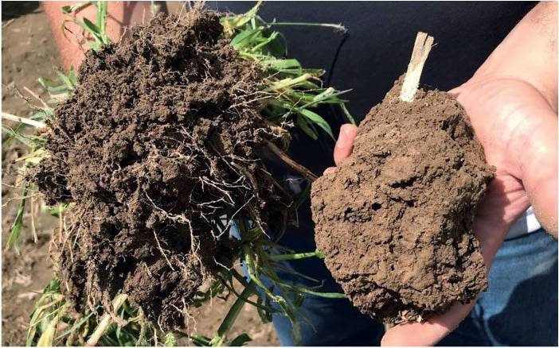
Healthy Soil

Slide 13
Benefits of Improving Soil Health
Applying these principles of soil health can:
Improve soil structure
Improve the amount of water available to plants
Reduce erosion
Improve nutrient management
Improve productivity

Slide 14
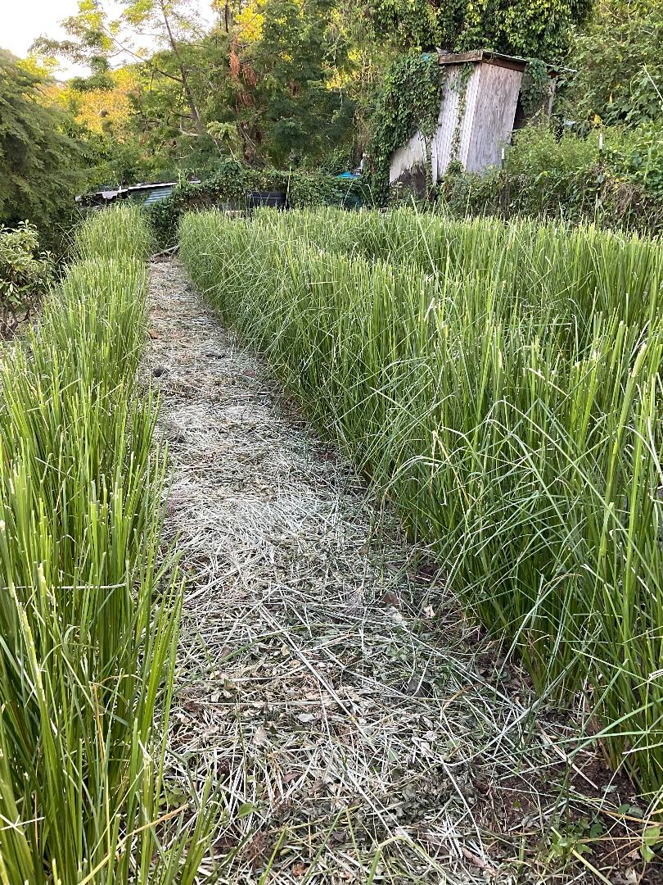
Vetiver Grass

Slide 15
Vetiver Grass
Chrysopogon zizanioides (L.) Roberty (1)
Family: Poaceae
Cultivar: Sunshine
Common Local Names
Jamaica: khus khus
Puerto Rico: pachuli
Haiti: herbe vetivert
India: khas khas

Slide 16
Vetiver Grass
Native to India, is a fast-growing noninvasive tropical perennial bunch grass
It is related to Sorghum and has some similarities to other aromatic grasses such as lemongrass (Cymbopopogon citratus) and citronella (Cynbopogon nardus). (2)
There are four+ types of Chrysopogon zizanioides the domesticated type which originated in southern India and is sterile and the wild type from northern India that is fertile. (1)
The wild type which is found in Africa, China, and Australia can become an invasive weed. In particular the wild type in Africa grows along riverbanks and is easily confused with the sterile variety.
Chrysopogon zizanioides (L.) Roberty is sterile and one cultivar Sunshine that was initially cultivated in Sunshine, Louisiana is now the primary cultivar found worldwide. (2) All of the sterile cultivars have been studied and have been found to be genetically the same. (2) The USDA has listed the Chrysopogon zizanioides (L.) Roberty Sunshine cultivar as being noninvasive.

Slide 17
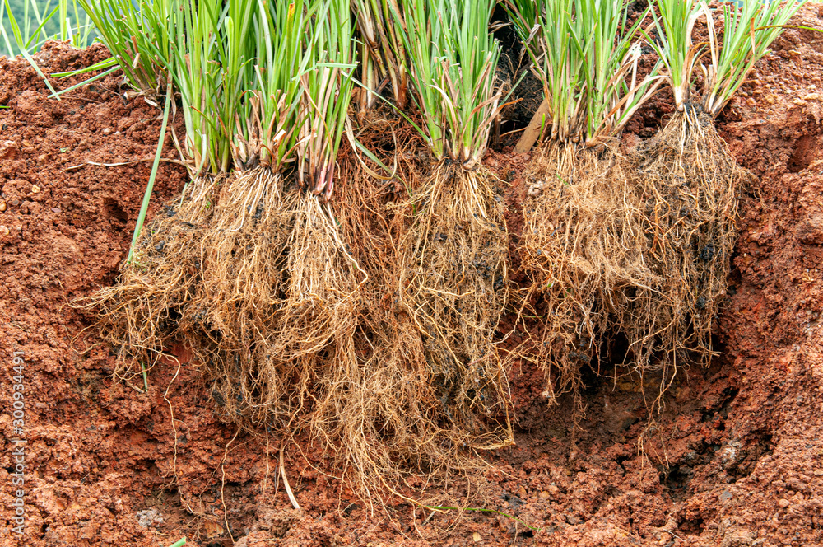
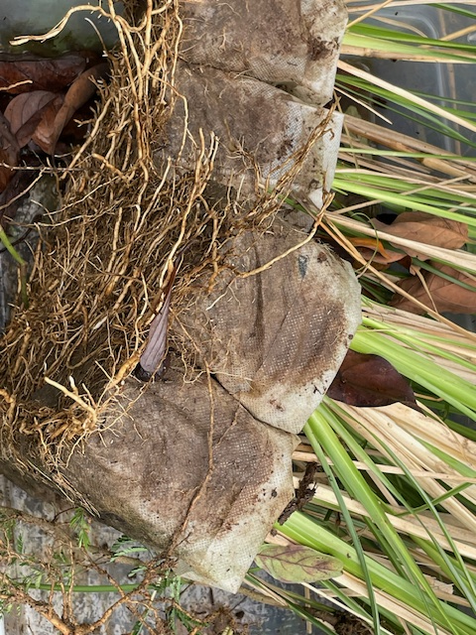
Vetiver Grass
Develops an extensive dense and deep root system.
This root system does not produce lateral roots therefore the bunches do not spread laterally.
It has associated nitrogen processing mycorrhiza, that explains its green growth throughout the year
In the first two years following planting this root system can extend up to 3 m deep creating a dense underground wall that stabilizes the soil.(3)
The roots have a tensile strength of 1/6 that of mild steel, and when planted in hedges they will increase soil sheer strength by up to 45%.
When the grass is planted very closely it produces a dense hedge up to 7 feet tall

Slide 18
Vetiver system
Promoted by Vetiver Network International
Used in 100 countries
Agriculture
Erosion control
Water conservation
Mulch
Forage
Pest control
Soil fertility
Engineering
Slope stabilization
Roads
Dams and ponds
Drains, Guts, and Gullies
Disaster Mitigation
Landslide Prevention
Land Rehabilitation – phytoremediation
Water Rehabilitation
Watershed Protection
Coastal Protection
Other
Oil
Roofing
Crafts

Slide 19
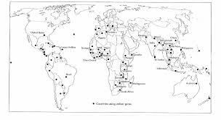

Slide 20
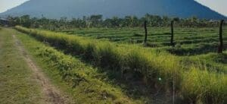
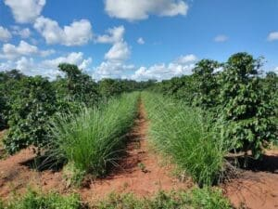

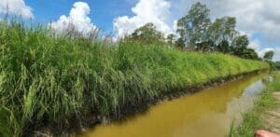
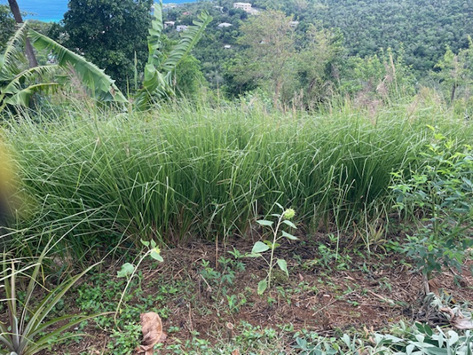
Uses for Increased Sustainability
Boundaries
Erosion control
Crop management
Remediation
Vetiver Network International

Slide 21
Growing Vetiver
Very adaptable
Prefers sunny, hot, and humid tropical climate
Tolerates:
Acid, alkaline, or saline soils,
Drought or flooding,(4) and
High levels of heavy metals such as lead, aluminum, cadmium, arsenic, zinc, and manganese. (1)
It is also able to survive freezing and fire. (4)

Slide 22
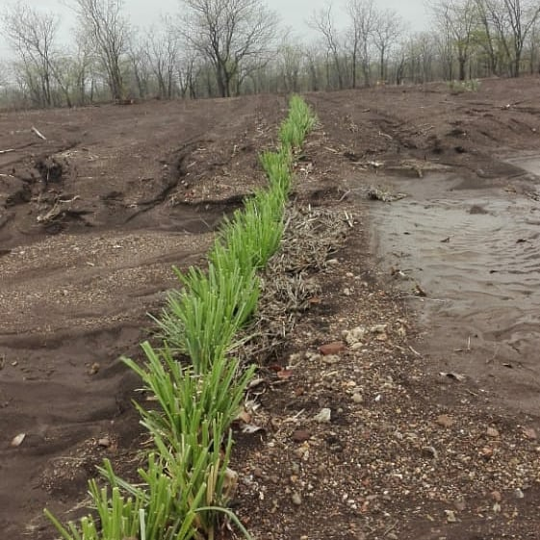
Erosion Control and Bioterracing
Planted as a hedge along a contour line, forms a filter barrier this
slows down the flow of rainfall runoff water so that the erosive velocity of water is halted, and
traps sediment carried by the runoff on the upslope side of the hedge.
The sediment depositions increase and the slope gradient becomes less,
further slowing the velocity of run off
Vetiver continues to grow and maintains effectiveness as these natural terrace risers gain height.
Able to reduce soil erosion by up to 90%
Reported soil loss reductions of over 100tons/ha have been reported (CIAT, Colombia)
Also acts as a windbreak,
Picture of erosion control in Zimbabwe

Slide 23
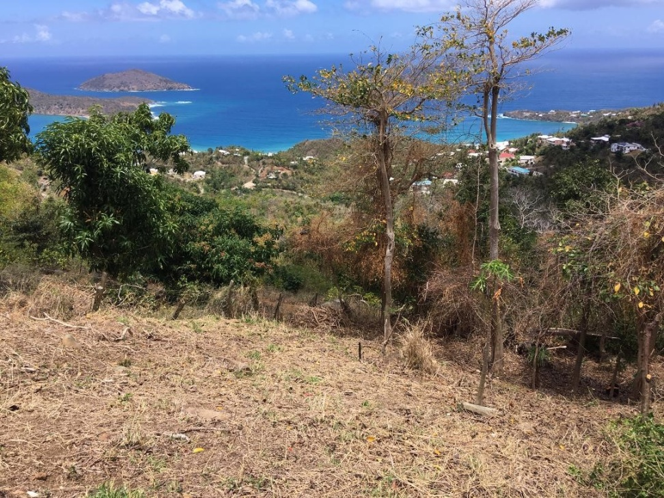
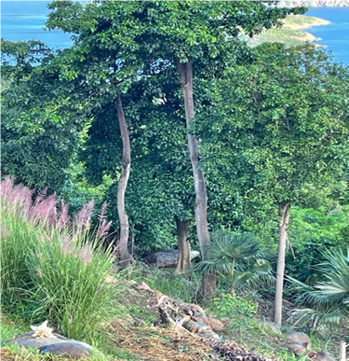
Erosion Control

Slide 24
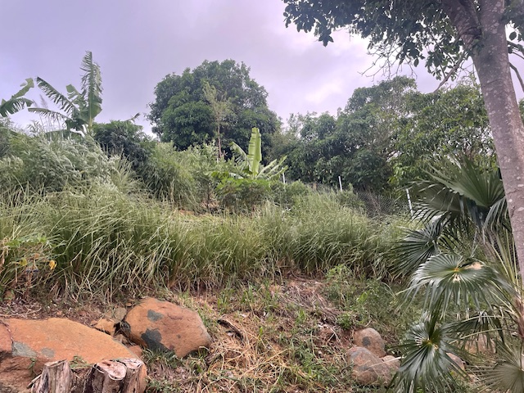
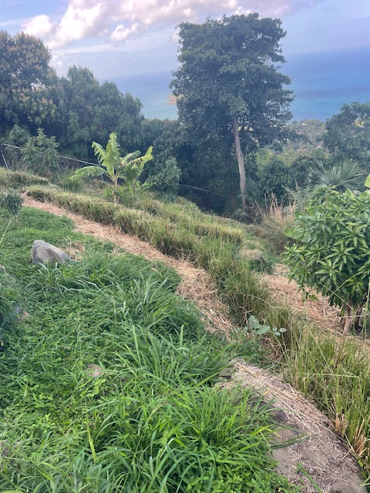
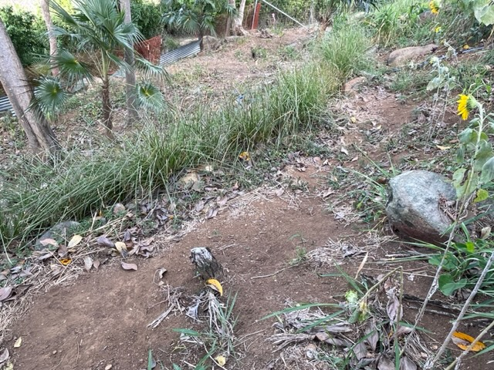
Erosion Control

Slide 25
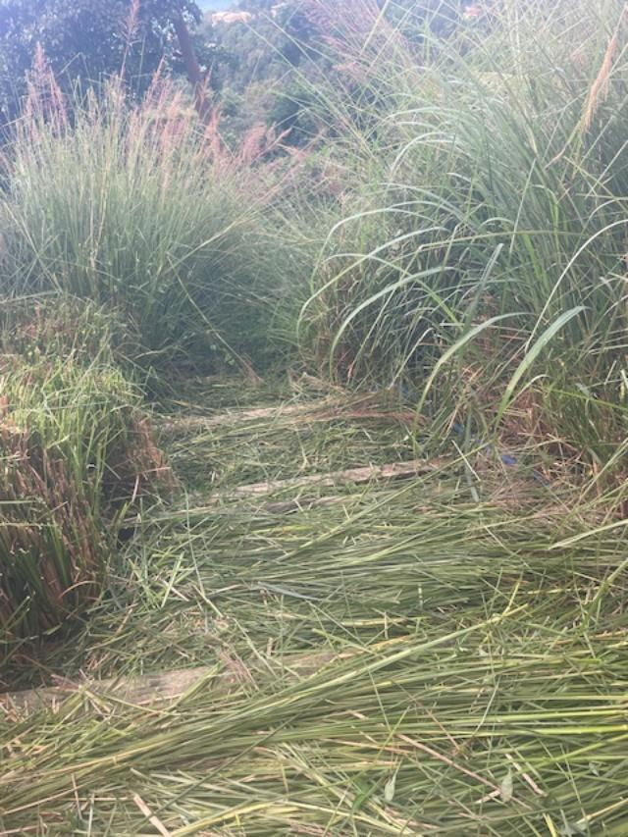
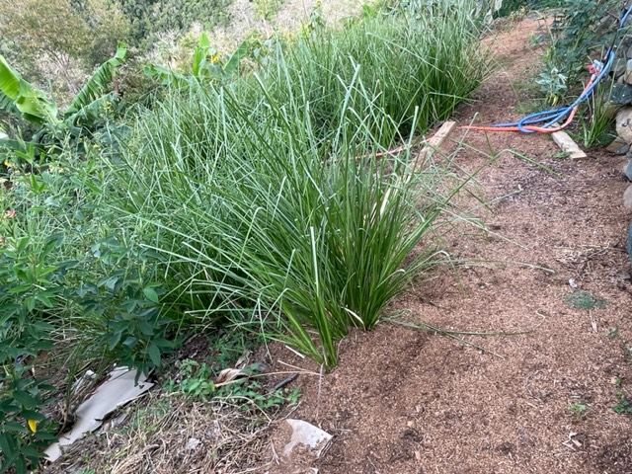
Erosion Control and Bioterracing

Slide 26
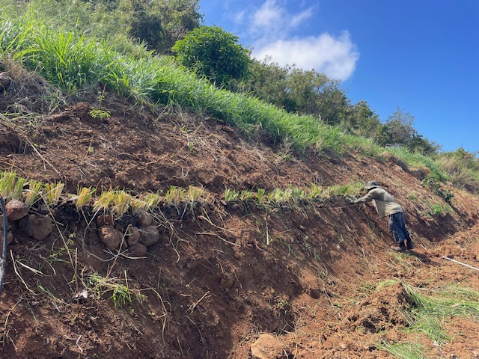

Slide 27
Water conservation
1 inch of rain equals 27,000-gal water over one acre – 65,500-gal runoff from 1 mile of two-lane paved road
Vetiver hedgerows will:
Reduce water runoff by as much as 70% particularly in extreme rainfall events
Improve water infiltration, and
increase soil moisture enhancement
Vetiver hedgerows generally planted on the contour and every 6 feet of vertical distance.
The runoff is slowed and spread over a larger area.
Experimental works in India with vetiver grass showed significant increase of soil moisture and crop yields (10)

Slide 28
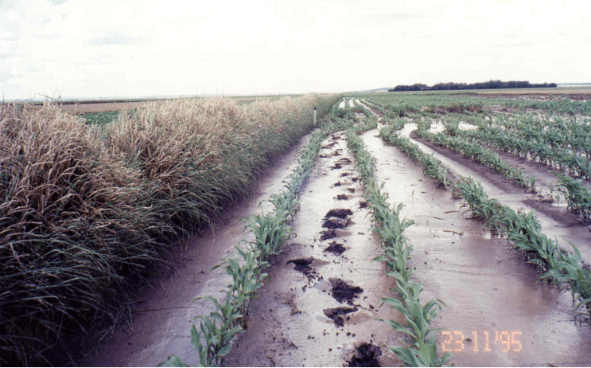

Water Conservation

Slide 29
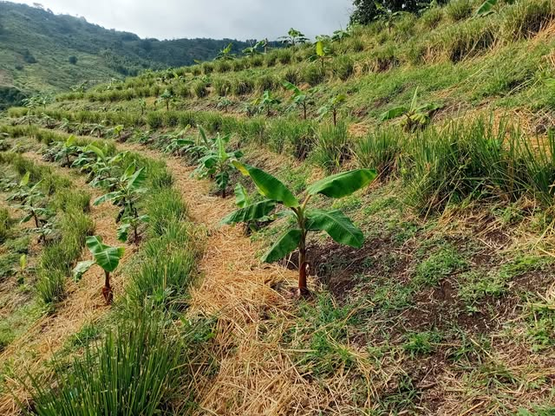
Erosion Control and Water Conservation
Vetiver International

Slide 30
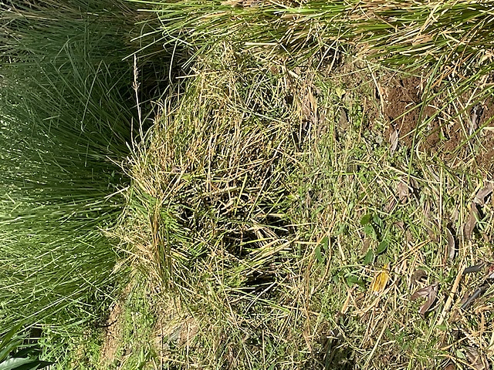
Mulch, Forage
Vetiver grass when used as a mulch further reduces soil loss from erosion and increases soil moisture. The mulch reduces soil temperature by as much as 15⁰C under extreme heat conditions; mulch degradation improves soil organic matter, enhancing soil micro flora and fauna activity, recycles soil nutrients, and reduces weed growth.
Vetiver Hay is easily sun dried in a few hours, and produces 10-20 dry-tons per ha/year under rainfed conditions more with improved nutrition and moisture
As it decomposes adds SOC
Forage – Moderate Quality Feed with Total Digestible Nutrients (TDN) of 55-60%

Slide 31
Pest Control
Very few pests
Termites and ants in the roots
Stem borer but does not affect the vetiver
Appears to be repellant to other pests
Nonhost for nematodes – roots repellant to southern root knot, Meloidogyne incognita
It is a trap crop for Chilo partellus, Busseola fusca, Sesamia calamistis, Sesamia inferens – maize and sorghum stem borers. Also, for theYellow Stem Borer (rice stem borer). Female moths fly 25m to lay eggs in the vetiver.
Supports parasitoid wasps and predatory insects

Slide 32
Improved Ecology
Vetiver hedgerows
Provide habitat for predatory insects reducing pest pressure for crops and orchards
Mealy bugs, aphids, white fly, and fruit fly
Provide habitat for pollinators – increasing productivity

Slide 33
Land and Water Rehabilitation
Otunola BO, Aghoghovwia MP, Thwala M, Gómez-Arias A, Jordaan R, Hernandez JC, Ololade OO. Improving capacity for phytoremediation of Vetiver grass and Indian mustard in heavy metal (Al and Mn) contaminated water through the application of clay minerals. Environ Sci Pollut Res Int. 2023 Apr;30(18):53577-53588. doi: 10.1007/s11356-023-26083-5. Epub 2023 Mar 2. PMID: 36859642; PMCID: PMC10119195.
Phytoremediation basically refers to the use of plants and associated soil microbes to reduce the concentrations or toxic effects of contaminants in the environment.
Vetiver's roots absorb heavy metals from soil and water, and the plant produces chelators and organic acids to bind with the toxic metal ions. The metal and chelator complex is then sequestered by the plant's cells, inactivating the metal ions. Phytodegradation
3 year study on reducing nitrogen and phosphorous runoff on sloping cropland in China with Vetiver Grass Hedgerows(VGH)(14)
5 fertilization treatments studied
VGH plus organic fertilizer
VGH plus inorganic fertilizer
either organic or inorganic fertilizer without VGH, and
no VGH or fertilizer (Control).
Runoff pollutants were significantly reduced with the VGH 98% inorganic and 94% organic fertilizers
Crop yields were increased

Slide 34
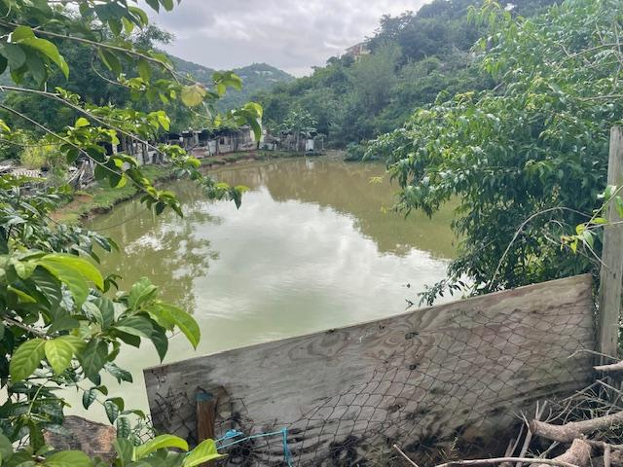
Ponds and Dams
Pond banks are affected by erosion and sedimentation decreases capacity
Banks and spillways overflow
Contamination from run-off

Slide 35
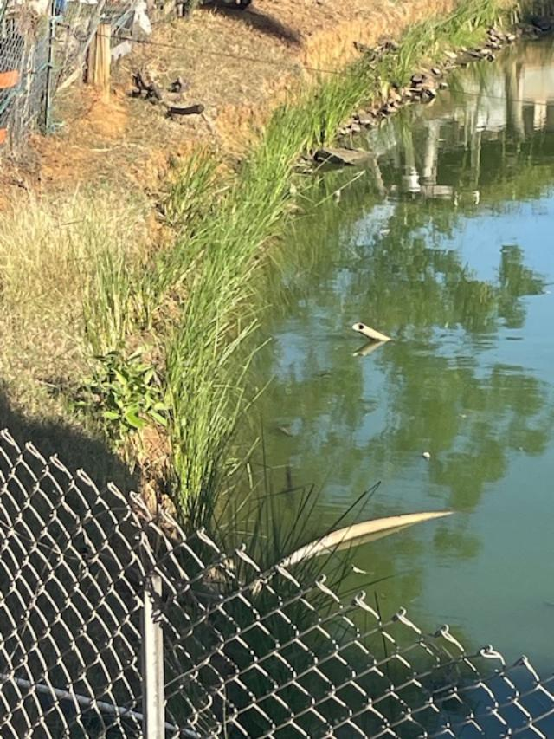
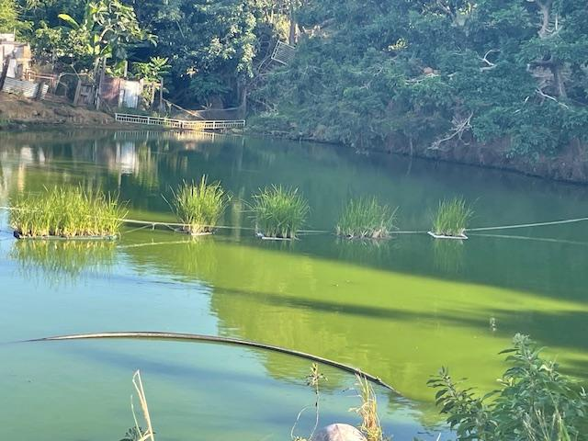
Dams and ponds

Slide 36
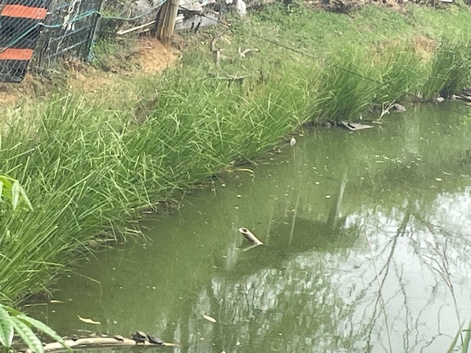
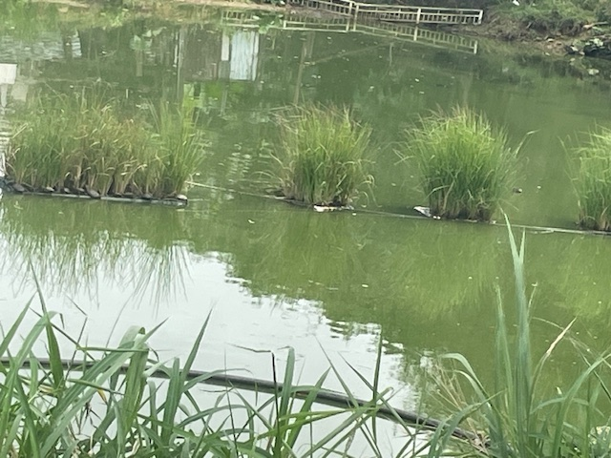
Pond

Slide 37
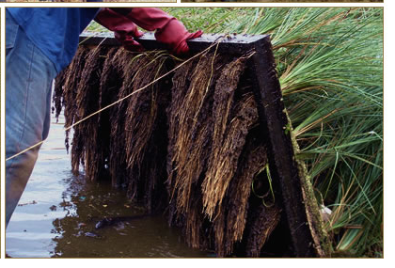
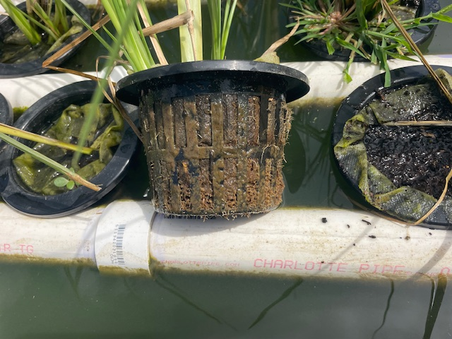
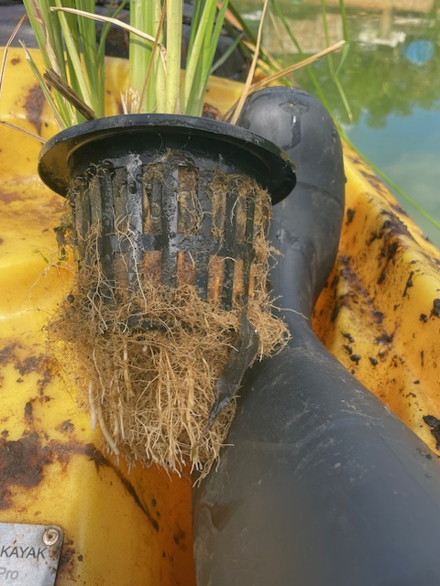
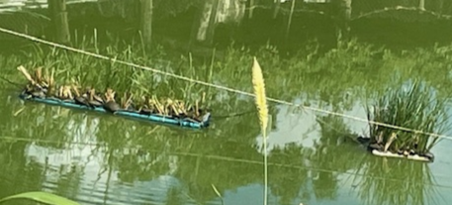

Slide 38
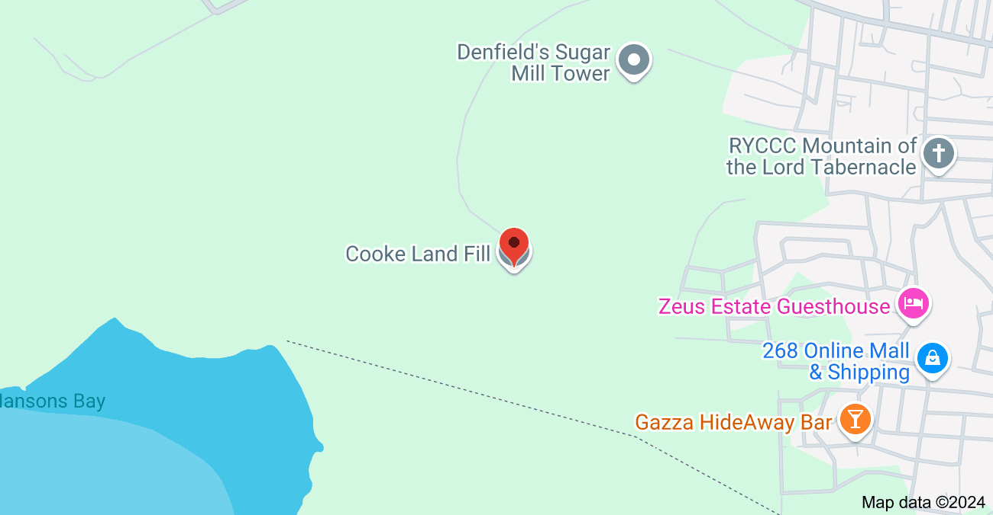
Land and Water Rehabilitation
In Antigua and Barbuda, Vetiver grass is being used to ameliorate and rehabilitate the Cooks Landfill, which borders one of the country’s largest mangrove swamps.
Google Maps

Slide 39
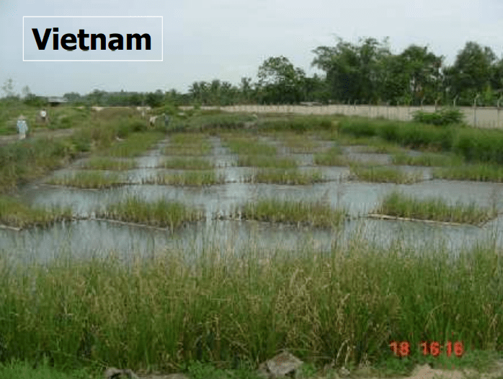
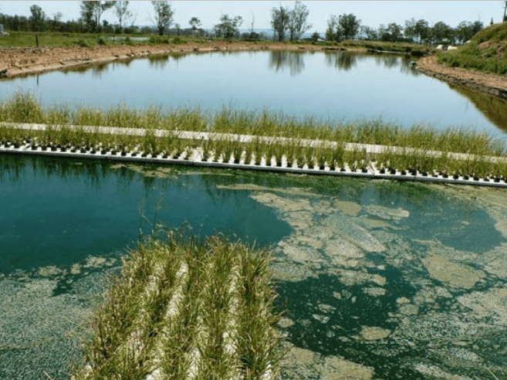
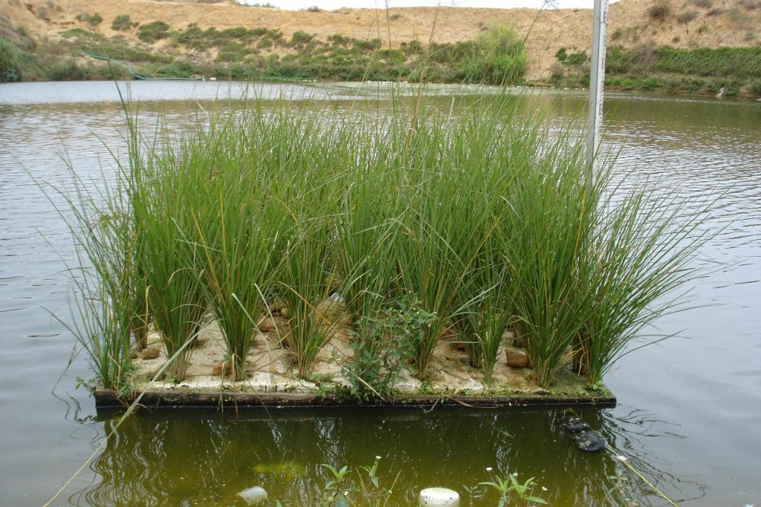
Land and Water Rehabilitation
May also be used to treat water:
Agricultural chemicals – N, P, Pesticides
Effluent – fish, animals, human – reduces coliforms
Industrial heavy metals

Slide 40
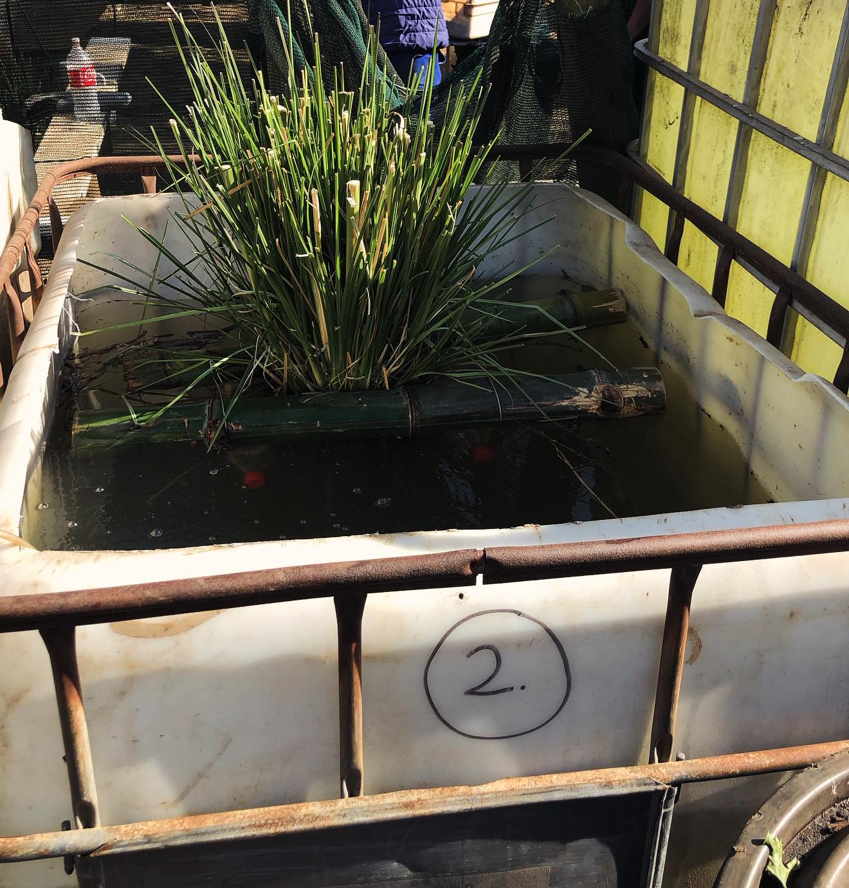
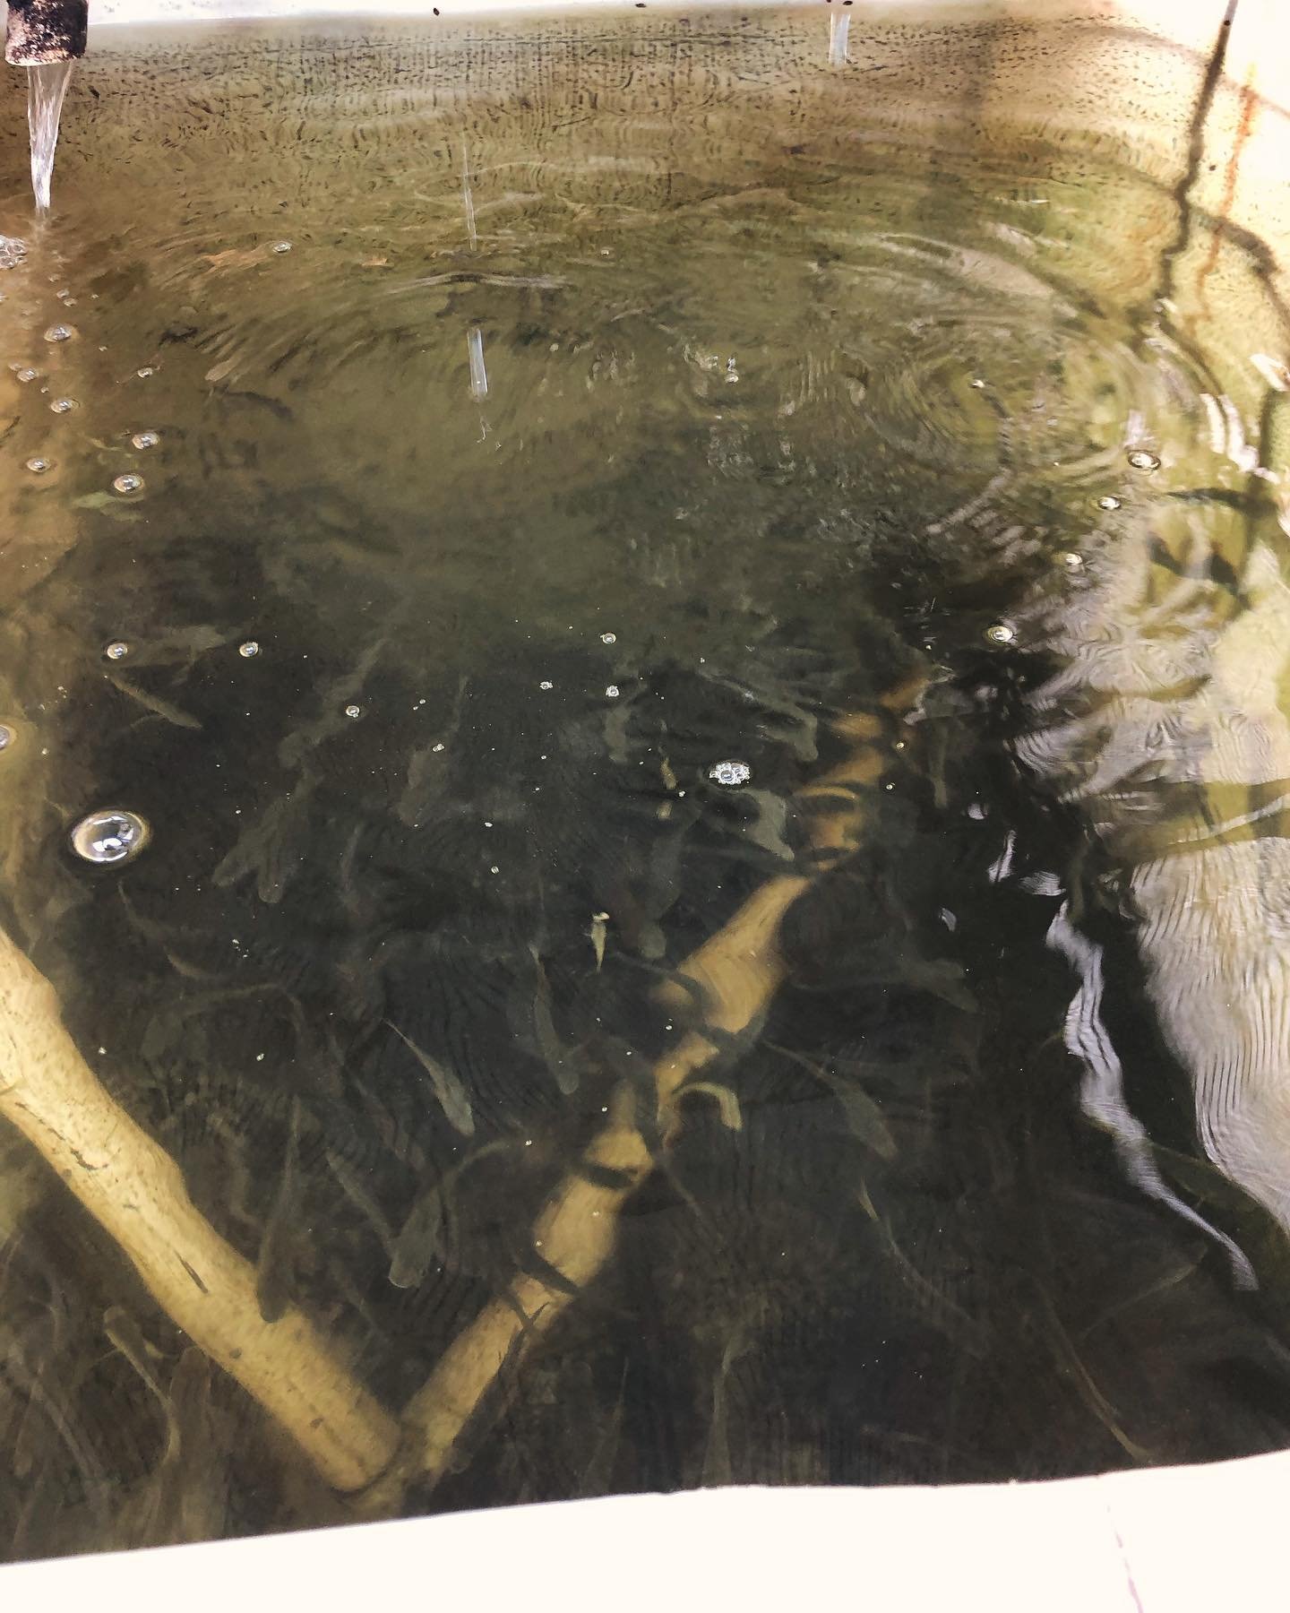
Water remediation

Slide 41
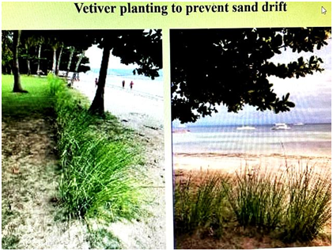
Coastal Protection
Prevents drifting of sand
Prevents erosion of the beach
Protects the coast, mangroves, and reefs from pollution
Tolerates high salinity will die if salinity is 45%
Seawater is 3.5%

Slide 42
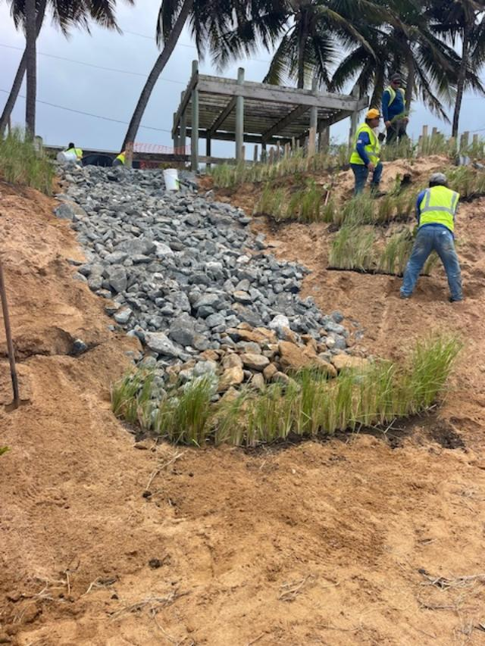
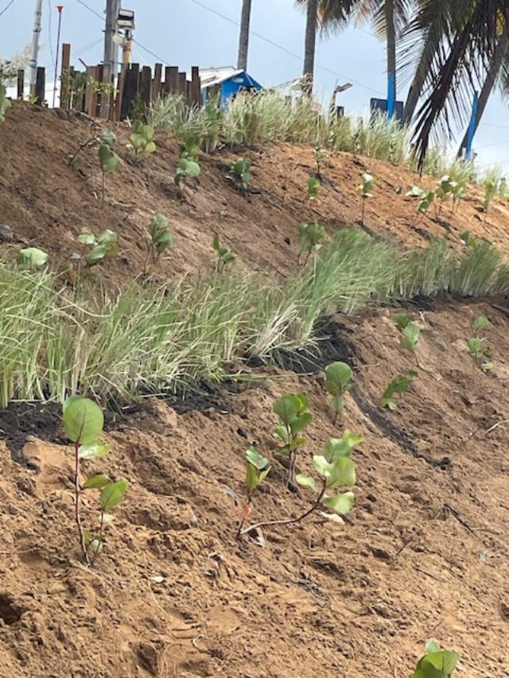
Coastal Protection

Slide 43
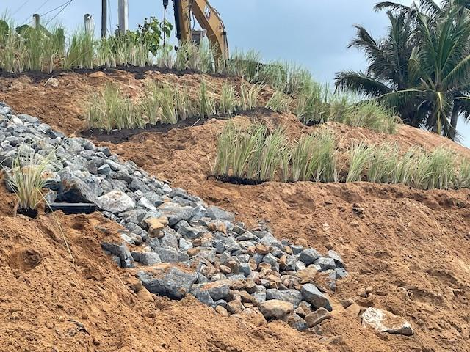

Slide 44
Use of Vetiver
Affordable low-tech solution
Improve soil health
Increase soil organic matter
Reduce erosion
Increase soil cover
Improve biodiversity
Maintain living roots
Protect coral reefs and coastal areas

Slide 45
References
Conservation: Soil. https://www.nrcs.usda.gov/
GSP. 2015. Revised World Soil Charter. Available at http://www.fao.org/fileadmin/user_upload/GSP/docs/ITPS_ Pillars/annexVII_WSC.pdf
FAO and ITPS. 2015. Status of the World’s Soil Resources (SWSR) – Main Report. Food and Agriculture Organization of the United Nations and Intergovernmental Technical Panel on Soils, Rome, Italy
What is Soil Health? https://www.sare.org/resources/what-is-soil-health/
Soil Health. https://www.farmers.gov/conservation/soil-health
Soil Health. https://www.fs.usda.gov/nac/topics/soil-health.php
Chronic land degradation: UN offers stark warnings and practical remedies in Global Land Outlook 2. 26 APRIL 2022 PRESS RELEASE. SUSTAINABLE LAND MANAGEMENT & RESTORATION. https://www.unccd.int/news-stories/press-releases/chronic-land-degradation-un-offers-stark-warnings-and-practical
Rojas-Sandoval. Chrysopogon zizanioides (vetiver). CABI Compendium. Feb 11, 2020. https://www.cabidigitallibrary.org/doi/full/10.1079/cabicompendium.18528934.
S. Barnard, V. Diedericks, K.R. Conradie. Genetic diversity of vetiver isolates (Chrysopogon zizanioides/nigritanus) available in South Africa based on ITS, ndhF and rbcL sequencing analyses. South African Journal of Botany Volume 86, May 2013. https://www.sciencedirect.com/science/article/pii/S0254629913000318
Vetiver Grass Technology. The vetiver Network International. https://www.vetiver.org

Slide 46
References
Dick Grimshaw, Feb 1 2026. VETIVER AS FORAGE AND ITS MANAGEMENT. Vetiver Grass Technology (VGT) Guides and Design Standards
Tropical Plants Database, Ken Fern. tropical.theferns.info. 2023-03-12. <tropical.theferns.info/viewtropical.php?id=Chrysopogon+zizanioides
Truong P, Van TT, Pinners E, 2008. Vetiver system applications technical reference manual. The Vetiver Network International.
The Vetiver Network West Indies. https://www.tvnwi.org
Datta R, Quispe MA, Sarkar D. Greenhouse study on the phytoremediation potential of vetiver grass, Chrysopogon zizanioides L., in arsenic-contaminated soils. Bull Environ Contam Toxicol. 2011 Jan;86(1):124-8. doi: 10.1007/s00128-010-0185-8. Epub 2010 Dec 29. PMID: 21190015
Truong, Paul. The global impact of vetiver grass technology on the environment
Proceedings of the Second International Conference on Vetiver. Jan 2000
B. Deesaeng, J. Pheunda, C. Onarsa and A. Boonsaner. Vetiver Potential For Increasing Groundwater Recharge. Watershed Research Division, Watershed Conservation and Management Office, National Park, Wildlife and Plant Conservation Department, Phaholyothin Rd., Chatuchak, Bangkok, Thailand 10900
J. Van den Berg 1 , C. Midega 2 , L. J. Wadhams 3 , and Z. R. Khan2 1. Can Vetiver Grass be Used to Manage Insect Pests on Crops? 1 School of Environmental Sciences, Potchefstroom University for Christian Higher Education, Private Bag X 6001, Potchefstroom, South Africa 2 International Center for Insect Physiology and Ecology, P.O. Box 30772, Nairobi, Kenya 3 Chemical Ecology Group, Rothamsted Research, Harpenden, Herts, AL5 2JQ, United Kingdom. https://www.vetiver.org/ICV3-Proceedings/SA_stem%20borer.pdf

Slide 47
References
P. Nopmalai, A. Sukhkasem, K. Kanjanathanaset, K. Wattanaprapat and I. Meesing. Study on Carbon Storage and Carbon Balance in Vetiver Grass Cultivation Areas in Northern Thailand. Land Development Department,Chatuchak, Bangkok, Thailand, 10900
Panja S, Sarkar D, Datta R. Removal of antibiotics and nutrients by Vetiver grass (Chrysopogon zizanioides) from secondary wastewater effluent. Int J Phytoremediation. 2020;22(7):764-773. doi: 10.1080/15226514.2019.1710813. Epub 2020 Jan 15. PMID: 31941351.
Oshunsanya SO, Li Y, Yu H. Vetiver grass hedgerows significantly reduce nitrogen and phosphorus losses from fertilized sloping lands. Sci Total Environ. 2019 Apr 15;661:86-94. doi: 10.1016/j.scitotenv.2019.01.129. Epub 2019 Jan 14. PMID: 30665135.
Tessema B, Wilson B, Daniel H, Kristiansen P, Baldock JA. Functional Links between Biomass Production and Decomposition of Vetiver (Chrysopogon zizanioides) Grass in Three Australian Soils. Plants (Basel). 2022 Mar 15;11(6):778. doi: 10.3390/plants11060778. PMID: 35336660; PMCID: PMC8950612.

