Slide 1
Theory of Sustainable Capture of Siganids for Aquaculture or Stock Enhancement
Simon Ellis

Slide 2
Marine Reef Fish Life Cycle

Slide 3
1. Larval Phase
2. Post larval or Pre-settlement Phase
3. Settlement Phase – also called metamorphosis
4. Post Settlement Phase – usually closely resemble adult

Slide 5
Settlement Mortality
Extremely high 90-99%
Usually due to predation or starvation
The final habitat of the fish only has so much room so if there are too many they are either displaced or die.
This limitation if called “carrying capacity”

Slide 6
The key to sustainable capture of any pelagic spawning marine reef fish is capturing them before they enter the post-settlement phase. “Capturing fish before they are subject to post-settlement mortality and transferring them to rearing programs, has the potential to yield over 90% more fish than capture of the same cohort 2 weeks later” R. Power, 2003.

Slide 7
Reef Fish Mortality

Slide 8
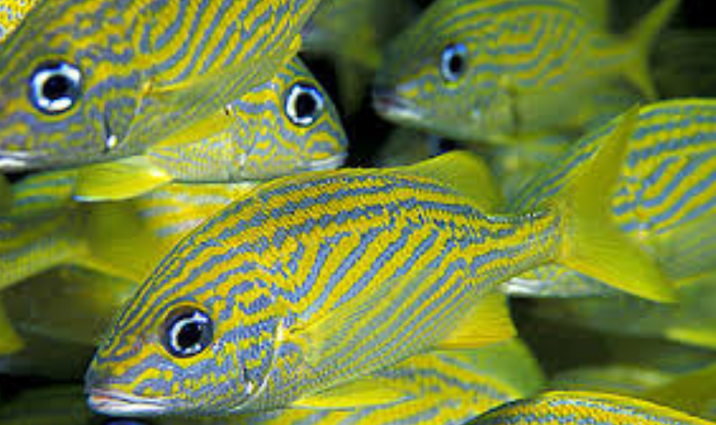
French Grunt post-settlement mortality

Slide 9
Pohnpei Example – S. argenteus
April 19 – approx. 100 fish per hour of capture effort
April 20 - approx. 30 fish per hour of capture effort
April 23 – approx. 6 fish per hour of capture effort
April 24 - approx. 6 fish per hour of capture effort
Started a little late. New moon in April was on the 16th
S. randalli. First seen in mangrove areas April 23rd and were no longer visibly present by 30th April

Slide 10
Potential Numbers
The April band transects showed about 1 newly settled Siganid for every 5 square meters
There are at least 4400 Hectares (17 square miles) of seagrass meadows on Pohnpei. Should note that health varies.
Extrapolated out this could equate to a potential for 88 million newly settled Siganids on Pohnpei’s sea grass beds at certain times of the year

Slide 11
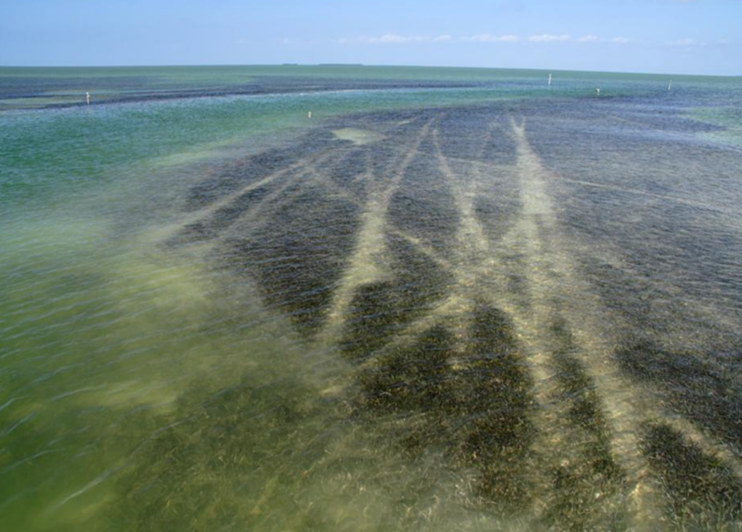
The Underappreciated Sea grass
Sea grass beds are fragile and easily damaged
Moderate walking around is OK
Propeller damage is one of the worst
Smithsonian estimates that world wide sea grasses are worth $19,000 per hectare in productivity

Slide 12
Conclusions
The potential for sustainable capture of Siganids in Pohnpei is high
However, the window where fish can be sustainably caught is small (7-10 days per cohort)
We are still conducing monthly surveys to see when fish settle
The last three years of data suggest April and May are the best times but this will be confirmed by continuing surveys
There are at least 4400 Hectares (17 square miles) of seagrass meadows on Pohnpei. That equates to a lot of baby rabbitfish!!!

